Slide 1
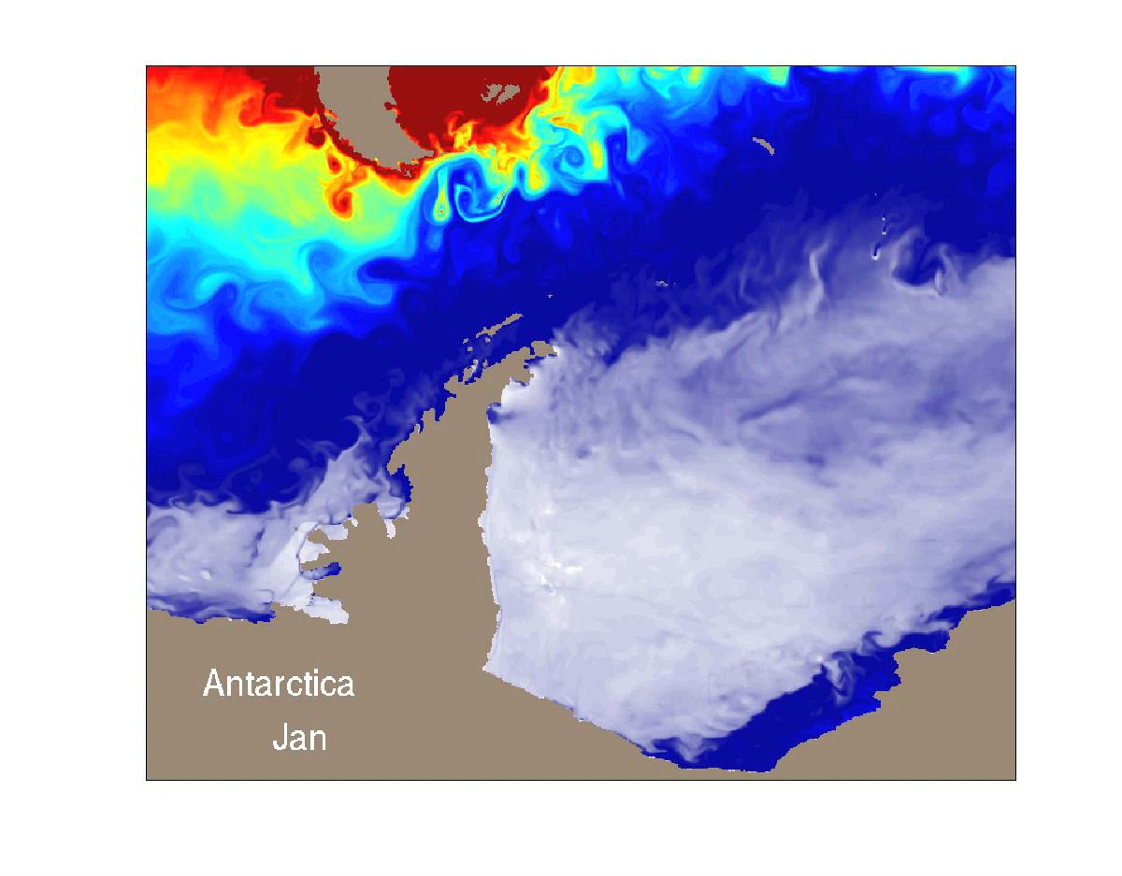
Sea ice seasonal prediction, climate change projections, and climate modeling
Bitz group
0.1 degree ocean and sea ice coupled to atmosphere

