Slide 1
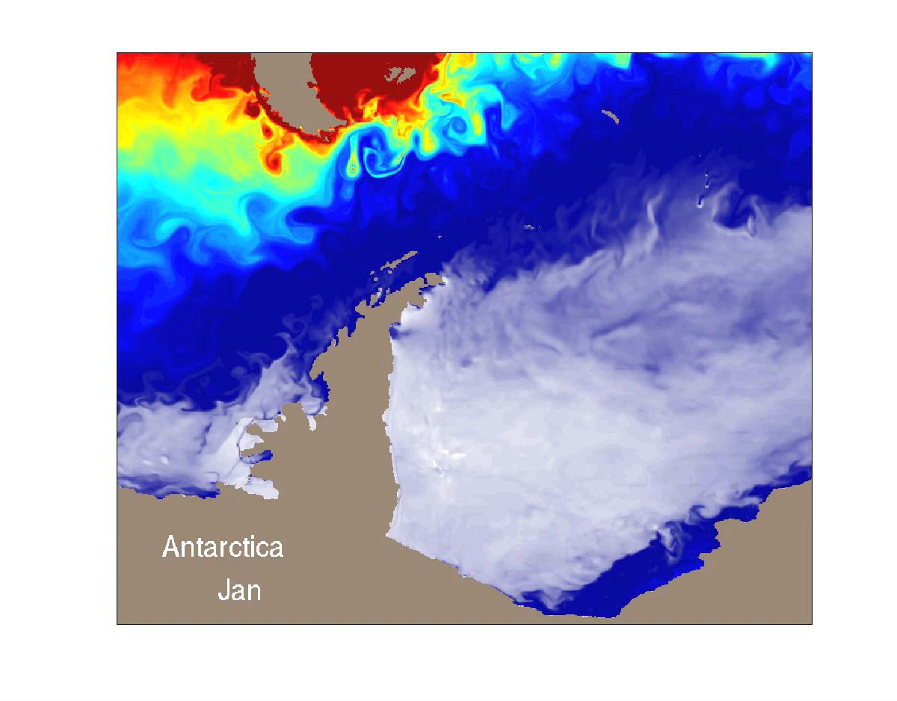
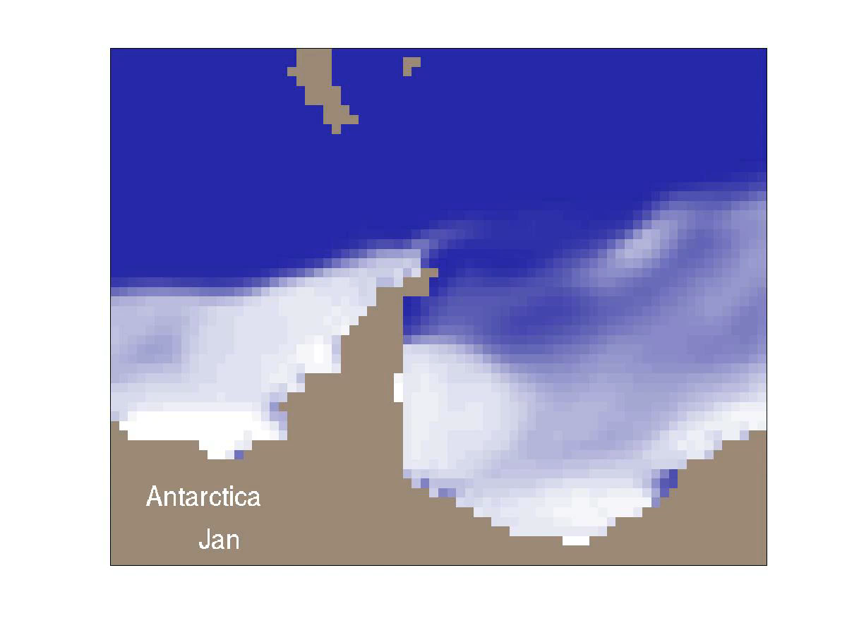
HR
LR
0.1° resolution
1.0° resolution
https://atmos.washington.edu/~bitz/bothmovies/hiresmovie.mov
https://atmos.washington.edu/~bitz/bothmovies/lowesmovie.mov

Slide 2
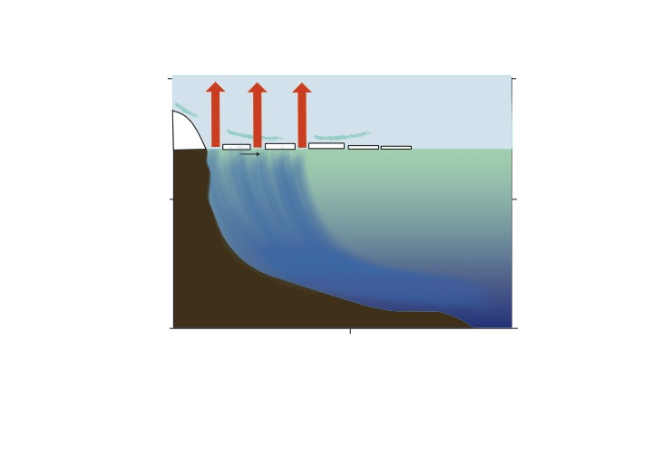
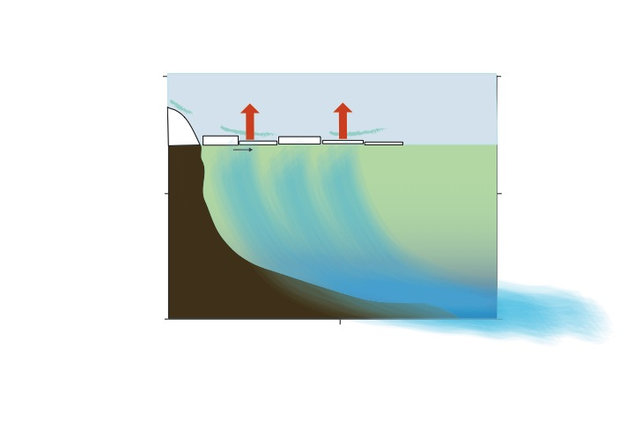
Heat loss though sea ice
Well Resolved Leads/Polynyas
Coarse Resolution
More concentrated heat loss
Less concentrated heat loss
Very cold
Less cold
Antarctic continental shelf
Antarctic continental shelf
Antarctic continental shelf
Better sea ice resolution allows for more concentrated heat loss very near coasts, increasing the drive of surface waters to denisfy, and forming more, and colder, AABW
cartoon by E. Newsom
Notes:
Make for heat and sea ice

Slide 3

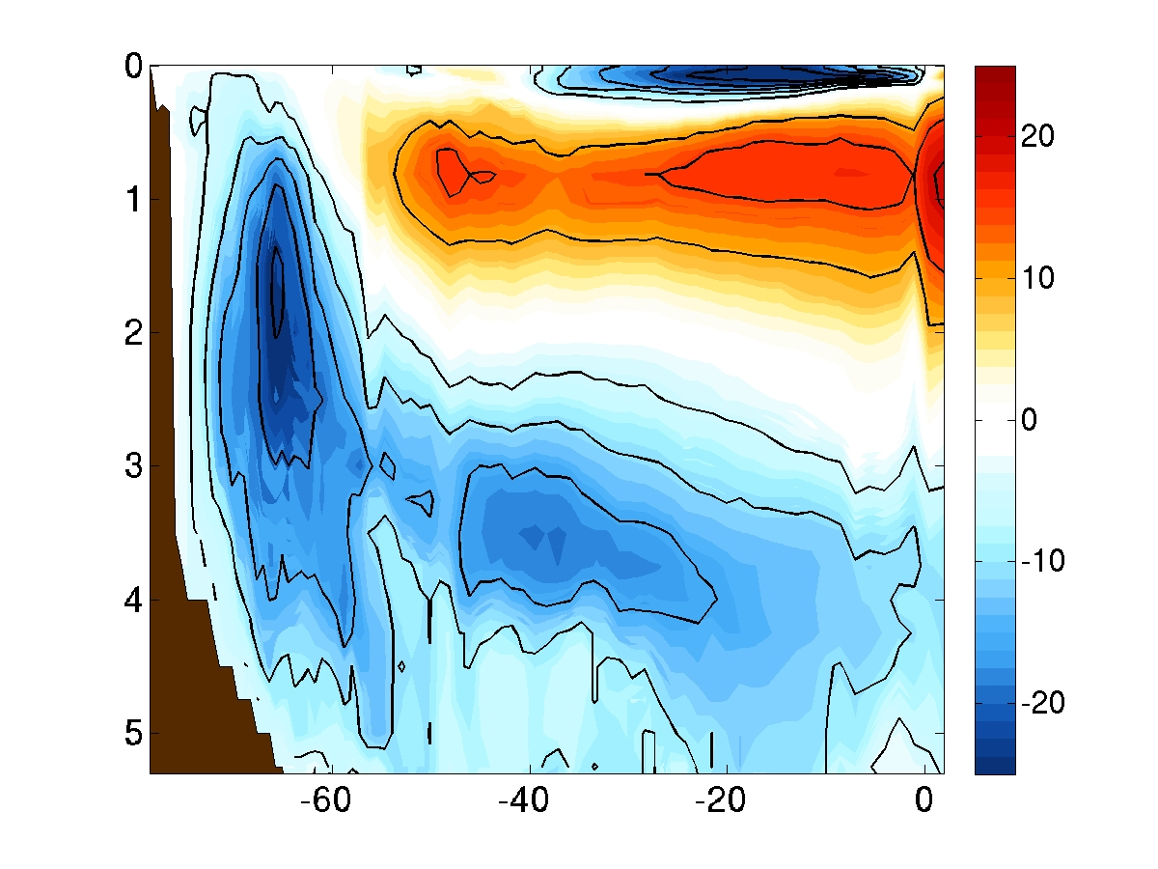
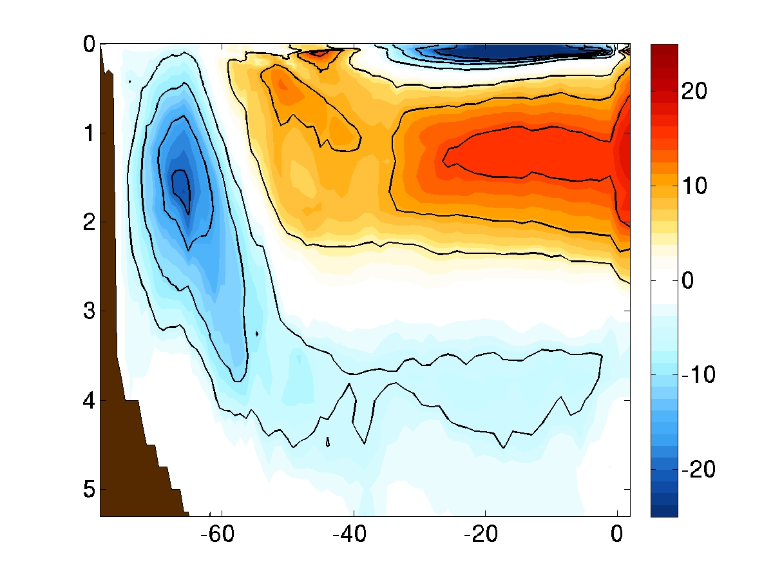
Isopycnal MOC
The Lower Cell is stronger, deeper, and extends more northward at fine resolution?
HR
LR
0.1° resolution
1.0° resolution
clockwise
clockwise
Depth
(km)
counterclockwise
counterclockwise
Sv=10⁶ m³/s
Latitude
Latitude
Newsom et al (2016)
Notes:
supports the implications that there is more bottom water being formed.
Encourages focus on lower cell

Slide 4
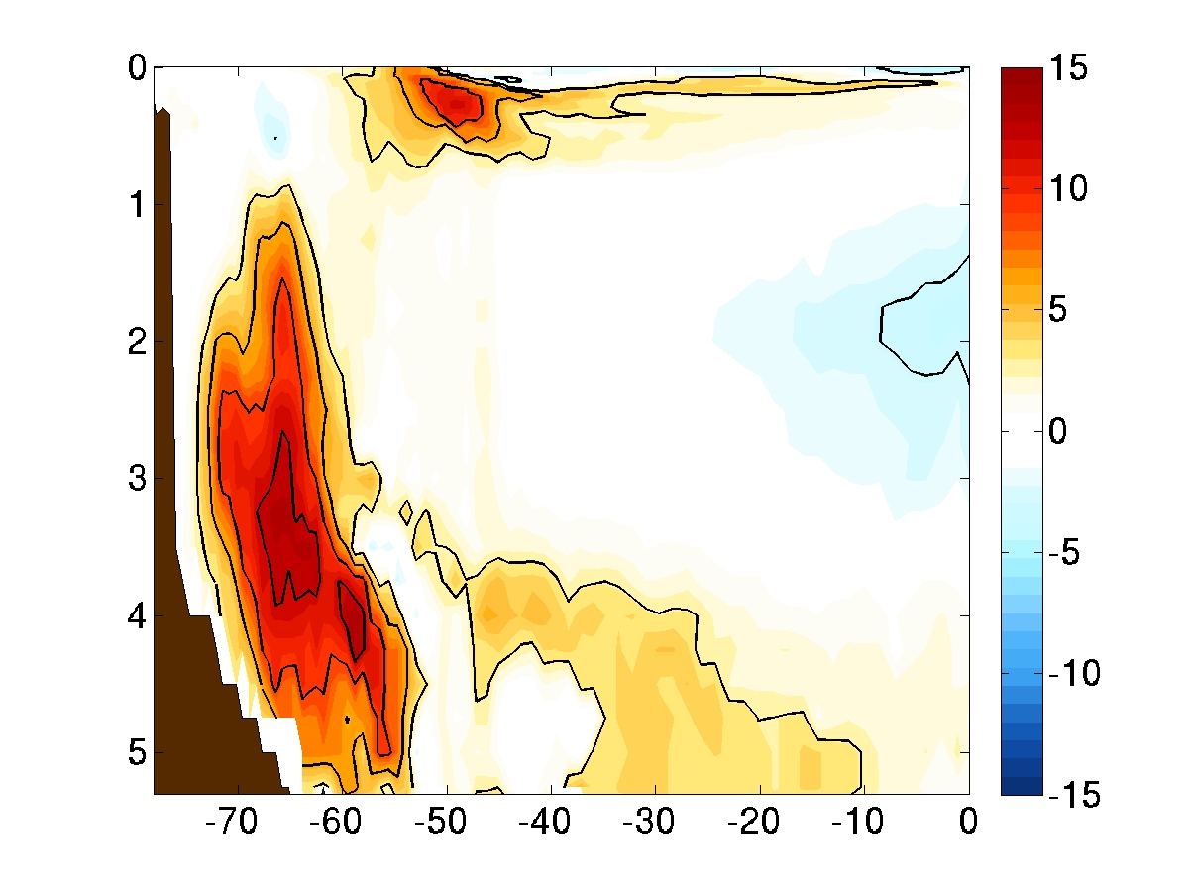
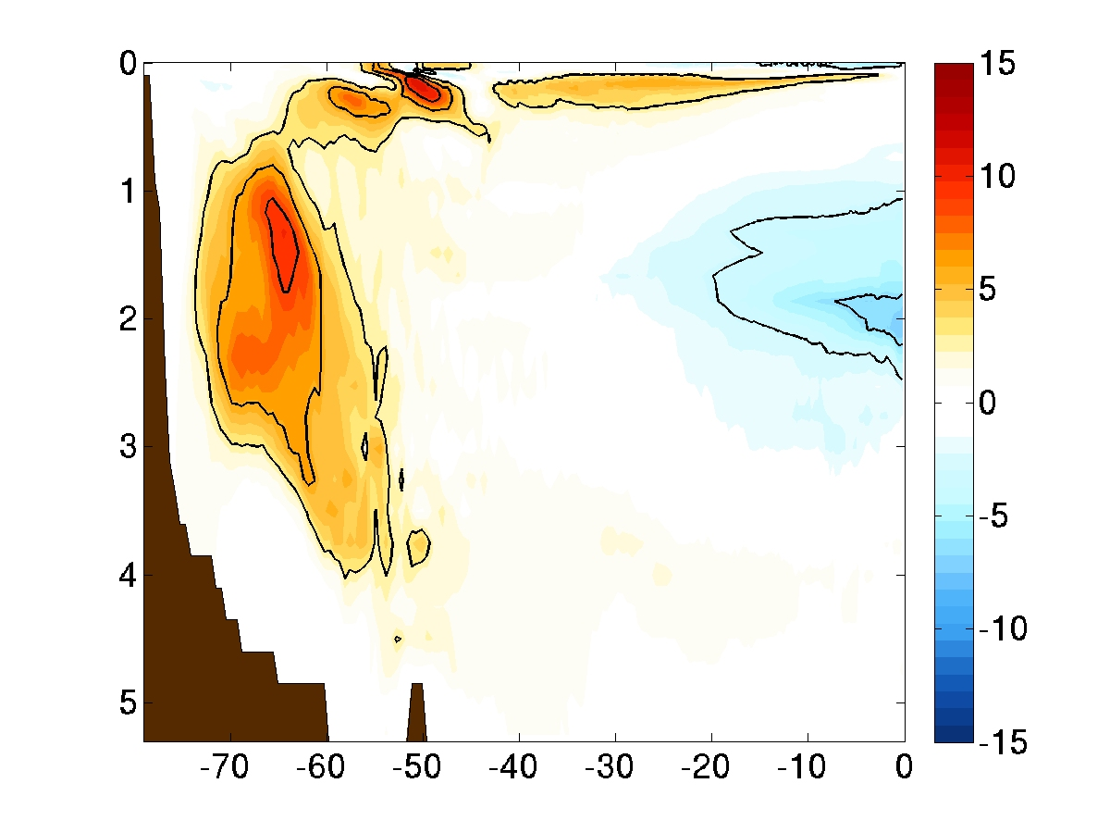
Circulation Changes
HR
LR
0.1° resolution
1.0° resolution
Depth (km)
Sv
Sv
Latitude
Latitude
HR has a stronger, deeper reduction in the Lower MOC strength.
This is primarily a feature of the steady flow (not an eddy-induced process)
Newsom et al (2016)
Notes:
Largest impact of co2- important- often hear about the upper cell.

Slide 5
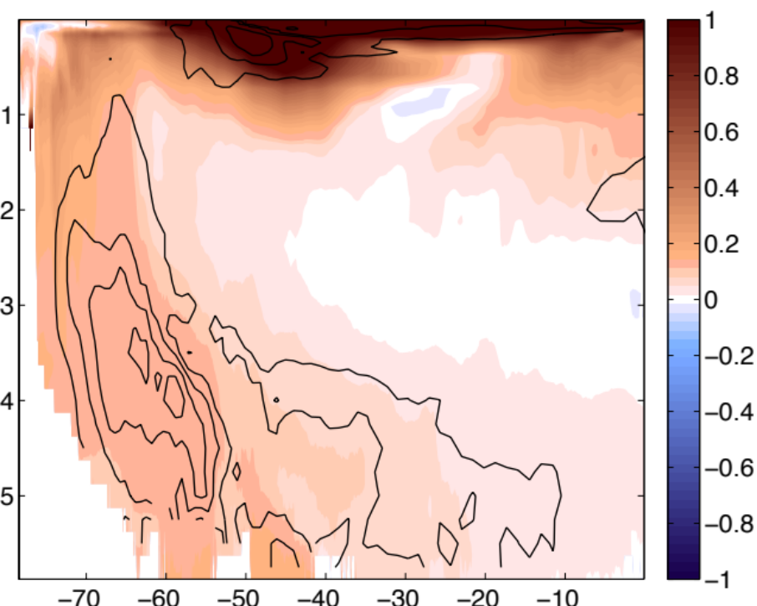
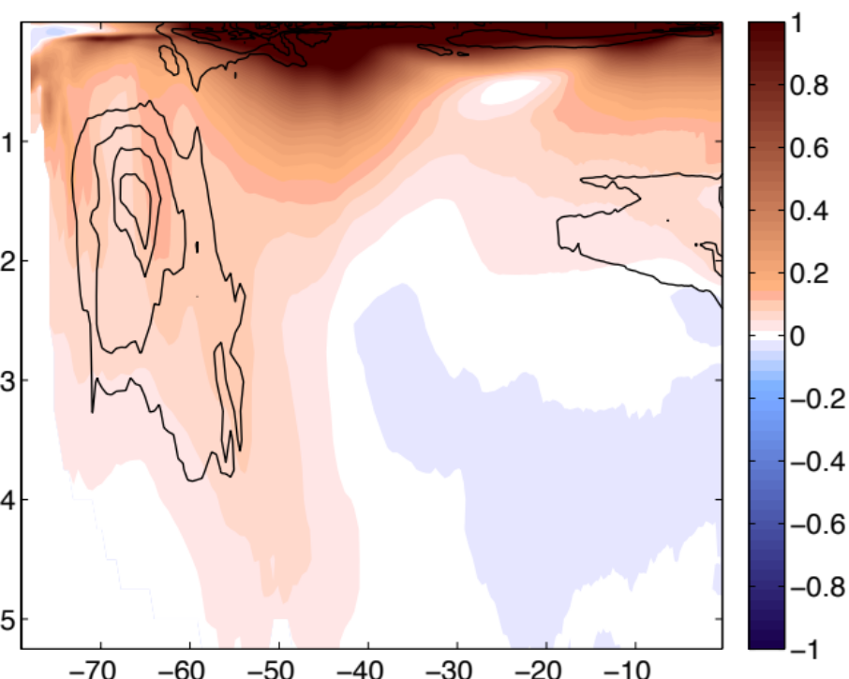
Ocean warming and heat uptake
HR
LR
0.1° resolution
1.0° resolution
°C
Depth (km)
Latitude
Latitude
Average temperature change with depth, overlaid with streamlines of change in the isopycnal circulation
Different dynamics -> affects spatial pattern of warming; significantly more warming in the abyssal ocean.
Newsom et al (2016)

Slide 6
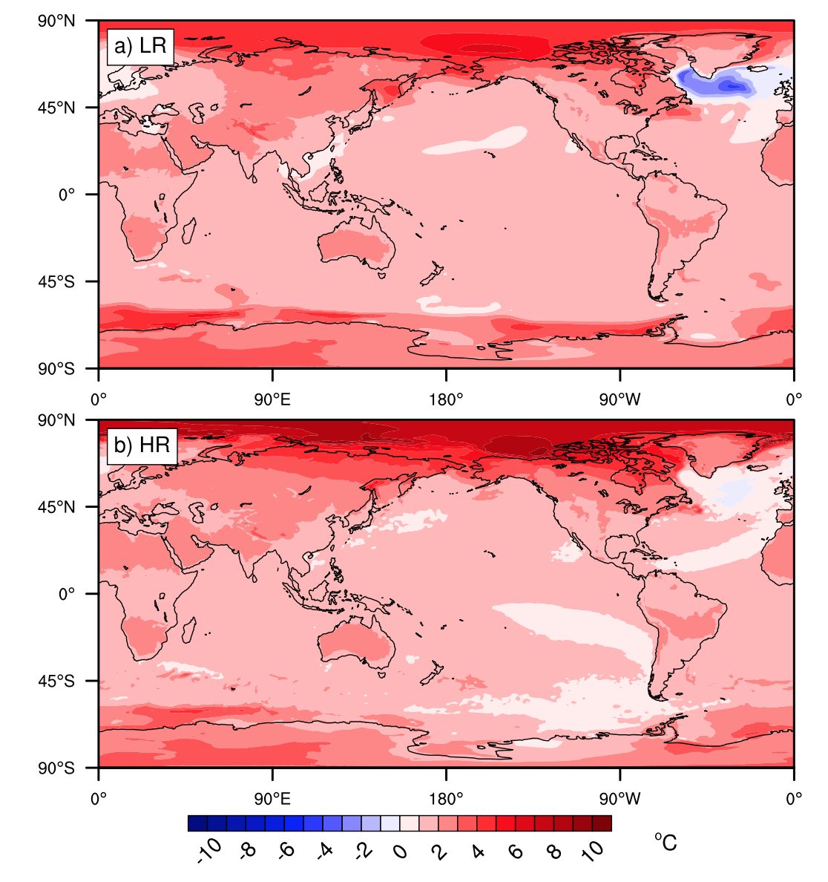
Surface warming at 2XCO2
1.0° resolution
0.1° resolution
Bryan et al (2014)

