Slide 1

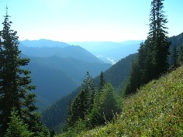
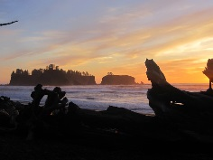
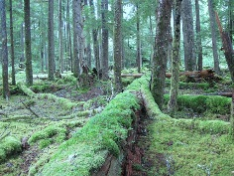
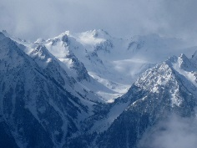
OLYMPEX – A NASA/GPM Ground Validation Field Campaign in the Pacific Northwest

Slide 2
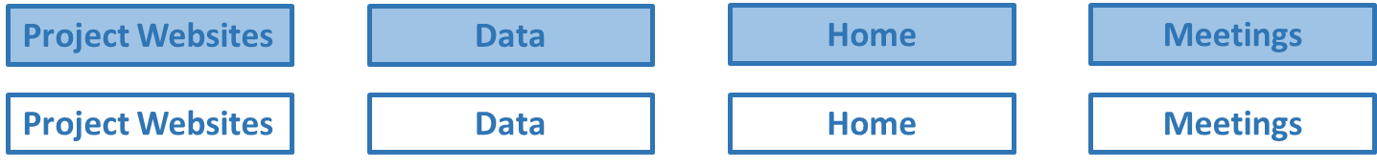
Project Websites
Data
Home
Meetings
Project Websites
Data
Home
Meetings
Reports
Ops Products
Model Products
Research Products
Missions
Reports
Ops Products
Model Products
Research Products
Missions
Home
Home

