Slide 2
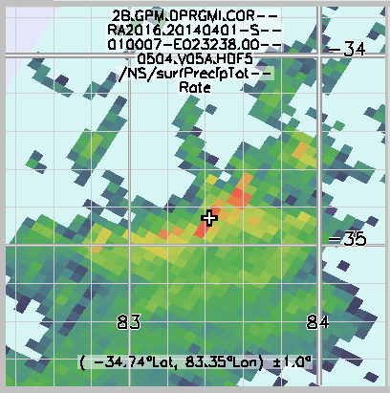
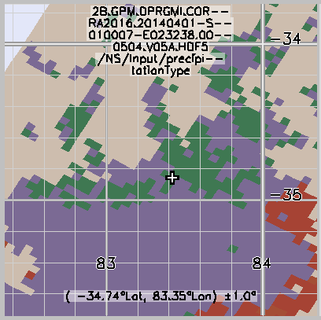

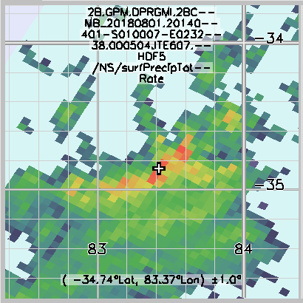
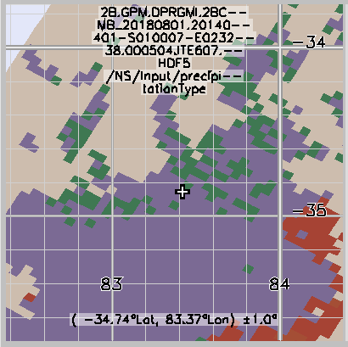
Surface Precipitation Changes (V05 vs ITE607)
Combined (V05)
Total Surface Precip
99.8 mm/hr (Conv)
Combined (ITE607)
Total Surface Precip
99.4 mm/hr (Strat)

