Slide 1
A study on reclassification of KuPR in DPR V06
By Hiroki Tsuji U. Tokyo
with Yukari N. Takayabu 10/16/2018

Slide 2
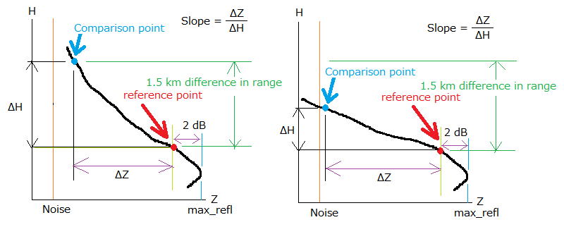
Reclassification to stratiform with “Slope Method”
Usual case
(b) Case for Z becomes noise above 1.5km from the base altitude
“Slope” is examined for convective precipitations. If Slope >= 7.5 dBZ/km, the type is reclassified as stratiform.
Exceptions to apply the Slope method: shallow rain, heavy ice precipitation, and large Z detected even BB exists (→??:yukari)
Slope Method is applied using zFactorNPCorrected, after the second loop of the Ku-band single frequency process.

Slide 3
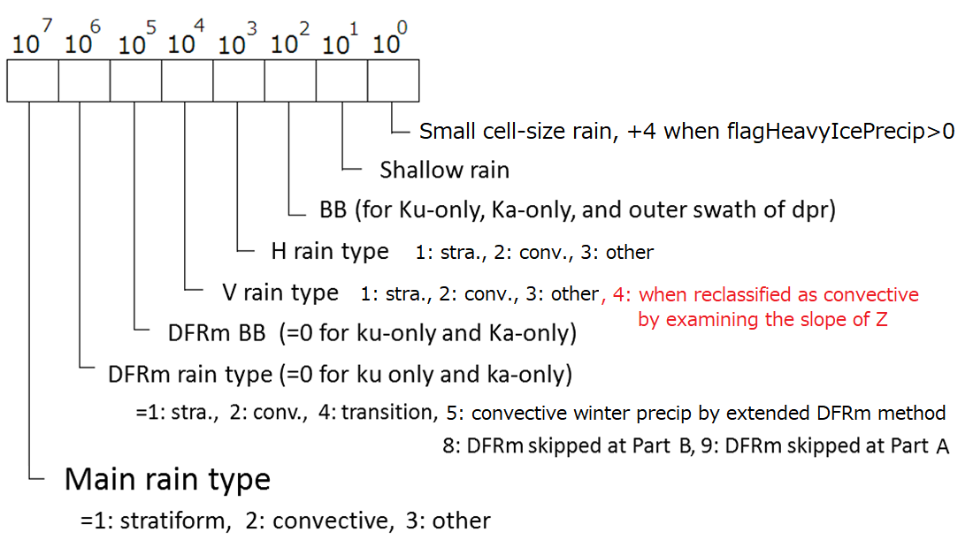
Modification of precipitation types for V06, with the application of “slope method” by Awaka
Stratiform

Slide 4
Ocean, number of pixels threshold = 40 mm/h
 | stratiform | convective | reclassified | stratiform | reclassified | (str1_40+sta4_40)/(sta1+sta4) | sta4_40/sta4
 | Vraintype=1 | Vraintype=2 | Vraintype=4 | NSPR≥ 40 mm/h | NSPR≥ 40 mm/h | (%) | (%)
N60- | 116723 | 7331 | 1307 | 0 | 0 | 0.00 | 0.00
N50-N60 | 156931 | 9223 | 3342 | 0 | 0 | 0.00 | 0.00
N40-N50 | 82248 | 11949 | 2737 | 3 | 10 | 0.02 | 0.37
N30-N40 | 66839 | 27568 | 3998 | 18 | 47 | 0.09 | 1.18
N20-N30 | 61369 | 44928 | 3322 | 15 | 59 | 0.11 | 1.78
N10-N20 | 131966 | 80356 | 6728 | 141 | 200 | 0.25 | 2.97
N0 -N10 | 148322 | 85962 | 8153 | 164 | 273 | 0.28 | 3.35
S10-S0 | 45831 | 48666 | 2861 | 33 | 48 | 0.17 | 1.68
S20-S10 | 20263 | 42534 | 1357 | 5 | 26 | 0.14 | 1.92
S30-S20 | 79891 | 32697 | 3342 | 4 | 40 | 0.05 | 1.20
S40-S30 | 113973 | 13194 | 4755 | 2 | 8 | 0.01 | 0.17
S50-S40 | 145492 | 9409 | 4202 | 2 | 5 | 0.00 | 0.12
S60-S50 | 214660 | 14152 | 1538 | 0 | 0 | 0.00 | 0.00
S60- | 93632 | 8698 | 302 | 0 | 0 | 0.00 | 0.00
ALL | 1478140 | 436667 | 47944 | 387 | 716 | 0.07 | 0.16
Data : GPM 2AKu V06A
2018 10/1 – 10/9
sta1 : stratiform(Vraintype=1)
sta4 : reclassified (Vraintype=4)
sta1_40: stratiform, NSPR≥ 40 mm/h
sta4_40: reclassified, NSPR≥ 40 mm/h
Notes:
Preciptypecheck_num_Mrain_ocean_20181012.f90
sum_ocean_20181012.f90

Slide 5
Ocean, number of pixels
threshold = 20 mm/h
 | stratiform | convective | reclassified | stratiform | reclassified | (str1_20+sta4_20)/(sta1+sta4) | sta4_20/sta4
 | Vraintype=1 | Vraintype=2 | Vraintype=4 | NSPR≥ 20 mm/h | NSPR≥ 20 mm/h | (%) | (%)
N60- | 116723 | 7331 | 1307 | 0 | 5 | 0.00 | 0.38
N50-N60 | 156931 | 9223 | 3342 | 2 | 9 | 0.01 | 0.27
N40-N50 | 82248 | 11949 | 2737 | 32 | 64 | 0.11 | 2.34
N30-N40 | 66839 | 27568 | 3998 | 142 | 194 | 0.47 | 4.85
N20-N30 | 61369 | 44928 | 3322 | 81 | 253 | 0.52 | 7.62
N10-N20 | 131966 | 80356 | 6728 | 685 | 576 | 0.91 | 8.56
N0 -N10 | 148322 | 85962 | 8153 | 659 | 844 | 0.96 | 10.35
S10-S0 | 45831 | 48666 | 2861 | 108 | 168 | 0.57 | 5.87
S20-S10 | 20263 | 42534 | 1357 | 25 | 94 | 0.55 | 6.93
S30-S20 | 79891 | 32697 | 3342 | 16 | 136 | 0.18 | 4.07
S40-S30 | 113973 | 13194 | 4755 | 27 | 97 | 0.10 | 2.04
S50-S40 | 145492 | 9409 | 4202 | 6 | 63 | 0.05 | 1.50
S60-S50 | 214660 | 14152 | 1538 | 0 | 2 | 0.00 | 0.13
S60- | 93632 | 8698 | 302 | 0 | 2 | 0.00 | 0.66
ALL | 1478140 | 436667 | 47944 | 1783 | 2507 | 0.28 | 0.66
Data : GPM 2AKu V06A
2018 10/1 – 10/9
sta1 : stratiform(Vraintype=1)
sta4 : reclassified (Vraintype=4)
sta1_40: stratiform, NSPR≥ 40 mm/h
sta4_40: reclassified, NSPR≥ 40 mm/h
Notes:
Preciptypecheck_num_Mrain_ocean_20181012.f90
sum_ocean_20181012.f90

Slide 6
Ocean, precipitation amount threshold = 40 mm/h
 | stratiform | convective | reclassified | stratiform | reclassified | (str1_40+sta4_40)/(sta1+sta4) | sta4_40/sta4
 | Vraintype=1 | Vraintype=2 | Vraintype=4 | NSPR≥ 40 mm/h | NSPR≥ 40 mm/h | (%) | (%)
N60- | 84940.35 | 6362.73 | 5516.02 | 0.000 | 0.000 | 0.00 | 0.00
N50-N60 | 145282.80 | 10663.88 | 14283.87 | 0.000 | 0.000 | 0.00 | 0.00
N40-N50 | 107412.20 | 34118.62 | 16749.00 | 130.719 | 567.207 | 0.56 | 3.39
N30-N40 | 118651.90 | 84346.48 | 28024.45 | 938.793 | 2773.779 | 2.53 | 9.90
N20-N30 | 93830.97 | 127582.90 | 24413.62 | 755.648 | 4083.425 | 4.09 | 16.73
N10-N20 | 225420.10 | 292295.60 | 55574.93 | 8932.242 | 13466.810 | 7.97 | 24.23
N0 -N10 | 257390.80 | 320842.10 | 72404.77 | 11382.650 | 17092.390 | 8.63 | 23.61
S10-S0 | 69107.54 | 148103.40 | 18507.05 | 2957.772 | 3179.074 | 7.00 | 17.18
S20-S10 | 30026.77 | 93169.73 | 10553.29 | 249.601 | 1701.453 | 4.81 | 16.12
S30-S20 | 118529.80 | 72389.05 | 22331.67 | 249.637 | 3100.098 | 2.38 | 13.88
S40-S30 | 135055.00 | 31239.07 | 28006.62 | 101.589 | 413.245 | 0.32 | 1.48
S50-S40 | 143576.60 | 16816.16 | 24040.25 | 125.803 | 218.246 | 0.21 | 0.91
S60-S50 | 142792.00 | 12436.27 | 5613.43 | 0.000 | 0.000 | 0.00 | 0.00
S60- | 53598.86 | 5456.11 | 837.26 | 0.000 | 0.000 | 0.00 | 0.00
ALL | 1725615.69 | 1255822.09 | 326856.24 | 25824.454 | 46595.727 | 3.53 | 3.53
Data : GPM 2AKu V06A
2018 10/1 – 10/9
sta1 : stratiform(Vraintype=1)
sta4 : reclassified (Vraintype=4)
sta1_40: stratiform, NSPR≥ 40 mm/h
sta4_40: reclassified, NSPR≥ 40 mm/h
Notes:
Preciptypecheck_num_Mrain_ocean_20181012.f90
sum_ocean_20181012.f90

Slide 7
Ocean, precipitation amount threshold = 20 mm/h
 | stratiform | convective | reclassified | stratiform | reclassified | (str1_20+sta4_20)/(sta1+sta4) | sta4_20/sta4
 | Vraintype=1 | Vraintype=2 | Vraintype=4 | NSPR≥ 20 mm/h | NSPR≥ 20 mm/h | (%) | (%)
N60- | 84940.35 | 6362.73 | 5516.02 | 0.000 | 115.893 | 0.13 | 2.10
N50-N60 | 145282.80 | 10663.88 | 14283.87 | 44.246 | 218.072 | 0.16 | 1.53
N40-N50 | 107412.20 | 34118.62 | 16749.00 | 887.449 | 1932.390 | 2.27 | 11.54
N30-N40 | 118651.90 | 84346.48 | 28024.45 | 4236.132 | 6639.661 | 7.41 | 23.69
N20-N30 | 93830.97 | 127582.90 | 24413.62 | 2493.049 | 9537.784 | 10.17 | 39.07
N10-N20 | 225420.10 | 292295.60 | 55574.93 | 23710.580 | 23861.820 | 16.93 | 42.94
N0 -N10 | 257390.80 | 320842.10 | 72404.77 | 24612.710 | 32805.420 | 17.41 | 45.31
S10-S0 | 69107.54 | 148103.40 | 18507.05 | 4919.809 | 6530.861 | 13.07 | 35.29
S20-S10 | 30026.77 | 93169.73 | 10553.29 | 765.040 | 3562.429 | 10.66 | 33.76
S30-S20 | 118529.80 | 72389.05 | 22331.67 | 556.701 | 5706.419 | 4.45 | 25.55
S40-S30 | 135055.00 | 31239.07 | 28006.62 | 728.950 | 2611.810 | 2.05 | 9.33
S50-S40 | 143576.60 | 16816.16 | 24040.25 | 224.814 | 1680.653 | 1.14 | 6.99
S60-S50 | 142792.00 | 12436.27 | 5613.43 | 0.000 | 44.129 | 0.03 | 0.79
S60- | 53598.86 | 5456.11 | 837.26 | 0.000 | 46.506 | 0.09 | 5.55
ALL | 1725615.69 | 1255822.09 | 326856.24 | 63179.479 | 95293.847 | 7.72 | 9.18
Data : GPM 2AKu V06A
2018 10/1 – 10/9
sta1 : stratiform(Vraintype=1)
sta4 : reclassified (Vraintype=4)
sta1_40: stratiform, NSPR≥ 40 mm/h
sta4_40: reclassified, NSPR≥ 40 mm/h
Notes:
Preciptypecheck_num_Mrain_ocean_20181012.f90
sum_ocean_20181012.f90

Slide 8
Land, number of pixels threshold = 40 mm/h
 | stratiform | convective | reclassified | stratiform | reclassified | (str1_40+sta4_40)/(sta1+sta4) | sta4_40/sta4
 | Vraintype=1 | Vraintype=2 | Vraintype=4 | NSPR≥ 40 mm/h | NSPR≥ 40 mm/h | (%) | (%)
N60- | 117051 | 6390 | 1198 | 0 | 0 | 0.00 | 0.00
N50-N60 | 89112 | 4774 | 1448 | 0 | 0 | 0.00 | 0.00
N40-N50 | 63448 | 5973 | 1526 | 0 | 7 | 0.01 | 0.46
N30-N40 | 44809 | 7849 | 1456 | 0 | 4 | 0.01 | 0.27
N20-N30 | 29919 | 7650 | 1169 | 0 | 10 | 0.03 | 0.86
N10-N20 | 23855 | 10868 | 1505 | 13 | 14 | 0.11 | 0.93
N0 -N10 | 46287 | 16122 | 2736 | 8 | 15 | 0.05 | 0.55
S10-S0 | 28729 | 9678 | 1553 | 1 | 9 | 0.03 | 0.58
S20-S10 | 15650 | 3658 | 622 | 1 | 1 | 0.01 | 0.16
S30-S20 | 17277 | 3756 | 601 | 1 | 4 | 0.03 | 0.67
S40-S30 | 9950 | 1988 | 373 | 0 | 2 | 0.02 | 0.54
S50-S40 | 4557 | 253 | 86 | 0 | 0 | 0.00 | 0.00
S60-S50 | 2125 | 157 | 20 | 0 | 0 | 0.00 | 0.00
S60- | 116 | 42 | 2 | 0 | 0 | 0.00 | 0.00
ALL | 492885 | 79158 | 14295 | 24 | 66 | 0.02 | 0.08
Data : GPM 2AKu V06A
2018 10/1 – 10/9
sta1 : stratiform(Vraintype=1)
sta4 : reclassified (Vraintype=4)
sta1_40: stratiform, NSPR≥ 40 mm/h
sta4_40: reclassified, NSPR≥ 40 mm/h
Notes:
Preciptypecheck_num_Mrain_ocean_20181012.f90
sum_ocean_20181012.f90

Slide 9
Land, number of pixels
threshold = 20 mm/h
 | stratiform | convective | reclassified | stratiform | reclassified | (str1_20+sta4_20)/(sta1+sta4) | sta4_20/sta4
 | Vraintype=1 | Vraintype=2 | Vraintype=4 | NSPR≥ 20 mm/h | NSPR≥ 20 mm/h | (%) | (%)
N60- | 117051 | 6390 | 1198 | 0 | 3 | 0.00 | 0.25
N50-N60 | 89112 | 4774 | 1448 | 0 | 17 | 0.02 | 1.17
N40-N50 | 63448 | 5973 | 1526 | 9 | 47 | 0.09 | 3.08
N30-N40 | 44809 | 7849 | 1456 | 14 | 32 | 0.10 | 2.20
N20-N30 | 29919 | 7650 | 1169 | 2 | 34 | 0.12 | 2.91
N10-N20 | 23855 | 10868 | 1505 | 25 | 71 | 0.38 | 4.72
N0 -N10 | 46287 | 16122 | 2736 | 22 | 81 | 0.21 | 2.96
S10-S0 | 28729 | 9678 | 1553 | 8 | 32 | 0.13 | 2.06
S20-S10 | 15650 | 3658 | 622 | 3 | 11 | 0.09 | 1.77
S30-S20 | 17277 | 3756 | 601 | 2 | 20 | 0.12 | 3.33
S40-S30 | 9950 | 1988 | 373 | 0 | 5 | 0.05 | 1.34
S50-S40 | 4557 | 253 | 86 | 0 | 1 | 0.02 | 1.16
S60-S50 | 2125 | 157 | 20 | 0 | 0 | 0.00 | 0.00
S60- | 116 | 42 | 2 | 0 | 0 | 0.00 | 0.00
ALL | 492885 | 79158 | 14295 | 85 | 354 | 0.09 | 0.48
Data : GPM 2AKu V06A
2018 10/1 – 10/9
sta1 : stratiform(Vraintype=1)
sta4 : reclassified (Vraintype=4)
sta1_40: stratiform, NSPR≥ 40 mm/h
sta4_40: reclassified, NSPR≥ 40 mm/h
Notes:
Preciptypecheck_num_Mrain_ocean_20181012.f90
sum_ocean_20181012.f90

Slide 10
Land, precipitation amount threshold = 40 mm/h
 | stratiform | convective | reclassified | stratiform | reclassified | (str1_40+sta4_40)/(sta1+sta4) | sta4_40/sta4
 | Vraintype=1 | Vraintype=2 | Vraintype=4 | NSPR≥ 40 mm/h | NSPR≥ 40 mm/h | (%) | (%)
N60- | 85950.46 | 6046.23 | 3932.33 | 0.000 | 0.000 | 0.00 | 0.00
N50-N60 | 75161.73 | 5533.88 | 6782.37 | 0.000 | 0.000 | 0.00 | 0.00
N40-N50 | 61717.33 | 20080.77 | 8987.38 | 0.000 | 354.828 | 0.50 | 3.95
N30-N40 | 57795.06 | 30248.11 | 8321.17 | 0.000 | 225.018 | 0.34 | 2.70
N20-N30 | 29432.46 | 25744.49 | 6541.99 | 0.000 | 663.649 | 1.84 | 10.14
N10-N20 | 27998.37 | 56500.74 | 8530.41 | 1041.856 | 1037.279 | 5.69 | 12.16
N0 -N10 | 61860.62 | 76320.96 | 14295.84 | 482.300 | 990.064 | 1.93 | 6.93
S10-S0 | 31673.08 | 37312.01 | 7288.72 | 130.936 | 545.051 | 1.73 | 7.48
S20-S10 | 17088.42 | 11300.30 | 2936.32 | 49.425 | 50.966 | 0.50 | 1.74
S30-S20 | 24328.54 | 13555.73 | 4056.34 | 43.329 | 452.107 | 1.75 | 11.15
S40-S30 | 9220.89 | 13196.79 | 1710.10 | 0.000 | 123.552 | 1.13 | 7.22
S50-S40 | 3286.40 | 338.18 | 402.53 | 0.000 | 0.000 | 0.00 | 0.00
S60-S50 | 1734.68 | 240.24 | 44.82 | 0.000 | 0.000 | 0.00 | 0.00
S60- | 54.48 | 102.95 | 2.61 | 0.000 | 0.000 | 0.00 | 0.00
ALL | 487302.51 | 296521.38 | 73832.92 | 1747.845 | 4442.514 | 1.10 | 1.48
Data : GPM 2AKu V06A
2018 10/1 – 10/9
sta1 : stratiform(Vraintype=1)
sta4 : reclassified (Vraintype=4)
sta1_40: stratiform, NSPR≥ 40 mm/h
sta4_40: reclassified, NSPR≥ 40 mm/h
Notes:
Preciptypecheck_num_Mrain_ocean_20181012.f90
sum_ocean_20181012.f90

Slide 11
Land, precipitation amount threshold = 20 mm/h
 | stratiform | convective | reclassified | stratiform | reclassified | (str1_20+sta4_20)/(sta1+sta4) | sta4_20/sta4
 | Vraintype=1 | Vraintype=2 | Vraintype=4 | NSPR≥ 20 mm/h | NSPR≥ 20 mm/h | (%) | (%)
N60- | 85950.46 | 6046.23 | 3932.33 | 0.000 | 84.107 | 0.09 | 2.14
N50-N60 | 75161.73 | 5533.88 | 6782.37 | 0.000 | 424.333 | 0.52 | 6.26
N40-N50 | 61717.33 | 20080.77 | 8987.38 | 195.897 | 1348.157 | 2.18 | 15.00
N30-N40 | 57795.06 | 30248.11 | 8321.17 | 338.131 | 976.437 | 1.99 | 11.73
N20-N30 | 29432.46 | 25744.49 | 6541.99 | 47.790 | 1318.323 | 3.80 | 20.15
N10-N20 | 27998.37 | 56500.74 | 8530.41 | 1367.910 | 2543.161 | 10.71 | 29.81
N0 -N10 | 61860.62 | 76320.96 | 14295.84 | 835.738 | 2716.722 | 4.66 | 19.00
S10-S0 | 31673.08 | 37312.01 | 7288.72 | 303.133 | 1113.810 | 3.64 | 15.28
S20-S10 | 17088.42 | 11300.30 | 2936.32 | 95.445 | 305.730 | 2.00 | 10.41
S30-S20 | 24328.54 | 13555.73 | 4056.34 | 64.328 | 842.682 | 3.20 | 20.77
S40-S30 | 9220.89 | 13196.79 | 1710.10 | 0.000 | 203.240 | 1.86 | 11.88
S50-S40 | 3286.40 | 338.18 | 402.53 | 0.000 | 36.525 | 0.99 | 9.07
S60-S50 | 1734.68 | 240.24 | 44.82 | 0.000 | 0.000 | 0.00 | 0.00
S60- | 54.48 | 102.95 | 2.61 | 0.000 | 0.000 | 0.00 | 0.00
ALL | 487302.51 | 296521.38 | 73832.92 | 3248.373 | 11913.227 | 2.70 | 4.56
Data : GPM 2AKu V06A
2018 10/1 – 10/9
sta1 : stratiform(Vraintype=1)
sta4 : reclassified (Vraintype=4)
sta1_40: stratiform, NSPR≥ 40 mm/h
sta4_40: reclassified, NSPR≥ 40 mm/h
Notes:
Preciptypecheck_num_Mrain_ocean_20181012.f90
sum_ocean_20181012.f90

Slide 12
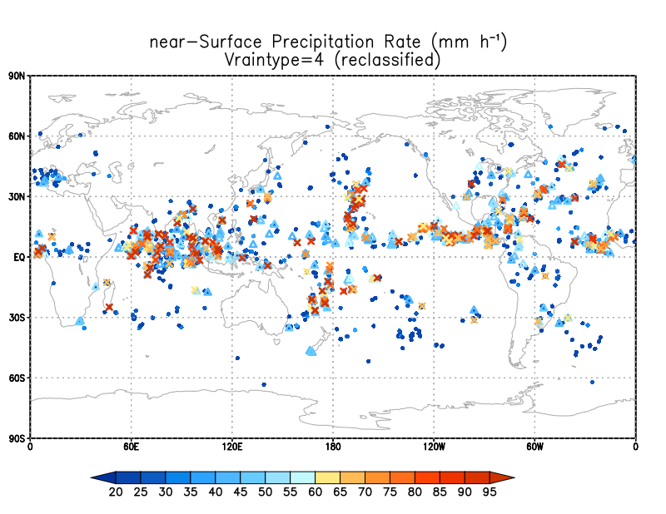
Reclassified pixels (Vraintype=4) with Precip ≧20 mm/h
●：20-40 mm/h
△：40-60 mm/h
×：60- mm/h
[mm/h]
Notes:
preciptypecheck_num_Mrain_all_20mm_20181012.f90
plot_location_recGE20_20181016.gs

Slide 13
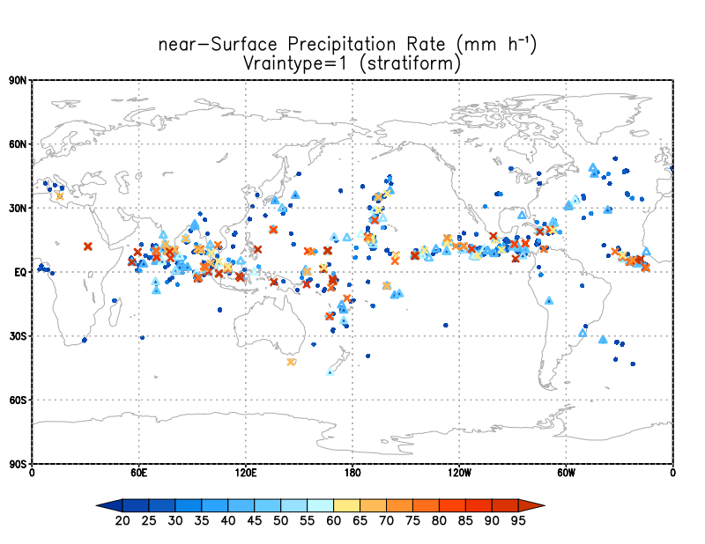
Stratiform pixels (Vraintype=1) with Precip ≧20 mm/h
●：20-40 mm/h
△：40-60 mm/h
×：60- mm/h
[mm/h]
Notes:
preciptypecheck_num_Mrain_all_20mm_20181012.f90
plot_location_strGE20_20181016.gs

Slide 14
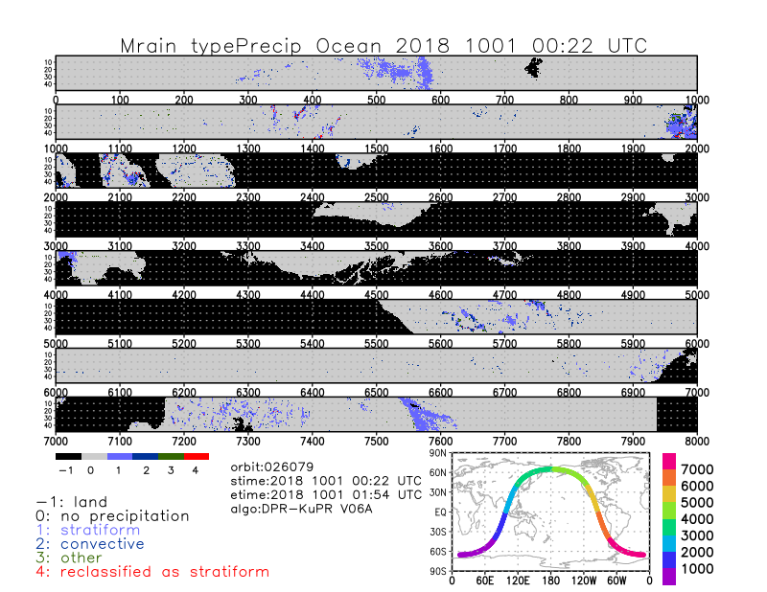
Notes:
preciptypecheck_num_Mrain_ocean_20181012.f90
Mrain_typePrecip_ocean_20181012.gs

Slide 15
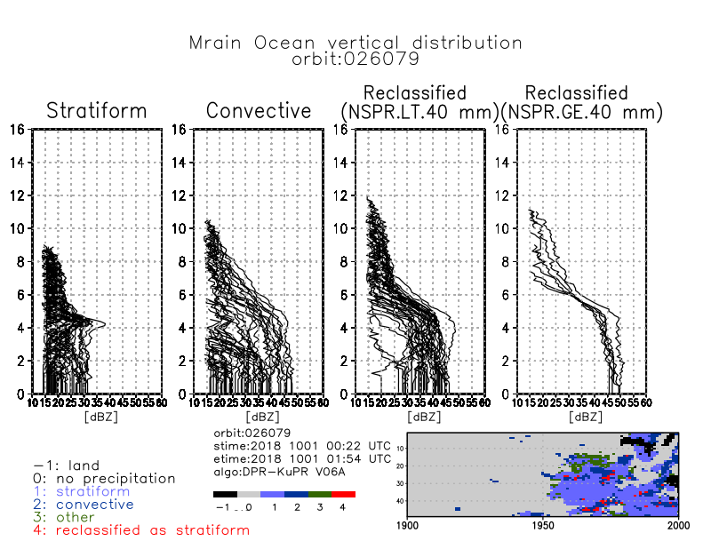
Notes:
Scan 1950-2000
preciptypecheck_Mrain_ocean_zFacvertical_20181012.f90 (iscan1=1950, iscan2=2000)
data_zFacvertical_20181012.txt
datalist_zFacvertical_20181012.txt
hdf5compile_Mrain_ocean_zFacvertical_20181012.sh
Mrain_zFacvertical_20181012.gs

Slide 16
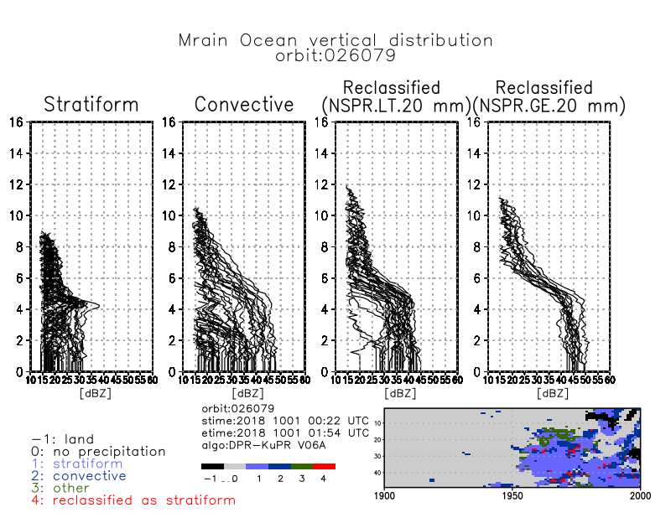
Notes:
Scan 1950-2000
preciptypecheck_Mrain_ocean_zFacvertical_20mm_20181012.f90 (iscan1=1950, iscan2=2000)
data_zFacvertical_20181012.txt
datalist_zFacvertical_20181012.txt
hdf5compile_Mrain_ocean_zFacvertical_20mm_20181012.sh
Mrain_zFacvertical_20mm_20181012.gs

Slide 17
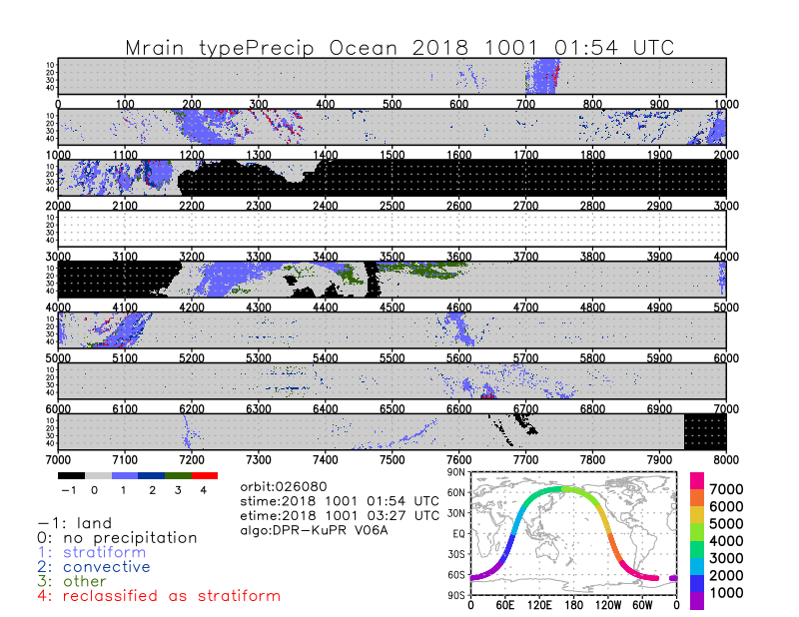
Notes:
preciptypecheck_num_Mrain_ocean_20181012.f90
Mrain_typePrecip_ocean_20181012.gs

Slide 18
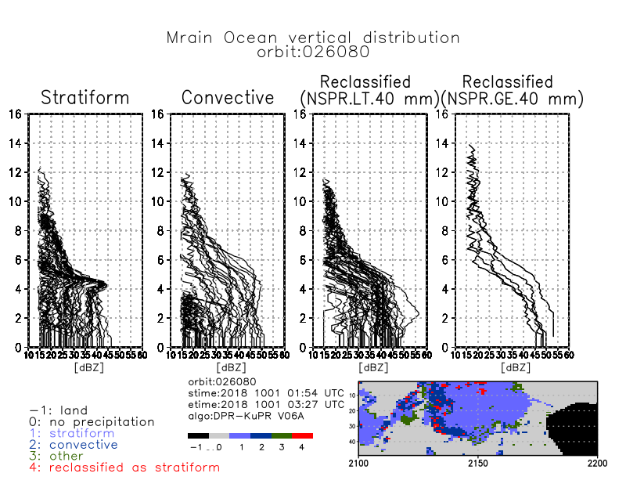
Notes:
Scan 2100-2200
preciptypecheck_Mrain_ocean_zFacvertical_20181012.f90 (iscan1=2100, iscan2=2200)
data_zFacvertical_20181012.txt
datalist_zFacvertical_20181012.txt
hdf5compile_Mrain_ocean_zFacvertical_20181012.sh
Mrain_zFacvertical_20181012.gs

Slide 19
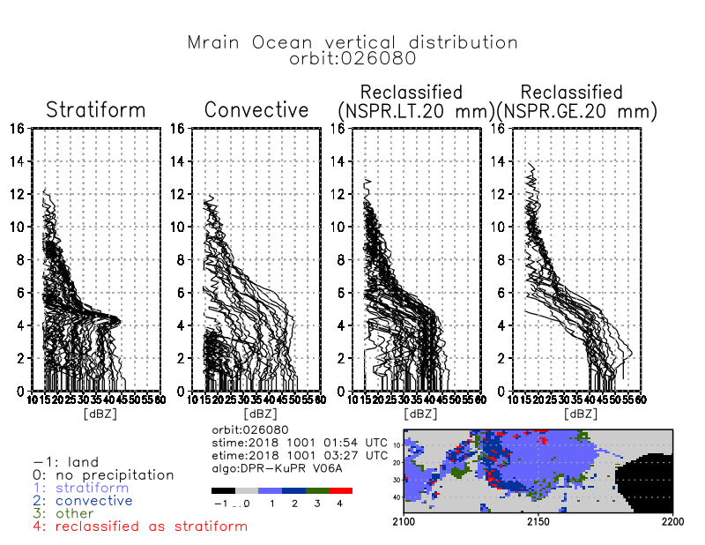
Notes:
Scan 2100-2200
preciptypecheck_Mrain_ocean_zFacvertical_20mm_20181012.f90 (iscan1=2100, iscan2=2200)
data_zFacvertical_20181012.txt
datalist_zFacvertical_20181012.txt
hdf5compile_Mrain_ocean_zFacvertical_20mm_20181012.sh
Mrain_zFacvertical_20mm_20181012.gs

Slide 20
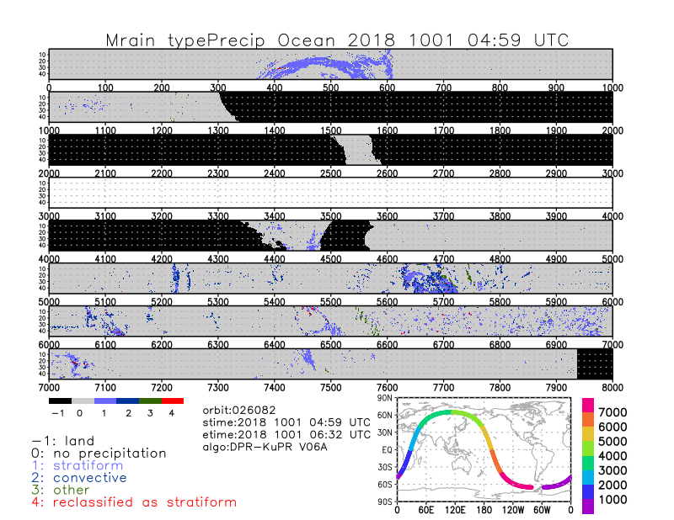
Notes:
preciptypecheck_num_Mrain_ocean_20181012.f90
Mrain_typePrecip_ocean_20181012.gs

Slide 21
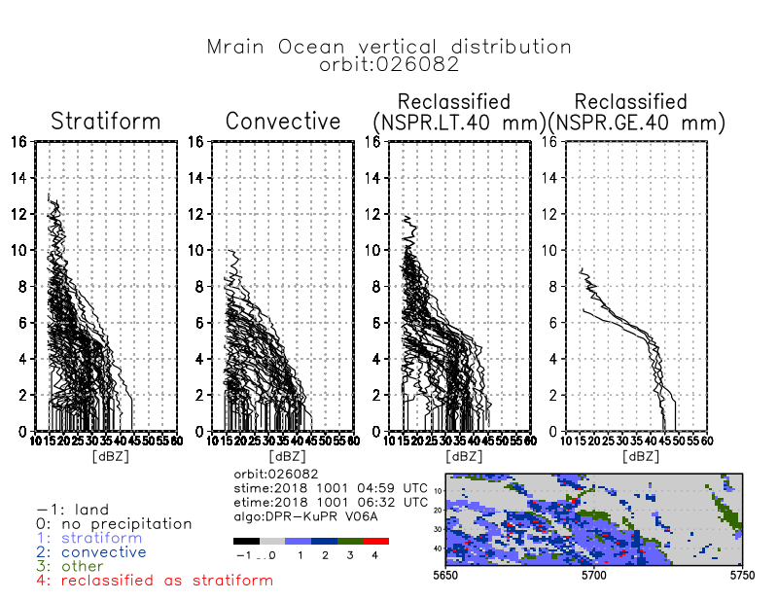
Notes:
Scan 5650-5750
preciptypecheck_Mrain_ocean_zFacvertical_20181012.f90 (iscan1=5650, iscan2=5750)
data_zFacvertical_20181012.txt
datalist_zFacvertical_20181012.txt
hdf5compile_Mrain_ocean_zFacvertical_20181012.sh
Mrain_zFacvertical_20181012.gs

Slide 22
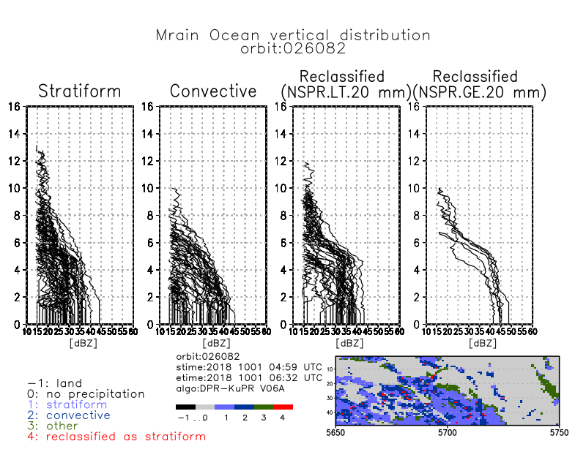
Notes:
Scan 5650-5750
preciptypecheck_Mrain_ocean_zFacvertical_20mm_20181012.f90 (iscan1=5650, iscan2=5750)
data_zFacvertical_20181012.txt
datalist_zFacvertical_20181012.txt
hdf5compile_Mrain_ocean_zFacvertical_20mm_20181012.sh
Mrain_zFacvertical_20mm_20181012.gs

Slide 23
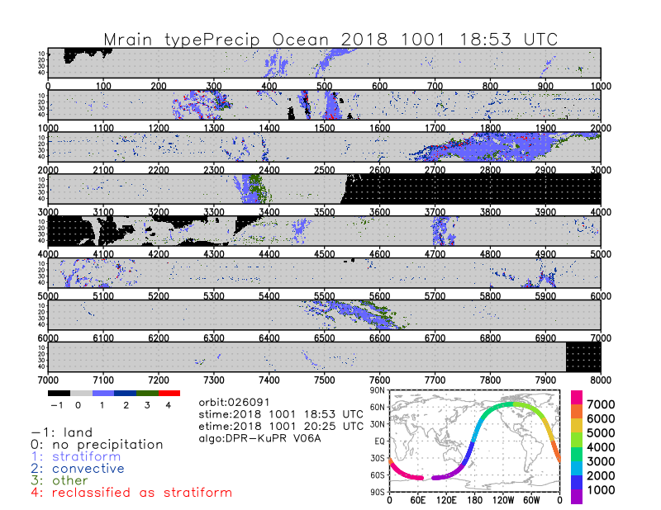
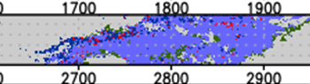
Cold front near Hawaii
Notes:
preciptypecheck_num_Mrain_ocean_20181012.f90
Mrain_typePrecip_ocean_20181012.gs

Slide 24
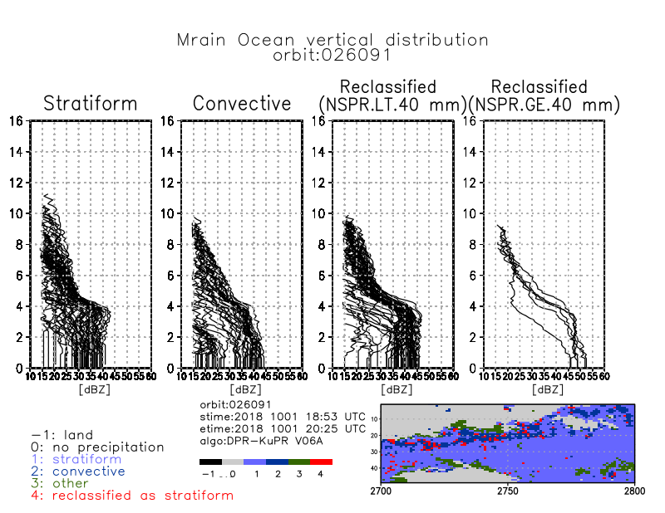
Cold front near Hawaii
Notes:
Scan 2700-2800
preciptypecheck_Mrain_ocean_zFacvertical_20181012.f90 (iscan1=2700, iscan2=2800)
data_zFacvertical_20181012.txt
datalist_zFacvertical_20181012.txt
hdf5compile_Mrain_ocean_zFacvertical_20181012.sh
Mrain_zFacvertical_20181012.gs

Slide 25
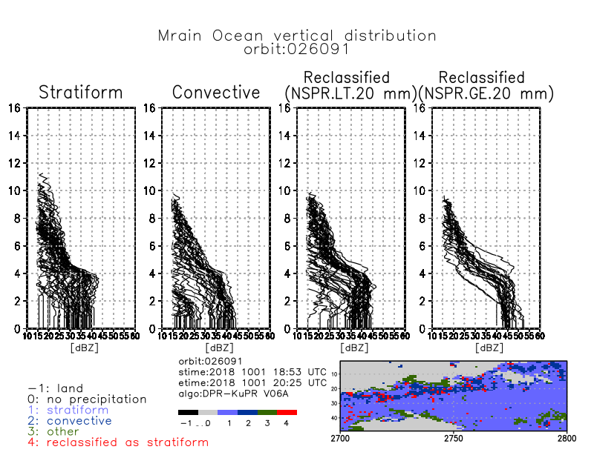
Cold front near Hawaii
Notes:
Scan 2700-2800
preciptypecheck_Mrain_ocean_zFacvertical_20mm_20181012.f90 (iscan1=2700, iscan2=2800)
data_zFacvertical_20181012.txt
datalist_zFacvertical_20181012.txt
hdf5compile_Mrain_ocean_zFacvertical_20mm_20181012.sh
Mrain_zFacvertical_20mm_20181012.gs

