Slide 1
Identification of Mesoscale Convective Precipitation in GPM Data
Bob Houze
PMM Science Team Meeting
San Diego, CA
October 18,2017

Slide 2
Impact of C/S classification on LH Product

Slide 3
Object | Echo Characteristic | Height | Area
Isolated Shallow Echoes | > min detectable | < 4 km | 2 pixels
Deep Convective Cores | > 40 dBZ (strong) | > 10 km | N/A
Wide Convective Cores | > 40 dBZ (strong) |  | > 1000 km² at some altitude
Broad Stratiform Regions | Contiguous stratiform |  | > 50,000 km² (strong)
Notes:
3D structure--thresholds: intensity, height, & area
<number>

Slide 4
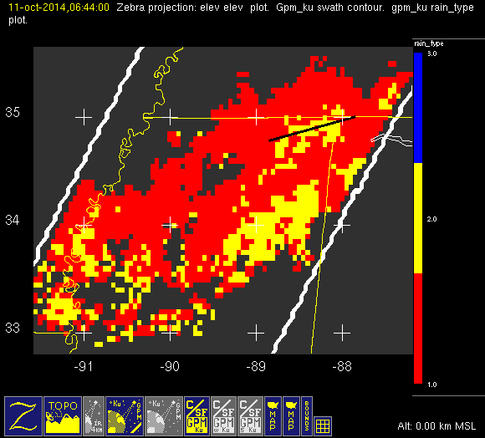
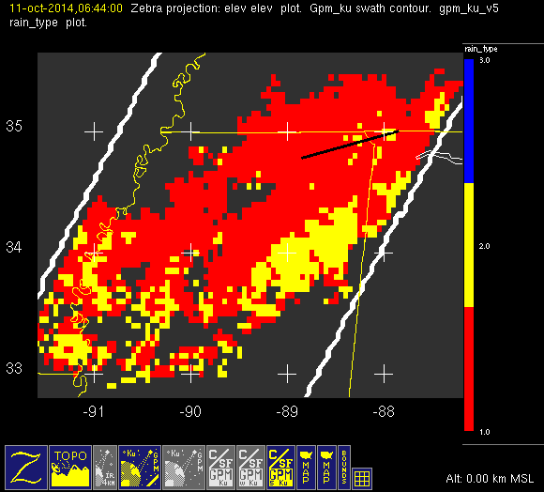
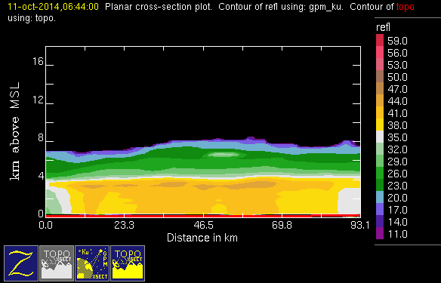
Comparison of v04 vs v05 c/s output

Slide 5
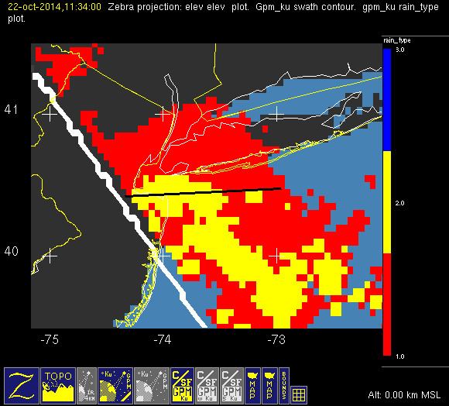
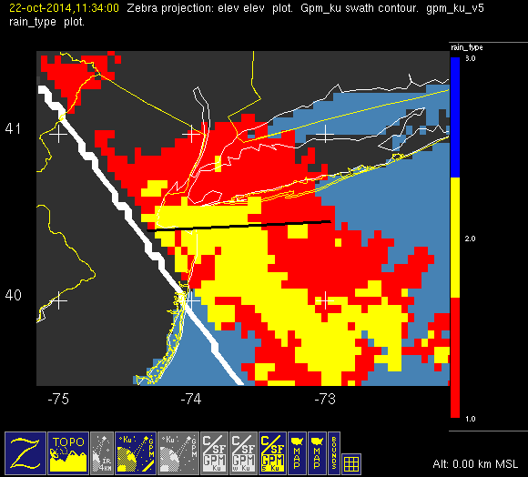
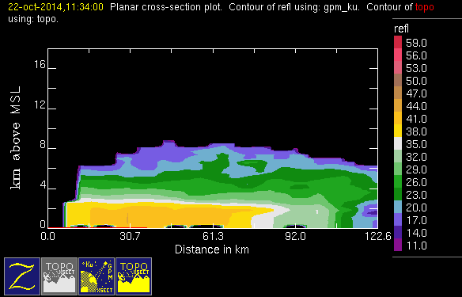
Problem case

Slide 6
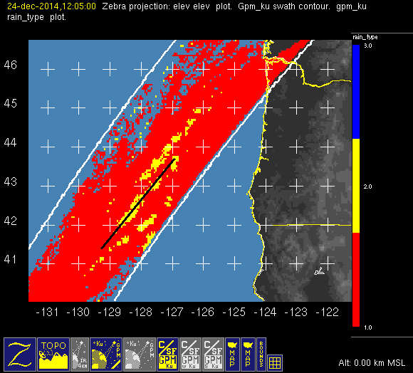
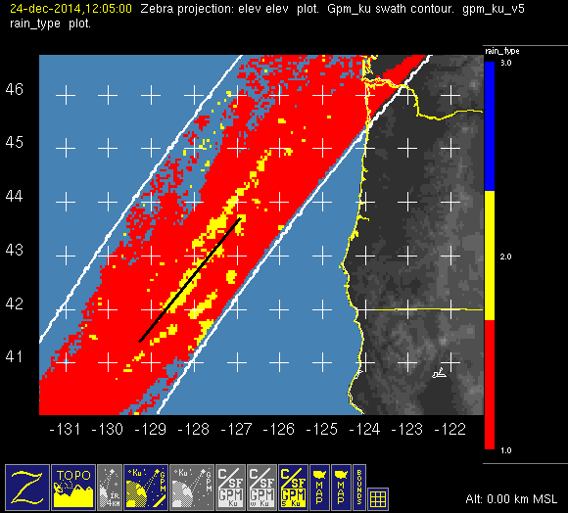
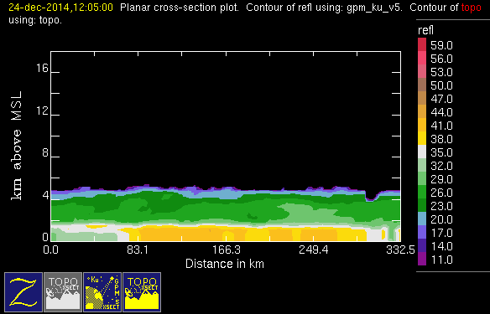
Problem case

Slide 7
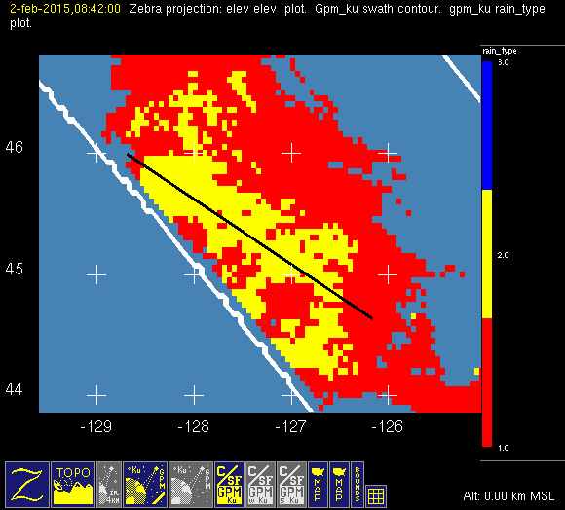
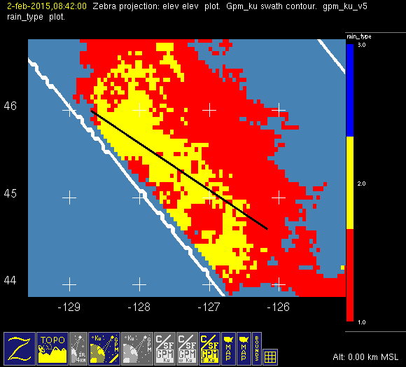
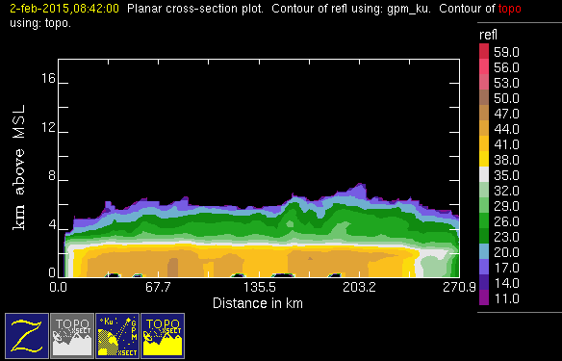
Problem case

Slide 8
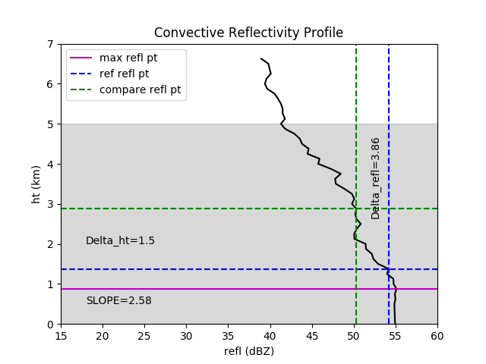
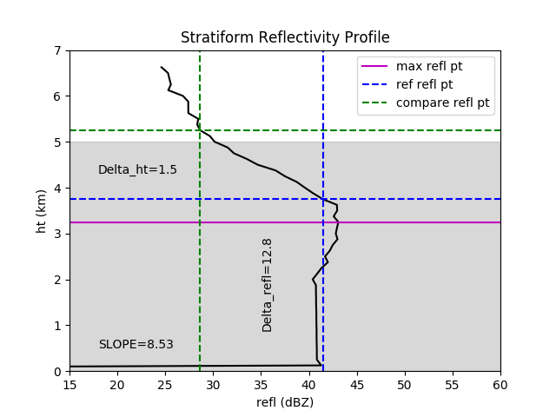
UW Modification to C/S Algorithm

Slide 9
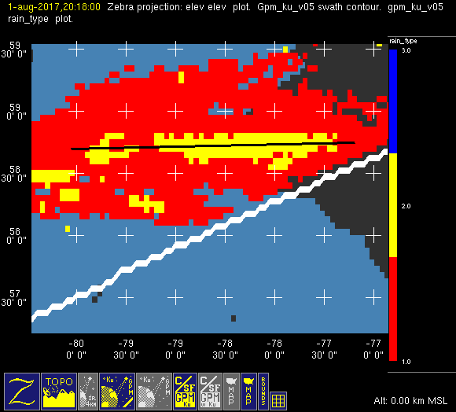
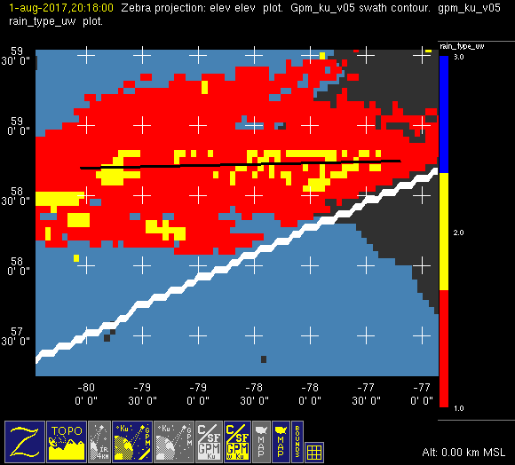
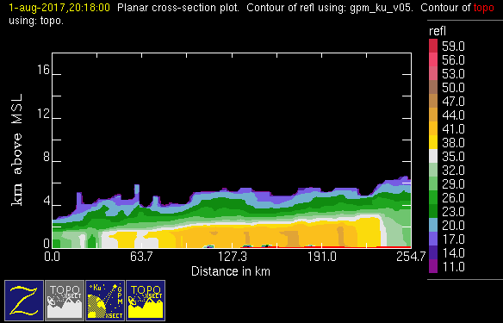
UW Mod to Problem case

Slide 10
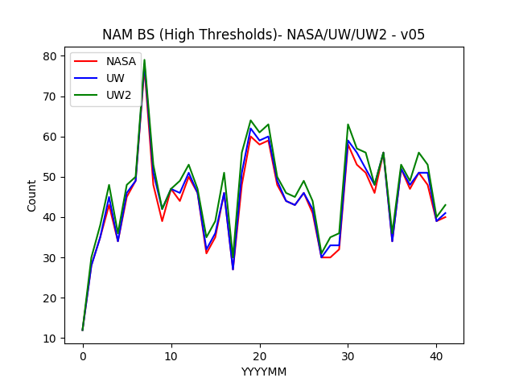
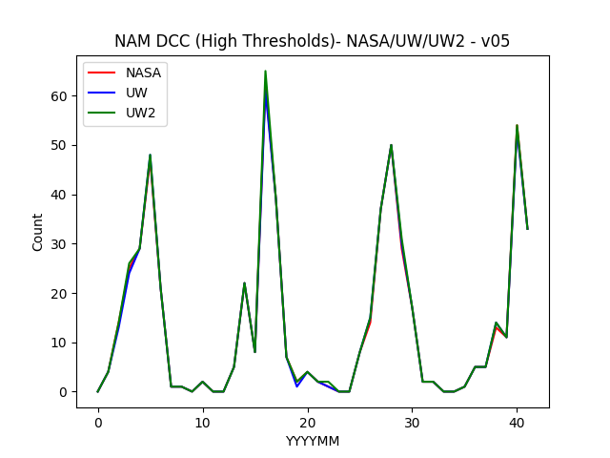
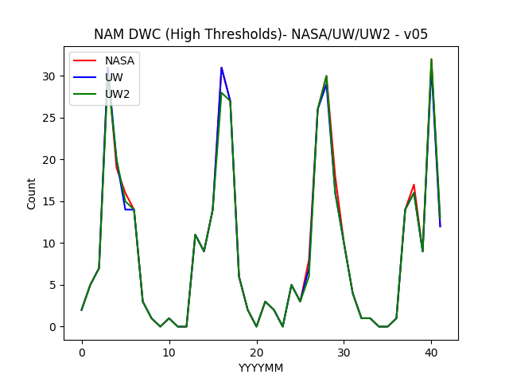
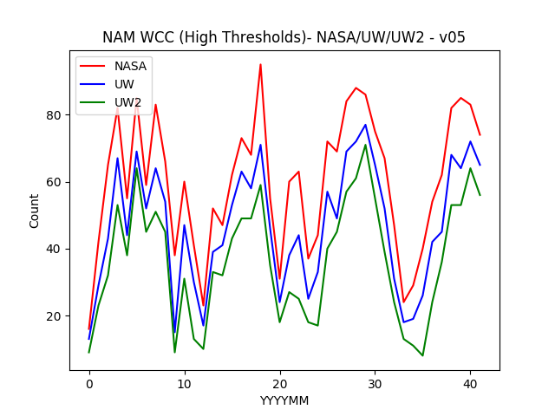
Comparison of v05 Counts
NASA/UW/UW2 (strong thresholds)

Slide 11
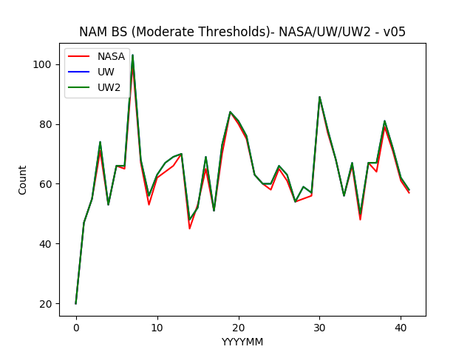
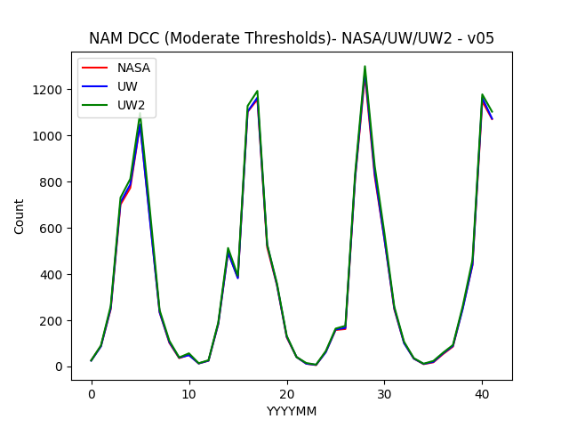
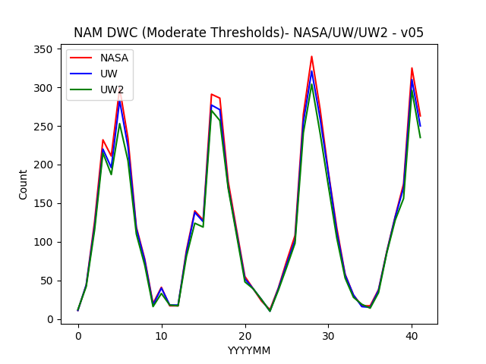
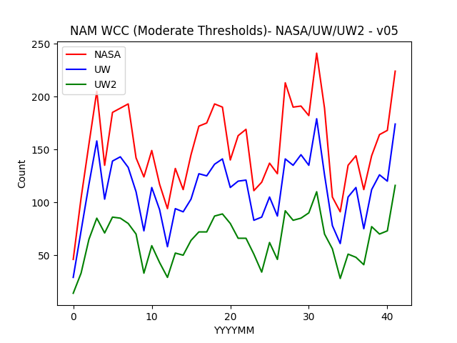
Comparison of v05 Counts
NASA/UW/UW2 (mod thresholds)

Slide 12
Probability Maps v05 – NASA vs UW (dcc,wcc,dwc,bs)
See files in
~brodzik/

Slide 13
Compare v04, v05, v05UW Prob Maps
WILL PUT THESE TOGETHER TOMORROW

Slide 14
Dependencies (need new word)
Latitude
Longitude
Month/Season
WILL PUT THIS TOGETHER TOMORROW

Slide 15
Conclusions

