Slide 1
Identification of Mesoscale Convective Precipitation in GPM Data
Robert Houze
PMM Science Team Meeting
San Diego, CA
October 18,2017

Slide 2
3D Object | Srength | Echo Characteristic | Height | Area
Isolated Shallow Echoes |  | > Min detectable | < 4 km | 2 pixels
Deep Convective Cores |  | > 40 dBZ | > 10 km
Wide Convective Cores |  | > 40 dBZ |  | > 1,000 km²
Broad Stratiform Regions |  | Contiguous stratiform |  | > 50,000 km²

Slide 3
3D Object | Srength | Echo Characteristic | Height | Area
Isolated Shallow Echoes | Strong | > Min detectable | < 4 km | 2 pixels
Deep Convective Cores | Strong | > 40 dBZ | > 10 km
Wide Convective Cores | Strong | > 40 dBZ |  | > 1,000 km²
Broad Stratiform Regions | Strong | Contiguous stratiform |  | > 50,000 km²

Slide 4
3D Object | Srength | Echo Characteristic | Height | Area
Isolated Shallow Echoes | Strong | > Min detectable | < 4 km | 2 pixels
Deep Convective Cores | Strong | > 40 dBZ | > 10 km
 | Moderate | > 30 dBZ | > 8 km
Wide Convective Cores | Strong | > 40 dBZ |  | > 1,000 km²
 | Moderate | > 30 dBZ |  | > 800 km²
Broad Stratiform Regions | Strong | Contiguous stratiform |  | > 50,000 km²
 | Moderate | Contiguous stratiform |  | > 30,000 km²

Slide 5
3D Object | Srength | Echo Characteristic | Height | Area
Isolated Shallow Echoes | Strong | > Min detectable | < 4 km | 2 pixels
Deep Convective Cores | Strong | > 40 dBZ | > 10 km
 | Moderate | > 30 dBZ | > 8 km
Wide Convective Cores | Strong | > 40 dBZ |  | > 1,000 km²
 | Moderate | > 30 dBZ |  | > 800 km²
Broad Stratiform Regions | Strong | Contiguous stratiform |  | > 50,000 km²
 | Moderate | Contiguous stratiform |  | > 30,000 km²

Slide 6
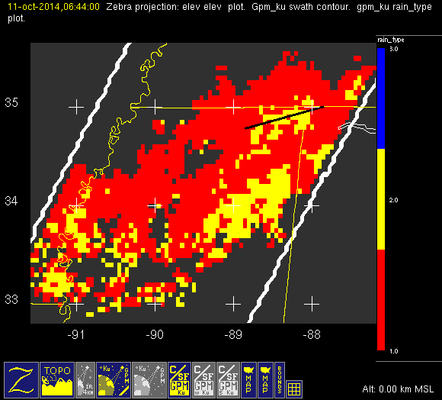
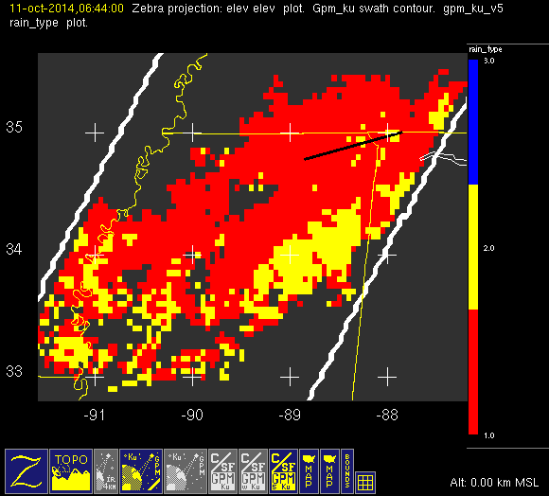
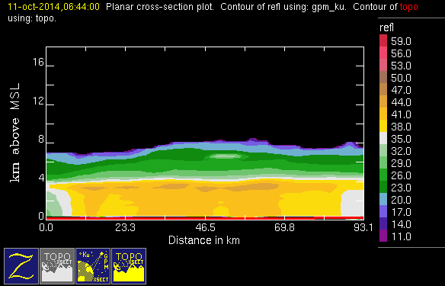
Comparison of v04 vs v05 c/s output
October
SE U.S.

Slide 7
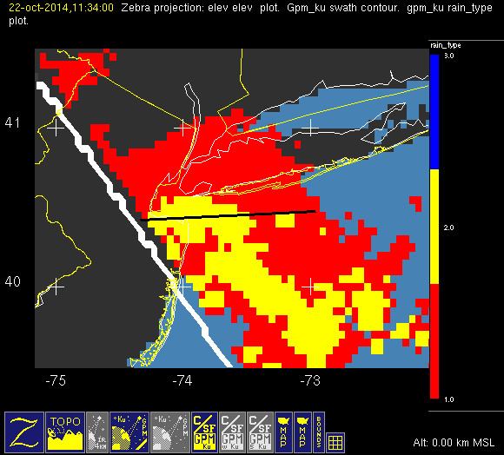
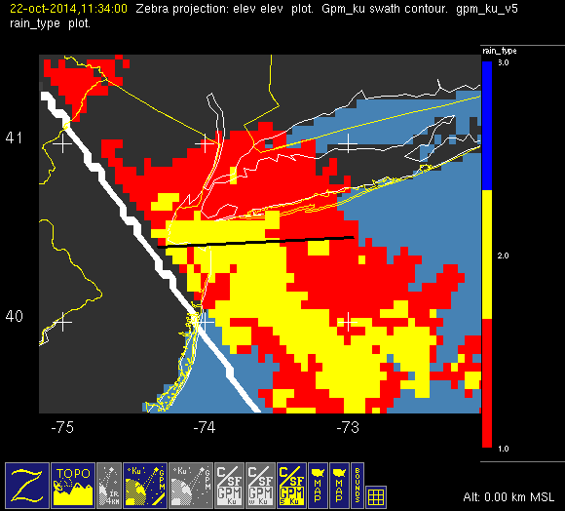
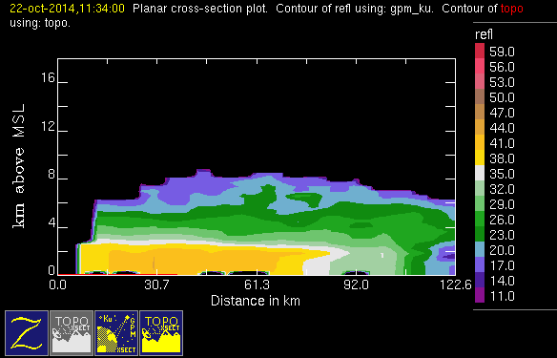
Problem case 1 East Coast Front
October
NE U.S.

Slide 8
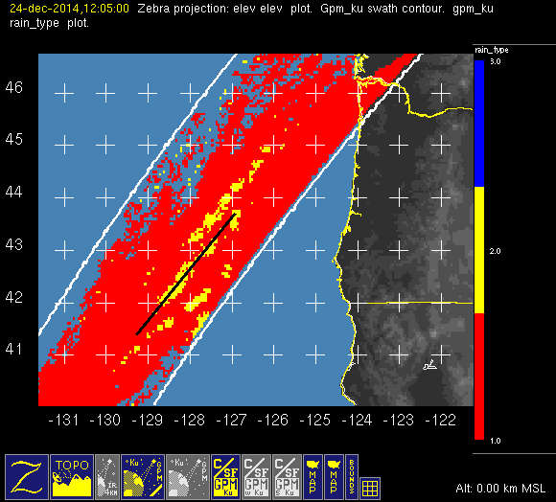
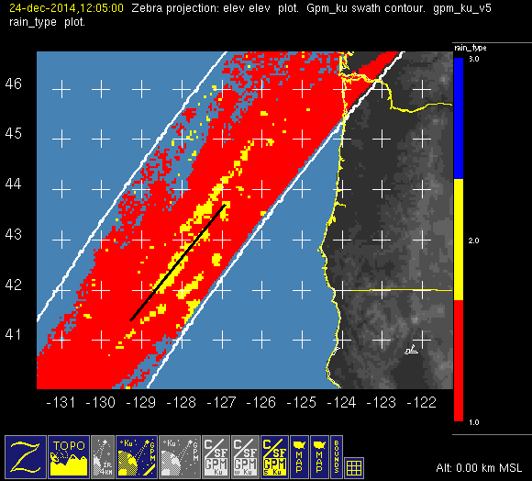
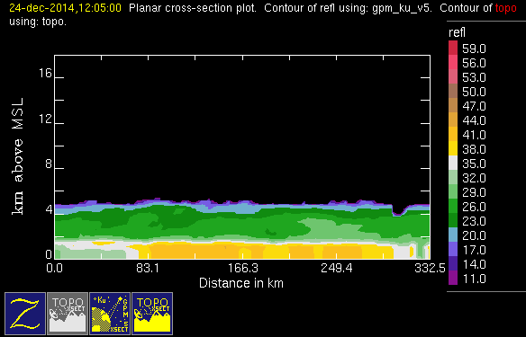
Problem case 2 West Coast Front
October NW U.S.

Slide 9
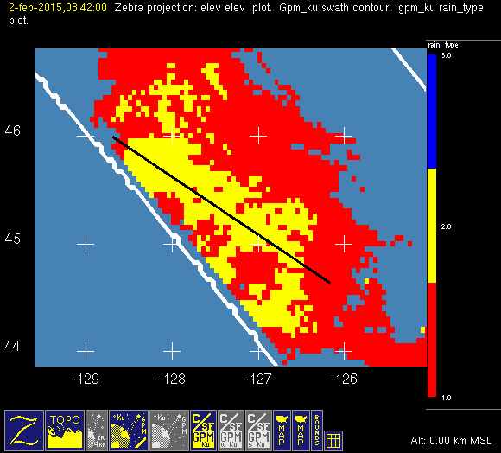
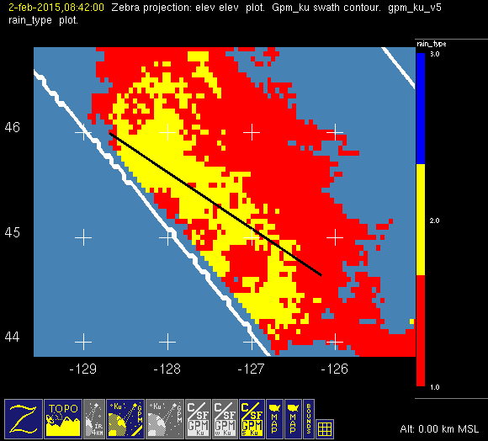
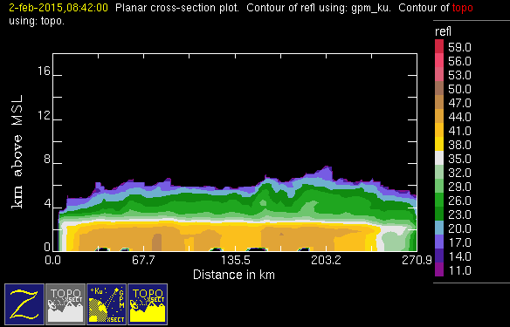
Problem case North Pacific
December
North Pacific

Slide 10
UW Modification to C/S Algorithm
Typical STRA Case
Typical CONV Case
Difficult STRA Case

Slide 11
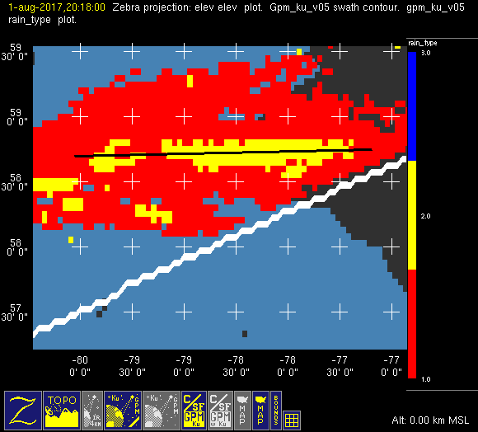
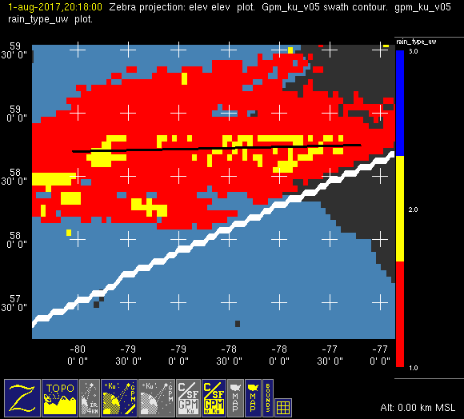
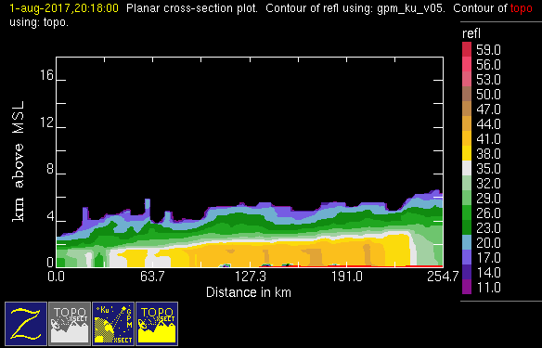
UW Mod to Problem case
August
Hudson Bay

Slide 12
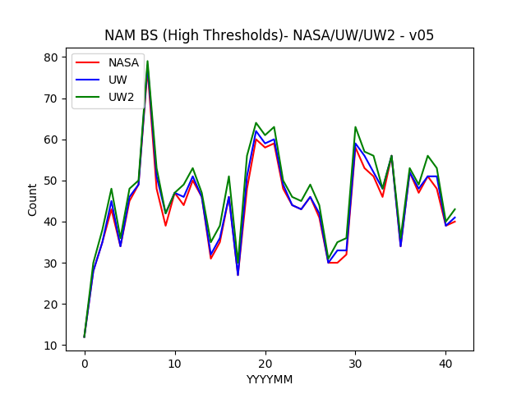
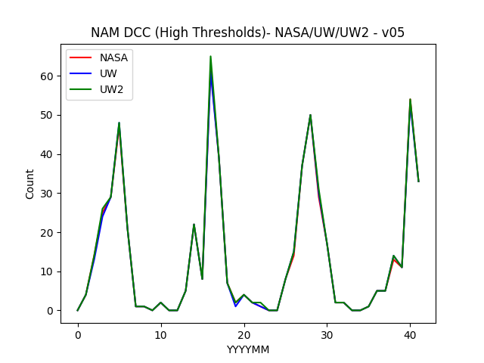
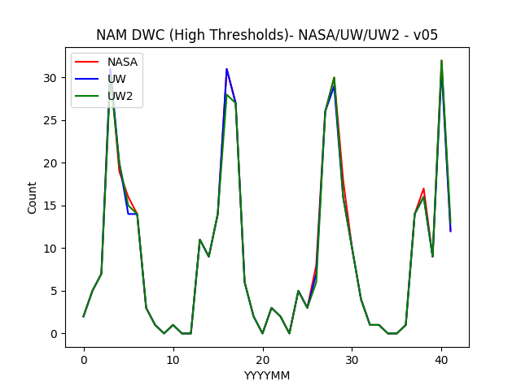
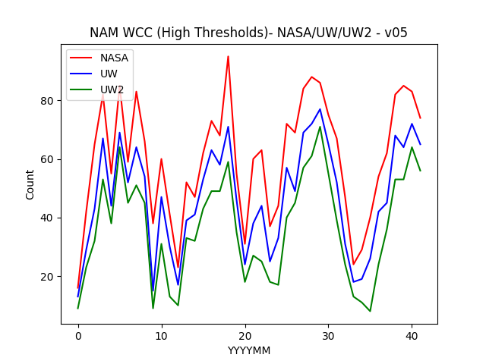
Comparison of v05 Counts
NASA/UW/UW2 (strong thresholds)

Slide 13
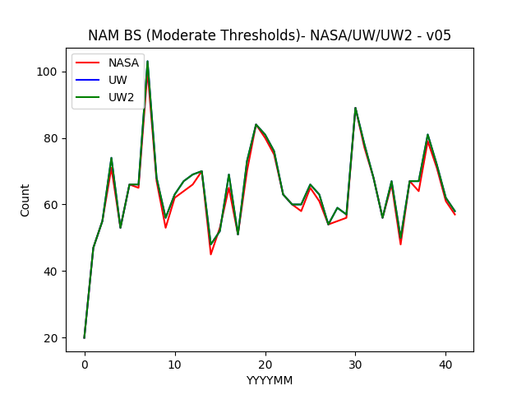
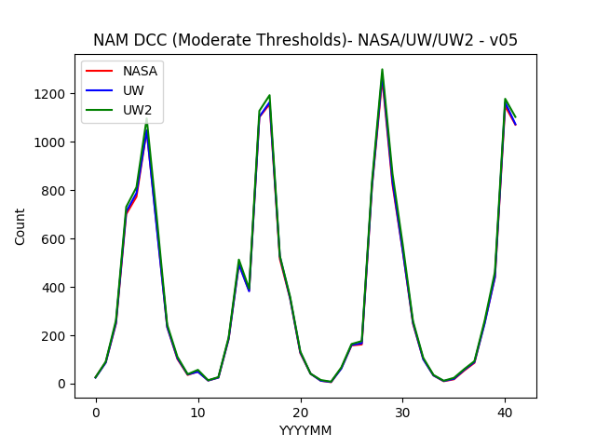
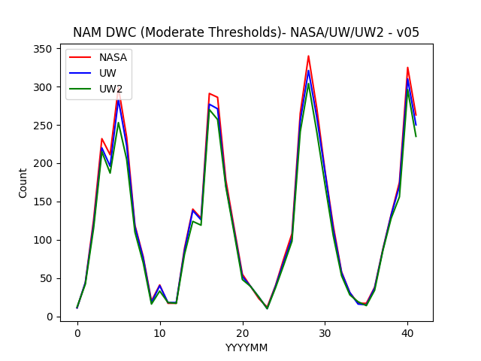
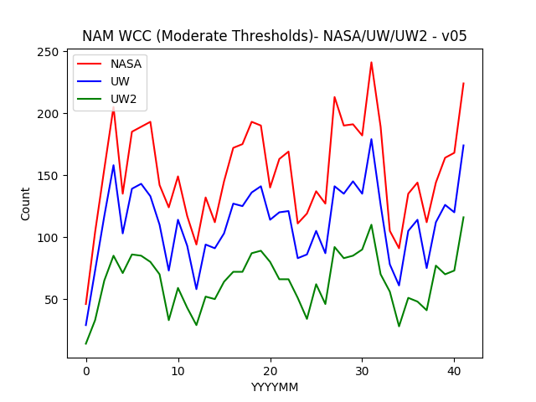
Comparison of v05 Counts
NASA/UW/UW2 (mod thresholds)

Slide 14
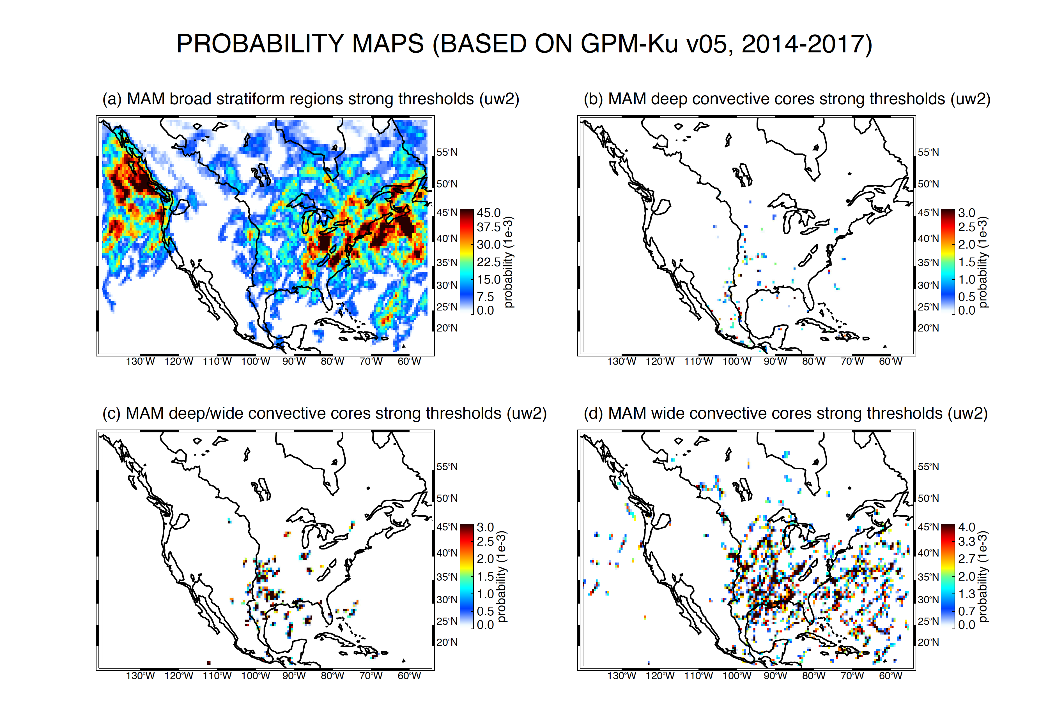

Slide 15
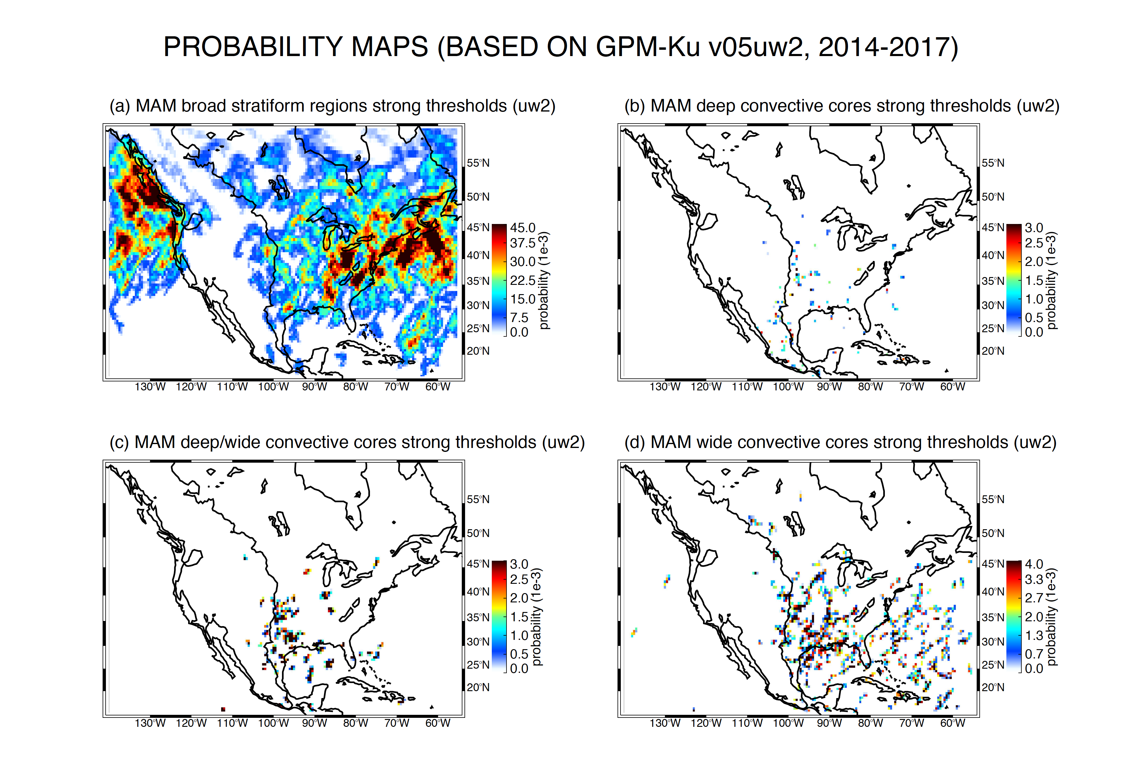

Slide 16
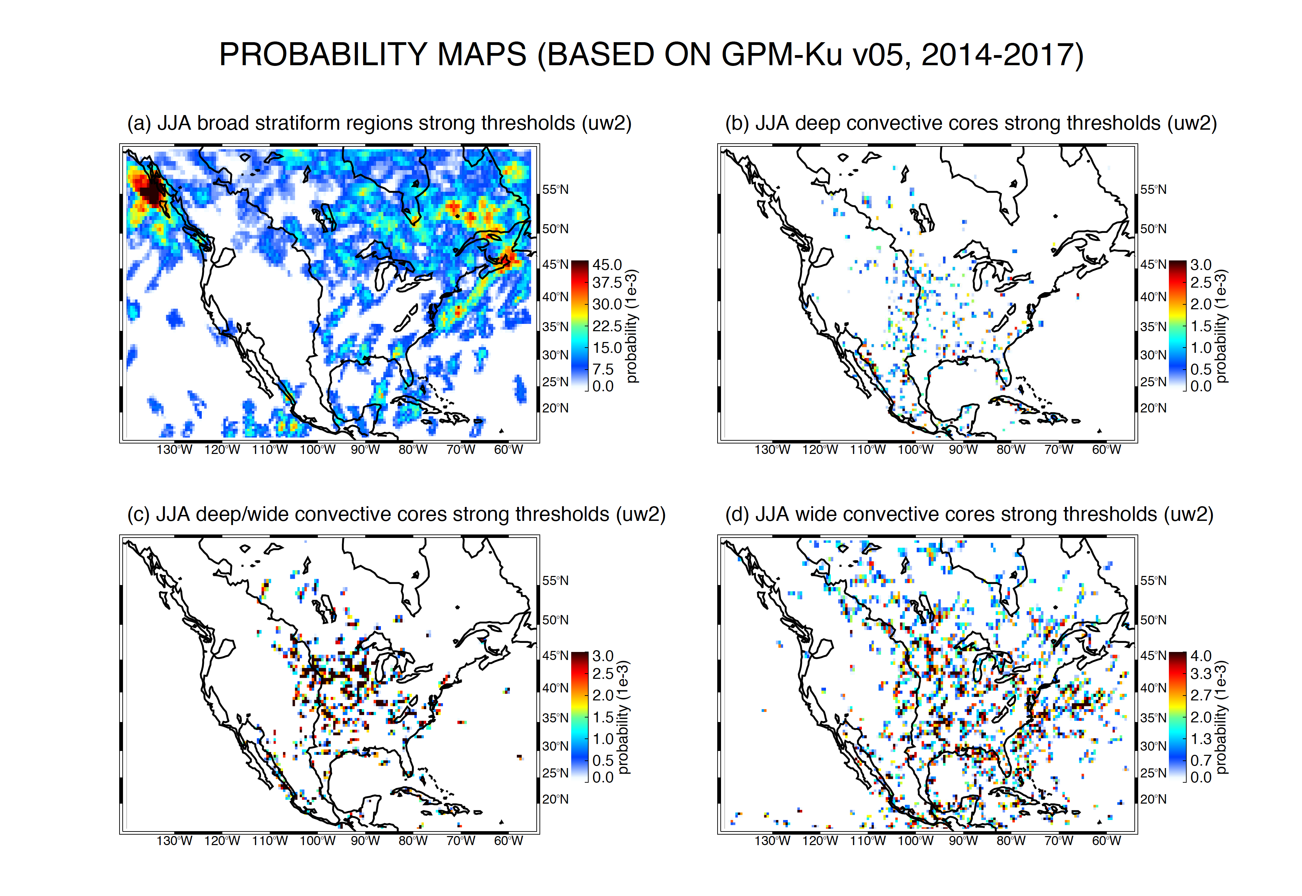

Slide 17
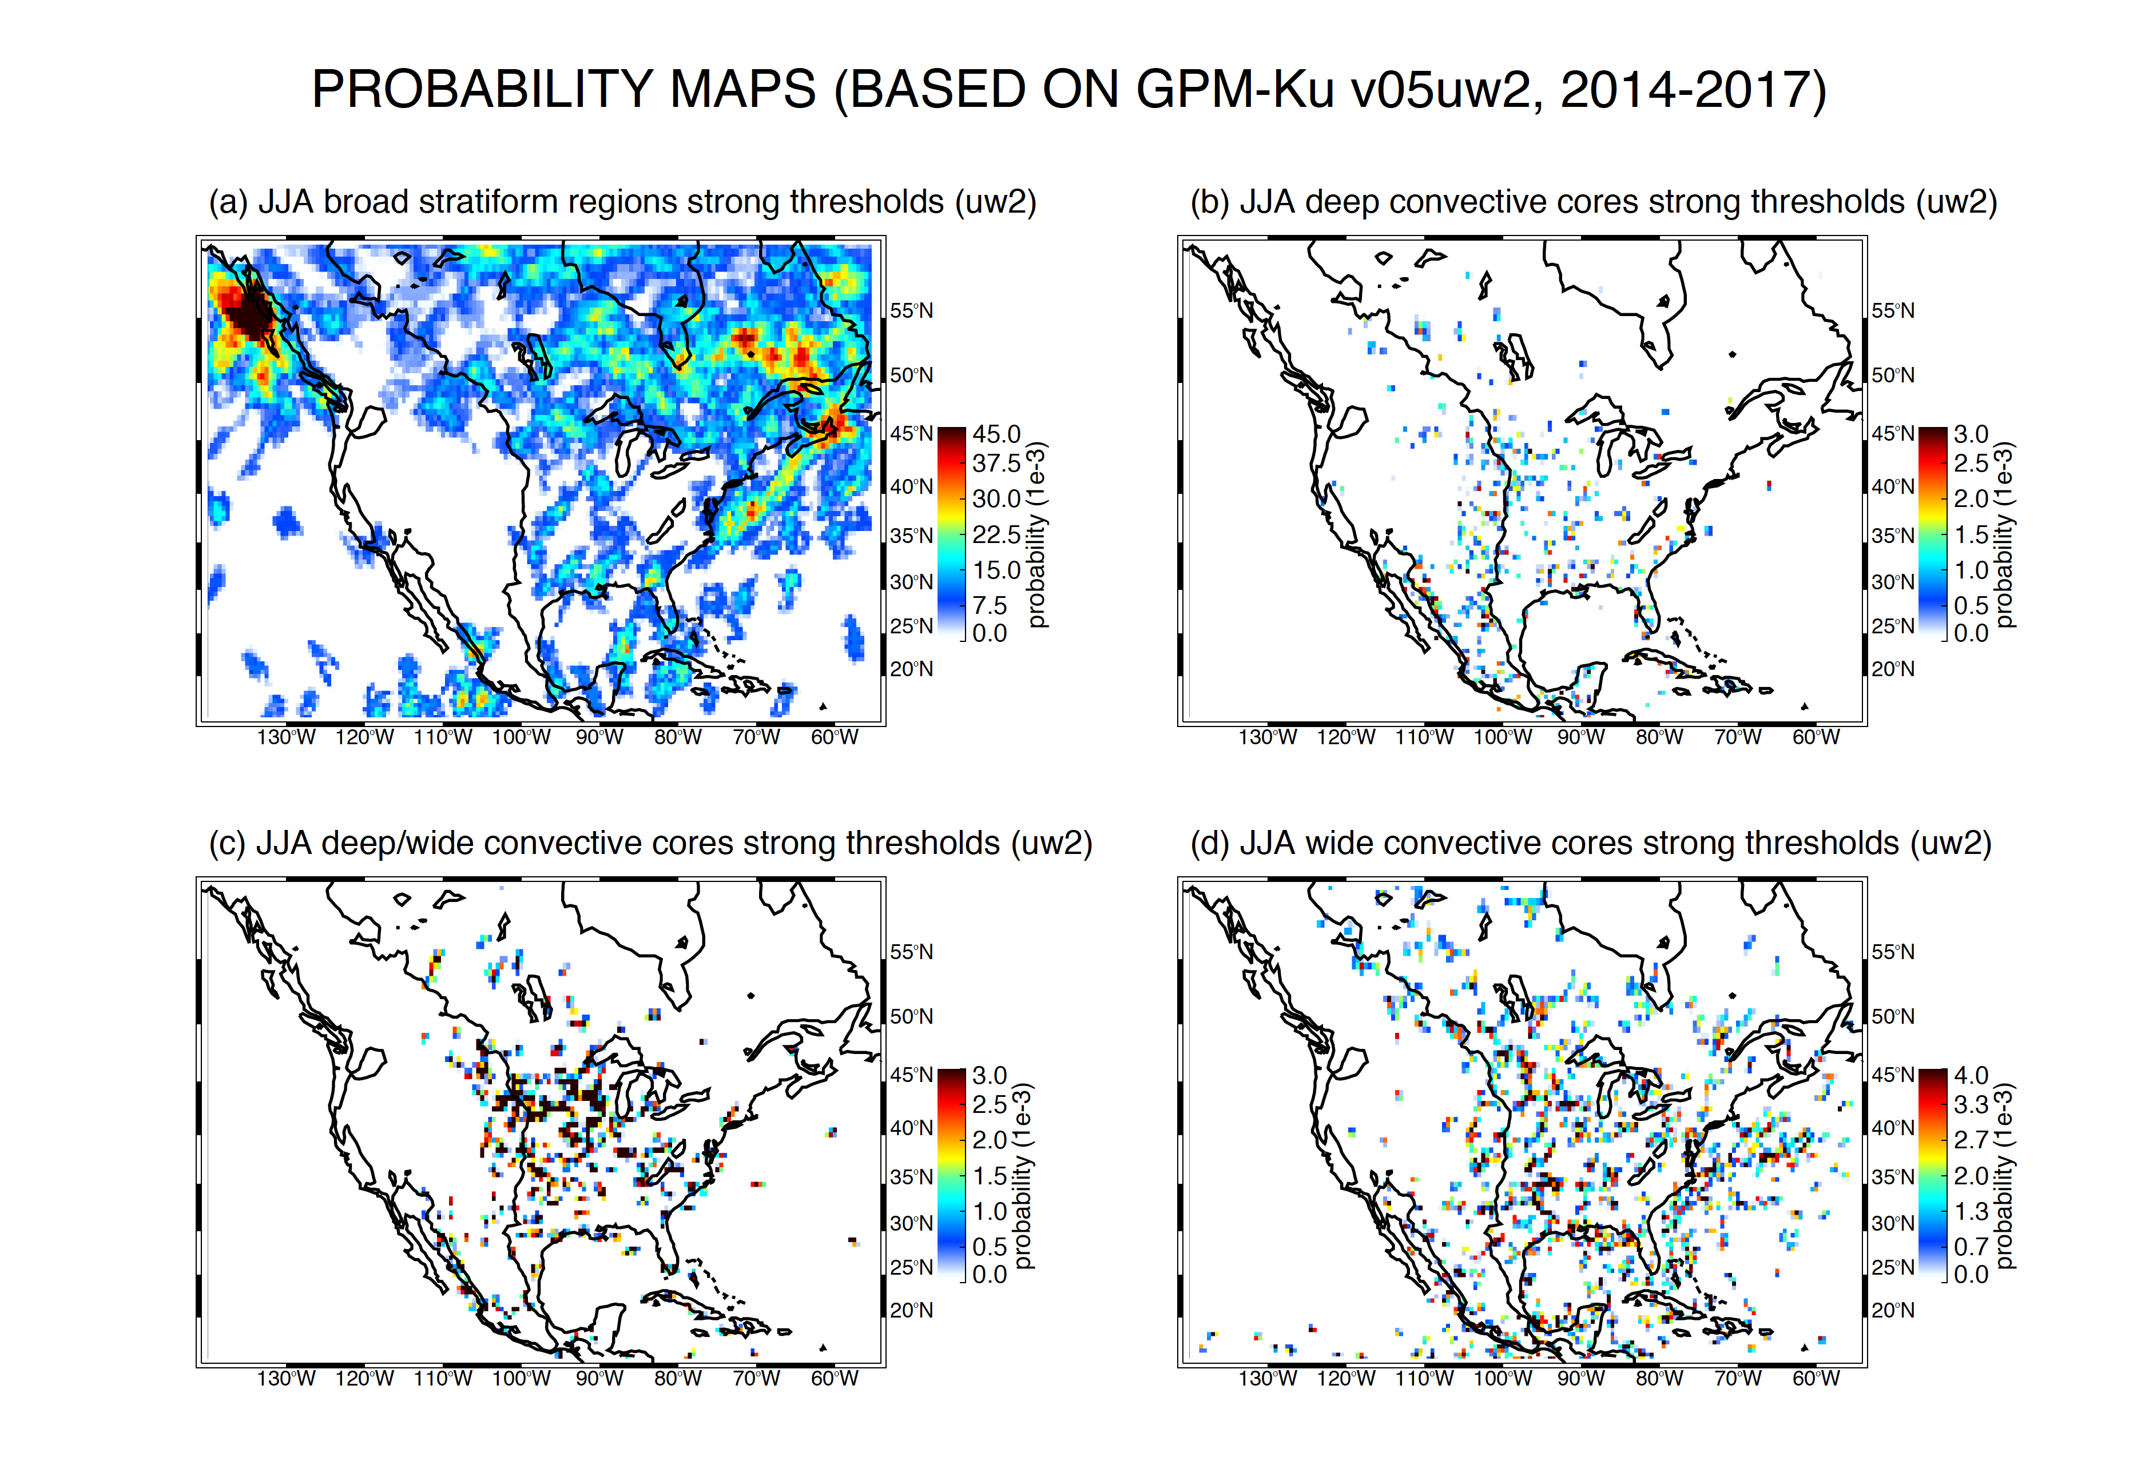

Slide 18
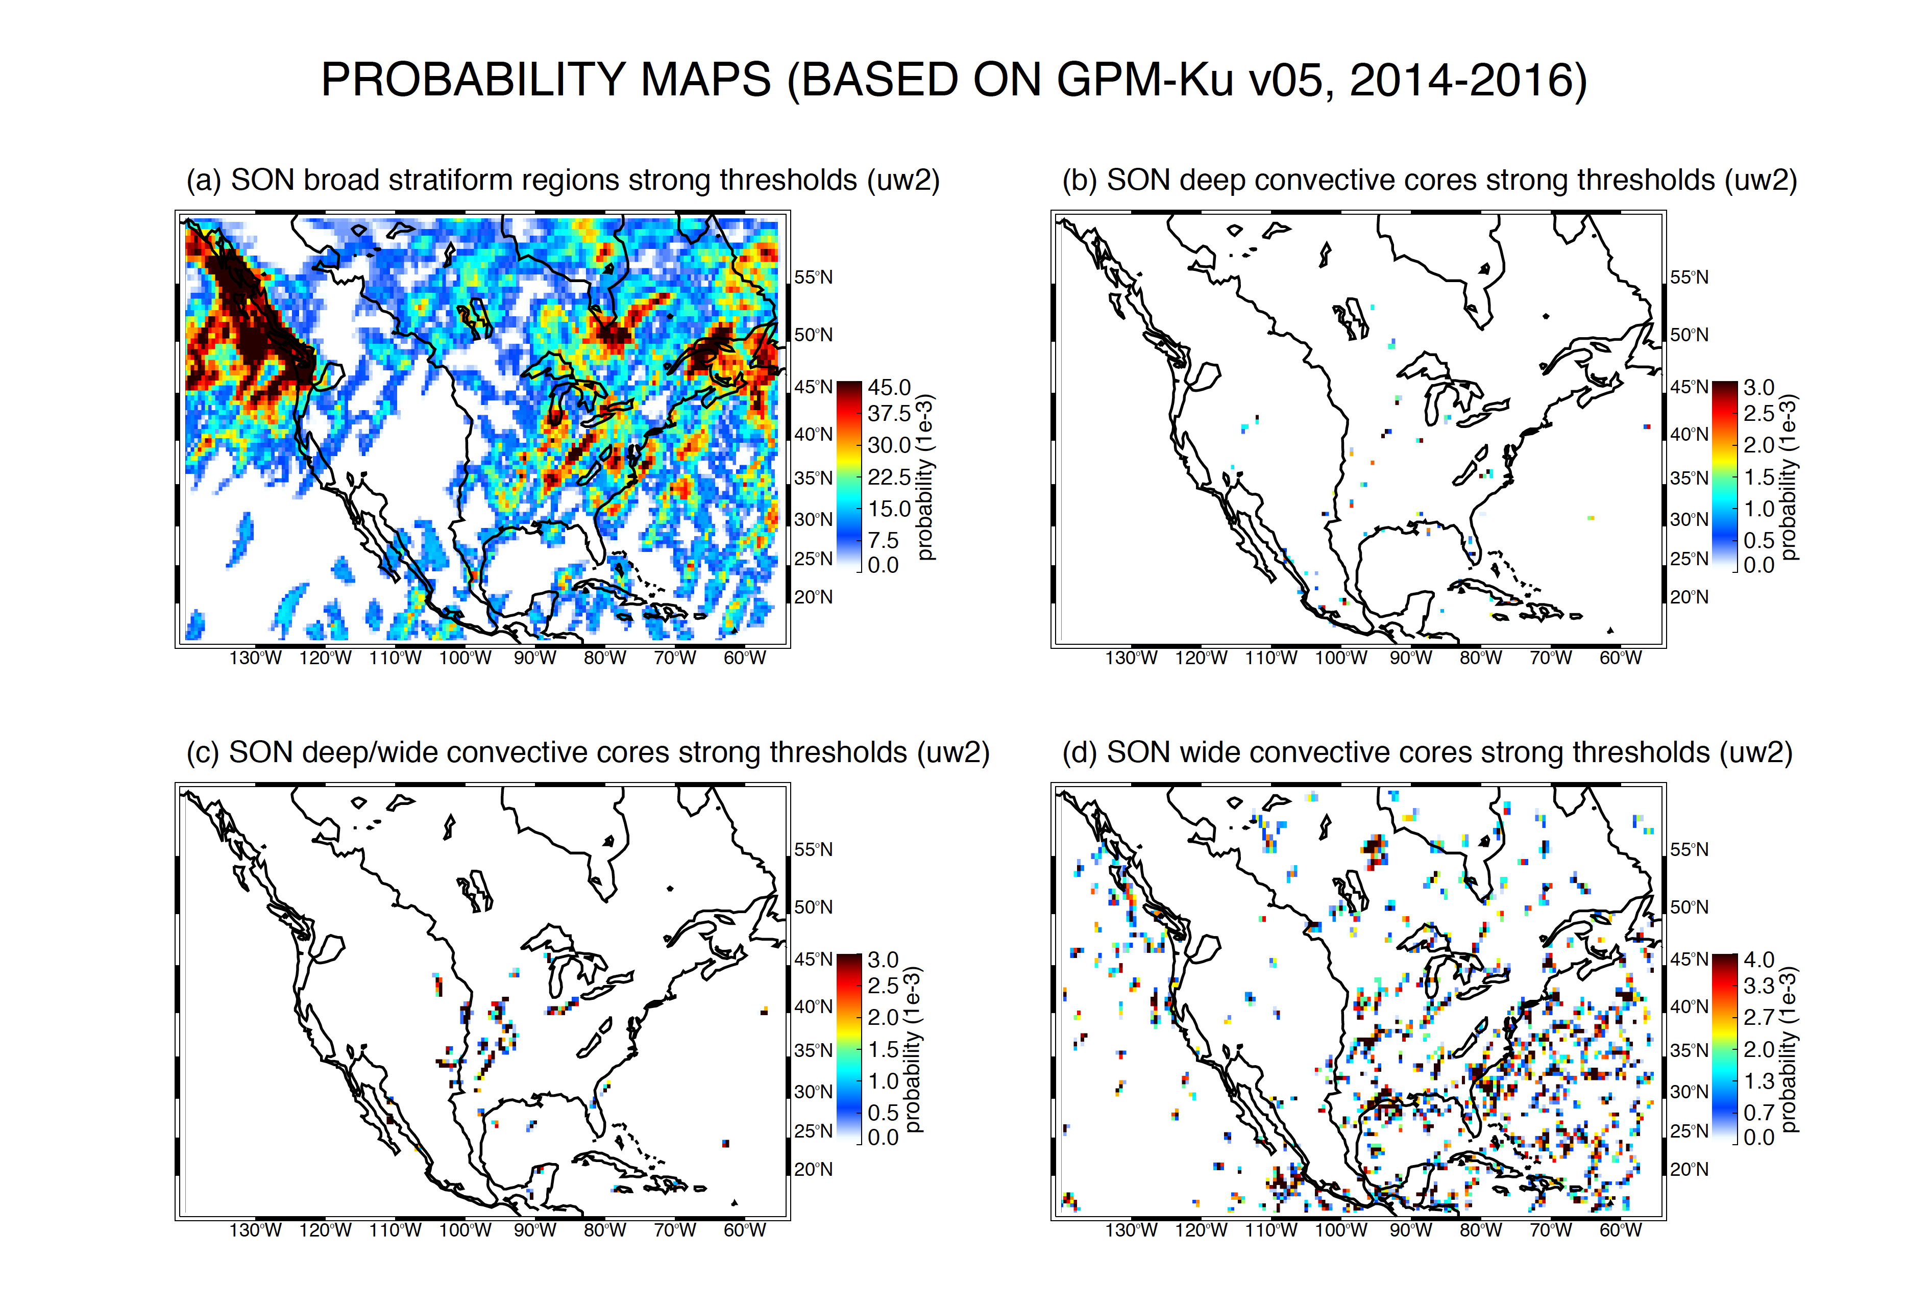

Slide 19
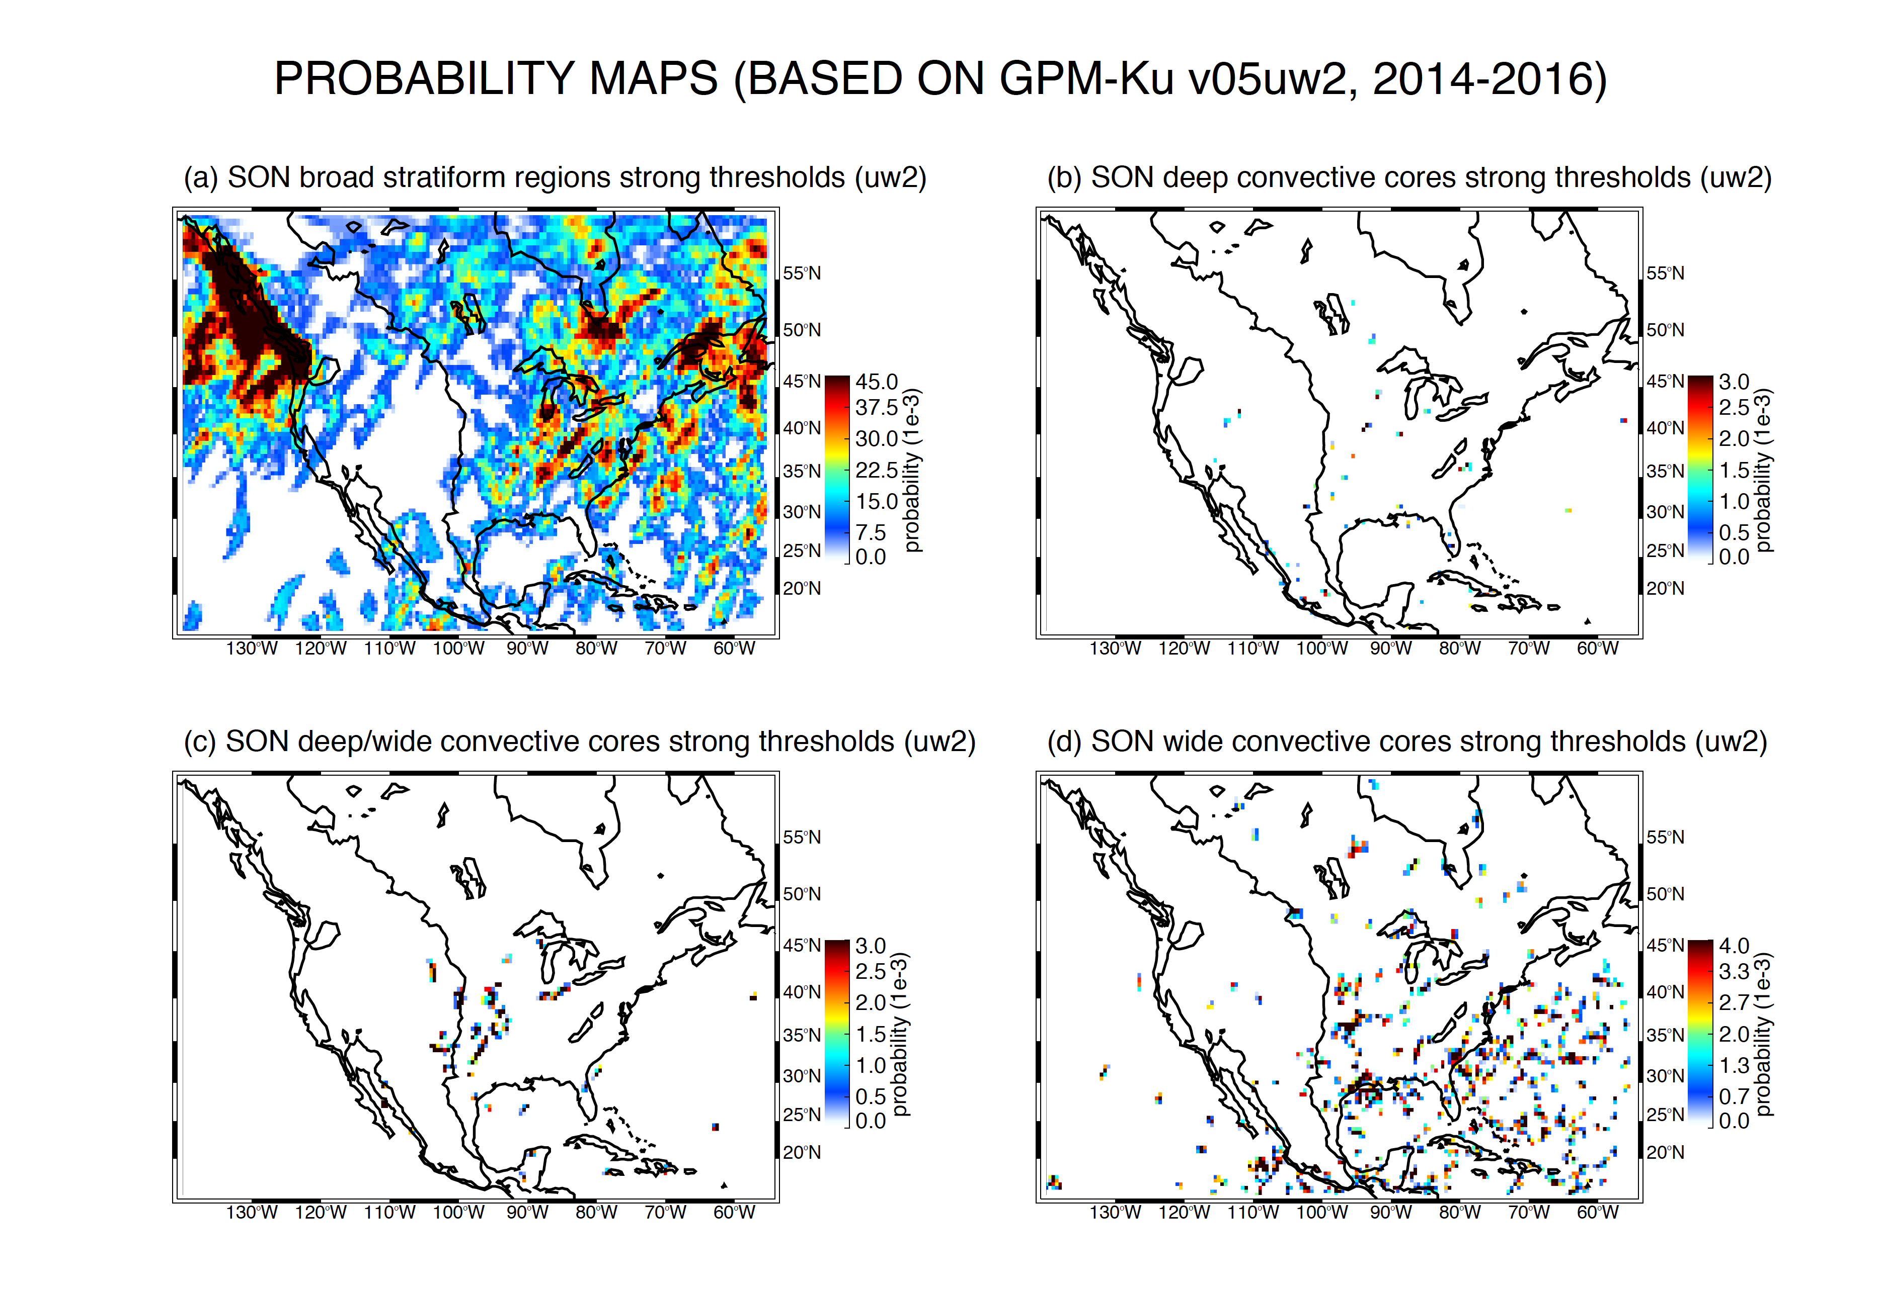

Slide 20
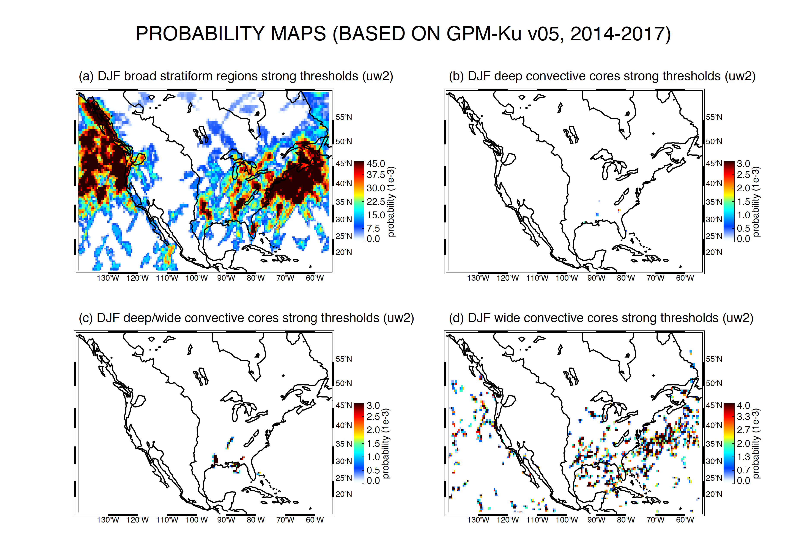

Slide 21
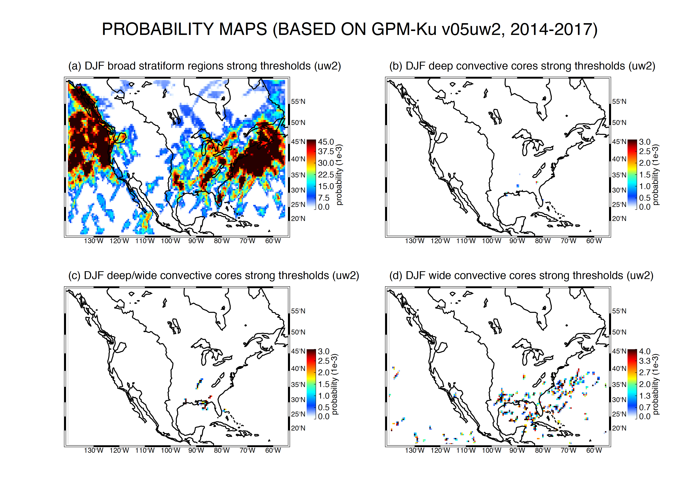

Slide 22
Dependencies (need new word)
Latitude
Longitude
Month/Season
WILL PUT THIS TOGETHER TOMORROW

Slide 23
Conclusions

Slide 24
Object | Echo Characteristic | Height | Area
Isolated Shallow Echoes | > min detectable | < 4 km | 2 pixels
Deep Convective Cores | > 40 dBZ | > 10 km | N/A
N/A
Wide Convective Cores | > 40 dBZ |  | > 1000 km² at some altitude
> 800 km² at some altitude
Broad Stratiform Regions | Contiguous stratiform |  | > 50,000 km²
Notes:
3D structure--thresholds: intensity, height, & area
24

Slide 25
Object | Echo Characteristic | Height | Area
Isolated Shallow Echoes | > min detectable | < 4 km | 2 pixels
Deep Convective Cores | > 40 dBZ (strong) | > 10 km | N/A
N/A
Wide Convective Cores | > 40 dBZ (strong) |  | > 1000 km² at some altitude
> 800 km² at some altitude
Broad Stratiform Regions | Contiguous stratiform |  | > 50,000 km² (strong)
Notes:
3D structure--thresholds: intensity, height, & area
25

Slide 26
Object | Echo Characteristic | Height | Area
Isolated Shallow Echoes | > min detectable | < 4 km | 2 pixels
Deep Convective Cores | > 40 dBZ (strong) > 30 dBZ (moderate) | > 10 km > 8 km | N/A
N/A
Wide Convective Cores | > 40 dBZ (strong) > 30 dBZ (moderate) |  | > 1000 km² at some altitude > 800 km² at some altitude
> 800 km² at some altitude
Broad Stratiform Regions | Contiguous stratiform |  | > 50,000 km² (strong) > 30,000 km² (moderate)
Notes:
3D structure--thresholds: intensity, height, & area
26

Slide 27
