Slide 1
Identification of Mesoscale Convective Precipitation in GPM Data
Robert Houze and Stacy Brodzik
PMM Science Team Meeting
San Diego, CA
October 16-20, 2017

Slide 2
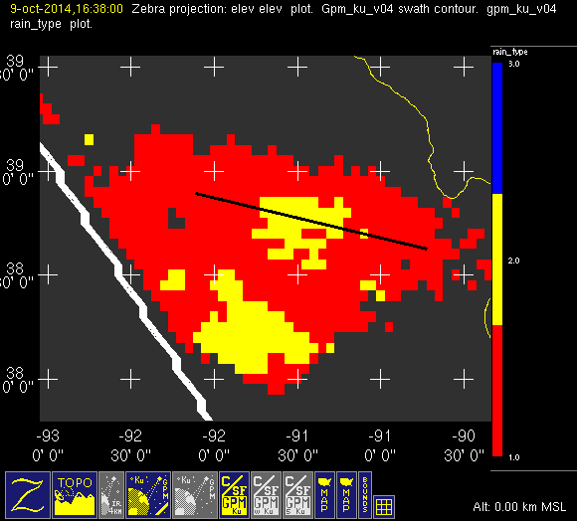
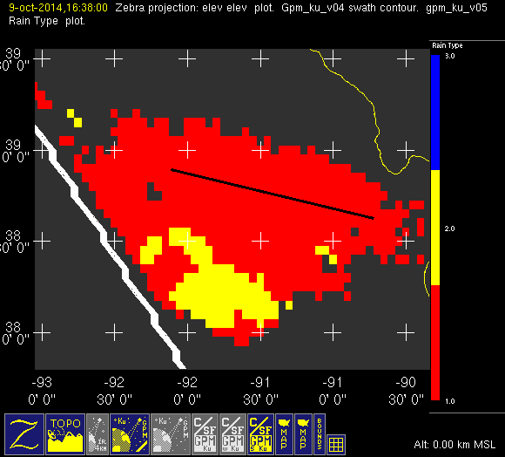
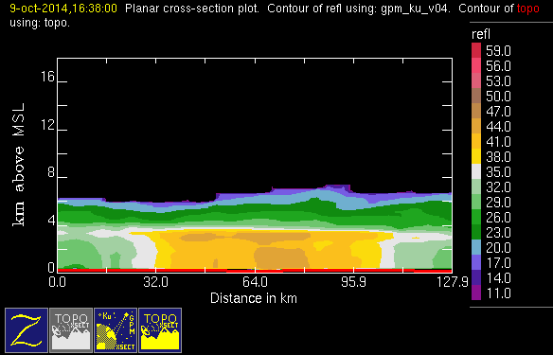
Comparison of v04 vs v05 c/s output
conv
stra
nasa v04
nasa v05
October
Missouri
(20141009/1637)
HUGE
improvement
Notes:
C/S algorithm shows a lot of improvement when comparing v04 to v05.

Slide 3
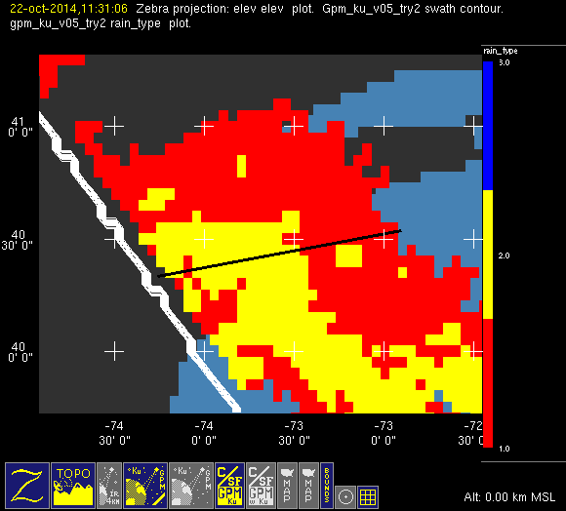
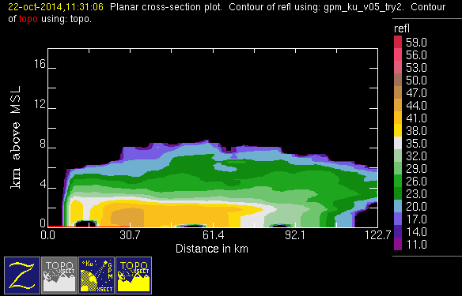
Problem case: East Coast Front
October
NE U.S.
conv
stra
nasa
v05
(20141022/1132)
Notes:
However, mis-classifications are still an issue.
The next 3 slides show obvious stratiform that is mis-classified as convective.

Slide 4
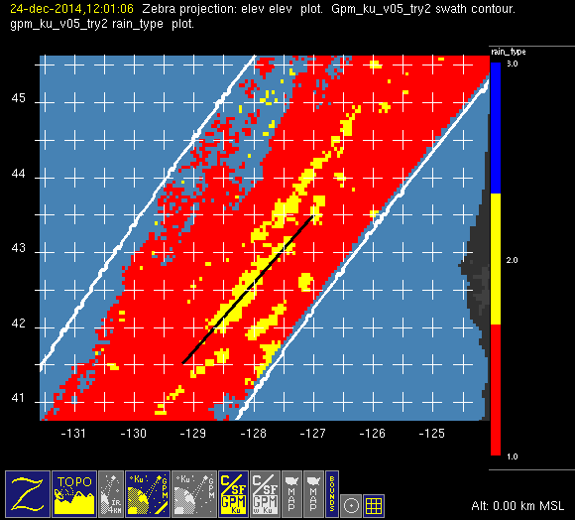
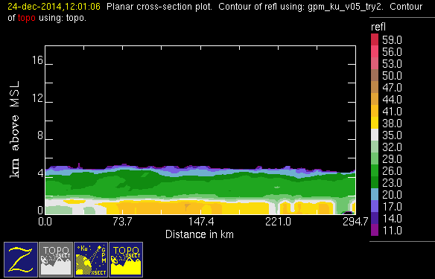
Problem case: West Coast Front
December NW U.S.
nasa
v05
conv
stra
(20141224/1202)

Slide 5
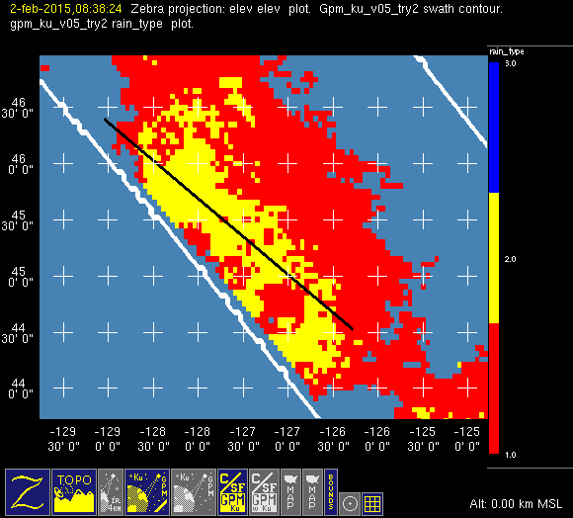
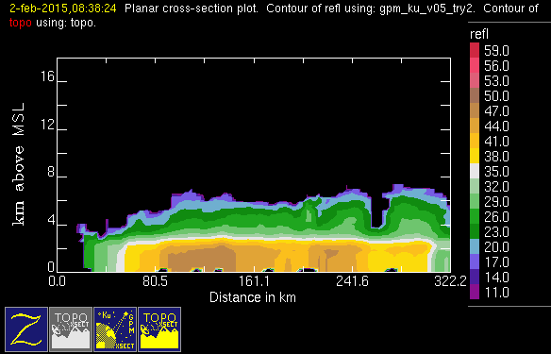
Problem case: North Pacific
February
North Pacific
conv
stra
nasa
v05
(20150202/0839)

Slide 6
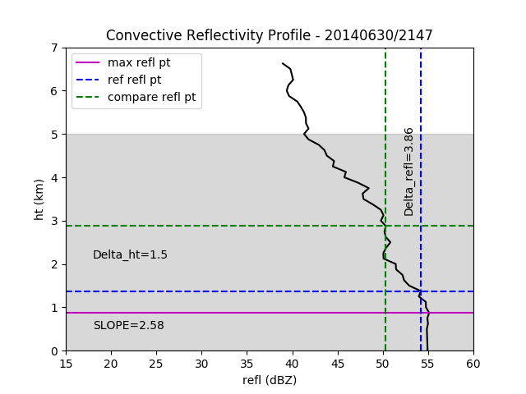
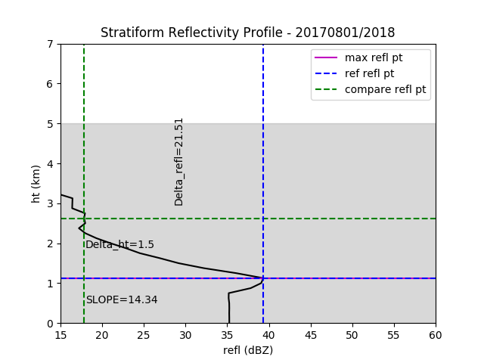
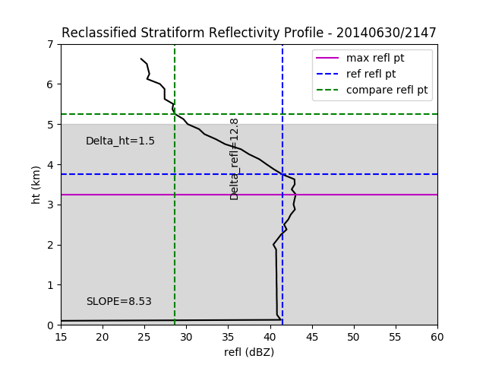
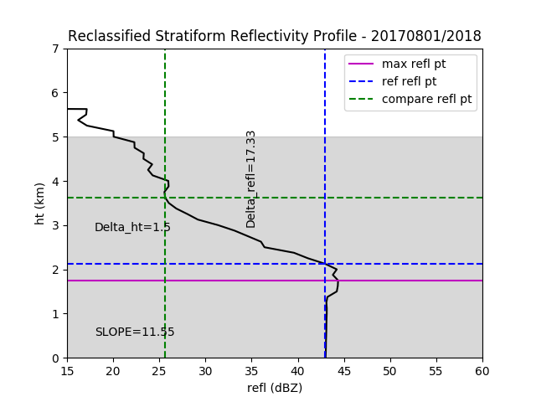
UW Modification to C/S Algorithm
Notes:
These are profiles of columns of gridded data.
The top two are prototypical of conv and stra refl.
The bottom two are problem profiles for the v05 c/s alg.
In each frame:
Magenta line represents ht of max refl in column
Blue lines represent highest point above max refl within +/- 2dBZ of max refl (I call this the reference point)
Green lines represent refl/ht that is 1.5 km above the reference point (I call this the compare point)
Reference point must be within shaded gray area (we chose a max BB ht of 5km) to run our algorithm to completion.
UW ALG: For each conv point, we compute slope between reference and compare points. If greater than 7.5dBZ/km, we reclassify it as stra

Slide 7
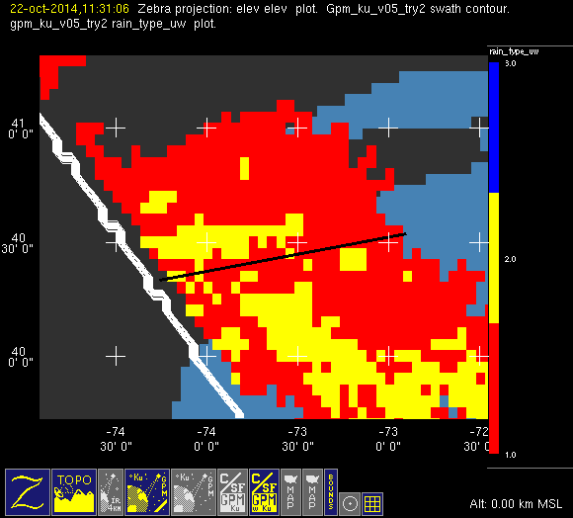
Problem case: East Coast Front
nasa
v05
uw
conv
stra
October
NE U.S.
(20141022/1132)
Notes:
The next three slides show the NASA v05 c/s field as compared to our modified one.
These are the same three cases that we showed in slides 3-5.

Slide 8
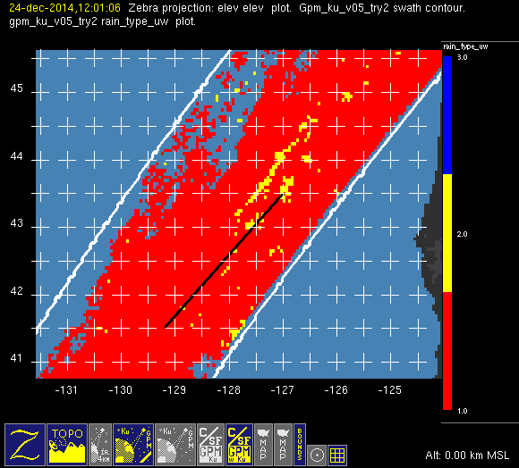
Problem case: West Coast Front
nasa
v05
uw
conv
stra
December NW U.S.
(20141224/1202)

Slide 9
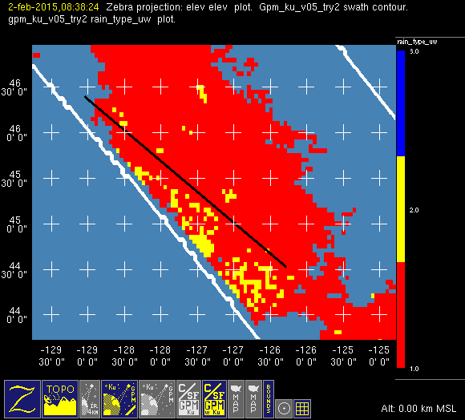
Problem case: North Pacific
nasa
v05
uw
conv
stra
February
North Pacific
(20150202/0839)

Slide 10
3D Object | Srength | Echo Characteristic | Height | Area
Isolated Shallow Echoes |  | > Min detectable | < 4 km | 2 pixels
Deep Convective Cores |  | > 40 dBZ | > 10 km
Wide Convective Cores |  | > 40 dBZ |  | > 1,000 km²
Broad Stratiform Regions |  | Contiguous stratiform |  | > 50,000 km²

Slide 11
3D Object | Srength | Echo Characteristic | Height | Area
Isolated Shallow Echoes |  | > Min detectable | < 4 km | 2 pixels
Deep Convective Cores | Strong | > 40 dBZ | > 10 km
Wide Convective Cores | Strong | > 40 dBZ |  | > 1,000 km²
Broad Stratiform Regions | Strong | Contiguous stratiform |  | > 50,000 km²

Slide 12
3D Object | Srength | Echo Characteristic | Height | Area
Isolated Shallow Echoes |  | > Min detectable | < 4 km | 2 pixels
Deep Convective Cores | Strong | > 40 dBZ | > 10 km
Moderate |  | > 8 km
Wide Convective Cores | Strong | > 40 dBZ |  | > 1,000 km²
Moderate | > 800 km²
Broad Stratiform Regions | Strong | Contiguous stratiform |  | > 50,000 km²
Moderate | > 30,000 km²

Slide 13
3D Object | Srength | Echo Characteristic | Height | Area
Isolated Shallow Echoes |  | > Min detectable | < 4 km | 2 pixels
Deep Convective Cores | Strong | > 40 dBZ | > 10 km
Moderate |  | > 8 km
Wide Convective Cores | Strong | > 40 dBZ |  | > 1,000 km²
Moderate | > 800 km²
Broad Stratiform Regions | Strong | Contiguous stratiform |  | > 50,000 km²
Moderate | > 30,000 km²

Slide 14
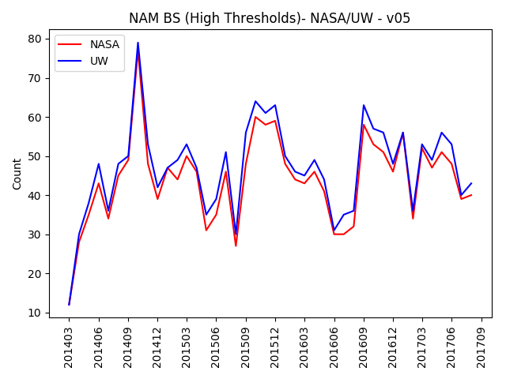
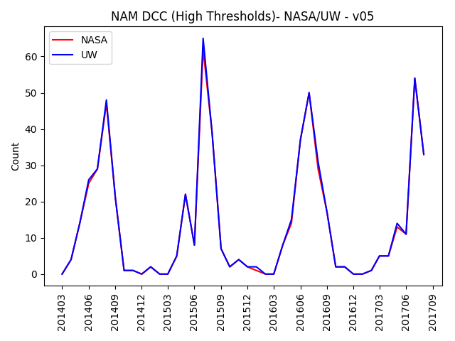
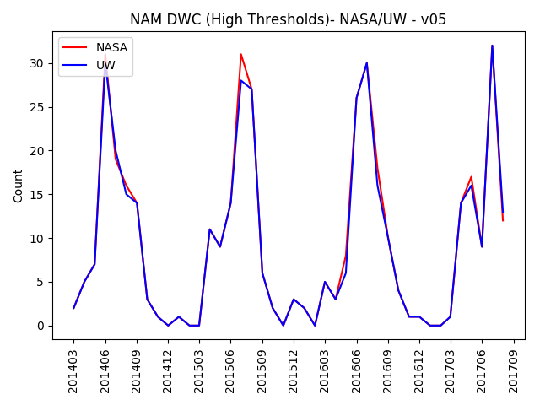
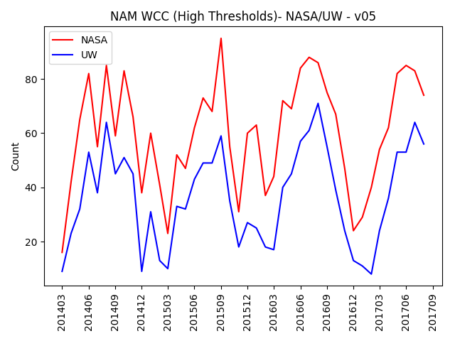
Comparison of v05 Counts
NASA/UW (strong thresholds)

Slide 15
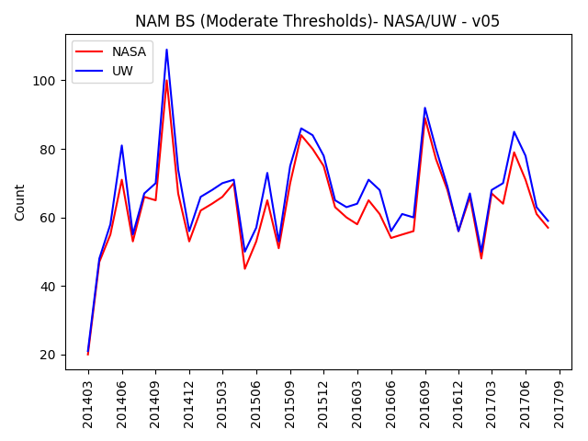
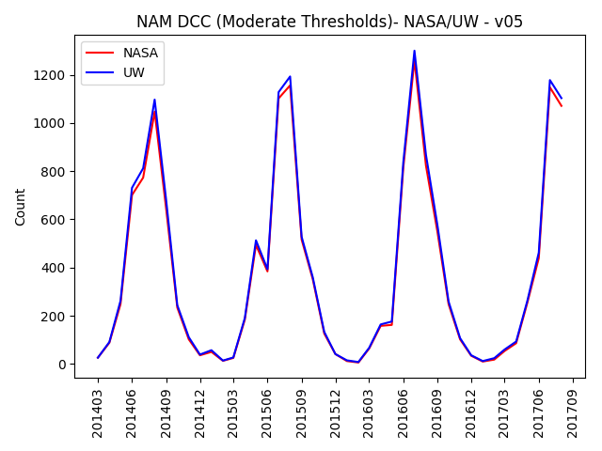
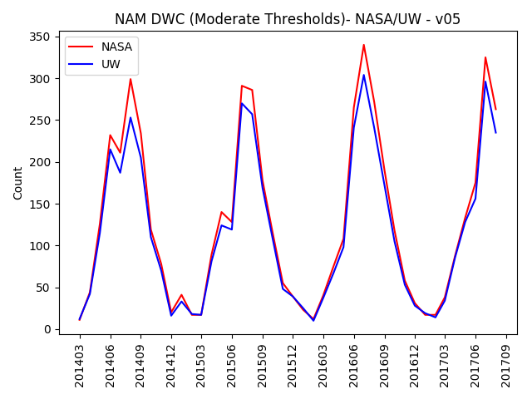
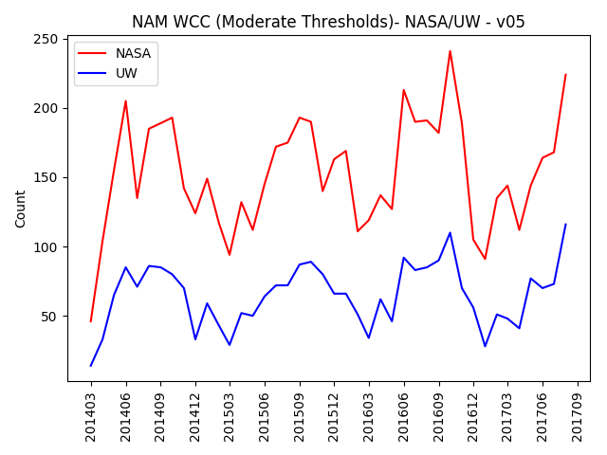
Comparison of v05 Counts
NASA/UW (moderate thresholds)

Slide 16
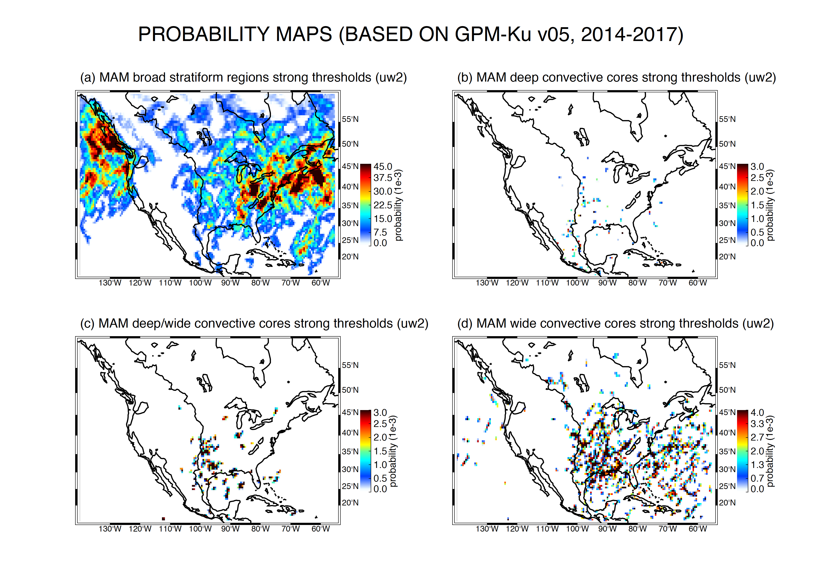
Notes:
The next eight slides compare probability maps for our classifications – BS, DCC, DWC, WCC – based on first NASA v05 c/s field and then the UW modified c/s field.
They are in groups of 3 months starting with MAM.
The most notable differences are in the WCC (lower right corner) maps, especially in DJF.

Slide 17
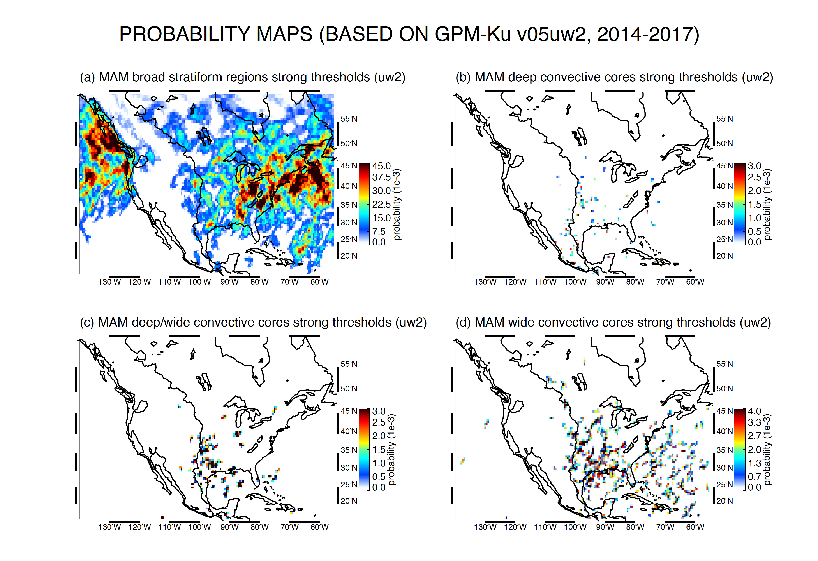
Notes:
<number>

Slide 18
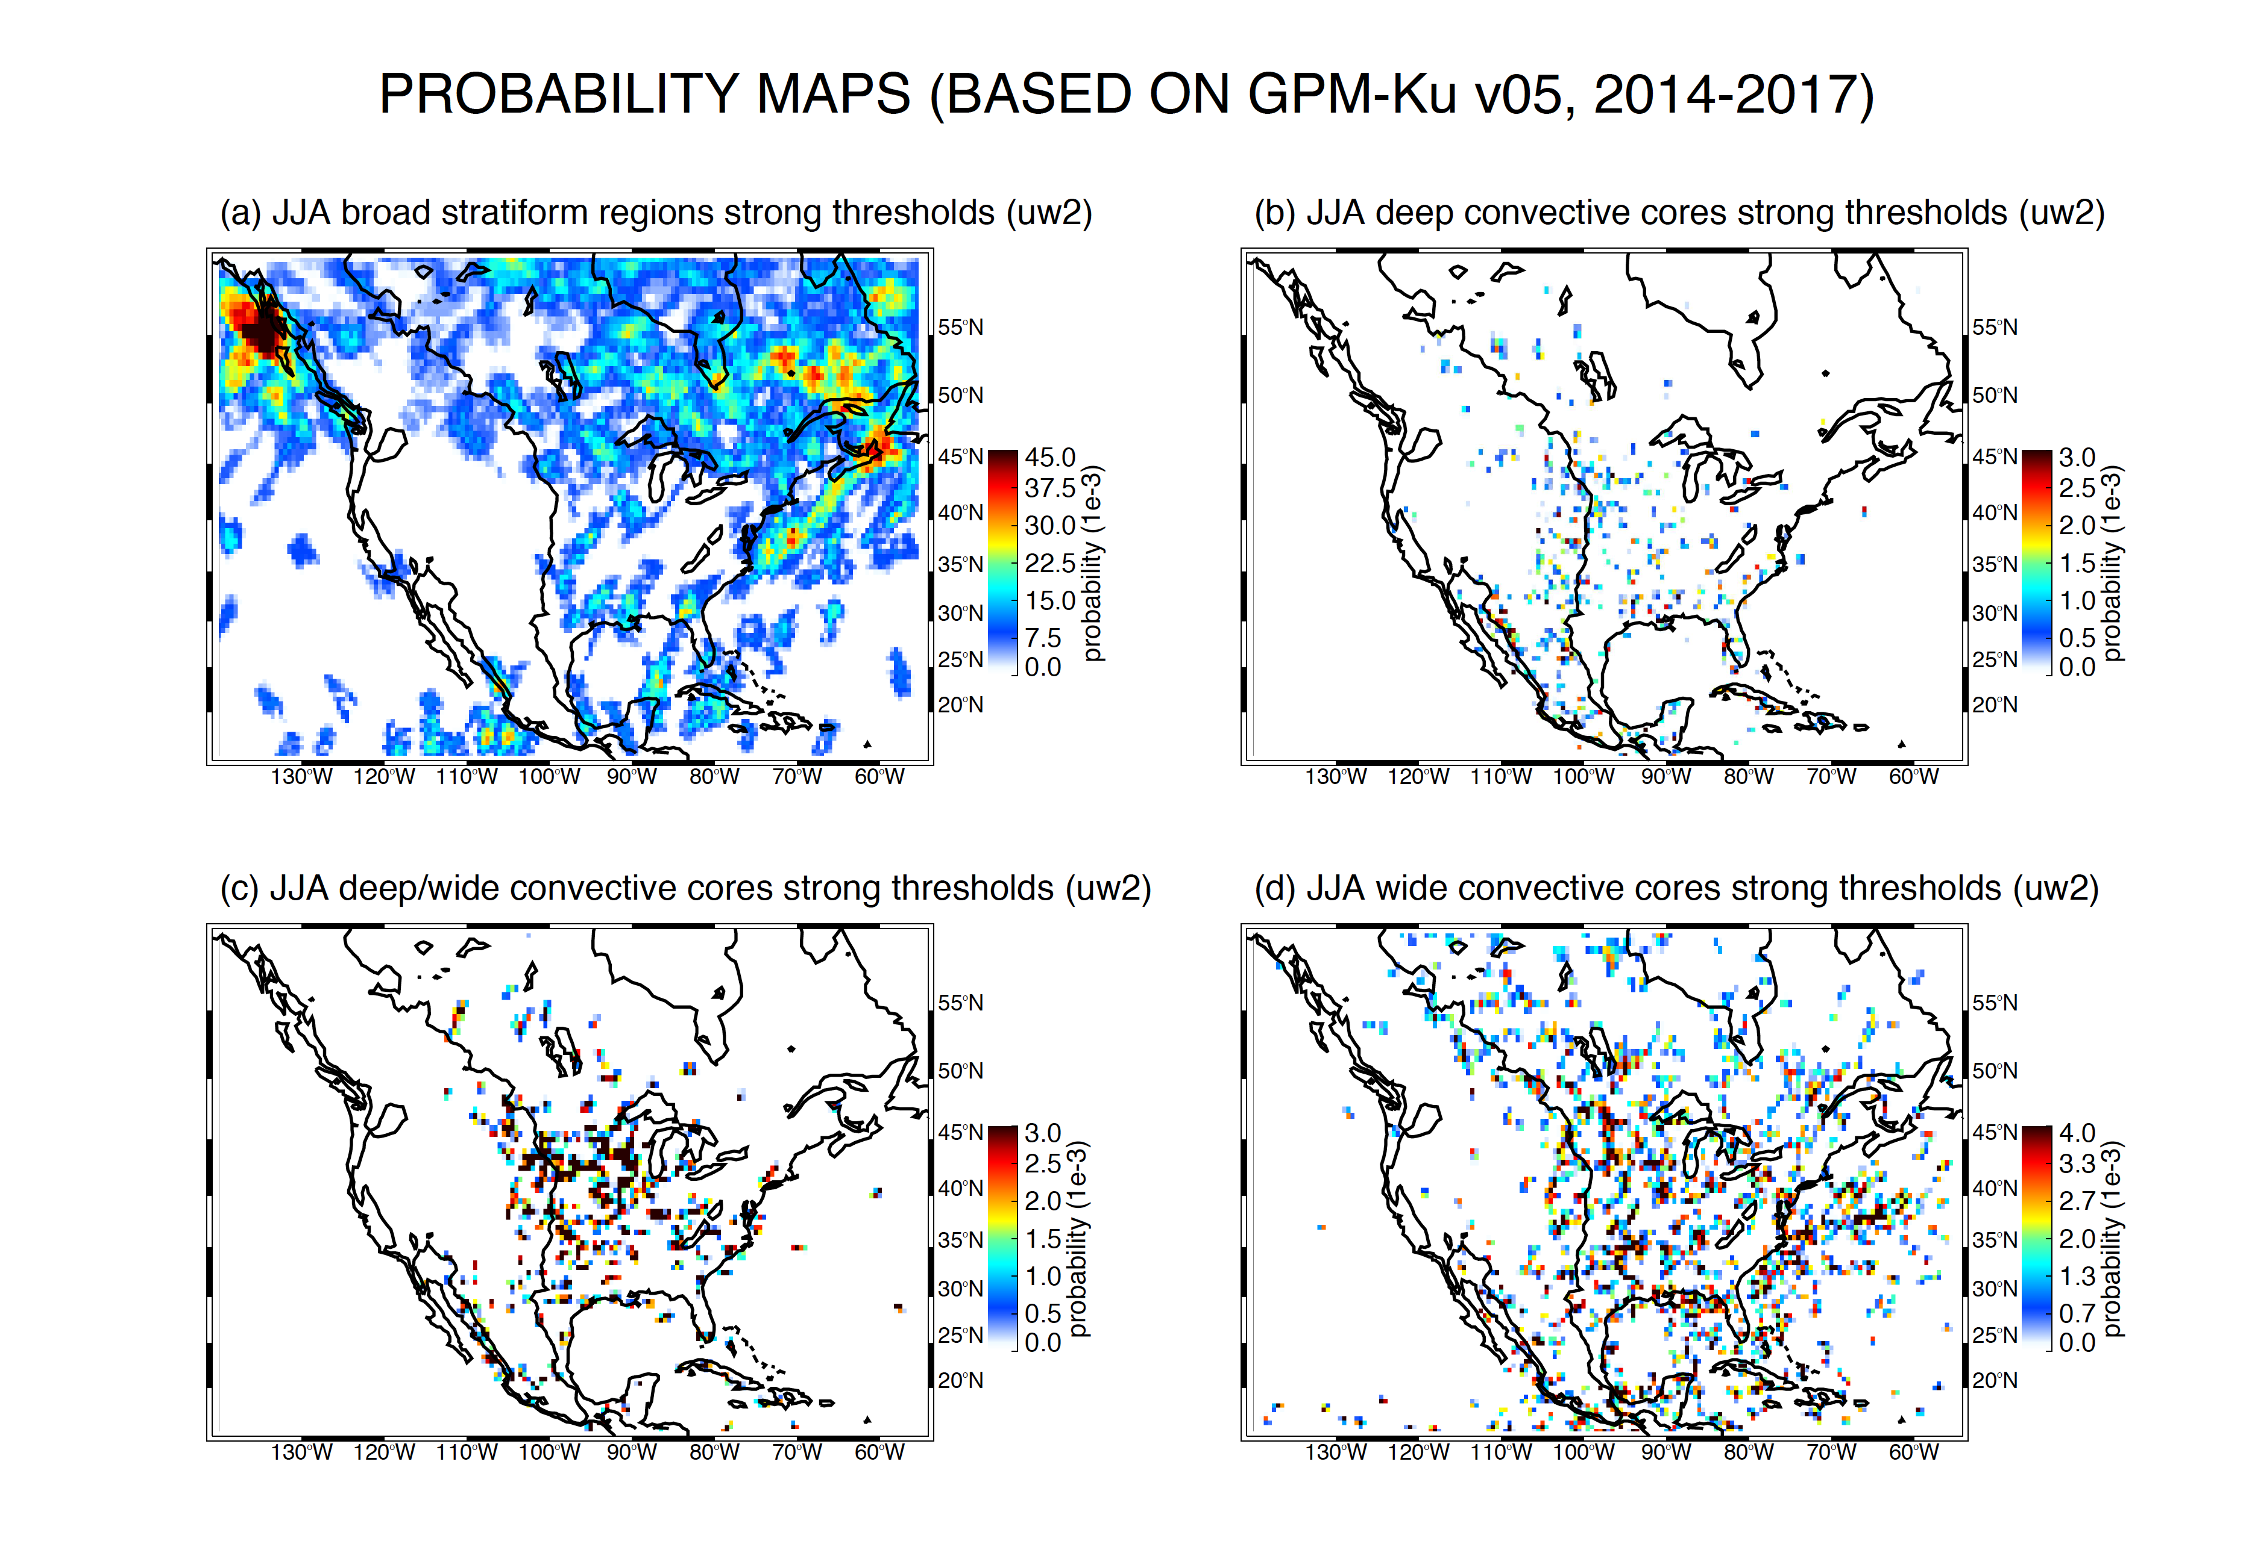

Slide 19
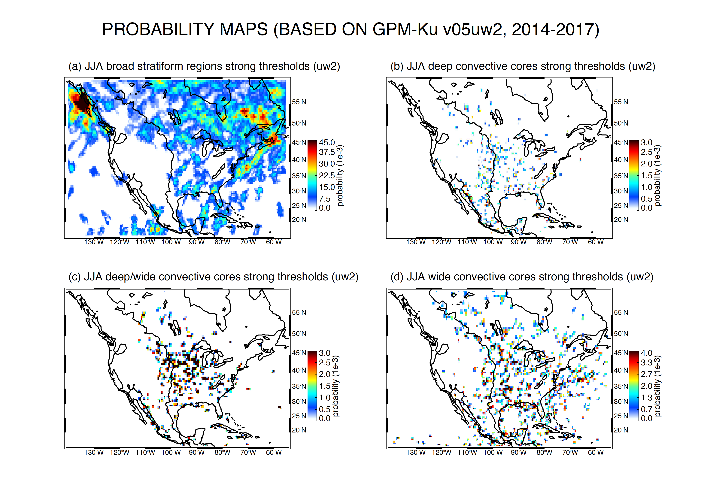

Slide 20
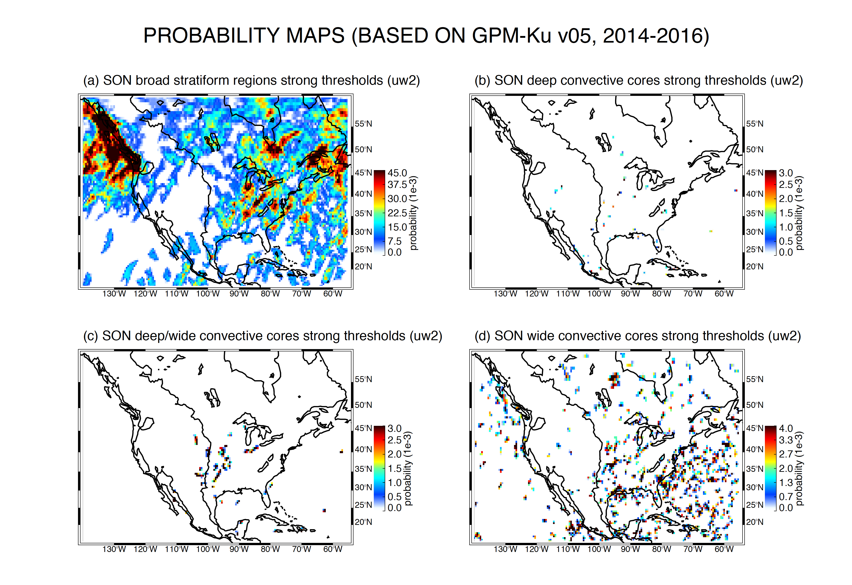

Slide 21
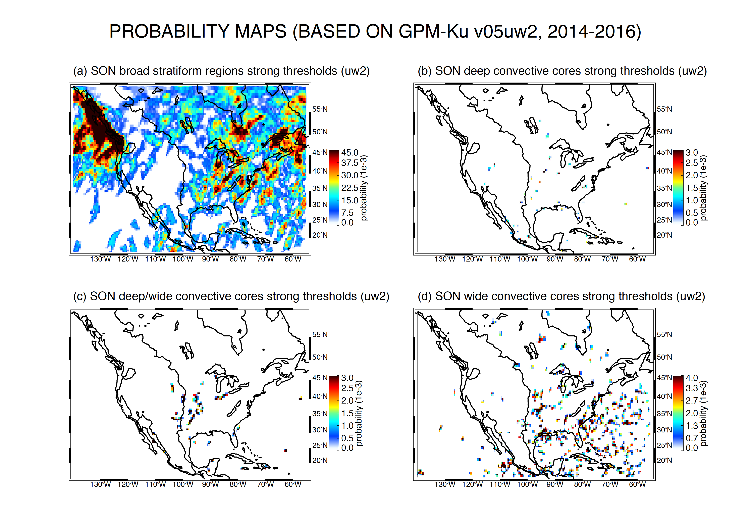

Slide 22
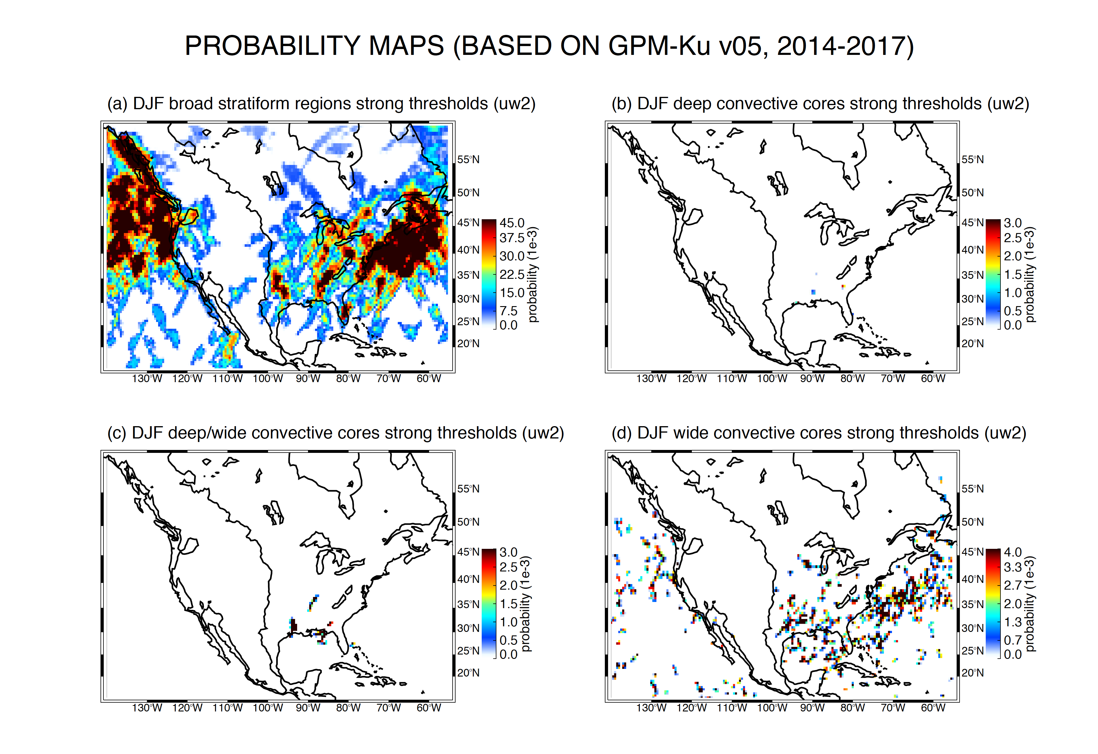

Slide 23
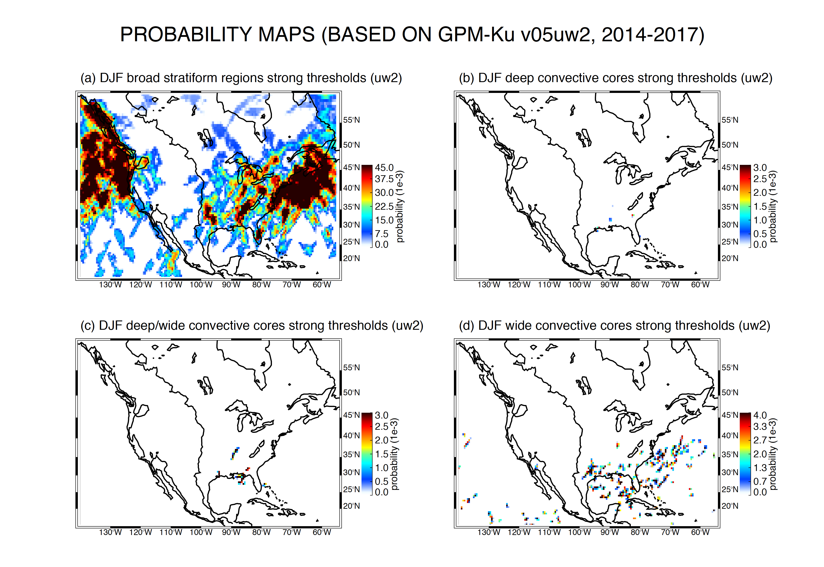

Slide 24
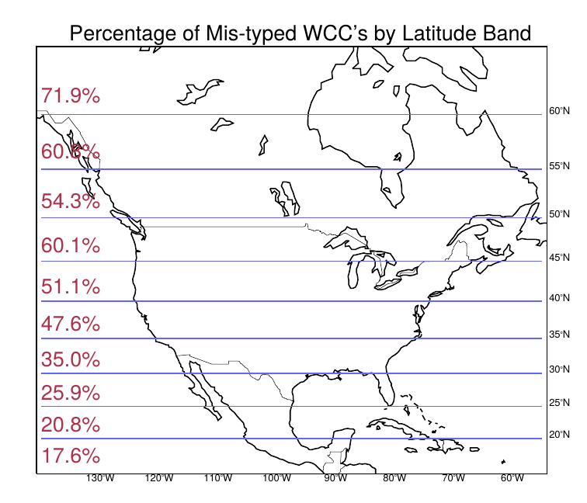
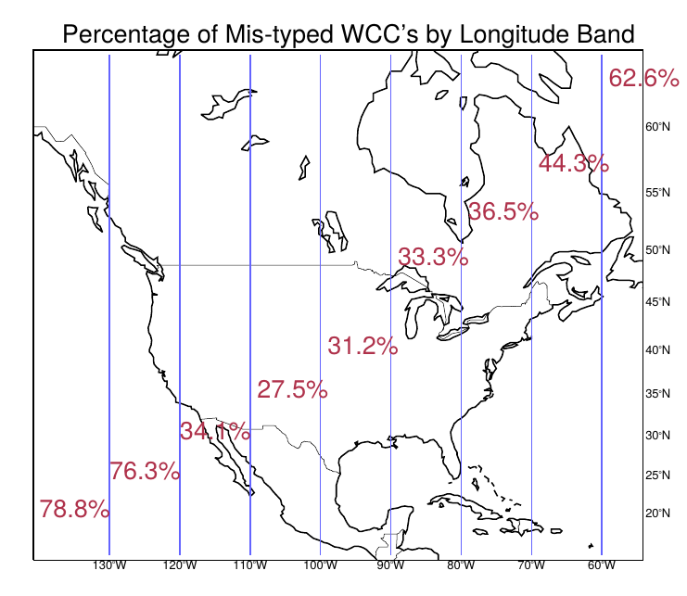
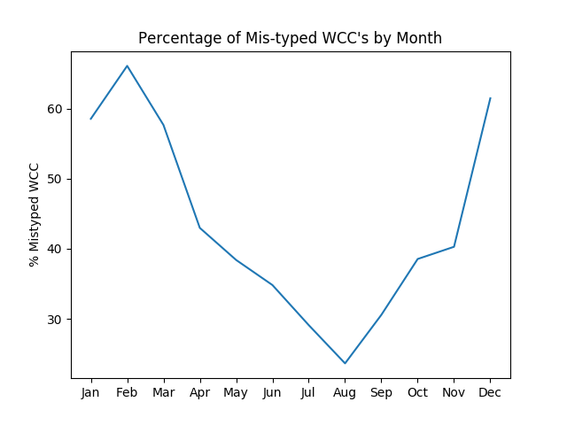
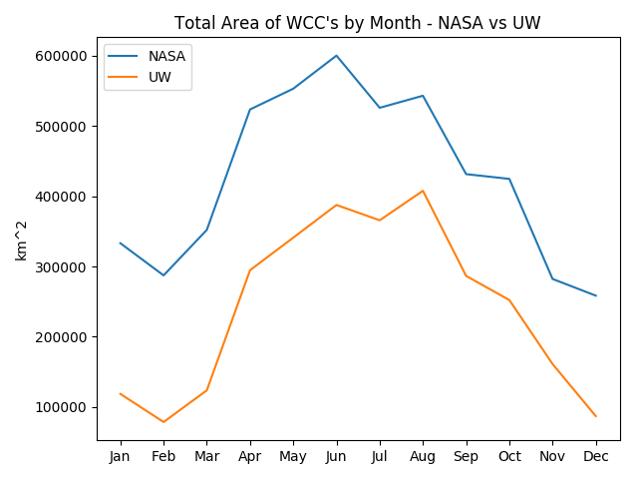
BASED ON STRONG THRESHOLD OUTPUT
Notes:
These charts are based on STRONG thresholds for WCC’s.
Largest percent of mis-classifications occur:
– at higher latitudes
– at longitudes containing large amounts of ocean
– in DJF
The last plot shows areal differences between the WCC’s and is just another way to look at the differences.

Slide 25
Conclusions
Notes:
This is for you to fill in:-)

