Slide 1
Identification of Mesoscale Convective Precipitation in GPM Data
Robert Houze and Stacy Brodzik
PMM Science Team Meeting
San Diego, CA
October 16-20, 2017

Slide 2
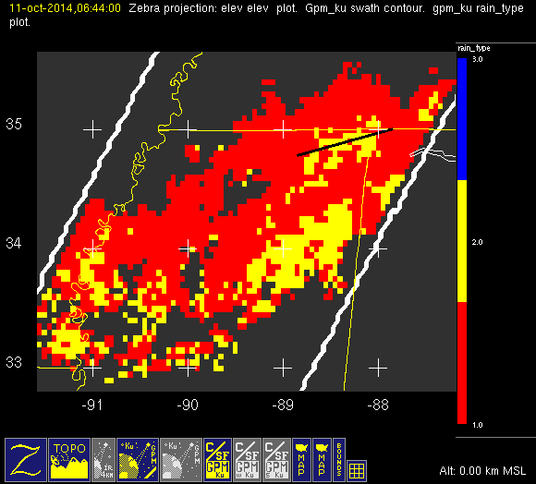
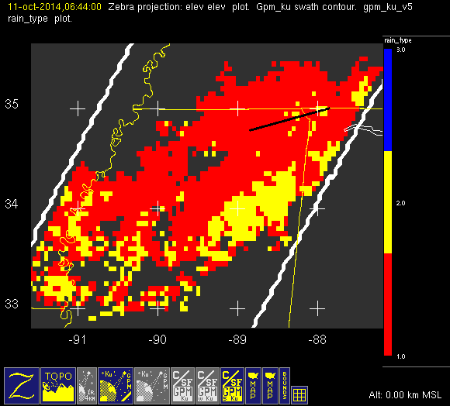
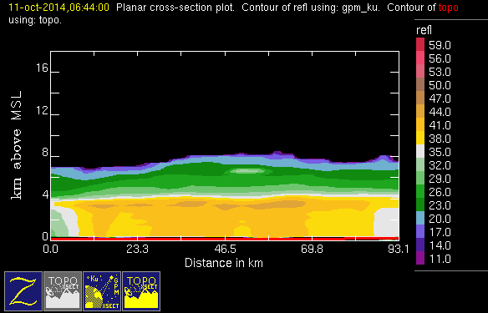
Comparison of v04 vs v05 c/s output
October
SE U.S.

Slide 3
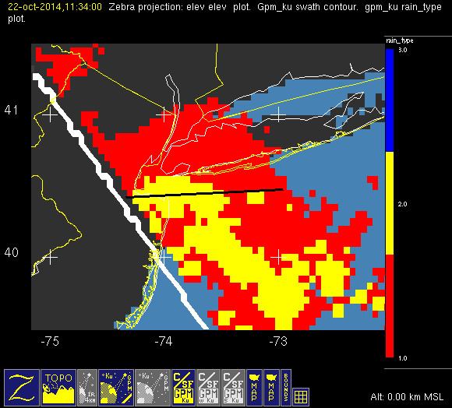
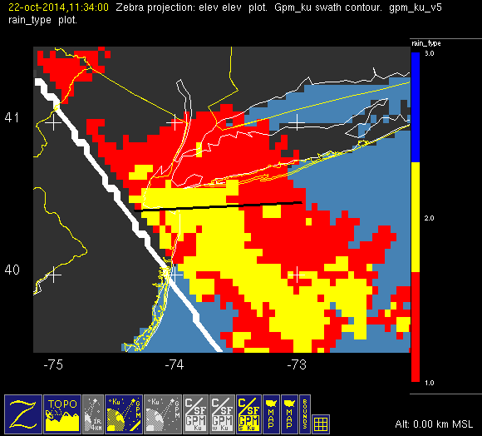
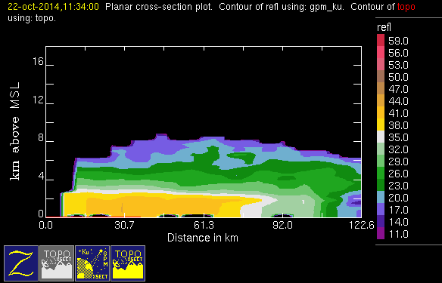
Problem case 1 East Coast Front
October
NE U.S.

Slide 4
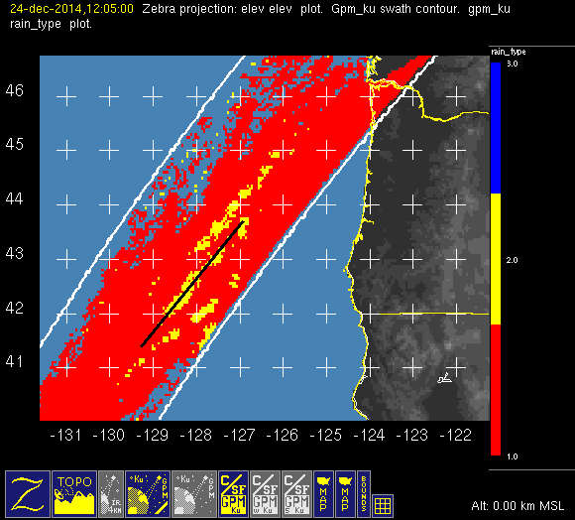
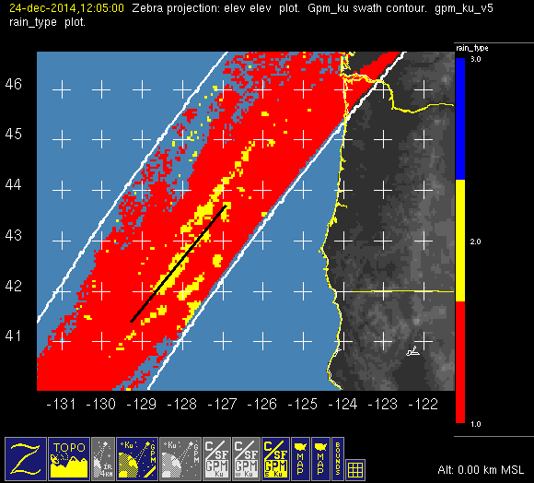
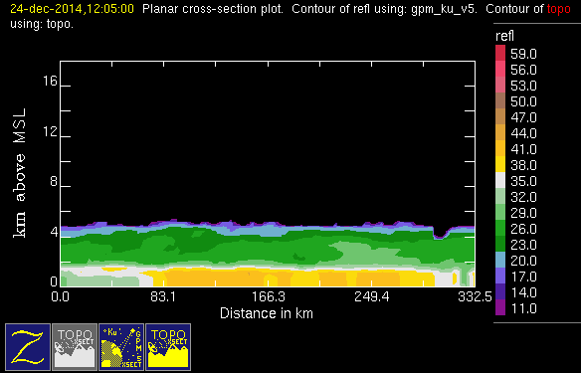
Problem case 2 West Coast Front
October NW U.S.

Slide 5
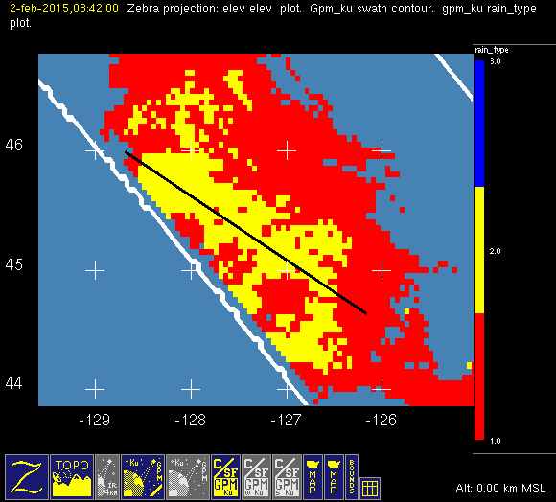
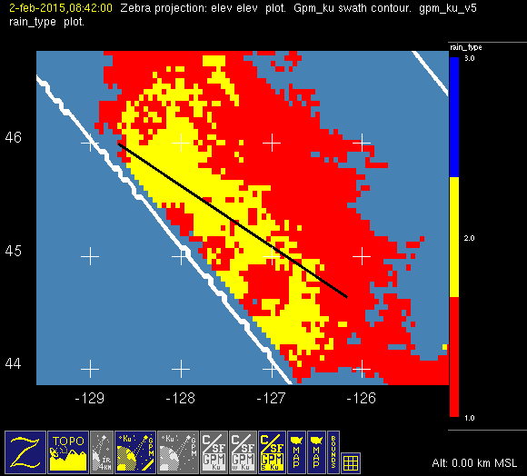
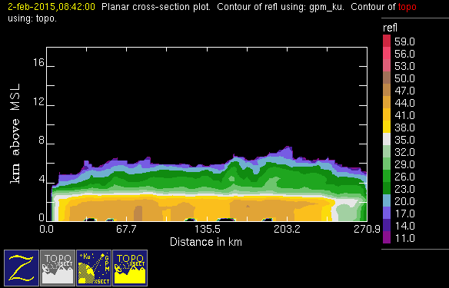
Problem case North Pacific
December
North Pacific

Slide 6
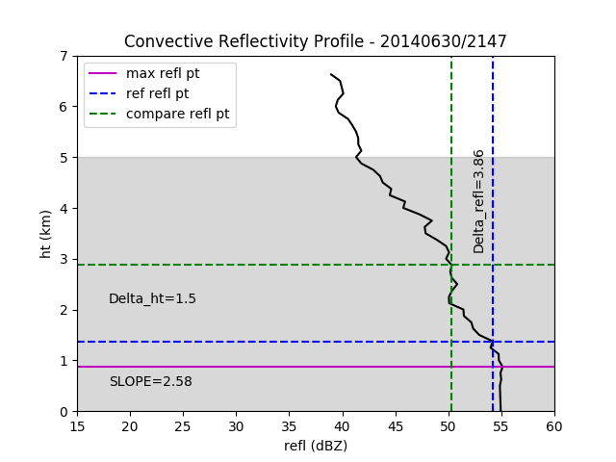
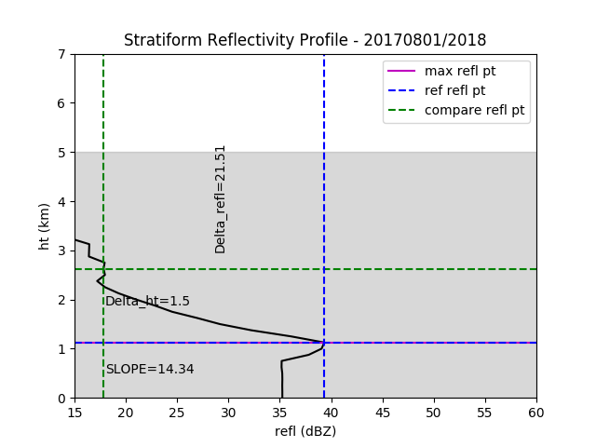
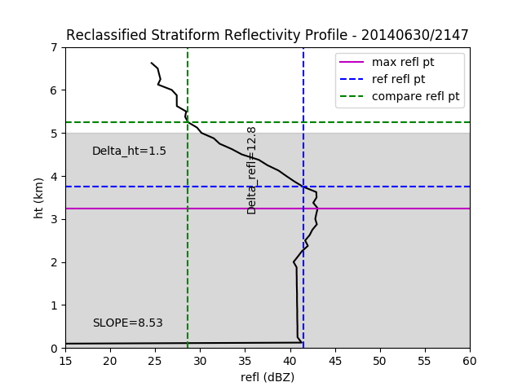
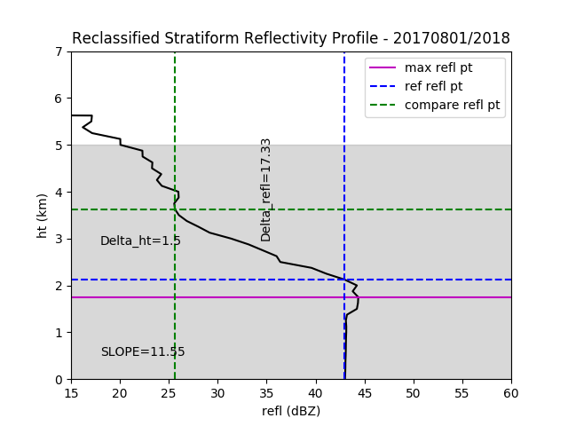
UW Modification to C/S Algorithm

Slide 7
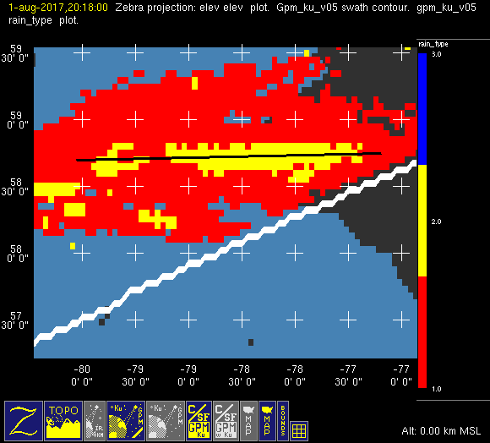
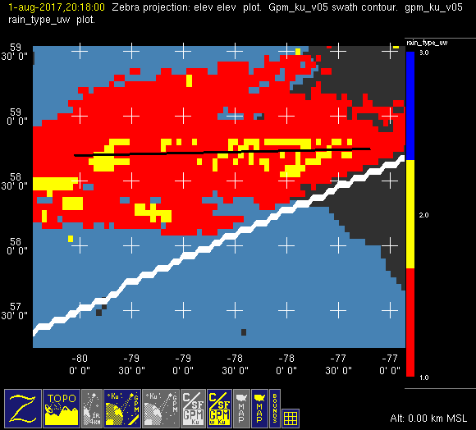
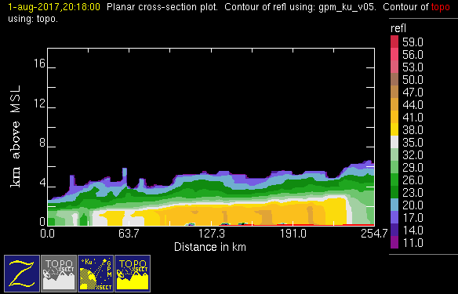
UW Mod to Problem case
August
Hudson Bay

Slide 8
3D Object | Srength | Echo Characteristic | Height | Area
Isolated Shallow Echoes |  | > Min detectable | < 4 km | 2 pixels
Deep Convective Cores |  | > 40 dBZ | > 10 km
Wide Convective Cores |  | > 40 dBZ |  | > 1,000 km²
Broad Stratiform Regions |  | Contiguous stratiform |  | > 50,000 km²

Slide 9
3D Object | Srength | Echo Characteristic | Height | Area
Isolated Shallow Echoes | Strong | > Min detectable | < 4 km | 2 pixels
Deep Convective Cores | Strong | > 40 dBZ | > 10 km
Wide Convective Cores | Strong | > 40 dBZ |  | > 1,000 km²
Broad Stratiform Regions | Strong | Contiguous stratiform |  | > 50,000 km²

Slide 10
3D Object | Srength | Echo Characteristic | Height | Area
Isolated Shallow Echoes | Strong | > Min detectable | < 4 km | 2 pixels
Deep Convective Cores | Strong | > 40 dBZ | > 10 km
Moderate | > 30 dBZ | > 8 km
Wide Convective Cores | Strong | > 40 dBZ |  | > 1,000 km²
Moderate | > 30 dBZ |  | > 800 km²
Broad Stratiform Regions | Strong | Contiguous stratiform |  | > 50,000 km²
Moderate | Contiguous stratiform |  | > 30,000 km²

Slide 11
3D Object | Srength | Echo Characteristic | Height | Area
Isolated Shallow Echoes | Strong | > Min detectable | < 4 km | 2 pixels
Deep Convective Cores | Strong | > 40 dBZ | > 10 km
Moderate | > 30 dBZ | > 8 km
Wide Convective Cores | Strong | > 40 dBZ |  | > 1,000 km²
Moderate | > 30 dBZ |  | > 800 km²
Broad Stratiform Regions | Strong | Contiguous stratiform |  | > 50,000 km²
Moderate | Contiguous stratiform |  | > 30,000 km²

Slide 12
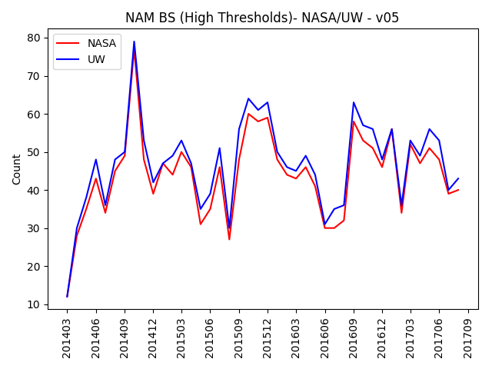
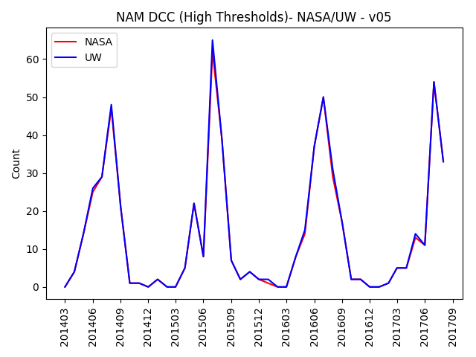
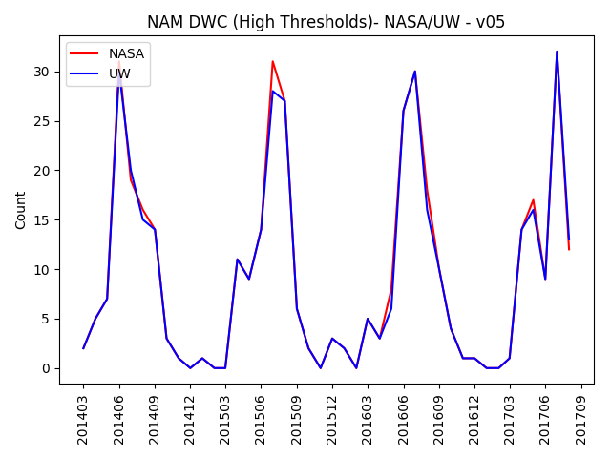
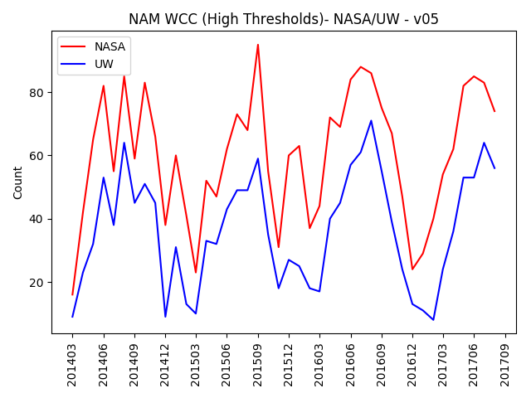
Comparison of v05 Counts
NASA/UW (strong thresholds)

Slide 13
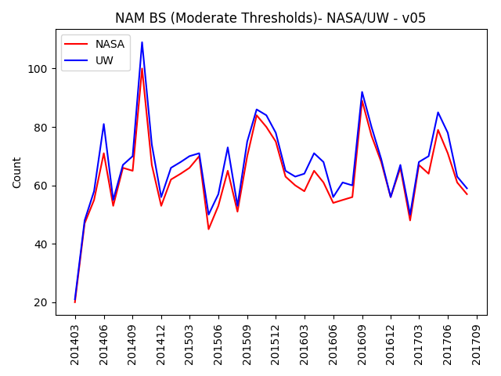
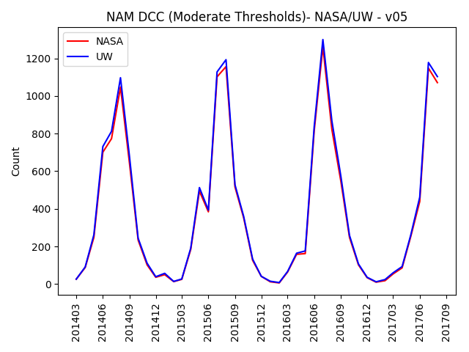
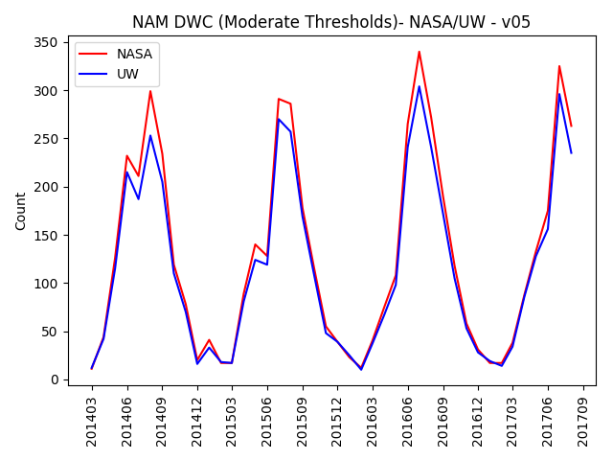
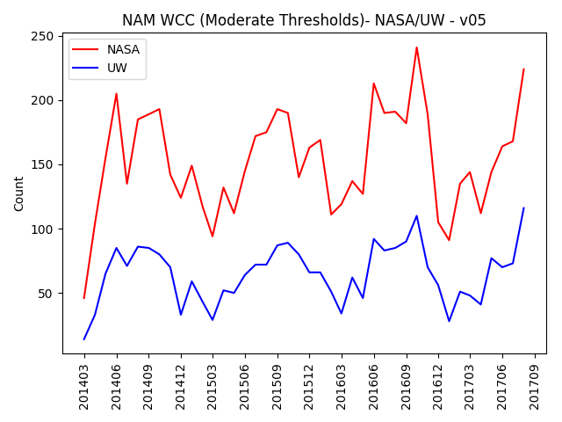
Comparison of v05 Counts
NASA/UW (moderate thresholds)

Slide 14
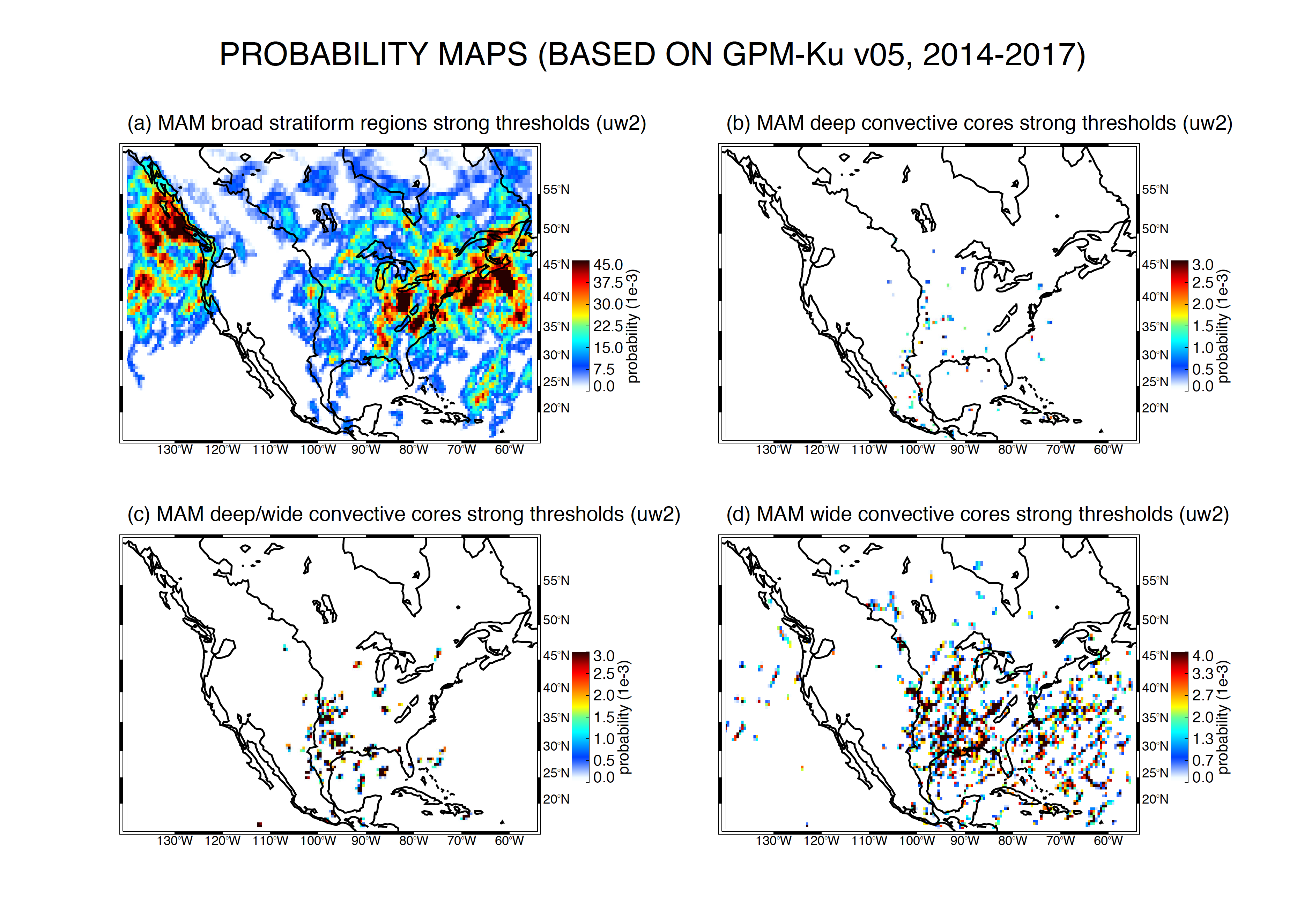

Slide 15
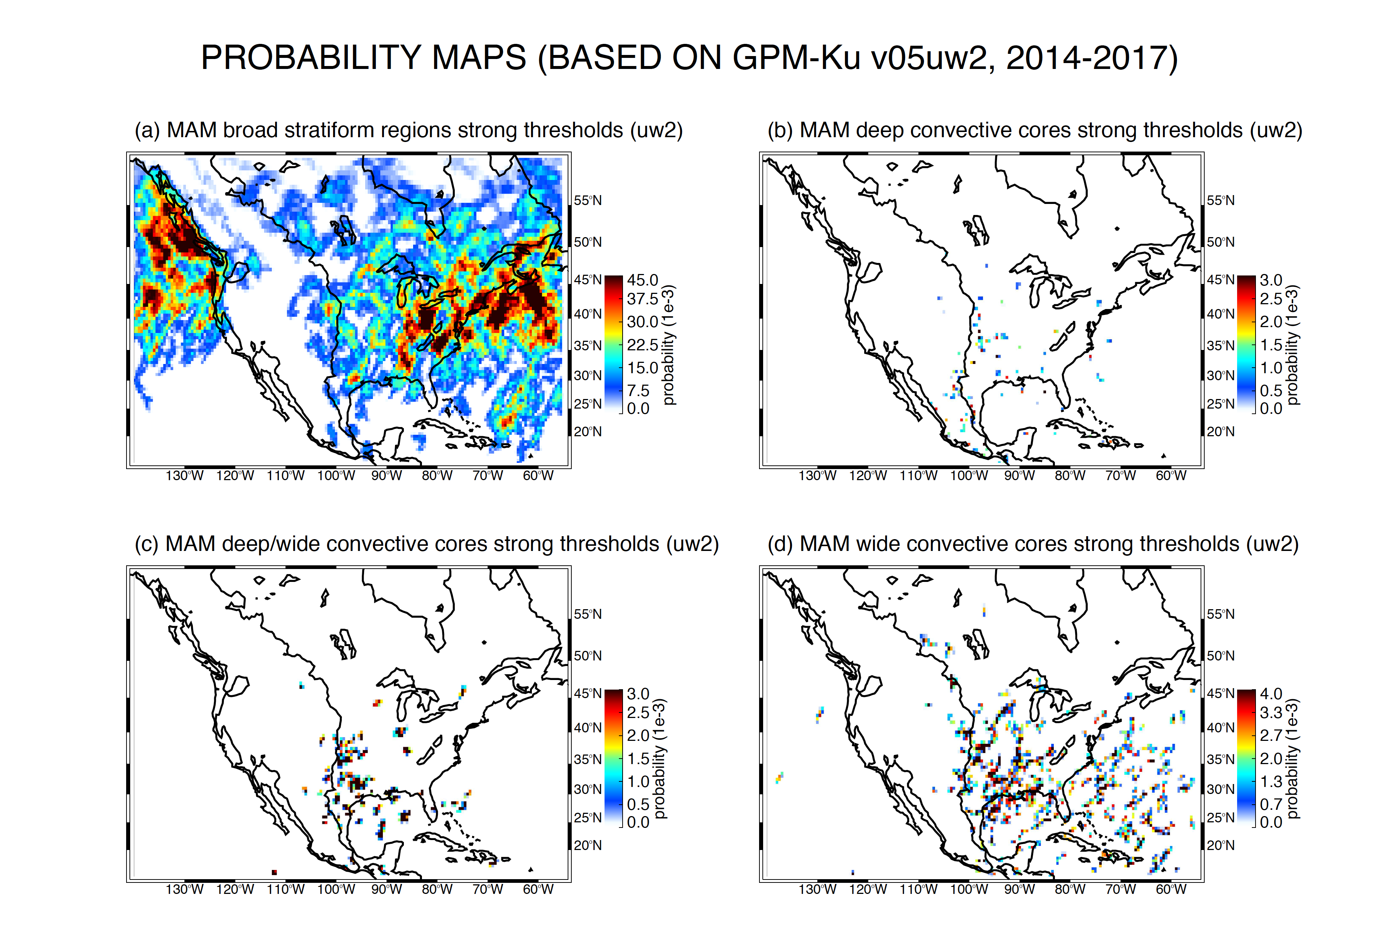
Notes:
15

Slide 16
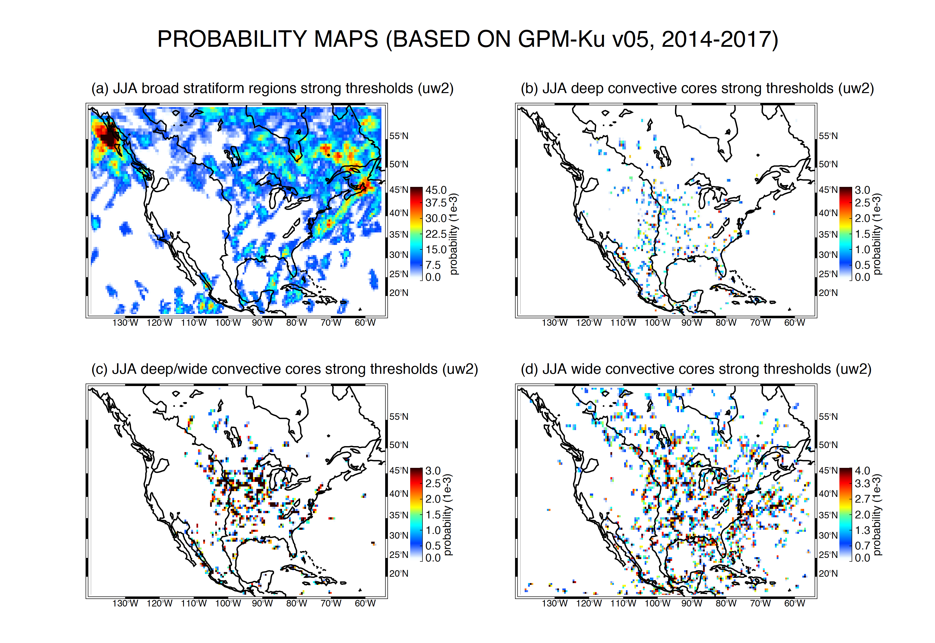

Slide 17
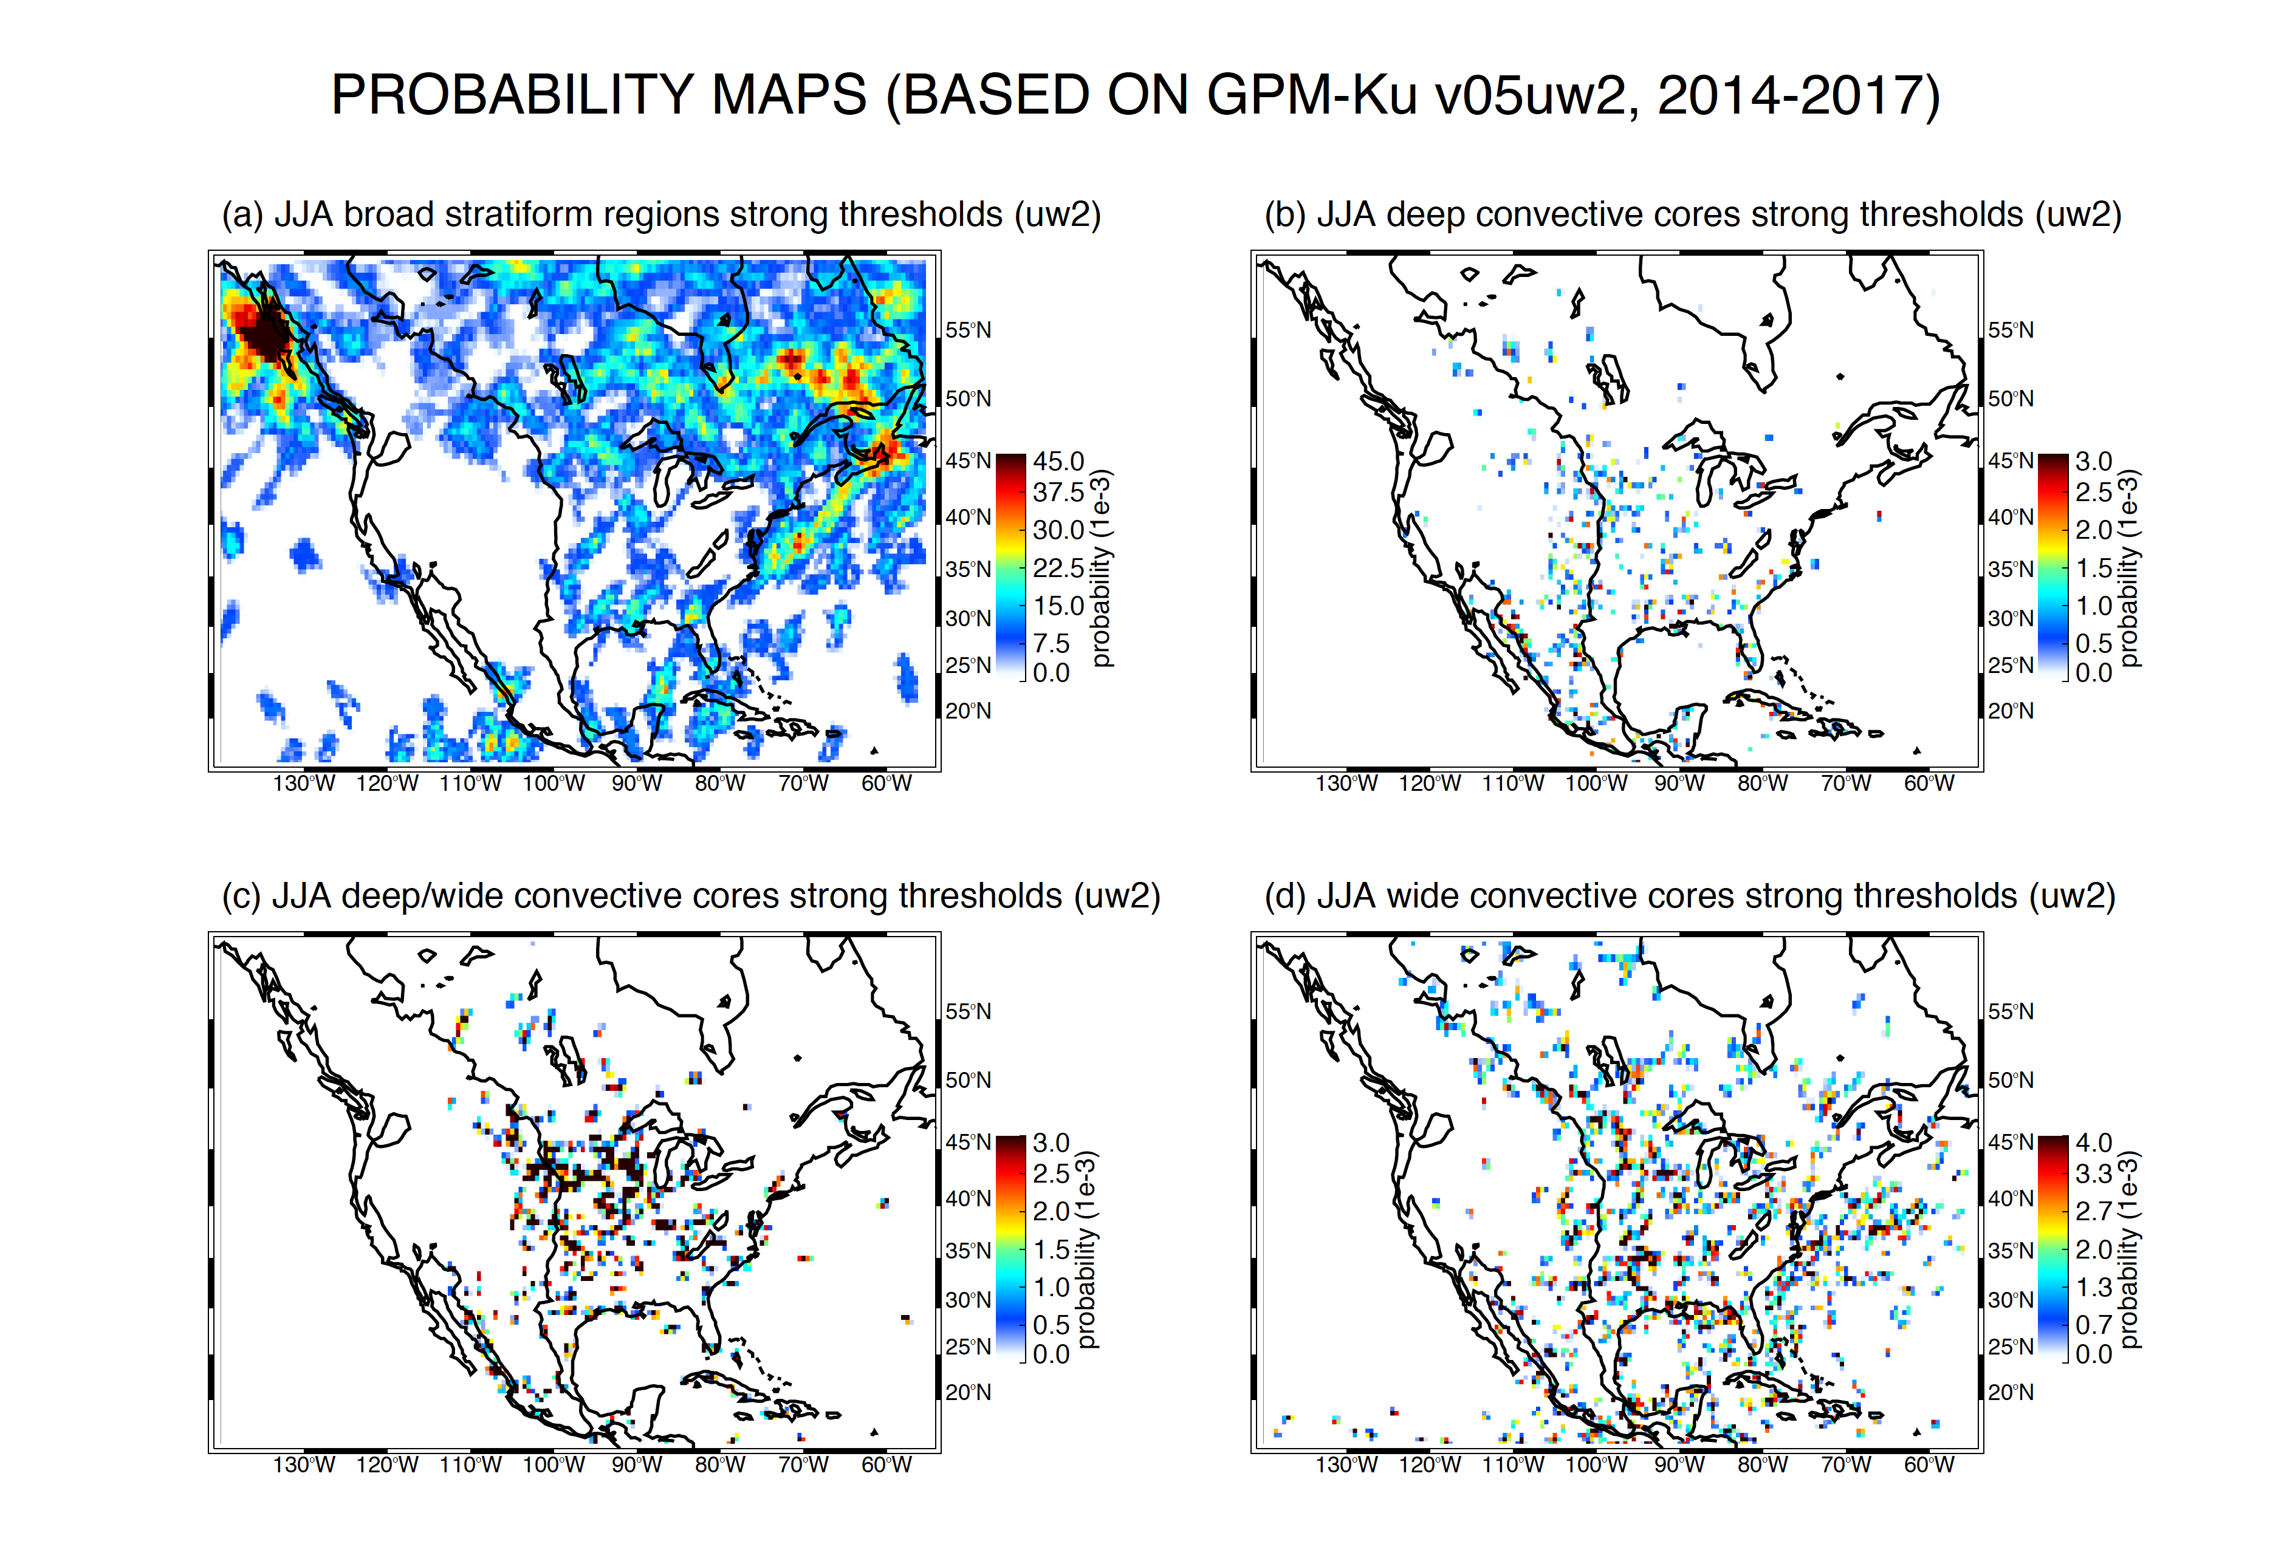

Slide 18
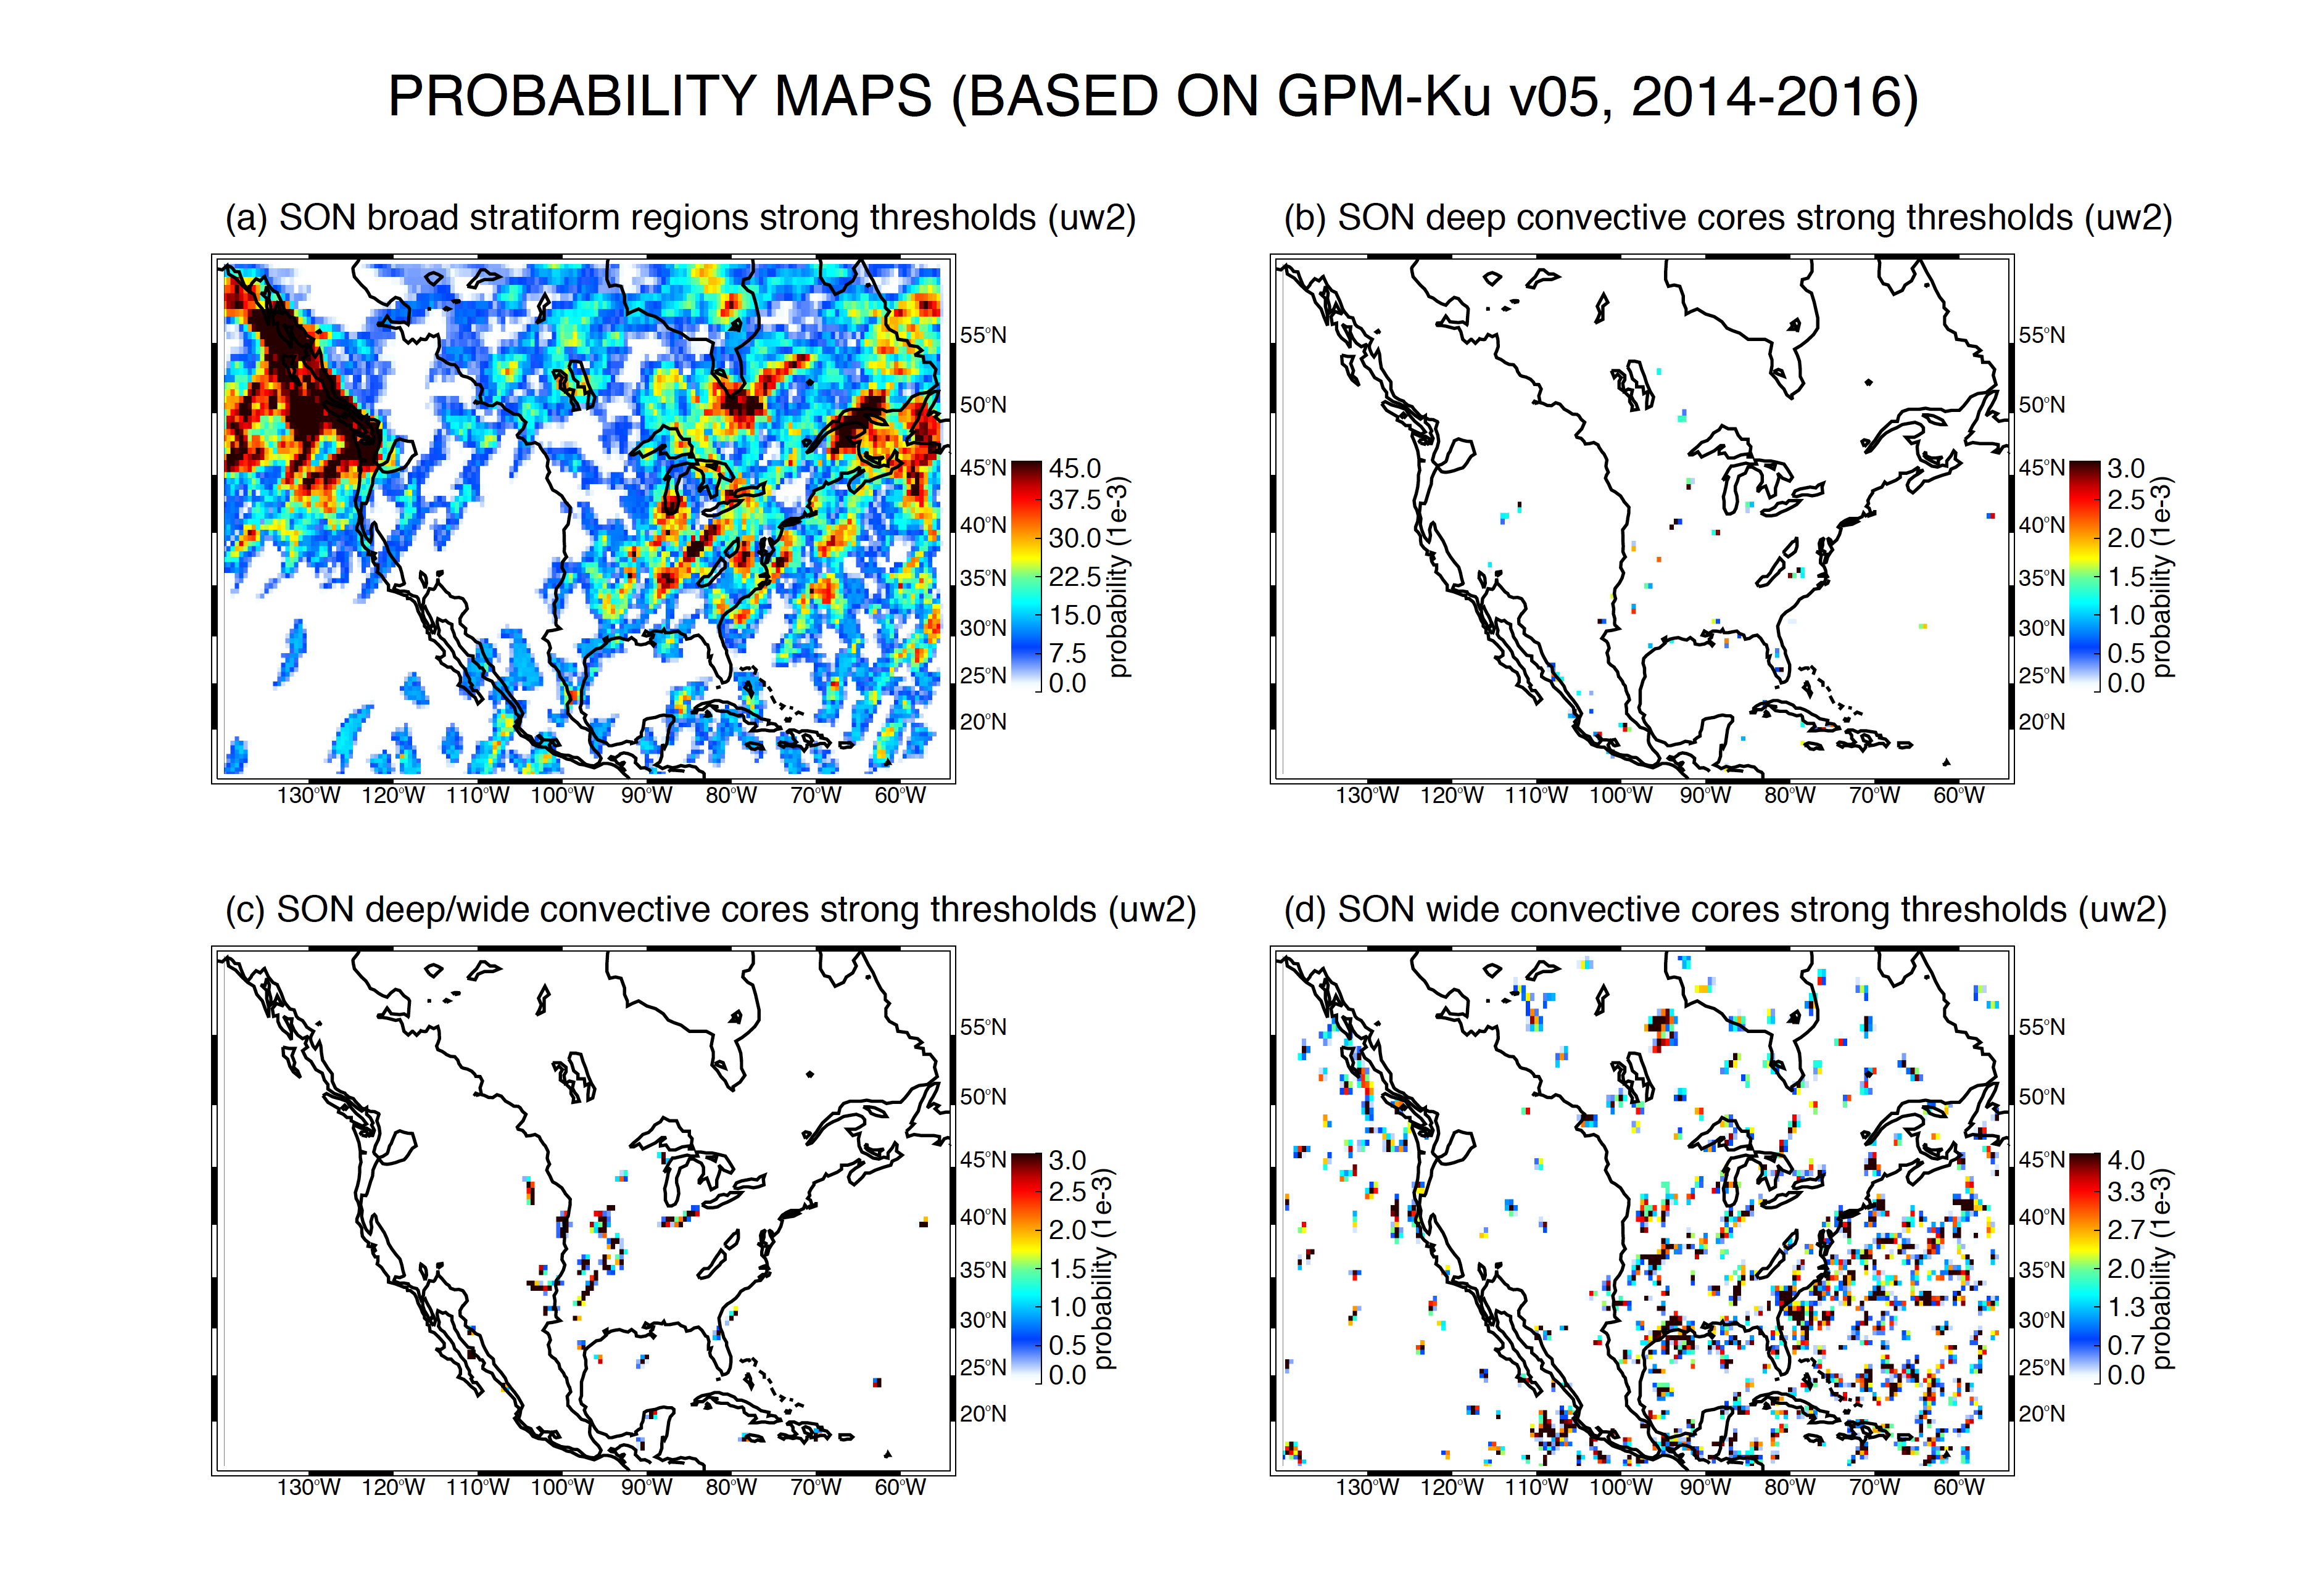

Slide 19
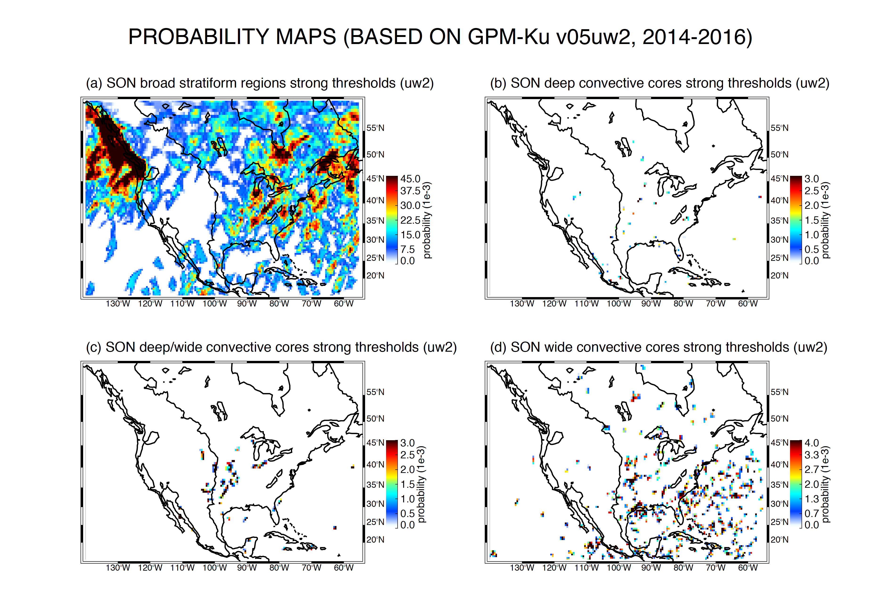

Slide 20
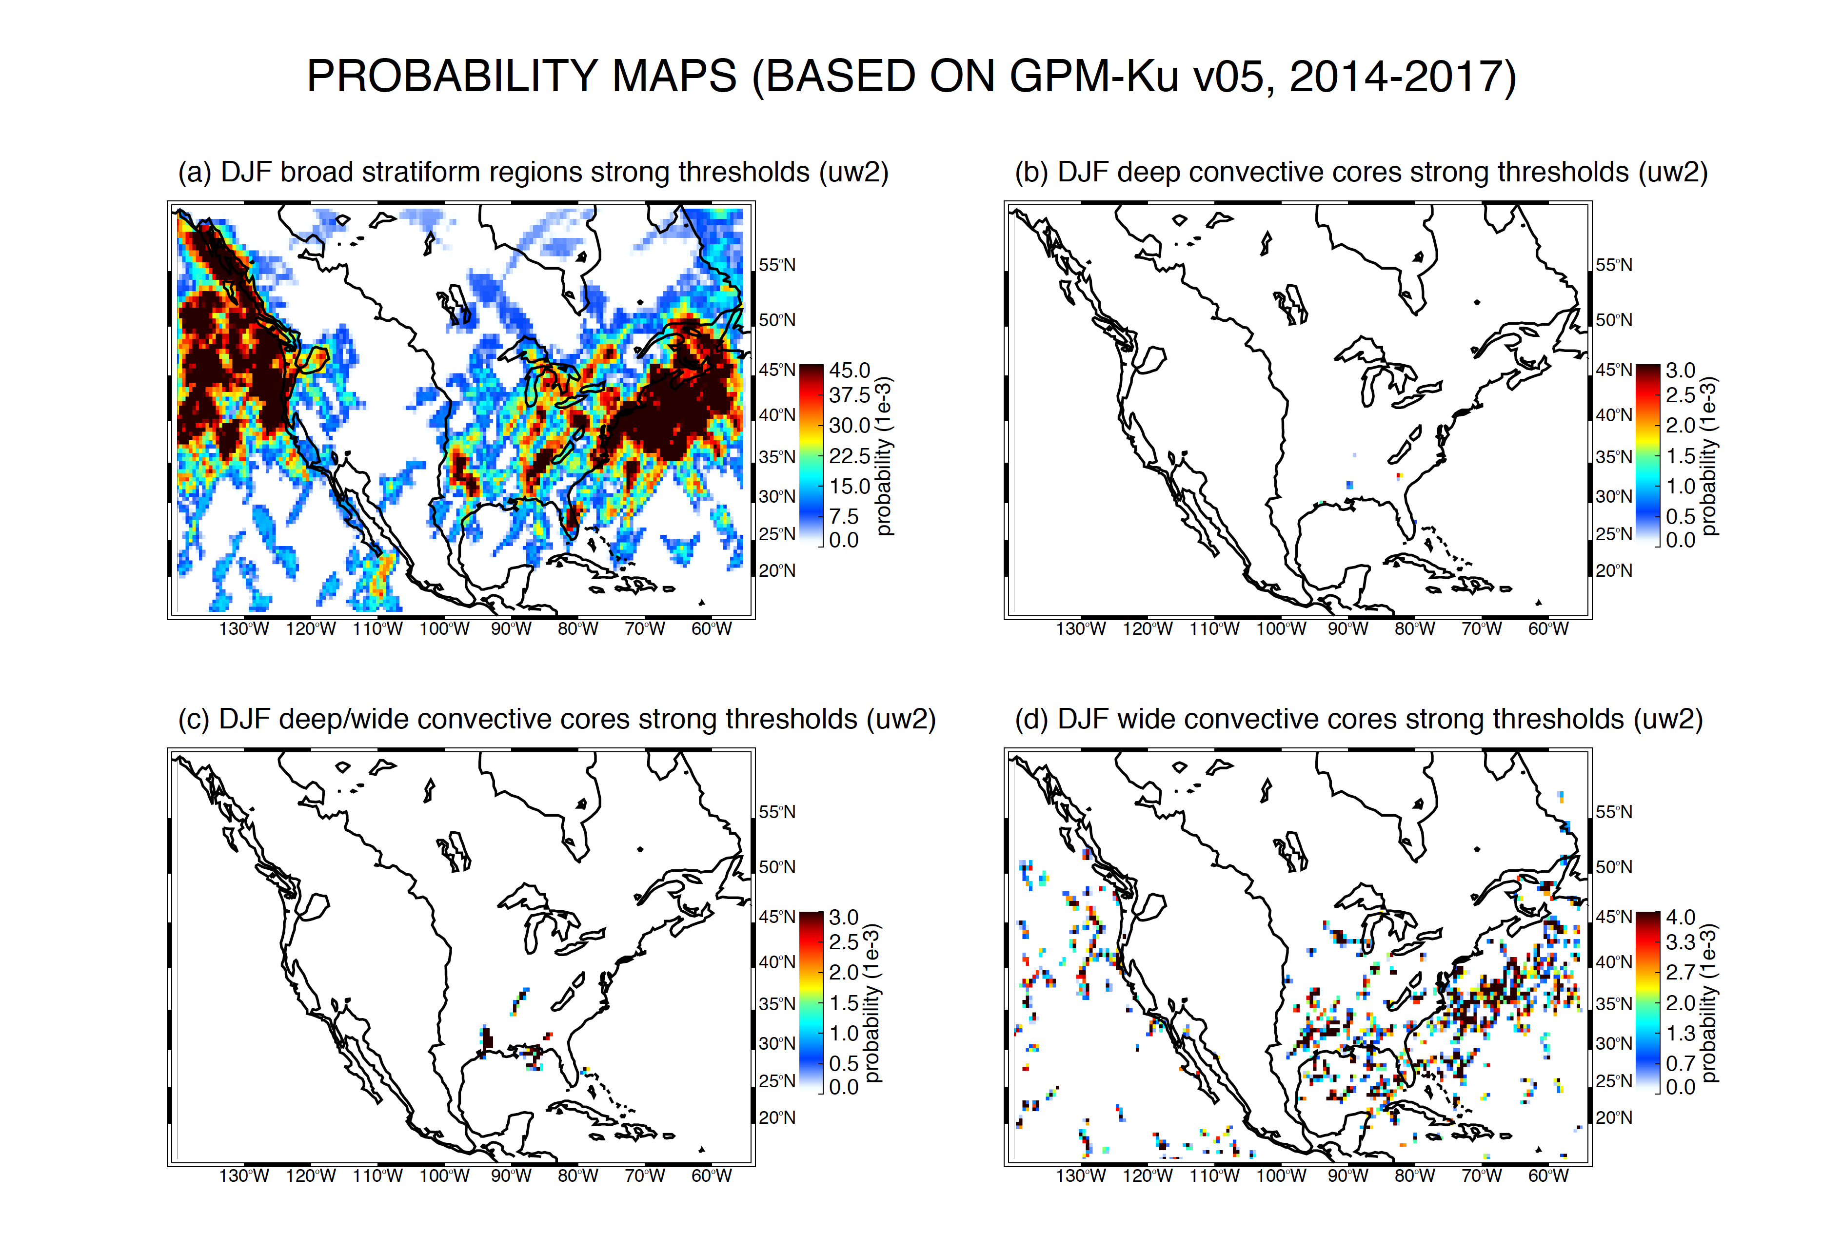

Slide 21
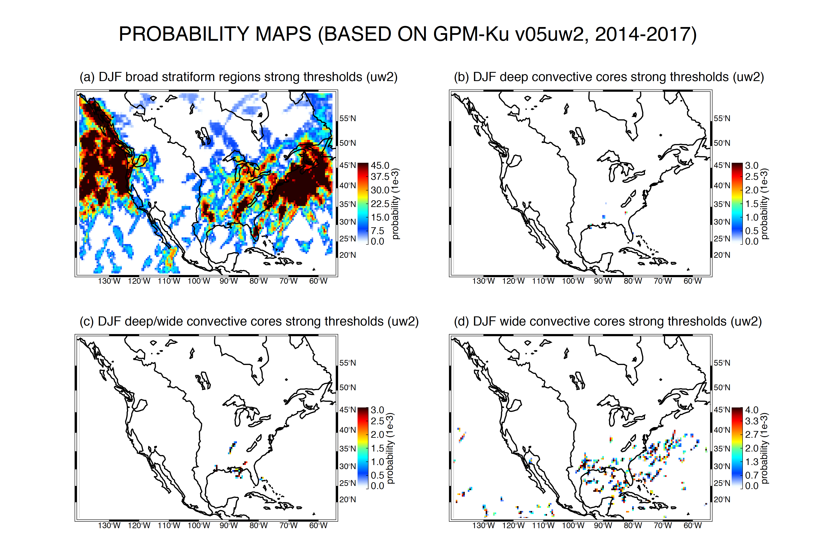

Slide 22
Dependencies (need new word)
Latitude
Longitude
Month/Season
WILL PUT THIS TOGETHER TOMORROW

Slide 23
Conclusions

