Slide 1
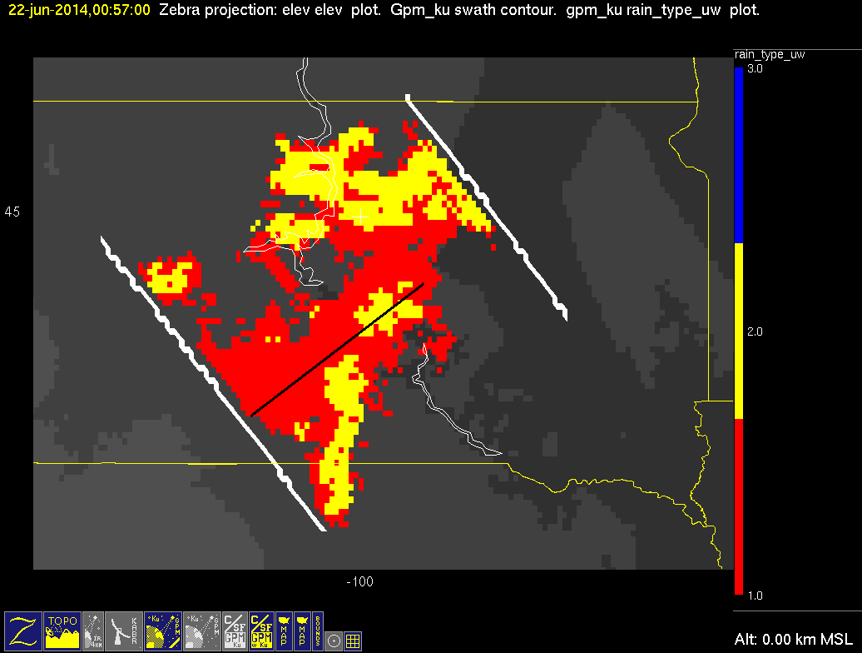
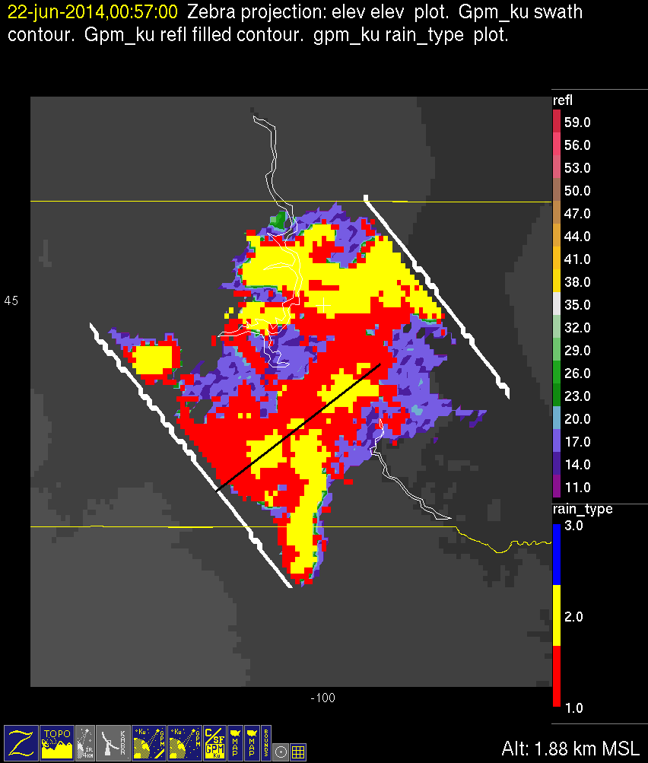
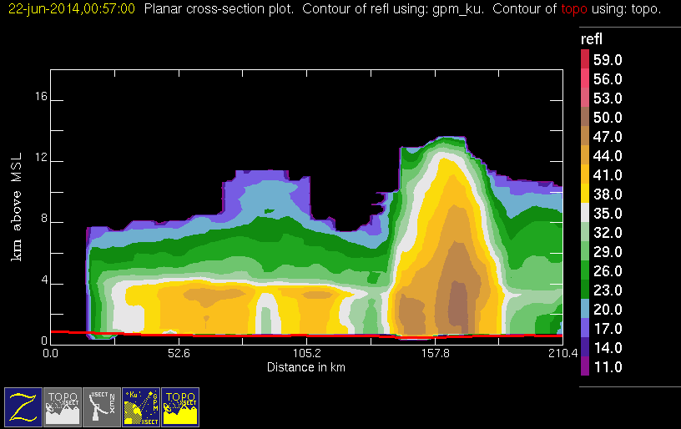
20140622 @ 005639 #1/2
mod
conv
stra

Slide 2


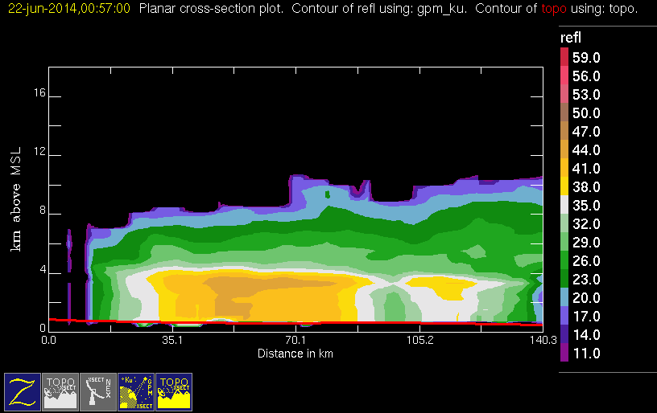
20140622 @ 005639 #2/2
mod
conv
stra

Slide 3
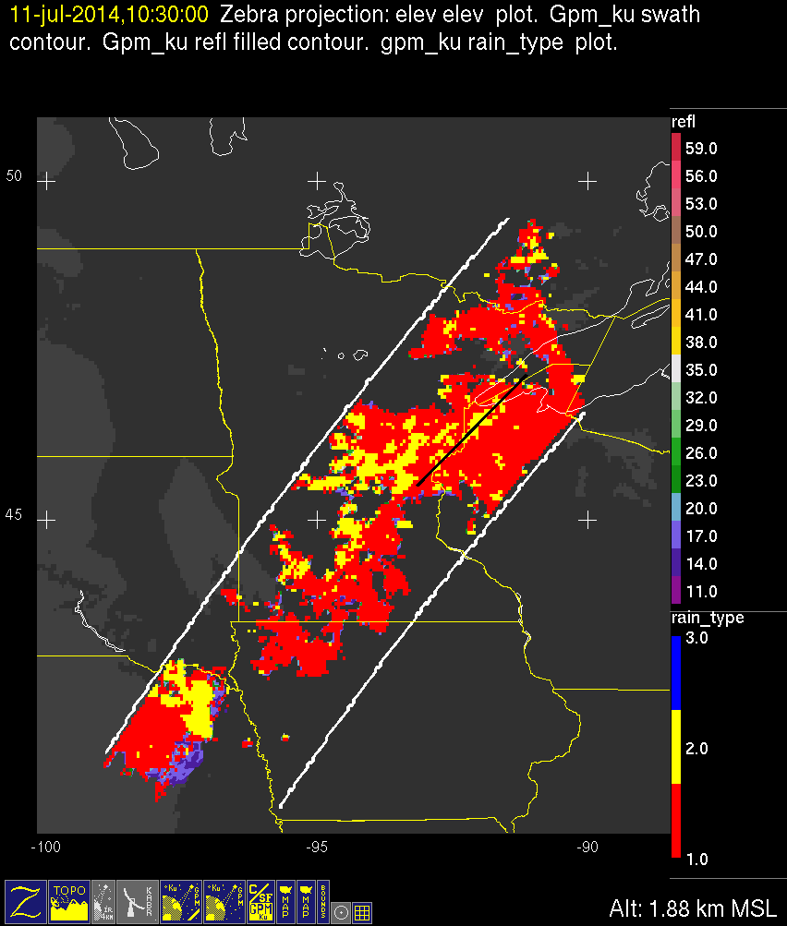
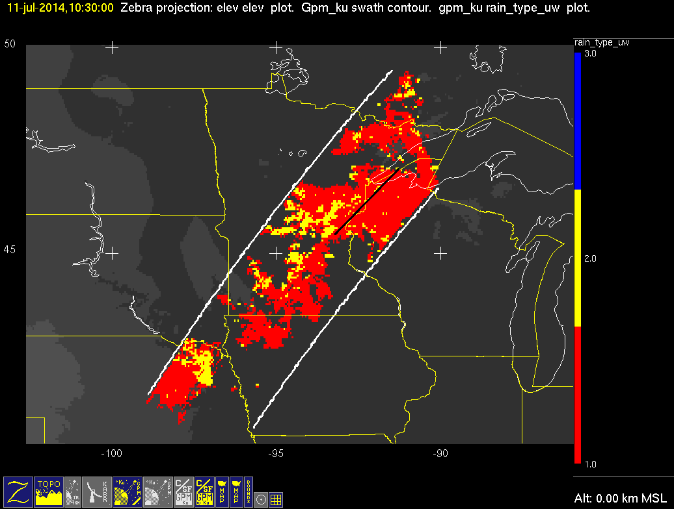
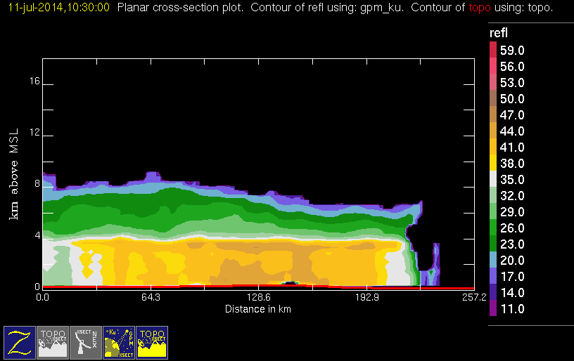
20140711 @ 102925
mod
conv
stra

Slide 4
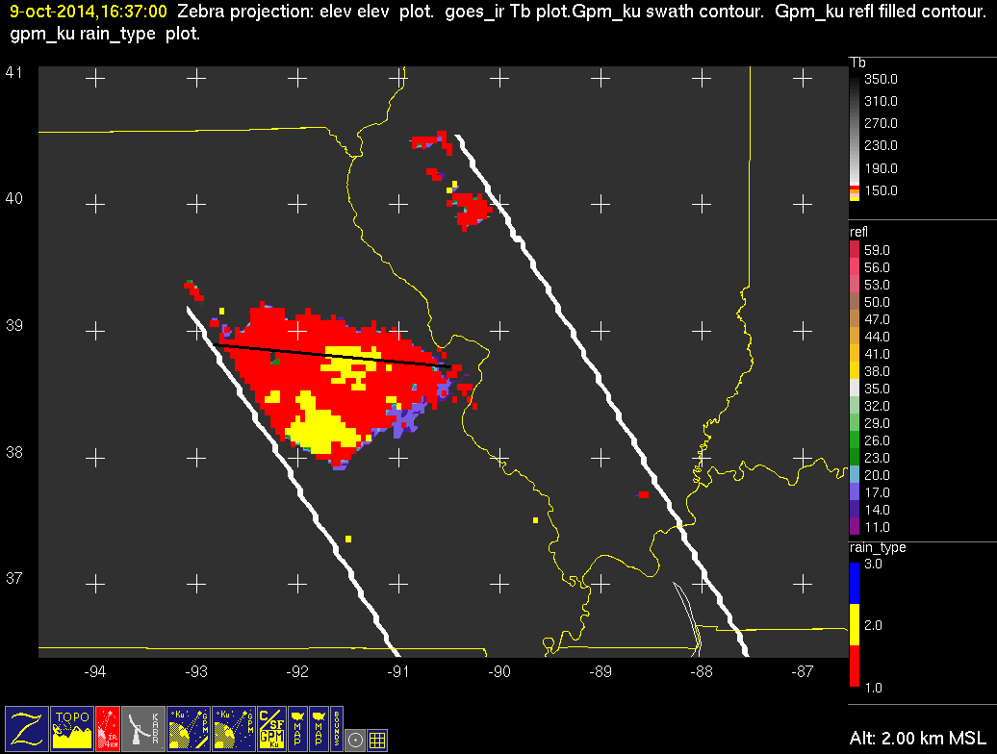
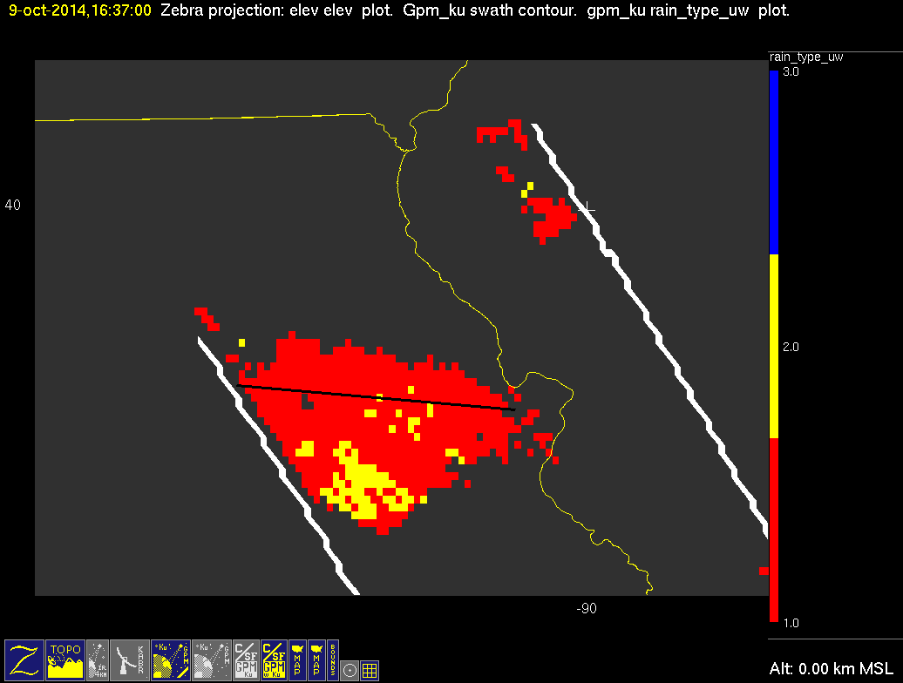
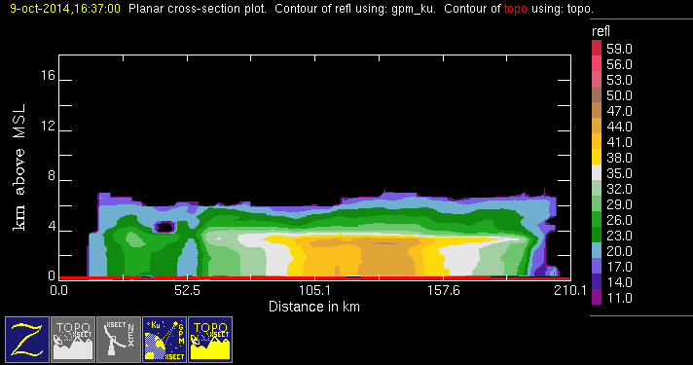
20141009 @ 163649
mod
conv
stra

Slide 5
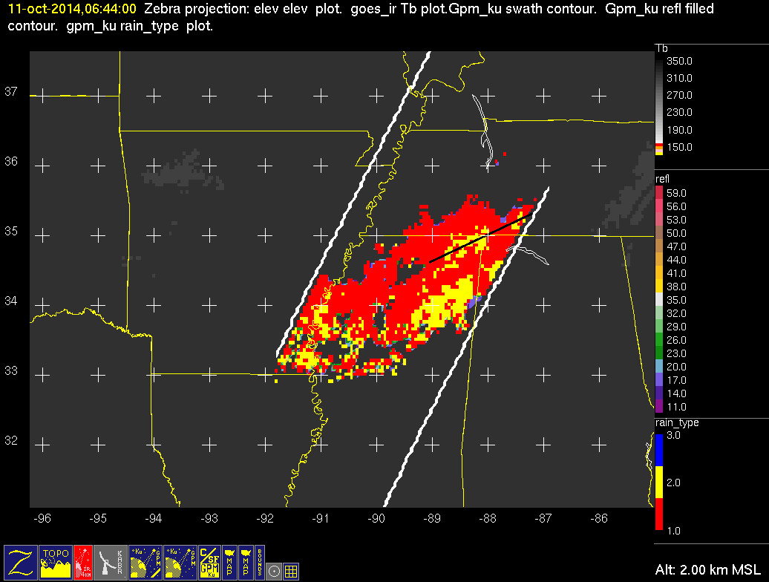
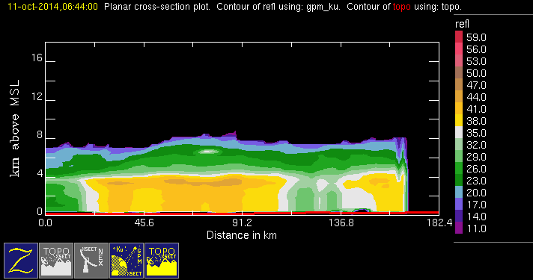
20141011 @ 064348
conv
stra

Slide 6
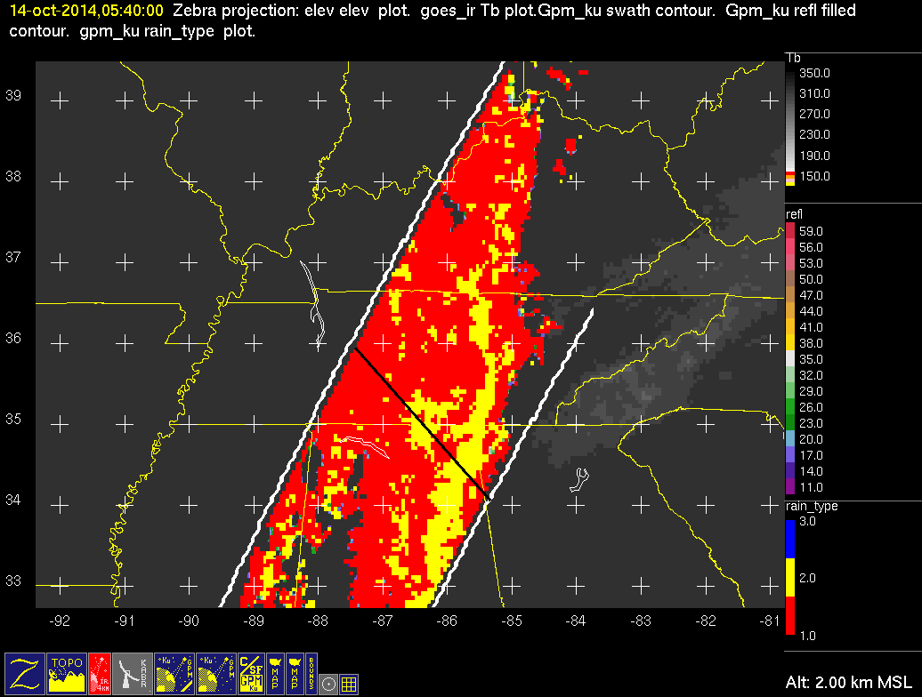
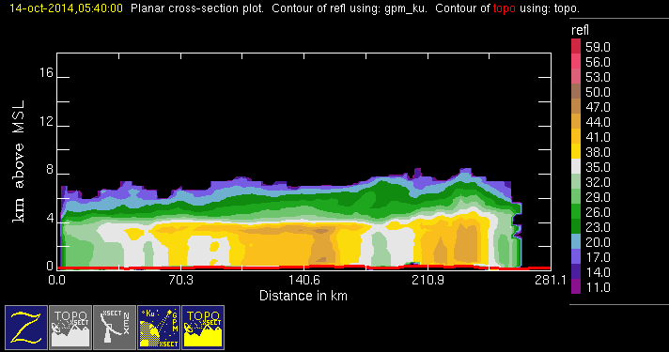
20141014 @ 053954
conv
stra

Slide 7
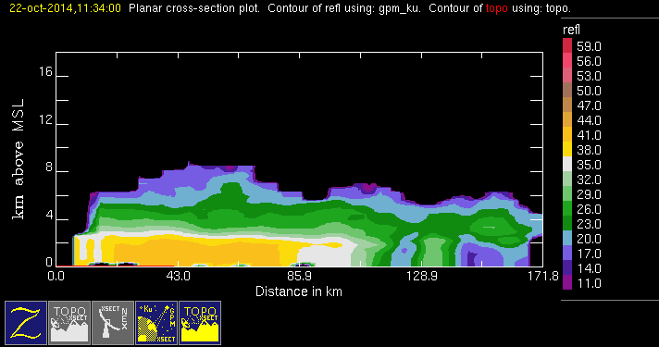
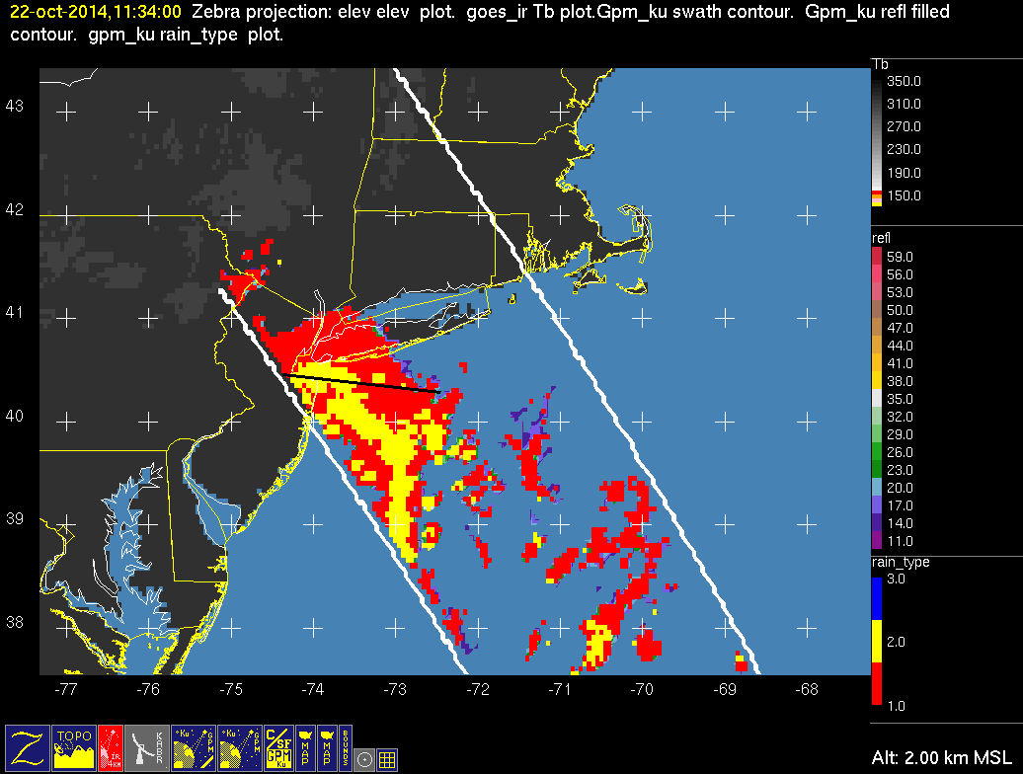
20141022 @ 113356
conv
stra

Slide 8
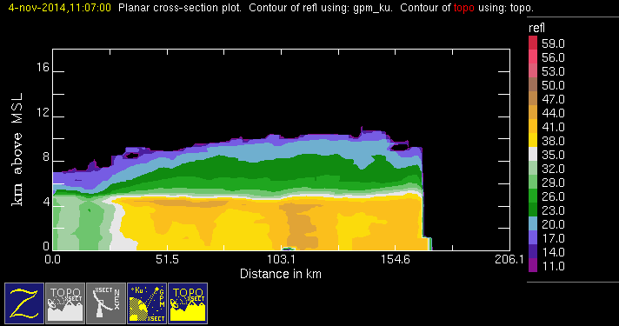
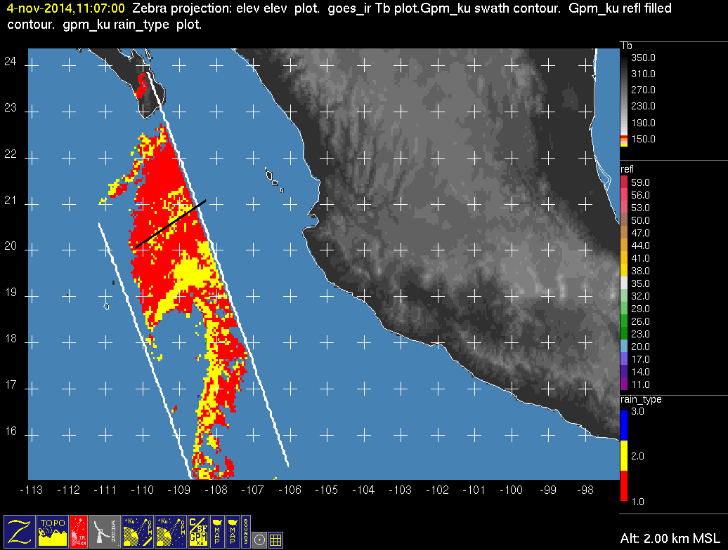
20141104 @ 110624 #1/2
conv
stra

Slide 9
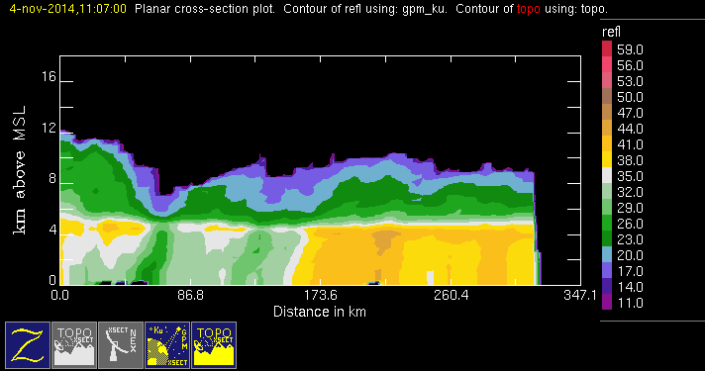

20141104 @ 110624 #2/2
conv
stra

Slide 10
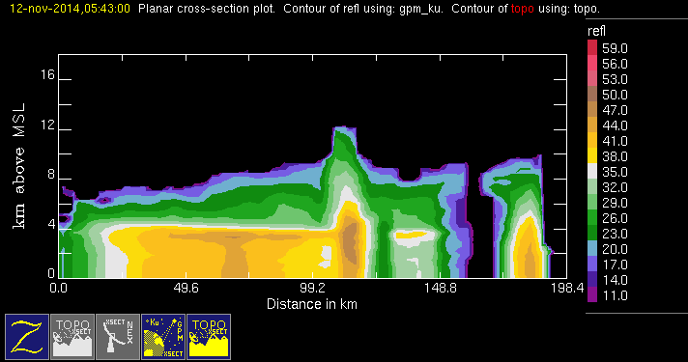
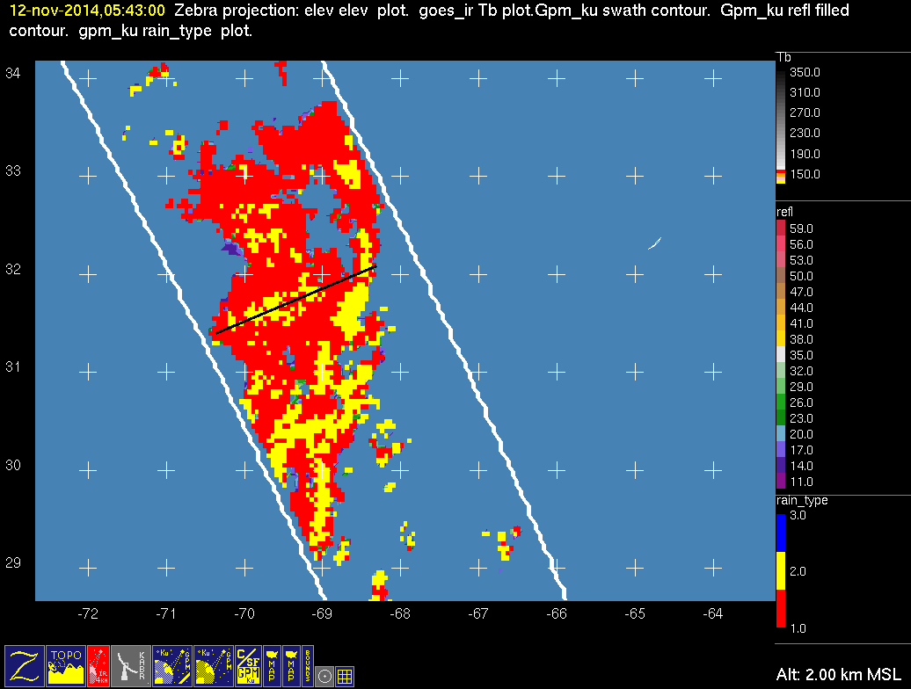
20141112 @ 054200 #1/3
conv
stra

Slide 11
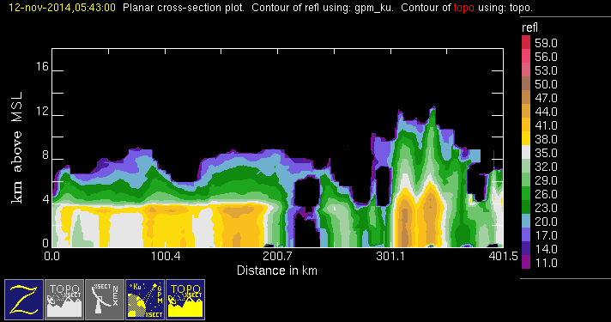
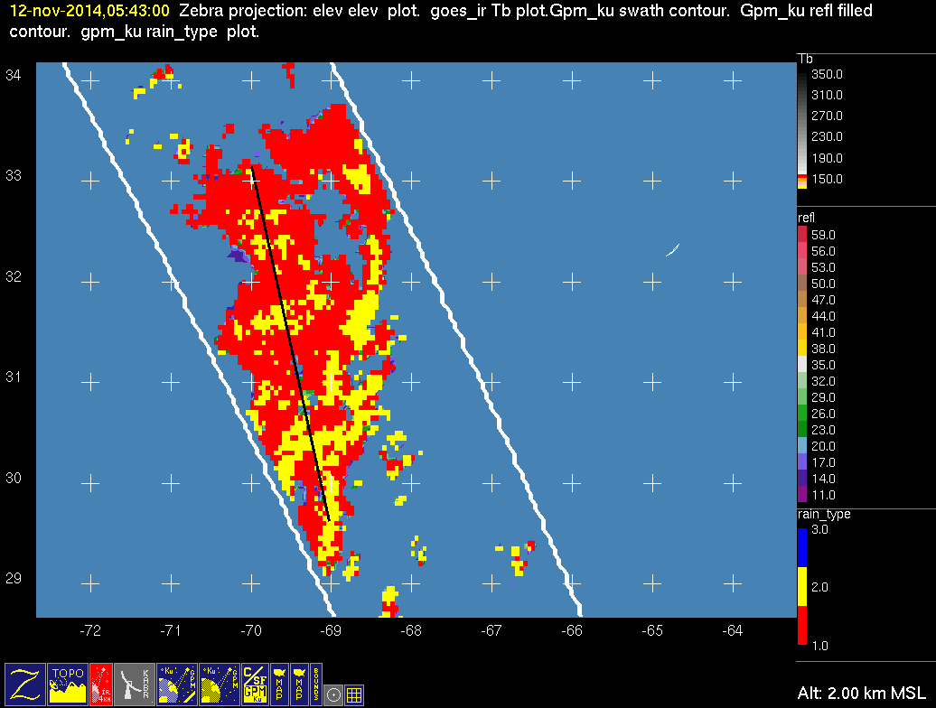
20141112 @ 054200 #2/3
conv
stra

Slide 12
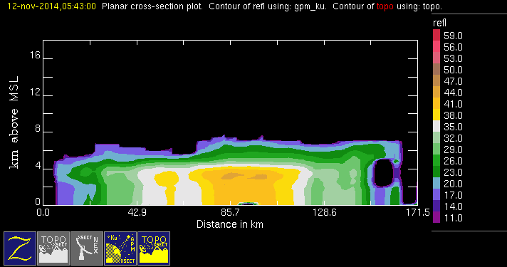

20141112 @ 054200 #3/3
conv
stra

Slide 13
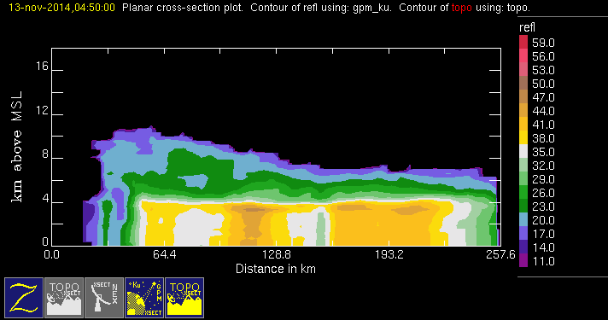
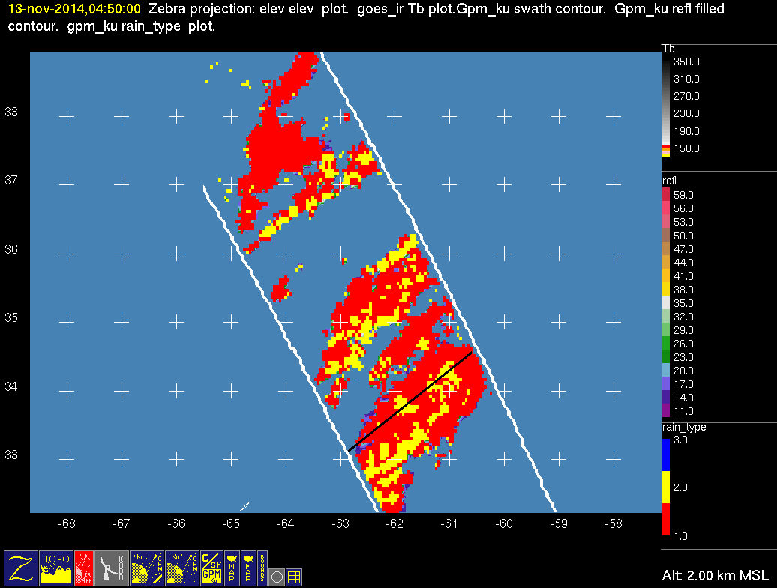
20141113 @ 044926
conv
stra

Slide 14
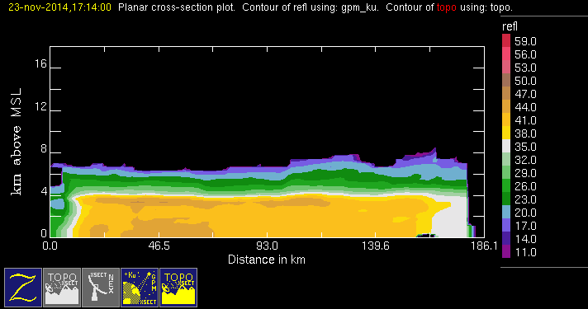
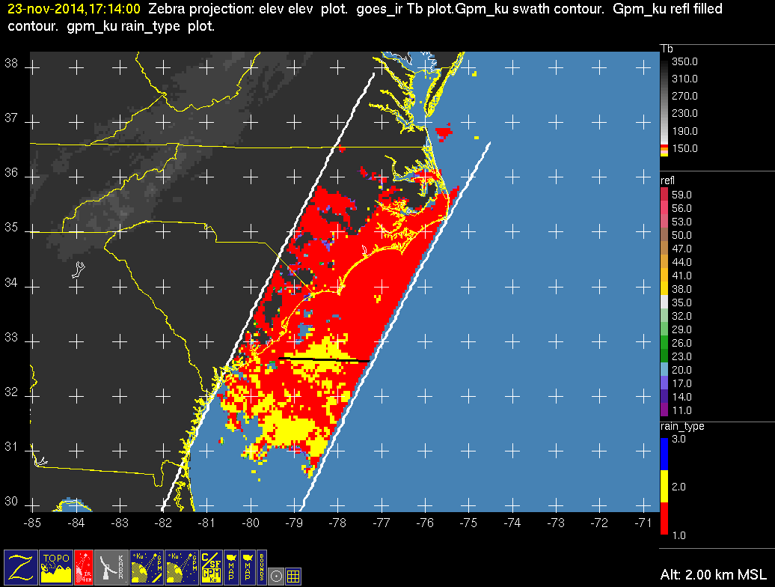
20141123 @ 171347 #1/2
conv
stra

Slide 15
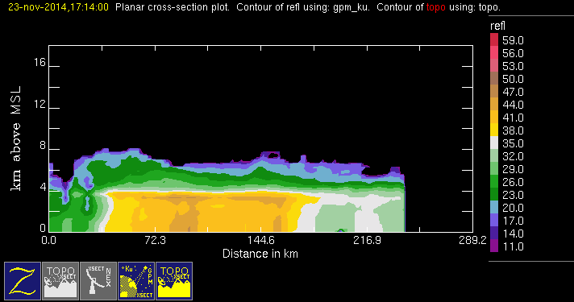

20141123 @ 171347 #2/2
conv
stra

Slide 16
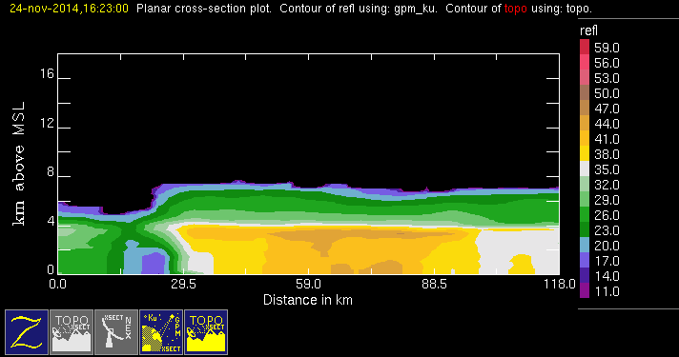
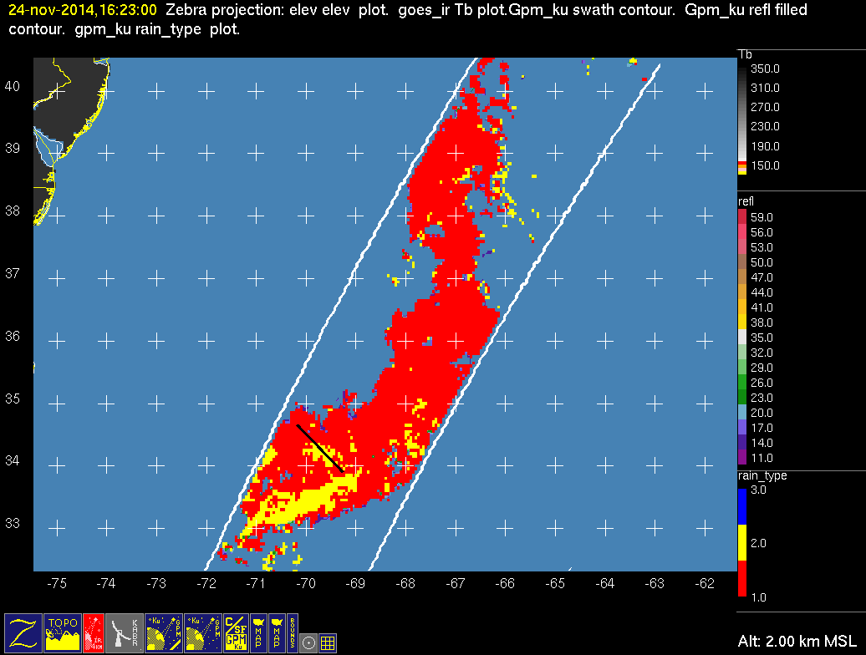
20141124 @ 162249
conv
stra

Slide 17
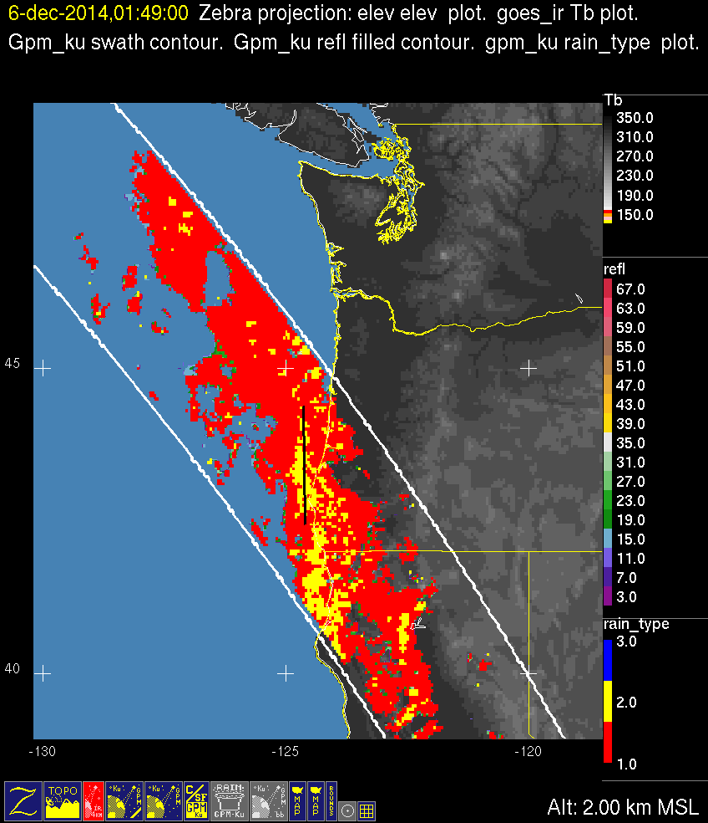
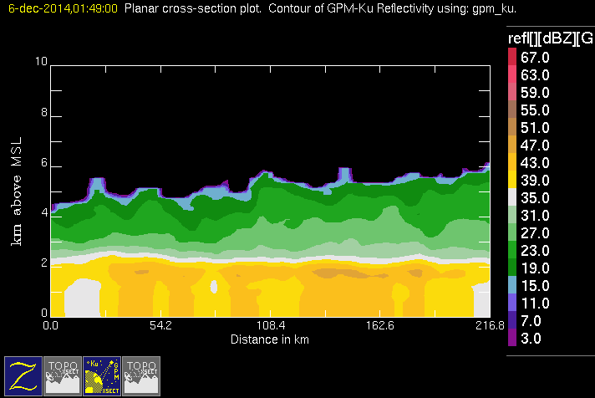
20141206 @ 014736
conv
stra

Slide 18
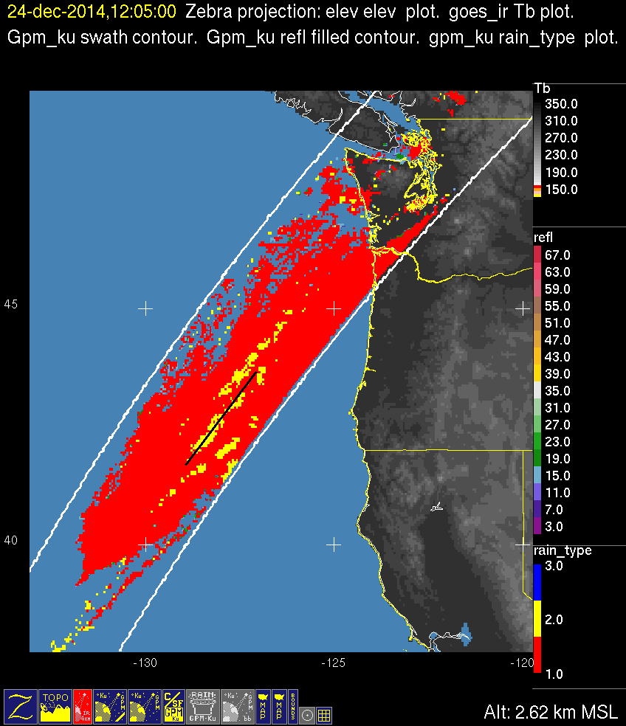
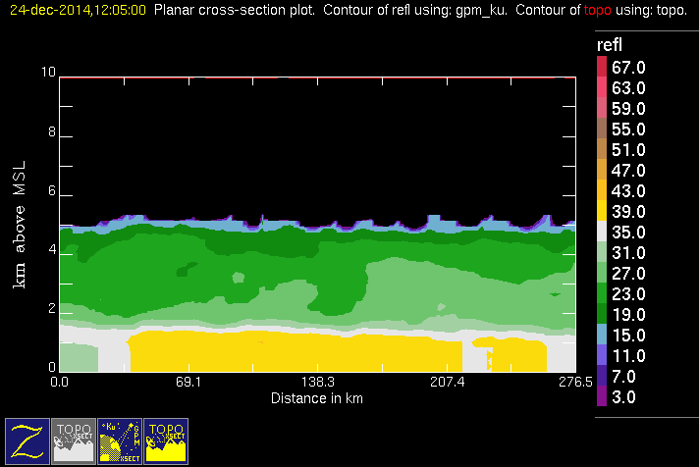
20141224 @ 120452
conv
stra

Slide 19
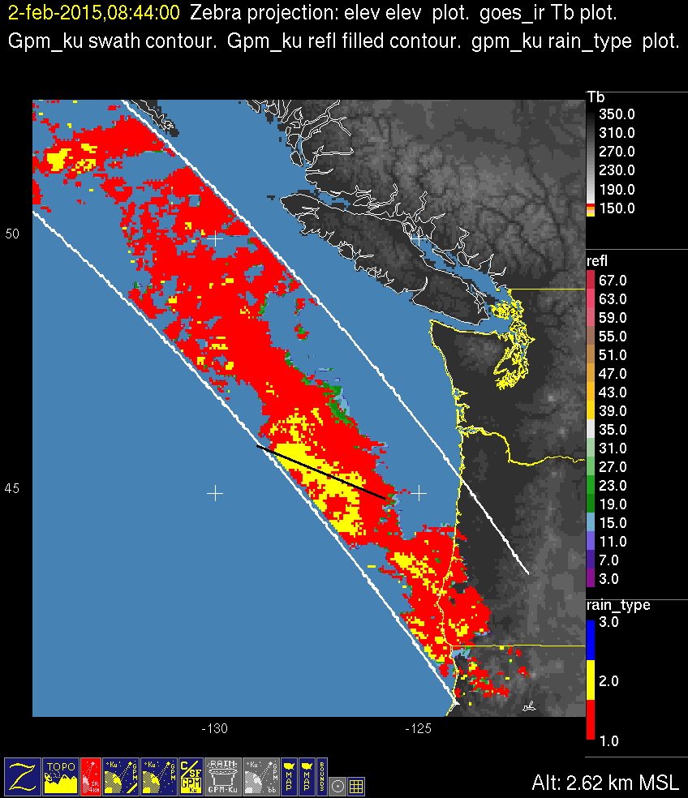
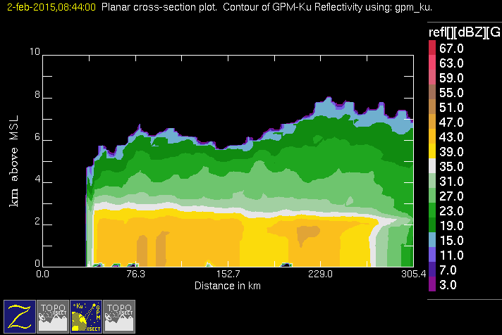
20150202 @ 084127
conv
stra

Slide 20
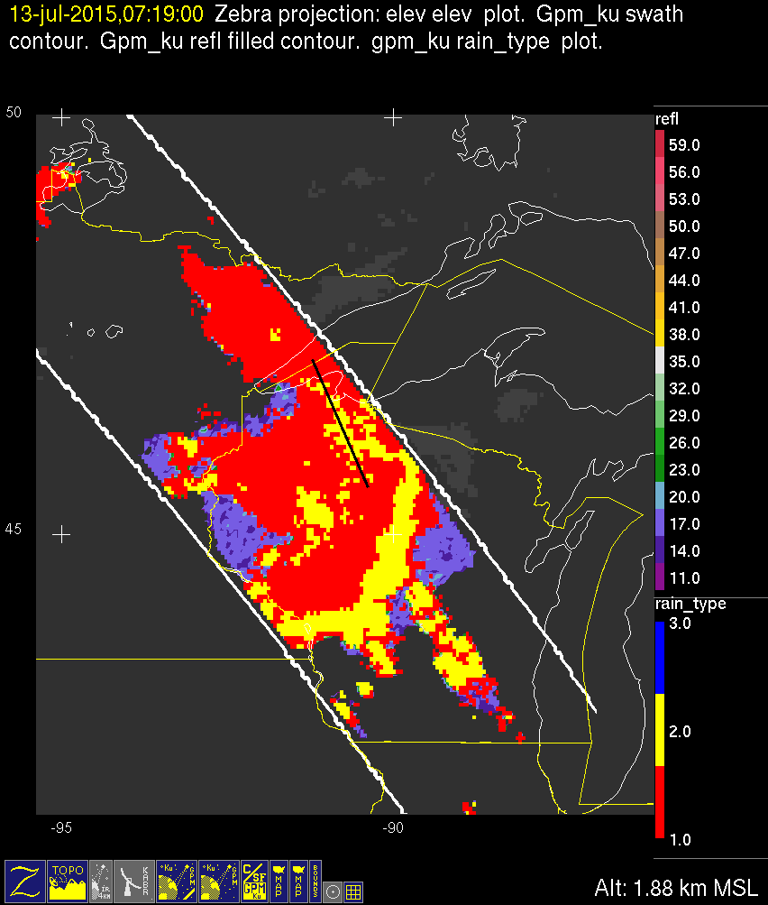
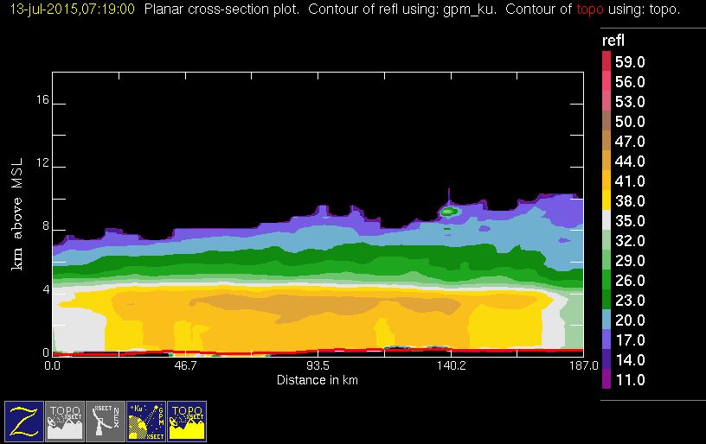
20150713 @ 071724 #1/5
conv
stra

Slide 21

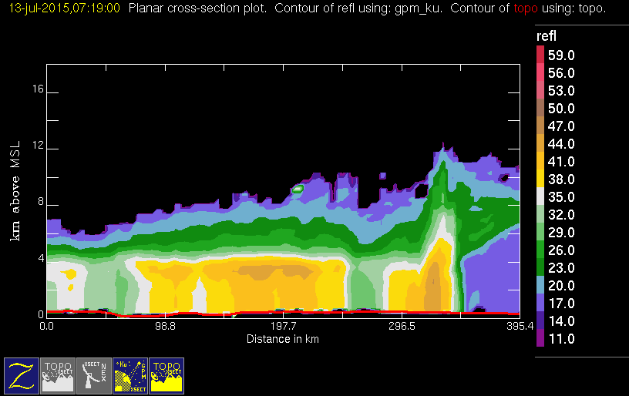
20150713 @ 071724 #2/5
conv
stra

Slide 22

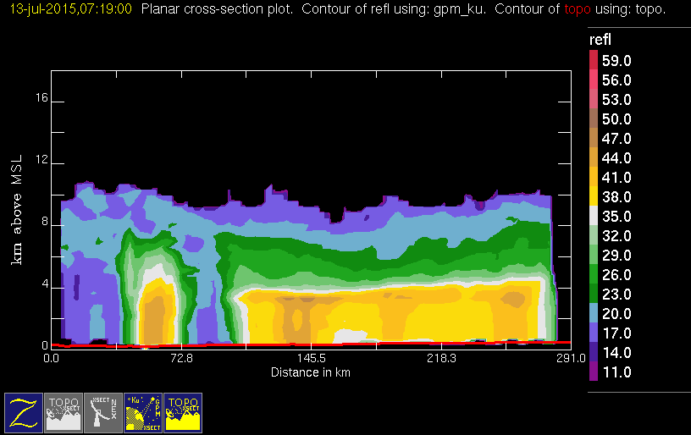
20150713 @ 071724 #3/5
conv
stra

Slide 23
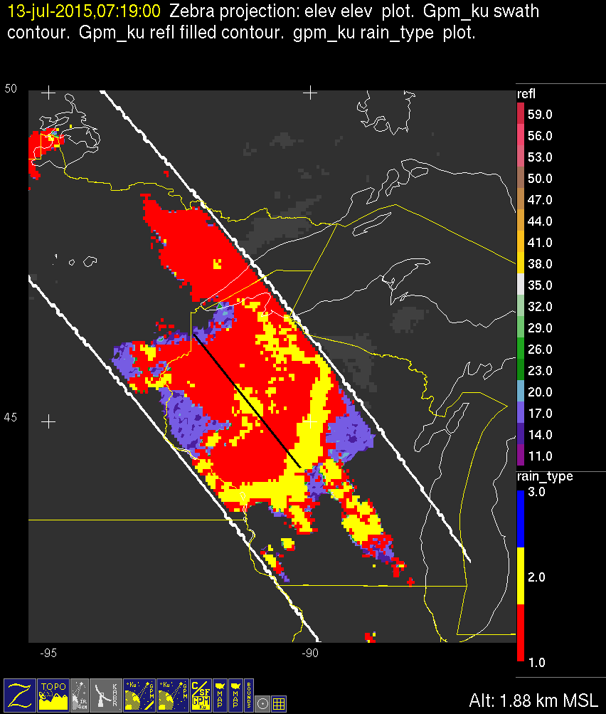
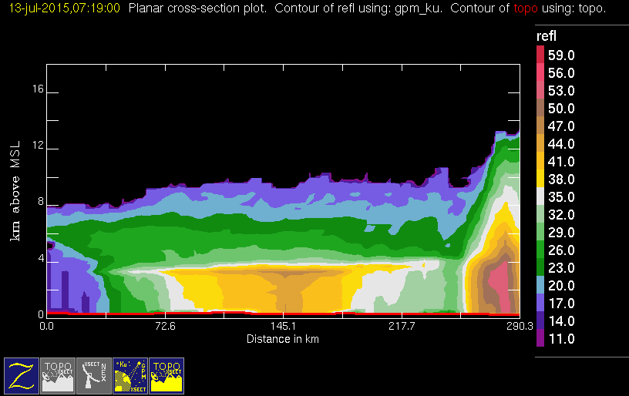
20150713 @ 071724 #4/5
conv
stra

Slide 24
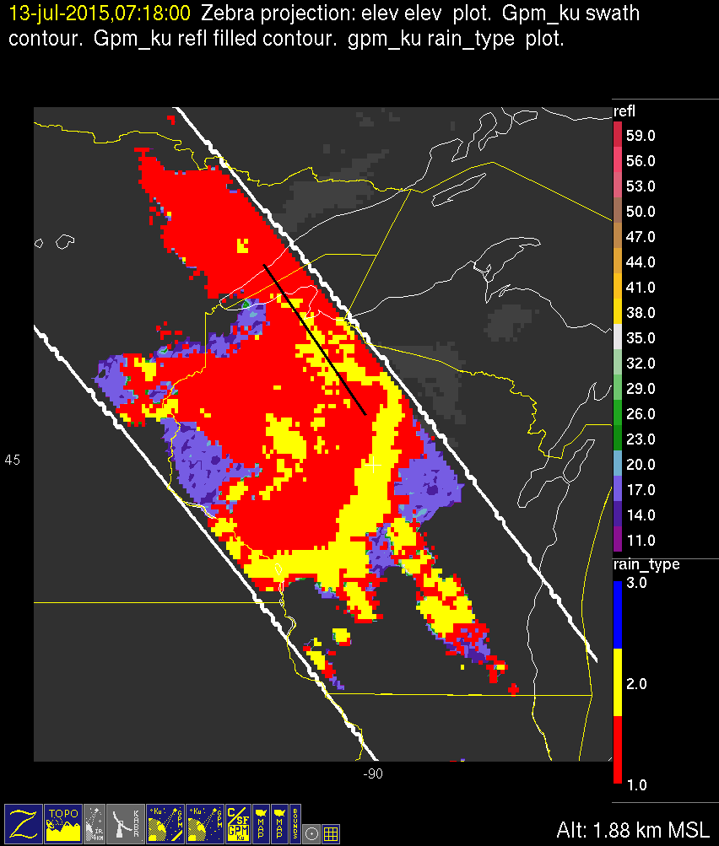
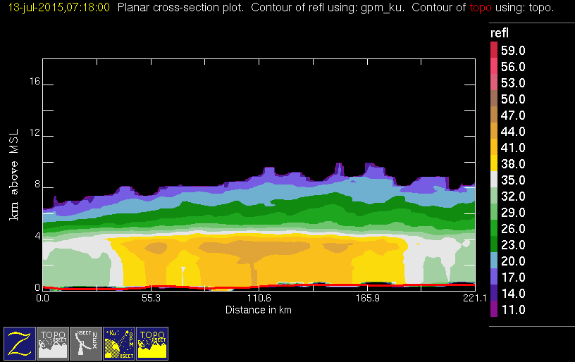
20150713 @ 071724 #5/5
conv
stra

Slide 25
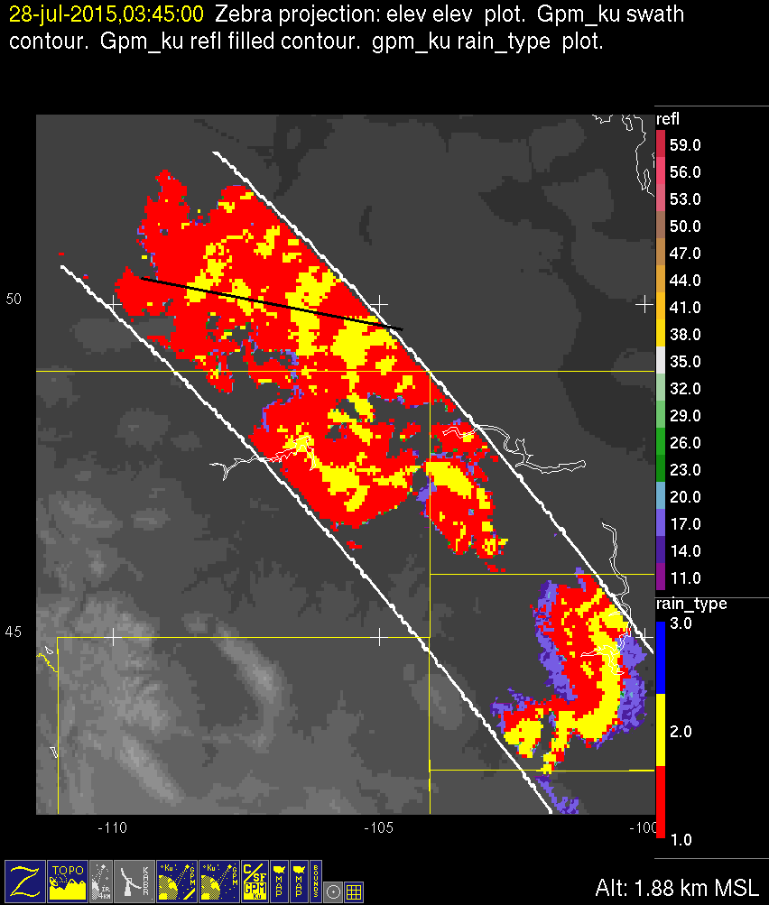
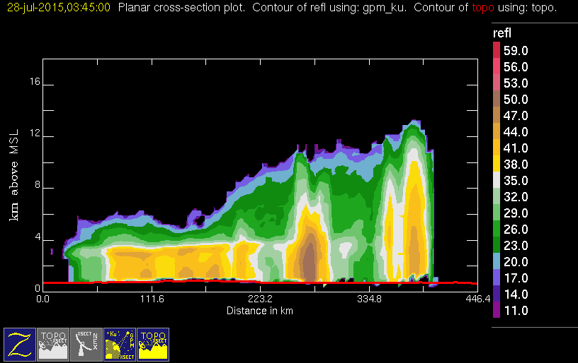
20150728 @ 034222 #1/3
conv
stra

Slide 26

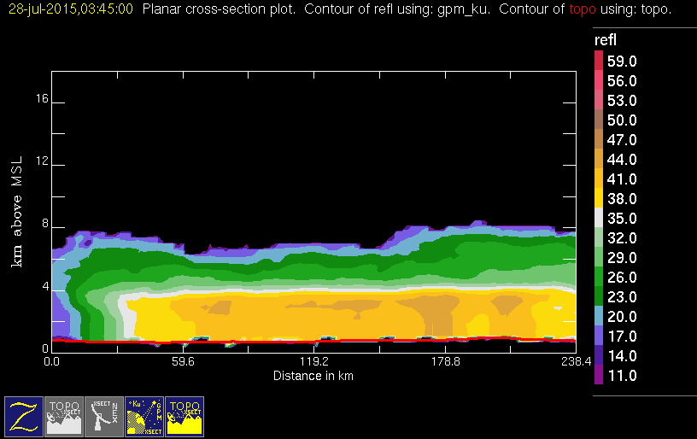
20150728 @ 034222 #2/3
conv
stra

Slide 27
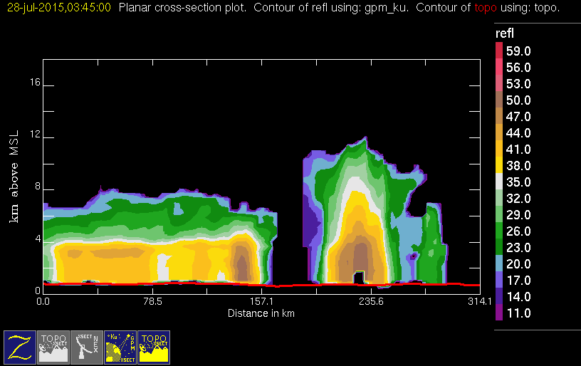

20150728 @ 034222 #3/3
conv
stra

Slide 28
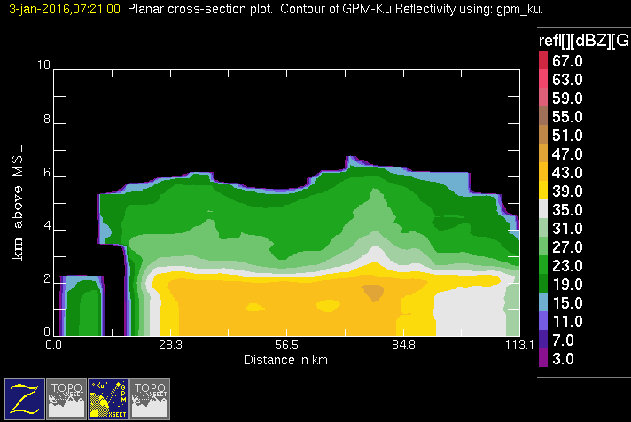

20160103 @ 071812
conv
stra

Slide 29


20150401 @ 125219
conv
stra

Slide 30
20150409 @ 103329

Slide 31


20150410 @ 111317
conv
stra

Slide 32


20150417 @ 094529
conv
stra

Slide 33


20150425 @ 205420
conv
stra

Slide 34


20150429 @ 053449 #1/2
conv
stra

Slide 35


20150429 @ 053449 #2/2
conv
stra

Slide 36

20150429 @ 053449 #3/3
conv
stra
conv
Stra
MOD

