Slide 1
UW MODIFICATION TO 2AKu rain_type FIELD
If the following three criteria are met for a grid point, the rain_type is changed to STRATIFORM:
The original classification is CONVECTIVE
The maximum reflectivity in the column is greater than 40dBZ
The height at which that maximum reflectivity occurs is between 3 and 5 km
Each of the following slides shows the original classification on the left, the UW modified classification on the right and a cross-section of the reflectivity which represents the cut where the black line is drawn on the horizontal plots.

Slide 2
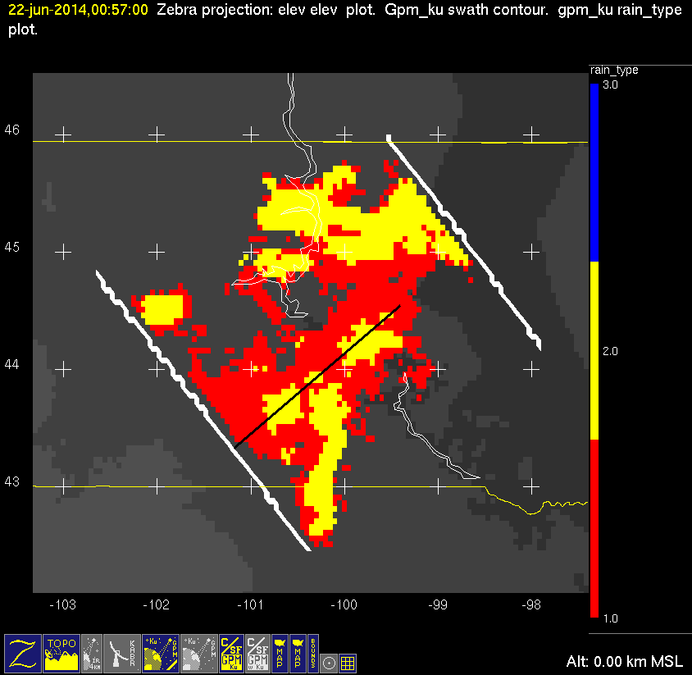
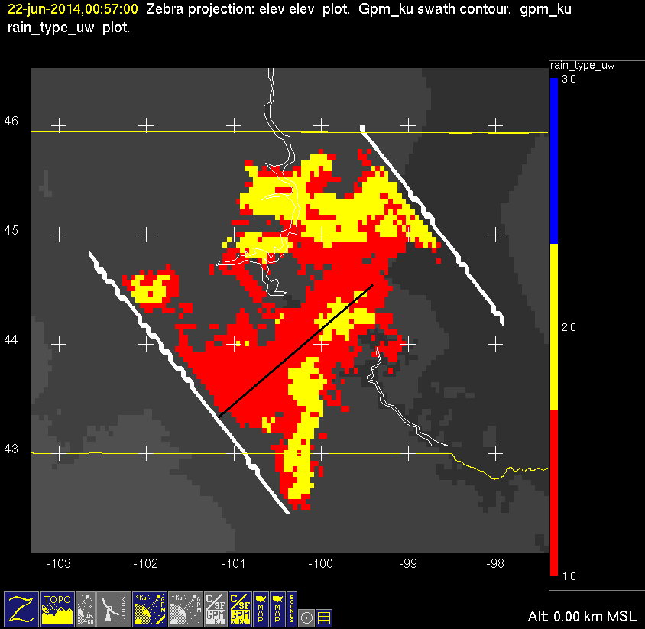
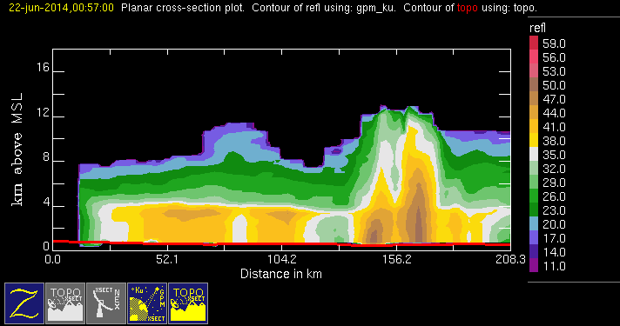
20140622 @ 005639
conv
stra
orig
mod

Slide 3
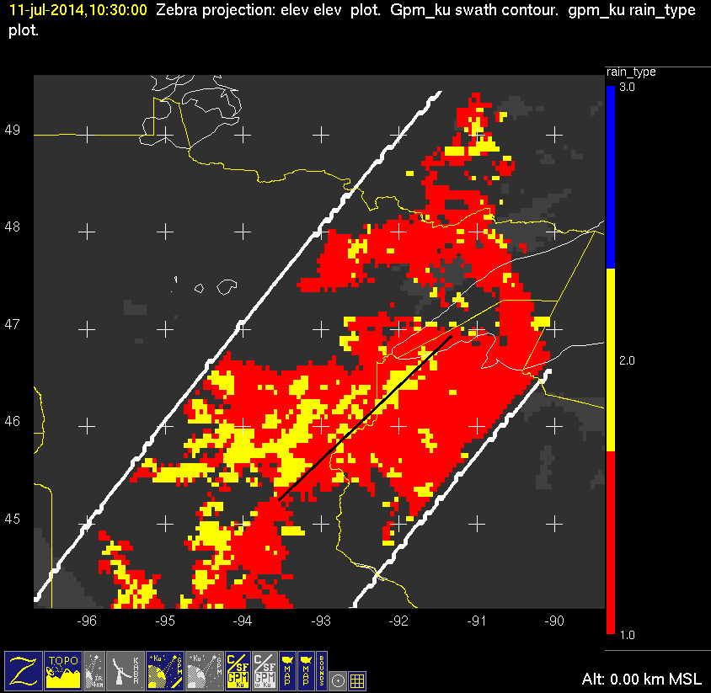
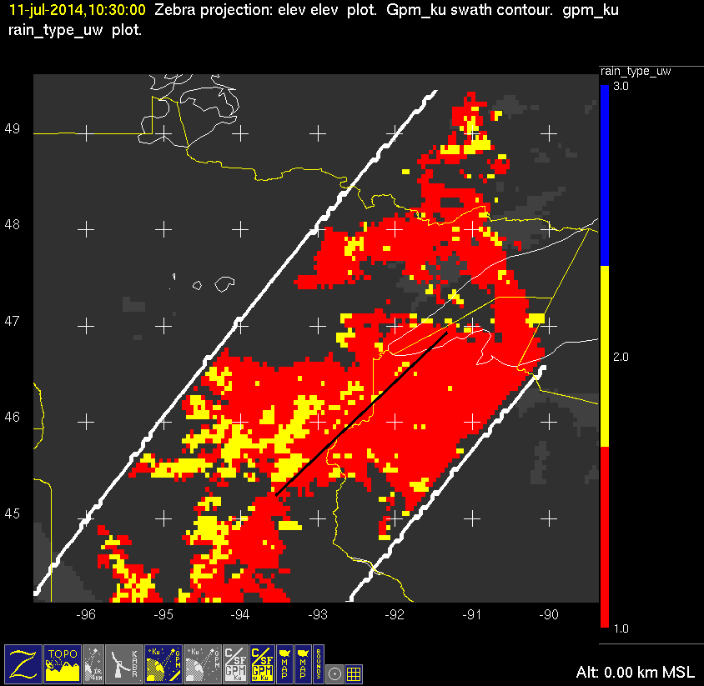
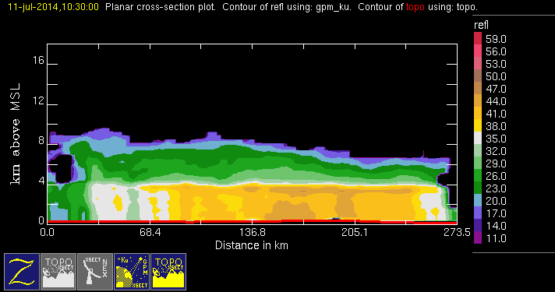
20140711 @ 102925
orig
mod
conv
stra

Slide 4
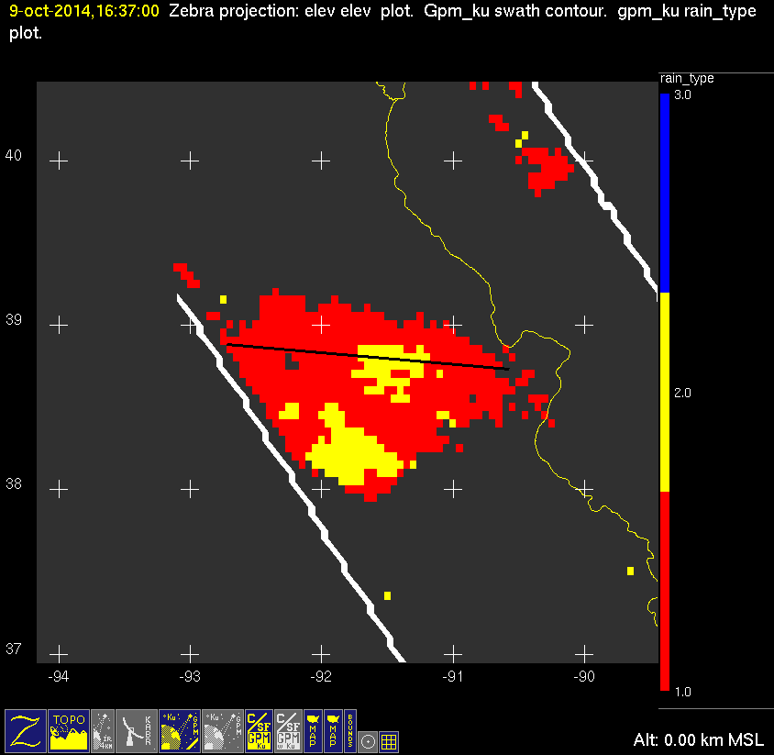
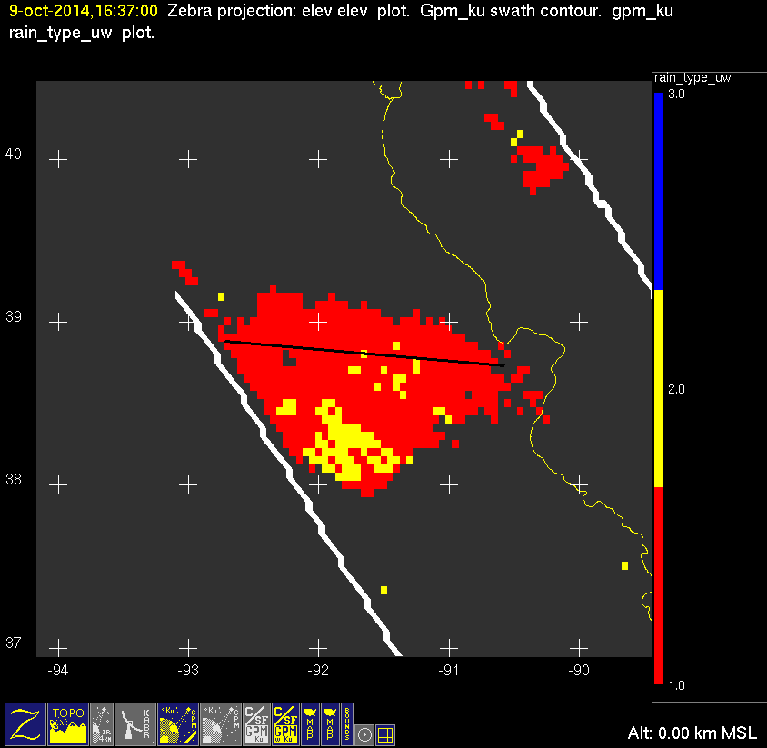
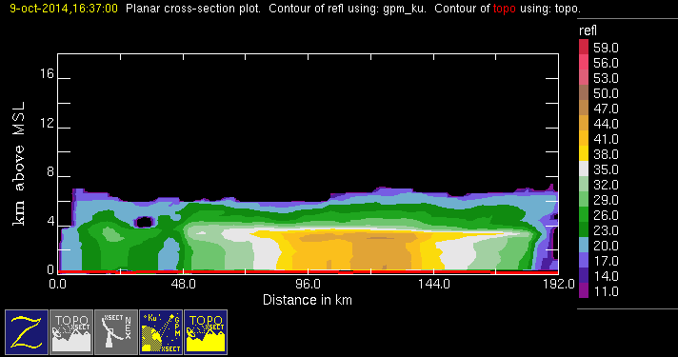
20141009 @ 163649
conv
stra
orig
mod

Slide 5
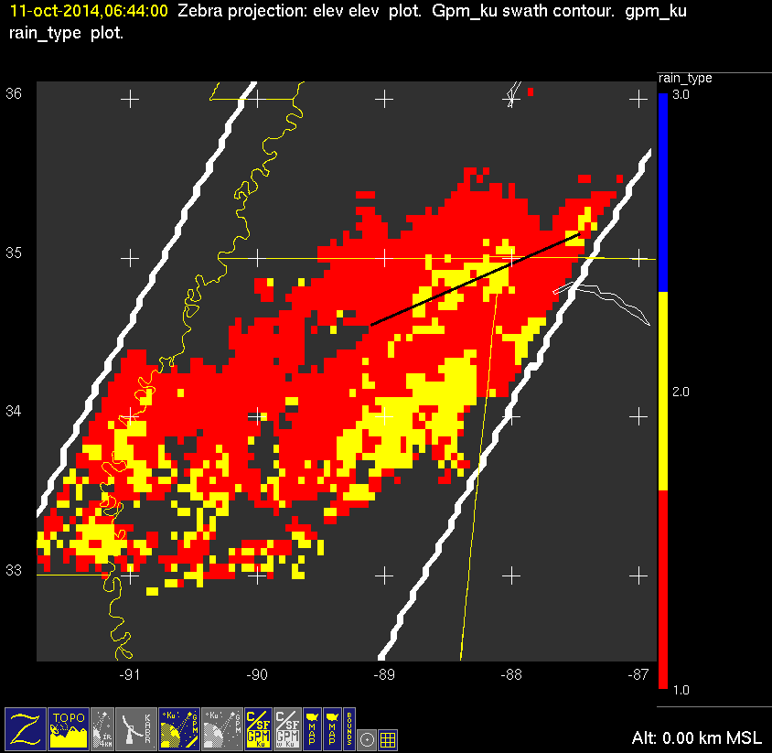
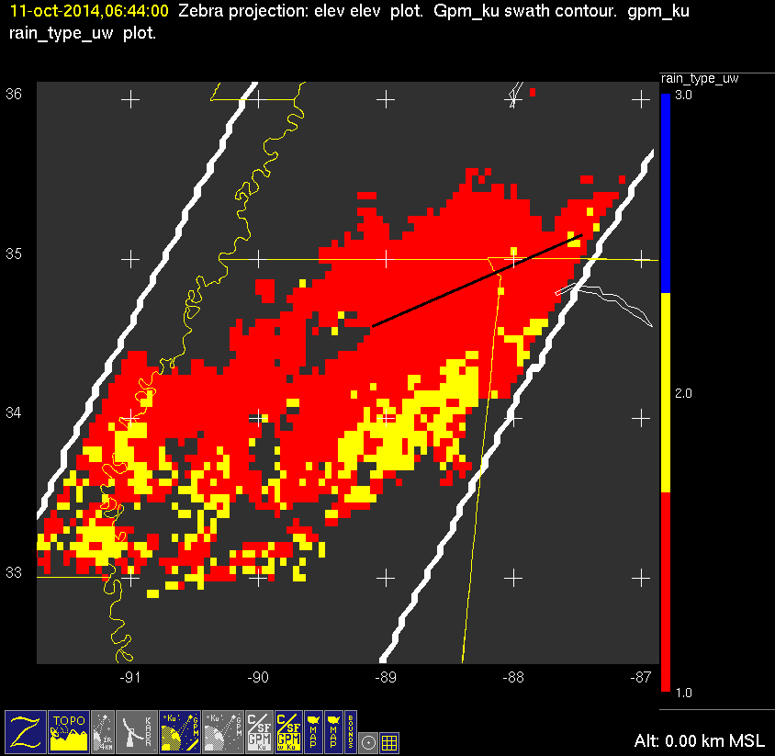
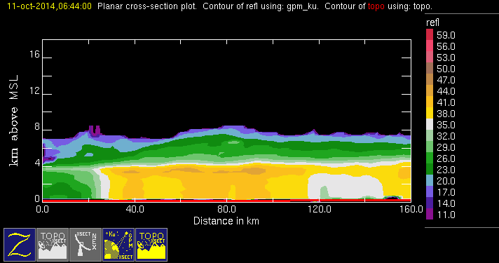
20141011 @ 064348
orig
mod
conv
stra

Slide 6
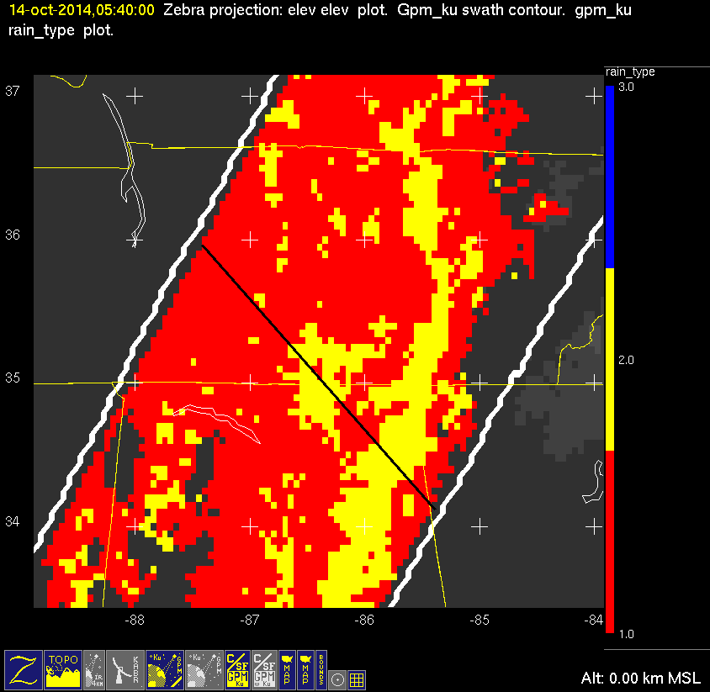
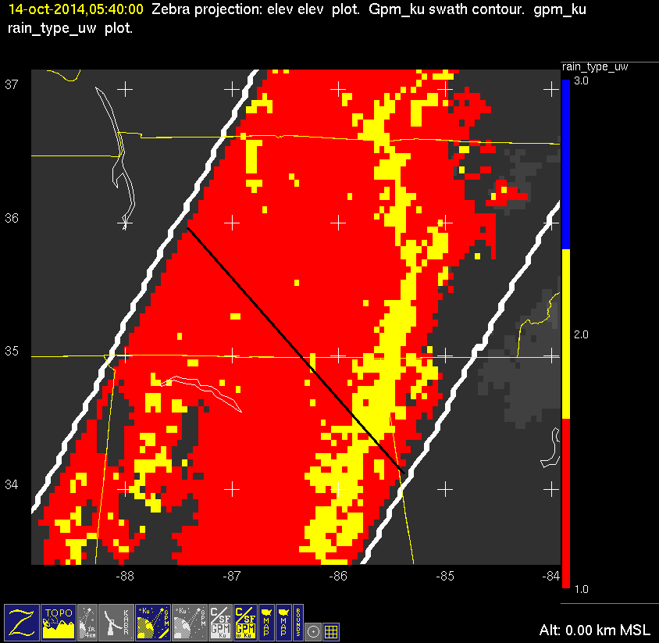
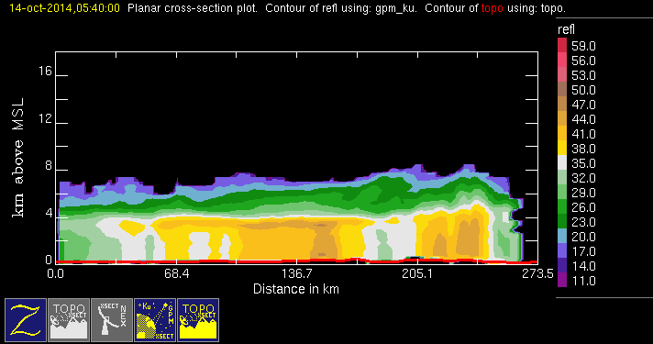
20141014 @ 053954
conv
stra
orig
mod

Slide 7
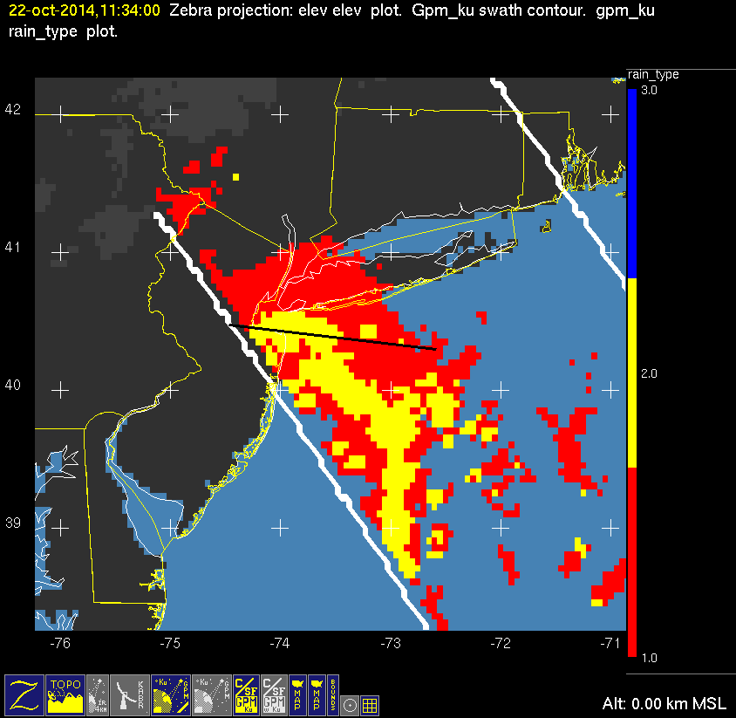

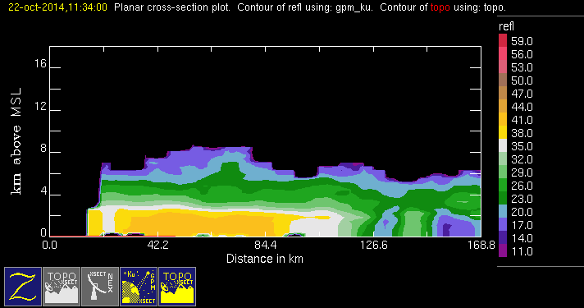
20141022 @ 113356
conv
stra
orig
mod
Failed height test

Slide 8
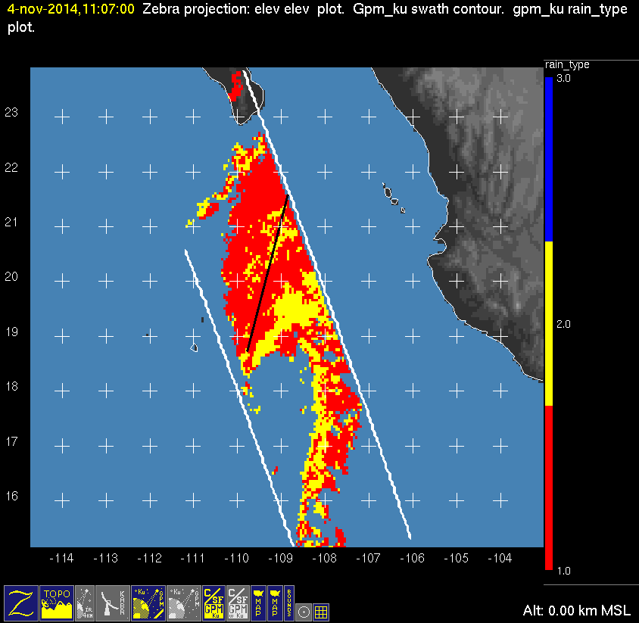
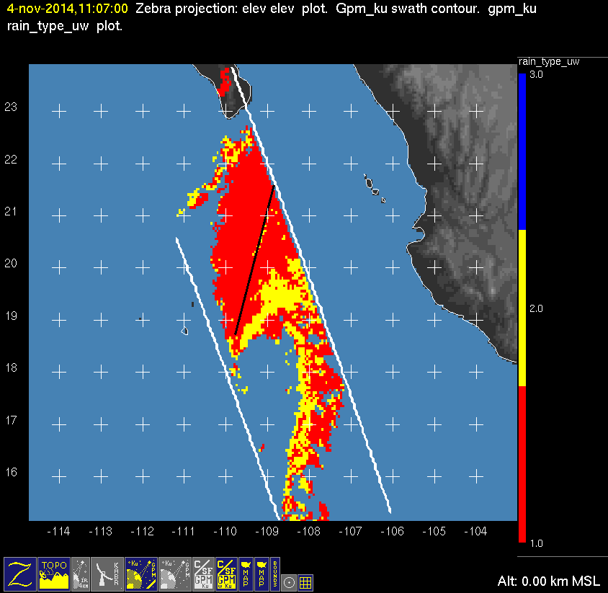
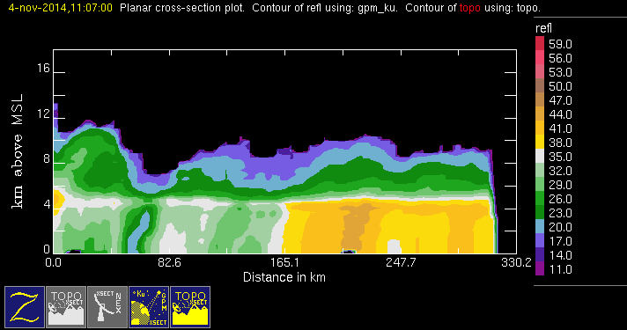
20141104 @ 110624
conv
stra
orig
mod

Slide 9
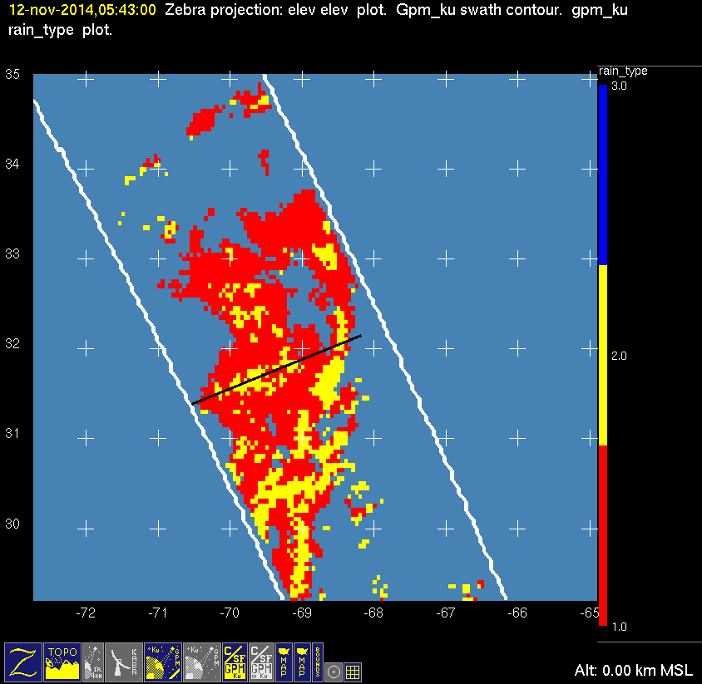
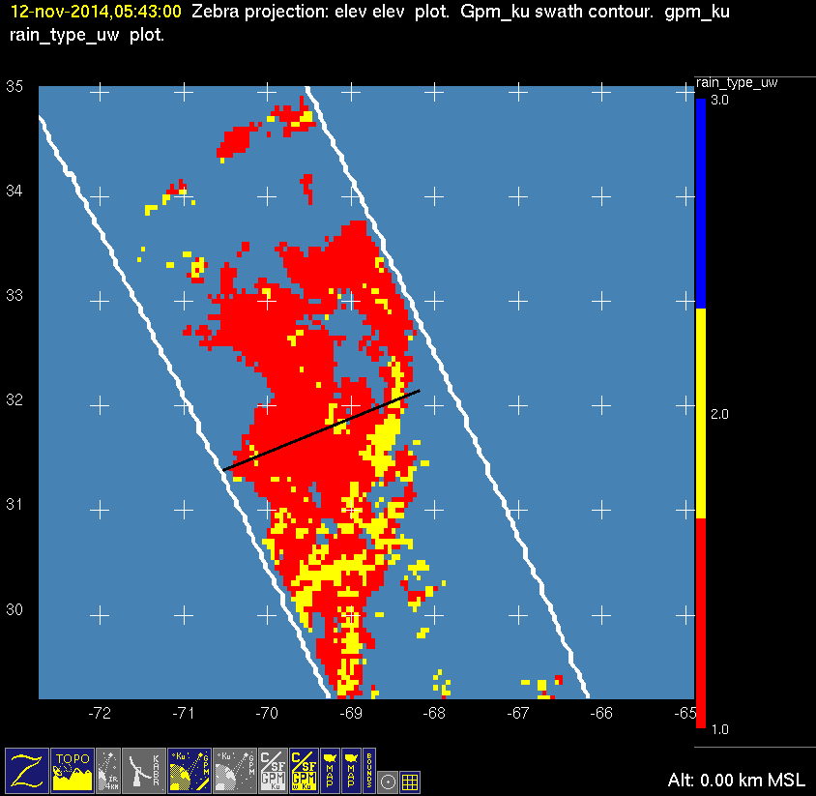
20141112 @ 054200 #1/2
orig
mod
conv
stra
Redo xsect and insert here

Slide 10
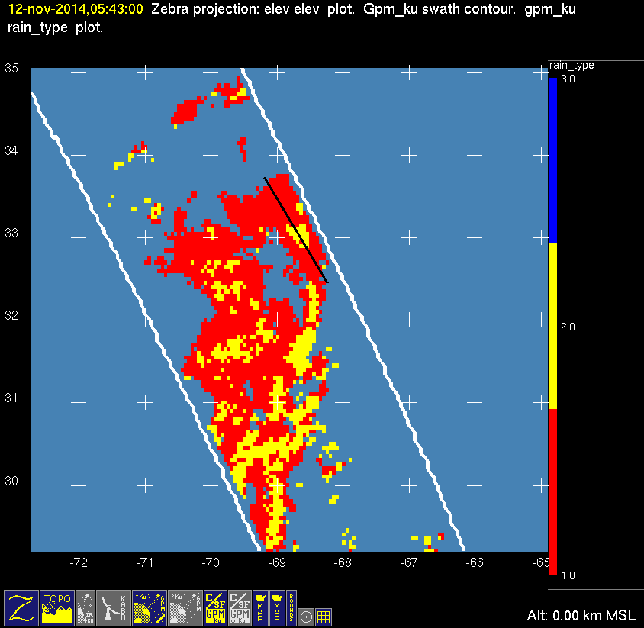
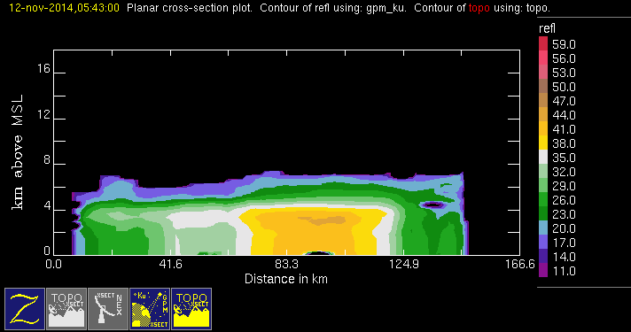
20141112 @ 054200 #2/2
orig
Redo rain_type_uw plot and insert here
conv
stra

Slide 11
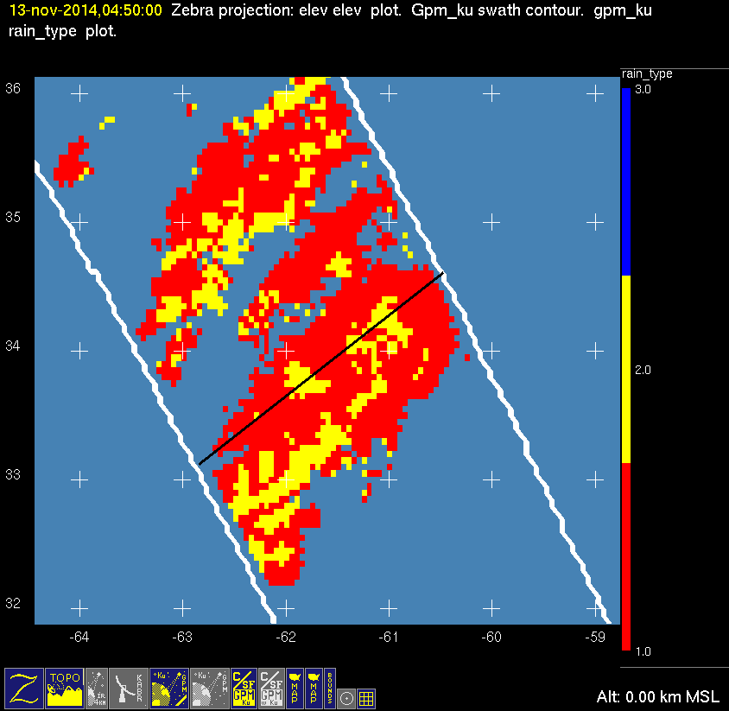
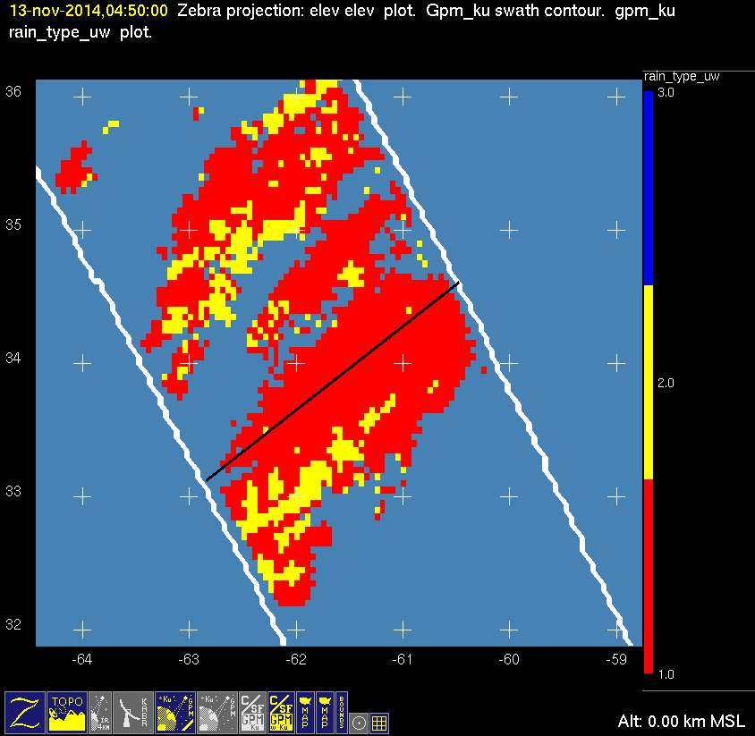
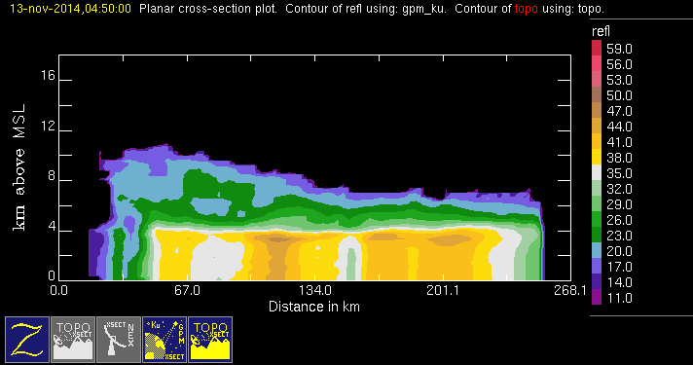
20141113 @ 044926
conv
stra
orig
mod

Slide 12
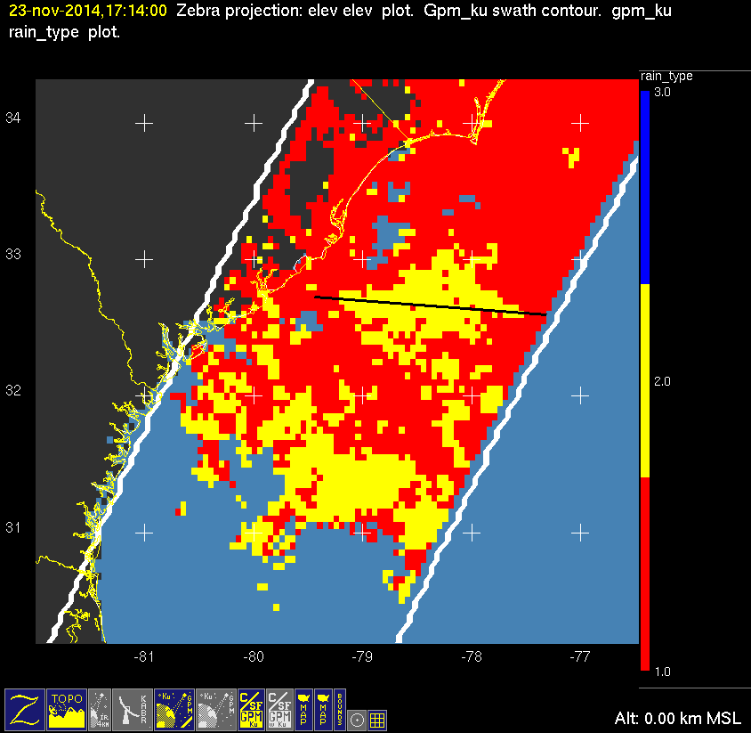
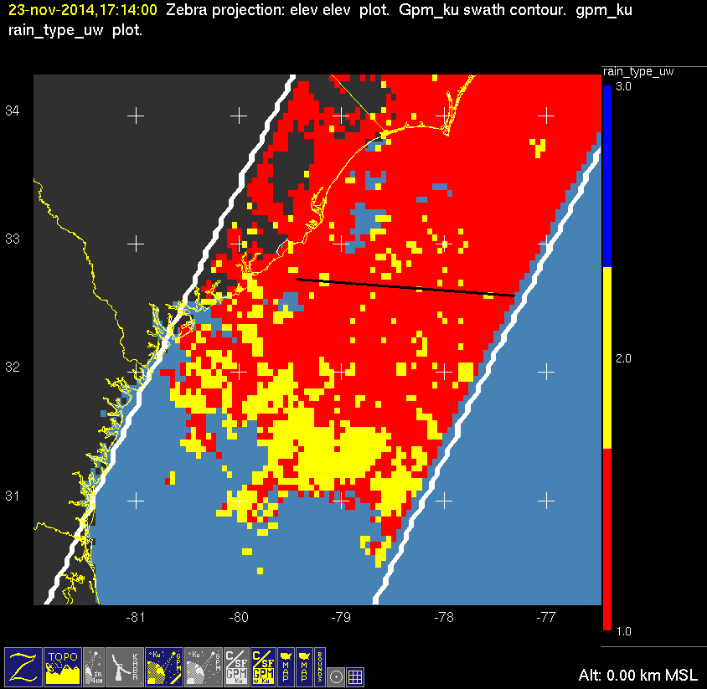
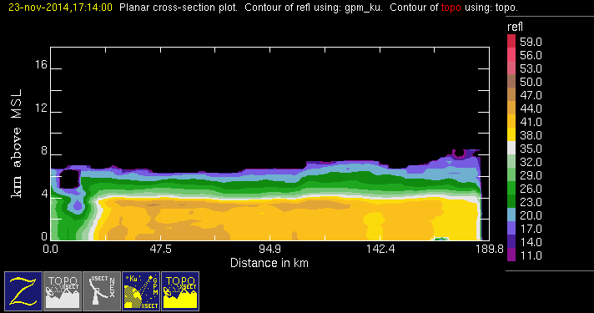
20141123 @ 171347
conv
stra
orig
mod

Slide 13
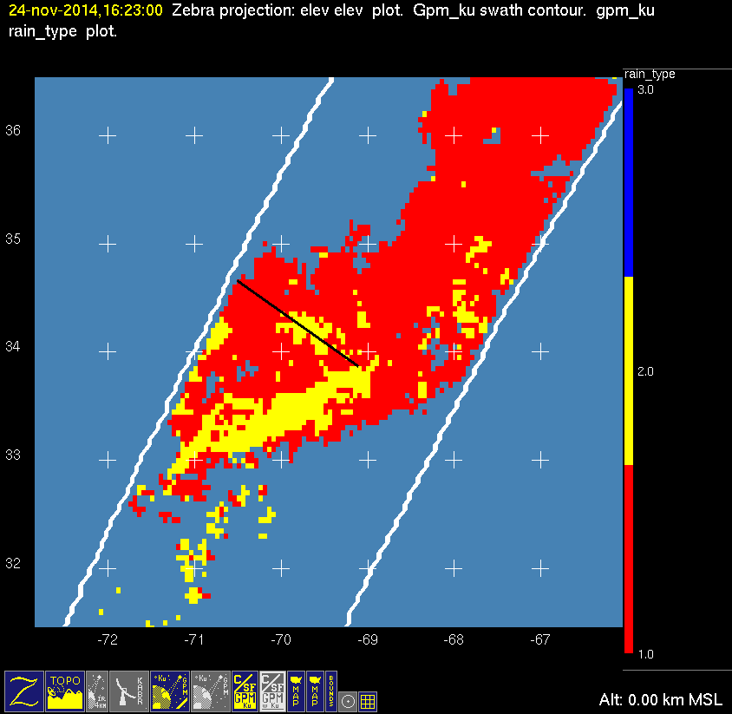
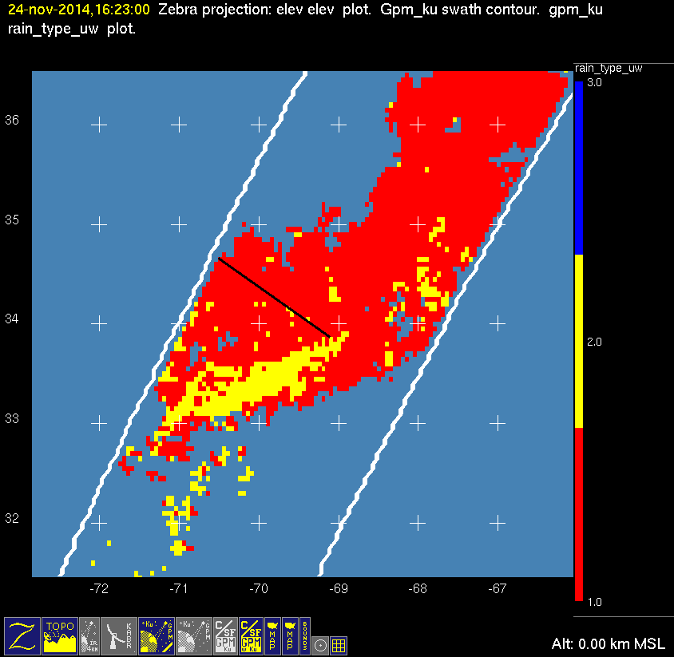
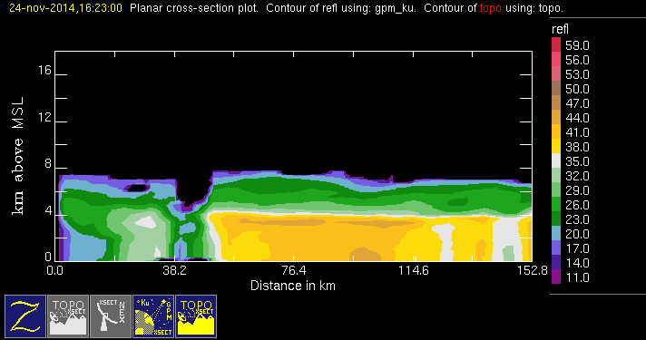
20141124 @ 162249
conv
stra
orig
mod

Slide 14
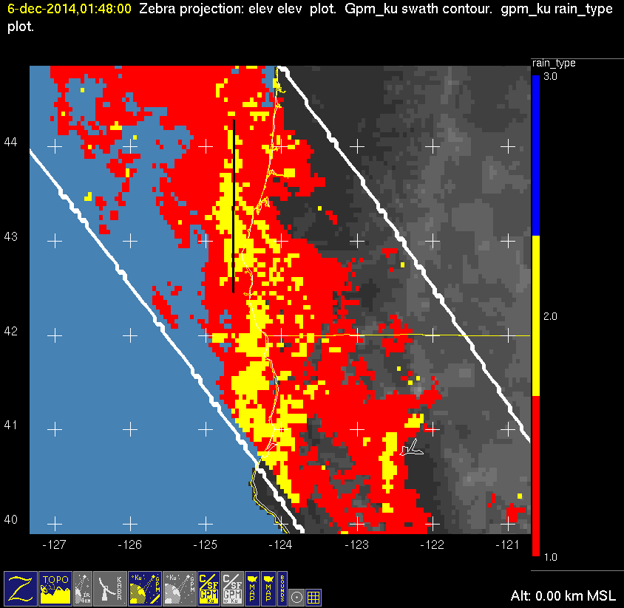
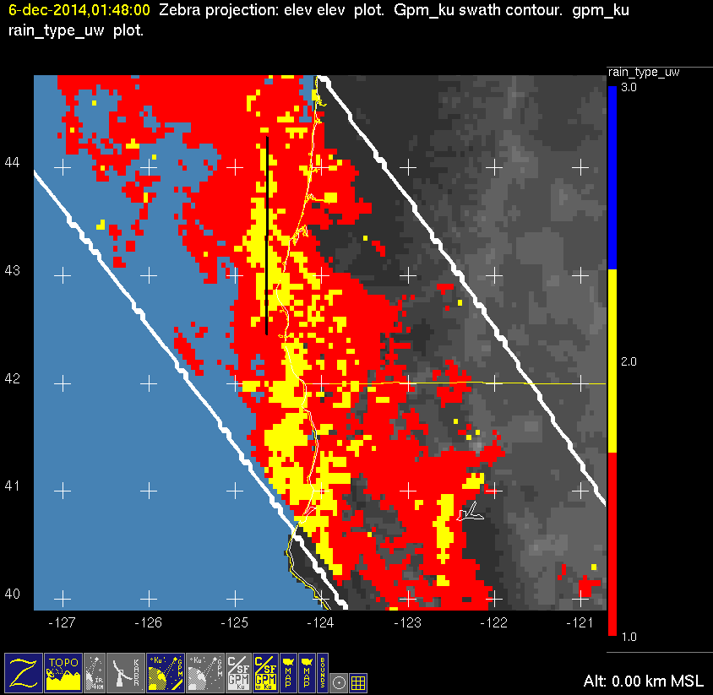
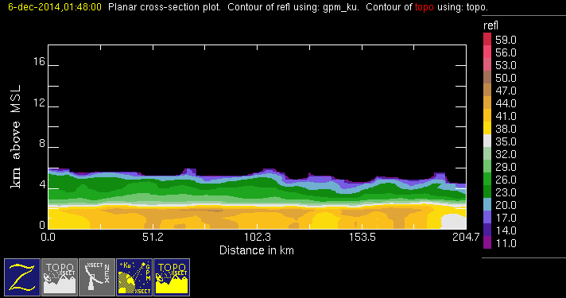
20141206 @ 014736
orig
mod
conv
stra
Failed height test

Slide 15
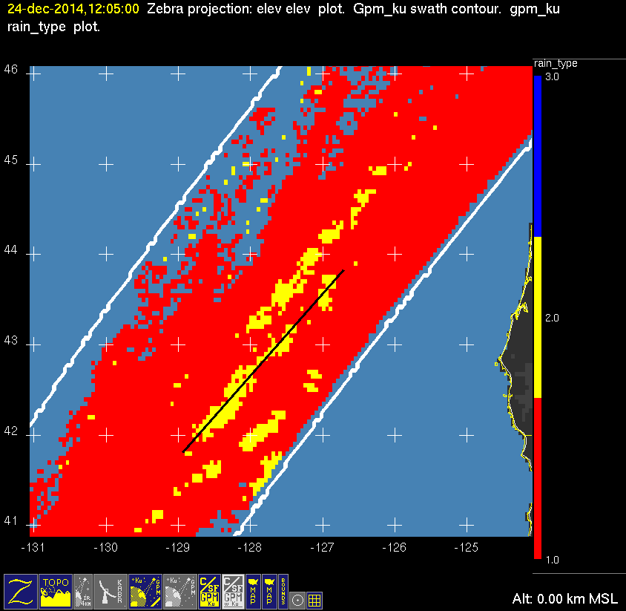

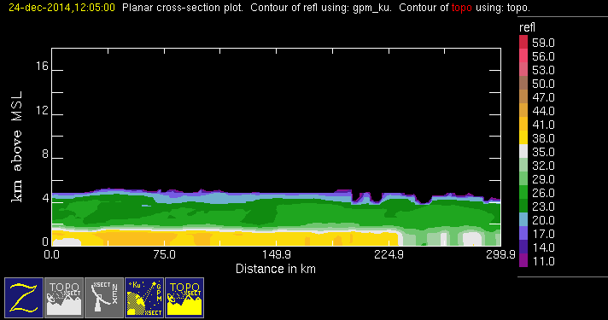
20141224 @ 120452
orig
mod
conv
stra
Failed height test

Slide 16
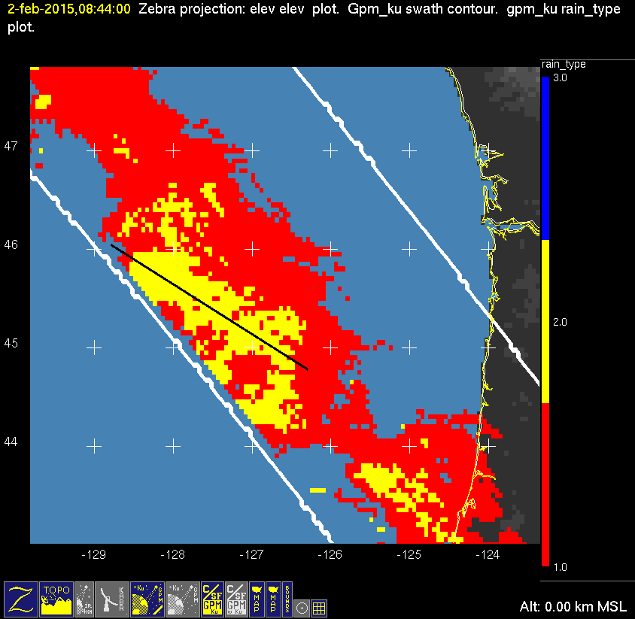
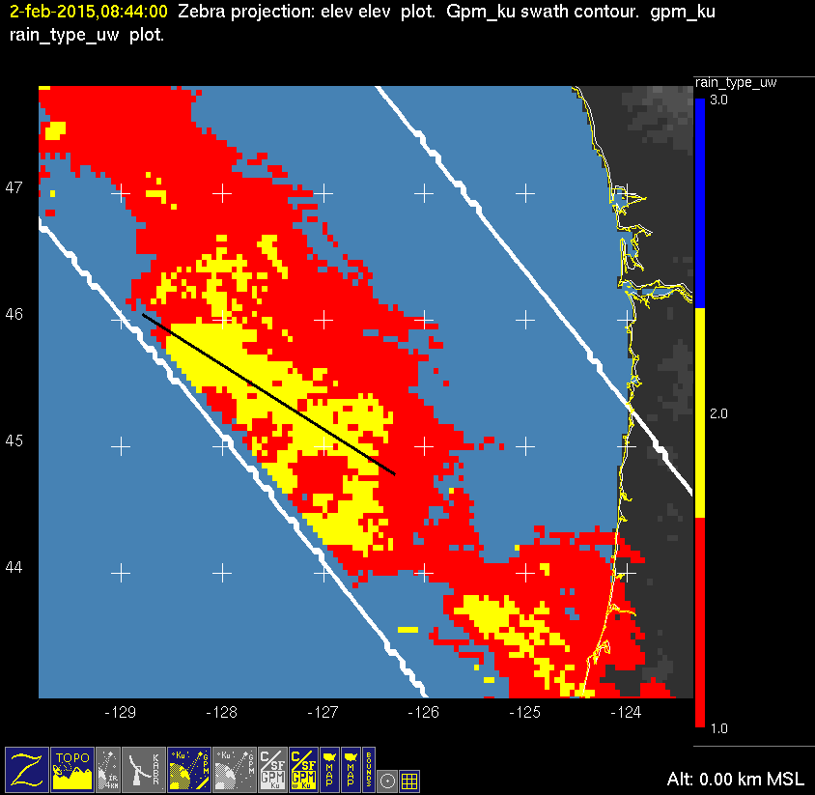
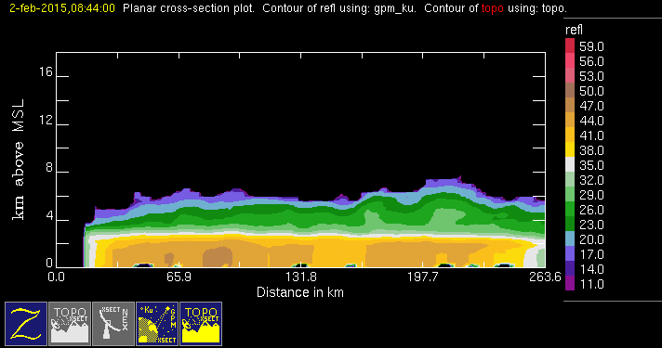
20150202 @ 084127
orig
mod
conv
stra
Failed height test

Slide 17
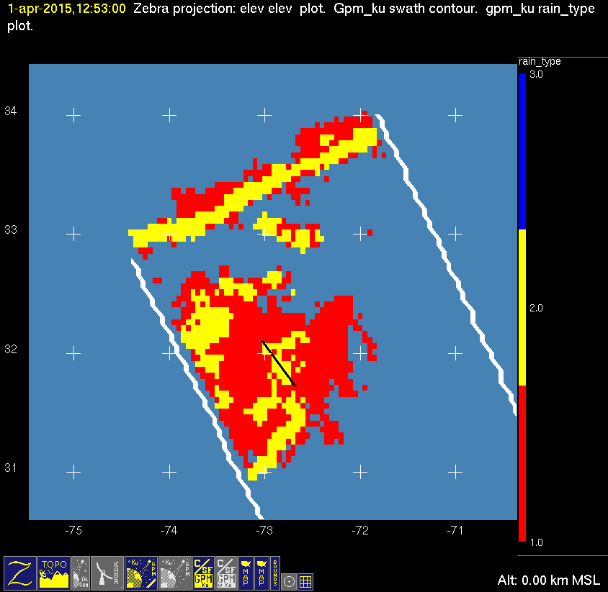
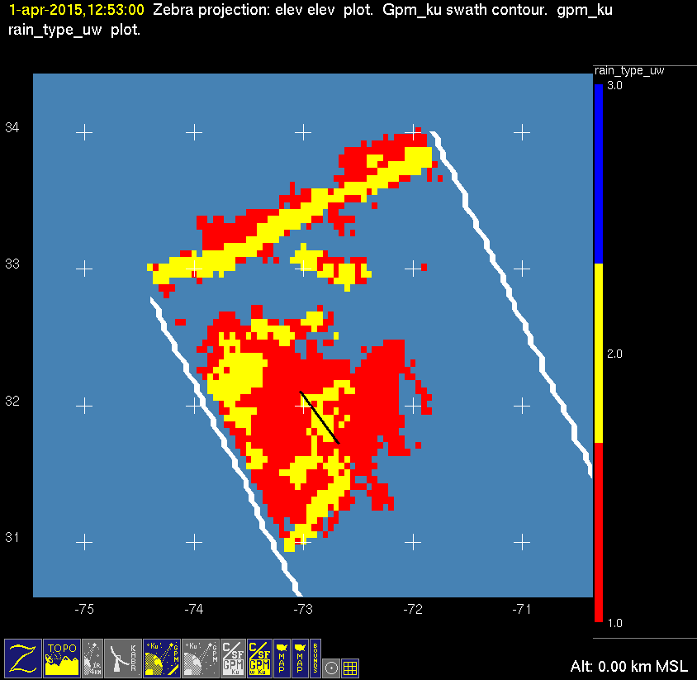
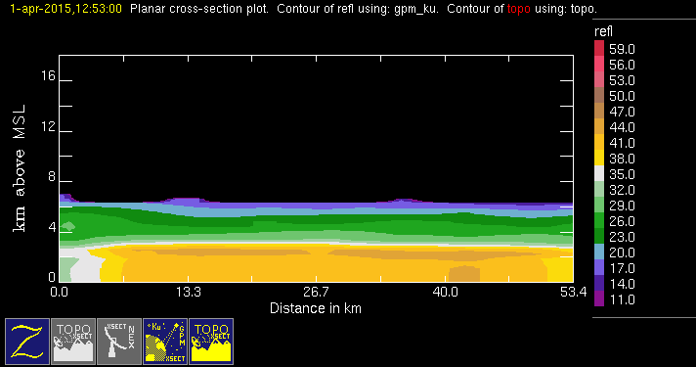
20150401 @ 125219
conv
stra
orig
mod
Failed height test?

Slide 18
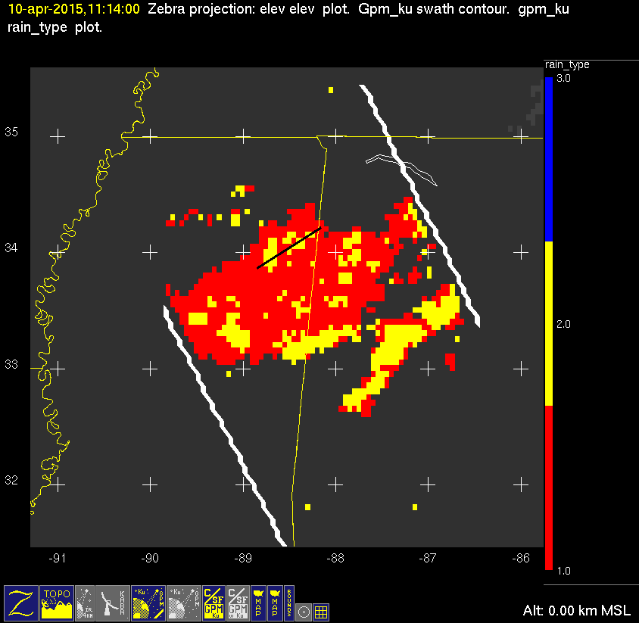
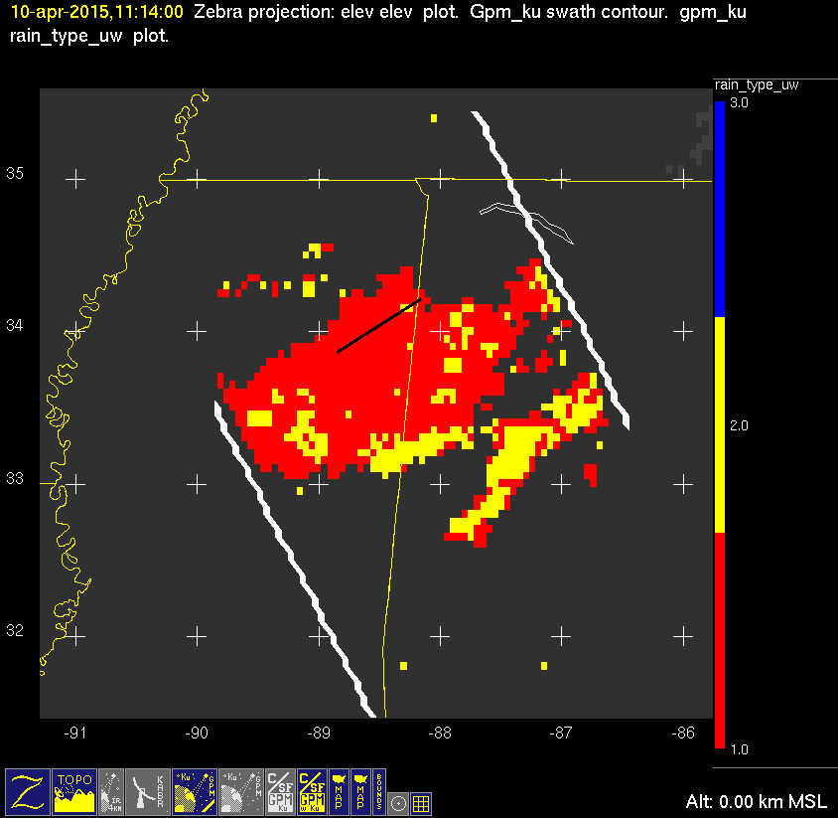
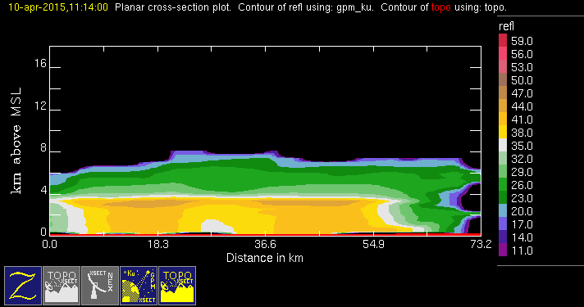
20150410 @ 111317
conv
stra
orig
mod

Slide 19
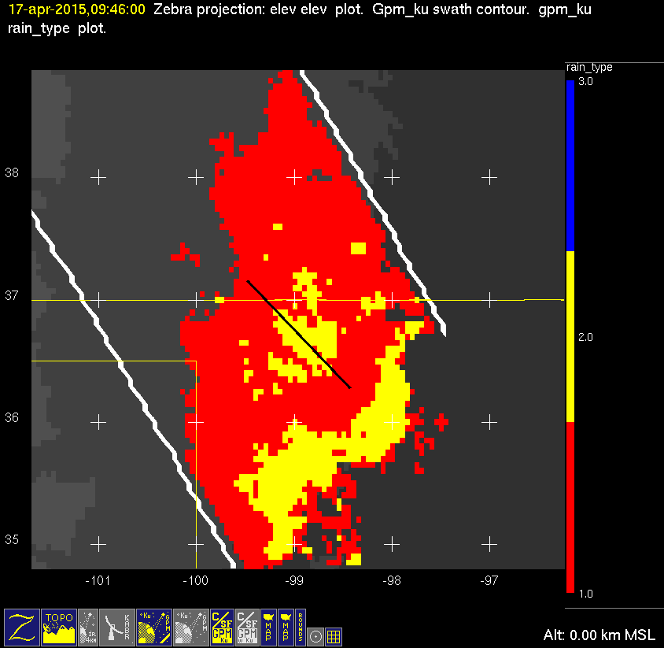

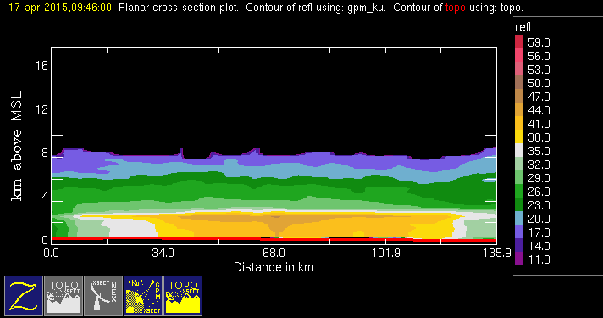
20150417 @ 094529
conv
stra
orig
mod
Failed height test

Slide 20
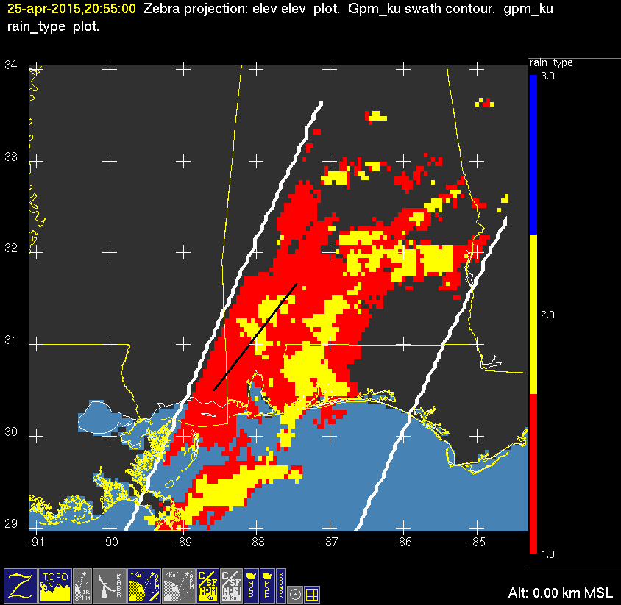


20150425 @ 205420
orig
mod
conv
stra

Slide 21



20150429 @ 053449 #1/2
orig
mod
conv
stra
Failed height test

Slide 22



20150429 @ 053449 #2/2
orig
mod
conv
stra

Slide 23



20150713 @ 071724 #1/2
orig
mod
conv
stra

Slide 24



20150713 @ 071724 #2/2
conv
stra
orig
mod

Slide 25



20150728 @ 034222 #1/2
orig
mod
conv
stra

Slide 26



20150728 @ 034222 #2/2
orig
mod
conv
stra

Slide 27



20160103 @ 071812
orig
mod
conv
stra
Failed height test

