Slide 1
UW MODIFICATION #1 TO 2AKu rain_type FIELD
If the following three criteria are met for a grid point, the rain_type is changed to STRATIFORM:
The original classification is CONVECTIVE
The maximum reflectivity in the column is greater than 40dBZ
The height at which that maximum reflectivity occurs is between 3 and 5 km

Slide 2
UW MODIFICATION #2 TO 2AKu rain_type FIELD
If the following four criteria are met for a grid point, the rain_type is changed to STRATIFORM:
The original classification is CONVECTIVE
The maximum reflectivity in the column is greater than 38dBZ
The max reflectivity in a column minus the reflectivity 1km higher is greater than or equal to 8 dBZ
The max reflectivity in a column minus the reflectivity 1km lower is less than or equal to 6 dBZ
.

Slide 3
Each of the following slides shows the original classification on the left, the UW mod #1 classification in the middle and the UW mod #2 classification on the right, as well as a cross-section of the reflectivity which represents the cut where the black line is drawn on the horizontal plots.
All cross sections are drawn from left to right.

Slide 4
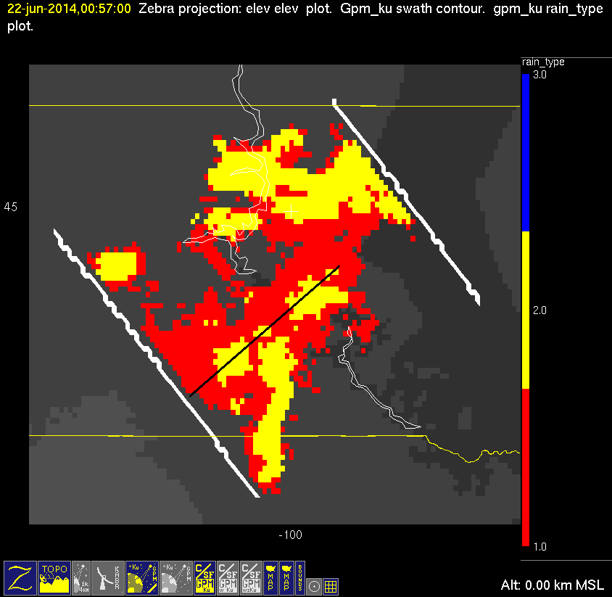
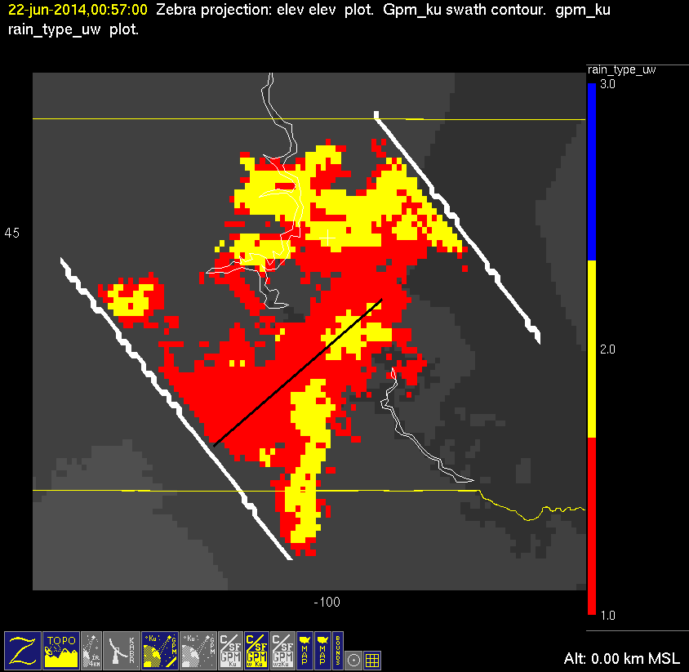
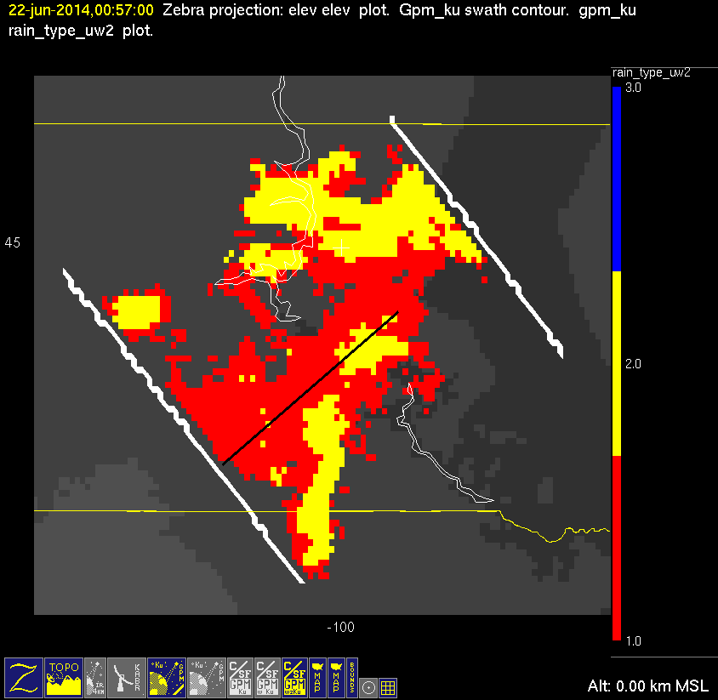
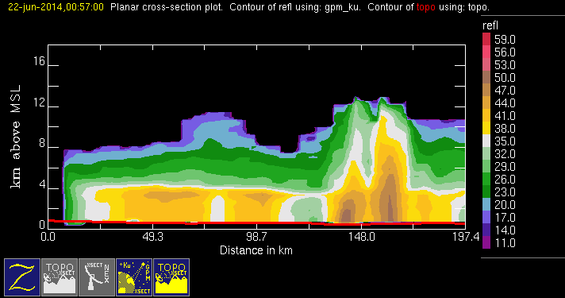
20140622 @ 005639
orig
mod1
mod2
conv
stra

Slide 5
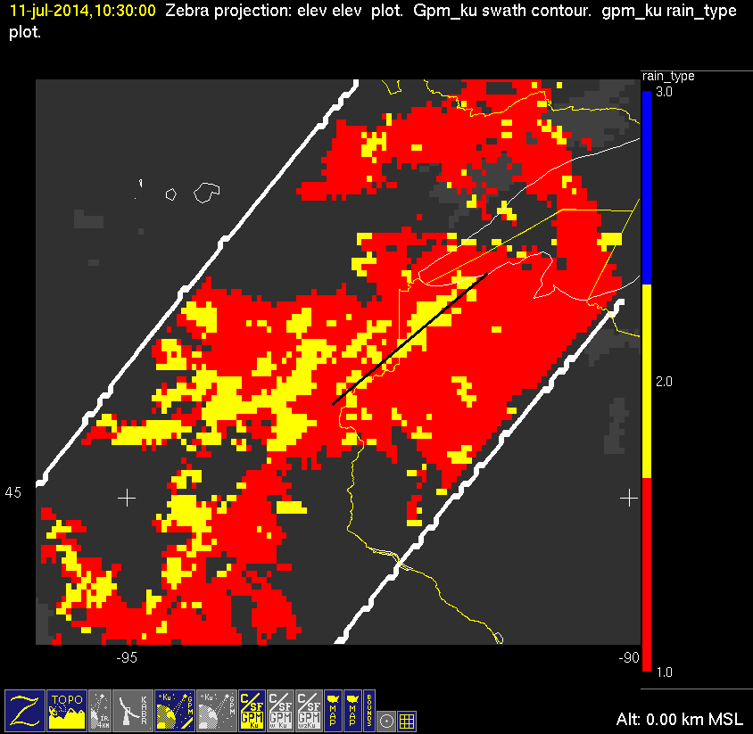
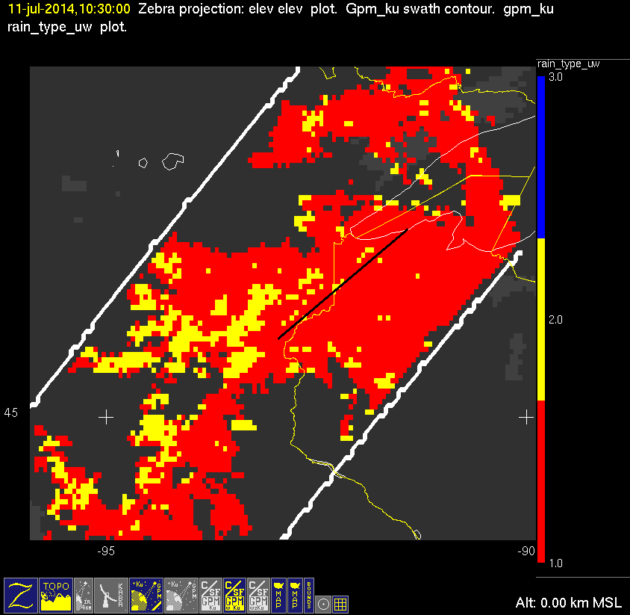
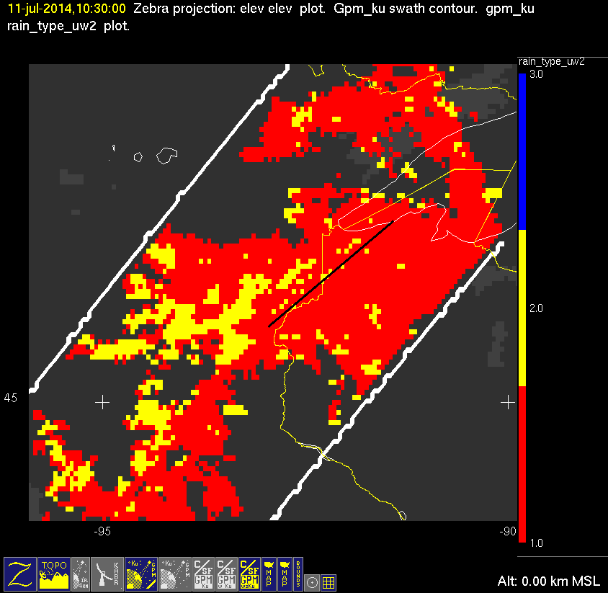
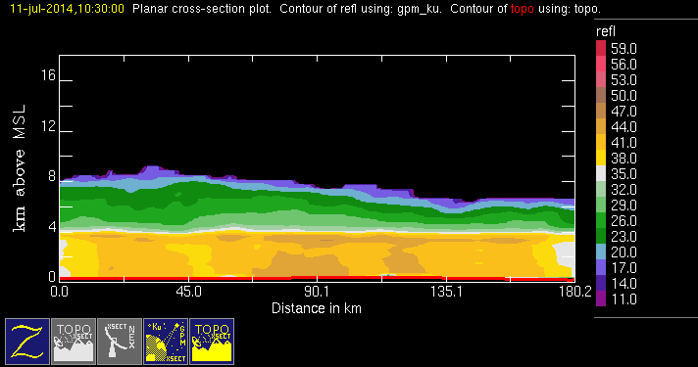
20140711 @ 102925
conv
stra
orig
mod1
mod2

Slide 6
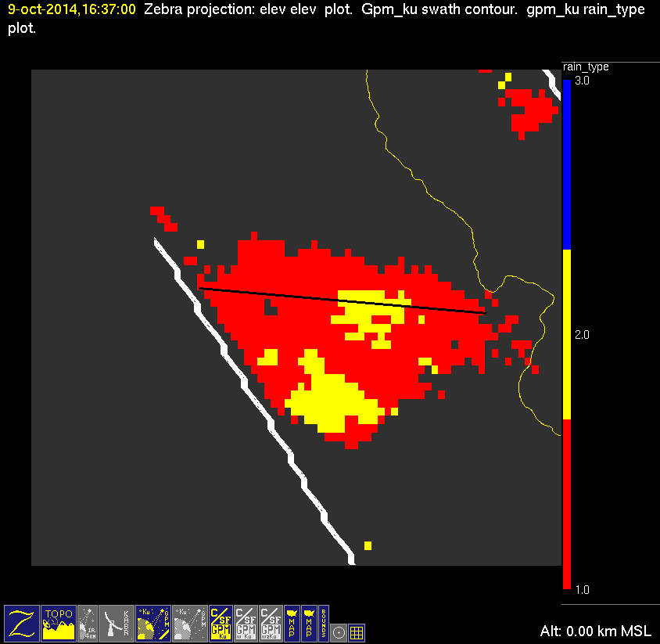
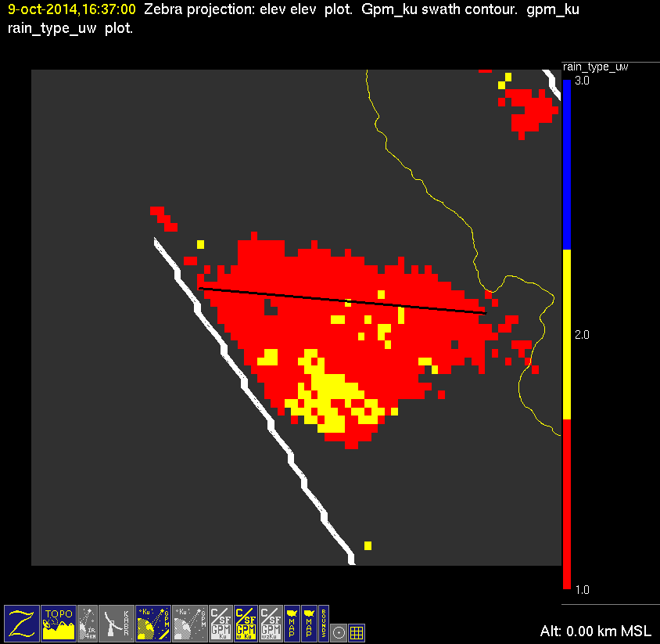
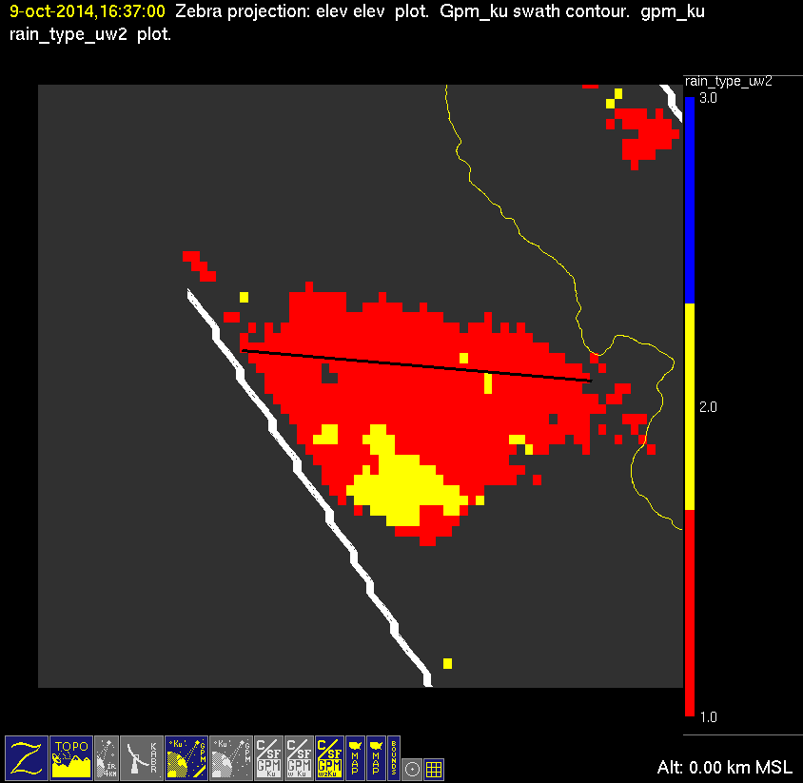
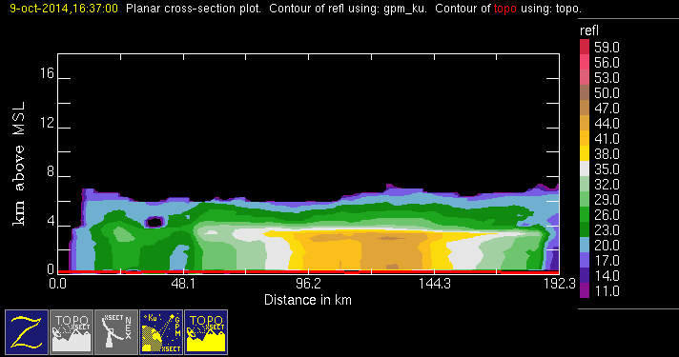
20141009 @ 163649
orig
mod1
mod2
conv
stra

Slide 7
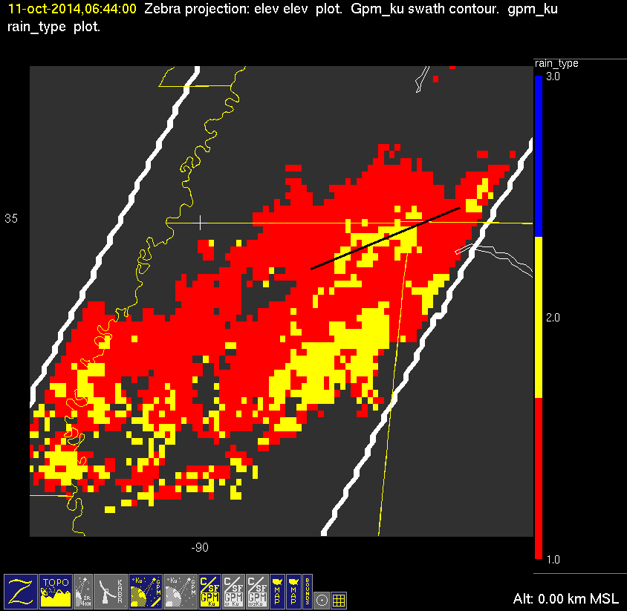
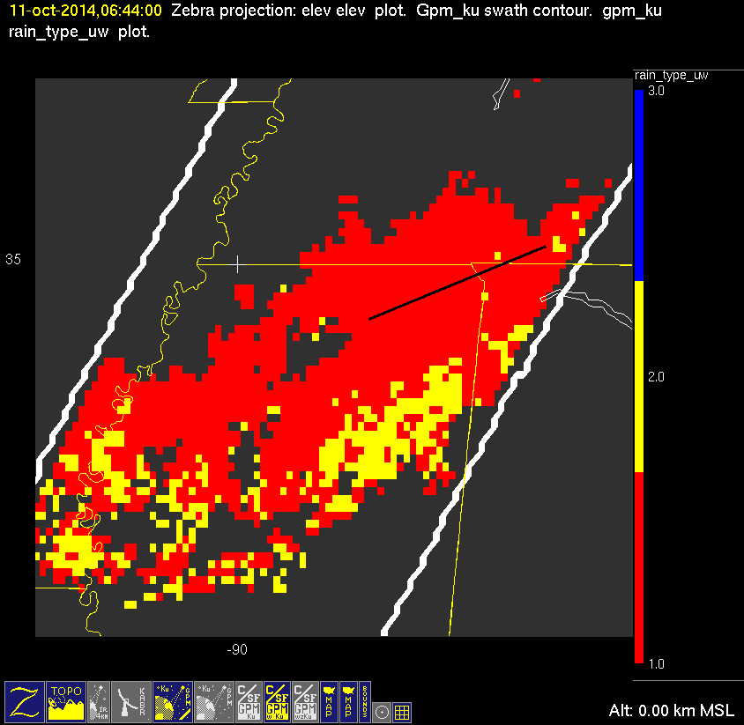
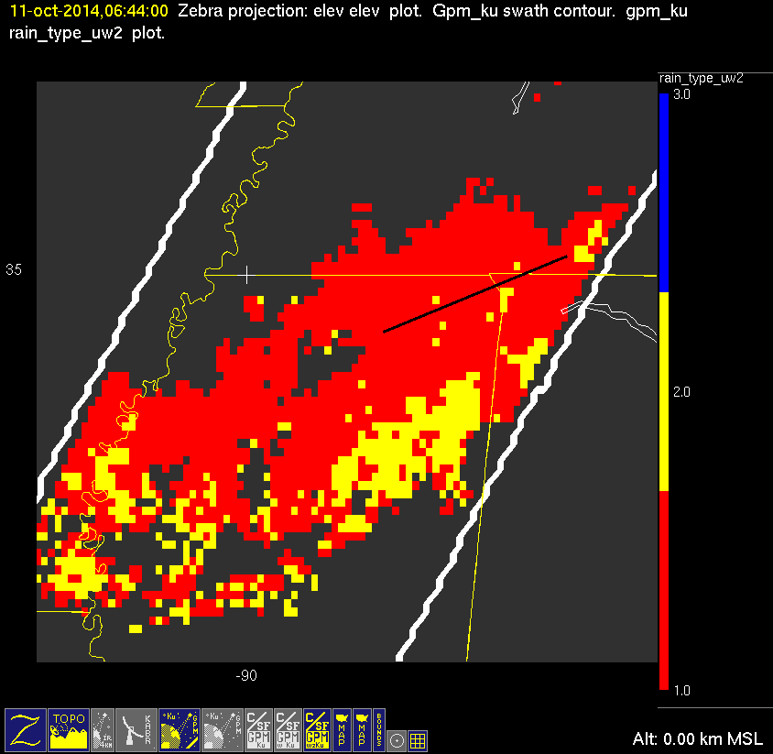
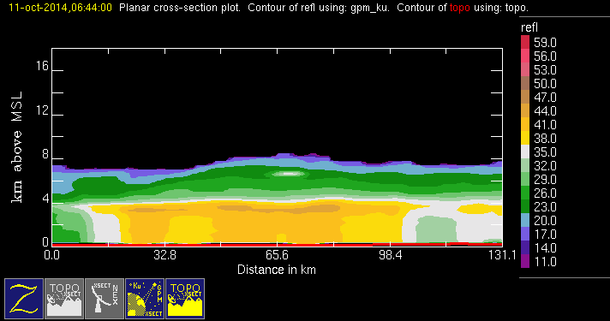
20141011 @ 064348
conv
stra
orig
mod1
mod2

Slide 8
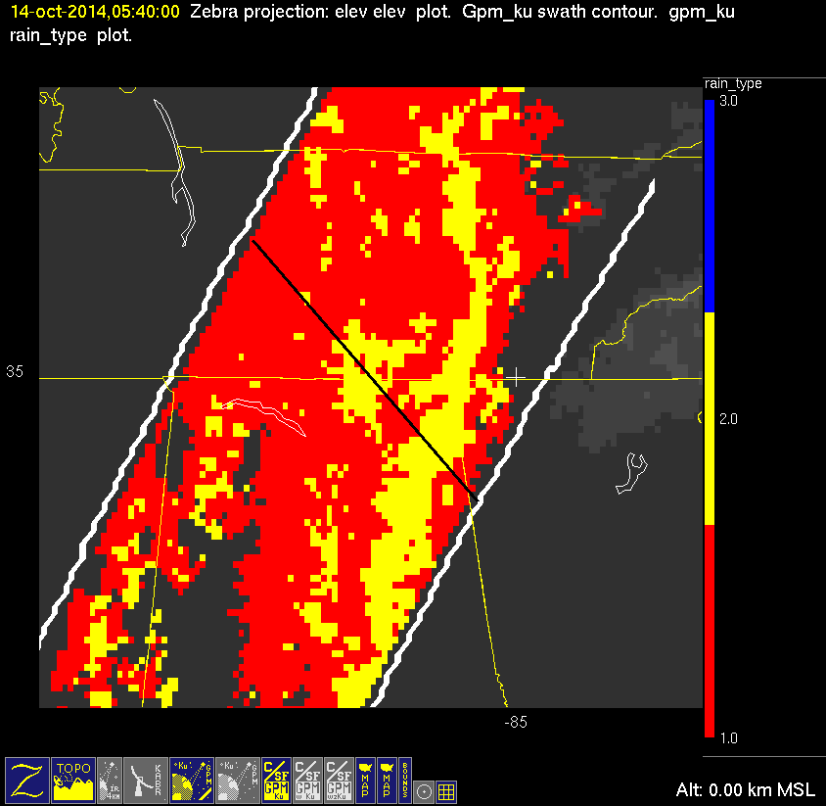
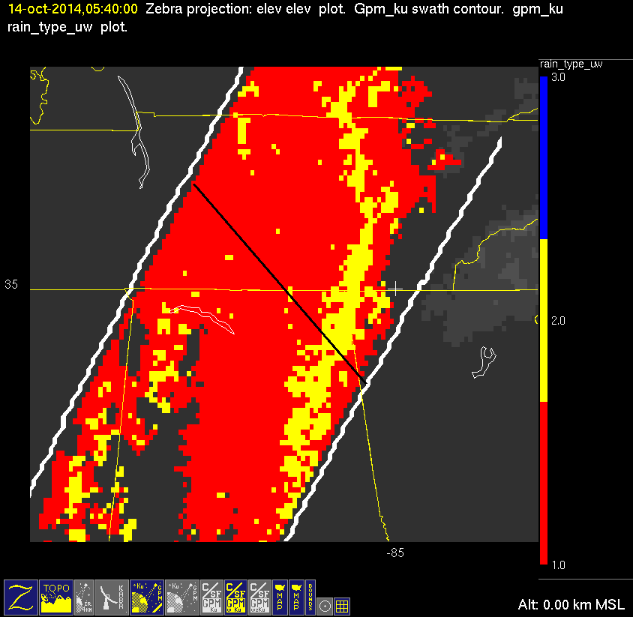
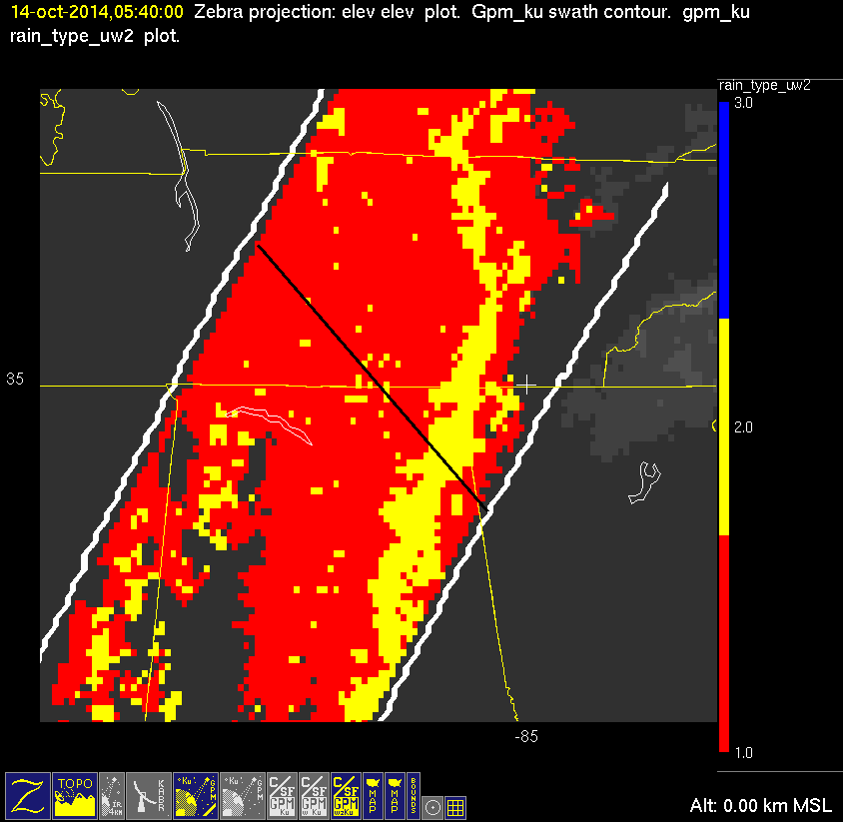
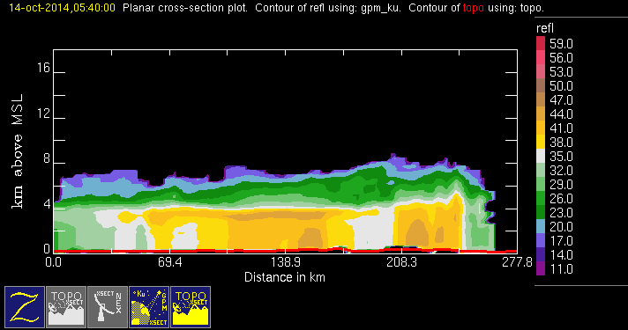
20141014 @ 053954
conv
stra
orig
mod1
mod2

Slide 9
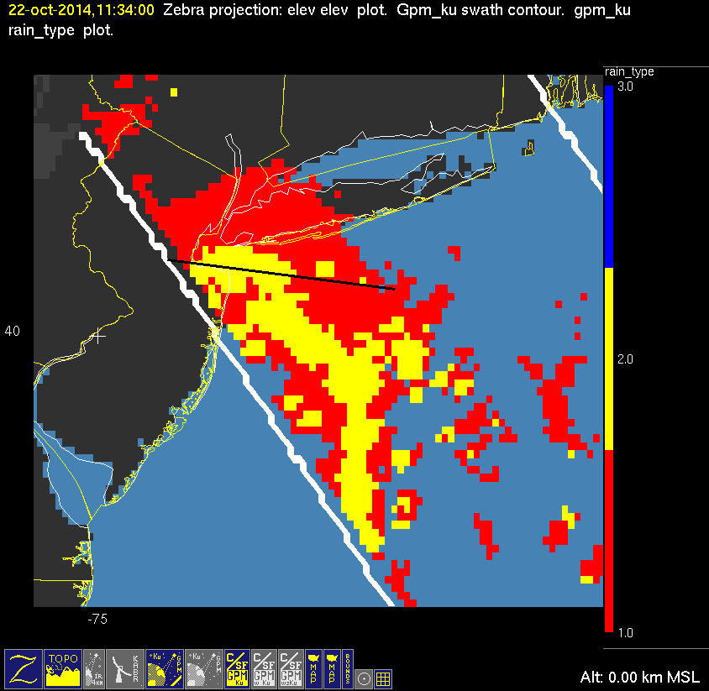


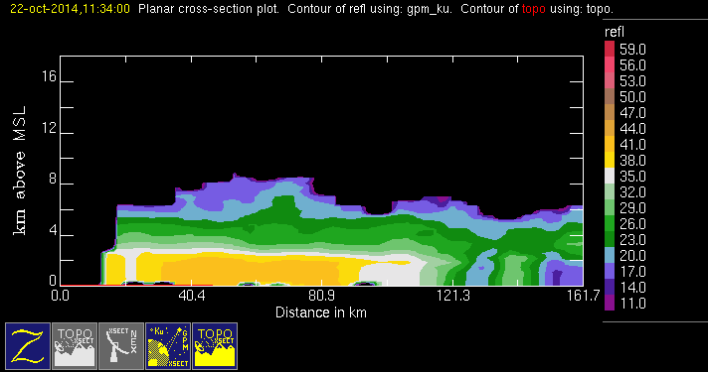
20141022 @ 113356
orig
mod1
mod2
conv
stra
This case fails both height and slope tests. Cross section shows nearly constant reflectivities from ground to 2km.

Slide 10
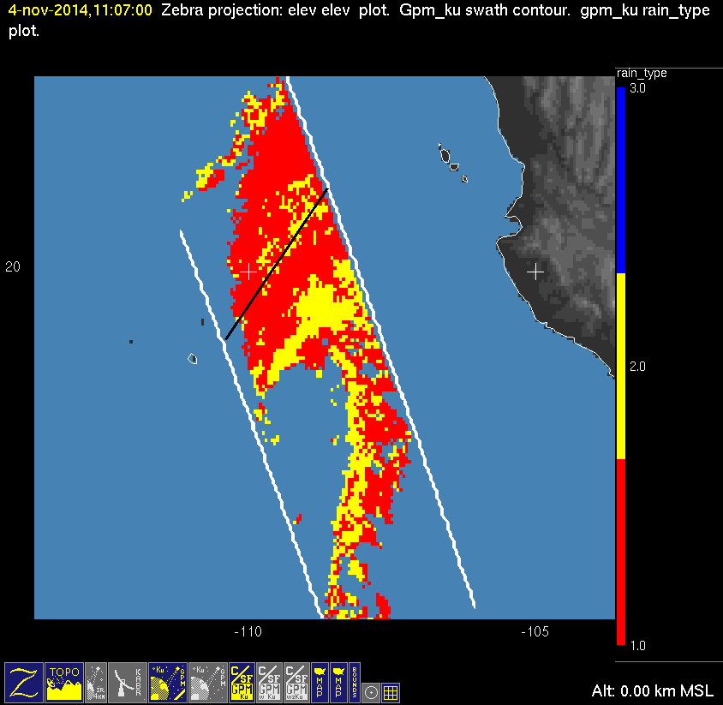

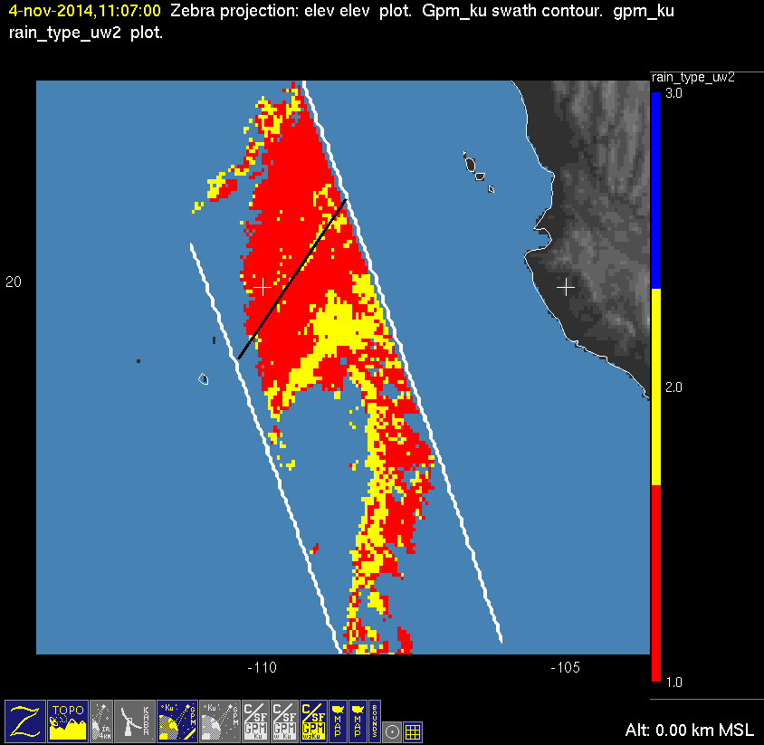
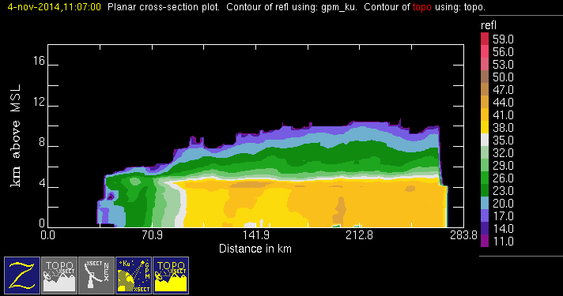
20141104 @ 110624 #1/2
orig
mod1
mod2
conv
stra

Slide 11
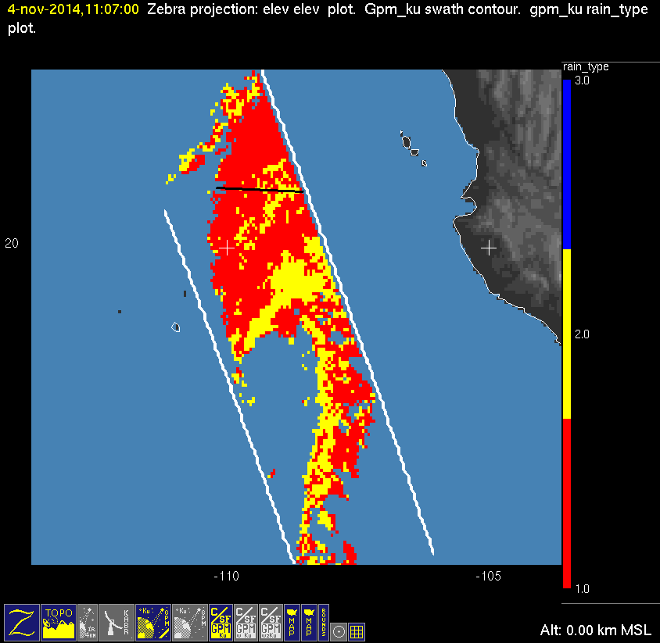


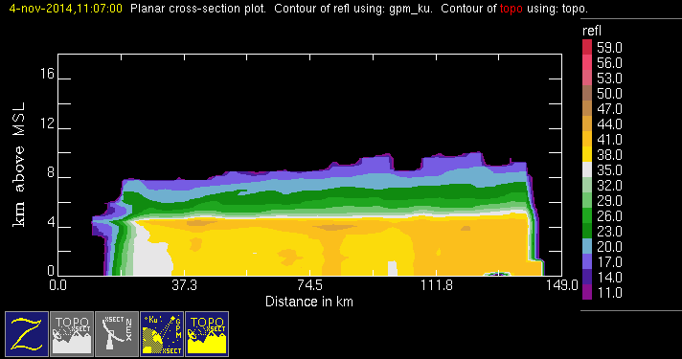
20141104 @ 110624 #2/2
orig
mod1
mod2
conv
stra

Slide 12
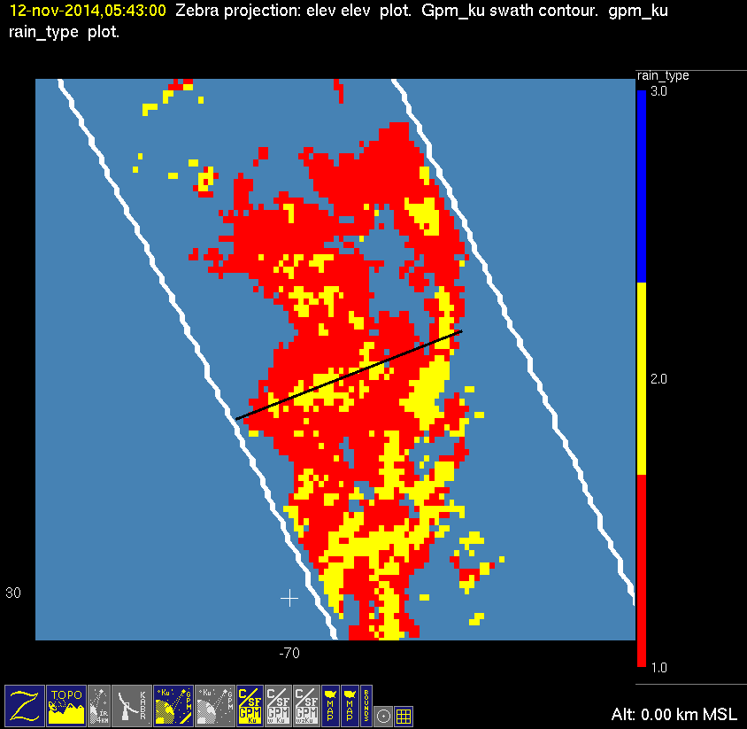
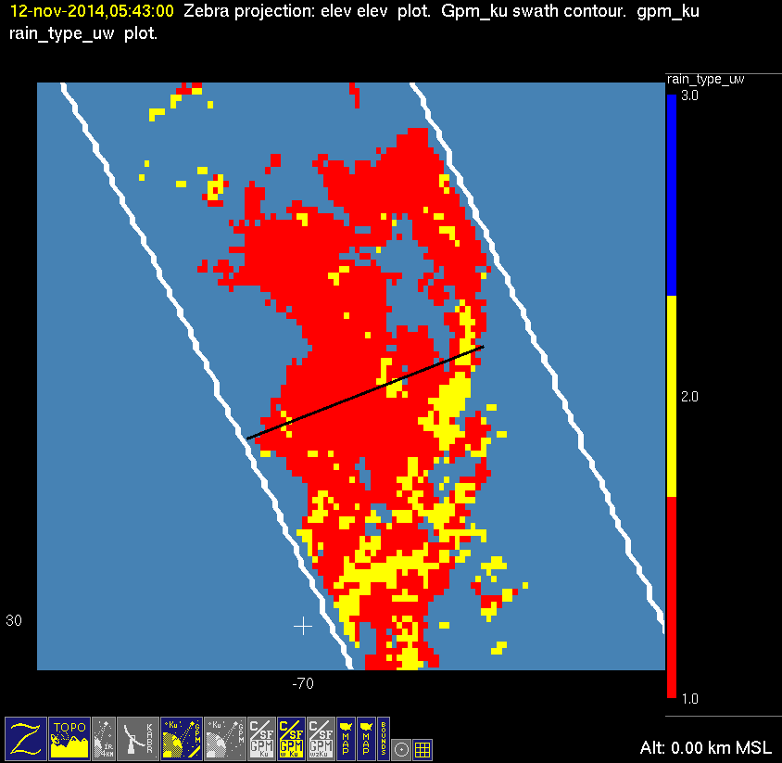
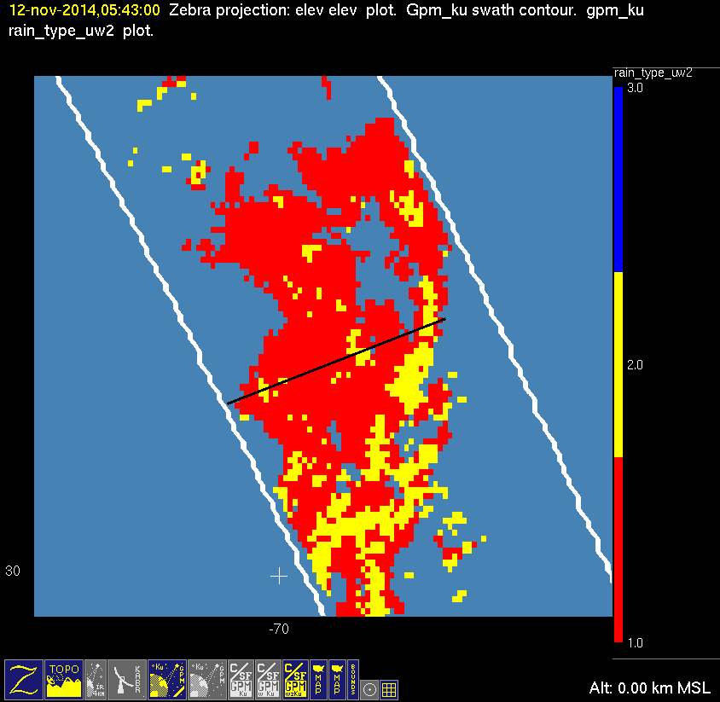
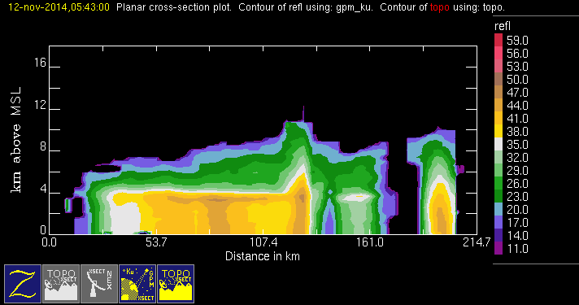
20141112 @ 054200 #1/2
orig
mod1
mod2
conv
stra

Slide 13



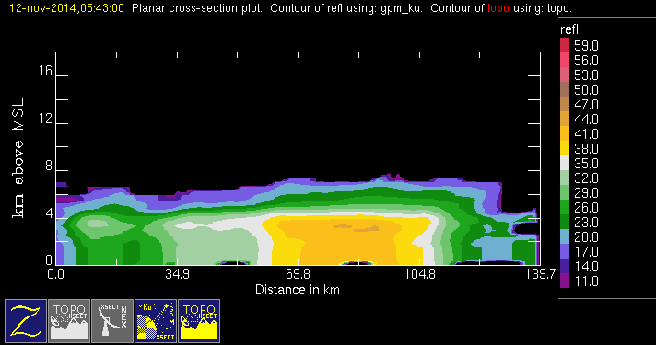
20141112 @ 054200 #2/2
orig
mod1
mod2
conv
stra
This case fails the slope test. Cross section shows nearly constant reflectivities from ground to 4km.

Slide 14
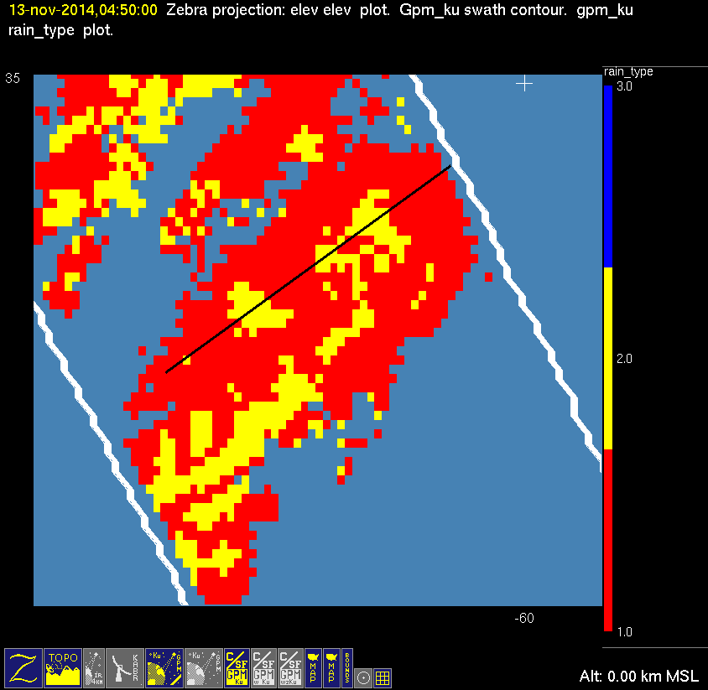
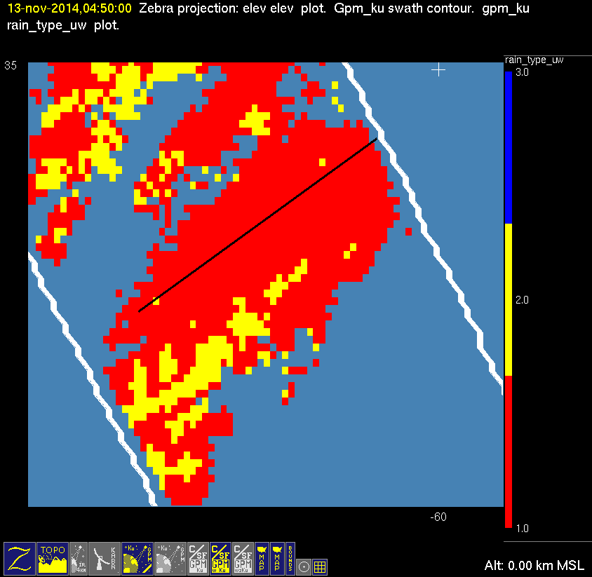
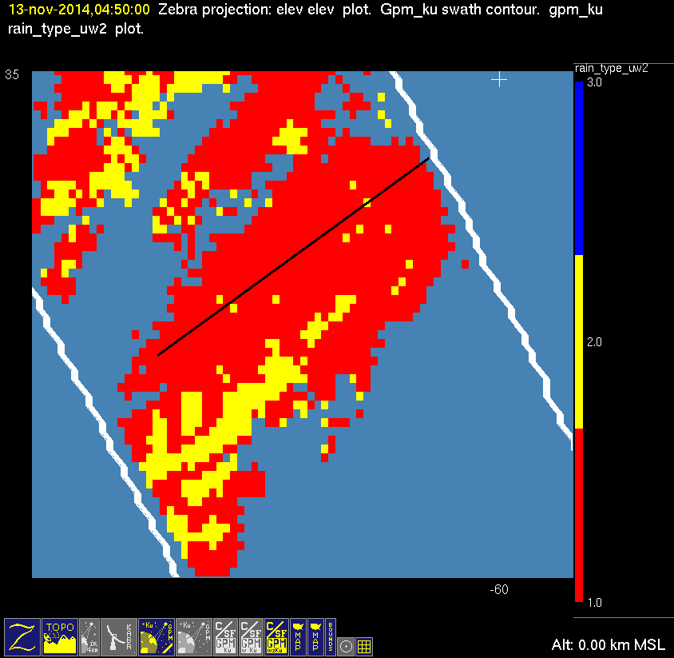
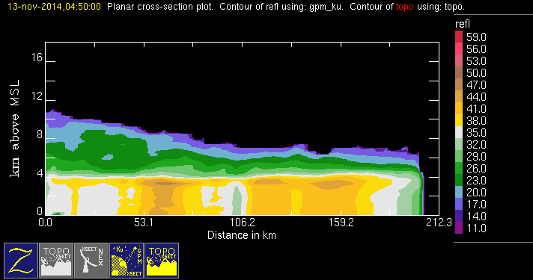
20141113 @ 044926
orig
mod1
mod2
conv
stra

Slide 15
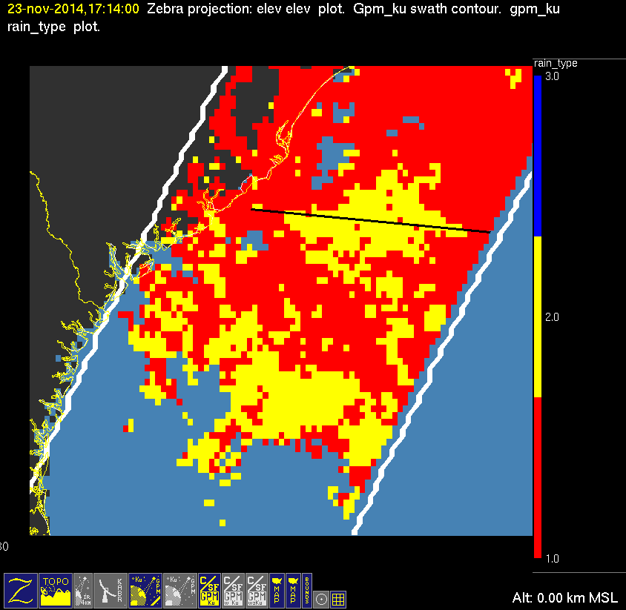
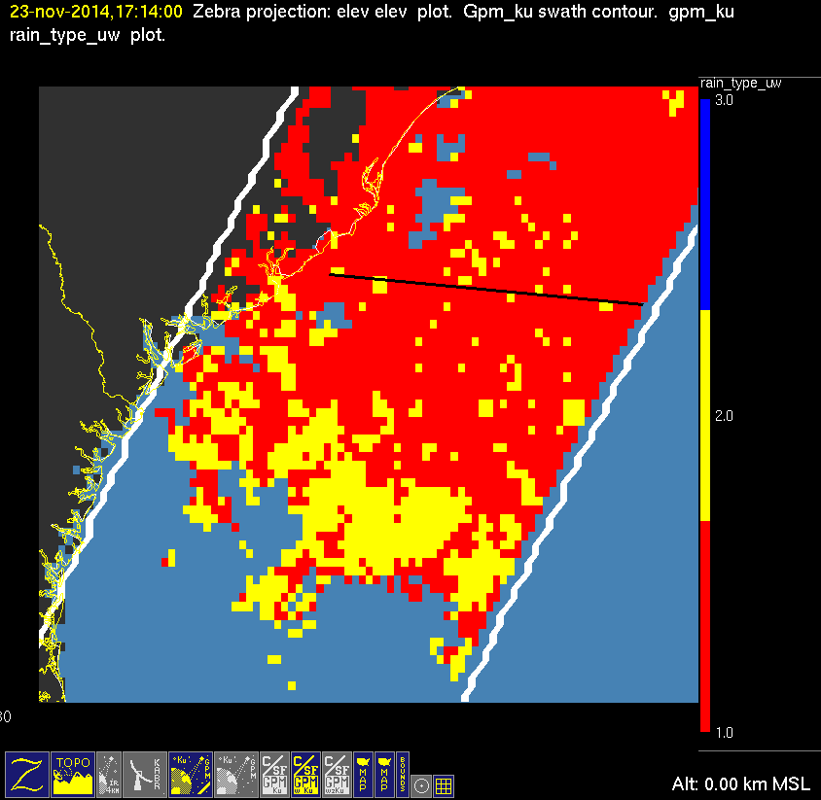
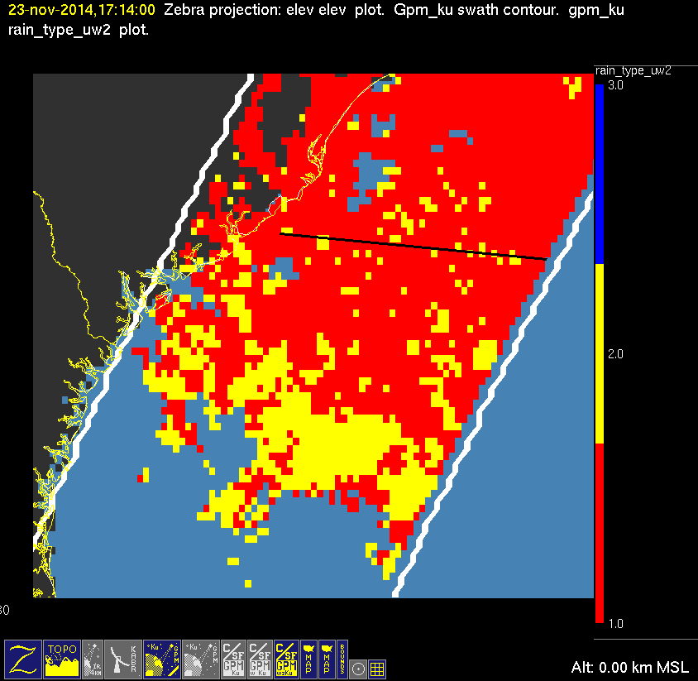
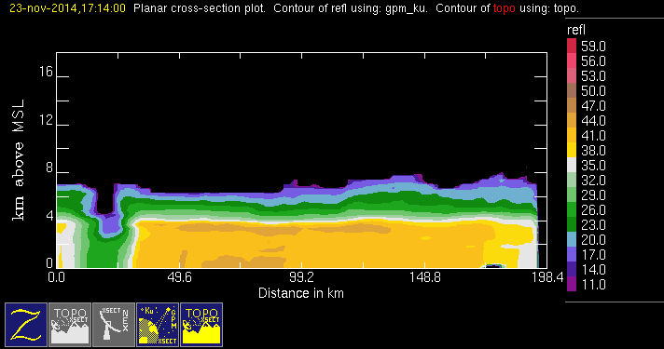
20141123 @ 171347
conv
stra
orig
mod1
mod2

Slide 16
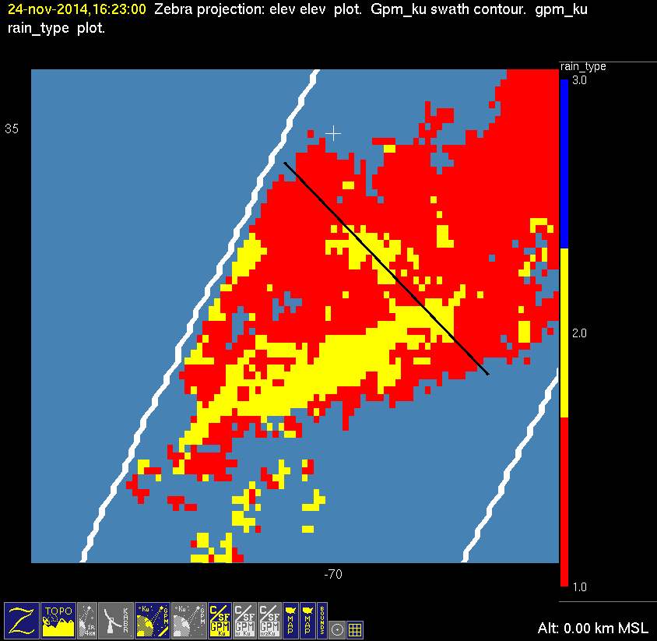
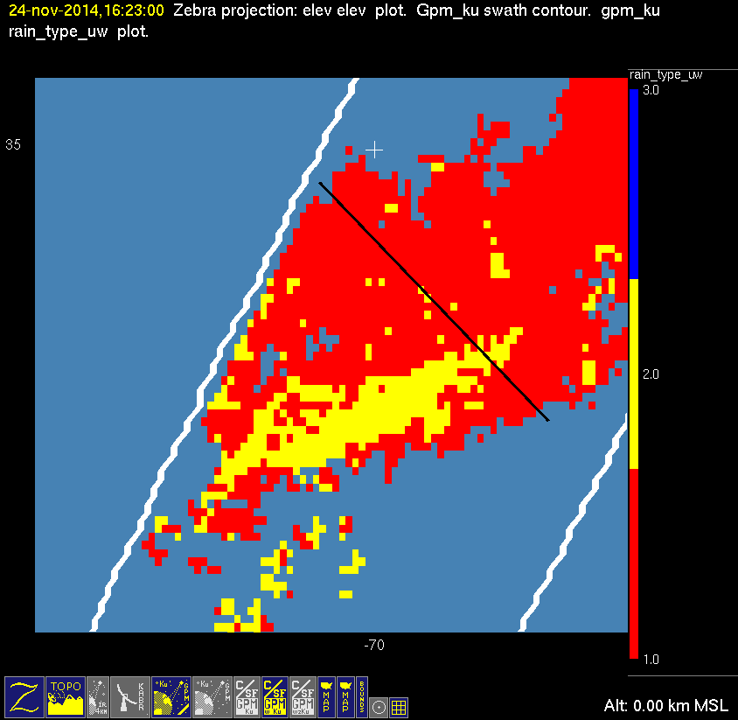

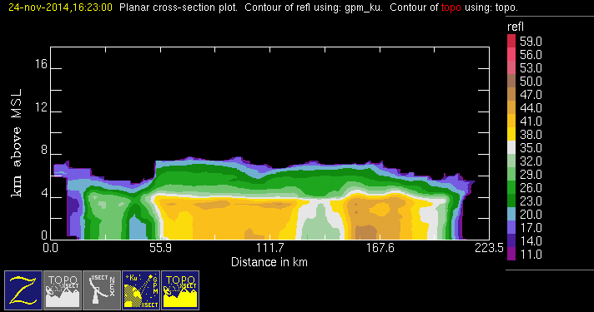
20141124 @ 162249
conv
stra
orig
mod1
mod2

Slide 17
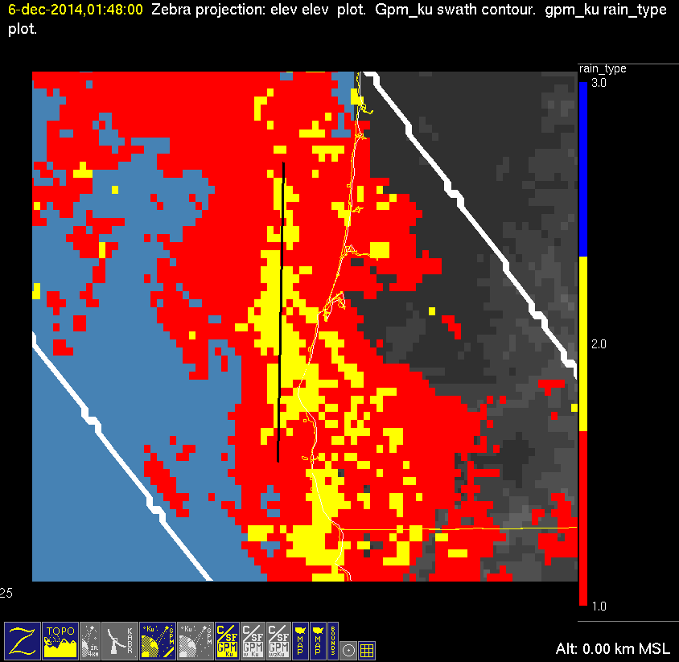

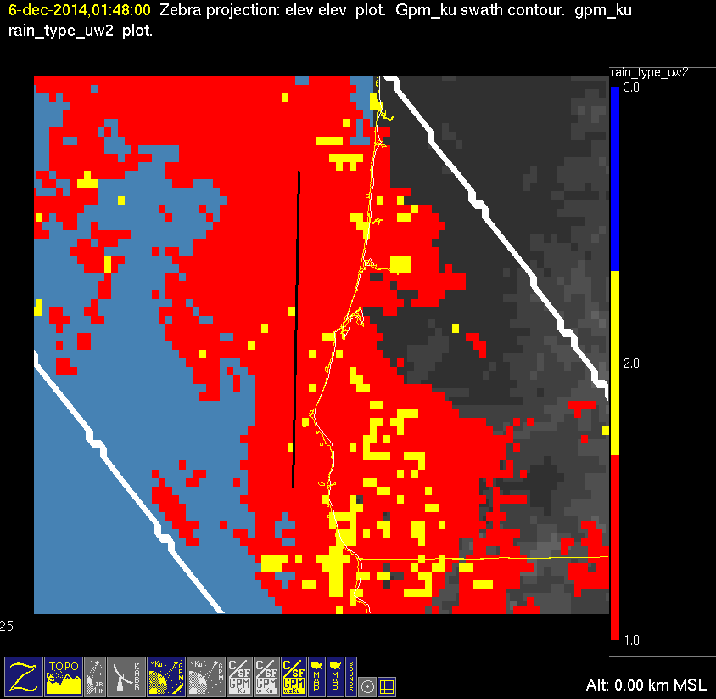
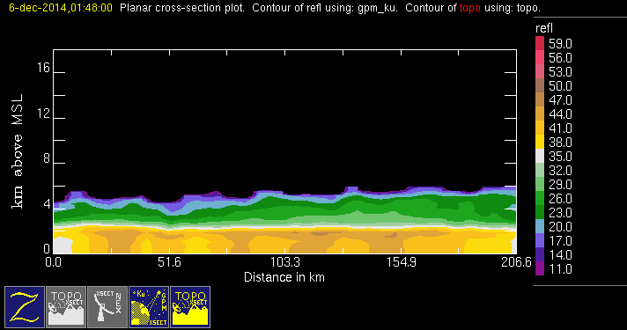
20141206 @ 014736
orig
mod1
mod2
conv
stra
This case fails the height test but passes the slope test. Cross section shows max reflectivities at very low altitudes.

Slide 18
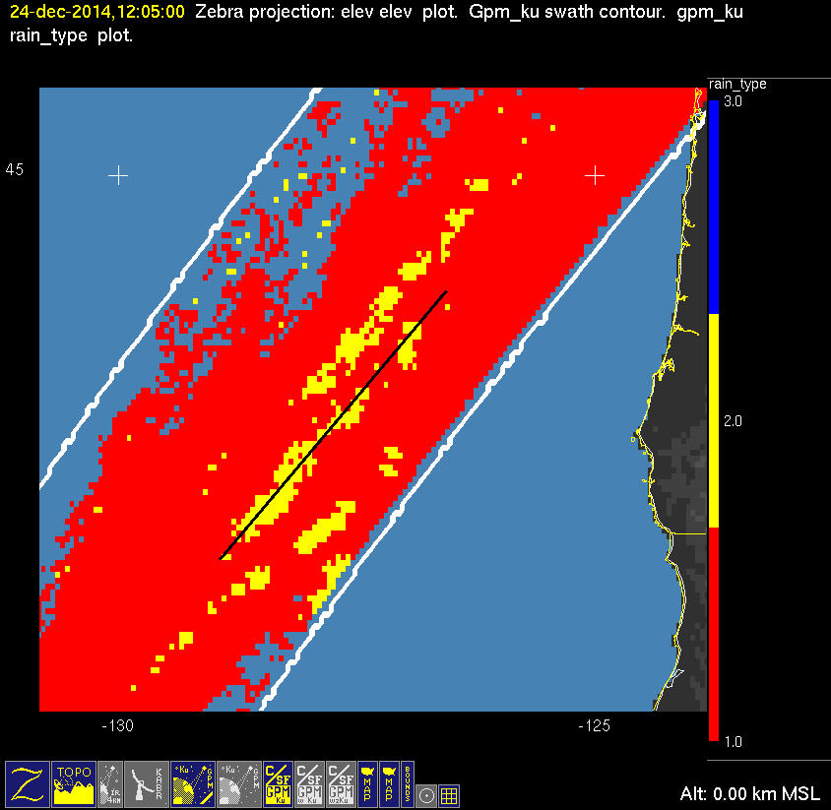
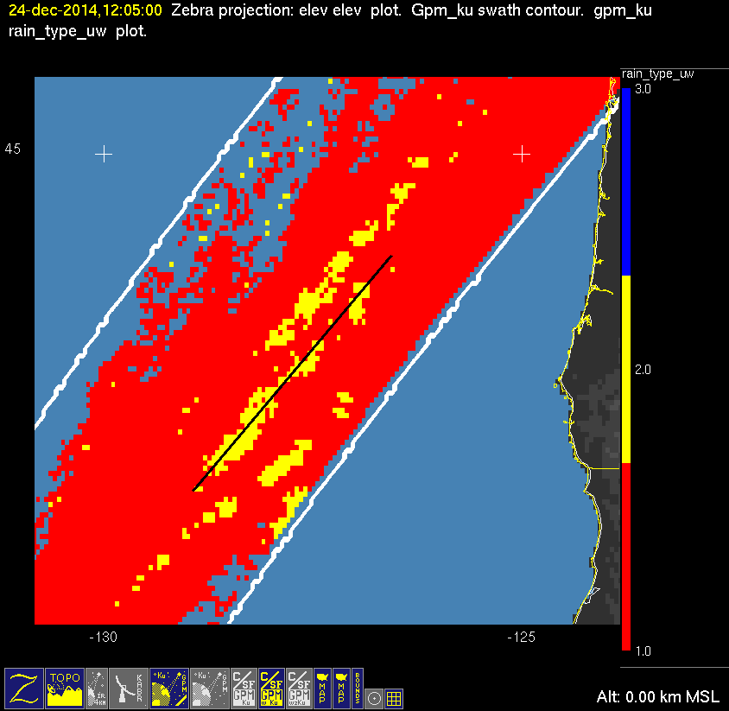
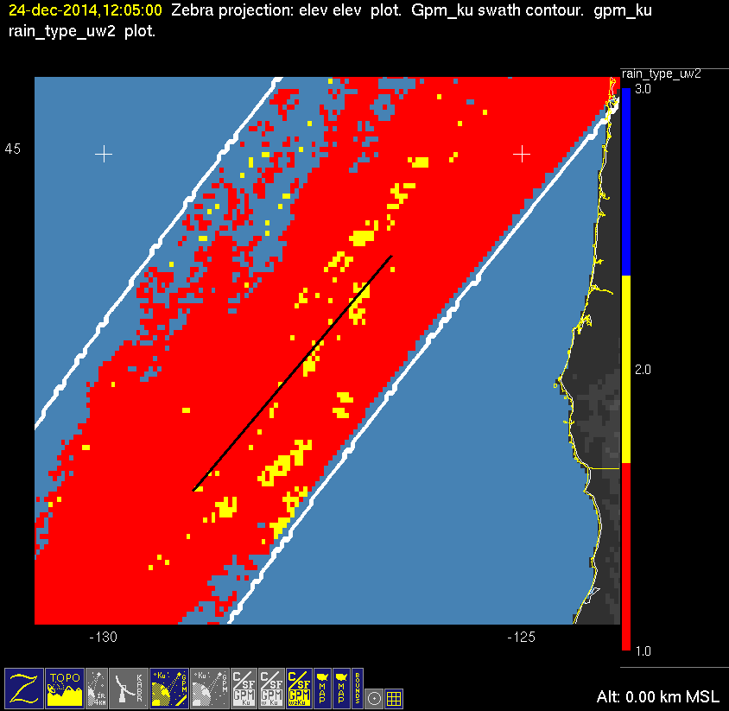
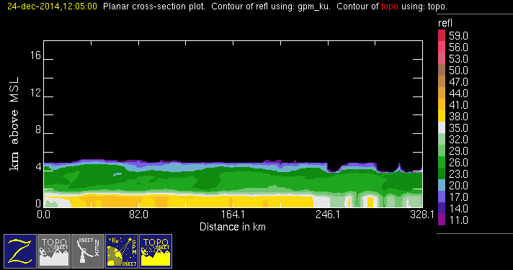
20141224 @ 120452
conv
stra
orig
mod1
mod2
This case fails the height test but passes the slope test. Cross section shows max reflectivities at very low altitudes.

Slide 19




20150202 @ 084127
orig
mod1
mod2
conv
stra
This case has a hard time with both tests. Cross section shows very low altitude and sometimes constant reflectivities from the ground to 2km.

Slide 20




20150401 @ 125219
orig
mod1
mod2
conv
stra
This case fails the height test but passes the slope test. Cross section shows max reflectivities at very low altitudes.

Slide 21




20150410 @ 111317
orig
mod1
mod2
conv
stra

Slide 22




20150417 @ 094529
orig
mod1
mod2
conv
stra
This case fails the height test but passes the slope test. Cross section shows max reflectivities at very low altitudes.

Slide 23




20150425 @ 205420
orig
mod1
mod2
conv
stra

Slide 24




20150429 @ 053449 #1/2
orig
mod1
mod2
conv
stra
BAD CASE
DISREGARD

Slide 25




20150429 @ 053449 #2/2
orig
mod1
mod2
conv
stra

Slide 26




20150713 @ 071724 #1/2
orig
mod1
mod2
conv
stra
This case fails the slope test. Cross section shows enough striation that slope test should have succeeded.

Slide 27




20150713 @ 071724 #2/2
orig
mod1
mod2
conv
stra

Slide 28




20150728 @ 034222 #1/2
orig
mod1
mod2
conv
stra

Slide 29




20150728 @ 034222 #2/2
orig
mod1
mod2
conv
stra

Slide 30




20160103 @ 071812
orig
mod1
mod2
convstra
This case fails the height test but passes the slope test. Cross section shows max reflectivities at very low altitudes.

