Slide 1
UW MODIFICATION TO 2AKu rain_type FIELD
If the following three criteria are met for a grid point, the rain_type is changed to STRATIFORM:
The original classification is CONVECTIVE
The maximum reflectivity in the column is greater than 38dBZ
The max reflectivity in a column minus the reflectivity 1.5km higher is greater than or equal to 8 dBZ
.

Slide 2
Each of the following slides shows the original classification on the left and the UW modified classification on the right, as well as a cross-section of the reflectivity which represents the cut where the black line is drawn on the horizontal plots.
All cross sections are drawn from left to right.

Slide 3
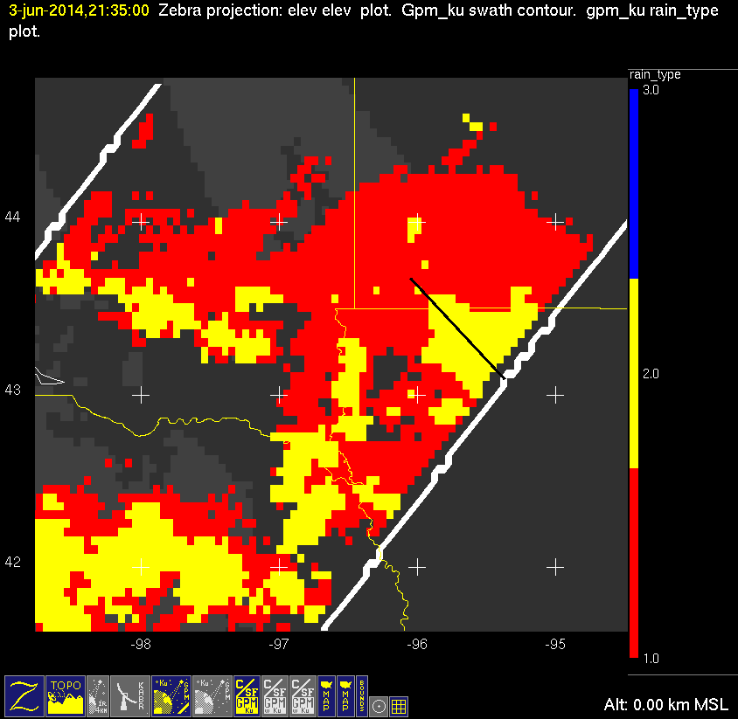
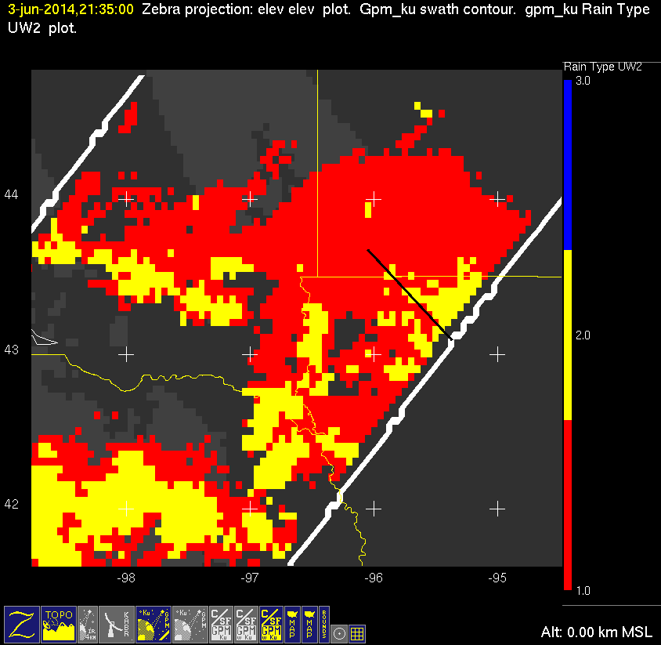
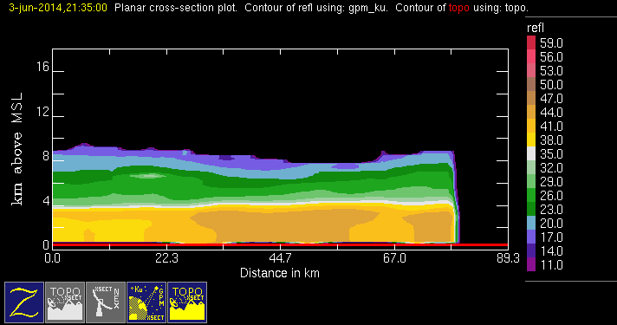
20140603 @ 2135
orig
uw
conv
stra

Slide 4
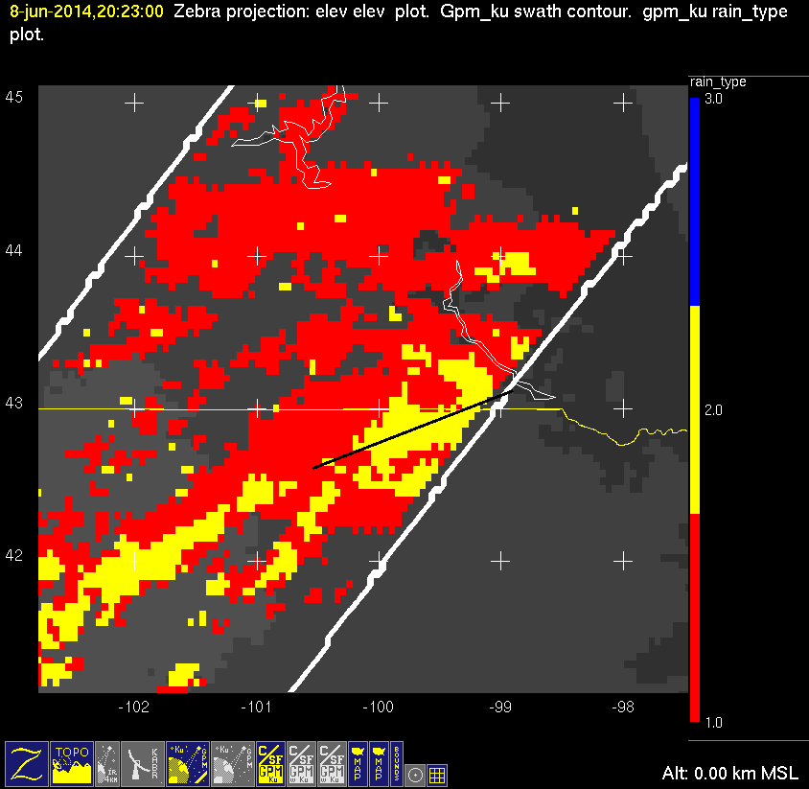
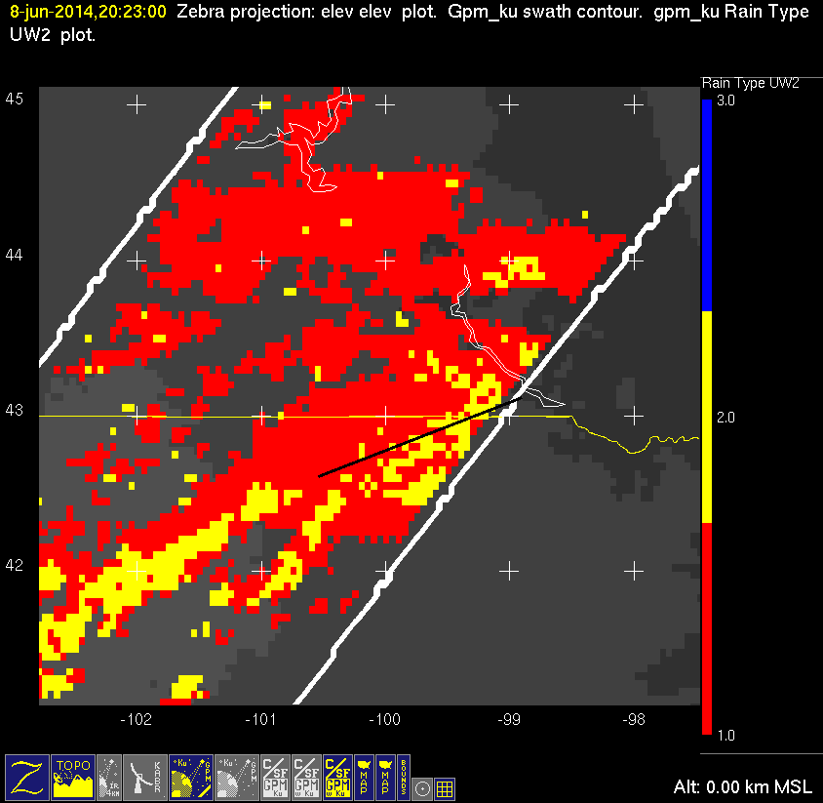
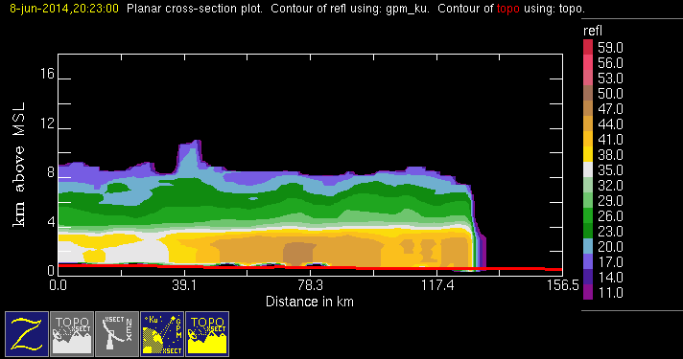
20140608 @ 2023
orig
uw
conv
stra

Slide 5
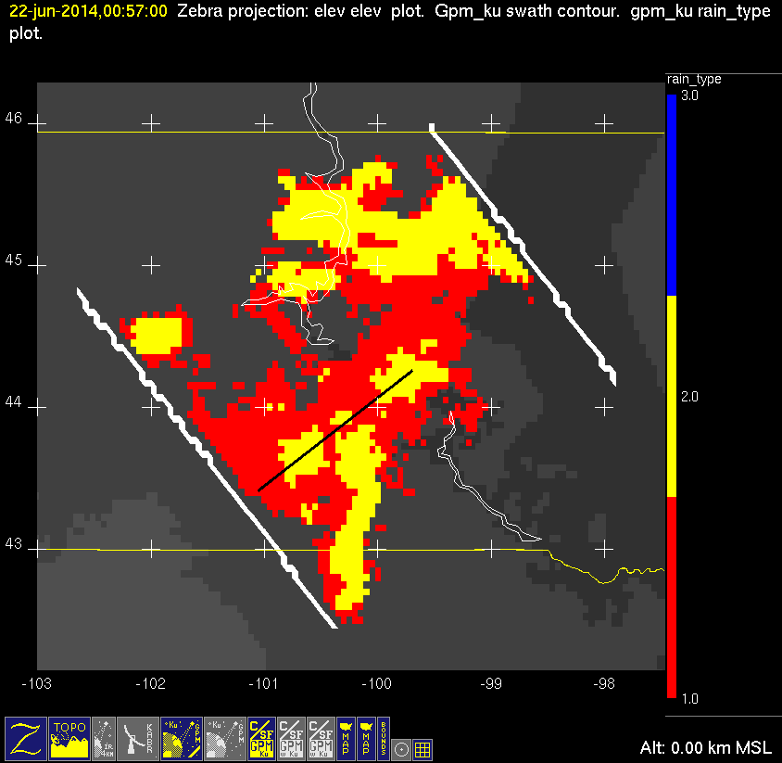
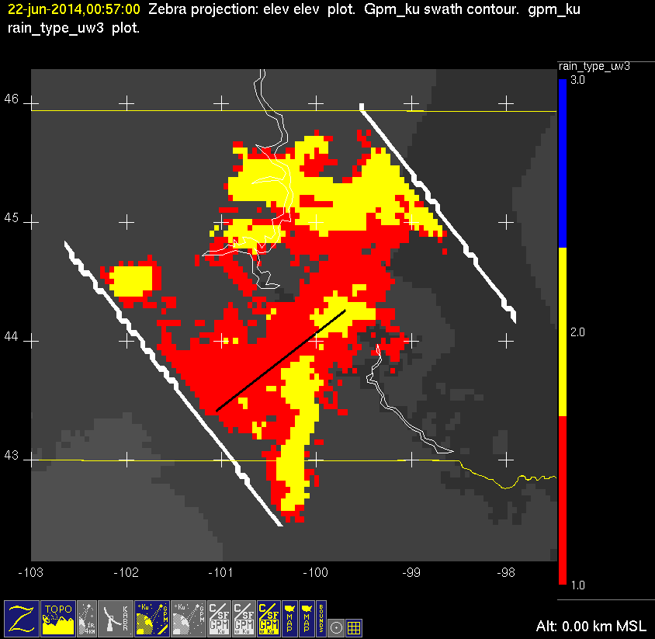
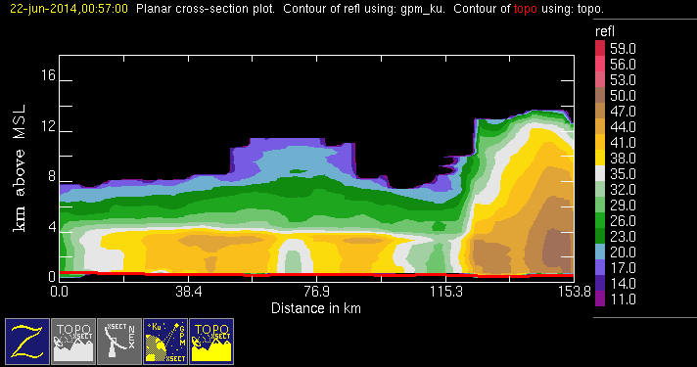
20140622 @ 005639
orig
uw
conv
stra

Slide 6
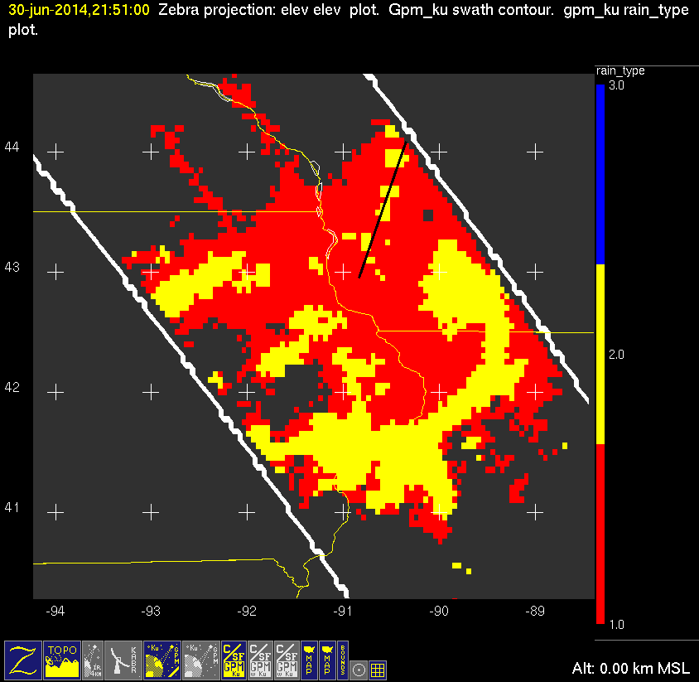
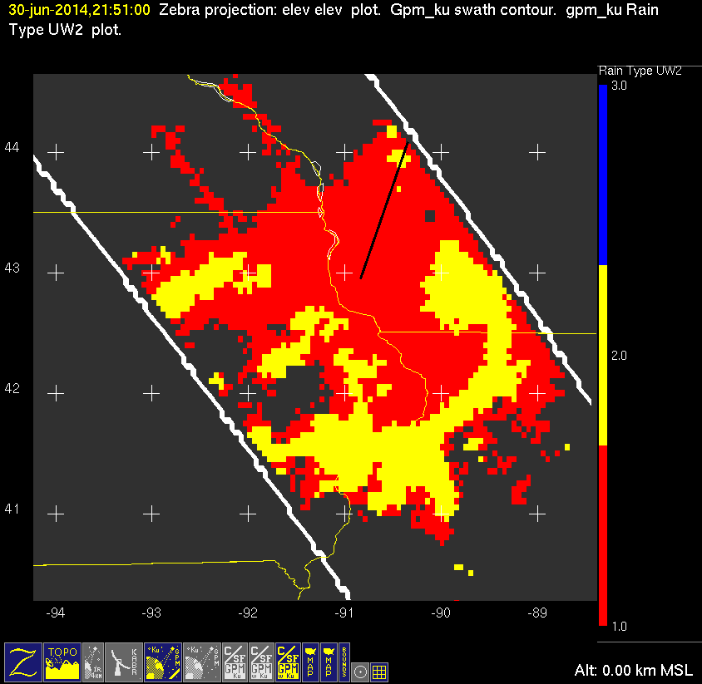
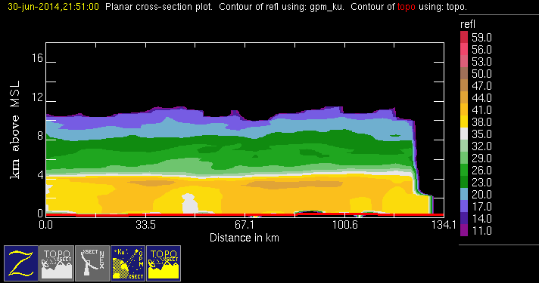
20140630 @ 2151
orig
uw
conv
stra

Slide 7
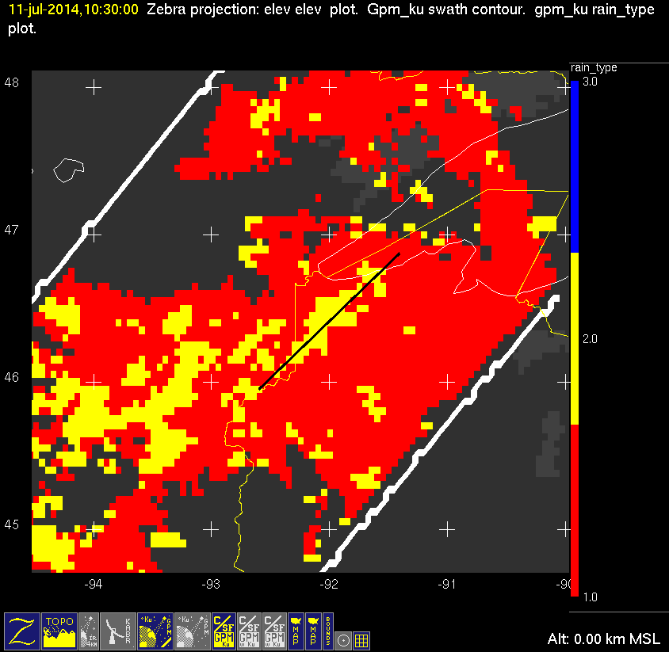
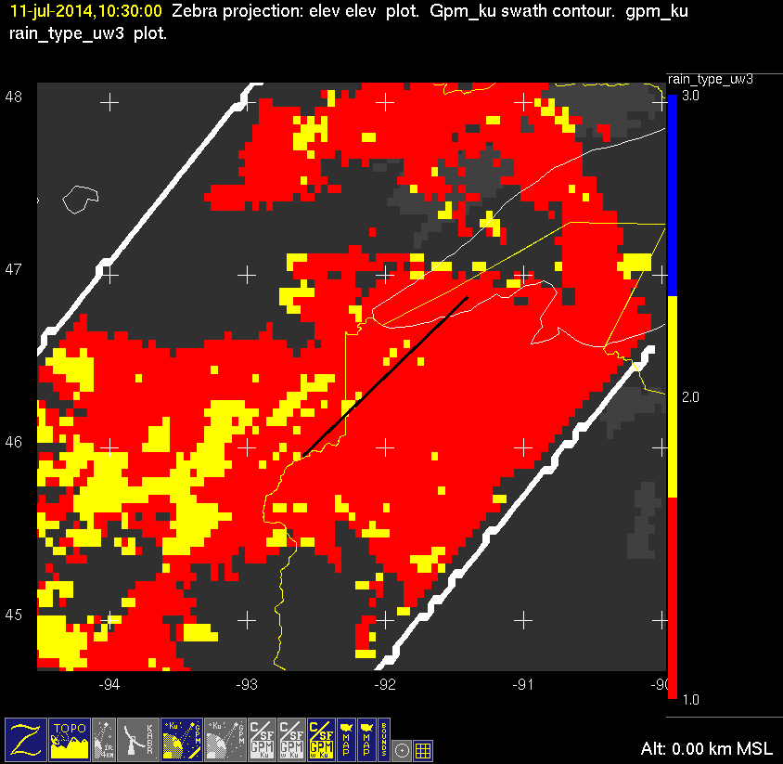
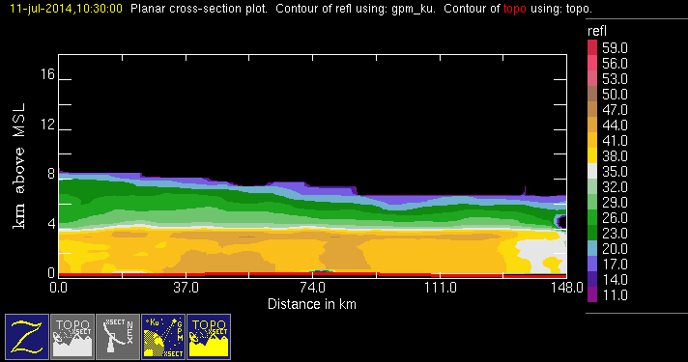
20140711 @ 1030
orig
uw
conv
stra

Slide 8
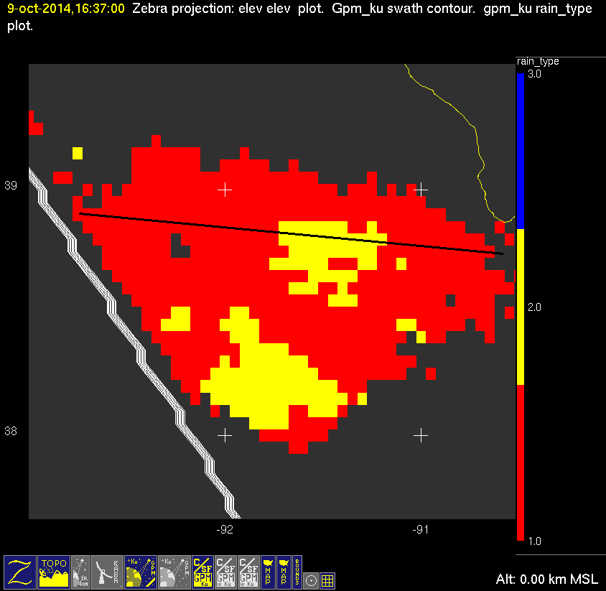
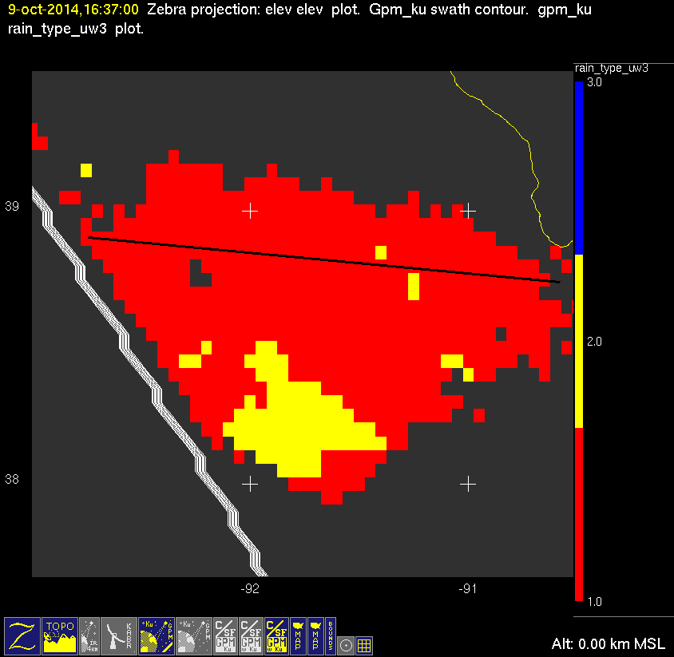
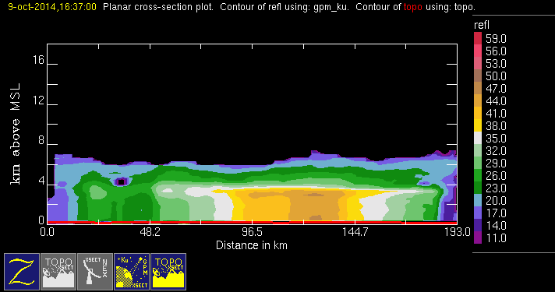
20141009 @ 1637
orig
uw
conv
stra

Slide 9
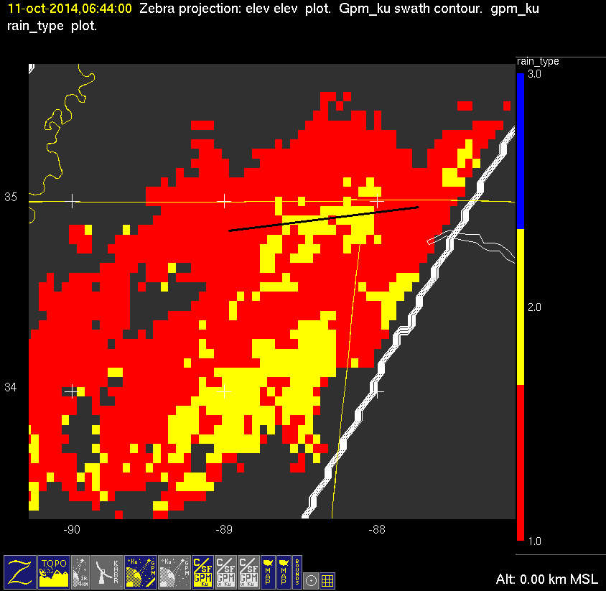
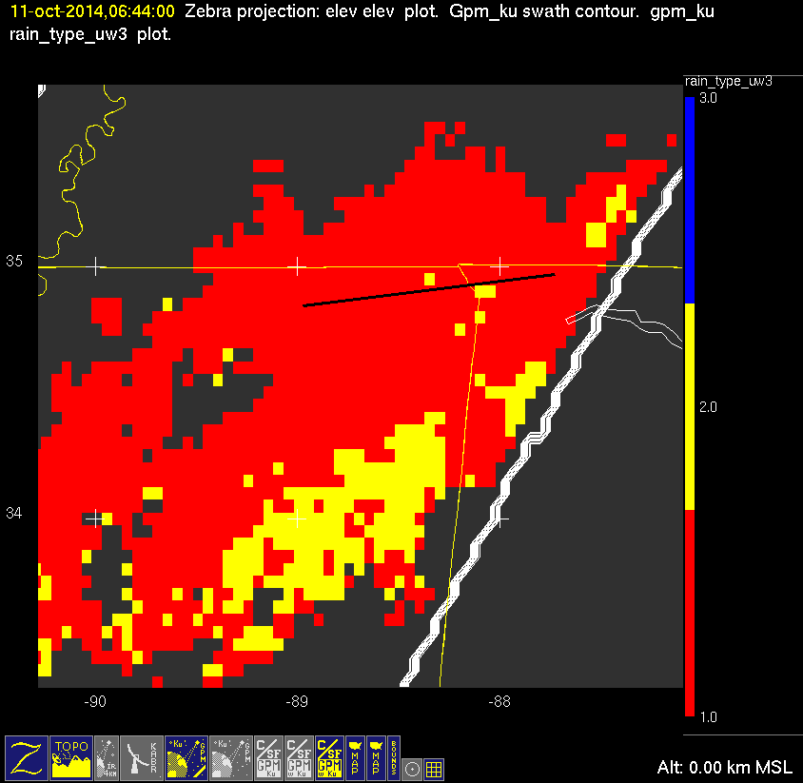
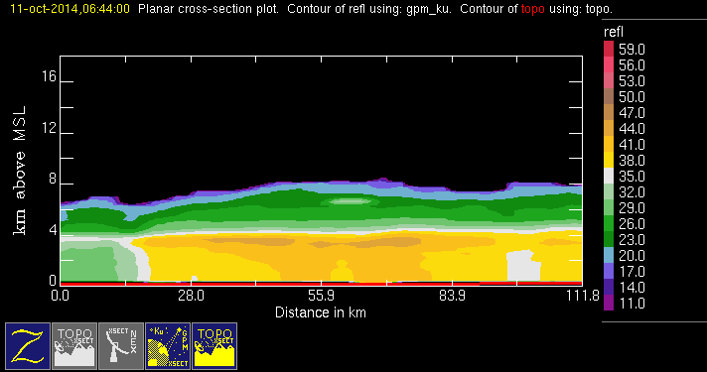
20141011 @ 0644
orig
uw
conv
stra

Slide 10
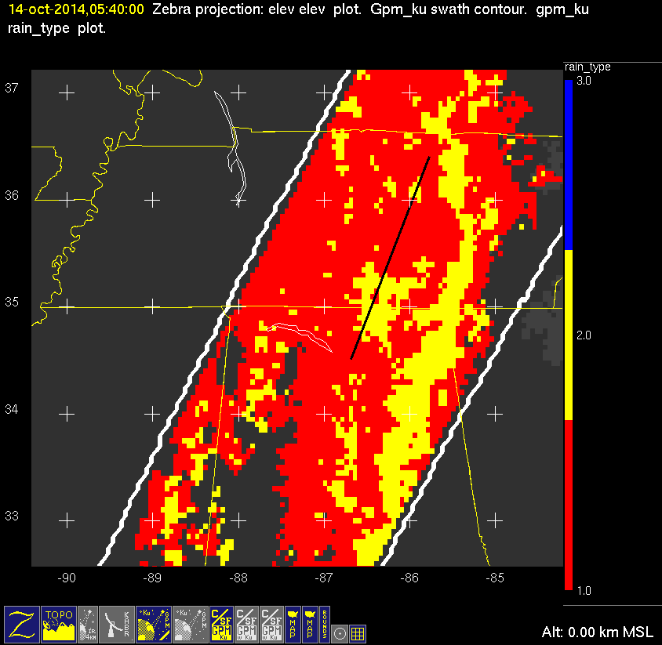
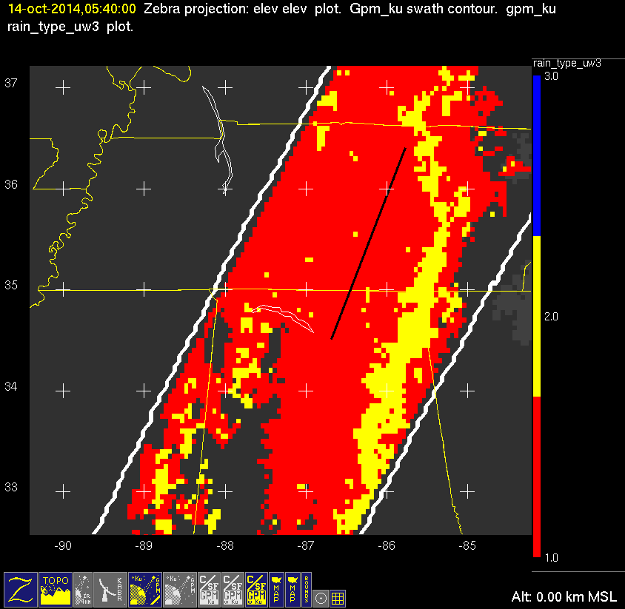
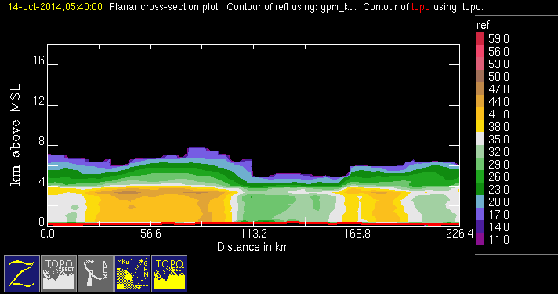
20141014 @ 0540
orig
uw
conv
stra

Slide 11
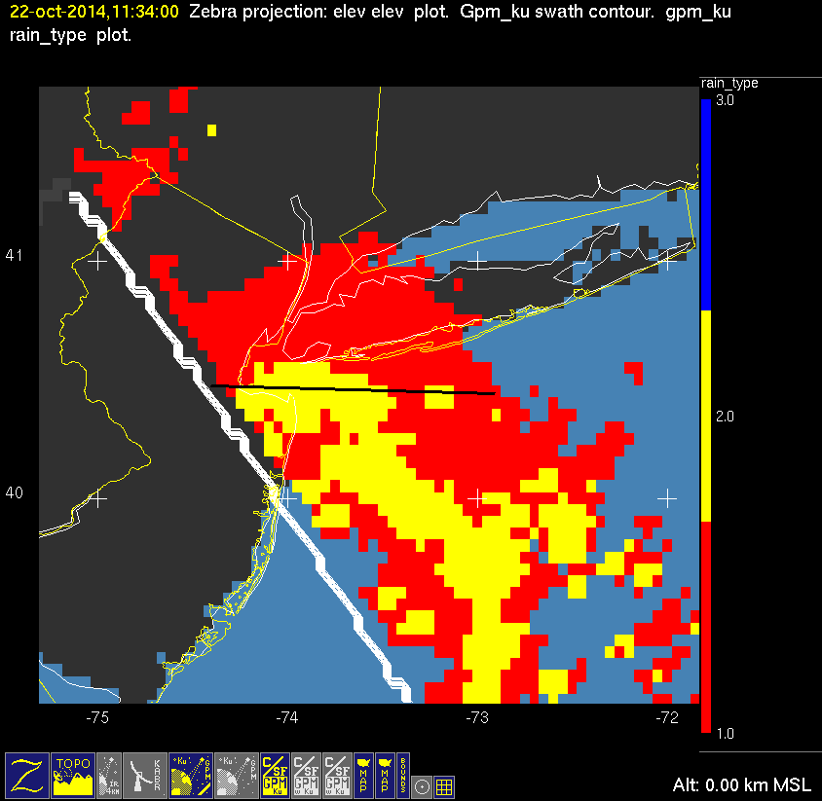

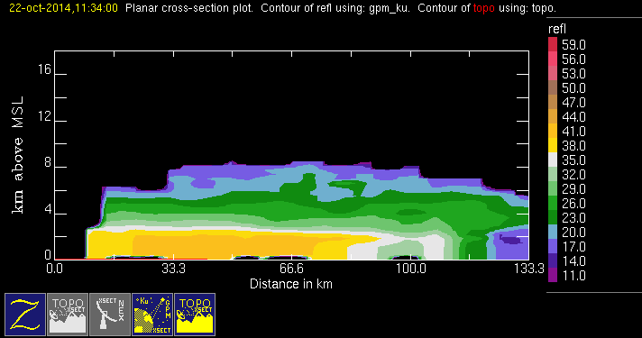
20141022 @ 1134
orig
uw
conv
stra
This case fails UW slope test. Cross section shows nearly constant reflectivities from ground to 2km.

Slide 12
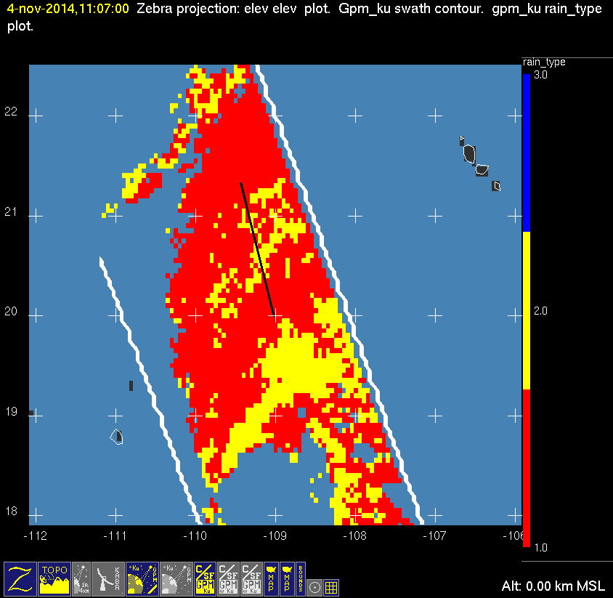
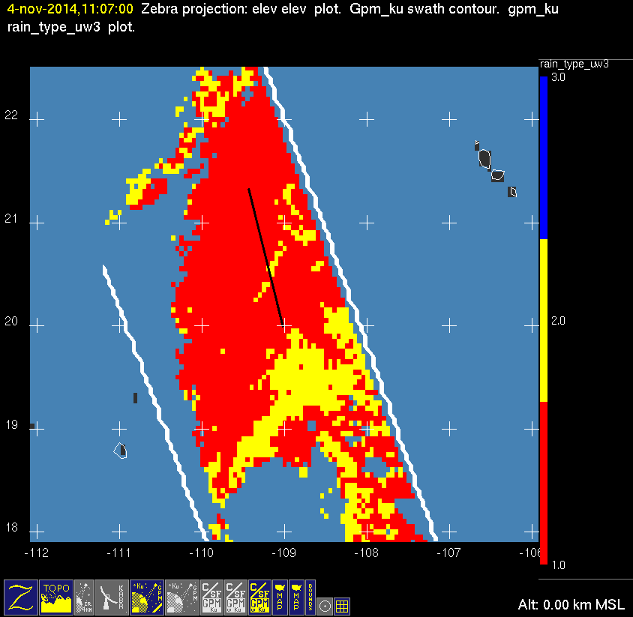
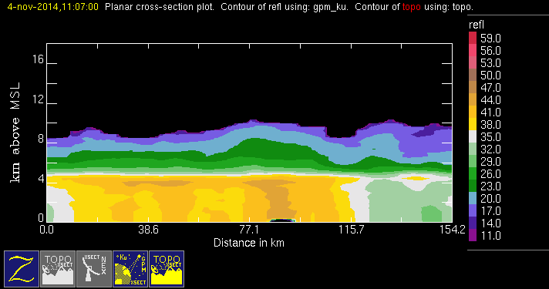
20141104 @ 1107
orig
uw
conv
stra

Slide 13
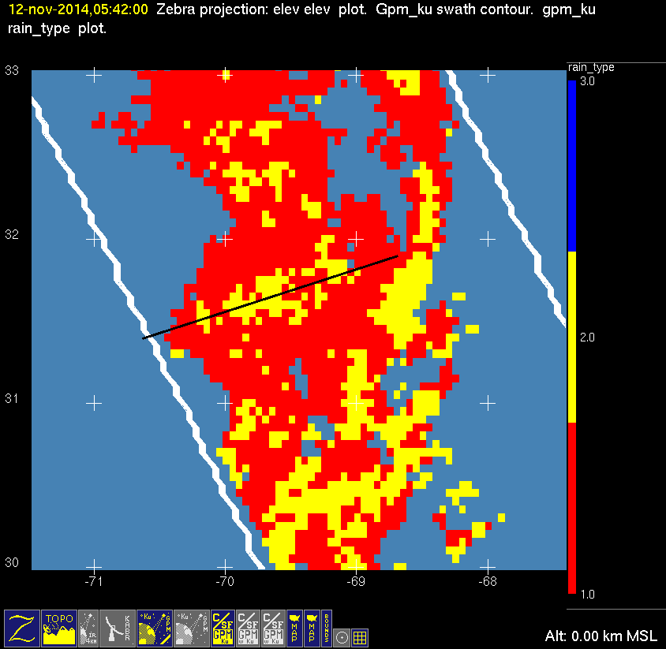
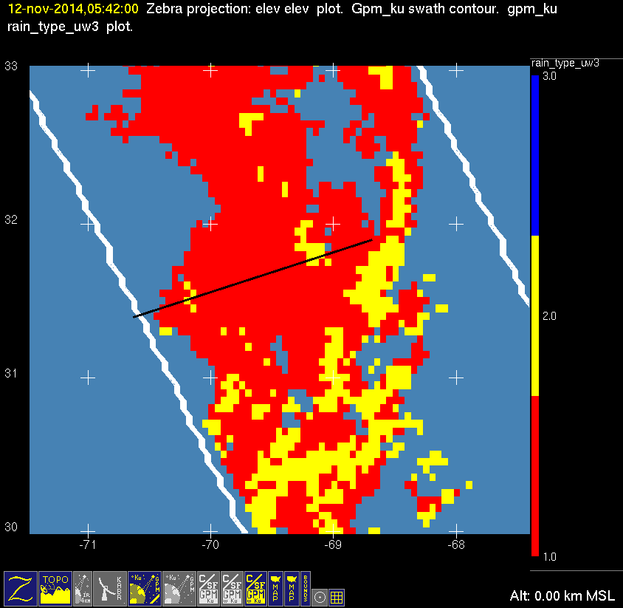
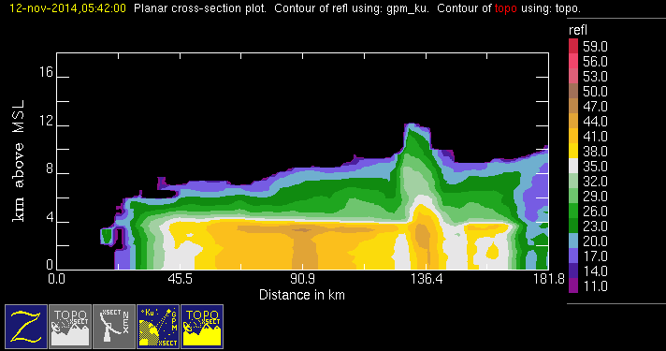
20141112 @ 0542
orig
uw
conv
stra

Slide 14
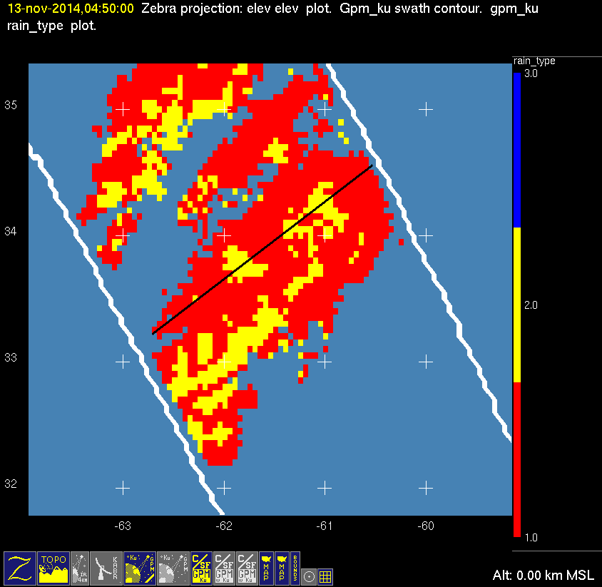
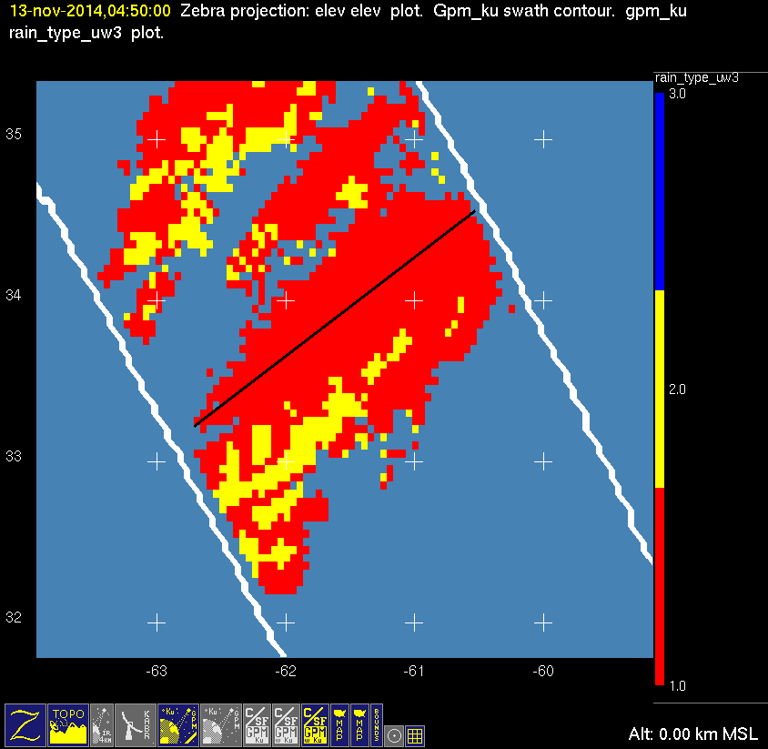
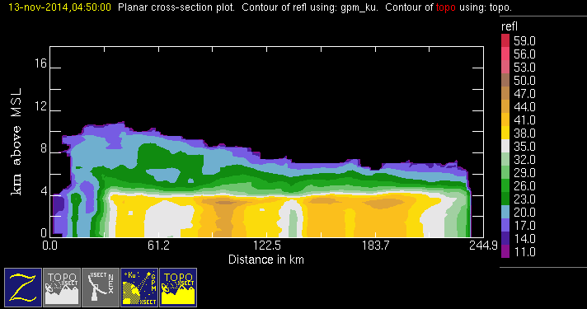
20141113 @ 0450
orig
uw
conv
stra

Slide 15
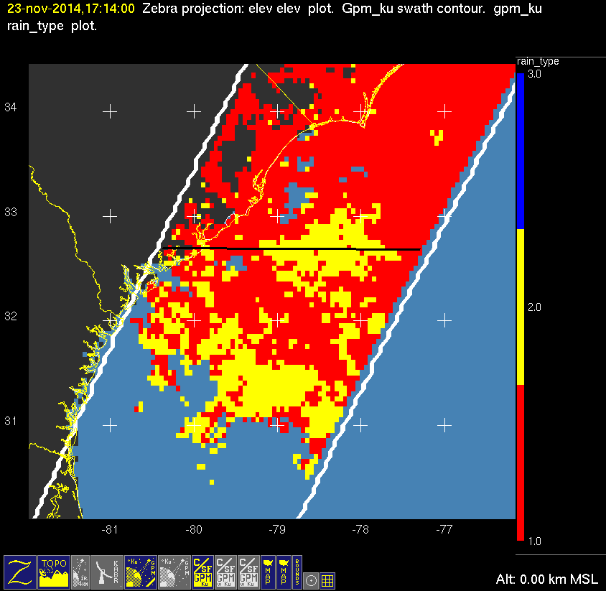
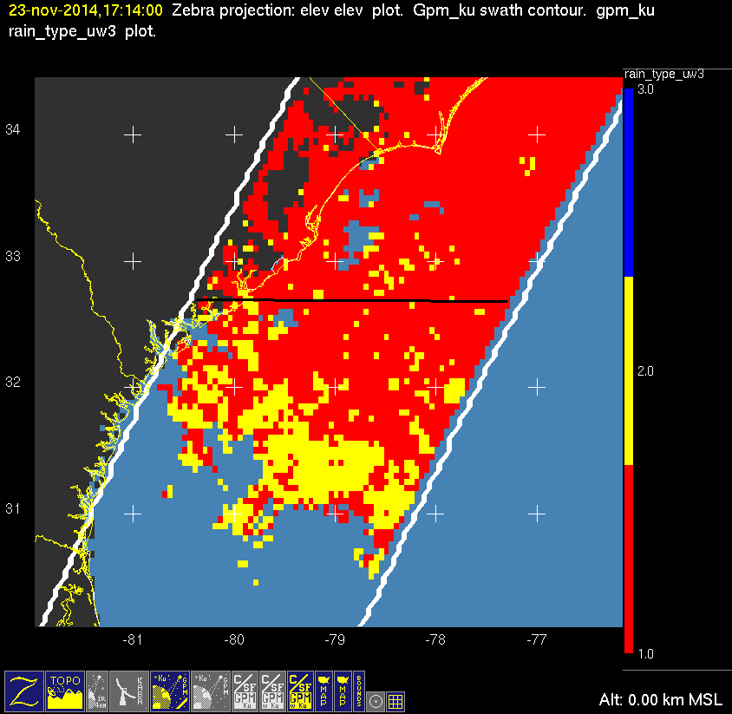
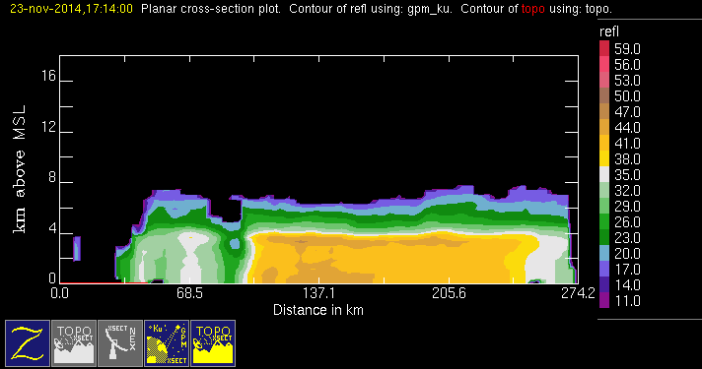
20141123 @ 1714
orig
uw
conv
stra

Slide 16
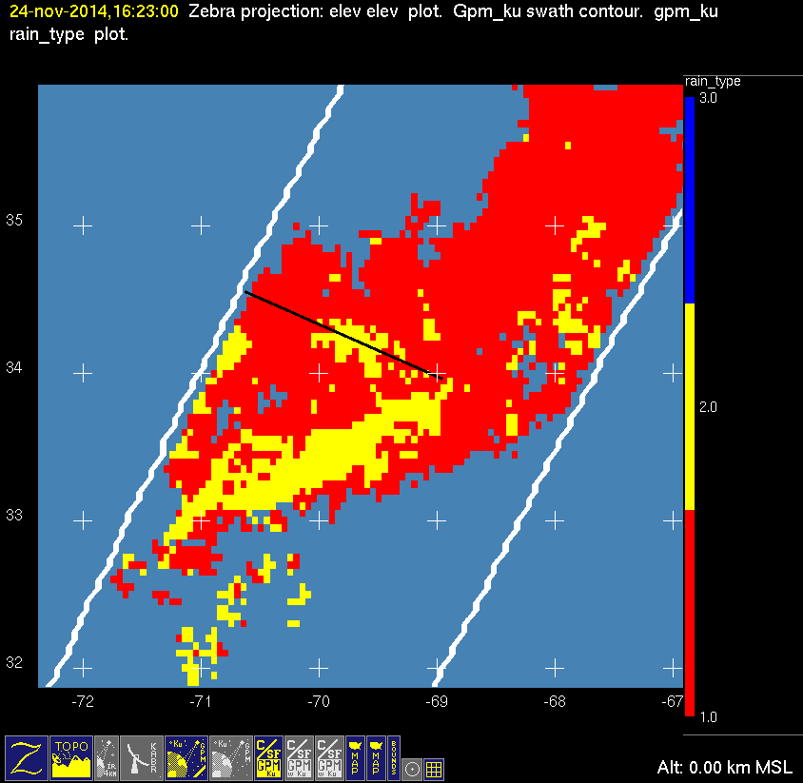
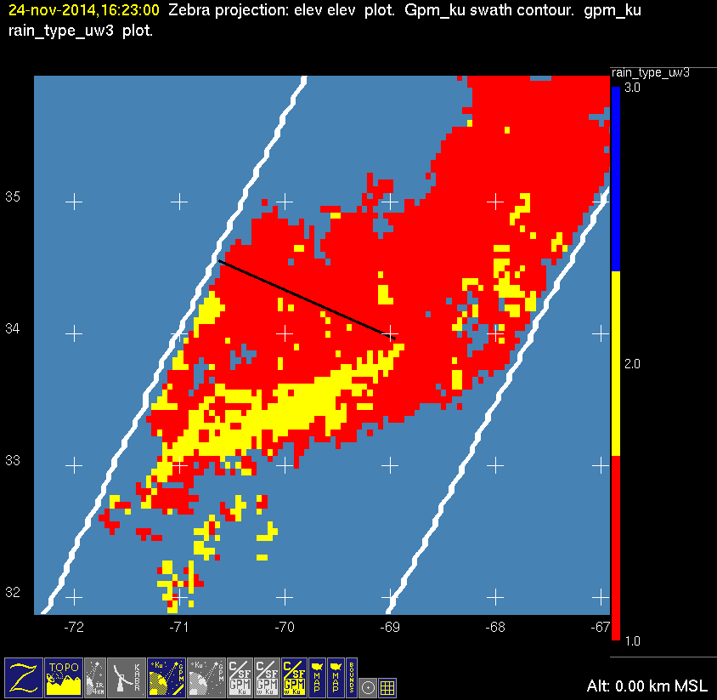
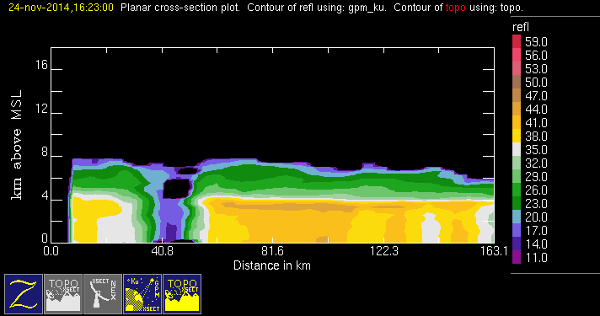
20141124 @ 1623
orig
uw
conv
stra

Slide 17
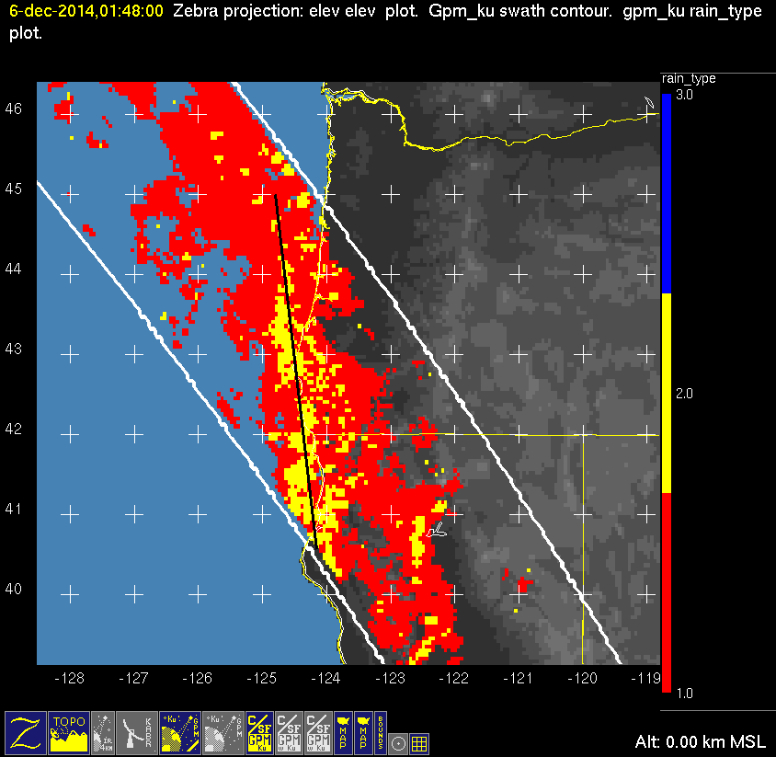
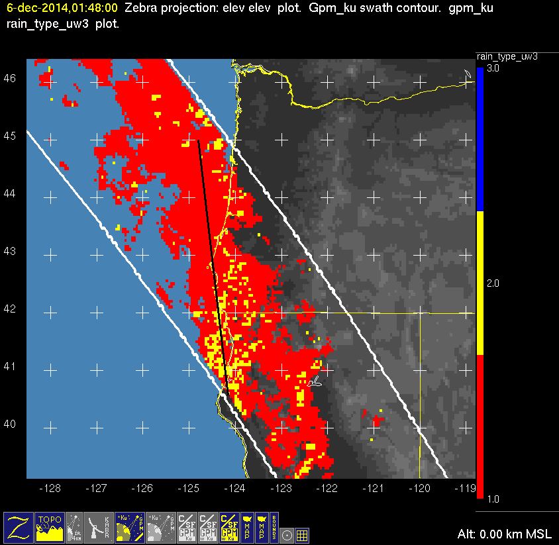
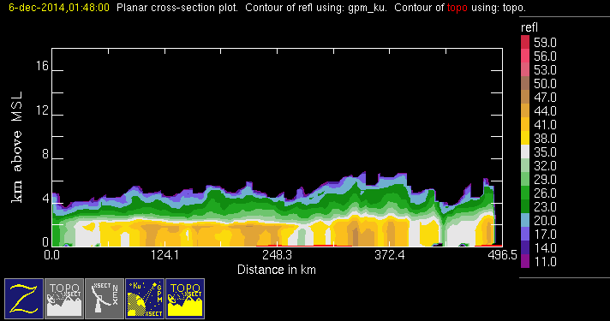
20141206 @ 0148
orig
uw
conv
stra

Slide 18
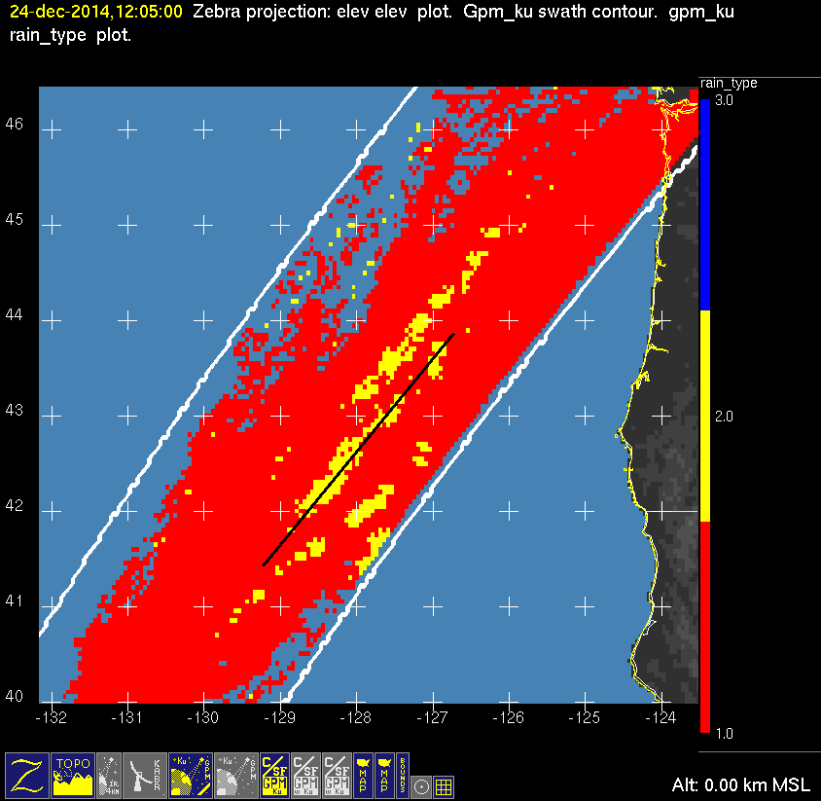
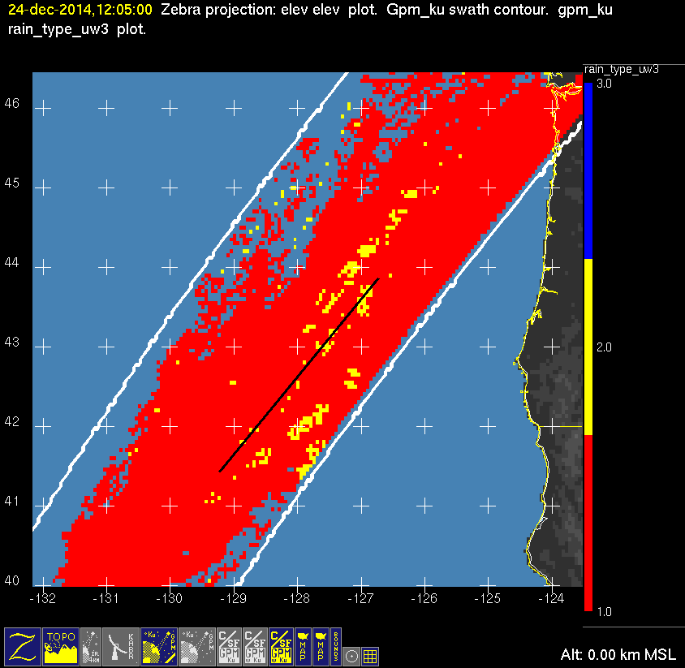
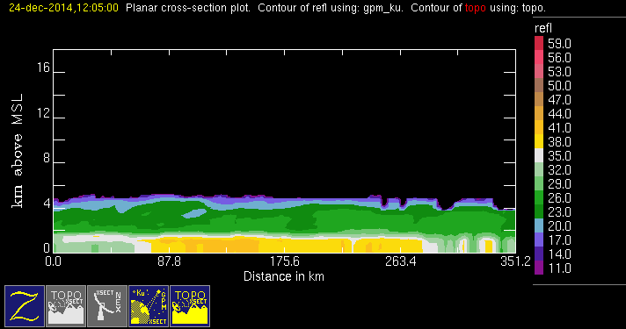
20141224 @ 1205
orig
uw
conv
stra

Slide 19
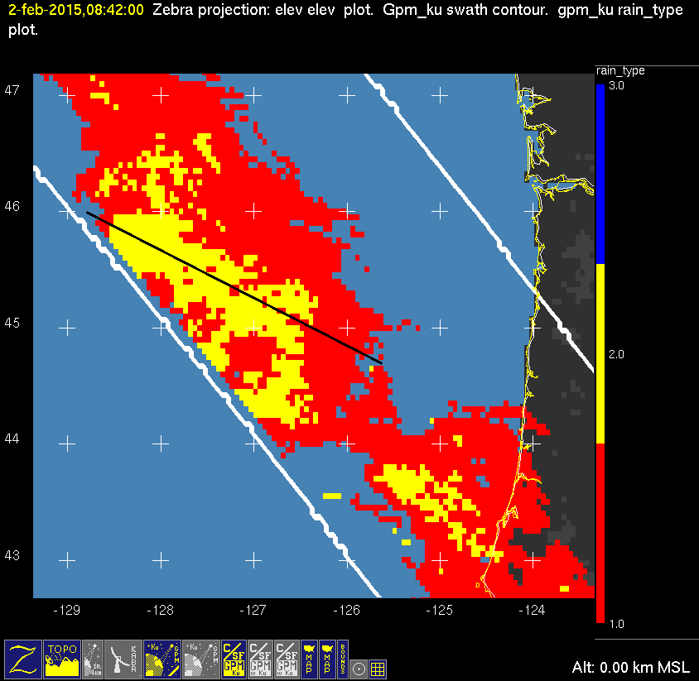
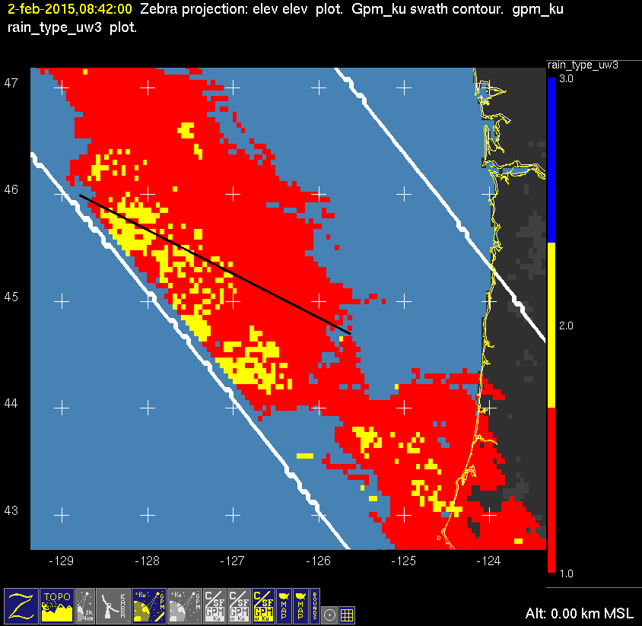

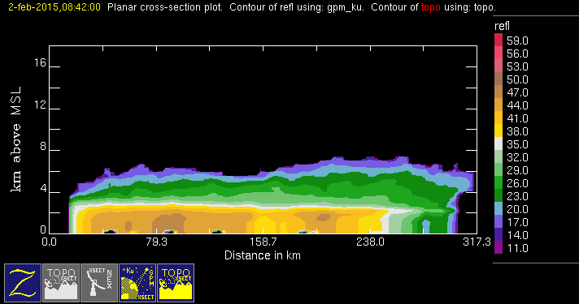
20150202 @ 0842
orig
uw
conv
stra

Slide 20



20150401 @ 1253
orig
uw
conv
stra

Slide 21



20150410 @ 1114
orig
uw
conv
stra

Slide 22



20150417 @ 0946
orig
uw
conv
stra

Slide 23



20150425 @ 2055
orig
uw
conv
stra

Slide 24



20150429 @ 0535
orig
uw
conv
stra

Slide 25



20150713 @ 0718
orig
uw
conv
stra

Slide 26



20150718 @ 0606
orig
uw
conv
stra

Slide 27



20150728 @ 0343 #1/2
orig
uw
conv
stra

Slide 28



20150728 @ 0343 #2/2
orig
uw
conv
stra

Slide 29



20150817 @ 2203
orig
uw
conv
stra
Not sure why this correction is not very good.

Slide 30



20160103 @ 0719
orig
uw
convstra

Slide 31



20160614 @ 0535
orig
uw
conv
stra

Slide 32



20160617 @ 1943
uw
orig
conv
stra

Slide 33



20160625 @ 0219
orig
uw
conv
stra

Slide 34
orig
conv
stra
uw
20150817 @ 2203

