Slide 1
COMPARISON OF GPM 2Ku rain_type FIELD: v04 vs UW MOD TO v04 vs v05
UW Mod to v04: If the following three criteria are met for a grid point, the rain_type is changed to STRATIFORM:
The original classification is CONVECTIVE
The maximum reflectivity in the column is greater than 38dBZ
The max reflectivity in a column minus the reflectivity 1.5km higher is greater than or equal to 8 dBZ
.

Slide 2
Each of the following slides shows the v04 classification on the left, the UW modified v04 classification in the center and the v05 classification on the right, as well as cross-sections of the reflectivity which represent the cuts where the black lines are drawn on the horizontal plots. The v04 cross-section is on the left and the v05 cross-section is on the right. The calibration increase in the reflectivities is evident.
All cross sections are drawn from left to right.

Slide 3
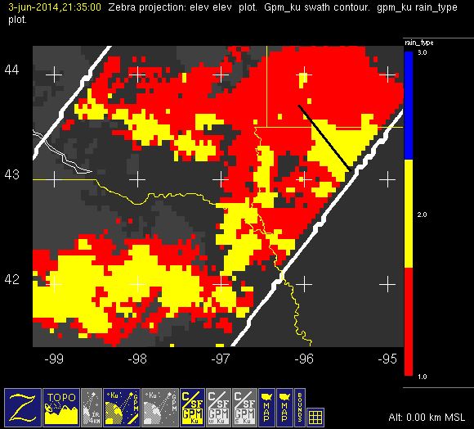
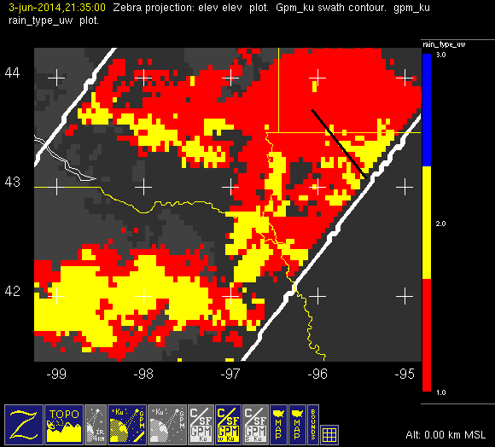
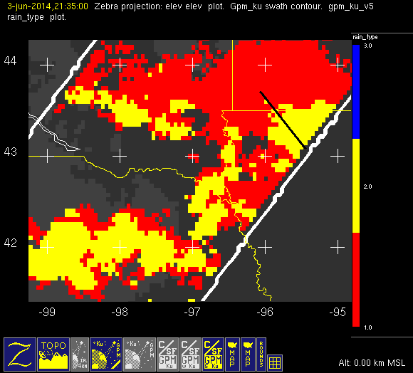
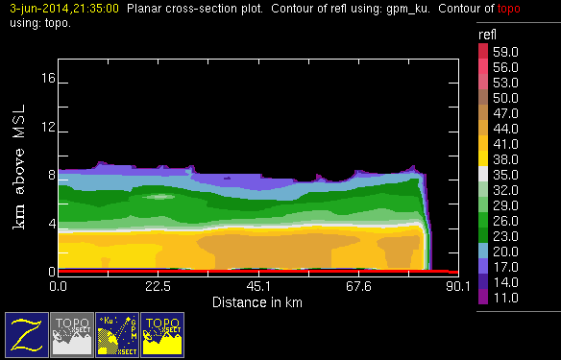
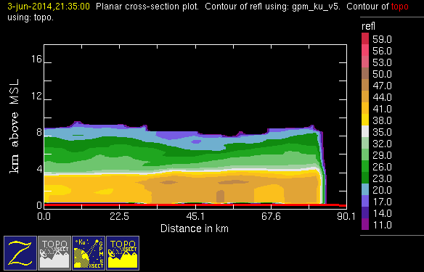
20140603 @ 2135
conv
stra
v04
uw
v05

Slide 4
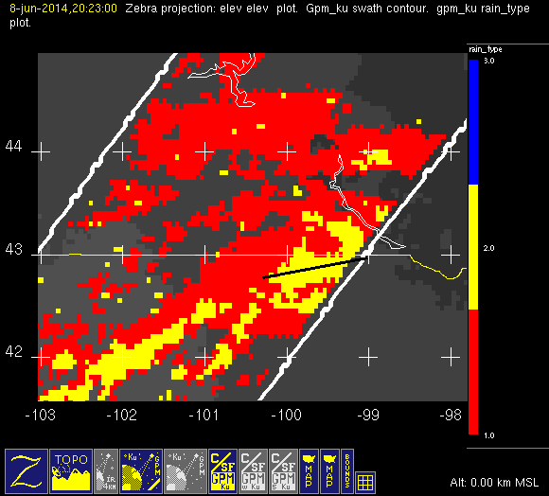
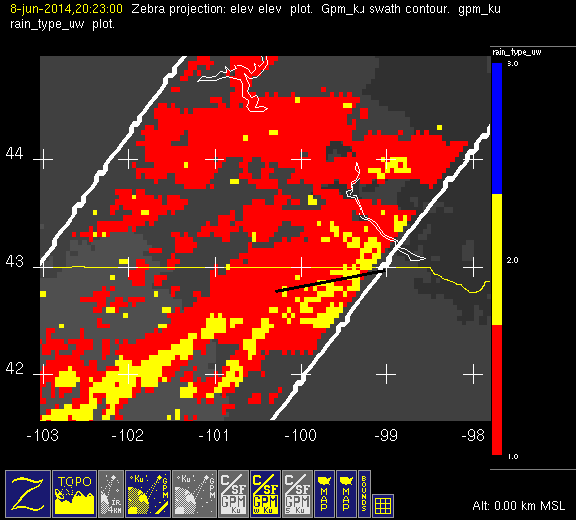
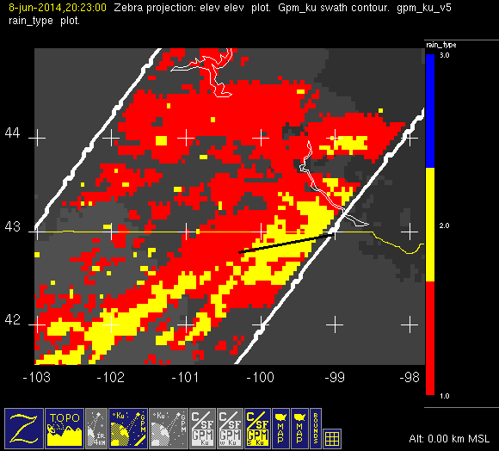
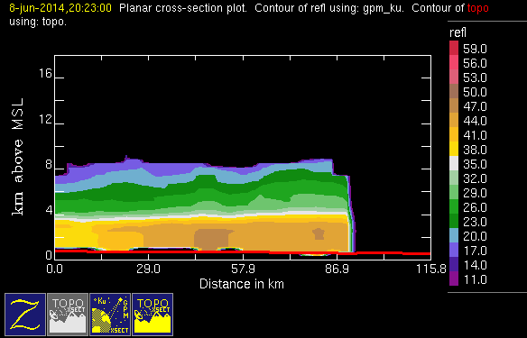
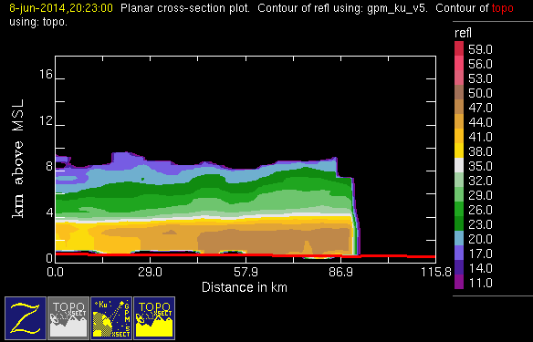
20140608 @ 2023
conv
stra
v04
uw
v05

Slide 5
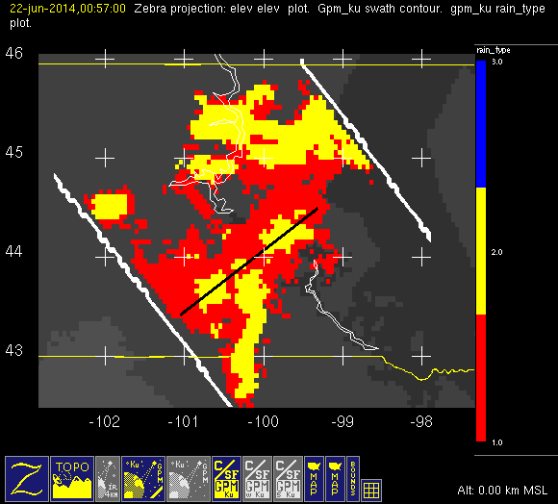
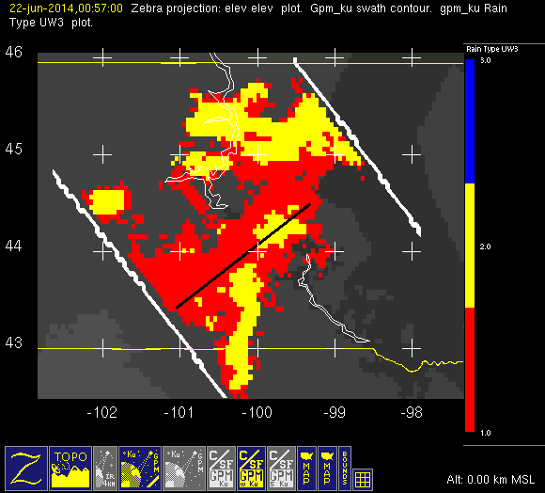
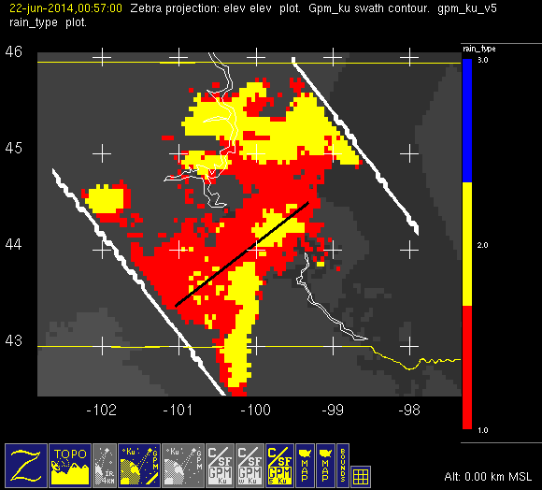
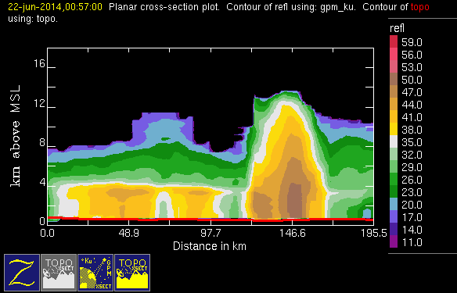
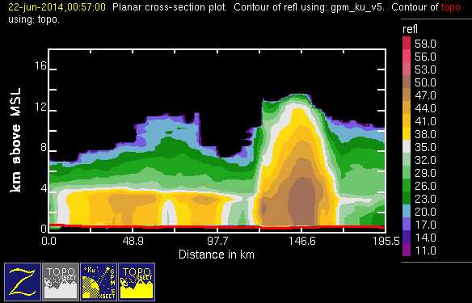
20140622 @ 0057
conv
stra
v04
uw
v05

Slide 6
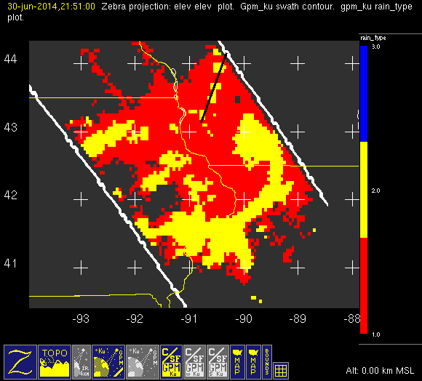

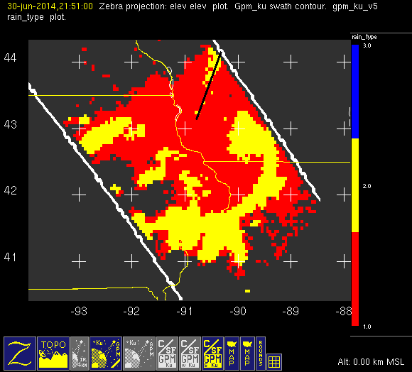
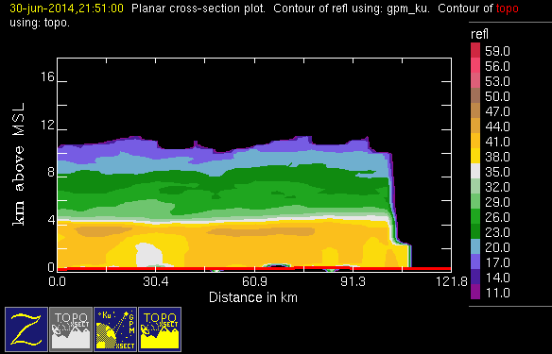
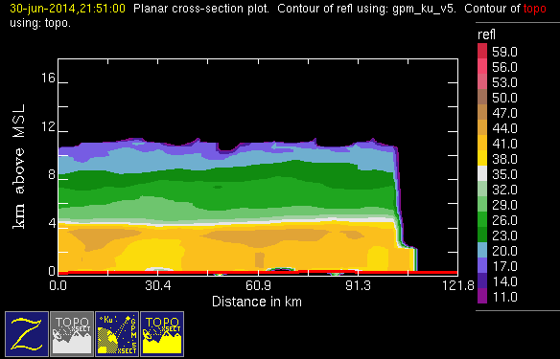
20140630 @ 2151
conv
stra
v04
uw
v05

Slide 7
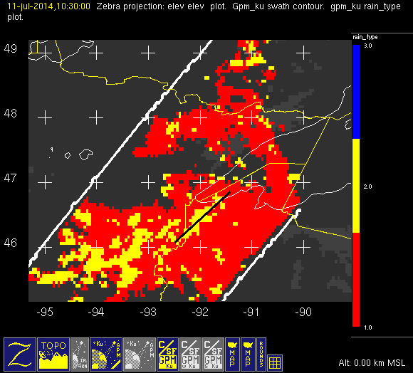
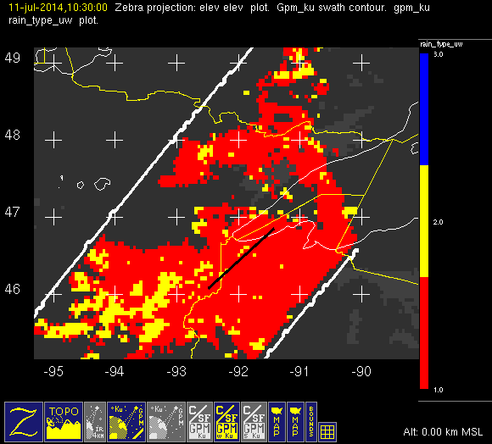
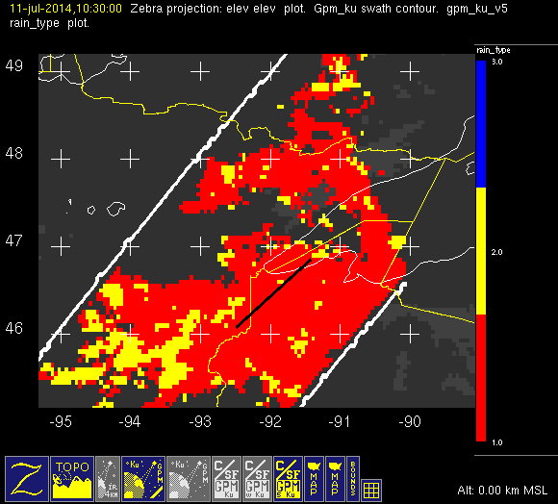
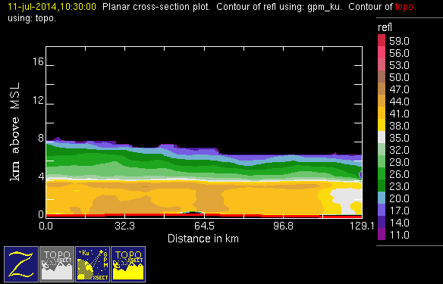
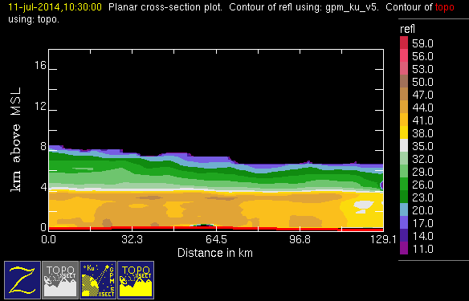
20140711 @ 1030
conv
stra
v04
uw
v05

Slide 8
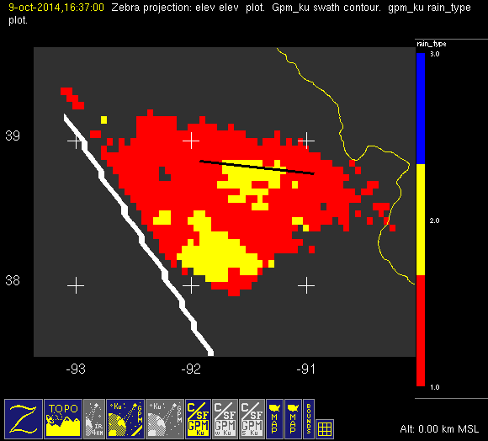
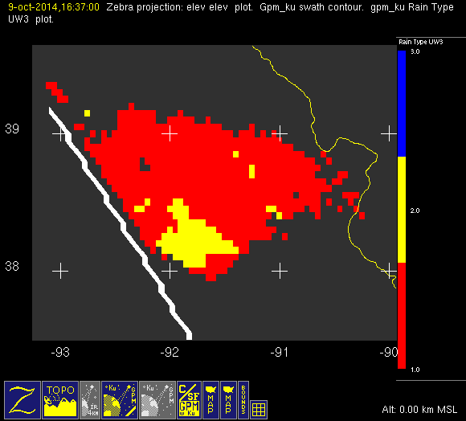
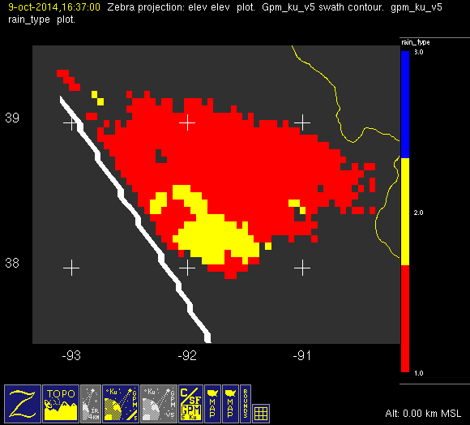
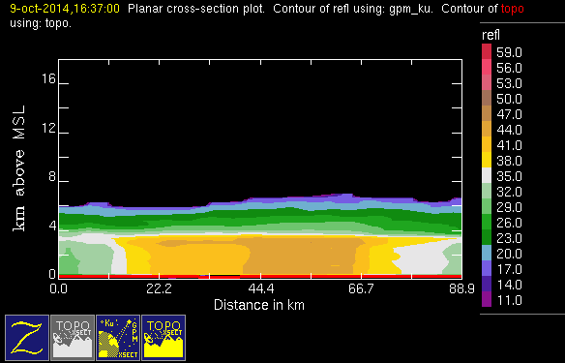
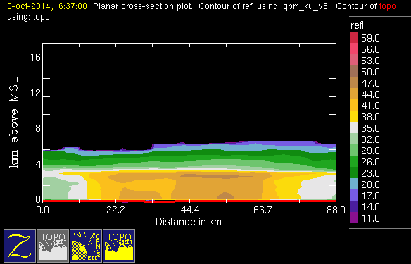
20141009 @ 1637
conv
stra
v04
v05
uw
v05

Slide 9
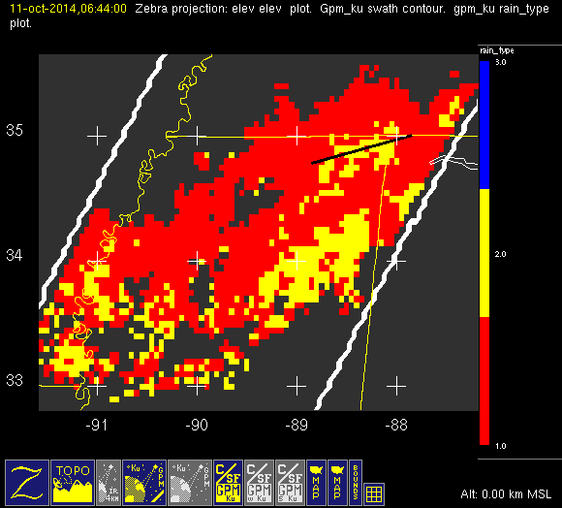
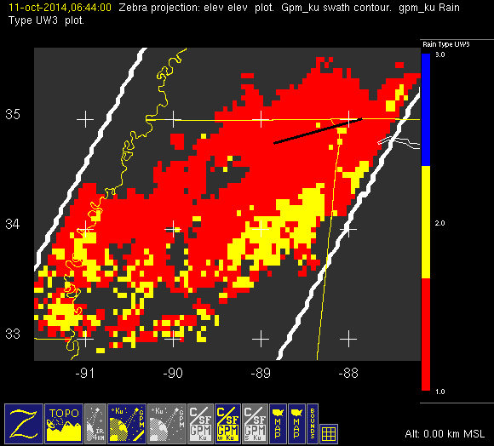
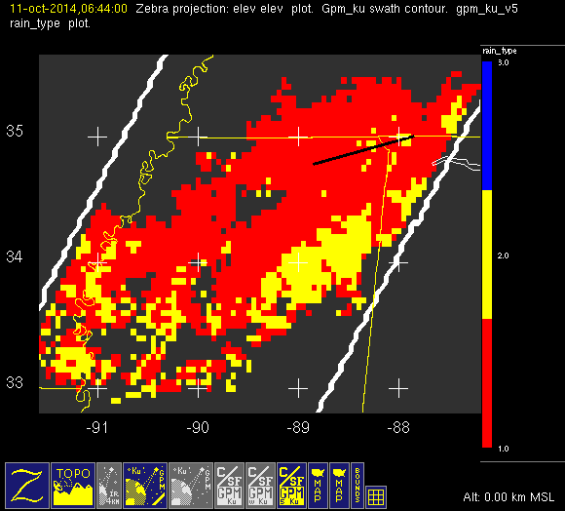
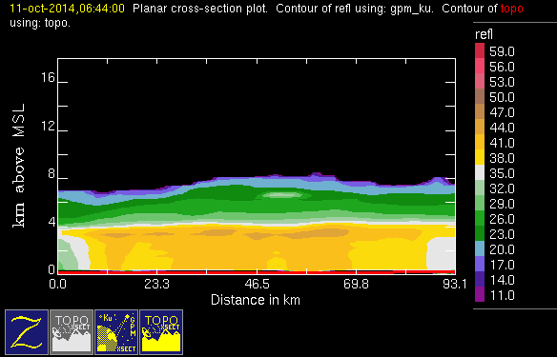
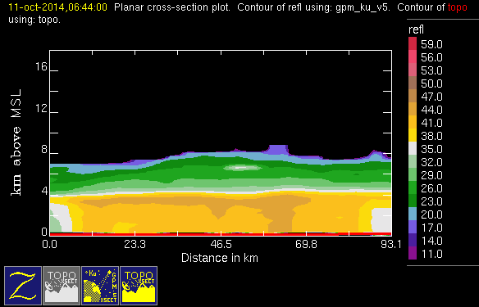
20141011 @ 0644
conv
stra
v04
uw
v05

Slide 10
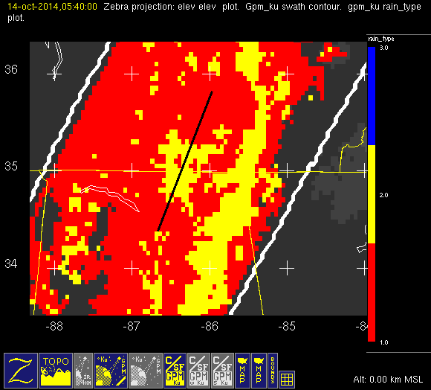
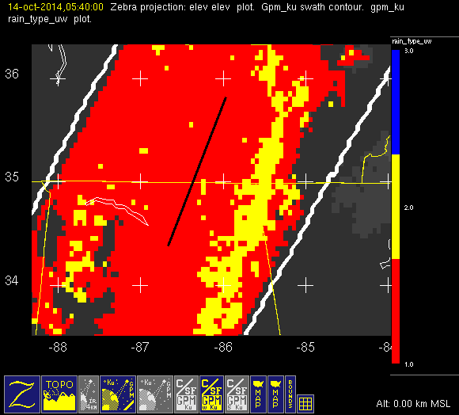
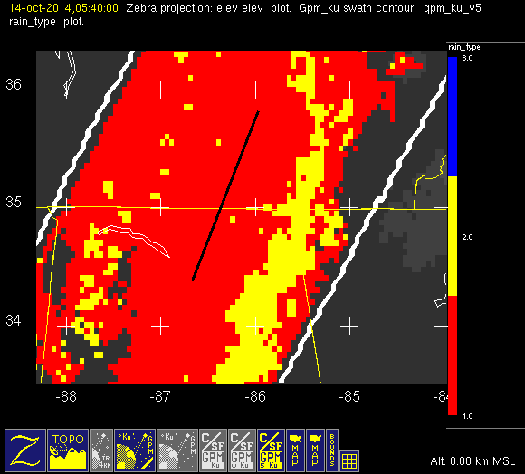
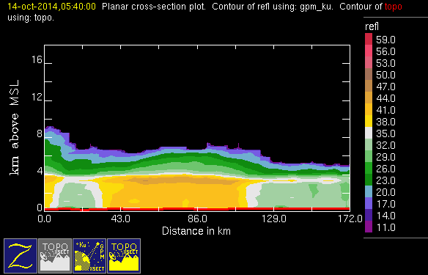
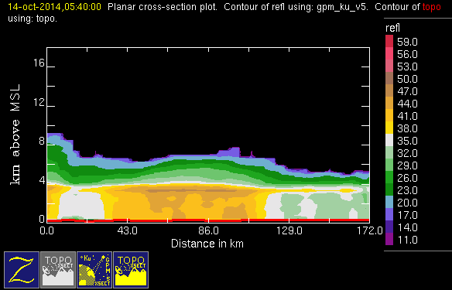
20141014 @ 0540
conv
stra
v04
uw
v05

Slide 11
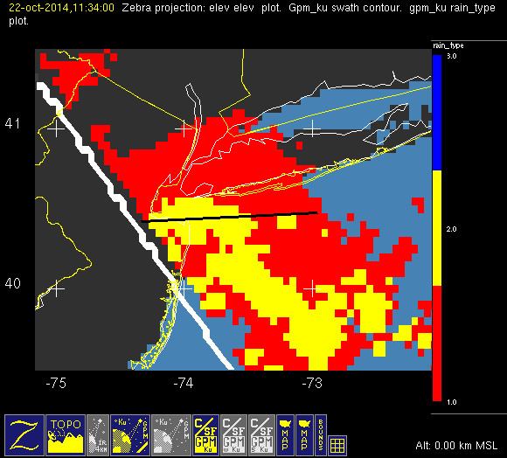
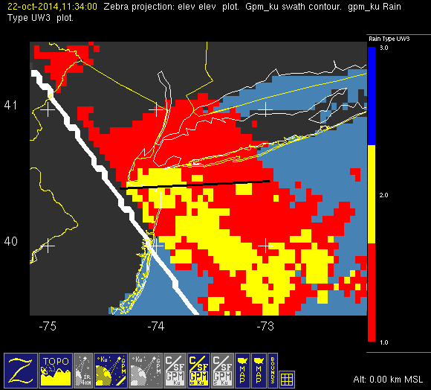
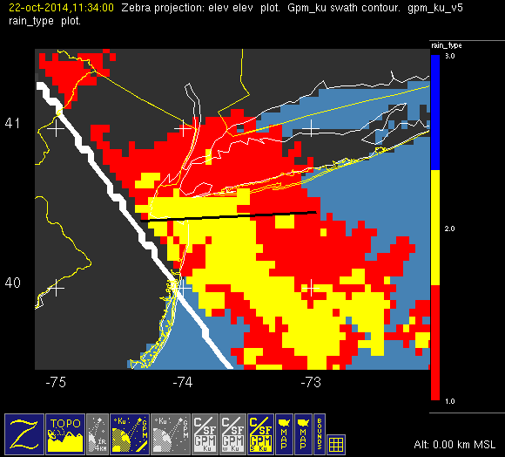
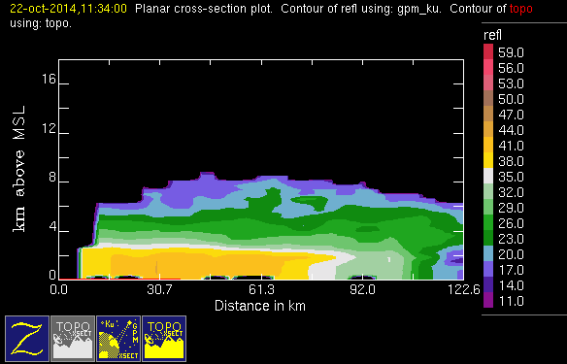
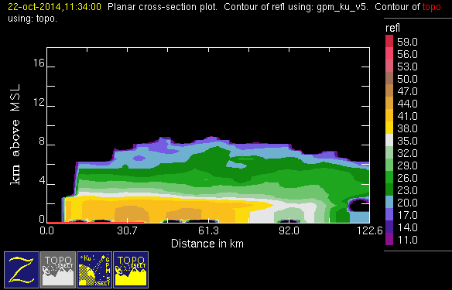
20141022 @ 1134
v04
uw
v05
conv
stra

Slide 12
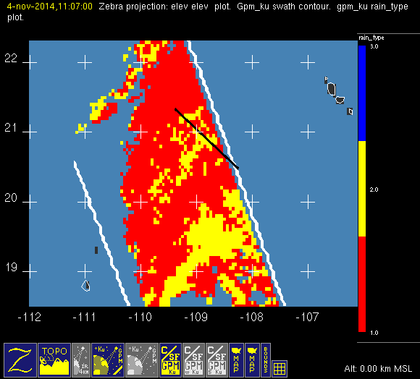
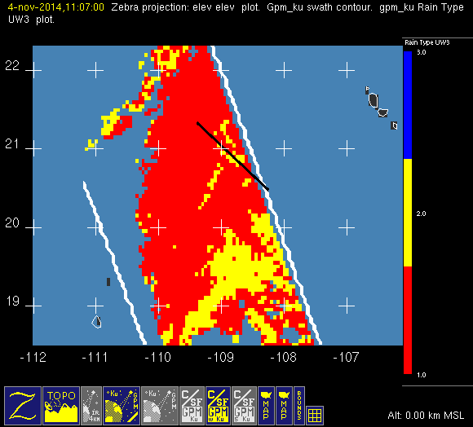
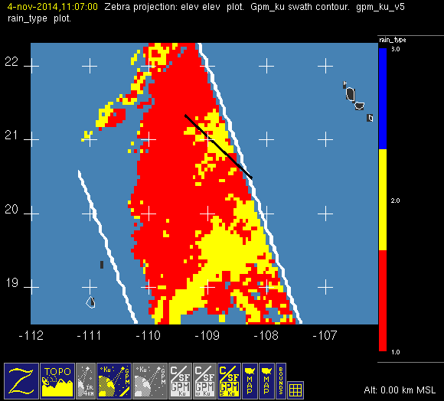
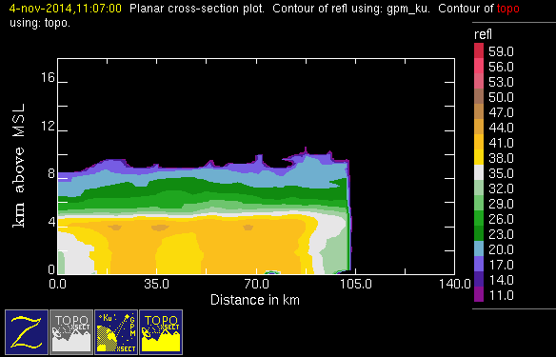

20141104 @ 1107
conv
stra
v04
uw
v05

Slide 13
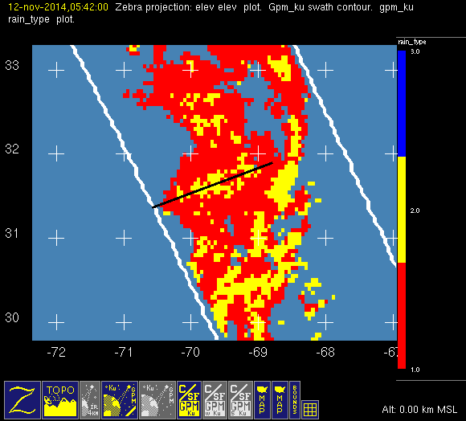
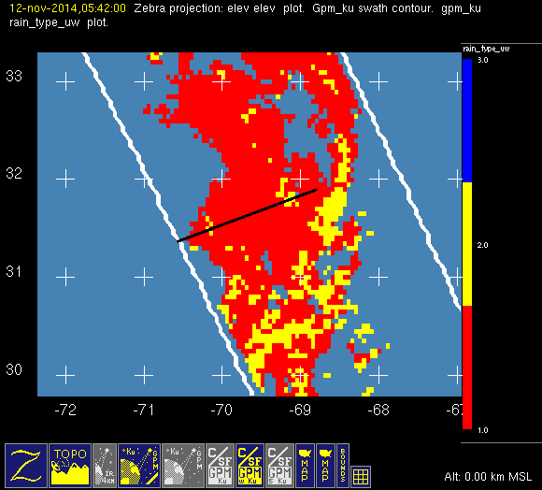



20141112 @ 0542
conv
stra
v04
uw
v05

Slide 14





20141113 @ 0450
conv
stra
v04
uw
v05

Slide 15





20141123 @ 1714
conv
stra
v04
uw
v05

Slide 16





20141124 @ 1623
conv
stra
v04
uw
v05

Slide 17





20141206 @ 0148
conv
stra
v04
uw
v05

Slide 18





20141224 @ 1205
conv
stra
v04
uw
v05

Slide 19





20150202 @ 0842
conv
stra
v04
uw
v05

Slide 20





20150401 @ 1253
conv
stra
v04
uw
v05

Slide 21





20150410 @ 1114
conv
stra
v04
uw
v05

Slide 22





20150417 @ 0946
conv
stra
v04
uw
v05

Slide 23





20150425 @ 2055
conv
stra
v04
uw
v05

Slide 24





20150429 @ 0535
conv
stra
v04
uw
v05

Slide 25





20150713 @ 0718
v04
uw
v05
conv
stra

Slide 26





20150718 @ 0606
conv
stra
v04
uw
v05

Slide 27





20150728 @ 0343 #1/2
v04
uw
v05
conv
stra

Slide 28





20150728 @ 0343 #2/2
conv
stra
v04
uw
v05

Slide 29





20150817 @ 2203
conv
stra
v04
uw
v05

Slide 30





20160103 @ 0719
conv
stra
v04
uw
v05

Slide 31





20160614 @ 0535
conv
stra
v04
uw
v05

Slide 32





20160617 @ 1943
conv
stra
v04
uw
v05

Slide 33





20160625 @ 0219
conv
stra
v04
uw
v05

