Slide 1
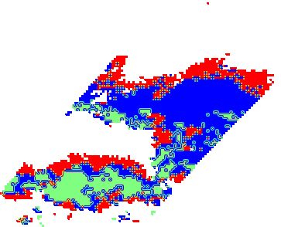
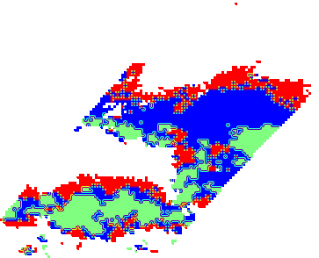

Orbit 1497
V05_uw rain_type
V05 rain_type
V05Apps_csf rain_type

Slide 2
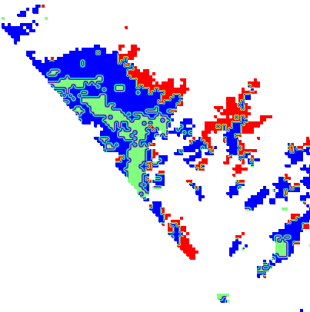
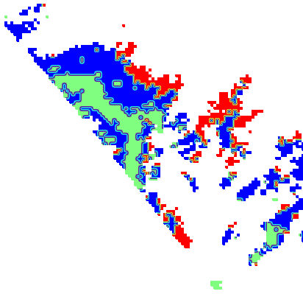
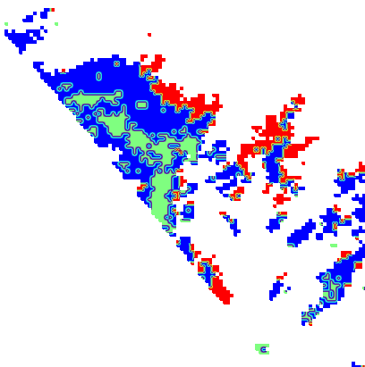
Orbit 3684
V05_uw rain_type
V05 rain_type
V05Apps_csf rain_type

Slide 3
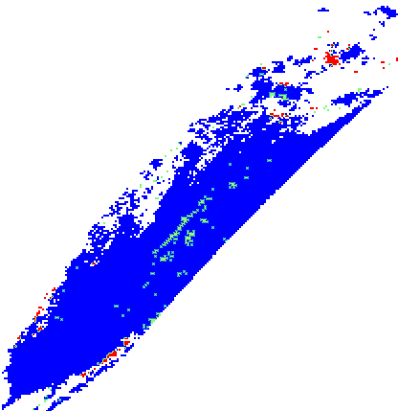
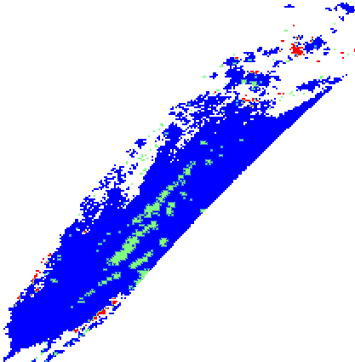
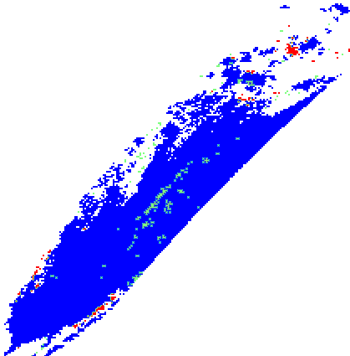
Orbit 4665
V05_uw rain_type
V05_uw rain_type
V05 rain_type
V05Apps_csf rain_type

