Slide 1
Time in Synoptic Meteorology
ATMS 370
2025

Slide 2
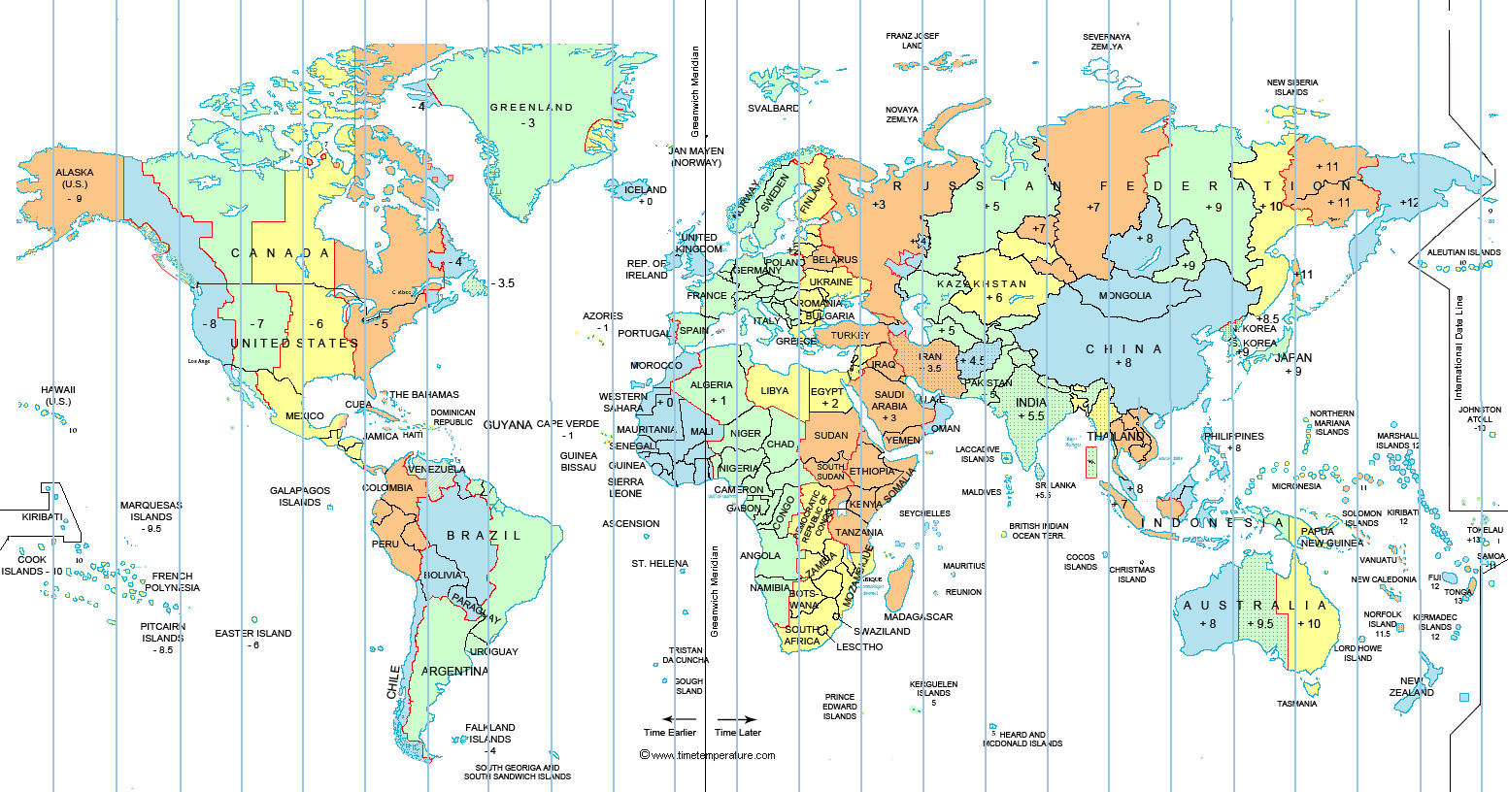
Meteorologists need to use the same time everywhere since we exchange data globally

Slide 3
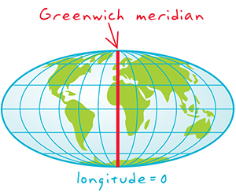
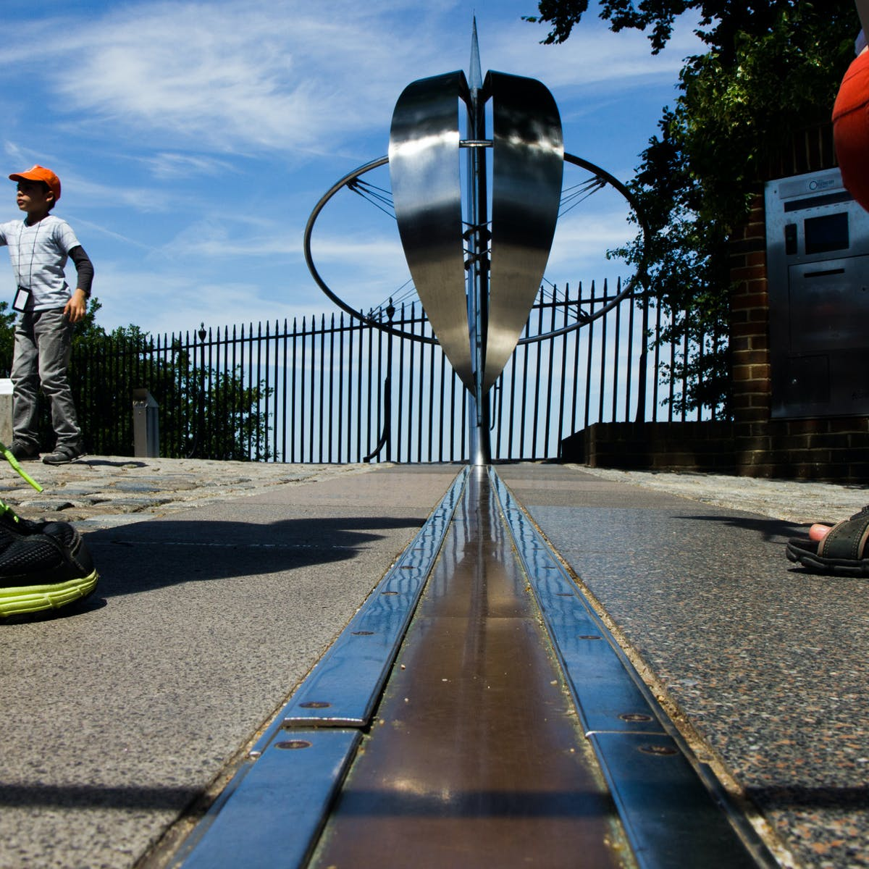
Meteorologists use the local standard time at the Greenwich Meridian (0° longitude, near London).

Slide 4
Many names for this time
Greenwich Mean Time (GMT)
Universal Coordinated Time (UTC)
Zulu Time (Z)
Generally, UTC is used today, but some groups (like the NWS) often use Z and GMT.

Slide 5
How to convert. UTC is LATER than Pacific time since the Greenwich Meridian is to our east
UTC = PST + 8 hr
UTC = PDT + 7 hr
Uses a 24 hr clock
First, convert local time to 24 hr clock
Then, add 7 or 8 hr depending on whether in daylight or standard time.
If the sum is equal to or greater than 24 hr, subtract 24h and add one day.

Slide 6
Examples
4 AM PDT 1 October:
  4 AM become O4
  Add 7 hr = 11 UTC 1 October
4 PM PDT 1 October
  4 PM become 16
  Add 7 hr = 23 UTC 1 October
6 PM PST 1 January
  6 PM becomes 18
  18 + 8= 26 UTC. Need to subtract 24 and becomes 02 UTC 2 January
Your test: 10 PM PST 1 January is what in UTC?
You need to be able to do this conversion or you won’t be able to understand weather maps.

Slide 7
