Slide 1
Ensembles and Probabilistic Prediction
Atmospheric Sciences 452
Spring 2025

Slide 2
Uncertainty in Forecasting
Most of the model forecasts we have talked about previously reflect a deterministic approach.
This means that we do the best job possible for a single forecast and do not consider uncertainties in the model, initial conditions, or how we solve equations.
These uncertainties are often very significant.
Traditionally, deterministic forecasting has dominated but that is rapidly changing.

Slide 3
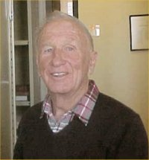
A Fundamental Issue
The work of Lorenz (1963, 1965, 1968) demonstrated that the atmosphere is a chaotic system, in which small differences in the initialization, well within observational error, can have large impacts on forecasts, particularly for longer projection forecasts.
In a series of experiments, he found that small errors in initial conditions can grow so that all deterministic forecast skill is lost at about two weeks.

Slide 4

Butterfly Effect: a small change at one place in a complex system can have large effects everywhere over time

Slide 5

Uncertainty Extends Beyond Initial Conditions
Initial conditions are uncertain because of observational errors and limitations of the observational system (e.g., don’t have data everywhere, sensors have errors).
Also uncertainty in our model physics (e.g., lack of understanding of key physics, uncertain parameters, and more).
And further uncertainty produced by our numerical methods (e.g., finite differencing truncation error, etc.).

Slide 6

How to Deal With Forecast Uncertainty?
To deal with forecast uncertainty, Epstein (1969) suggested stochastic-dynamic forecasting, in which forecast errors are explicitly considered during model integration.
Essentially, uncertainty estimates are added to each term in the primitive equations.
This stochastic method was not computationally practical, since it added many additional terms.

Slide 7
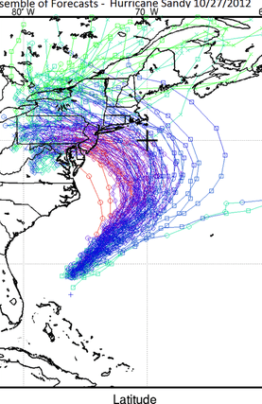
Ensemble NWP
Another approach, ensemble prediction, was proposed by Leith (1974), who suggested running a collection (ensemble) of forecasts, each starting from a different initial state.
The variations in the resulting forecasts could be used to estimate the uncertainty.
The ensemble approach was not possible at that time due to limited computer resources.
Became practical in the late 1980s as computer power increased.
Dominant approach used today.

Slide 8
Applications of Ensemble Prediction
Can use ensembles to estimate the probabilities that some weather feature will occur.
The ensemble mean is more accurate on average than any individual ensemble member.
Information on forecast reliability. Forecast skill of the ensemble mean is related to the spread of the ensembles
  When ensemble forecasts are similar and spread is low, skill of the ensemble mean is generally higher.
  When forecasts differ greatly, ensemble mean forecast skill is less.

Slide 9
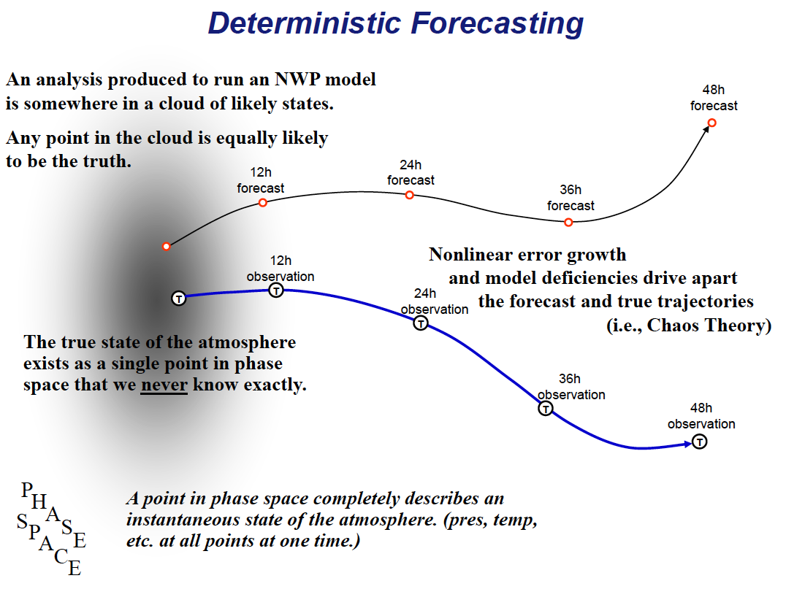

Slide 10
Ensemble Prediction
12h
forecast
24h
forecast
e
36h
forecast
a
c
u
j
n
T
Analysis Region
g
t
M
Several forecasts are made, all trying to start near truth.
M is the ensemble-mean forecast
T
phase
space
48h forecast Region

Slide 11
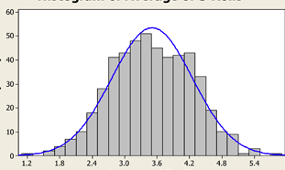
Ensemble Forecasts Can Be Used to Create Probability Density Functions (PDFs) by fitting Gaussian or other curves to ensemble members

Slide 12
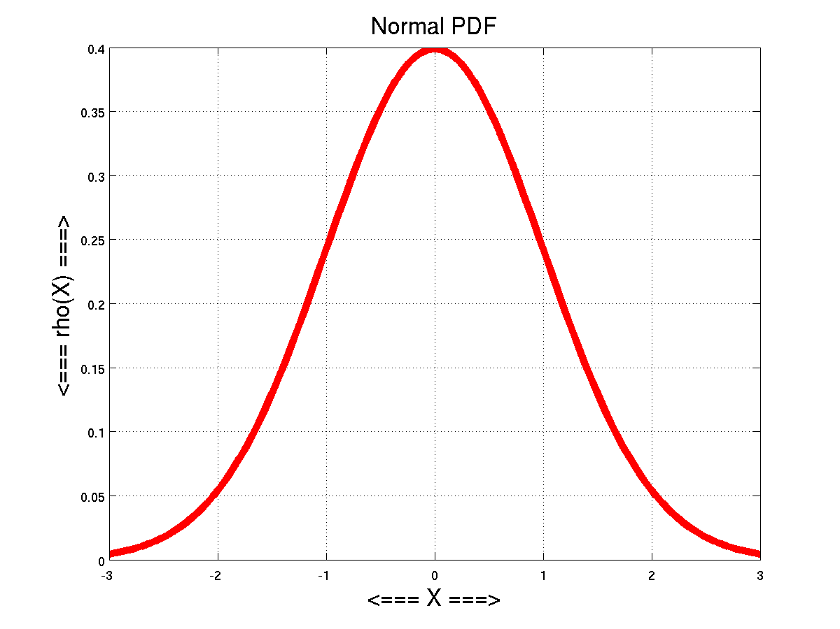
Example of a PDF
Most probable
Probability
52
56
60

Slide 13
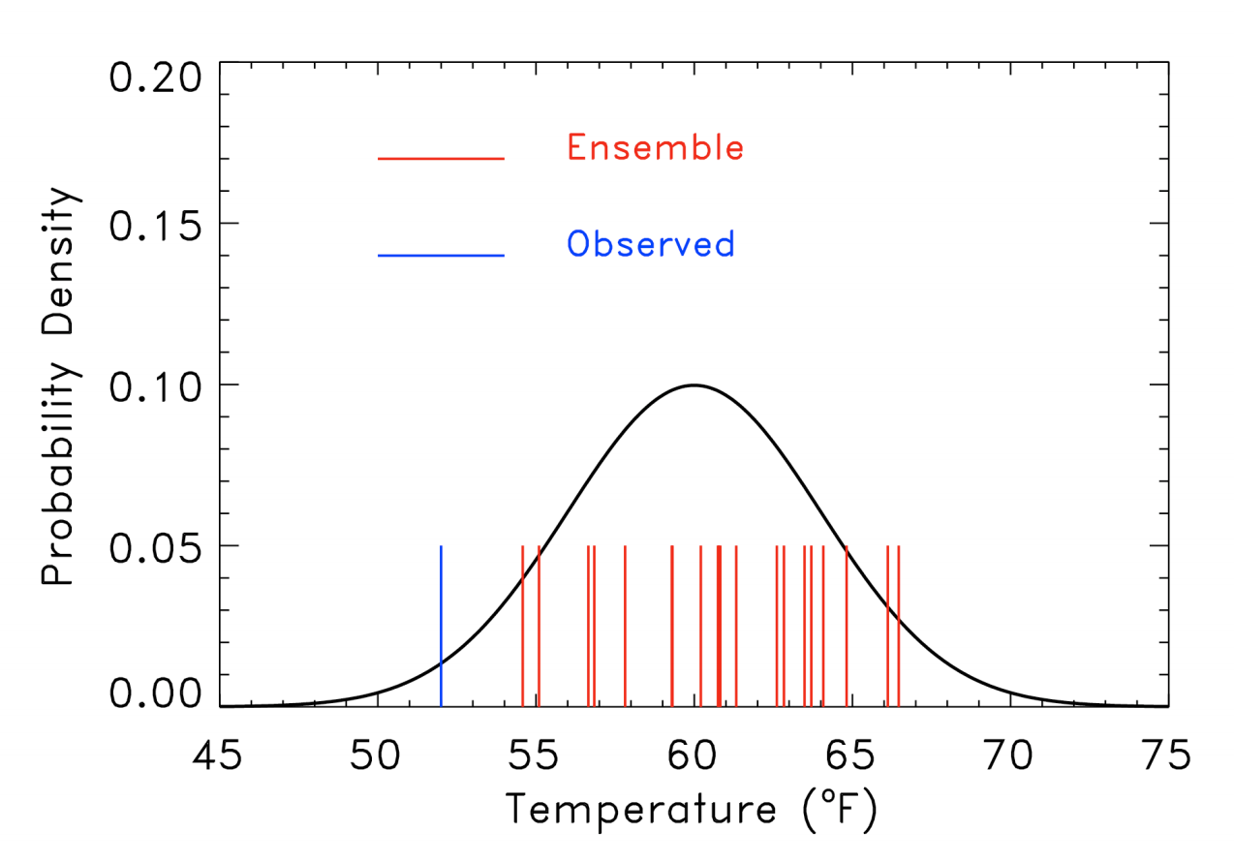
Problematic when observations fall outside of the ensemble: underdispersive ensemble

Slide 14
Ensembles and their PDFs can be used to provide probabilities for meteorological parameter
Simplest approach: What percentage of the ensemble members are within some range?
But can do better than that!
Useful probabilities depend on the ensemble being calibrated and reliably representing the chances of some event happening.

Slide 15
Ensemble systems need to provide probabilistic guidance that is both reliable and sharp.

Slide 16
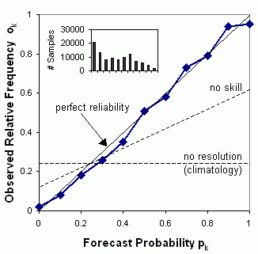
Elements of a Good Probability Forecast
Reliability (also known as calibration)
  A probability forecast p, ought to verify on average with relative frequency p.
  Forecasts from climatology are reliable (by definition), so calibration alone is not enough.
Reliability
Diagram

Slide 17
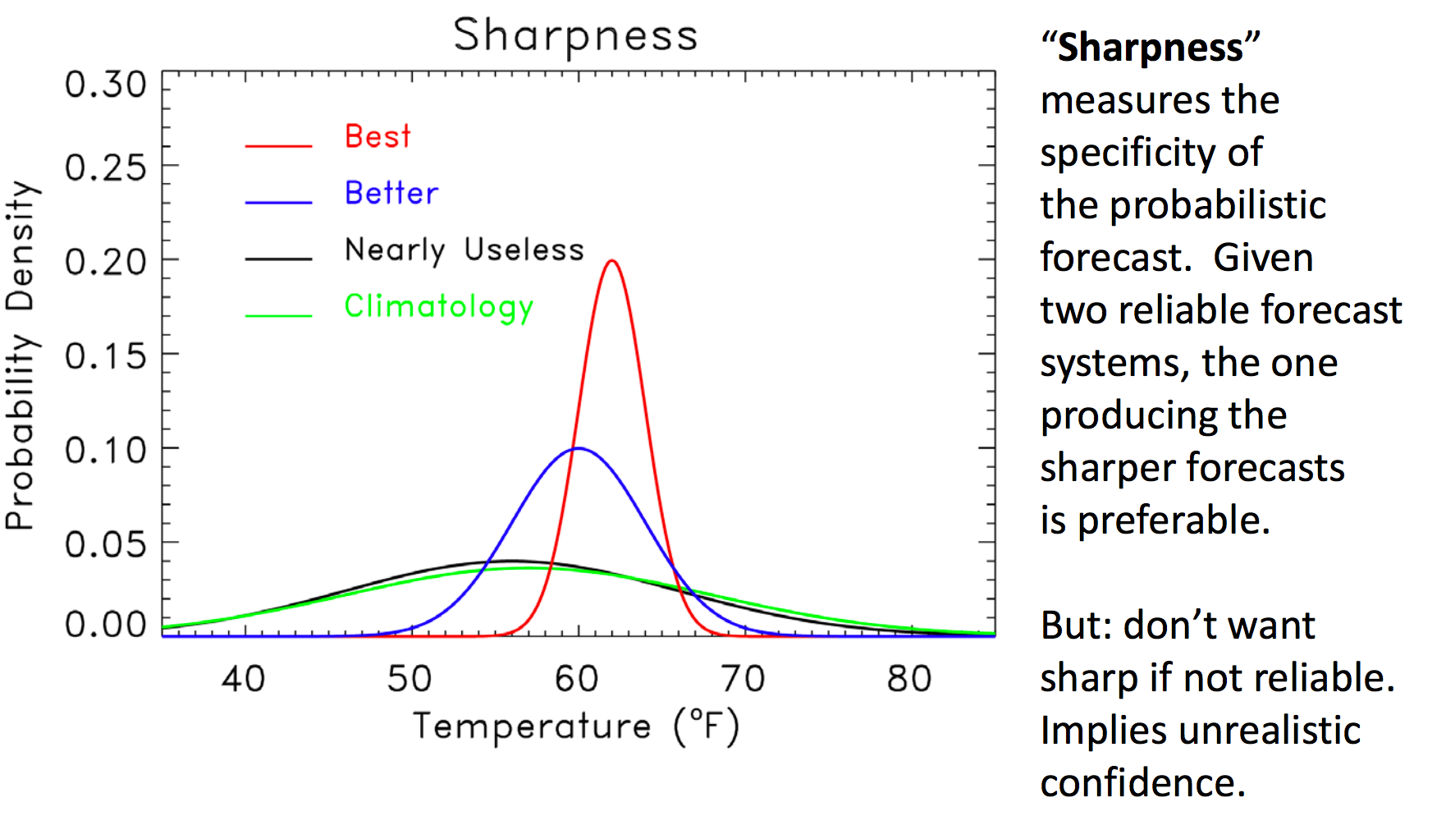
Elements of a Good Probability Forecast
Sharpness (a.k.a. resolution)
  The variance or width of the predicted distribution should be as small as possible.

Slide 18
Sharpness is Good
There is a 66% chance temperature will be between 73 and 77F.
There is a 66% chance temperatures will be between 60 and 80F.
Which is more useful?

Slide 19
Under and Overdispersive Ensembles
If an ensemble does not have enough spread and frequently does not encompass truth, it is underdispersive.
If the spread is too large and often predicts events that are not observed, the ensemble is overdispersive.
Most current ensemble systems are underdispersive.
Like GEFS and the UW ensemble system

Slide 20
Under-dispersive ensembles don’t encompass reality

Slide 21
How can we tell objectively whether an ensemble is underdispersive or overdispersive?

Slide 22
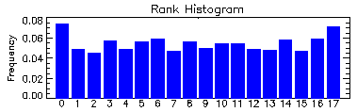
Rank Histogram
Rank histograms (sometimes called verification rank histograms or Talagrand diagrams) compares the spread of ensemble forecasts with observations.

Slide 23
How to make a rank histogram
Step 1: Place ensemble forecasts for some time in order (that is where the term “rank” comes in).
  Example: Assume a 5-member ensemble. The ensemble forecast values at some point could be: {0.25, 0.7, 1.49, 2.17, 4.2}.

Slide 24
Creating Rank Histogram
Step 2: Define bins based on the forecast values from Step 1. There are 6 bins for this list of 5 forecasts ({0.25, 0.7, 1.49, 2.17, 4.2}:
  Values below 0.25 (the lowest ensemble forecast),
  Values between 0.25 and 0.7,
  Values between 0.7 and 1.49,
  Values between 1.49 and 2.17,
  Values between 2.17 and 4.2,
  Values above 4.2 (the highest forecast).

Slide 25
Steps
Step 3: For each ensemble forecast put observed value in the appropriate bin. Do this for all forecasts to be considered.
Step 4: You end up with a histogram of how the observations end up in various bins.

Slide 26
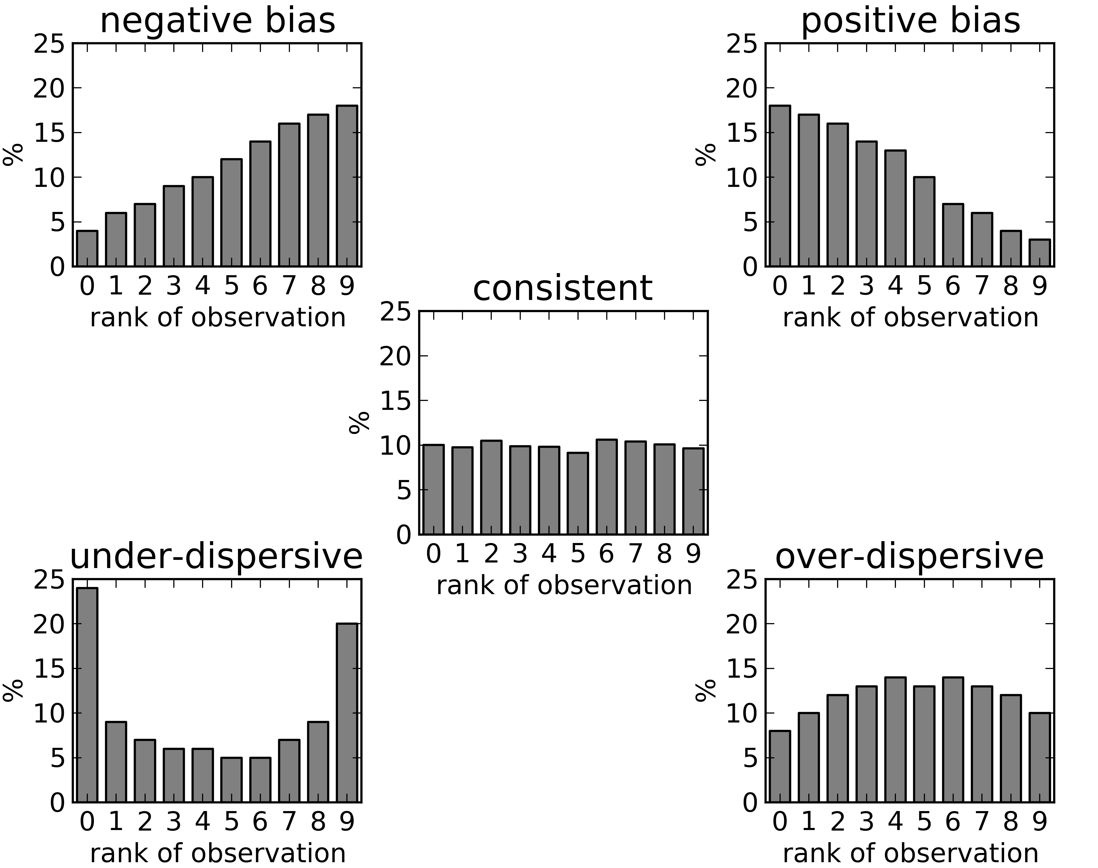
A flat rank histogram is good
Why? Because there should be an equal probability of any ensemble member being correct

Slide 27
In an underdispersive ensemble observations (truth) are missed by the ensemble
Most end up in the tails

Slide 28
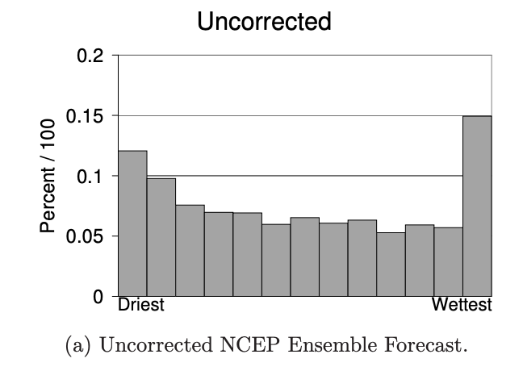
NCEP’s GEFS ensemble is typically underdispersive

Slide 29
Overdispersive: Truth is not frequent enough in the ”tails”

Slide 30
9-member ensemble rank histograms

Slide 31
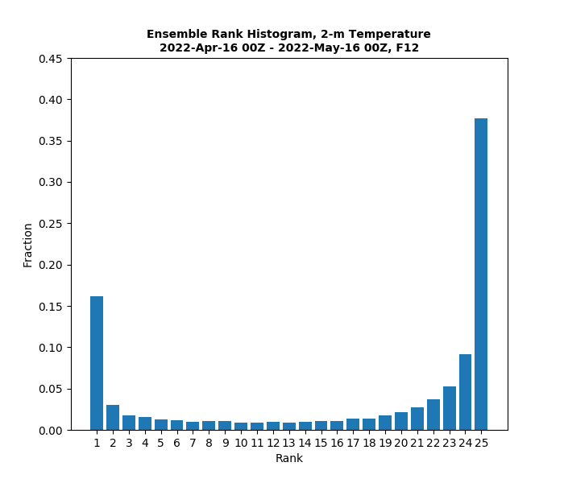

Slide 32
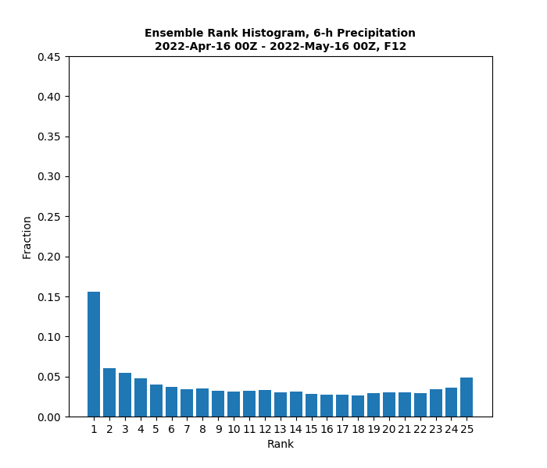

Slide 33
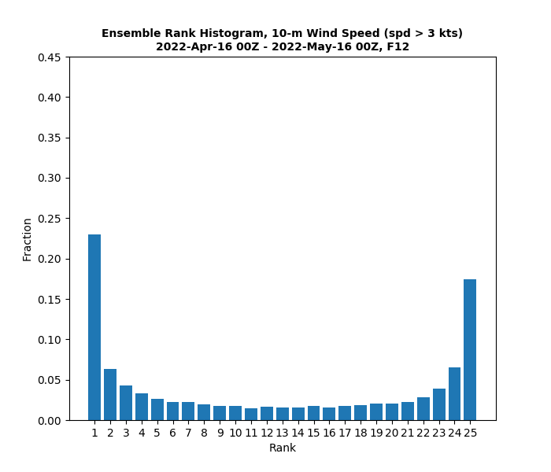

Slide 34
Why are forecasts uncertain?

Slide 35
In general:
Larger ensembles are generally better
Can better explore uncertainty in initial conditions
Can better explore uncertainty in model physics and numerics
Practical experience: Typically need 50-100 ensemble members to do a decent job.
Most operational ensemble systems are too small (NCEP GEFS has 31 members).

Slide 36
How to get uncertainty in ensembles
Vary initial state within the range of observational uncertainty.
Vary physics options (e.g., different physics parameterizations)
Stochastic physics: Add “noise” or variability to parameters within the physics parameterizatin.

Slide 37
Variety of Ways to View Ensembles and Their Output

Slide 38
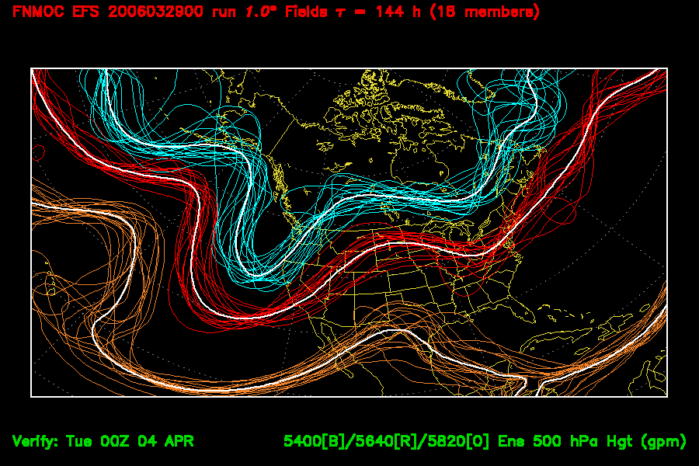
Spaghetti Diagrams: Plot isolines for all ensemble members for various values.

Slide 39
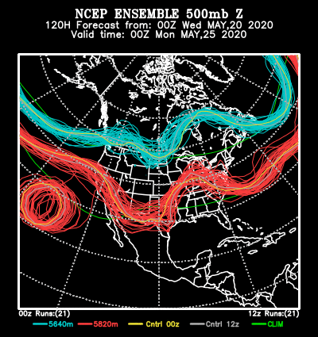
https://psl.noaa.gov/map/images/ens/spag_ussm_animation.html

Slide 40
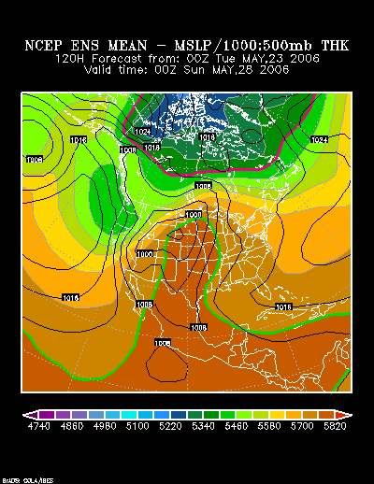
Ensemble Mean. Highly skillful on average, but “smears” out features

Slide 41
https://psl.noaa.gov/map/images/ens/z500anom_ussm_animation.html

Slide 42
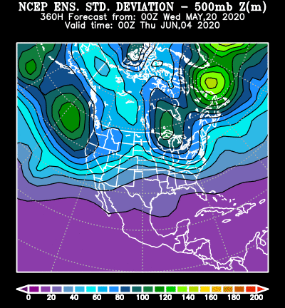
Standard Deviation of Ensemble: Measure of the Variability and Uncertainty

Slide 43
https://psl.noaa.gov/map/images/ens/std_ussm_animation.html

Slide 44
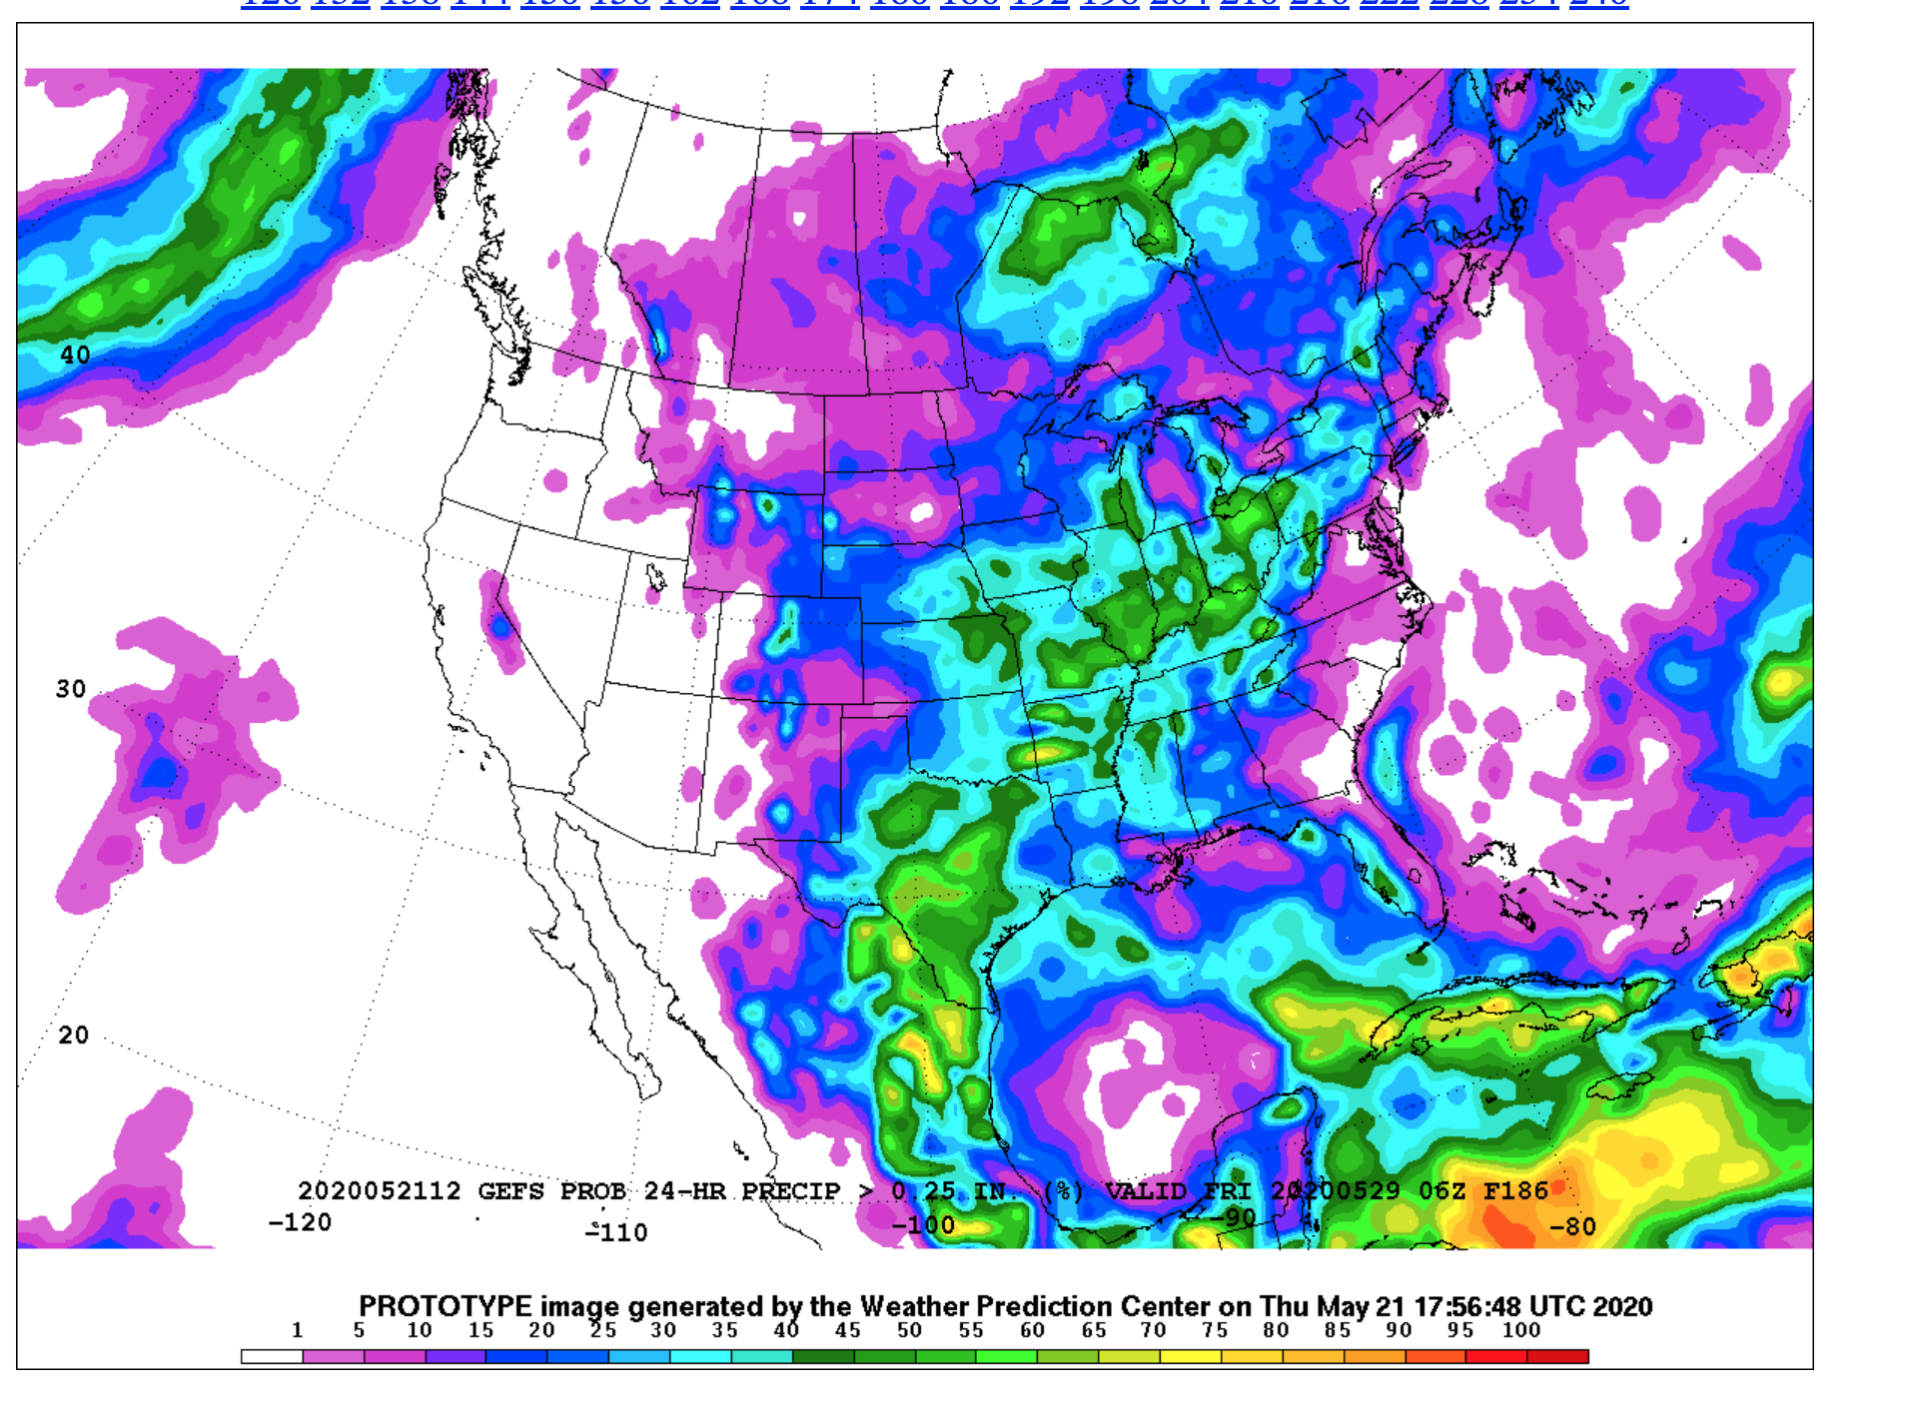
Probability of exceeding some amount

Slide 45
Ensemble Plumes are Increasingly Popular

Slide 47
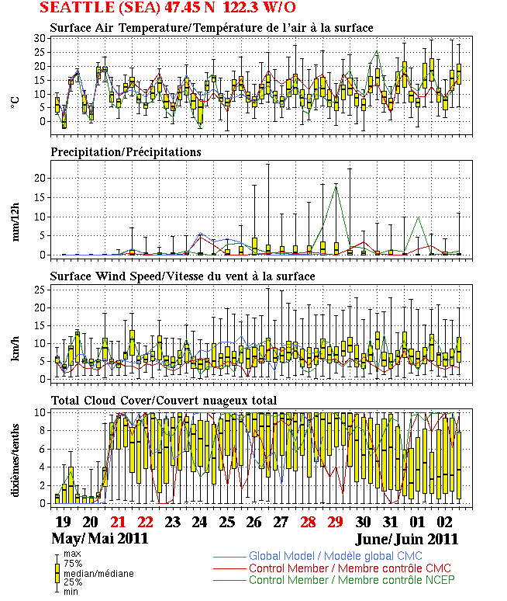
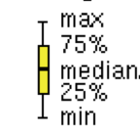
Box and
Whiskers
Yellow box
Shows the interquartile range
https://weather.gc.ca/ensemble/naefs/EPSgrams_e.html

Slide 48
History of Probabilistic and Ensemble Prediction in the US

Slide 49
Early Forecasting Started Probabilistically
Cleveland Abbe, who organized the first forecast group in the United States as part of the U.S. Signal Corp, did not use the term “forecast” for his first prediction in 1871, but rather used the term “probabilities,” resulting in him being known as “Old Probabilities” or “Old Probs” to the public.
A few years later, the term ‘‘indications’’ was substituted for probabilities and by 1889 the term ‘‘forecasts’’ were used.

Slide 50
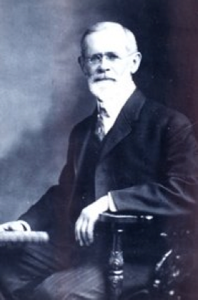
“Ol Probs”
Cleveland Abbe (“Ol’ Probabilities”), who led the establishment of a weather forecasting division within the U.S. Army Signal Corps,
Produced the first known communication of a weather probability to users and the public.
Professor Cleveland Abbe, who issued the first public
“Weather Synopsis and Probabilities” on February 19, 1871

Slide 51
History of Probabilistic Prediction
The first operational probabilistic forecasts in the United States were produced in 1965.
These forecasts, for the probability of precipitation, were produced by human weather forecasters and thus were subjective probabilities. Not based on ensembles.
The first objective probabilistic forecasts were produced as part of the Model Output Statistics (MOS) system that began in 1969.

Slide 52
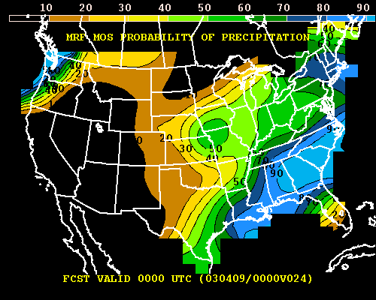
MOS: Probabilities from a Deterministic Forecast
Can produce probabilities by looking at past verifications of forecasts.
For a certain model forecast, what % of the time did it rain in the past?

Slide 53
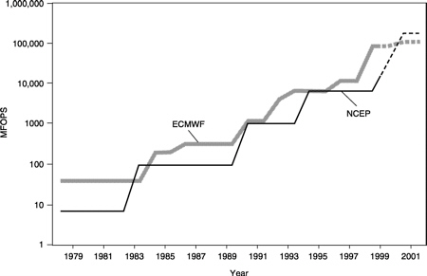
Ensemble Prediction Based Proabilities Became Available as NCEP/NWS Secured More Computer Resources During the late 1980s and 1990s

Slide 54
Operational Ensemble Prediction
Ensemble prediction began at NCEP in the early 1990s. ECMWF rapidly joined the club.
During the past several decades the size and sophistication of the NCEP and ECMWF ensemble systems have grown, with the medium-range, global ensemble systems becoming an integral tool for many forecasters.
NCEP also constructed a higher resolution, short-range ensemble system (SREF).

Slide 55
Some Major Global Ensembles
NCEP GEFS (Global Ensemble Forecasting System): GFS, 31 members every 6 hr, (roughly 25 km resolution), 64 levels
http://www.esrl.noaa.gov/psd/map/images/ens/ens.html)
Canadian CEFS: GEM Model, 21 members, 100 km grid spacing, 0 and 12Z
ECMWF: 51 members, 62 levels, 0 and 12Z, roughly 9 km (here)

Slide 56
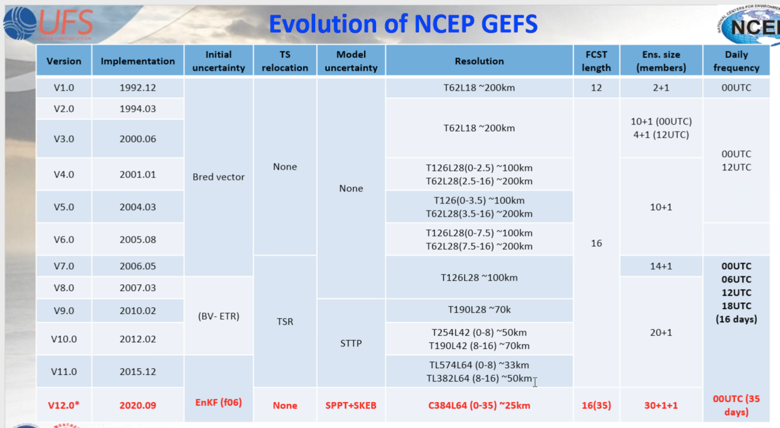

Slide 57
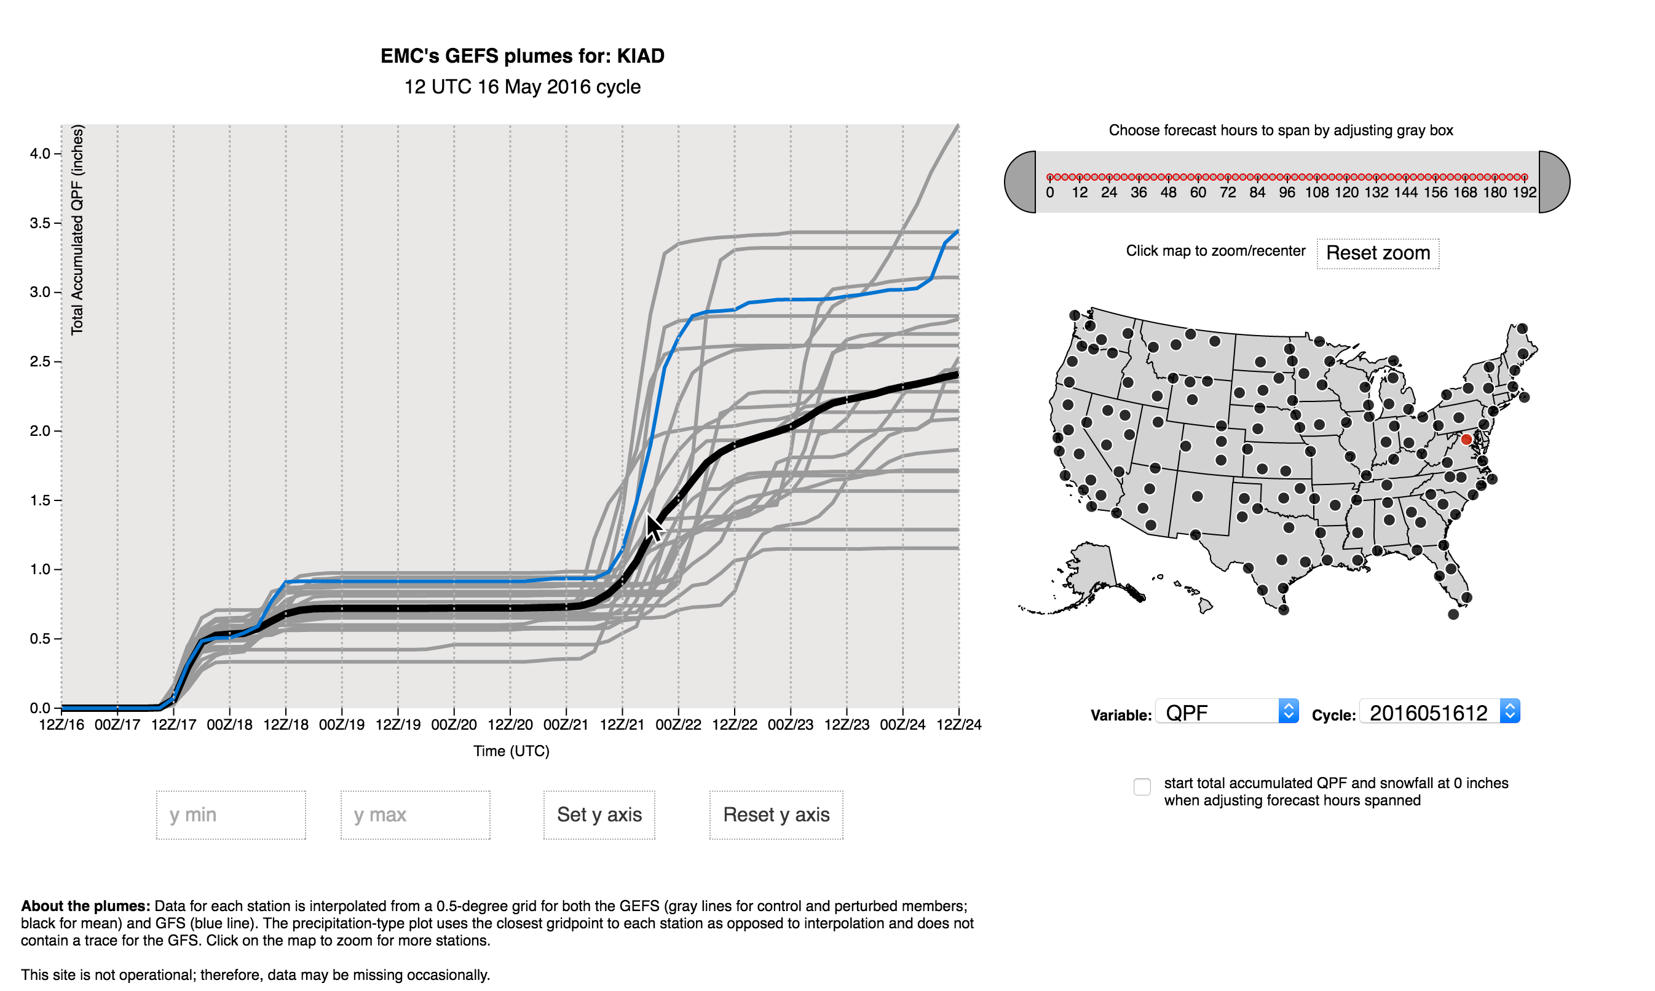
GEFS Ensemble Plume

Slide 58
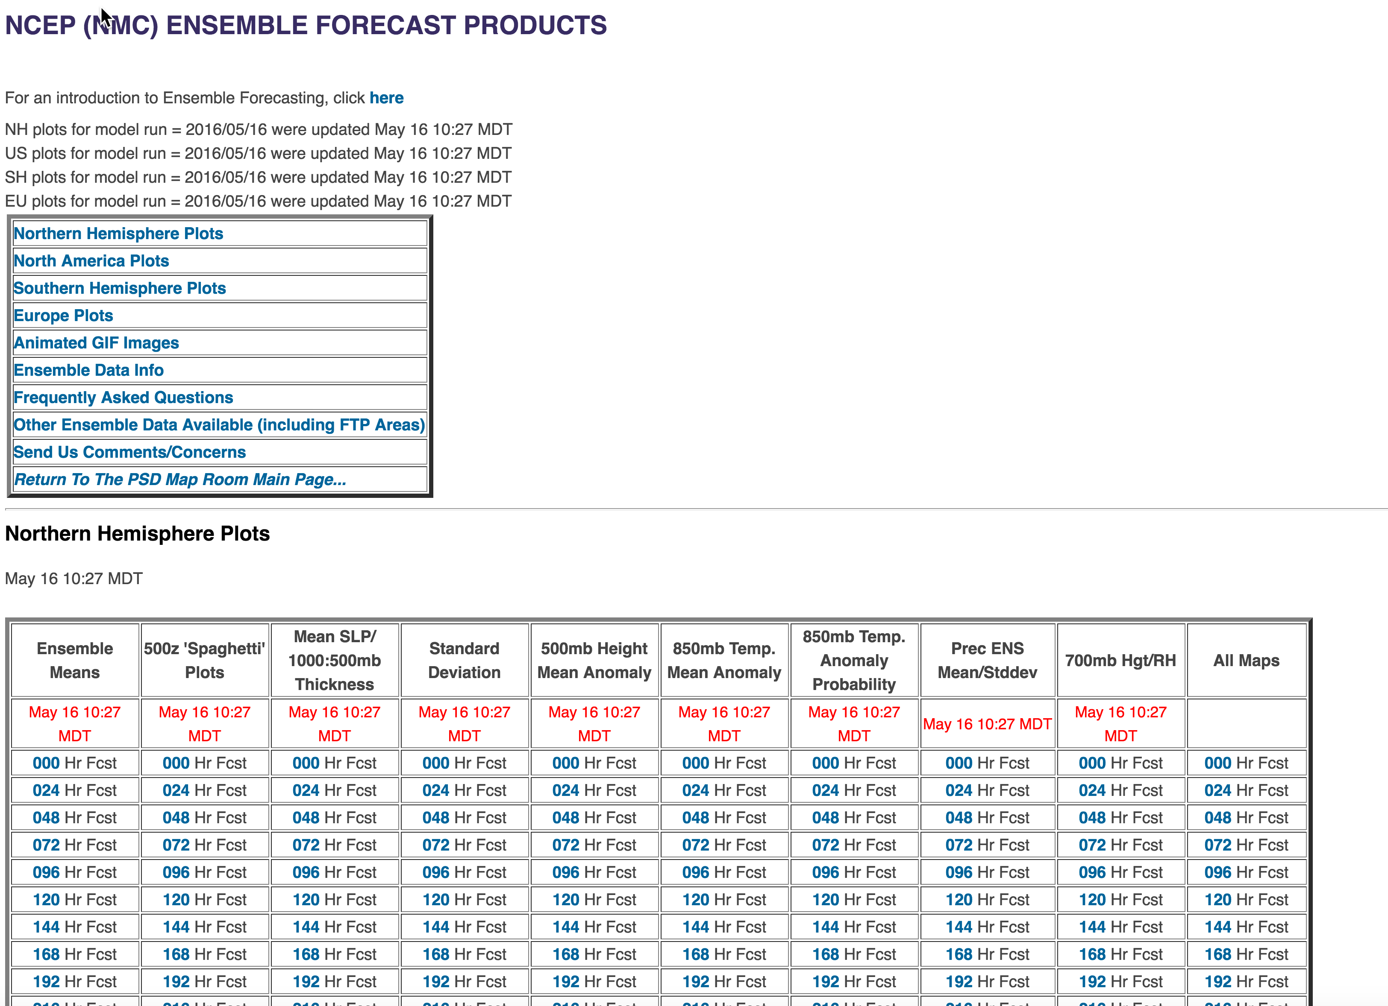
GEFS Ensemble Access

Slide 59
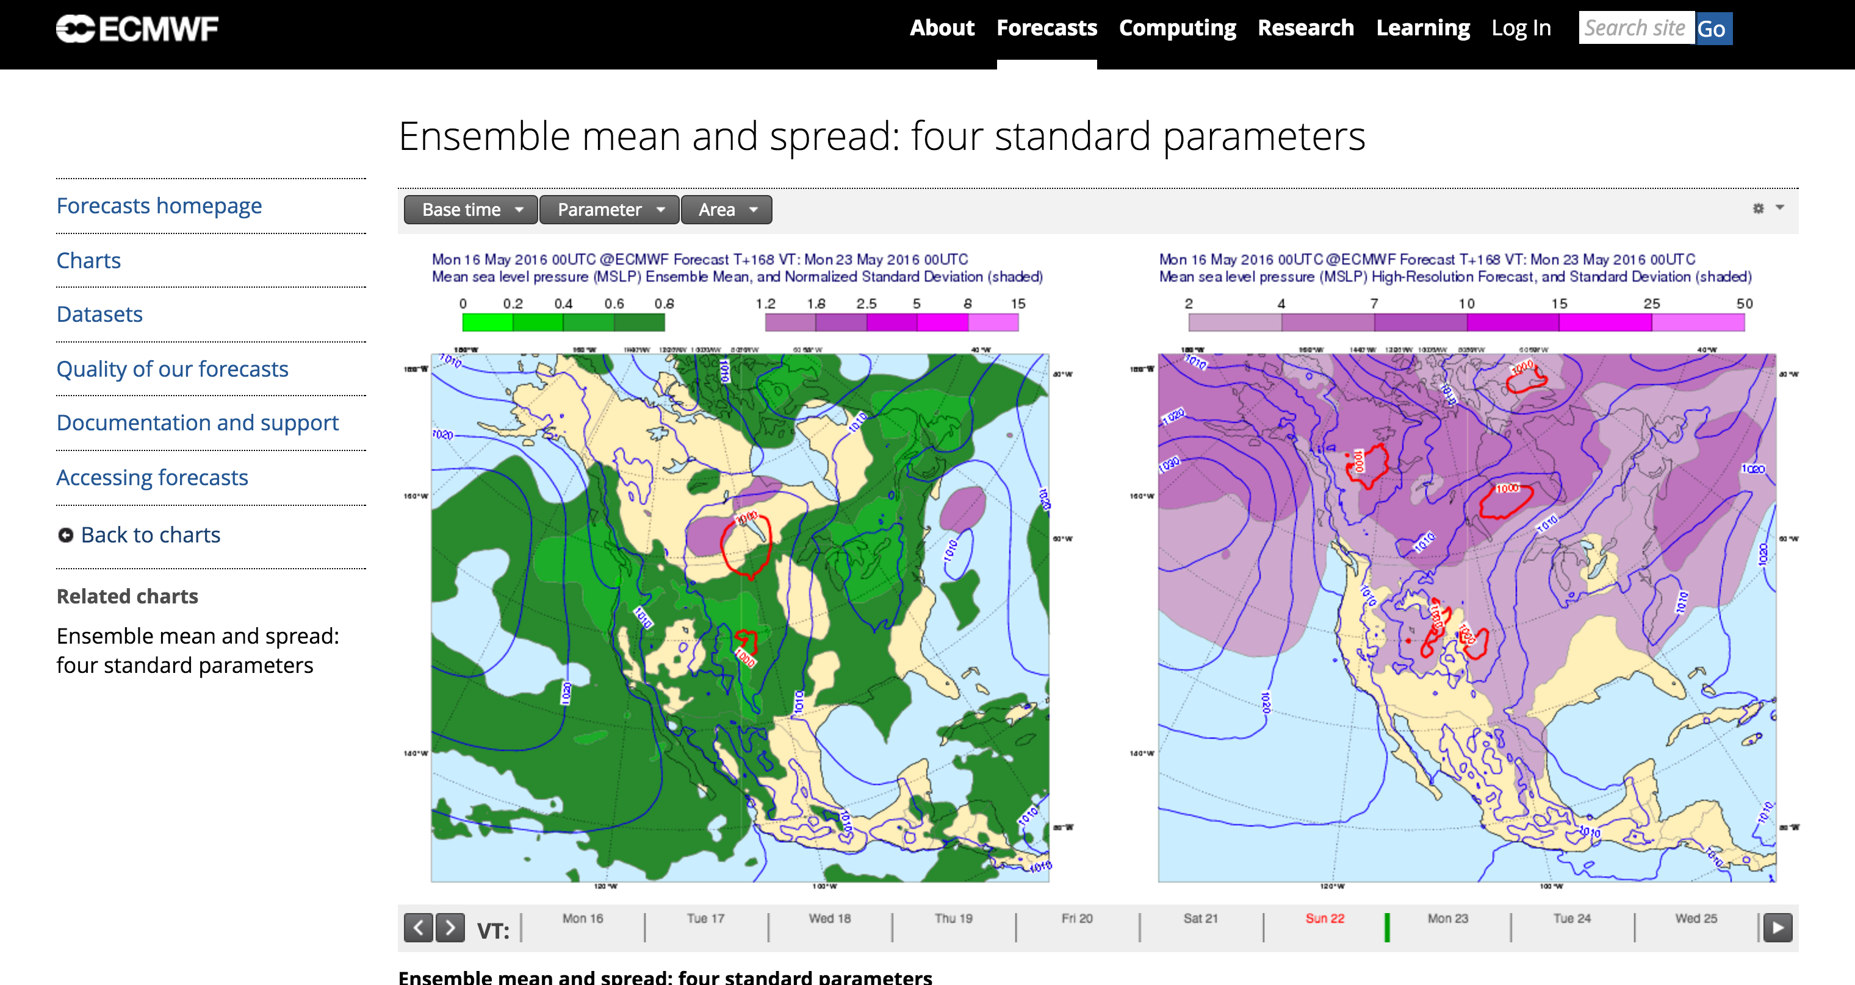
ECMWF Global Ensemble: 51 members, 9-km

Slide 60
Combinations of National Ensemble Systems
North American Ensemble Forecasting Systems (NAEFS): Combines Canadian and U.S. Global Ensembles:
http://www.meteo.gc.ca/ensemble/naefs/EPSgrams_e.html

Slide 61
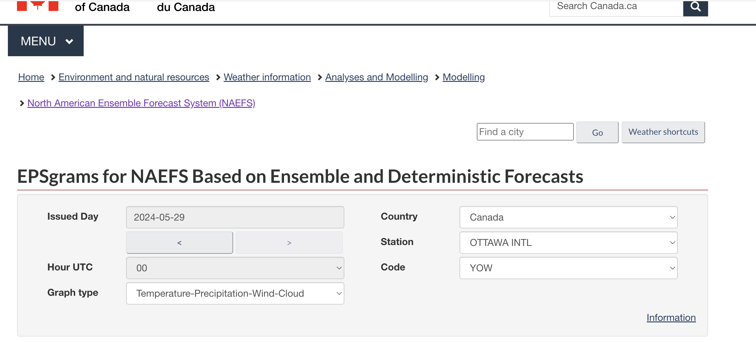

Slide 62
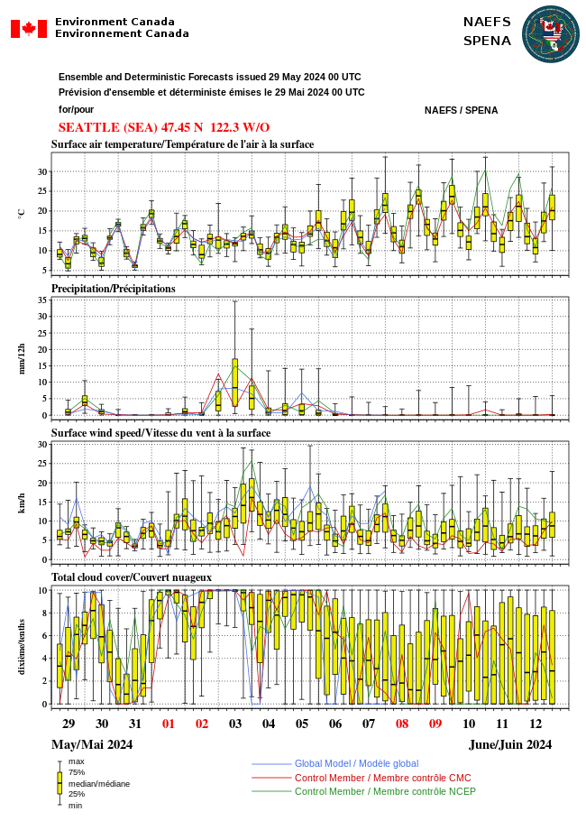

Slide 63
NCEP Short-Range Ensembles (SREF)
Resolution of 16 km
Out to 87 h four times a day (03, 09, 15 and 21 UTC initialization)
Uses both initial condition uncertainty and physics uncertainty.
Uses the NMM-B and WRF-ARW models (26 total members)

Slide 66
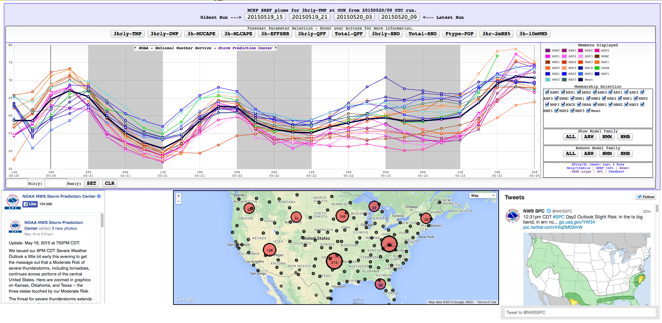
http://www.spc.noaa.gov/exper/sref/fplumes/

Slide 67
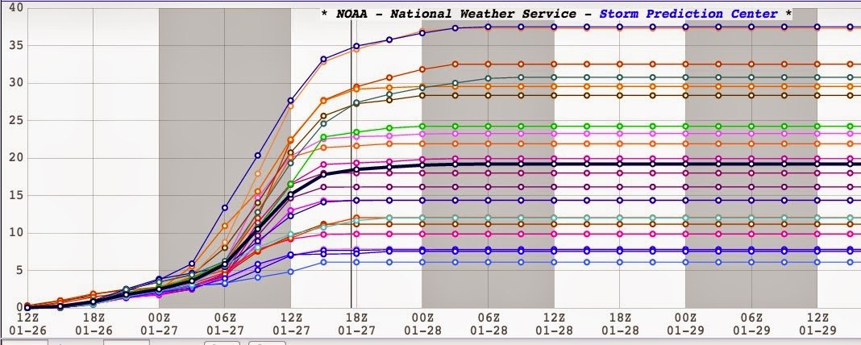
SREF

Slide 68
Major Issues for NCEP/NWS SREF
The solutions of the SREF tend to cluster around the NMMB and ARW members
Clustering is not good for an ensemble system—not randomly sampling from truth

Slide 69
SREF will be dropped soon
Poorly designed and old
Not much higher resolution than the global ensembles

Slide 70
Time Lagged High-Resolution Ensemble
The best approach to create an ensemble is to complete many runs starting at a certain time.
A cheap (but inferior) way is to put together an ensemble from runs made a different times but verifying at the same time.

Slide 71
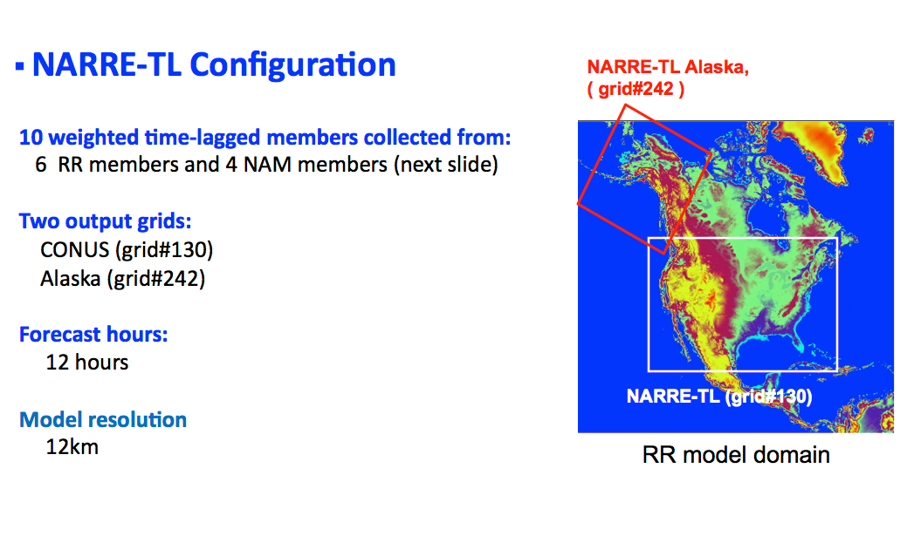
Example: NARRE- (N. American Rapid Refresh Ensemble)

Slide 72
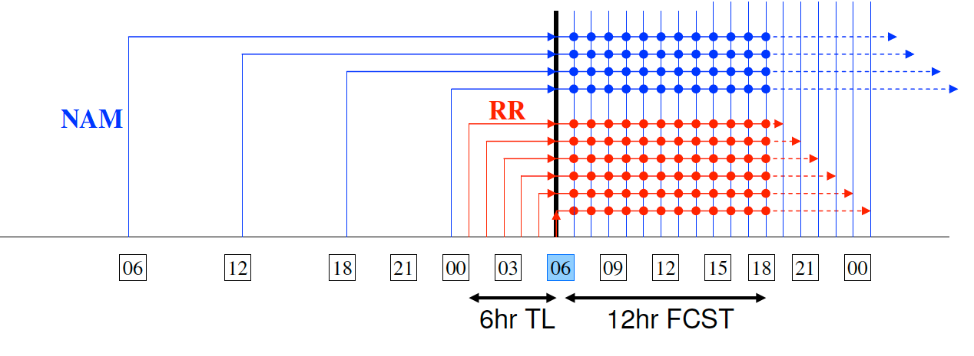

Slide 73
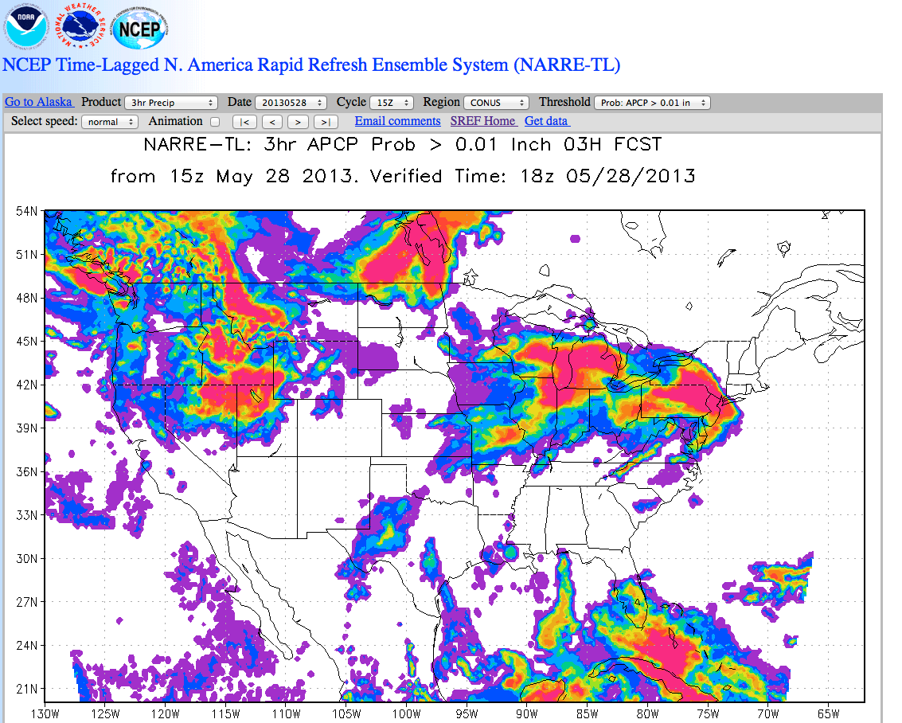
https://www.emc.ncep.noaa.gov/mmb/SREF_avia/FCST/NARRE/web_site/html/apcp3hr.html

Slide 74
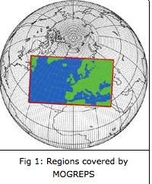
British Met Office MOGREPS
Met Office Global and Regional Ensemble Prediction System
24 members, 18 km, global
18 members, 2.2 km, UK

Slide 75
The Next Frontier: Convection-allowing Ensembles
To model convection must move to 4 km or smaller grid spacing
Need a large enough ensemble to explore uncertainty

Slide 76
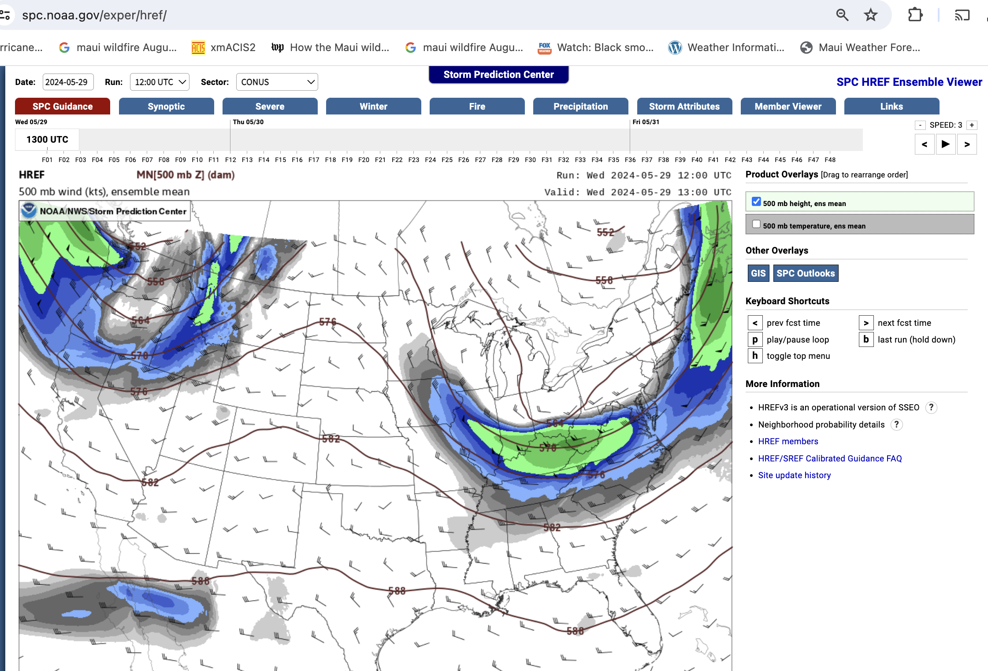
NOAA Has a Small High-Resolution Ensemble (HREF)

Slide 77
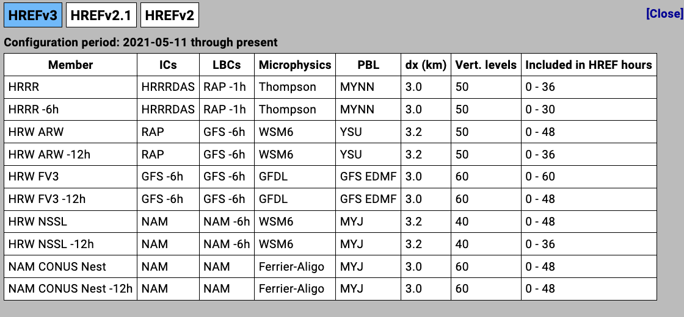
A Kludge of a Variety of High-Resolution Runs

Slide 78
https://www.spc.noaa.gov/exper/href/

Slide 79
NCAR Now runs a 8-member high-resolution ensemble
Uses MPAS
3-km grid spacing
Only for May-June

Slide 80
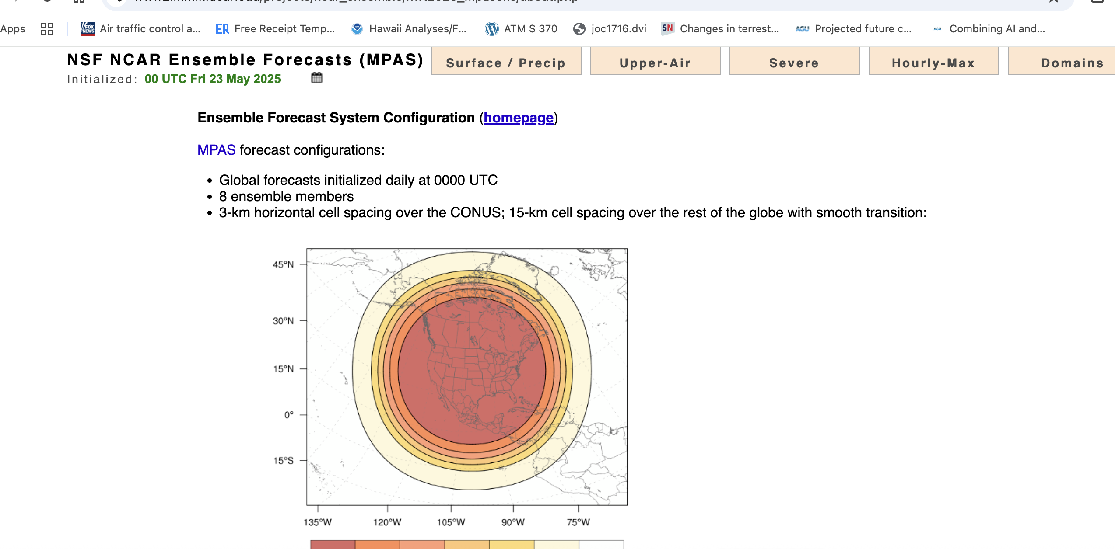

Slide 81
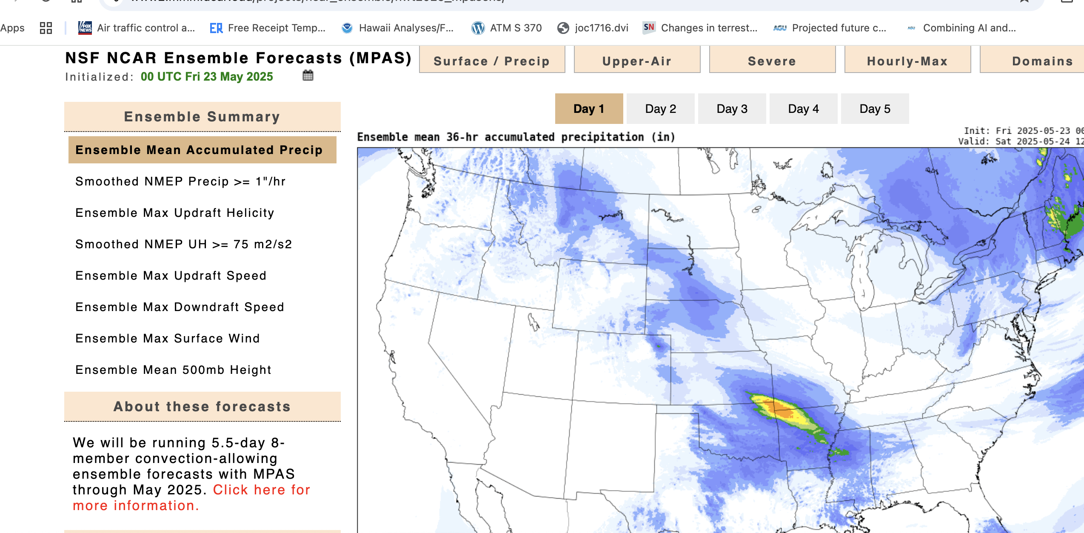

Slide 82
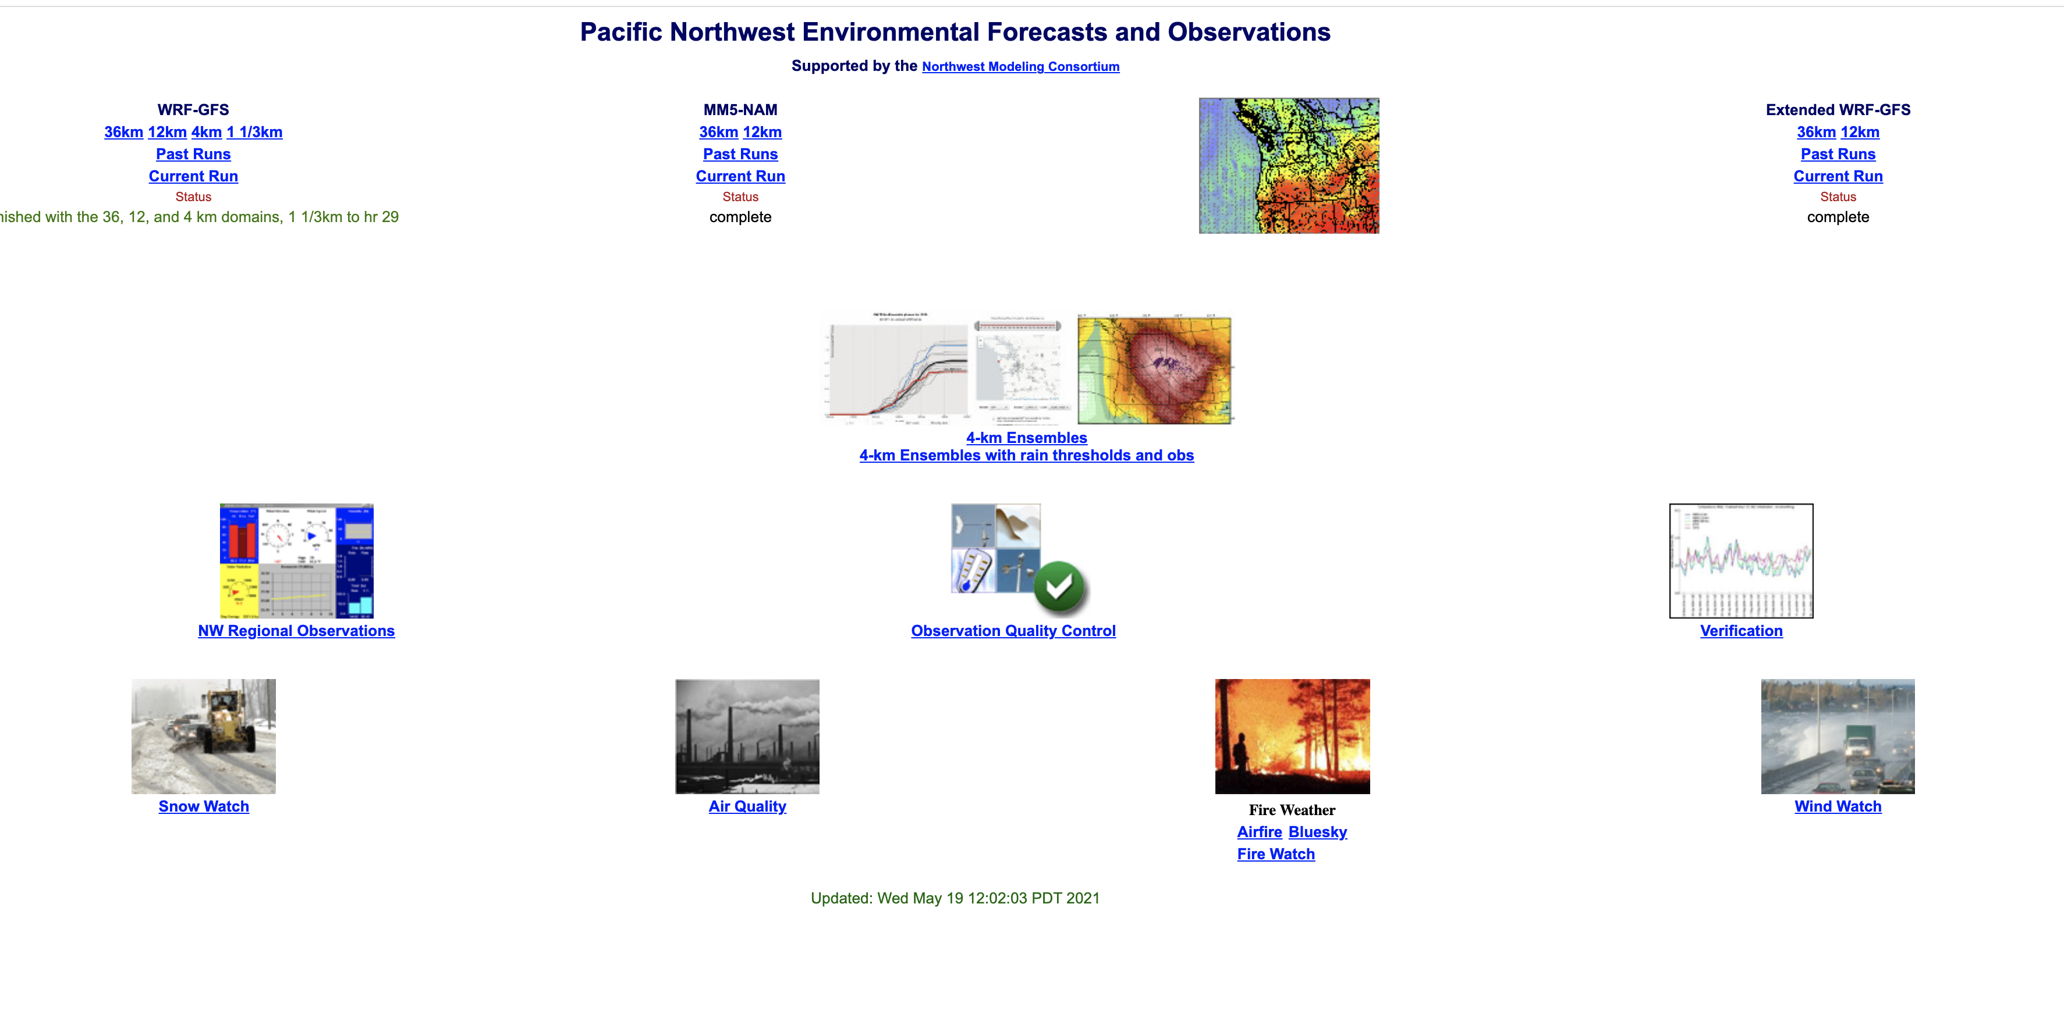
UW High-Resolution Ensemble System: 4-km, 25 members
https://a.atmos.washington.edu/mm5rt/

Slide 83
Summary of Issues With Modern Ensembles
Virtually all modern ensembles are underdispersive, which means the truth often falls outside of the ensemble
Need to find ways of better exploring initial condition and physics uncertainty.
Ensembles need to larger and higher resolution.
Their output needs to be statistically calibrated, so they give reliable probabilities

Slide 84
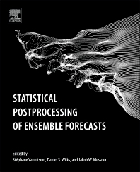
Ensemble Post-Processing
Ensemble output can be post-processed to improve them
Can weight better ensemble members more.
Correct biases
Improve the width of probabilistic distributions (pdfs)—correct for underdispersion and over dispersion

Slide 85
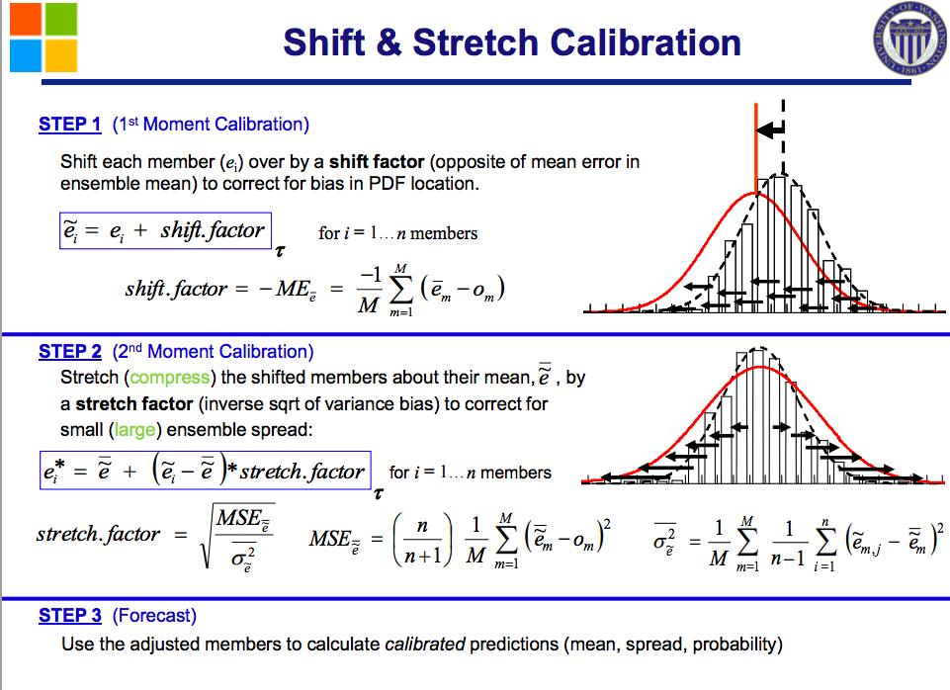
Ensembles can be calibrated
Correct Bias
Correct
Spread

Slide 86

Ensemble Systems Probabilities Provide Value Over Deterministic
Prediction

Slide 87
There is a whole theory on using probabilistic information for economic savings: Decision Theory
C= cost of protection
L= loss if bad event event occurs
Decision theory says you should protect if the probability of occurrence is greater than C/L

Slide 88

Example: Wind Damage to Aircraft

Slide 89
Critical Airport Event: sfc winds > 50kt
Cost (of protecting): $150K
Loss (if damage ): $1M

Slide 90
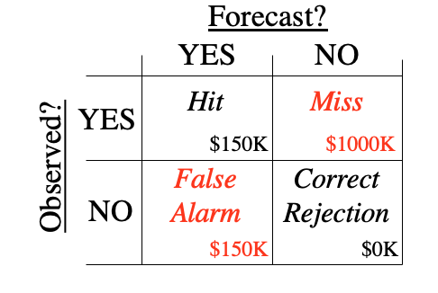
Contingency Table

Slide 91
Decision theory says you should protect if the probability of occurrence is greater than C/L
In this case: C= 150K
L= 1000 K
C/L=.15 or 15%

Slide 92
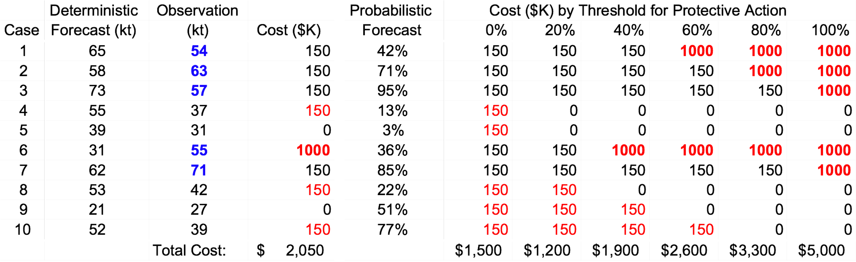
Decision Theory Example
Forecast?
YES NO
Critical Event: sfc winds > 50kt
Cost (of protecting): $150K
Loss (if damage ): $1M
YES
NO
Hit
False
Alarm
Miss
Correct
Rejection
Observed?
$150K
$1000K
$150K
$0K
Optimal Threshold = 15%

Slide 93
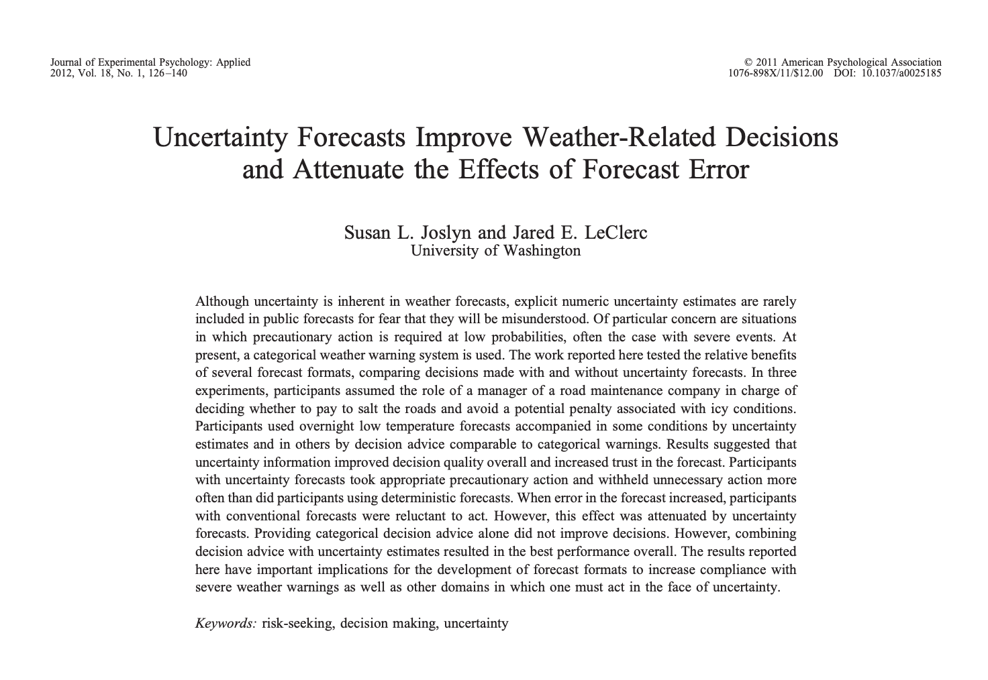
Better decisions with uncertainty information

Slide 94
Deterministic Nature?
People seem to prefer deterministic products: “tell me exactly what is going to happen”
People complain they find probabilistic information confusing. Many don’t understand POP.
Media and internet not moving forward very quickly on this.

Slide 95
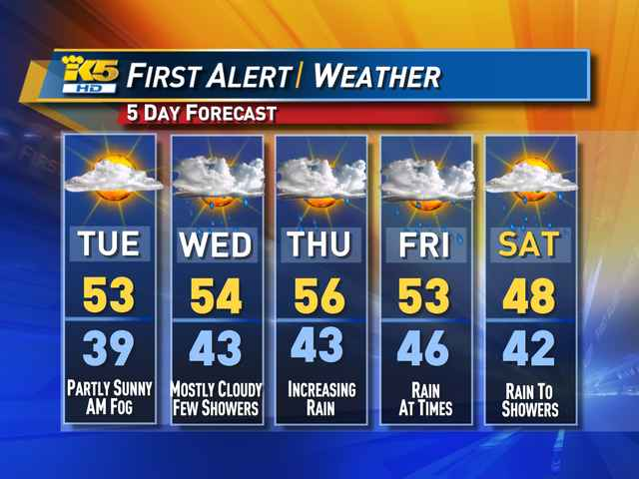

Slide 96
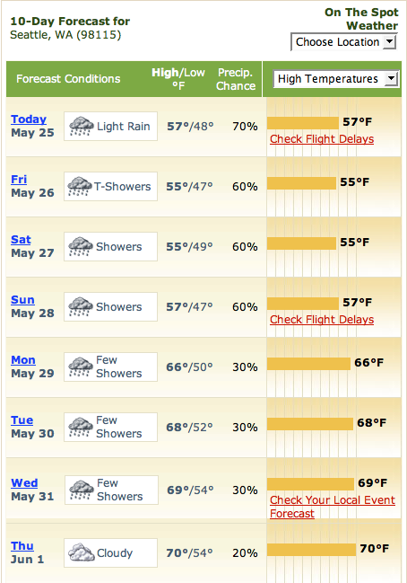
Commercial sector is no better

Slide 97
A great deal of research and development is required to develop effective approaches for communicating probabilistic forecasts which will not overwhelm people and allow them to get value out of them.

Slide 98
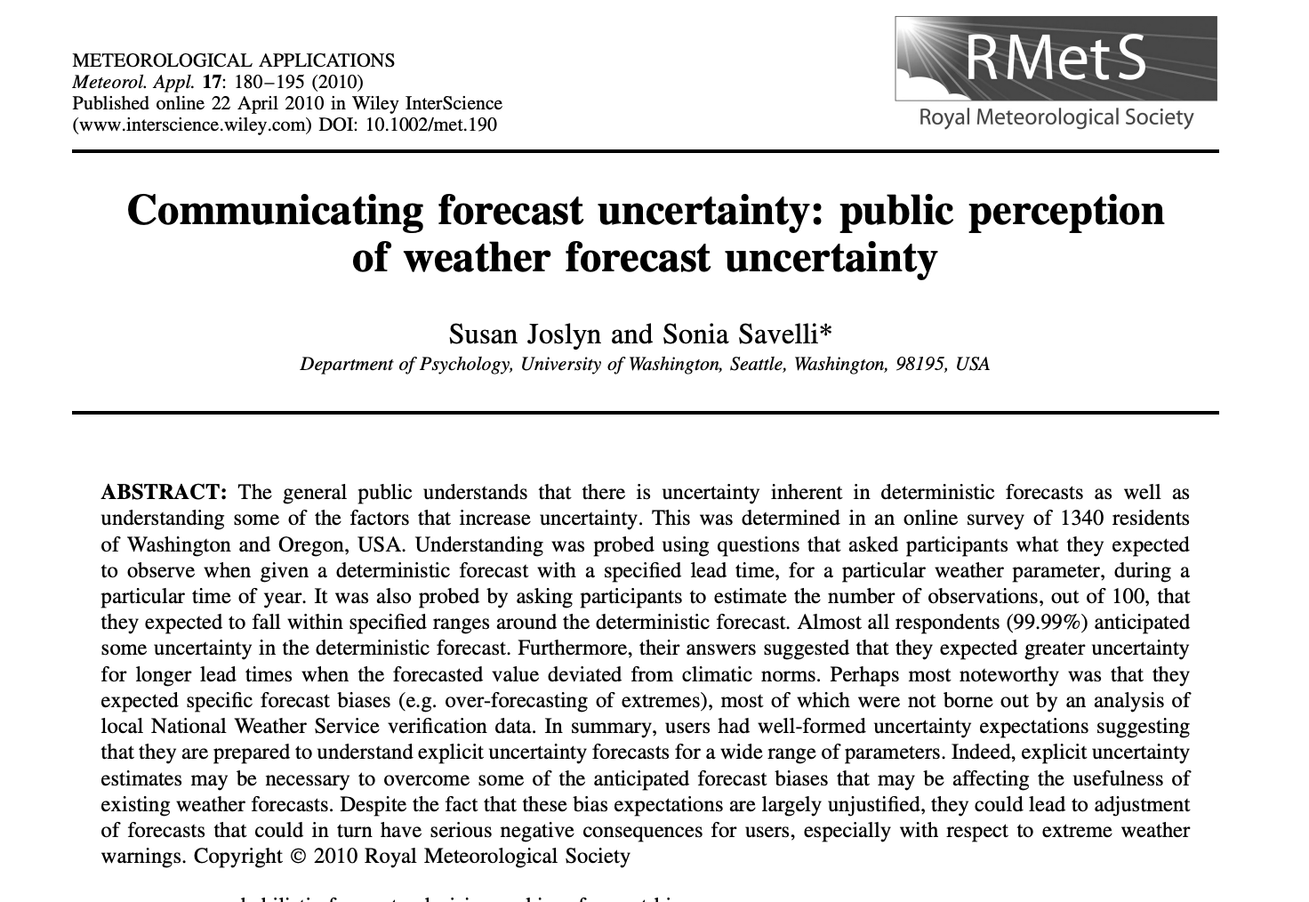

Slide 99
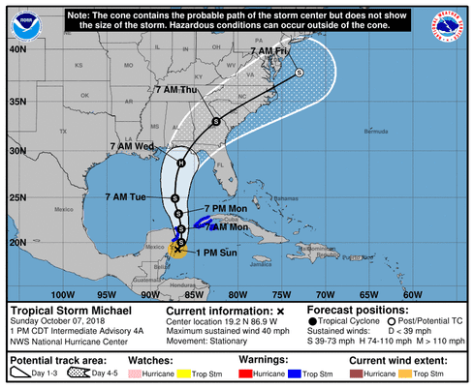
Uncertainty Information in Hurricane Forecasting

Slide 100


Slide 101


Slide 102
Machine Learning, Ensembles, and Probabilistic Prediction
ML/AI NWP allows for the creation of large ensembles at little cost.
Ensemble AIFS (European Center)-50 members

Slide 103


Slide 104
Issues with AI-ensembles
Initial condition uncertainty is straightforward
What about physics uncertainty?
What about extreme and unprecedented situations?

Slide 105
AL/ML Post-Processing
Would be MUCH better than MOS or the National Blend of Models (the MOS replacement).
Could produce improved probabilistic guidance without ensembles.

Slide 106
The END

Slide 107
Ensembles Have Proven Their Value!

Slide 108


Showed Value During NE U.S. Snowstorm http://cliffmass.blogspot.com/2015/01/forecast-lessons-from-northeast.html

