Slide 1
452 Precipitation Forecasting
ATMS 452
Spring 2025

Slide 2
Prediction of Clouds and Precipitation is Challenging
Most precipitation is inherently mesoscale and many models lack sufficient resolution.
H₂0 vapor is relatively poorly observed on both the mesoscale and synoptic scale.
Microphysics problems are substantial. Other physics problems (e.g., PBL) add to the difficulties.
Cumulus parameterizations are problematic.

Slide 3
Cloud and precipitation microphysics
Microphysics refers to the physical processes occurring at the scale of individual cloud and precipitation particles or hydrometeors (sub‐micron to several centimeters).

Slide 4
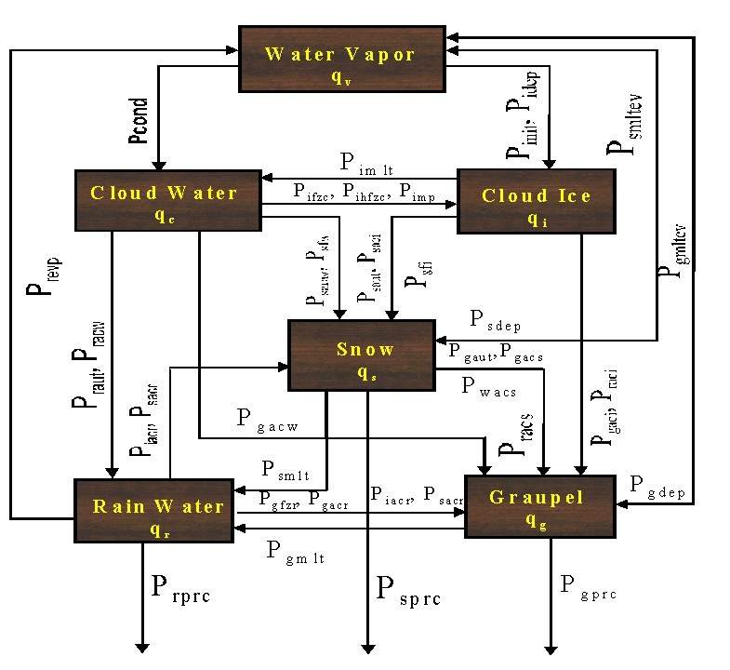
Model Microphysics: Highly Complex and Too Simple

Slide 5
Model Microphysics
Most models use bulk parameterizations that predict mixing ratios (e.g., g of X to kg of dry air) of various cloud/precipitation species (like cloud water). Called single-moment schemes
Newer schemes are double moment, predicting mixing ratio and the number concentrations of each precipitation/cloud type.
Both single and double moment schemes assume size distributions for clouds and precipitation, often some kind of exponential.

Slide 6
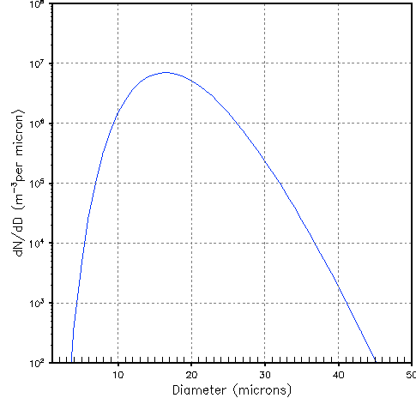
Cloud Droplet Size Distribution

Slide 7
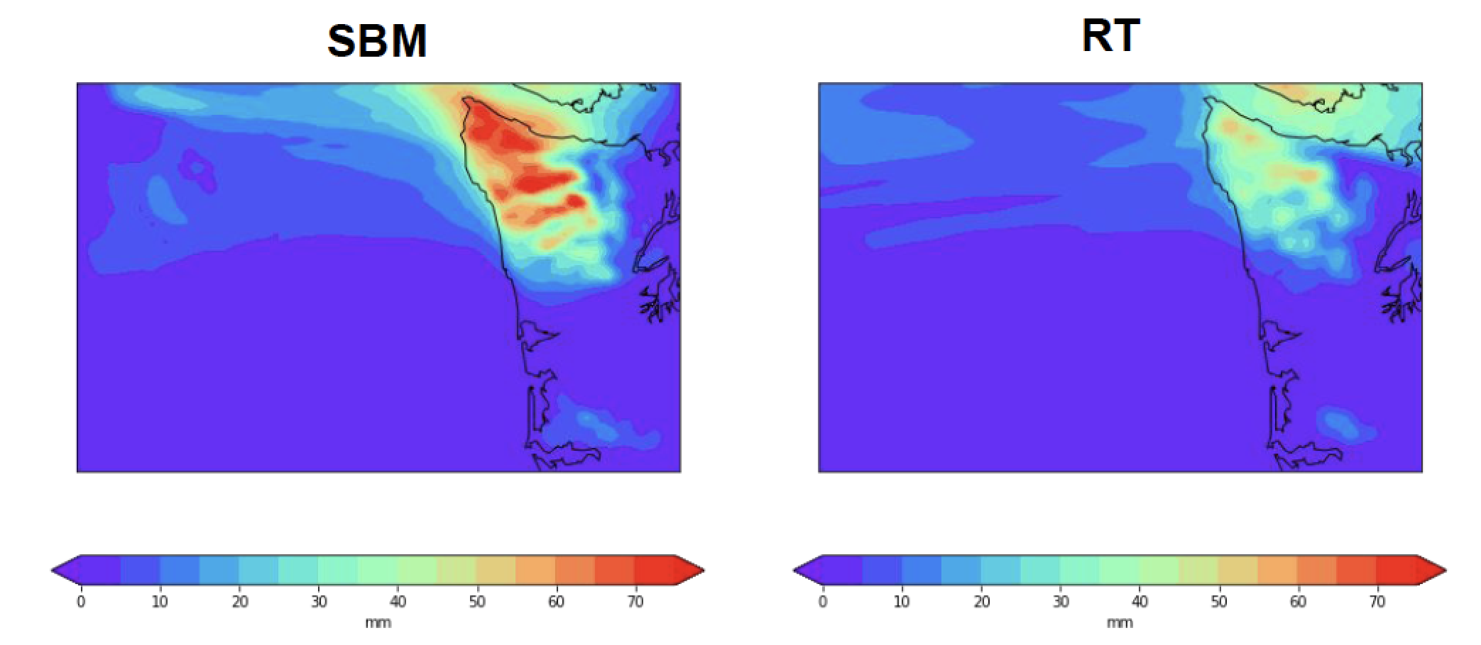
Spectral Bin Microphysics Schemes are even more sophisticated
They predict the details of the size distribution by dividing it into size bins, each of which is forecast over time.
Produces more skillful precipitation
Computationally expensive. Too much for operational application.

Slide 8
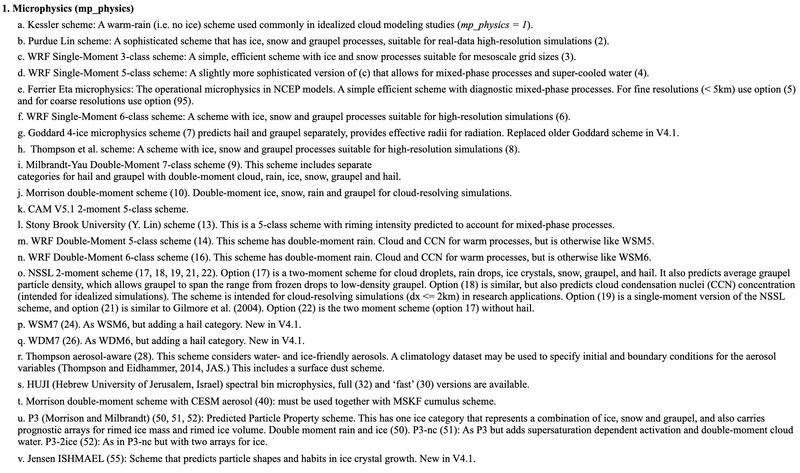
There are a LOT of Microphysics Parameterizations Available

Slide 9
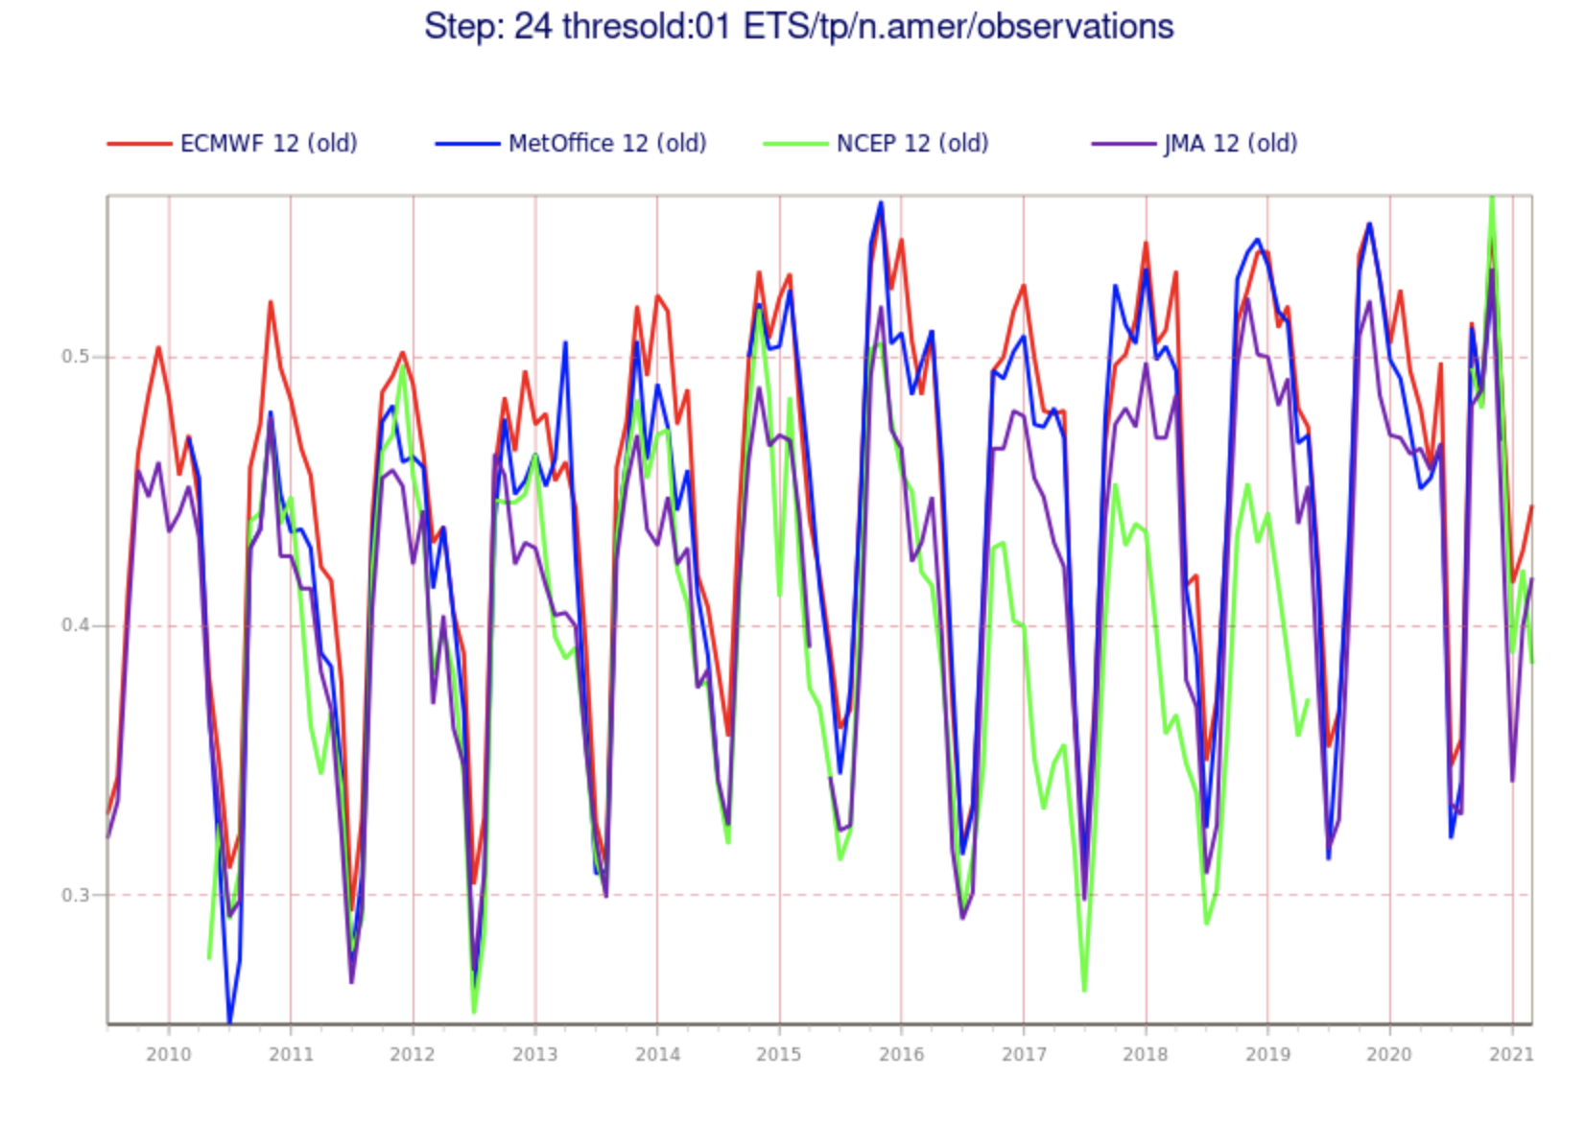
Precipitation Forecast Skill
Modest improvement during the past 30 years
Skill declines with intensity
Humans add less skill than for most other weather parameters

Slide 10

Question.
Is Precipitation Forecast Skill Generally Better in the Summer or Winter?

Slide 11
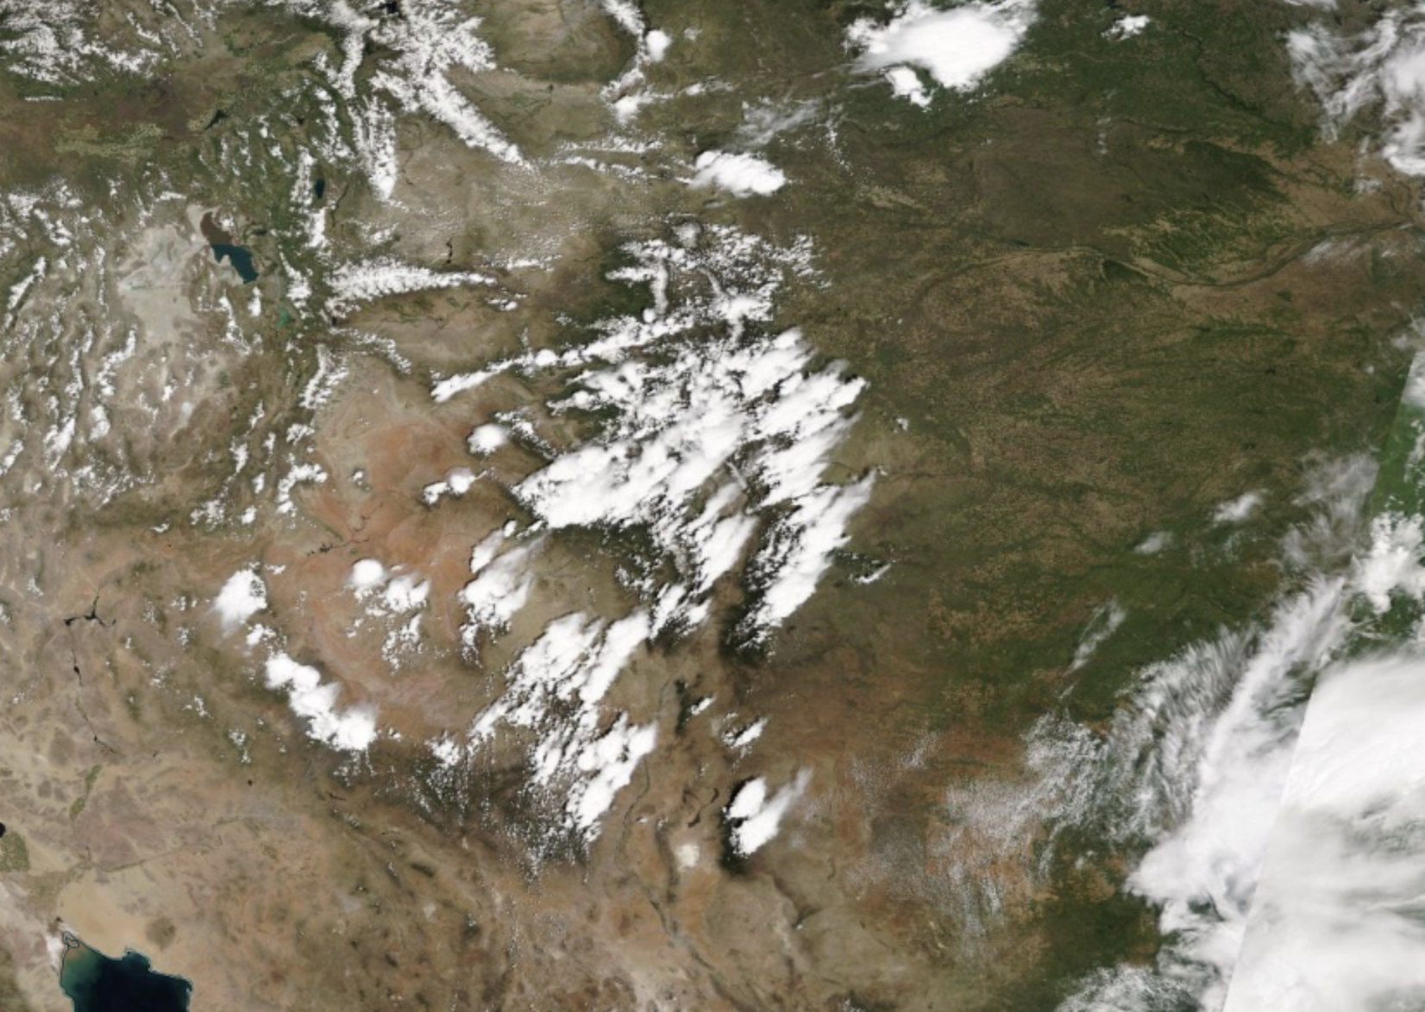
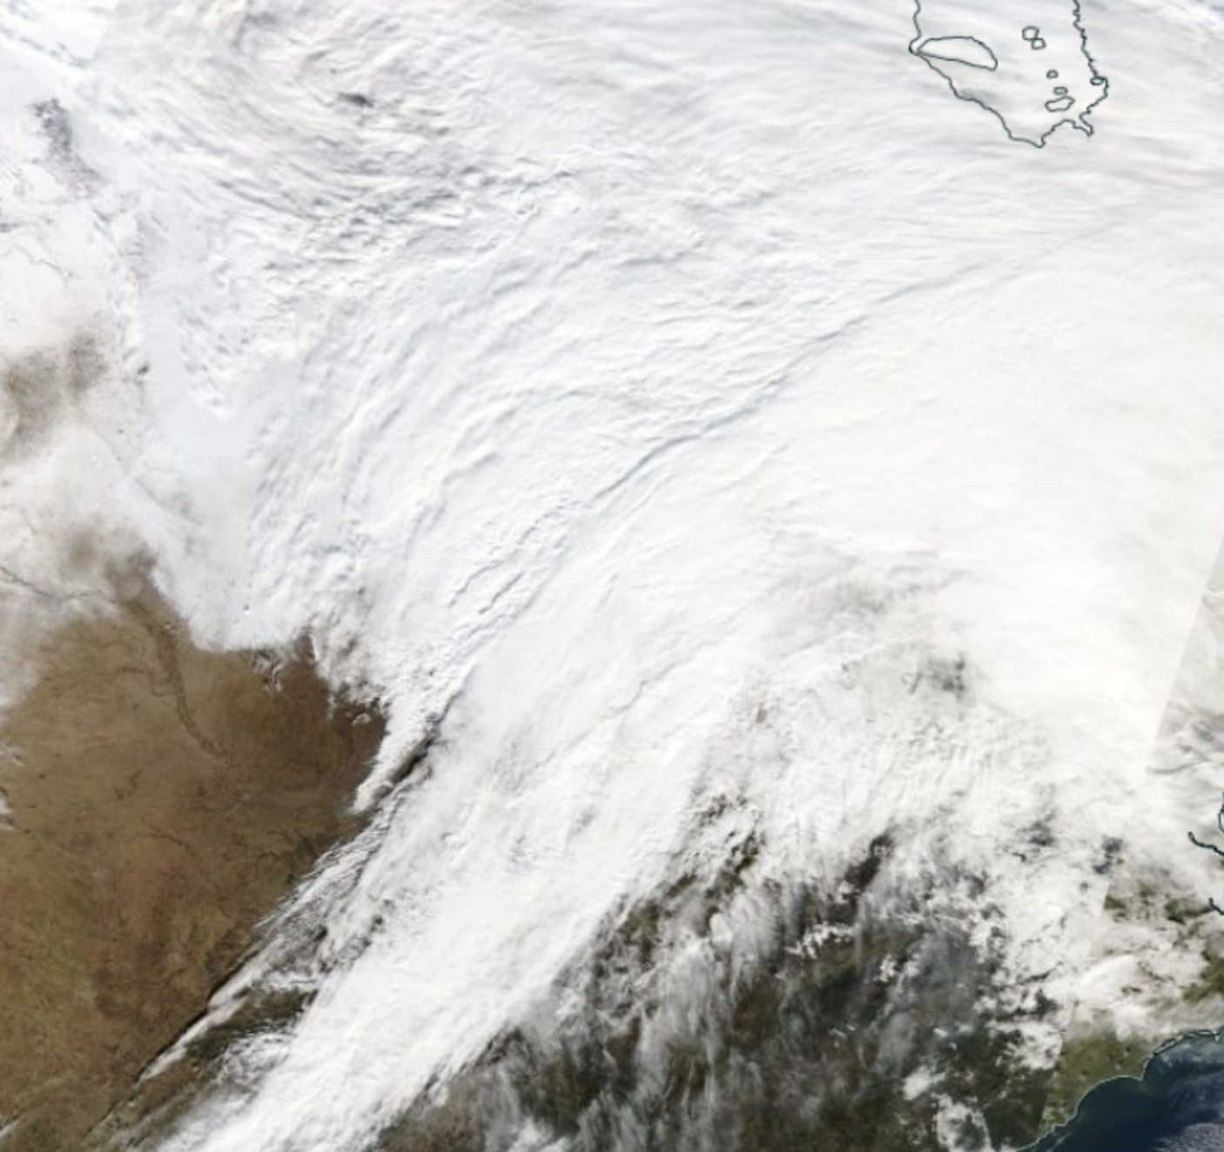
The Answer
Better in winter when precipitation is more synoptic and stratiform
Less skillful in summer when more convective
Less skillful
More Skillful

Slide 12
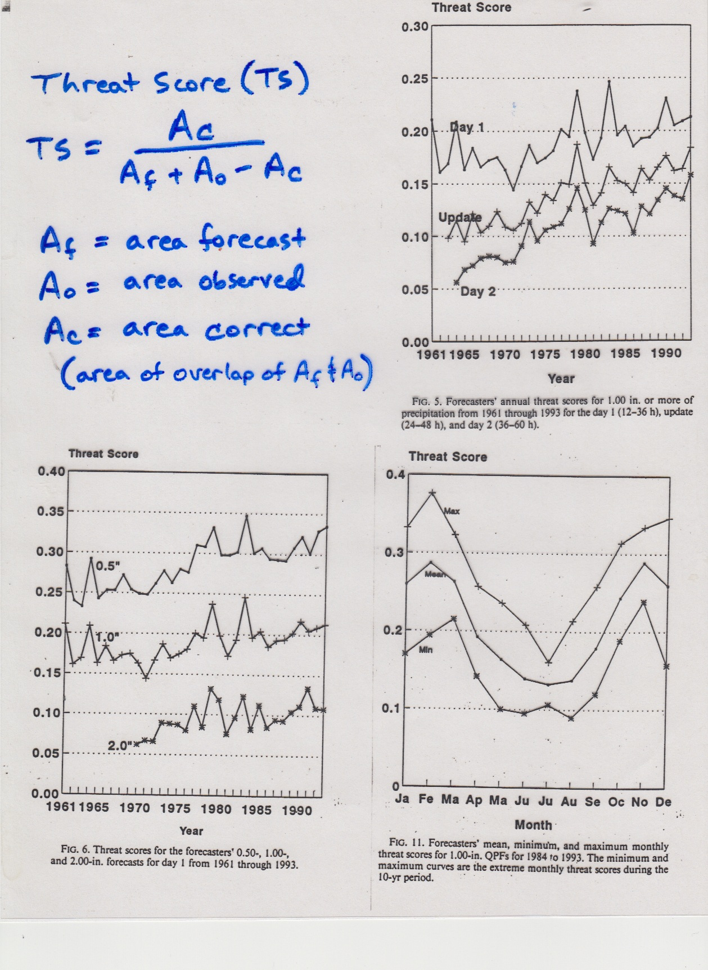

Slide 13
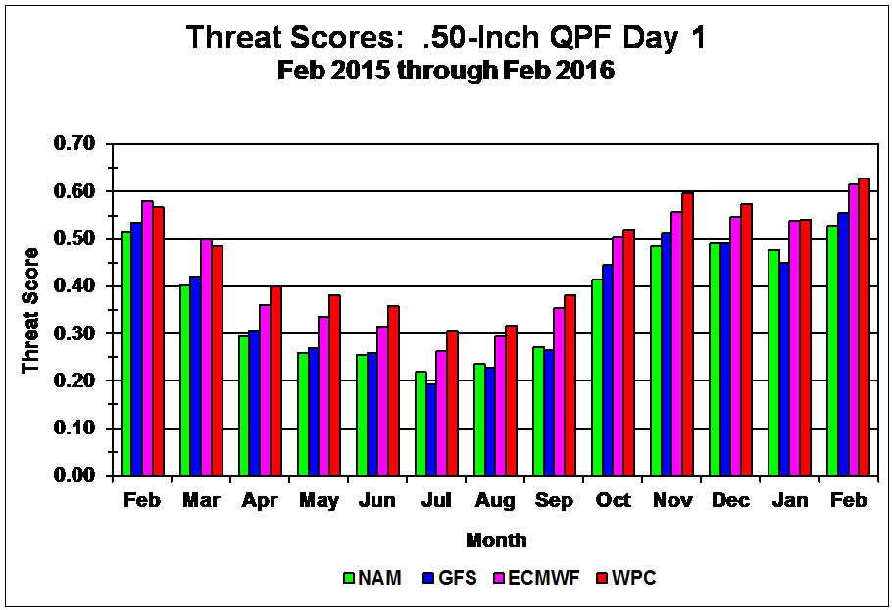
More recent

Slide 14
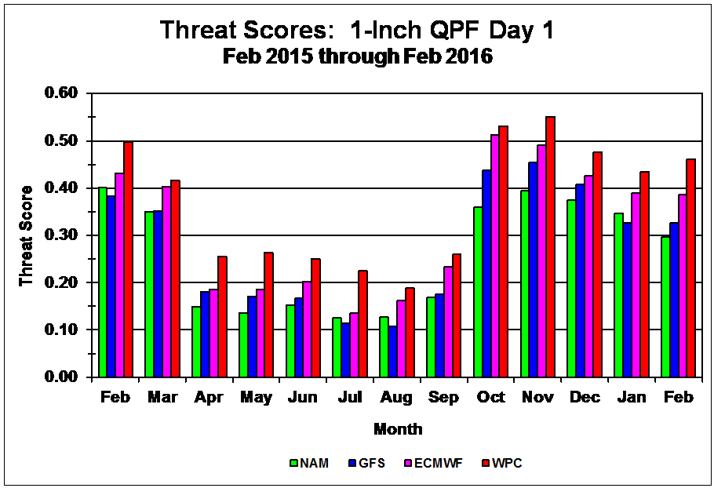

Slide 15
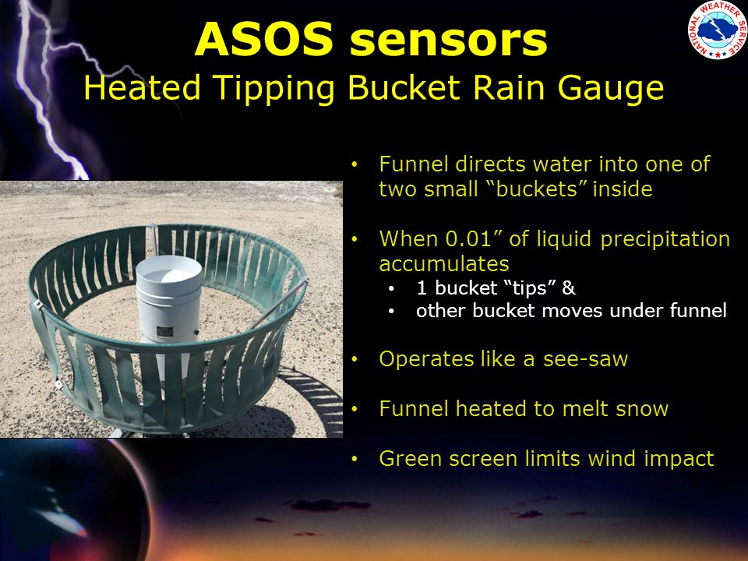
NWS ASOS Rain Gauge

Slide 16
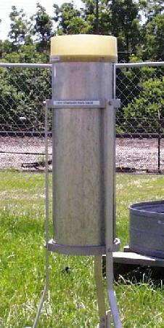
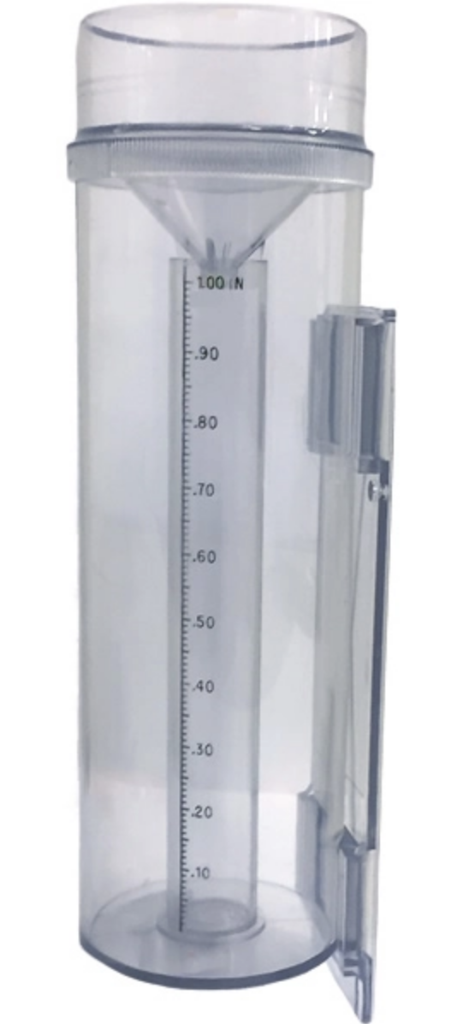
At lesser sites, 8” rain gauges typical, also plastic Cocorahs gauges

Slide 17
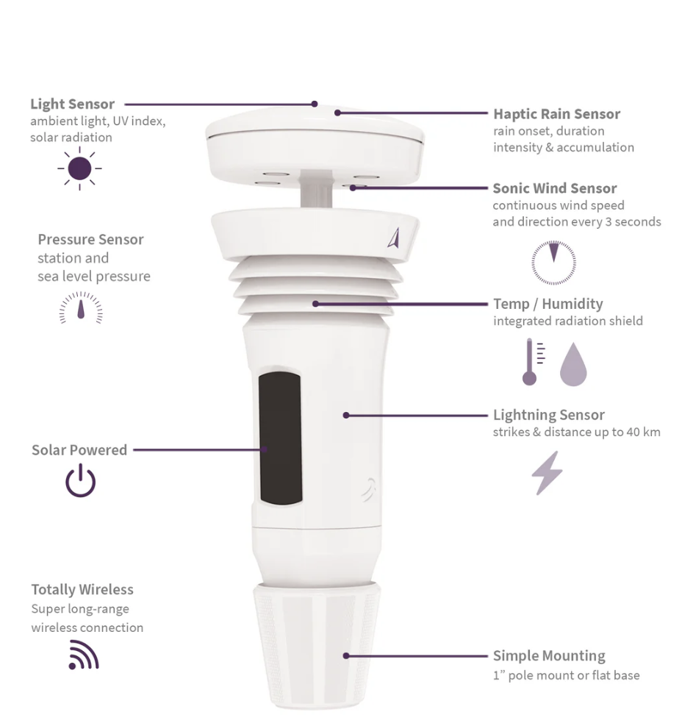
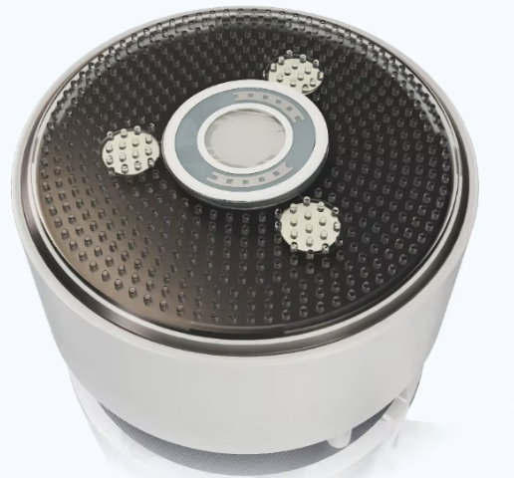
New Technology Haptic Sensors (less accurate)

Slide 18
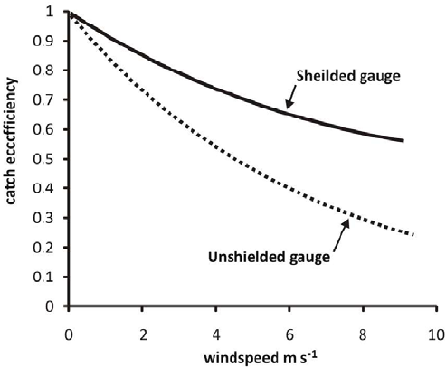
Undercatch can be a problem, particularly when wind speed increases
Worse for snow than rain
Worse for unshielded gauge

Slide 19
Mechanisms producing saturation, clouds and precipitation
Dynamical forcing as expressed by QG dynamics: broad frontal-scale clouds.
Topographic: upslope precip, mountain waves clouds.
Convection: produced by destablization of the atmosphere.
Total precipitation is the product of all three

Slide 20
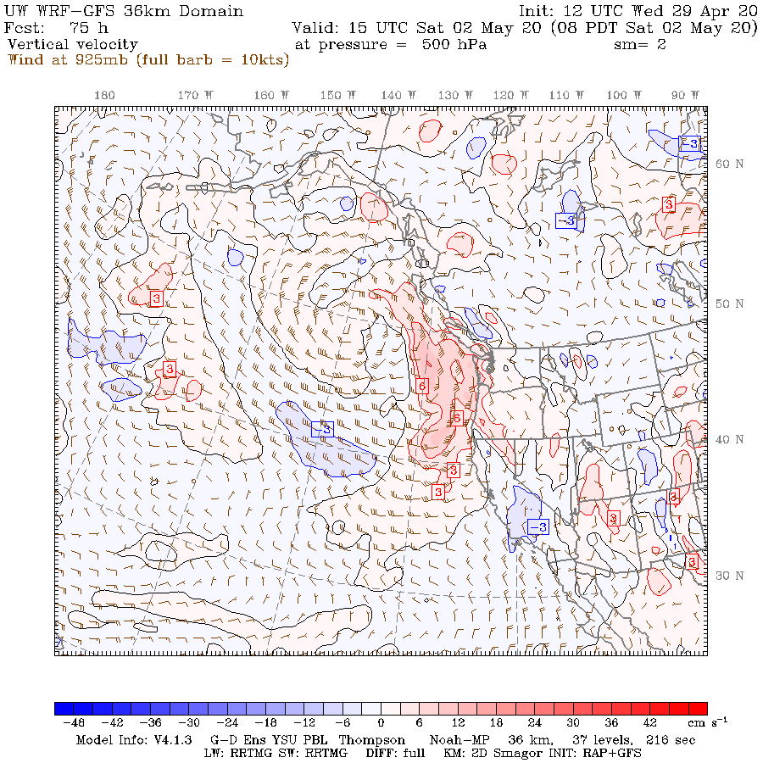
Dynamical forcing as expressed by QG dynamics
  Vertical motions acting to maintain thermal wind balance
  Can be diagnosed directly from model output
  Models do well with such large scale uplift

Slide 21
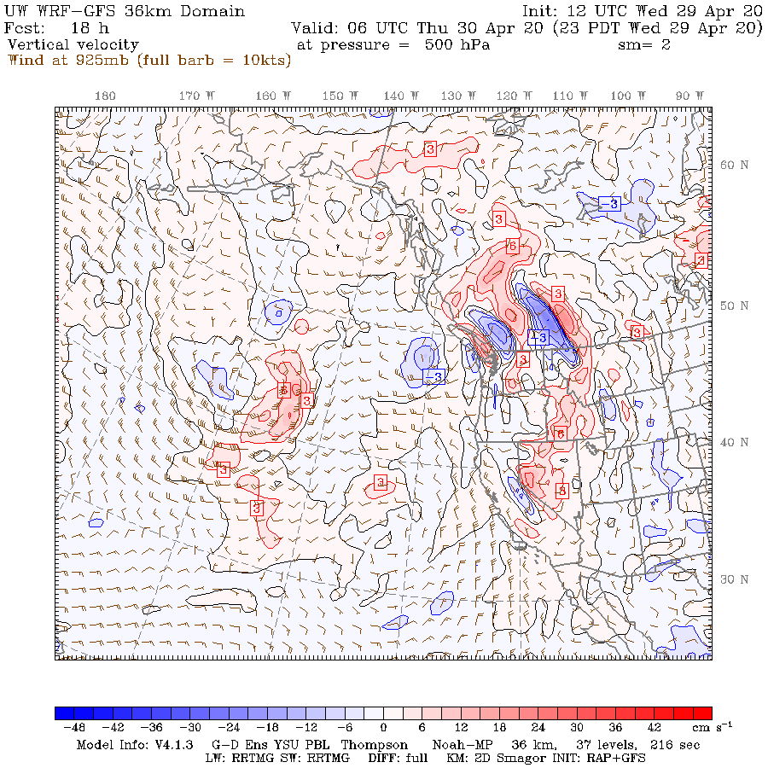
Topographic Forcing of Clouds and Precipitation
Topographic: upslope precip and clouds, mountain waves, rain shadows
  With sufficient resolution, often skillfully forecast by models
  Some problems with microphysics over terrain produce serious biases (e.g., underprediction along the NW coastal mountains)

Slide 22
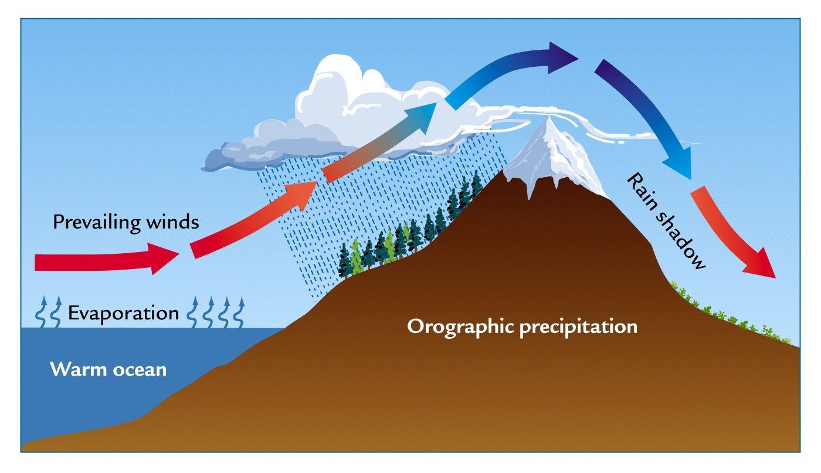
Topographic Forcing of Precipitation
Windward enhancement
Lee rain shadowing

Slide 23
In general, need model grid spacing of at least ~15 km to play the precipitation game in terrain

Slide 24
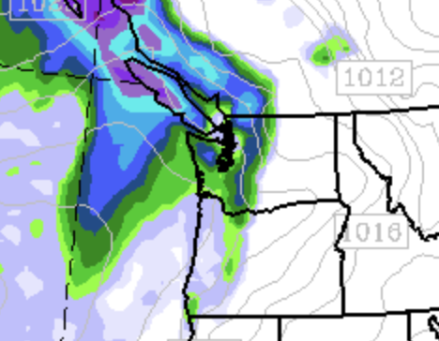
36-km

Slide 25
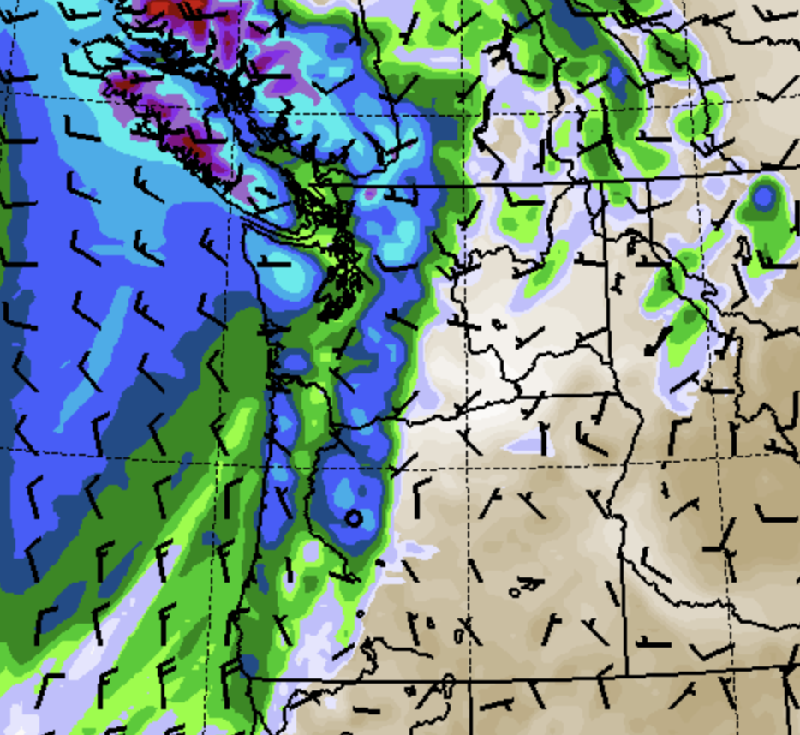
12 km

Slide 26
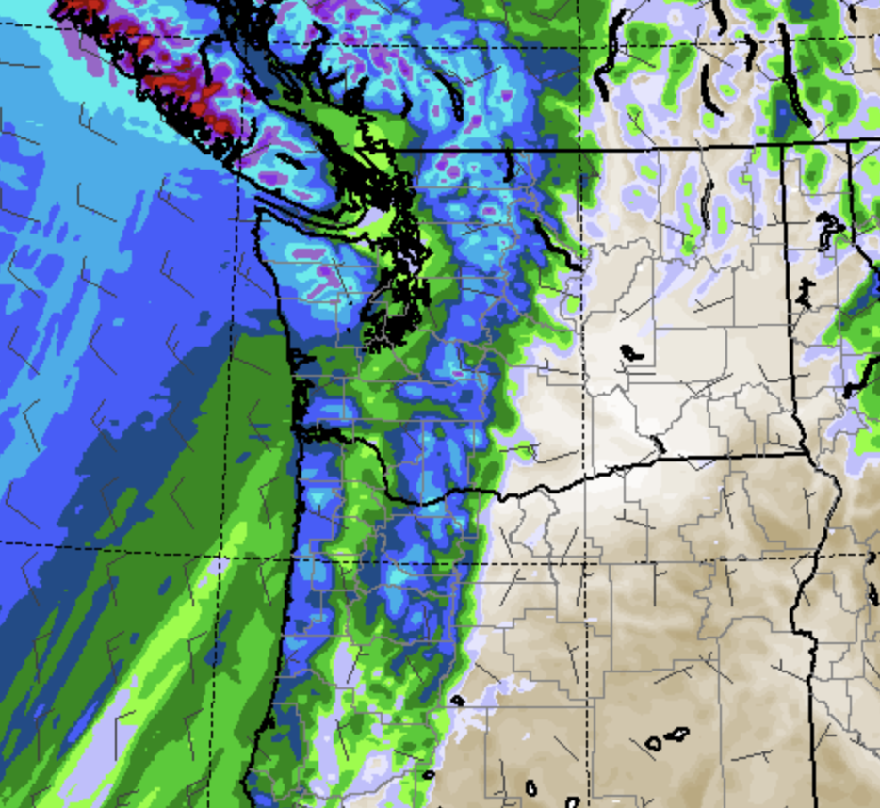
4 km

Slide 27
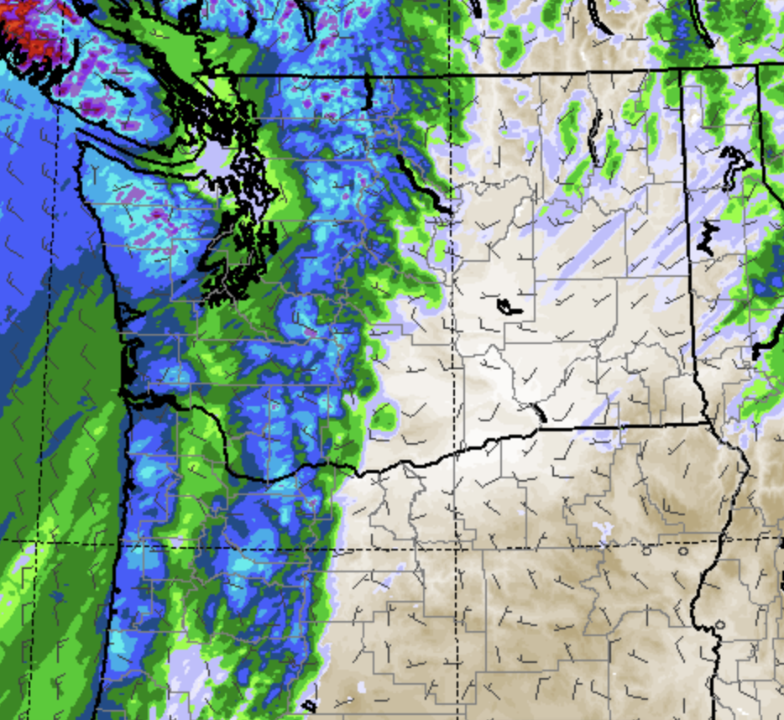
1.3 km

Slide 28
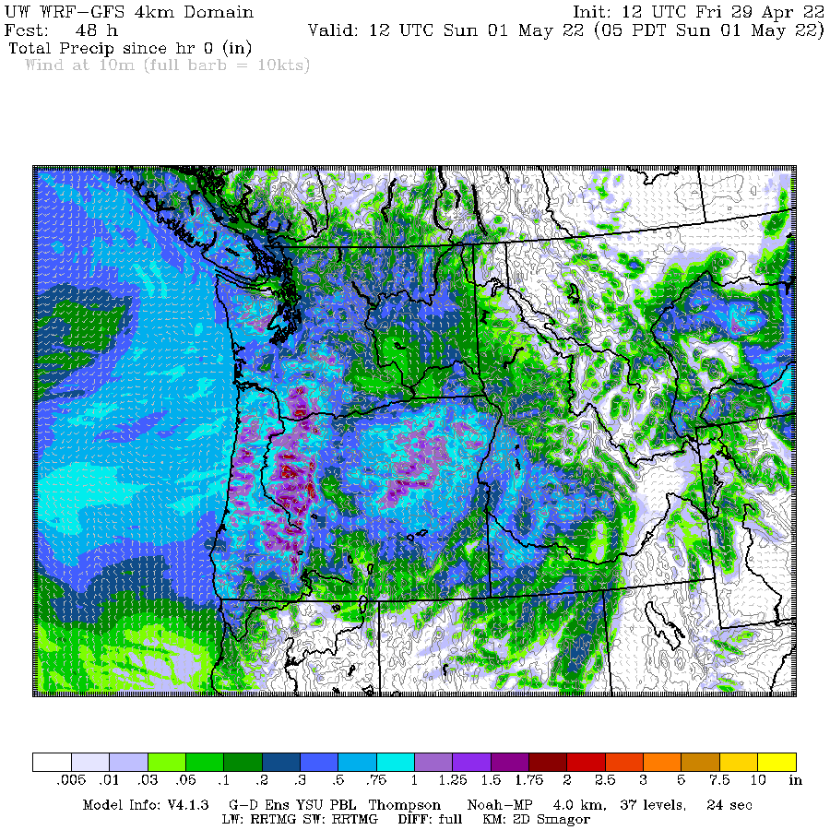
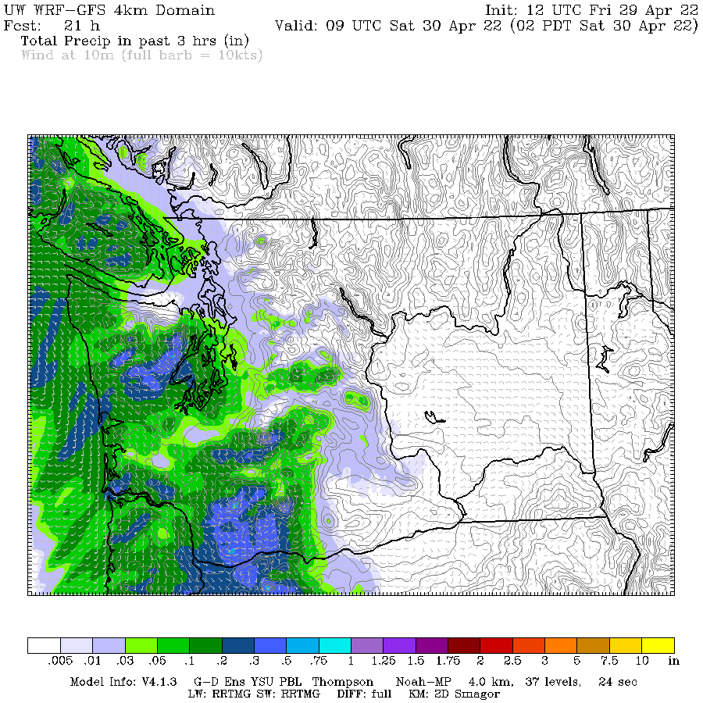
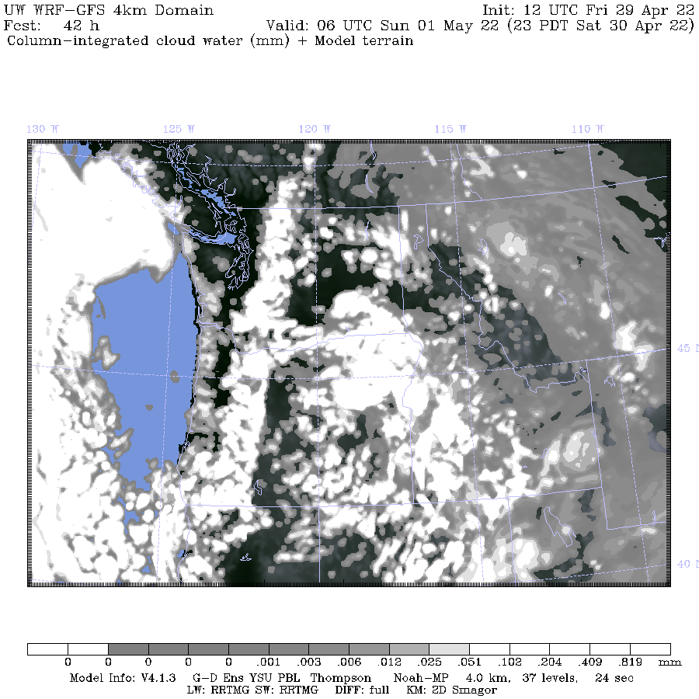

Slide 31
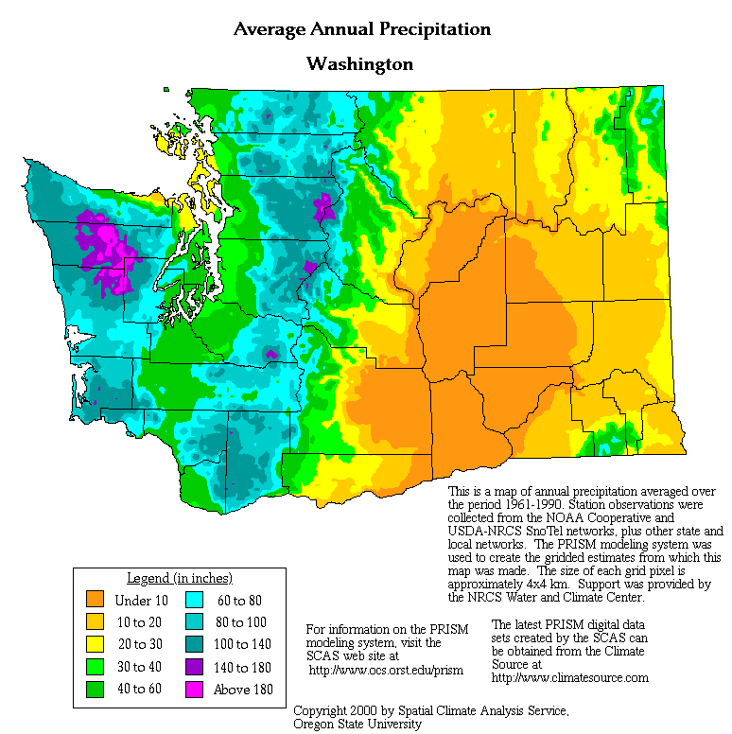
Annual Precipitation

Slide 32
Orographic precipitation can occur in isolation or in concert with precipitation from synoptic scale systems

Slide 33
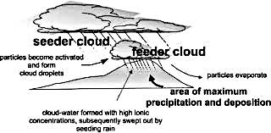
Example: Feeder-seeder mechanism

Slide 34
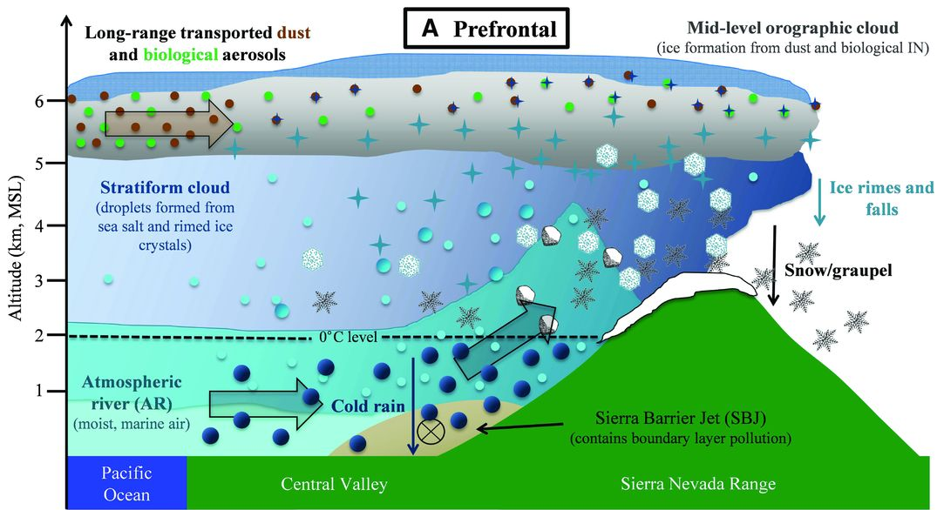

Slide 35
Warm Rain and Cold-Cloud Processes Versus Terrain
Warm rain processes tend to be most active above the lower slopes of terrain (condensation and coalescence dominant). Can produce heavy rain at lower elevations, often with small to moderate droplet sizes.
Cold-cloud/mixed phase (snow, riming, etc) processes more dominant on upper slopes

Slide 36
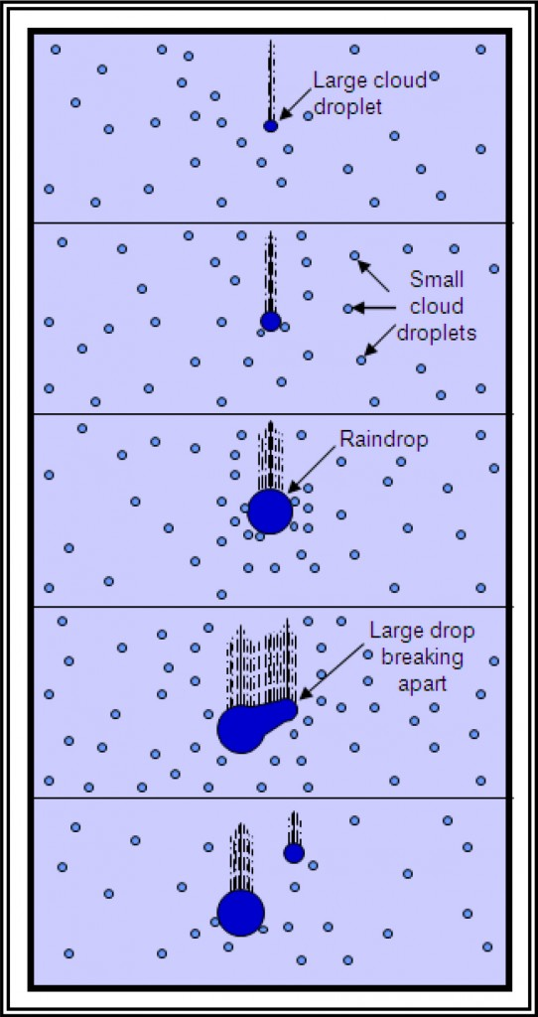
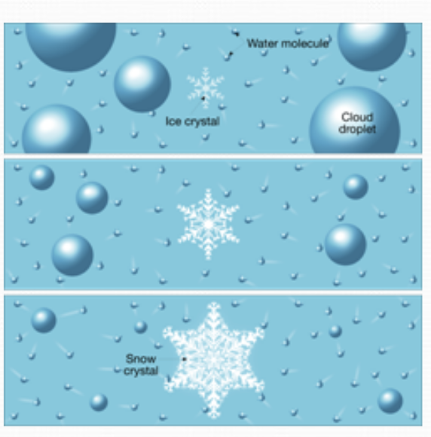
Cold cloud
Warm rain

Slide 37
Windward Enhancement
For relatively stable flow and typical barrier heights (5-8K ft), max precip tends to be on upper slopes of the barrier (typically 3000-6000 ft).
But does depend on height of mountains, stability, wind direction, shear, freezing level, and location.
Precip eventually starts to DECREASE at higher elevations. (moisture availability, terrain cross section)
In NW precipitation starts to lessen between 5000 and 7000 ft. Less on top of Mt. Rainier.

Slide 38
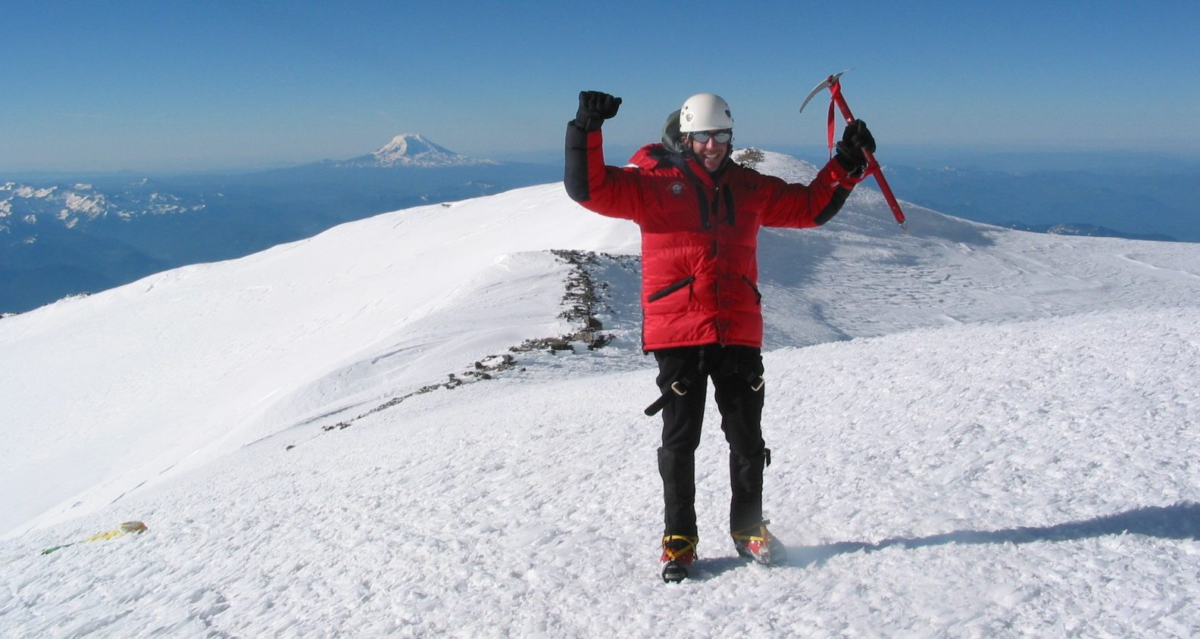
Drier up there

Slide 39
How large is orographic windward enhancement?
2-10x for major mountain barriers (thousands of feet high)
1-3x for smaller barriers (hundreds of meters)
Orographic effects are strongest when winds are perpendicular to barrier

Slide 40
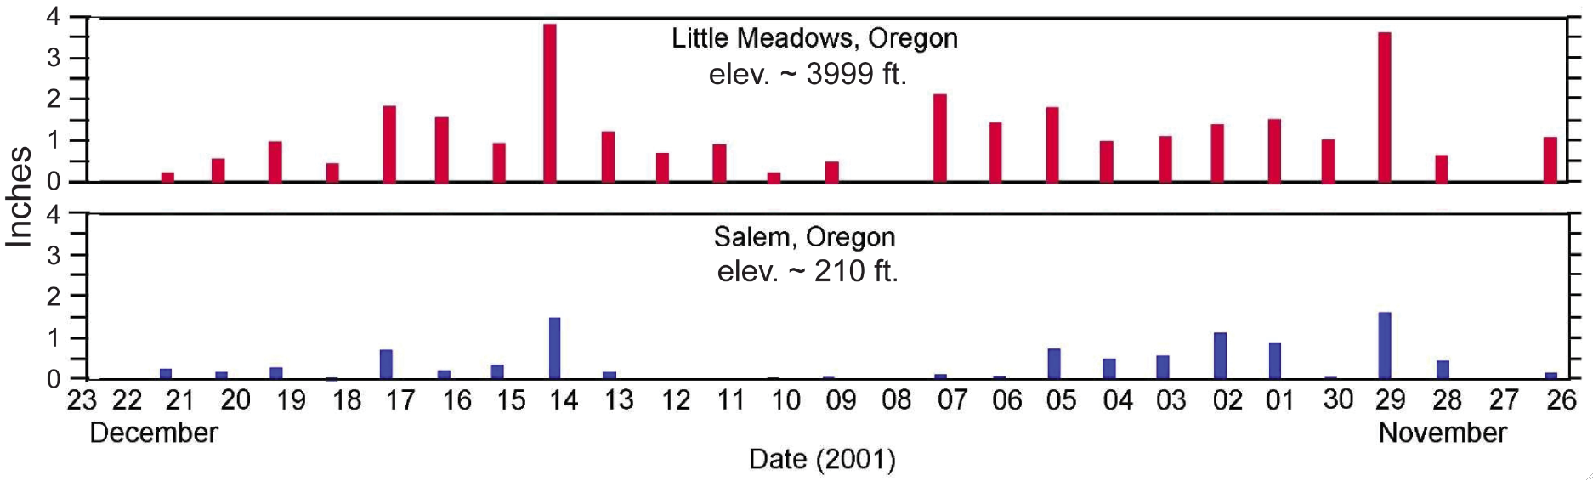
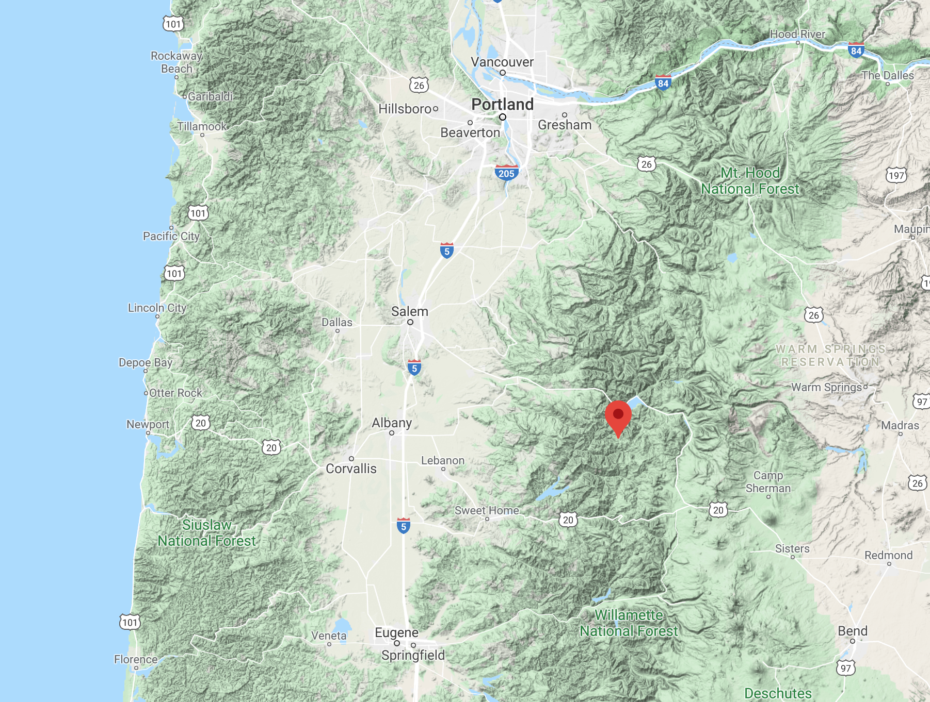

Slide 41
Orographic precipitation enhancement
Notes:
The basic idea is simple. The details of the dynamics and microphysics are more complicated. Flow over topography is a special case of dynamics that has to be considered separately or in addition to the other processes producing lifting and condensation. The pattern of fallout of the orographic precipitation is sensitive to the microphysical processes. How fast can the precip fall out?

Slide 42
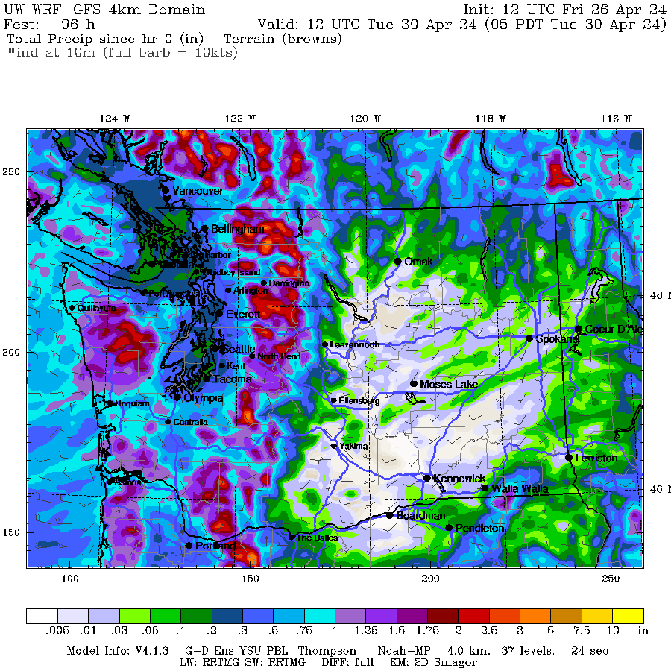

Slide 43
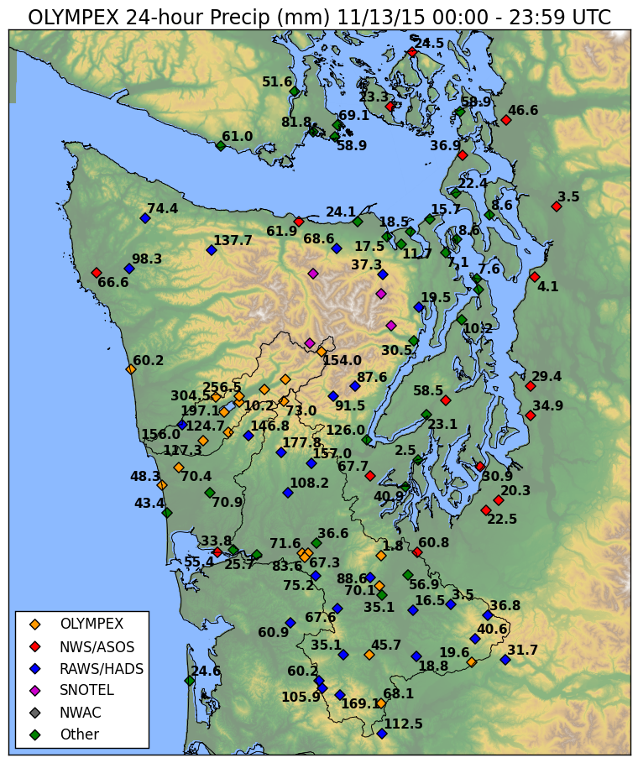

Slide 44
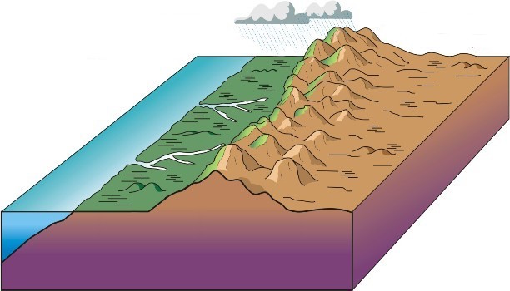
Orographic Precipitation Depends on Wind Direction
Heavier orographic precipitation with flow perpendicular (normal) to the barrier.
Heavy
Light

Slide 45
For low stability conditions, convection can be released on the lower foothills of terrain, resulting in max precipitation at the lowest elevations rather than higher up on the terrain.

Slide 46
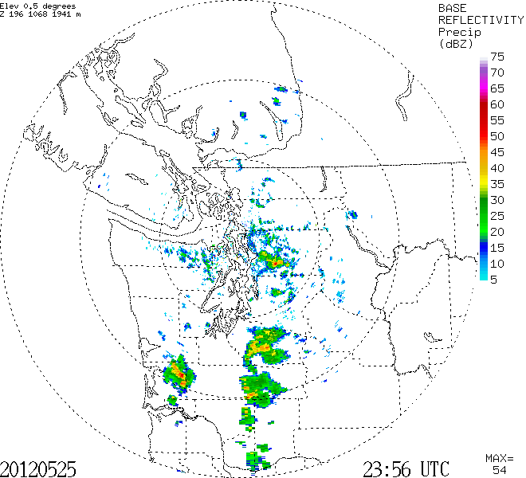

Slide 47
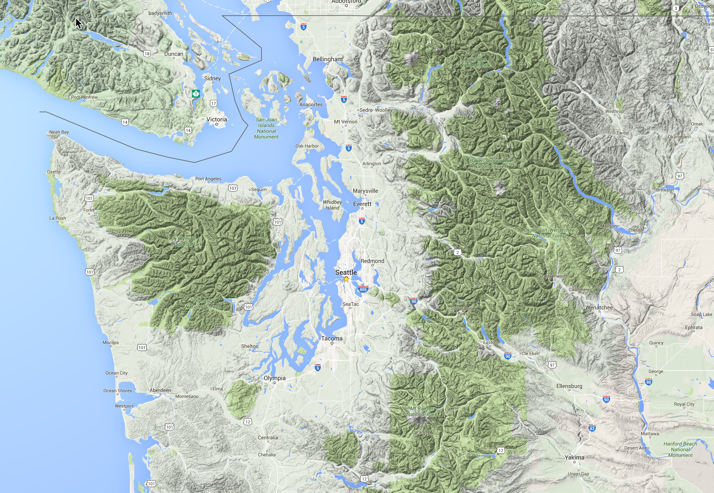

Slide 48
The Lake Whatcom Flood and Debris Flow Event of January 9, 1983
Moist, unstable flow climbed the mountains around Lake Whatcom (near Bellingham)
6-10 inches over 36 hr over the lower slopes
Substantial flooding and major debris flows down Smith Creek and other local streams.

Slide 49
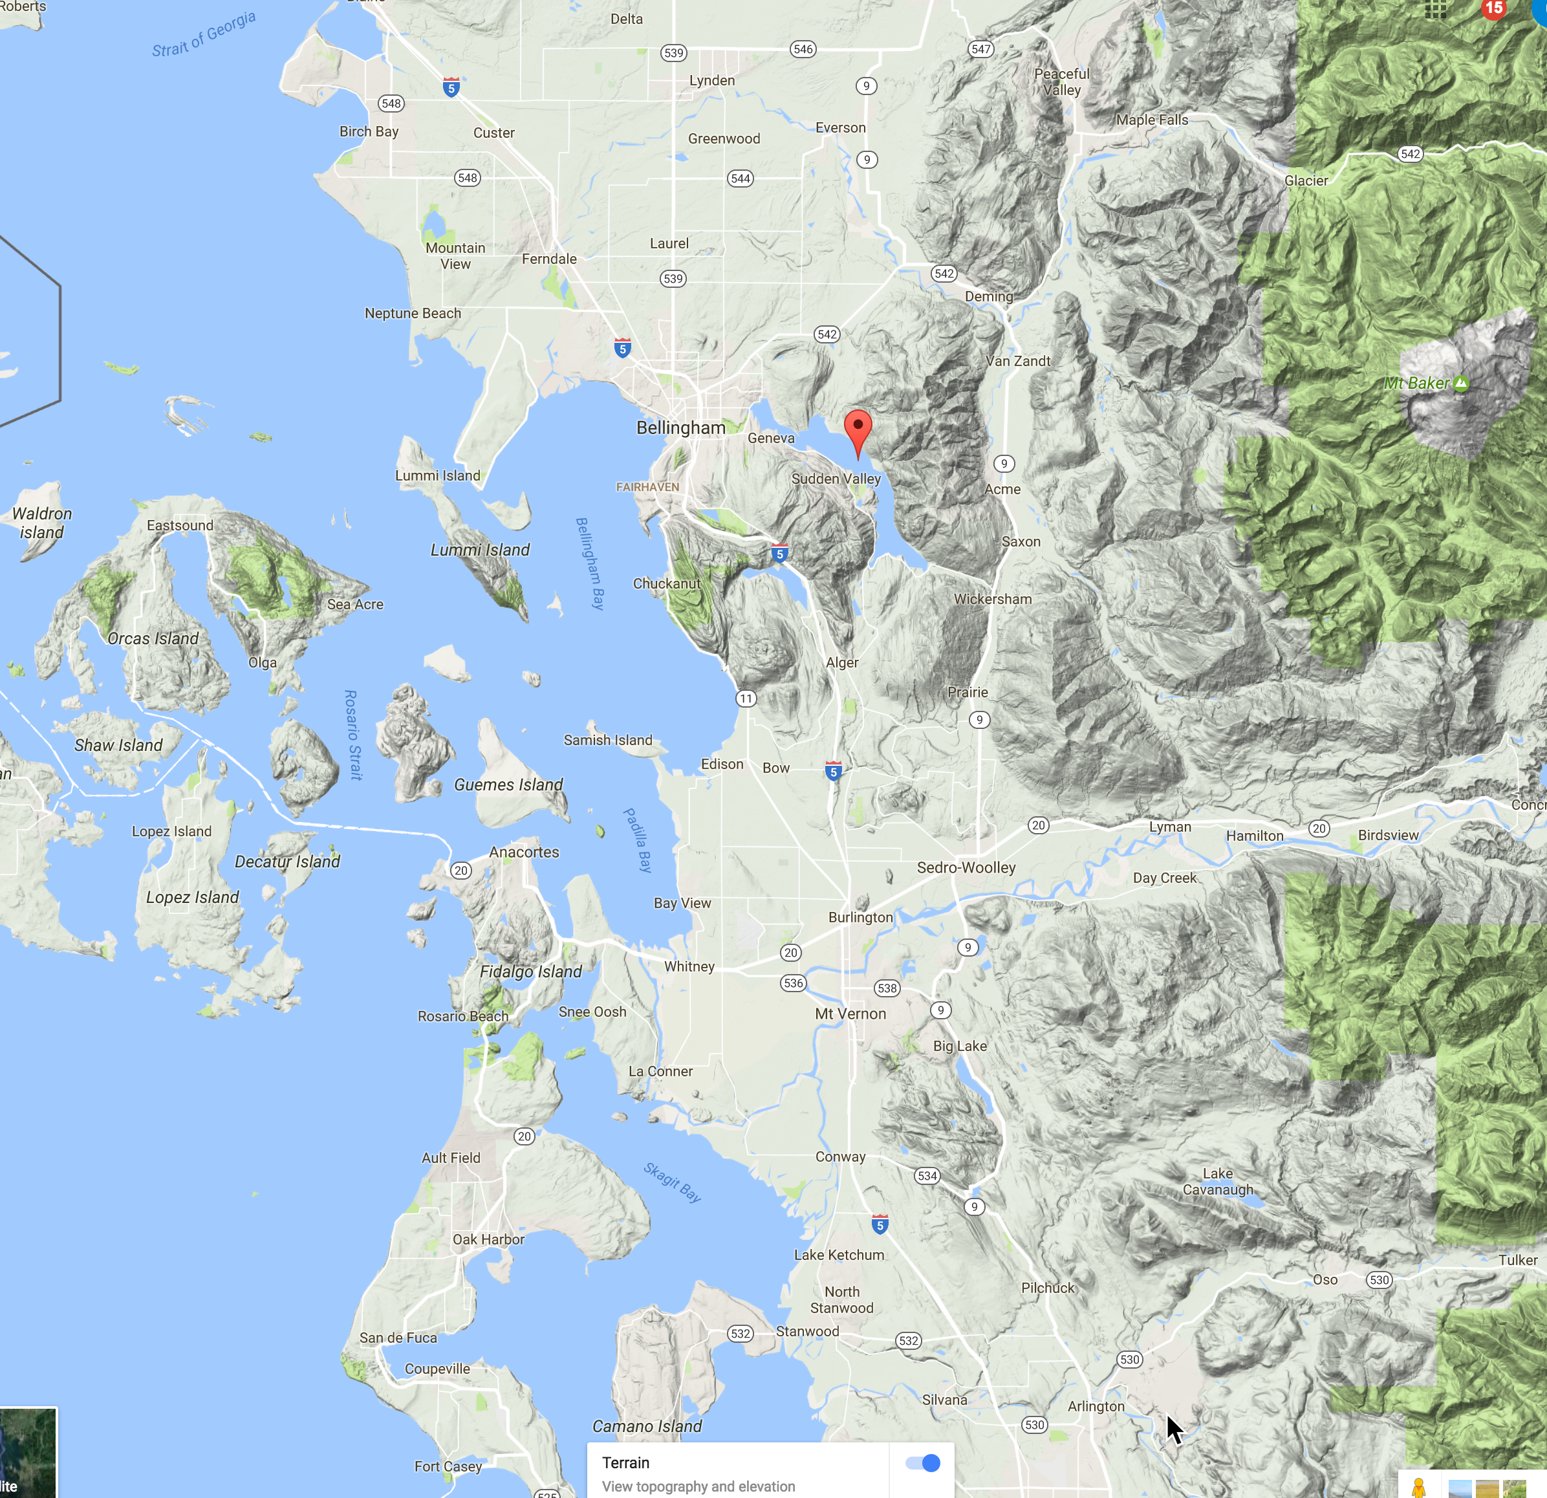

Slide 50
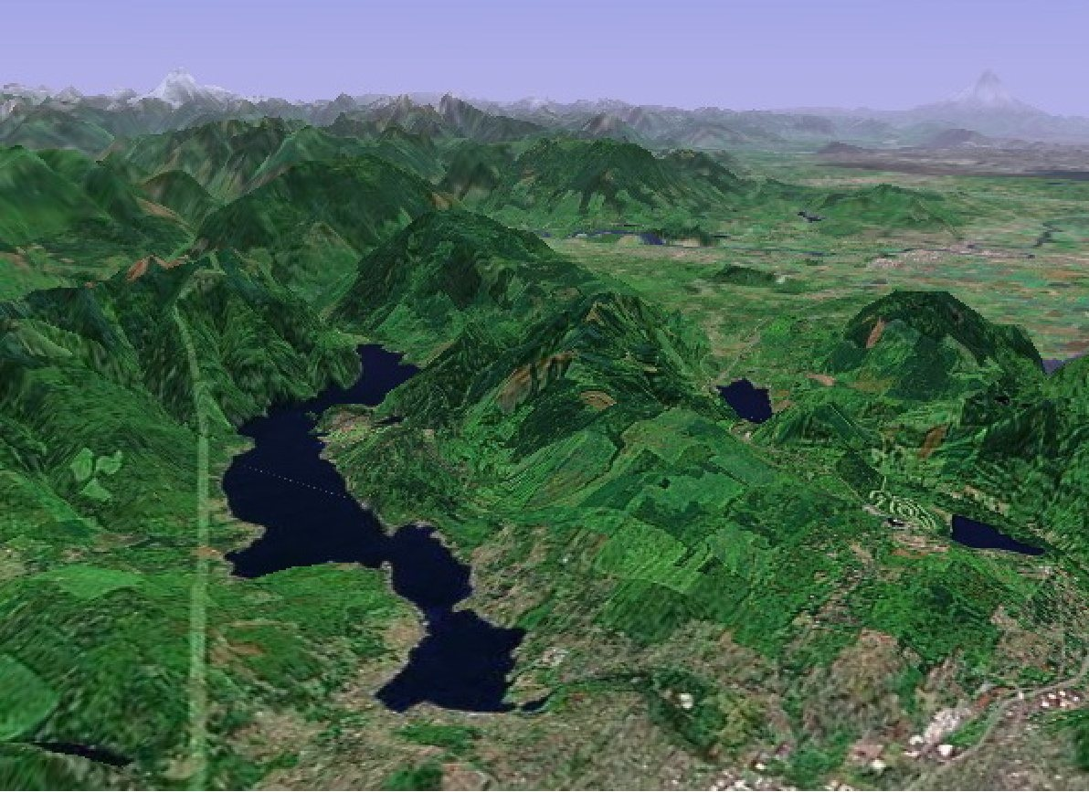

Slide 51
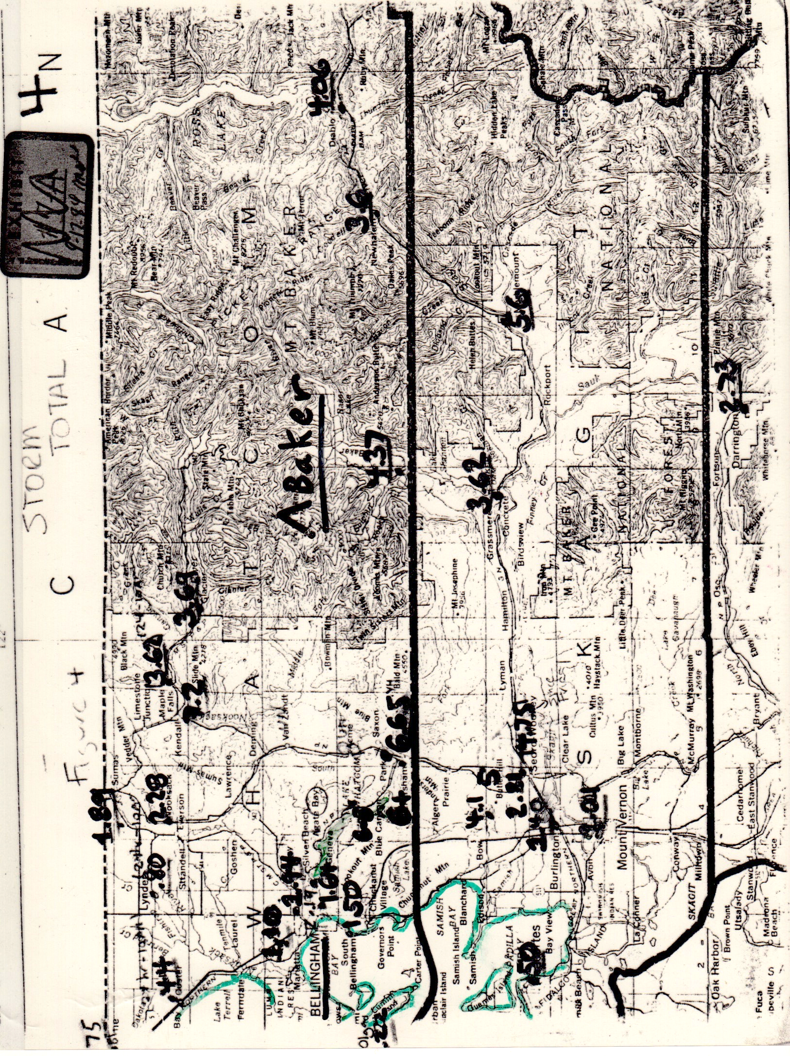

Slide 52
6-8

Slide 53
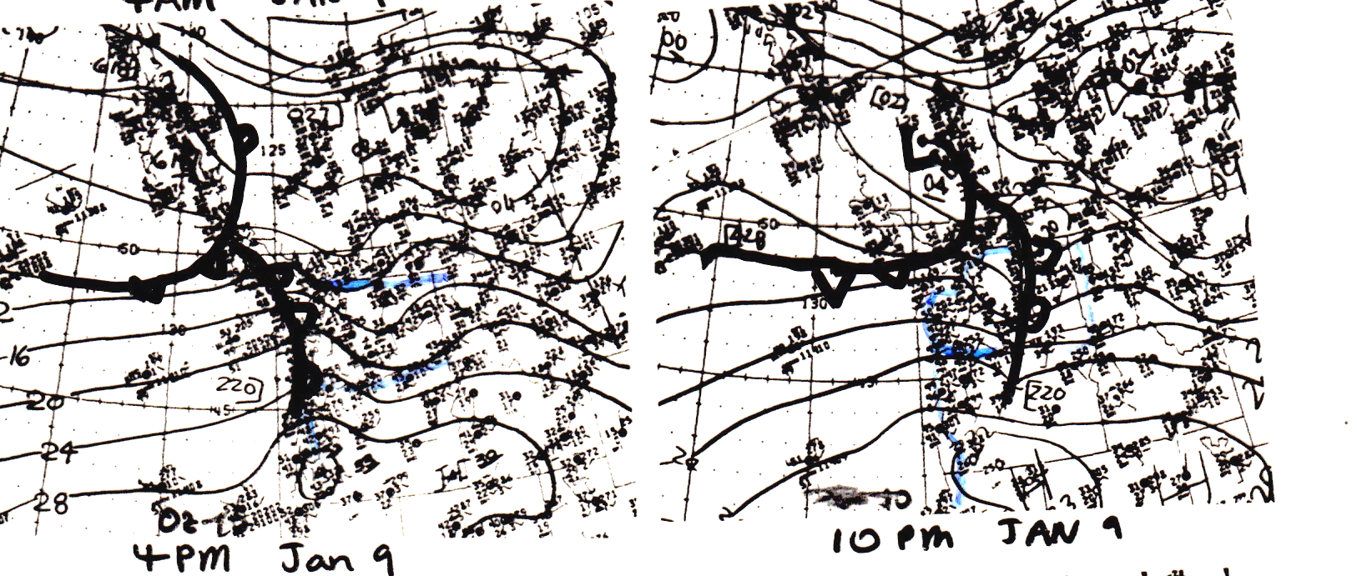

Slide 54
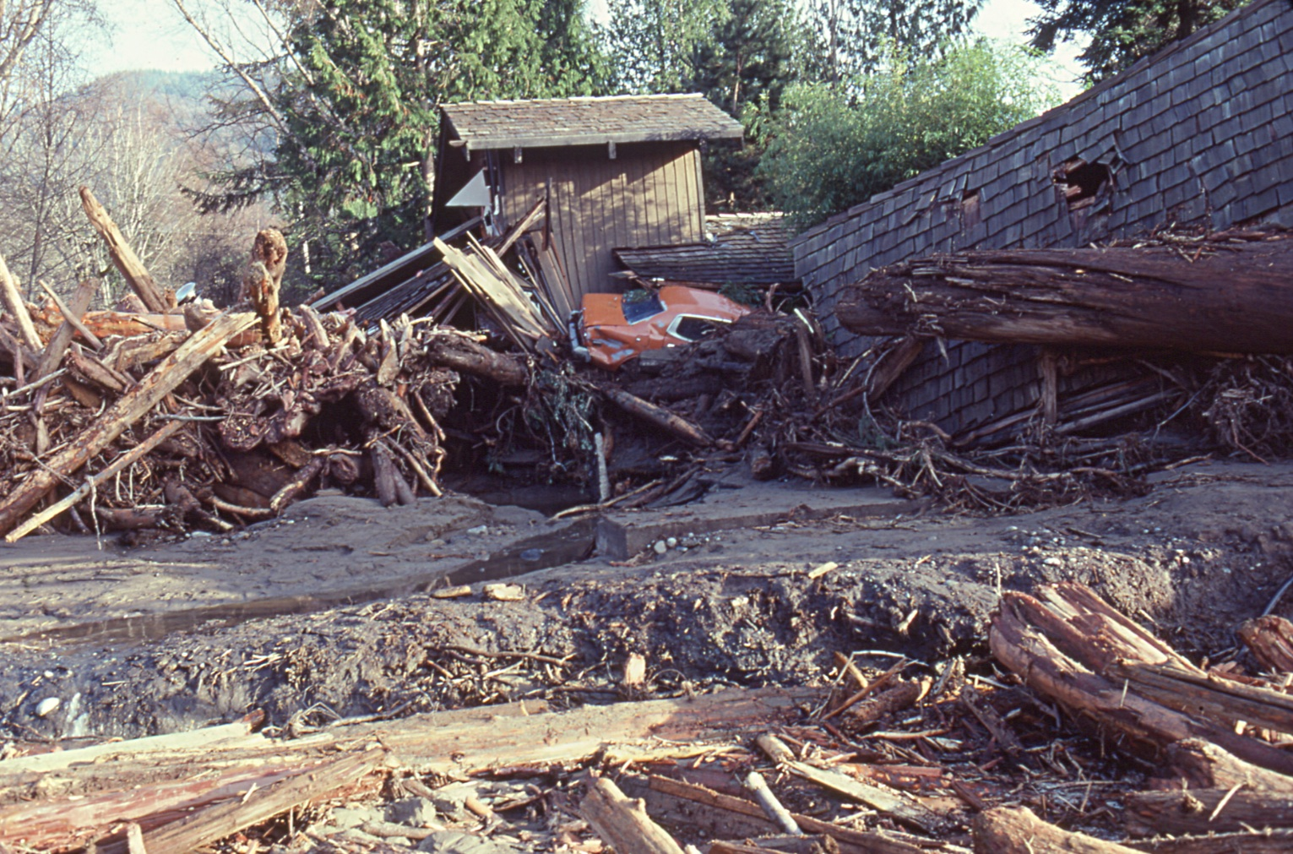
Picture Courtesy of Don Easterbrook, WWU

Slide 55
Rain Shadows
Lack of precipitation and clouds on lee sides of barriers.
Associated with subsiding flow.
Can extend 50-150 km downstream of terrain.
As the flow approaching a barrier changes direction, so does the orientation of the rain shadow.

Slide 56
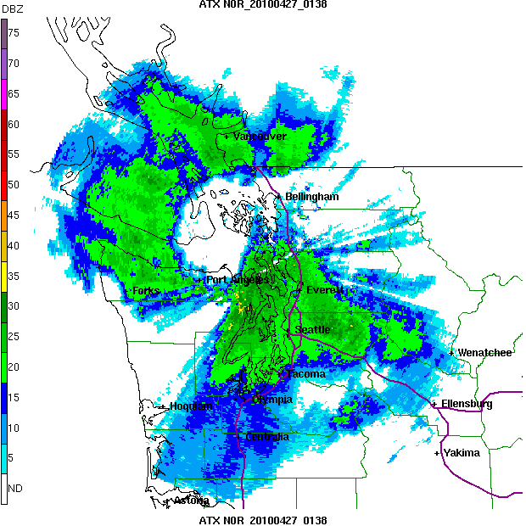
Rainshadow

Slide 57
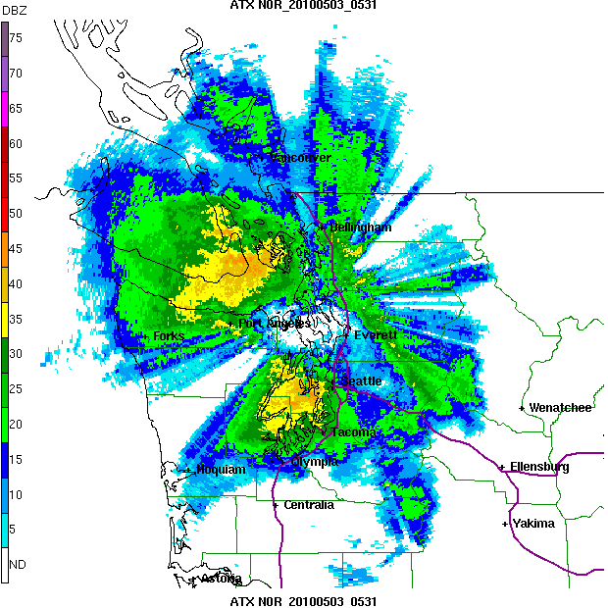

Slide 58
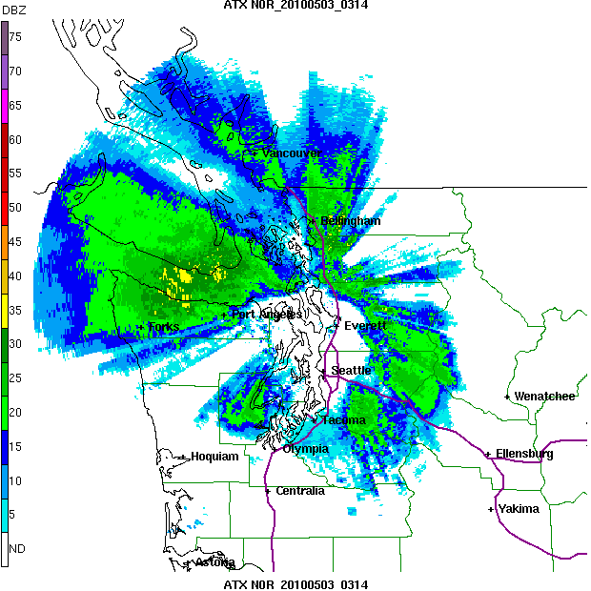

Slide 59
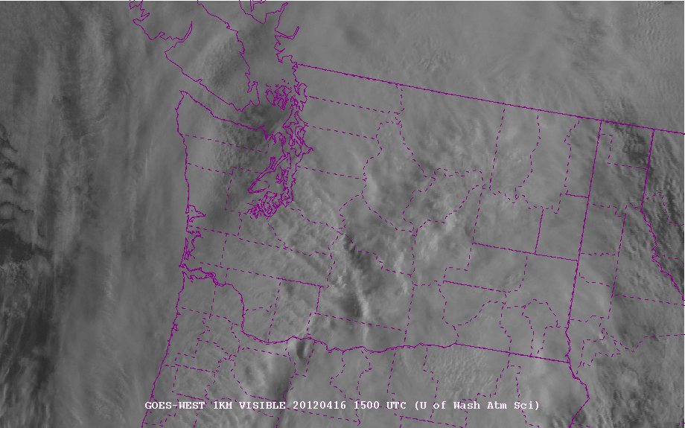
Apparent on Satellite Imagery

Slide 60
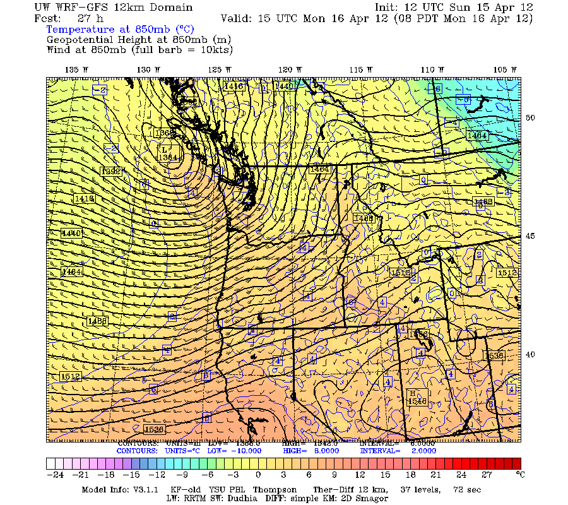
850 hPa at same time

Slide 61
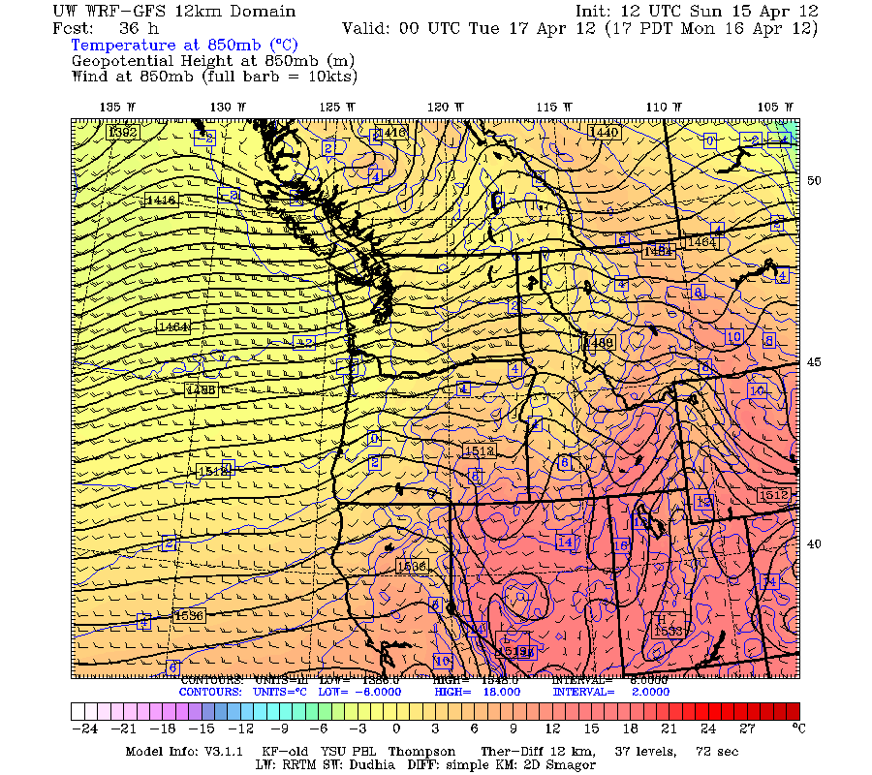
Change in approaching flow direction

Slide 62

Rain Shadow Shifts

Slide 63


Models do a decent job with rainshadows with sufficient resolution

Slide 64
1
Two main
Rain shadows
In WA
2

Slide 65


Sequim: roughly 15 inches per year.
.

Slide 66

Eastern WA Desert ~10 inches a year

Slide 67

Many Rainshadows Around the World

Slide 68


Slide 69


Slide 70


Smaller Scale Terrain Modulates
Precipitation
10-km

Slide 71

Small-Scale Spatial Gradients in Climatological Precipitation on the Olympic Peninsula. Journal of Hydrometeorology
Volume 8, Issue 5 (October 2007)

Slide 72

Annual Climatologies of MM5 4-km domain

Slide 73

Verification of Small-Scale Orographic Effects

Slide 74


Slide 75
But With All the Advances in Predicting Orographic Precipitation Deficiencies Remain
One of the most serious is underpredicting precipitation on the windward side of coastal mountain barriers.

Slide 76

New Research
Today
Spatial forecast errors of the UW/GFS analyses for (a) 36 km, (b) 12 km, (c) 4 km, (d) 1.33 km WRF, and (e) 13 km NCEP GFS for Nomber-December 2015. The size and color indicate the magnitude and sign of the error, respectively. Red circles indicate underprediction and blue designate overprediction

Slide 77

Coastal Precipitation Underprediction
Appears to be a problem with the warm rain parameterization used in most model microphysics schemes.
A solution has been developed at the UW (RCON).

Slide 78
Progress in Precipitation Prediction in Terrain Using Numerical Models
Increasing resolution has been the main driver

Slide 79

NGM, 80 km,
1995

Slide 80

NGM 1995

Slide 81

2001: Eta Model, 22 km

Slide 82


36-km
MM5
2005
12-km

Slide 83

NWS WRF-NMM (12-km)-2007

Slide 84

2007-2008
4-km MM5
Real-time

Slide 85


Slide 86
An Example of the Benefits of Resolution

Slide 87


Slide 88


Slide 89


Slide 90


Slide 91

Coastal Precipitation Effects
Coastal convergence
Coastal destablization

Slide 92
Coastal Wind Convergence

Slide 93
Coastal Wind Divergence

Slide 94



Slide 95


Slide 96

Coastal Destabilization
Warming at surface increases lapse rate

Slide 97


Slide 98

One of the most profound examples of orographic enhancement occurs during atmospheric rivers on U.S. West Coast

Slide 99
Atmospheric Rivers
Meridional flow of moisture from the tropics to midlatitudes is often limited to relatively narrow currents of moisture accompanied by unusually warm temperatures.
Can release huge amounts of precipitation when ARs are forced to rise on terrain.

Slide 100

The Terminology Started in 1998

Slide 101

In the NW, often called the “Pineapple Express”
A relatively narrow current of warm, moist air from the subtropics…often starting near or just north of Hawaii.

Slide 102


Slide 103
Two main diagnostics: Integrated Water Vapor (IWV) and Integrated Water Vapor Transport (IVT)

Slide 104

IWV is the column total water vapor

Slide 105


Slide 106

IVT is water vapor times the wind: how much water vapor is the wind bringing into a region
IVT more closely related to precipitation
Than IWV

Slide 107


Slide 108

The current of warm, moist air associated with atmospheric rivers are generally found in the warm sector, parallel and in front of the cold front.
Used to be called the “warm frontal jet”

Slide 109

Upslope flow and enhanced moisture associated with ARs greatly increases precipitation rates on terrain.

Slide 110

A Devastating Pineapple Express:
November 6-7, 2006

Slide 111

November 6-9,
2006
Dark Green: about 20 inches

Slide 112

Forecasting Atmospheric Rivers
Models are quite good.
A big issue is that slight changes in direction can have a huge impact on who gets precipitation

Slide 113

Idealized Modeling Study

Slide 114

https://cw3e.ucsd.edu/
Group at Scripps in San Diego dedicated to ARs

Slide 115
Convective clouds and precipitation
Convection: produced by destabilization of the atmosphere.
  Often controlled by synoptic scale features.
  Often poorly predicted by models.
  Most global models use parameterized convection---with a lot of problems
  Some higher-resolution models using convection-permitting resolution (4 km or smaller grid spacing). No parameterization. MUCH BETTER Skill.
  More on this later

Slide 116
Convective Precipitation
Historically, subjective approaches dominated (CAPE, shear, sounding interpretation, synoptic typing, etc)
Convection is associated with the least skillful precipitation forecasts in virtually all models.
Need at least 2-4 km grid spacing to get convection even half right.
If grid spacing is coarser, then must use cumulus parameterization

Slide 117

Terminology
Explicit convection: model has enough resolution to simulate convection (less than ~4 km grid spacing). Also called convection-permitting resolution.
Parameterized convection: model parameterization uses large-scale variables to determine precipitation and other impacts of convection. Example: Kain-Fritsch, Grell, Kuo, SAS.

Slide 118
Convection
Convective parameterizations attempt to simulate the impacts of convection without explicitly simulating the details.
A kluge: relates convective impact to larger scale variables
Most convective parameterizations have serious flaws
But they are often necessary: can’t ignore the aggregate effects of convection.

Slide 119

What convective parameterizations need to account for

Slide 120

Convection is often sub-grid scale

Slide 121
Parameterized Convection in Models
Most operational models we work with have parameterized convection (GFS, NAM, ECMWF)
Some high-resolution operational models have dropped convective parameterization (e.g., 3-km HRRR)
WRF can be run with or without convective parameterization

Slide 122



Example of Explicit Convection
Real-time WRF 4 km BAMEX Forecast
Valid 6/10/03 12Z
4 km BAMEX forecast 36 h Reflectivity
4 km BAMEX forecast 12 h Reflectivity
Composite NEXRAD Radar

Slide 123




Real-time 12 h WRF Reflectivity Forecast
Valid 6/10/03 12Z
4 km BAMEX forecast
10 km BAMEX forecast
22 km CONUS forecast
Composite NEXRAD Radar
Parameterized

Slide 124


Hurricane Isabel Reflectivity at Landfall
18 Sep 2003 1700 Z
Radar Composite
41 h forecast from 4 km WRF

Slide 125


Slide 126


Slide 127


Slide 128
The Long Term
Within 10-15 years, all forecast models will transition to convection-permitting resolution.
This will result in convective parameterizations being dropped in general.
Convective skill will rise and result in generally more skillful overall forecasts.
Initialization of convection will still be an issue.
Predictability of convection will remain an issue.

Slide 129
Poor Parameterized Convection is Why Precipitation Skill Slides During the Summer, Particularly for Heavy Precipitation

Slide 130
2025 Update: ML NWP
ML NWP is being run operationally at ECMWF
No convective parameterization
Appears to do particularly better in the tropics.
Why?
Speculation: convective parameterizations are poor and ML can determine the aggregate effects of convection better.

Slide 131
Diurnal Effects on Convective Precipitation
Convection is highly modulated diurnally
  Sea breeze/land breeze effects
  Peninsulas amplify diurnal
  Terrain effects (uplope/downslope circulations)
Often models—and particularly those with parameterized convection-- get the diurnal variation wrong.

Slide 132



Diurnal Effects
Sea Breeze Front (associated convection is particularly strong for conditionally unstable conditions)
Clearing/drying behind

Slide 133


The Peninsula Effect

Slide 134
Slope winds and convergence over crests

Slide 135


Slide 136


Slide 137


Slide 138

Time of Peak Precipitation: JJA
Convection propagates
Eastward from Rockies

Slide 139

Virtually all models with parameterized convection do not get the eastward propagation of convection from the Rockies correct
But those with explicit convection do!

Slide 140

Models with explicit convection also are much for realistic for the MJO and other tropical convective systems

Slide 141
Predicting Clouds
Zero-order approach: use relative humidity
70% 1000-500 mb RH often corresponds with thicker, middle-level clouds that have a serious impact on radiation.
700 and 850 mb RH is also used by some.

Slide 142



Slide 143


850 hPa RH often compares well to low clouds

Slide 144

Time-Height Cross Sections of RH are Very Useful (70% or more)

Slide 145

Direct Use of Model Clouds
All modern models predict clouds, specifically mixing ratios of cloud liquid water and cloud ice.
The quality varies…and keep in mind there are serious deficiencies in even the best microphysical schemes.
Also problems with other physical parameterizations: boundary layer turbulence or radiation can also mess up model clouds.

Slide 146
Direct Use of Model Clouds
Most problematic: stratus, stratocumulus, and FOG.
Remember, some models have spin-up issues: precipitation and clouds improve during the first 3-9 hours. Particularly true of UW WRF which is cold-started (no clouds at initialization!)

Slide 147


Slide 148


Slide 149


Slide 150
Cloud/Precip Forecasting Strategy
Very short-term (0-3 hr): persistence, temporal extrapolation (informed by human judgement) is HARD to beat. Nowcasting.
  Use radar and satellite animation. Models generally less useful for very short forecasts.
  New data assimilation/modeling systems: e.g., EnKF, RUC/RR/HRRR are becoming viable and eventually will take this on successfully.

Slide 151

HRRR model useful after 3 hr

Slide 152
Strategy Continued
Short-term (2-6 hr): Satellite extrapolation becomes more important. Model becomes more dominant at the end
Daily (6-24 h): Satellite extrapolation and model, weighing models more at longer range.
Remember model spin up issues.

Slide 153

Precipitation Strategy
Know regional precip/cloud climatology
  Diurnal and geographic features tend to be very repeatable, particularly during the warm season
  Example: Colorado Front Range convection
Know normal and records.

Slide 154

Ensemble Systems Are Improving: Laying the Foundation for Probabilistic Precipitation Prediction

Slide 155

The problem…most ensemble systems are poorly constructed and not calibrated

Slide 156
Calibrated Probabilistic Prediction Using Ensembles and Machine Learning
Most ensemble systems are highly underdispersive (often miss reality)
Ensemble members are not equally likely
Machine learning and other approaches can be used to calibrate ensembles to produce improved and reliable probabilities
UW WRF-En Project Website:
https://a.atmos.washington.edu/mm5rt/precip/

Slide 157

Human Forecaster Issues
Precipitation is a parameter that in general forecasters add the least skill compared to objective guidance.
Psychological issues exist for high and low precipitation probabilities

Slide 158

Reliability Diagram

Slide 159

Reliability diagrams for Precipitation (48h forecast)

Slide 160
Rain Psychology
Human forecasters tend to overpredict 10-30%
    exaggerating the threat of rain when it is not likely.
    “Its probably not going to rain…but I will throw in 10-30% anyway to cover myself”
And underpredict rain when it is highly probable
    Well it looks like it will rain…but I am unsure… so I will knock down the probabilities to 60-80% to cover myself”

Slide 161
Reliability diagrams for Precipitation (48h forecast)

Slide 162
Humans Help with Heavier Precipitation and Shorter Range Precipitation
http://www.wpc.ncep.noaa.gov/html/hpcverif.shtml#qpf

Slide 163


Slide 164


Slide 165


Slide 166

The End

