Slide 1
Atmospheric Sciences 101
Autumn 2021
Instructor: Cliff Mass
TA:
Spencer Ressel

Slide 2
Goals of class
Become knowledgeable observers of the atmosphere
Learn how to interpret satellite and radar imagery, as well as weather maps
Acquire basic understanding of key atmospheric phenomena
Use the atmosphere to understand basic physical principles and laws
Basic introduction to climate change and global warming.
Become good weather consumers. Learn about best weather web sites, best weather apps, know what is hype and what is real.

Slide 3
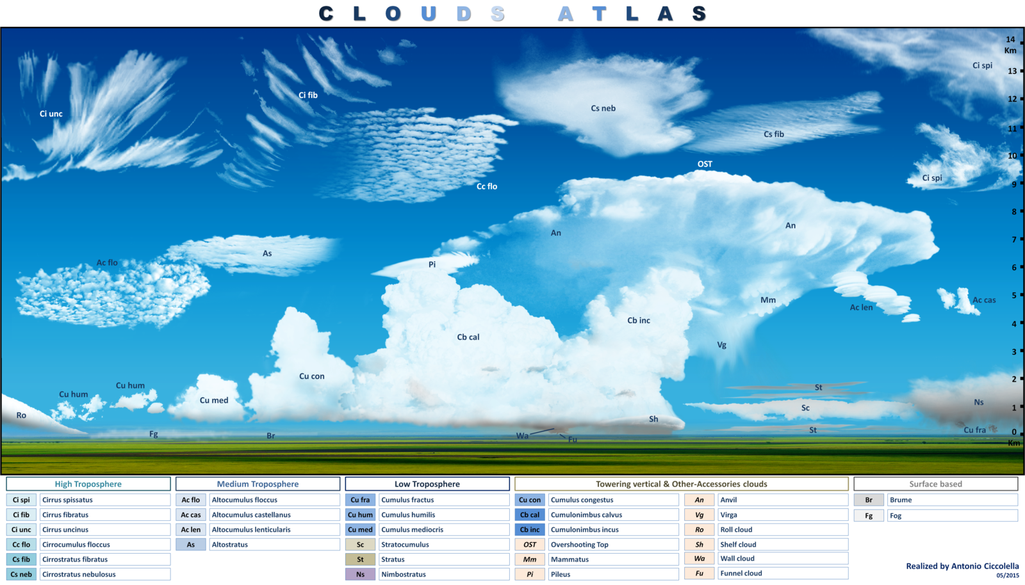
Course Outline
Quick Start Mini-Course
Introduction. Temperature and its measurement
Pressure and its measurement
Wind and humidity
Surface weather map
Fronts and cyclones. Upper air observations
Upper air charts. Weather satellite imagery
Weather radar
Identifying clouds

Slide 4
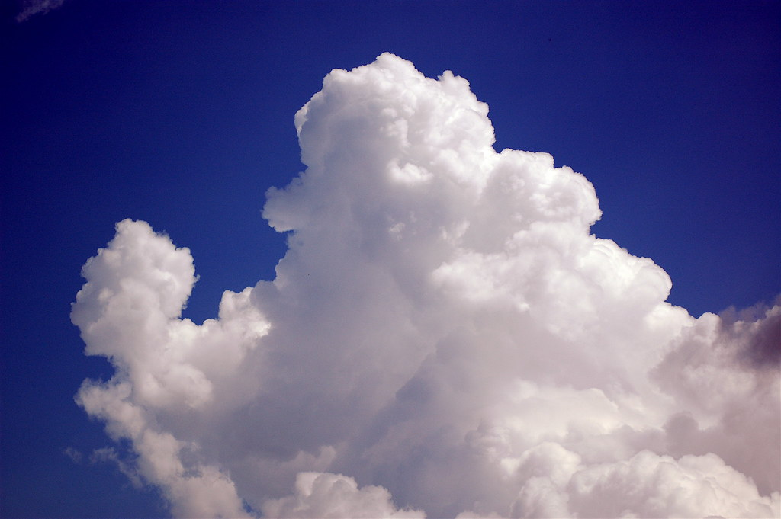
Course Outline
The Basics
Composition and origin of the atmosphere
Vertical structure of the atmosphere
Gas laws. Adiabatic warming and cooling
Moisture and its measurement
Condensation, evaporation, and latent heat
Dew, frost, and fog
Stability and instability
Cloud development
Precipitation mechanisms and weather modification
Force and motion. Coriolis and pressure gradient forces
Geostrophic balance. Effects of friction and topography
Radiation laws. Solar and terrestrial (infrared) radiation
Greenhouse effect and global warming
Optical phenomena

Slide 5
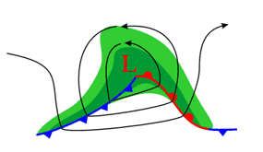
Course Outline
Storms and Weather Systems
Global wind systems
Air masses and fronts
Midlatitude cyclones and their development
Local winds (sea breezes, mountain/valley winds)
Thunderstorms
Tornadoes
Hurricanes and tropical meteorology
Weather Forecasting
Weather forecasting
Personal weather forecasting; how to find reliable weather data on the net.
Additional Topics
El Nino/ENSO and it local/global effects Air pollution and the ozone hole

Slide 6
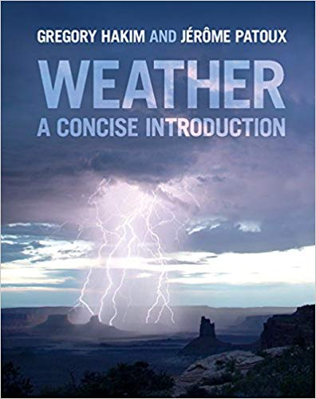
Books
No required book, but recommend Hakim/Patoux: Weather, A Concise Introduction
Generally parallels the lectures.

Slide 7
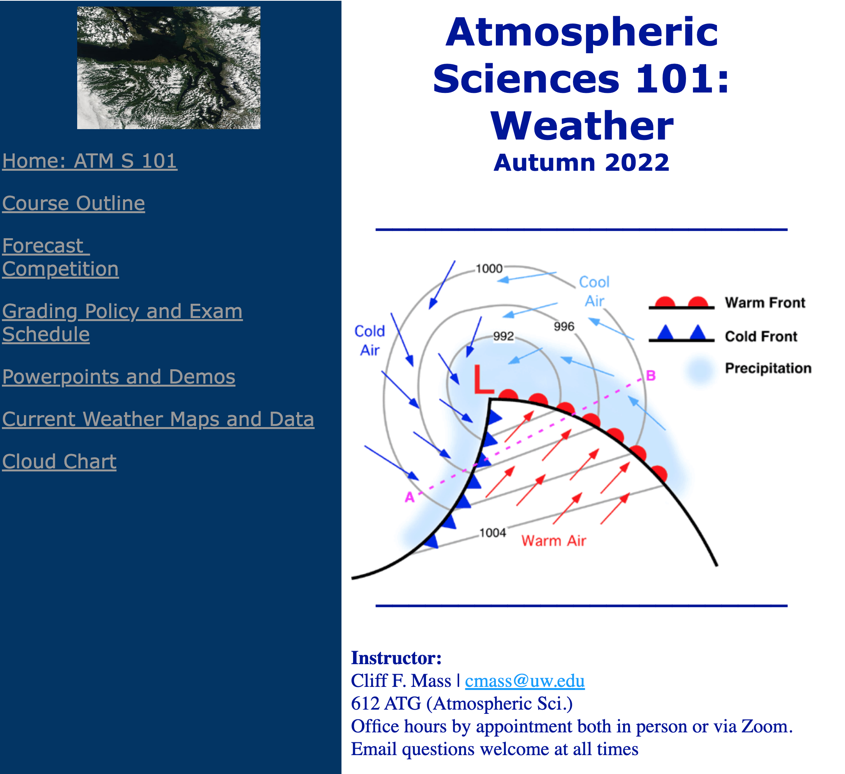
Class web site: Many class materials are there https://atmos.uw.edu/~cliff/ATMS101Y2022.html
Check frequently
Has course outline
All class powerpoints are found there
Forecast competition for extra cred
Cloud atlas and more!

Slide 8
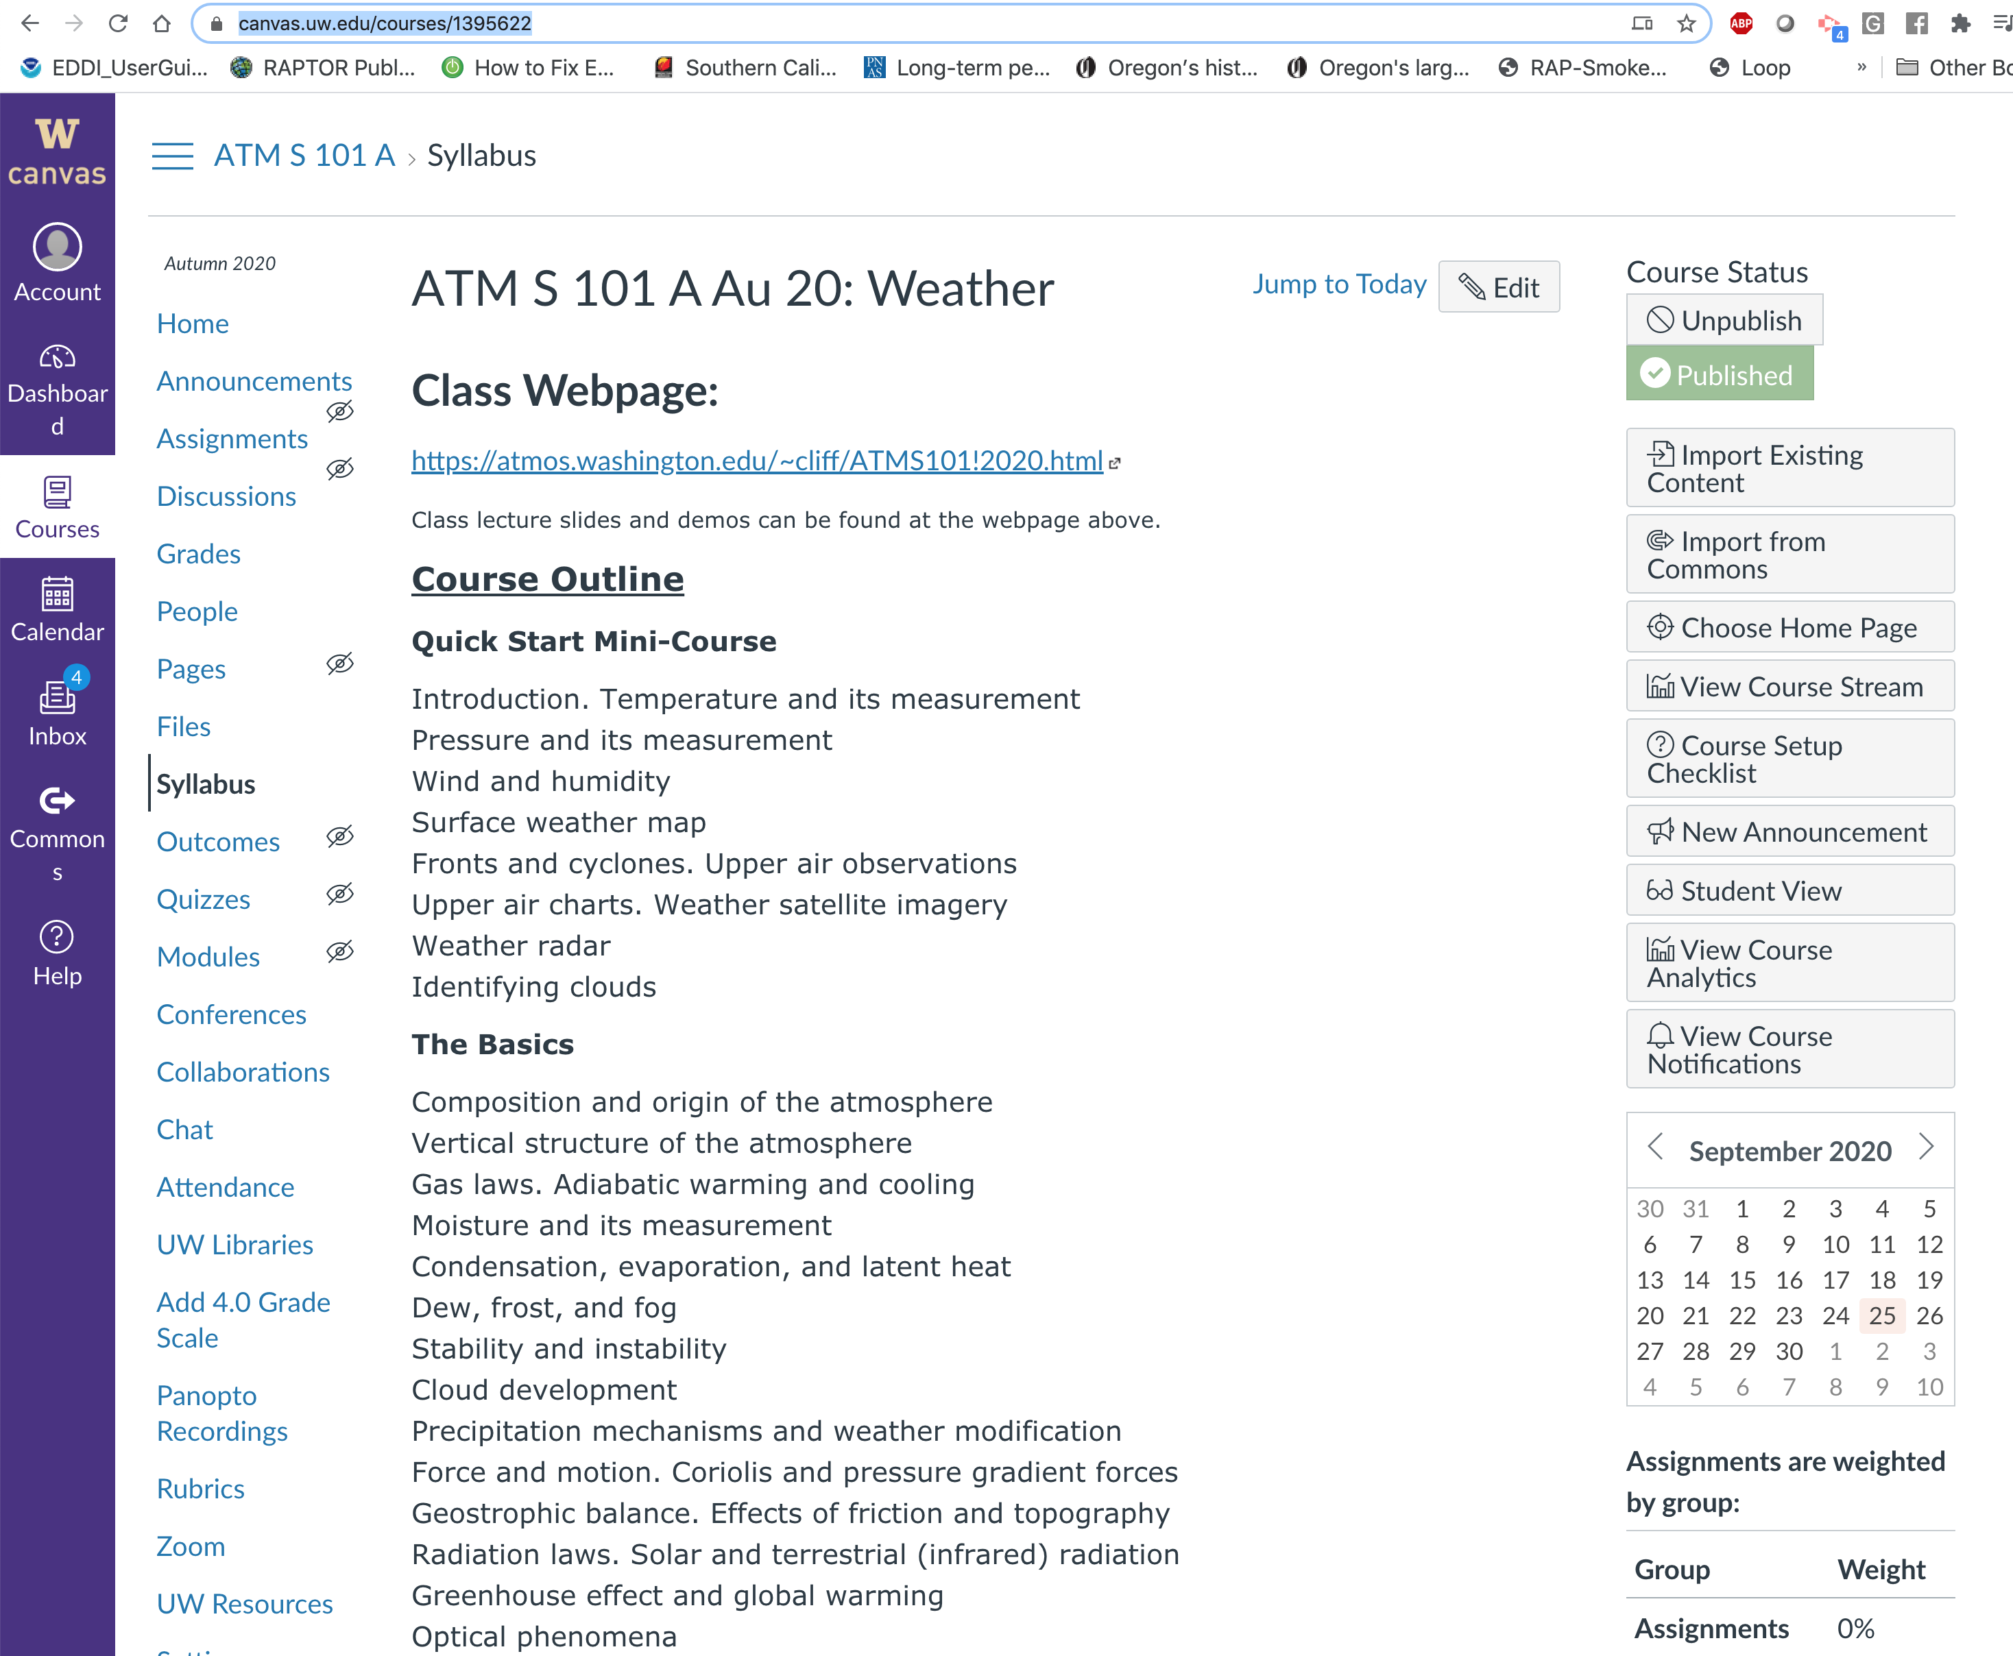
Exams, Quizzes, and Homeworks found on the class Catalyst Site
https://canvas.uw.edu/courses/1577752

Slide 9
Grading
Grading:
Midterm: 25%;
Quizzes: 25%;
Homework 25%;
Final exam, 25%.
Exam Schedule:
Mid-Term Exam: TBD
Final Exam: TBD
Homework:
There will be five homework assignments--the lowest grade will be dropped. Homeworks will be due at the beginning of class on the dates specified. No late homework will be accepted.
Quizzes:
There will be five quizzes. The lowest quiz grade will be dropped. There will be no quiz during the first week, the week before the midterm, the week of the midterm, and the last week.
Extra credit available for those in the forecast competition (more on this later).

Slide 10
More
Each class will generally be divided into:
  10 minutes weather discussion
  40 minutes lecture
Office hours, etc.
  Spencer will schedule both group and one-on-one office hours (in person and zoom)
  We will be happy to have office hours by appointment (zoom or in person)
  I will have some group question sessions before exams (in person or zoom)

Slide 11

Questions?

Slide 12
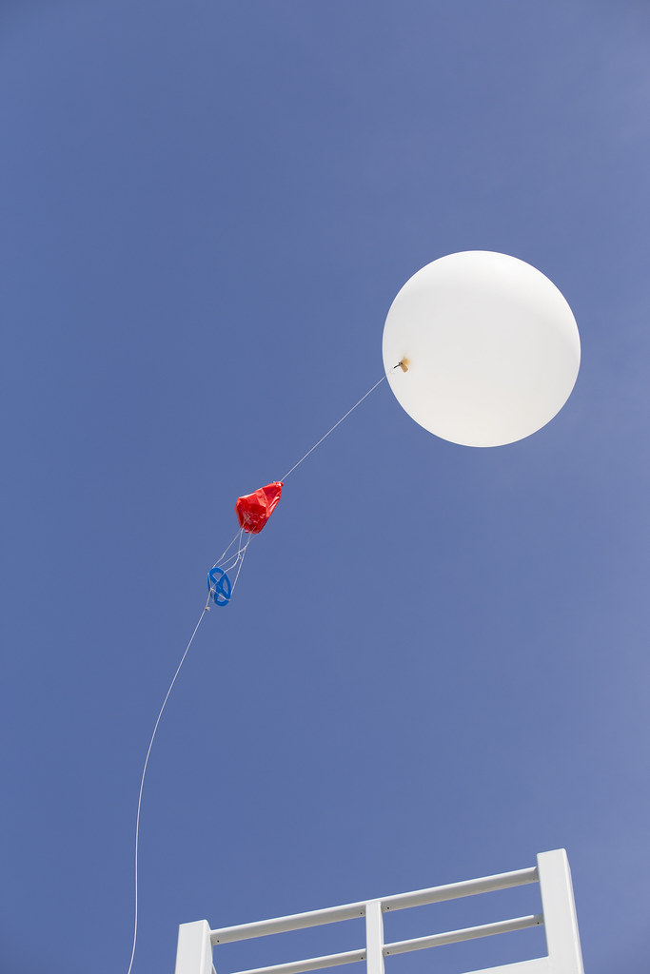
Meteorology and Atmospheric Sciences
Meteorology from
  Meteoron –Greek for phenomenon or thing in the sky
  ology—study of
the branch of science concerned with the processes and phenomena of the atmosphere
Atmospheric Sciences is basically the same thing.

