Slide 1
Aviation Meteorology
Atmospheric Sciences 452
Spring 2025

Slide 2
Aviation Meteorology and Forecasting
FAA estimates than 50% of aircraft accidents are weather related
Meteorology has substantial implications of weather
Cancellations
Delays
Extra fuel
Controls who can fly

Slide 3
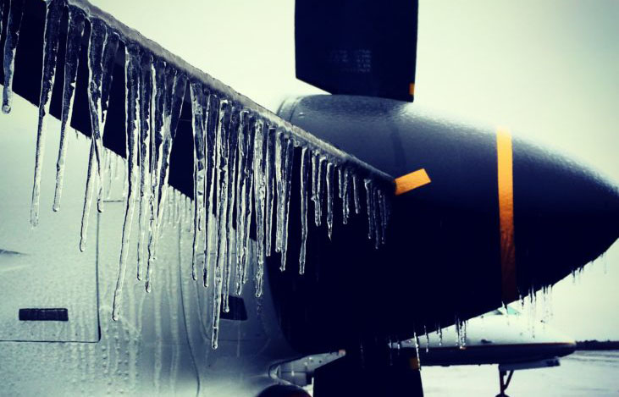
Major Aviation Hazards
Icing
Turbulence
Obstructions to Visibility
Wind shear

Slide 4
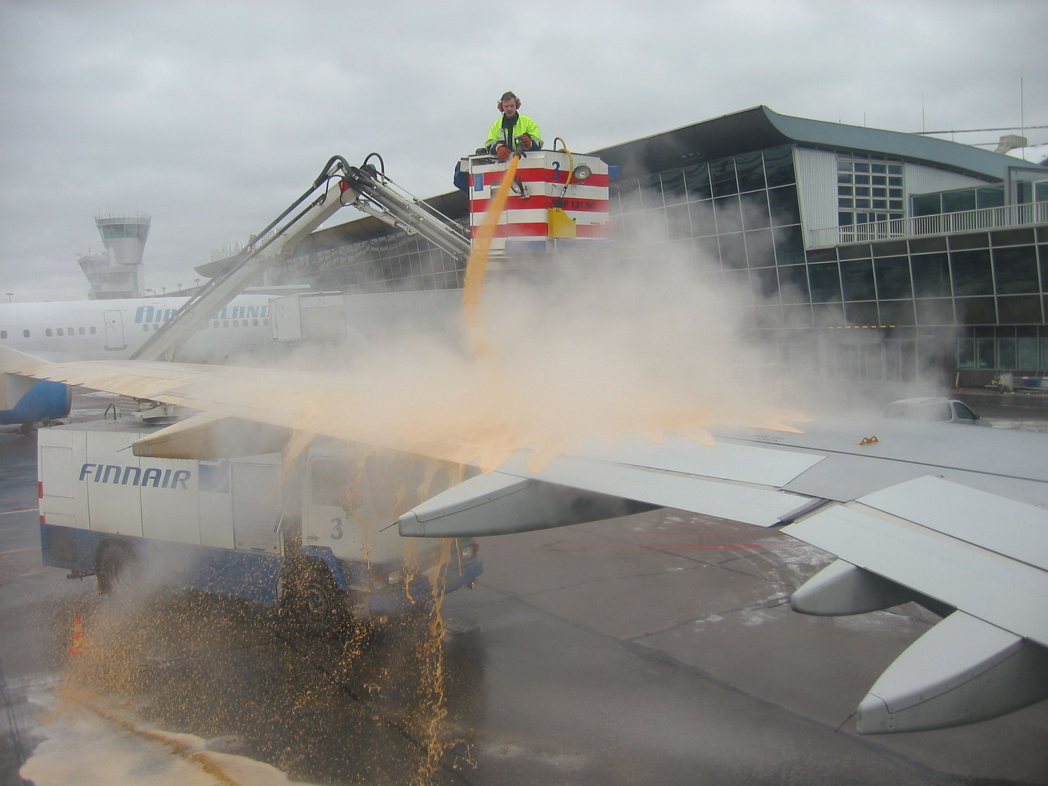
Aircraft Icing
Two major failure modes:
Commercial plane taking off in or after snowfall
General aviation plane in terrain with clouds/precipitation

Slide 5

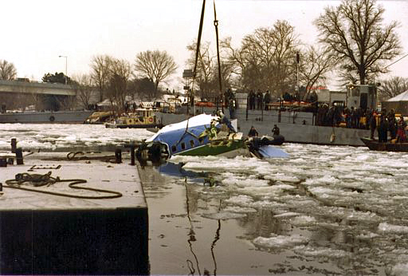
Air Florida Flight 90 13 January 1982 78 killed
https://www.youtube.com/watch?v=S3uS_8OyoEI

Slide 6
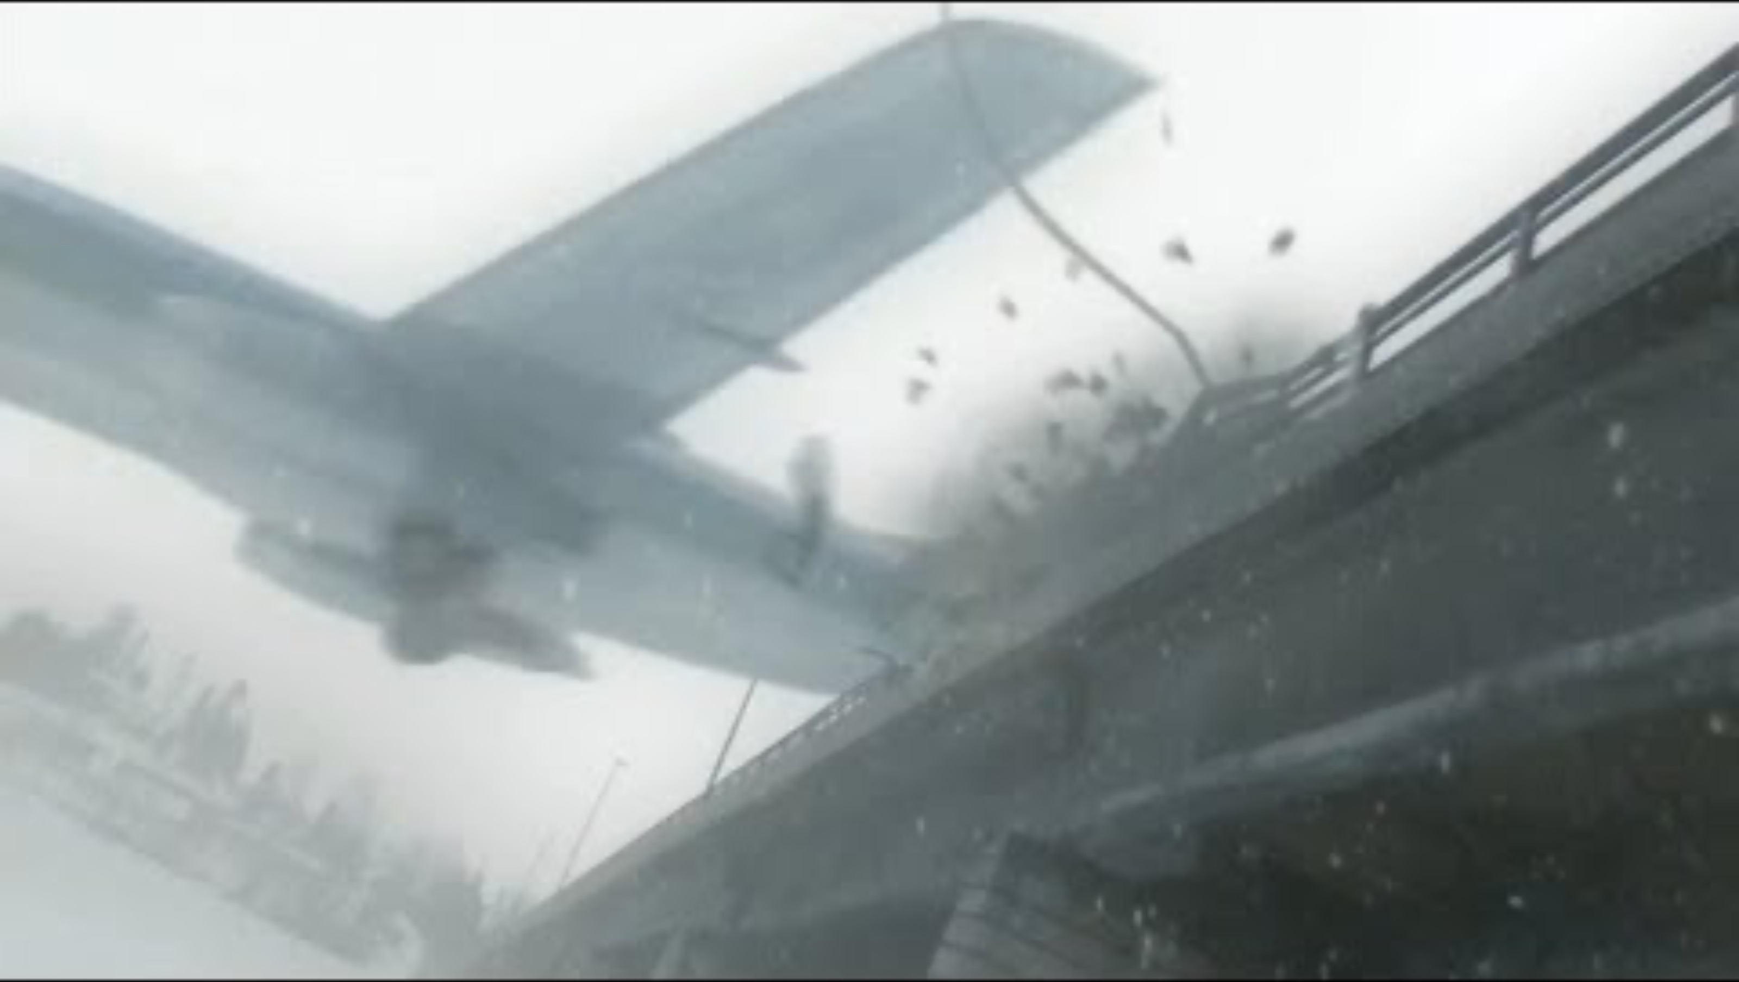

Slide 7
Icing Causes Problems in Several Ways
Increased weight
Decreased lift by changing shape of airfoil
Increased drag
Engine system icing
Reduced control of aircraft surfaces
Sensor malfunction.

Slide 8
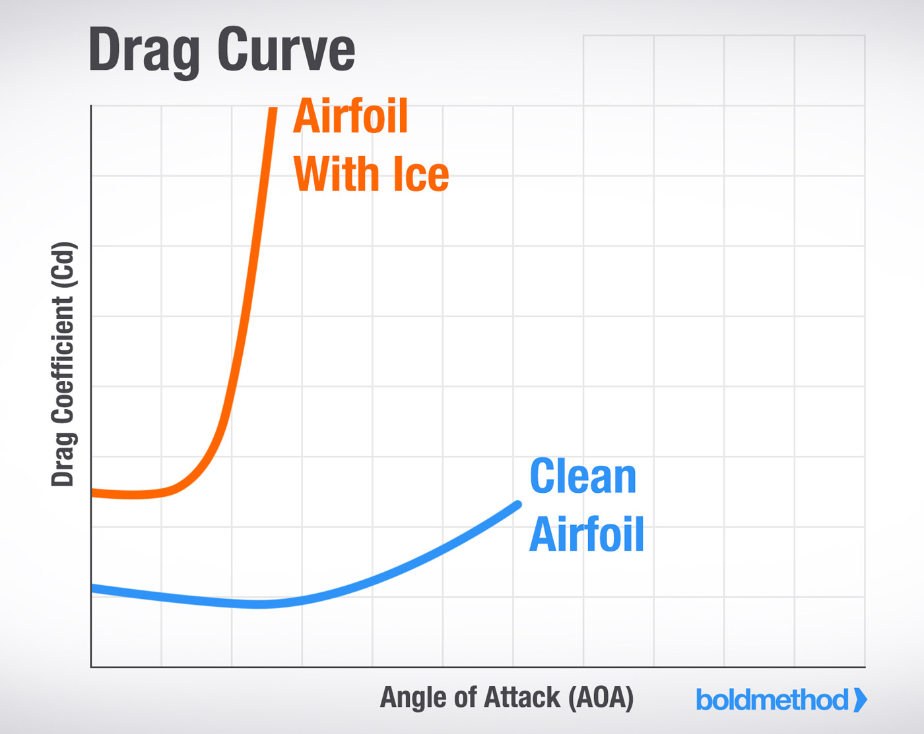
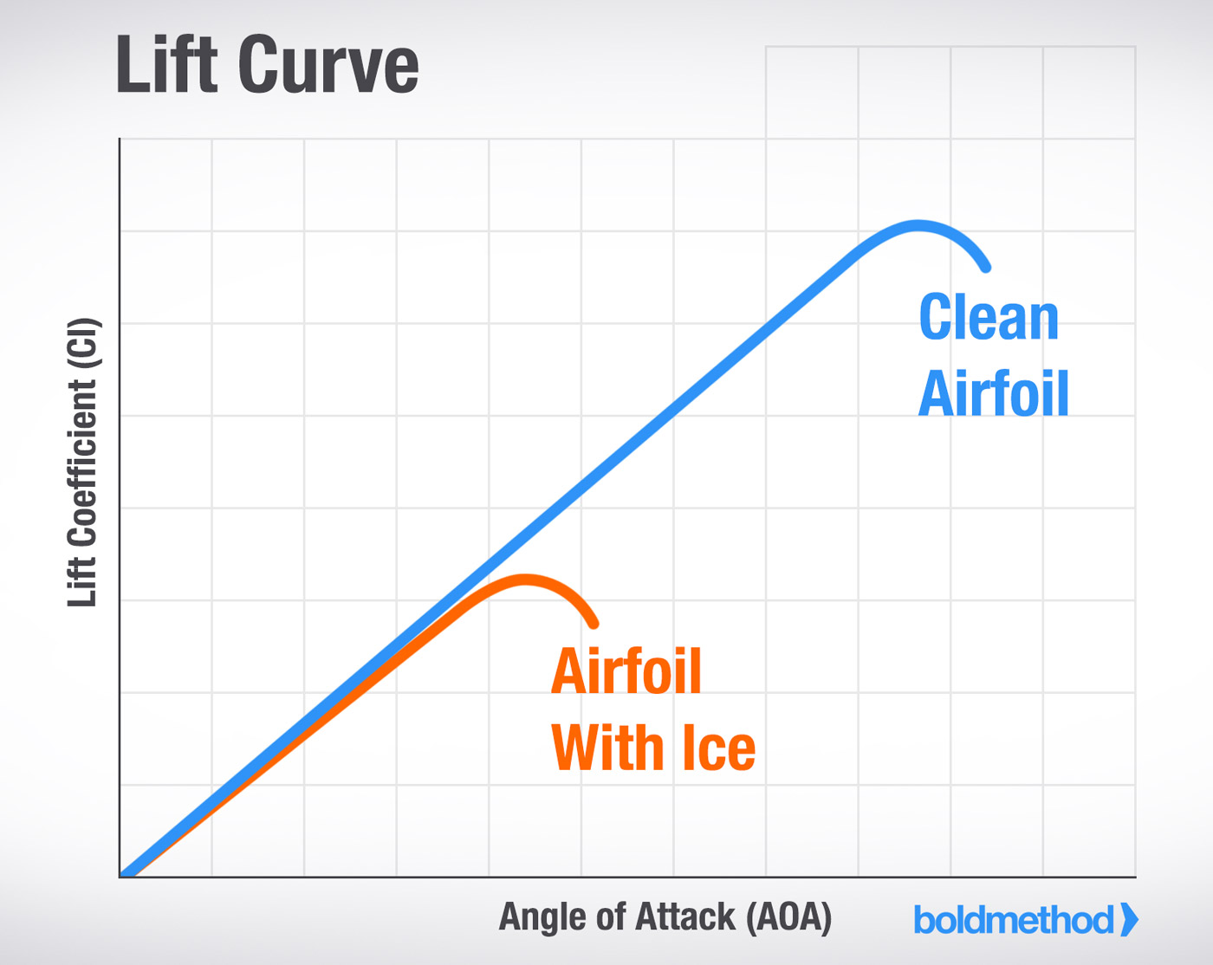

Slide 9
Types of Icing
Rime: rough, milky, opaque ice formed by instantaneous freezing of small supercooled drops
Clear Ice: glossy, clear or translucent. Formed by relatively slow freezing of large supercooled droplets.
Frost: Light, feathery deposits of ice crystals.

Slide 10
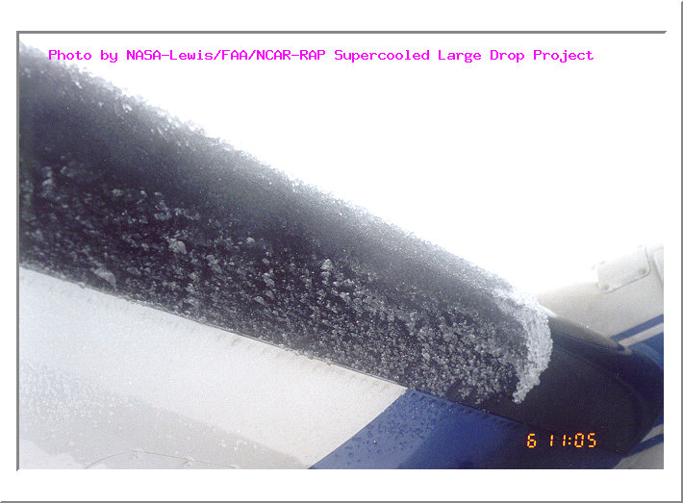
Rime Ice: Small supercooled water droplets freezing

Slide 11


Slide 12
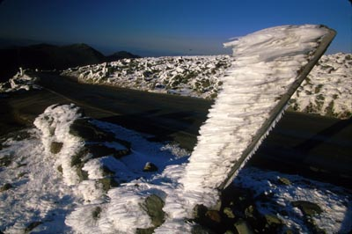
Rime Icing can occur at the ground!

Slide 13
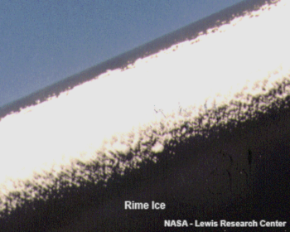

Slide 14
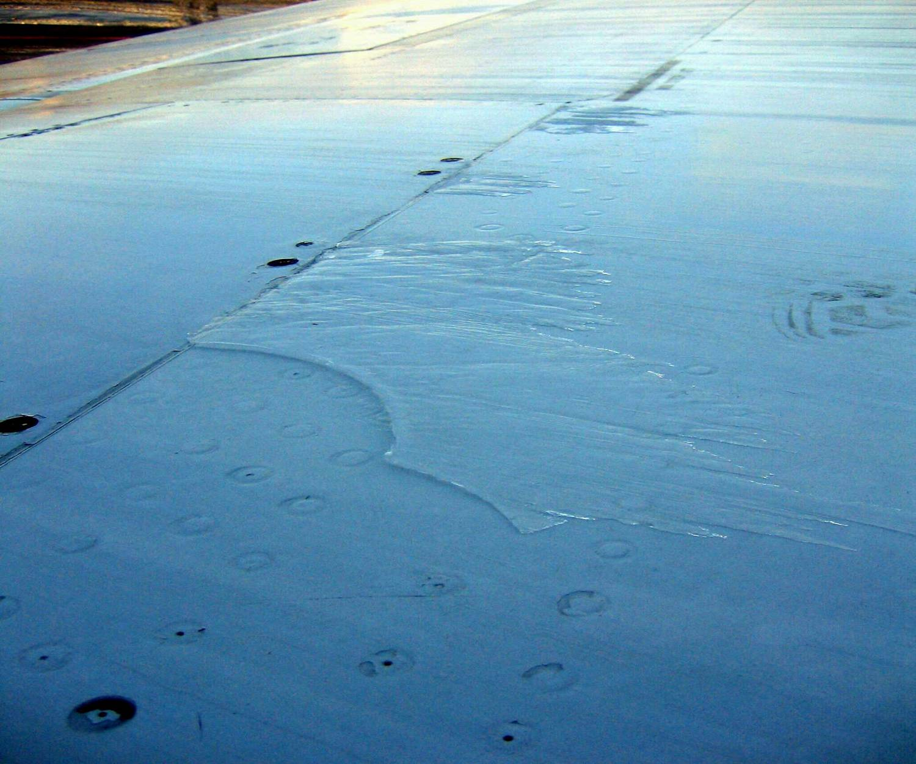
Clear Ice: Large supercooled water droplets: spread out before freezing

Slide 15
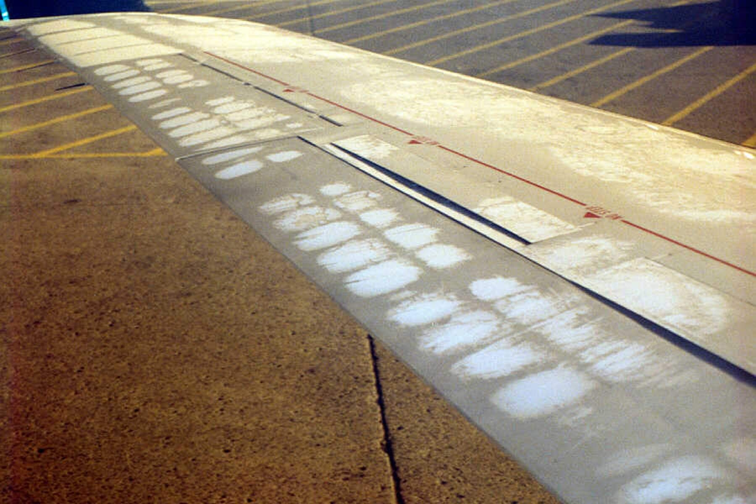
Frost: Surface cooling with deposition of H20 vapor

Slide 16
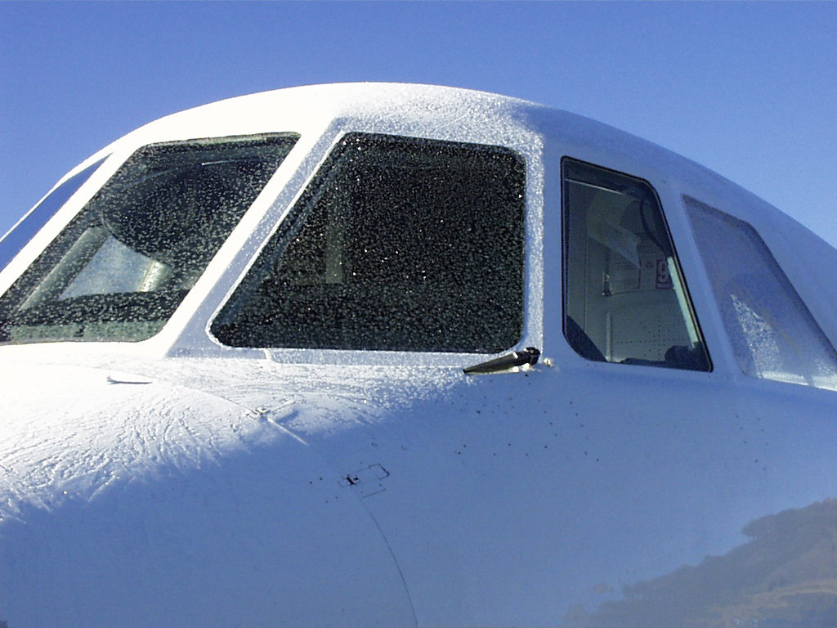
Frost

Slide 17
Icing Can Get Very Severe, Particularly on the Windward Side of Terrain Where Cloud Liquid Water Content is Very High

Slide 18
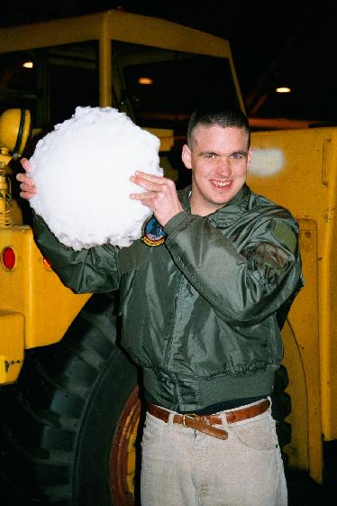

NOAA P3 During IMPROVE Experiment (western Oregon)

Slide 19
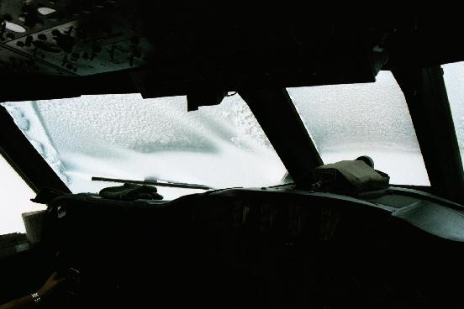

Slide 20
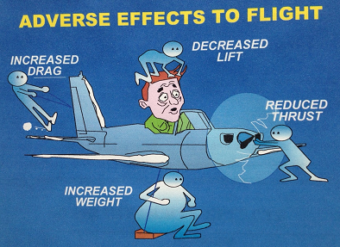
Relative Frequencies (500-700 hPa)
Rime-72%
Clear-10%
Clear-Rime: 17%
Frost: 1%

Slide 21
Intensity of Icing
Trace: Perceptible but not hazardous
Light: Accumulation may create a problem under prolonged exposure (> 1hr). Deice occasionally.
Moderate: Short encounters are potentially hazardous. Deicing/anti-icing mandatory
Severe: Deicing/anti-icing equipment is inadequate. Immediate diversion is necessary

Slide 22
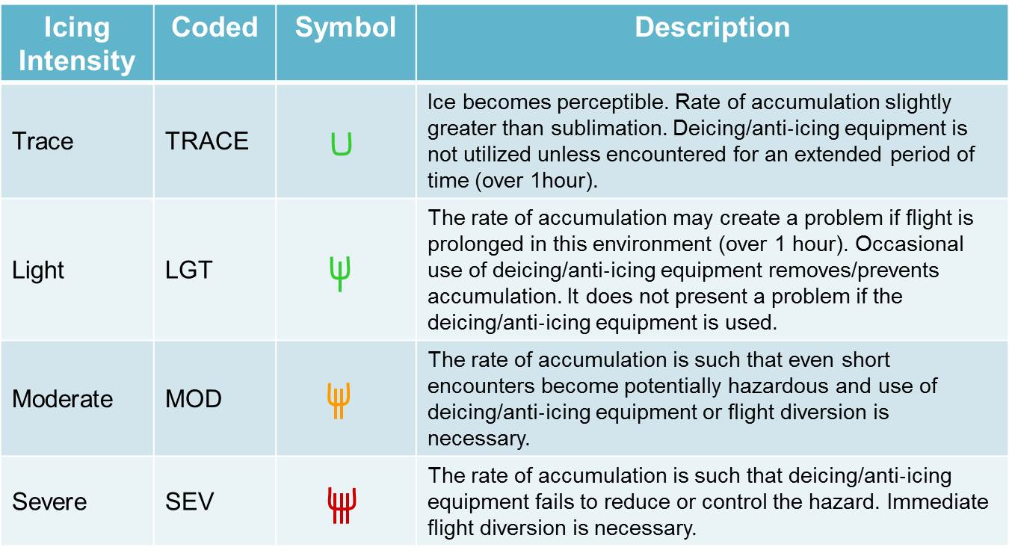

Slide 23
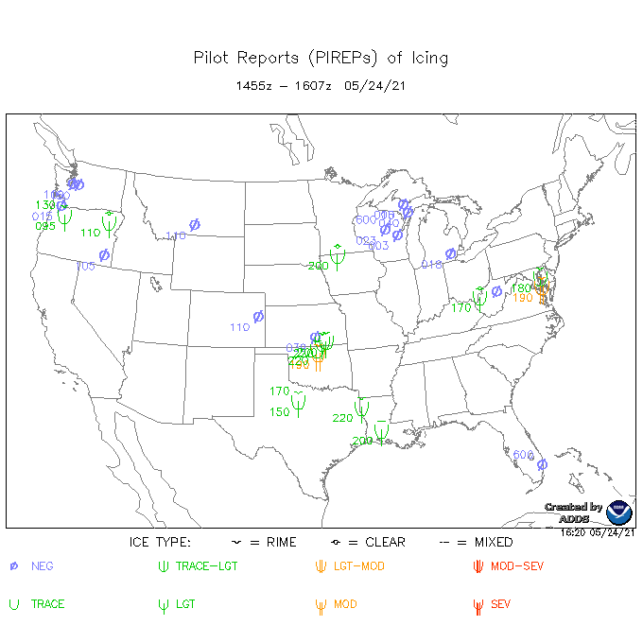
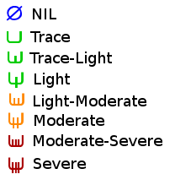
From NOAA AWC

Slide 25
Physical Factors Affecting Aircraft Icing
Worst icing occurs as aircraft fly through supercooled clouds or freezing rain.
Ice crystals (e.g., snow) are not a problem—just bounce off aircraft.
Major factors include temperature, liquid water content, and droplet size distribution

Slide 26
Temperature
T < -40C: no supercooled water and no threat
T > 0C, no problem
T between 0C and roughly -15C is the big threat range.
Few active freezing nuclei in this temperature range
Thus, lots of supercooled water, which freezes on contact with airframe.

Slide 27
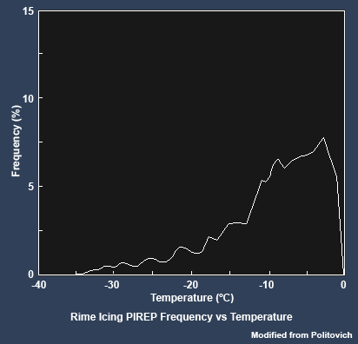

Slide 28
Liquid Water Content (LWC)
Important factor in determining ice accumulation rate.
In general, MUCH greater in cumuloform than stratiform clouds.
High in orographic clouds on windward slopes
Generally largest in higher portion of clouds.

Slide 29
LWC
Windward
slopes
Convection

Slide 30
Droplet Size Distribution
Small particles are collected less effectively than large ones.
Why? Small particles tend to follow the airstream that is deflected by the aircraft.
Large droplets have so much momentum that have a greater tendency to hit the plane.

Slide 31
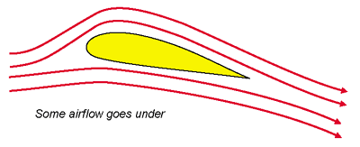
Small droplets tend to be deflected more by the flow around aircraft
Small
Large

Slide 32
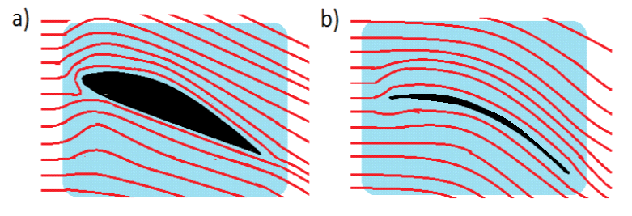
Non-Meteorological Factors
Collection efficiency of aircraft
Radius of curvature of aircraft structure is important
Sharp, narrow structures encourage more collection, since flow is less disturbed.

Slide 33
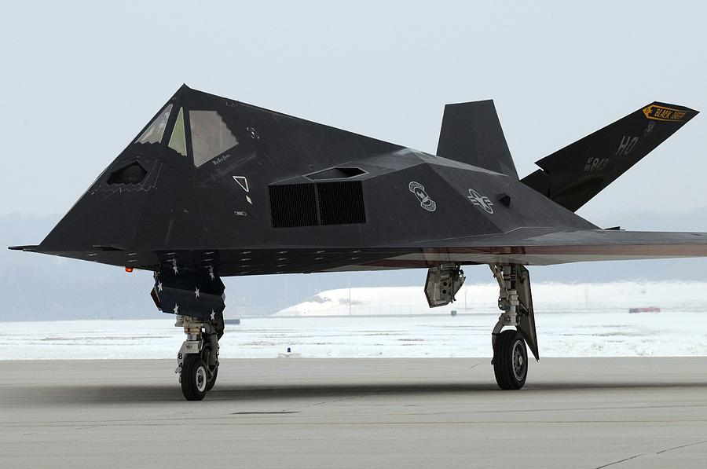
Icing issues at low speeds?

Slide 34
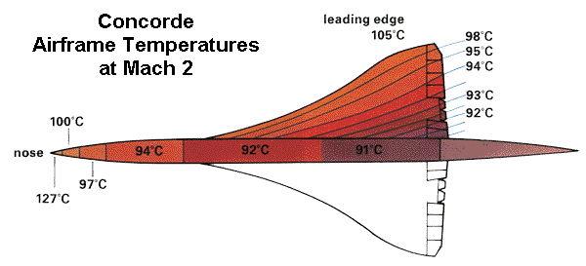
Aerodynamical heating
Adiabatic compression and friction
Very slow aircraft ~1F
Supersonic at low altitude ~50F!

Slide 35
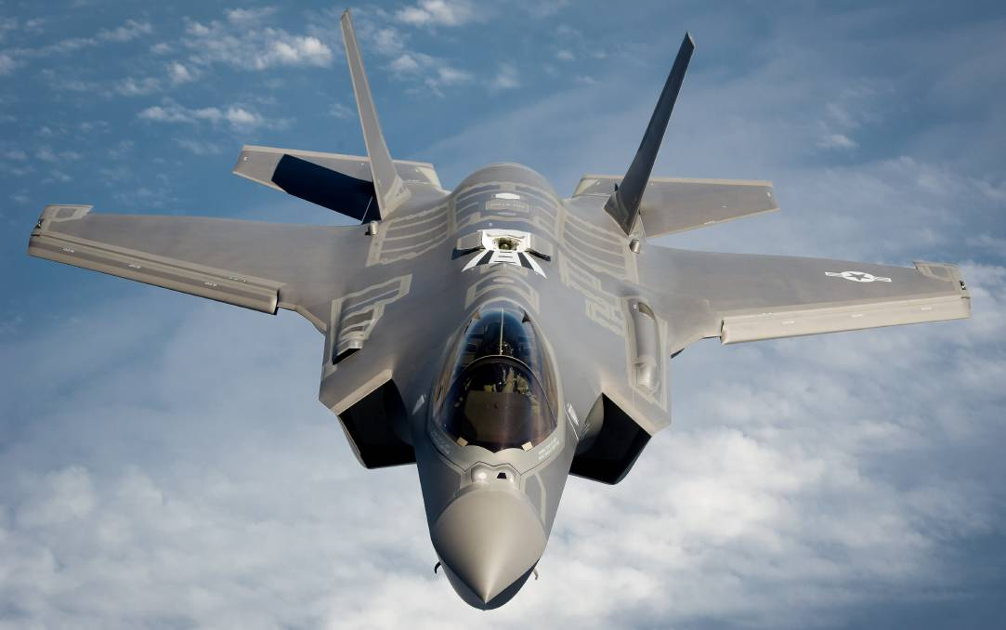
No icing worries when going fast

Slide 36
Aircraft Icing by Meteorological Situation
Low-mid stratiform (stratus, stratocumulus)
Convective-cumuloform
Cirrus
Warm fronts
Cold fronts
Orographic clouds
Freezing Rain

Slide 37

Low-Mid-Level Stratiform
Stratus, stratocumulus
Icing generally trace to light, max values near top of cloud.

Slide 38

Convective, Cumuloform
Potentially SERIOUS icing threat because of the large LWC content and lots of supercooled water.
Icing area is smaller horizontally but greater vertically than stratiform.
Icing in cumulus can range from trace to severe.
Worse in upper part of cloud.
Most severe in cumulus congestus just before transition to cumulonimbus

Slide 39
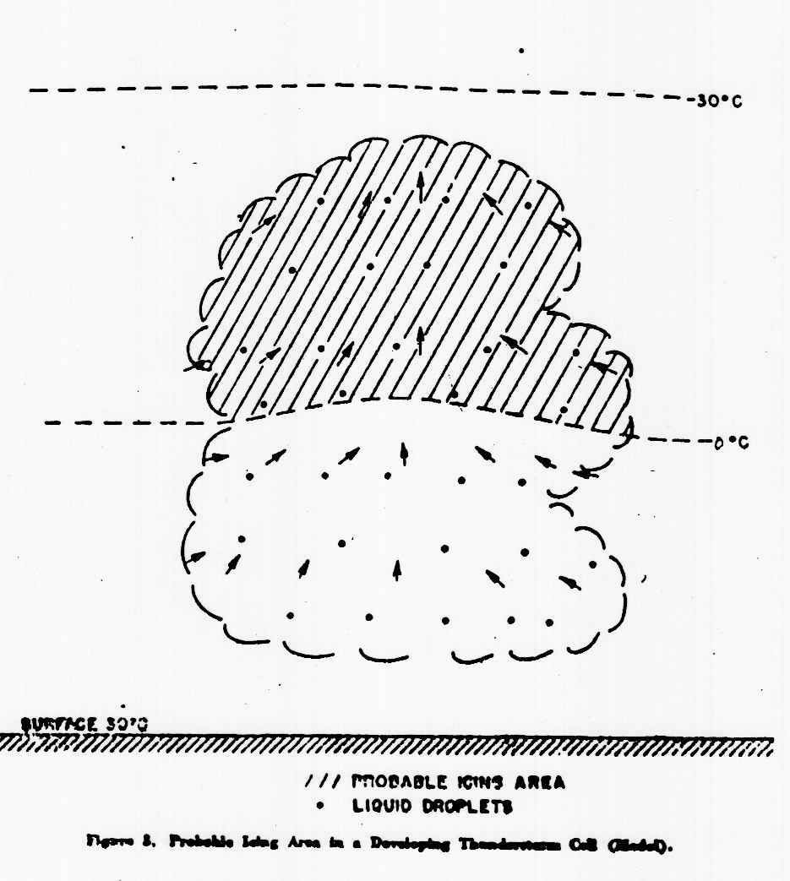
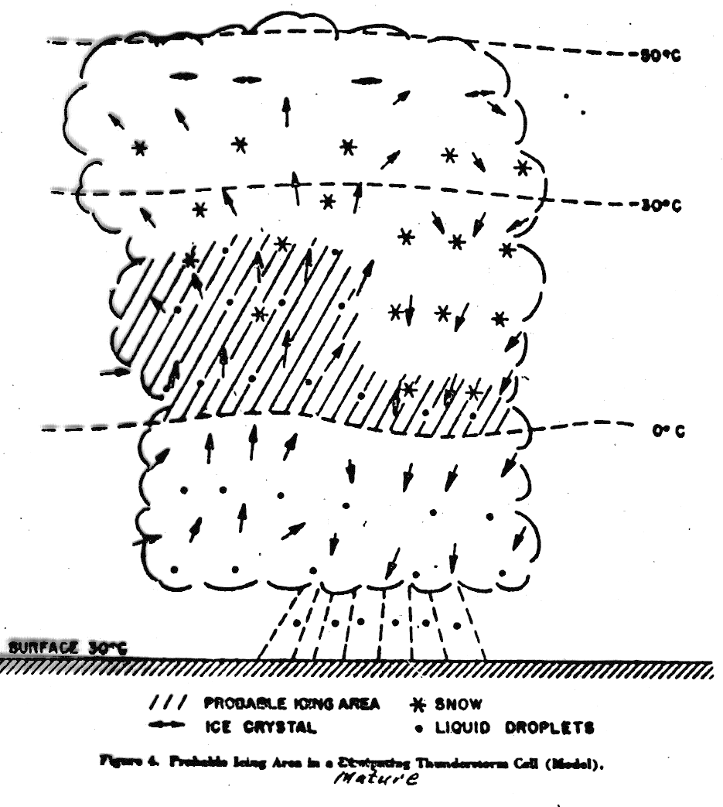
In mature cumulonimbus, icing mainly in updraft region.

Slide 40

Cirrus.. no problem since an ice cloud

Slide 41
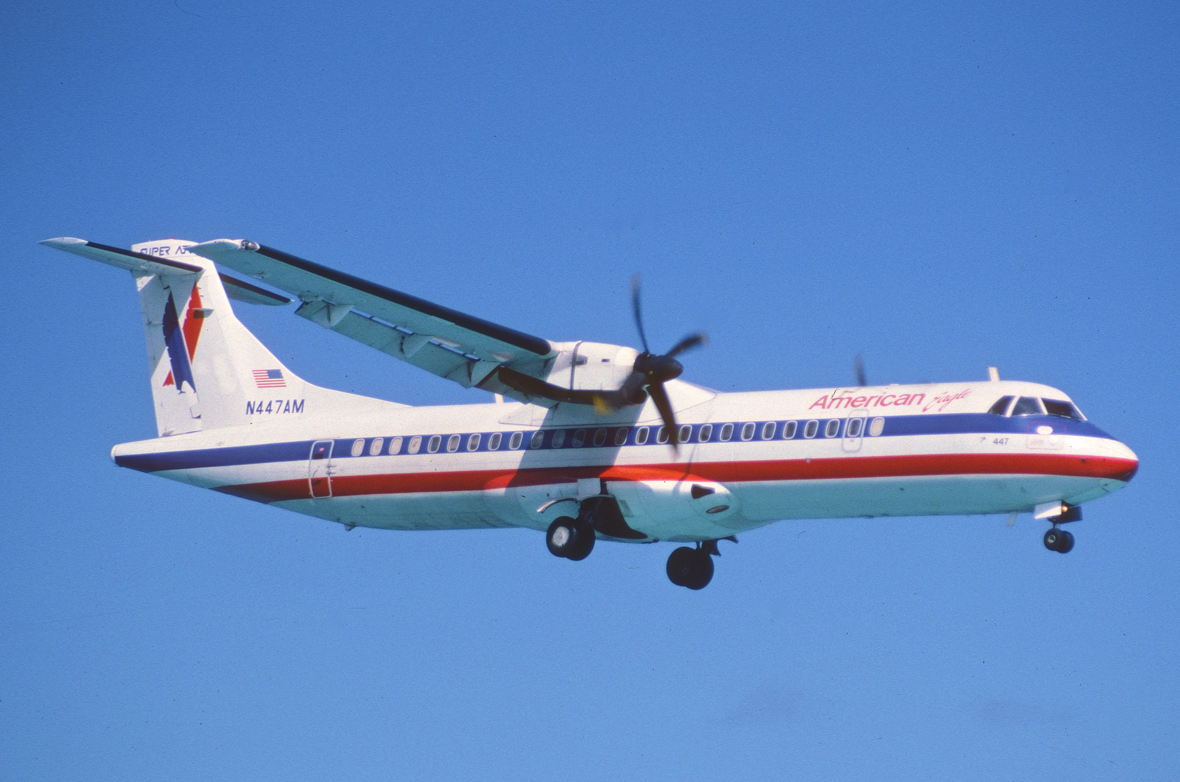
Frontal clouds--~85% of icing incidents

Slide 42
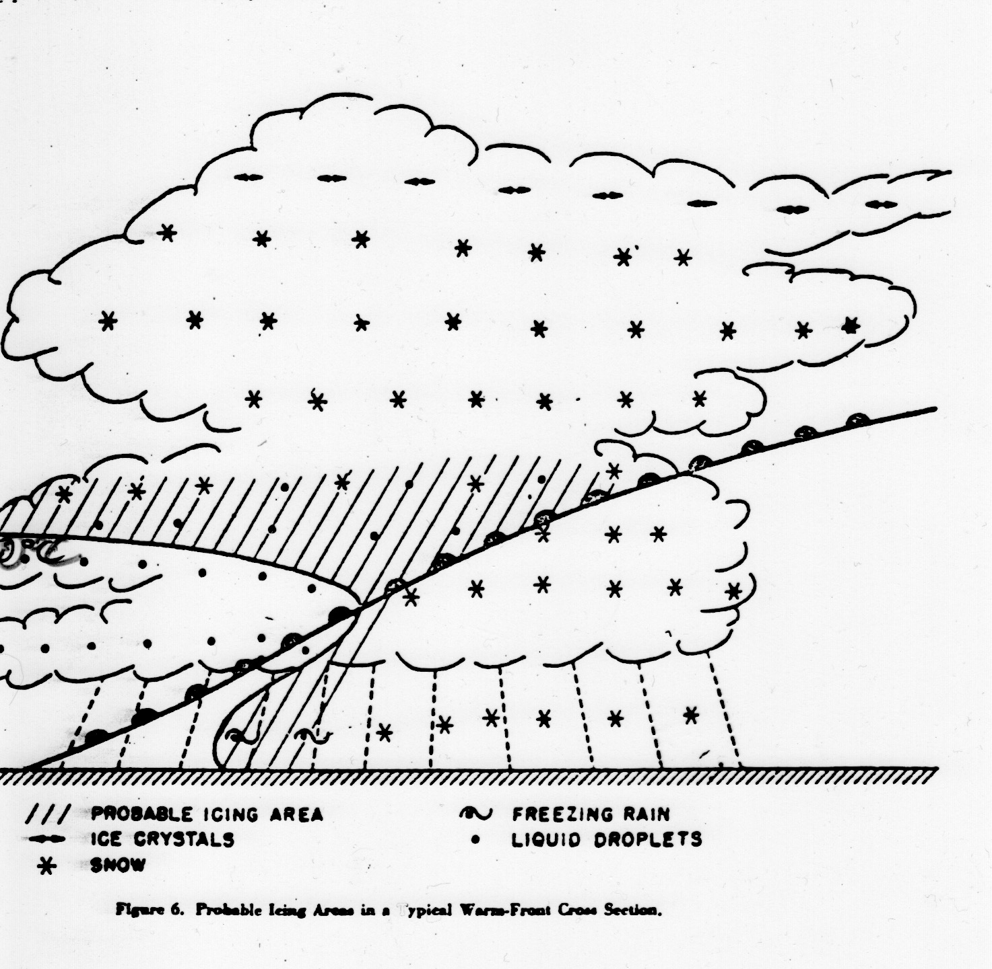
Warm Front Icing Area
Beneath warm front in cold air (freezing rain)
Above warm front (300-900 m layer), where T is below 0C
0C

Slide 43
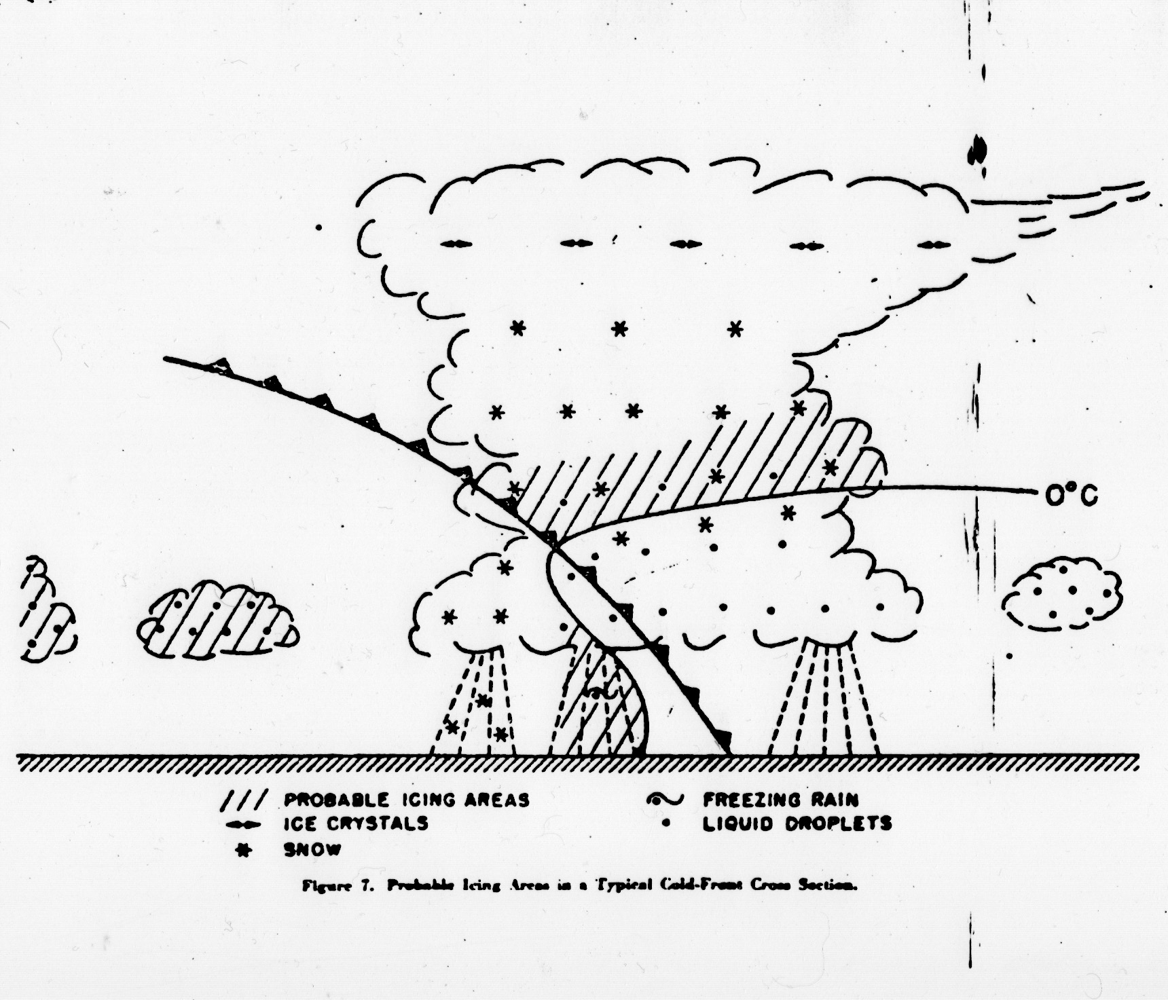
Cold Front
Largest in supercooled cumuloform clouds associated with the front

Slide 44
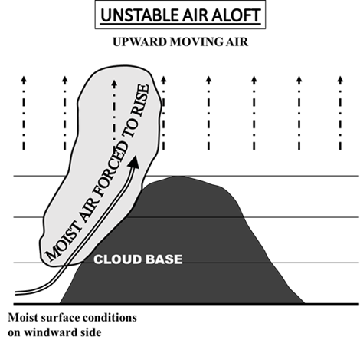
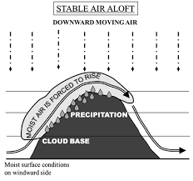
Orographic Clouds
Can be a huge threat
Can have large LWC and big water droplets
Particularly bad with maritime polar (mp) air hitting a major barrier (like the Cascades)

Slide 45

Boeing does not need to go far to test new aircraft in icing conditions

Slide 46
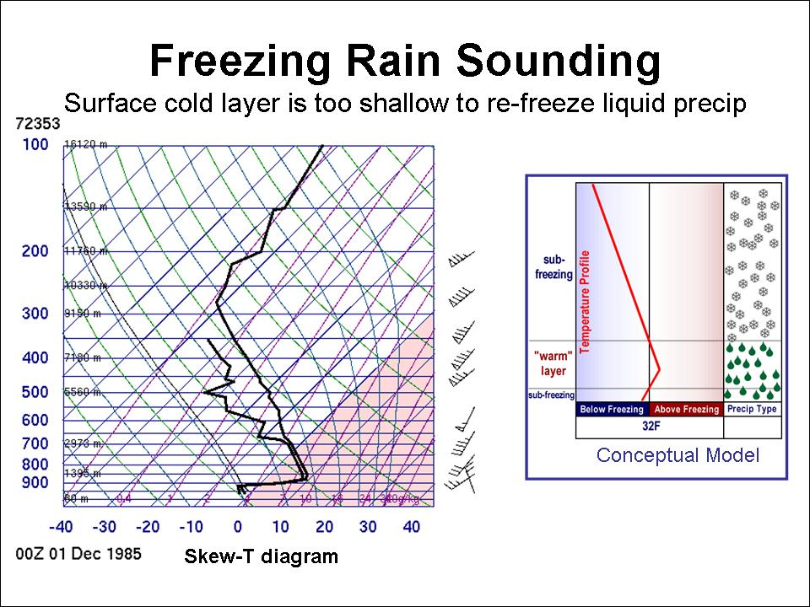
Freezing Rain
Rain in an above-freezing layer aloft, falling into a sub-zero layer below, producing supercooled water

Slide 47
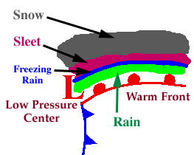
Often north of warm fronts
Frequent occurrence in the US Midwest

Slide 48
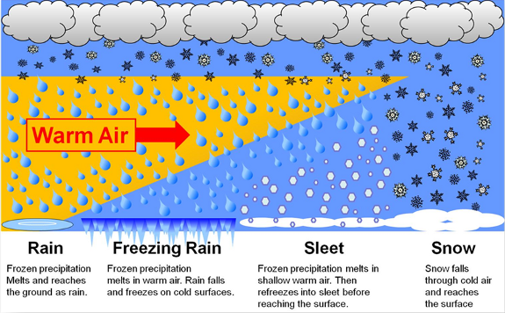

Slide 49
Freezing Rain and Terrain: Shallow Cold Air Trapped Near Surface
Topographic basins—like the Columbia Basin-- act as cold-air bowls that fill with subfreezing air
Gaps, like the Columbia Gorge, can serve as conduits of low-level cold air below freezing
Cold air damming situations east of barriers such as the Appalachians

Slide 50
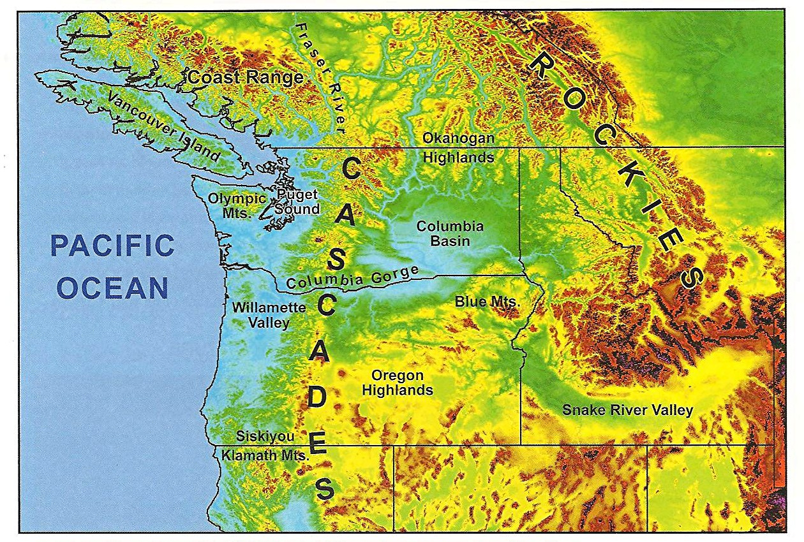
Columbia Gorge and Columbia Basin: FZ Rain Major Threat!

Slide 51
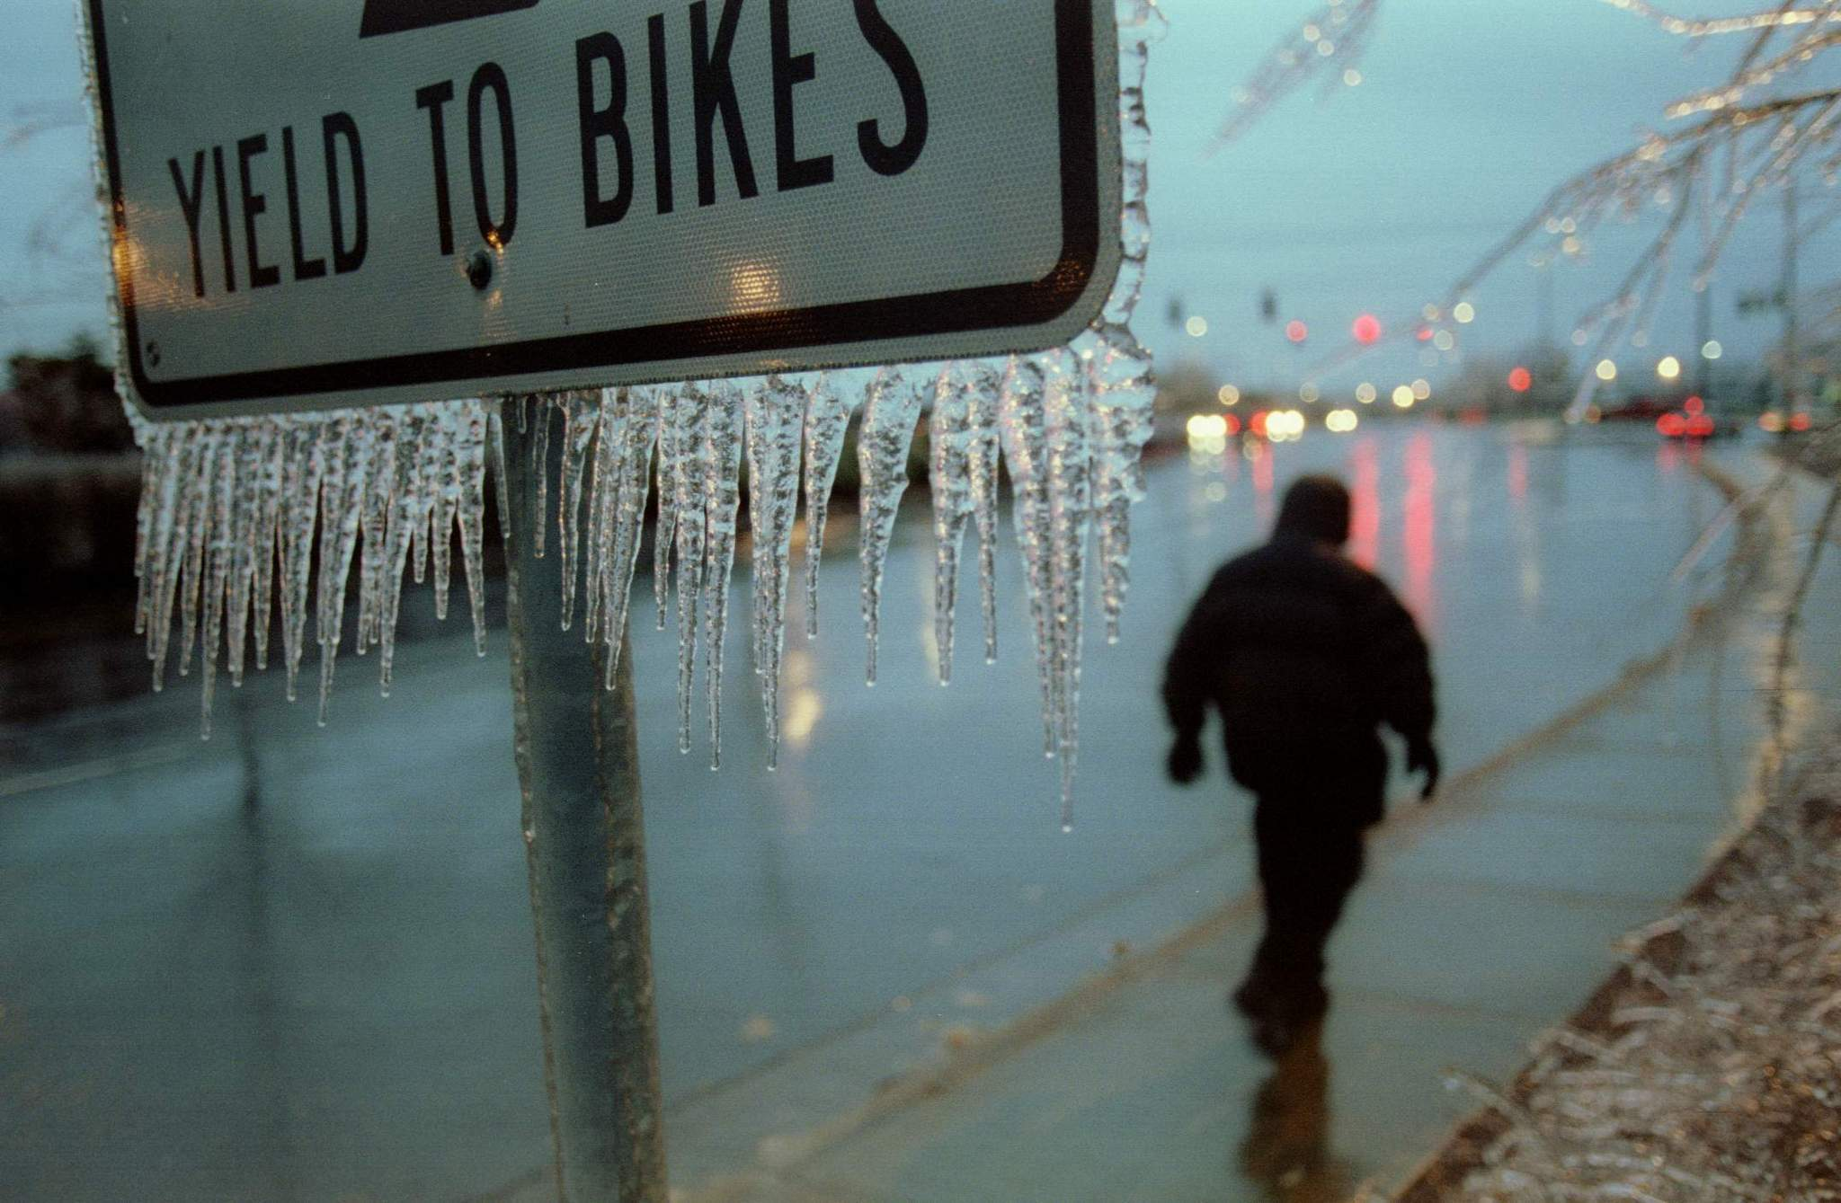
Portland is well known for freezing rain

Slide 52
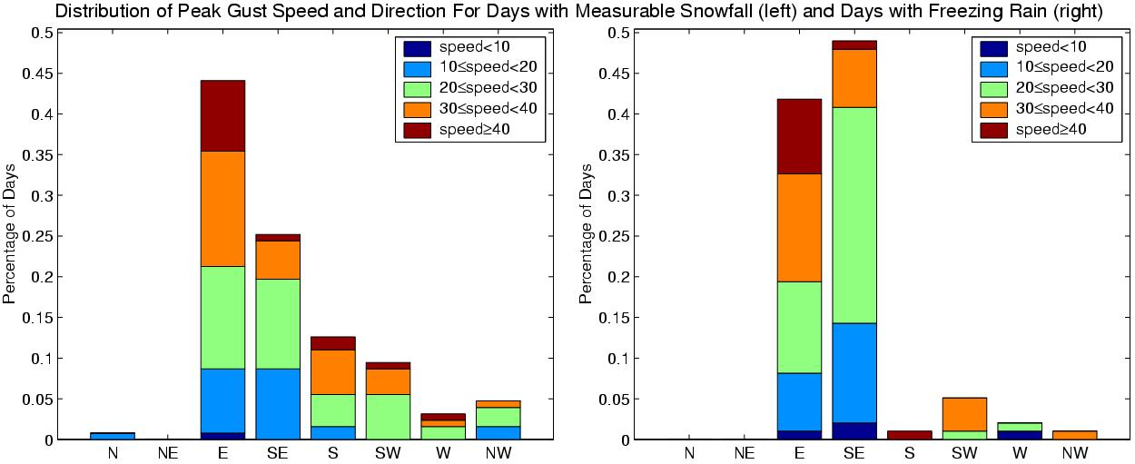
Freezing Rain in Portland
FreeFre
Snowfall
Freezing Rain

Slide 53
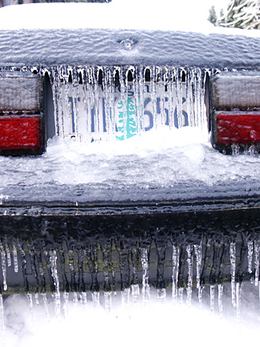

Slide 54
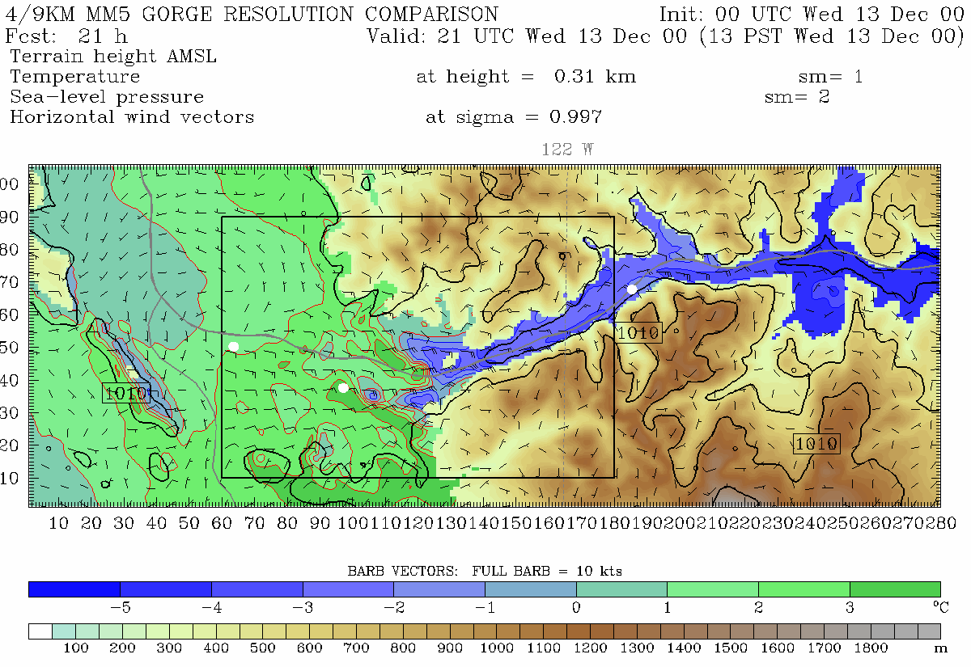
444.4 m grid spacing, Pass Height = 100 m
Portland
Troutdale
Cascade Locks
Notes:
Min pass height is at far right of domain near Cascade Locks (same place as 4/3 domain)
This plot is from 310 m. Note, vortex. See this on radar data too. Zoomed in plot will be from 150 m

Slide 55
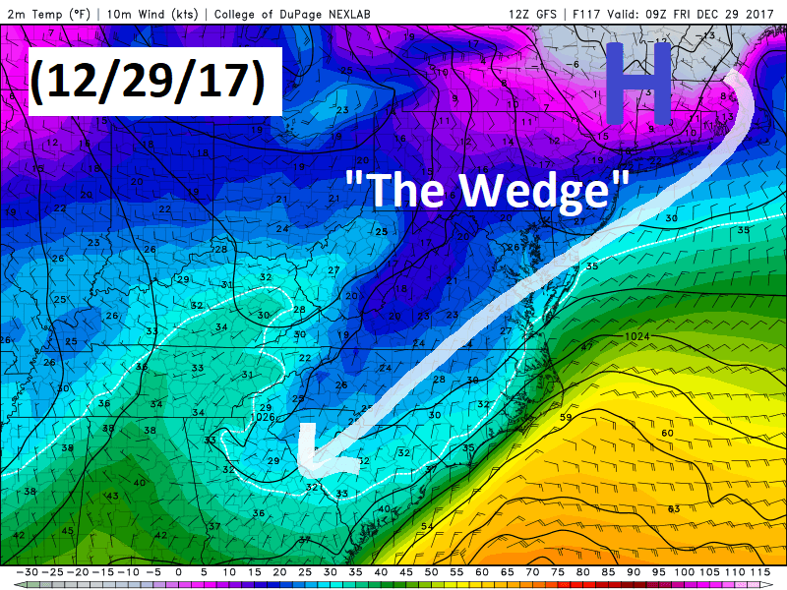
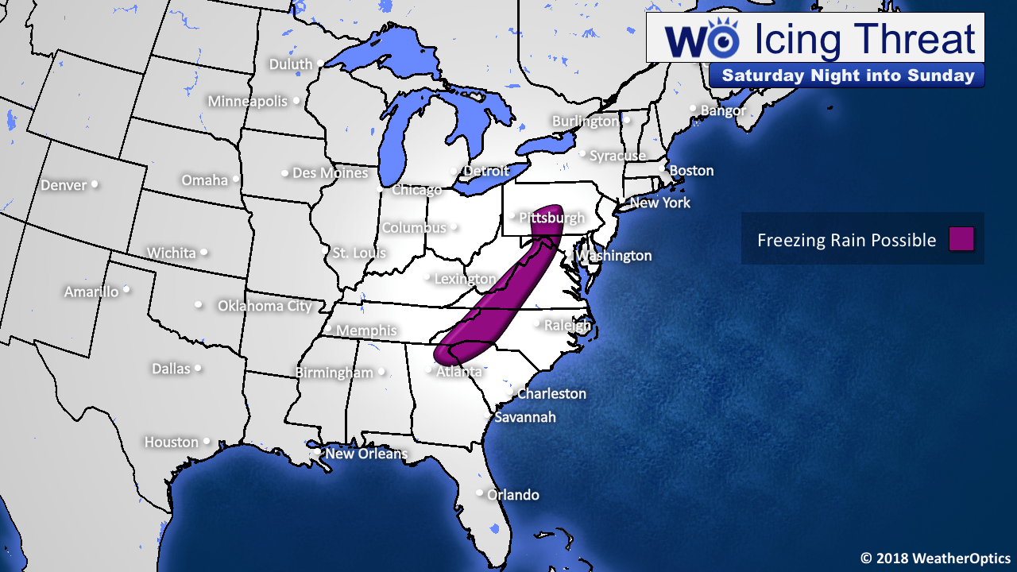
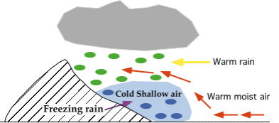
East Coast Cold Air Damming Freezing Rain

Slide 56
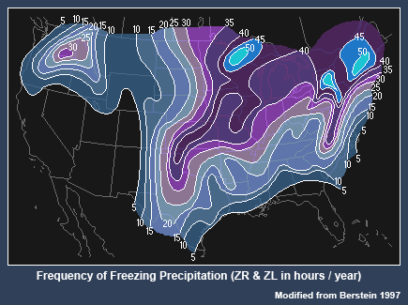
Freezing Rain Climatology

Slide 57
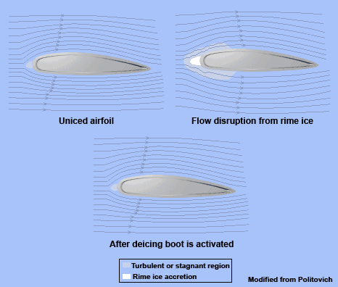
Many Aircraft Have Deicing Equipment: Including Icing Boots and Heating

Slide 58
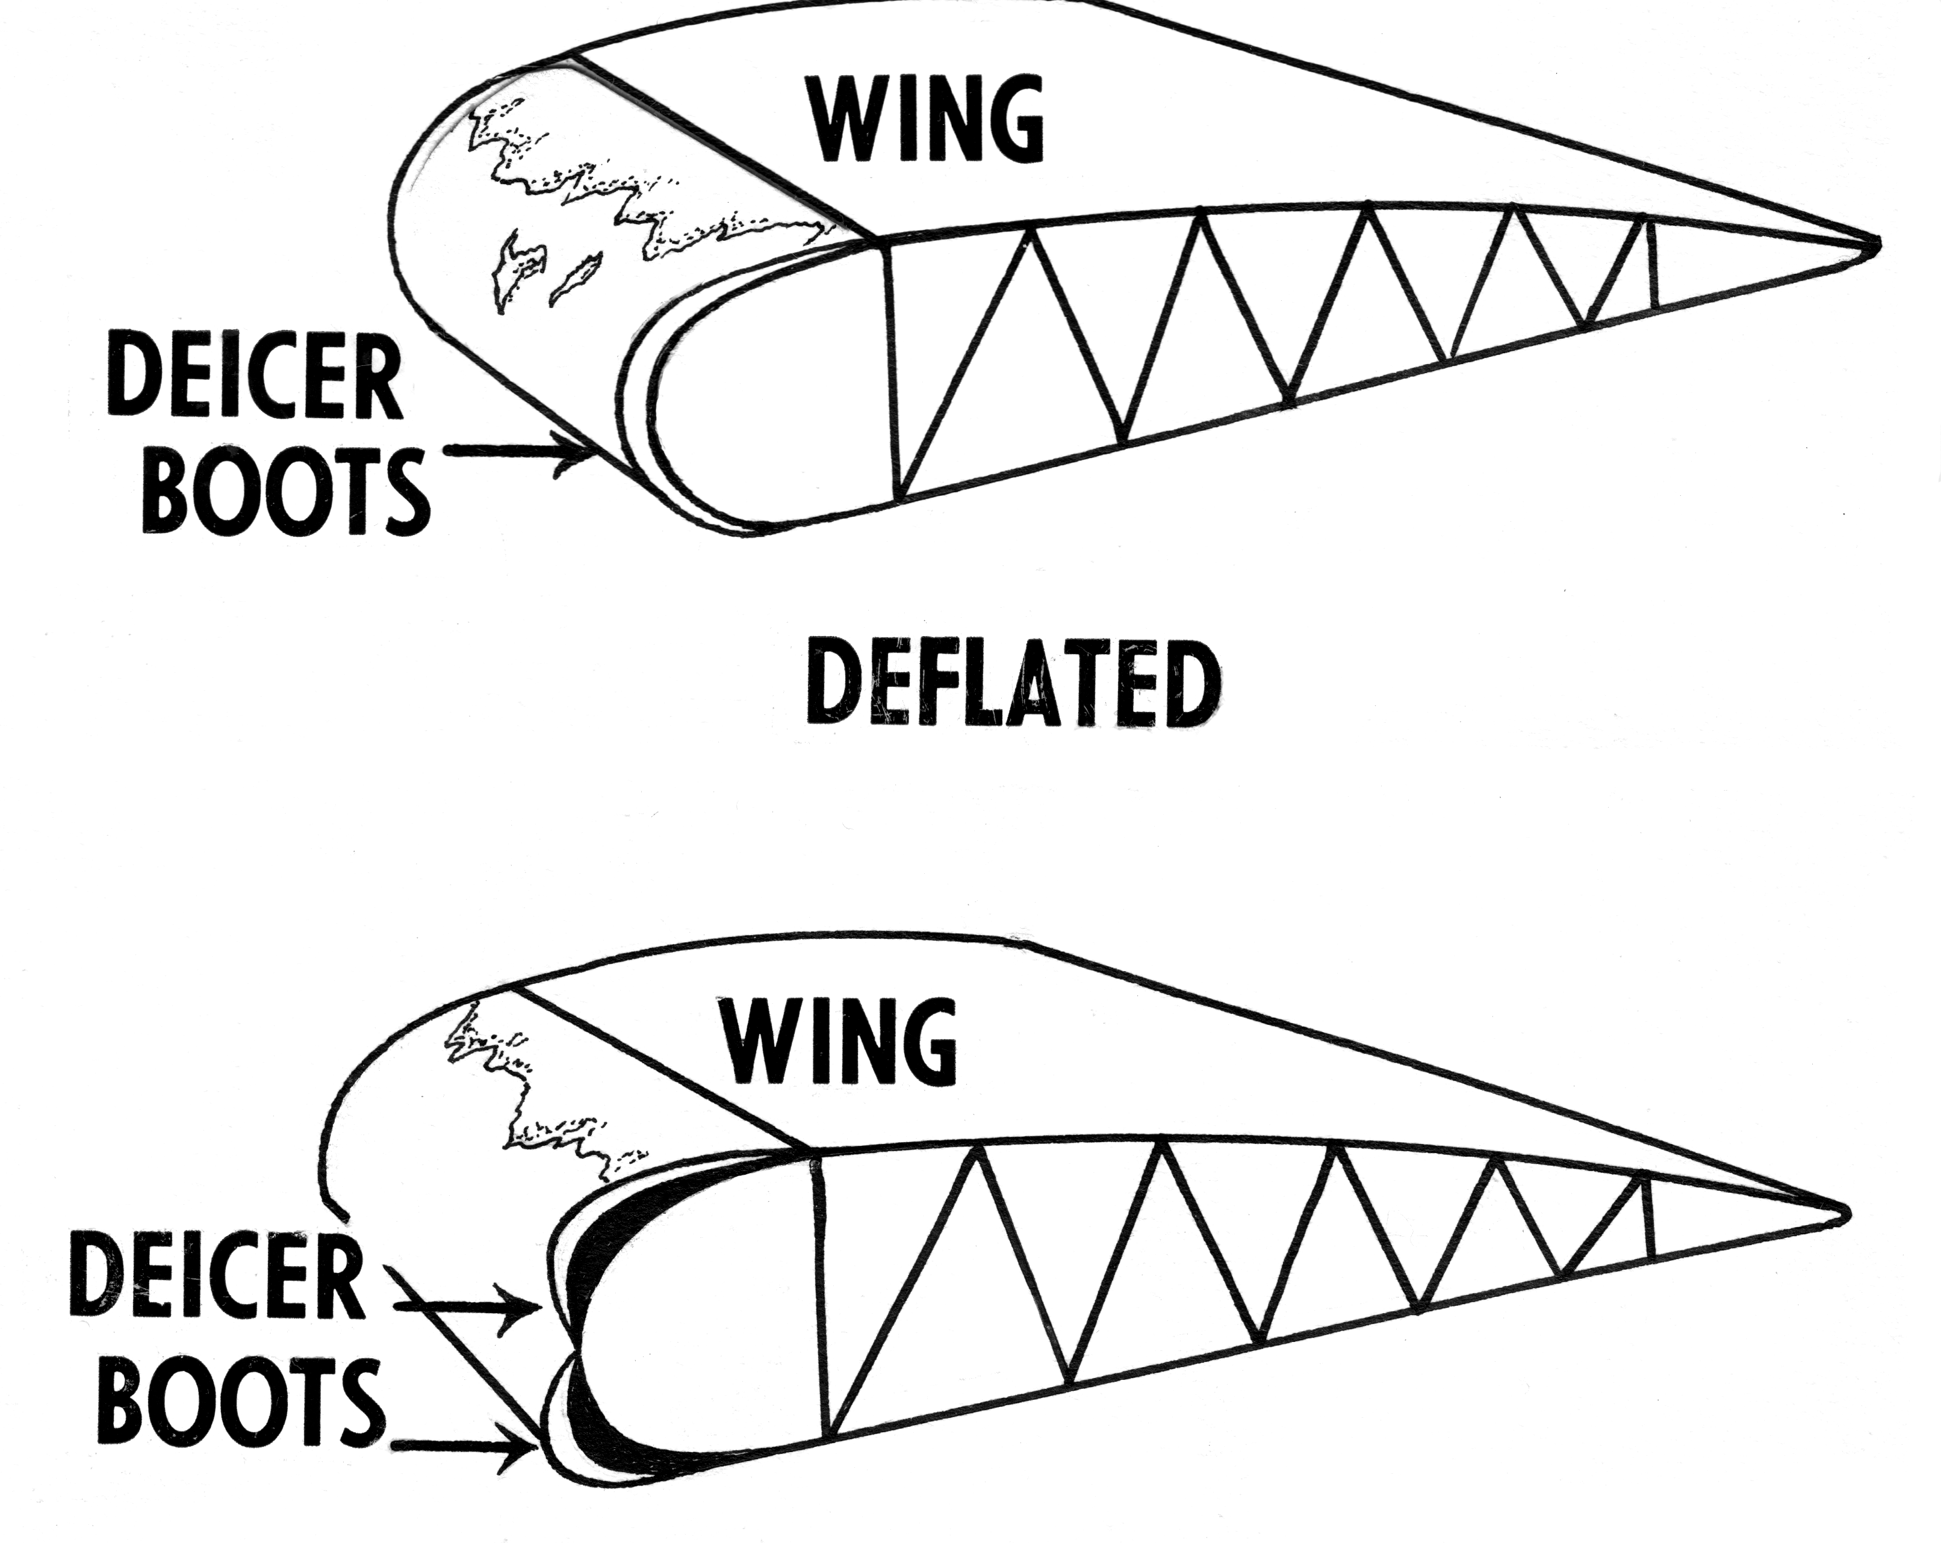

Slide 59

Heated wings—surface heating or hot air inside

Slide 60
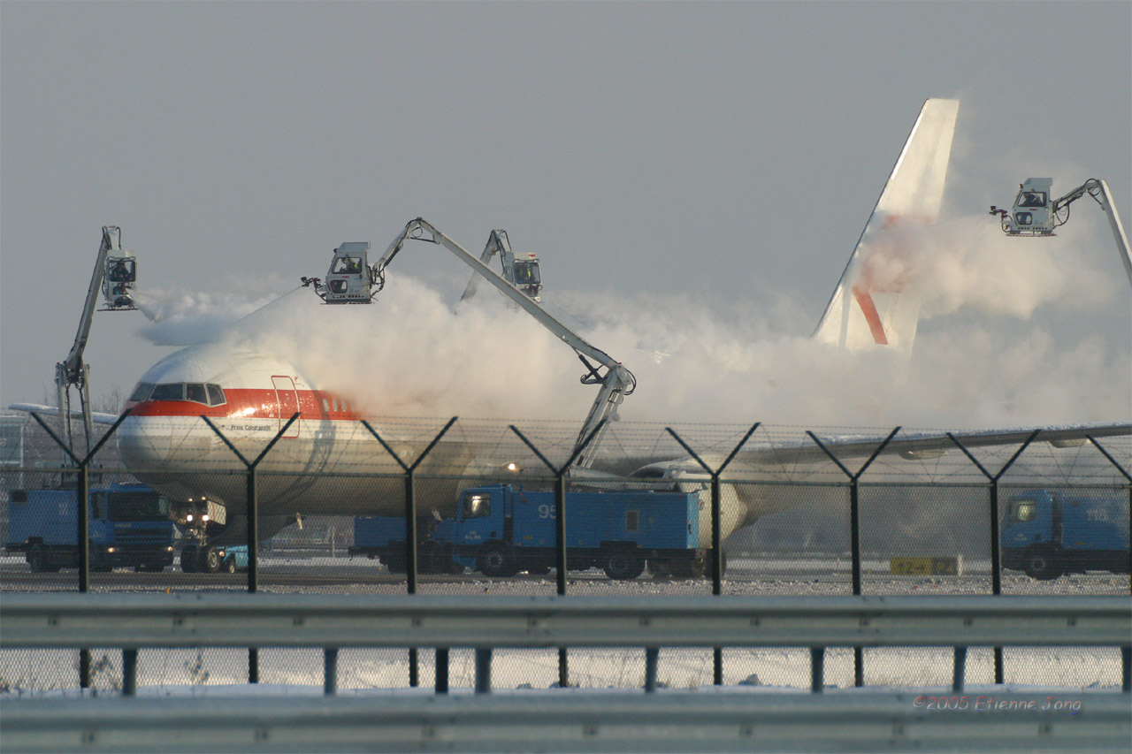
Greater Emphasis on Deicing at Airports

Slide 61
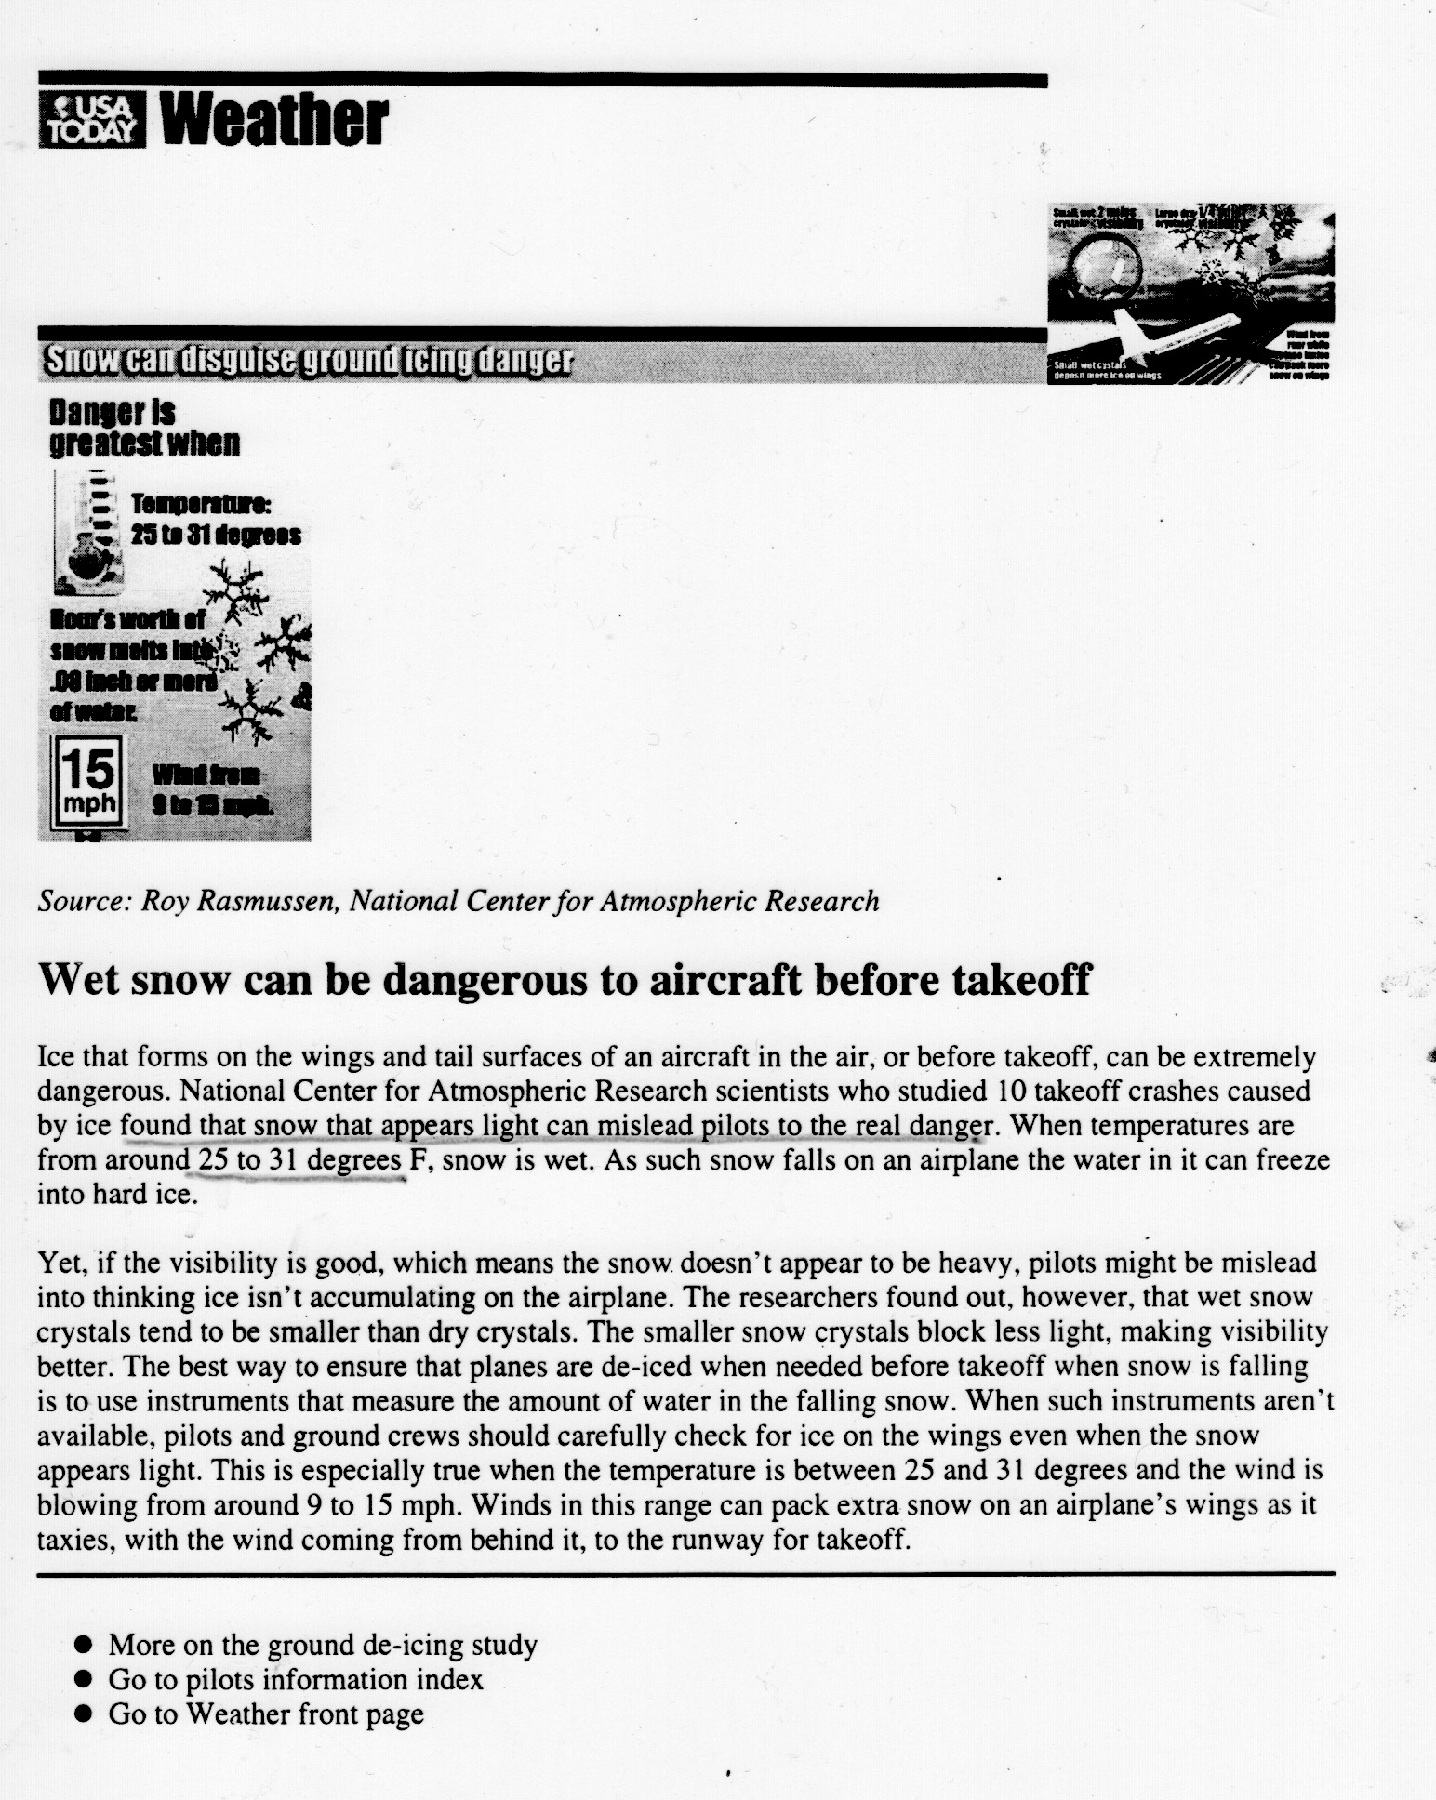
There have been field programs to study aircraft icing
WISP: Winter Icing and Storms Project
Biggest Threat 25-31F

Slide 62
Pilots often report icing conditions aloft through PIREPS (Pilot Reports)

Slide 63
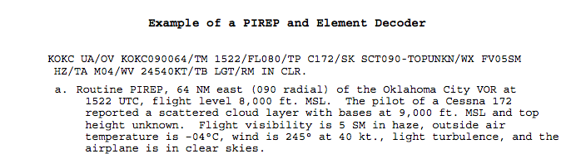
Pilot Reports (PIREPS)

Slide 64
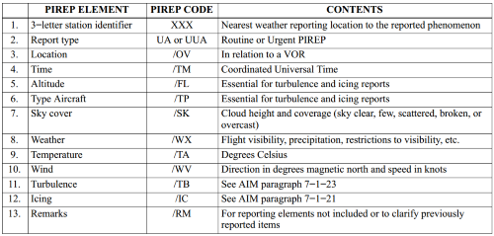

Slide 65
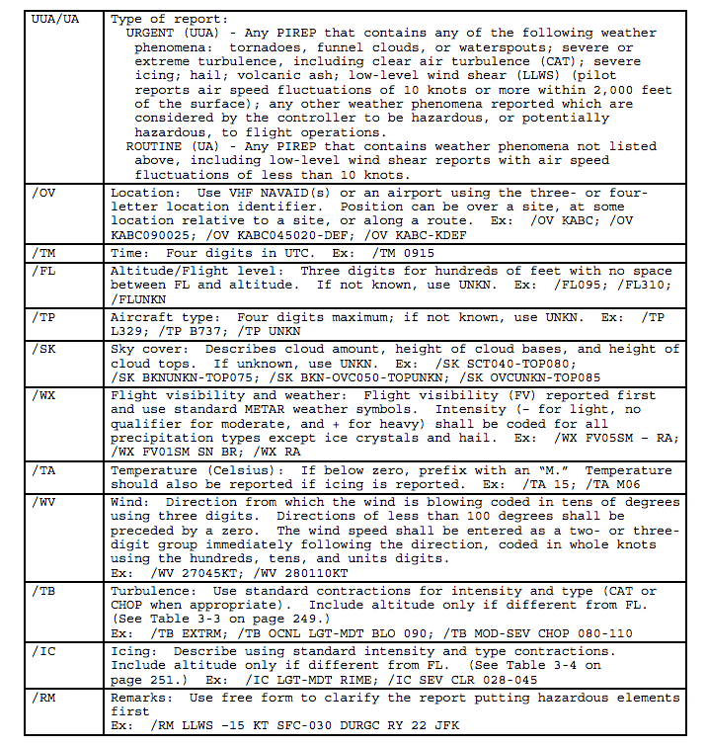

Slide 66
Available at the Aviation Weather Center (AWC) AWC is the center of US operational aviation weather prediction
http://www.aviationweather.gov/adds/pireps

Slide 67
Lots of icing guidance available from the Aviation Weather Center website

Slide 68

s
https://www.aviationweather.gov/
CIP: Current icing potential
FIP: Future Icing Potential
SLD: Supercooled Large Drops

Slide 69
Aircraft Turbulence: Five Types
Mechanical turbulence (near surface)
Convective turbulence
Vertical wind shear induced turbulence
Wave-related turbulence
Wake turbulence

Slide 70
Turbulence
Most dangerous and severe are thunderstorm and mountain-wave related turbulence
Generally, only a matter of discomfort but can be dangerous for unbelted passengers and flight crew.
Truly extreme turbulence has seriously damaged aircraft (e.g., loss of jet engine)

Slide 71


Slide 72
Turbulence Intensity Levels
Light: Slight changes in aircraft attitude and or altitude. Acceleration < .5 g
Moderate: Moderate changes. Plane remains in control. Loose objects move about. Acc: .5 to 1 g
Severe: Abrupt changes. Loose objects tossed about. Acc > 1 g
Extreme: Loss of control of plane, several g’s

Slide 73

Turbulence Levels

Slide 74


Slide 75


Slide 76


Slide 77

Mechanical Turbulence: Produced by Wind Interacting with Surface Roughness

Slide 78
Mechanical Turbulence
Depends on:
Wind strength (stronger winds more turb)
Surface roughness (rougher surface more turb)
Stability (less stability more)
Most significant in lowest few hundred meters above surface.
https://www.youtube.com/watch?v=w0CX9uCvNFY
https://www.youtube.com/watch?v=Z2QXWqw7iFI

Slide 79


Slide 80


Slide 81
Convective Turbulence
Convective BL without significant CU activity (thermals in BL)
Produced by heated surface during the day
Light to moderate turbulence. Typically, lowest 1-2 km.
Near or in cumulus convection
Can be severe
Strongest at edges of updrafts and downdrafts
Can also be above and immediately downwind of cumulonimbus

Slide 82


Surface Based Convective Turbulence

Slide 83

https://www.youtube.com/watch?v=d3lz4AV_aUI
Surface convection simulation

Slide 84


Slide 85
Convective Turbulence Near Active Cumulus Convection

Slide 86

American Airlines Flight 242

Slide 87


Turbulence worst at boundaries of updrafts and downdrafts Why?

Slide 88

Answer
Wind shear can result in turbulence.

Slide 89
Wind-Shear-Induced Turbulence: Not Necessarily with Convection
Occurs when horizontal winds change rapidly with height (speed or direction or both).
Often associated with frontal zones, upper fronts, jet stream flanks, sharp troughs
Most associated with Kelvin-Helmholtz Instability (KHI)
KHI develops in stably stratified flow when the vertical shear exceeds a certain threshold.

Slide 90

KHI Clouds Produced By Vertical Wind Shear

Slide 91


Slide 92

In a fluid tank

Slide 93

Shear-Induced Turbulence is Related to the Richardson Number (Ri)
stability
shear

Slide 94
Richardson Number
Theoretical studies and observations suggest Ri needs to get to .25 or below for instability
You need some stability to allow the build up of shear for instability (rubber band analog)

Slide 95

The Analog

Slide 96
Some Videos
https://www.youtube.com/watch?v=ELaZ2x42dkU
https://www.youtube.com/watch?v=qEGbzZM0Baw

Slide 97


Slide 98


Slide 99
Shear-Induced Turbulence
Tends to be patchy
A few thousand-foot shift in altitude can change things radically.
Can occur inside or outside of clouds
Outside of clouds known as Clear Air Turbulence (CAT).

Slide 100

Some preferred locations for shear-induced turbulence aloft
Upper trough on cold side of jet
Along jet north and northeast of developing low
Above and below midlatitude jet core

Slide 101

From FAA Manual
CAT

Slide 103


Slide 104
Low-Level Wind Shear Turbulence
Can occur when relatively low wind speeds are found near the surface and much stronger winds above, separated by an inversion or stable layer.

Slide 105
Low-Level Wind Shear Turbulence
The shear builds up until the stability can no hold it in check, and the layer breaks down into turbulent motions.

Slide 106

Low-level shear turbulence: eastern WA example
Cold air near surface in basin
Warmer air above, with inversion in between
Strong winds in warm air, weak winds in cold air
The result is a small Ri and turbulence at low levels (e.g., Tri-Cities)

Slide 107
Predicting Shear-Induced Turbulence
Models provide wind and temperature fields.
Can thus calculate RI. When below .25 forecast turbulence!
Also “rules of thumb” used by “old timers”
> 4 knots shear per 1000 ft: potential for light turbulence
>6 knots shear per 1000 ft: potential for moderate to severe turbulence.

Slide 108

Objective Shear-Induced Turbulence Guidance
Uses model output to calculate
Ri.

Slide 109
Shear-Induced Turbulence
Often patchy… ascending or descending a few thousand feet can get you out of it.
That is why pilots sometimes “test altitudes” or get “ride reports” from FAA controllers and request new altitudes.

Slide 110

Wake Turbulence
Greatest behind large planes
A major reason for separation rules.
Biggest problem on/near runways but can have impact aloft when aircraft cross recent flight path.

Slide 111


Aircraft Wake Turbulence

Slide 112


Slide 113
Movie1 https://www.youtube.com/watch?v=aHSi_Lpbqzw

Slide 114


Slide 115

Boeing Field
Notes:
115

Slide 116


Slide 117
Gravity wave-related turbulence
Most associated with the breakdown of vertically propagating gravity waves, particularly waves created by mountains (mountain waves).
Gravity waves can produce up to severe turbulence for all levels of the troposphere and stratosphere
Convection can also produce gravity waves
Turbulence can accompany trapped lee waves in associated rotors

Slide 118

Breaking Vertically Propagating Wave

Slide 119

Severe turbulence in hydraulic jumps downstream of terrain

Slide 120

Turbulence with breaking mountain waves
Can spread as much as 100 miles downstream of an orographic barrier
Can be significant from mountain top to ~5 kft above tropopause
Rockies are highly susceptible to producing such waves and turbulence

Slide 121
https://www.king5.com/article/news/3-hurt-on-seattle-bound-flight-after-severe-turbulence/281-1d83e118-5be1-4be3-b247-178d59747187

Slide 122

Wave-Turbulence Above Thunderstorms

Slide 123

Wave-Turbulence Above Thunderstorms

Slide 124

Trapped Lee Waves: Rotors Are Dangerous

Slide 125
Forecasting Wave Turbulence
Same approach as downslope windstorms:
Strong winds perpendicular to mountain crests
Enhanced stability or critical level at or above crest level
High-resolution models have become more and more skillful and thus represent a valuable tool.

Slide 126


Slide 127

Low-Level Wind Shear Associated with Gust Fronts and Downbursts

Slide 128
Downbursts: Generally Associated with Convection. Associated with cool, negatively buoyant air.
Notes:
128

Slide 129
Downbursts: Generally Associated with Convection
Notes:
129

Slide 130
Two Main Types of Downbursts
MACROBURST: A large downburst with its winds extending more than 2.5 miles in horizontal dimension. Damaging winds, lasting 5 to 30 minutes, could be as high as 134 mph.
MICROBURST: A small downburst with its outburst, damaging winds extending 2.5 miles or less. Winds as high as high as ~170 mph

Slide 131

Notes:
131
Wet microburst photo taken by Bill Bunting. A series of three sides.
Downburst Hazards. Downburst winds can exceed 100 mph and are capable of doing the same damage as a weak to strong tornado. Rapidly shifting wind direction and changes in visibility pose problems to mobile spotters.

Slide 132

Notes:
132

Slide 133

Notes:
133
Strongest winds occur in the curl.
Heavy rains and flooding are likely when you see something like this. Don’t drive your vehicle into something like this.

Slide 134

Notes:
134

Slide 135

Notes:
135

Slide 136


Slide 137


Slide 138

Looks Benign? Could have a microburst!

Slide 139

Why downbursts?
Associated with precipitation
Precipitation falling into unsaturated air then evaporates, causing cooling, and increased air density. Heavy and negatively buoyant.
Falling precipitation drags air downward.

Slide 140


Slide 141


Slide 142


Slide 143
Downburst Video
http://www.youtube.com/watch?v=TkavH9aZue8
https://www.youtube.com/watch?v=a_G2KRzha7o
https://www.youtube.com/watch?v=HDfodeURad0

Slide 144
Extremely Dangerous For Aircraft Landing and Taking Off

Slide 145

Research by NCAR and collaborators in the 1980s uncovered the deadly one-two punch of microbursts: aircraft level off when they encounter headwinds, then find themselves pushed to the ground by intense downdrafts and tailwinds.
Notes:
145

Slide 146

During take-offs
the pilot experiences a headwind and increased aircraft performance
followed by a short period of decreased headwind, a downdraft
and finally a strong tailwind
Notes:
146

Slide 147

During landings
the airplane begins the descent flying into a strong headwind,
a downdraft and finally a strong tailwind
Notes:
147

Slide 148


Eastern Air Lines 66
June 24, 1975
New York – Kennedy Airport
112 killed
12 injured
Crashed while landing
Boeing 727
Notes:
148

Slide 149

Pan Am 759
July 9, 1982
New Orleans Airport
145 passenger/crew killed
8 on ground killed
Crashed after takeoff
Boeing 727
Notes:
149

Slide 150


Delta 191
August 2, 1985
Dallas-Fort Worth Airport
Crashed on landing
8 of 11 crew members and 128 of the 152 passengers killed,
1 person on ground killed
Lockheed L-1011
Notes:
150

Slide 151



USAir 1016
July 2, 1994
Charlotte/Douglas Airport
Crashed on landing
37 killed
25 injured
McDonnell Douglas DC-9
Notes:
151

Slide 152

August 1, 1983 the strongest microburst recorded at an airport was
observed at Andrews Air Force Base in Washington DC. The wind speeds
may have exceeded 150 mph in this microburst. The peak gust was
recorded at 211 PM – 7 minutes after Air Force One, with the President
on board, landed on the same runway.
Notes:
152

Slide 153


Gust Fronts Have Some of the Same Dangers

Slide 154



Slide 155


Slide 156


Slide 157


Damage to Trees from
Downbursts
Wisconsin on the 4th of July, 1977, with winds that were estimated to exceed 115 mph, and completely flattening thousands of acres of forest
Notes:
157

Slide 158

Microburst “Season & Time”
The best-known downburst aviation disasters in the U.S. happened in the summer.
Most occur in the late afternoon or early evening

Slide 159


Slide 160
Joint Airport Weather Studies (JAWS)
Major research effort between FAA and NCAR during the 1980s to understand and find ways of dealing with downbursts.
Centered at Stapelton Airport in Denver
Once the phenomenon was understood, proposed solution included terminal doppler radars and LLWAS (Low Level Wind Shear Alert System).

Slide 161


Slide 162

The Terminal Doppler Weather Radar (TDWR) is now deployed at 44 major airports. The TDWR mission is to provide wind shear detection services to air traffic controllers and supervisors

Slide 163

Low Level Windshear Alert System (LLWAS)

Slide 164

LLWAS
Multiple wind sensors scattered around airport and environs
Telemetered in real time to central computer.
Produces display and warnings.

Slide 165


Slide 166
The threat still exists
The threat of downbursts has been reduced but not eliminated.
Microbursts noted in an average of 25 National Transportation Safety Board accidents and incident reports a year from 1983 through 2001.
The vast majority of cases were nonfatal and most involved general aviation.

Slide 167

Forecasting Microbursts
Useful tool is DCAPE: Downward Available Potential Energy

Slide 168


Slide 169


Slide 170
Two Types of Microbursts
Wet Microburst
Descent dominated by heavy precipitation dragging air down
Can have contribution of evaporation aloft.
Dry Microburst
Descent dominated by evaporation if precipitation falling into sub-saturated air below.
Often no rain reaches the ground

Slide 171

Forecasting Microbursts

Slide 172
Forecasting Microbursts

Slide 173
Obstruction to Visibility
Two main parameters of concern:
Horizontal visibility
Ceiling: height of first broken layer (> 5/8 coverage)
Determines
Who can fly
Where they can fly
Fuel requirements
Need for backup airports

Slide 174

Flight Rule Criteria

Slide 175
Major Issues for Visibility and Ceiling
Fog and stratus—radiation fog is generally the worst problem.
Haze and smoke
Dust storms
Blowing snow and heavy precipitation

Slide 176
How Aviation Forecasts and Warnings are Communicated
TAFS, TWEEBS, AIRMETS, and SIGMETS

Slide 177
Aviation Forecasts and Warnings
TAF-Terminal Aerodrome Forecast
A concise statement of the expected meteorological conditions at an airport during a specified period (generally 24 h)
Issued every six hours for major civil airfields for an area within approximately five statute miles an airport runway.

Slide 178

Example

Slide 179


Slide 180
TWEB: Transcribed Weather Broadcast
TWEBs are meteorological and aeronautical data recorded that are recorded and broadcasted continuously over selected low/medium frequency navigational aids and/or VHF Omni-Directional (VOR) equipment

Slide 181
AIRMET (Airman’s METerological Information)
A concise description of weather phenomena that are occurring or may occur (forecast) along an air route that may affect aircraft safety.
AIRMETs cover non-severe weather: moderate turbulence and icing, sustained surface winds of 30 knots or more, or widespread restricted visibility.

Slide 182


Slide 183
SIGMET (SIGnificant METeorological Information)
A weather advisory that contains meteorological information information of severe weather that concerns the safety of aircraft.
There are two types of SIGMETs - convective and non-convective.
The criteria for a non-convective SIGMET are severe or greater turbulence over a 3,000-square-mile (7,800 km²) area, severe or greater icing over a 3,000-square-mile (7,800 km²) area or instrument conditions over a 3,000-square-mile (7,800 km²) area due to dust, sand, or volcanic ash.

Slide 184
Convective SIGMET
Line of thunderstorms at least 60 miles long with thunderstorms affecting 40% of its length.
Area of thunderstorms covering at least 40% of the area concerned and exhibiting a very strong radar reflectivity or a significant satellite or lightning signature.

Slide 185
Convective SIGMET
Embedded or severe thunderstorms expected to occur for more than 30 minutes.
Special issuance criteria include:
tornado
hail greater than or equal to 3/4 inches in diameter
wind gusts greater than or equal to 50 knots
Any convective SIGMET implies severe or greater turbulence, severe icing, and low level wind shear.

Slide 186


