Slide 1
Meteorological Blogs
Cliff Mass

Slide 2
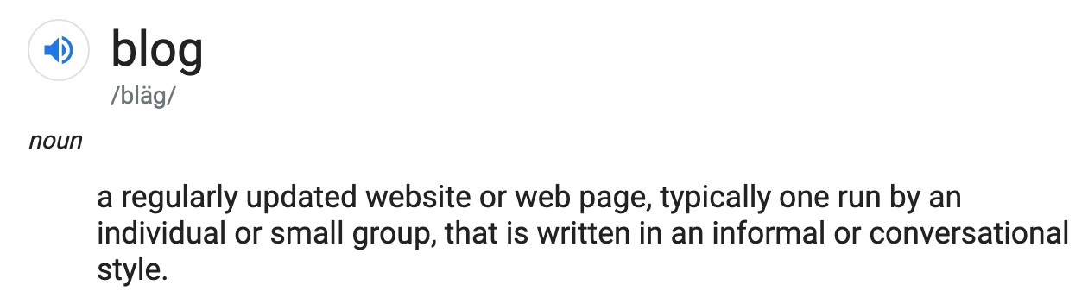
What is a blog?

Slide 3
What is a blog?
Many blogs also offer the opportunity for readers to provide comments.
Some have advertising and side messaging.
Many have coordinated Facebook pages and twitter feeds to increase audience.
They provide a longer-form that tweets and most Facebook messages.

Slide 4
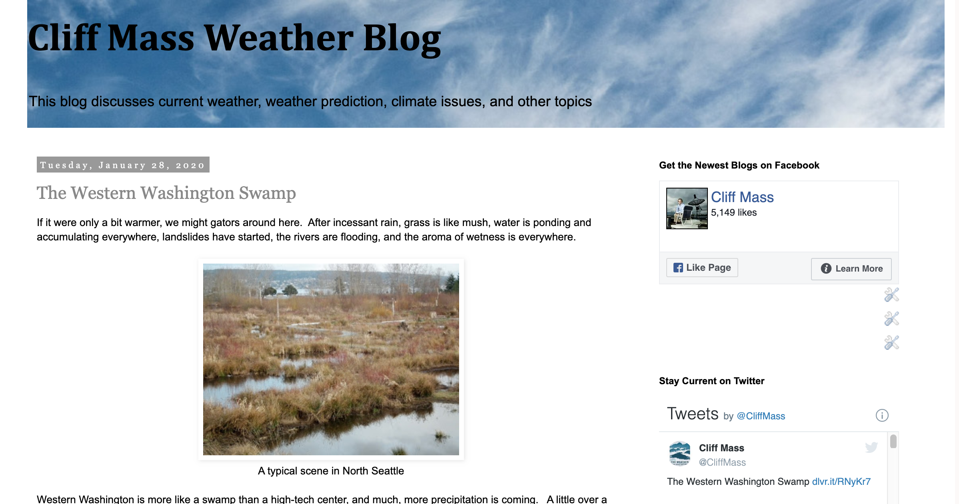
Why should you listen to me about this?
I have run a blog (The Cliff Mass Weather and Climate Blog) since 2008.
Have written over a thousand blogs.
I am a student of blogs and have followed a number of them in some depth, including rankings and impact.
Watching my audience statistics: have learned what works and doesn’t.

Slide 5
Some Meteorological Blogs
The Top-100 Weather Blogs
Major Categories
TV Stations (e.g., KOMO-Scott Sistek)
Academics (like mine)
Major Media (e.g., Washington Post CapitalWeather Gang)
Climate (WUWT, Real-Climate)
Enthusiasts (Seattle Weather Blog).

Slide 6
How to Create An Effective Blog

Slide 7
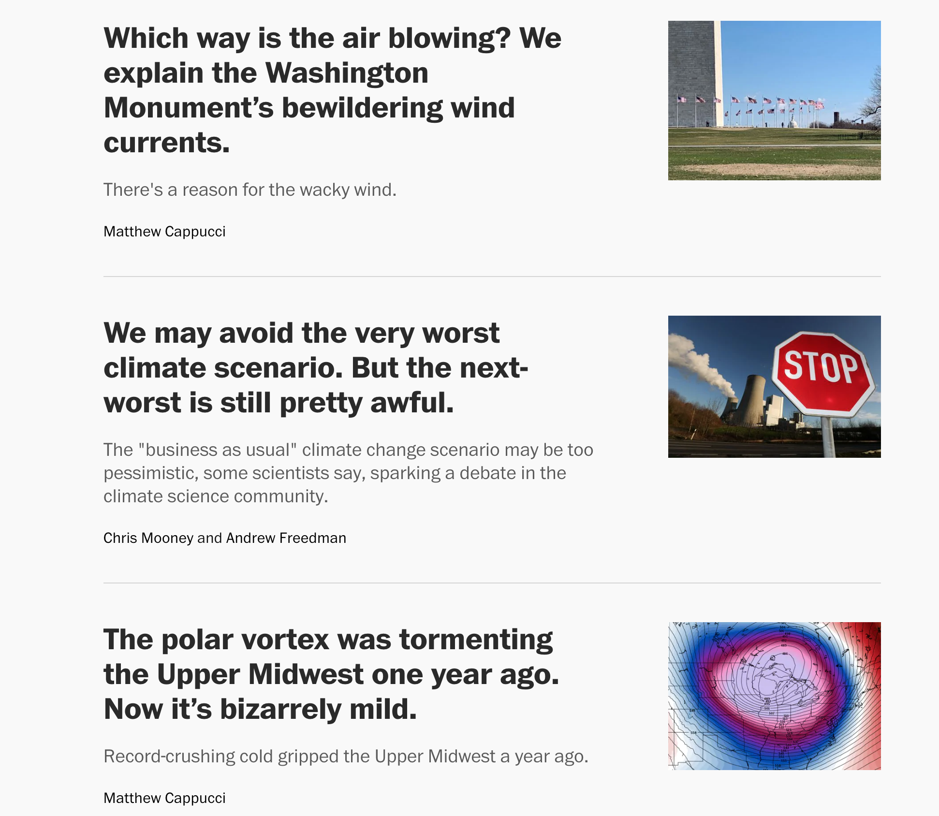
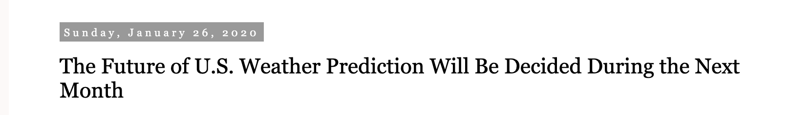
The Blog Headline Needs to be Compelling and Interest Grabbing (But Honest)
Well written questions, the stimulate curiosity, can be useful

Slide 8

The first few lines are critical
You need to convince the reader that the blog will be about something important or something they are interested in.
You have to convince them that YOU can provide useful information to them.
It is helpful to provide your key findings or points in the introduction, just in case they don’t read the rest.

Slide 9
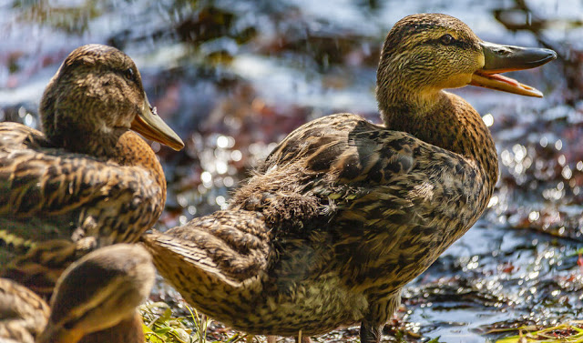
Language
Blogs are best written in a conversational or informal style
Don’t try to impress with complex phrasing and vocabulary.
It is all about being accessible.
Humor is very good to use liberally

Slide 10
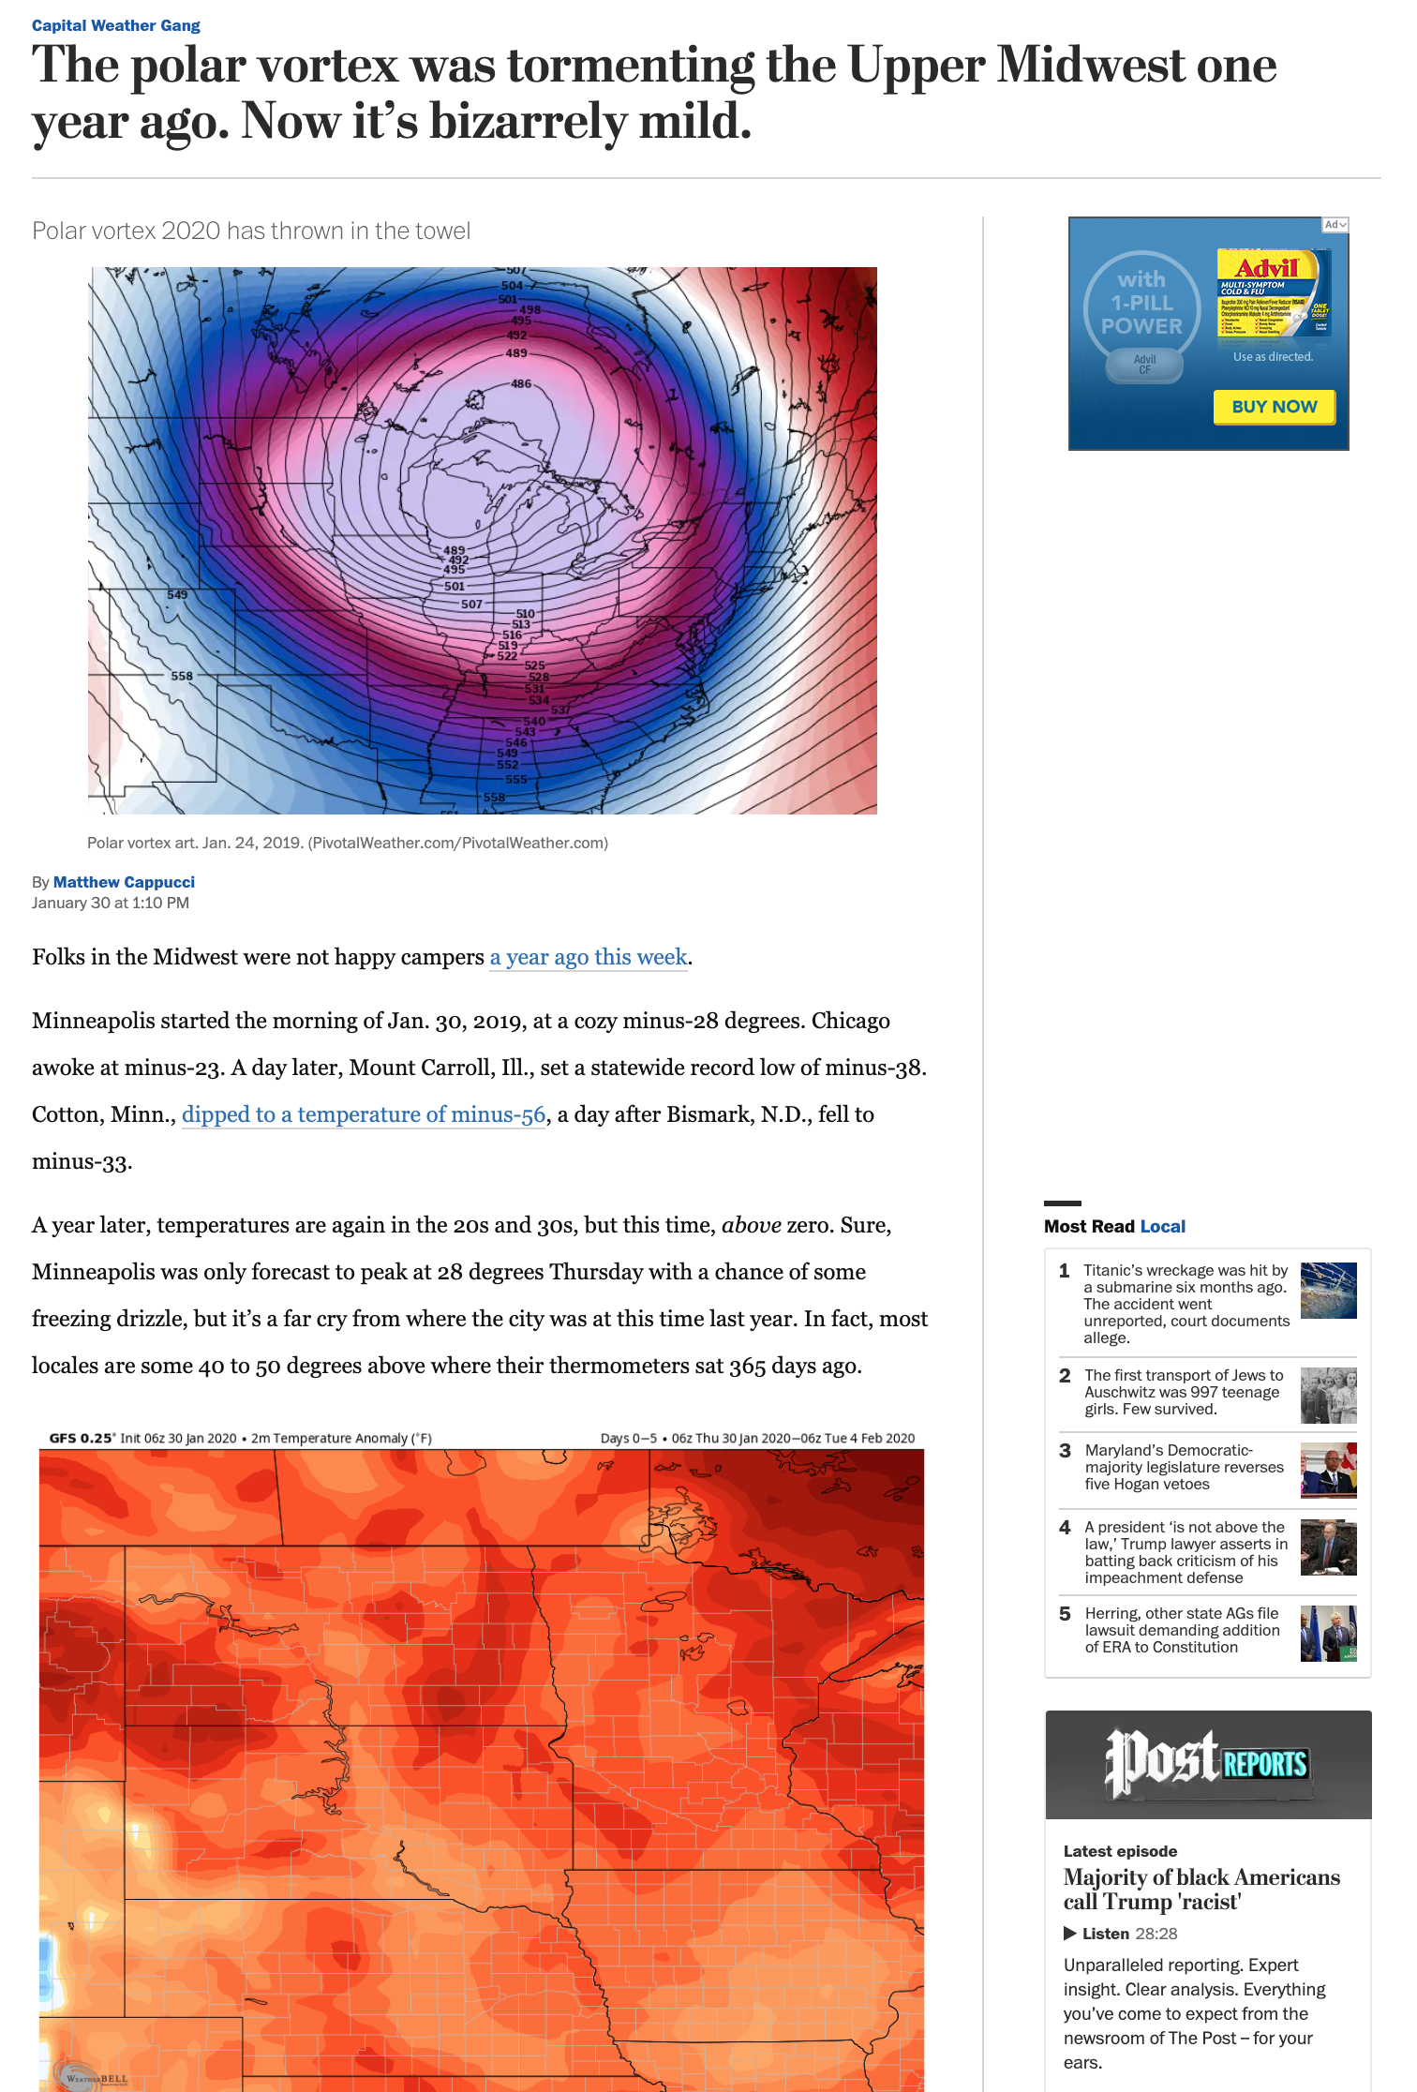
Design
Never run off with long text passages– no more than 3-4 sentences in a row, with a blank line between paragraphs.
It is very, very important to intersperse lots of images.
Images should be large.

Slide 11

Comments
Allowing comments affords readers a chance to interact with and other readers.
Folks love the comments section
But having a comments section has big challenges.
Some commenters call you names, call other names, are obscene, are use your blog to advertise products or causes.

Slide 12
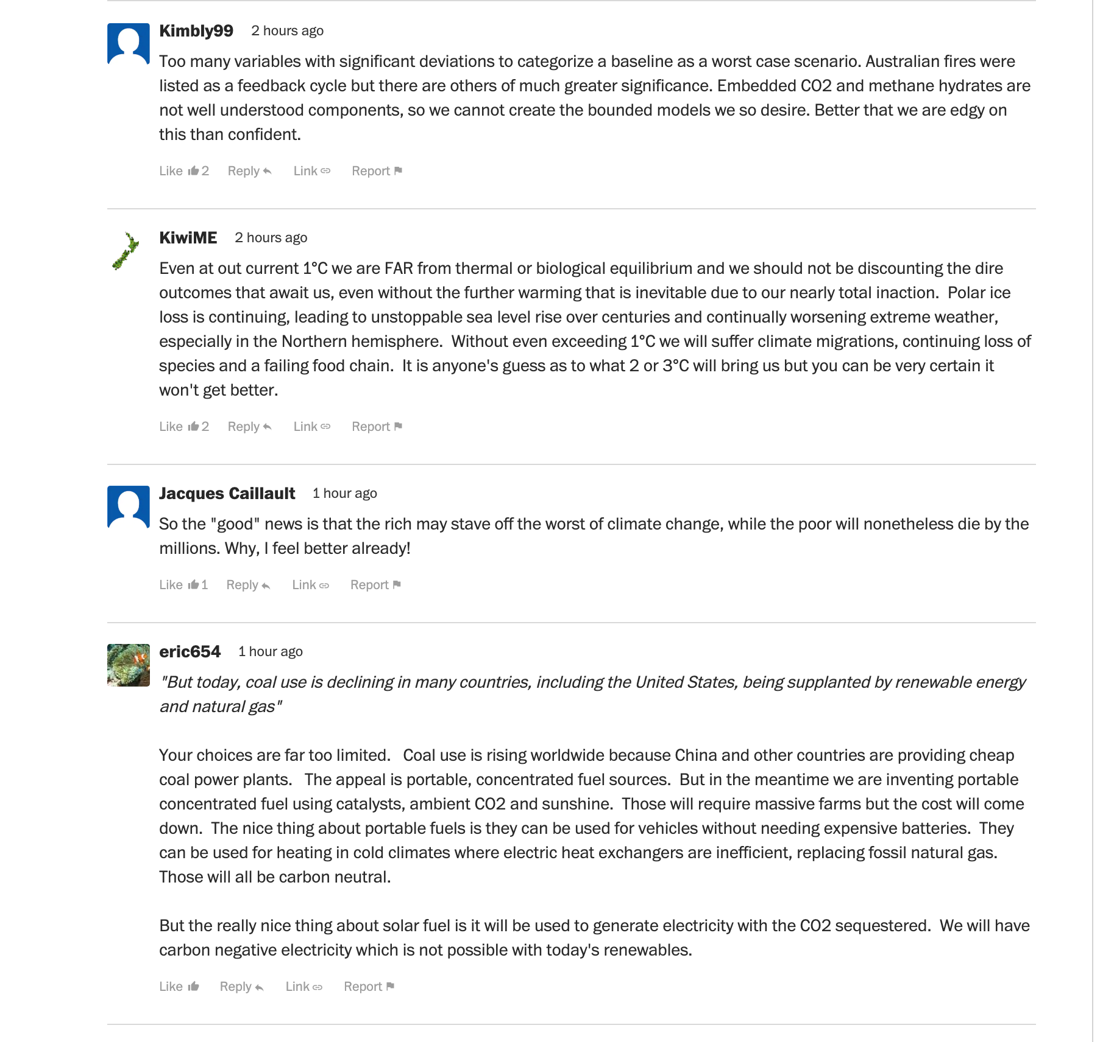
Comments
Moderation of comments is very useful
But on a popular blog it can take a lot of time
Can be personally disturbing.
Requiring commenters to have a google or other login helps slightly

Slide 13
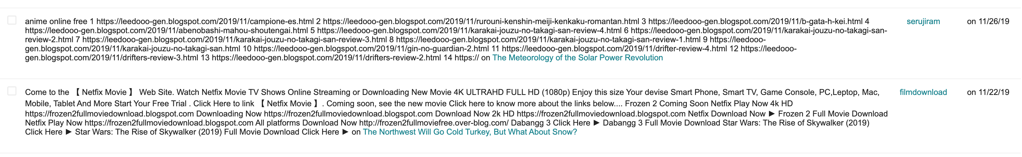
The negative side of comments

Slide 14
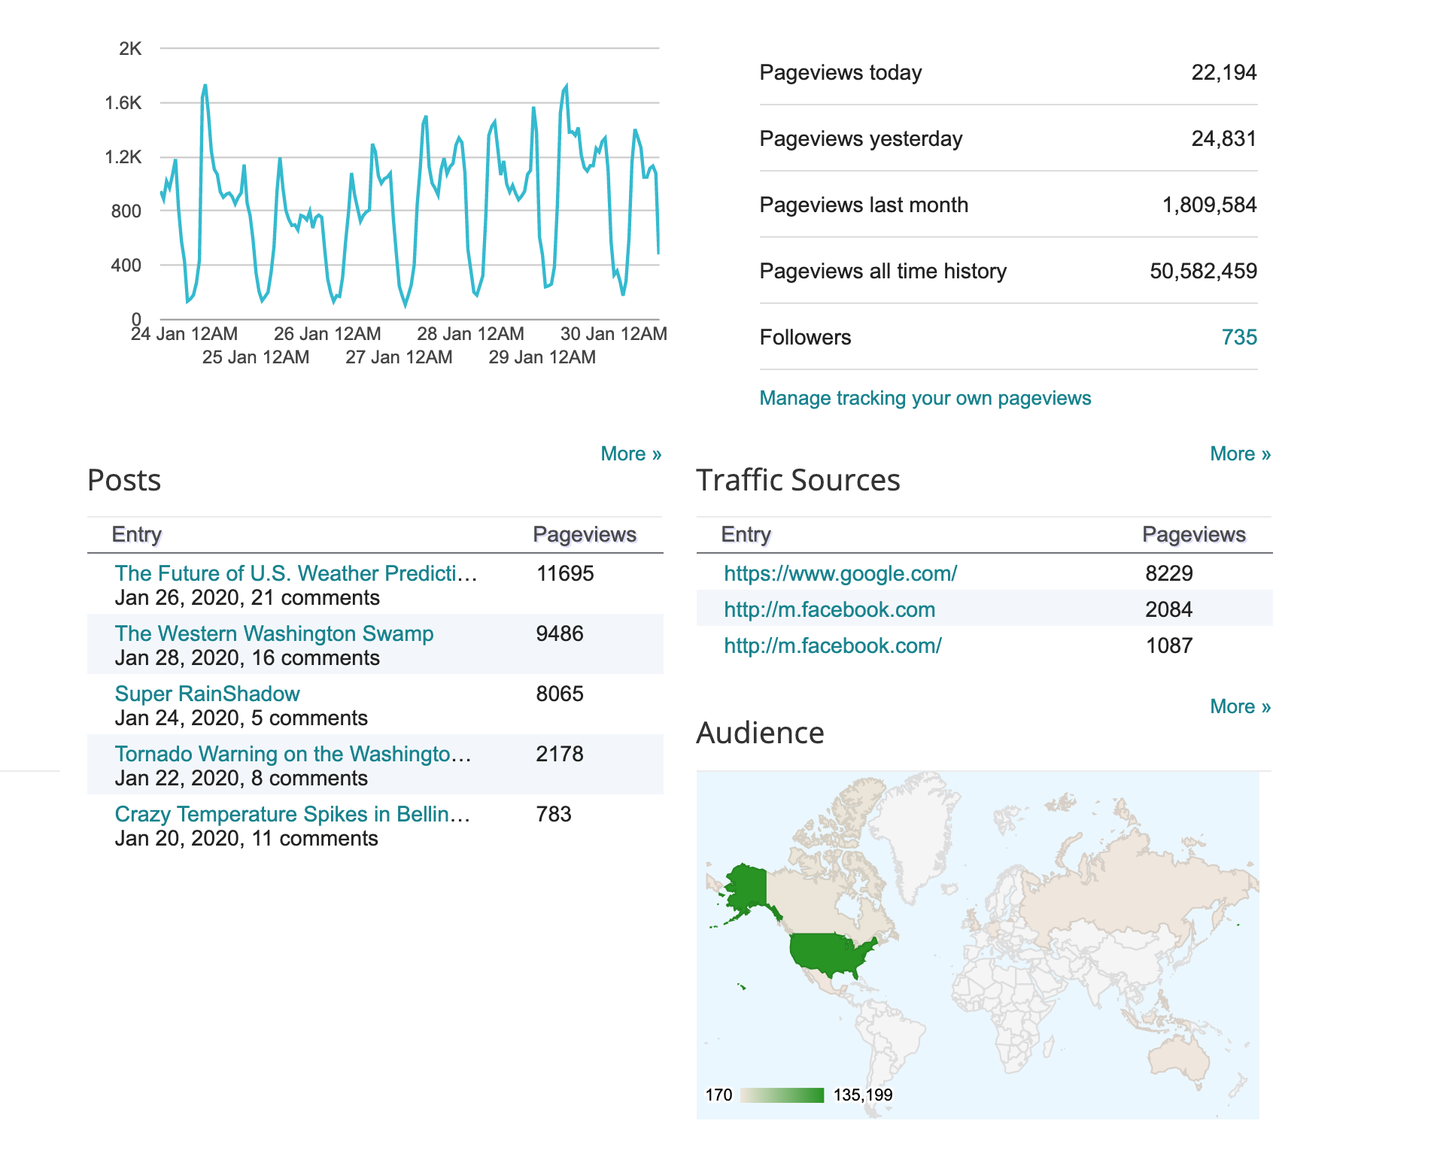
Analytics and objective blog information
Most blogs have analytics regarding viewership and more available
You can also add analytics or use web-based ones.
Knowing your audience and how they react to your blogs can help you hone your delivery

Slide 15
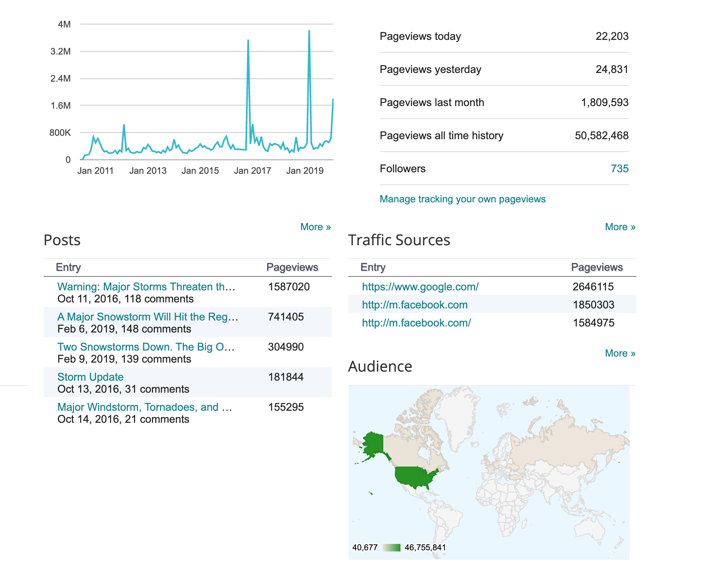

Slide 16
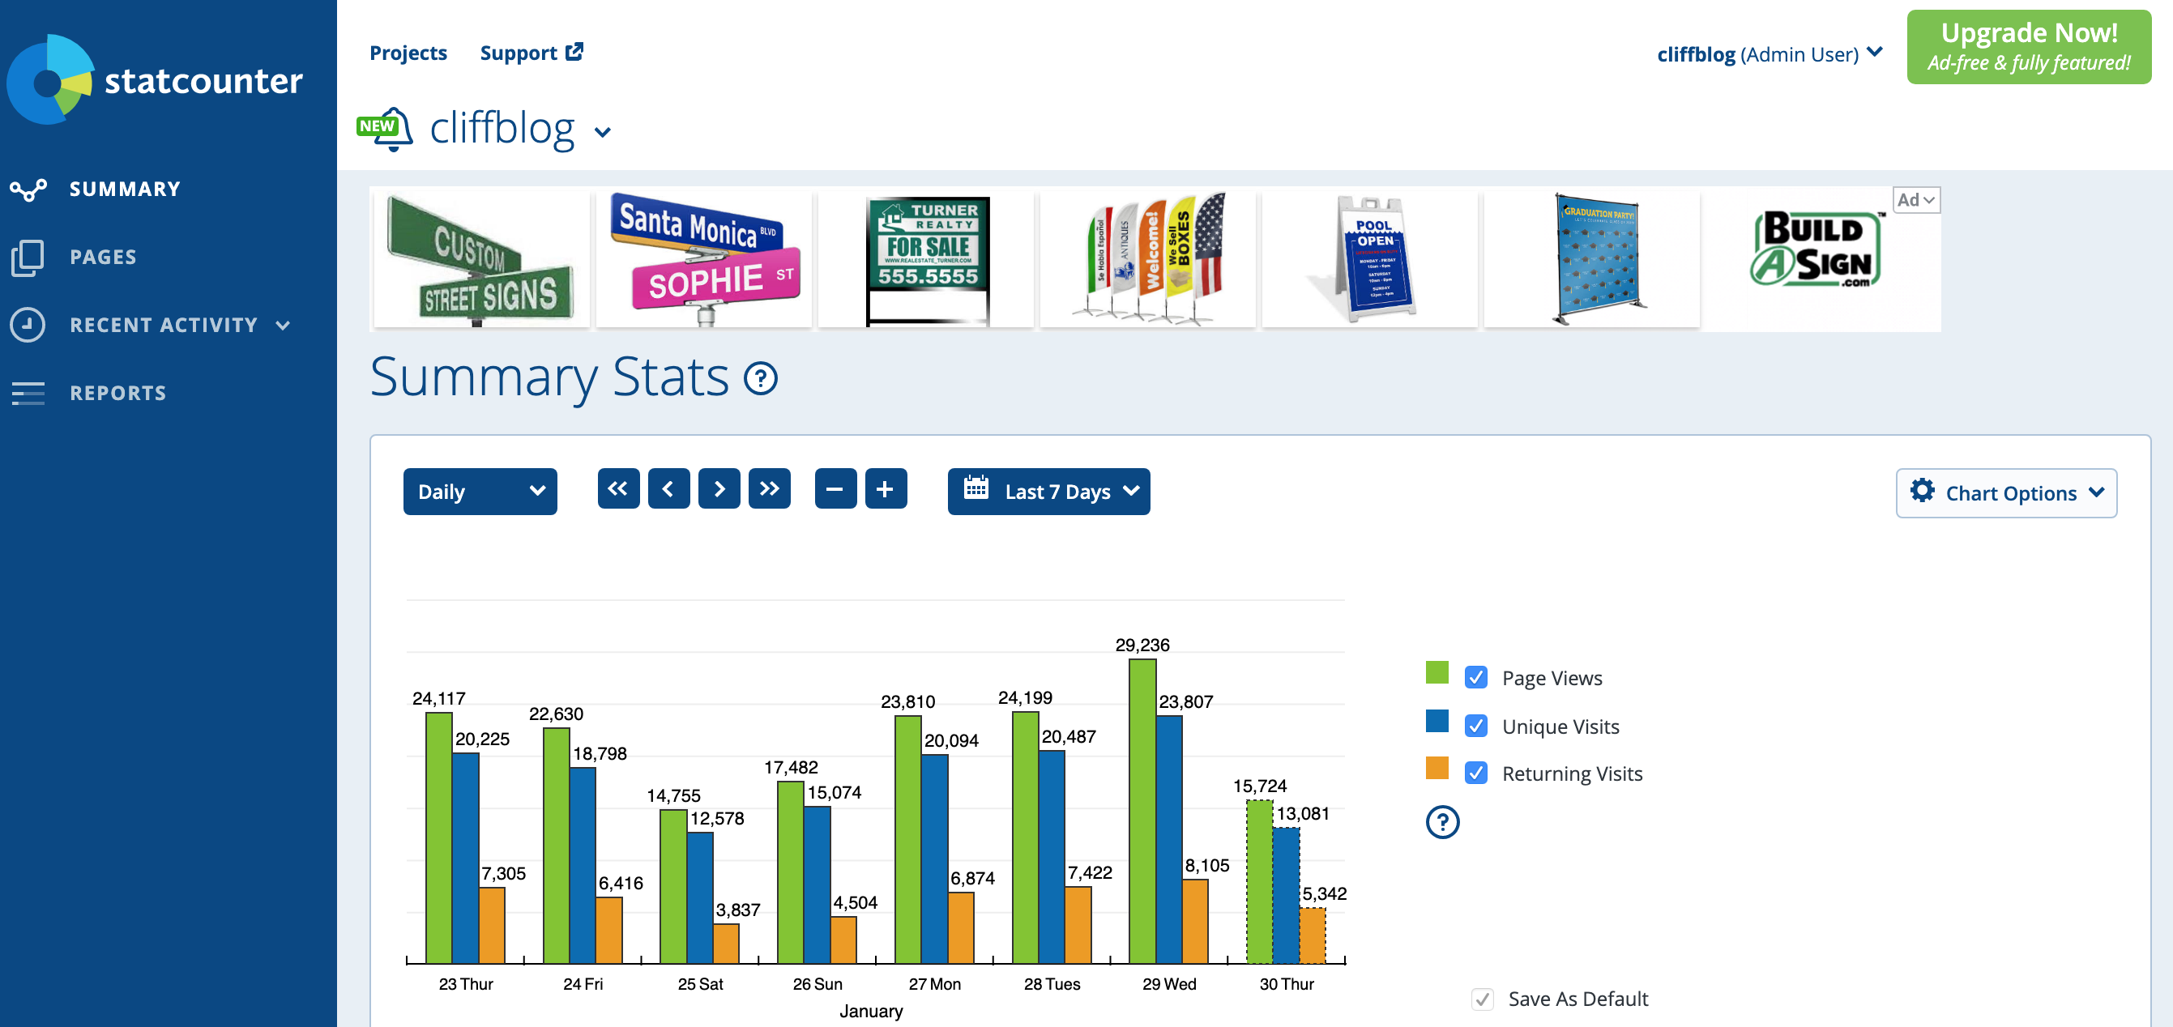

Slide 17
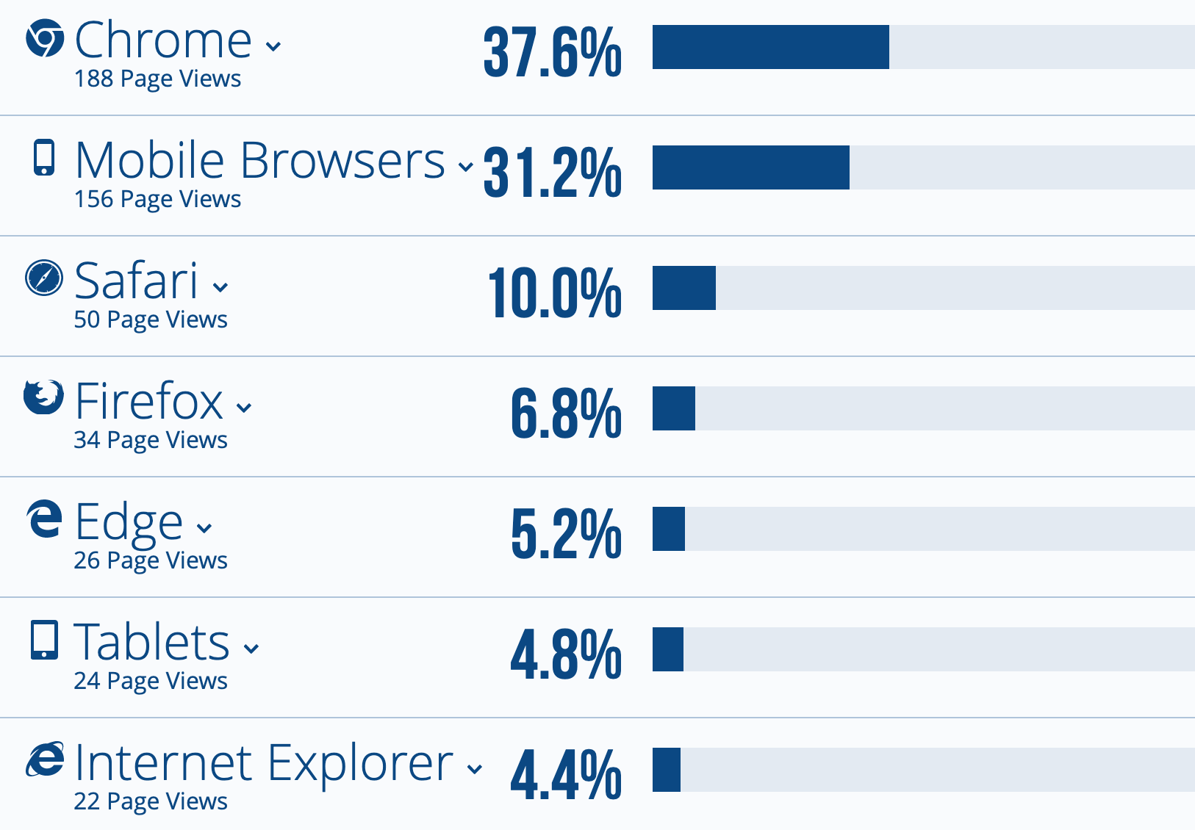
Analytics

Slide 18
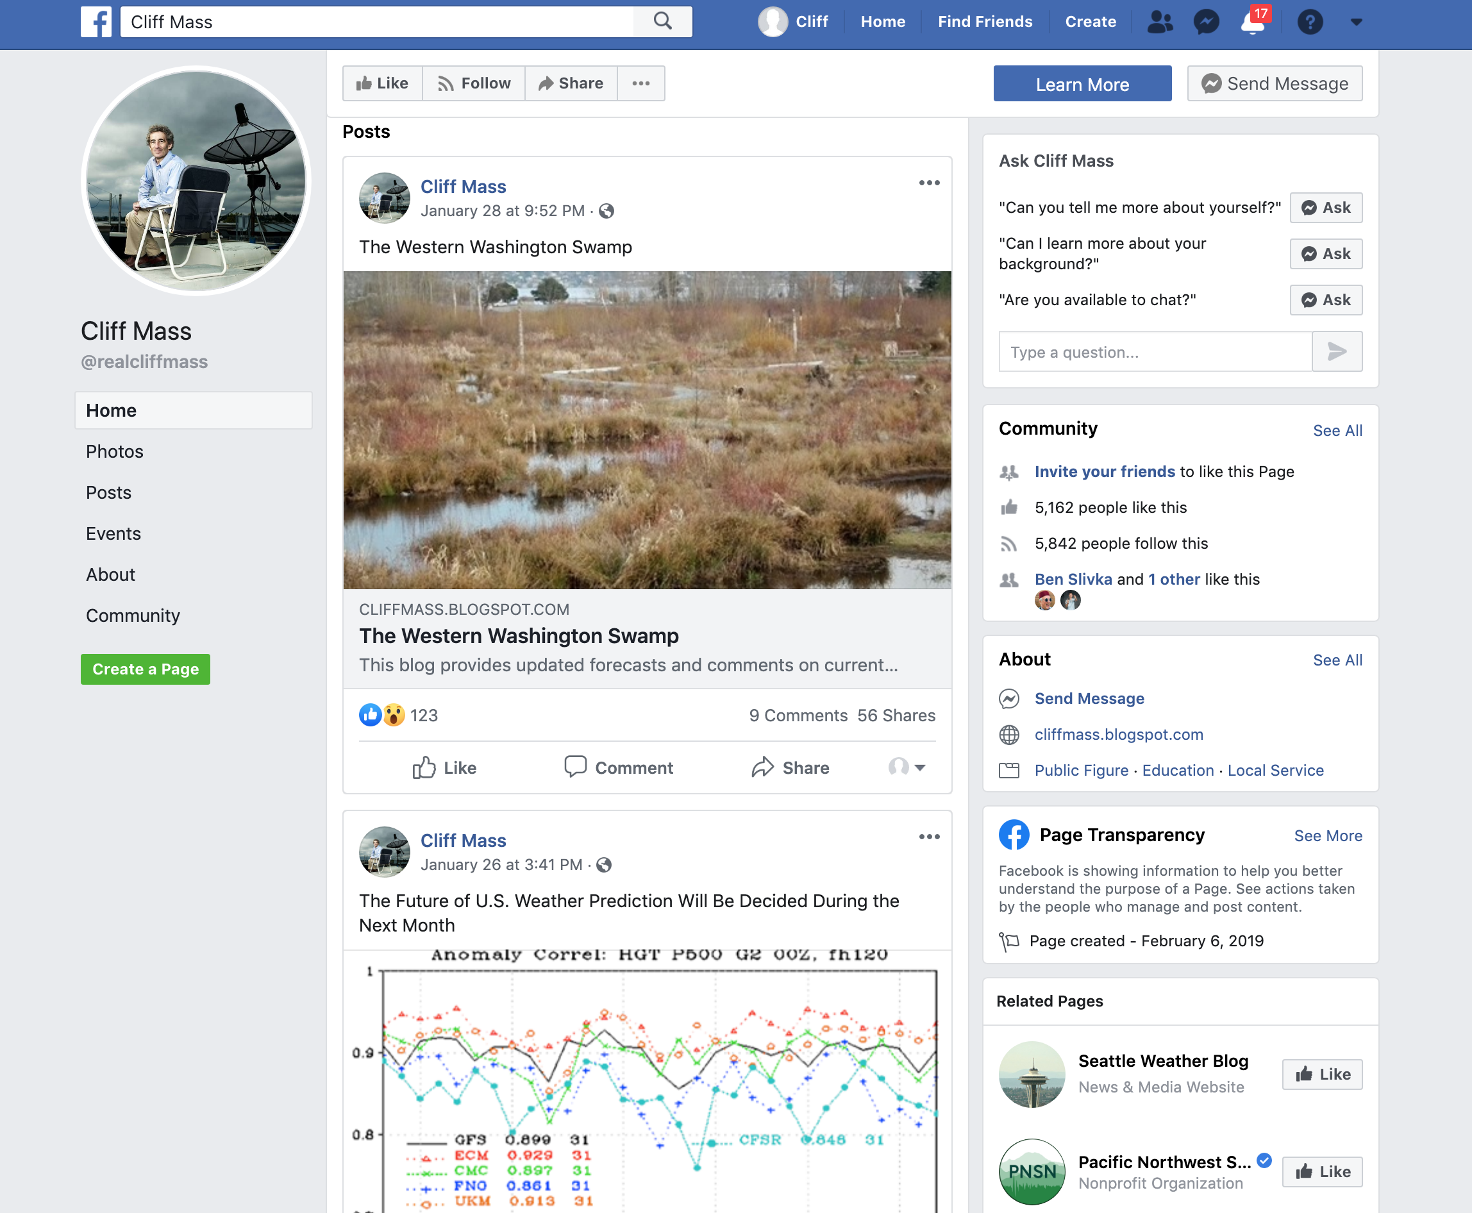
You can enhance your blog traffic by maintaining a coordinated Facebook page and twitter feed

Slide 19
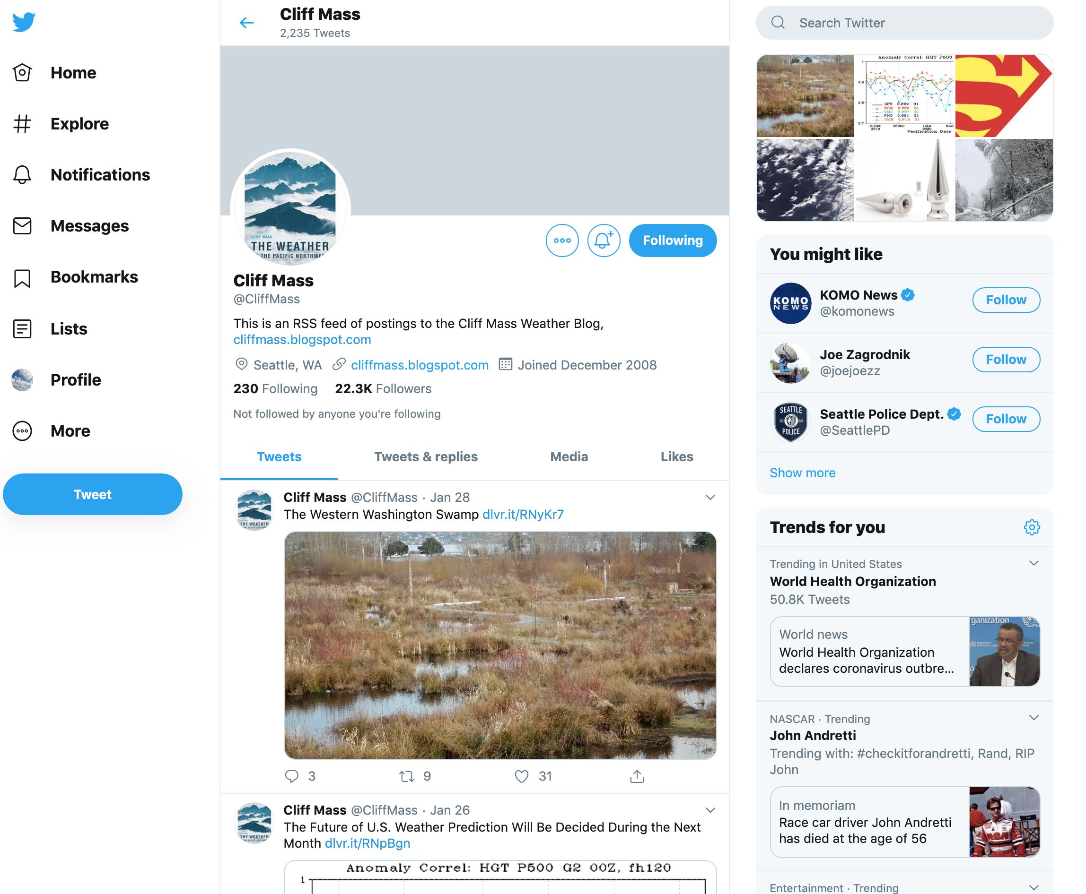

Slide 20
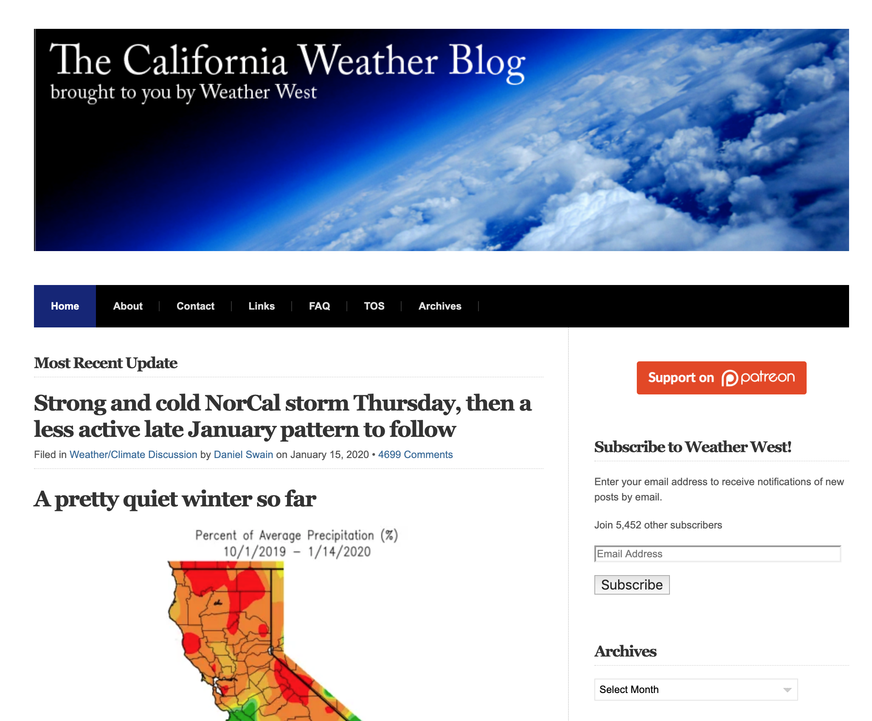
How often should you blog?
Regular blogging results in a long-term increase in readership and impact.
My compromise is every other day, but some folks have been successful with less frequency, AS LONG AS IT IS REGULAR.

Slide 21

Getting Ideas for Your Weather Blog
Current weather events
Your reader comments will often provide good ideas
Explaining in depth an interesting weather feature
Check out other weather blog for ideas you can expand or riff on.

Slide 22
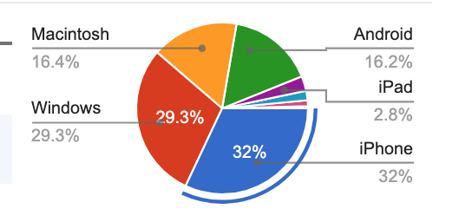
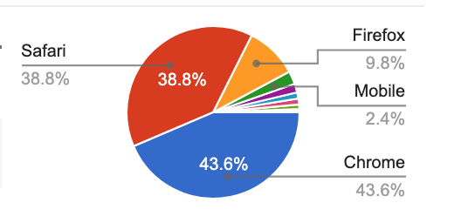
Remember Your Blog Can Be Viewed on Multiple Platforms
Blogs need to be optimized so they are accessible and clear on multiple platforms.
Smartphones are often the most used device.
Statistics for My Blog

Slide 23
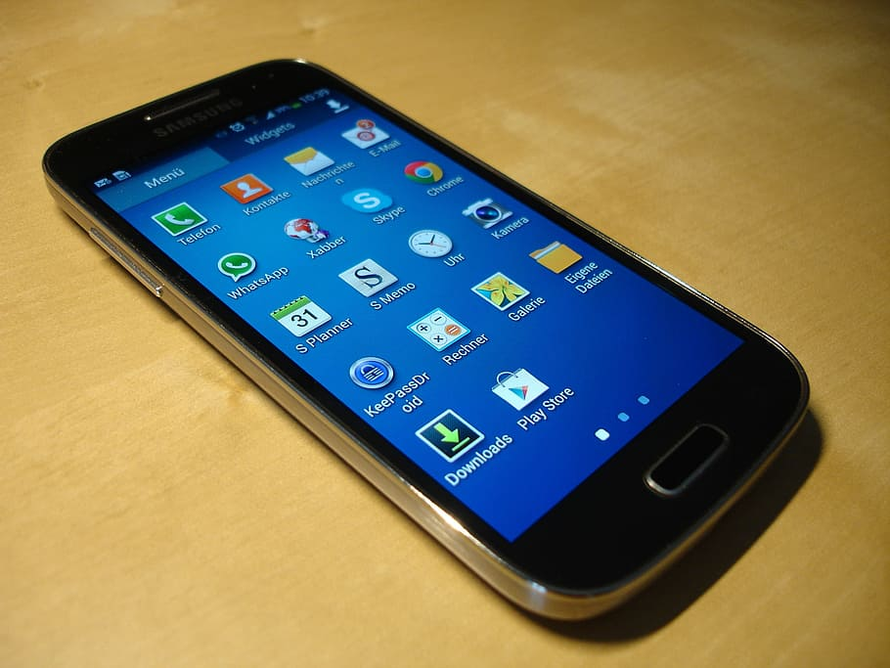
Optimizing for Smartphones
Extended Posts: Break them up with bolded headers and provide plenty of paragraph breaks.
File Sizes: Keep graphics small
Number of Pages: Unlike desktops, most navigation on smartphones and tablets happens through scrolling. Thus, a one-page presentation is ideal for the mobile platform, as users can simply scroll down to find what they need.

Slide 24
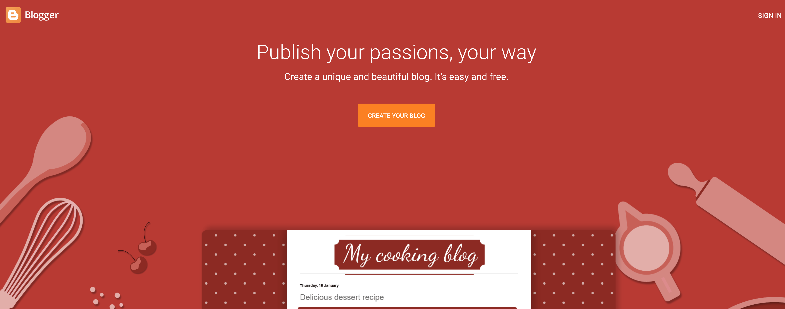
Tools for Creating Blogs: BlogSpot and WordPress are Very Popular

Slide 25
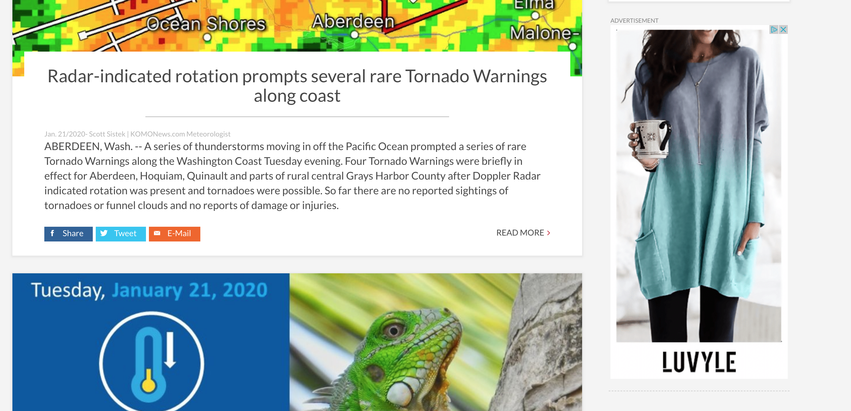
Can You Get Rich with Advertising on Your Blog?
Probably not, unless you have very large hit rates.
Folks must click on ads for you to make money.
Some ads are not pleasant—need to filter worst stuff.
If you get 10,000 hits a day, you might make 5-10 dollars.
Need hundreds of thousands of hits in a day to make real money.

Slide 26

Final Note: Blogs Can Be Very Powerful Tools, Once You Have An Audience
Once established, your blog information can spread virally if controversial, timely, or particularly interesting.
Blogs can result in societal or other change, that can be both positive or negative.
Blogs can promote very strong positive and negative reactions…you have to be cognizant of that.
Bottom line: an established blog can be a very powerful tool.

Slide 27
The End

