Slide 1
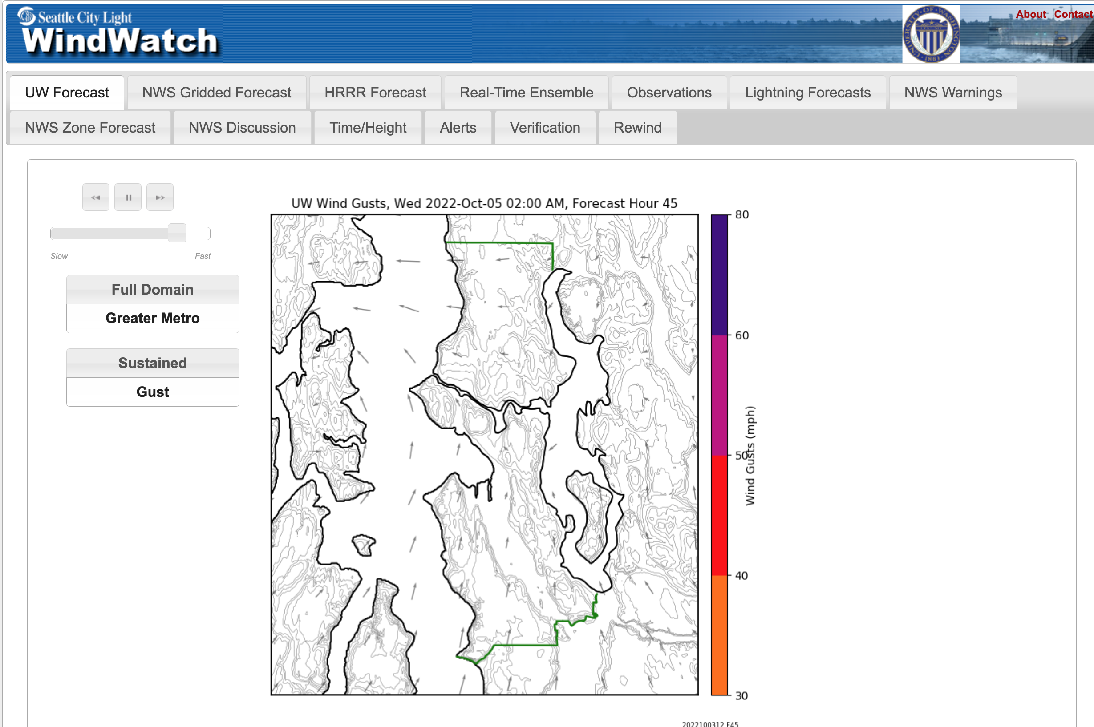
Seattle WindWatch

Slide 2
Seattle WindWatch Goals
Provide state-of-art, real time meteorological guidance for City Light operational decisions.
Provide real-time alerts
Provide real-time graphics for City Light Operational Center
Be available for consultation regarding major events.

Slide 3
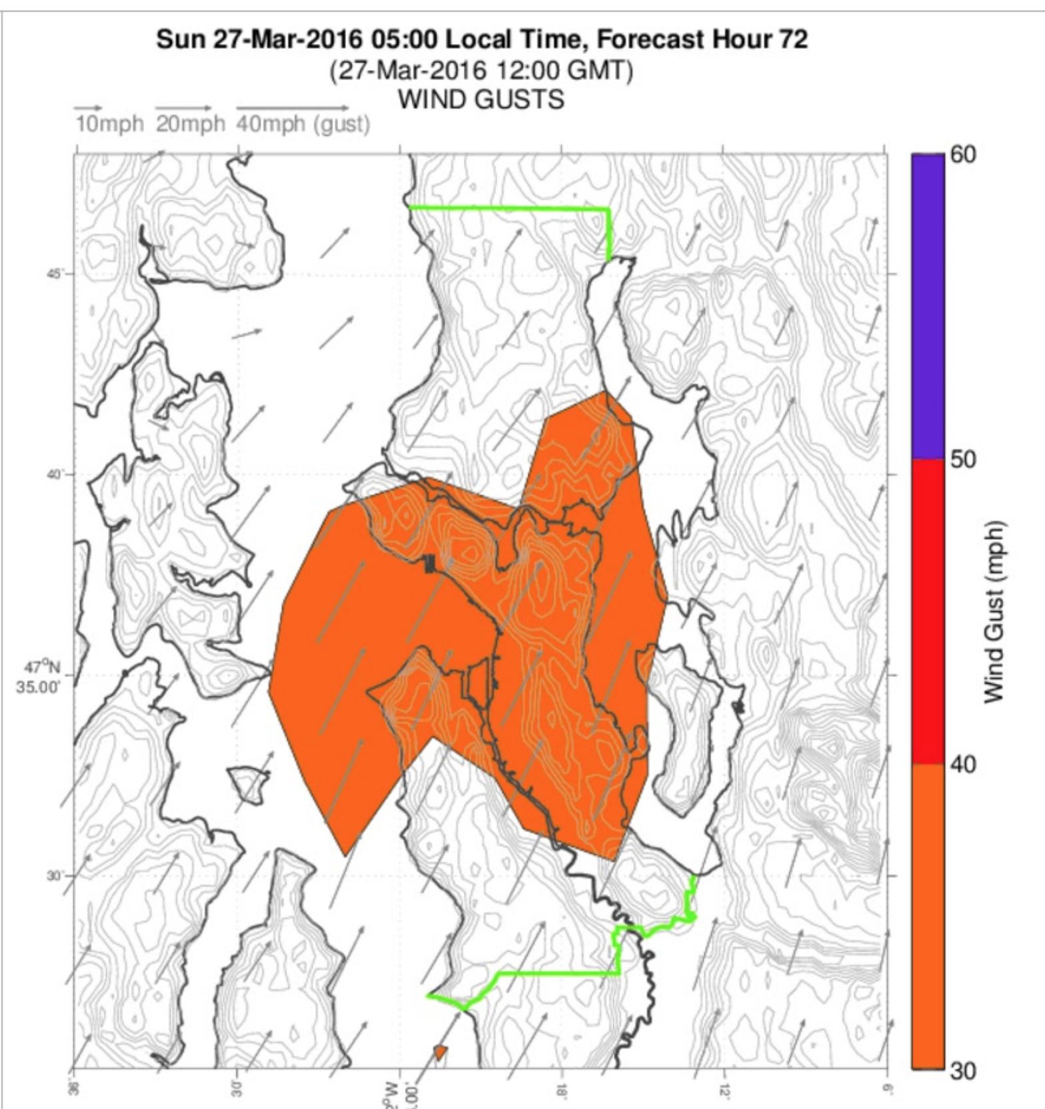
Goals
To enable City Light to plan responses to strong winds, lightning, etc.
Get personnel and supplies ready.
Know where in the city the worst threats would be.

Slide 4
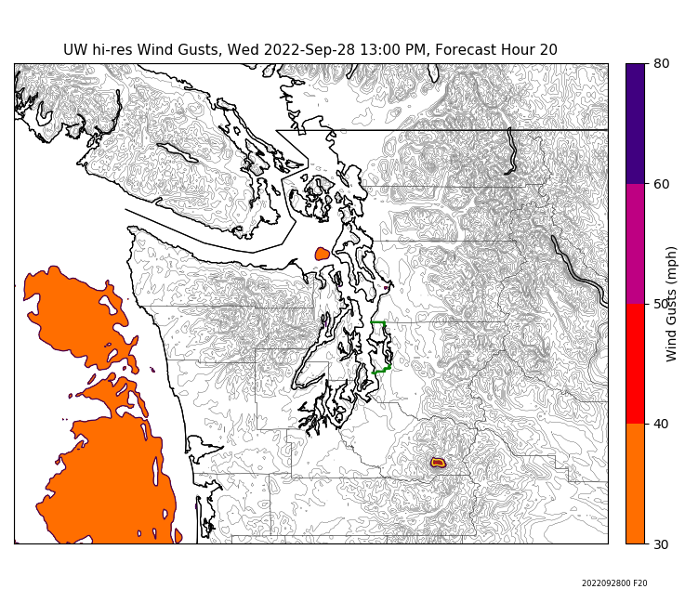
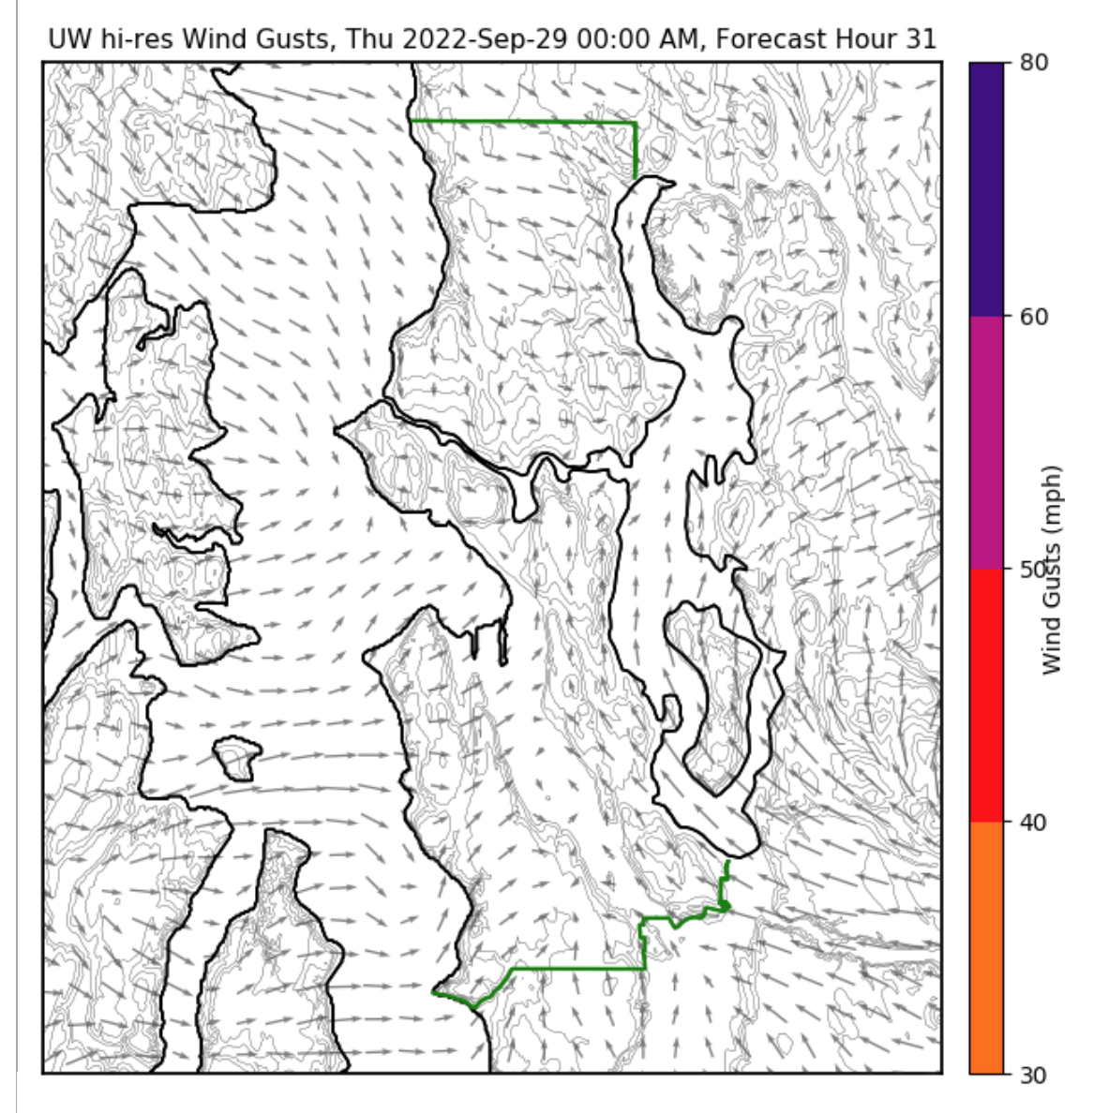
Seattle WindWatch Wind Forecasts
Includes real-time forecasts from the UW WRF modeling system
The highest resolution real-time forecasting system in the US

Slide 5
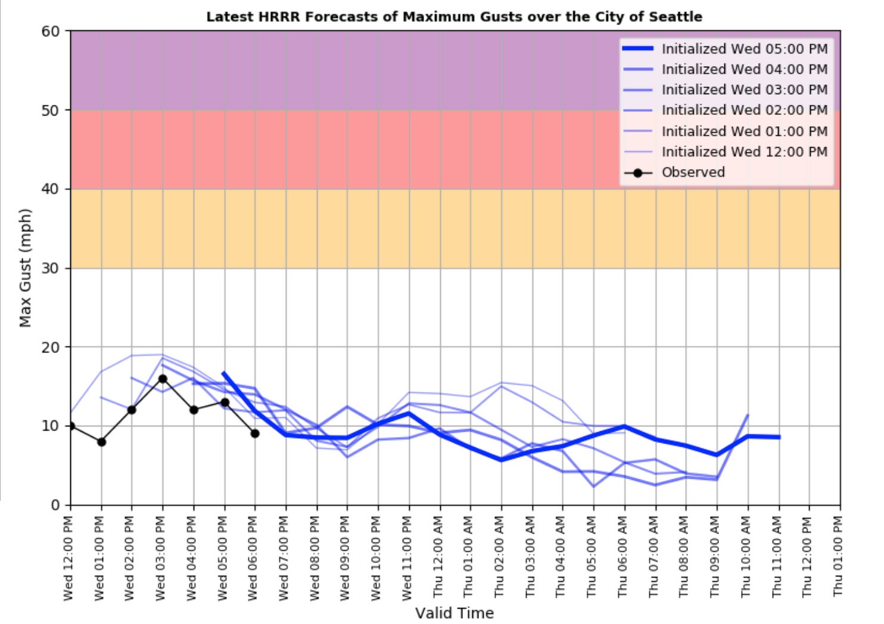
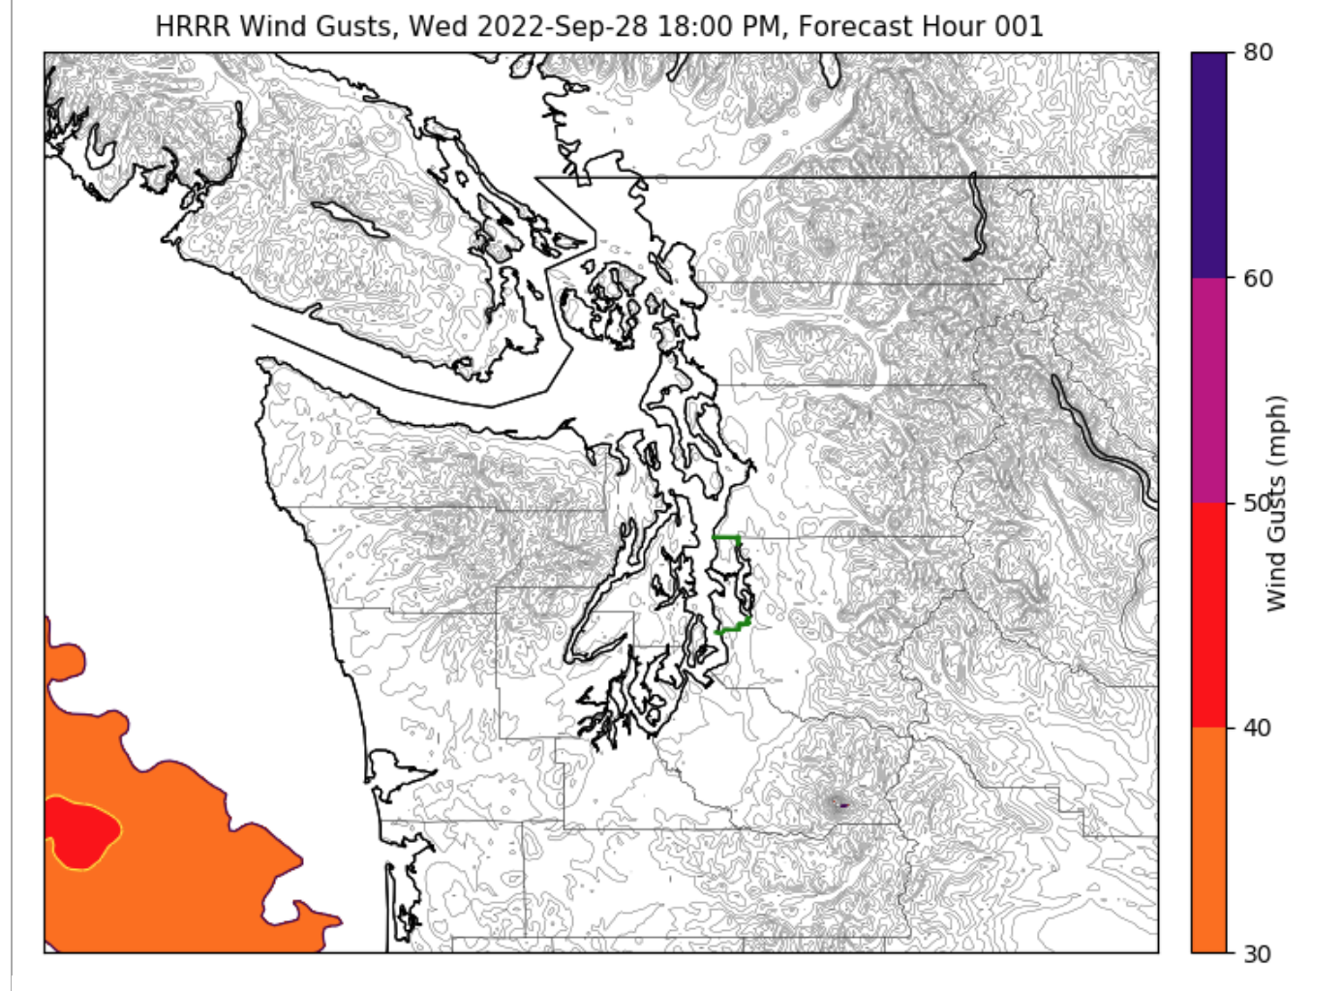
Includes the Hourly Updated NOAA HRRR Wind Forecasts

Slide 6
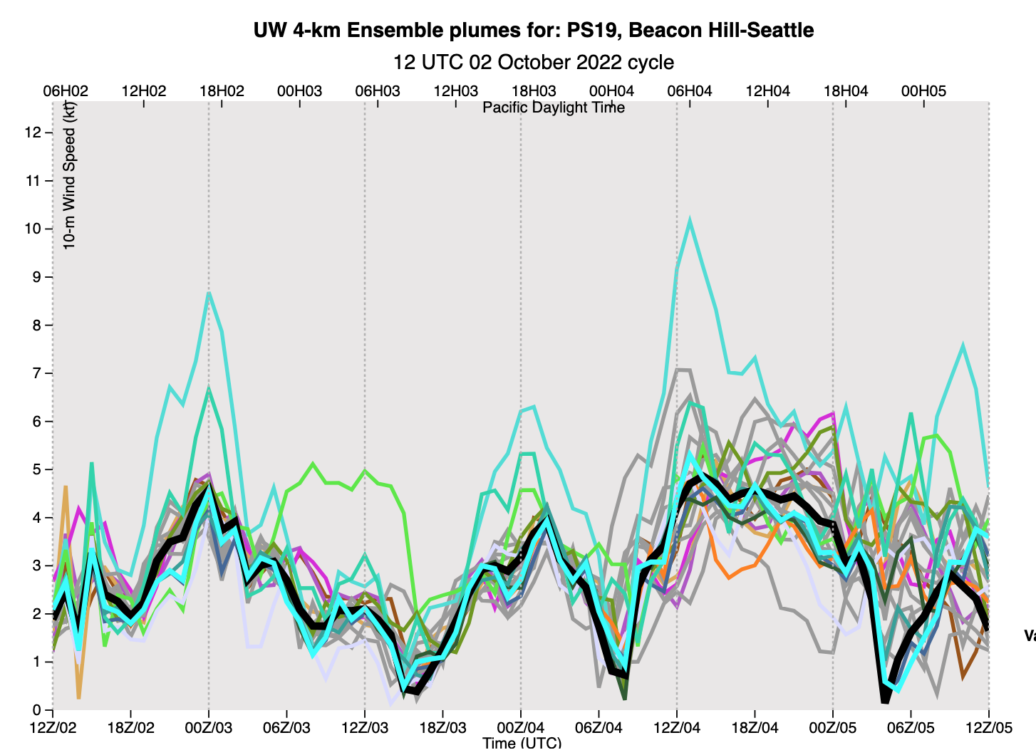
Includes uncertainly guidance from the UW high-resolution ensemble system
In an ensemble system you run the model many times to understand probabilities and uncertainties.
The UW has the largest high-resolution ensemble system in the country.

Slide 7
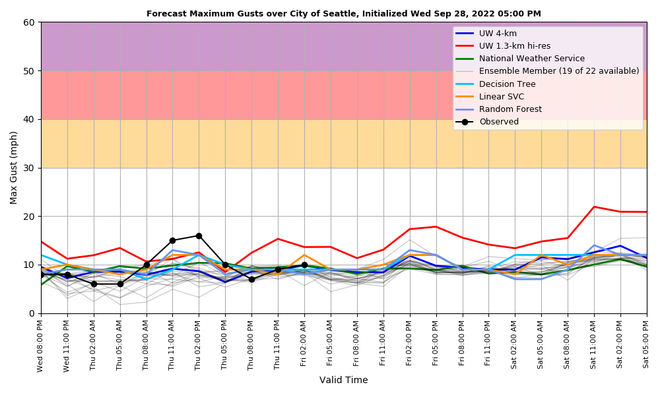
The UW System Not Only Has the High-Resolution Ensemble System But Calibration Using Machine Learning

Slide 8
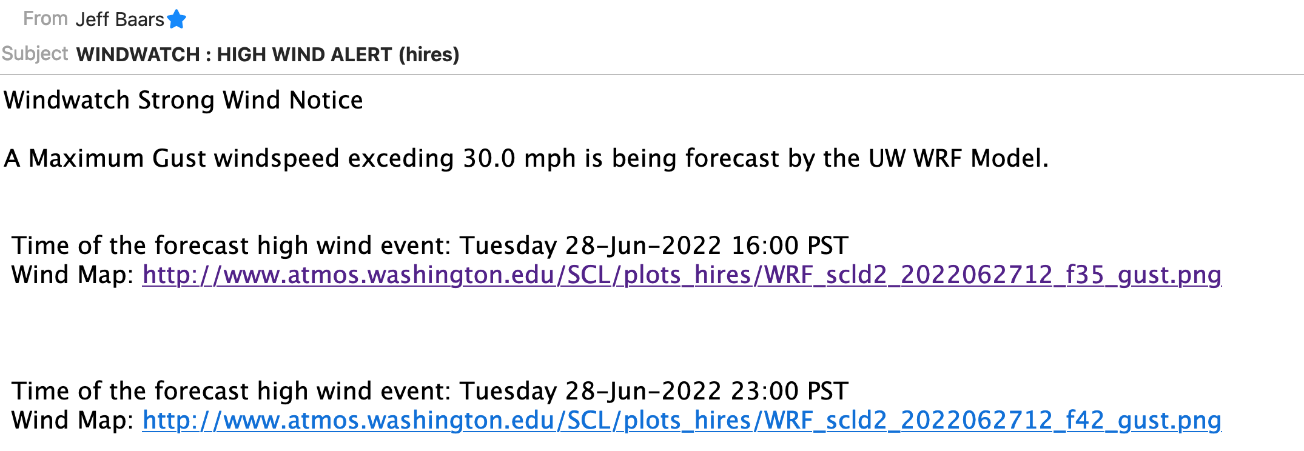
Automated Email Warnings

Slide 9
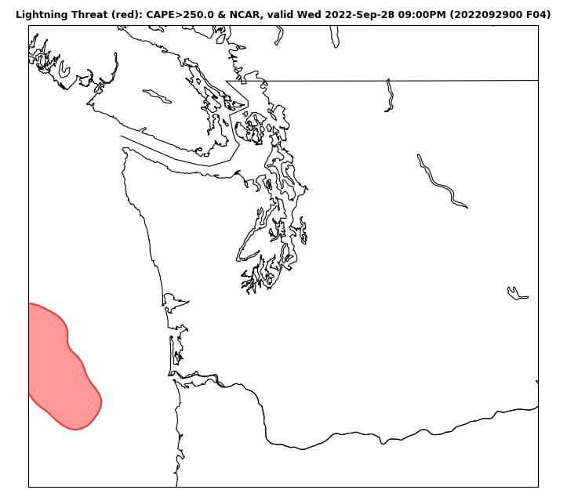
Recent Addition: Lightning Prediction

Slide 10
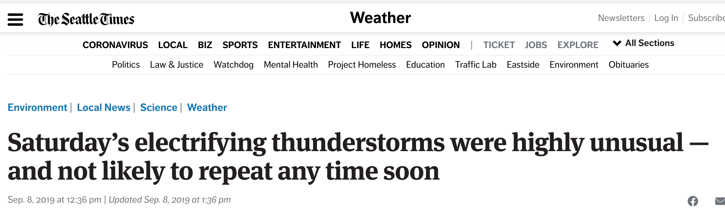

Slide 11
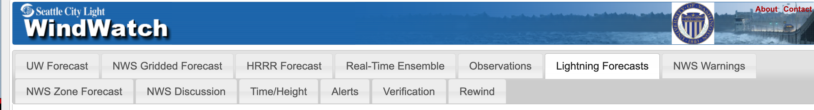
Plus Other Capabilities

Slide 12
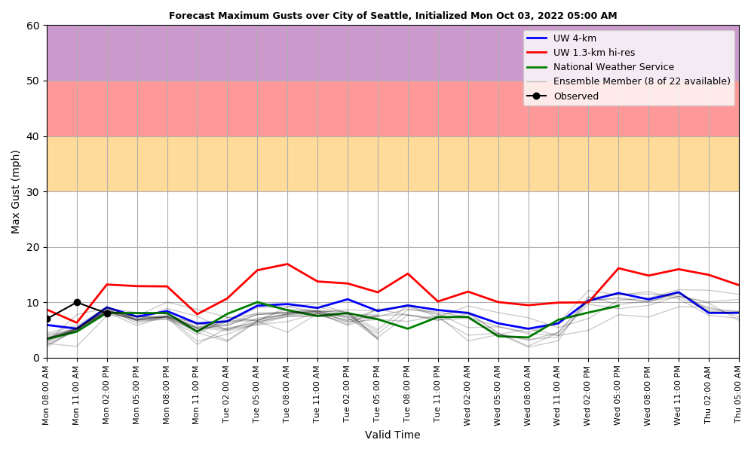
Future Improvements
The ensemble system will be expanded and improved
The machine learning post-processing will improve
The result will be more reliable probabilistic/uncertainty predictions of strong winds.
Reduce false alarms

Slide 13
Why not predict the actual damage to the City Light System?
Damage and outages depend not only on predicted winds but on known conditions, such as:
Time of year
Previous storms (number and strength)
Previous climatological conditions (e.g., particularly dry or wet previous weeks, snowfall, degree of ground saturation)
Location

Slide 14
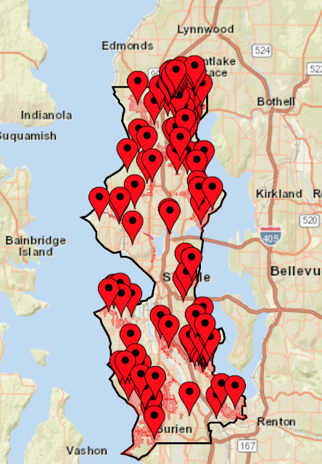
How to predict power system damage
Need history of damage to City Light system/outages
Could feed that into machine learning software with potential predictors (as noted in the previous slide)
Could then provide predicted damage before the event!

Slide 15
Other ideas?

