Slide 1

Mesoscale Climate Surprises over the Pacific Northwest Initial Results of a Large High-Resolution Regional Climate Ensemble for 1970–2100
Cliff Mass, Rick Steed and Jeff Baars,
Atmospheric Sciences
University of Washington

Slide 2
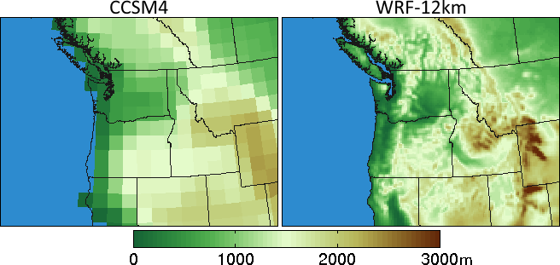
Global climate models are too coarse to simulate key Northwest terrain features
Climate Model Terrain

Slide 3

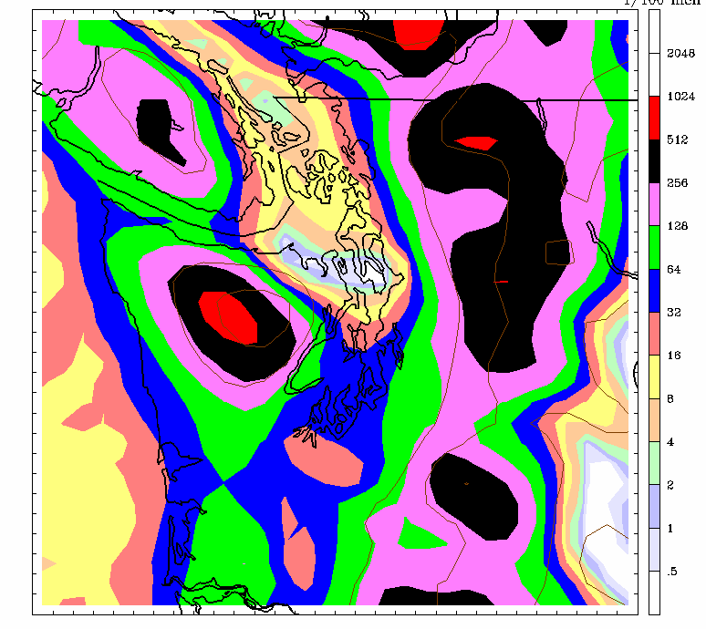
Need at Least 12 to 15-km Grid Spacing to Realistically Simulate the Essential Mesoscale Meteorology of the Region
36-km
12-km

Slide 4
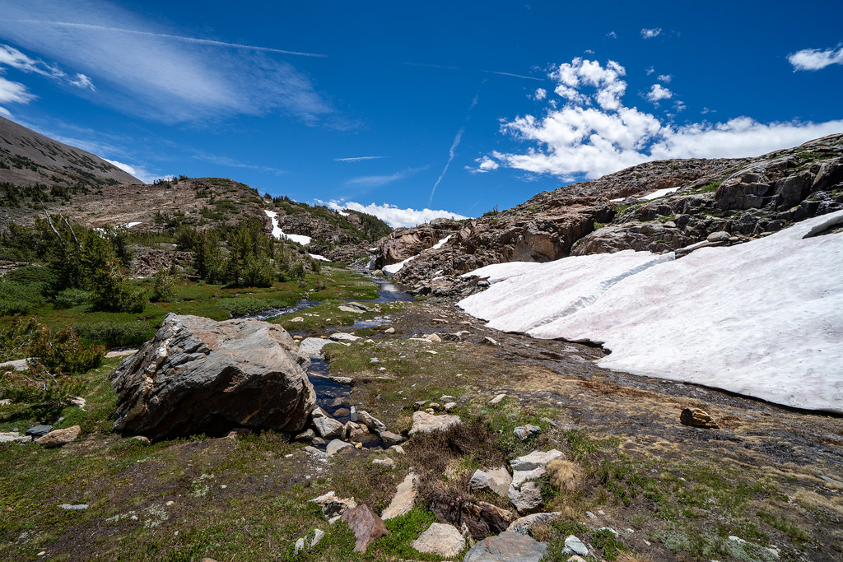
Are There Regional Climate Surprises That Can Only Be Determined by Dynamical Downscaling?
Snow-albedo feedbacks
Orographic precipitation effects
Convective features
Downslope winds and heat waves
Cloud effects
Regional sea breeze effects

Slide 5
Early Downscaling Work at UW Showed Interesting Mesoscale Feedbacks
MM5 mesoscale model using 12-km grid spacing
ECHAM-5 GCM
1970-2100
RCP8.5 equivalent

Slide 6
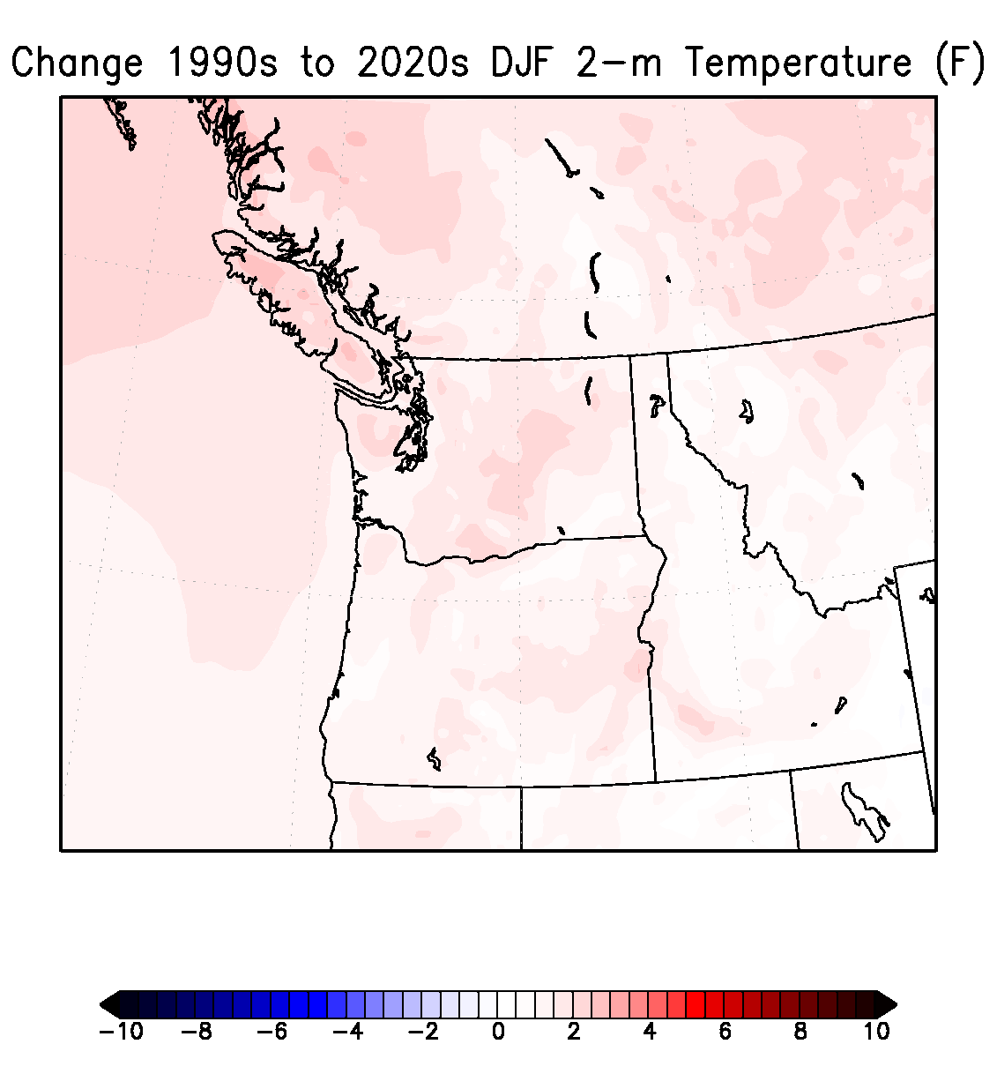
Change in Winter Surface Air Temperatures (F)
Notes:
6

Slide 7
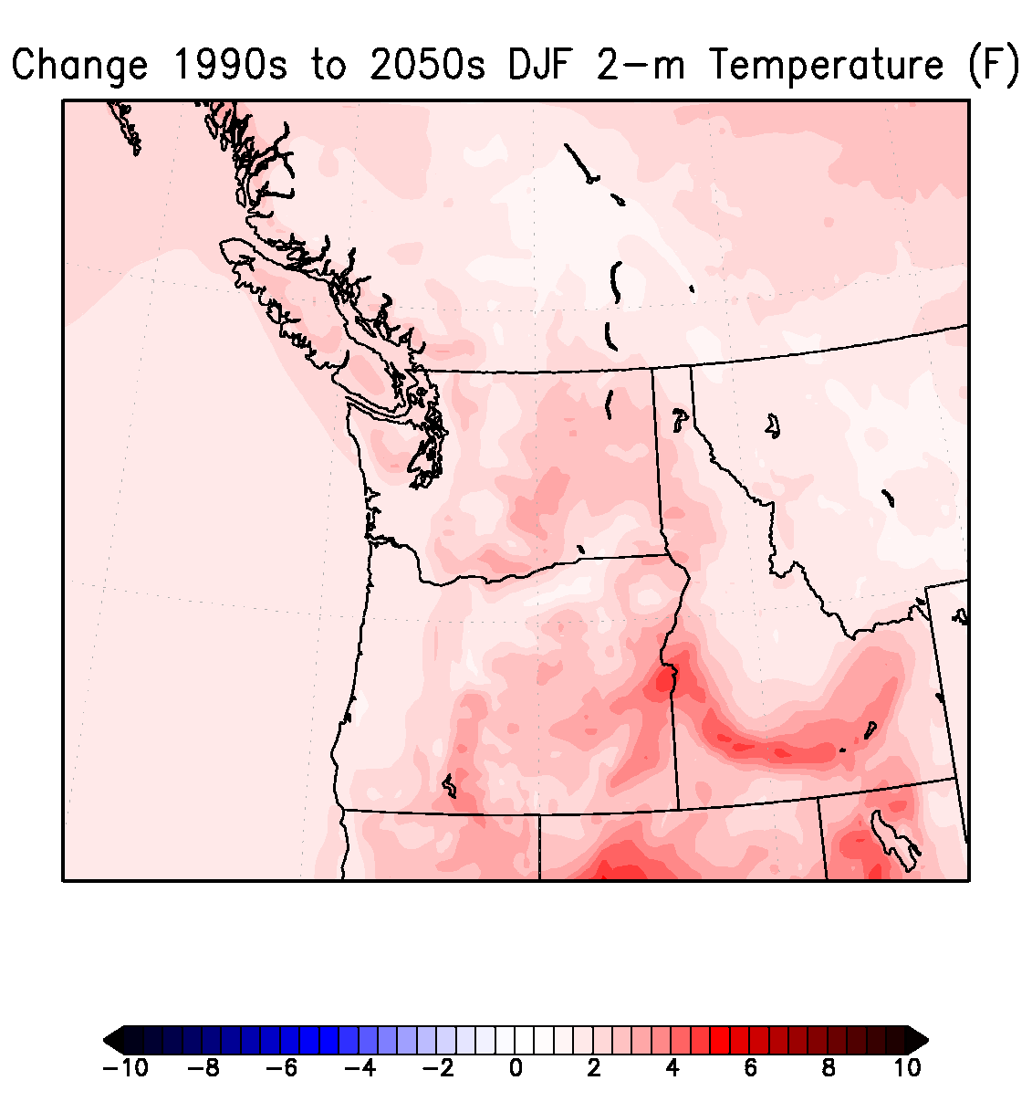
Notes:
7

Slide 8
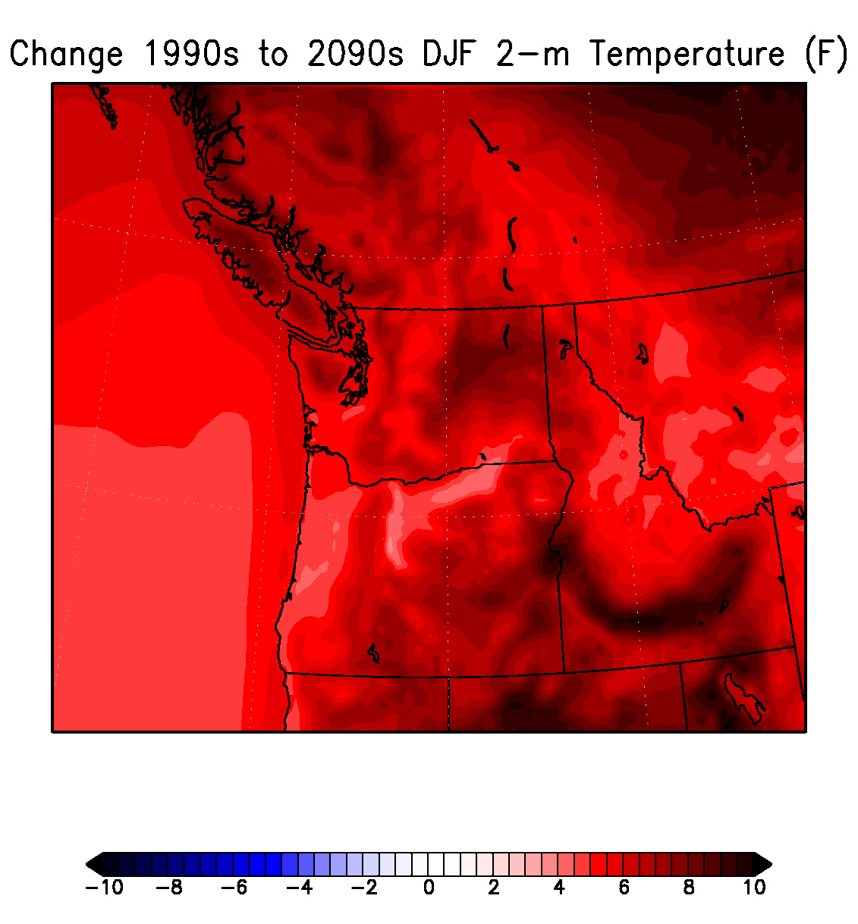
Notes:
8

Slide 9
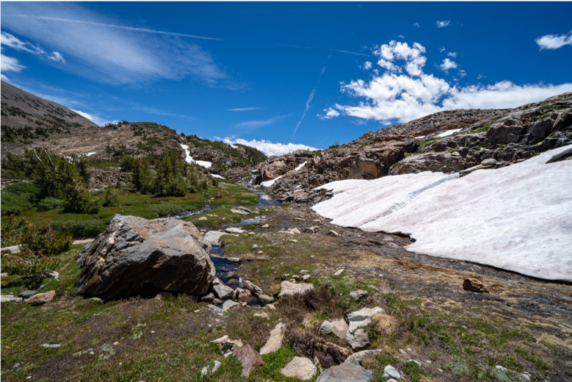
Snow Melt on Slopes Causes Warm Bands

Slide 10
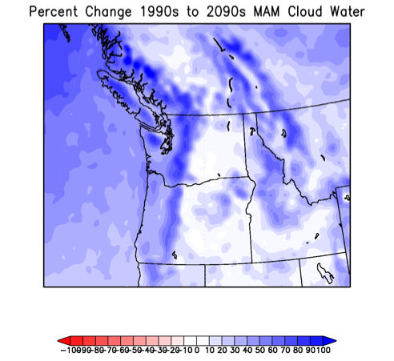
Low-level Low Clouds March-April-May Changes (1990s-2090s)

Slide 11
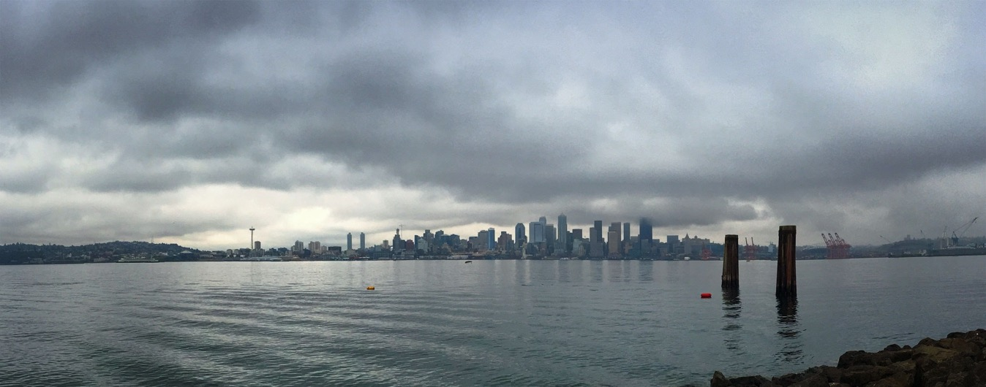
More low clouds during spring/early summer west of Cascades under GW
Preferential pressure falls over the continent versus the Pacific Pushes More Marine Air In

Slide 12
But what about the uncertainties in these mesoscale downscaling projections? How might they vary using differing driving GCMs and different physics? Or differing emission scenarios?

Slide 13
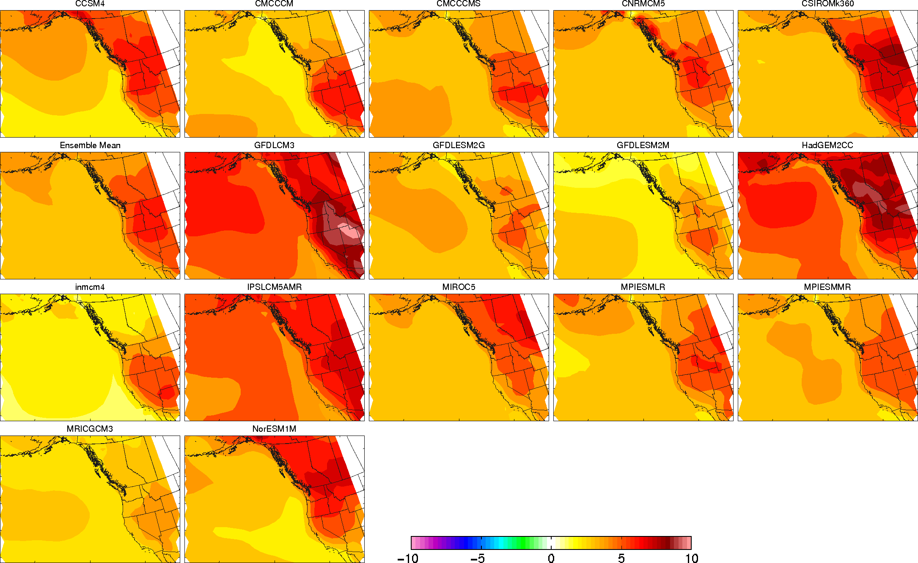
Substantial Differences in GCM
Surface Temperature Change from 1970-2000 compared to 2070-2100

Slide 14

New work High-resolution (12-km) WRF Ensemble Driven by 12 CMIP-5 Global Models.
Paid by

Slide 15
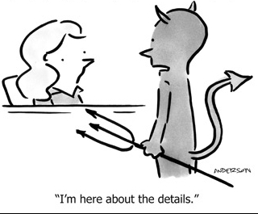
Some Details
WRF 3.7.1
RCP 8.5: Perhaps too aggressive, but shows the worst case.
Ran under 12 CMIP-5 GCMs with 6-hr output
36 and 12 km nests, with 36-km nudged to the parent GCM
Runs ran 1970-2100. No breaks
Used both Amazon AWS cloud and local clusters.

Slide 16
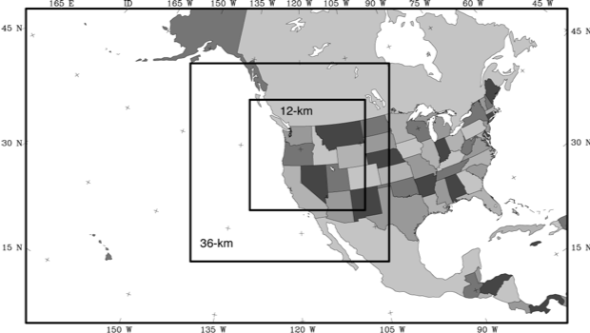
Domain Structure

Slide 17
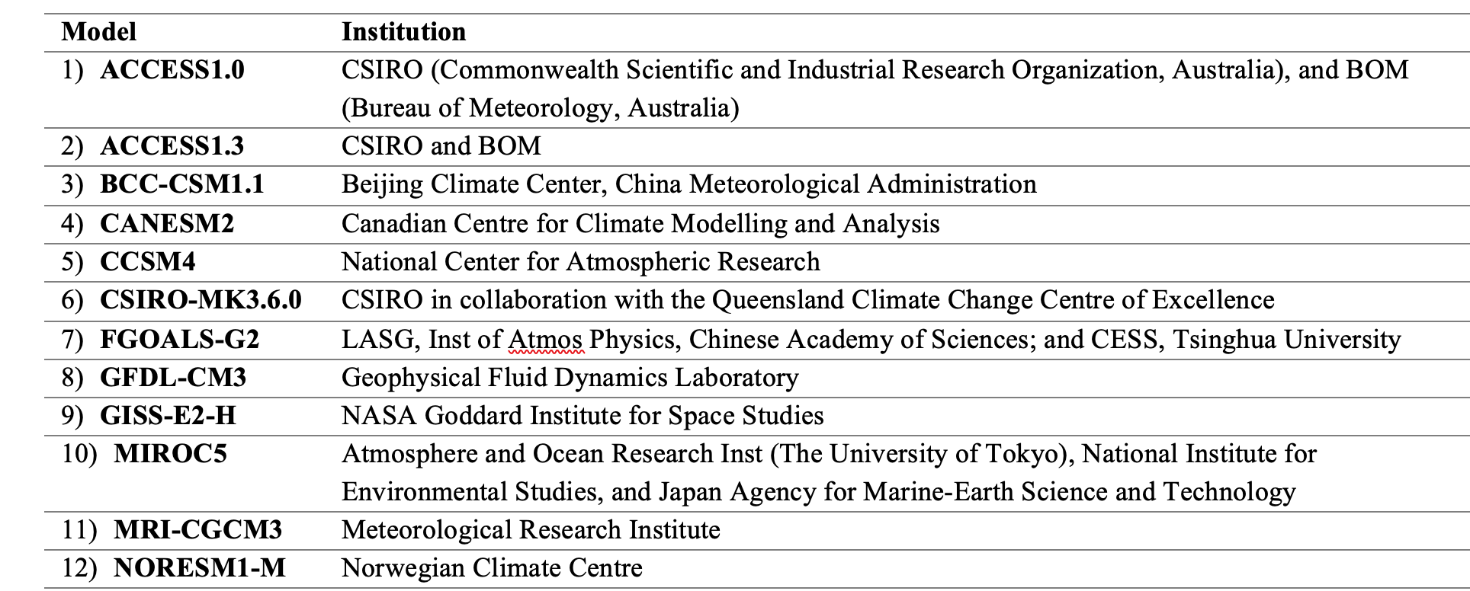
GCMs Used

Slide 18
Some Interesting Initial Results (will mainly show ensemble mean differences)

Slide 19
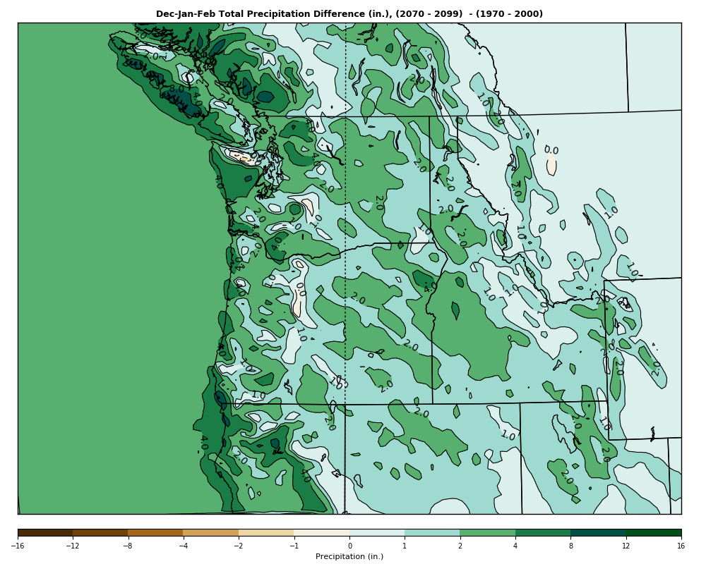
Overall Winter Precipitation Increases But Declines in Lee of Major Barriers
DEC-JAN-FEB Precipitation
(2070-2099) – (1970-2000)

Slide 20
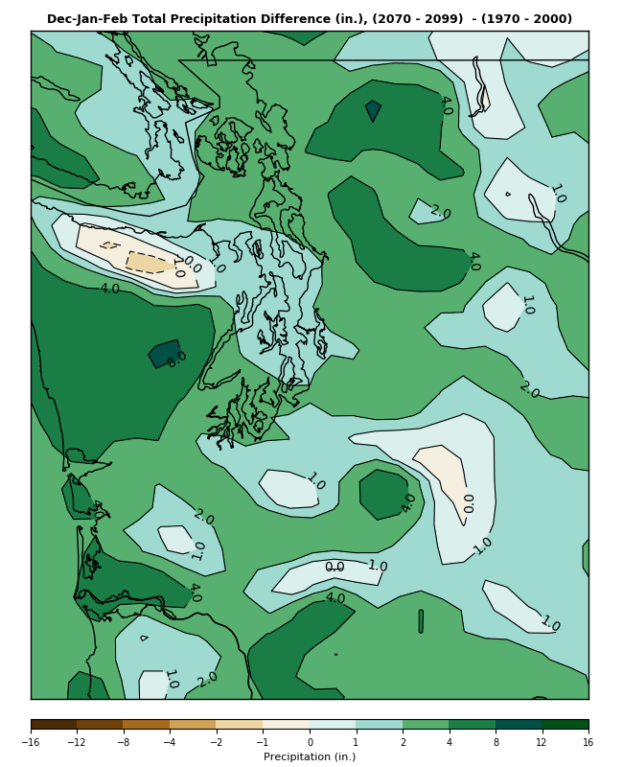
Why? Warmer temperatures produce more rain on upper windward slopes and thus less blow-over to the lee sides?

Slide 21
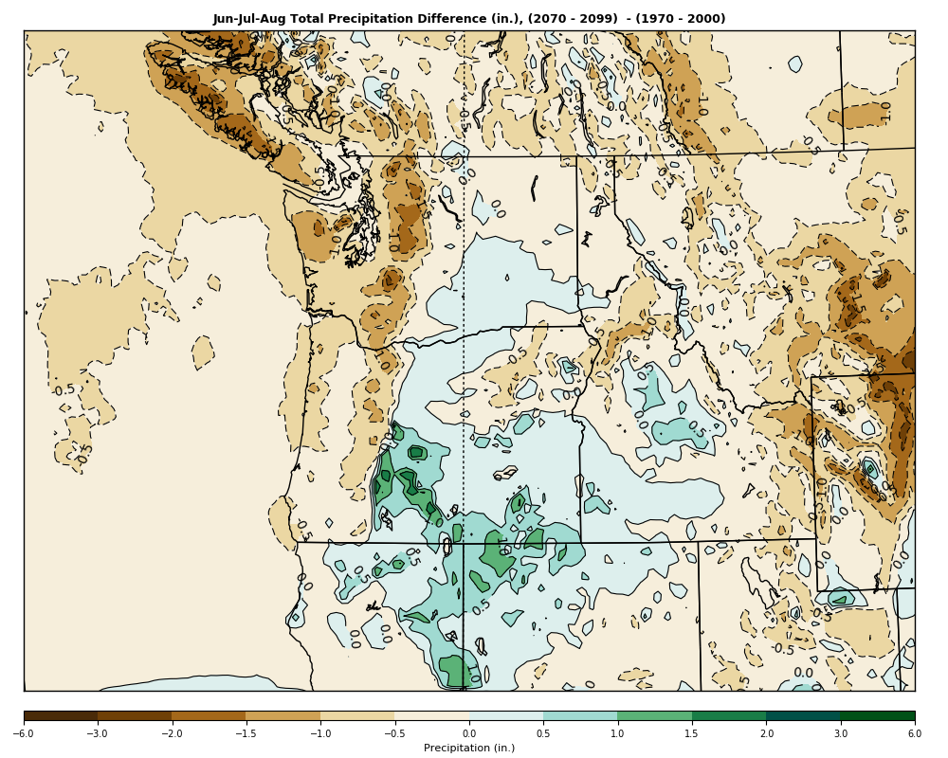
Summer Precipitation: More Surprises
Drier over the Cascades and to the West
Wetter to the east of the Cascades
Why?
More thunderstorms? More moisture from SW monsoon?
June-July-August
Precipitation
(2070-2099) – (1970-2000)

Slide 22
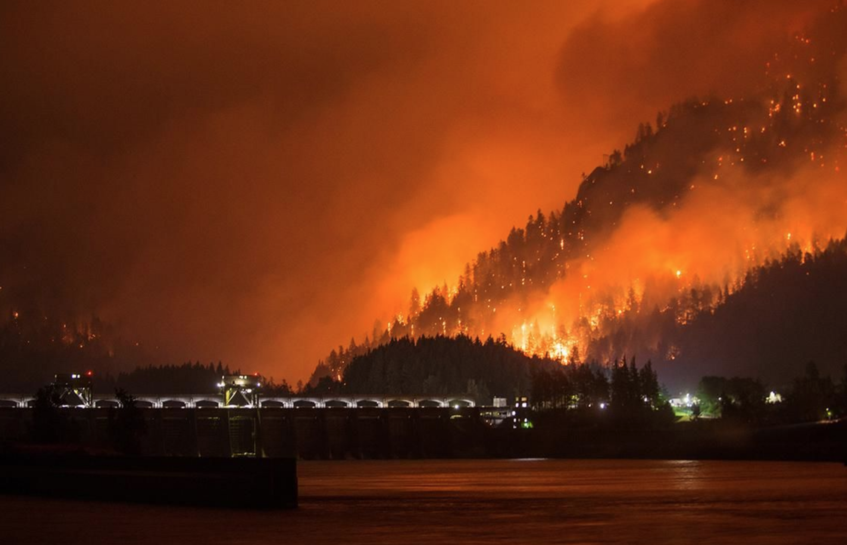
How Will Easterly Flow Across the Cascades Change Under Global Warming?
Easterly winds are associated with heat waves over western Oregon and Washington
Every great wildfire west of the Cascade crest has been associated with strong easterly flow.

Slide 23
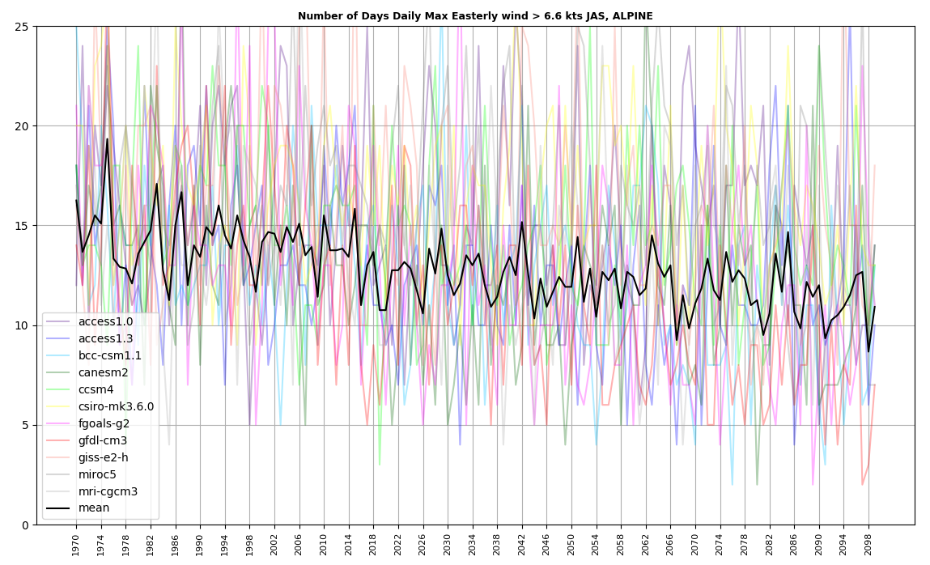
Point near Crest of Central WA Cascades
Strong easterly wind days will decline

Slide 24
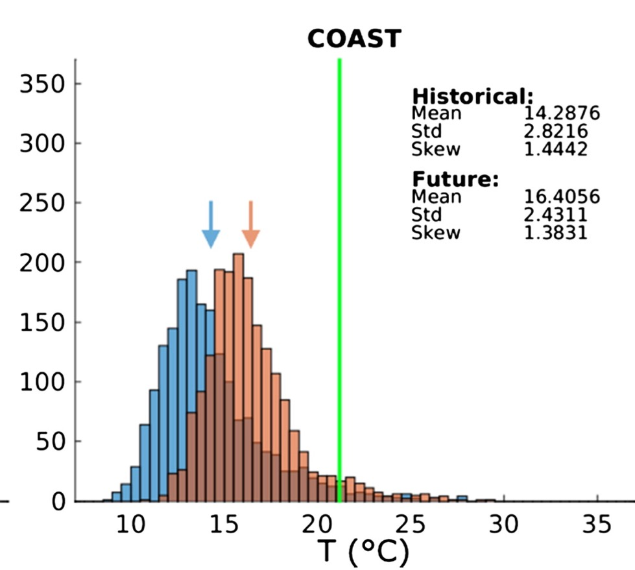
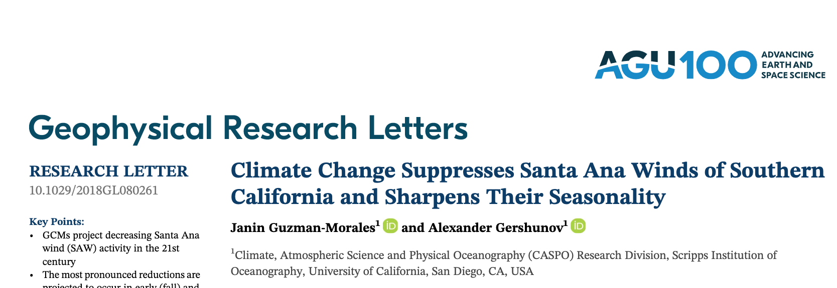
Big Implications
Will work against major fires west of the Cascades
Will take the edge off west-side heat waves under global warming
Similar results from climate modeling over southern CA.

Slide 25
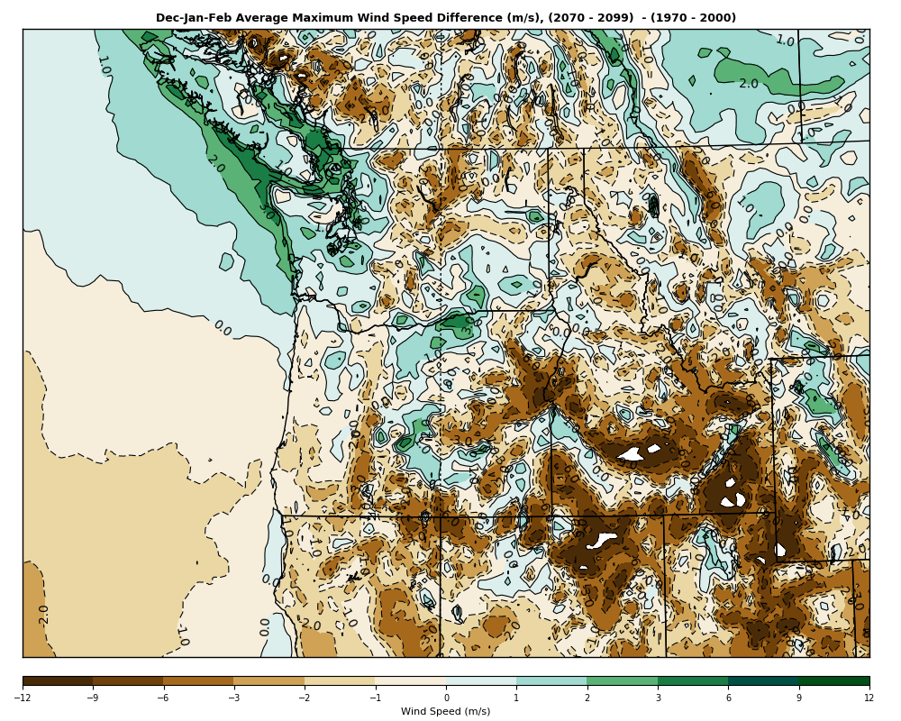
Stronger Winds and Storms During Winter Under Global Warming?
Not over most of the domain

Slide 26
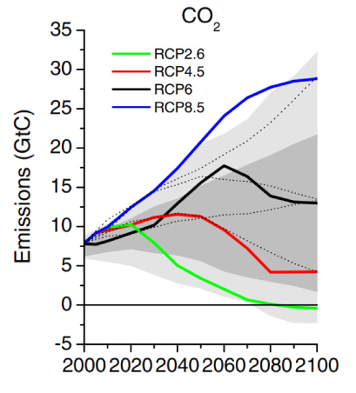
Just starting the analysis of this rich model data set
Also will be redoing the runs with an upgraded WRF model and RCP 4.5
More physics diverstiy

Slide 27
The END

