Slide 1
Cloud Development and Precipitation Processes Atmospheric Sci 101 Autumn 2025

Slide 2
Clouds are made of water droplets or ice crystals or both
How do water droplets/ice crystals form and grow?
How do various types of clouds form?
How can clouds lead to precipitation?
Why don’t cloud particles just fall out of sky?
Does cloud seeding work?

Slide 3
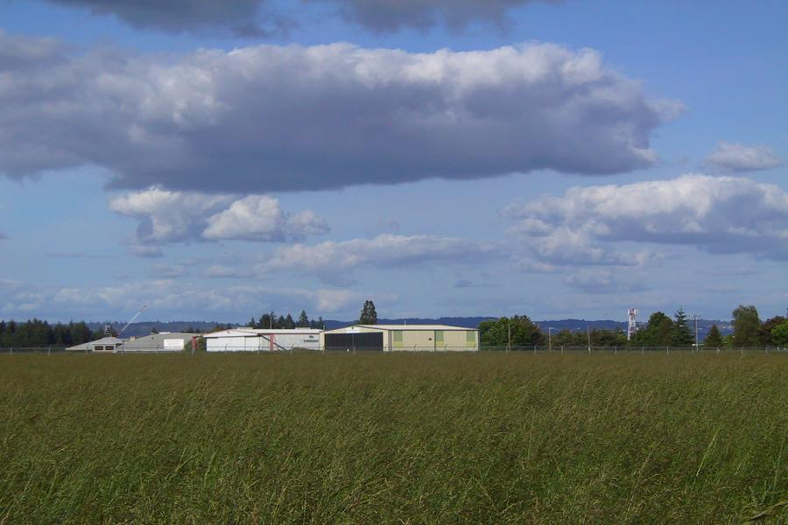
Water cloud—note sharp edges

Slide 4
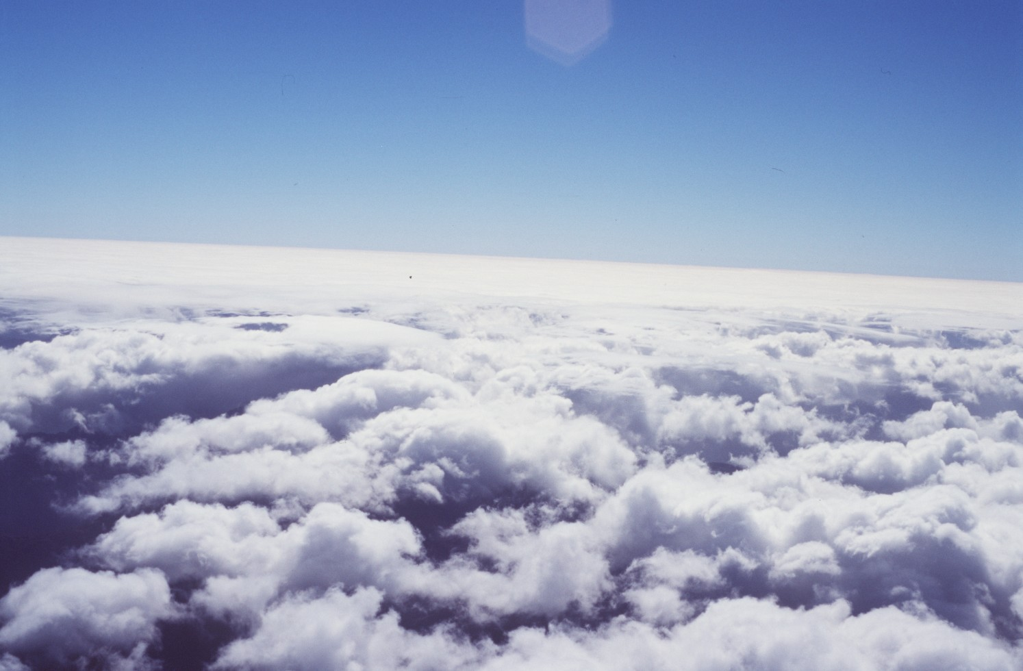
Water cloud

Slide 5
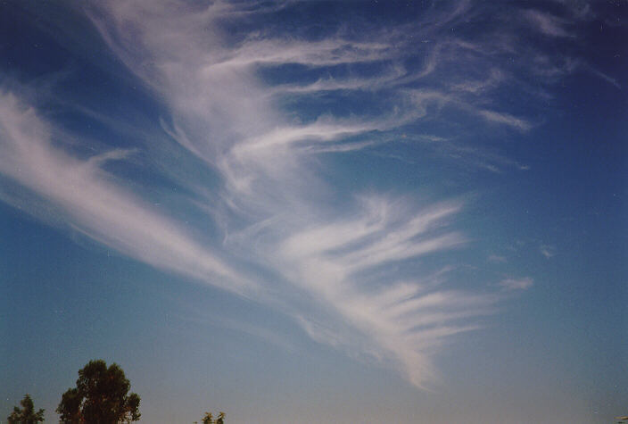
Ice clouds: diffuse edges

Slide 6

Most clouds form as a result of adiabatic expansion and cooling accompanying upward motion
The main exception is clouds near the surface that form when moist air is cooled by a cool surface (e.g., radiation fog, advection fog)

Slide 7
Cooling Until Saturation
Initially, as the air cools the amount of water vapor remains the same
As the air cools, it can ”hold” less and less water vapor. The relative humidity increases.
Eventually, it can only “hold” the amount of water vapor it started with.
As this point, the relative humidity is 100%, which is called saturation.

Slide 8
Believe it or not
Condensation (vapor to liquid) does not necessarily occur when relative humidity (RH) reaches 100%.
For absolutely clean air…no particles…RH has to get well above 100% for condensation or deposition to occur.

Slide 9
But in the real atmosphere, there are particles that foster condensation at 100%: Condensation nuclei Freezing nuclei

Slide 10
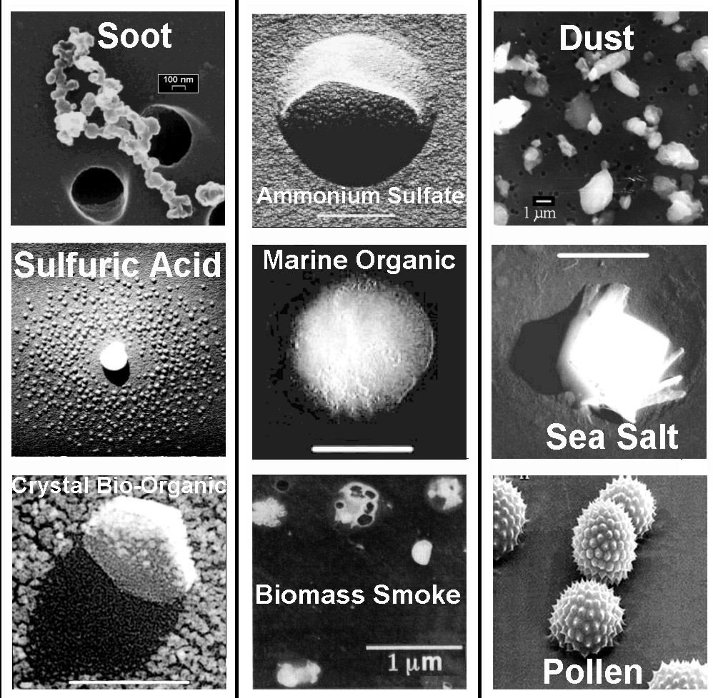
Condensation
And
Freezing
Nuclei

Slide 11

Condensation and Freezing Nuclei
Even clean air contains a large number of particles
An index-finger volume of air contains 1000-150,000 particles
Marine air is relatively clean
Continental air and particularly urban air has more particles.

Slide 12
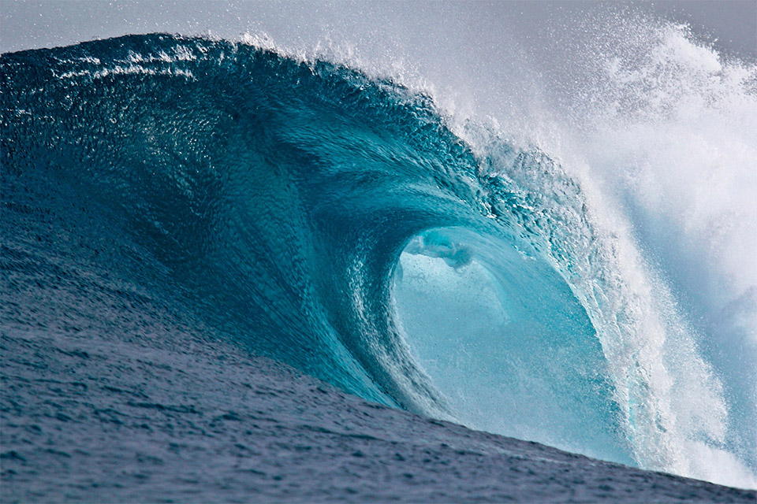
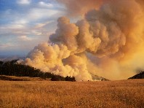
Some Sources of Condensation/Freezing Nuclei
Dust/soil from surface
Volcanic dust
Factory smoke
Forest fires
Combustion
Salt from ocean spray

Slide 13
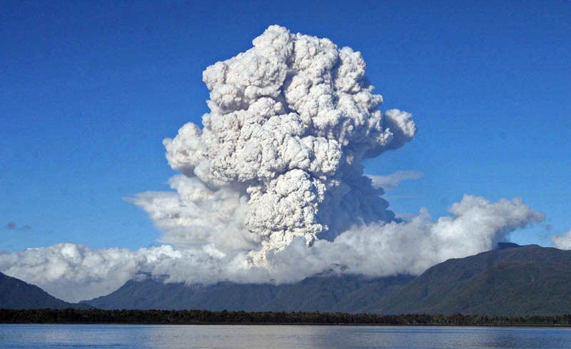
Lots of particles injected into the atmosphere!

Slide 14
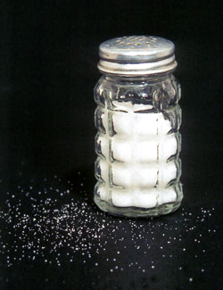
Some particles such as salt particles have great attraction for water.
Called hygroscopic nuclei.
Condensation can initiate on hygroscopic nuclei at RHs as low as 70%!
Why a salt shaker often stops working on humid days.

Slide 15

Marine air has a lot of moisture and many salt particles: can result in enhanced condensation, lots of small droplets, and reduced visibility/haze

Slide 16
Normally enough condensation nuclei so that condensation and cloud formation occurs at around 100% RH

Slide 17
Growth of Clouds
Condensation nuclei are very small (.1 to 10 microns/μm) Micron is a millionth of a meter
Typical cloud droplets are about 20 microns in size
Raindrops are about 2000 microns
How do droplets grow and do so rapidly?

Slide 18
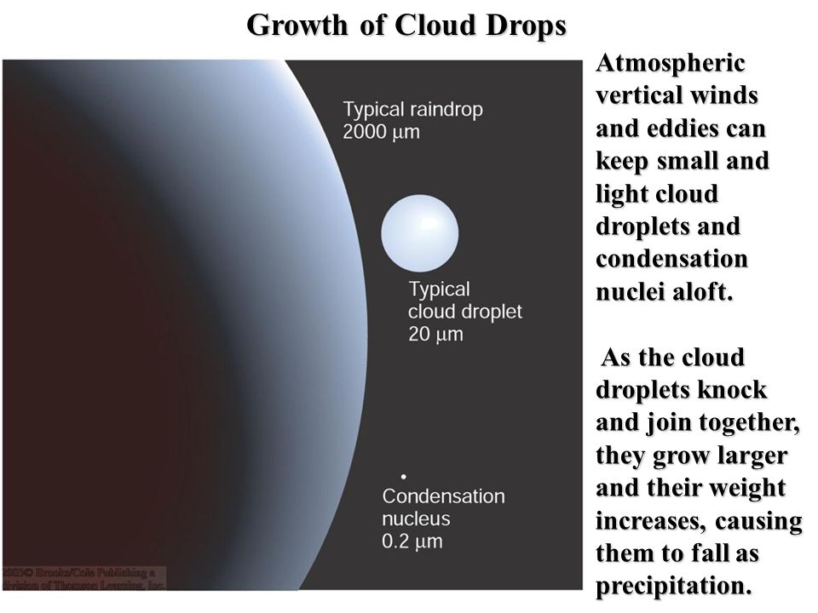

Slide 19
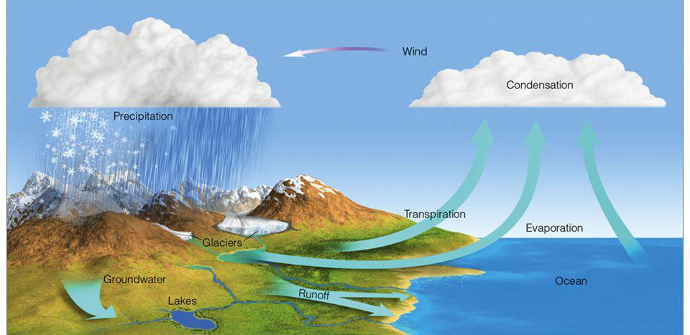
Getting to cloud drop size is relatively straightforward
Rising air > adiabatic cooling > RH increase to saturation > condensation
Condensation occurs around 100% RH for non-hygroscope nuclei and below 100% for hygroscopic nuclei

Slide 20

End up with cloud droplets of ~20 microns in size

Slide 21
Still a long way to go!

Slide 22
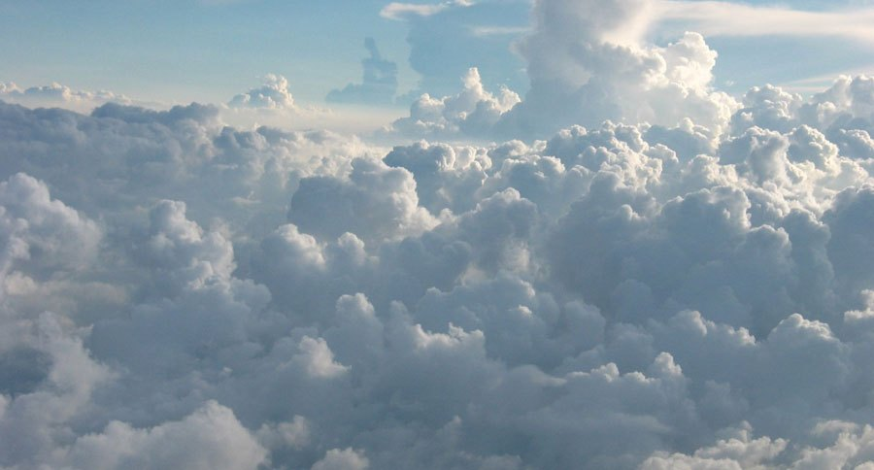
Cloud droplets have weight, why don’t they all fall to the ground?
The weight of the average cumulus cloud is 1.1 million pounds!

Slide 23

The Answer: concept of Terminal Velocity
Terminal Velocity: the constant speed that a freely falling object eventually reaches when the resistance of the medium through which it falls prevents further acceleration.

Slide 24
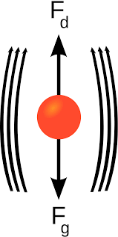
Terminal Velocity
When an object starts to fall, it accelerates due to the force of gravity.
But there is an opposing force: air drag
Drag is proportional to speed through air. More speed, more drag.
Eventually drag equals the gravitational force and the object stops accelerating, achieving the terminal velocity.

Slide 25


Slide 26


Slide 27
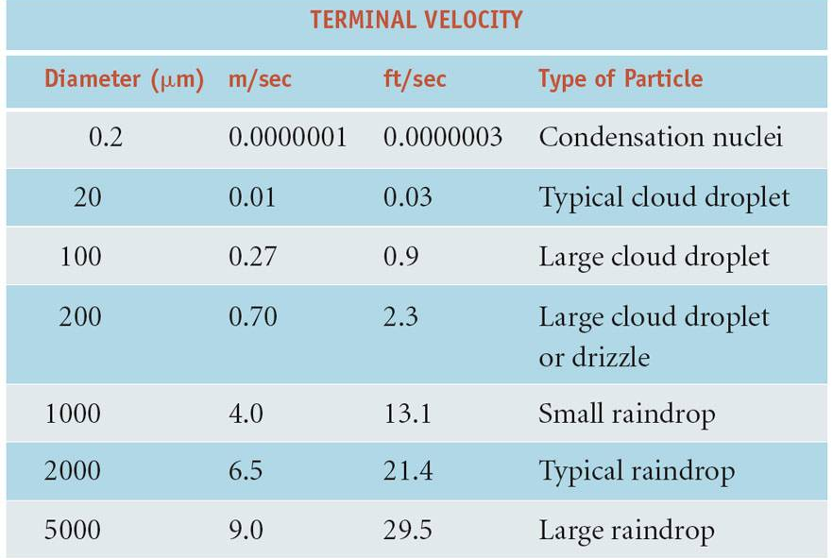

Slide 28

To fall 1-km
Cloud droplet: 1.16 days
Large raindrop: 1.85 minutes

Slide 29
So why don’t cloud droplets all fall out?
A small cloud droplet has a terminal velocity of ~.01 meter per second or about .02 knots
Large cloud droplet perhaps .27 meter per second or .5 knot
Upward motion in clouds typically as large or larger than these terminal velocities.
Thus, cloud droplets don’t all fall out!

Slide 30

Next puzzle: how do we go from cloud droplet size to raindrop size? 20 to 2000 micron—a hundred-fold increase in diameter!
Condensation is WAY too slow, would take days for clouds to produce precipitation
In real world, it can happen in minutes

Slide 31
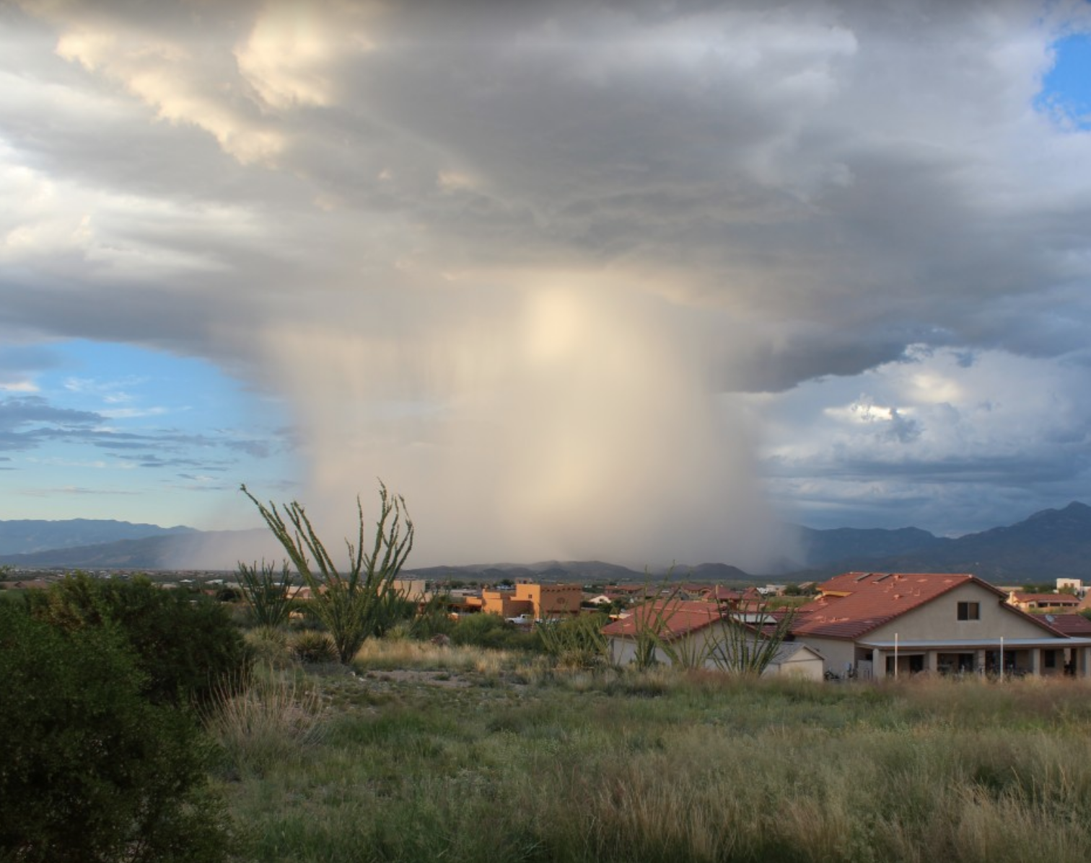
Two ways to go from cloud droplet to precipitation
Collision/coalescence mechanism that occurs in clouds with water droplets only. Also known as the warm rain mechanism.
Cold-cloud mechanism that occurs in clouds with both liquid water droplets and ice crystals. Includes supercooled water.

Slide 32
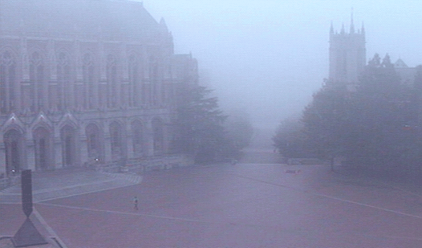
The Collision/Coalescence or the Warm Rain Mechanism

Slide 33
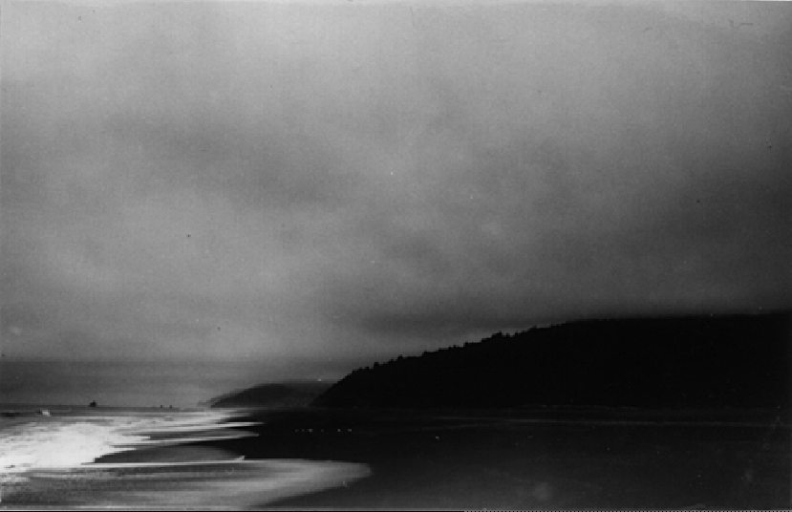

Slide 34
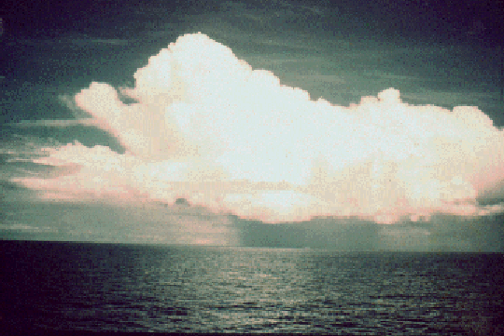
Warm Tropical Cumulus: No Ice!

Slide 35
Coalescence or Warm-Rain Mechanism
Occurs in clouds made up of only liquid water (generally clouds warmer than -15C)
All drops are not equal, some larger than others.
Larger ones fall faster (larger terminal velocity). They collect the smaller droplets and then fall even faster, getting larger and larger!

Slide 36
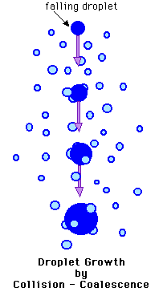
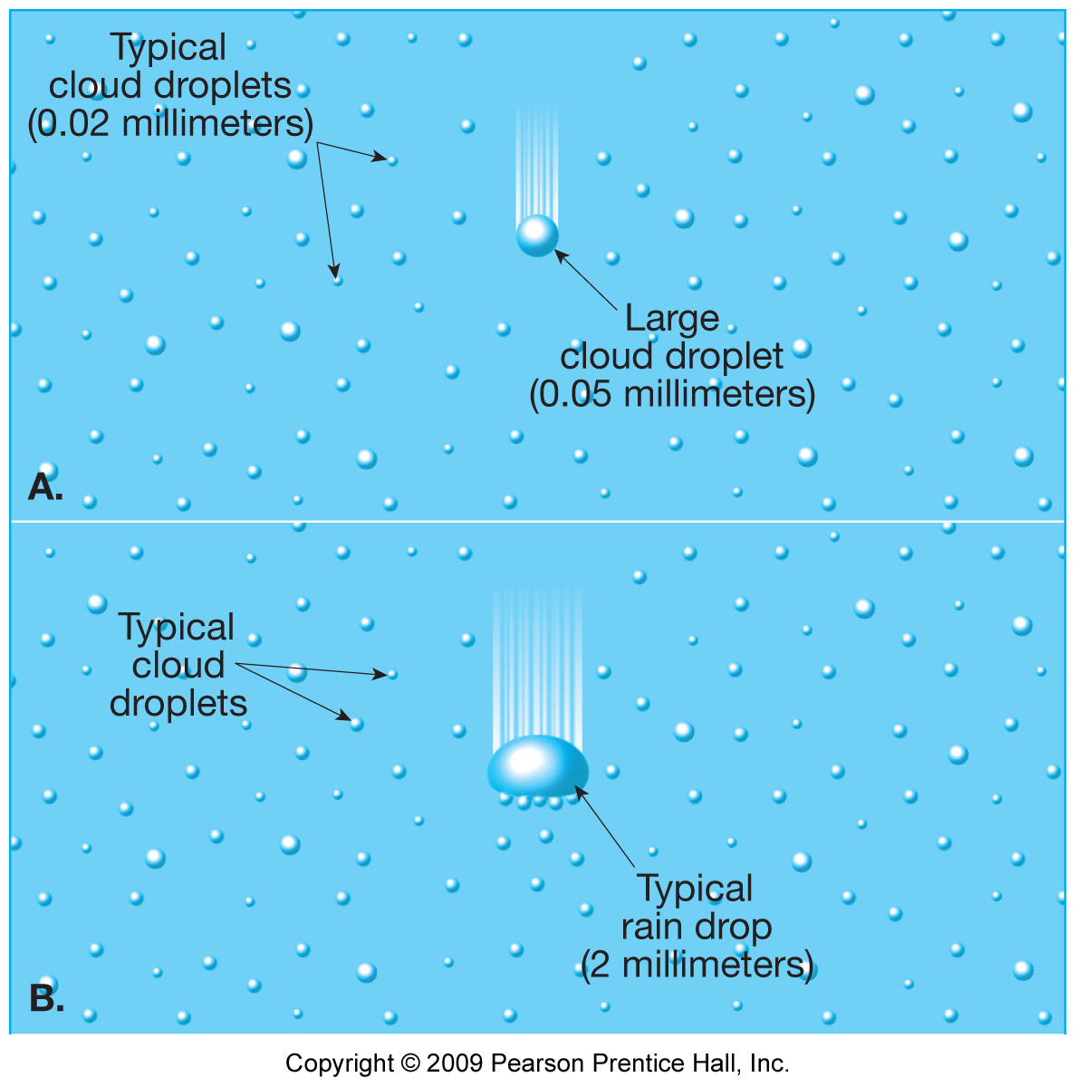

Slide 37
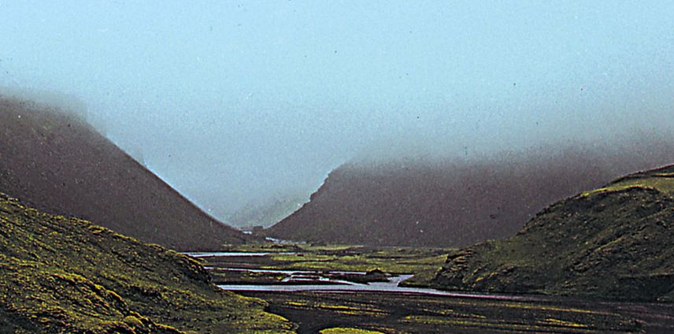
Collision/Coalescence Example
Warm stratus cloud. Low elevation, typically ~500 m thick. Slow upward motion (~.1 ms⁻¹).
Since they are shallow, falling droplets don’t stay in cloud long. Stay small.
Only grow to 200- 300 microns (about .01 inch). Drizzle

Slide 38
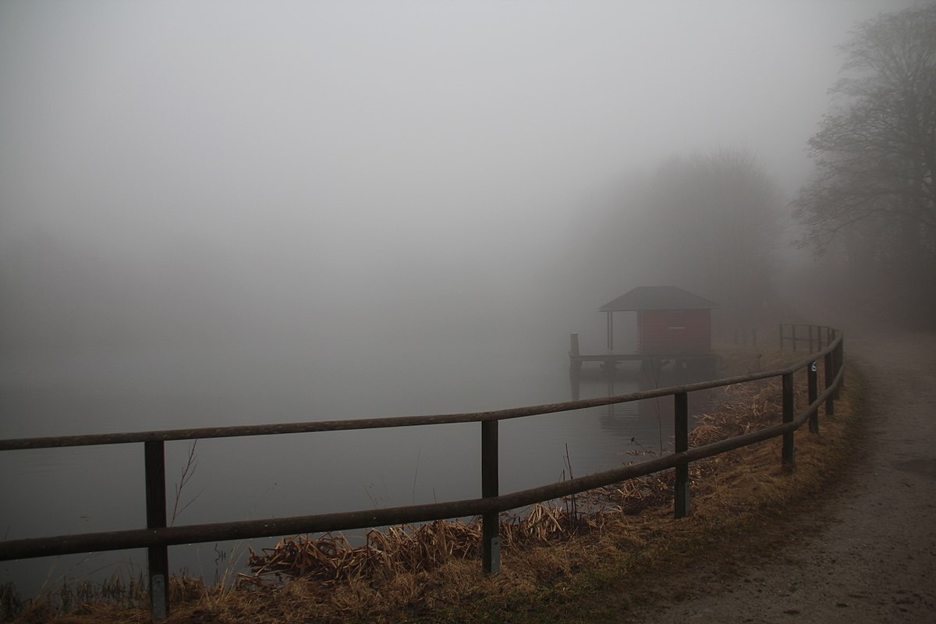

Slide 39
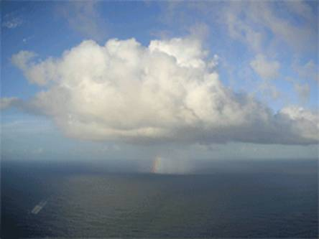
Warm Tropical Cumulus
Can grow several km high
Large upward motion can keep drops aloft for a while
Can get big drops (>5000 microns, 5 mm)

Slide 40

How Big Can A Raindrop Get?

Slide 41

How big can a rain drop get?
Generally, don’t exceed 7000 microns (7 mm, 3 inches)
Why? Get torn apart by air drag!
Biggest raindrop in the world? Discovered by UW Researchers!

Slide 42
The Record
The largest raindrop measured 8.6 mm (0.338 in) across. Detected on two occasions; September 1995 (Brazil) and July 1999 (Marshall Islands).
The raindrops were imaged while falling by a laser instrument on a research aircraft in studies by UW Professor Peter V. Hobbs and Arthur Rango (both USA)

Slide 43

What is the shape of raindrops?
Not like this!

Slide 44
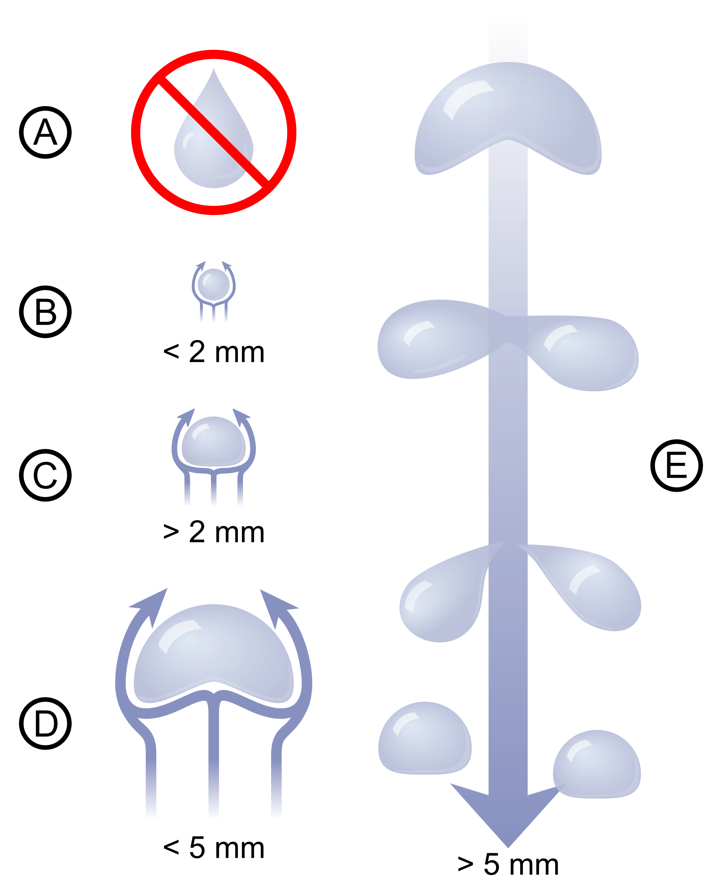
Raindrop shape changes depending on size
Small drops are circular
Become flattened as they get bigger.

Slide 45
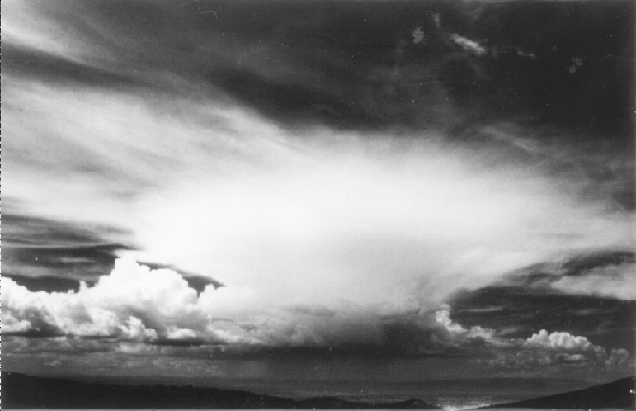
Cold Cloud Process

Slide 46
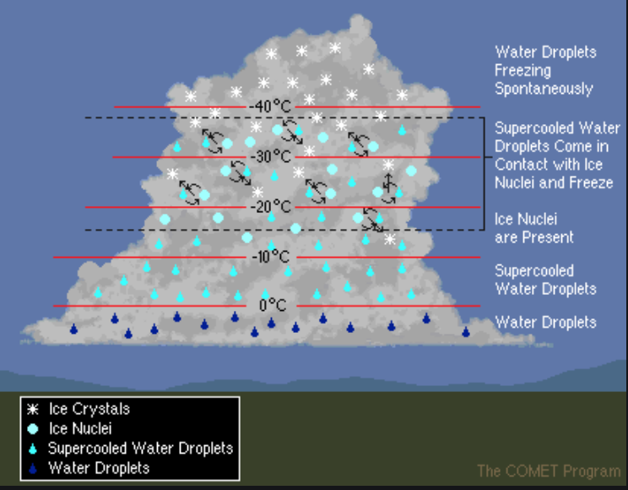
Cold Cloud Process a.k.a. the ice crystal process or the Bergeron process
Consider clouds in which large parts have T< 0C and with BOTH ice crystals AND supercooled liquid water droplets.
Such clouds are known as mixed phase clouds.

Slide 48
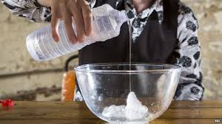
To understand such clouds, you have to know about supercooled water
When T > 0C water is liquid
When T less than or equal to -40C, then all ice.
But between 0 and -40C, and particularly between 0 and -15C water can be supercooled, liquid even though its temperature is below 0C!

Slide 49
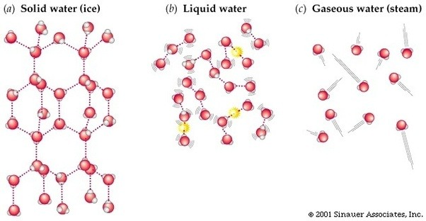
Why supercooled water?
To freeze, molecules have to transition from moving around (as liquid) to a specific crystal structure.
They don’t do this quickly unless they have a template to do so: an ice or freezing nuclei

Slide 50

Think of water molecules like kids…. Hard to get them to line up

Slide 51
Supercooled Water: Liquid dynamite!
Can freeze on contact with a cold surface or when disturbed.
https://www.youtube.com/watch?v=DpiUZI_3o8s
https://www.youtube.com/watch?v=OIN21UNgNCE

Slide 52
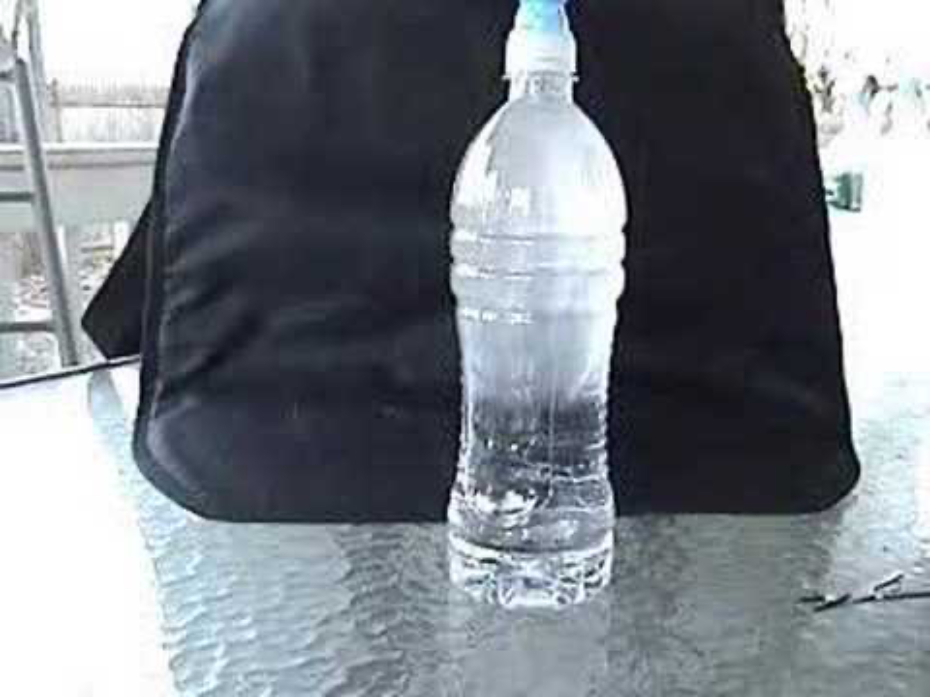
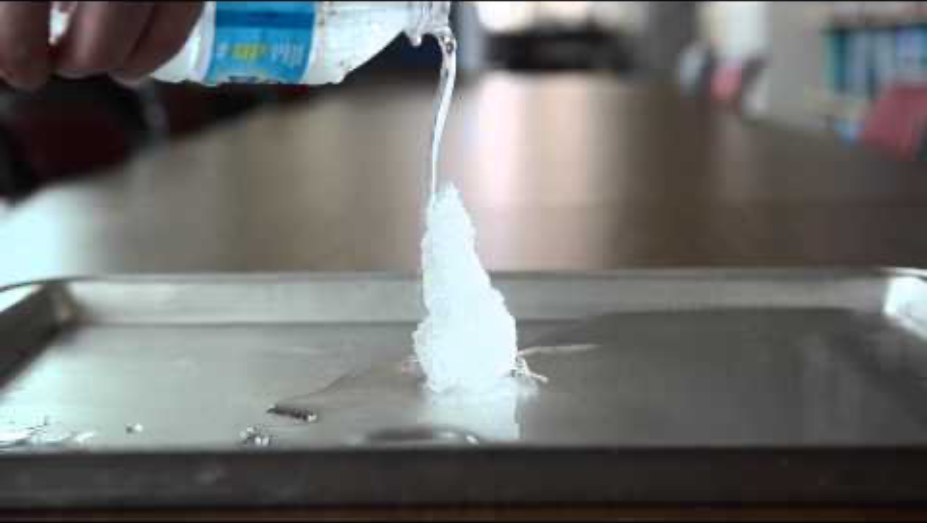

Slide 53
Back to the cold cloud process: How go from clouds to precipitation?

Slide 54
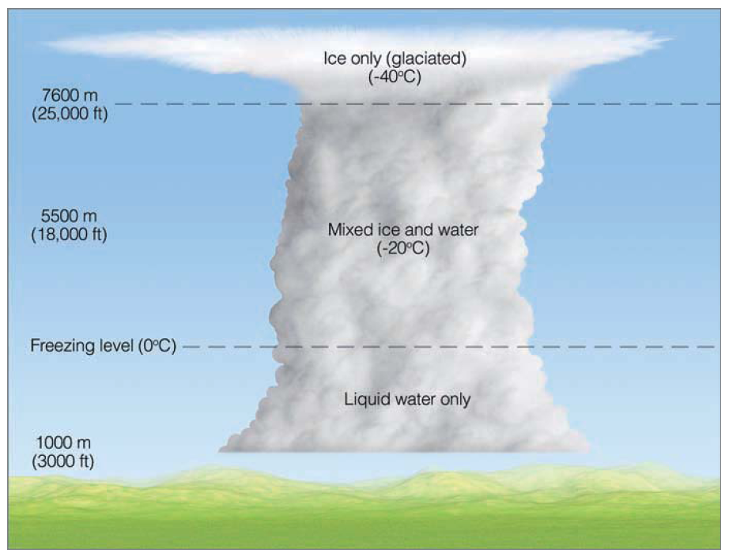
Start with no precipitation

Slide 55
Magic happens in mixed phase clouds
Start with both liquid water (supercooled) cloud droplets and ice crystals in a below freezing layer
Droplets and ice crystals are too small to fall out quickly.
Water vapor tends to move from liquid cloud droplets to the ice crystals, allowing ice crystals to grow at the expense of the water droplets.

Slide 56
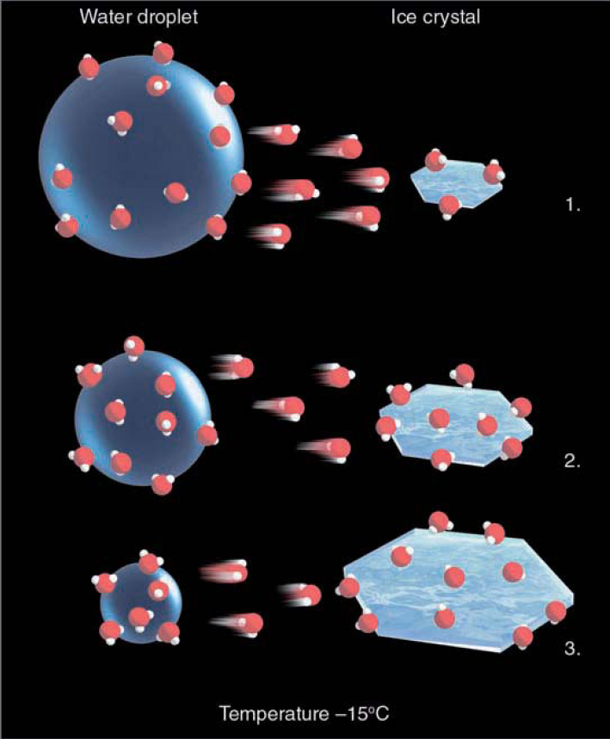
Why? Because the saturation vapor pressure over water is greater than over ice

Slide 57
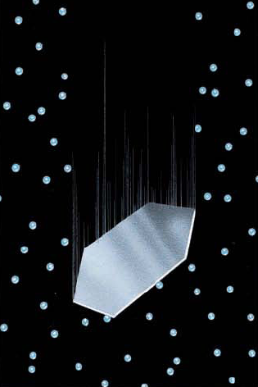
Cold-cloud process
As ice crystals grow and become heavier, their terminal velocity increases and they collide with supercooled droplets, which freeze on contact
This process is called riming.
They get even bigger and fall faster

Slide 58
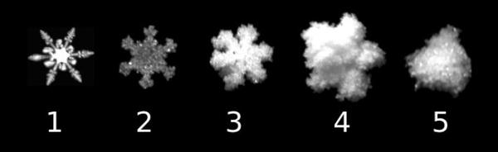
Riming in Action

Slide 59
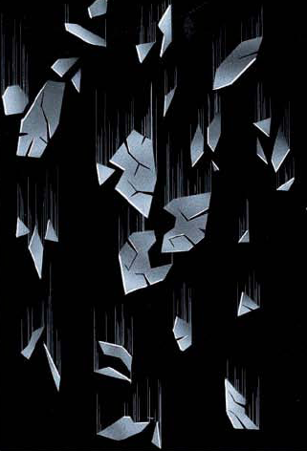
Splintering: as they get larger, some ice crystals splinter into many ice crystals, which in turn grow by riming. Known as, ice multiplication

Slide 60
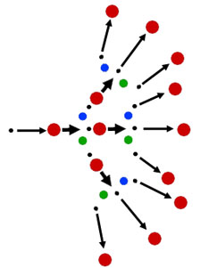
Chain Reaction!
Ice crystals grow, splinter, and grow, getting larger and falling faster.
Can happen fast (minutes)

Slide 61

Aggregation: some ice crystals hit and stick together into complex crystal assemblies

Slide 62
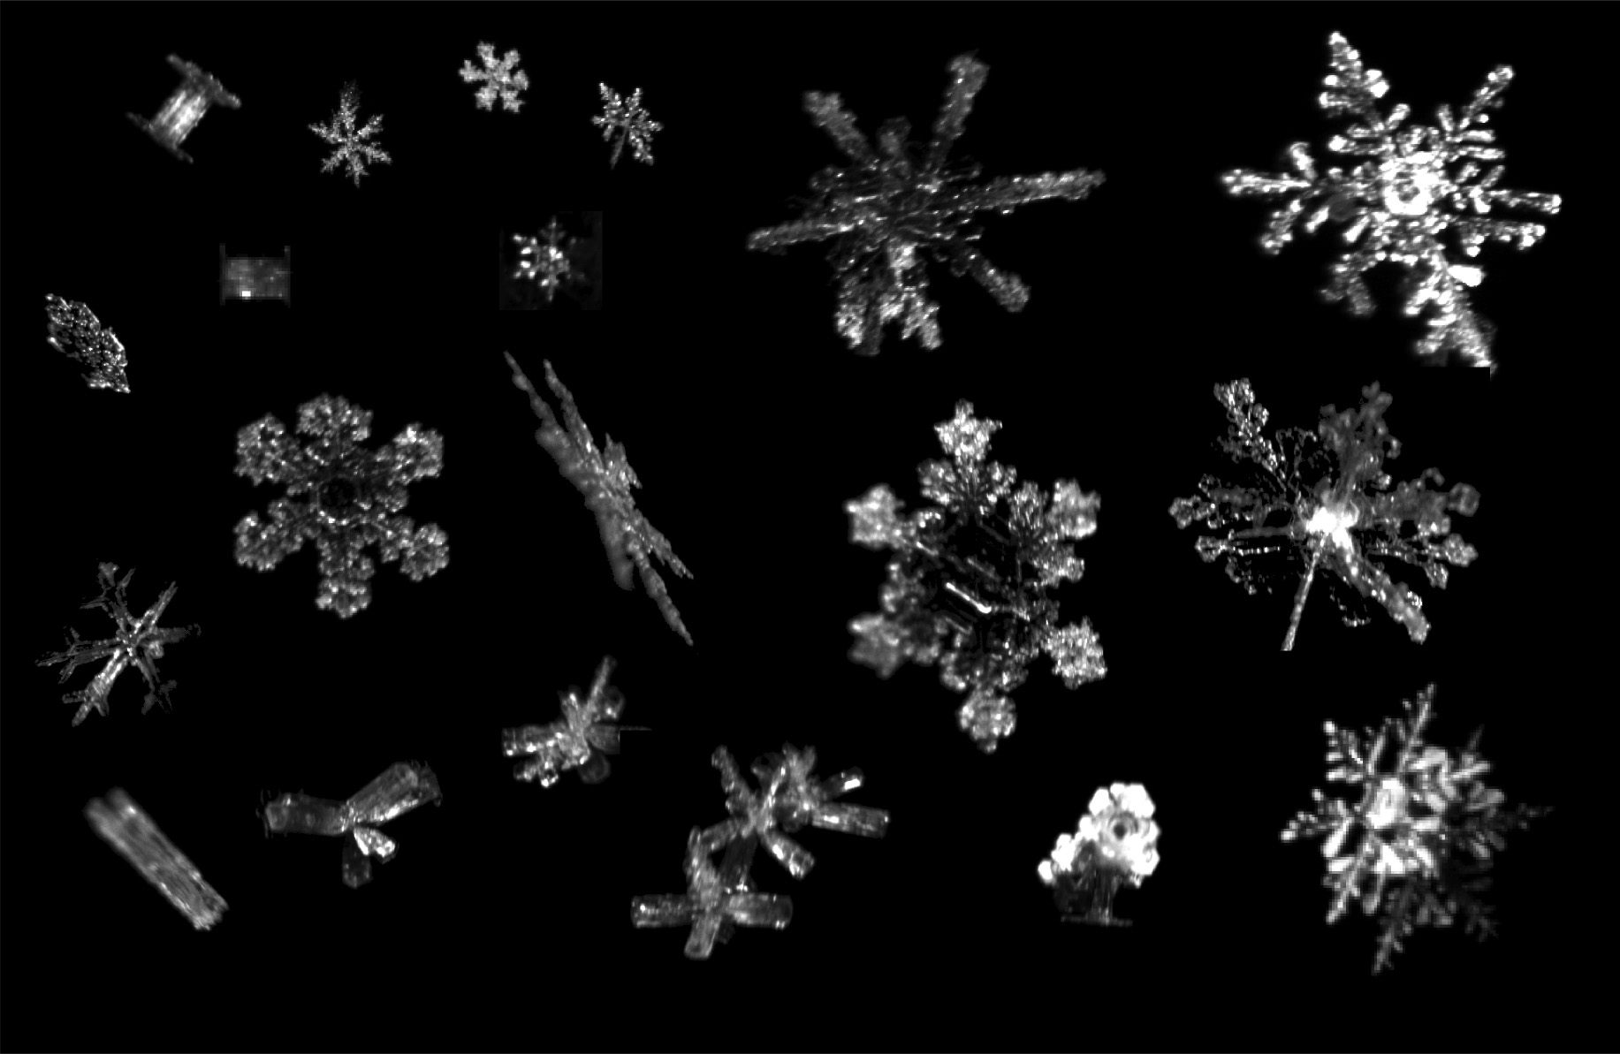
Aggregation Produces Snowflakes-some very big

Slide 63
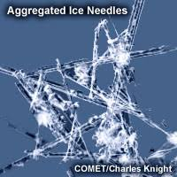

Slide 64
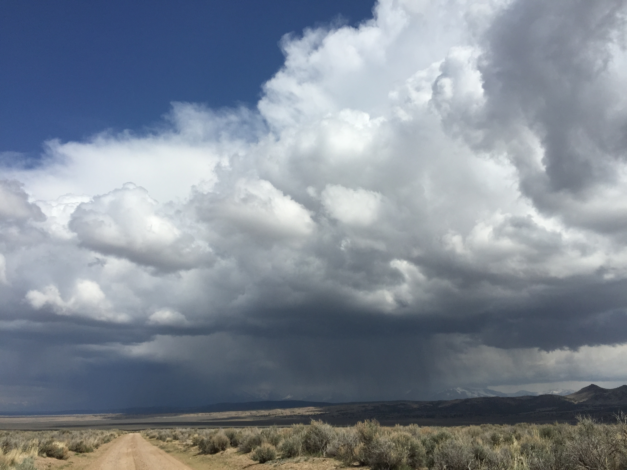
Cold Cloud Process in Mixed Clouds
Active in most clouds producing precipitation in the midlatitudes
Very fast, efficient process
Most NW precipitation from it

Slide 65
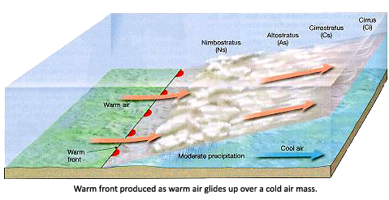
Even in warm front clouds

Slide 66
What Determines Precipitation Type at the Surface?

Slide 67
Believe it or Not!

Slide 68
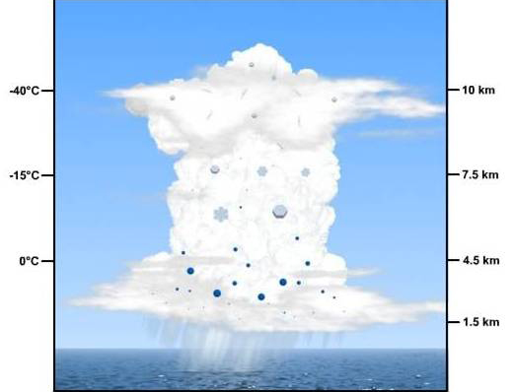
Most midlatitude rain starts as snow aloft

Slide 69
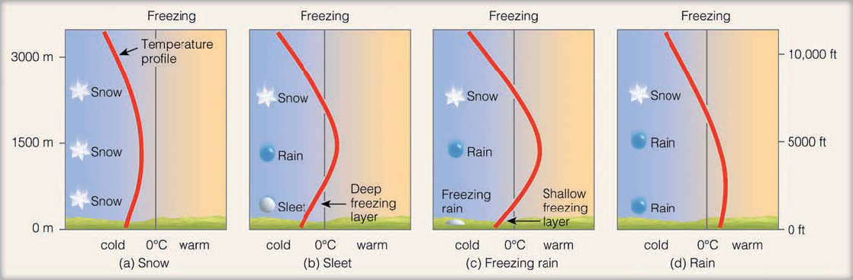
Temperature Structure Aloft Determines Precipitation Type

Slide 70
Freezing Rain (FZ)

Slide 71
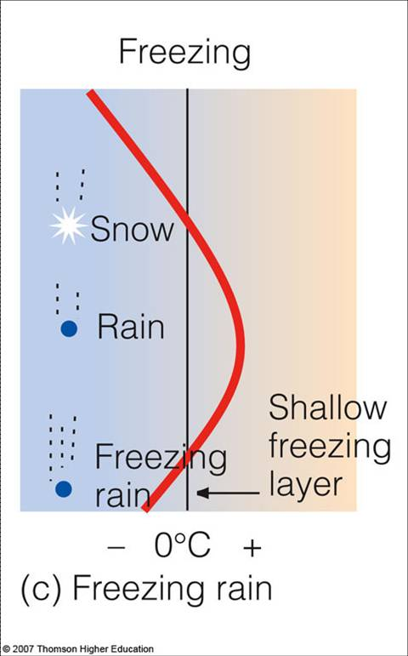

Slide 72
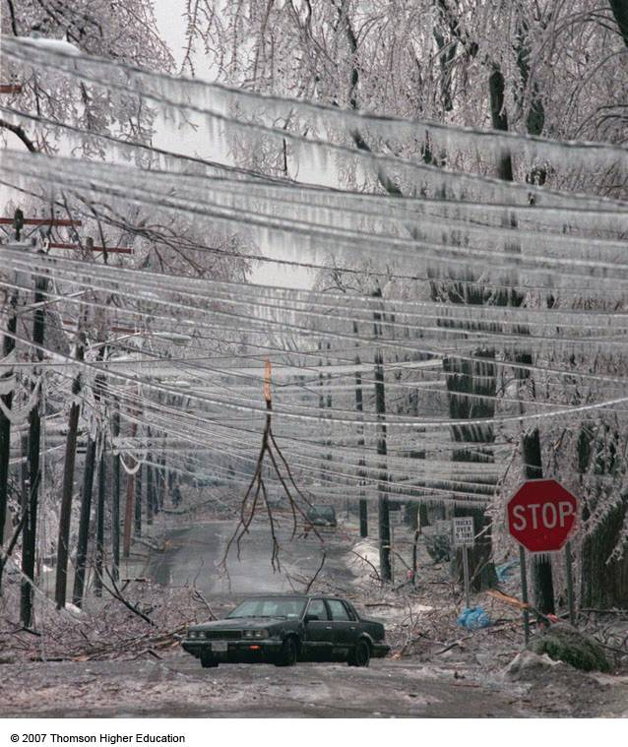
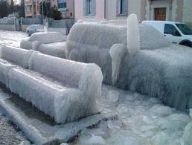
Freezing Rain

Slide 73
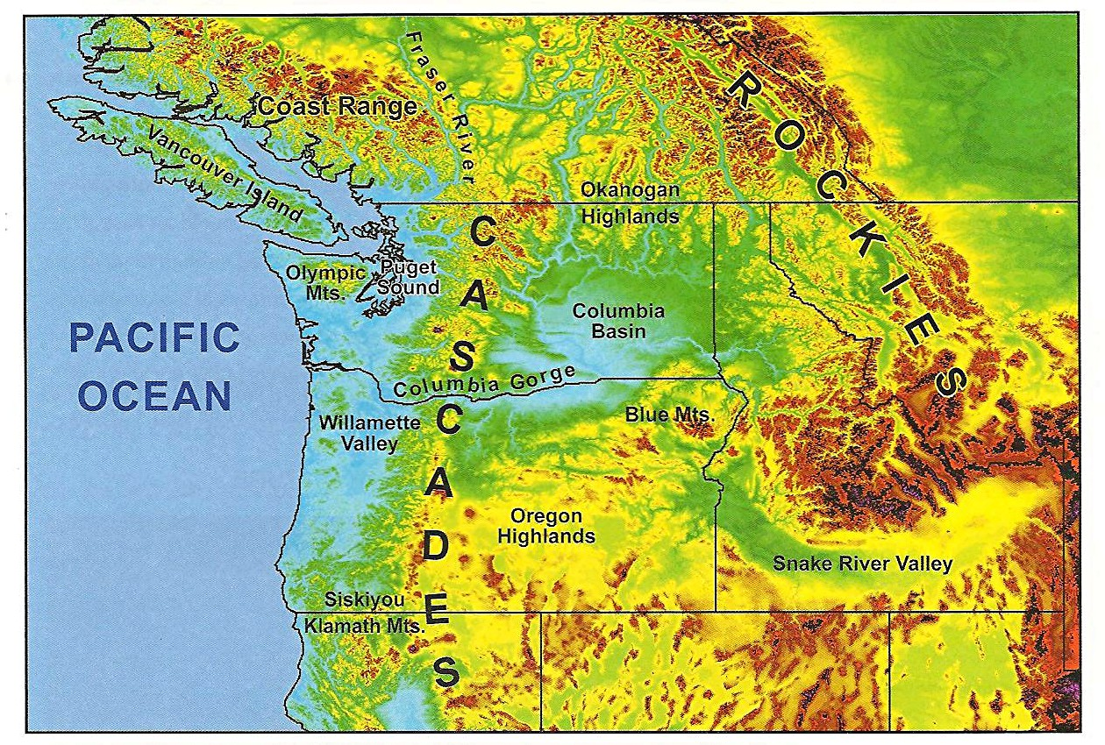
Columbia Gorge and Columbia Basin: Freezing Rain Major Threat!

Slide 74
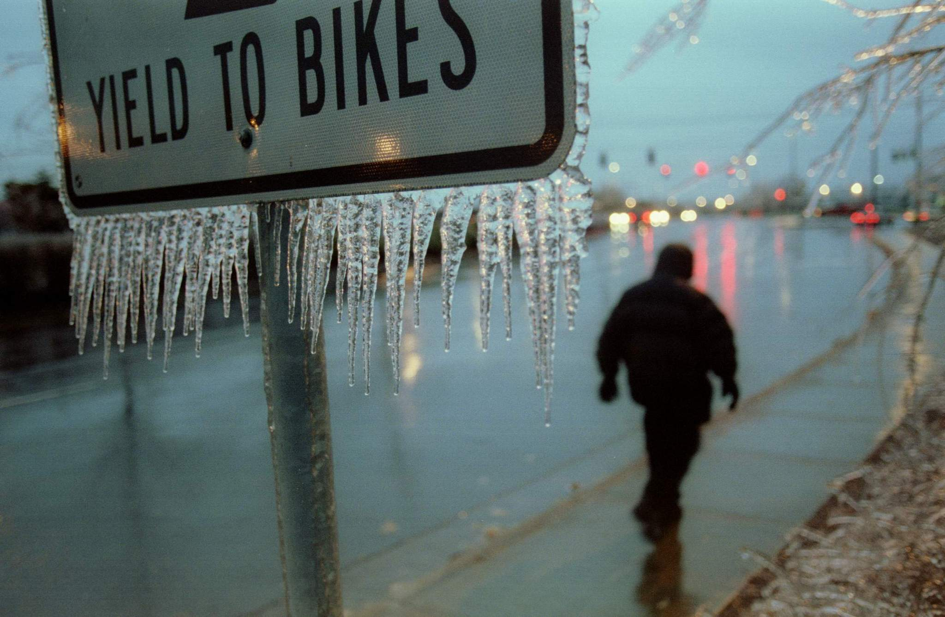
Portland is well known for freezing rain

Slide 75
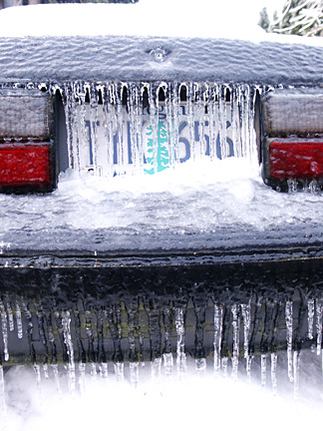

Slide 76
COLD
AIR

Slide 77
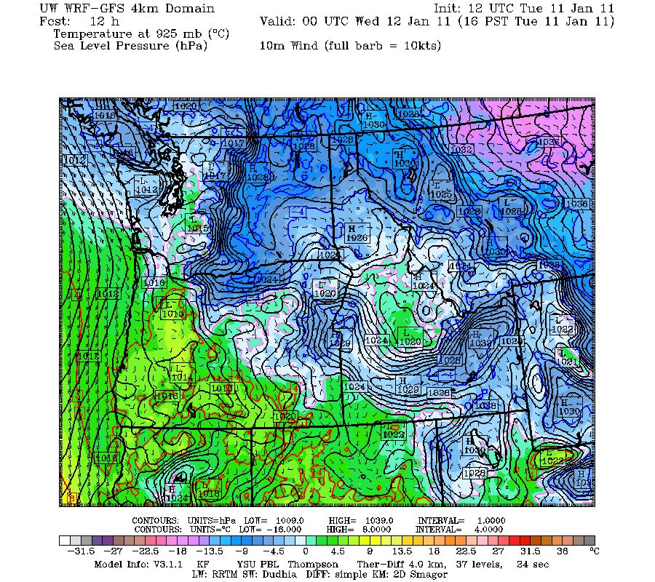
Freezing Rain in the Gorge: Low Level Cold Air From
Eastern WA with Rain Falling in From Overhead

Slide 78
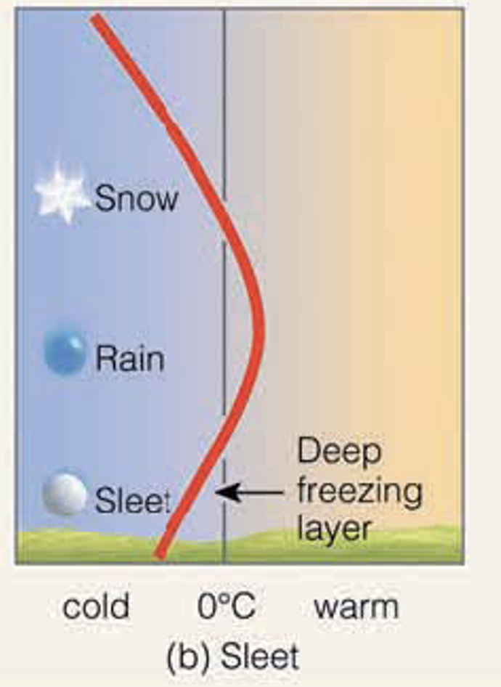
Sleet
Deeper Cold Results in Rain
Freezing into ice pellets

Slide 79
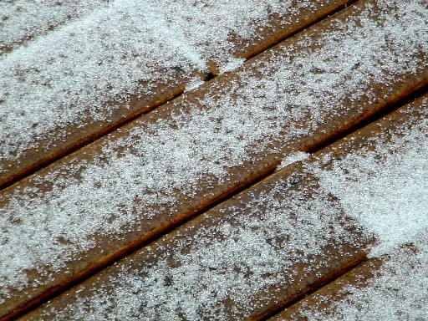

Slide 80


Slide 81
Snow
Air is below freezing at all levels

Slide 82

Snow Doesn’t Necessarily Melt Immediately When It Falls into Above-Freezing Air

Slide 83
Freezing Level Versus Snow Level
Freezing level: the altitude at which the atmosphere drops to 0C.
Snow level: the level at which all the snow melts, with rain below.
Typically, the snow level is about 1000 ft (300 m) below the freezing level.

Slide 84


Important terminology: snow level and freezing level
Freezing Level
32F
1000 ft
Snow Level

Slide 85

For many of our snow events the snow level is low and visible

Slide 86

Can often see the snow melting on radar: produces a bright band
Ice crystals get covered with liquid water….like a huge drop

Slide 87


Melting Snowflakes

Slide 88

”Bright Band” on Weather Radar

Slide 89

Bright Band (red line) on weather radar

Slide 90

Cloud Seeding
The artificial modification of clouds to alter clouds and precipitation

Slide 91
The Main Approach
Some clouds have lots of supercooled water, but too few ice crystals for effective precipitation development.
Often a lack of ice nuclei where cloud is relatively warm (0 to -15C).
Thus, the cold cloud process does not work and not much (or any) precipitation.

Slide 92

A Cumulus Congestus With No Precipitation

Slide 93
So how do we jump start the cold-cloud process?
Drop in super-active ice nuclei or particles that will help the supercooled water transition to ice. Such as:
Ground-up dry ice (solid CO₂)
Silver Iodide (AgI), which has a structure similar to ice. An effective ice nuclei as warm as -4C.

Slide 94

Silver Iodide Has A Six-Sided Structure Similar to Ice

Slide 95
The Idea
Wait for some “juicy” supercooled clouds with lots of liquid water
Then using an aircraft, drop AgI or dry ice into the clouds
Or burn material with AgI at surface and allow the smoke to spread into clouds.

Slide 96


Slide 97


Slide 98


Slide 99


Slide 100

Some companies offer such services!

Slide 101


Slide 102
Does cloud seeding work?
Careful statistical studies with controls found little influence to perhaps a 10-15% enhancement. Not economically viable for increasing precipitation.
A major problem: it is hard to know what WOULD have happened if the seeding had not taken place.

Slide 103

But some, in desperation, are trying it

Slide 104
There is one way that cloud seeding can be very effective: reduction of supercooled fog (a.k.a. freezing fog) in cold climates
Dropping dry ice into a supercooled water cloud can promote ice crystals, which fall out of cloud/fog
Often used at airports in northern climes

Slide 105


Slide 106

Contrails

Slide 107

Contrails
Name from CONdensation Trails
Cirrus-like lines behind jet aircraft flying at high altitudes
Moisture from combustion in jet engines. Plus plenty of cloud condensation and freezing nuclei in exhaust
Produces a trail of liquid water droplets that freeze rapidly
More evident when atmosphere is at or near saturation

Slide 108


Combustion in jet engines results in water vapor and particles being emitted

Slide 109


Slide 110


Slide 111


Slide 112


Slide 113


Slide 114


Slide 115


Slide 116
Contrails are enhanced when atmosphere is near (or at) saturation
Like when there are cirrostratus clouds around!

Slide 117


Slide 118

Big Test of Contrail Occurrence: Sept 11th Contrails disappeared

Slide 119

Contrails and Climate

Slide 120

Contrails
Contrails warm at night due to effects on infrared: absorbing and emitting IR back to surface
Cools slightly during day
Recent studies suggest a net weak warming effect.

Slide 121

Chemtrails (a major fiction)

Slide 122


