Slide 1
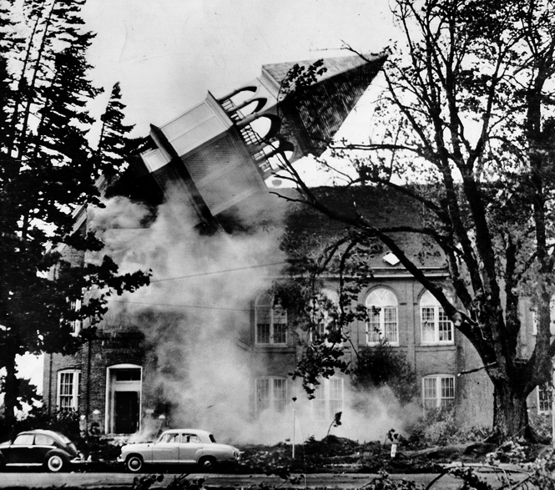
The Columbus Day Storm October 12, 1962 Cliff Mass, Atmospheric Sciences
The steeple atop historic Campbell Hall, on the Oregon College of Education Campus, Monmouth.

Slide 2
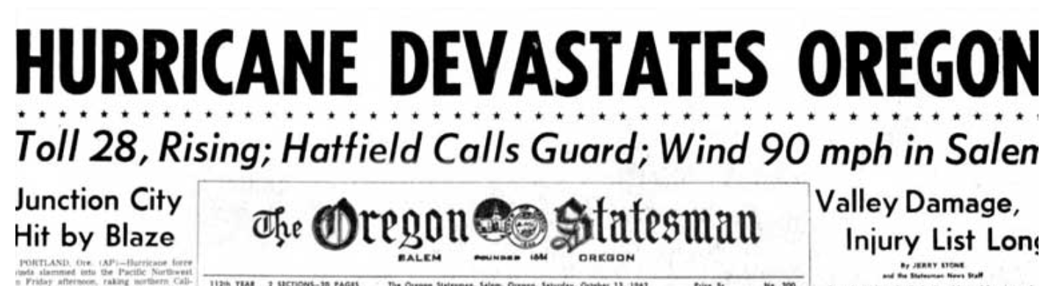
This Talk
Will describe the most powerful midlatitude cyclone to strike the Northwest in a century.
Will review the essential synoptics and dynamics
How well forecast? Will such storms increase under global warming?

Slide 3

Native Americans knew about great storms of the region
Moved their coastal camps inland during the winter
Developed a mythology
The Thunderbird

Slide 4
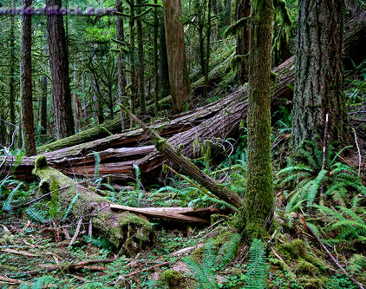
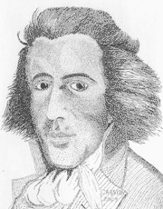
European explorers appreciated the threat…
John Meares,1788, off of Cape
Flattery of the Olympics Peninsula
“The force of southerly storms was evident to every eye; large and extensive woods being laid flat by their power, the branches forming one long line to the North West, intermingled with the roots of innumerable trees, which have been torn from their beds and helped to mark the furious course of their tempests.”

Slide 5
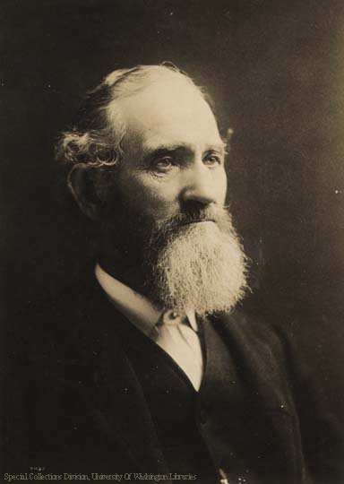
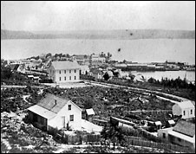
Early settlers learned quickly about the storms
Arthur Denny
The heaviest wind storm since the settlement of the country was on the night of November 16, 1875. … threw down considerable timber and overturned light structures, such as sheds and out buildings.
Seattle

Slide 6
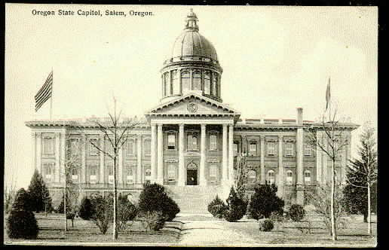
The Great Gale: January 9, 1880
Hit northern Oregon and southern Washington toppling tens of thousands of trees.
Wind gusts were estimated to reach 138 mph on the coast and 70-80 mph in the interior.
Buildings throughout the Willamette Valley, were damaged or destroyed. Part of the roof of the Oregon State Capital in Salem was blown off.
955 hPa central pressure and
The equal of the CD storm?

Slide 7
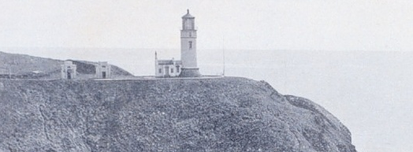
January 29, 1921
Hurricane-force winds struck the entire Washington Coast
At North Head sustained winds reached 126 mph, with a maximum one-minute wind of 150 mph before the sensor failed.
At Tatoosh Island, 150 miles to the north, winds reached 110 mph.

Slide 8
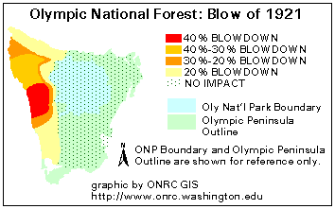
In some areas over 40% of the trees were blown down
As a result, this event has become known as the
“The Olympic Blowdown Storm”

Slide 9
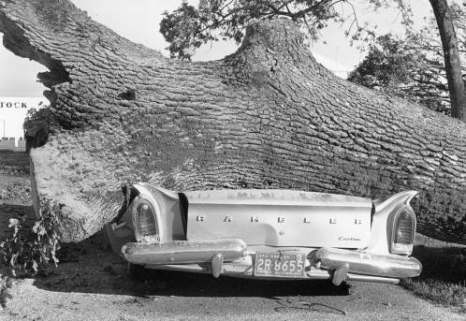
But these and other storms were overshadowed by the Columbus Day Storm
The strongest Pacific storm to strike the NW over the past 100 years
Probably the most powerful non-tropical cyclone to hit the lower-48 states in a century.

Slide 10
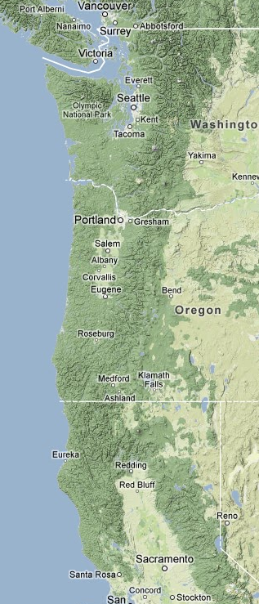
Extraordinary Impact
An extensive area, stretching from northern California to southern British Columbia experienced hurricane-force winds, massive treefalls, and power outages.
Sustained winds reaching 60-70 mph and gusts over 120 mph.
In Oregon and Washington, 46 died and 317 required hospitalization.
Flooding and landslides in northern California.

Slide 11
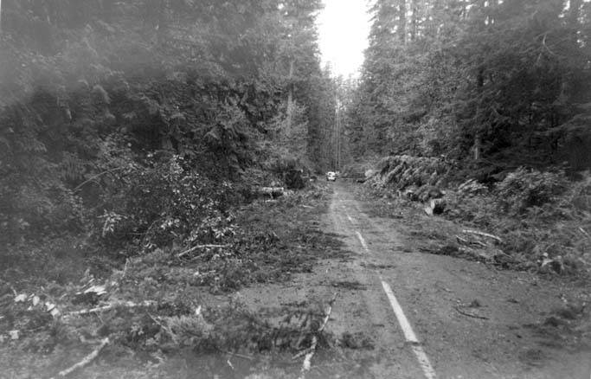
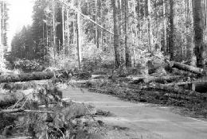
Impacts
Ten to 15 billion board feet of timber were downed, enough to build a million homes and far greater than the yearly output of the NW forest industry.
53,000 homes were damaged, thousands of utility poles were toppled, and the twin 520-ft steel towers that carried the main power lines of Portland were crumpled.

Slide 12
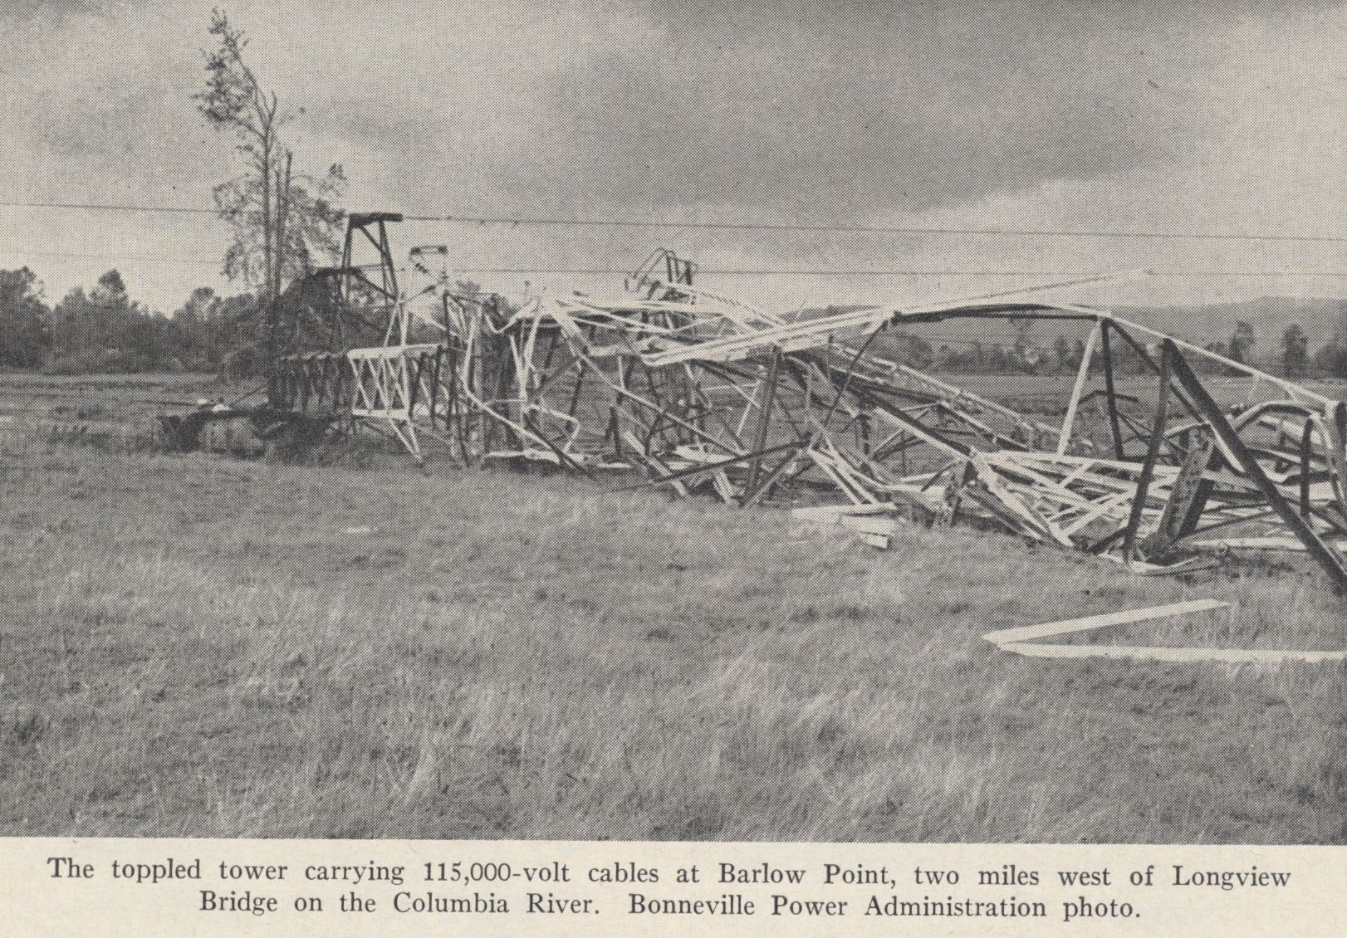

Slide 13
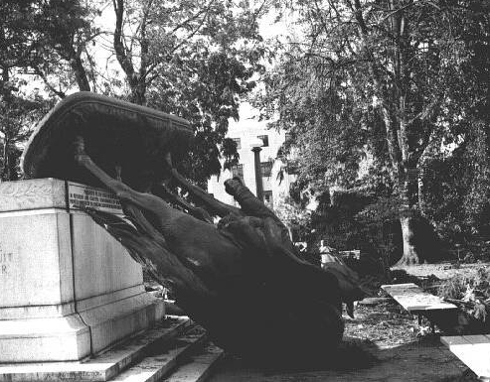
On the state capitol ground in Salem, Oregon, the bronze status, the Circuit Rider was toppled

Slide 14
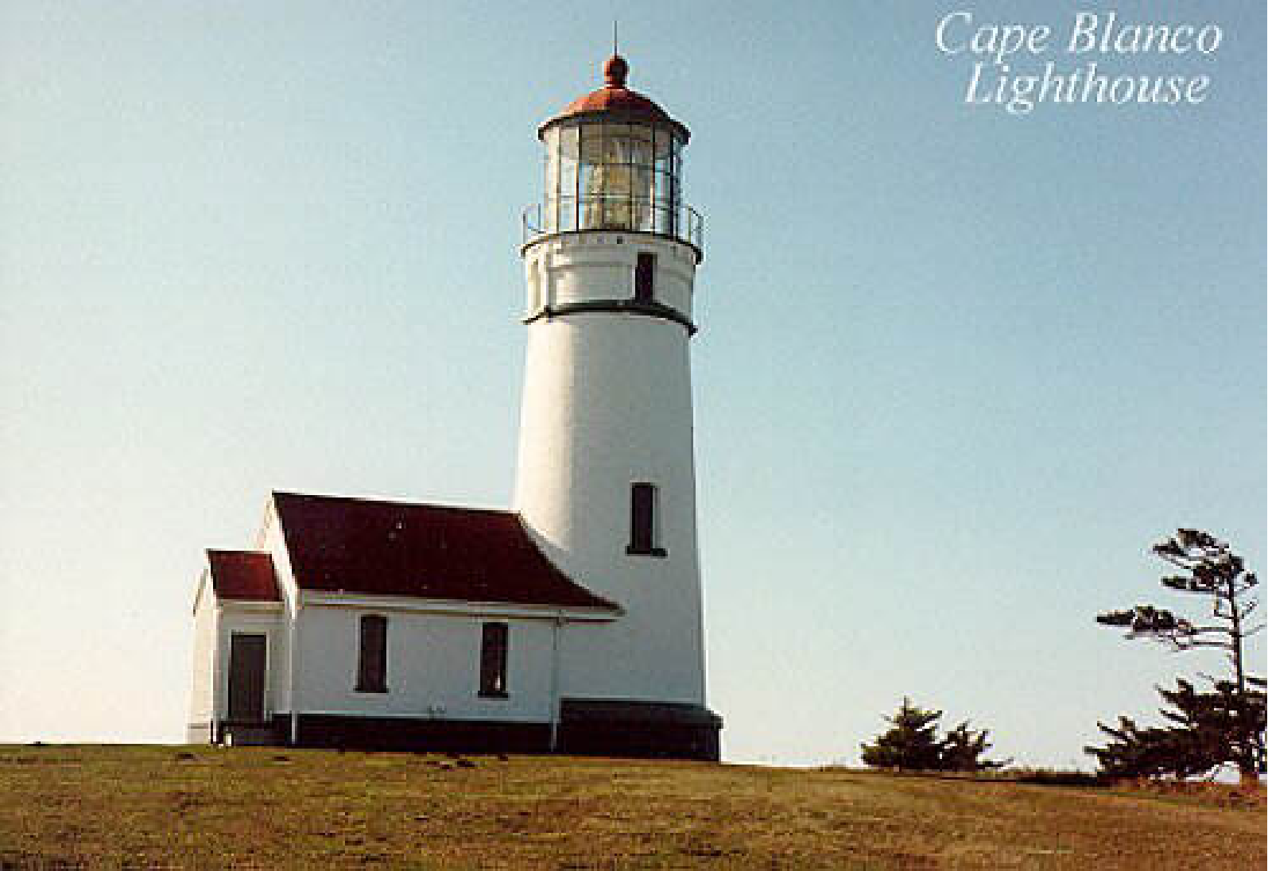
Columbus Day 1962: At Cape Blanco estimated winds were 150 mph with gusts to 179!

Slide 15
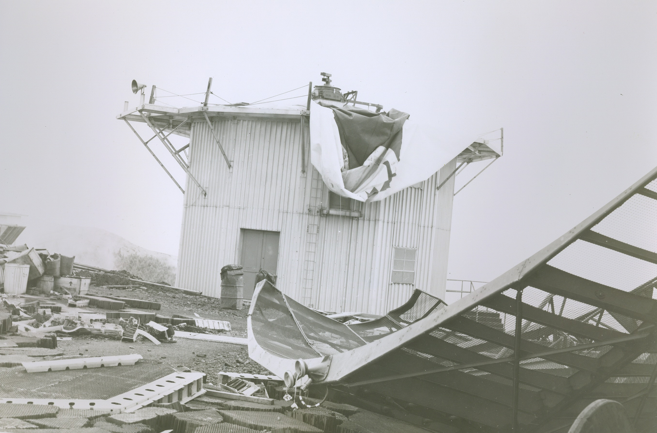
Mt. Hebo Radar Facility: Gusts exceeding 130 mph
Courtesy: Mark Cole

Slide 16
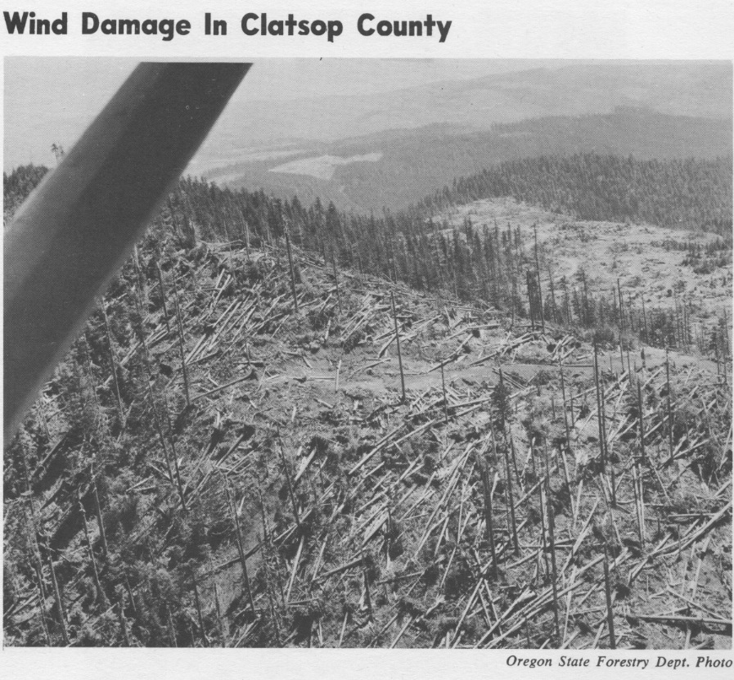
Impact on the Forestry Industry

Slide 17
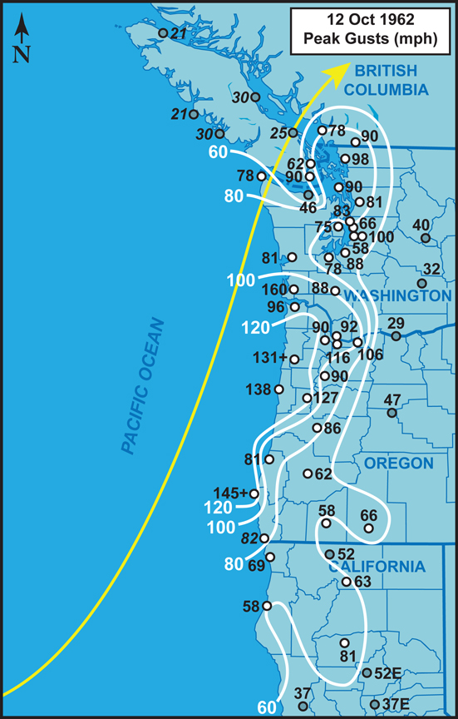
Max Winds (mph)
Columbus Day Storm 1962
Credit:
Wolf
Read

Slide 18
The Columbus Day Storm was the equivalent to a category 3 hurricane.
The Saffir-Simpson Hurricane Scale
Note that 1-minute average winds are used below.
Category One:
Winds 74-95 mph, above 980 mb
Category Two:
Winds 96-110 mph, 965-980 mb
Category Three:
Winds 111-130 mph , 945-965 mb
Category Four:
Winds 131-155 mph, 920-945 mb
Category Five:
Winds greater than 155 mph, below 920 mb
Category Six:
Only in the imagination of TV scriptwriters

Slide 19
A Synoptic Overview

Slide 20
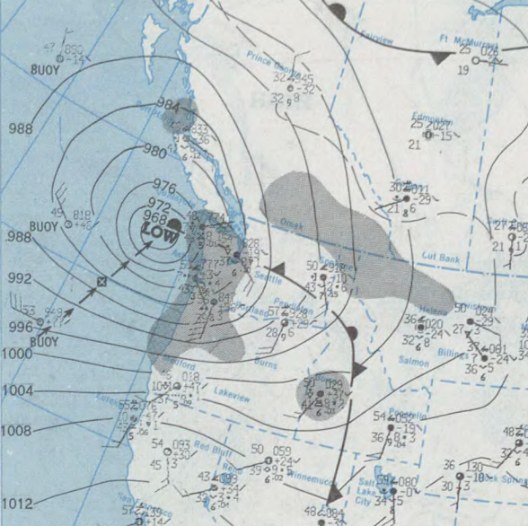
Many of the Great Windstorms of Northwest Have Come in Pairs or Triads
The Columbus Day storm was an example
Why multiple storms? A favorable long wave pattern gets set up.
November 14, 1981

Slide 21
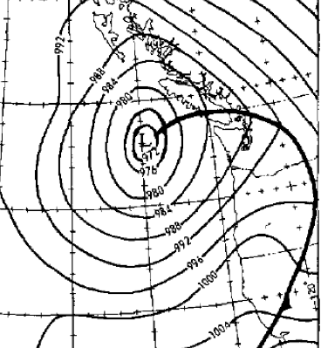
On Wednesday, October 11th, a deep low-pressure system moved northward offshore
4 PM October 11, 1962

Slide 22
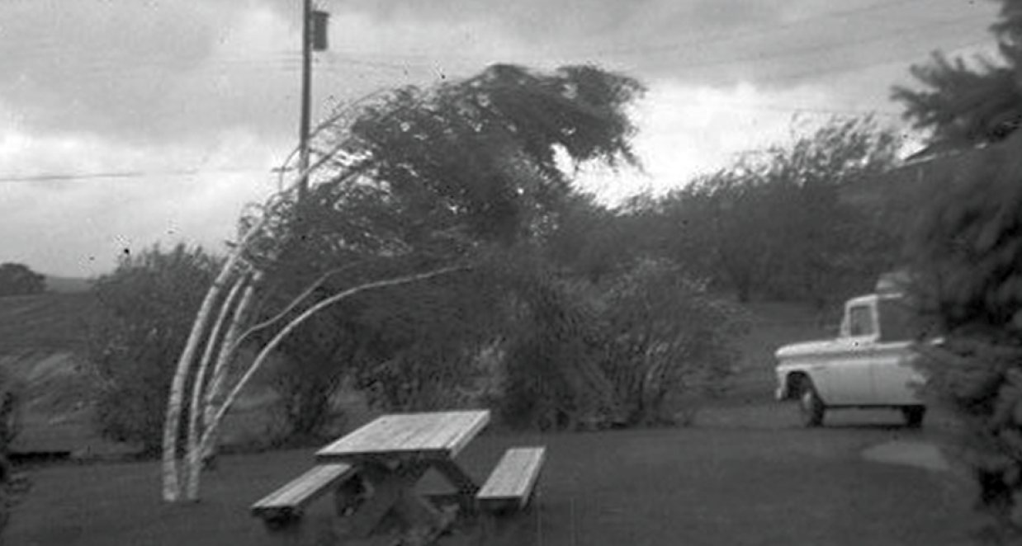
The Lead Up
Strong winds (40-50 mph) struck the Oregon and Washington coast.
Forecasters in the Portland and Seattle offices of the Weather Bureau knew there was another, fast-moving, disturbance out there.
The primitive computer models of the day were predicting a weak system making landfall south of Portland.

Slide 23
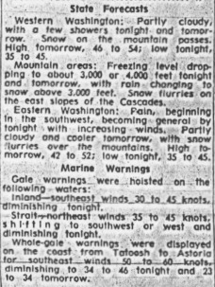
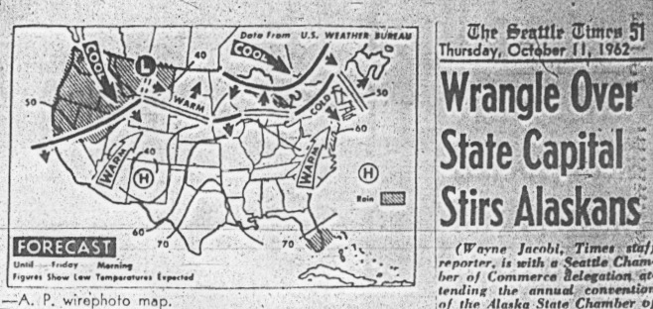
October 11th Forecast: No Major Storm on October 12th!
Seattle Times

Slide 24
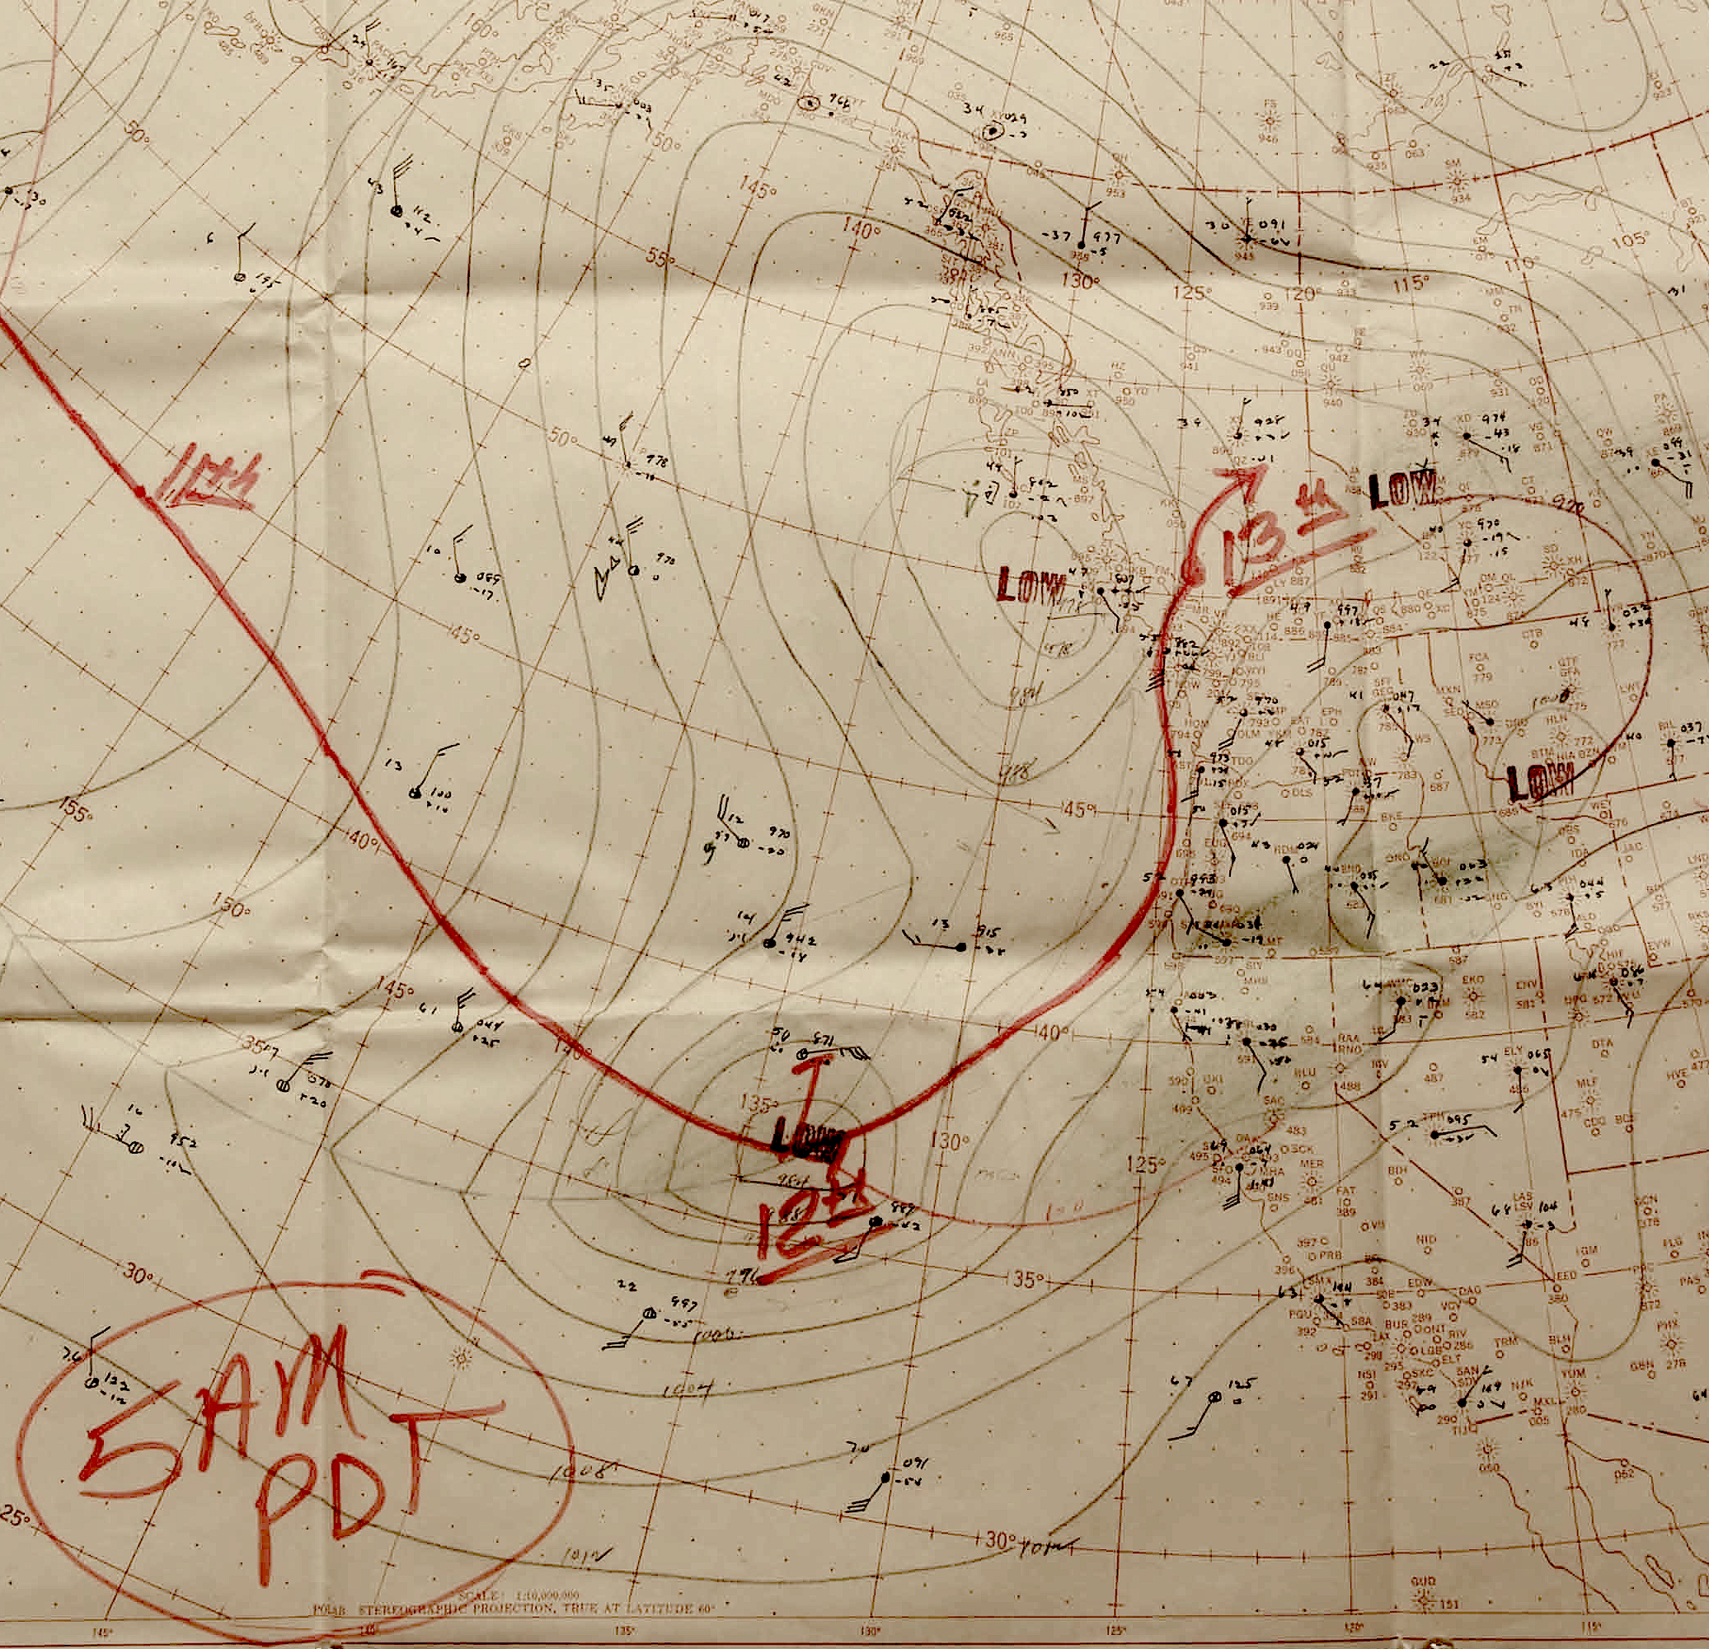
As Weather Bureau forecasters analyzed the sparse data over the Pacific for the 5 AM October 12th chart, they realized the storm was stronger and a substantial threat to the NW

Slide 25
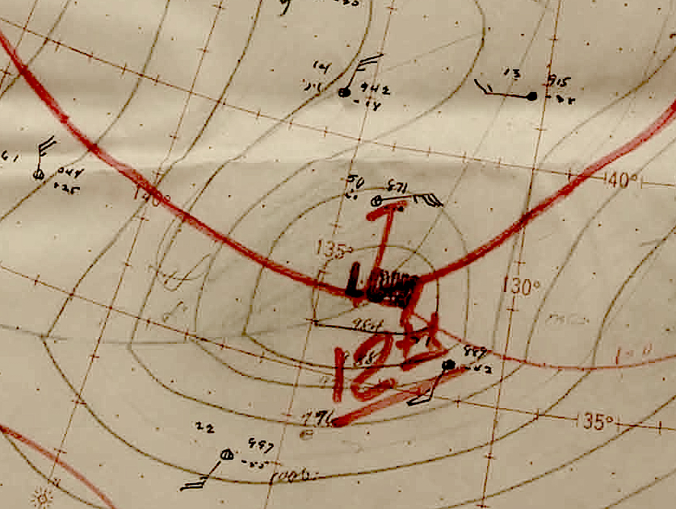

Slide 26
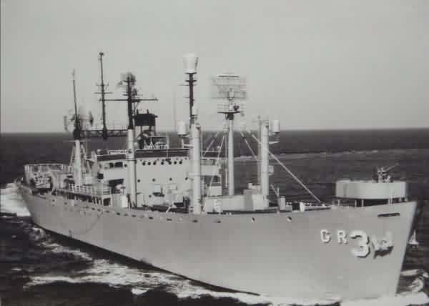
Jaw-dropping observations
At 7 AM reports from a series of radar picket ships off the coast started to come in.
A ship at 40N, 130 W reported a pressure fall of 22.5 hPa in 3 hours with sustained southeast winds of 50 knots!
Another picket ship had northwest winds at 80 knots (92 mph), a pressure of 962 hPa, and a pressure fall of 33 hPa in 3 hr.
A Brazilian ship, 60 miles SW
of Cape Blanco, 964 hPa, SE
85 mph
U.S.S Skywatcher

Slide 27
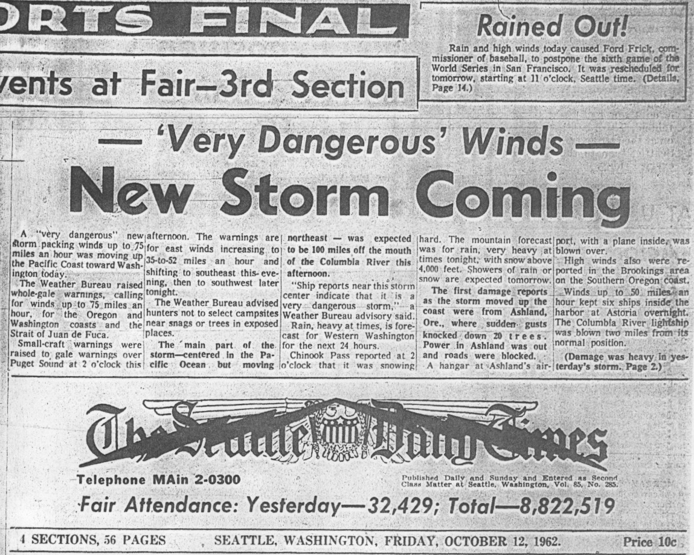
Forecasts were updated to predict a more dangerous storm

Slide 28
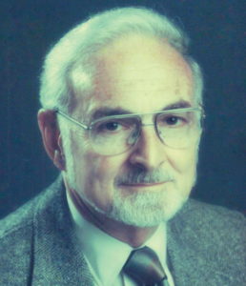
A Department Connection
Several of the Weather Bureau forecasters on duty in Portland (Glen Boire, Jim Holcomb, and George Miller), were UW graduates, trained by Professor Richard Reed.

Slide 29
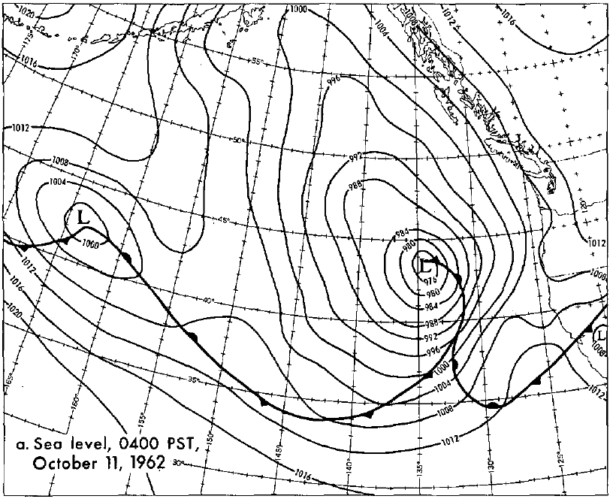

Slide 30
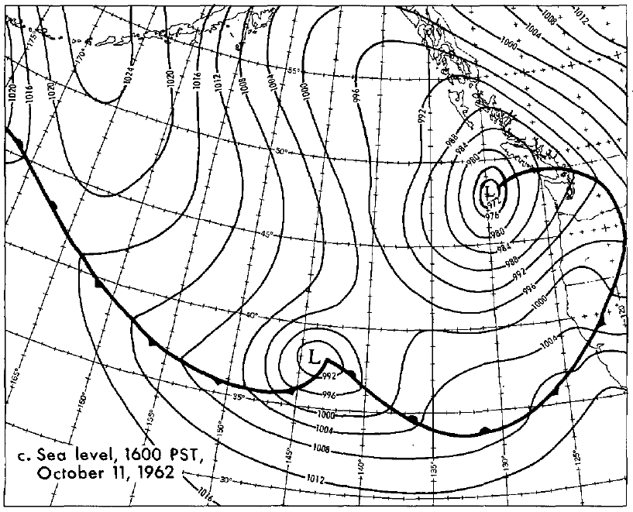

Slide 31
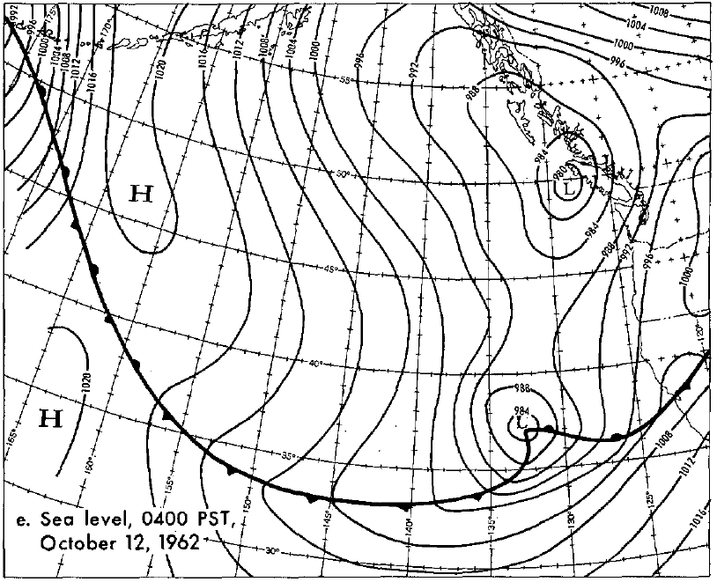

Slide 32
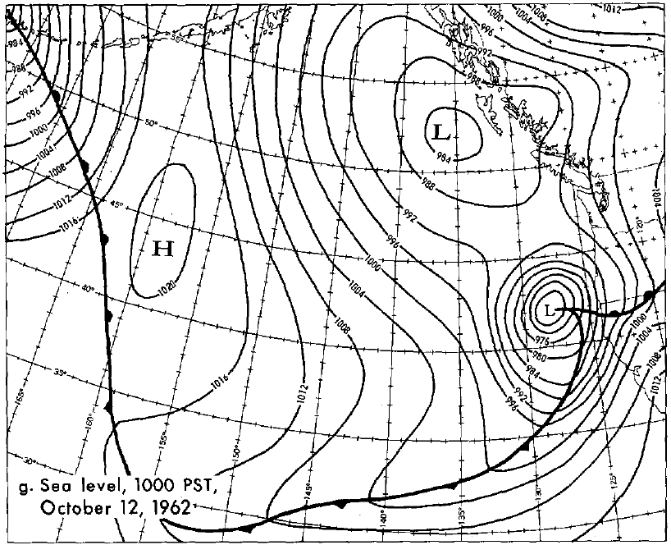

Slide 33
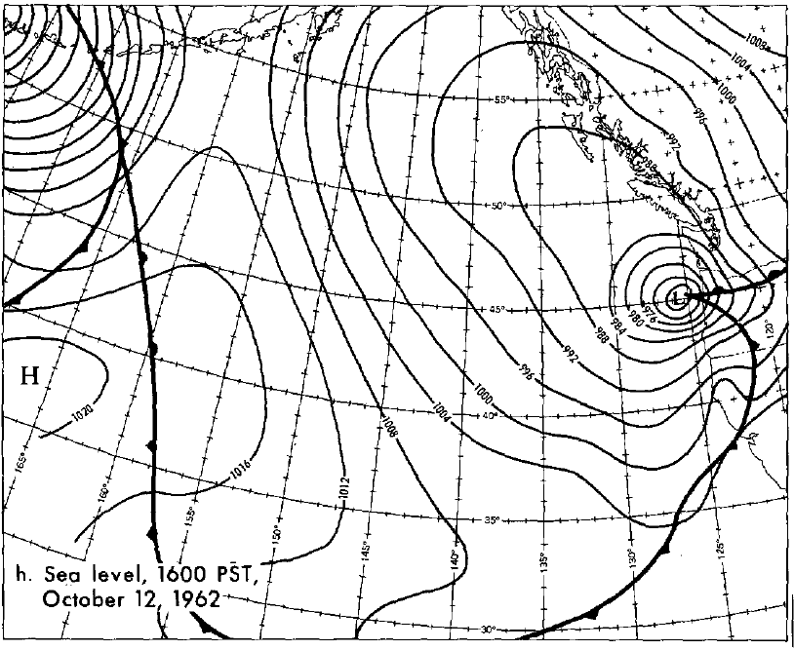

Slide 34
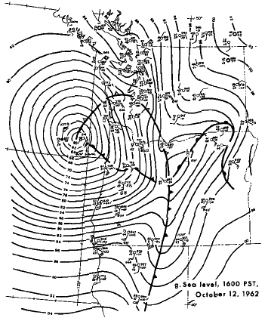
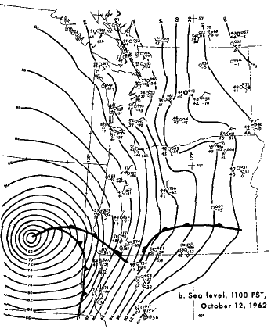
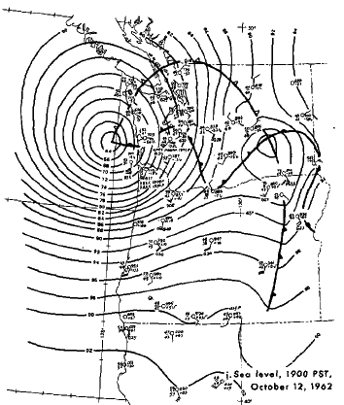
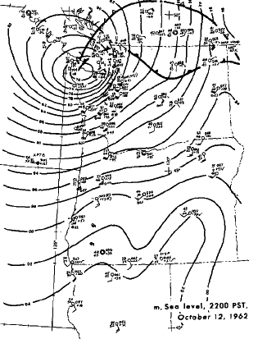

Slide 35
A Wall of Wind Spread Northward
1 PM; Crescent City, 69 mph, Red Bluff, 71
3 PM: North Bend, 69 mph
4 PM: Eugene 67 mph, gusting to 86. Corvallis sustained 98 mph, gusts to 127 mph.
5:30 PM: Winds gusting to 79 mph at Portland AP.
6:14 PM 116 mph at Portland’s Morrison St. Bridge

Slide 36
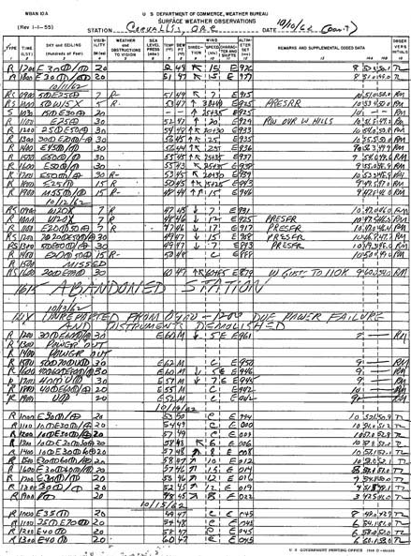
Weather Station Abandoned Corvallis, Oregon
Winds were 60 knots gusting to 85, with a peak gust of 110 knots
At 16:15, "ABANDONED STATION" is written in the middle of the form.
The only time in the history of the Pacific Northwest that an official weather station was abandoned due to severe weather.

Slide 37
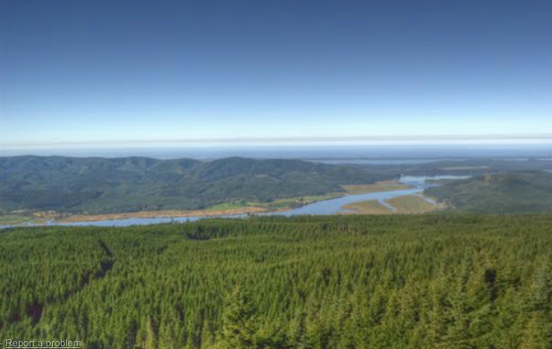
Western Washington that night
Olympia SW 58 G 78mph
Sea-Tac SSW 44 G 58 mph
Bellingham SSE 58 G 98 mph
Renton G 100 mph
Naselle Radar Site: G 160 mph

Slide 38
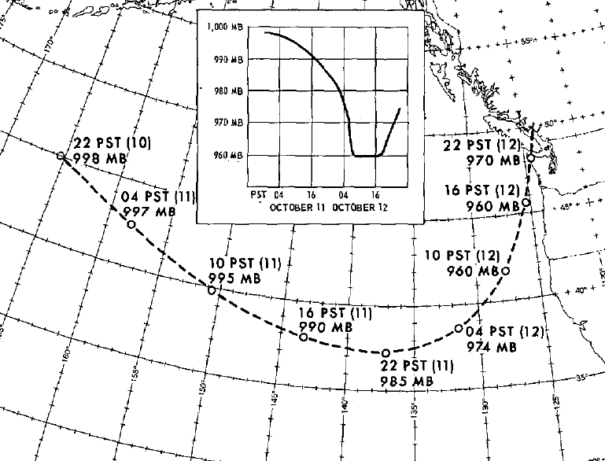

Slide 39
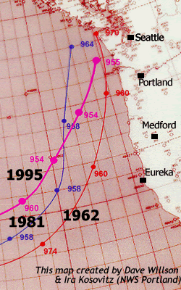
The perfect path…
The path was a classic for big winds hitting western Washington and Oregon
But why is this path so dangerous for us?

Slide 40
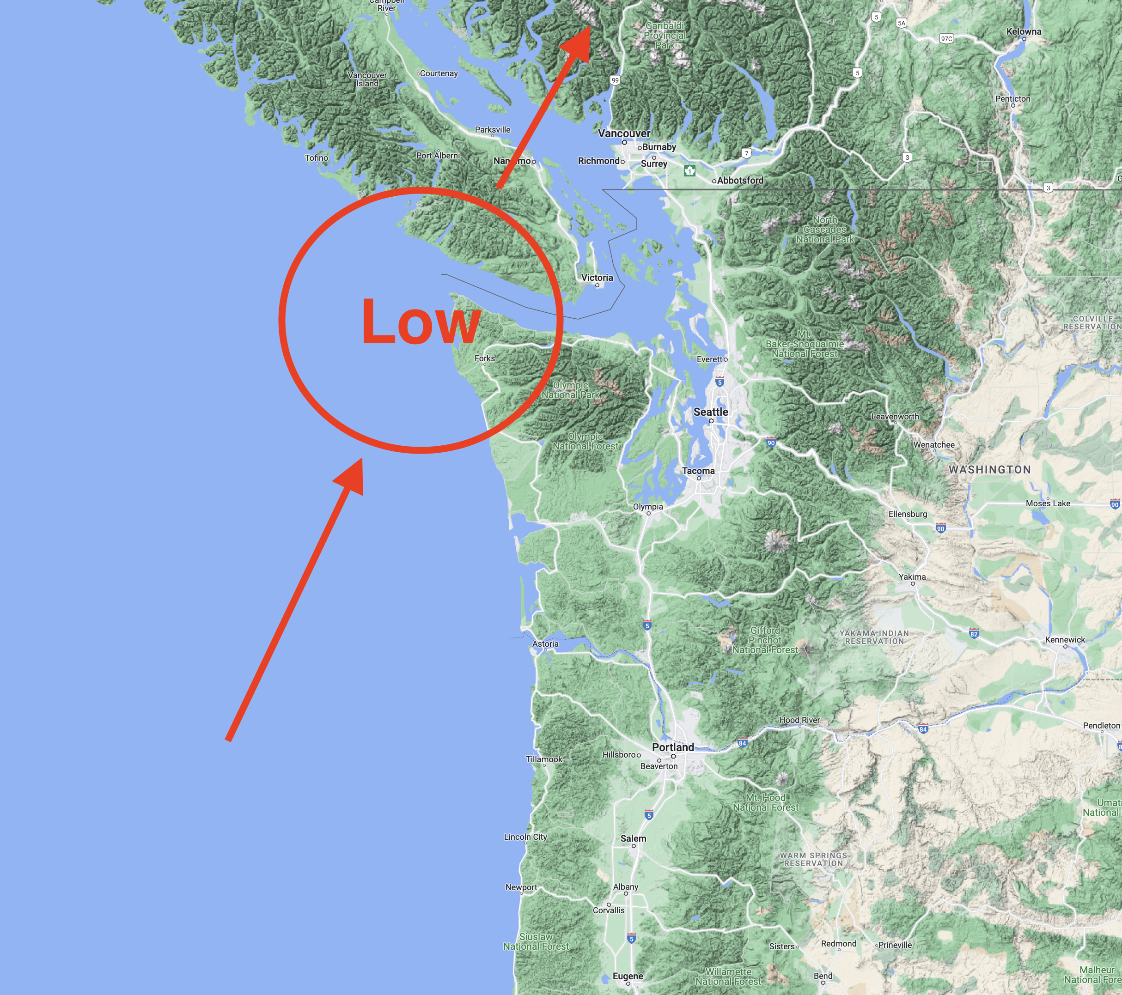
Why is this a perfect location/path of the low center for big winds in western Washington?

Slide 41
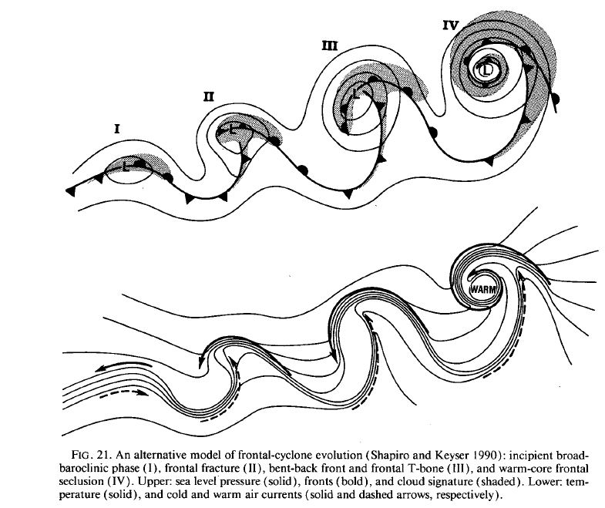
Reason 1: The Structure of Pacific Midlatitude Cyclones

Slide 42
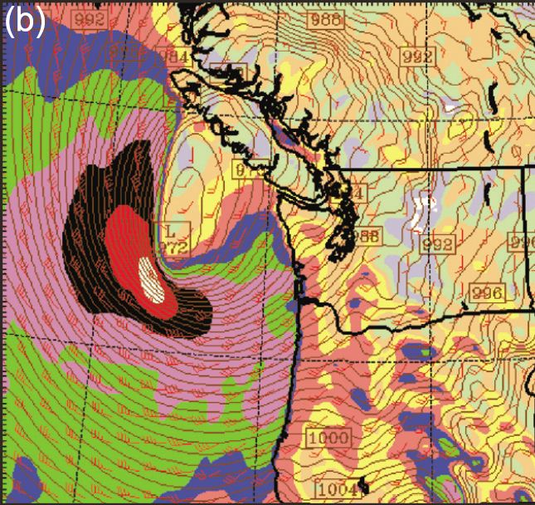

Slide 43
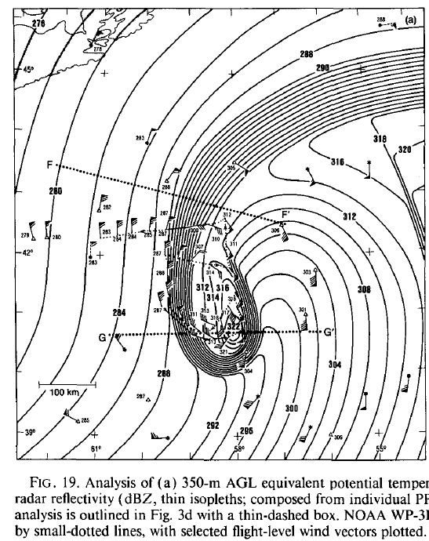

Slide 44
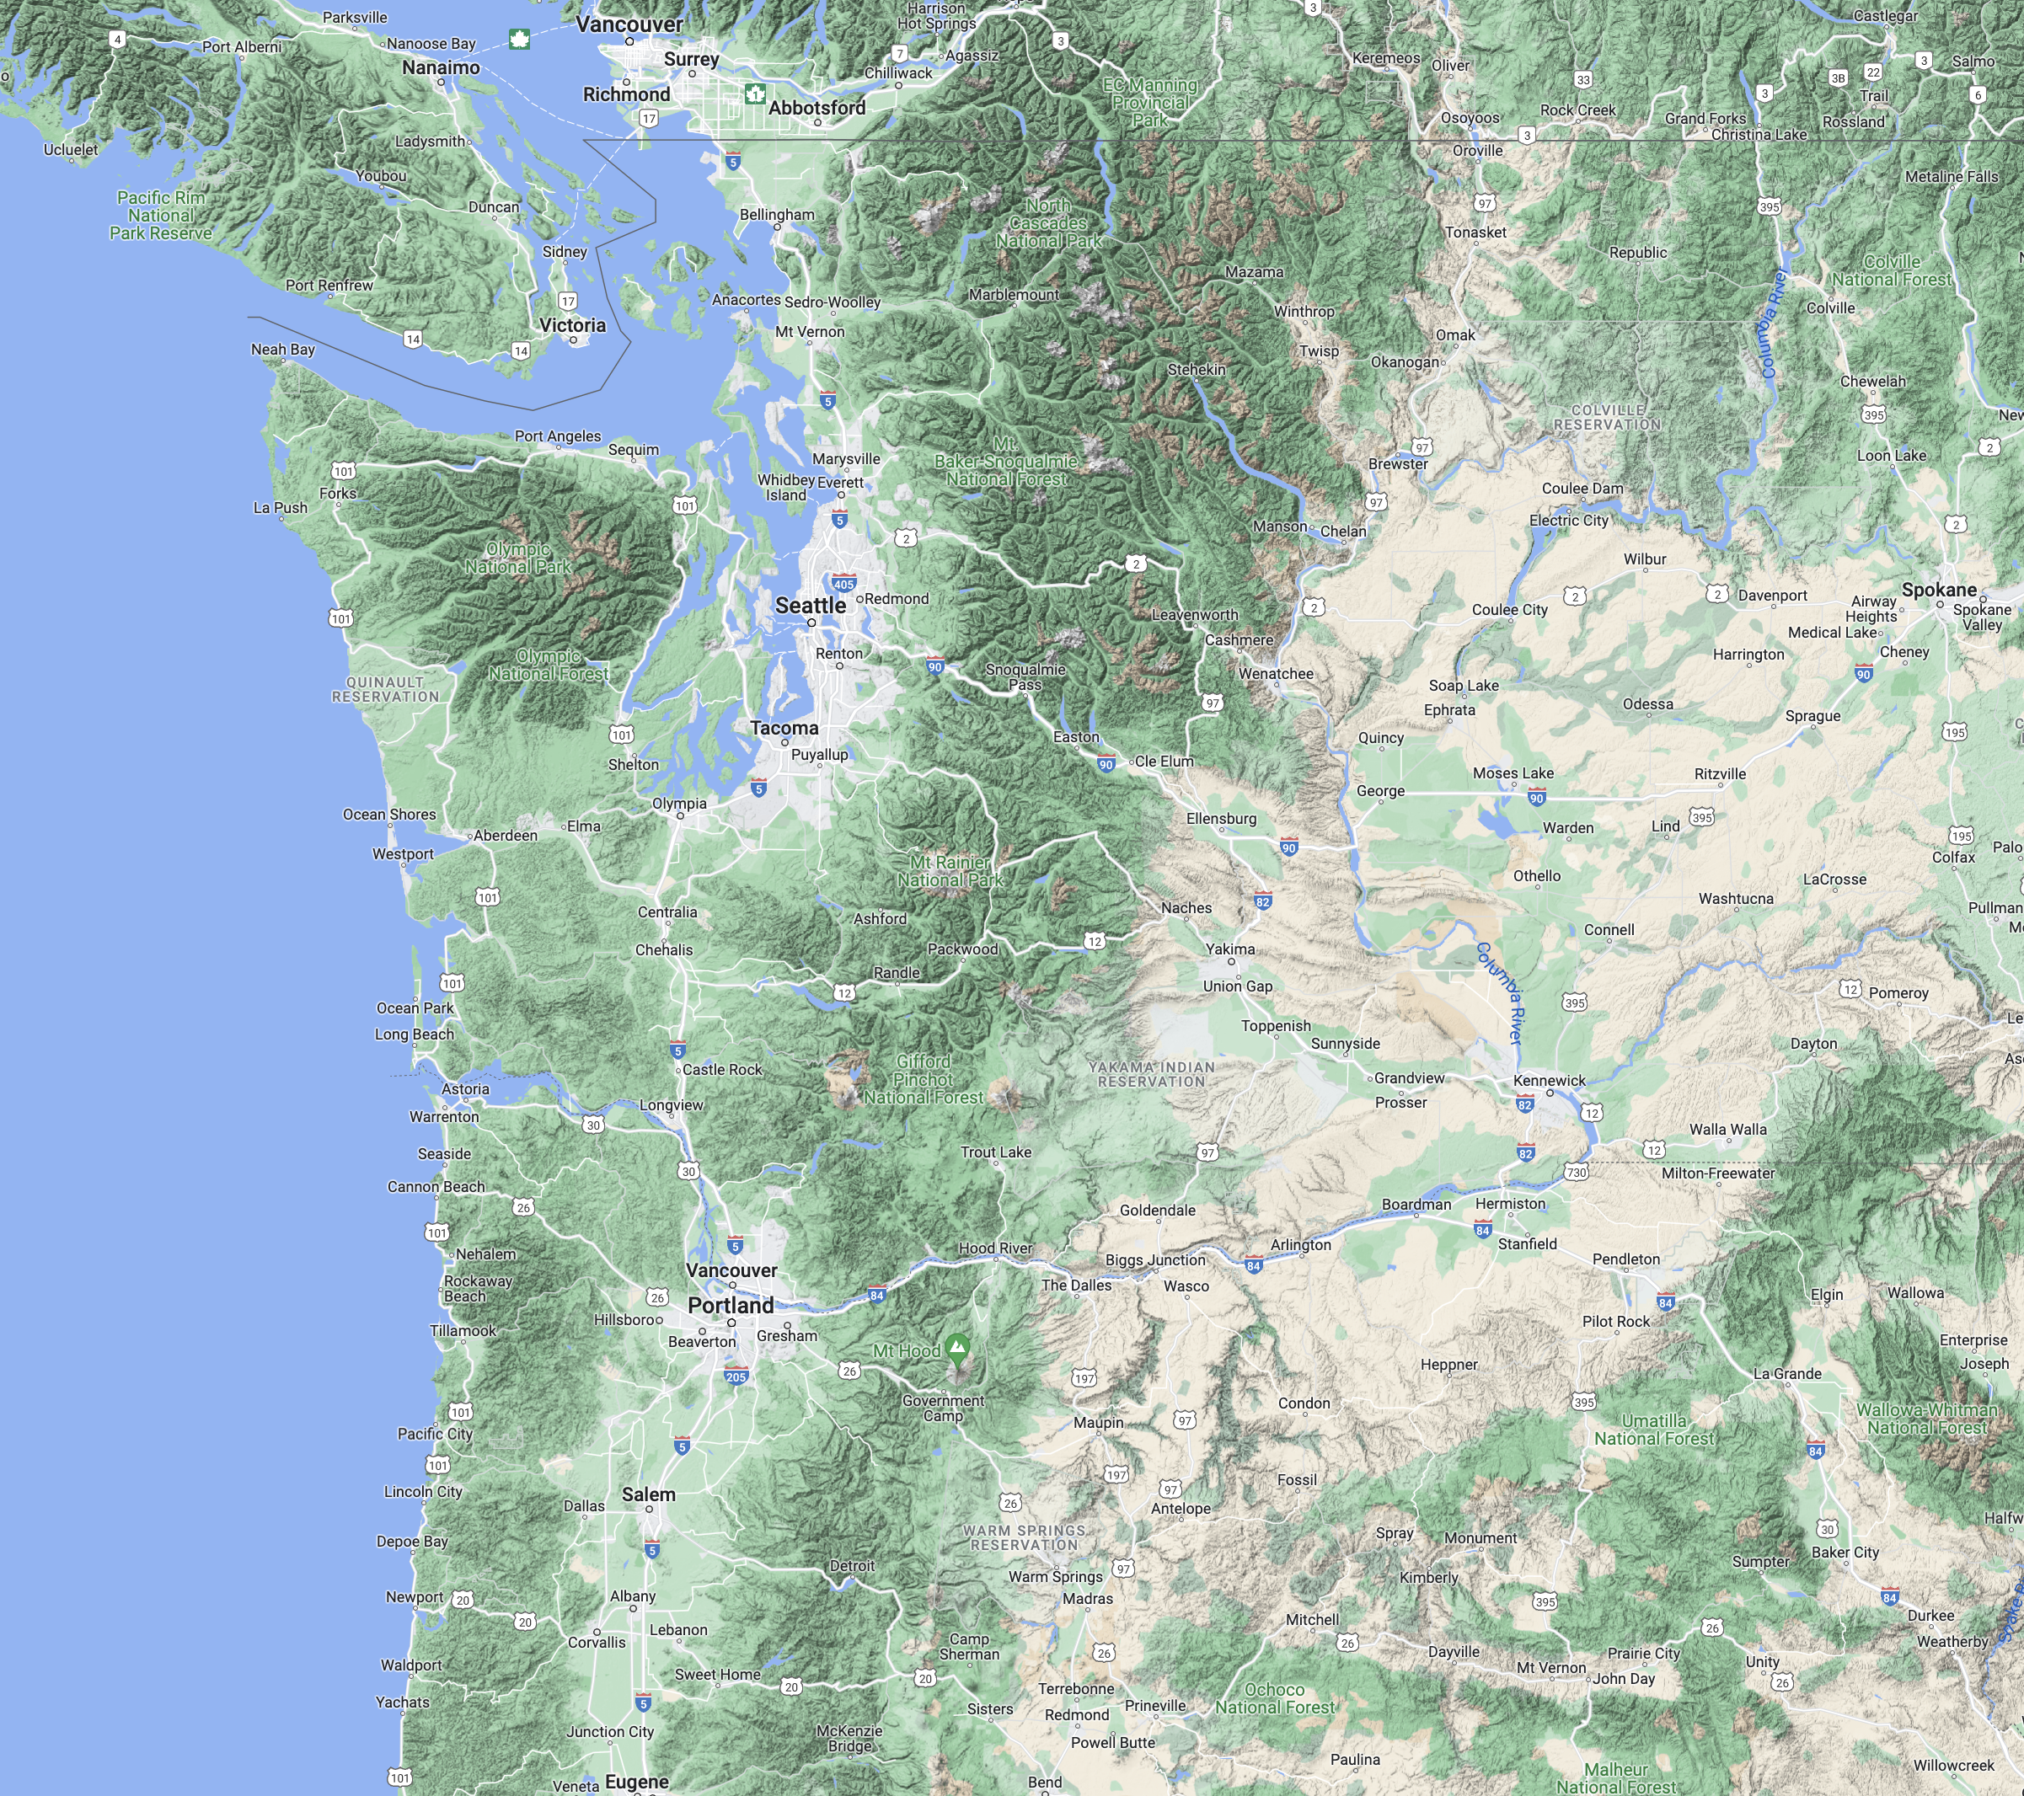
Reason 2. Effects of Terrain

Slide 45
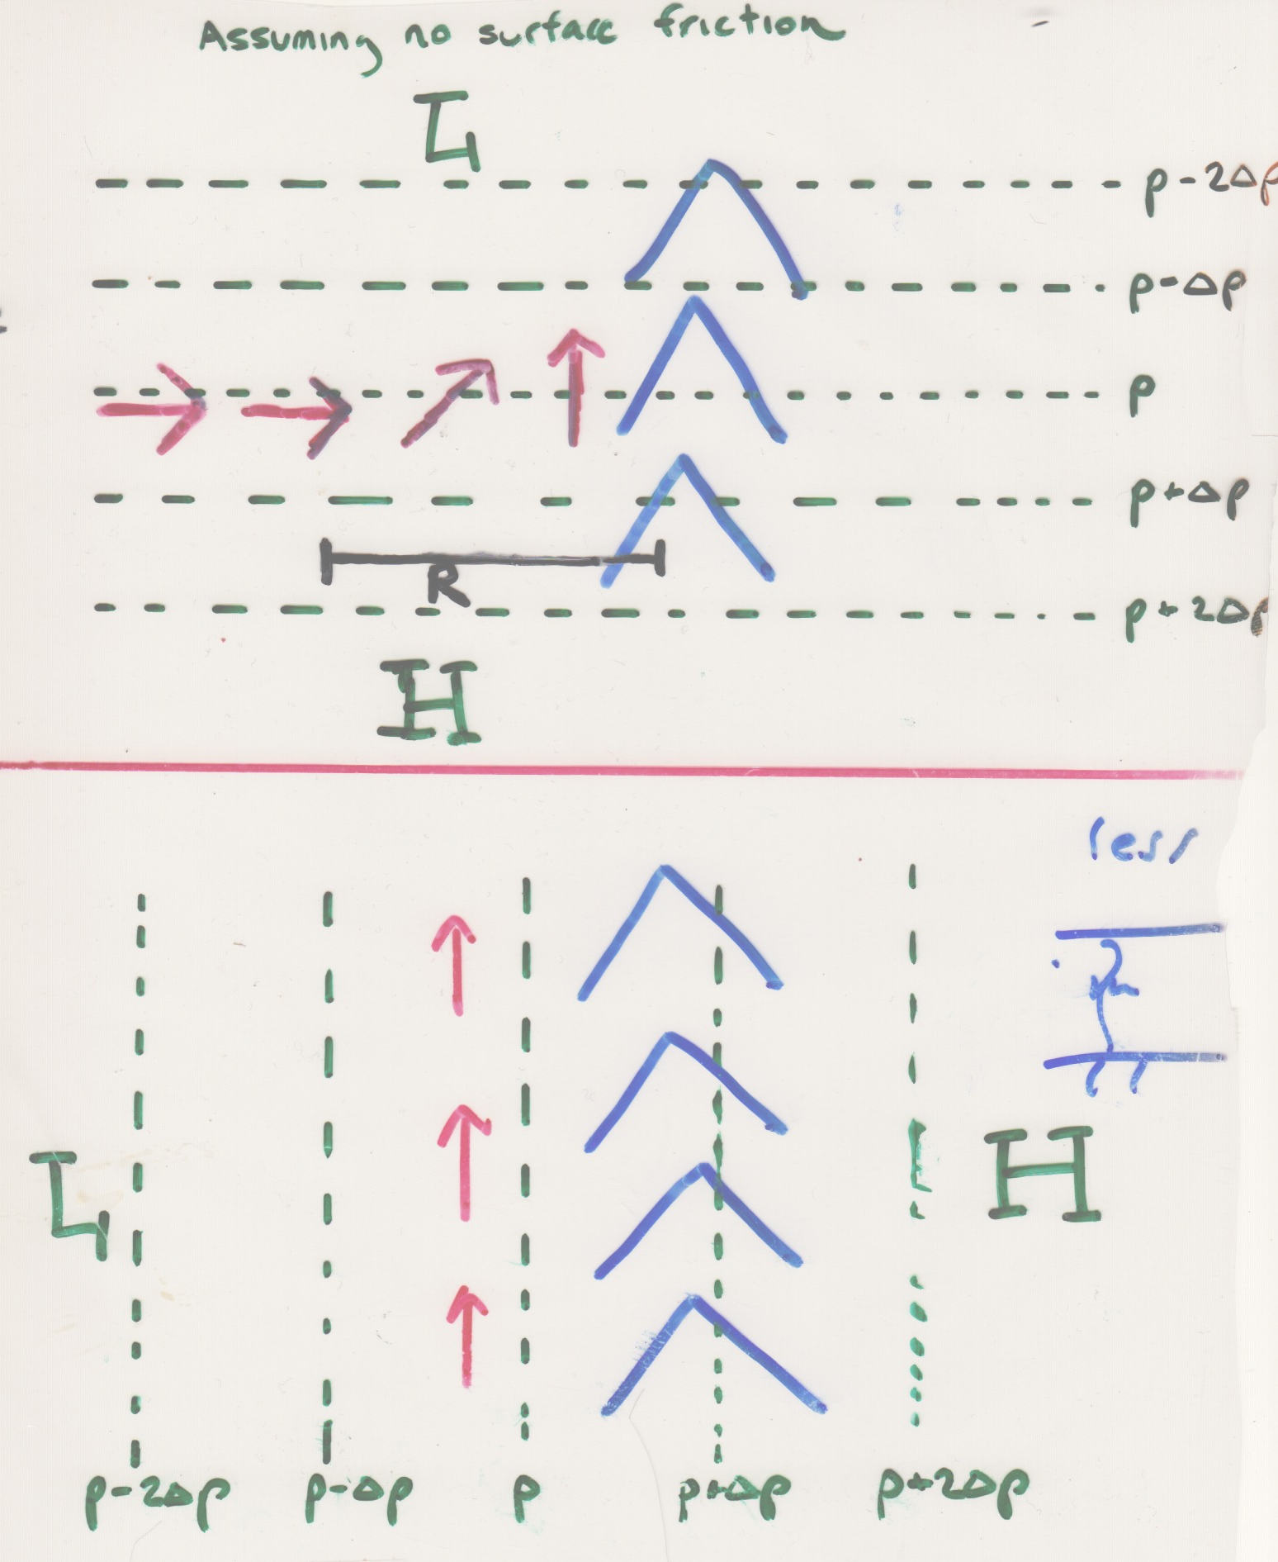
Wind speeds can be greater when the pressure gradient is alongbarrier

Slide 46
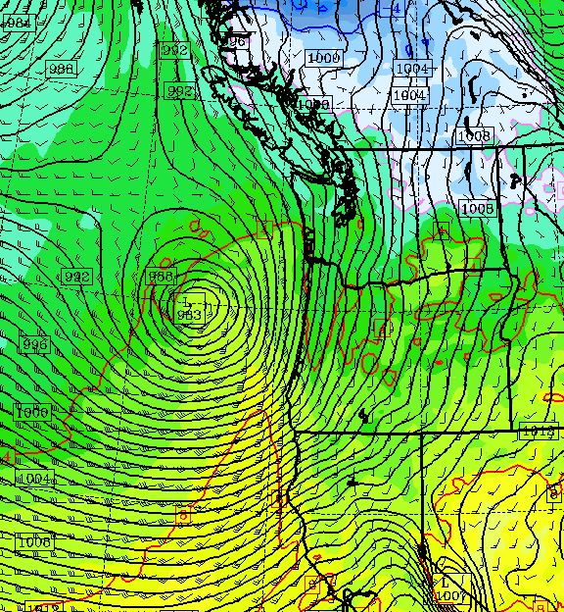
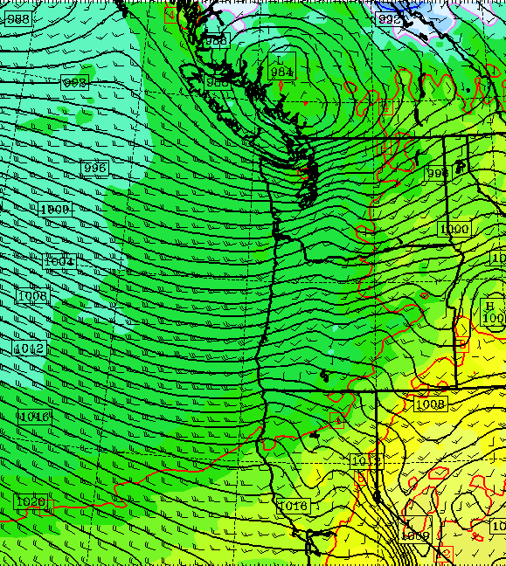
Explains why cyclones produce strongest winds in Seattle when low centers are north of Puget Sound
Weaker winds over Puget Sound
Stronger Winds over Puget Sound

Slide 47
Effects of stability and mixing
Less stable, more mixing, less shear
Stable, Large Vertical Shear

Slide 48

The Chanukah Eve Windstorm (2006) Stability Changes and Winds

Slide 49

Momentum mixing: 12/17/2006

Slide 50


Slide 51

The Columbus Day Storm as many of the other intense early season storms began as a tropical disturbance in the western Pacific.
Typhoon Frieda moved northeastward and transformed into a midlatitude cyclone.

Slide 52

Frieda Underwent Extratropical Transition (ET)

Slide 53

Why the tropical connection helps
During ET the tropical storm can interact with the jet stream, producing an amplification of an atmospheric wave train, sometimes producing a deep trough over the eastern Pacific.

Slide 54


Slide 55

Why tropical connection helps
Some tropical disturbances can maintain some of the lower circulation and then move through the large-scale pattern until this get into a favorable position—the eastern side of the trough!-- over the eastern Pacific.
There they explode!

Slide 56


Could a modern weather prediction model run at high resolution accurately forecast the CD Storm?
Rick Steed ran the WRF model, initialized the NCEP reanalysis grids.
Dave Ovens did the same with the 20th Century Reanalysis Grids

Slide 57
The Answer: No Consider a forecast begun the day before (October 11th) at 5 AM.

Slide 58


Slide 59

1

Slide 60


Slide 61


Slide 62




Slide 63

The Problem?
The lack of data over the Pacific.
Just a few ship reports and island stations.
Today we have massive satellite data assets, buoys, ships, and aircraft observations.

Slide 64




Slide 65

Ever since the early 1990s meteorologists have successfully predicted nearly every major Pacific windstorm the day before…and many several days before.

Slide 66

Will Northwest Windstorms Increase in Intensity Under Global Warming?

Slide 67
The Answer Appears to be No
No observed increasing trend
None suggested by climate models.
UW investigated this issue for Seattle City Light

Slide 68


Slide 69


Slide 70


Slide 71

Number of times per year winds exceed a high-wind threshold (DJF) at Seattle for several simulations

Slide 72

UW Climate Impacts Report
“For the 2030s and 2050s, most regional climate models project a slight decrease in the number of hours where wind gust speeds exceed 30, 40, 50 mph”

Slide 73

Recent Book

Slide 74

The End

