Slide 1
Consortium Meeting
February 6, 2020
Cliff Mass
University of Washington

Slide 2
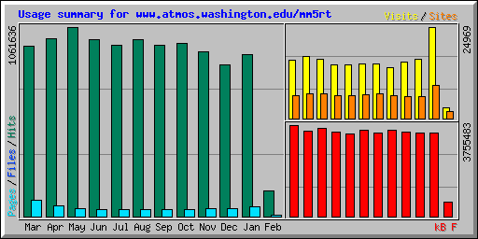
Usage

Slide 3
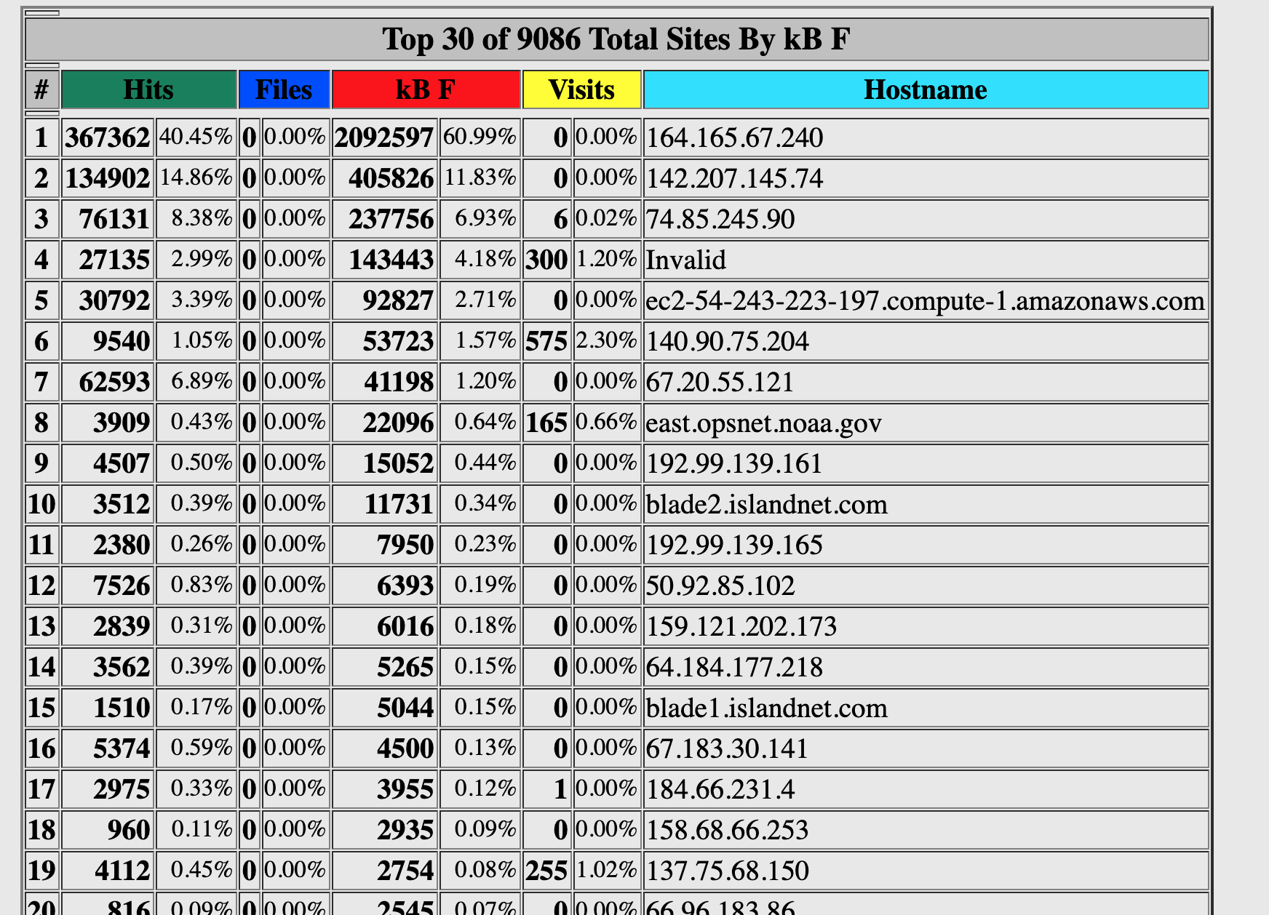
January download of data
Idaho
Univ. of N. BC
CanvasDreams, HostPortland

Slide 4
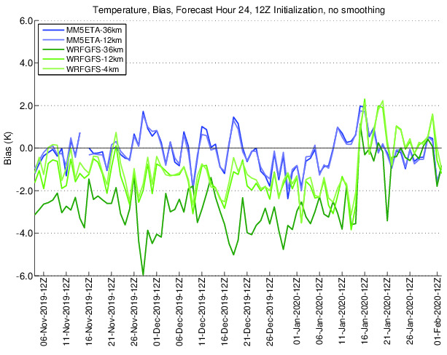
Some Changes Since the Last Meeting: High Resolution System
Dealing with issues regarding excessively cold temperatures over snow
Beginning with the 2020011100 run, switched back to Noah Land Surface Model (LSM) as the default due to cold bias problems with Noah-MP over snow in Western Washington.
Same problem we noted last year: with snow, Noah-MP provides excessively cold temperatures. Noah is better.

Slide 5
Changes in Ensemble System
10/14/2019 Beginning with the 2019101412 run, we have added the wrf4p3 ensemble member. This uses WRF 4.0.3 and the new P3 microphysics scheme (option 51) which includes one-category ice plus double-moment cloud water.
11/6/2019 Added WRF4ACM2 physics member with the 2019110612 case. This member uses WRF version 4 with the Pleim-Xiu land surface model and surface layer along with the Pleim planetary boundary layer scheme.
1/28/2020 Started using WRF version 4.1.3 as default with the 2020012812 case. Looking to see if the Noah-MP has improved cold bias over snow with 4.1.3.

Slide 6
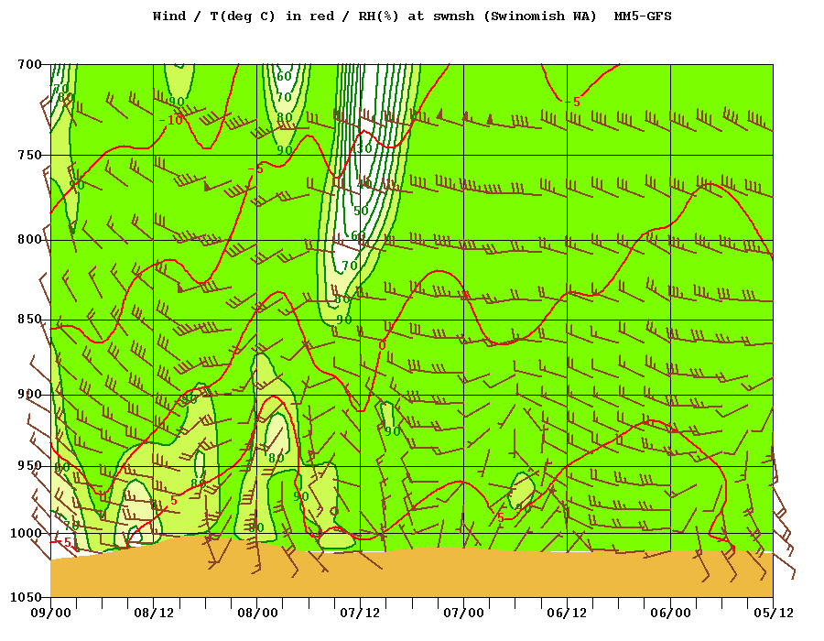
Other Stuff
Added sounding/meteogram/time-height location at La Connor for Swinomish Tribe as requested by Jay McAlpine Oct 28, 2019
Expanded Idaho DEQ data push from forecast hours 7-55 to 7-84 for12-km domain and from hours 7-31 to 7-84 for the 4-km domain on Jan 8, 2020

Slide 7
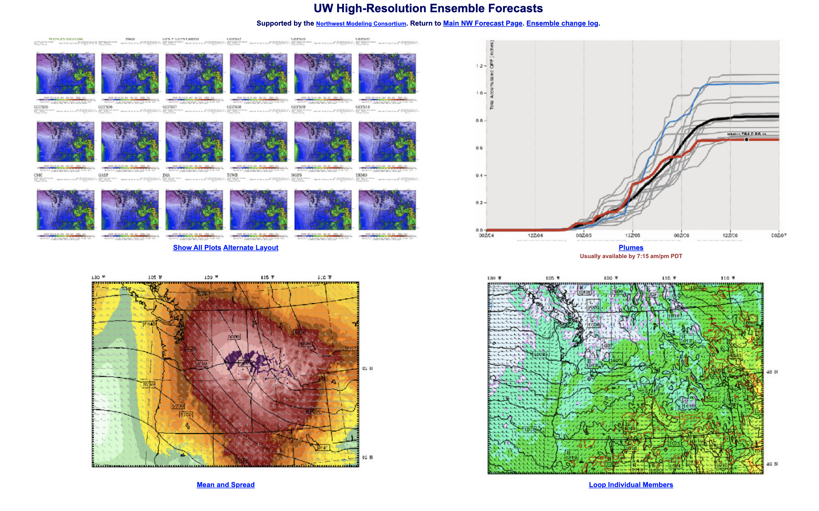
Enhancement Made to Ensemble Website

Slide 8
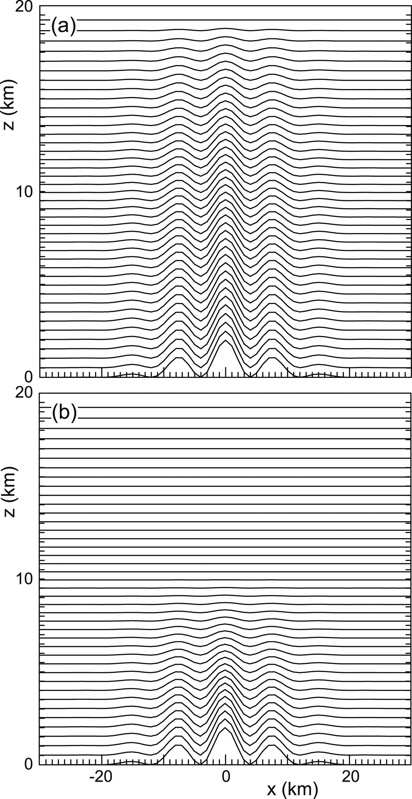
Testing of Updated Version of WRF for High-Resolution
Still using 3.7.1 for high-res, because our annual tests had not indicated improvements. Now four years old.
Tested 4.1.3 including hybrid vertical coordinates.
4.1.3 includes many bug fixes and supposed improvements in physics.
Hybrid vertical coordinate system reduces noise aloft

Slide 9
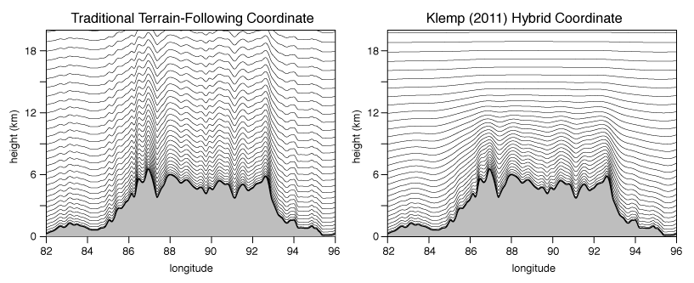
Hybrid Coordinate Reduces Noise in Upper Troposphere (sigma low down, pressure aloft)

Slide 10
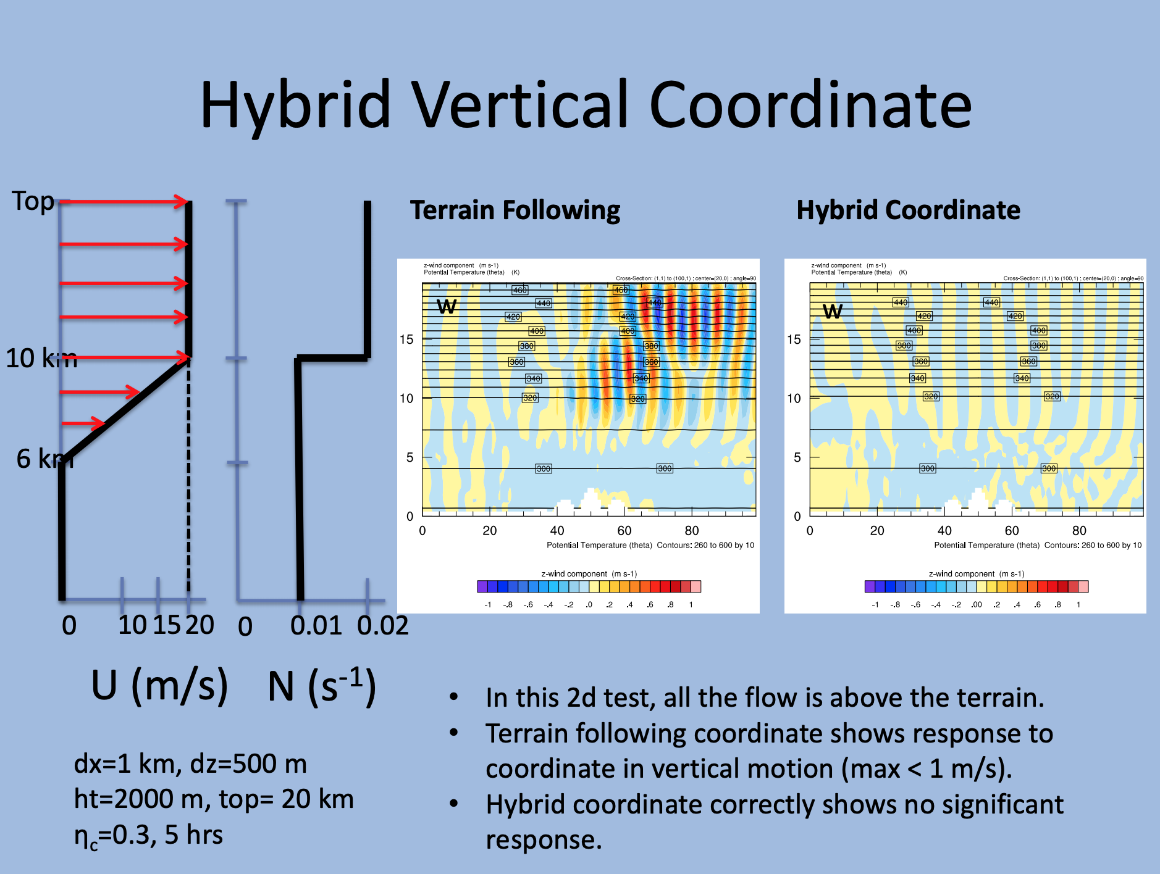

Slide 11
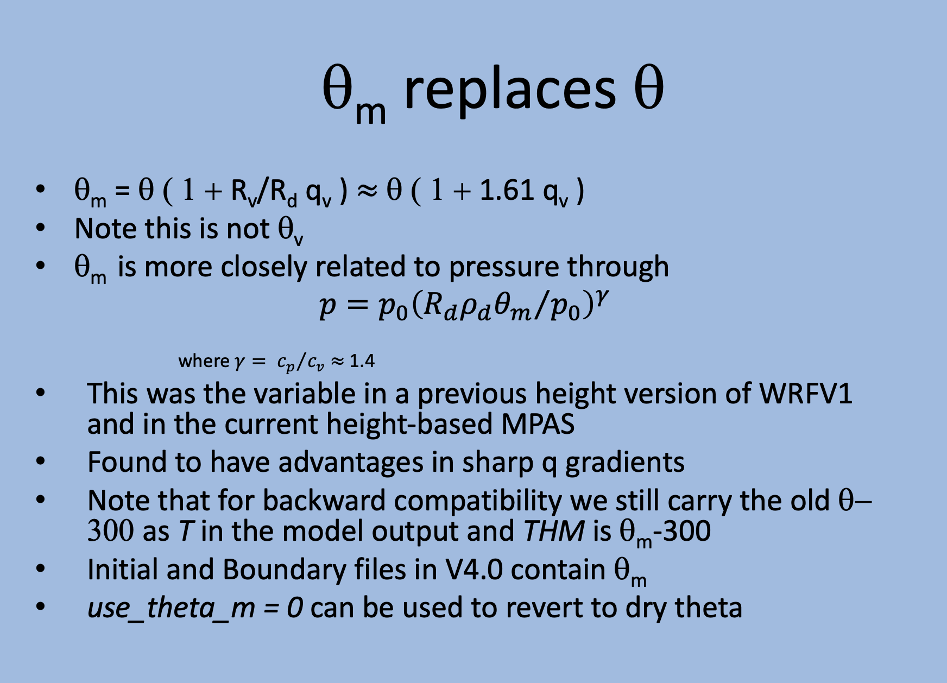

Slide 12
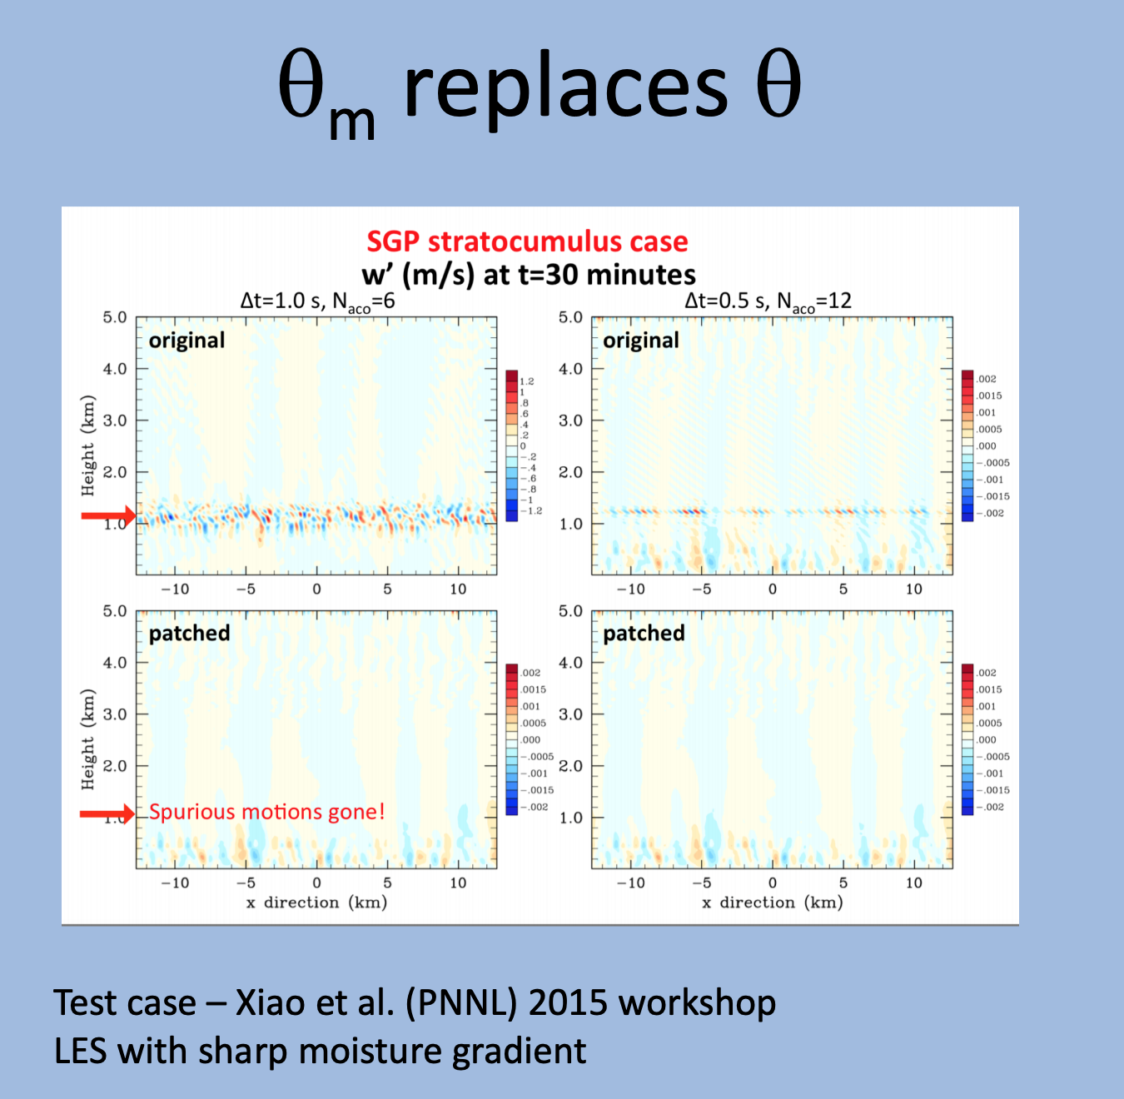

Slide 13
We have done extensive testing of our current system versus a proposed replacement (4.1.3 with hybrid vertical coordinate)
Let’s take a look at the results…
Dave and I believe if the results are as good or better than current version, we should seriously consider the shift
It appears that the new system is equally stable as current one.

Slide 14
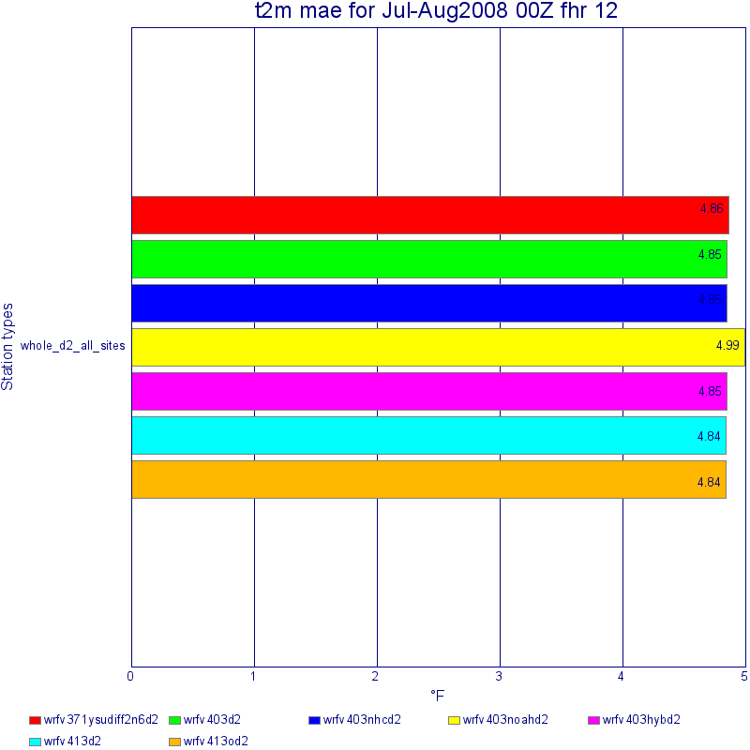
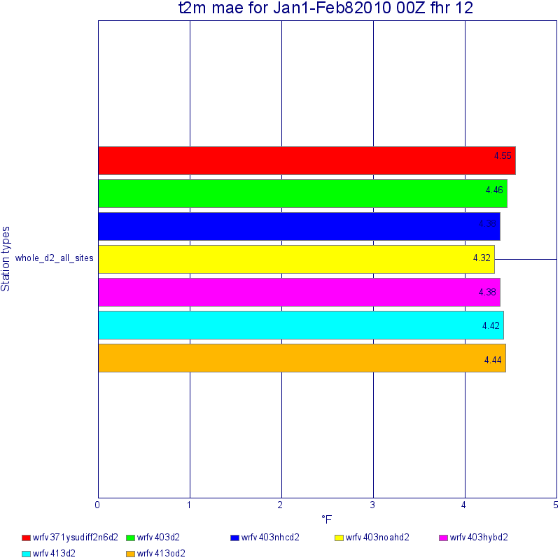
OLD
NEW

Slide 15
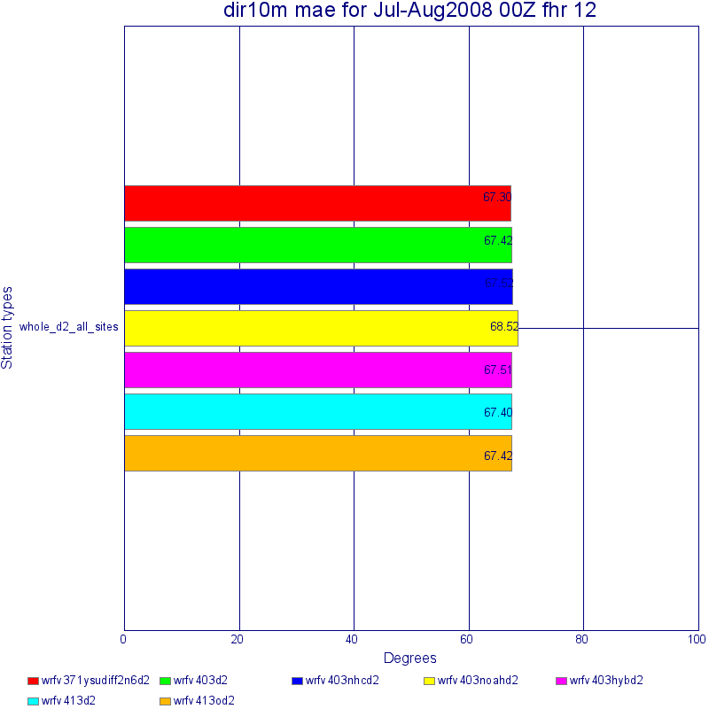


Slide 16
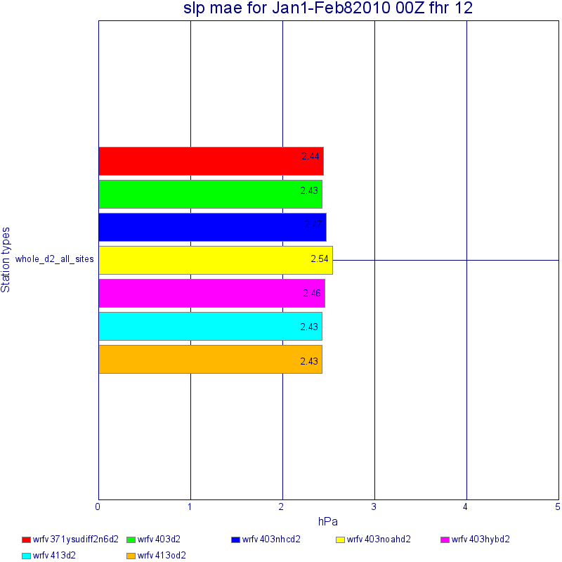
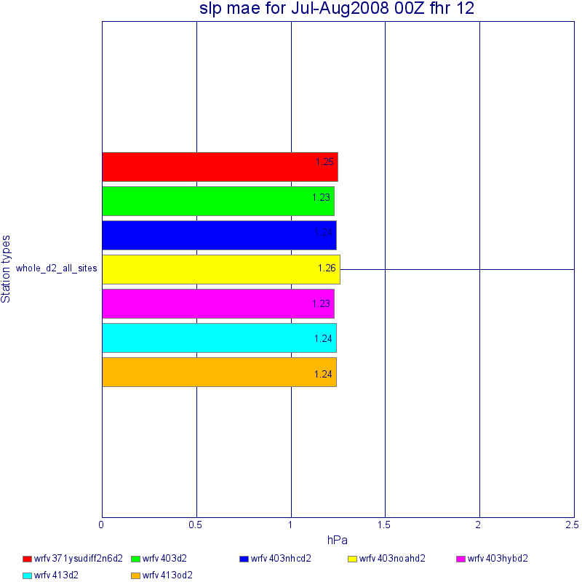

Slide 17
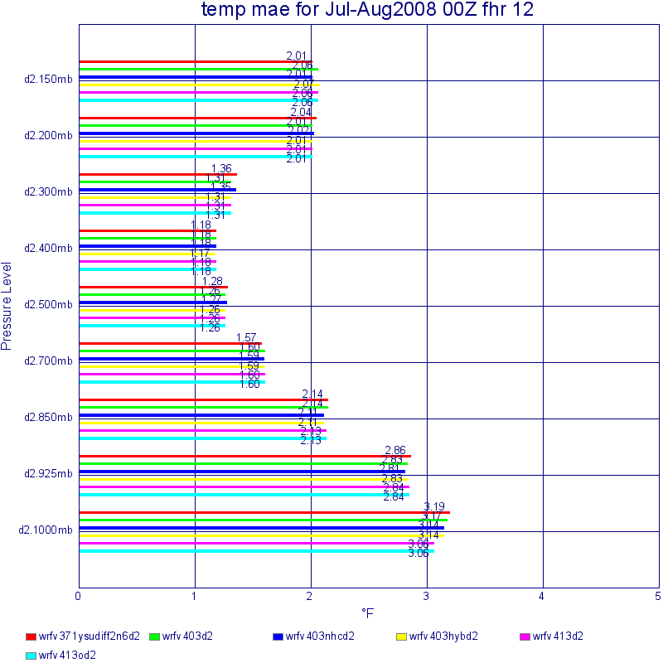
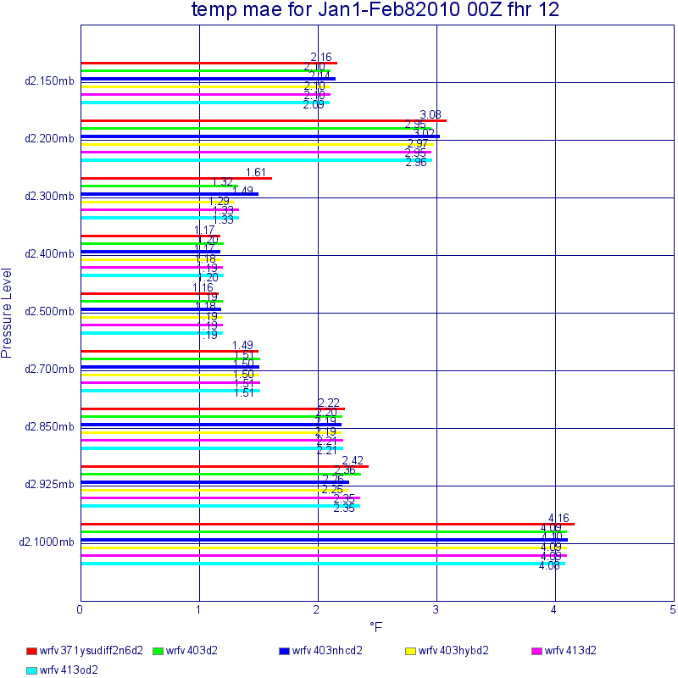

Slide 18
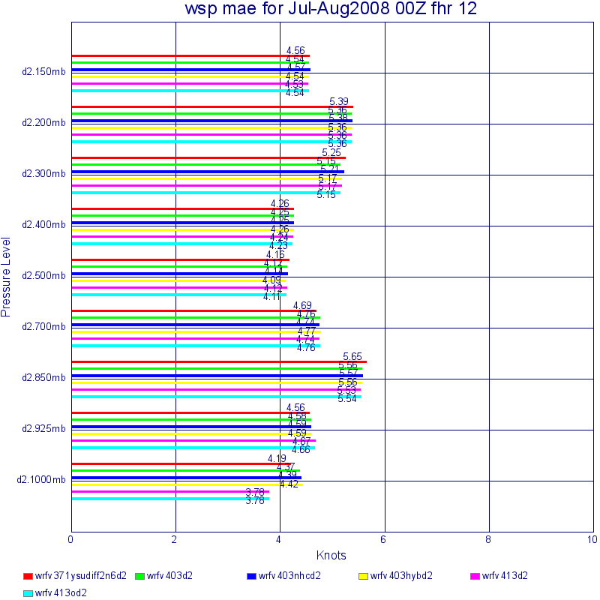
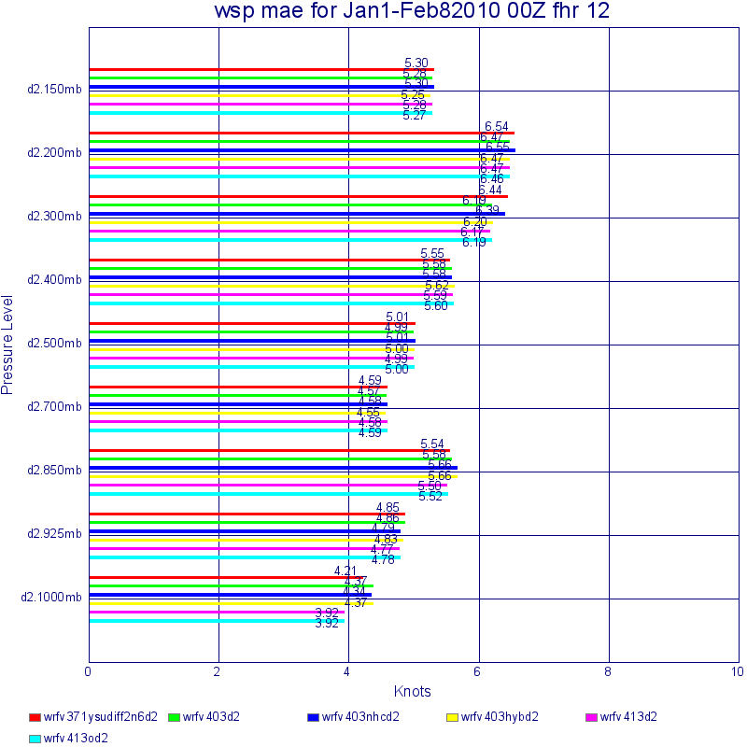

Slide 19
Our conclusion: move to the updated WRF system
Slightly improved scores overall, but not a huge jump
Improvements are probably in things we can’t measure (structures in mid and upper troposphere).
Timing is similar
Will continue to work with NCAR to improve the Noah-MP LSM

Slide 20
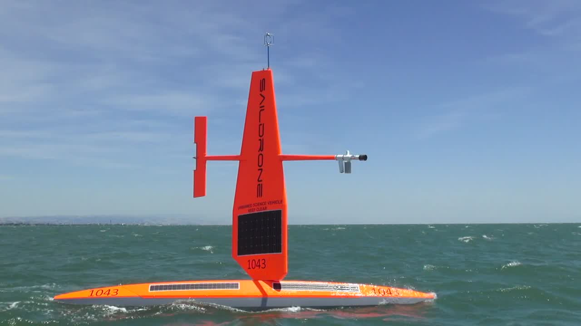
Saildrone
Can we improve the consortium’s forecasts by adding a line of unmanned weather observing sites offshore?
Have worked with a Oakland, CA company, Saildrone, which has placed a line of six boats up and down the Pacific coast.

Slide 21
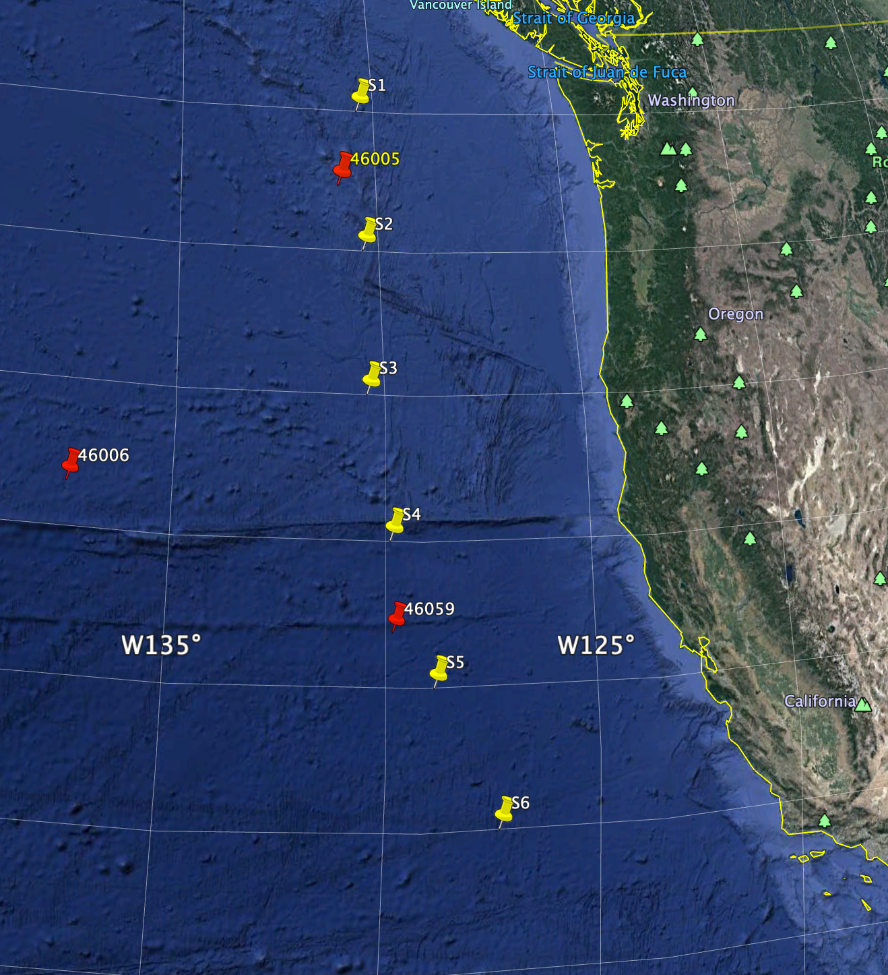
Locations

Slide 22
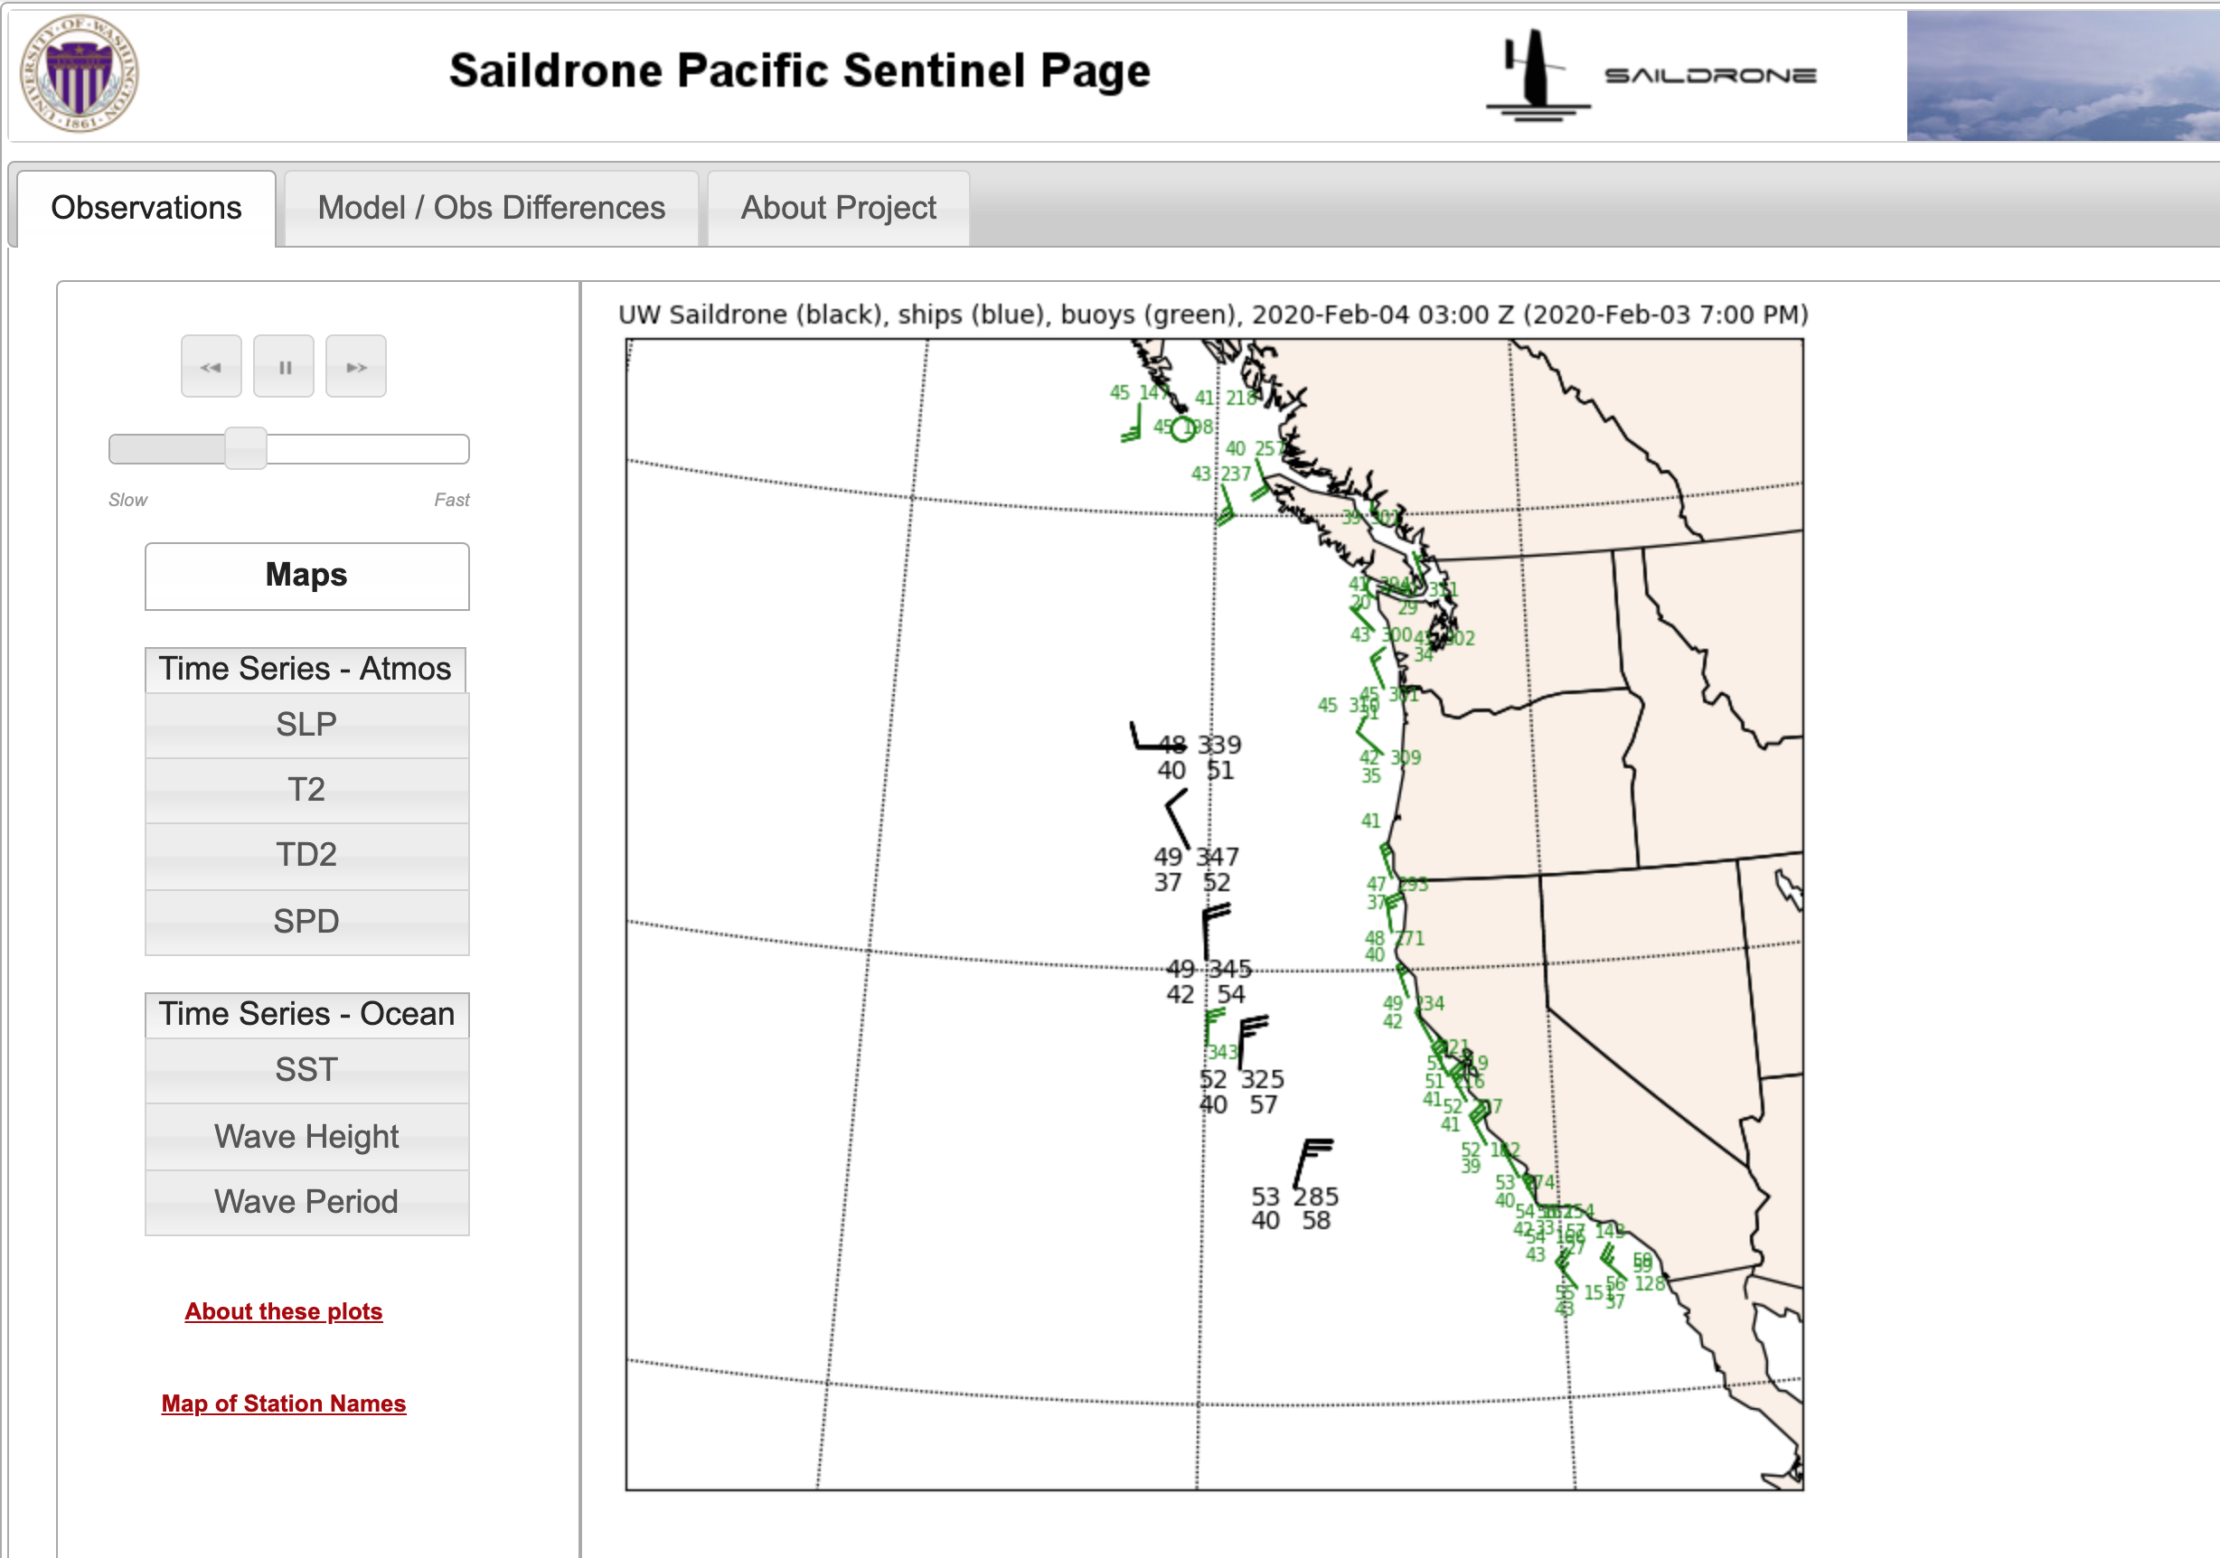
UW Saildrone Website

Slide 23
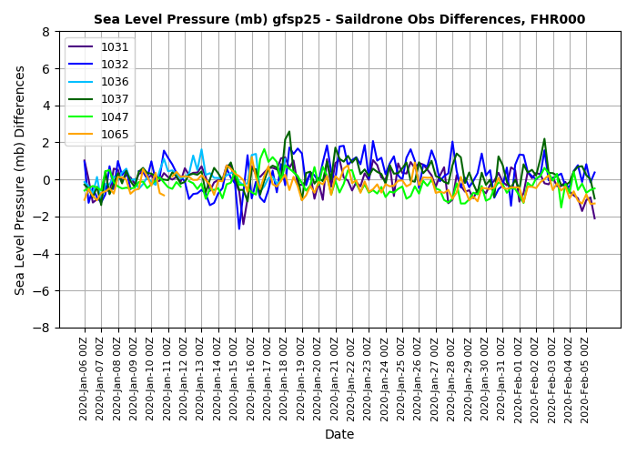
Surprising Results: How Good are the Grids We Get From NCEP over the Eastern Pacific?

Slide 24
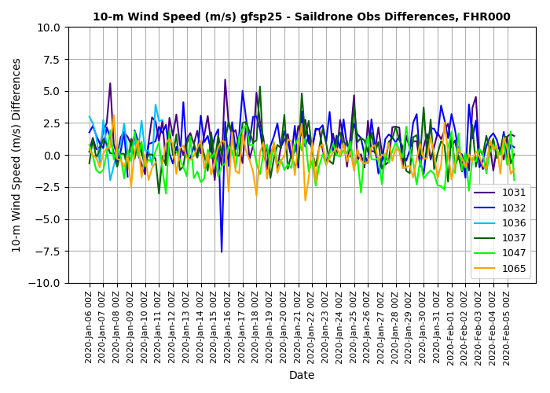

Slide 25
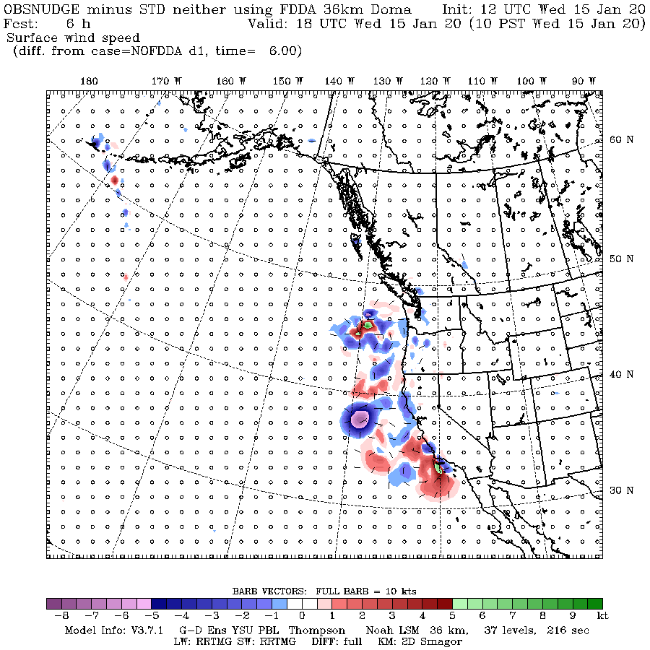
Doing Some Experiment Where We Try Observation Nudging to the Saildrones

Slide 26
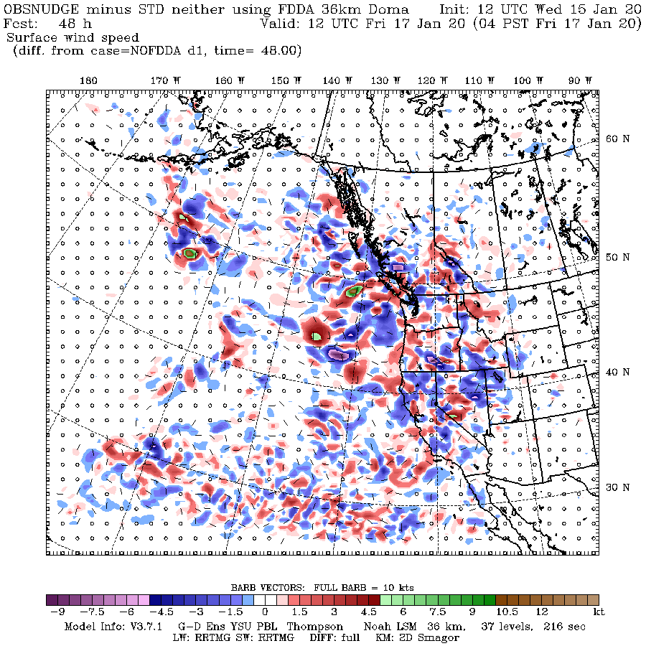

Slide 27
Announcement: Northwest Weather Workshop will be on May 1-2, 2020
Proposed theme: Meteorology and Agriculture
Talk titles due on April 1, 2020

