Slide 1
Consortium Meeting October 3
Cliff Mass
University of Washington

Slide 2
Tasks completed
Smoke system was improved and made more robust…..but not used due to lack of smoke.
Dave and I attended WRF workshop
Fixed Intel compiler issue for WRF (4.0.3)
Rewrote software ensemble plume code so they come out 2.5 hours earlier.
Reran August 12-20 2018 4-km cases for Brian Potter to compare smoke vs non-smoke simulations

Slide 3
Tasks Completed
Added 15 new bufkit sounding, time-height, and meteogram sites for Idaho DEQ .
Setup and ran a 4-km domain for the entire Western US for Joe Vaughan
With demise of profiler, now creating sounds using aircraft data for Seattle. Added Portland and Spokane soundings as well.

Slide 4
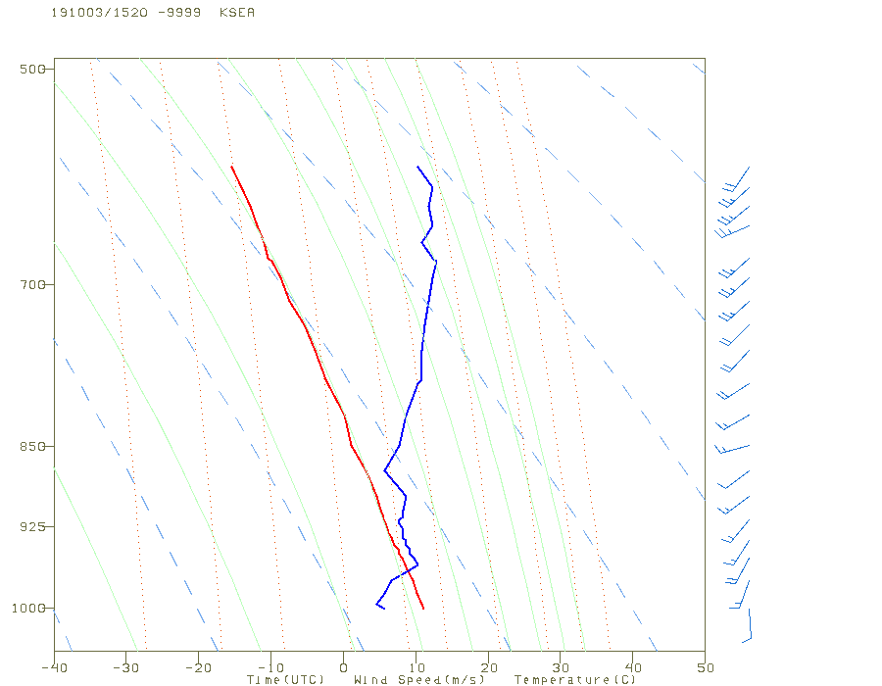

Slide 5
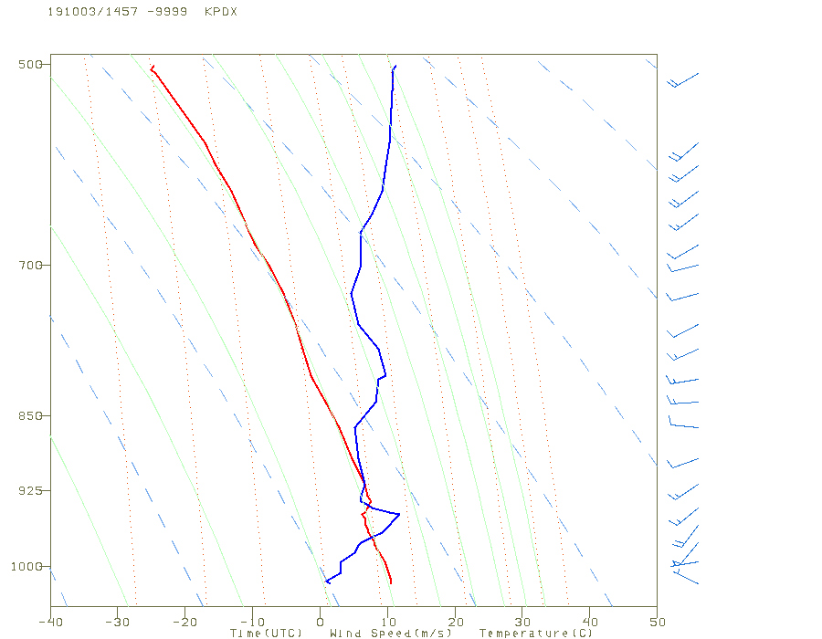

Slide 6
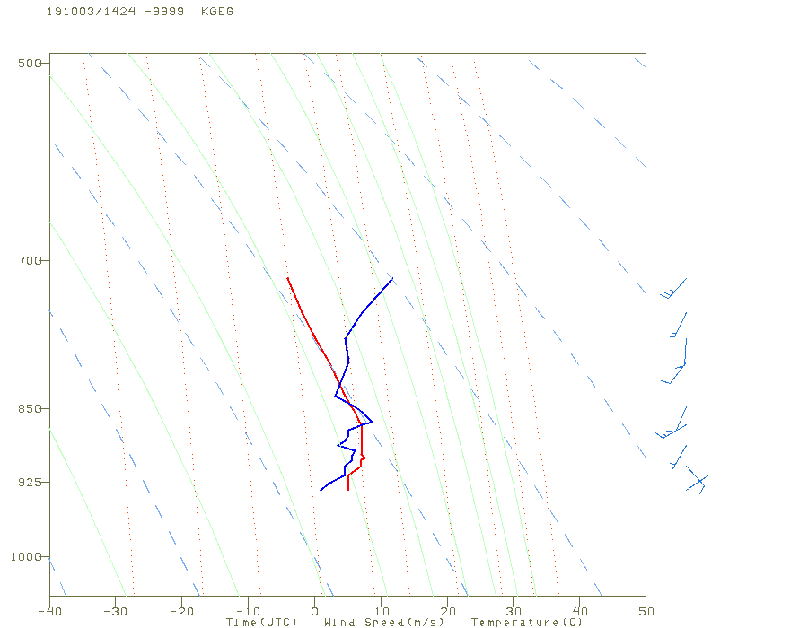

Slide 7
Plotted Soundings
These are using the ACARS feed. Could add more major airports if consortium wanted it (e.g., Boise).
The alternative TAMDAR feed (commuter aircraft) has not been reliable (Panasonic sold it off). Working on that now…that adds more local airports.

Slide 8

The Driving Global Model has Changed from GFS to FV-3 on June 12th

Slide 9
Implications for us
Better microphysics
Same effective resolution, but now a grid versus spectral model
Slight improvement in verification scores…same data assimilation system.
Dave had to deal with some issues on the transition…including communications/grid issues….but quickly got on top of it.

Slide 10
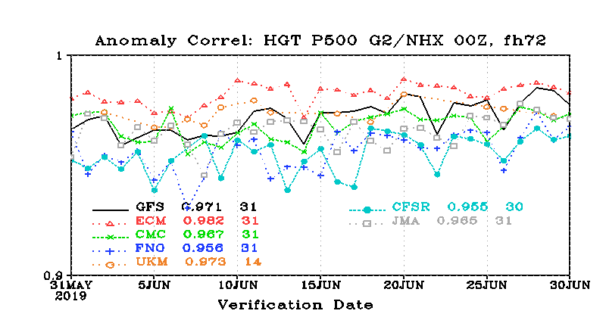

Slide 11
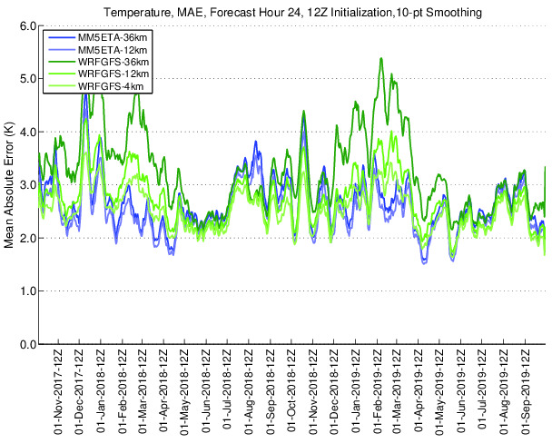
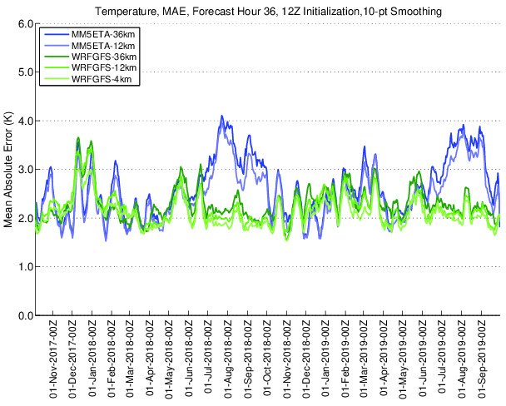
No Apparent Damage

Slide 12
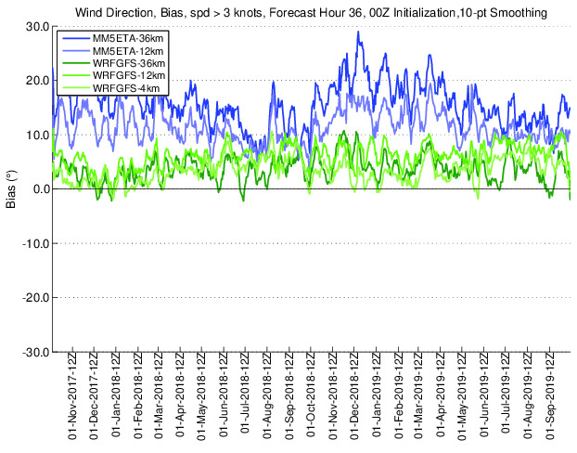

Slide 13
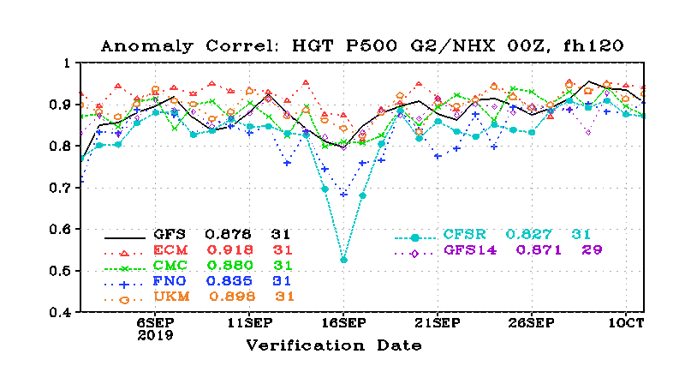
Latest

Slide 14
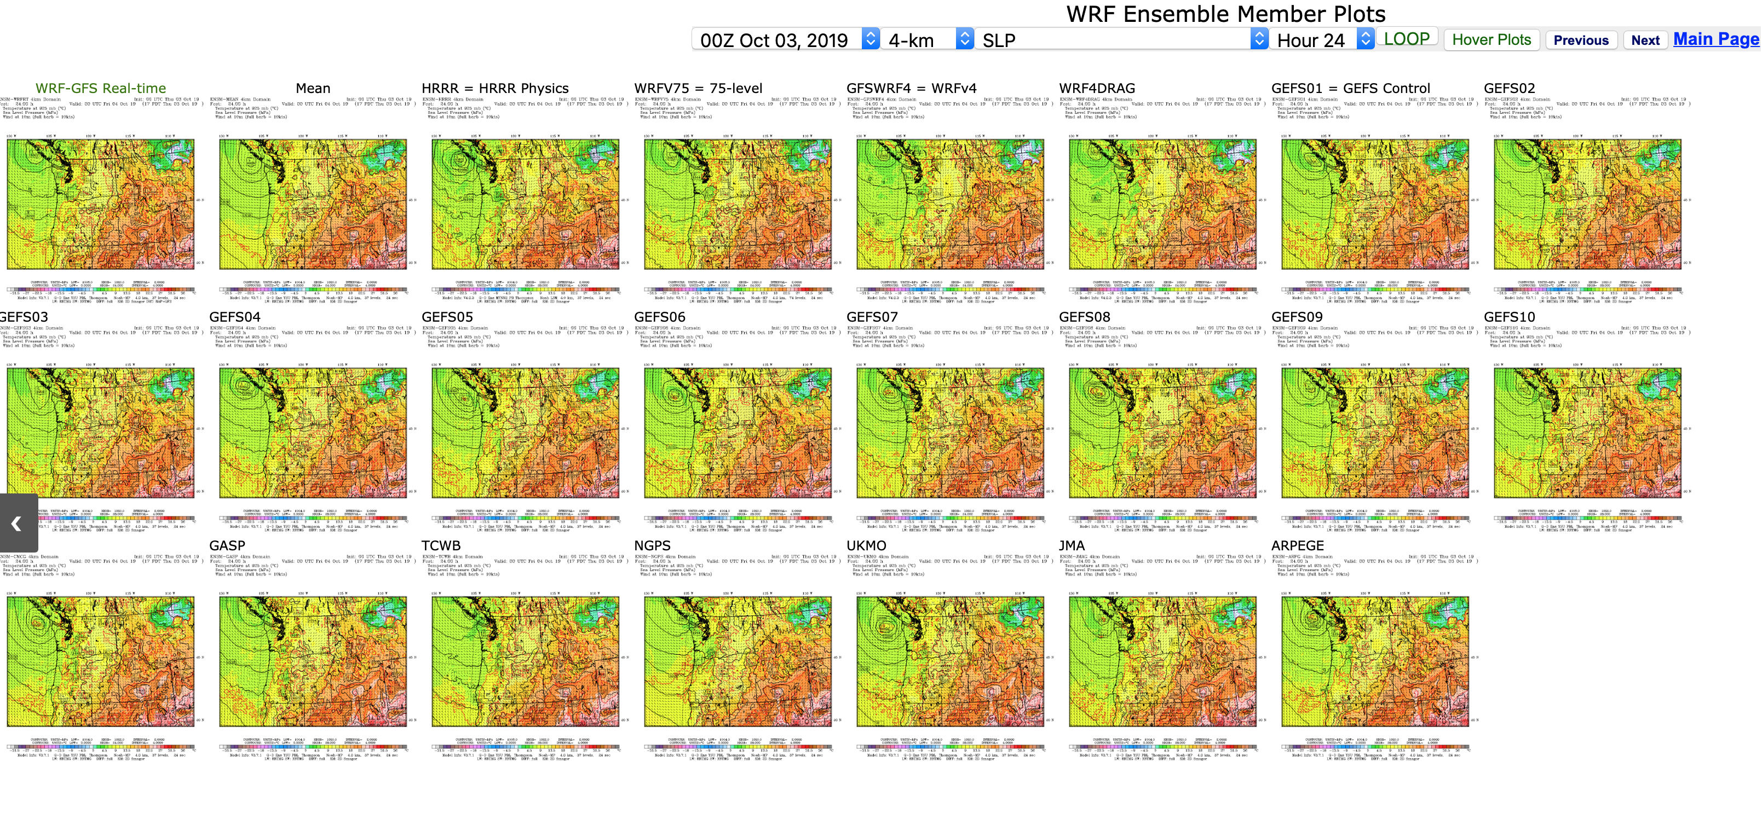
Ensemble System Improvements and Hardening

Slide 15
Added Arpege (French) and Model Variations in the Spring
Dave has hardened up the code and now the ensembles are highly reliable.
Adding two more this week. Adding an additional boundary layer scheme (ACME/Pleim) and an additional microphysics scheme (P3)
If we want more ensembles, need more nodes.
If new head node with lots of RAM-disks could speed up processing by roughly 30 minutes.

Slide 16
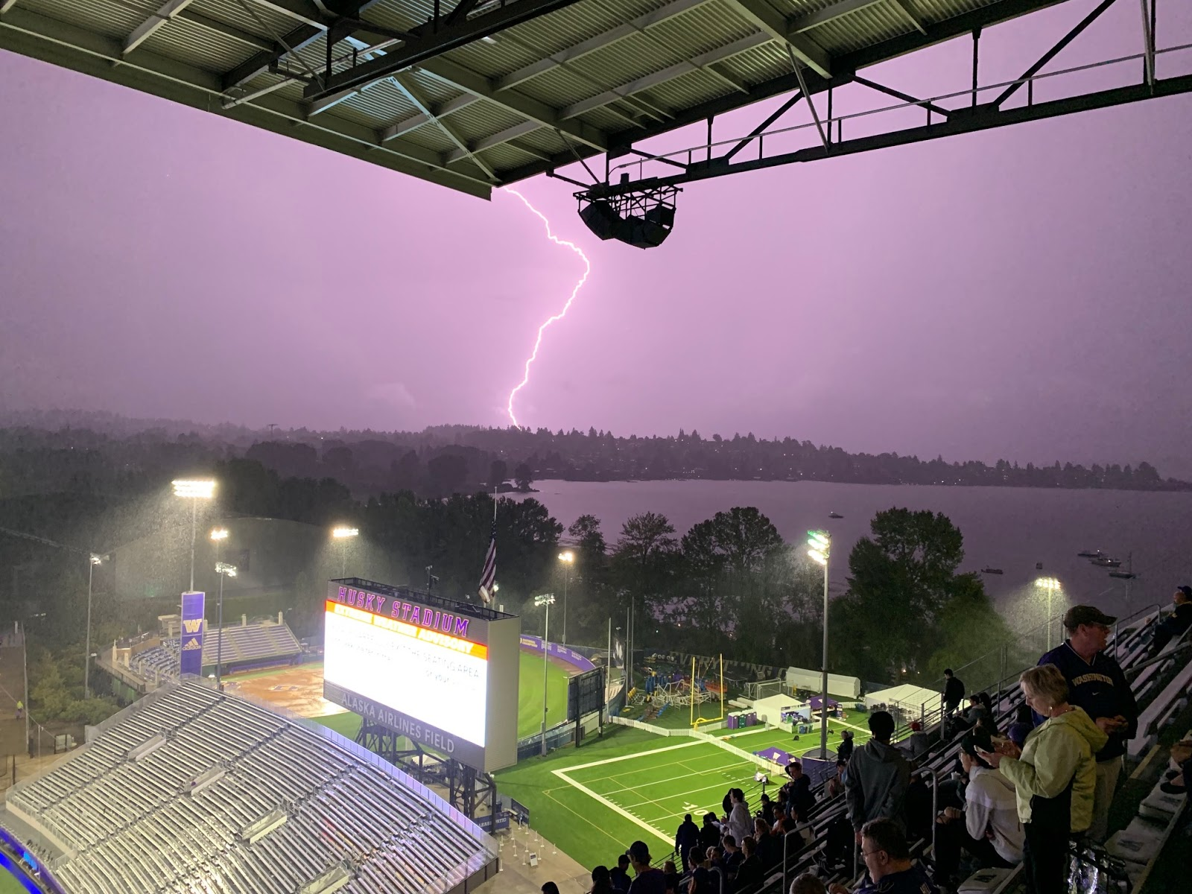
The ensemble system can be very useful: example the Sept 7 thunderstorms over Puget Sound

Slide 17
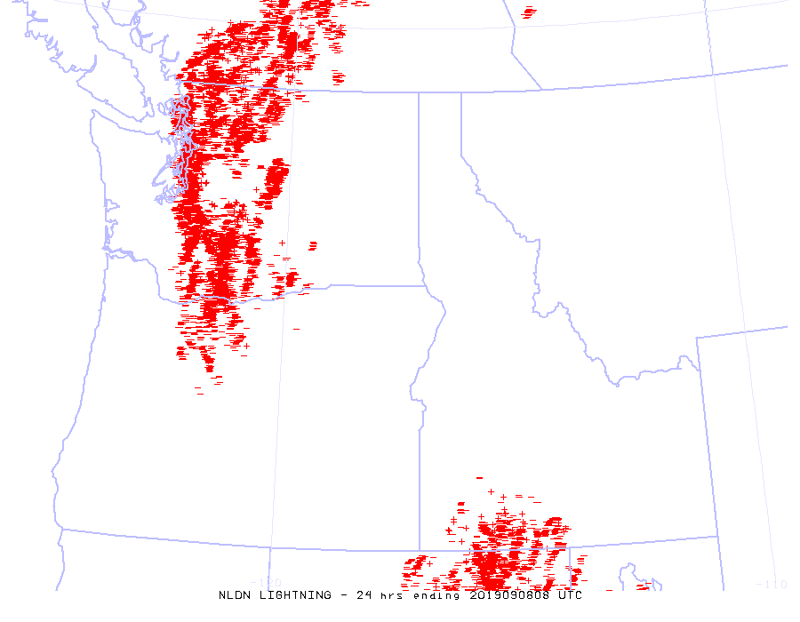

Slide 18
NWS Forecasts and Models Were Poor—held the convection on the mountains

Slide 19
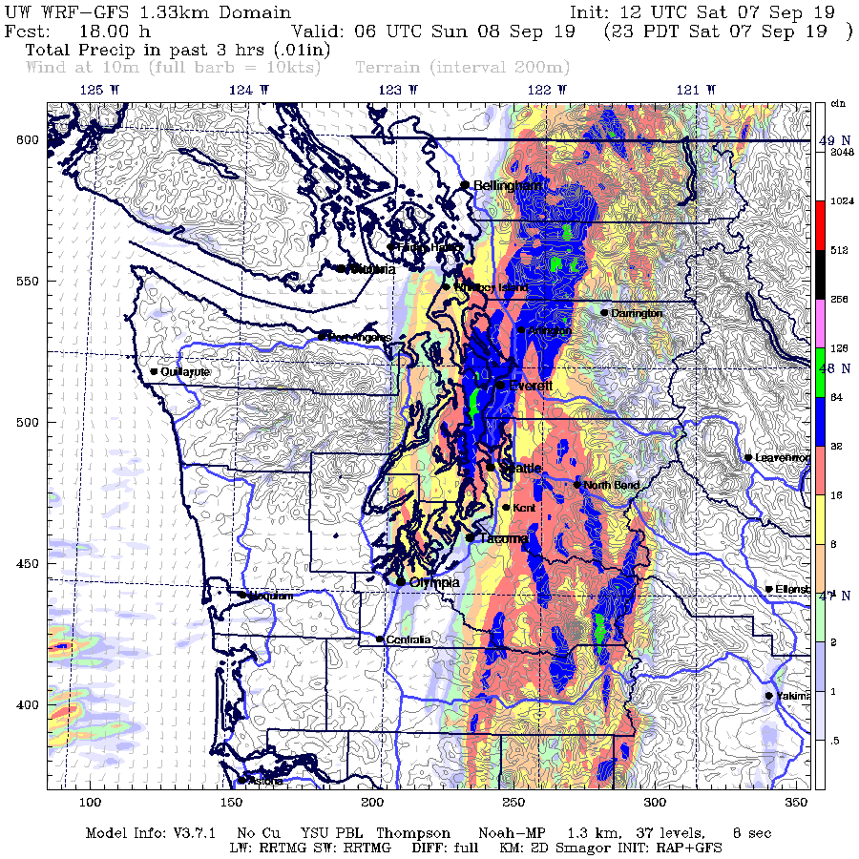
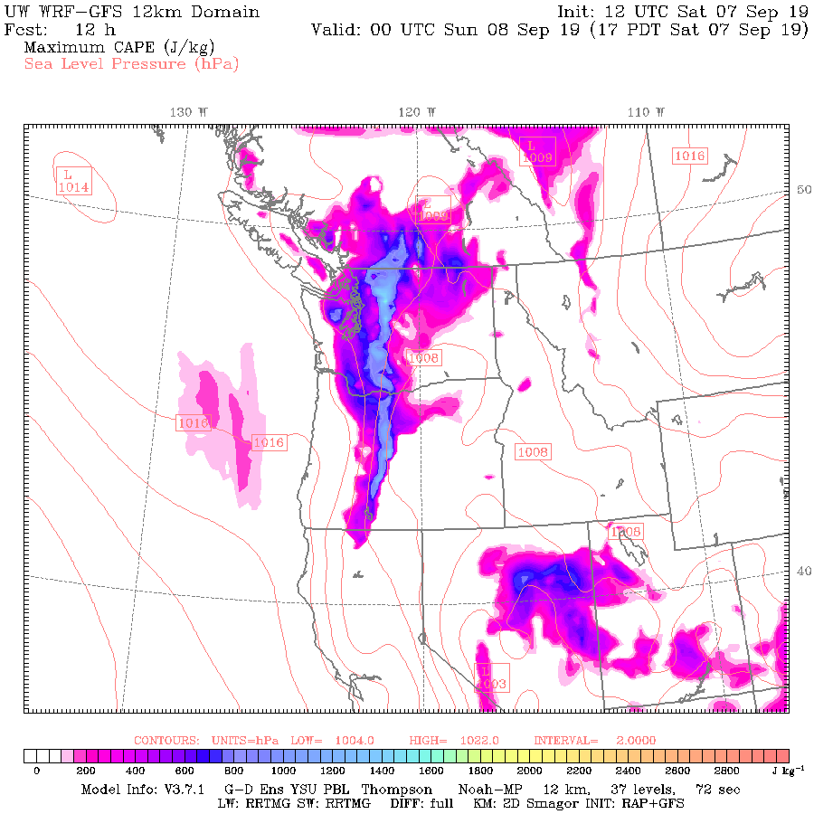
But our system did very well

Slide 20
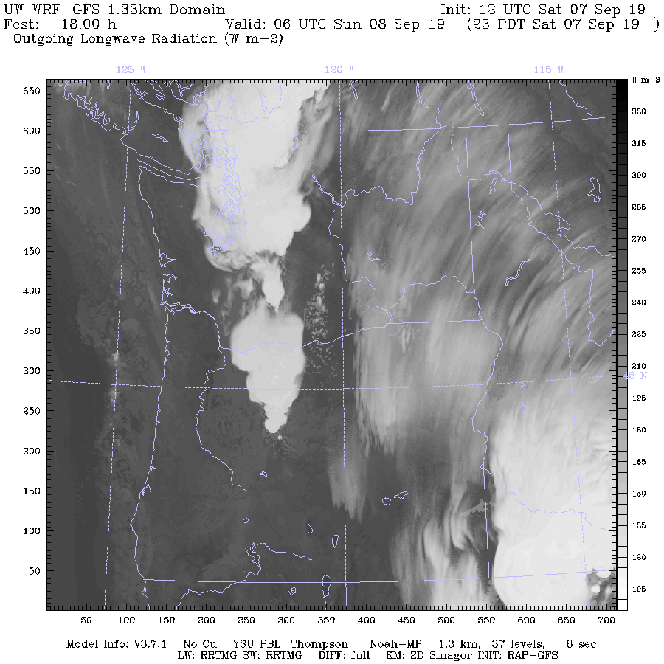

Slide 21
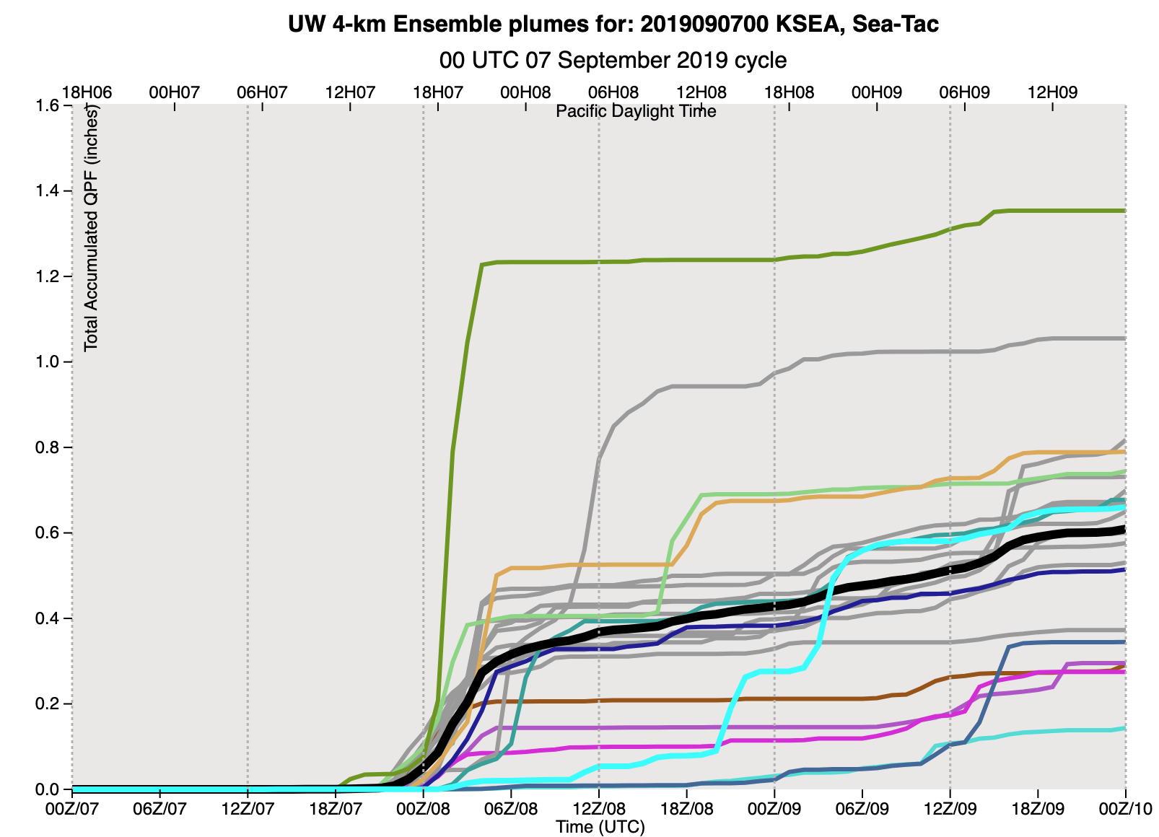
Ensembles Were Spectacular

Slide 22
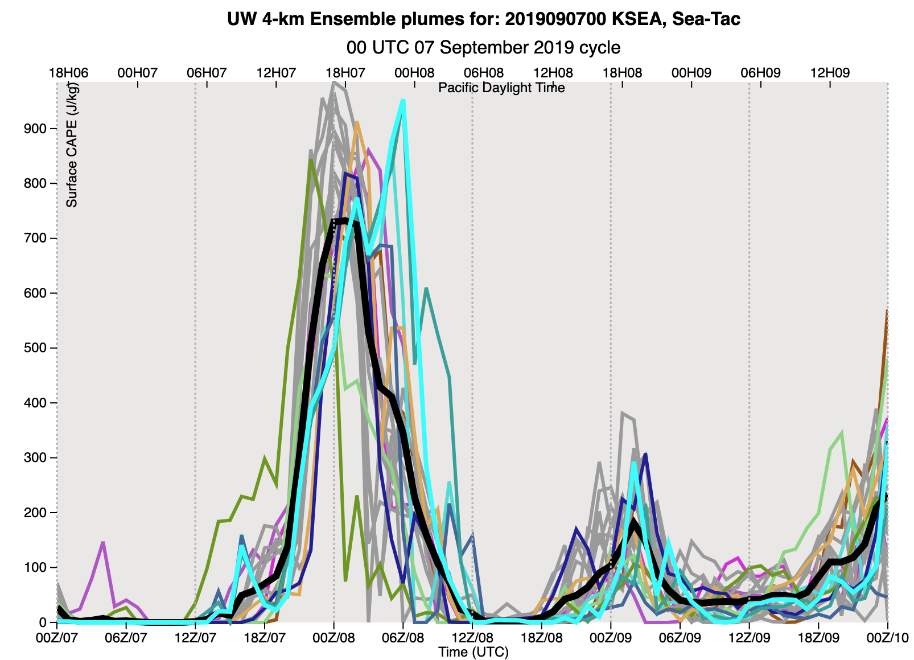

Slide 23
Some Things to Do
Calibrated probabilistic guidance from ensembles (BMA, Machine Learning)
Upgrade some graphics (e.g., cross sections)
Upgrade model verification (e.g., cloud base using ceilometer, cloud tops from GOES, cloud top species—GOES).
Try to get TAMDAR to be reliable.
More ensembles and faster if we can get computers.

