Slide 1
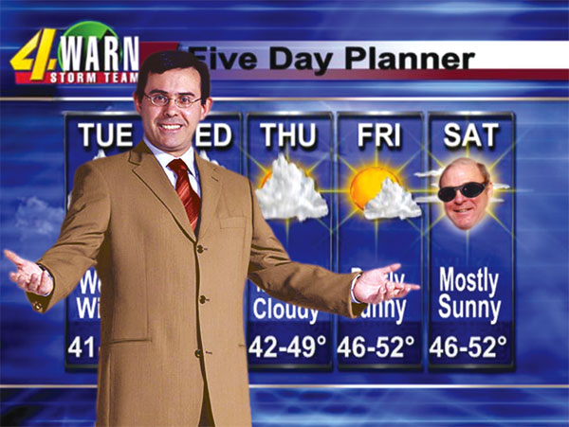
A Consumer’s Guide to Weather Forecasting Information
ATMS 101
Autumn 2025

Slide 2
Being a good weather consumer means
Knowing where to get reliable information
Knowing what is hype and what is real
Knowing the limits of weather prediction
Knowing how to read the sky and how to interpret basic weather information

Slide 3
The most common question I am asked

Slide 4
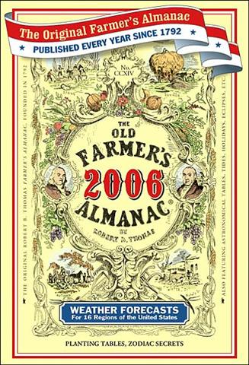
Are the predictions in the Old Farmer’s Almanac Useful?

Slide 5

Absolutely not
Nick Bond of UW/NOAA in Seattle evaluated the Almanac’s forecasts over several years
Found absolutely no skill. Better off flipping a coin.

Slide 6
Where can you get weather information?
Print newspapers
  Forecasts are generally old and superficial
Radio
  Often dated or wrong information
TV
  Varies substantially in quality
  Tends to hype storms
Online and mobile
  Probably the best and most comprehensive source

Slide 7
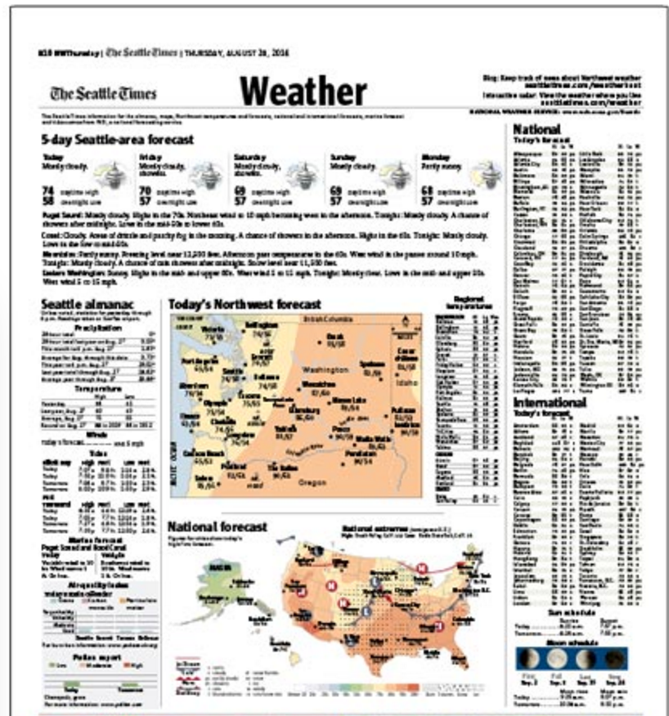
Newspaper Print Weather Pages
Outdated forecasts

Slide 8
TV Weather
Only about half of tv weather folks are really meteorologists (i.e., have an actual degree). They are “weathercasters”
The weekday ones tend to have stronger backgrounds.
Their forecasts for the first few days tend to be very close to the National Weather Service
Lots of hype--
  “Pinpoint severe weather center”
  “County by county forecasts”
  “Doppler radar weather”

Slide 9

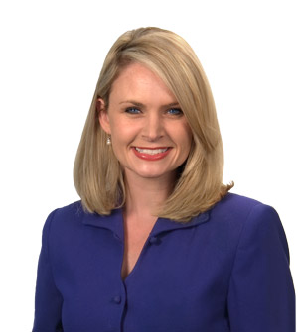
Local TV Weather Types with Degrees in Atmospheric Sciences

Slide 10
Online
You can get the latest forecasts
You can get the raw weather observations (e.g., surface observations, radar)
You can look at the forecasts from the computer models.
You can view weather cams all over the region
You can get deceiving and wrong information that looks compelling.

Slide 11
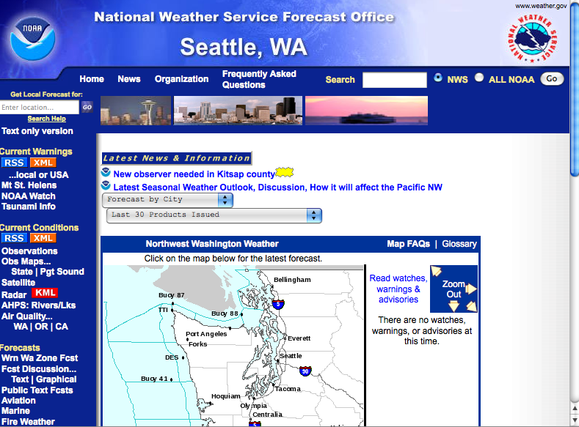
The National Weather Service

Slide 12
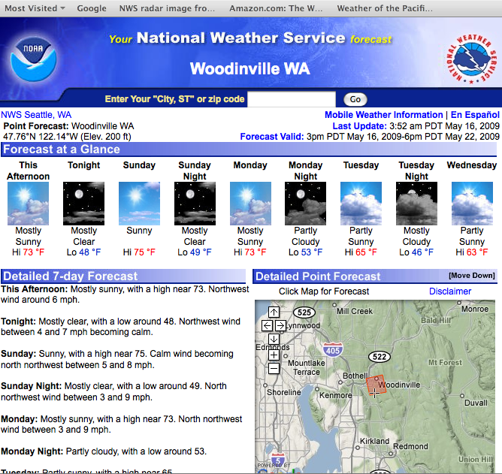

Slide 13
The NWS Forecast Discussion…getting into the mind of the forecaster

Slide 14
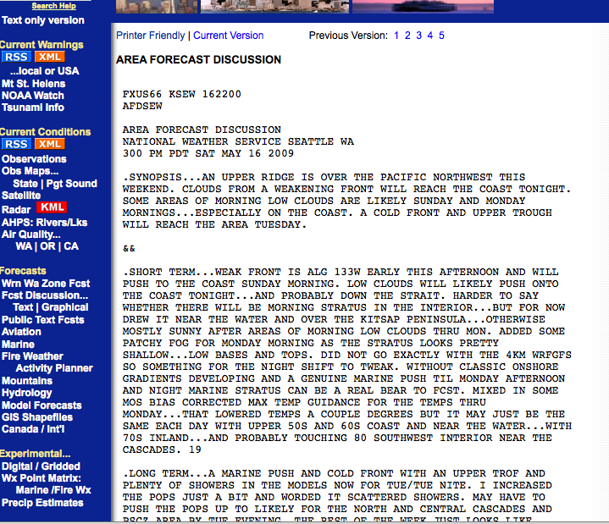

Slide 15
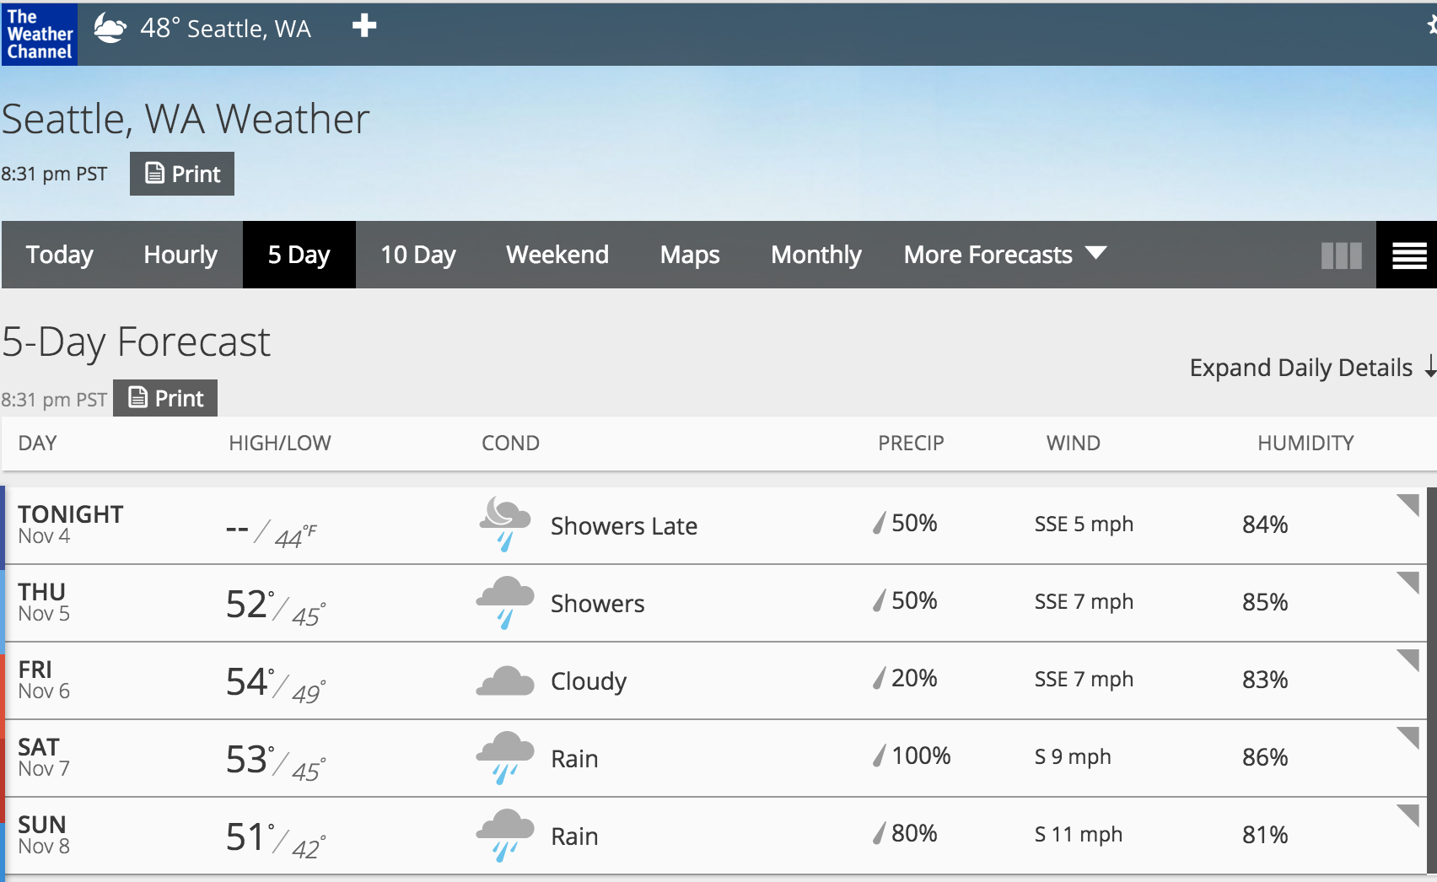
Weather.com has very good forecasts—better than the National Weather Service
Completely automated.
Highly sophisticated statistical improvement of National Weather Service and other forecast models.

Slide 16
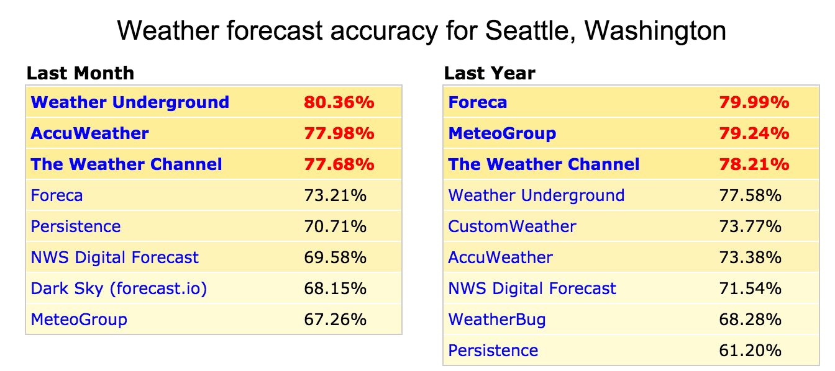
Who has the best forecasts? Check forecastadvisor.com

Slide 17
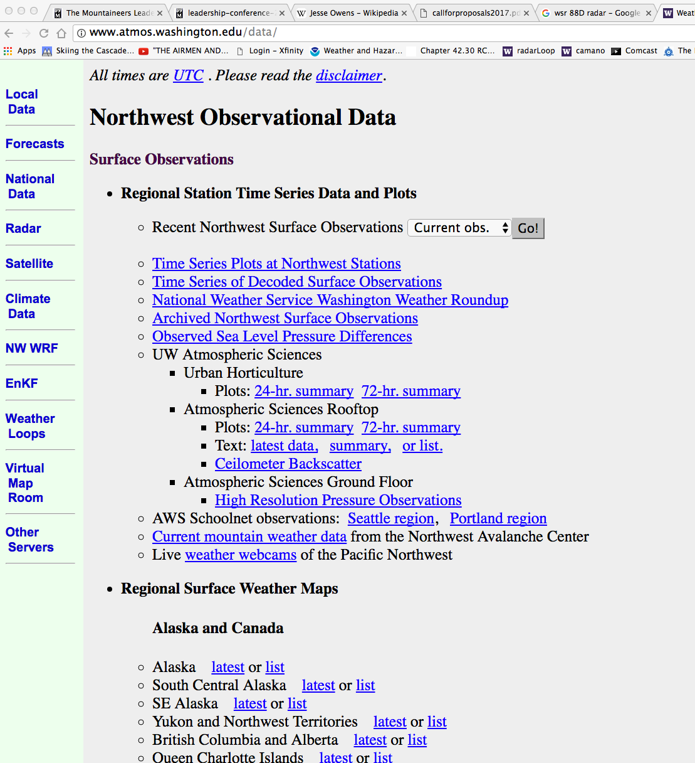
Our Department website is a great place to start

Slide 18
Smartphone Weather Apps Are Very Useful
Smartphones are the perfect weather delivery tool
  Good graphics,
  they know where you are,
  good communications,
  and more…

Slide 19
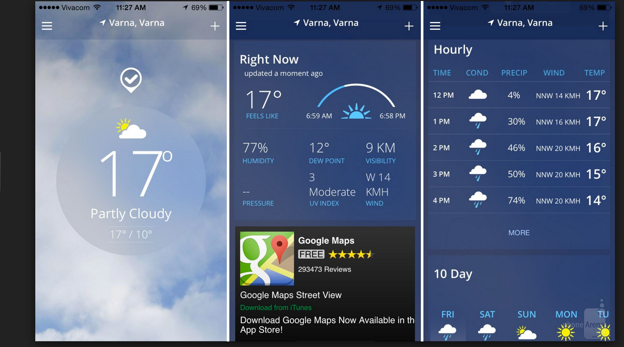
WeatherChannel App

Slide 20
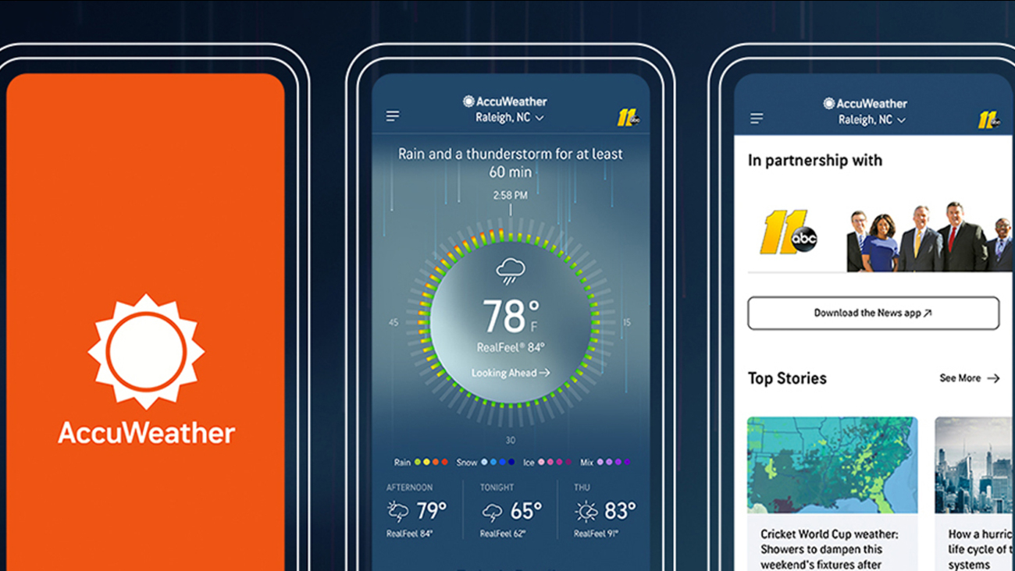

Slide 21
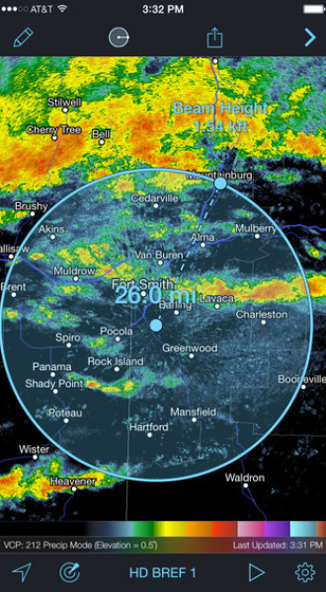
Radarscope: The Professional’s Choice for Looking at Radar Imagery

Slide 22
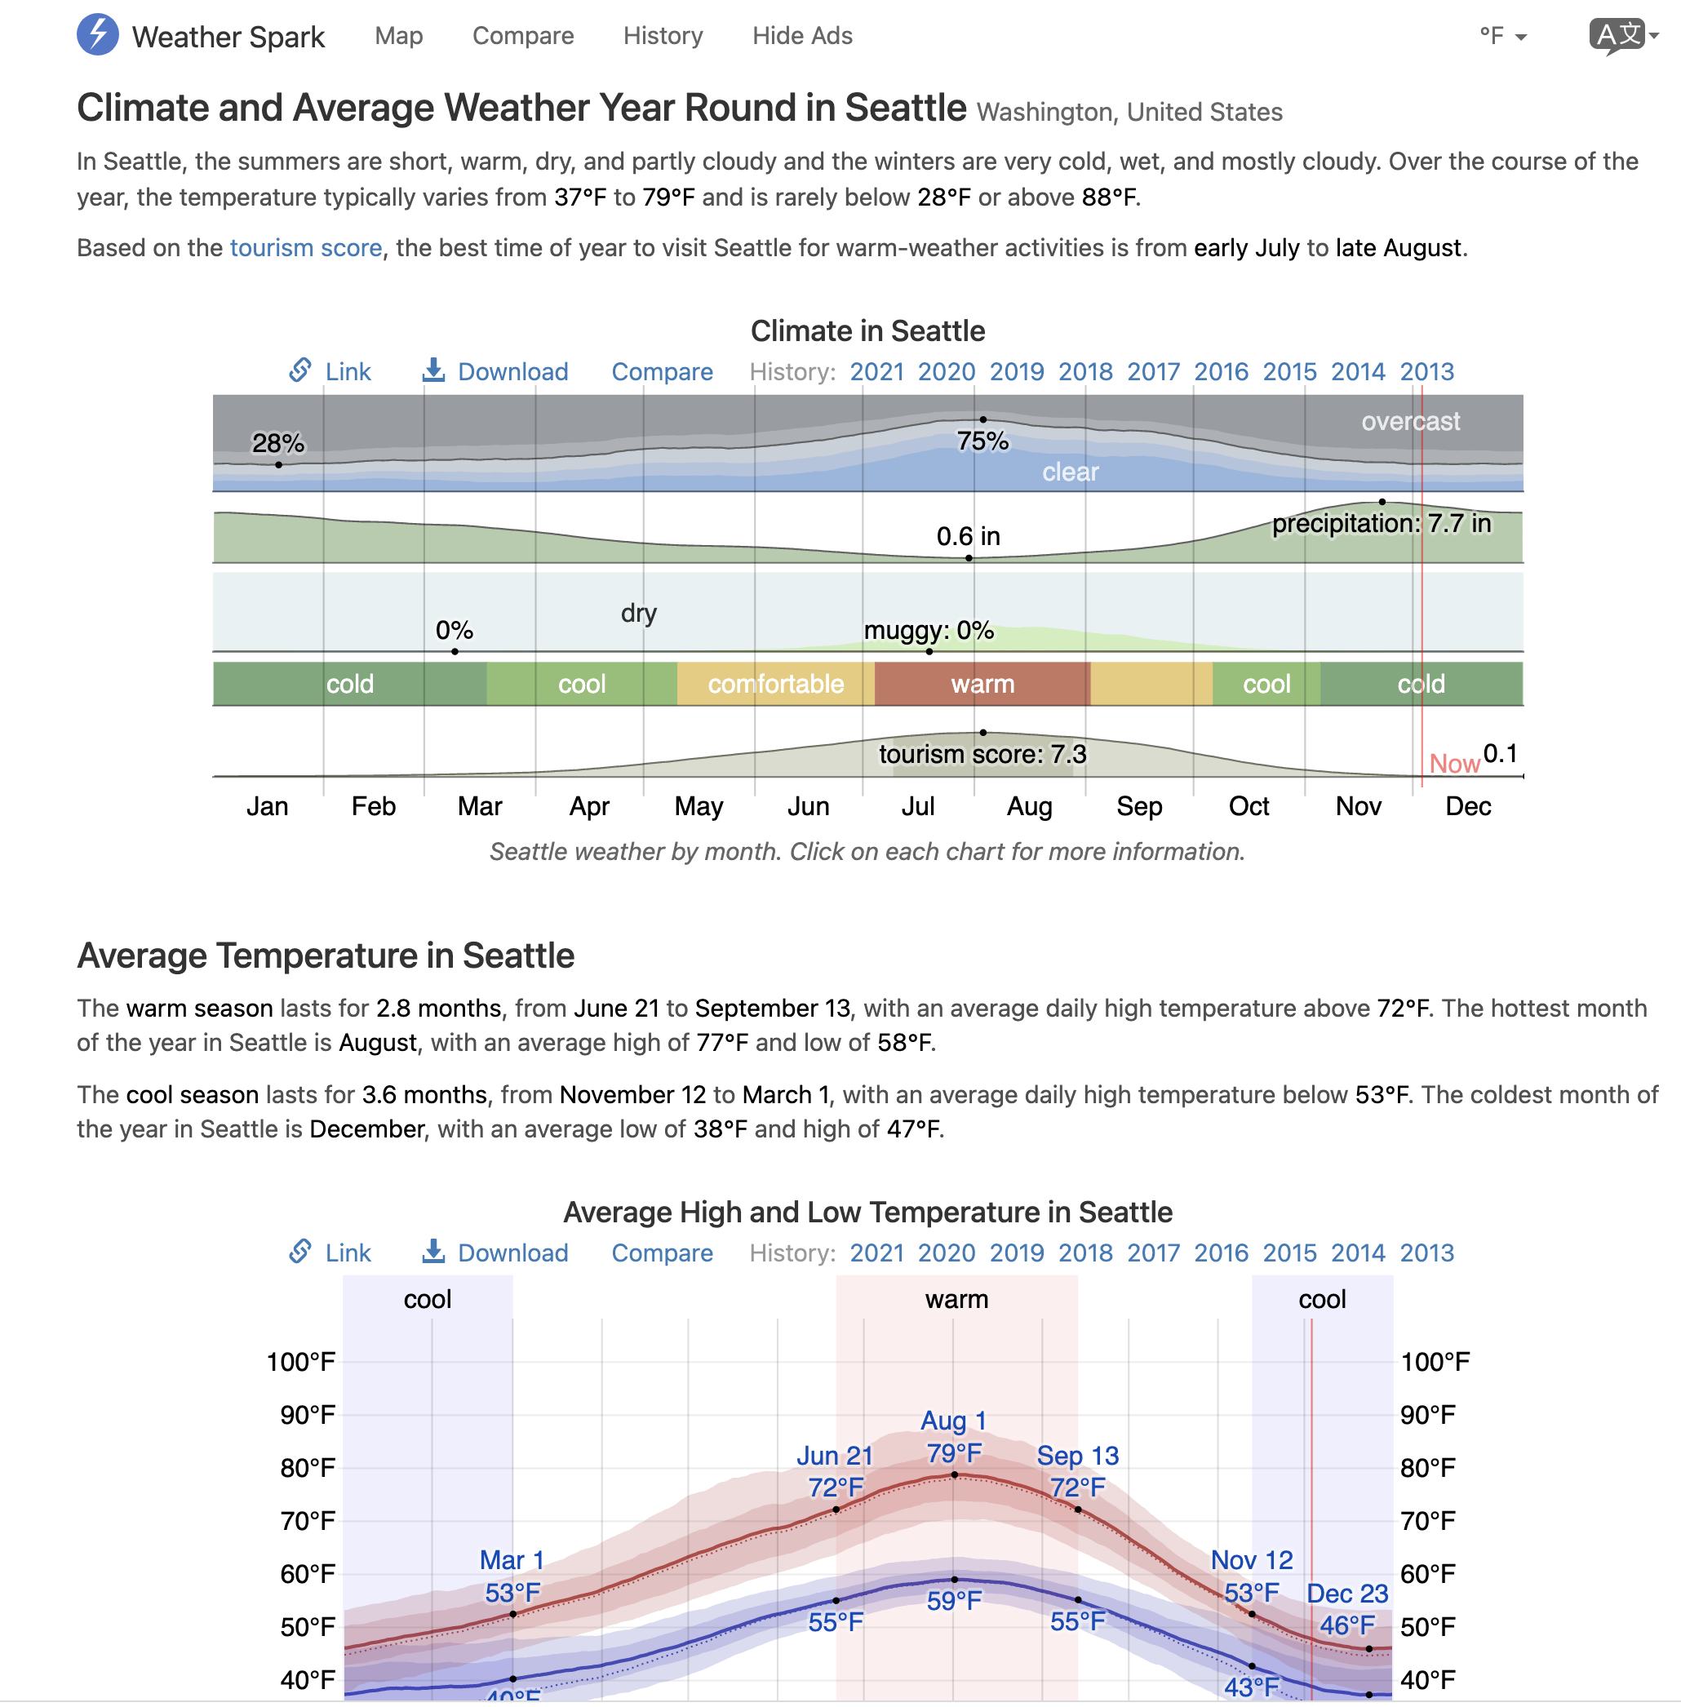
Know the Climatology Your Location Can Be Good For Planning
WeatherSpark is one of my favorites
Many others

Slide 23
Terminology

Slide 24
20% chance of rain means?
It will rain over 20% of the area?
It will rain 20% of the time
There is a 20% chance it will rain at a specific point over some period.
Most people are not sure

Slide 25
The Correct Answer
There is a 20% chance it will rain at a specific point over some period (often 12 hours).

Slide 26
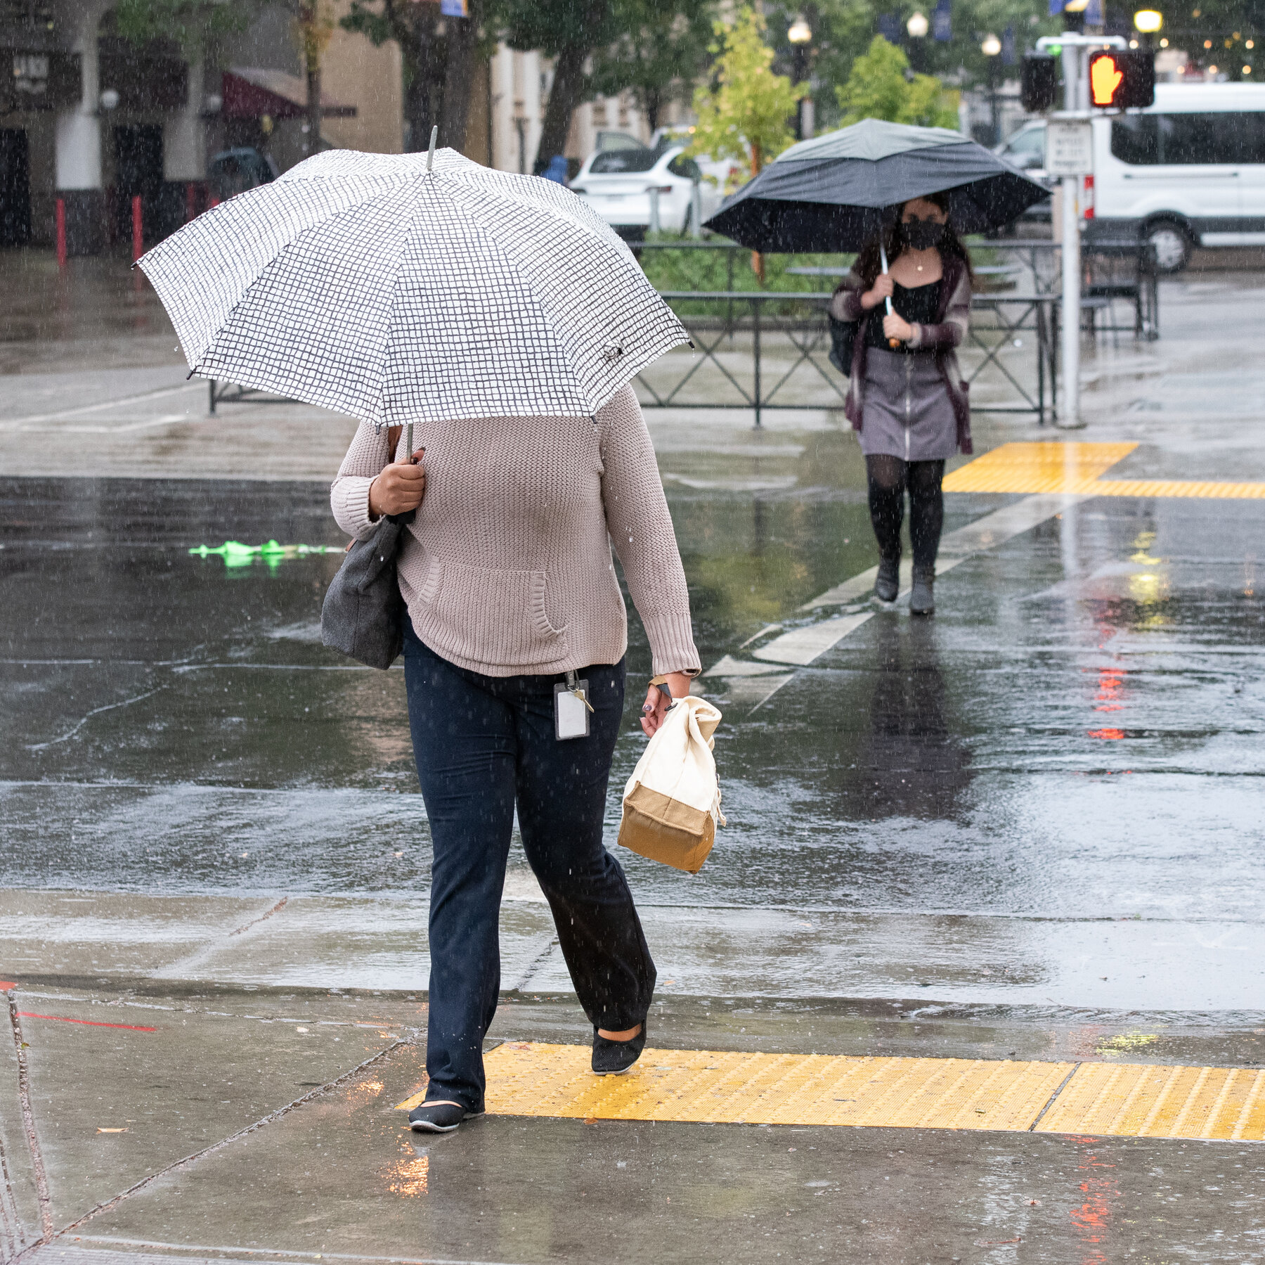
Measurable Rain
At least .01 inches (enough to just uniformly wet a surface)
A trace is when it rains less than this.

Slide 27

Partly Sunny/Partly Cloudy

Slide 28
Partly Cloudy/Partly Sunny
Partly Cloudy
  Between 3/8 and 5/8 of the sky is covered by clouds.
Partly Sunny
  Between 3/8 and 5/8 of the sky is covered by clouds.
  The term "Partly Sunny" is used only during daylight hours.

Slide 29
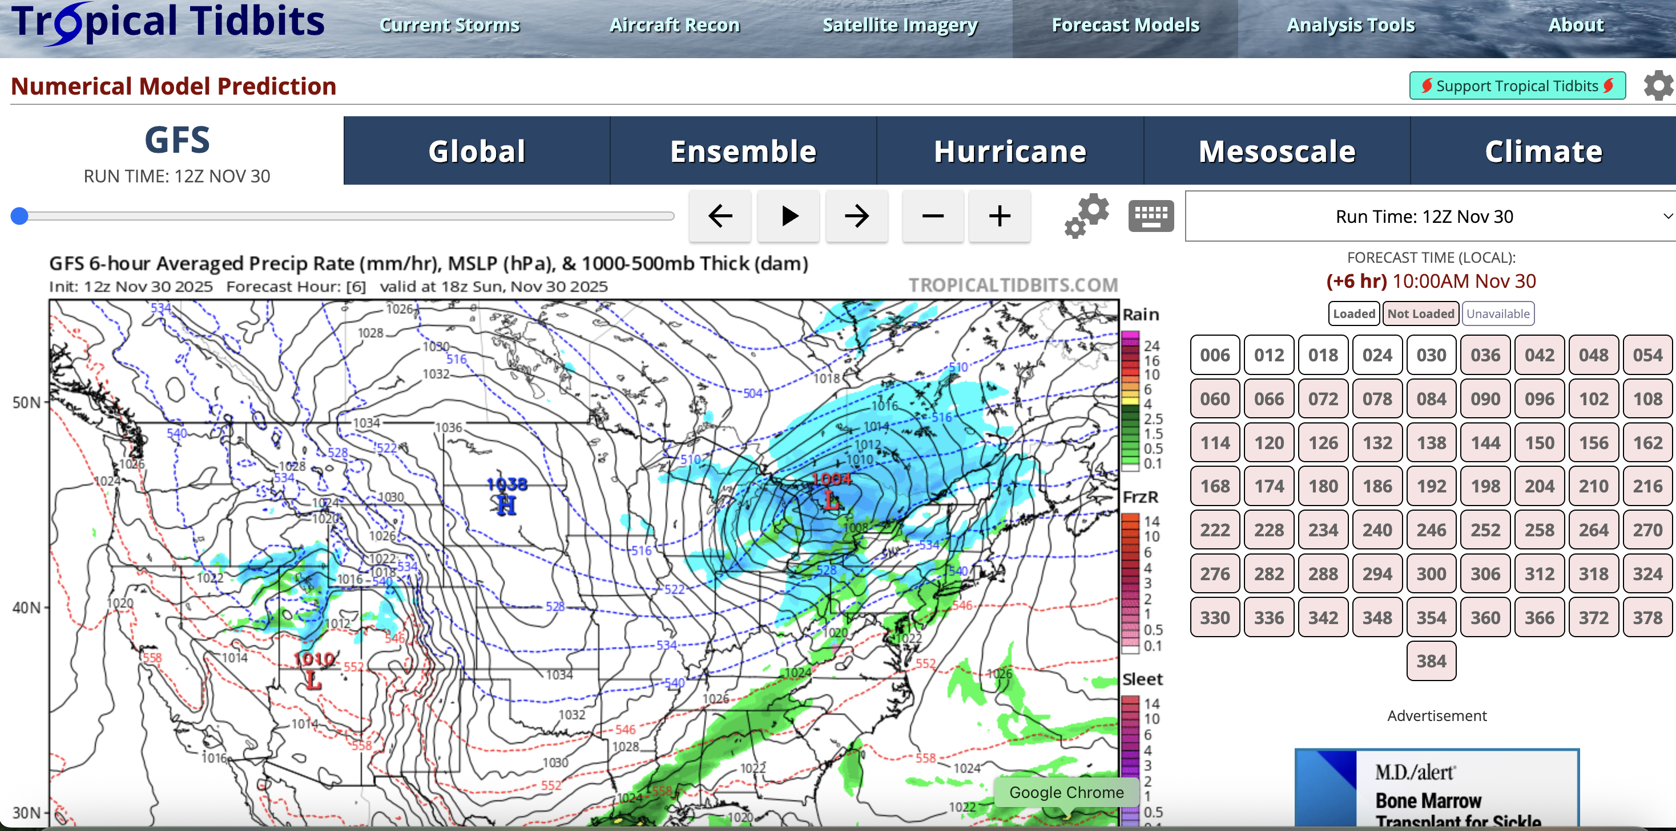
Nearly All Observations/Model Forecasts are Available Online
https://www.tropicaltidbits.com/analysis/models/

Slide 30
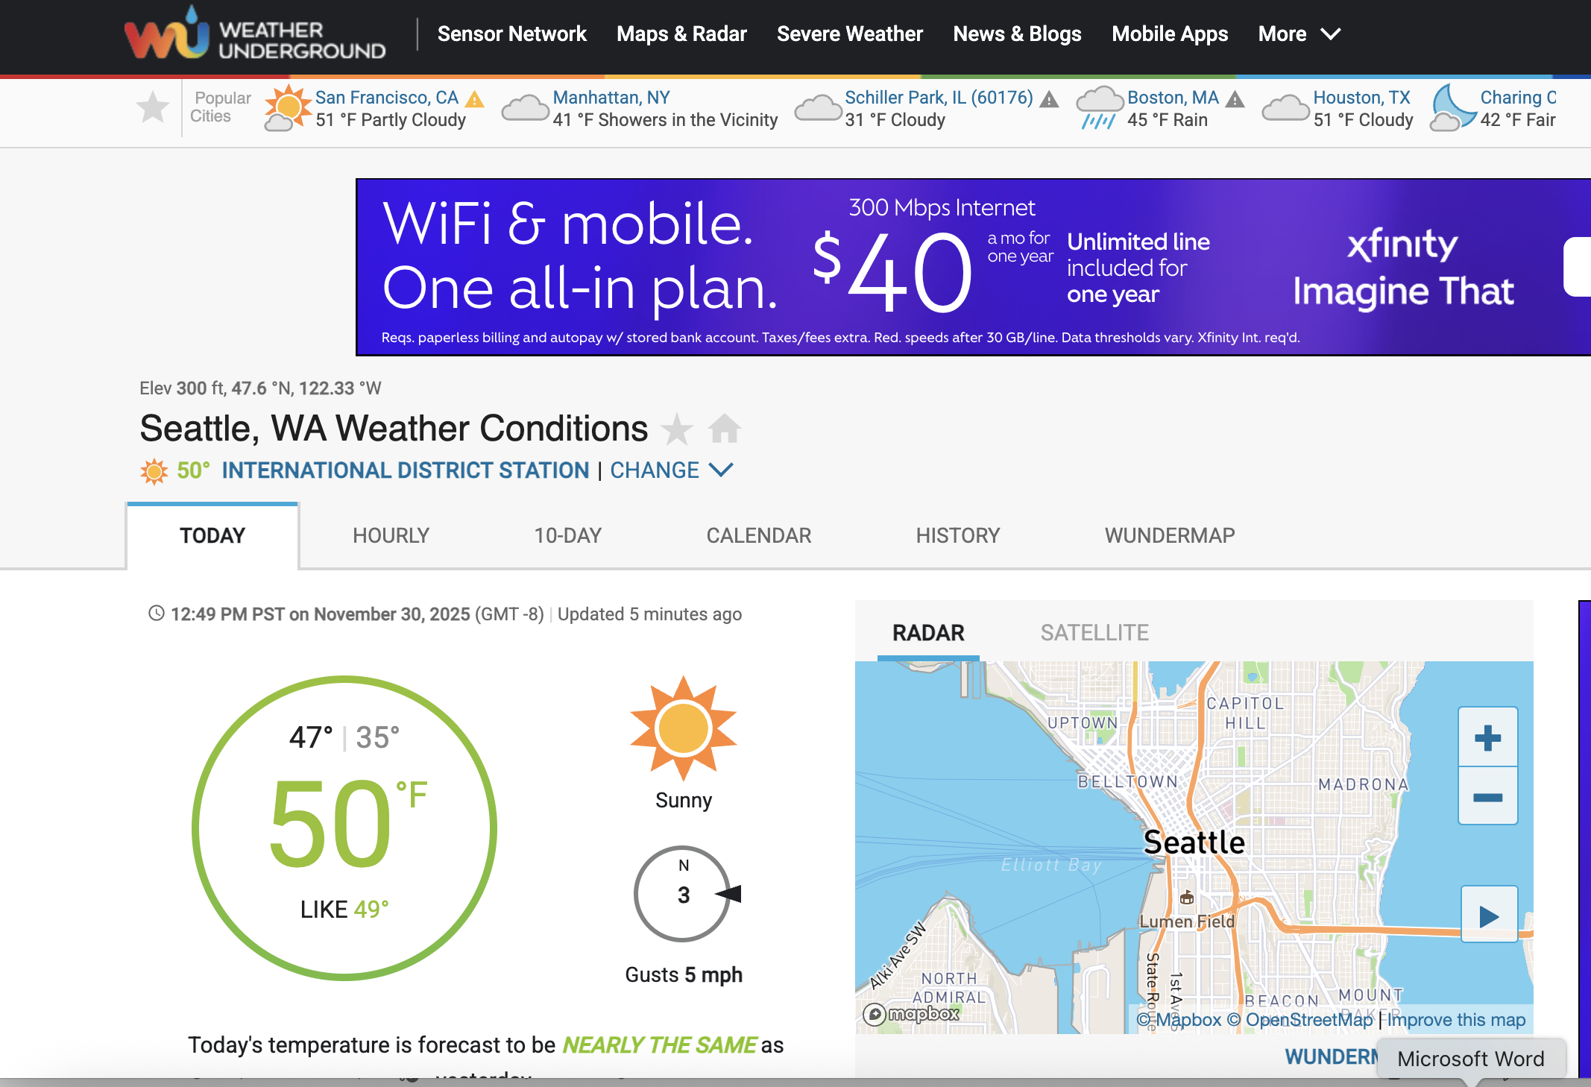
WeatherUnderground

Slide 31
