Slide 1
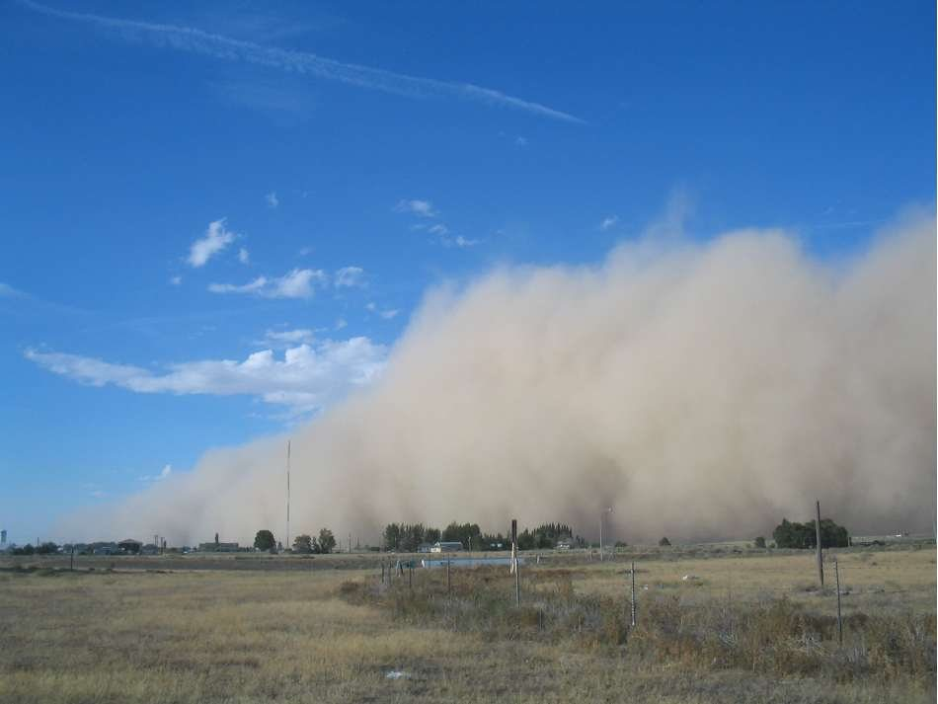
Duststorms: An old but increasing problem

Slide 2
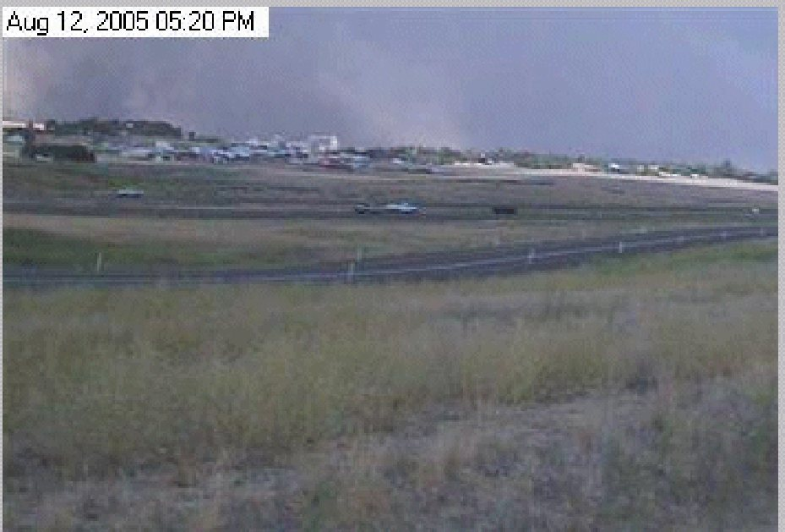


Slide 3
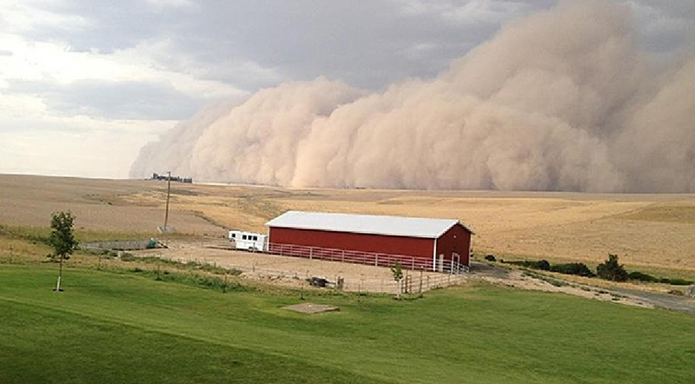
Dust/sand storms
Often associated with strong cold fronts or the outflow from strong convection.
Minimum wind speed threshold depends on characteristics of surface (fine dust easier to loft than large sand particles).

Slide 4
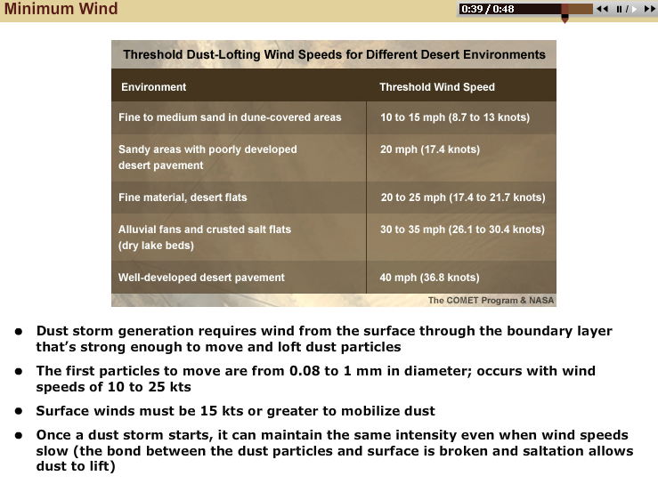

Slide 5
Sunday https://cliffmass.blogspot.com/2020/02/dust-storm-season-begins-in-eastern.html

Slide 6
https://www.youtube.com/watch?v=kUEqmOgv964 https://www.youtube.com/watch?v=yr819WqZMak

Slide 7
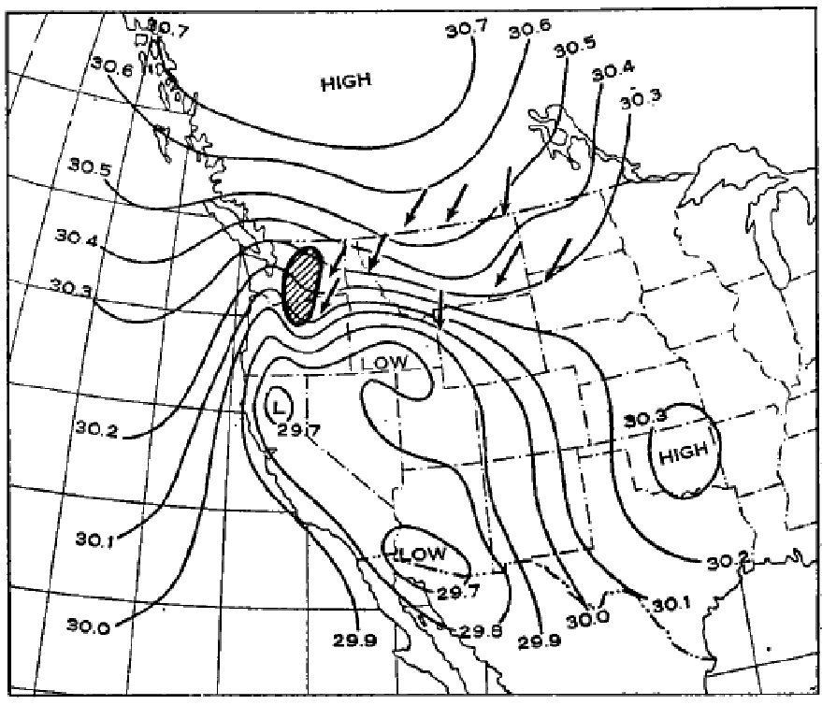
April 21, 1931: The Biggest Duststorm in NW History

Slide 8
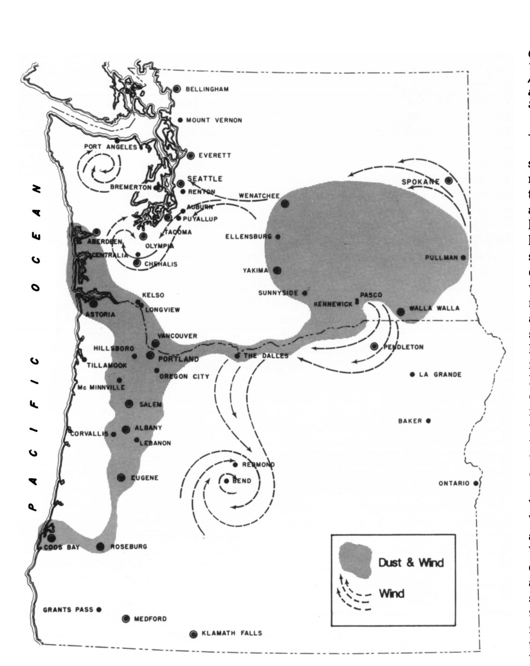
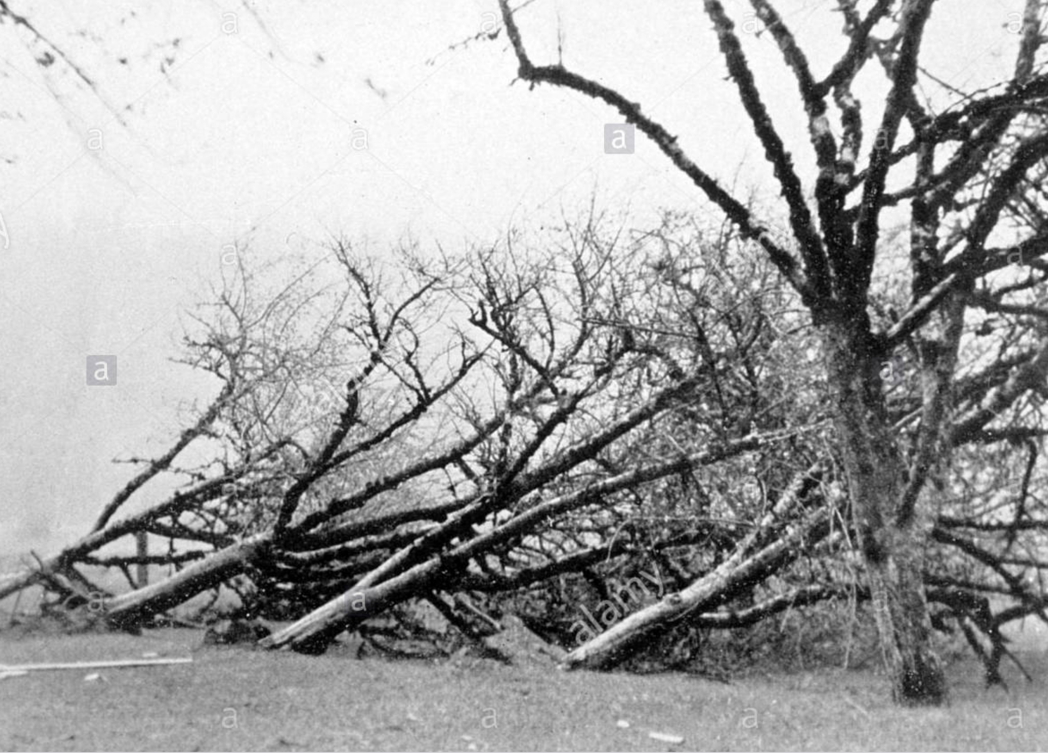

Slide 9
Why are duststorms increasing?
Drier conditions in western U.S
Poor agricultural practices
More disturbance of soils—more grazing, more off-road vehicles, more mountain biking, more exploration for oil and another resources.
More dust coming from Asia.

Slide 10
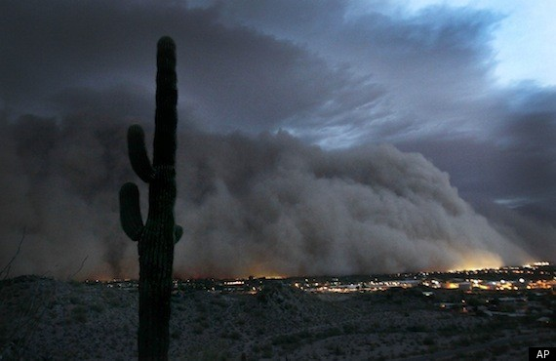
Phoenix Dust Storm

Slide 11
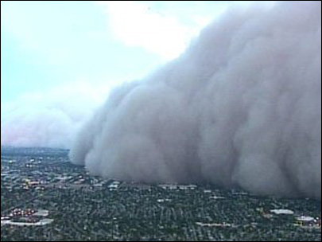

Slide 12
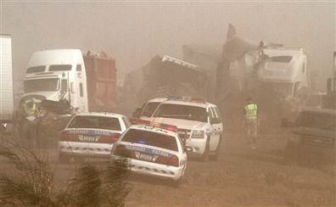

Slide 13
