Slide 1
Subseasonal and Seasonal Forecasts
ATMS 452
Subseasonal: 2-6 weeks
Seasonal: 1.5-12 months

Slide 2
How far out in time do we have skill?
Weather prediction skill is now extending into the second week
Superstorm Sandy was a famous example, but there are more.

Slide 3
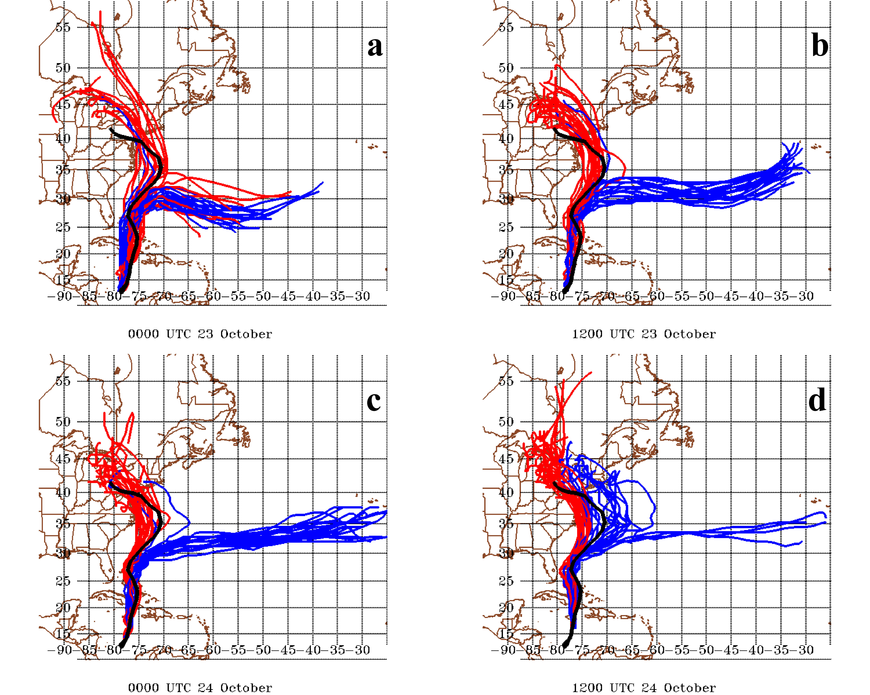
Hit NY on Oct. 29

Slide 4
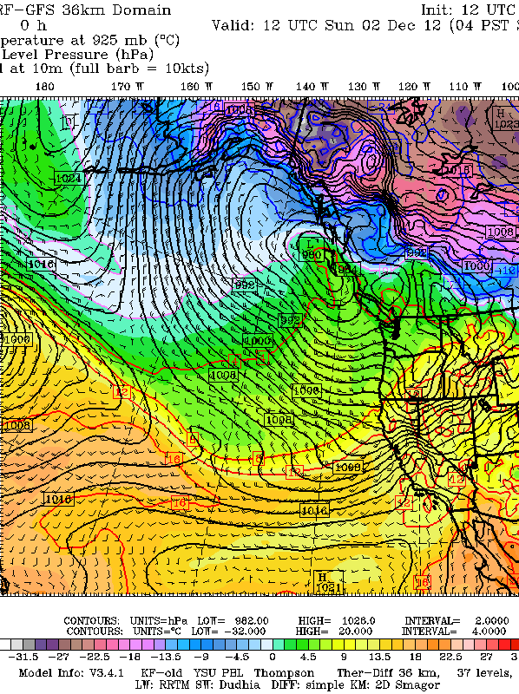
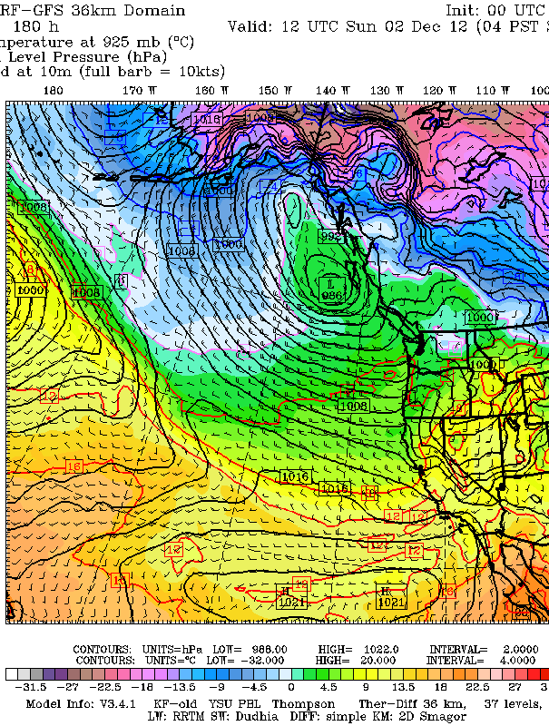
Observed 180 hr (7.5 days)

Slide 5
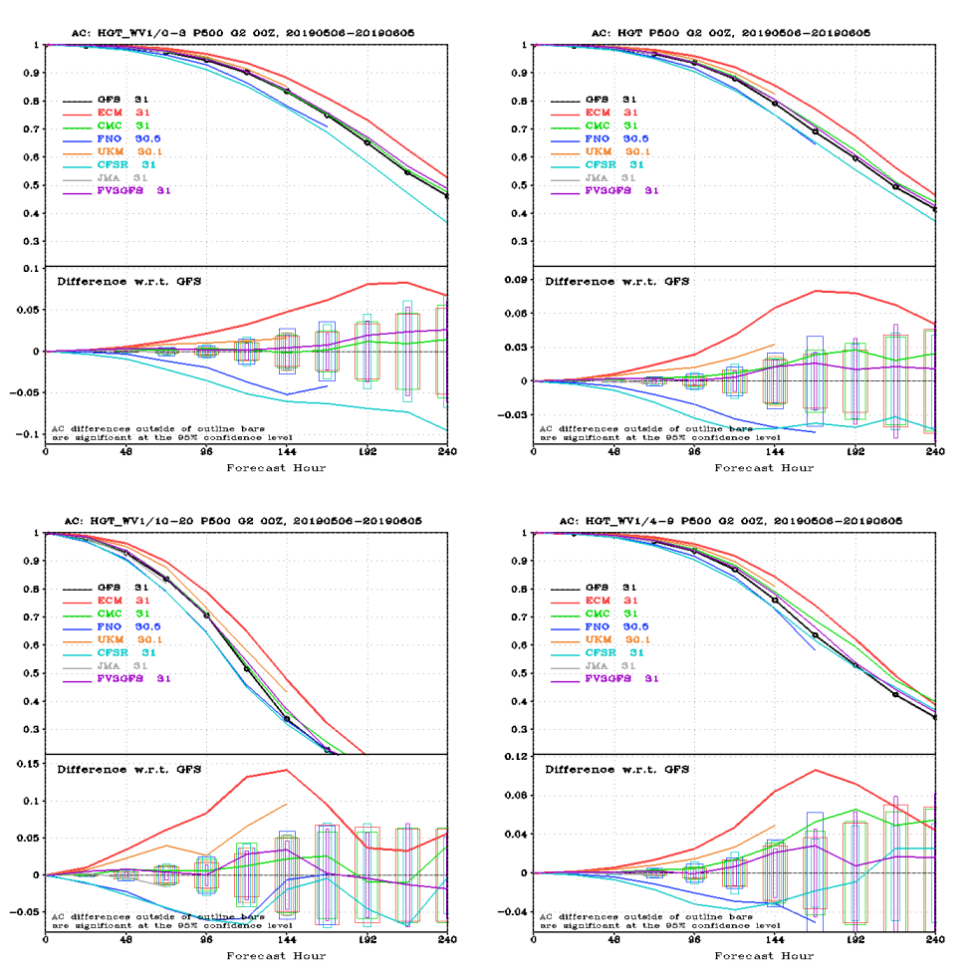

Slide 6
A number of global models are run out several weeks or more
GFS goes out to 384 hour (16 days)
ECMWF: Deterministic model: 10 days, 46 days (twice a week), and 7 months (once a month, coupled atmos/ocean)
CFS (NOAA Climate Forecast System): out to 9 months. Coupled atmos/ocean

Slide 7
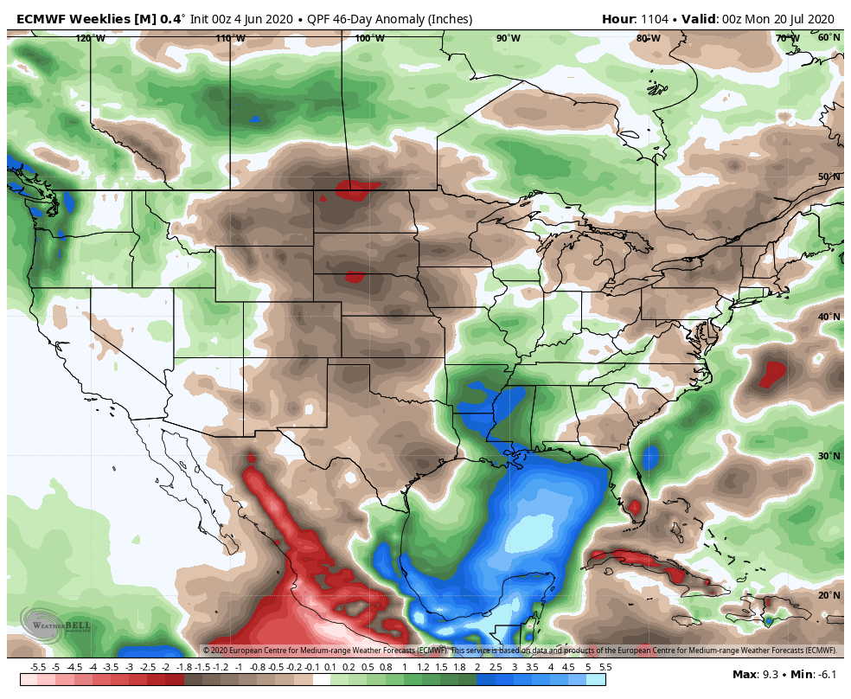

Slide 8
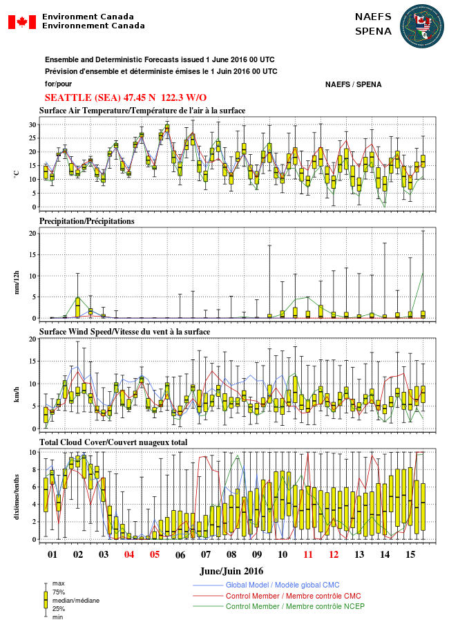
For week two, the best approach is to use global ensembles for prediction and to determine confidence

Slide 9
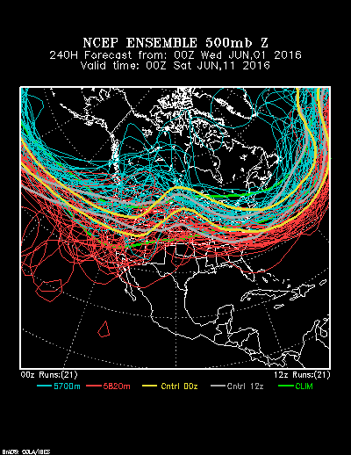
http://www.esrl.noaa.gov/psd/map/images/ens/ens.html#us

Slide 10
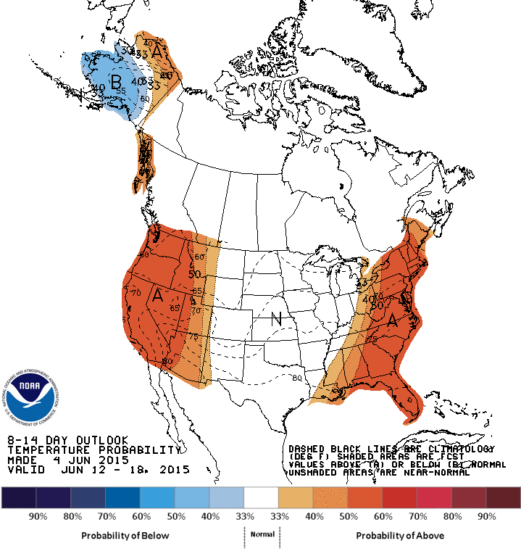
The Climate Prediction Center has graphics that summarize week two: model/human mix

Slide 11
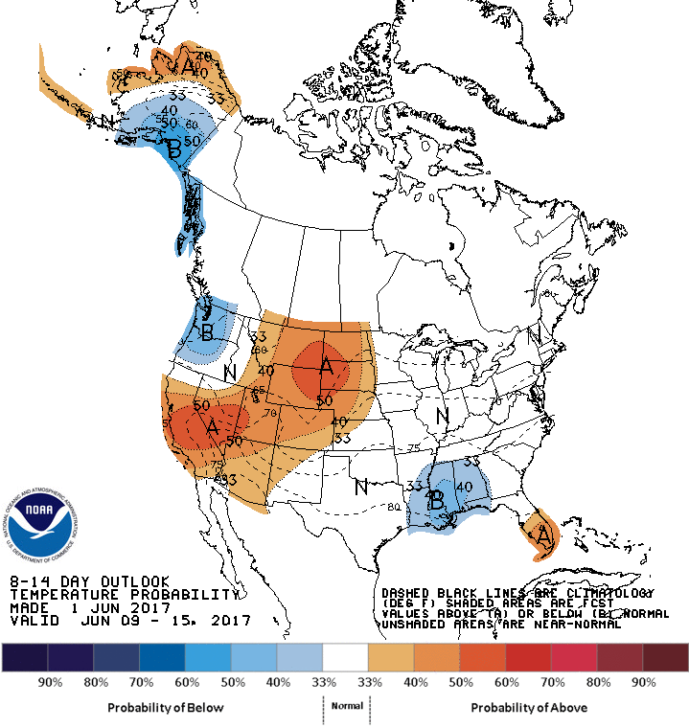
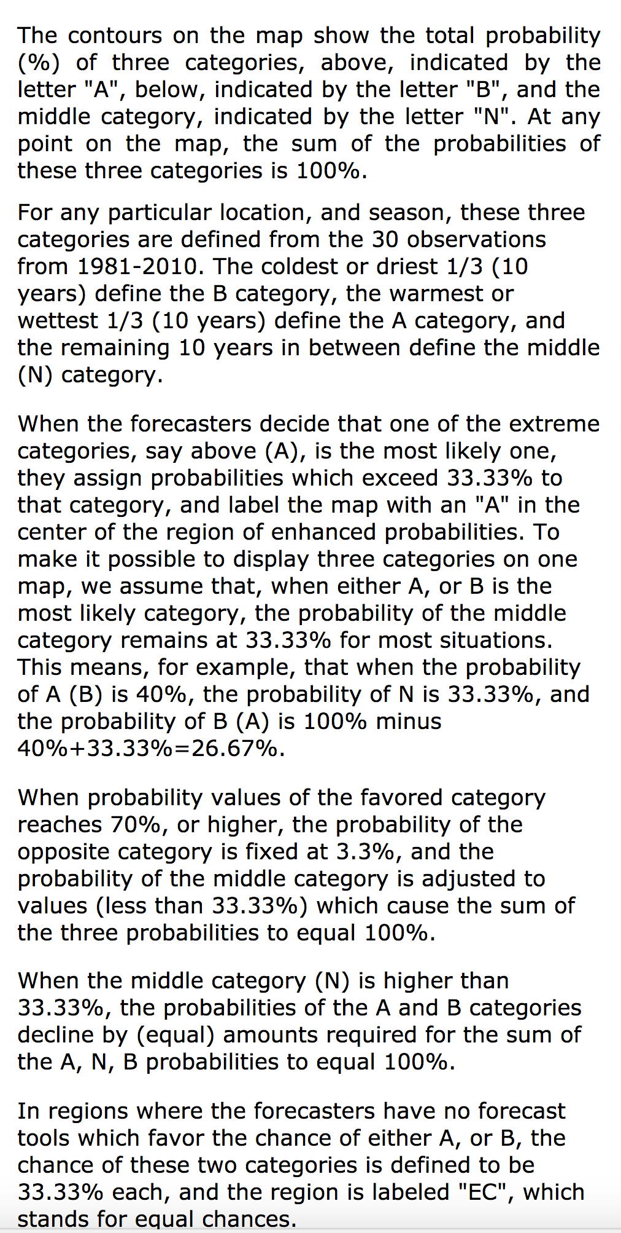
How to read three category maps

Slide 12
Longer than 2 weeks
There is the potential to forecast mean or average characteristics of the atmosphere further in time than 2 weeks.
One key to this long-range forecasting is the memory of the ocean.
Slowly changing surface characteristics can also be important (e.g., snow cover, sea ice coverage, soil moisture)
These slowly changing surface characteristics can have a substantial impact on the atmosphere

Slide 13
Extremely useful to review the SST and atmospheric circulation anomalies of the past months or year
Some anomalies are slowly varying, so provide information regarding future weather

Slide 14
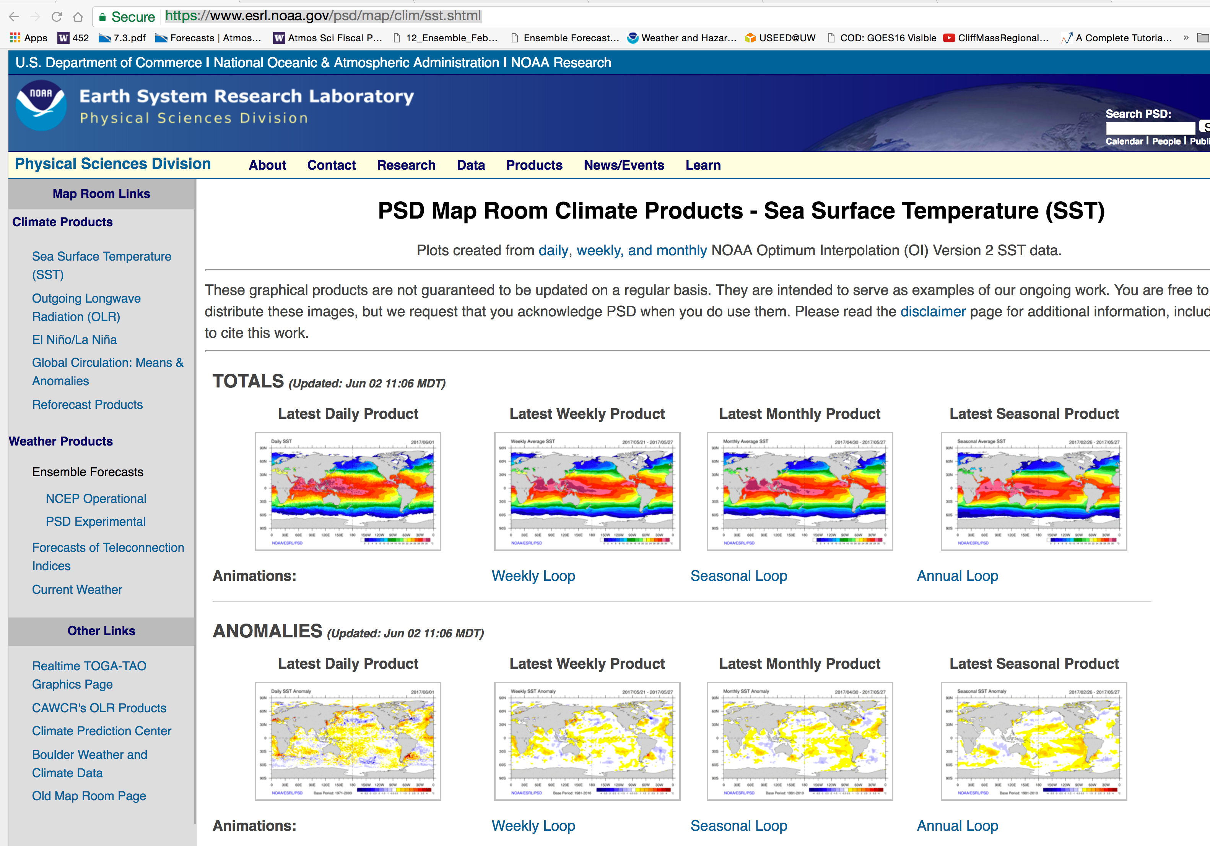
Very useful to review SST anomalies here

Slide 15
Some large-scale circulation anomalies are slowly changing or have some predictability
Can view them here.

Slide 16
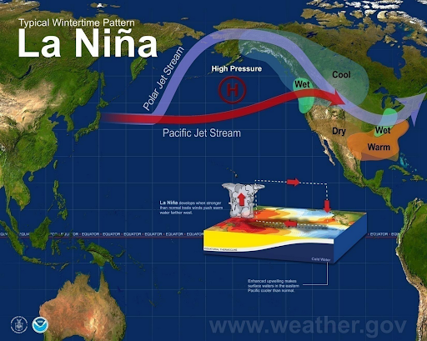
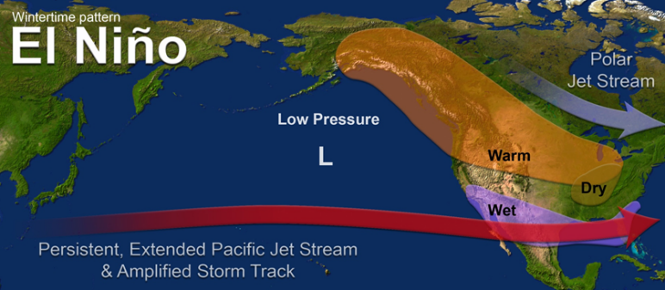
The Classic Example: El Nino and La Nina
Persistent and large tropical Pacific SST anomalies influence convection, which influences large scale wave patterns.

Slide 17
ENSO (El Nino Southern Oscillation)
An important atmosphere/ocean feature that has an average period of three to seven years.
Goes between El Nino, Neutral, and La Nina (ENSO cycle, El Nino Southern Oscillation)
Has large influence both in the tropics and midlatitudes.
Major source of forecast skill beyond a few weeks.

Slide 18
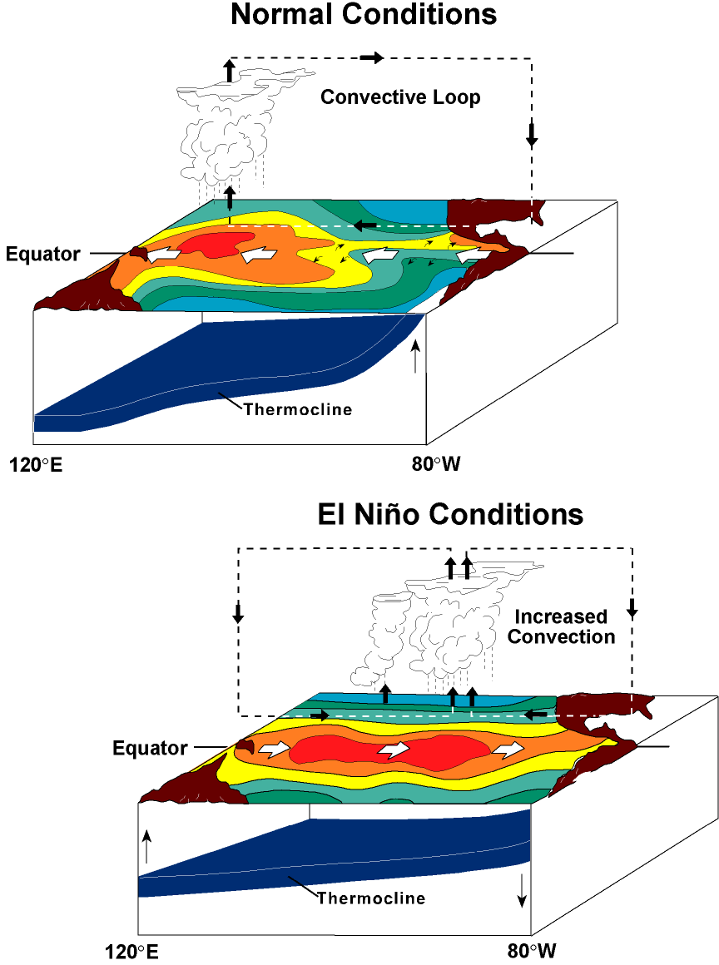

Slide 19
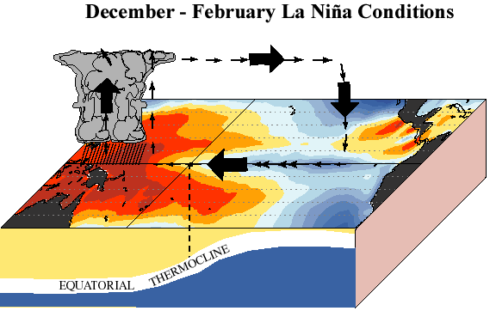

Slide 20

Think of sloshing
Water in a Bath
Tub

Slide 21
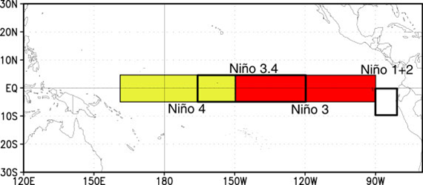
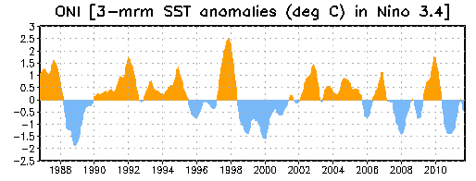
An Important Measure of ENSO is the Surface Temperature in the Tropical Pacific

Slide 22
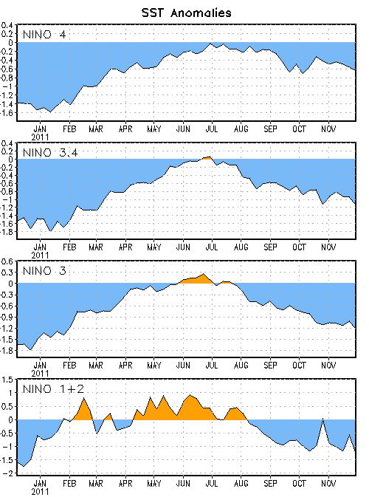
Niño Region SST Departures (ºC)
The latest weekly SST departures are:
Niño 4 -0.6ºC
Niño 3.4 -1.1ºC
Niño 3 -1.2ºC
Niño 1+2 -1.3ºC

Slide 23
Why do we care?
The circulations in the midlatitudes are often different during El Nino, Neutral, and La Nina years.
Since the temperature of the tropical Pacific changes relatively slowly, this gives some meteorologists some insights into the weather over the next several months.
We do have ENSO forecast models of marginal skill.

Slide 24
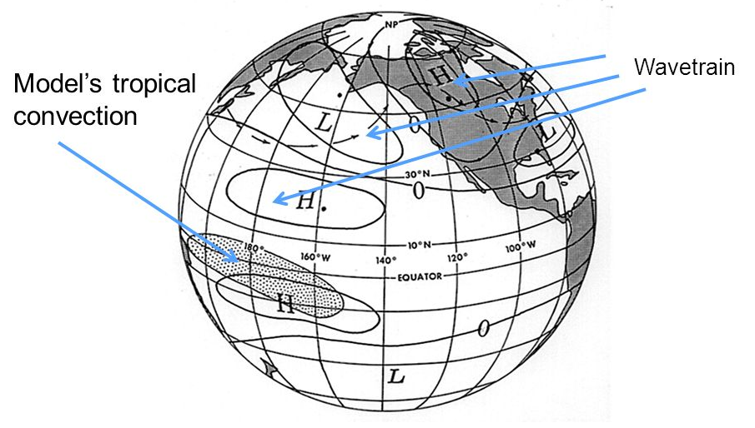
Teleconnections from the tropics
PNA Area

Slide 25
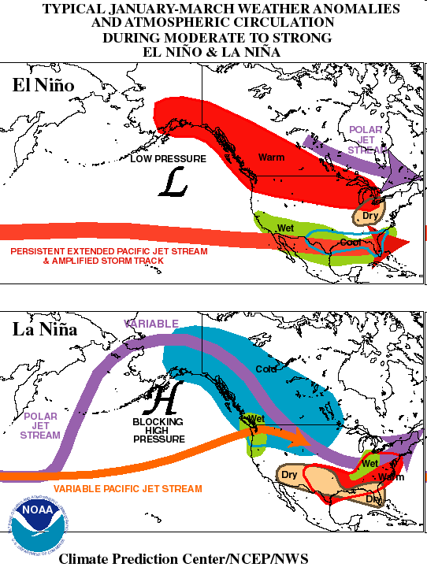
El Nino: wet over southern tier of states, warmer to the north

Slide 26
La Nina – strong Aleutian High

Slide 27
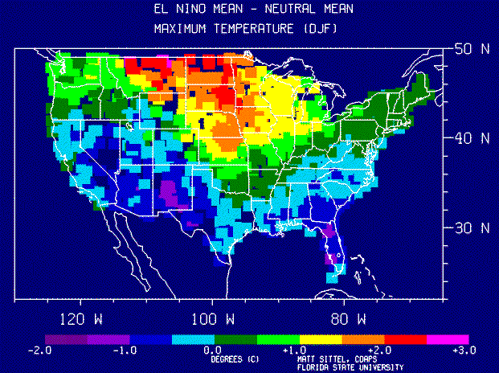

Slide 28
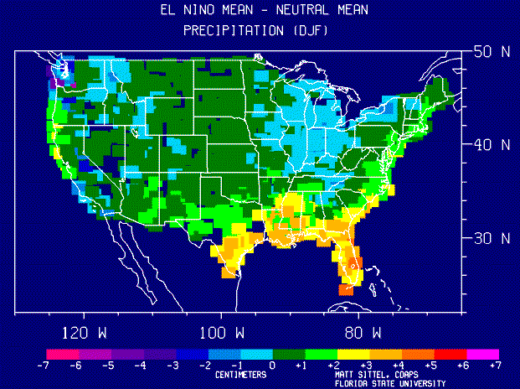

Slide 29
The correlation between El Nino/La Nina (ENSO) and midlatitude weather is a key tool for extended forecasting
The BEST web site for information is at the Climate Prediction Center
https://www.cpc.ncep.noaa.gov/products/precip/CWlink/MJO/enso.shtml
https://www.cpc.ncep.noaa.gov/products/analysis_monitoring/lanina/enso_evolution-status-fcsts-web.ppt
http://www.cpc.ncep.noaa.gov/products/analysis_monitoring/enso_advisory/index.shtml

Slide 30
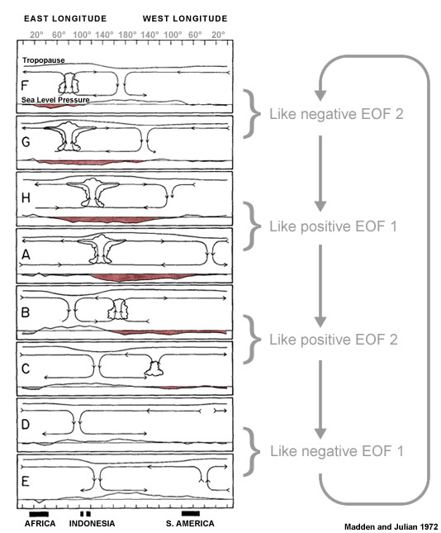
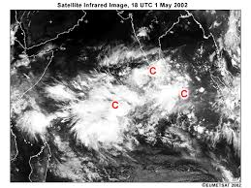
Other important subseasonal feature: The Madden Julian Oscillation (MJO)

Slide 31
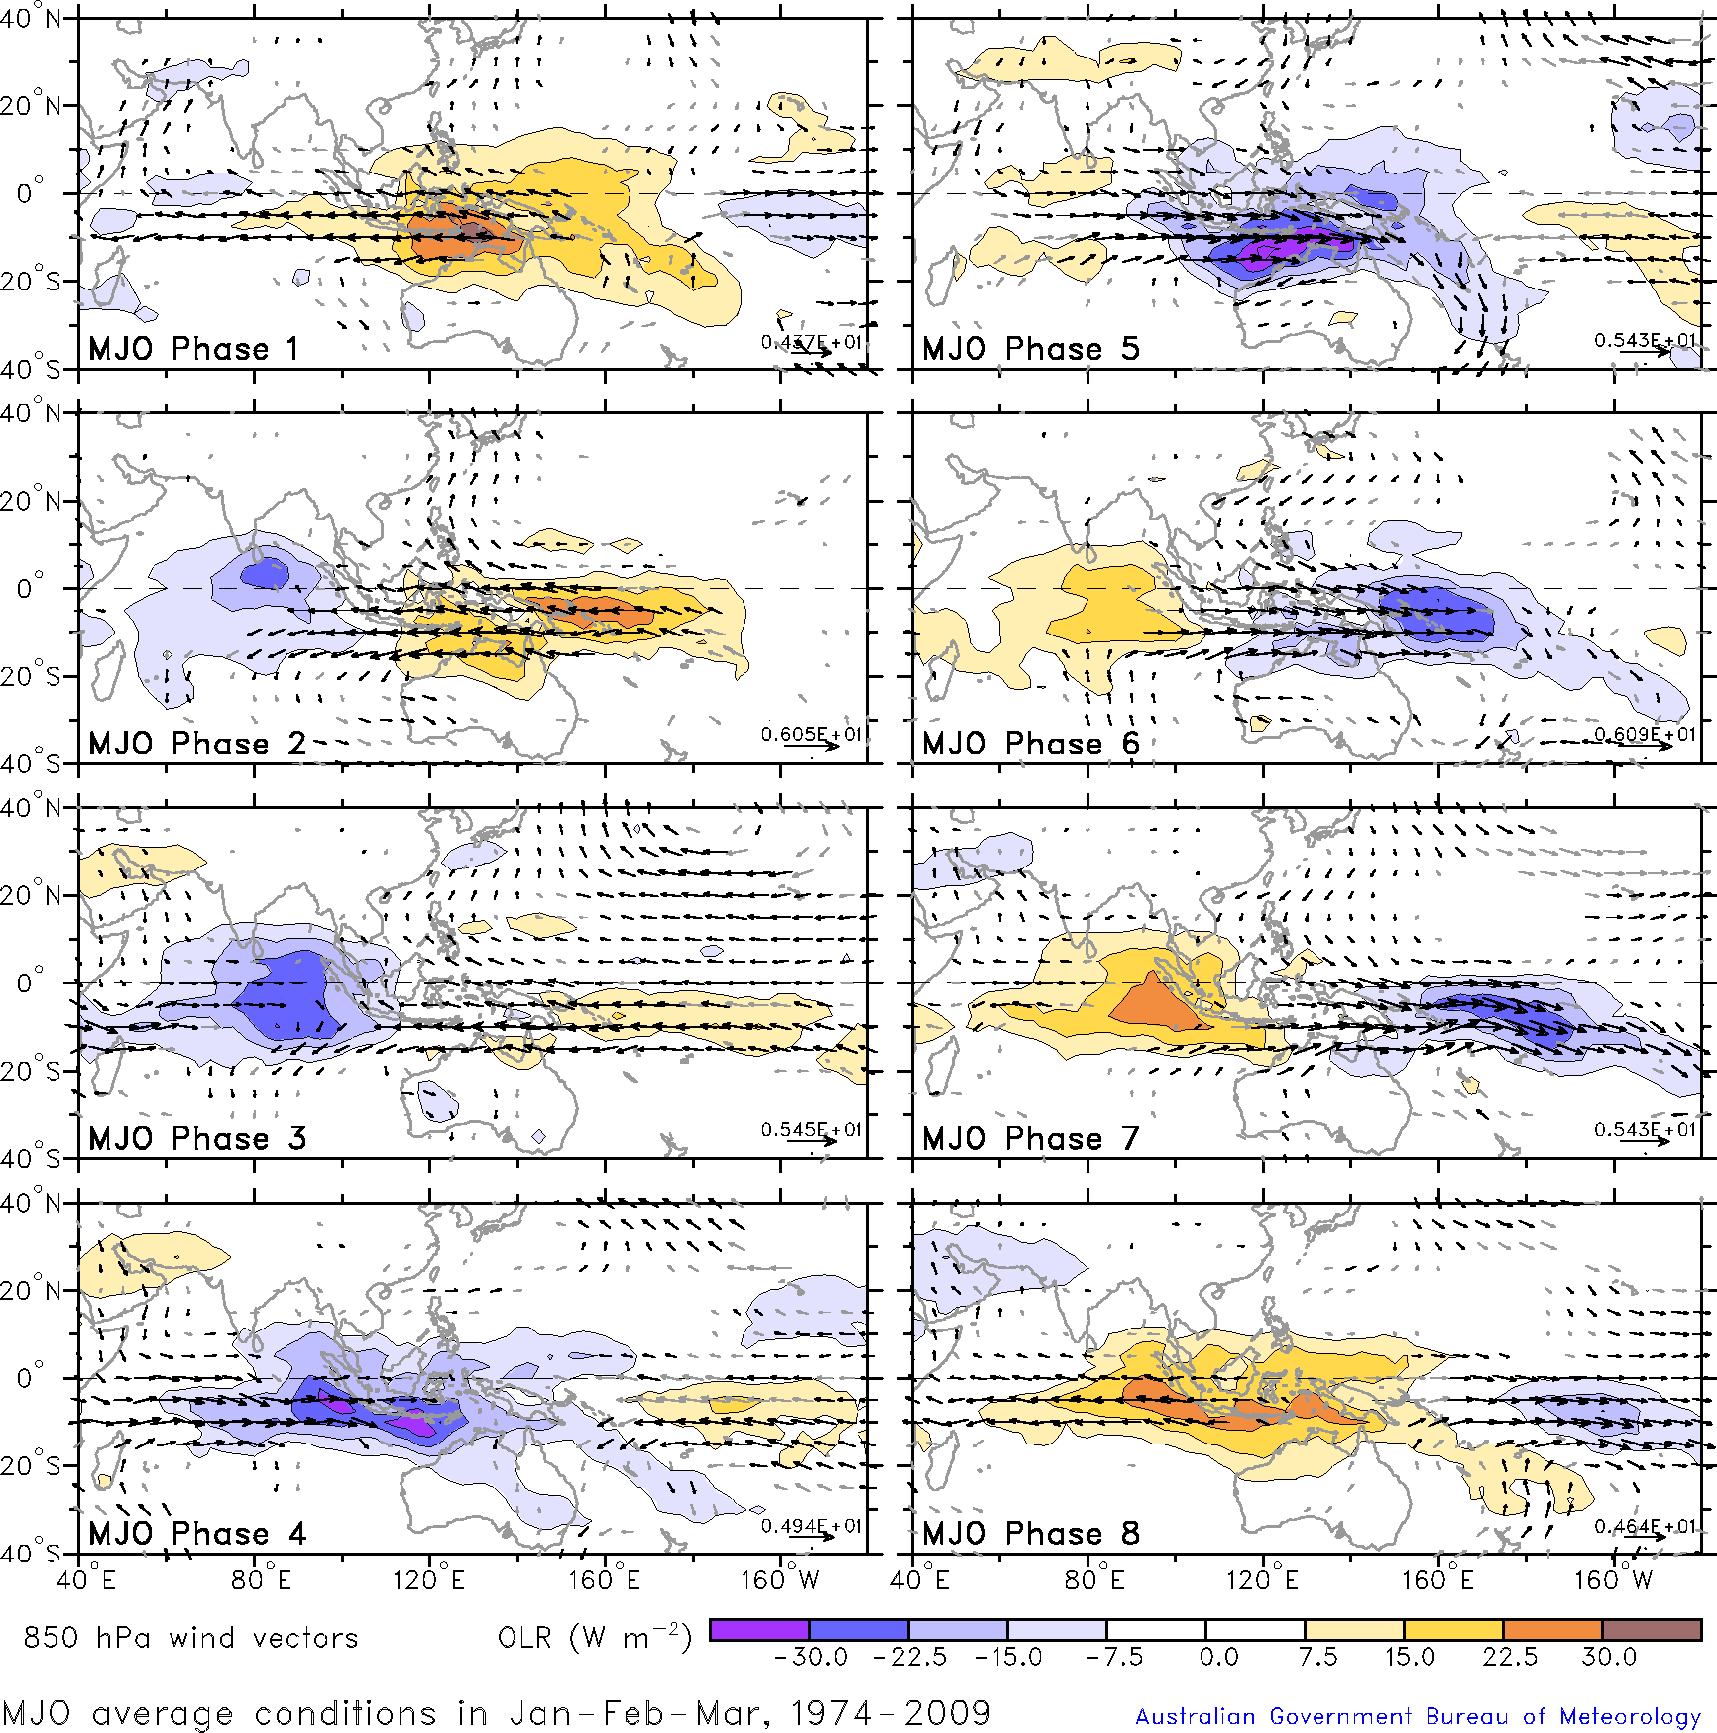
MJO Phases

Slide 32
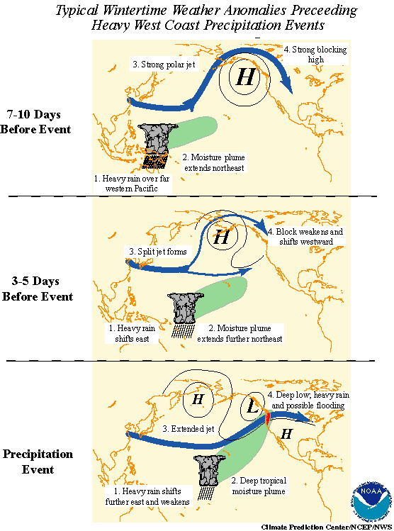
Has implications for West Coast atmospheric rivers

Slide 33
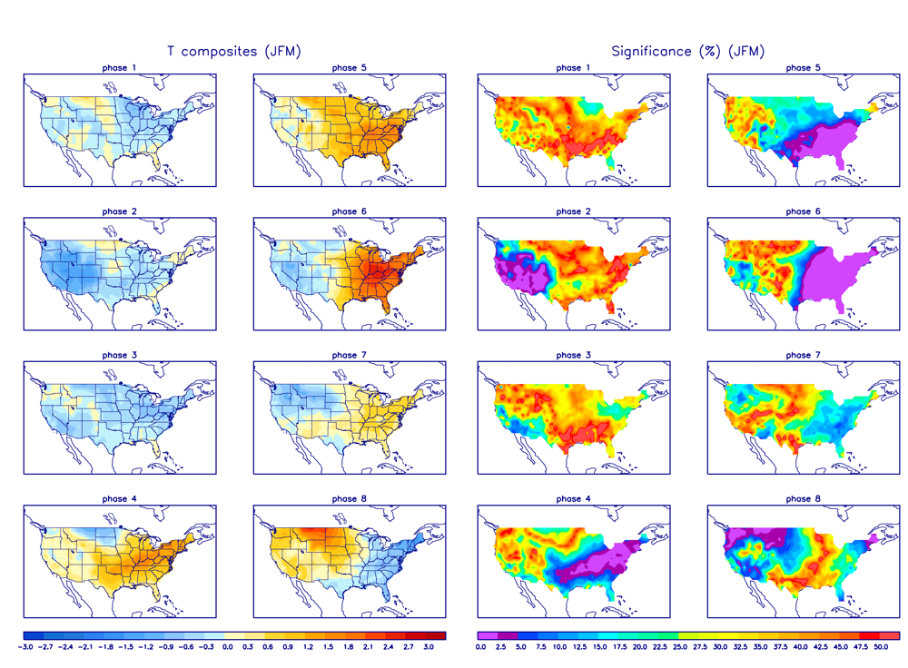
And for US Temp and Precip

Slide 34
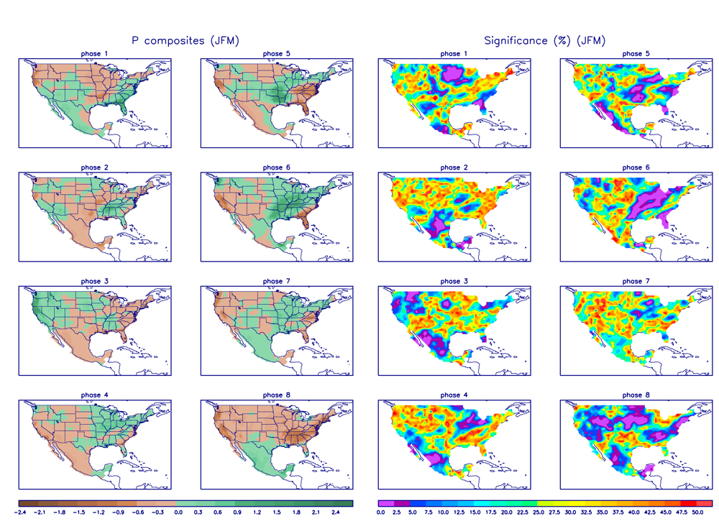

Slide 35
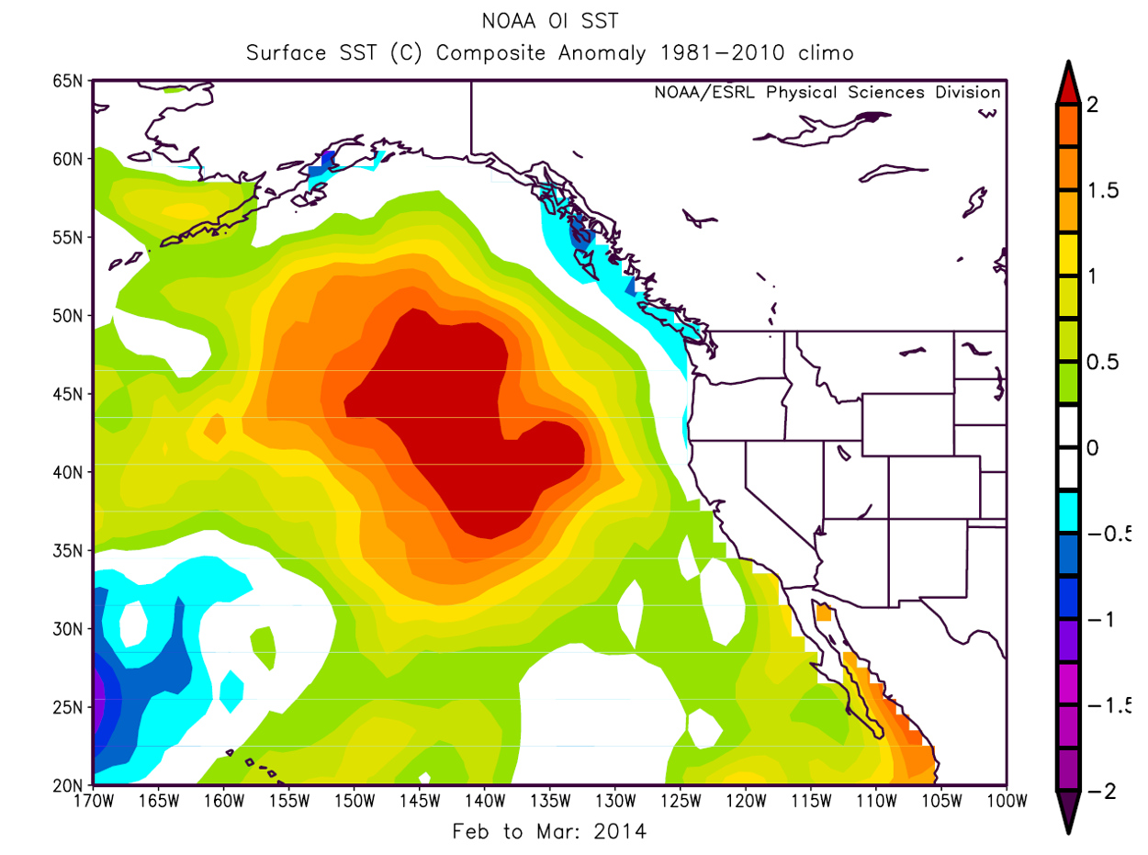
Long Term Impacts of Midlatitude Sea Surface Temperature Anomalies
Example: the BLOB.

Slide 36
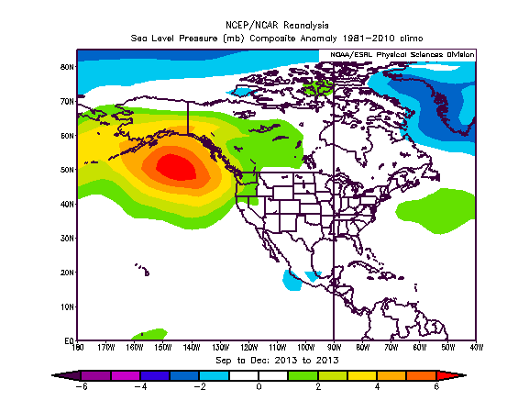
Caused by sustained high pressure

Slide 37
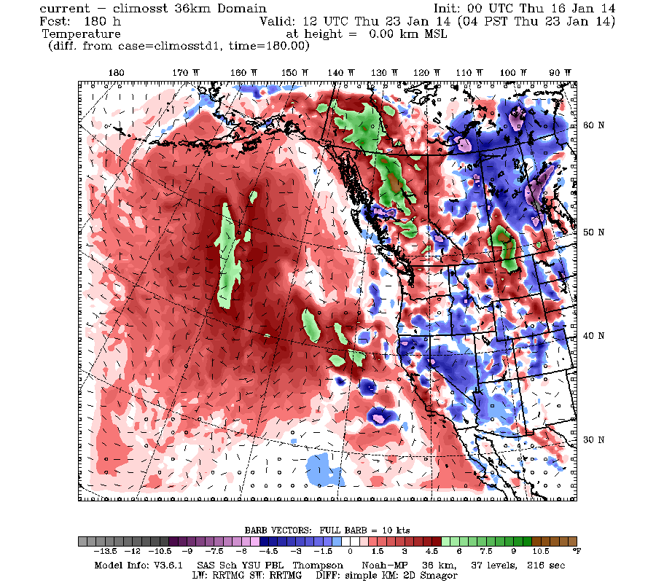
SST anomalies have a lot of persistence: in the case of the Blob contribute to warming downstream

Slide 38
Long Range Numerical Forecasts
During the past two decades, a new generation of extended forecasting systems have been developed that run coupled global atmosphere/ocean models out MONTHS
An example is the NOAA Climate Forecasting System (CFS)…now CFSv2
Runs a version of the GFS and a coupled ocean model out 9 months.

Slide 39
The CFS
GFS run at roughly 60 km grid spacing and 64 levels.
Run every six hours (4 runs each time…an ensemble)

Slide 40
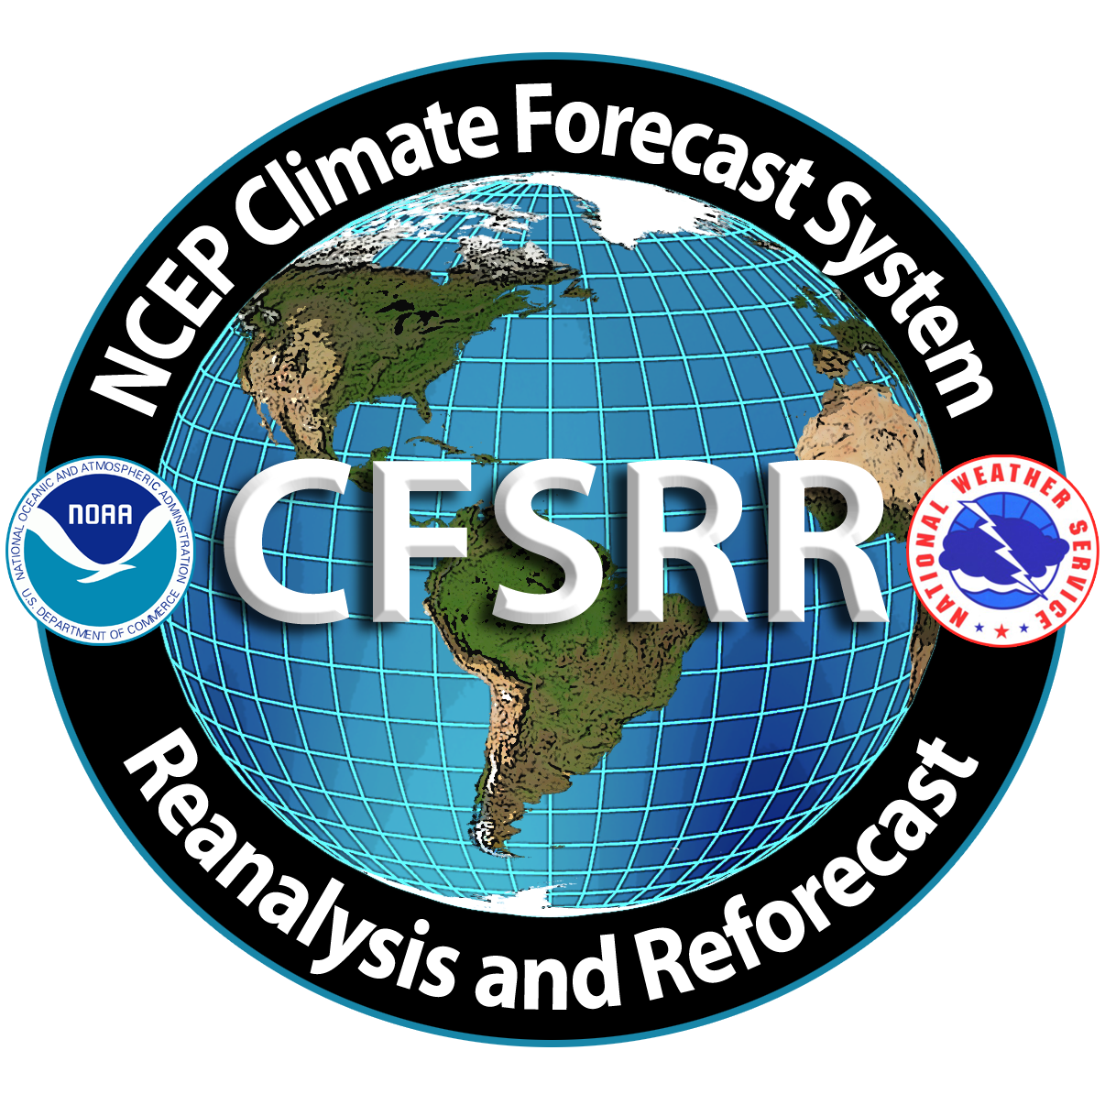



Operational Configuration for CFSv2 real time forecasts (T126L64)
There will be 4 control runs per day from the 0, 6, 12 and 18 UTC cycles of the CFS real-time data assimilation system, out to 9 months.
In addition to the control run of 9 months at the 0 UTC cycle, there will be 3 additional runs, out to one season. These 3 runs per cycle will be initialized as in current operations.
In addition to the control run of 9 months at the 6, 12 and 18 UTC cycles, there will be 3 additional runs, out to 45 days. These 3 runs per cycle will be initialized as in current operations.
There will be a total of 16 CFS runs every day, of which 4 runs will go out to 9 months, 3 runs will go out to 1 season and 9 runs will go out to 45 days.
0 UTC
6 UTC
12 UTC
18 UTC
9 month run (4)
1 season run (3)
45 day run (9)

Slide 41
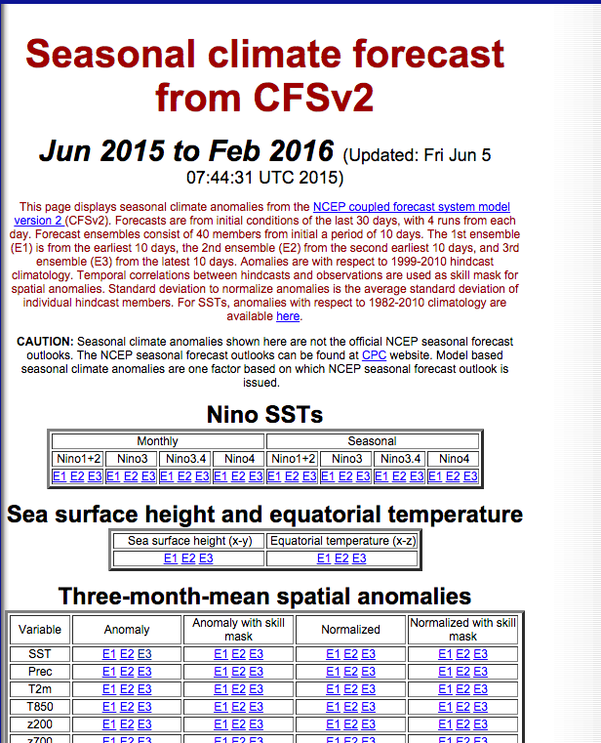
http://www.cpc.ncep.noaa.gov/products/people/wwang/cfsv2fcst/

Slide 42
CFS loses skill quickly after several weeks

Slide 43
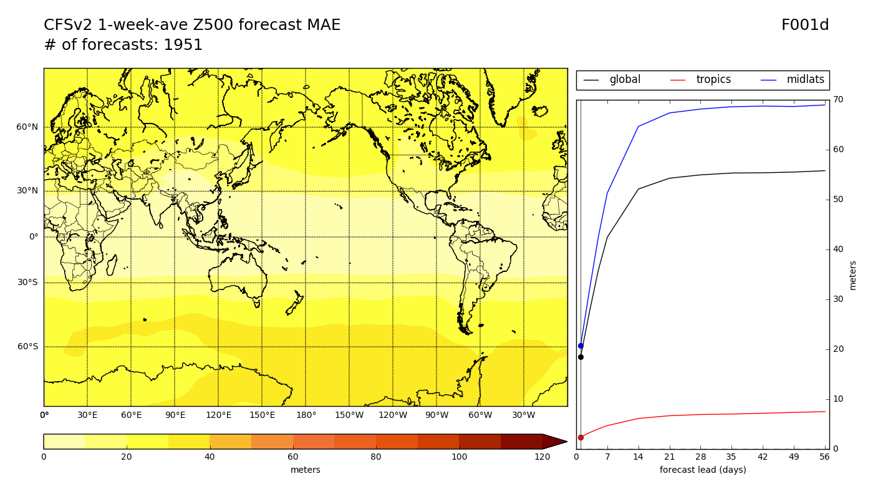
Z500 MAE - week 1 *de-biased

Slide 44
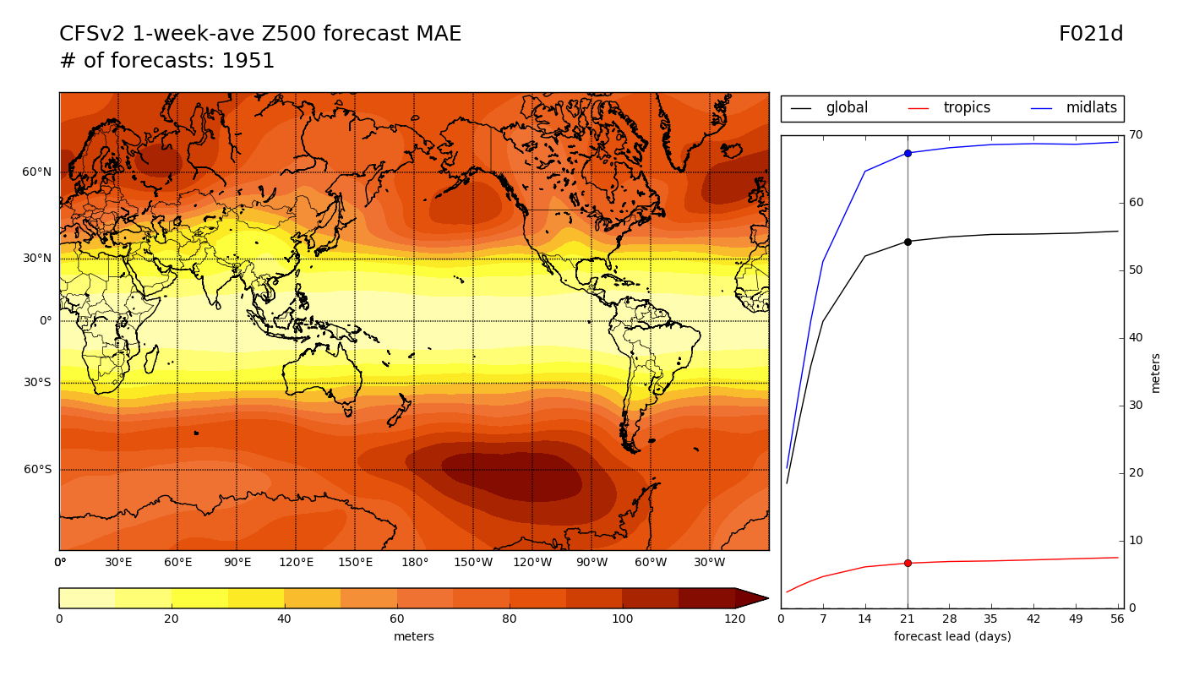
Z500 MAE - week 4 *de-biased

Slide 45
Z500 MAE - week 4 *de-biased
Errors saturate after 3 weeks
Storm tracks
Errors rapidly grow in the first week

Slide 46
SSTs: Holds Skill Longer

Slide 47
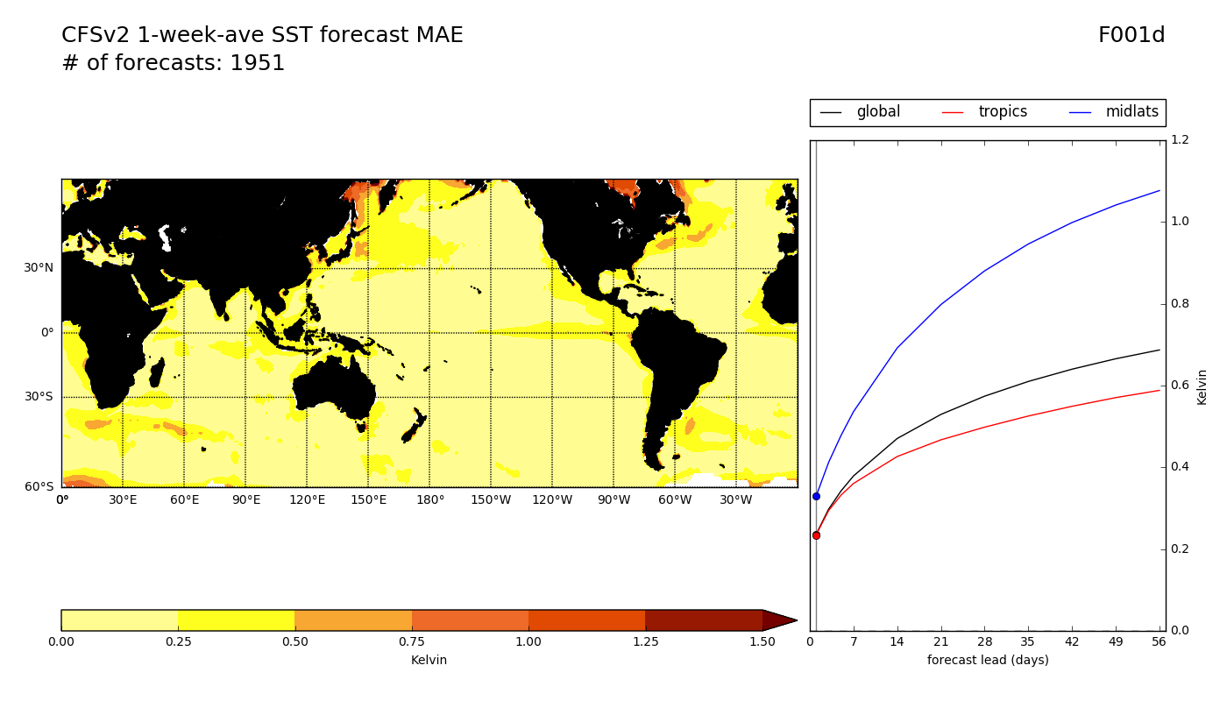
SST MAE - week 1 *de-biased

Slide 48
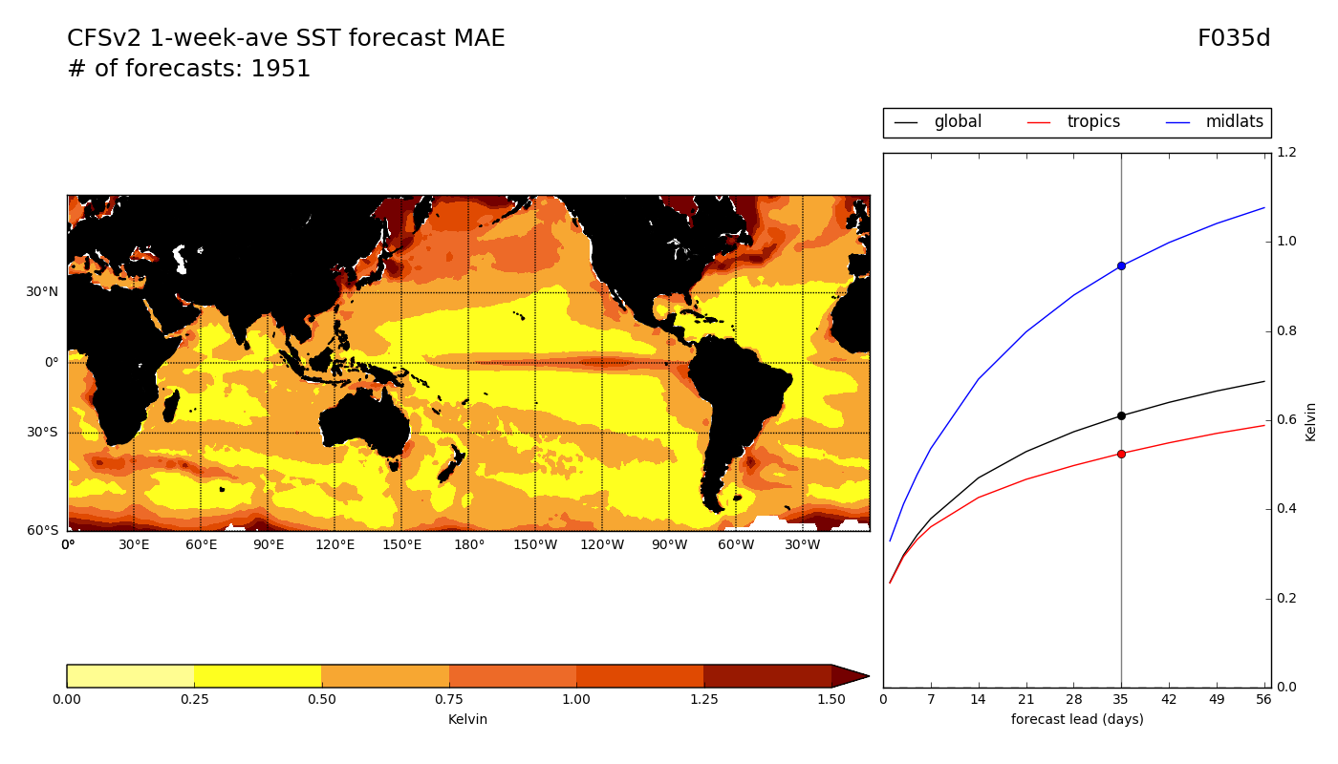
SST MAE - week 6 *de-biased

Slide 49
There are seasonal forecast ensembles. Examples include:
NMME: North American Multimodel Ensemble (combines CFS and Canadian)
IMME (International Multimodel Ensemble)
Link here:
http://www.cpc.ncep.noaa.gov/products/NMME/

Slide 50
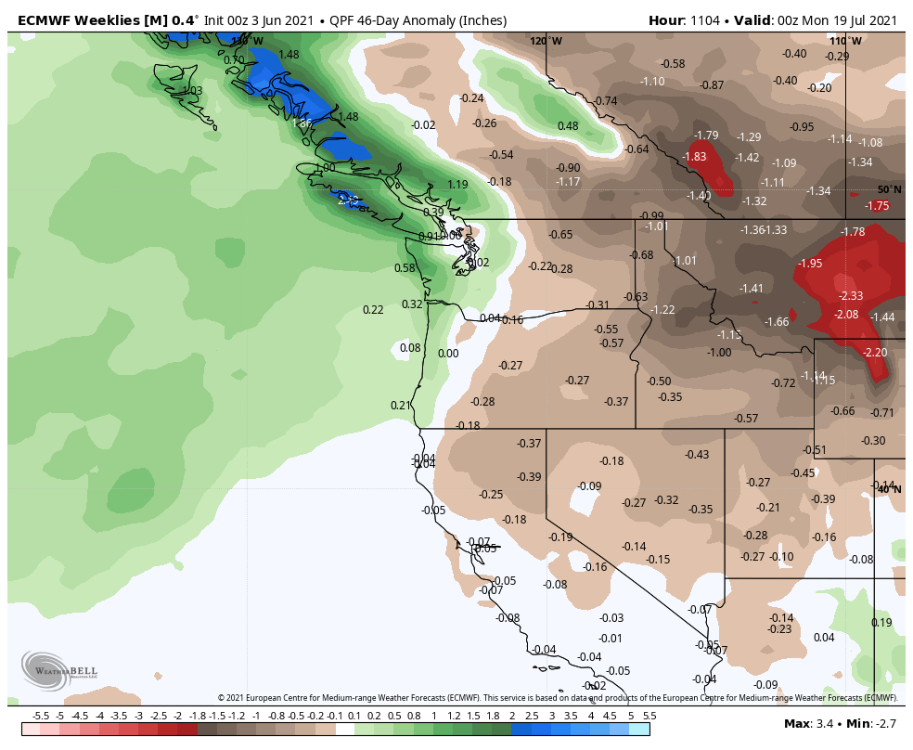
European Center is Best for first 1.5 months

Slide 51
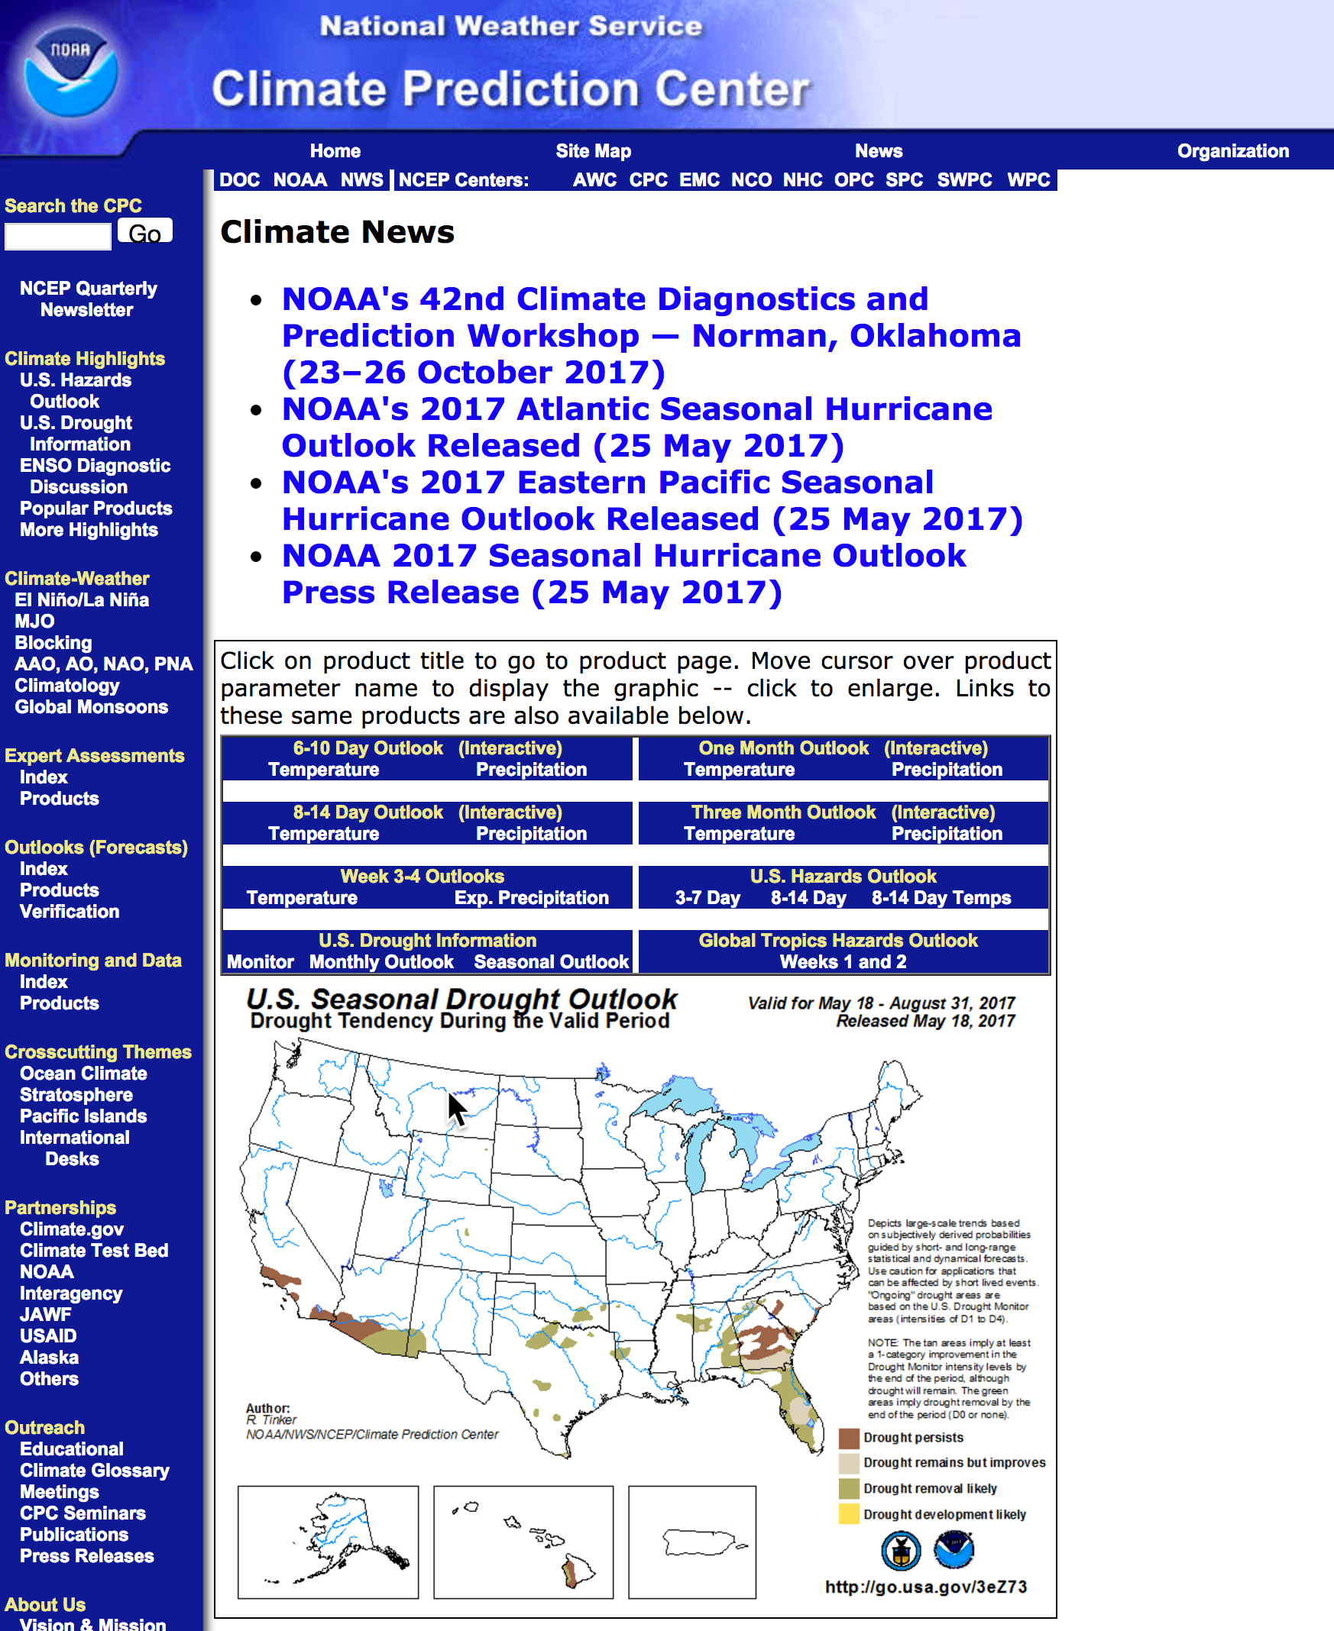
Climate Prediction Center (CPC)

Slide 52
Why do subseasonal and seasonal forecasts go bad after a few weeks?
Initialization errors grow with time (a la Lorenz)
Physics deficiencies
Poor, parameterized convection is a very possible major sources of error.

Slide 53
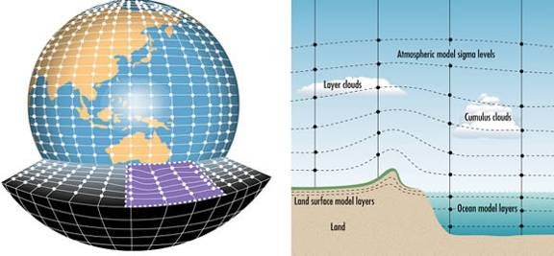
The Future
Running global models at convection-permitting resolution

Slide 54
Subseasonal Experiments with MPAS
3-km grid spacing for the entire globe
One-month runs
Initialized with GFS FNL analyses
No cumulus parameterization
Thompson Microphysics
MYNN PBL
NOAA LSM
RRTMG Radiation
SST remains constant during the simulations

Slide 55
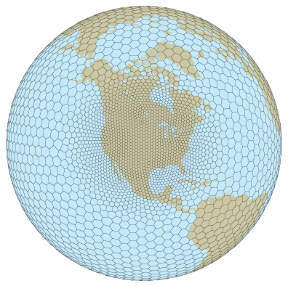
MPAS

Slide 56
Note:
Using constant SST is substantially hurting skill of simulations and would not be used in operational simulations.
FNL initialization are quite coarse (.5 degree).
We will compare:
  TRMM analyses (REALITY)
  CFSv2 operational forecasts
  MPAS at 15 km resolution globally with Grell-Frietas cumulus parameterization
  MPAS at 3 km resolution globally without cumulus parameterization

Slide 57
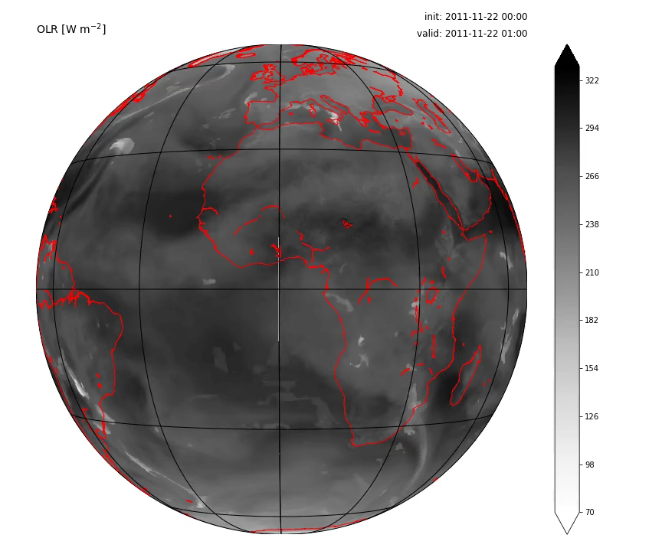
Case 1: DYNAMO MJO2 (2011-11-22)

Slide 58
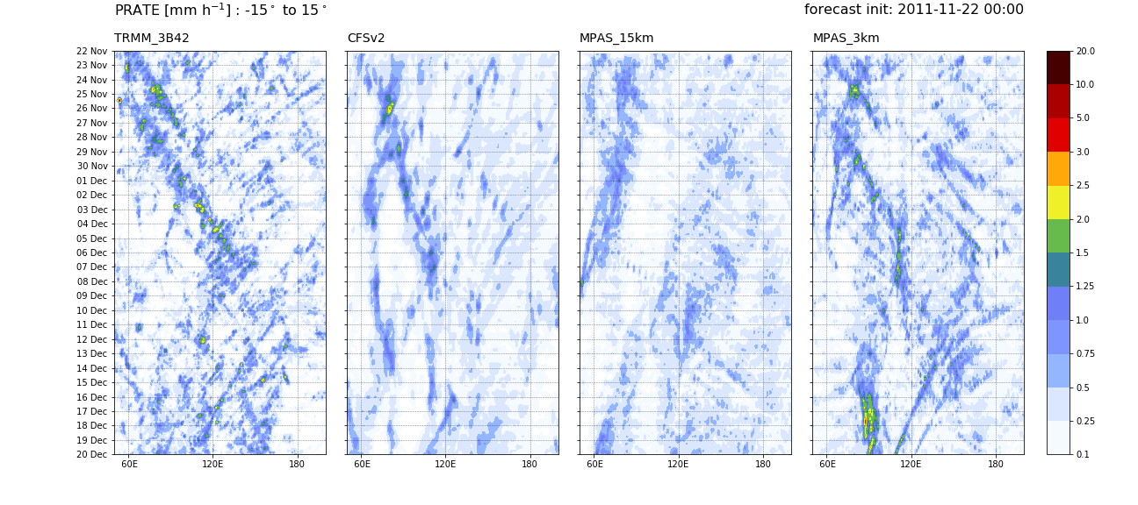
Case 1: Hovmöllers – precip. rate

Slide 59
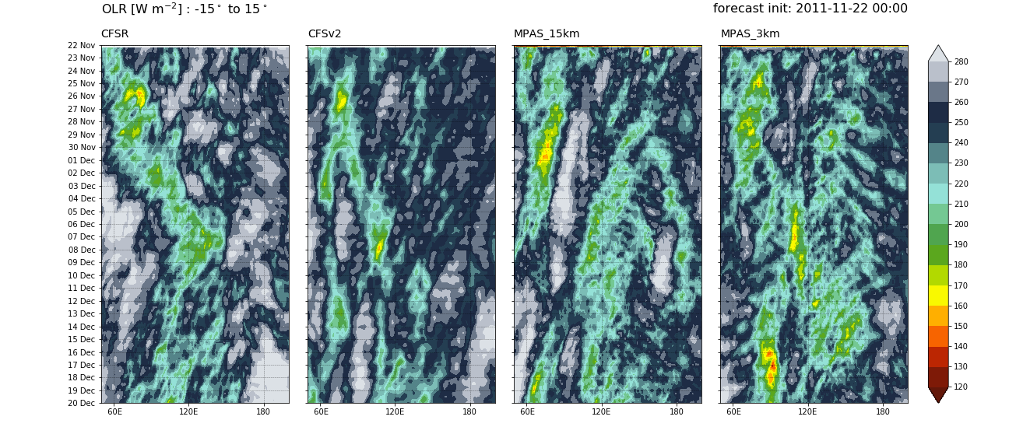
Case 1: Hovmöllers – OLR

Slide 60
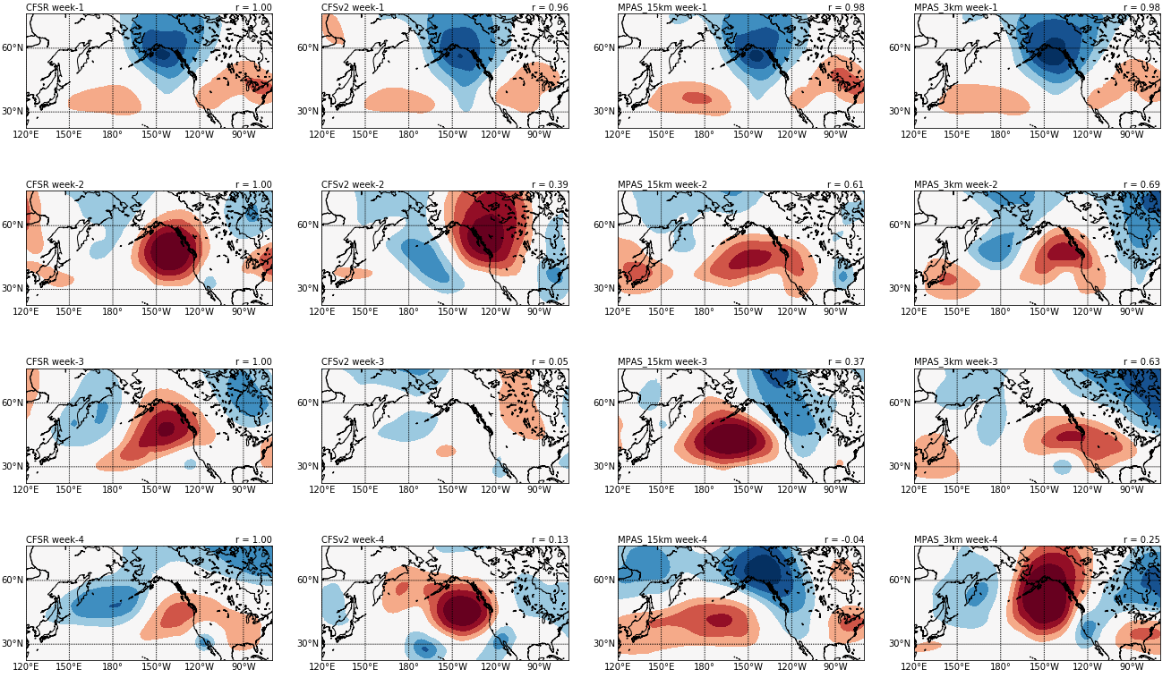
Case 1: Extratropical Z500’

Slide 61
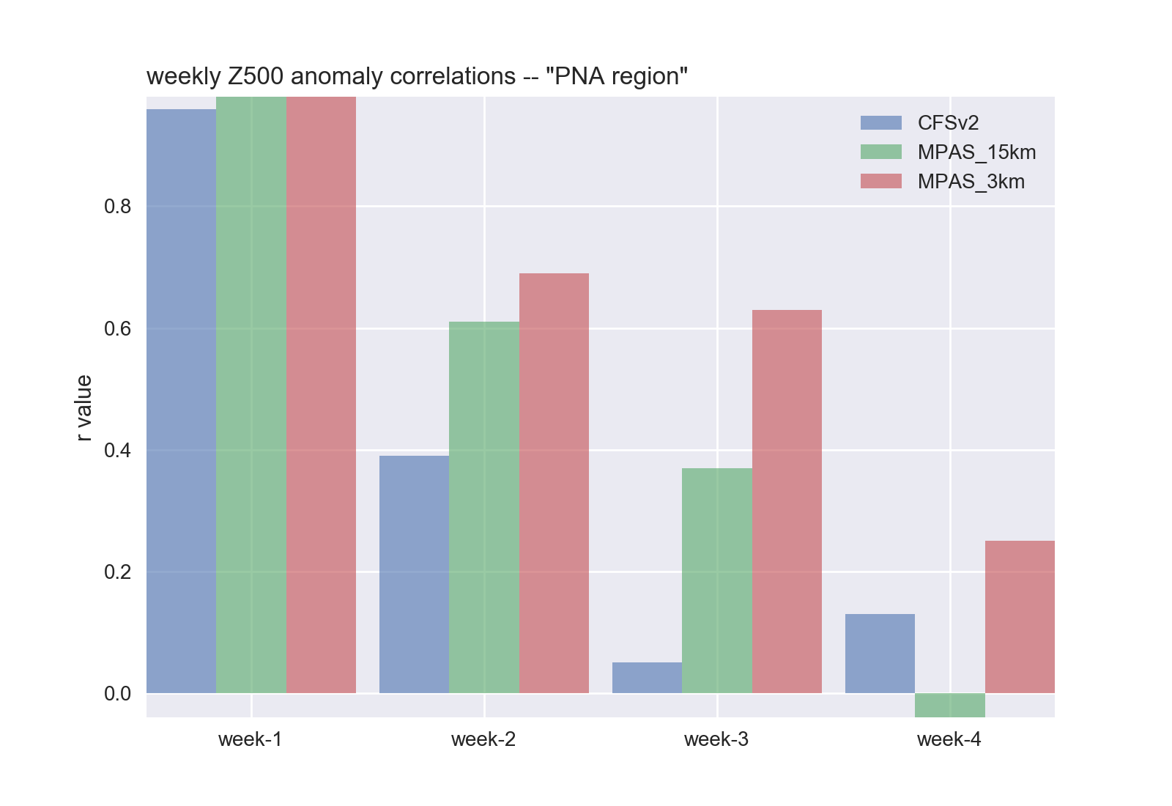
Case 1: Extratropical Z500’

Slide 62
Global High Convection Permitting Resolution is the Future of Extended Prediction
The big issue is lack of computer resources
Probably ten years off.

Slide 63
Final Notes
Online course evaluation: please do it!
I am available for one-on-one zoom calls this weekend and Monday AM if you have questions.
Also welcome email questions.
Exams will be sent to you on Monday at 2:30 PM in WORD and PDF versions
Planning on having a NON-REQUIRED refreshment session (more from Nick)

