Slide 1
Subseasonal and Seasonal Forecasts
ATMS 452
Spring 2025

Slide 2
Terminology
Subseasonal forecasts: 2-6 weeks
Seasonal forecasts: 1.5-12 months

Slide 3
How far out in time do we have forecast skill?
Weather prediction skill is now extending into the second week
Superstorm Sandy was a famous example, but there are more.

Slide 4
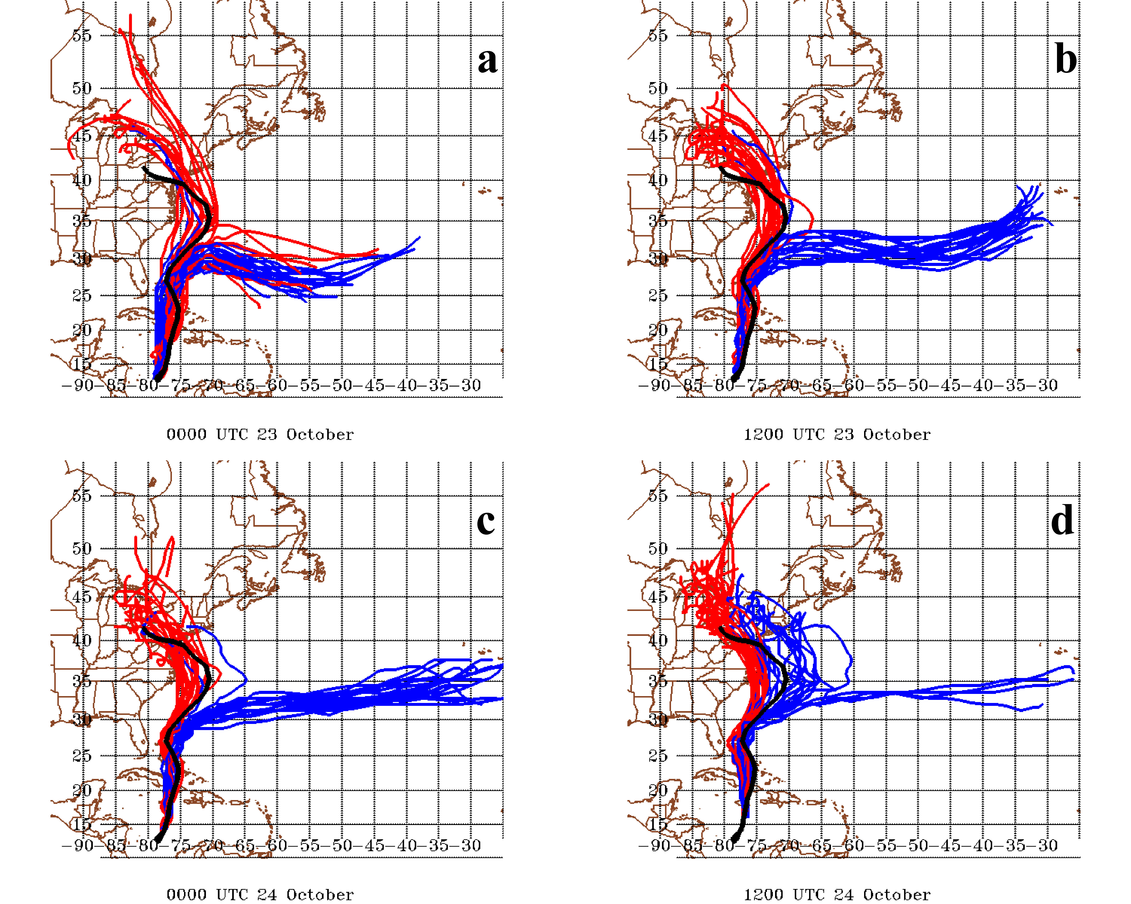
Hit NY on Oct. 29

Slide 5
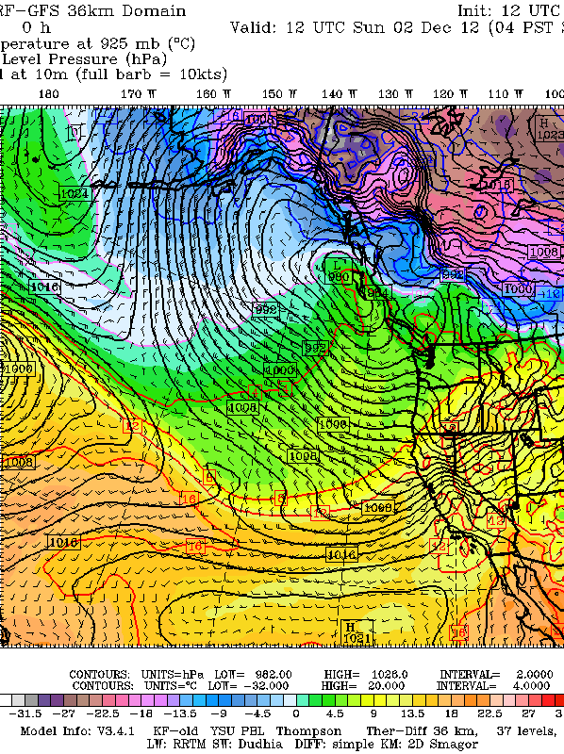
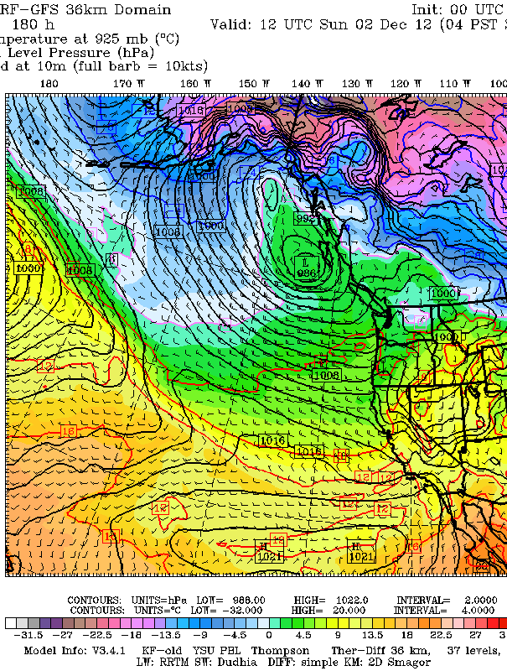
Observed 180 hr (7.5 days)

Slide 6
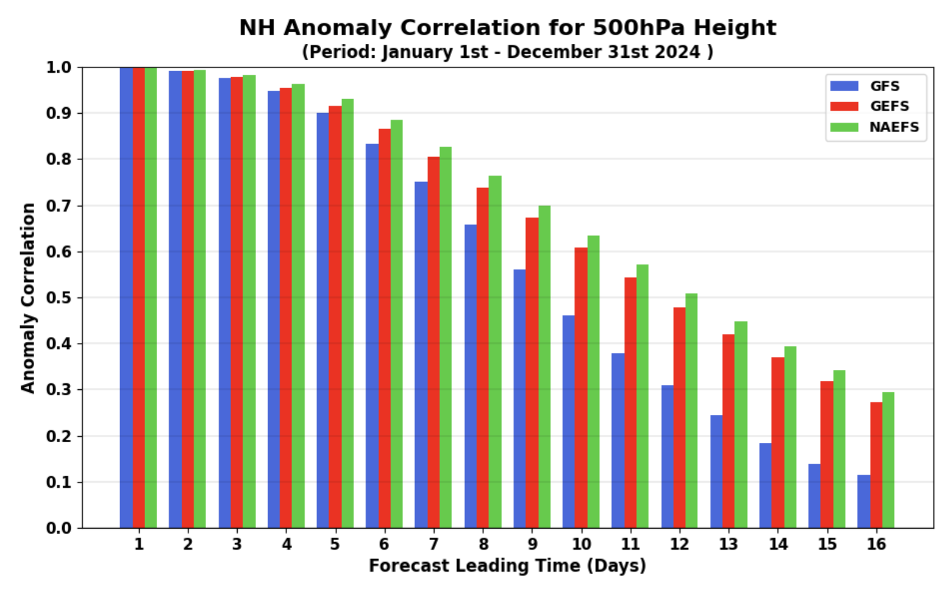
8 days

Slide 7
A number of global models are run out several weeks or more
GFS goes out to 384 hour (16 days)
ECMWF: Deterministic model: 10 days, 46 days (twice a week), and 7 months (once a month, coupled atmos/ocean)
CFS (NOAA Climate Forecast System): out to 9 months. Coupled atmos/ocean

Slide 8
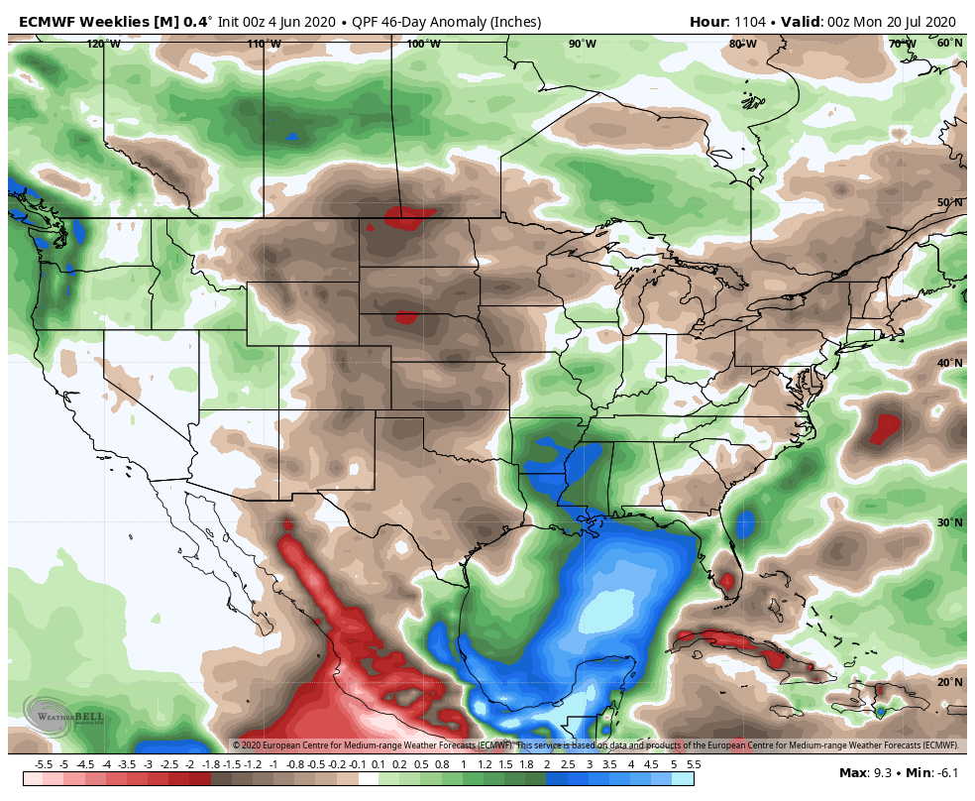

Slide 9
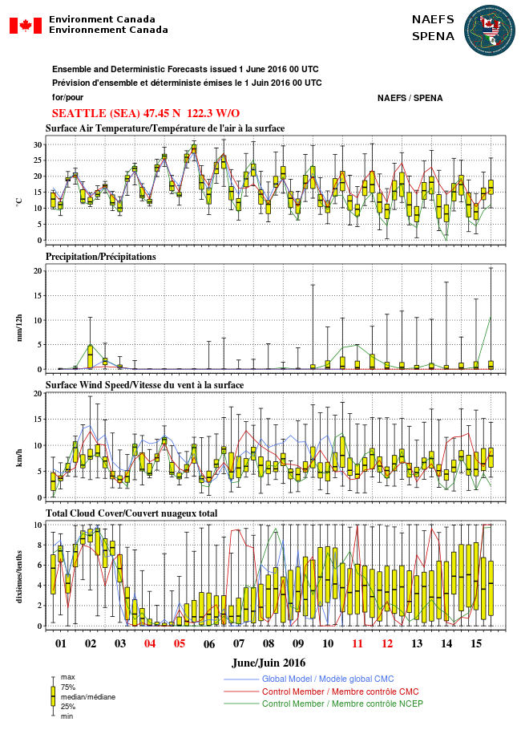
For week two, the best approach is to use global ensembles for prediction and to determine confidence

Slide 10
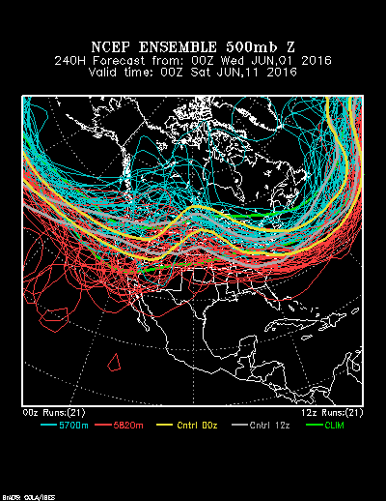
http://www.esrl.noaa.gov/psd/map/images/ens/ens.html#us

Slide 11
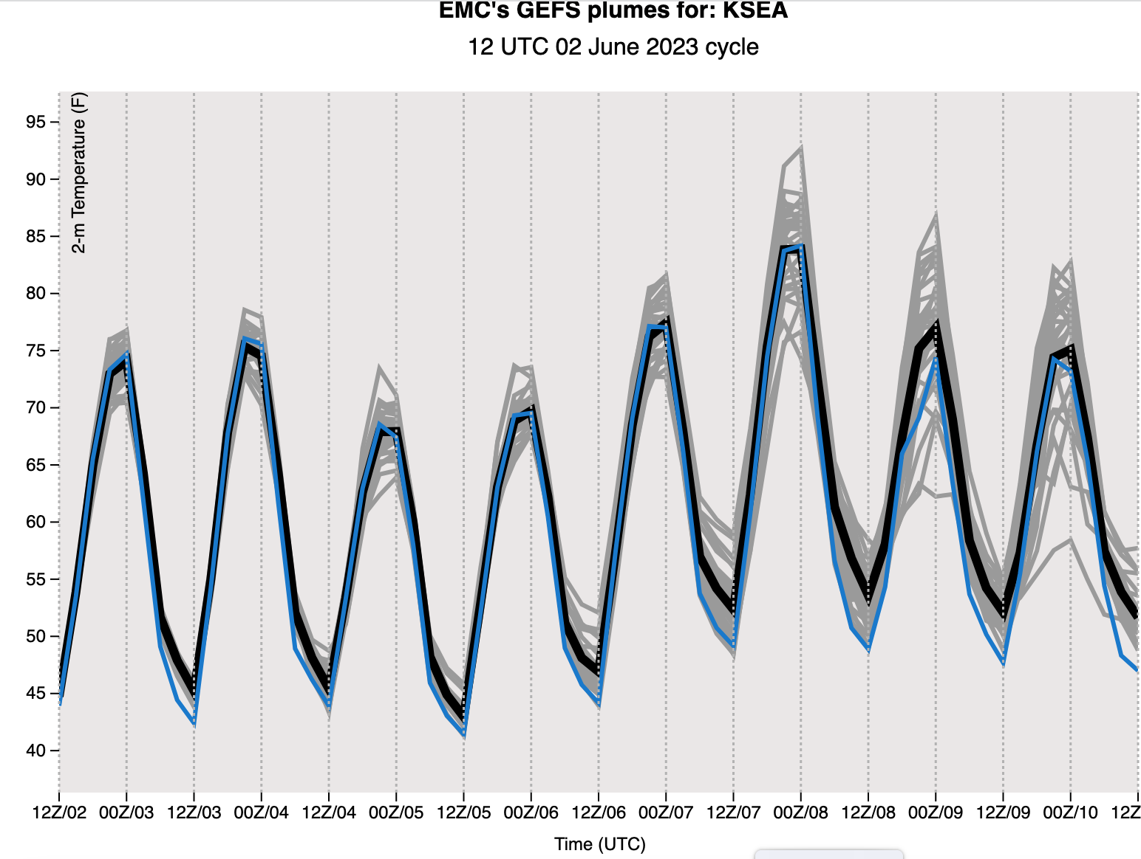
How does one appraise the skill of 7-14 day forecasts?
Look at spread of ensemble. Is their agreement?
Plume plots are very useful.

Slide 12
Consider temporal consistency (dprog/dt)
Do forecasts verifying at the same time, but initialized at different times, lock on to a solution?
UW WRF system has the ability to evaluate this consistency

Slide 13
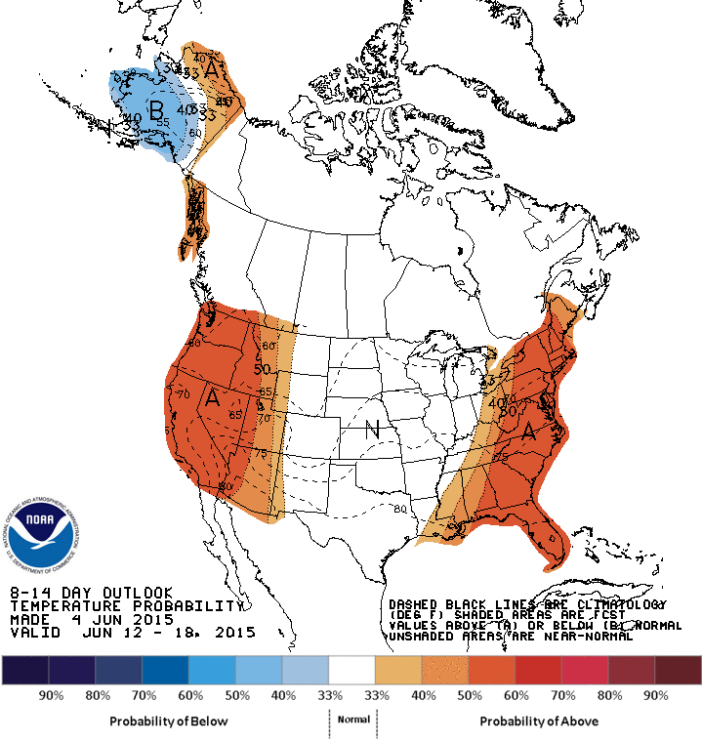
The Climate Prediction Center has graphics that summarize week two forecast: model/human mix

Slide 14
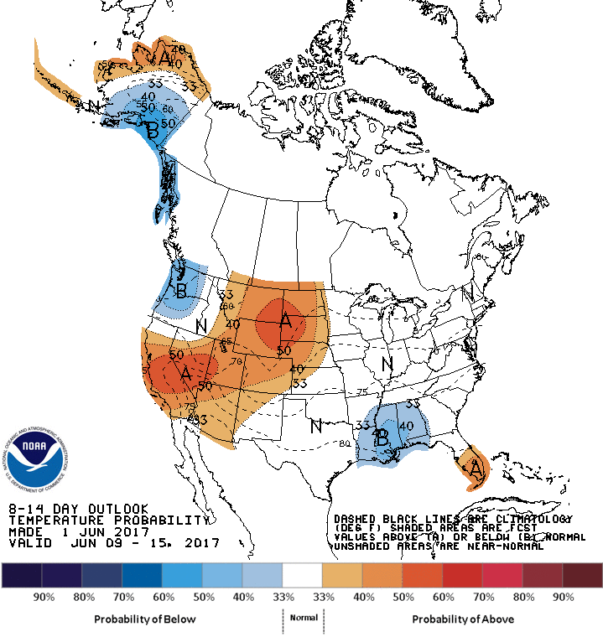
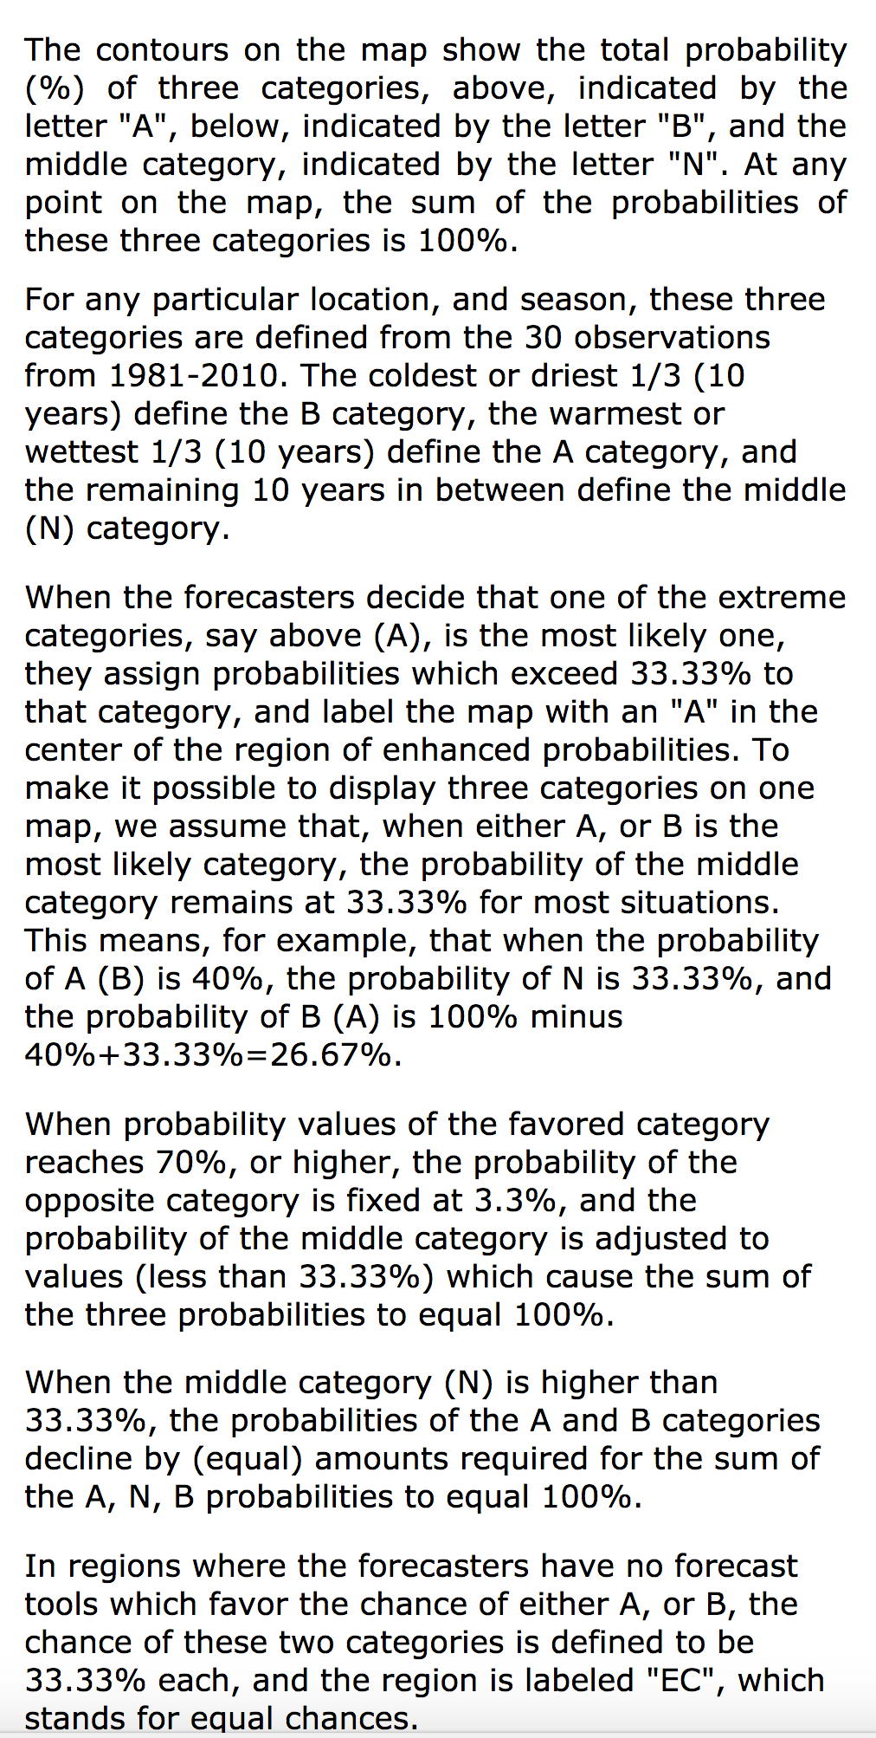
How to read three category maps

Slide 15
Machine Learning NWP is enhancing predictability for week 2-3 (7 days +)

Slide 16
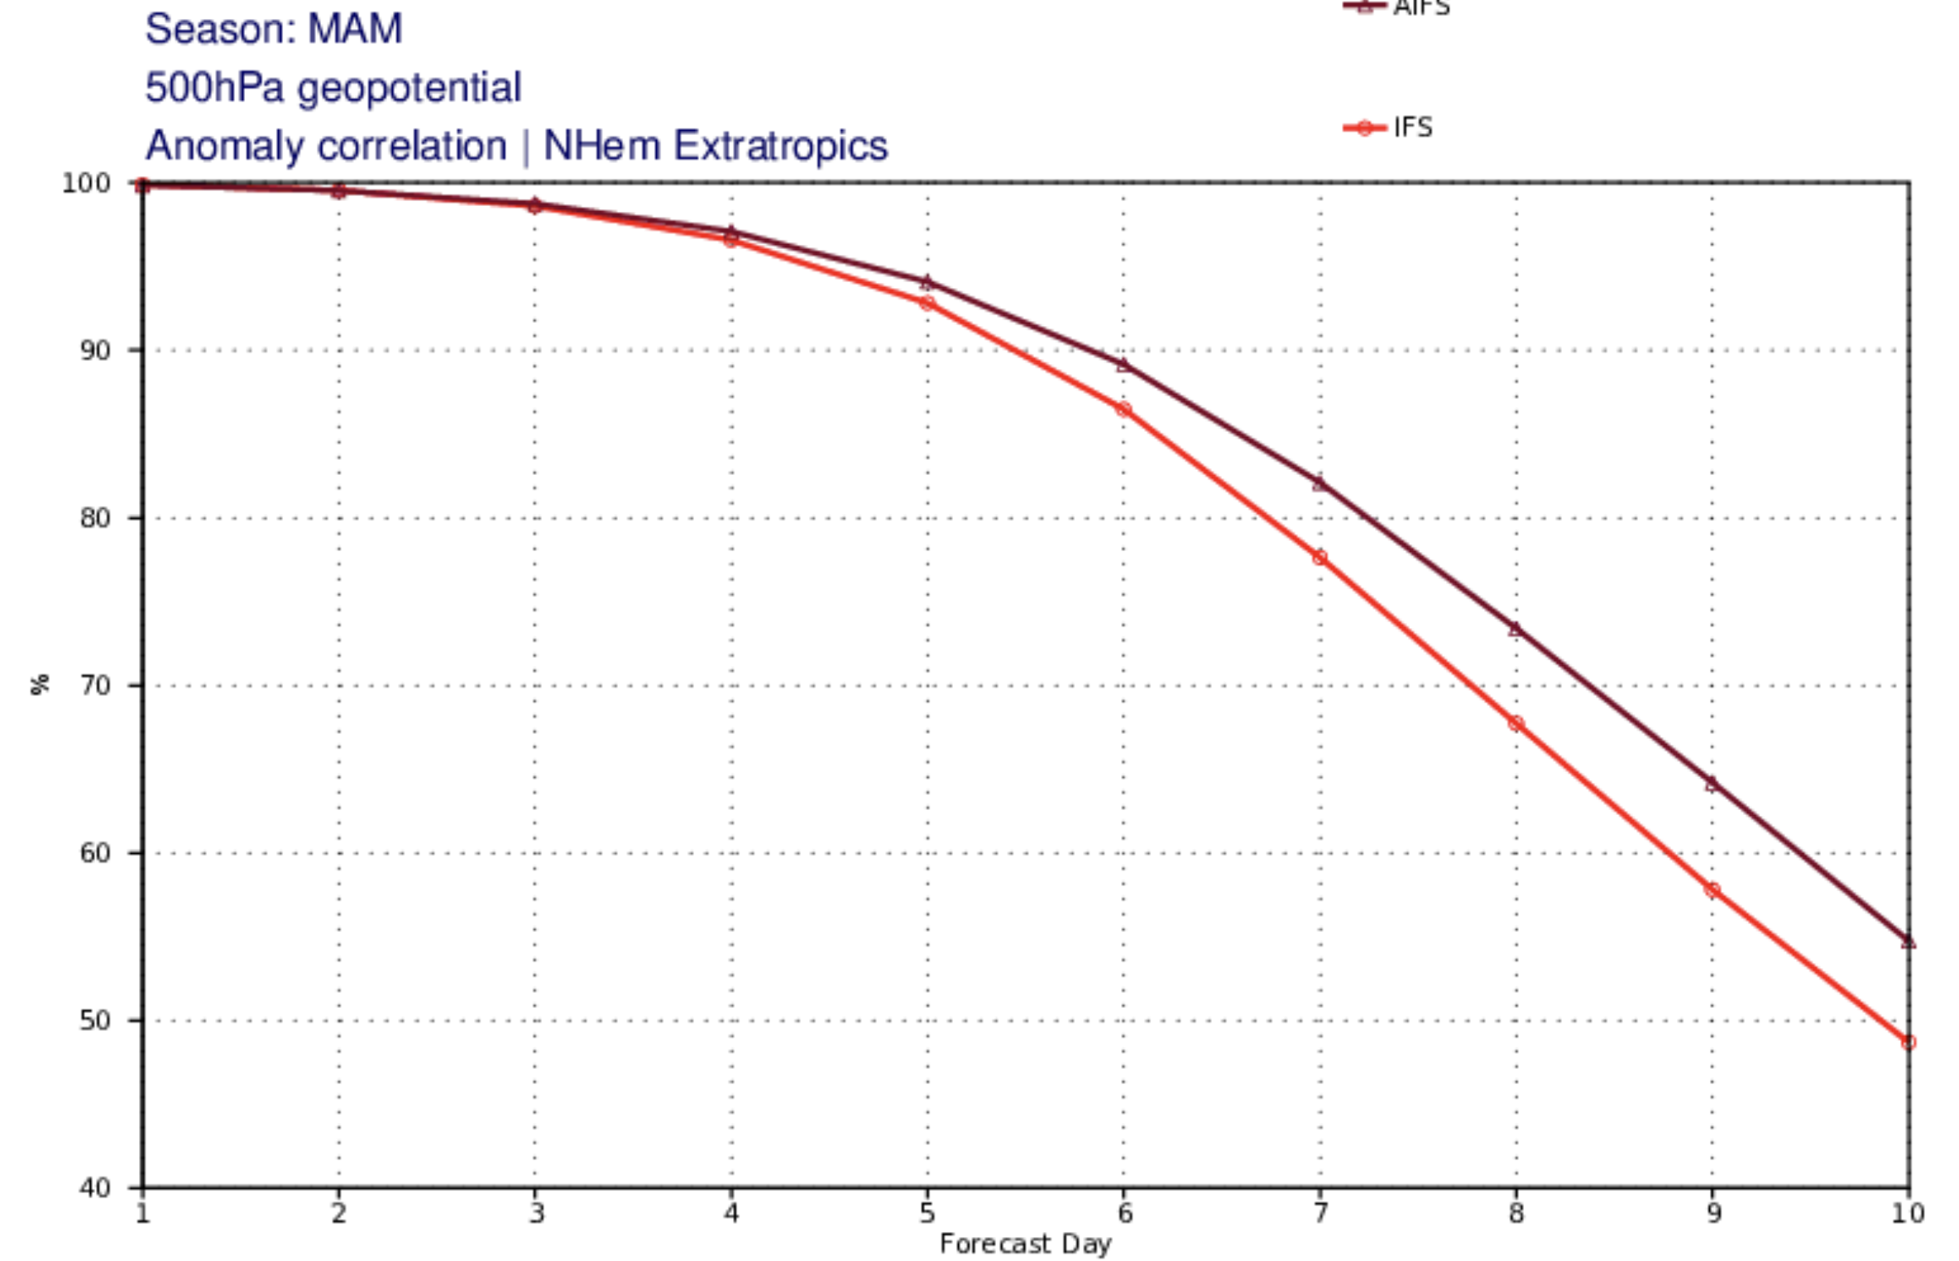
European
Center
500-hPa
Anomaly Correlation
March-April-May
AIFS Model
Physical
Model (IFS)
Northern Hemisphere
Extratropics

Slide 17
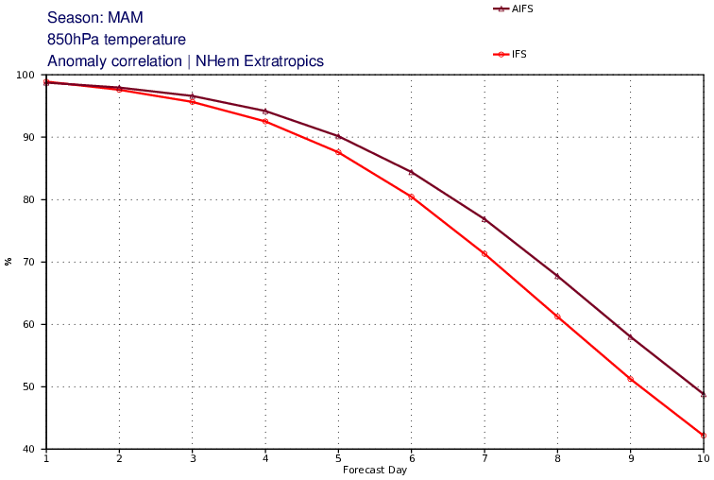
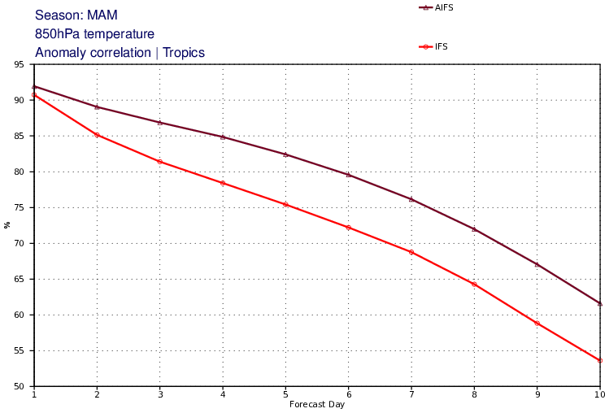
The Tropics Versus Northern Hemisphere:
850 hPa temperature
AI
Northern Hemisphere
Extratropics
Tropics
Physical
Model
AI NWP is far more skillful in tropics compared to traditional models.

Slide 18
Longer than 2 weeks
There is the potential to forecast mean or average characteristics of the atmosphere further in time than 2 weeks.
One key to this long-range forecasting is the memory of the ocean.
Slowly changing surface characteristics can also be useful (e.g., snow cover, sea ice coverage, soil moisture)
These slowly changing surface characteristics can have a substantial impact on the atmosphere

Slide 19
Extremely useful to review the SST and atmospheric circulation anomalies of the past months or year
Some anomalies are slowly varying, so provide information regarding future weather

Slide 20
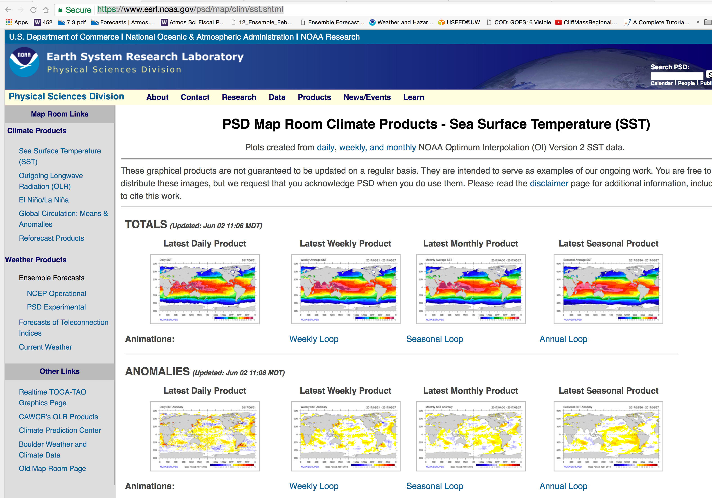
Useful to review SST anomalies here

Slide 21
Some large-scale circulation anomalies are slowly changing or have some predictability
Can view them here.

Slide 22
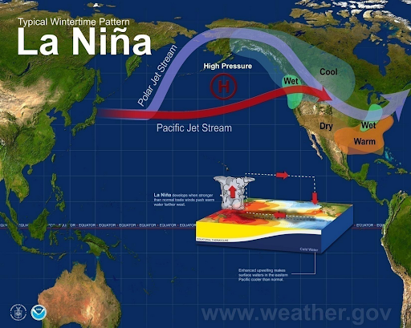
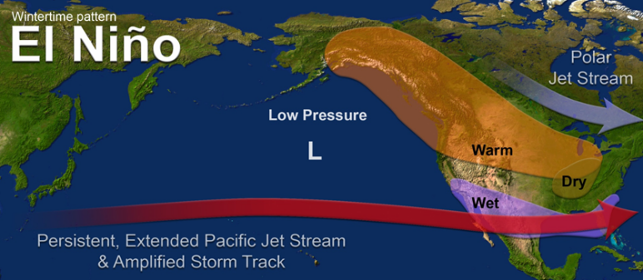
The Classic Example: El Nino and La Nina
Persistent and large tropical Pacific SST anomalies influence convection, which influences large-scale wave patterns.

Slide 23
ENSO (El Nino Southern Oscillation)
An important atmosphere/ocean feature that has an average period of three to seven years.
Goes between El Nino, Neutral, and La Nina (ENSO cycle, El Nino Southern Oscillation)
Has large influence both in the tropics and midlatitudes.
Major source of forecast skill beyond a few weeks.

Slide 24
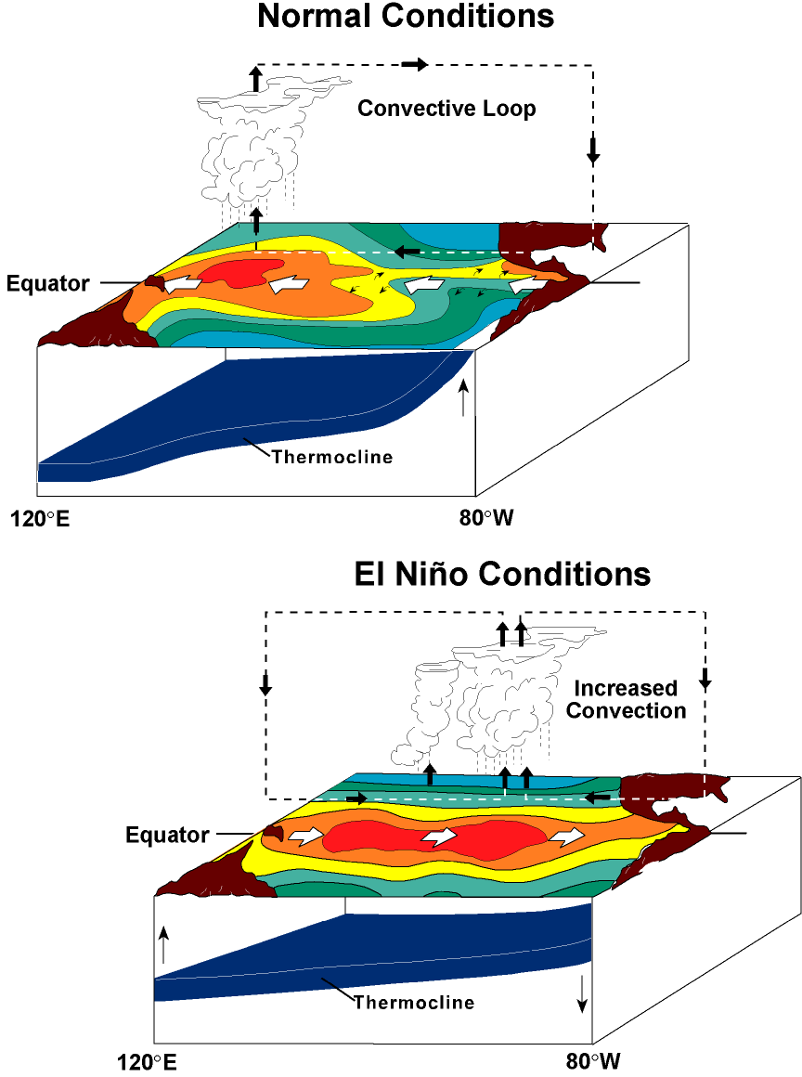

Slide 25
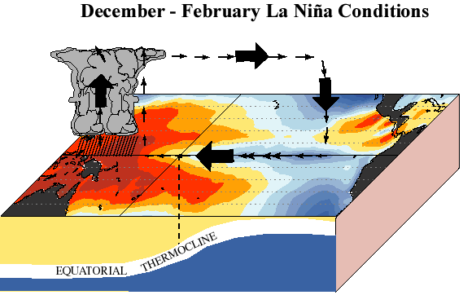

Slide 26

Think of sloshing
Water in a Bath
Tub

Slide 27
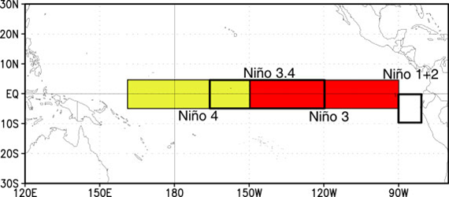
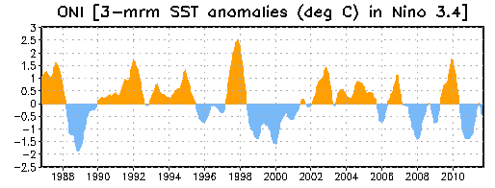
An Important Measure of ENSO is the Surface Temperature in the Tropical Pacific

Slide 28
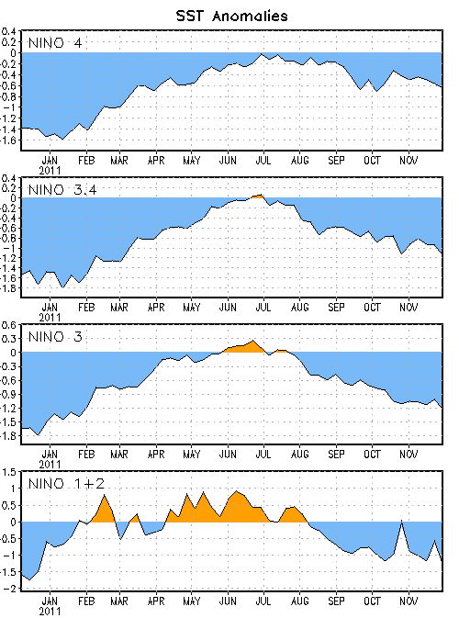
Niño Region SST Departures (ºC)
The latest weekly SST departures are:
Niño 4 -0.6ºC
Niño 3.4 -1.1ºC
Niño 3 -1.2ºC
Niño 1+2 -1.3ºC

Slide 29
Why do we care?
The circulations in the midlatitudes are often different during El Nino, Neutral, and La Nina years.
Since the temperature of the tropical Pacific changes relatively slowly, this gives some meteorologists some insights into the weather over the next several months.
We do have ENSO forecast models of marginal skill.

Slide 30
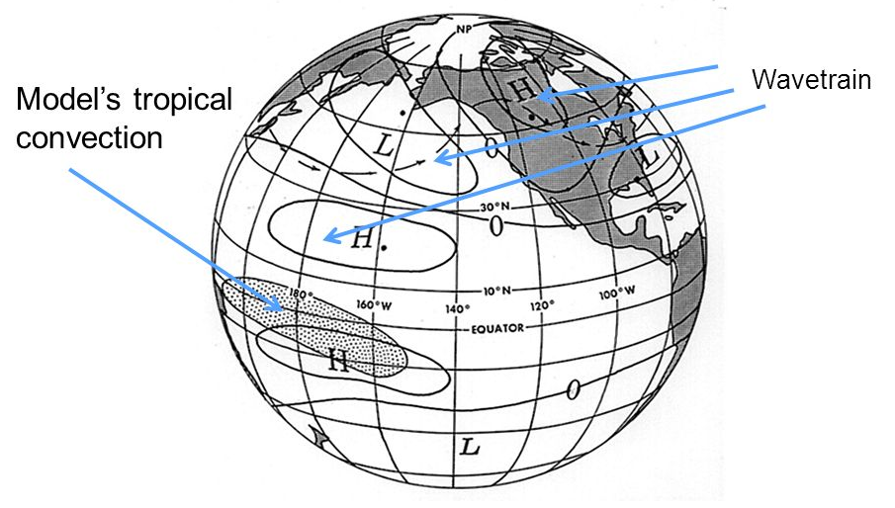
Teleconnections from the tropics
PNA Area

Slide 31
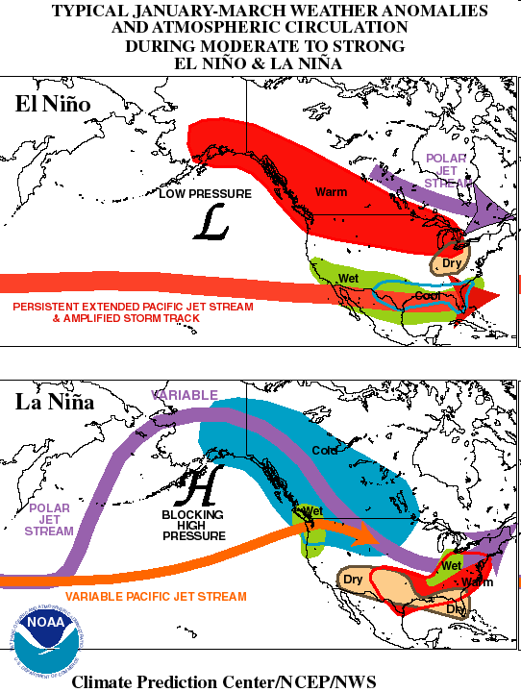
El Nino: wet over southern tier of states, warmer to the north

Slide 32
La Nina – strong Aleutian High

Slide 33
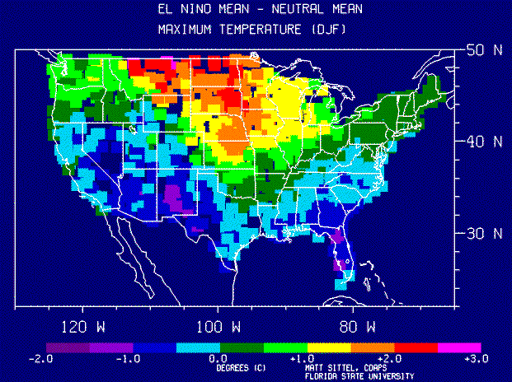

Slide 34
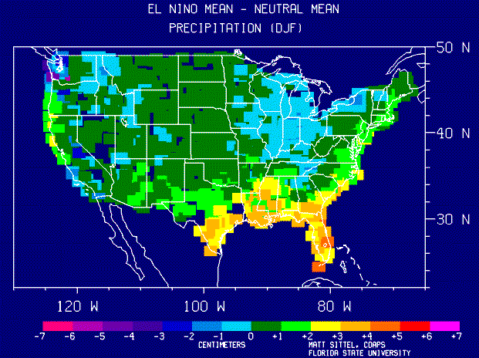

Slide 35
The correlation between El Nino/La Nina (ENSO) and midlatitude weather is a key tool for extended forecasting
The BEST web site for information is at the Climate Prediction Center
https://www.cpc.ncep.noaa.gov/products/precip/CWlink/MJO/enso.shtml
https://www.cpc.ncep.noaa.gov/products/analysis_monitoring/lanina/enso_evolution-status-fcsts-web.ppt
http://www.cpc.ncep.noaa.gov/products/analysis_monitoring/enso_advisory/index.shtml

Slide 36
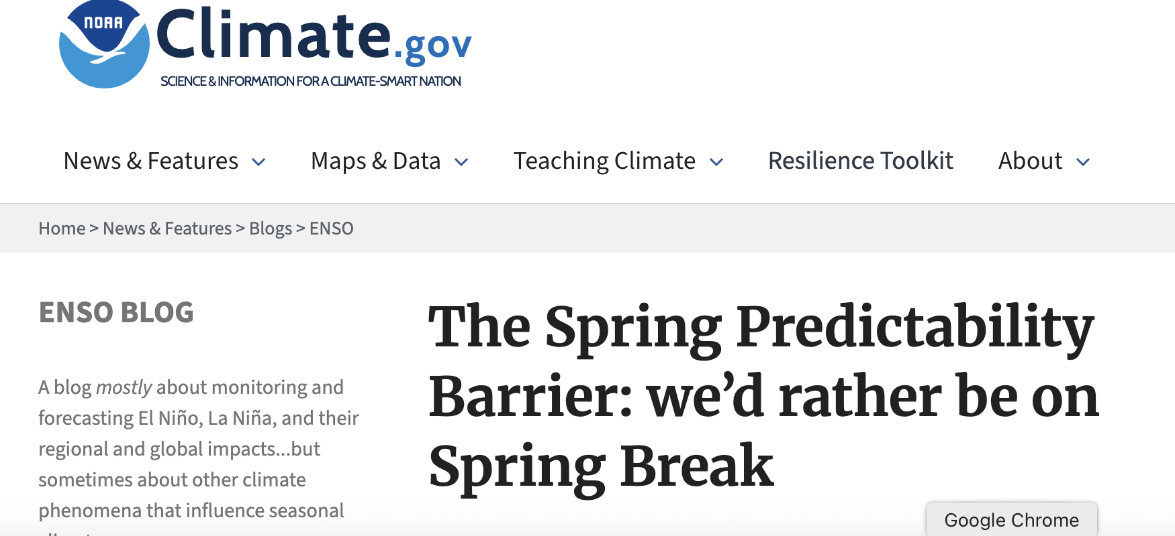
The Spring Predictability Barrier for ENSO

Slide 37
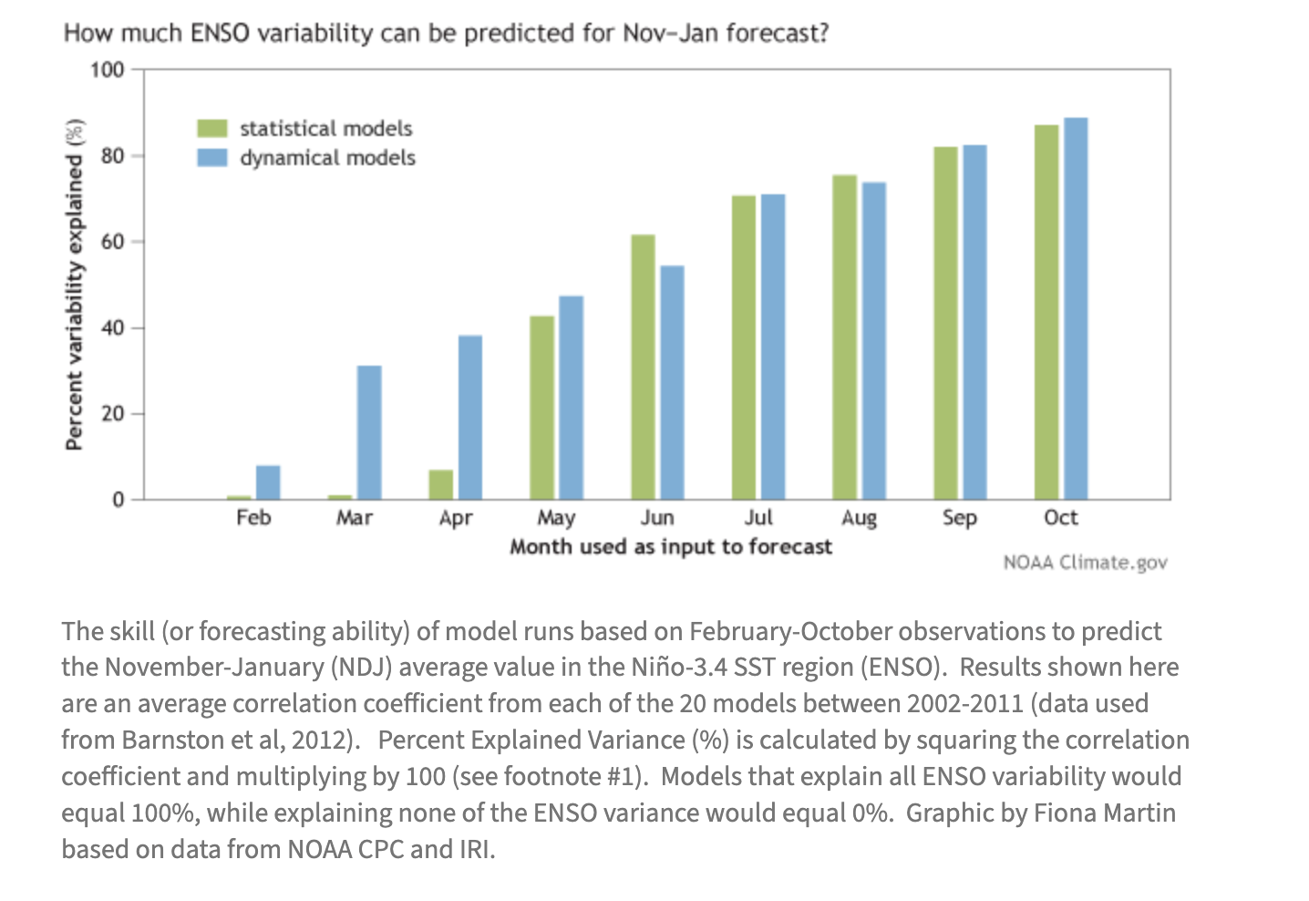
After the spring, the ability of the models to predict ENSO becomes increasingly better.
Much better skill in June than March for the upcoming winter

Slide 38
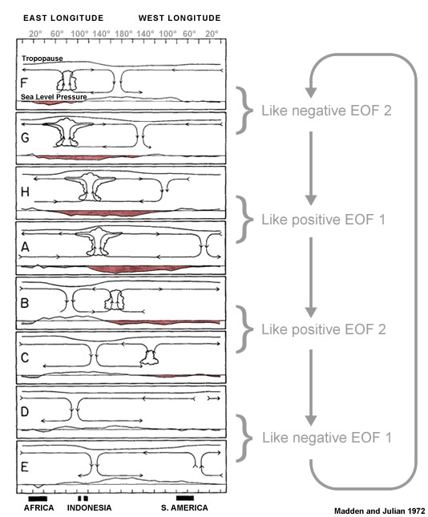
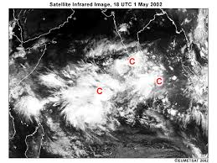
Other important feature for subseasonal prediction: The Madden Julian Oscillation (MJO)

Slide 39
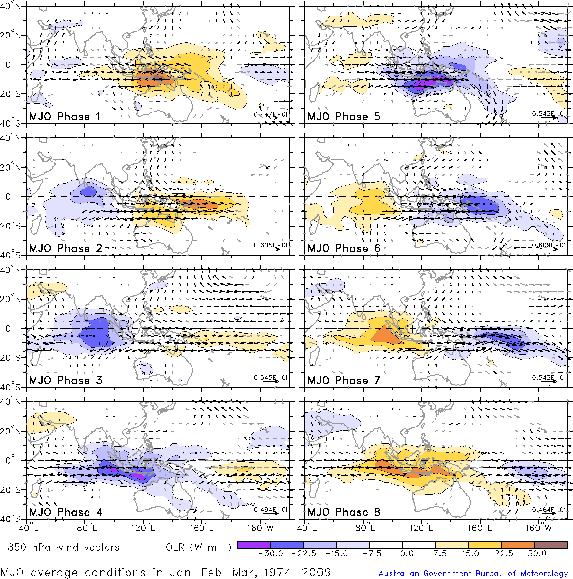
MJO Phases (8)

Slide 40
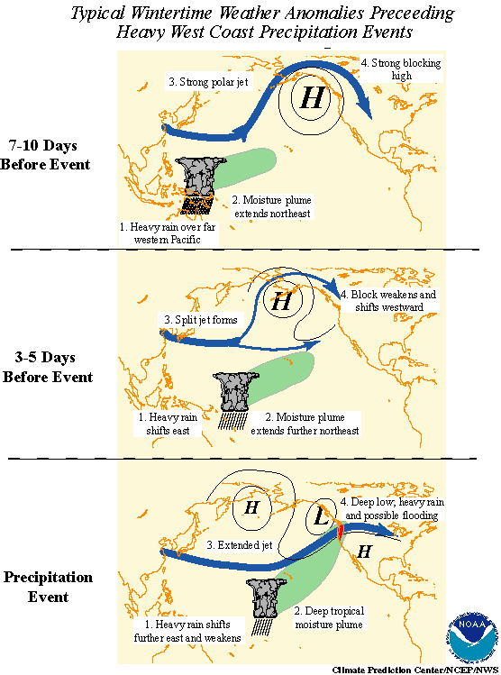
Has implications for West Coast atmospheric rivers

Slide 41
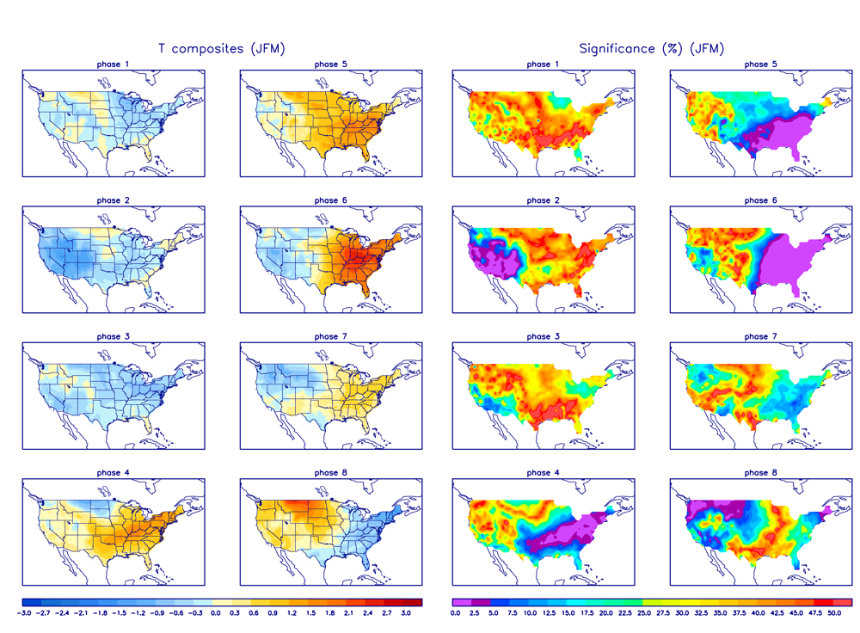
And for US Temp and Precip

Slide 42
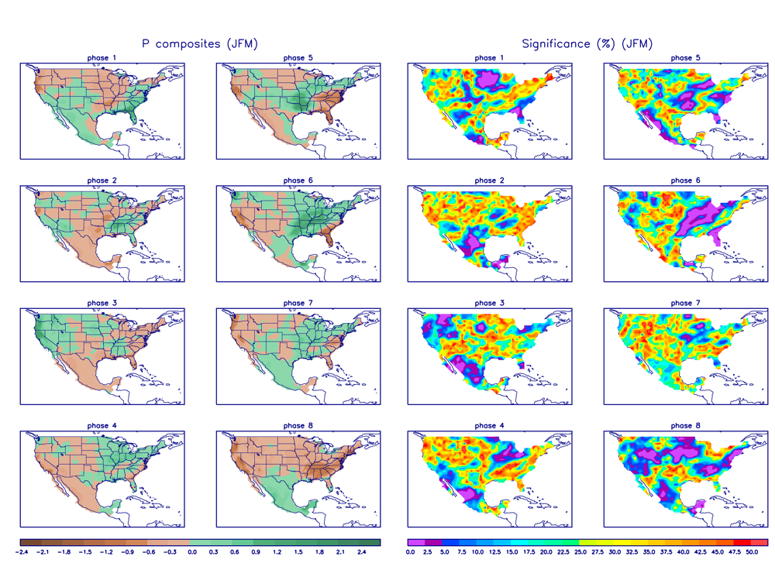

Slide 43
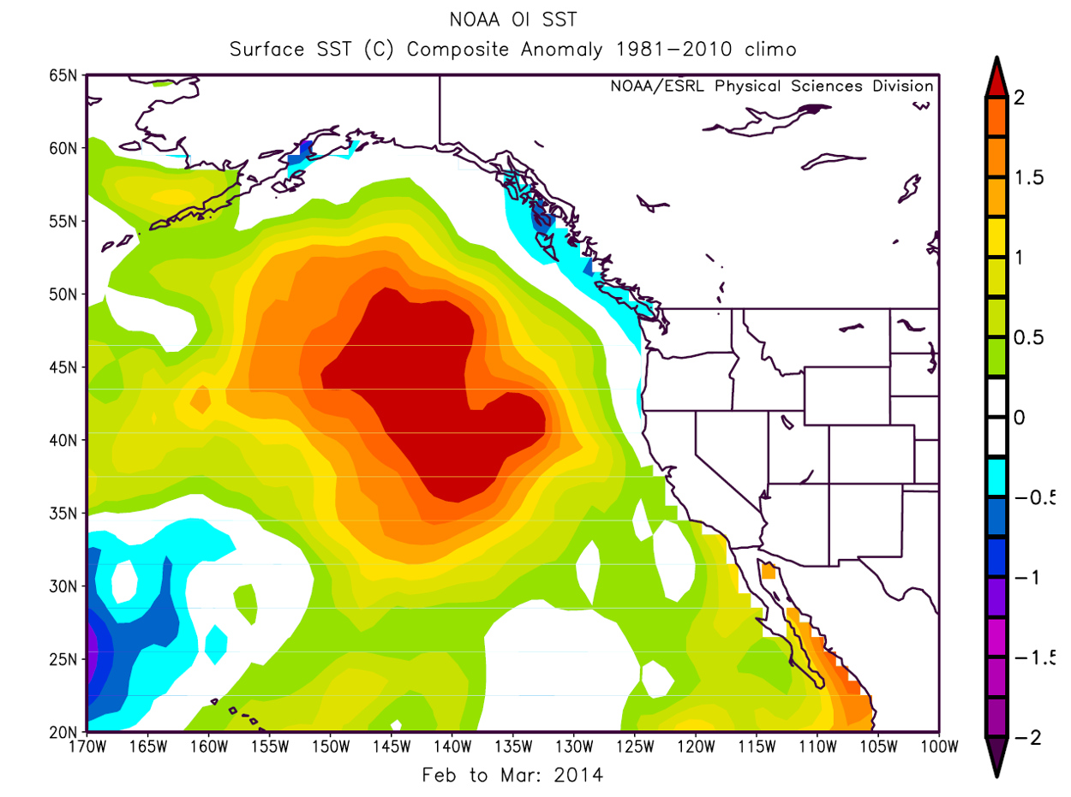
Impacts of Sustained Midlatitude Sea Surface Temperature Anomalies
Example: the BLOB.

Slide 44
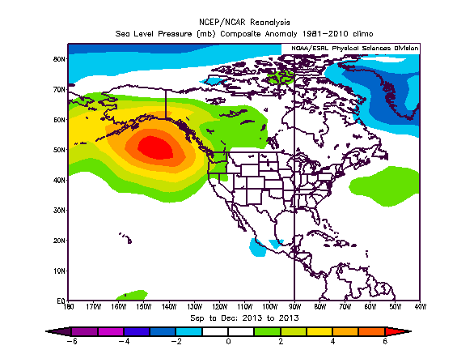
Caused by sustained high pressure

Slide 45
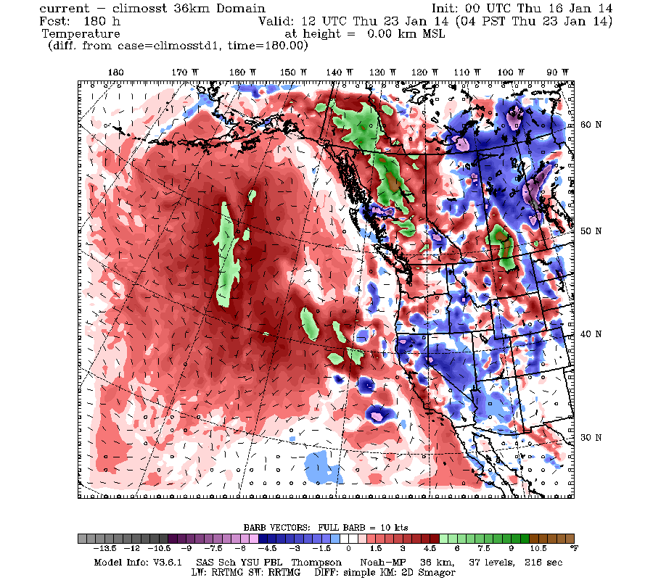
SST anomalies have a lot of persistence: in the case of the Blob contribute to warming downstream

Slide 46
Long Range (Seasonal) Numerical Forecasts
During the past two decades, a new generation of extended forecasting systems have been developed that run coupled global atmosphere/ocean models out MONTHS
An example is the NOAA Climate Forecasting System (CFS)…now CFSv2
Runs a version of the GFS and a coupled ocean model out 9 months.

Slide 47
The NOAA Climate Forecast System (CFS)
GFS run at roughly 60 km grid spacing and 64 levels.
Run every six hours (4 runs each time…an ensemble)

Slide 48
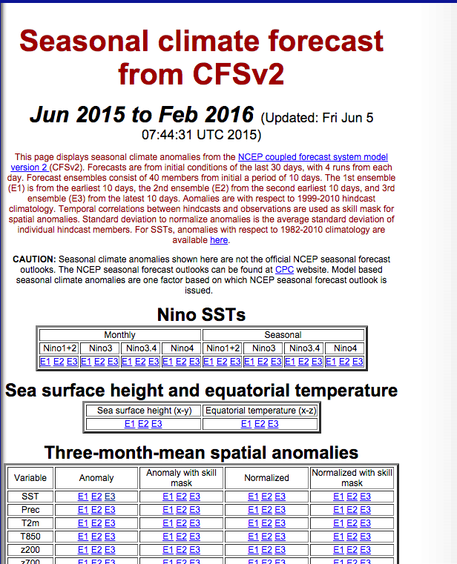
http://www.cpc.ncep.noaa.gov/products/people/wwang/cfsv2fcst/

Slide 49
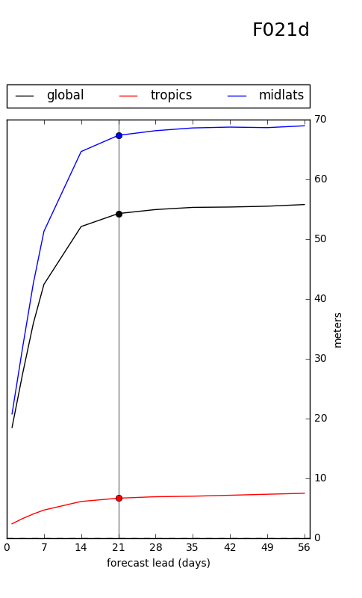
Z500 Mean Absolute Error (MAE)
CFS
Errors saturate after 3 weeks
Errors rapidly grow in the first week

Slide 50
SSTs: Holds Skill Longer

Slide 51
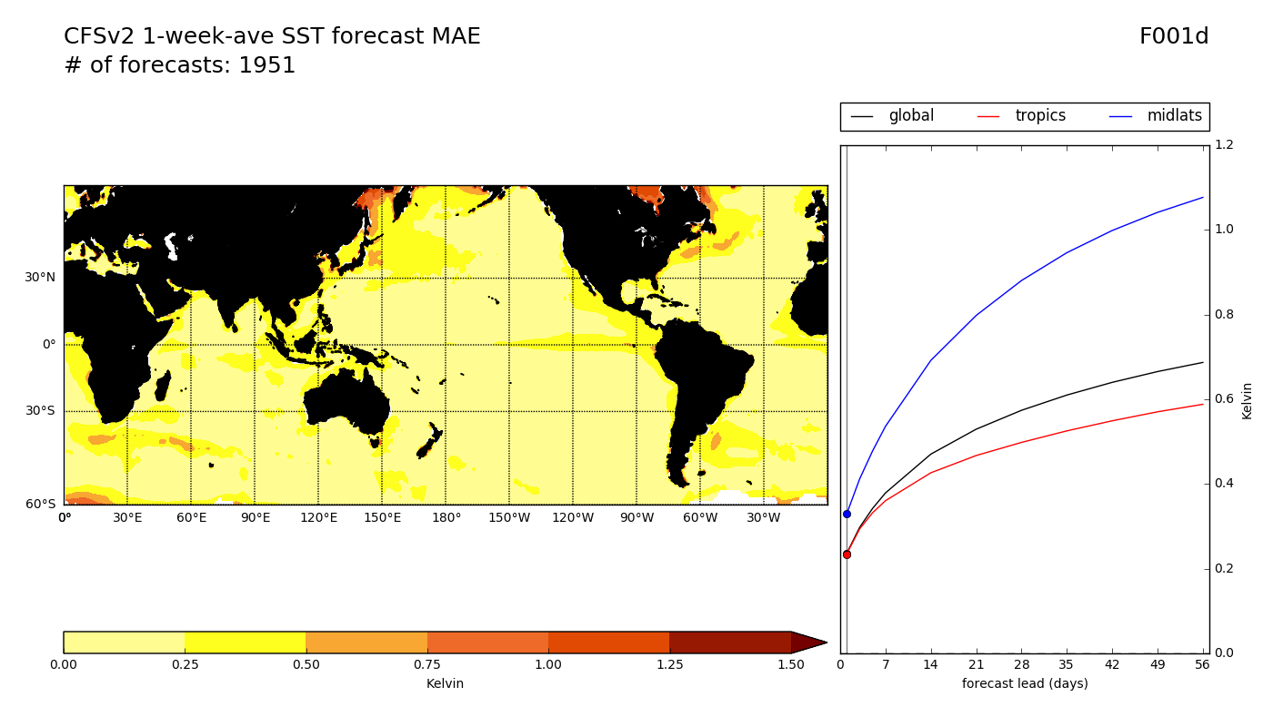
SST MAE - week 1 *de-biased

Slide 52
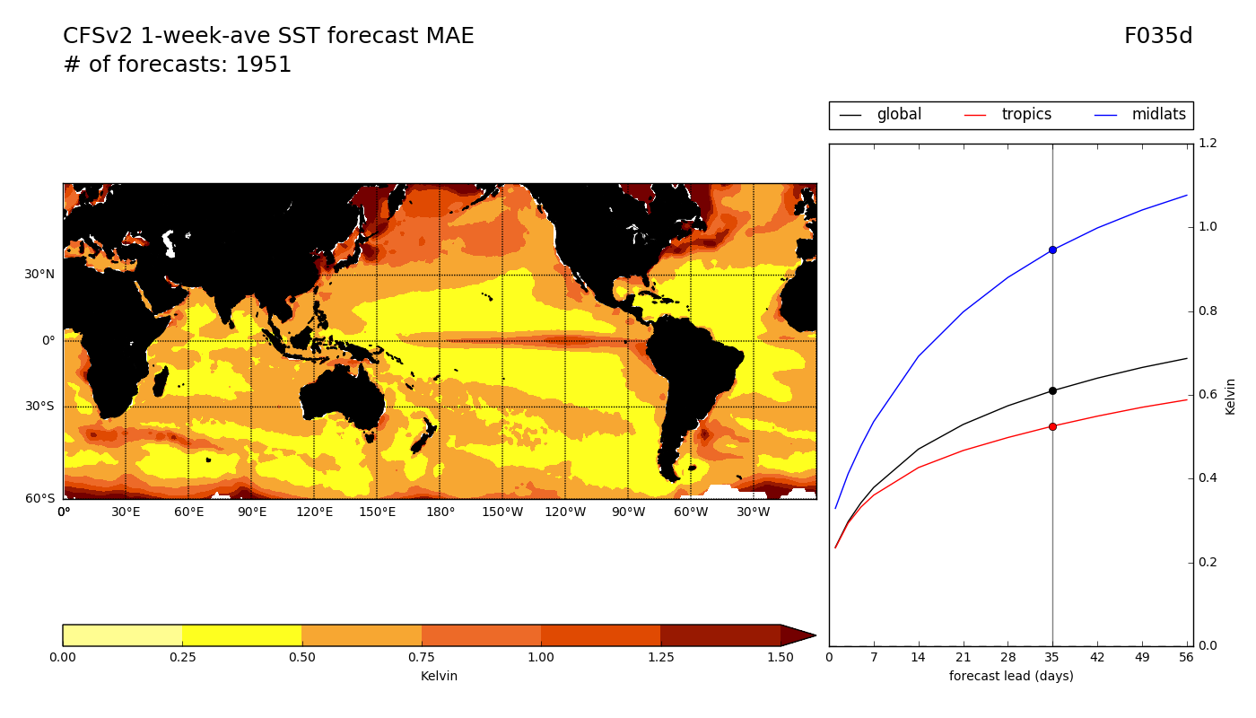
SST MAE - week 6 *de-biased

Slide 53
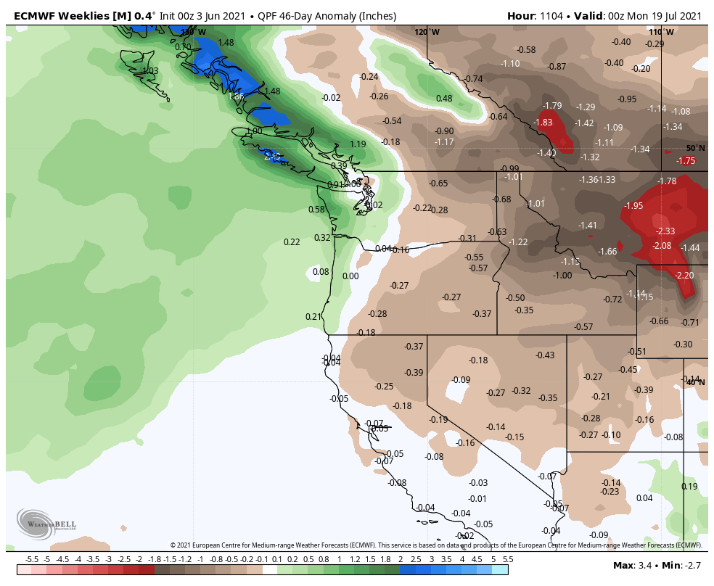
European Center is Best for first 1.5 months

Slide 54
There are seasonal forecast ensembles. Examples include:
NMME: North American Multimodel Ensemble (combines UA and Canadian)
IMME (International Multimodel Ensemble)
Link here:
http://www.cpc.ncep.noaa.gov/products/NMME/

Slide 55
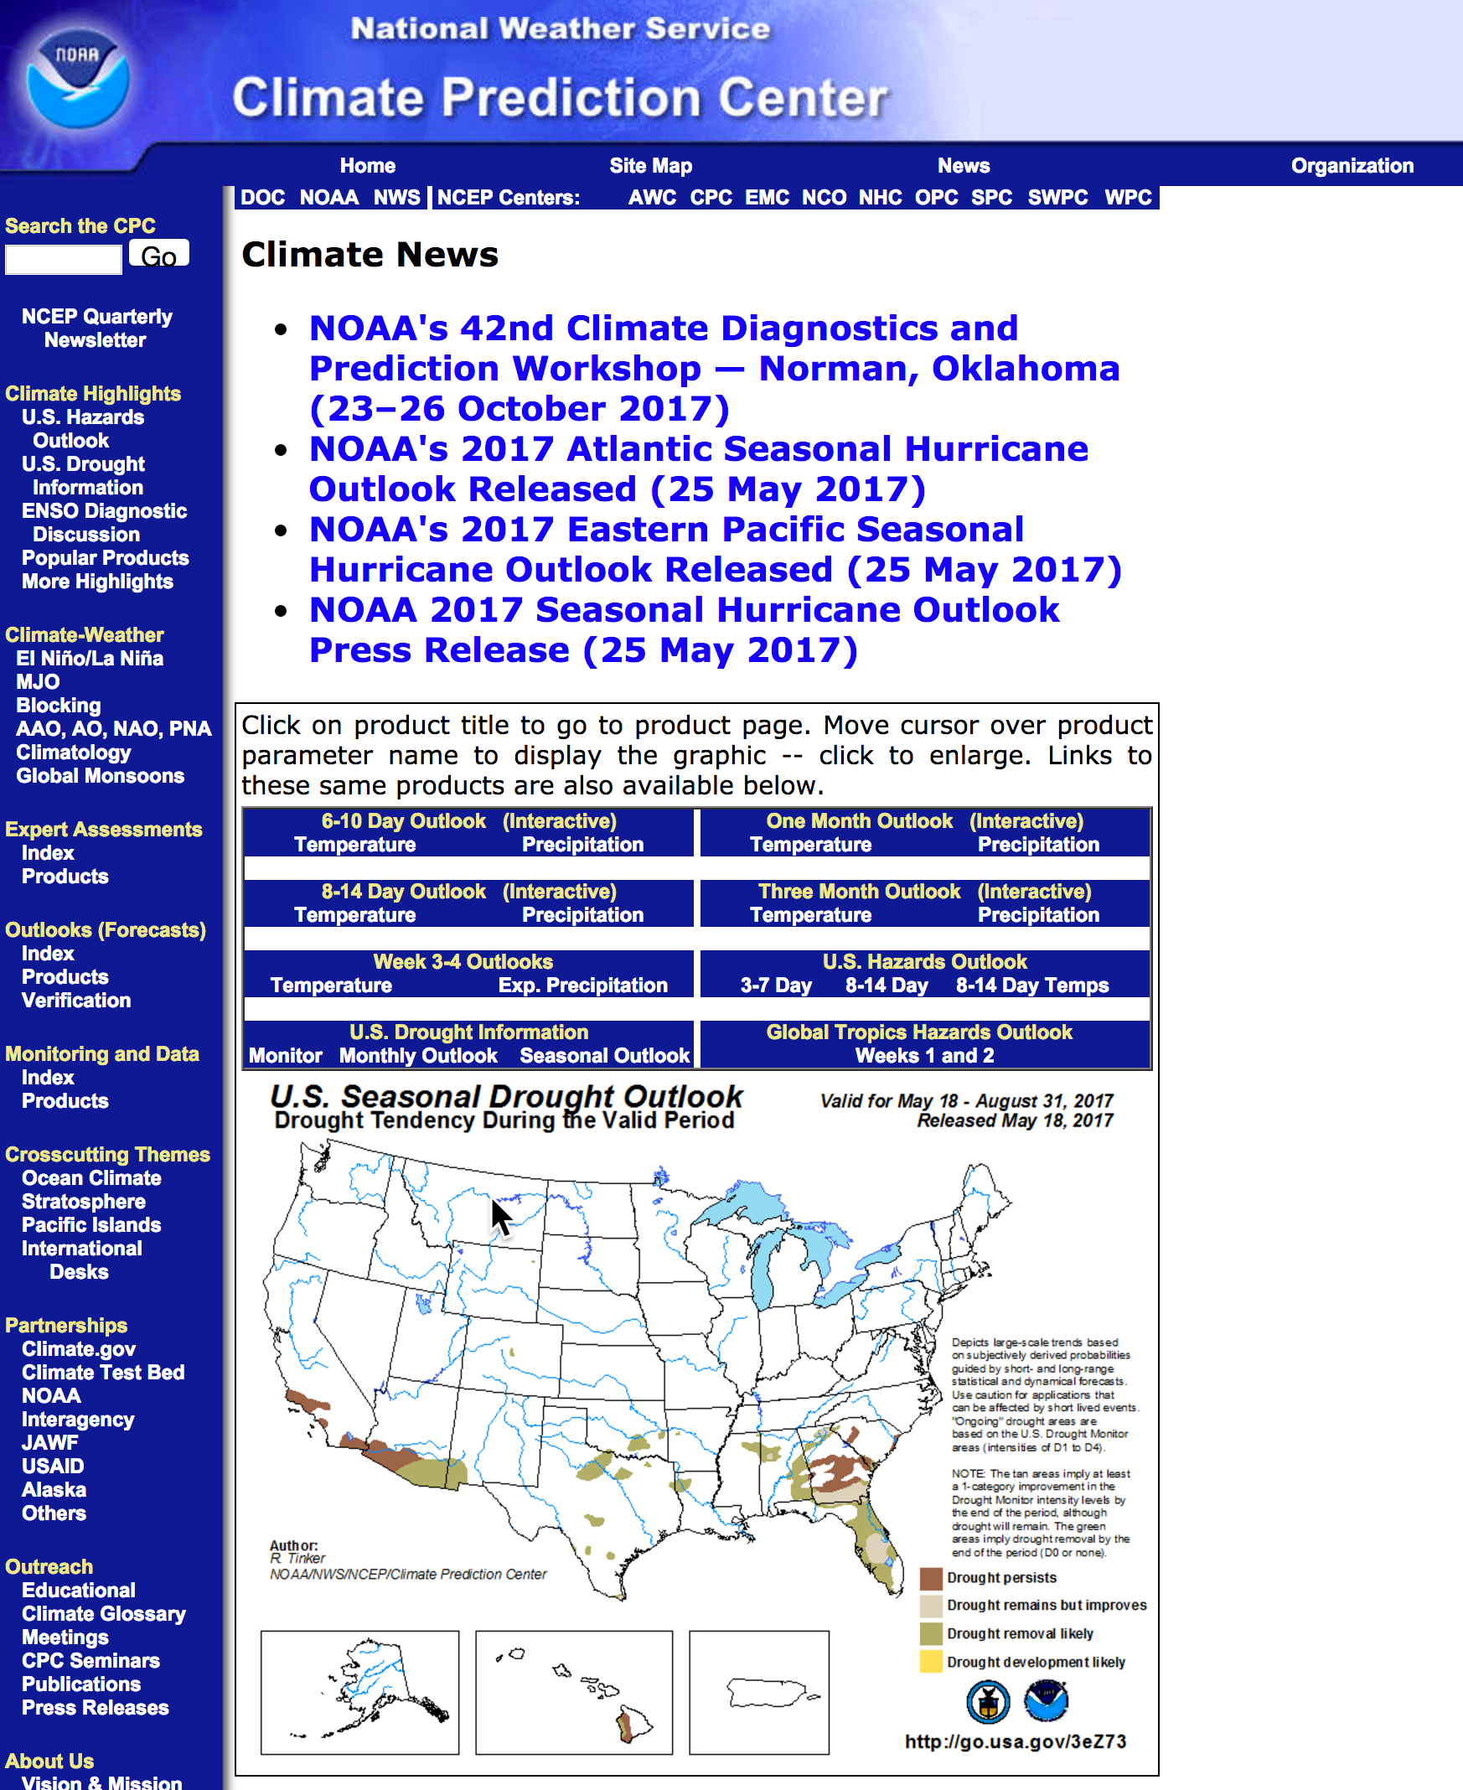
Climate Prediction Center (CPC)

Slide 56
Why do subseasonal and seasonal forecasts go bad after a few weeks?
Initialization errors grow with time (a la Lorenz)
Physics deficiencies
Poor description of surface characteristics (e.g., soil moisture)
Poor, parameterized convection is a very possible major sources of error.

Slide 57
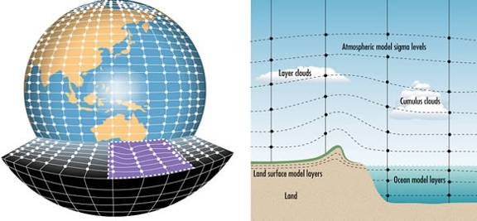
The Future
Running global models at convection-permitting resolution (2-4 km grid spacing)

Slide 58
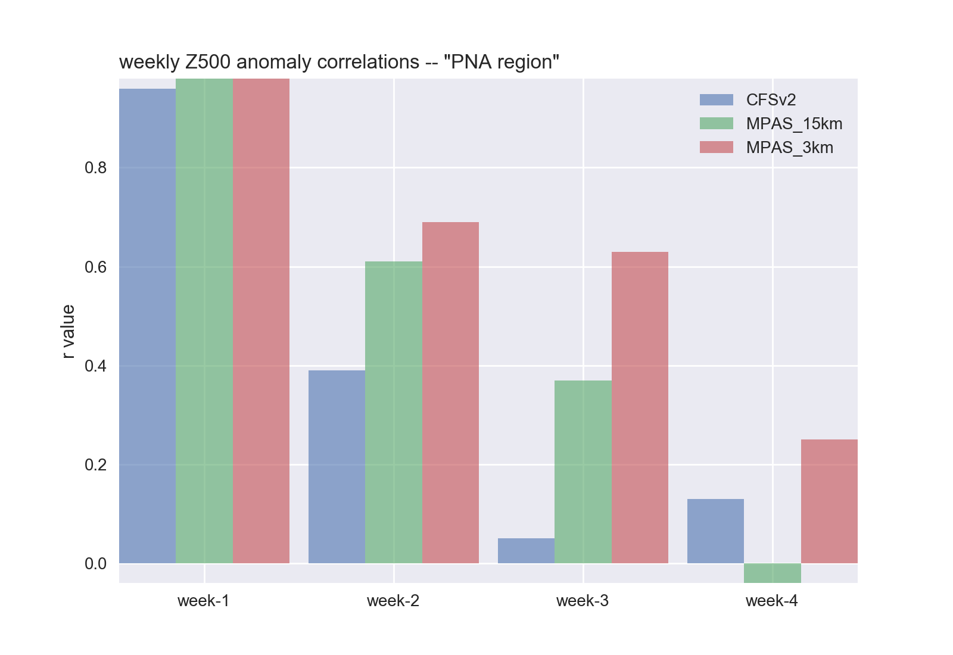
Case 1: Extratropical Z500’

Slide 59
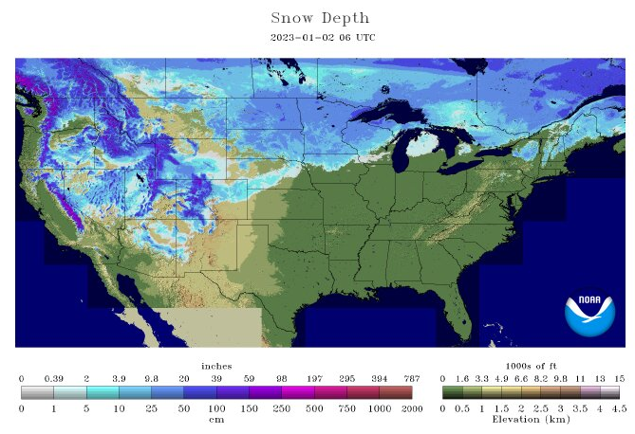
Machine Learning and Slowly Varying Surface Conditions
The atmosphere responds to slowly varying surface parameters such as:
  SST
  Soil moisture
  Snow distribution on land
  Salinity over the ocean
  Sea-ice distribution

Slide 60
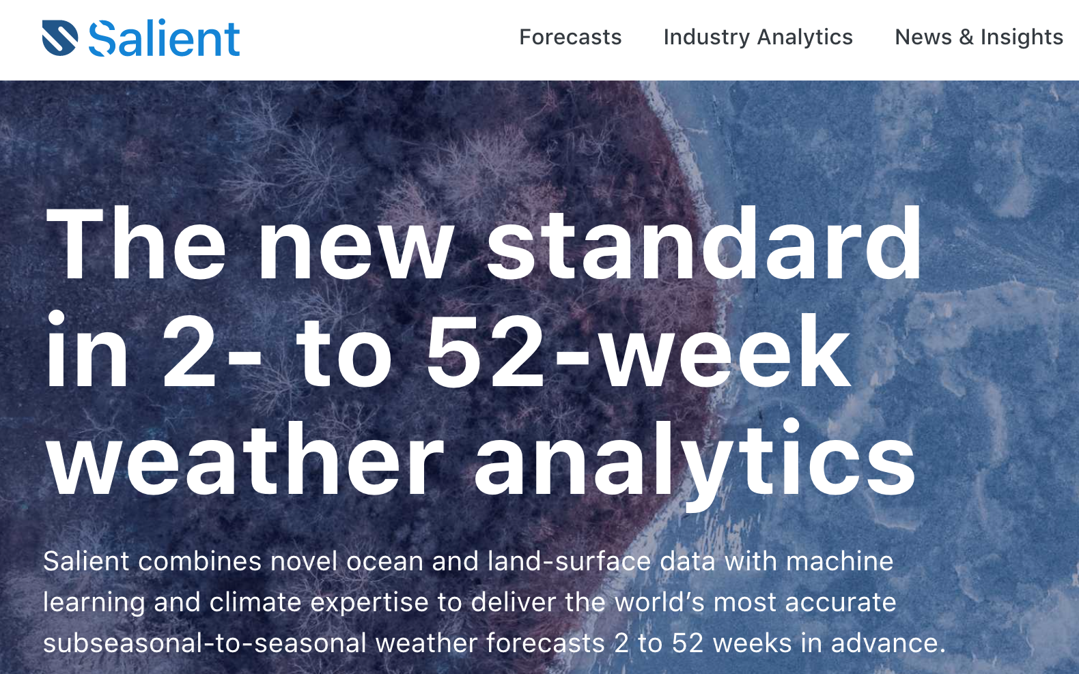
Some Private Sector Firms Offering Long-term Predictions Combining the Two

Slide 61
Final Notes
Online course evaluation: please do it!
I am available for one-on-one zoom calls this weekend and Monday AM if you have questions.
Also welcome email questions.

Slide 62
The End

Slide 63
Subseasonal Experiments with MPAS
3-km grid spacing for the entire globe
One-month runs
Initialized with GFS FNL analyses
No cumulus parameterization
Thompson Microphysics
MYNN PBL
NOAA LSM
RRTMG Radiation
SST remains constant during the simulations

Slide 64
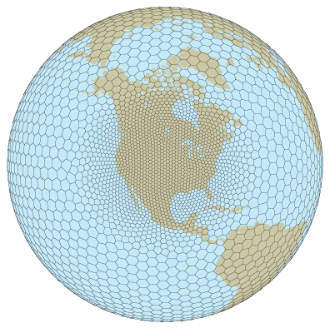
MPAS

Slide 65
Note:
Using constant SST is substantially hurting skill of simulations and would not be used in operational simulations.
FNL initialization are quite coarse (.5 degree).
We will compare:
  TRMM analyses (REALITY)
  CFSv2 operational forecasts
  MPAS at 15 km resolution globally with Grell-Frietas cumulus parameterization
  MPAS at 3 km resolution globally without cumulus parameterization

Slide 66
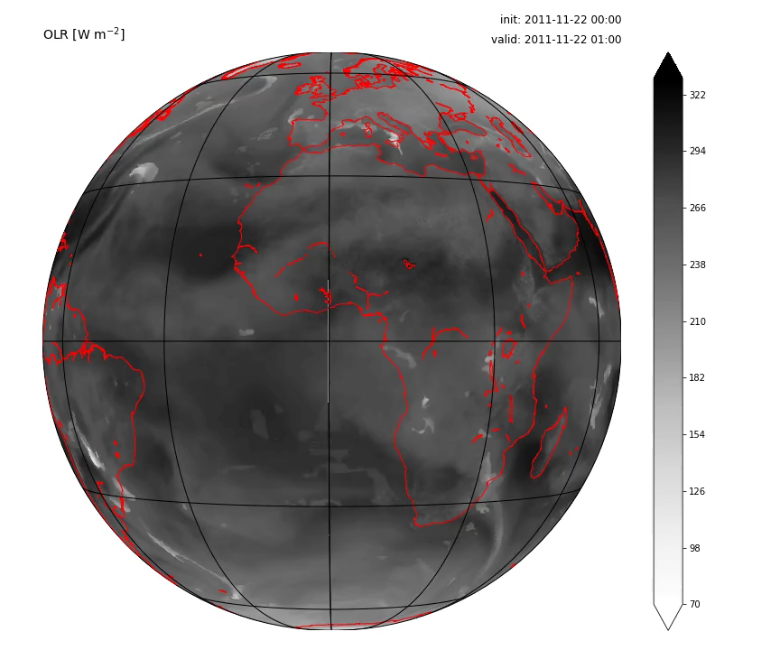
Case 1: DYNAMO MJO2 (2011-11-22)

Slide 67
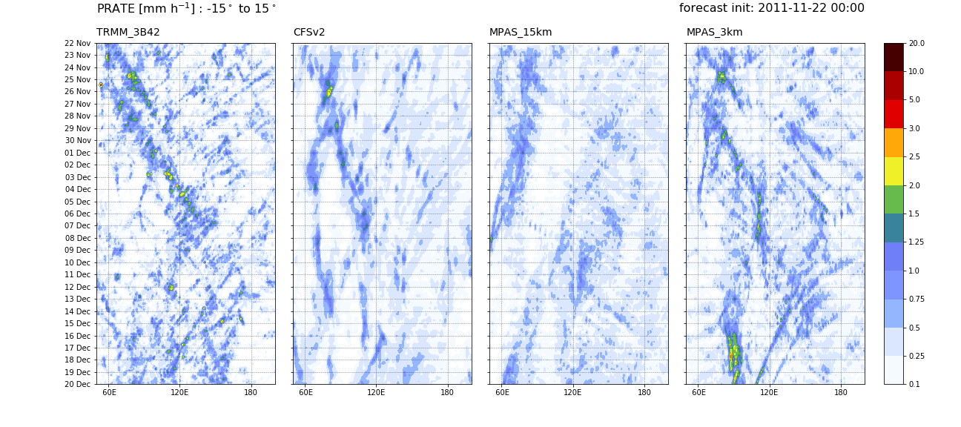
Case 1: Hovmöllers – precip. rate

Slide 68

Case 1: Hovmöllers – OLR

Slide 69

Case 1: Extratropical Z500’

Slide 70
Global High Convection Permitting Resolution is the Future of Extended Prediction
The big issue is lack of computer resources
Probably ten years off.

