Slide 1
Final Day of ATMS 101!
Final Exam
In CLASS
Wednesday, December 1 at 8:30 AM-10:20 AM
Comprehensive, but will more questions on second half
Closed book and no electronics

Slide 2
Final Day
Happy to answer your questions via email.
Can talk over the phone or through zoom for individual questions.
Course Evaluation is now online. Appreciate your feedback.

Slide 3
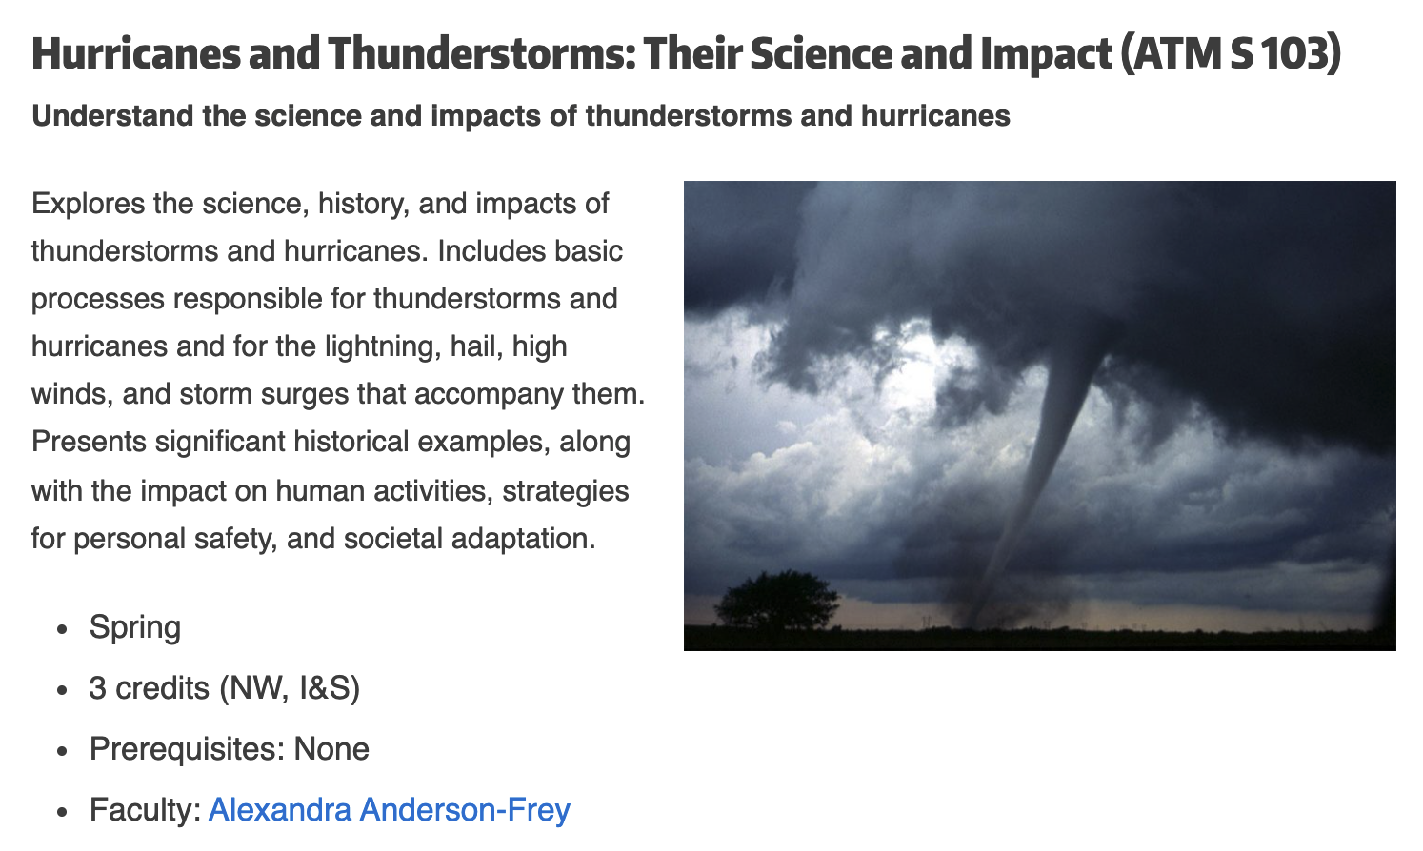
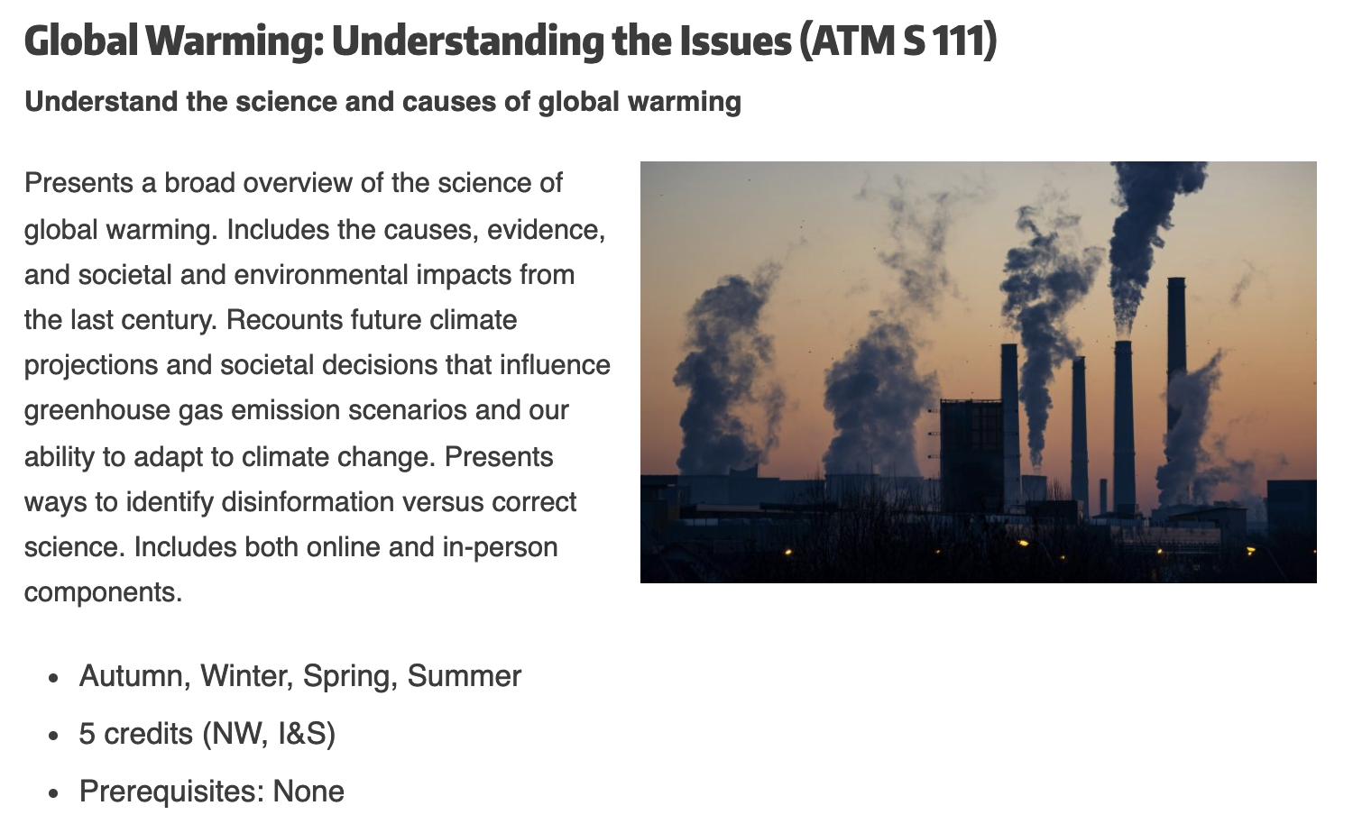
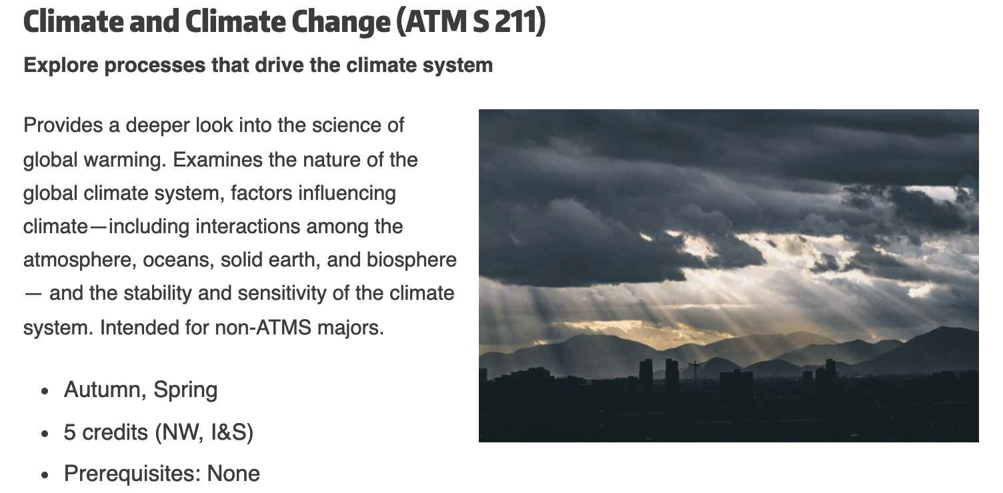
Want to learn more about the atmosphere?

Slide 4
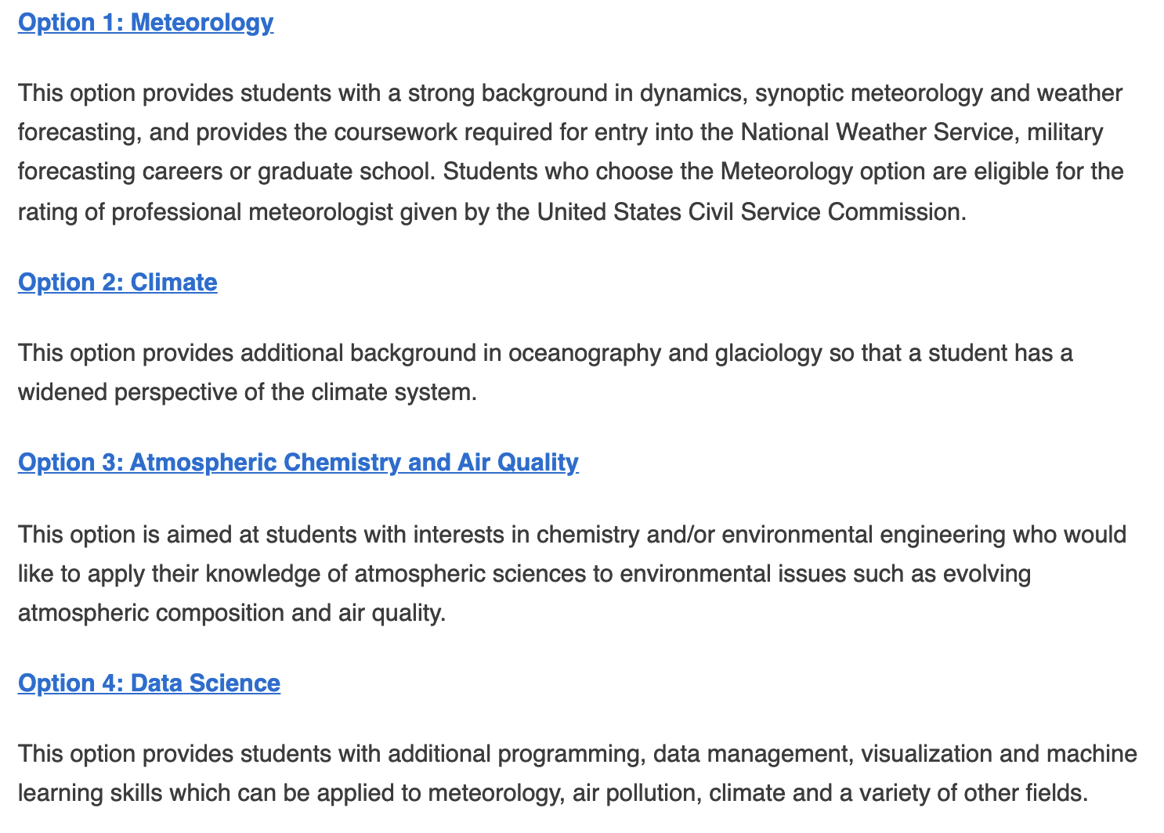
Atmospheric Sciences Major
B.S. in Atmospheric Sciences
Four tracks

