Slide 1
Fronts
Atmospheric Sciences 101
Autumn 2025

Slide 2
Refresher
A front is a boundary between relatively uniform warm air and a zone in which temperatures cools rapidly

Slide 3
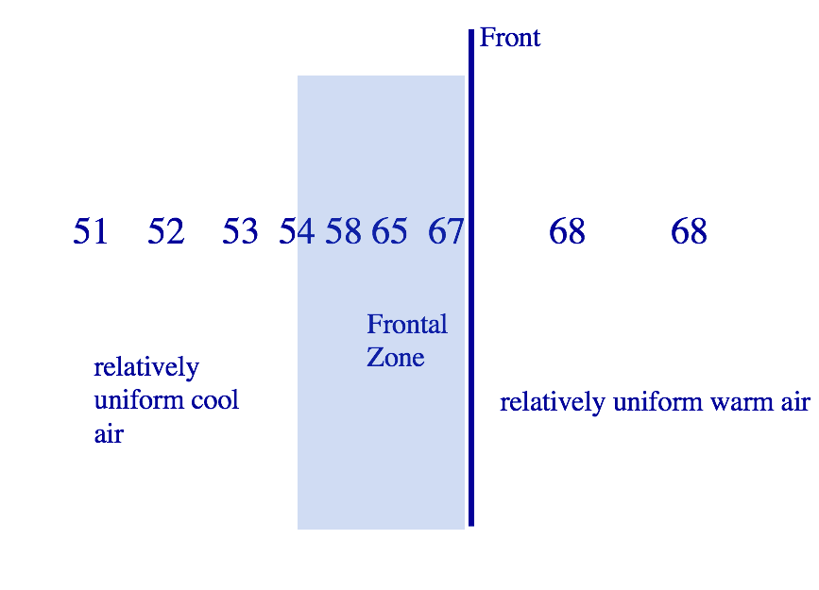

Slide 4
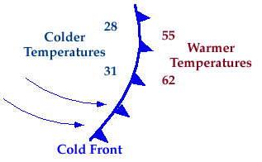
Four Main Types of Fronts

Slide 5
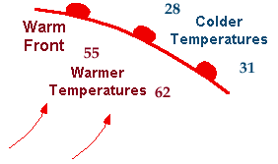
Warm Front

Slide 6
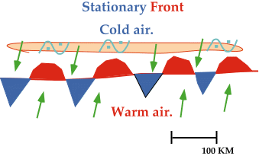
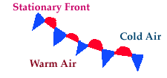
Stationary Fronts

Slide 7

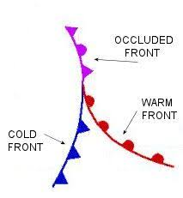
Occluded Front (a hybrid)

Slide 8
As a front passes there are changes in:
Temperature
Dew point
Wind direction
Pressure
Cloudiness

Slide 9
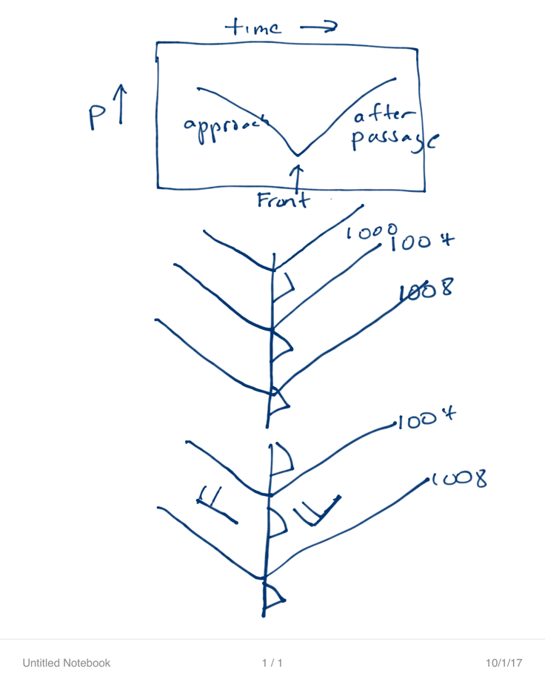
Fronts are associated with troughs of low pressure

Slide 10
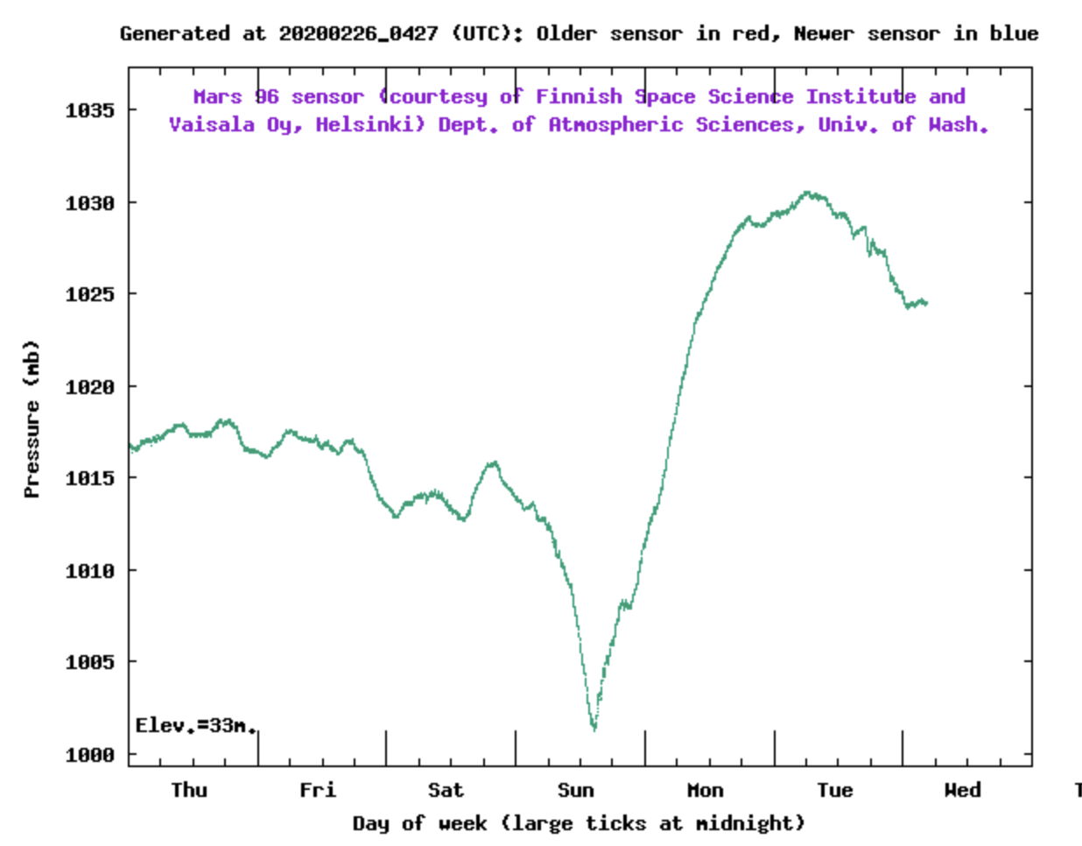

Slide 11
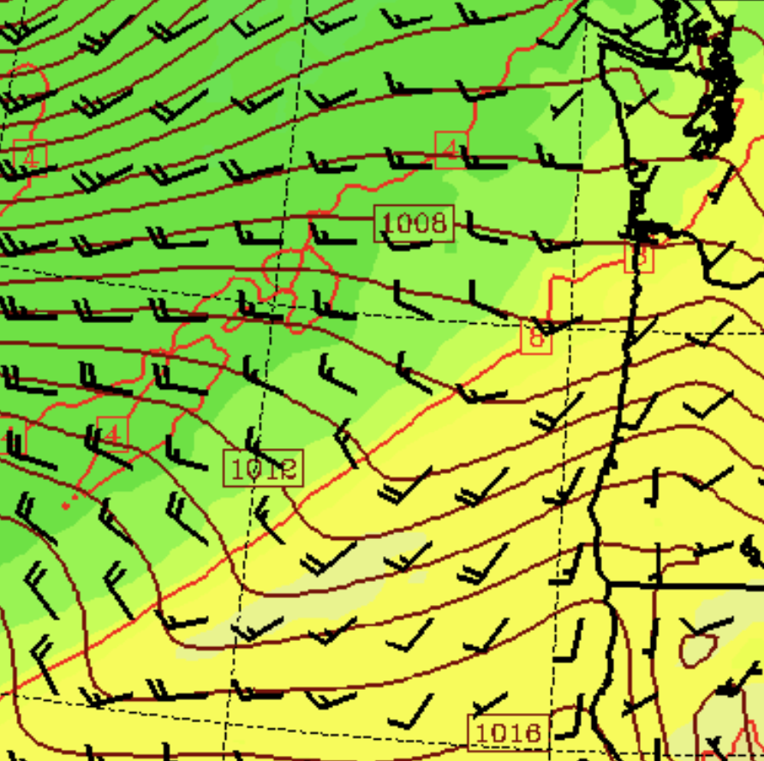

Slide 12
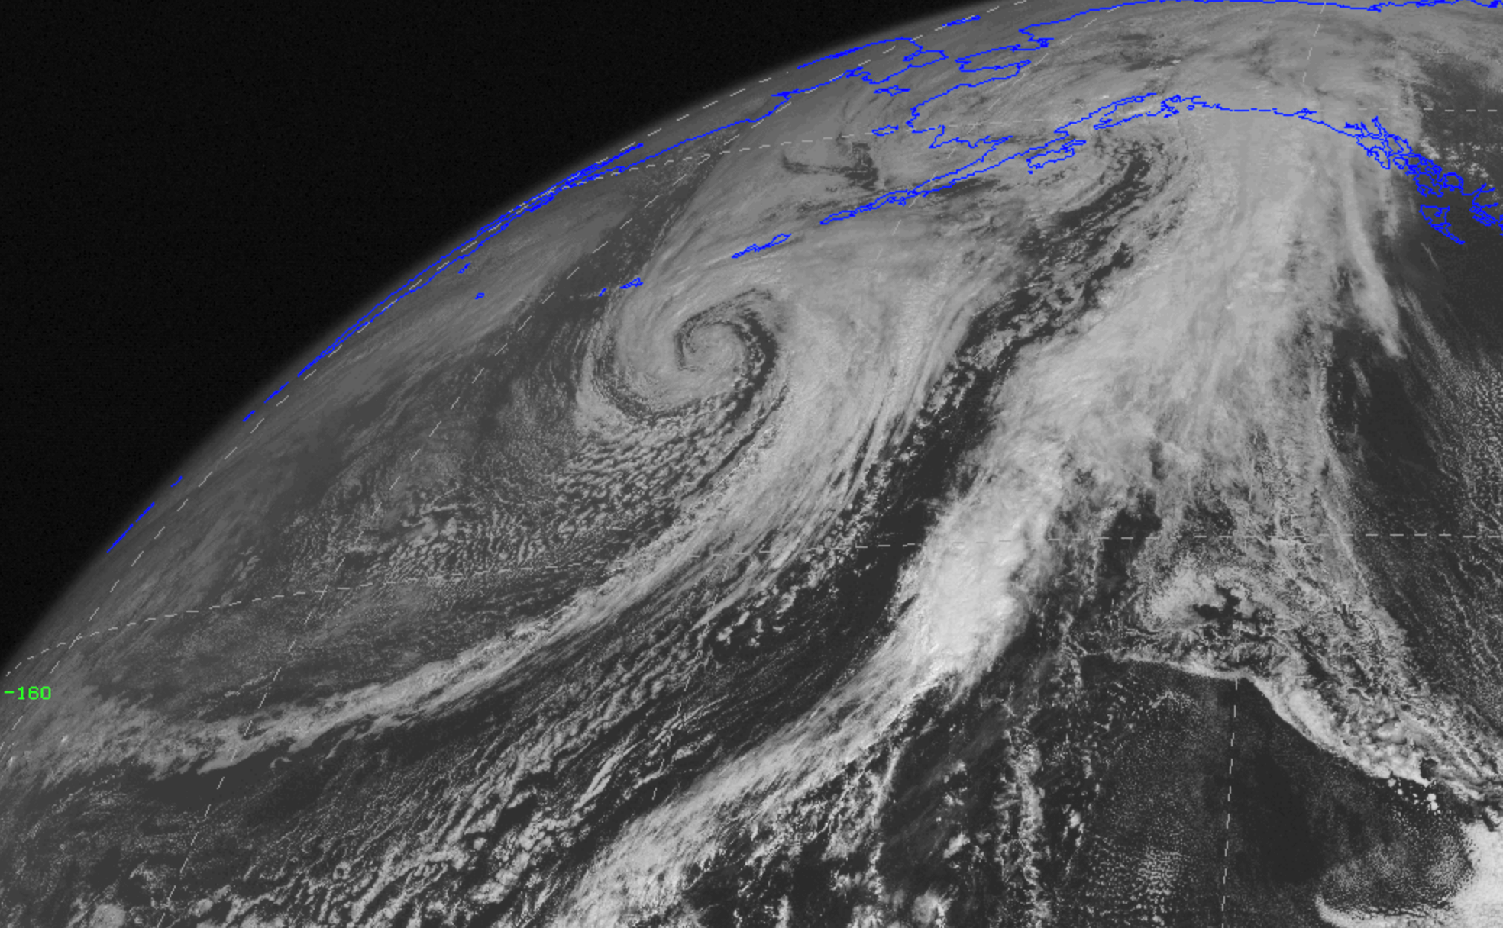
Fronts are associated with bands of clouds

Slide 13
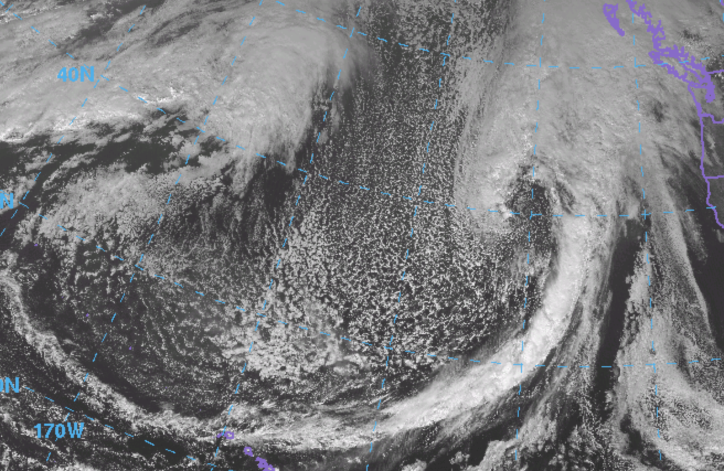

Slide 14
Vertical Structure of Fronts

Slide 15
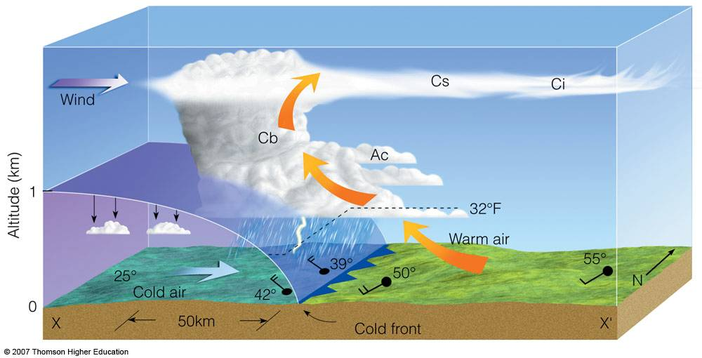
Cold Front
Slope 1:50, moves fast (20-30 mph), convection on leading edge

Slide 16
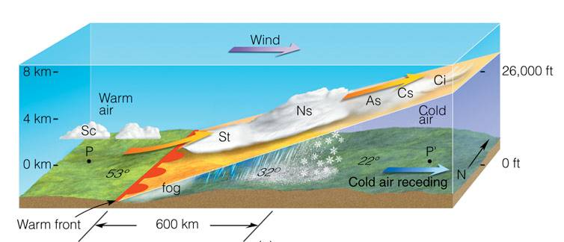
Warm Front
Smaller slope (1:200), slower (1—15 knots), more stratiform clouds

Slide 17
Stationary Front: similar structure to warm front, but without movement

Slide 18
There is a typical progression of clouds as cold and warm fronts approach and pass by
Cirrus
Cirrostratus
Altostratus
Nimbostratus
Cumulus after cold front

Slide 19
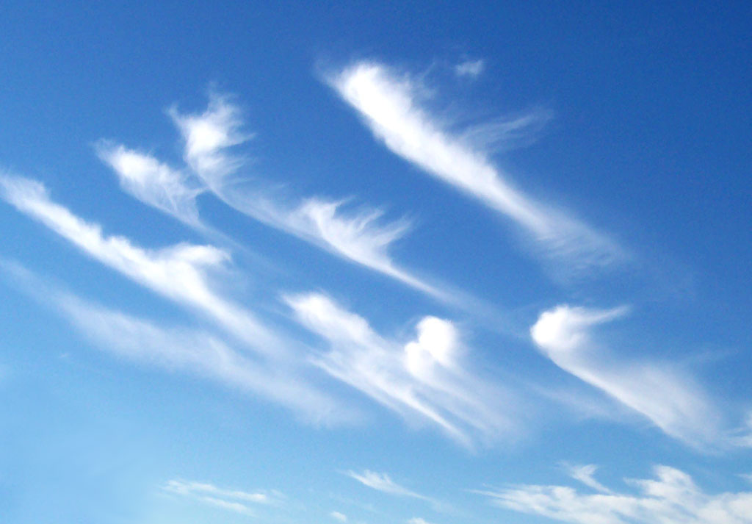

Slide 20
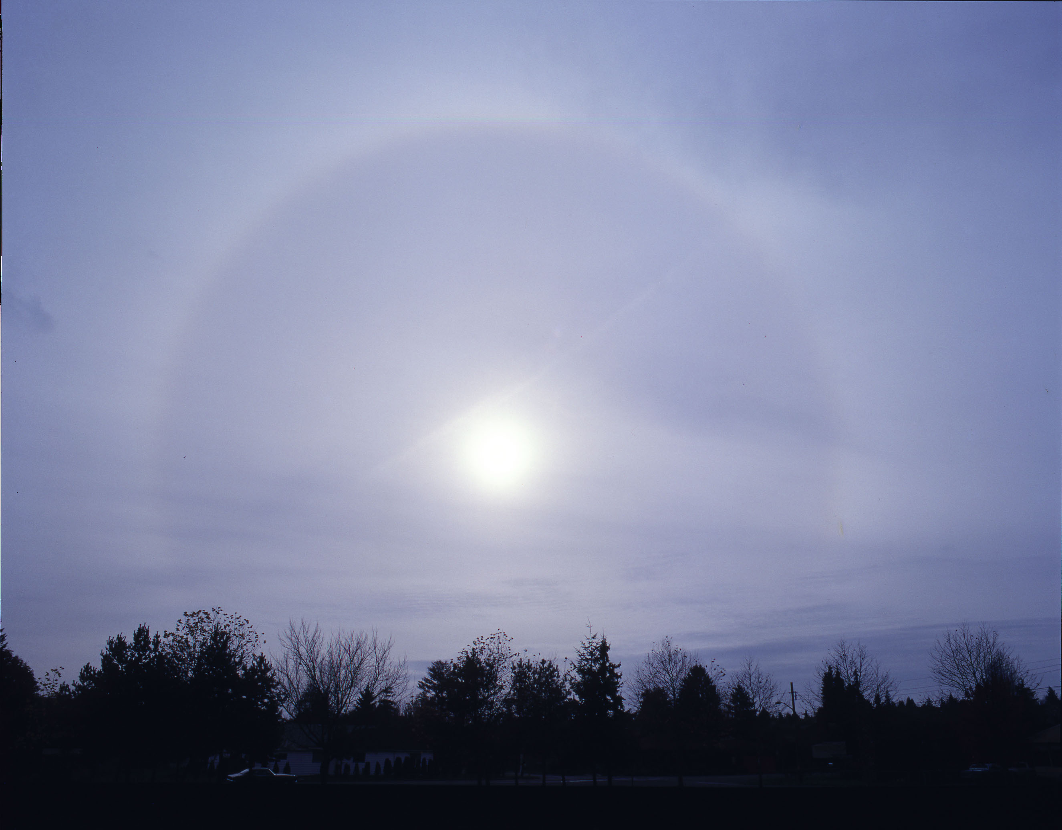

Slide 21
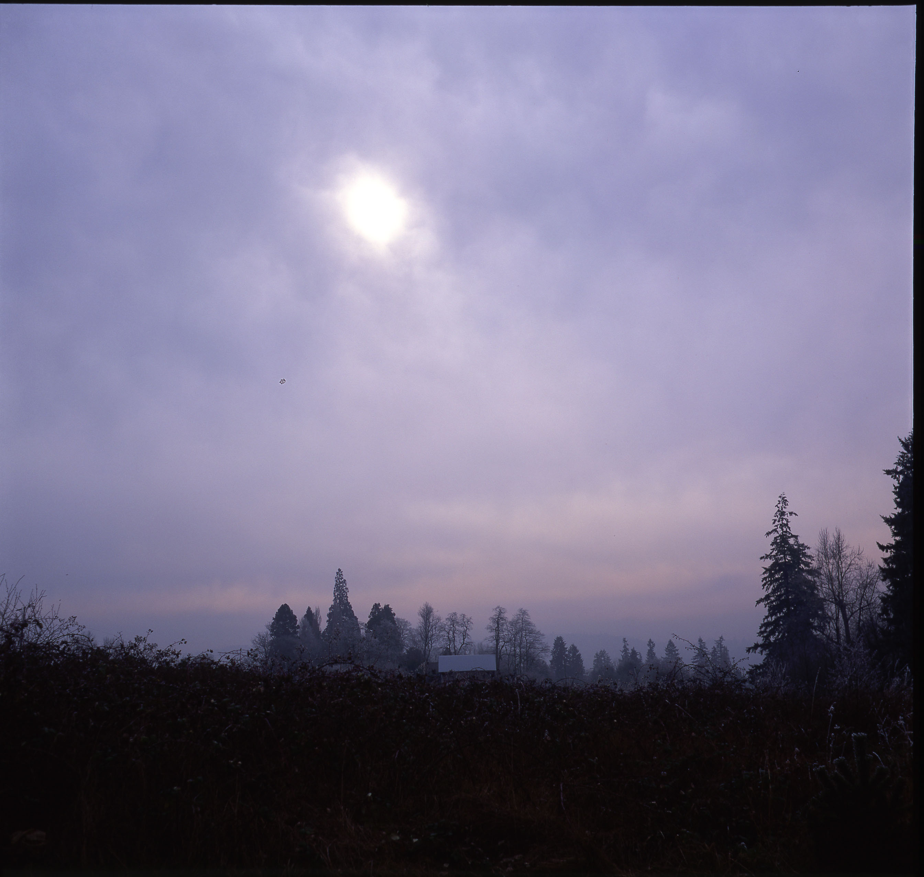

Slide 22
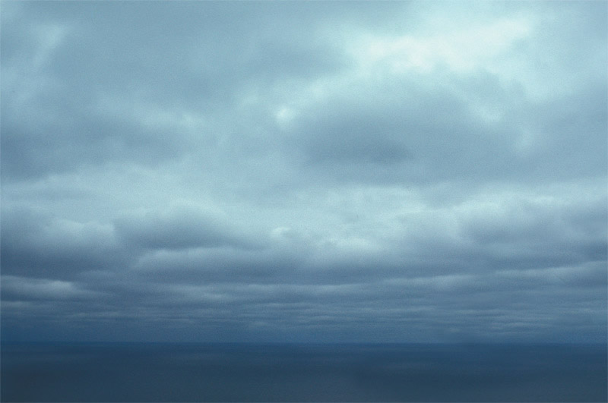

Slide 23
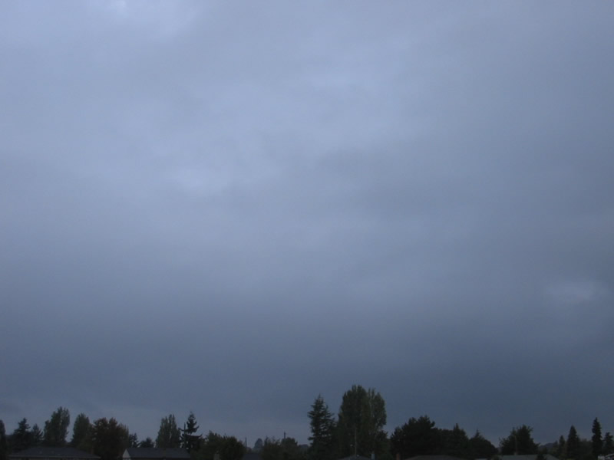

Slide 24
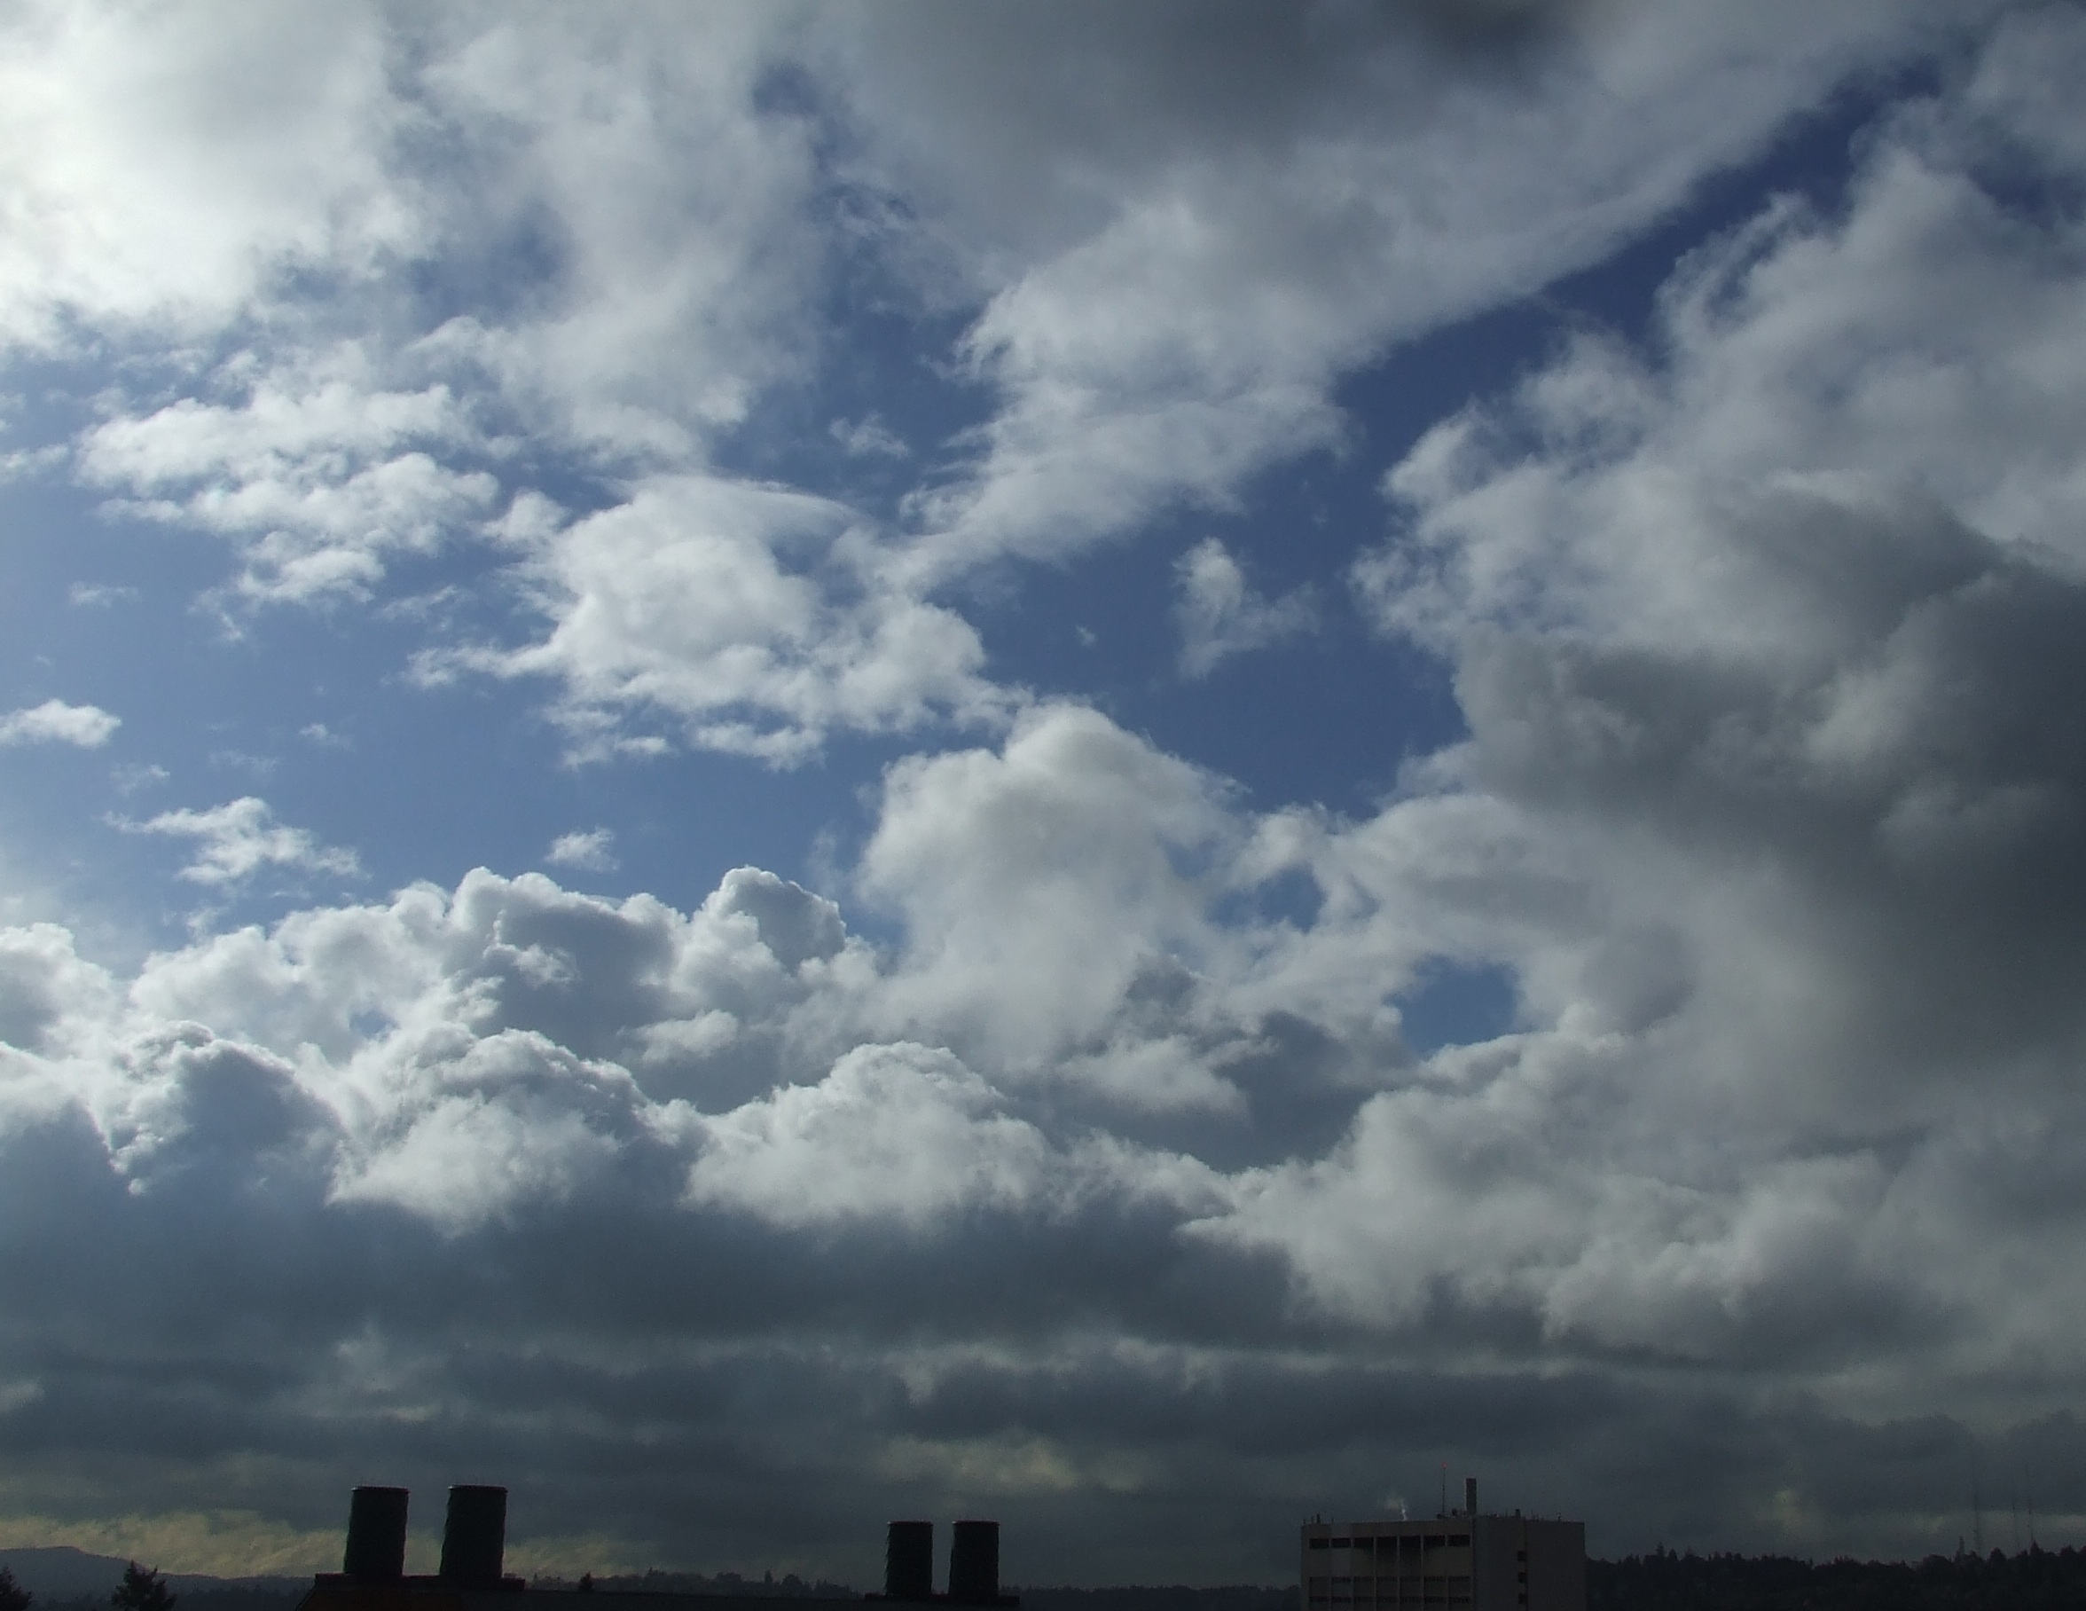

Slide 25
There is another type of front: the occluded front
But to understand this this front, you need to learn about the life cycle of fronts and cyclones.

Slide 26
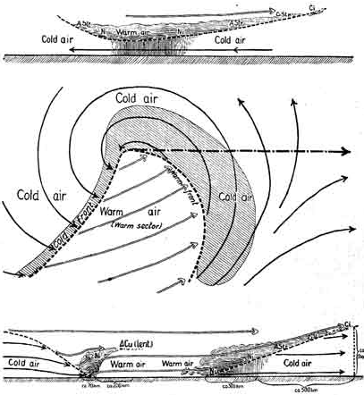
For much of the 20th century the dominant paradigm for cyclone/frontal evolution has been the Norwegian Cyclone Model (Bergen School)
Bjernkes, 1919

Slide 27
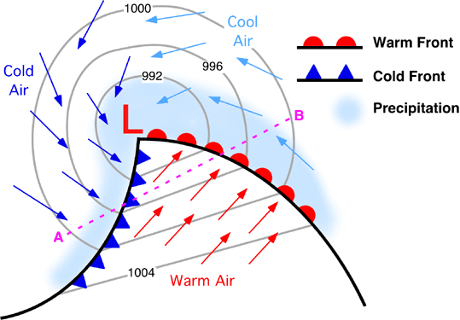
Typical Midlatitude Cyclone And Fronts
Warm Sector

Slide 28
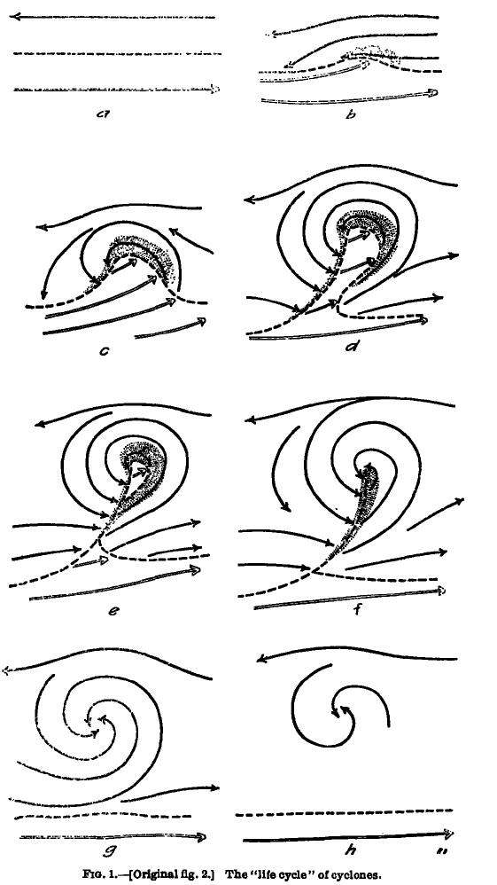
Concept of Evolution of Cyclones
Bjerknes and Solberg
1922

Slide 29
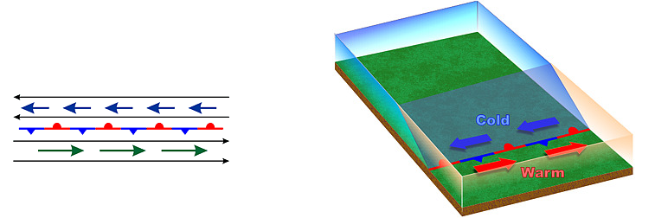
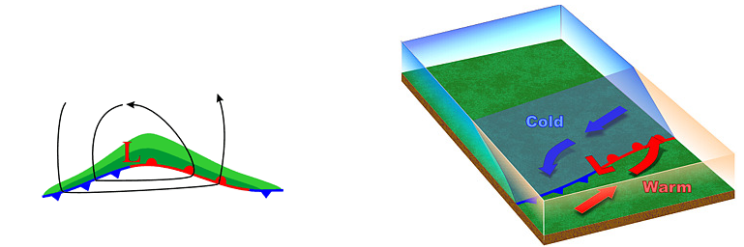
Stationary Polar Front
Wave Forming on Polar Front

Slide 30
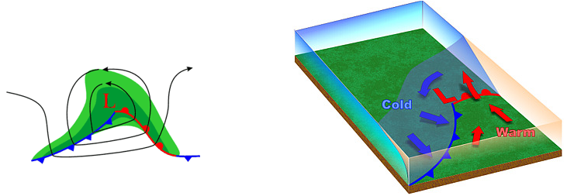
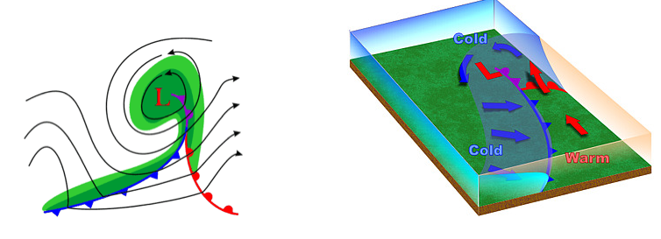
Wave Amplifies
Occlusion as Cold Front Catches Up to Warm Front

Slide 31
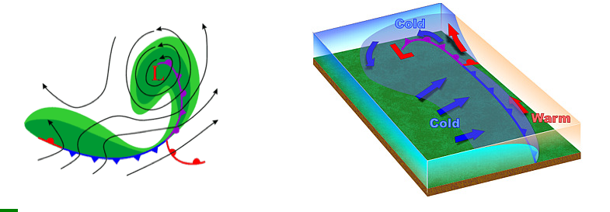
Occlusion Lengthens and System Weakens

Slide 32
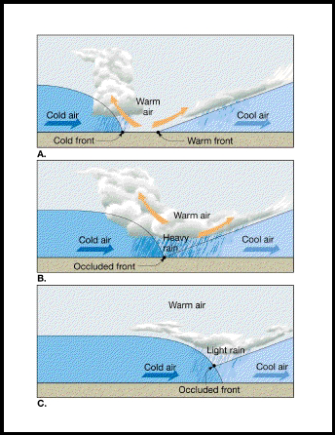
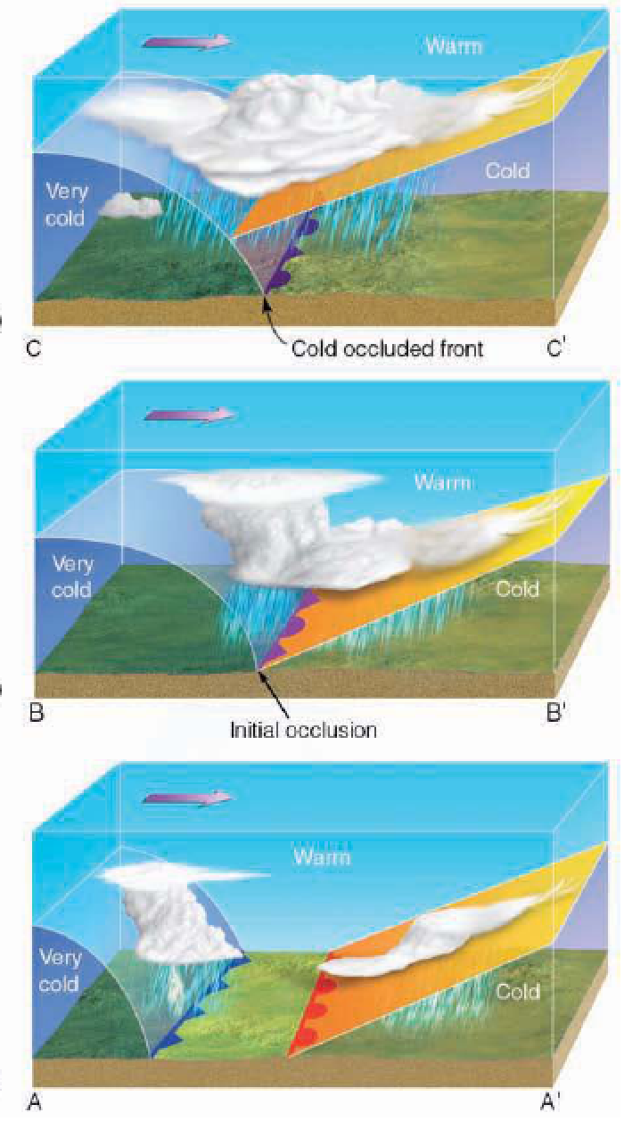
The Occlusion Process

Slide 33
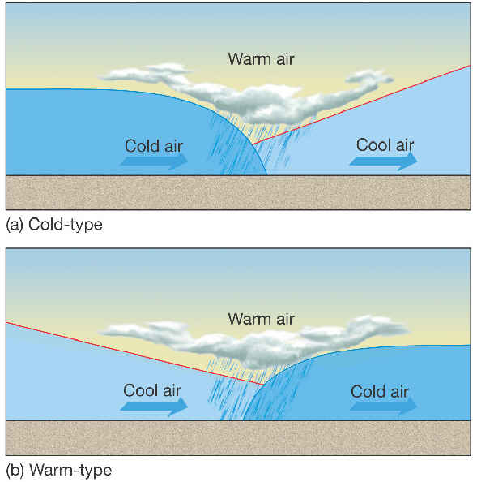
Warm or Cold Occlusions?
Cold
Occlusion
Warm
Occlusion

Slide 34
In the real world, only the warm occlusion is observed

Slide 35
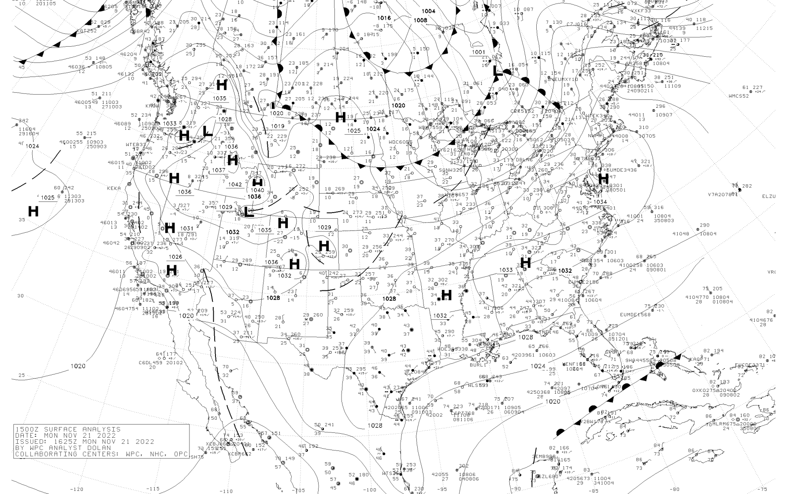

Slide 36
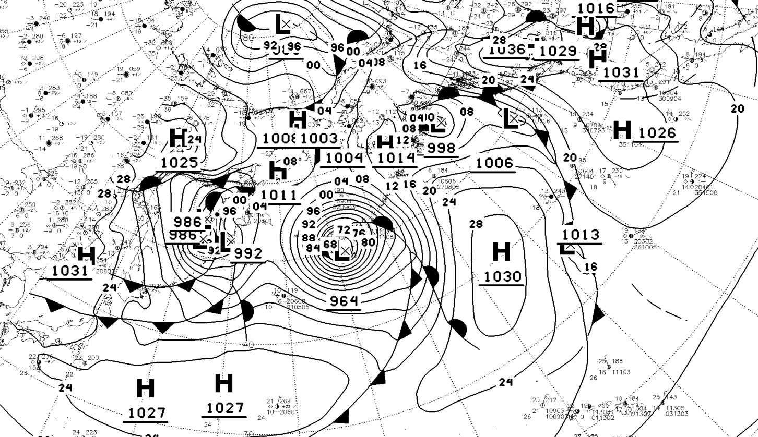

Slide 37
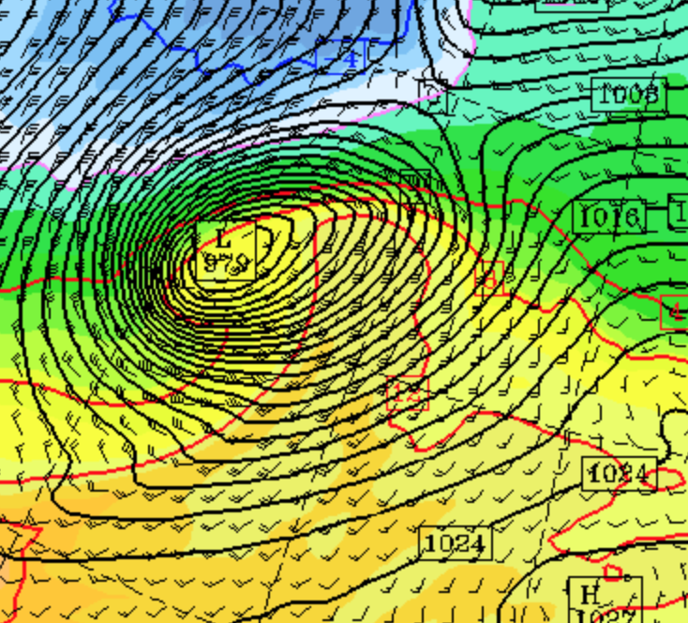
No Fronts on Model Output

Slide 38
Low-level frontal characteristics can vary depending on the surface conditions
For example, fronts coming off the Pacific Ocean often have weak horizontal temperature changes at the surface, but more contrasts aloft (say above 5000 ft).
Why?

Slide 39
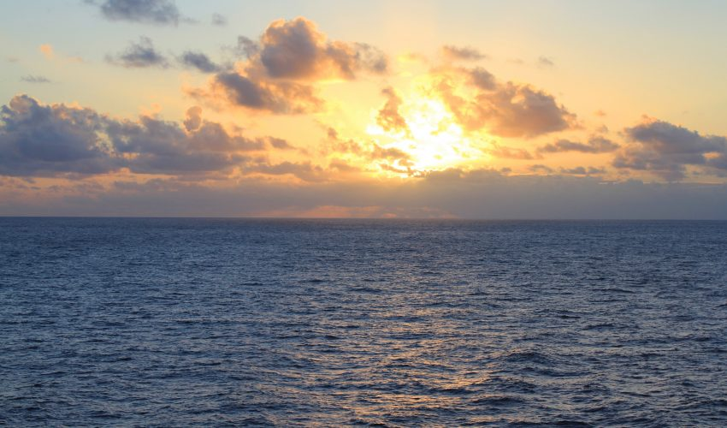
The Moderating Effects of the Pacific Ocean!

Slide 40
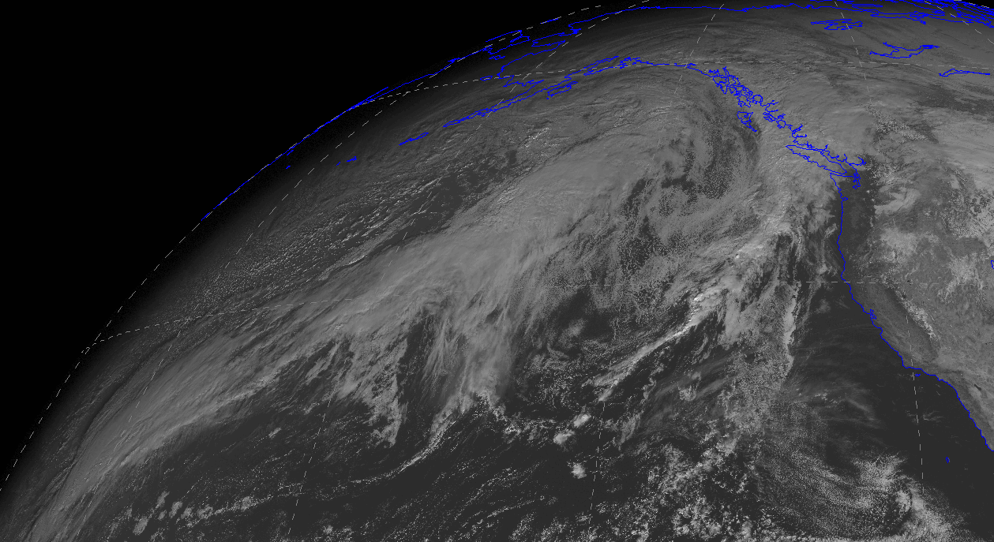
Passing over thousands of miles of ocean modifies the lower atmosphere

Slide 41
Modification of air going from cold land to warm water
Cold air aloft
Cold Land
Warmer Water

Slide 42

COLD
WARMER
COOL
WARMER
LAND
WATER

Slide 43
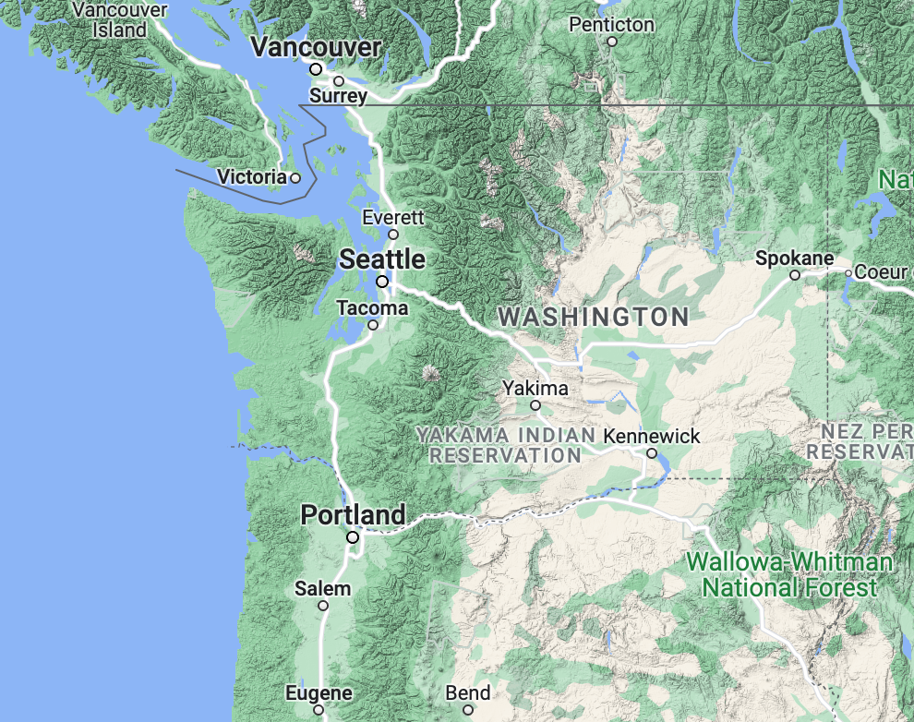
Our fronts are torn up and disrupted at low levels by our terrain

Slide 44
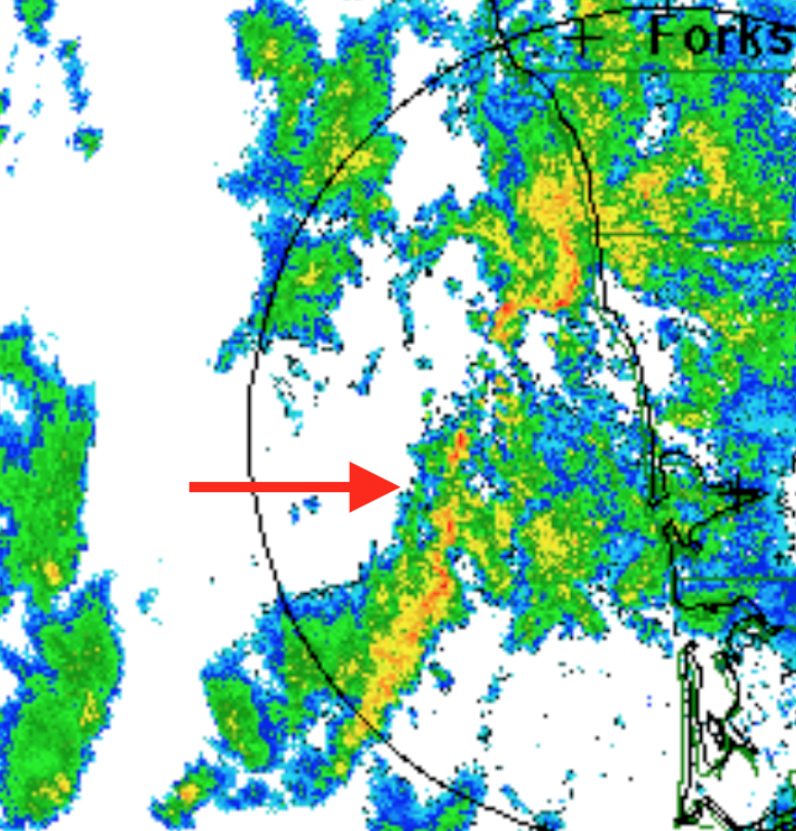
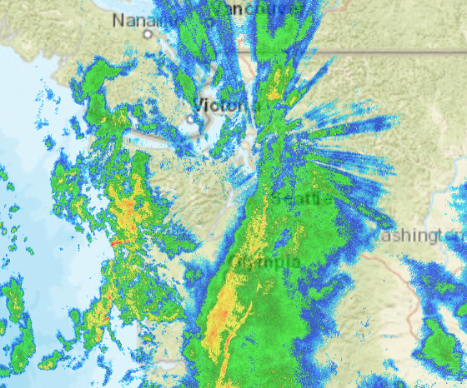
October 25

Slide 45
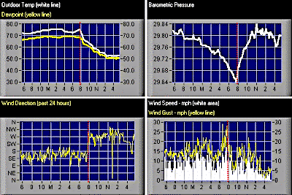
Low-level frontal changes are stronger over land away from terrain. (Memphis below)

Slide 46
During the 1930s-1950s we learned the relationship between cyclones and fronts and upper-level flow
Upper troughs associated with surface lows, with upper troughs lagging to the west.
Upper ridges associated with surface highs, with upper ridges lagging to the west.

Slide 47
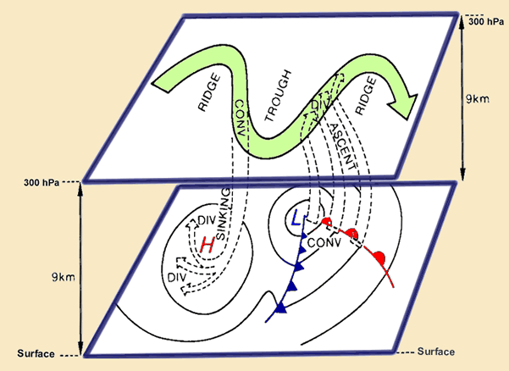

Slide 48
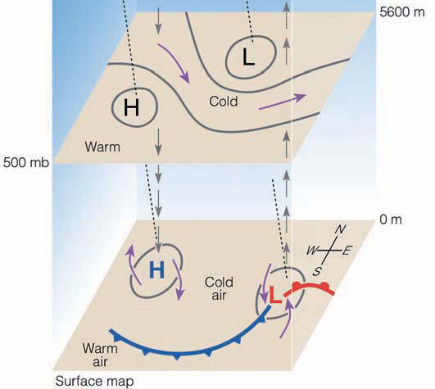
Active fronts are generally in front of (east of) upper level troughs

Slide 49
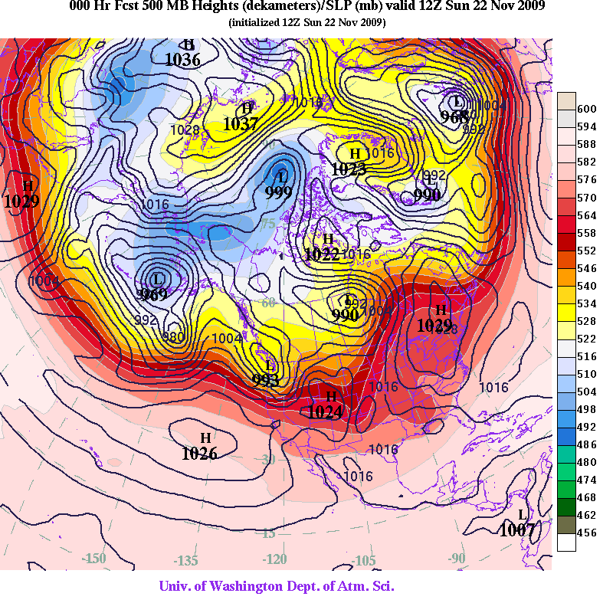
https://atmos.washington.edu/~ovens/wxloop.cgi?h500_slp+/-168//

Slide 50
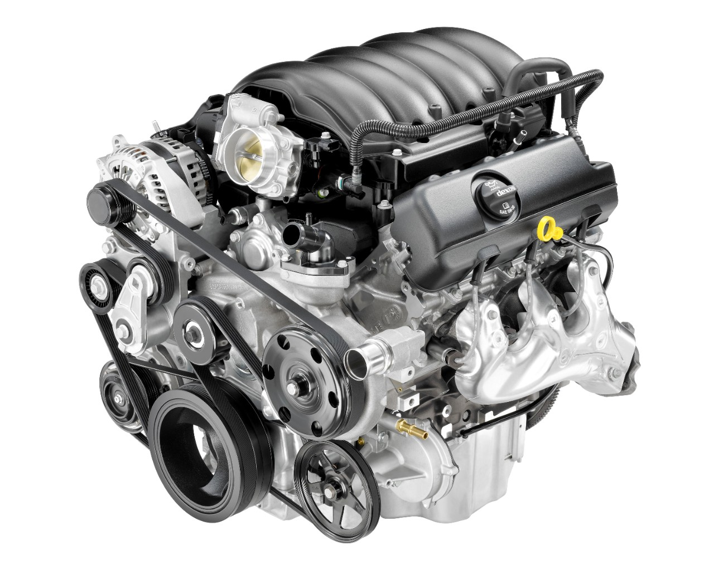
What is the energy source of midlatitude cyclones?

Slide 51
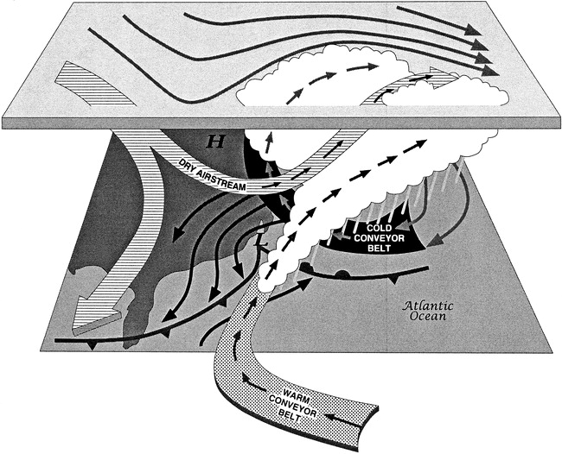
The answer: warm air rising and cold air sinking

Slide 52
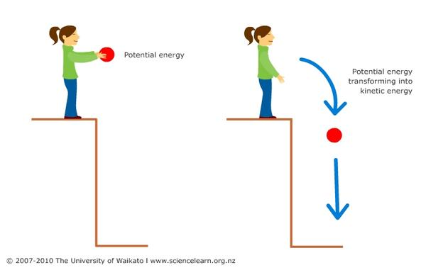
Warm (less dense) air rising and cold (more dense) air sinking lowers the center of gravity of the atmosphere
Like dropping a weight.
Potential energy (energy inherent in being aloft) is converted to kinetic energy (energy of moving air)

Slide 53
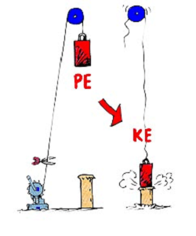
The conversion from potential energy to kinetic energy is enhanced by having large differences of temperatures (large horizonal temperature gradients)

Slide 54
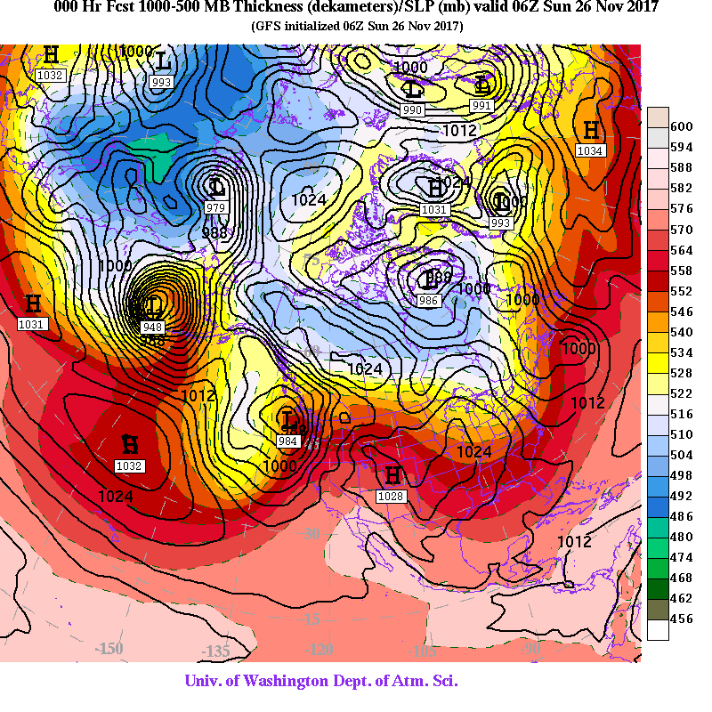
No accident that cyclones grow in regions of large temperature gradients

Slide 56
