Slide 1
Gas Laws
Atmospheric Sciences 101
Autumn 2025
The atmosphere is made up of gases so we need to know the basic laws of how gases behave

Slide 2
Gas laws describe the relationships between the four key parameters describing the behavior of gases
Temperature
Pressure
Density
Volume

Slide 3
Key Gas Parameters
Temperature (T): a measure of the average kinetic energy (KE) of atoms and molecules. (°C, °F). Expressed in °K for calculations.
Pressure (P): Force per unit area: F/A. Expressed in Pascals (N/m²⁾. Often in terms of hPa (100 N/m²)

Slide 4
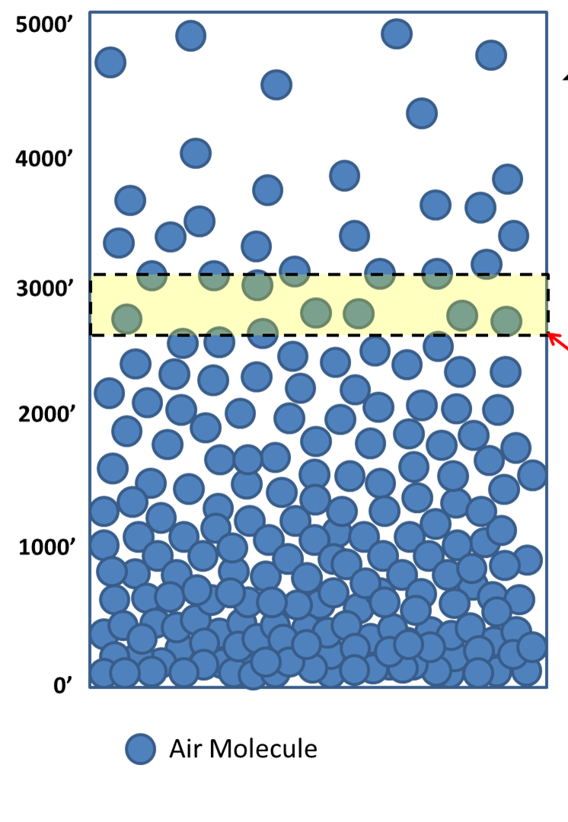
More Key Parameters
Density (ρ): ρ = Mass/Volume.
ρ= Μ/V
  Expressed in kg/m³ in the metric system.
  At the earth’s surface ρ ~ 1 kg/m³ , 1 kg = 1000 grams ~2.2 lbs
Volume (V): Expressed in m³

Slide 5
The Key Gas Parameters are Related by
GAS LAWS

Slide 6
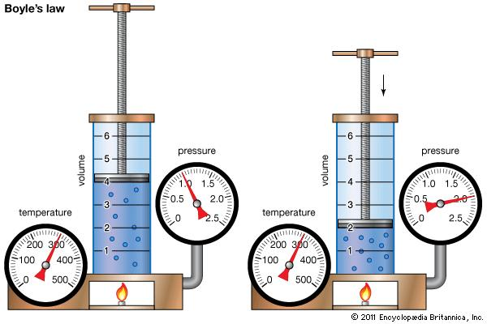
Boyle’s Law (~1660)
Start with a sample of air with a temperature (T), pressure (P), and volume (V). If T is kept constant, then:
PV=constant

Slide 7
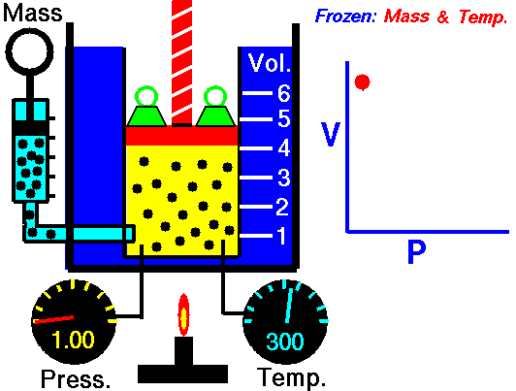
Boyles Law
Basis of air pumps we all use

Slide 8
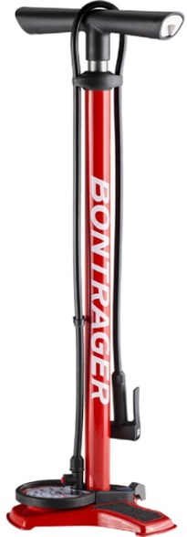
We are all familiar with Boyle’s Law in our daily lives.

Slide 9
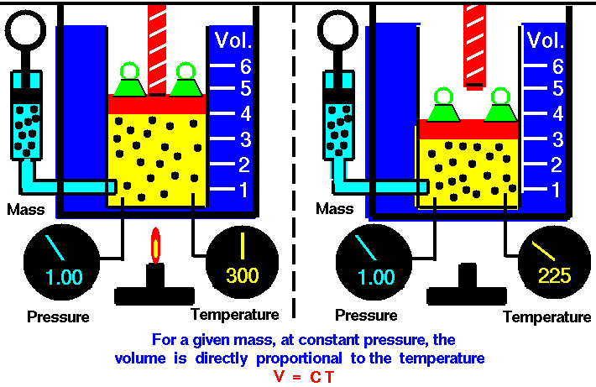
Law of Charles and Guy Lussac
If you increase temperature, while keeping pressure constant, volume will increase.
V= constant * T (°K)
V = CT
Basis of car engines.

Slide 10
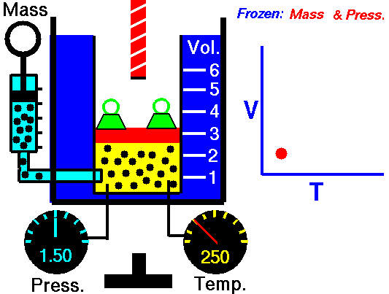

Slide 11
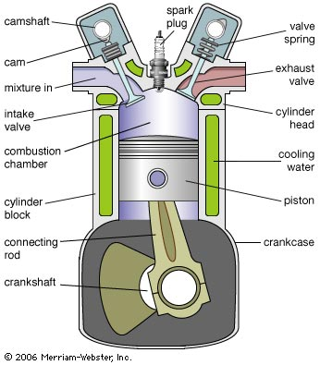
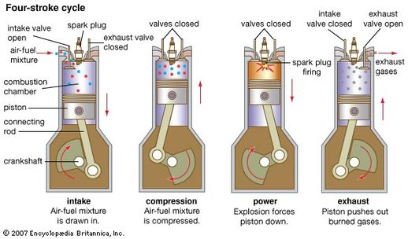

Slide 12
Why use two gas laws when you can use one?
?

Slide 13
Can combine both gas laws into one: the Perfect Gas Law (a.k.a., the Ideal Gas Law)
P= ρRT
Where ρ is density (kg m⁻³), R is a gas constant, P is pressure (Nm⁻²), and T is temperature (K)
One of the key relationships of meteorology

Slide 14
Let’s prove it contains the other laws
Start with P= ρRT for a particular sample of air (thus mass is constant)
Assume T=constant.
Then you have: P= ρ *constant or
P = constant* M/V
or PV=constant
BOYLE’S LAW!

Slide 15
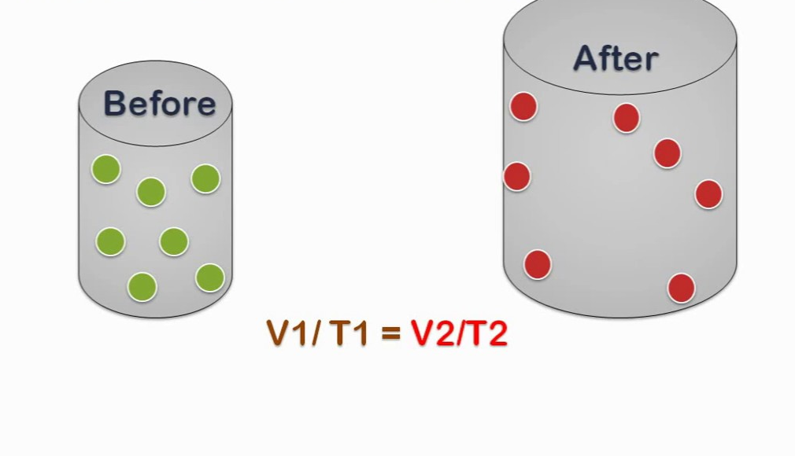
Gas Law Importance
We will use gas laws to explain many weather features
The perfect gas law is one of the key relationships used in computer weather forecast models.

Slide 16

Adiabatic Processes
Clouds form as air cools when it rises.
Why does rising air cool?
And air warms as it forced to sink. Why?
Why does the spray from aerosol cans feel cold?
And why are bike pumps warm after use?

Slide 17

Explained by adiabatic processes!
Air parcel: An identifiable collection of air that stays together. Think of the air in balloon.
An adiabatic process is a process that occurs WITHOUT the exchange of energy with the surroundings.

Slide 18
Adiabatic processes
In a meteorological context, an adiabatic process is one in which there is no exchange of energy between an air parcel and the surrounding air.

Slide 19

Think of air in an insulated box

Slide 20
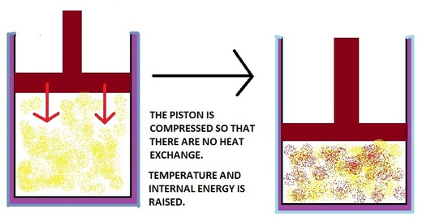
How do temperature and pressure vary for an air parcel during an adiabatic process?
Imagine an insulated cylinder with air in it, so there is NO heat exchange with the outside environment.
Push down the piston. Pressure and temperature increase.
P₂ > P₁
T₂ > T₁
T₁, P₁
T₂, P₂
1
2

Slide 21

Adiabatic processes
If an air parcel is compressed adiabatically, temperature will rise
If an air parcel to expands, its temperature will fall.
But why?

Slide 22
Adiabatic processes
  When compressing an air parcel, you are doing work on the molecules in the parcel, giving them a “shove” and making them move faster. Temperature rises.
  If an air parcel expands, energy is needed to push out the boundaries of the parcel, resulting in cooling.

Slide 23
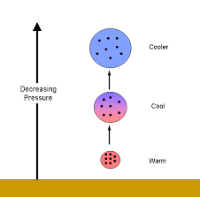
To Put It Another Way: The Adiabatic Law
In the absence of heat exchange with the outside, an air parcel warms when compressed and cools when it expands.
Explains a great deal of what it occurring in the atmosphere

Slide 24
The Adiabatic Law
When air is forced to rise, it moves into an environment of lesser pressure (since pressure decreases with height).
With less pressure on the air parcel, it expands
Expansion results in cooling

Slide 25
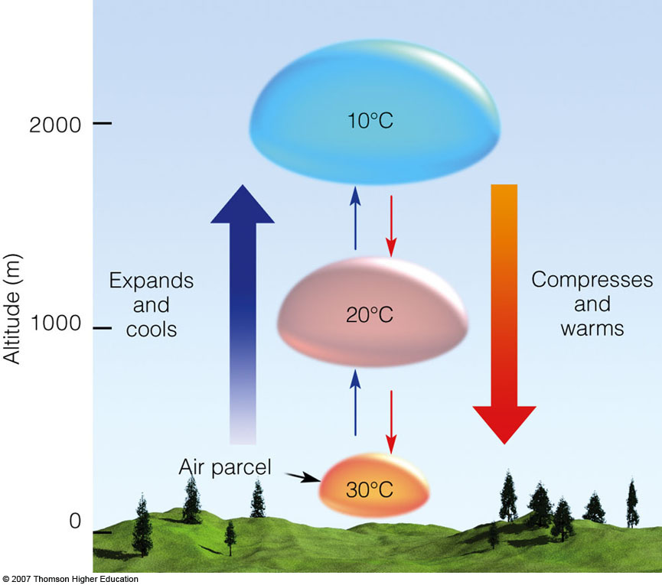
Adiabatic Law
When air sinks, it moves into an environment with higher pressure, compressing and warming the air parcel.

Slide 26

An example that many of you have experienced—a very cold spray from aerosol cans due to adiabatic expansion and cooling

Slide 27
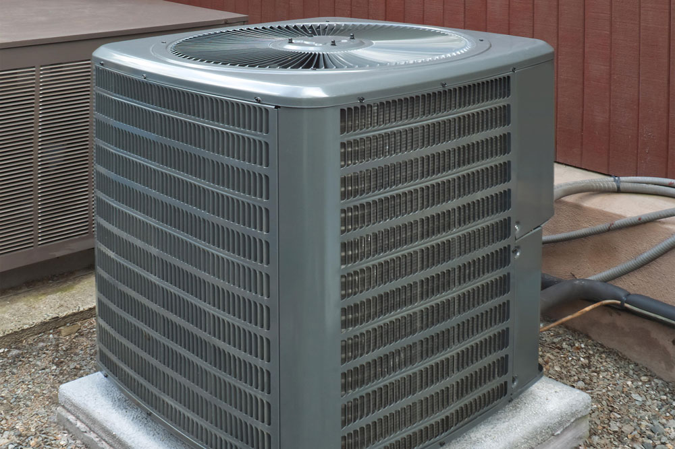
Heat pumps and AC Uses Adiabatic Principles

Slide 28
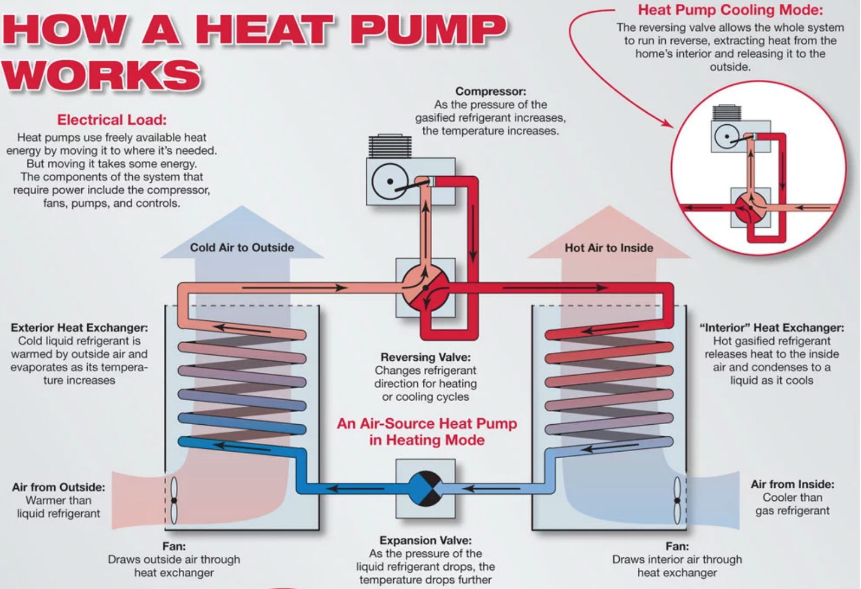

Slide 29
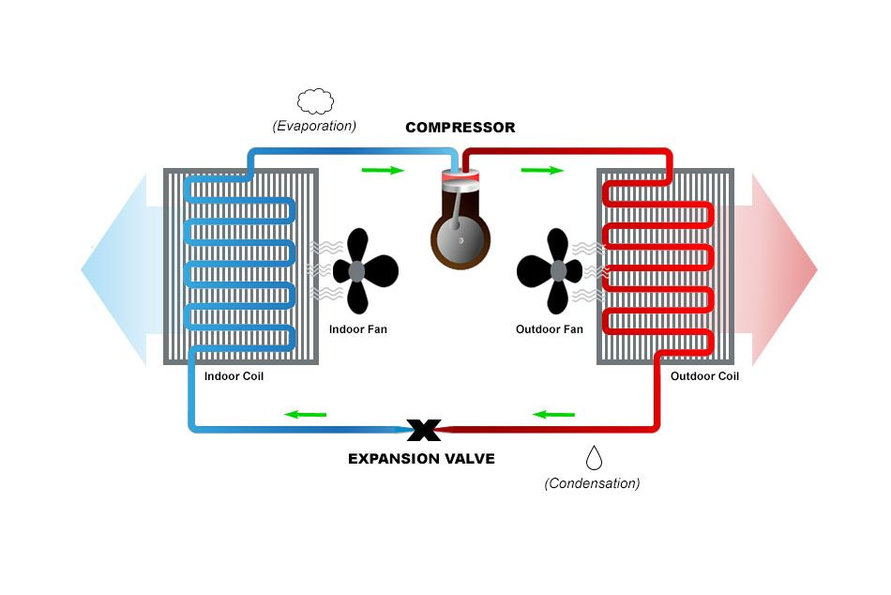
Heat Pump

Slide 30
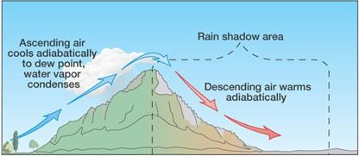
Influence on saturation and clouds
As an air parcel rises, adiabatic cooling can result in increased relative humidity and saturation.

Slide 31
Influence on saturation and clouds
The amount of water vapor in an air parcel does not change as it initially rises
As the temperature falls, the air parcel has less ability to hold water vapor. Thus, RH increases.
With enough vertical motion, the RH climbs to 100% and the air reaches saturation—any more rising leads to water condensing out and cloud formation.
Flow moving up mountains is a good example

Slide 32
Downslope warming and drying
On the other hand, sinking air warms adiabatically and relative humidity decreases. Thus, clouds evaporate, producing a cloud-free zone or rain shadow.

Slide 33
Great examples here in Washington

Slide 34
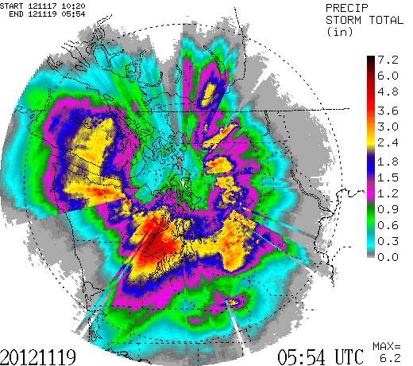

Slide 35
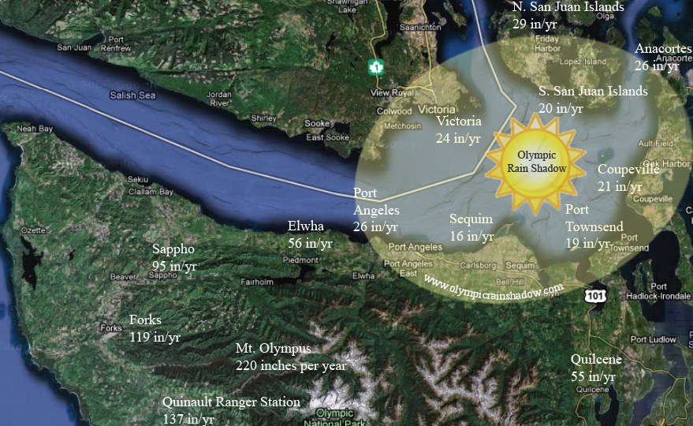


Slide 36
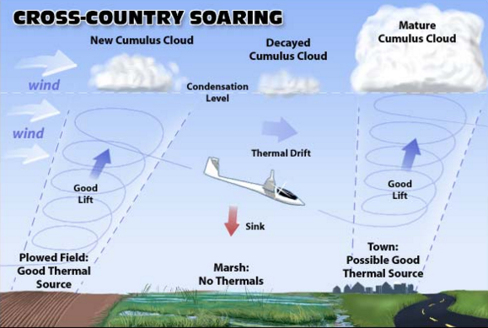
Adiabatic cooling/warming can occur outside of mountains as well

Slide 37
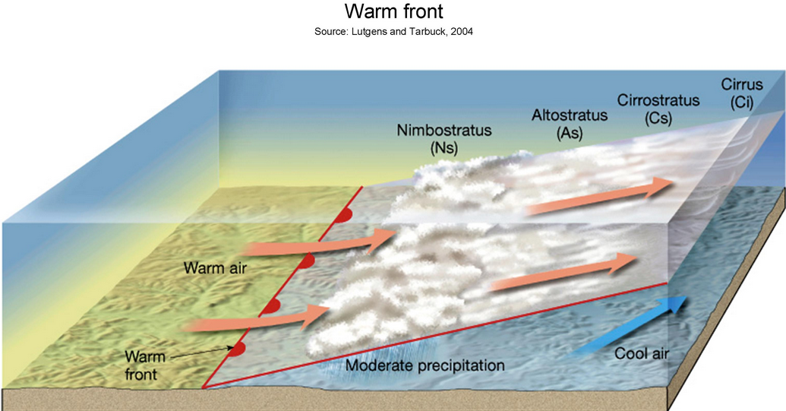
Warm Front: Rising air and adiabatic cooling

Slide 38

All of these clouds are associated with adiabatic cooling

