Slide 1
Global Scale Winds
Also known as the
General Circulation of the Atmosphere
Atmospheric Sciences 101
Autumn 2025

Slide 2
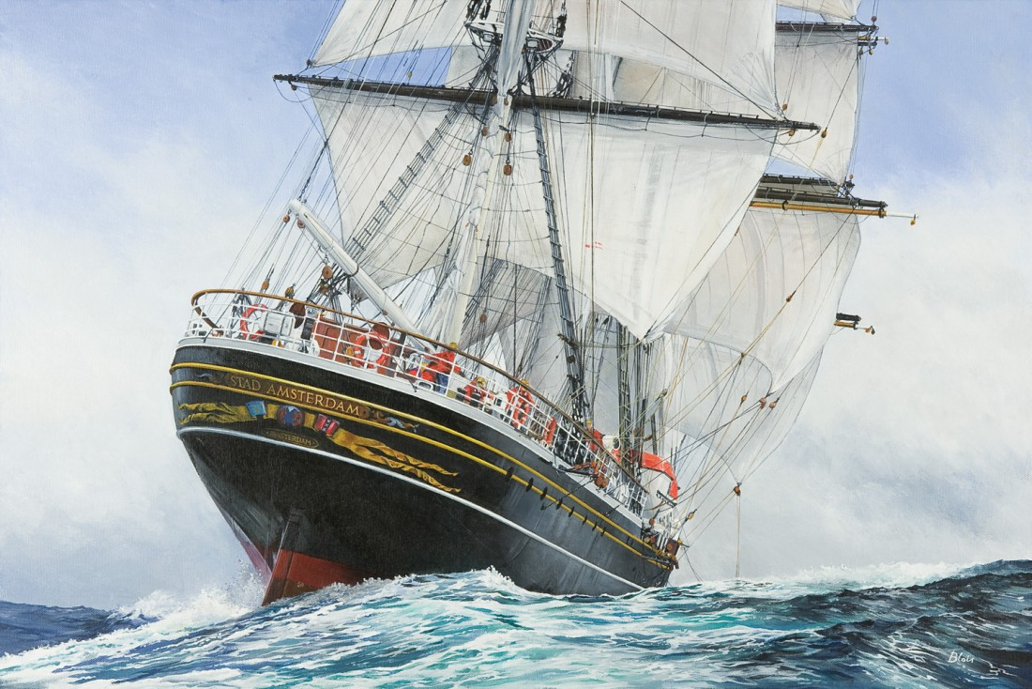
During the age of discovery (1400s-1600s) there was considerable interest in the large-scale wind patterns of the atmosphere

Slide 3
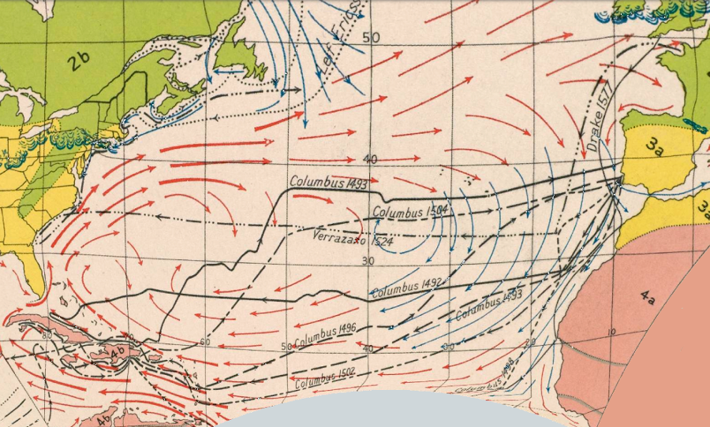
For good reason: sailing ships depended on the winds!

Slide 4
What are and what explains the large-scale wind patterns?
?

Slide 5
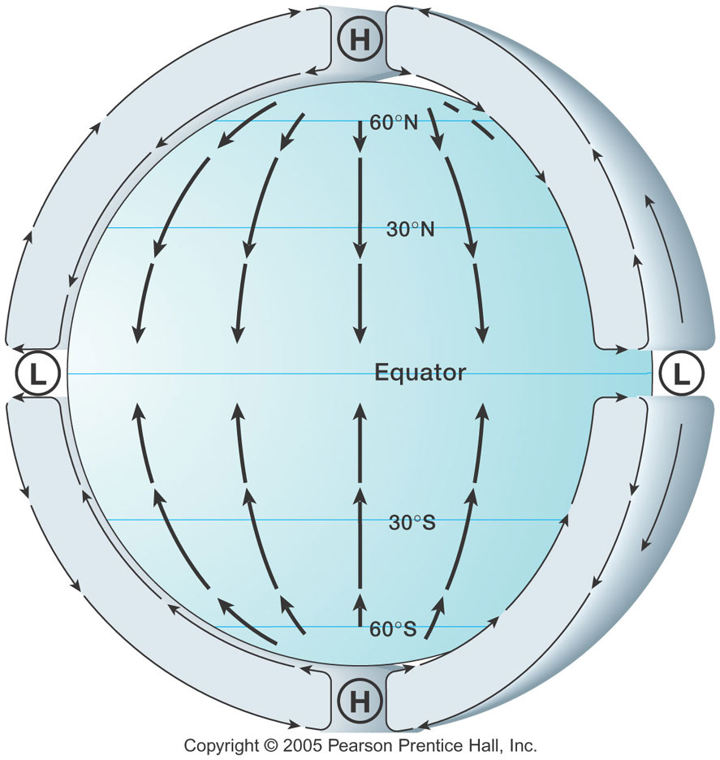
Hadley Cell
Edmond Halley
And George
Hadley,
Early 1700s
Warm tropics
Cool polar regions
Rising air in the tropic
Sinking air near the poles

Slide 6
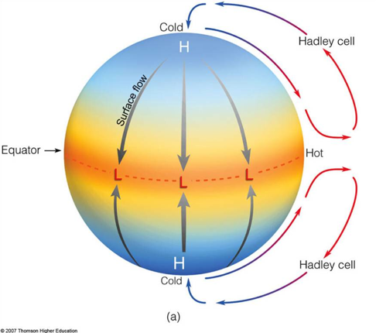
Early Ideas about the Hadley Cell
Also known as the Hadley Circulation

Slide 7
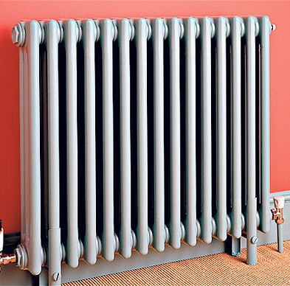
Analogous to the circulation in a room with a heater and window
window
Cooling
Heating

Slide 8
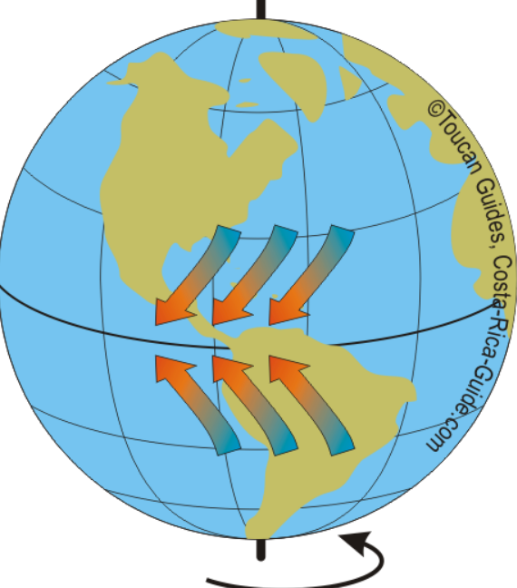
Early mariners were aware that the trade winds—winds in the tropics– The blew towards the equator and towards the west
Two trades—north and south of the equator

Slide 9
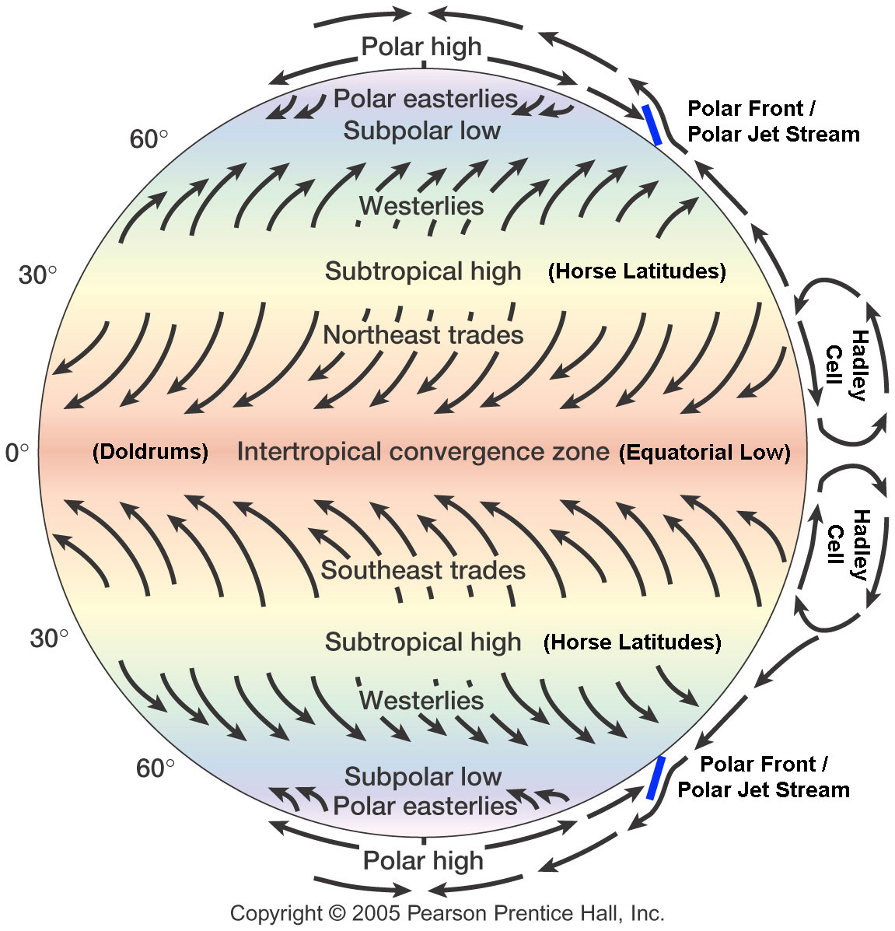
They were right! But there were other complications!

Slide 10
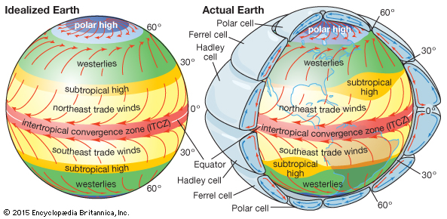
The real global atmosphere is more complicated, with westerly flow in the midlatitudes

Slide 11
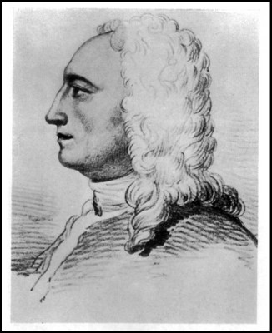
George Hadley in 1735 suggested that the easterly flow in tropics was due to what became known as the Coriolis Force, which acts to the right of flow wind direction in the northern hemisphere on a rotating planet

Slide 13
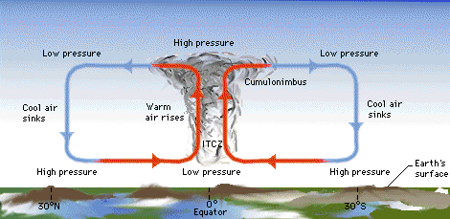
Intertropical Convergence Zone (ITCZ)
Associated with convergence between the NE and SE trades
Not necessarily on the equator (generally north of it)
Also known as the doldrums

Slide 14
The air converging at low levels causes upward motion that leads to clouds

Slide 15
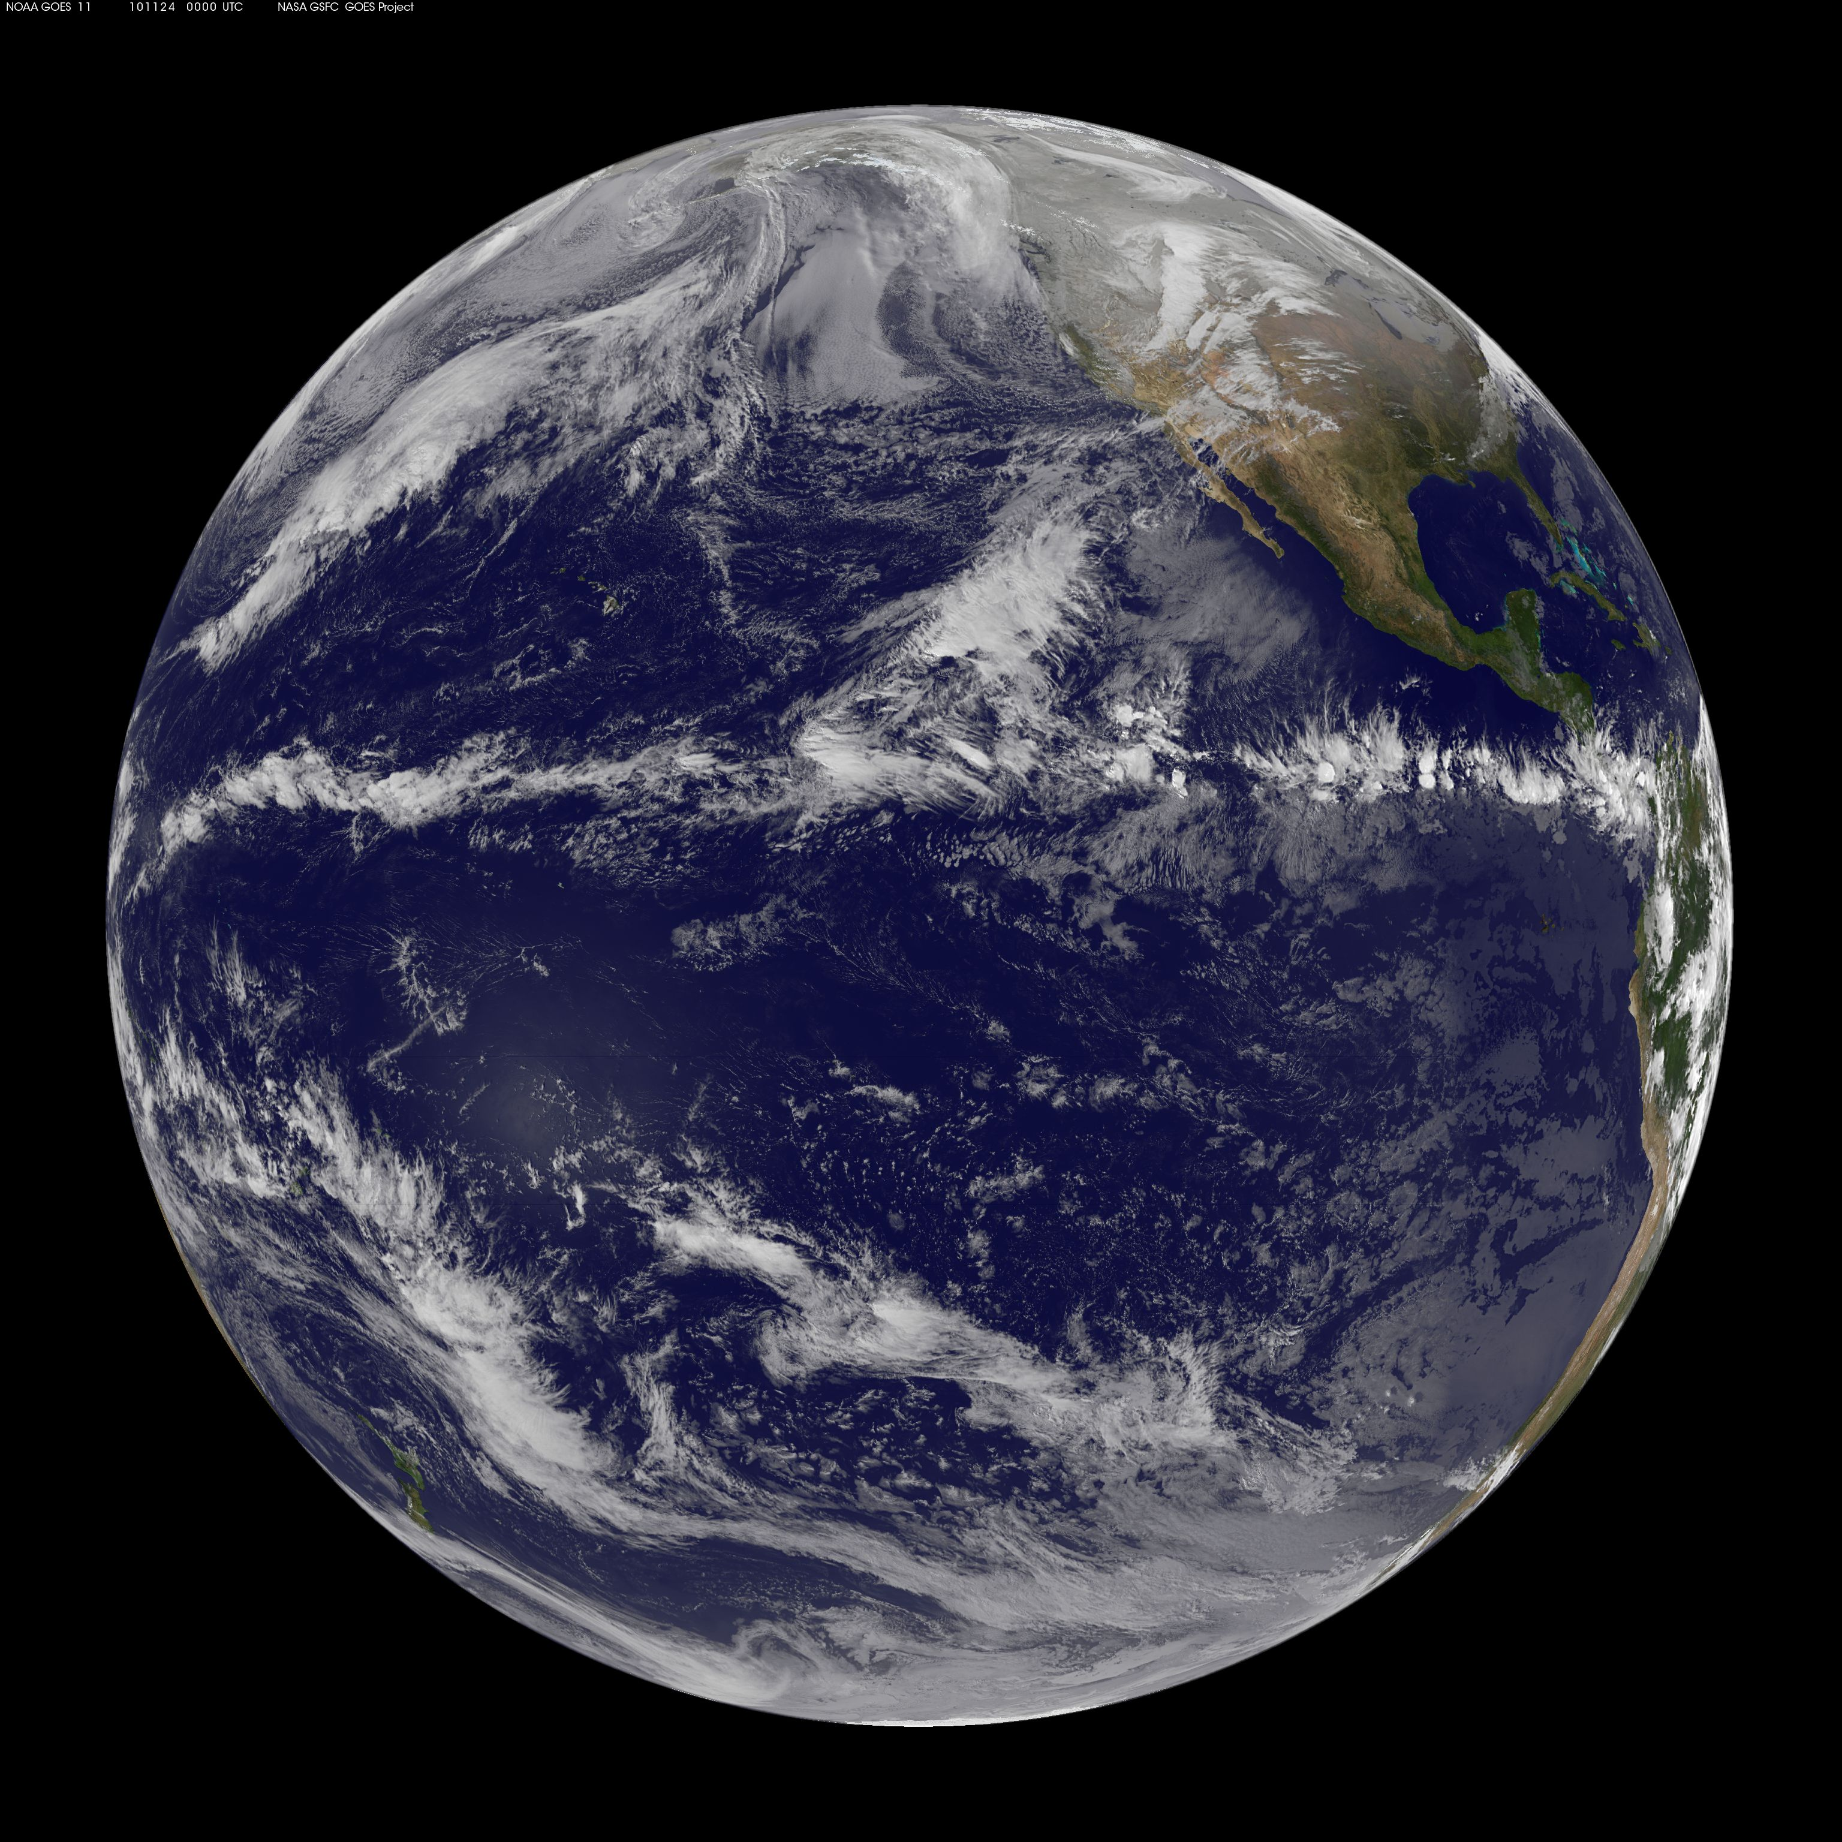
Clouds along the ITCZ

Slide 16
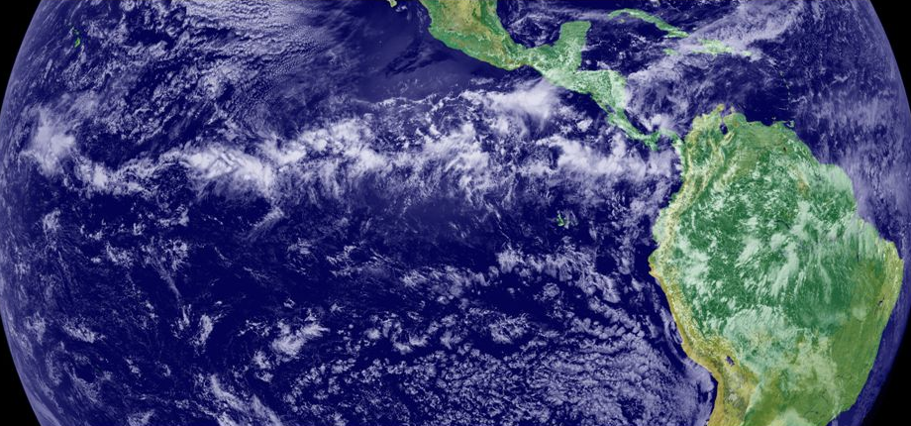
Lots of clouds in the ITCZ

Slide 17
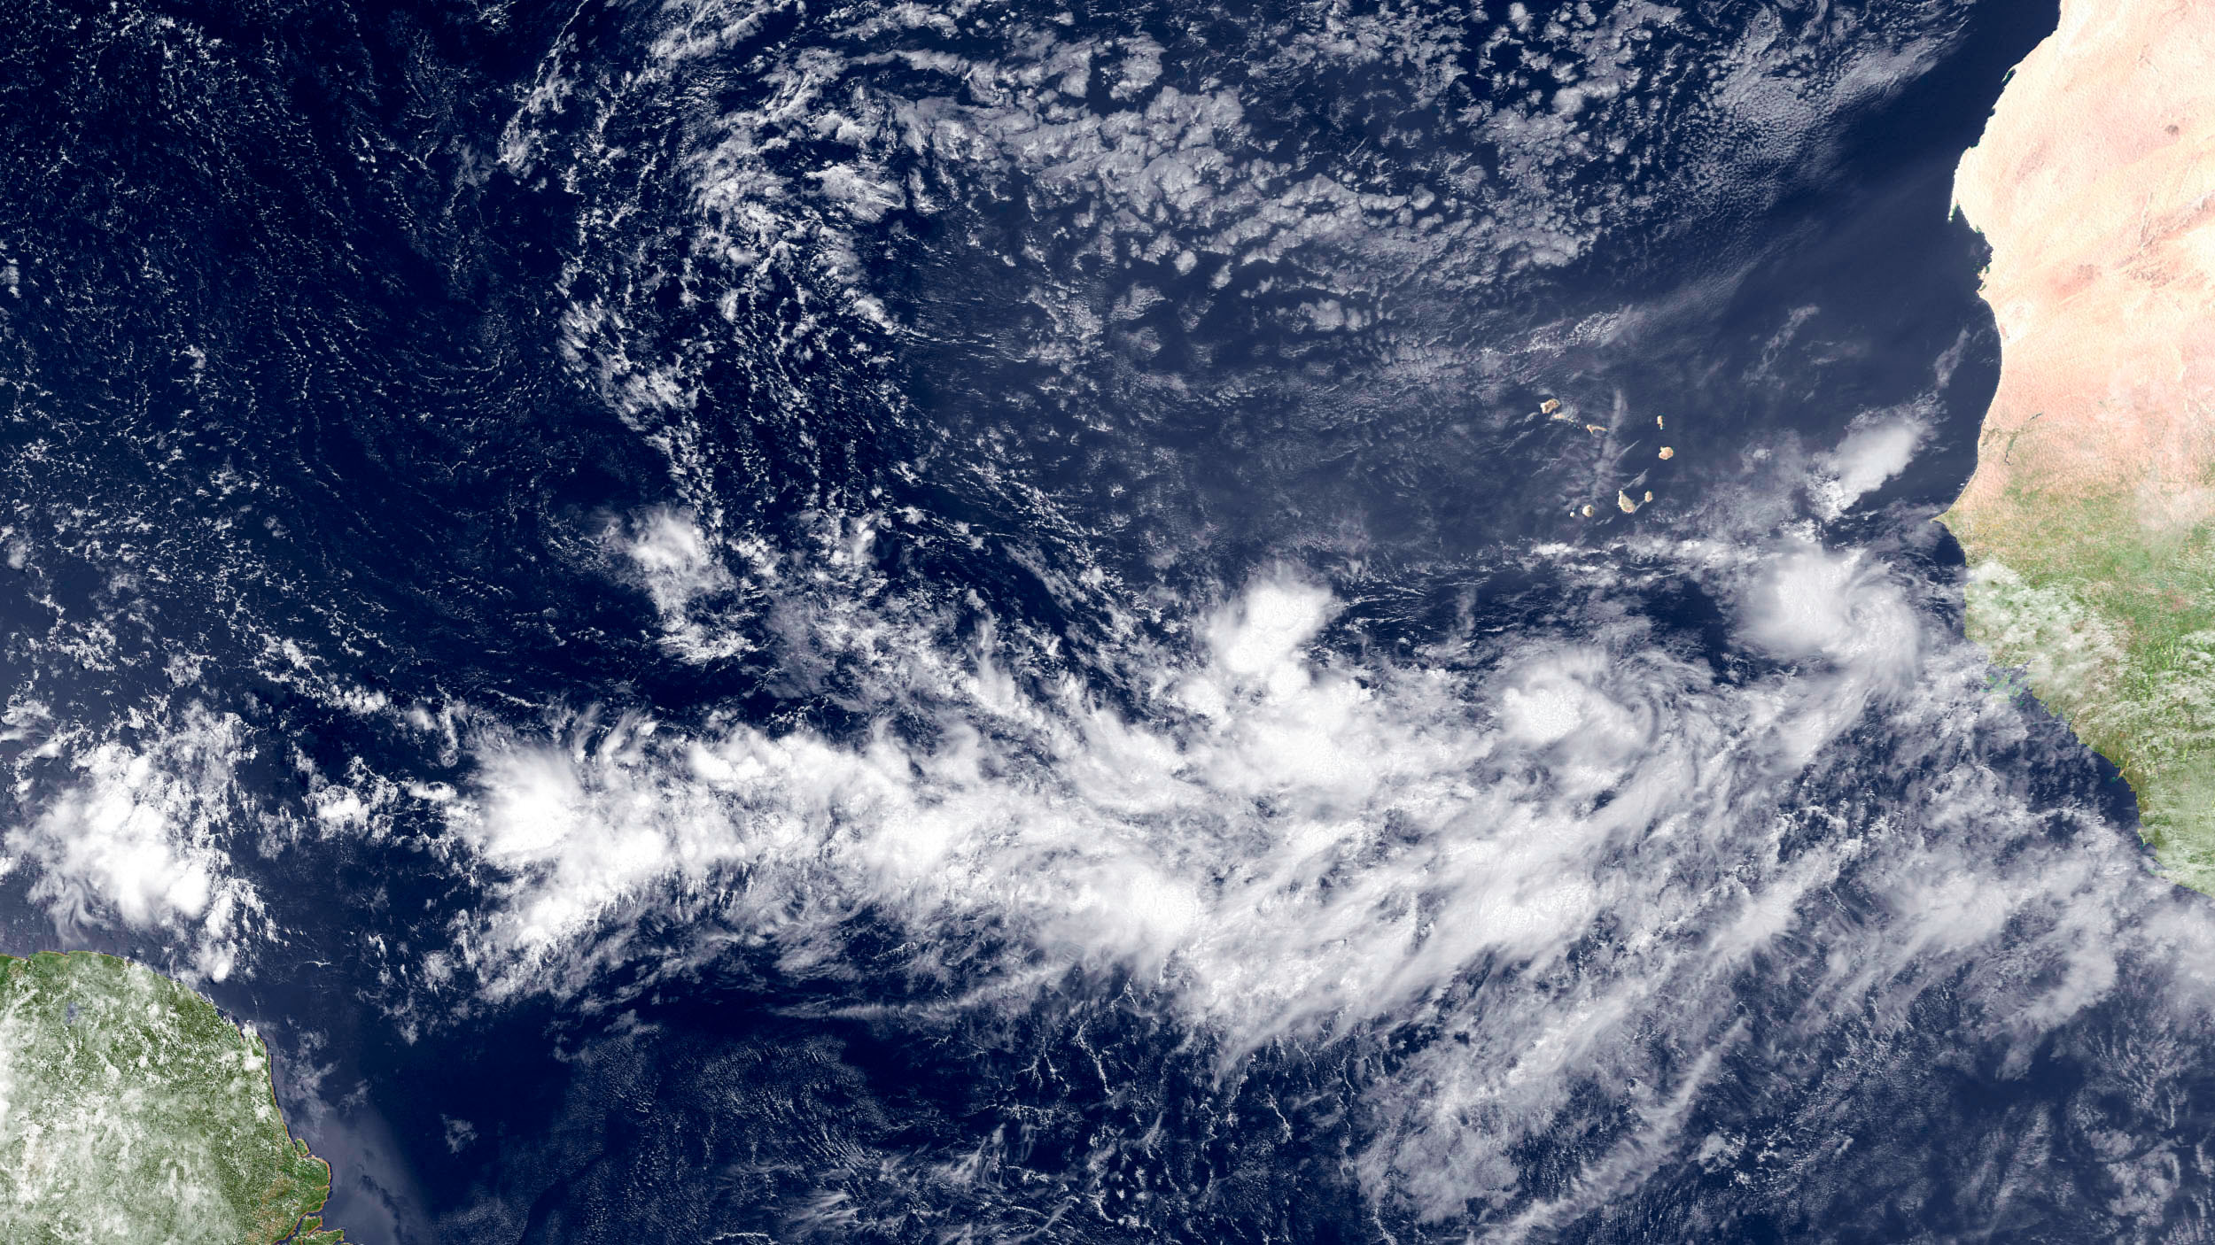
ITCZ composed of cloud clusters (cumulonimbus cells with cirrus outflow)

Slide 18
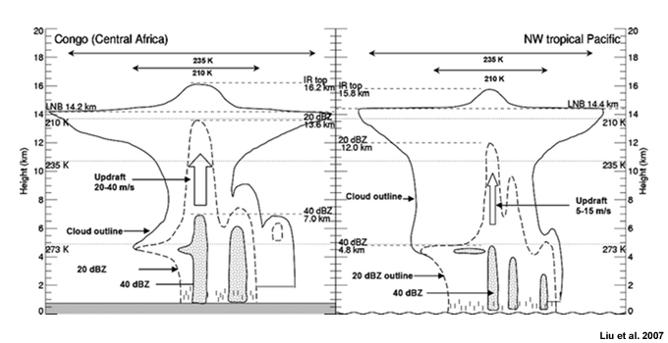
Cloud Cluster Structure

Slide 19
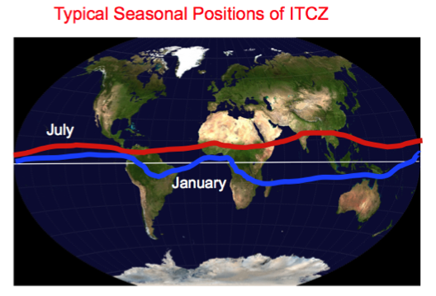
ITCZ Necessarily on the Equator

Slide 20
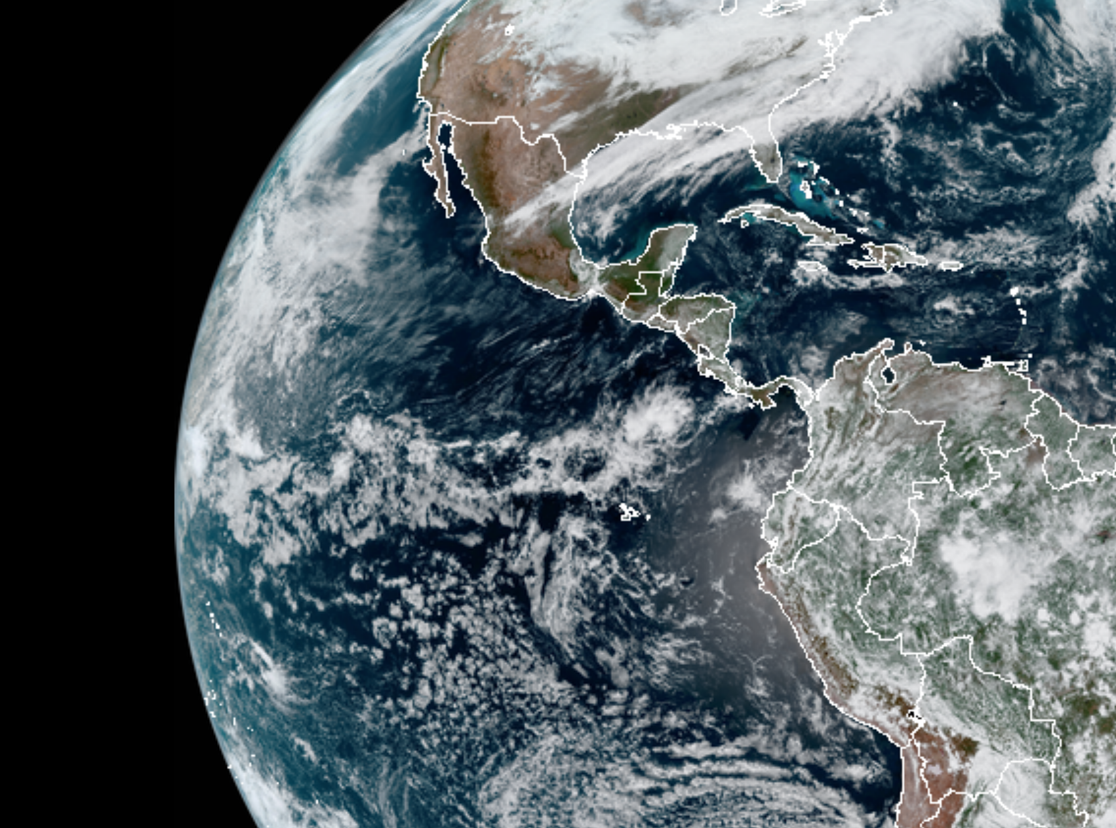

Slide 21
The Actual Hadley Cell is Limited to within 30°of the equator

Slide 22
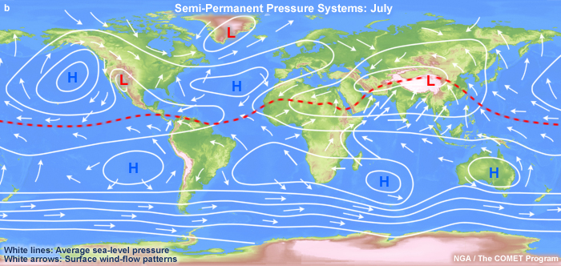
Descending branch of tropical Hadley cell is associated with subtropical highs

Slide 23
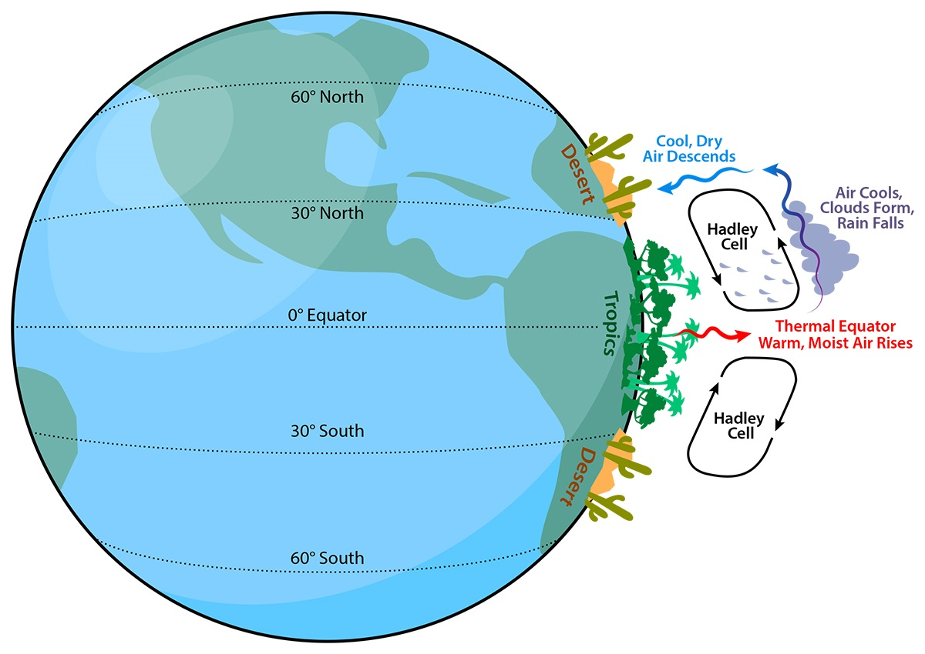
Subtropical Highs are associated with descending air and dry conditions around 30N and 30S

Slide 24
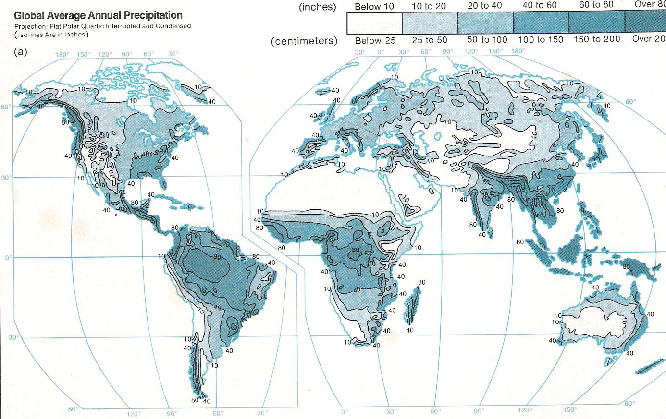
Many desert/arid areas in descending branch

Slide 25
North of the subtropical highs there are the midlatitude westerlies and the Ferrell Cell

Slide 26
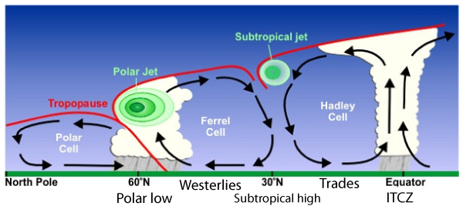
Ferrell Cell,Two Jet Streams, and the Polar Cell

Slide 27
Let’s Talk about Jet Streams

Slide 28
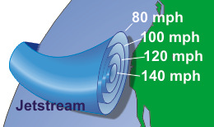
Jet Stream: Think of a narrow current of strong winds

Slide 29
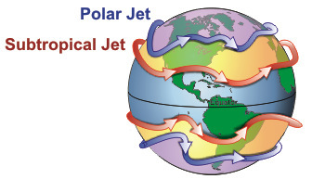
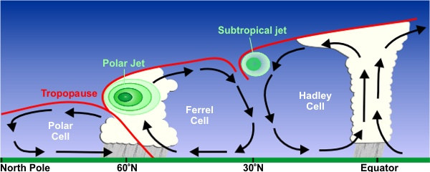
Polar jet is most important
Stratosphere
10-16km
7-12km
http://www.srh.noaa.gov/jetstream//global/jet.htm

Slide 30
The Midlatitude (or Polar) Jet Stream
A long, narrow current of strong winds in the midlatitudes that is generally found in the upper troposphere and lower stratosphere (roughly 25,000-35,000 ft, 400-250 hPa).
First became obvious during WWII as high flying aircraft was sped up or slowed down on their missions.
Strongest can exceed 200 mph. Nearly always from the west in midlatitudes

Slide 31
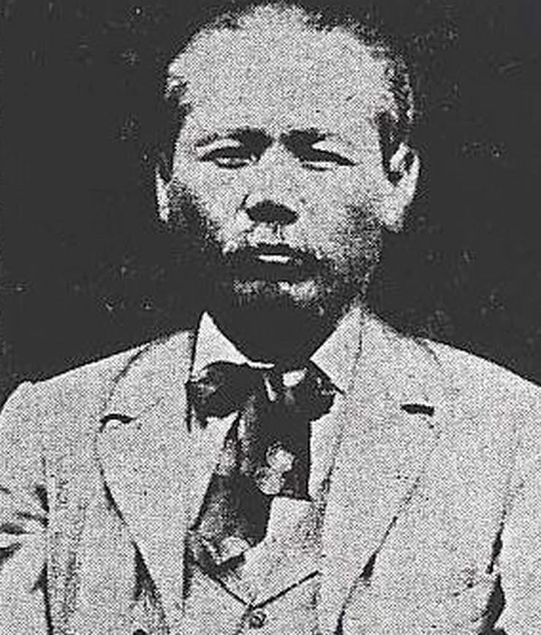
Wasaburo Oishi, Japanese Discoverer of the Jet Stream (1920s)

Slide 32
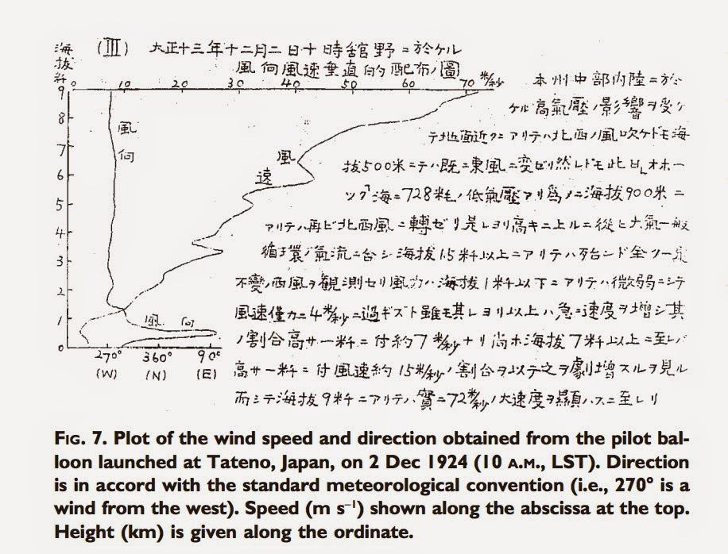

Slide 33
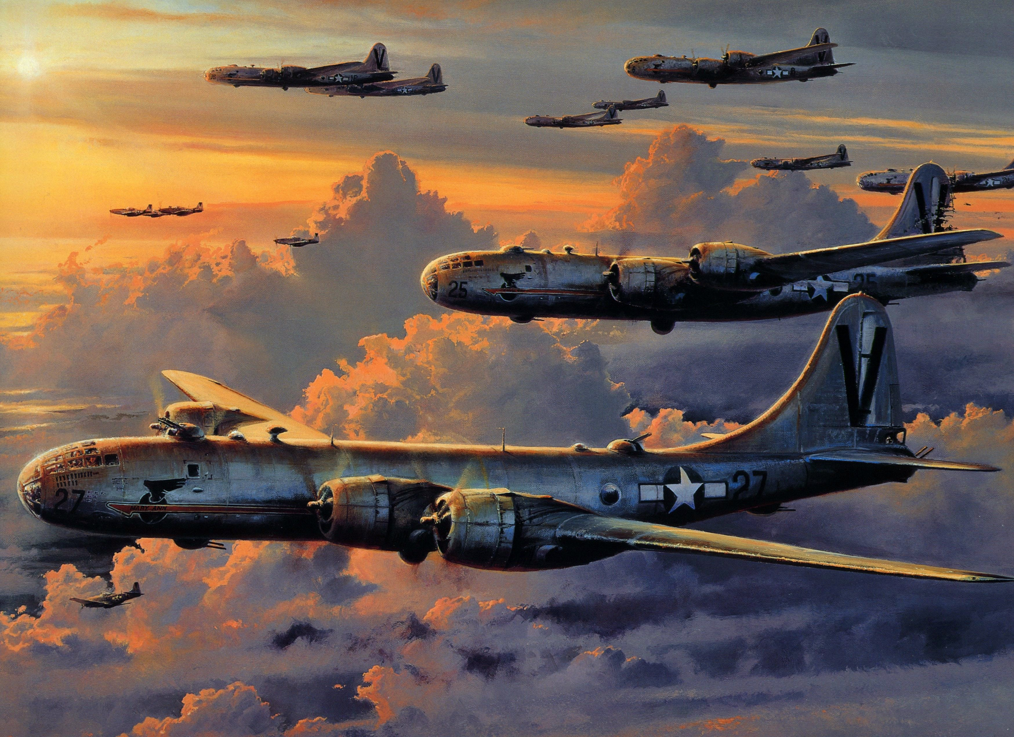
B-29s flying westward to Japan Noted the Jet Stream

Slide 34
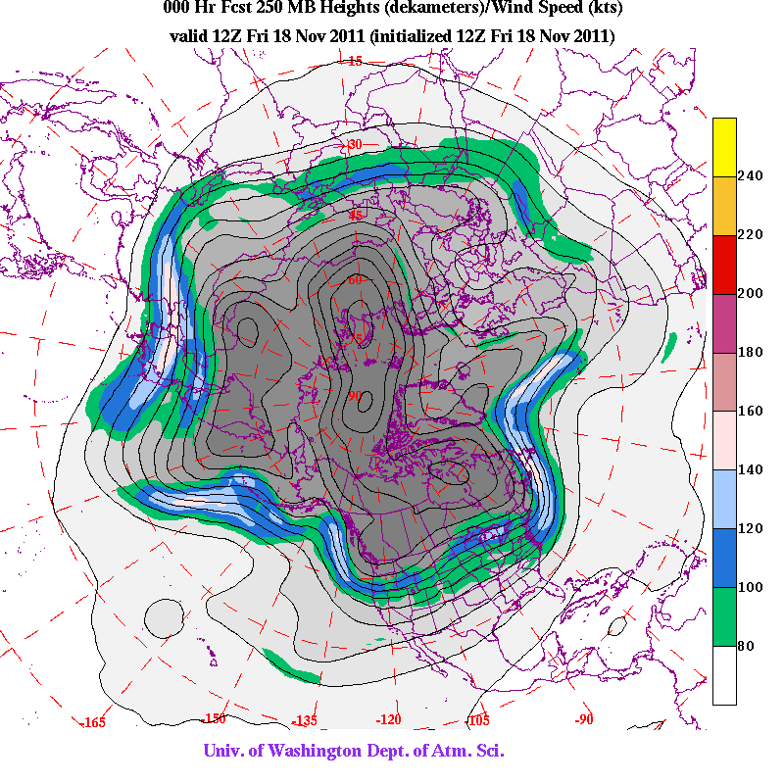
The Jet Stream is NOT uniform

Slide 35
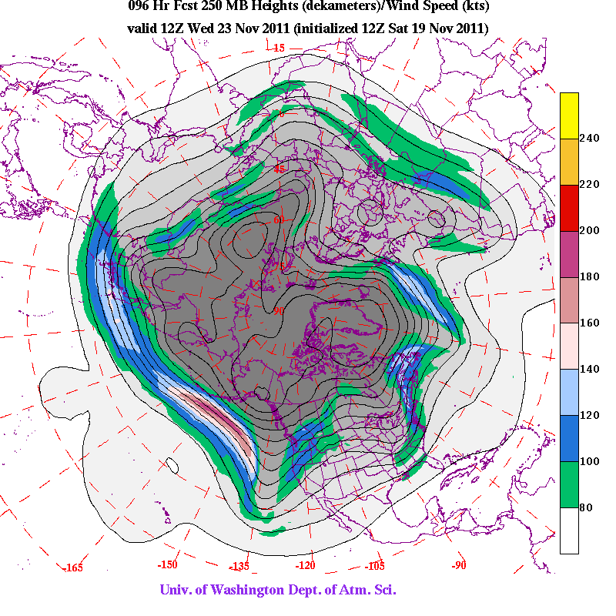

Slide 36
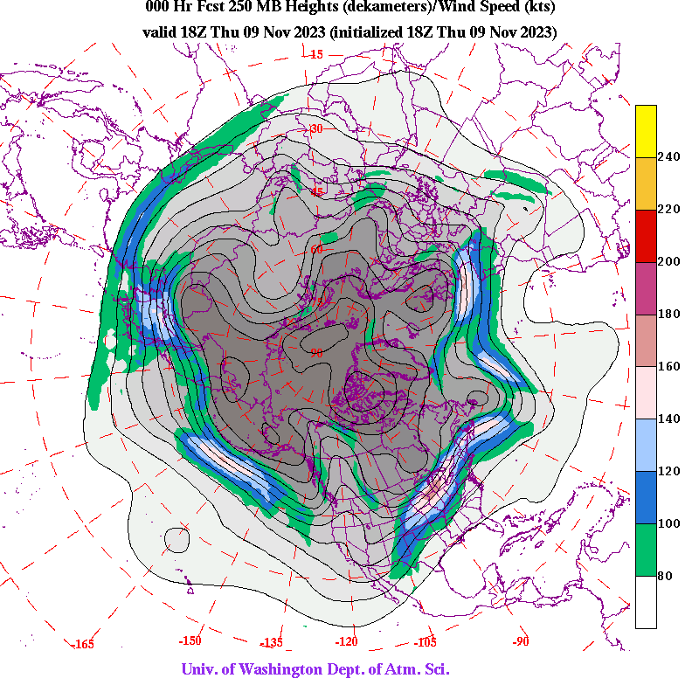

Slide 37
Why Do We Care About the Jet Stream?
Knowing the location of jet streams can aid in weather forecasting. Jet streams steer storm systems.
Jet streams affect air travel, as flight times can be dramatically affected by either flying with the flow or against the flow of a jet stream.
Clear-air turbulence is often found at the flanks of a jet stream. Uncomfortable and is a potential hazard to aircraft passenger safety.

Slide 39
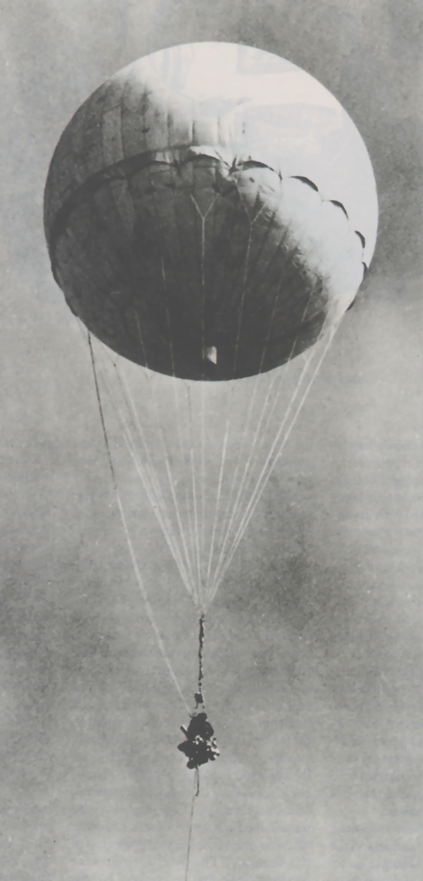
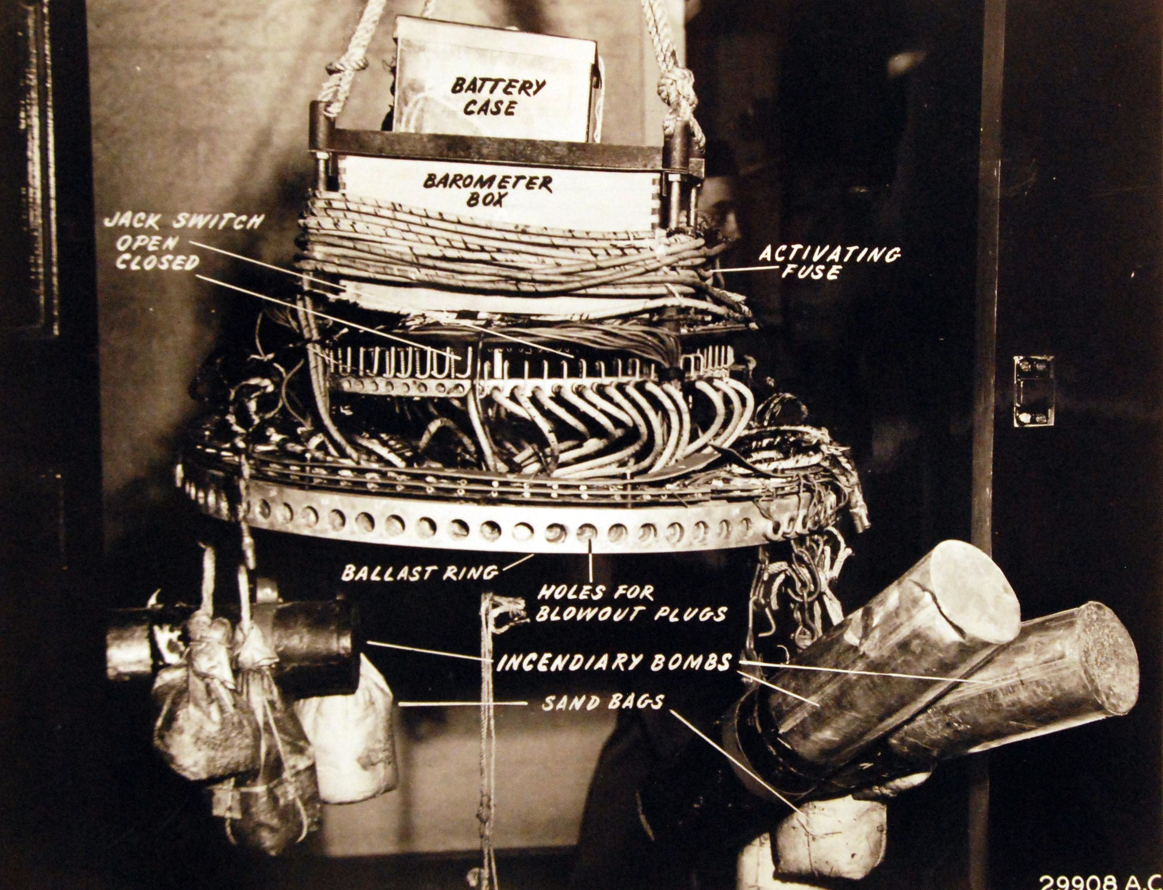
The Jet Stream as a Weapon Delivery System: Fu-Go Balloons in WW2 Launched from Japan

Slide 40
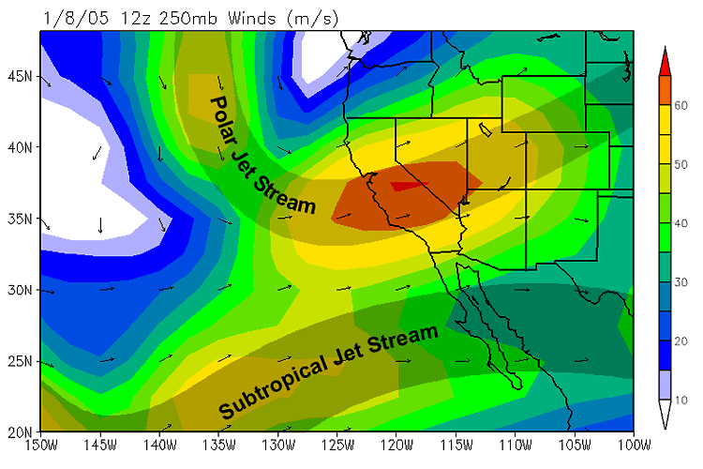
Subtropical Jet Stream: Located to south of polar jet stream

Slide 41
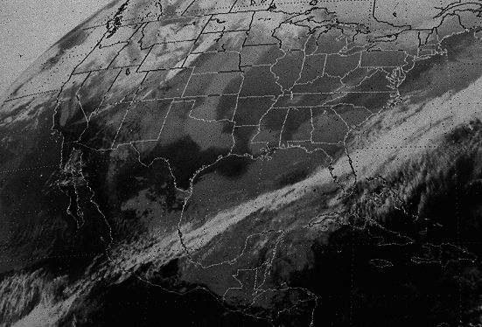
Subtropical Jet Stream Often Associated with a cloud band

Slide 42

Why Do Jet Streams Exist?

Slide 43
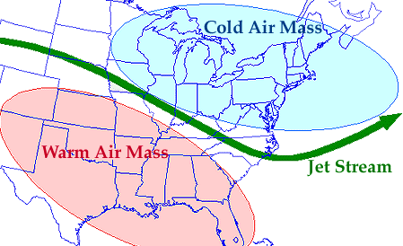
Jet Streams Associated with Large Horizontal Temperature Gradients

Slide 44
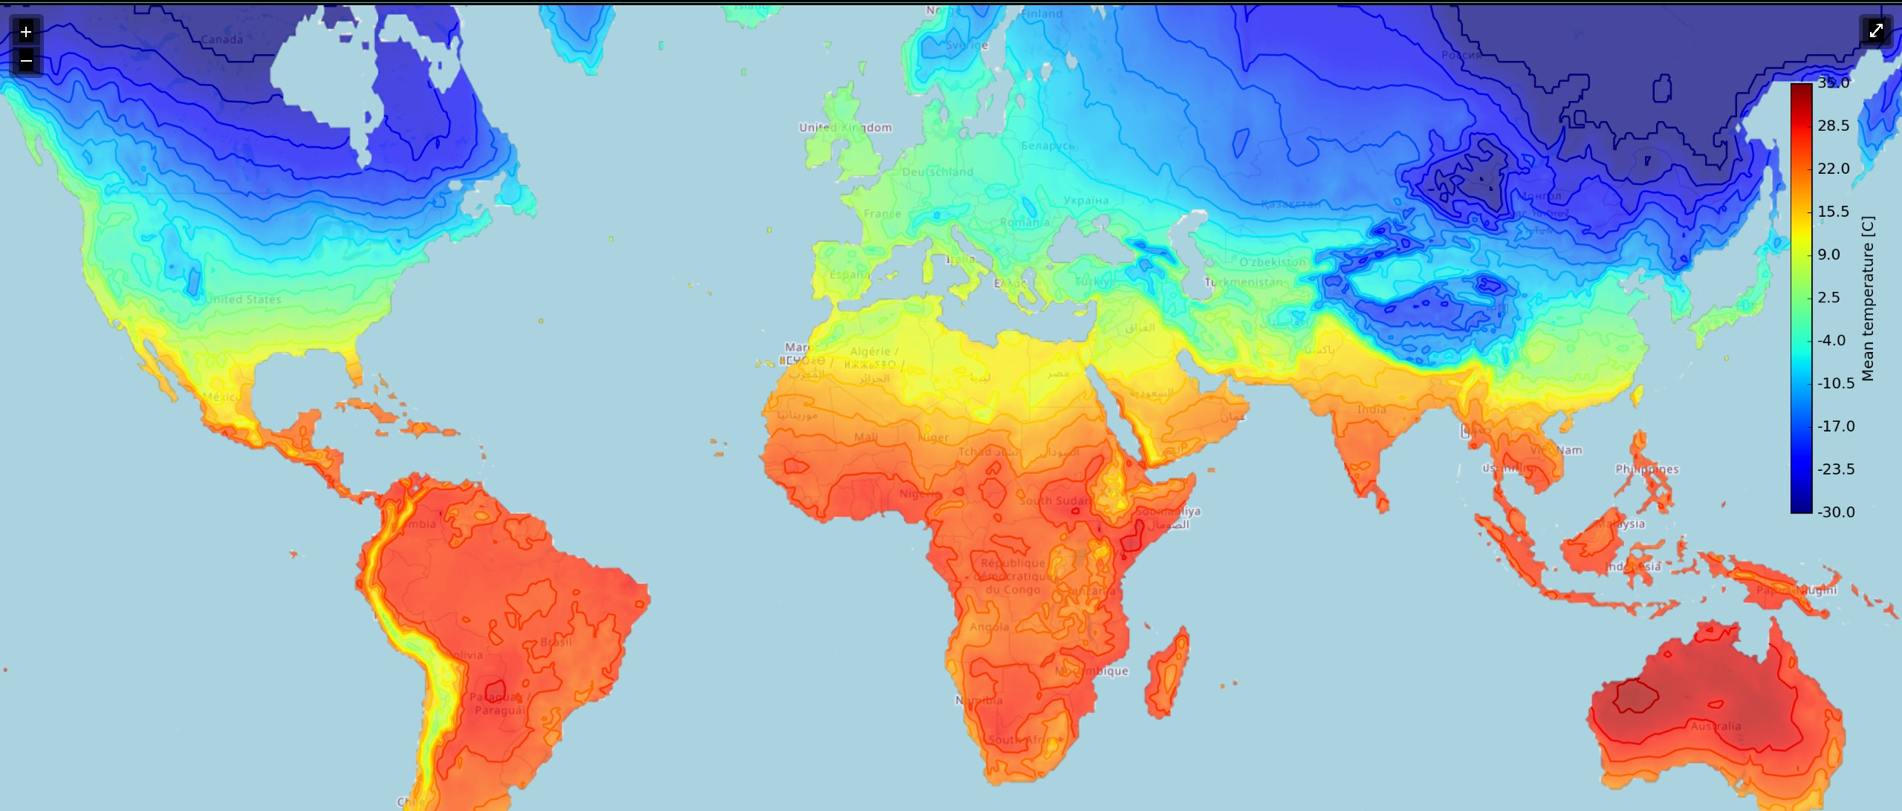
Average January Temperatures

Slide 45
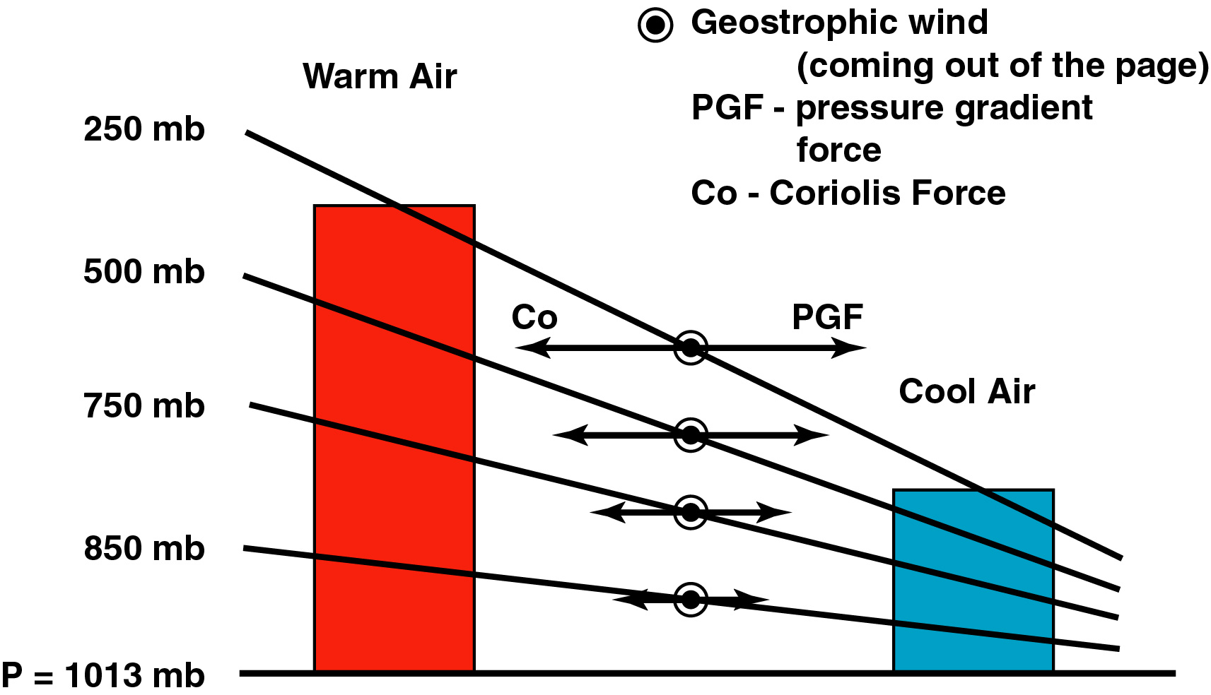
Temperature Gradients Produce Horizontal Pressure Gradients
south
north

Slide 46
Another way of saying it
Horizontal differences in temperature can produce horizontal differences in pressure.
Horizonal differences in pressure produce winds.

Slide 47
Midlatitude (or Polar) Jet Stream Facts
Strongest in winter. Why? Horizontal temperature gradients are largest then
The jet stream weakens and moves northward during the spring and summer.
Strongest jets streams on average are where the largest temperature gradients occur: western Pacific and western Atlantic in the midlatitudes.

Slide 48
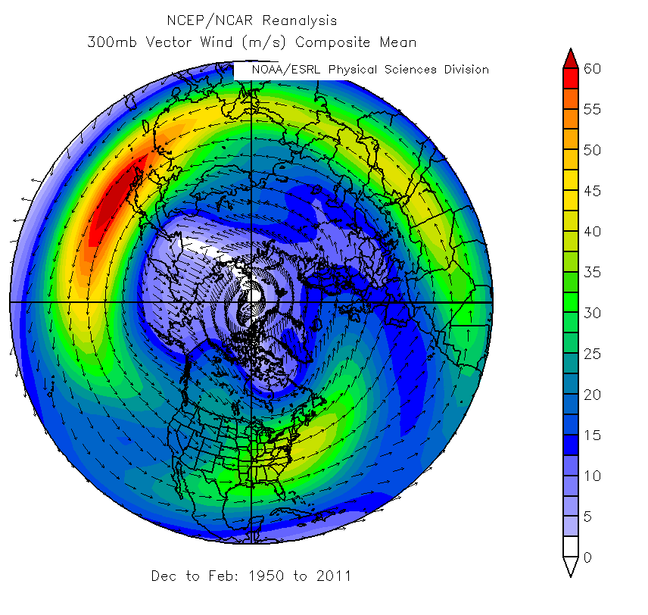

Slide 49
Average January Temperatures
Explain Why Jet Streams are Strongest in Certain Locations

Slide 50
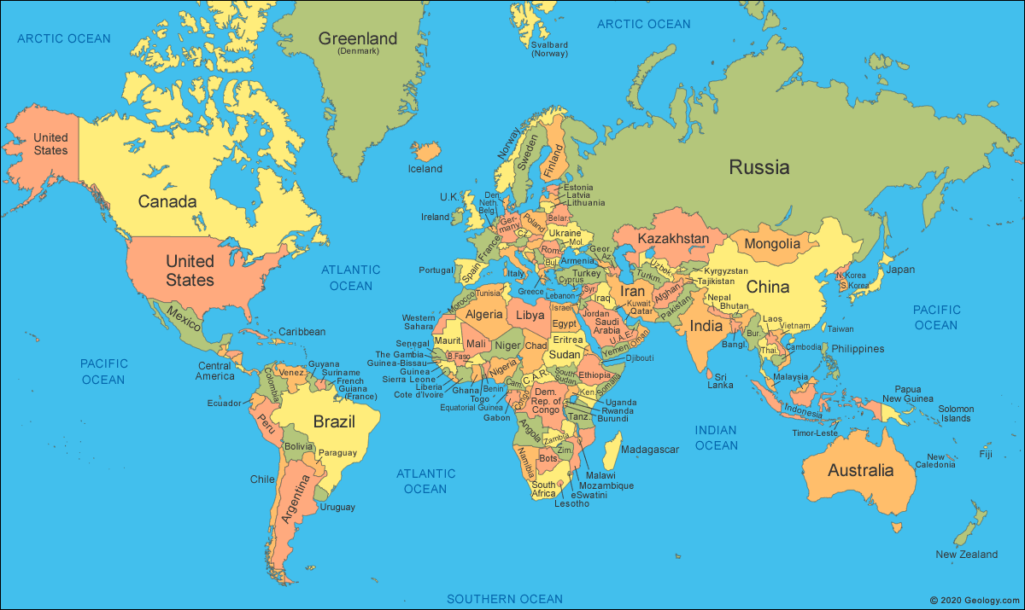
Why are winds generally from the west in the midlatitudes?

Slide 51
Winds are Westerly in the Midlatitudes Because There is Warm Air in the Tropics and Colder Air in the Polar Regions
Warm

Slide 52
Temperature Differences
500 mb
700 mb
850 mb
P_{surface}
Warm
Cold
South
North

Slide 53
At any level pressures aloft are higher to the south and lower to the north
500 mb
700 mb
850 mb
P_{surface}
Warm
Cold
South
North

Slide 54
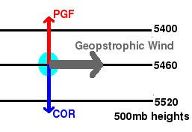
The produces a wind from the west
Note that the winds are parallel to the height lines for upper-level chart or isobars for surface (sea level) chart. Lower pressure to the left.

Slide 56
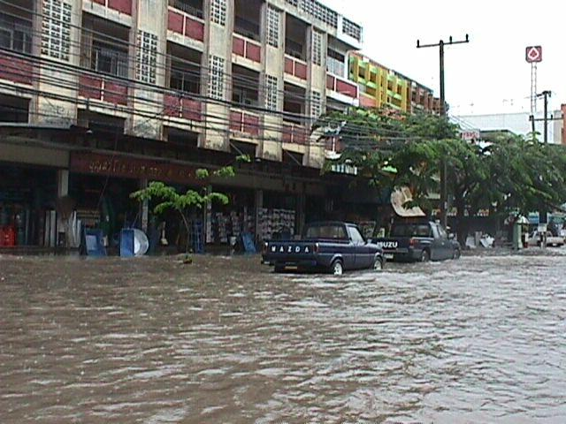
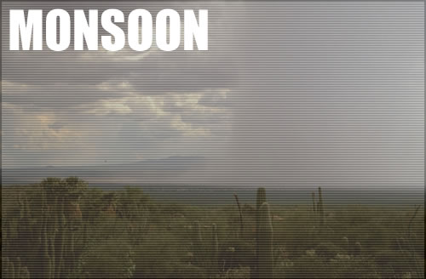
Indian Monsoon
SW US Monsoon

Slide 57
Monsoons
A monsoon is a term from Arabic wordL "Mausin," or "the season of winds."
This originally referred to the seasonally shifting winds in the Indian Ocean and surrounding regions, including the Arabian Sea.

Slide 58
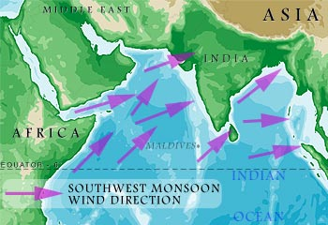
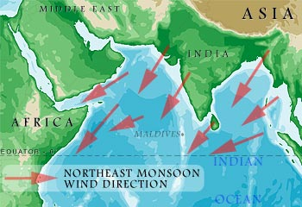
Indian/SE Asia Monsoon
summer
winter

Slide 59
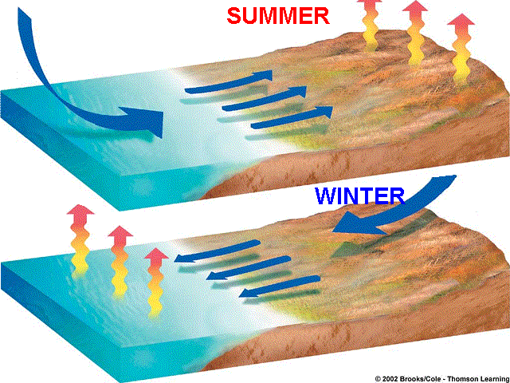
Like a giant sea breeze

Slide 60
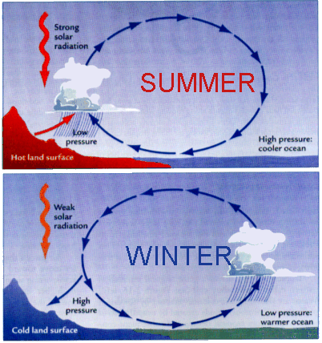
Indian Monsoon Origin

Slide 61
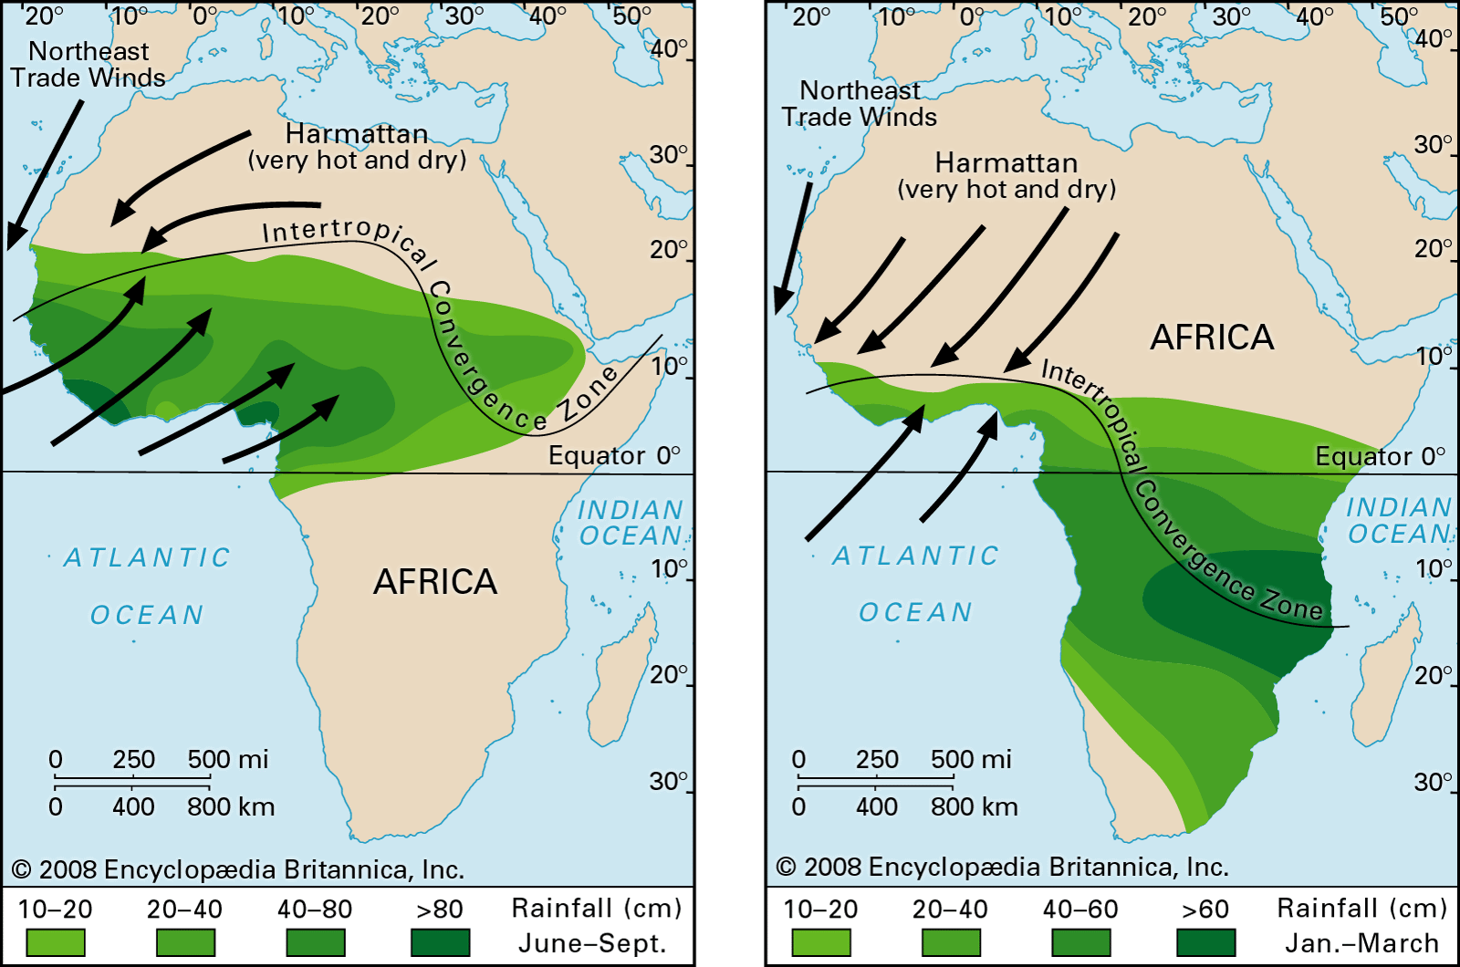
West African Monsoon

Slide 62
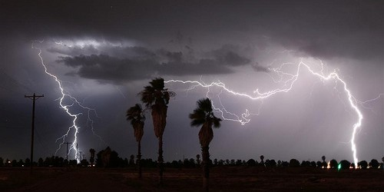
Southwest U.S. Monsoon
Also called the North American Monsoon

Slide 63
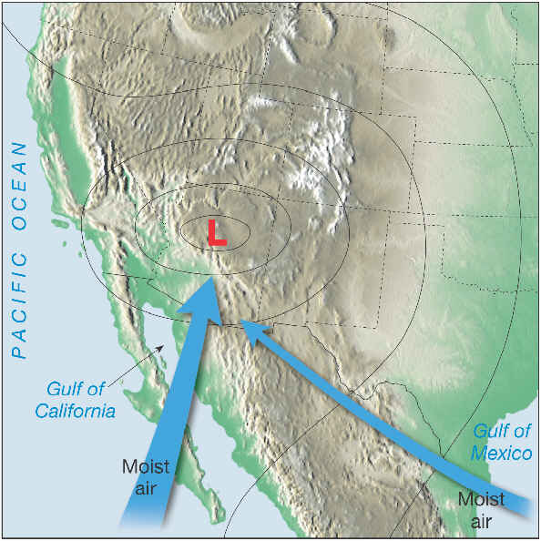
Summer Situation

Slide 64
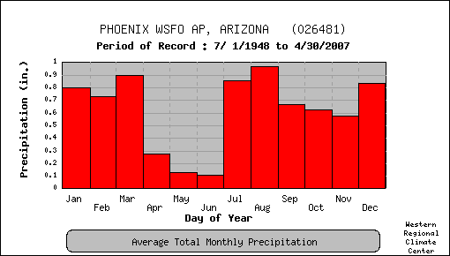
The Arizona: Rainy Season is the Summer—During the Monsoon

Slide 65

https://vimeo.com/297875063

Slide 66
Air Masses
Air Mass: an extremely large body of air whose temperature and moisture are horizontally nearly uniform.
Large: dimensions of thousands of kilometers (e.g., a cold, dry air mass over Siberia)
Source regions: regions where air masses form. Generally large flat areas of relatively uniform characteristics.

Slide 67
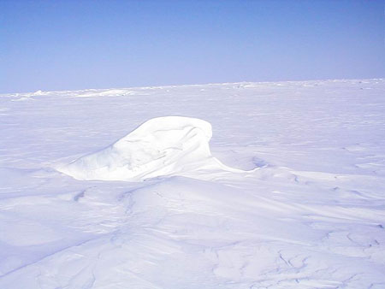
Example: Arctic Air Masses Tend to Form in Large Flat Areas with snow or ice

Slide 68

Air Mass Source Regions
Another example: large desert regions producing warm, dry air masses
Midlatitudes are poor source regions because surface temperature and moisture vary considerably.

Slide 69
Air Mass Classification System
P: air from polar region
T: from warm, tropical region
c: continental (land source--dry)
m: maritime source (ocean source--moist)
Can combine these into the four basic air mass categories

Slide 70
Air Mass Classification
 | Polar (P) | Tropical (T)
Continental (c) | cP Cold, dry, stable | cT Hot, dry, stable aloft, unstable near the surface
Maritime (m) | mP cool, moist unstable | mT Warm, moist often unstable

Slide 71


Slide 72


Slide 73
Continental Polar
Associated with bitter, cold weather
Little moisture
Originates over northern Canada, Alaska, Siberia
Slowly moderates as moves southward
Associated with high pressure and sinking air
Skies often clear.

Slide 74

Continental Polar Air Rarely Gets into Western Washington. Why?

Slide 75

The Mountains!

Slide 76

The conversion of cP air into mP air
When cP air moves over warm water it can rapidly warm and moisten at low levels.
Becomes unstable at low levels
Cloud streets of cumulus and cumulonimbus

Slide 77

Bering Sea Cloud Streets

Slide 78


Slide 79

mP is the number one air mass in Seattle during the cool season

Slide 80

Maritime Tropical
Warm and moist.
Originates over tropical and subtropical oceans

Slide 81

Maritime Tropical
Relatively rare over the Northwest, but we CAN get it during Atmospheric River events

Slide 82

Local Version: The Pineapple Express:
November 6-7, 2006

Slide 83

Atmospheric Rivers

Slide 84

The eastern U.S. ”enjoys” mT nearly all summer

Slide 85


Slide 86

The mT source region: the Gulf of Mexico and southern Atlantic

Slide 87

Continental Tropical

Slide 88
Continental Tropical
Usually originates over large arid regions in the subtropics
Associated with high pressure and sinking air aloft
Examples: the Sahara and northern Mexico/SW U.S.
Tends to be unstable at low levels due to heating at the surface
Often associated with drought

Slide 89


Slide 90
One reason we care about air masses: lots of meteorological action at their boundaries
….such as fronts

