Slide 1
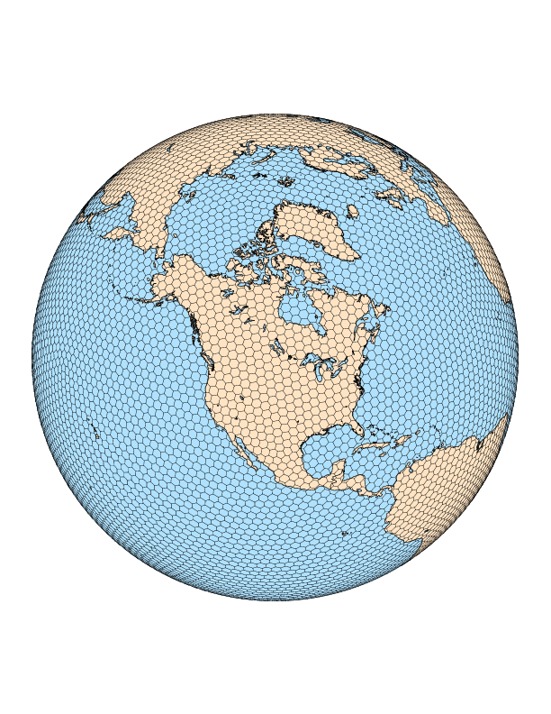
global convection-permitting Numerical Weather Prediction
Cliff Mass AND NICK WEBER
Department of Atmospheric Sciences
Hebrew University, June 12, 2022

Slide 2

Does convection- permitting resolution offer major benefits for global weather prediction?

Slide 3

Will such resolution take us to the promised land of improved global subseasonal prediction?

Slide 4
Some Motivations
Global Model forecasts are degraded by poorly simulated tropical convection
Large scale Tropical variability is not well captured By Parameterized Convection
Global Models Poorly simulate Important processes
MJO
Convectively coupled waves
Poor diurnal cycle in precipitation
Excessive light rain

Slide 5

This project began with an evaluation of the subseasonal prediction skill of the NOAA/NWS CFSv2 extended-range forecasting system Used in the U.S.
Motivation

Slide 6
CFSv2 model evaluation
Global, coupled atmosphere-ocean-land model
T126 (~100km, ~1⁰ resolution)
Evaluated for 1982-2010 against GDAS (NCEP Global Analysis)
Jan 1
Jan 2
Jan 3
Jan 4
Jan 5
9-month
3-month
45-day
Saha et al., 2011

Slide 7
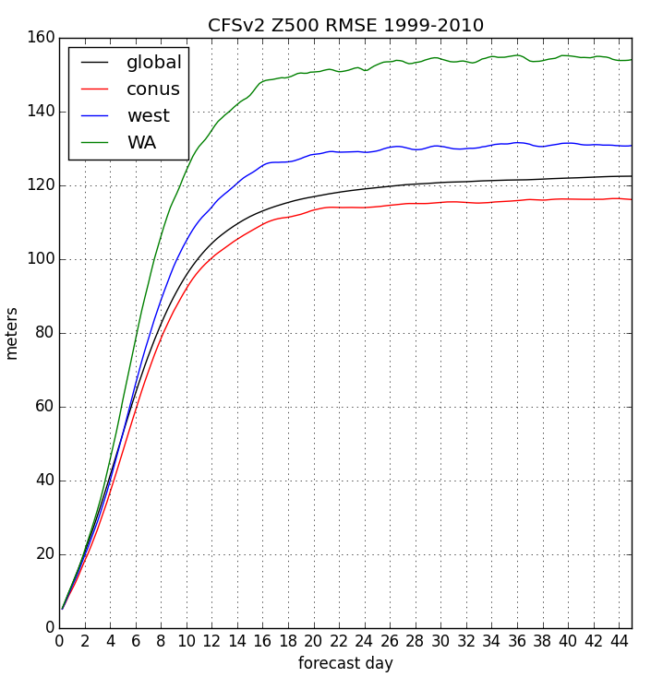
500 hPa Heights: Errors Saturate After Two Weeks Minimal Skill In Third Week

Slide 8
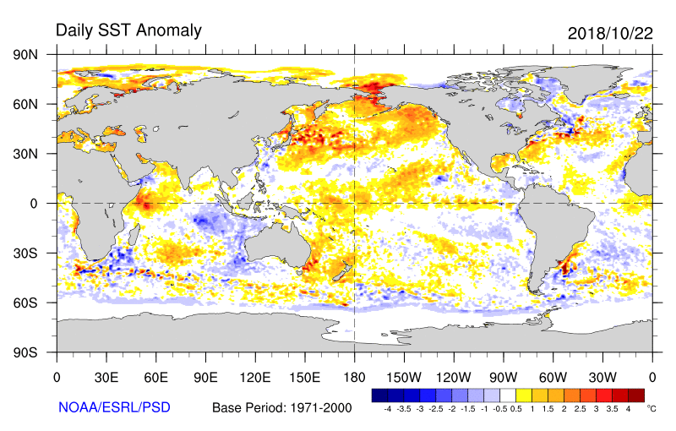
So Why Does CFSv2 Go So Bad After Week Two? After Week Two?
Why doesn’t it retain some skill from slowly changing boundary conditions?
Like sea surface temperature, snow and sea ice distributions, soil moisture anomalies?

Slide 9
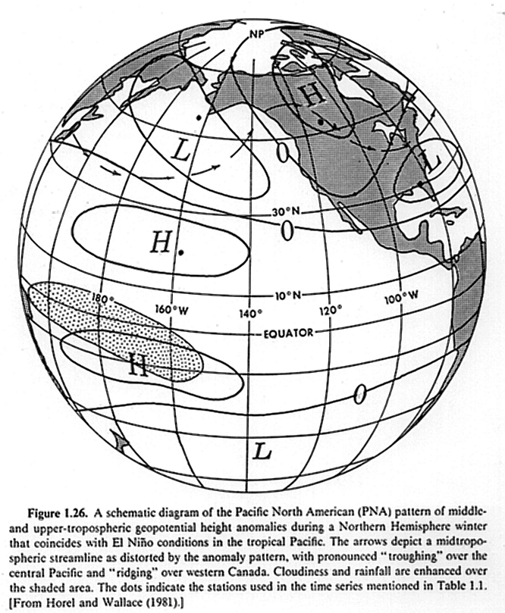
Could problems with Parameterized convection be a contributor to CFS loss of skill? How Quickly does Skill For Convective Features Decline?

Slide 10
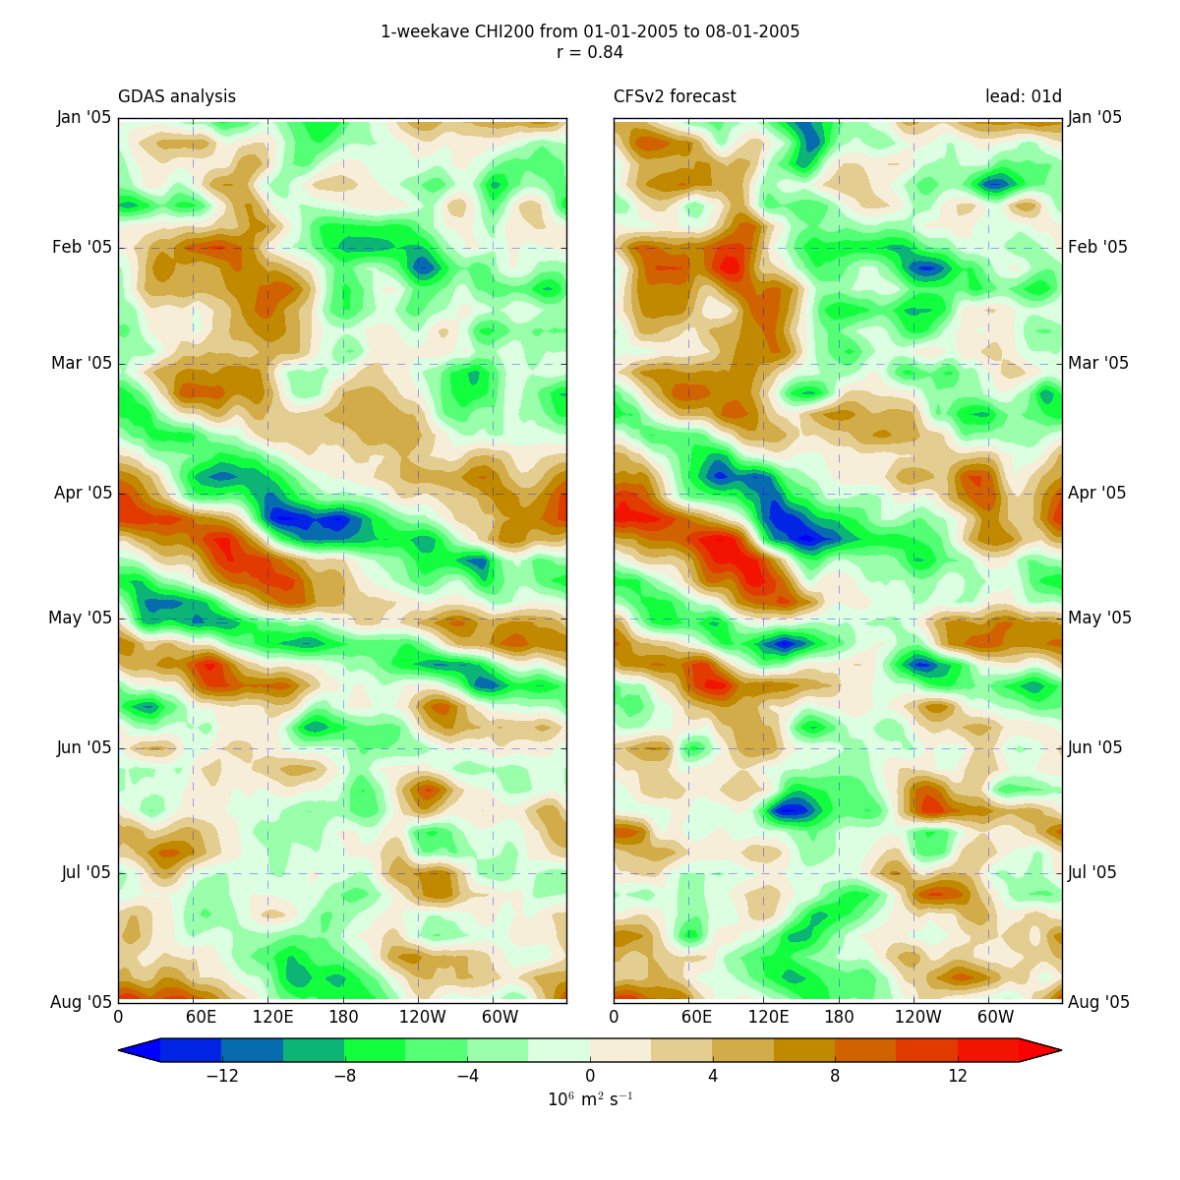
Upper Level Divergence: Chi200 analyses vs week-1 forecasts
Initialization
Spring/summer 2005
Hovmoller Diagrams Averaged from 5S to 5N
GDAS Analysis
Model Initialization

Slide 11
: analyses vs week-1 forecasts
Initialization
Clear propagating convective features in both the analyses and initialization
Analysis Forecast

Slide 12
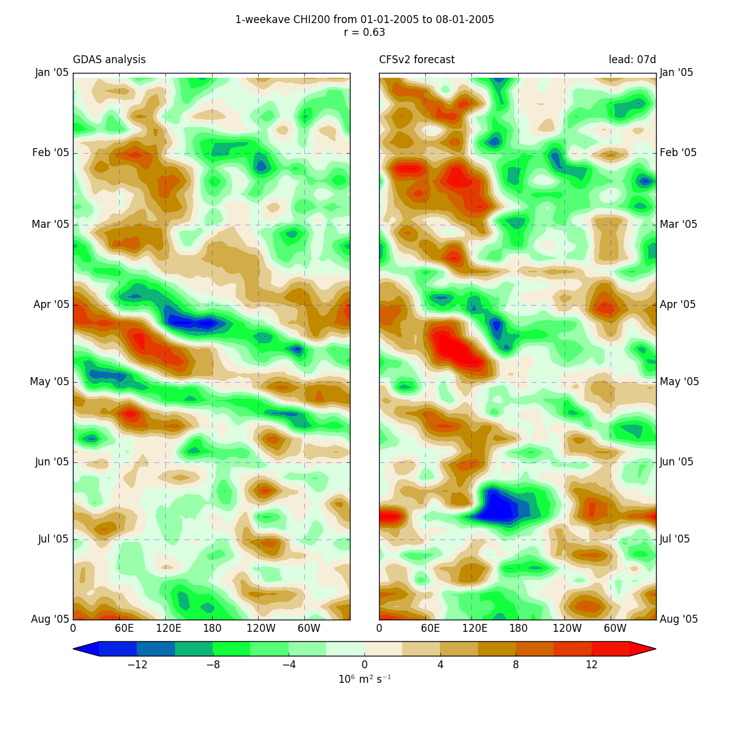
7 day Forecastweek-2 forecasts
Analysis
7-Day Forecast

Slide 13
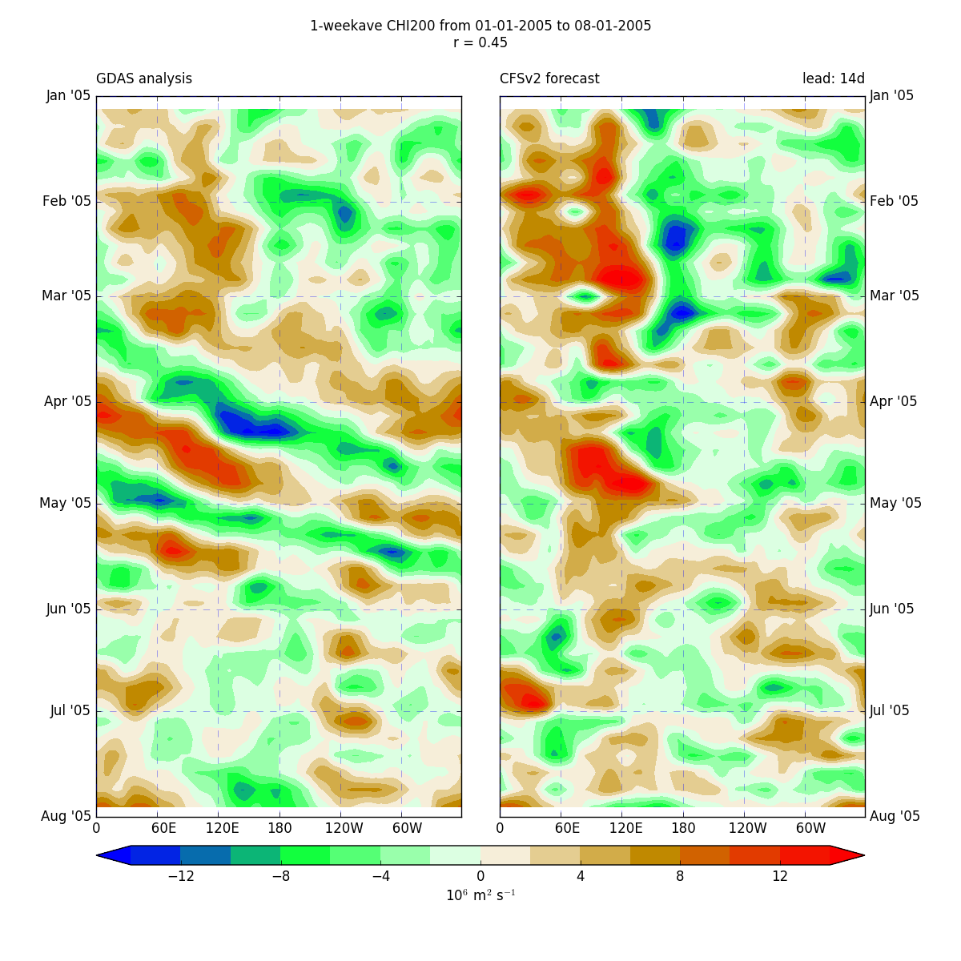
14-day ForecaSt le: analyses vs week-3 forecasts

Slide 14
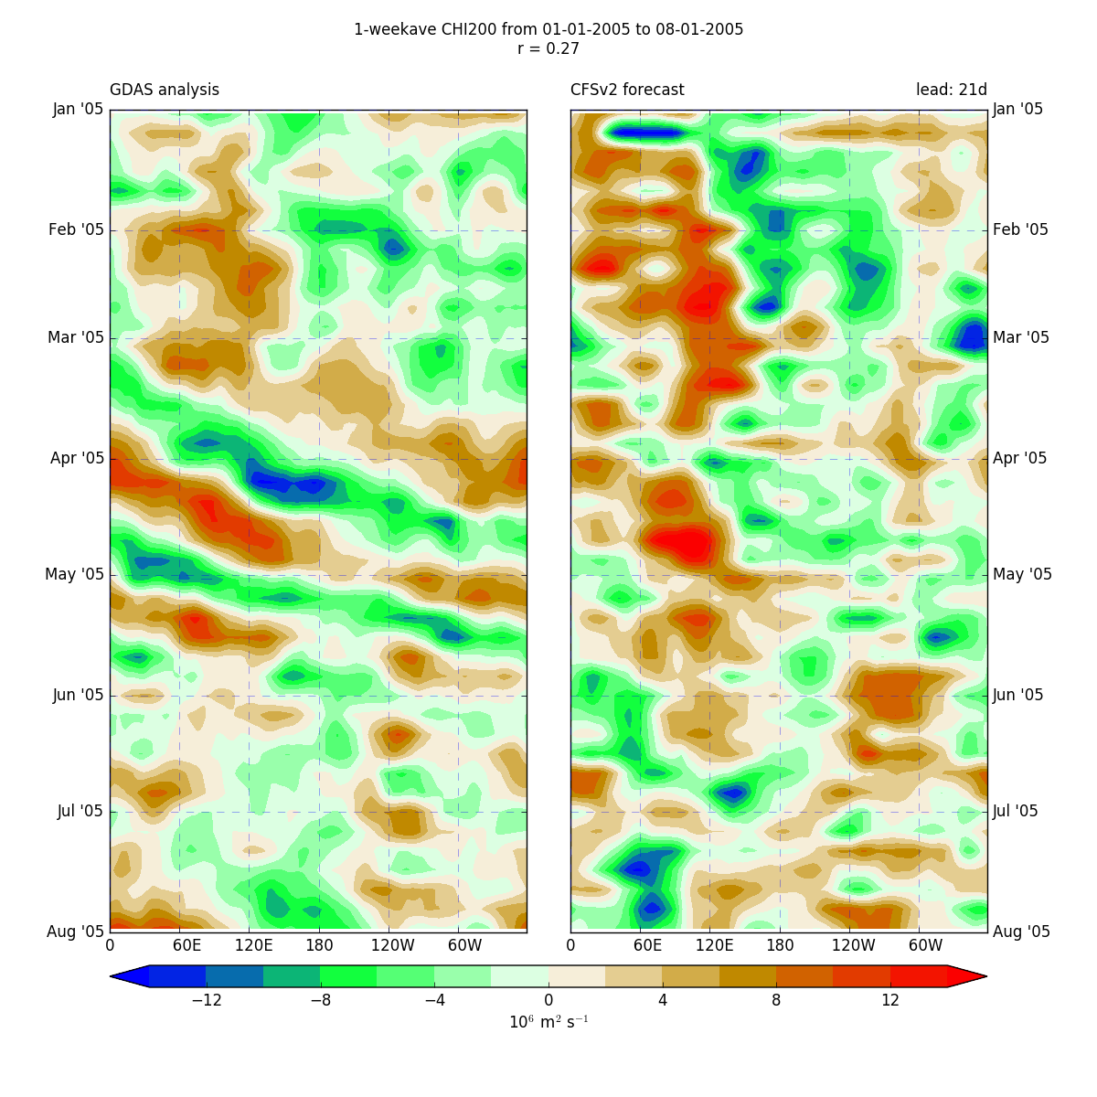
21-Day Forecastforecasts

Slide 15
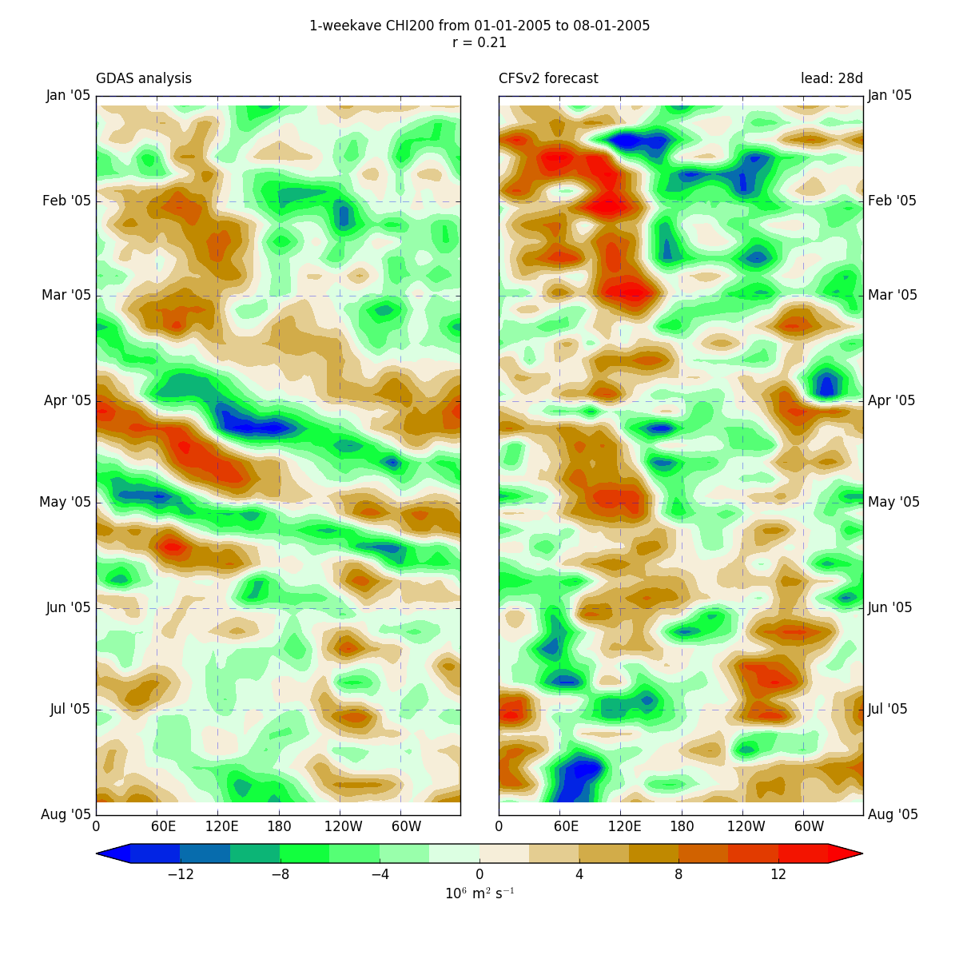
28-day Forecast : analyses vs week-5 forecasts
Propagating Tropical Convection is Lost

Slide 16

the big question
If we ran global models at convection-allowing resolution (say 3-km grid spacing), would global prediction improve?
Would extended prediction particularly improve?

Slide 17
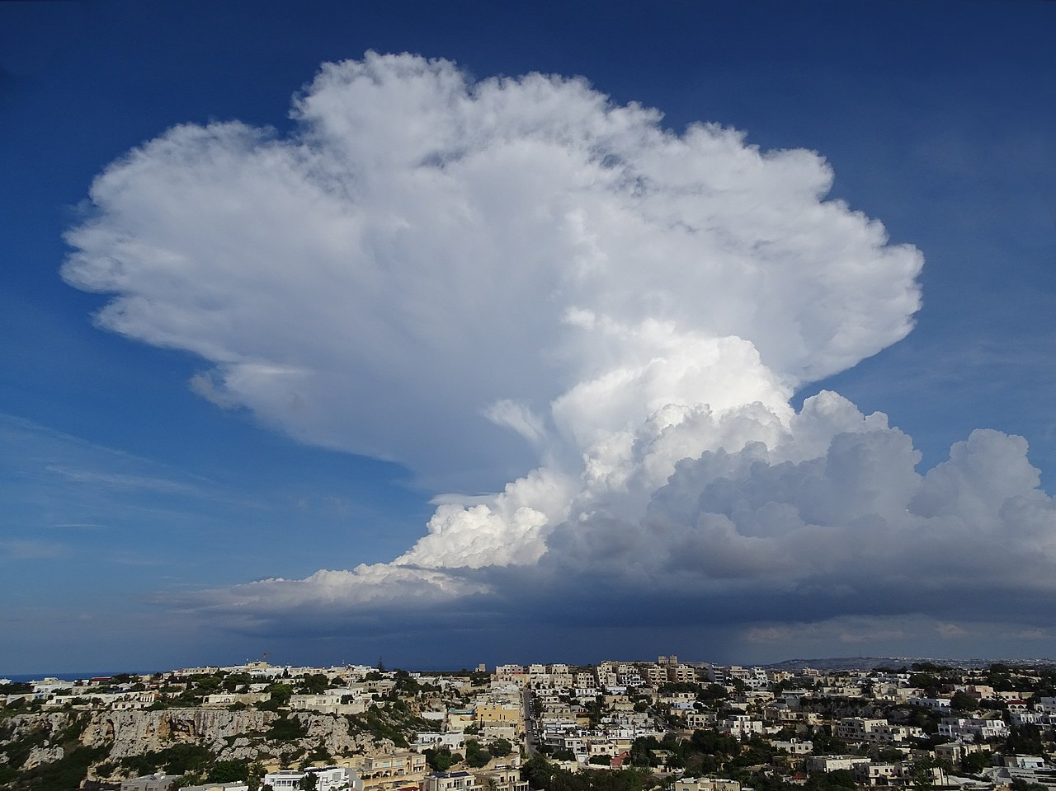
Generally Associated with Grid Spacing of less than 4-km.
Convective-Permitting Resolution (a.k.a., Convective-Allowing Resolution or Explicit Convection)
Convective parameterizations are generally dropped, but not always

Slide 18

Improving global weather prediction With Explicit Convecton?
Convective areas have a huge impact on global circulations, with teleconnections from the tropics greatly impacting midlatitude weather systems.
Global forecast models are relatively coarse, using convective parameterizations.
Convective parameterizations have substantial problems.
There is a deep literature showing that convection-allowing resolutions (4-km grid spacing or less) can greatly improve the fidelity of model forecasts.

Slide 19
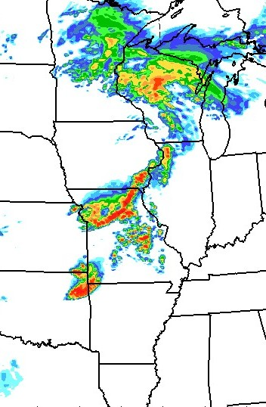
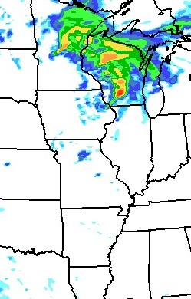
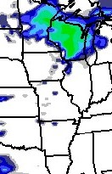
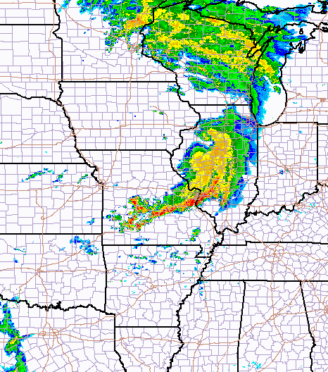
Real-time 12 h WRF Reflectivity Forecast
Valid 6/10/03 12Z
4 km BAMEX forecast
10 km BAMEX forecast
22 km CONUS forecast
Composite NEXRAD Radar
Explicit
Parameterized

Slide 20
Convection-permitting models (Cpm’s)
More realistically simulate numerous aspects of tropical convection
High computational cost often results in compromises:
“Gray zone” resolution (4-12 km grid spacing)
Small domains
Short integrations

Slide 21
NO COMPROMISE EXPERIMENT
Extended GLOBAL Convective Permitting Simulation
Few such simulations in the literature
Examine the potential for extended prediction
Captures both tropical convection and its teleconnections
Notes:
Perfect for extended/climate applications! No reliance on lateral boundary conditions.

Slide 22
simulations
The model: MPAS v5.1 (global)
Physics: ‘convection_permitting’ suite
GFS analyses used for initialization
Sea surface temperatures (SSTs) fixed at initial value
Four cases (all integrated 28 days):
November 22, 2011 (DYNAMO)
February 8, 2013
December 2, 2003
December 8, 2013
Notes:
Explain DYNAMO

Slide 23
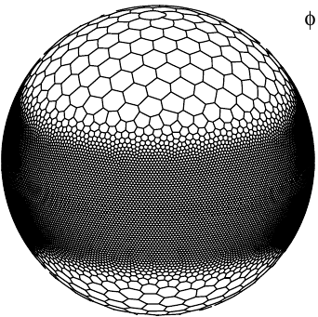
simulations
Configurations:
15-km resolution, nTiedke Cu scheme (M15)
3-km resolution, no Cu scheme (M3)
15-km resolution, no Cu scheme (M15noCu)
15-to-3-km tropical channel, Grell-Freitas (Mchannel)*
Verification: satellite measurements, ERA5 reanalysis
15-km resolution
20N
3-km
resolution
20S
15-km resolution
*only for case 1

Slide 24
Cost of one 3-km run
Supercomputer: Cheyenne (5.34 petaflops)
Run on 1024 nodes → 36,864 cores
Core hours: 2.7 million
Wall clock: 74 hours
Output: ~80TB

Slide 25
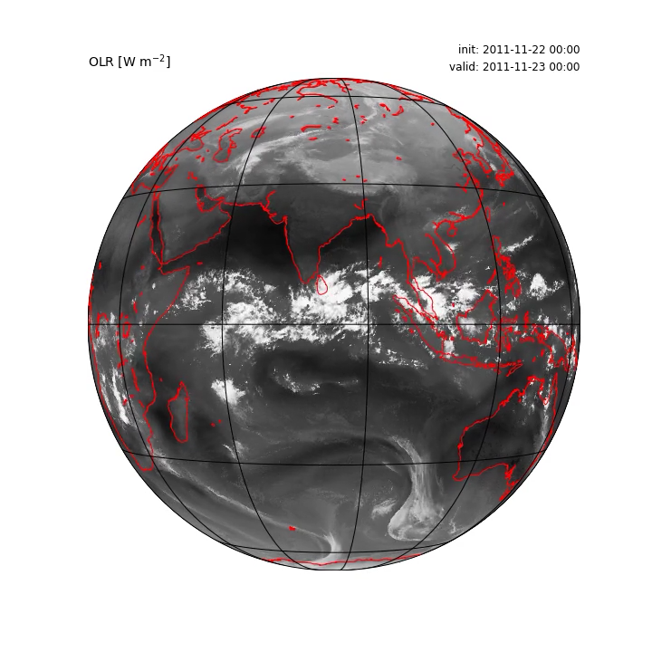
Satellite or model?

Slide 26
Precipitation Statistics TRMM Verification
Frequency of
Precipitation
>.01 mm/h (light)
Notes:
TRMM precipitation measurements aren’t perfect—especially with very light precipitation.

Slide 27
Precipitation Statistics
Probability of
Precipitation
> .5 mm/h (moderate)

Slide 28
Precipitation Statistics
Probability of
Precipitation
(>5.0 mm/h) Heavy

Slide 29
Precipitation Statistics
Black is observed
M15 with convective parameterization produces too much light precipitation
M15 produces too little heavy precipitation
Green is 3 km global
Convective
Parameterization
15km
Notes:
Mean statistics appear to be robust across all four cases
How can M3 have a precipitation bias if it simulates a realistic distribution of rain rates?

Slide 30
Precipitation Statistics
Black is observed
Opposite issues when you take away the Cu scheme (M15noCu)
Too little light and too much heavy
Green is 3 km global
Convective
Parameterization
15km
Notes:
Mean statistics appear to be robust across all four cases
How can M3 have a precipitation bias if it simulates a realistic distribution of rain rates?

Slide 31

Precipitation Statistics
Black is observed
M3 and Mchannel closely match TRMM estimates
Green is 3 km global
Convective
Parameterization
15km
Notes:
Mean statistics appear to be robust across all four cases
How can M3 have a precipitation bias if it simulates a realistic distribution of rain rates?

Slide 32
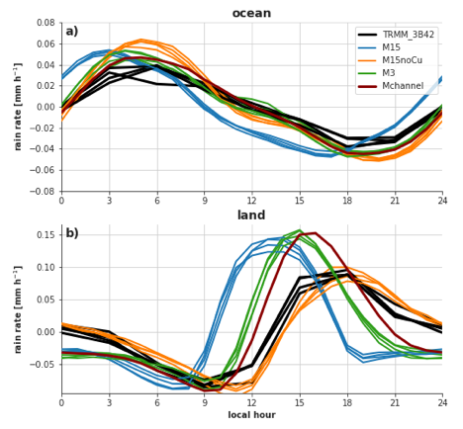
Diurnal Precipitation
Over ocean, diurnal timing is improved when parameterization is not used in the tropics
Over land, 3 km helps, but noCU is better!
Notes:
Diurnal cycle: a popular metric for gauging a model’s representation of precipitation
(Also potentially important for MJO propagation!)

Slide 33
Eastward-propagating MJO in observations
The global CPM (M3) is the only configuration able to capture its eastward propagation
M15 favors stationary or westward-moving convection
the MJO:
Propagation characteristics
Notes:
We’re looking at all cases/configurations again.

Slide 34
Notes:
We’re looking at all cases/configurations again.

Slide 35
Kelvin wave Composite During Dynamo Experiment
Kelvin wave composite
Stronger convective response in M3
Q₁ is the convective heat source
Convective-permitting

Slide 36
Impacts on Forecast Skill and Predictability

Slide 37
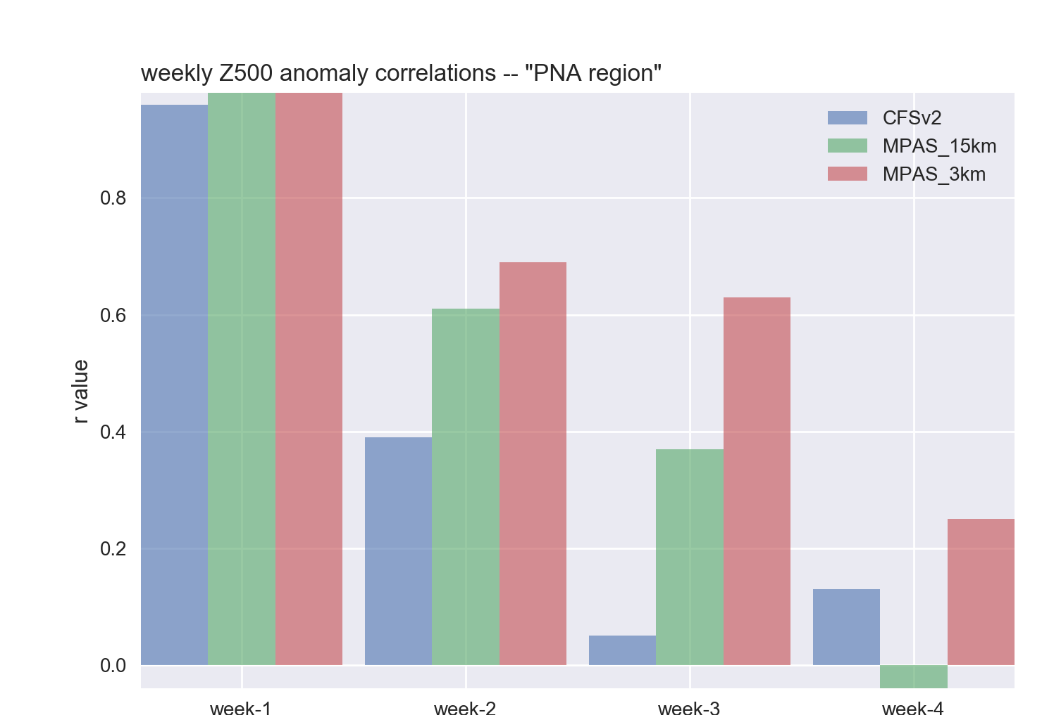
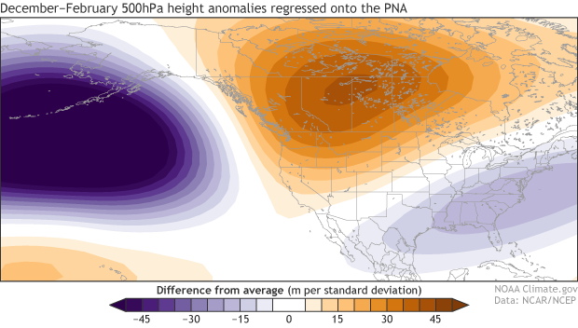
Case 1: Extratropical Z500’
Verified over PNA Area

Slide 38
Extra- tropical prediction SKILL Week 3

Slide 39
Weekly Z500 performance
The M3 configuration, on average, improved large-scale midlatitude forecasts
Notes:
NOTE: the three cases where M3 has a good MJO are the same three cases that it had better Z500 skill
Week-3 improvement occurs at the surface as well!

Slide 40
What about skill at the surface?
Errors in pressure, wind, and precip. are generally reduced
Especially near terrain, coastlines
All weeks, Case 1

Slide 41
All Weeks, All Cases
Largest error reduction occurs in week-3
Thick lines are averages of all cases

Slide 42
Summary of Four Cases
Best: Global 3-km, no convective parameterization
Middle: 15-km global, with parameterization
Worst: 15-km, no parameterization; tropical 3-km channel

Slide 43
Take-aways
Global convective-permitting models have become a viable tool for research (and soon NWP) applications
Their realistic simulation of large-scale tropical phenomena is rooted in improved convective processes
MJO and Z500 verification results are consistent with improved simulation of tropical convection
More cases and coupled CPMs/ocean models are needed

Slide 44
Convective-Permitting Global Models Are Probably Have Major Promise for Short-term to Subseasonal Prediction But Massive Computer Resources Are Needed

