Slide 1
History of Weather Forecasting
Atmospheric Sciences 452
Spring 2025

Slide 2
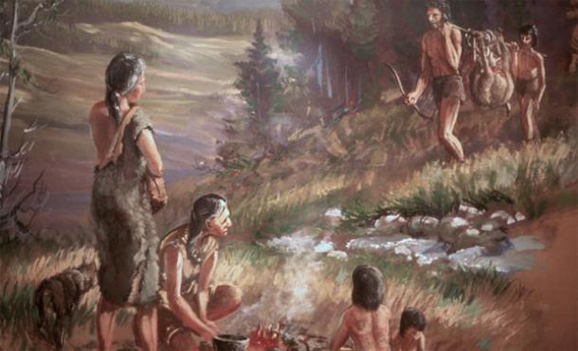
Weather forecasting is as old as our species

Slide 3
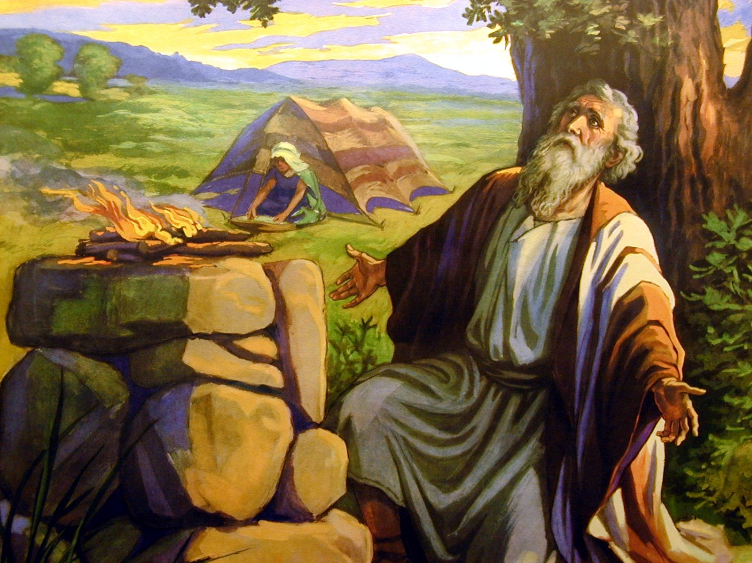
Ancient people were keen observers of the sky and developed practical weather forecasting rules
Book of Job (37:22) states, “Fair weather cometh out of the north”
Which is true for many midlatitude locations where northerly flow is typically cool and dry.

Slide 4
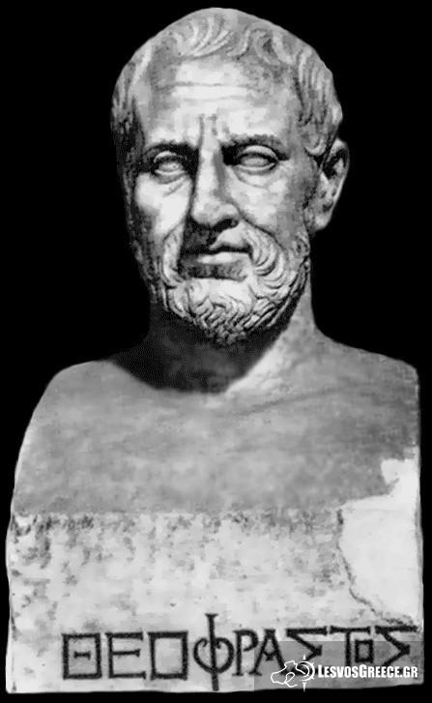
Ancient Greek Weather Advice
In Meteorologica, Aristotle (384-322 BC) suggested that a close examination of the sky could provide useful forecasts.
One of Aristotle’s pupils, Theophrastus of Ereos, wrote a volume On Weather Signs, which had many correct insights.

Slide 5
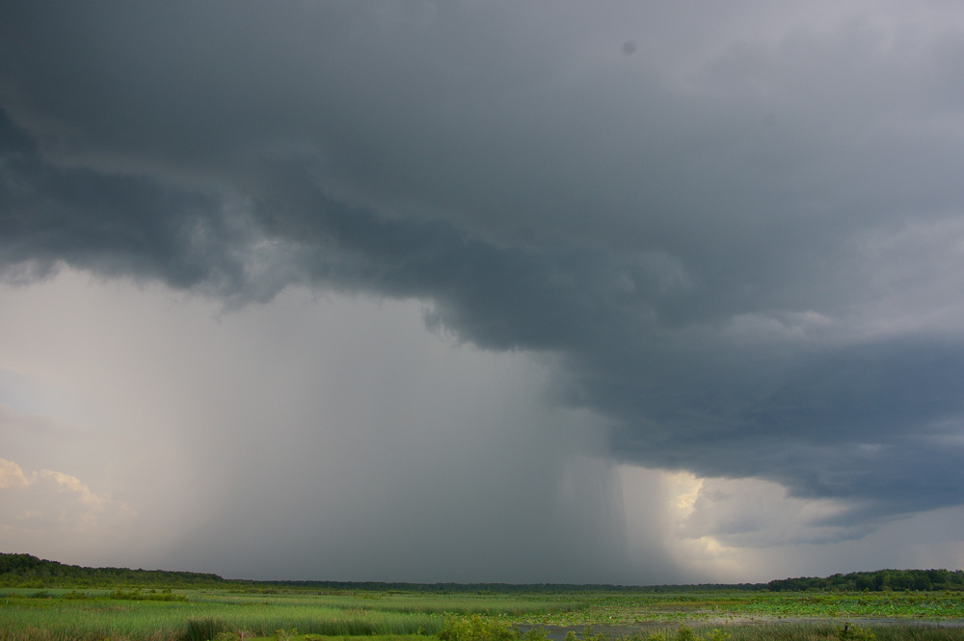
Theophrastus Example
“If the breezes come from the east or south, rain is indicated; if from the west or north, cold weather.” (generally true)

Slide 6

Ancient And Pre-Modern Societies Summarized Forecasting Wisdom in Proverbs
"Red sky at night, sailor's delight. Red sky in the morning, sailor take warning.”
"Clear moon, frost soon.”
"Halo around the sun or moon, rain or snow soon."

Slide 7
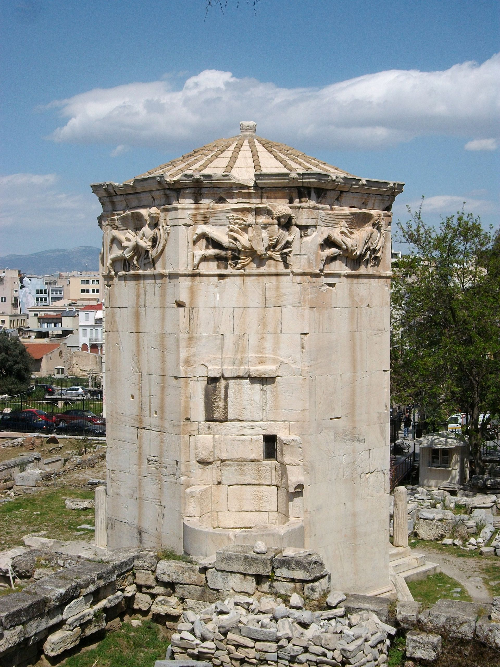
Ancient Weather Instruments
Wind vanes were perhaps the most ancient meteorological instruments.
Mesopotamian and Sumerian documents, dating back nearly 4,000 years, describe primitive wind vanes, and streamers.
Tower of the Winds, 50 BCE

Slide 8
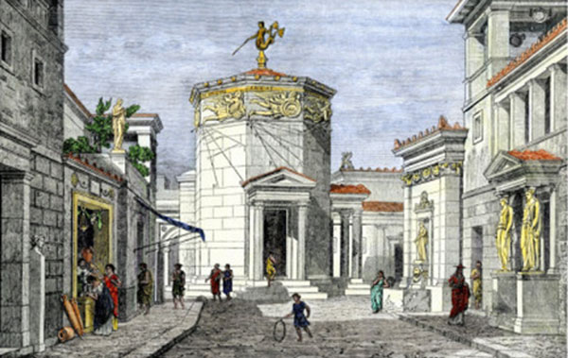
Tower of the Winds

Slide 9
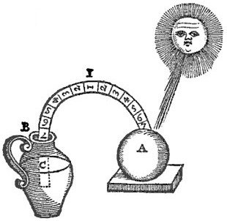
Ancient Weather Instruments
Bowls were used as rain gauges (India, 4th century BC)
First thermometer (Philo of Byzantium, 240 BC)
Philo’s
Thermometer

Slide 10
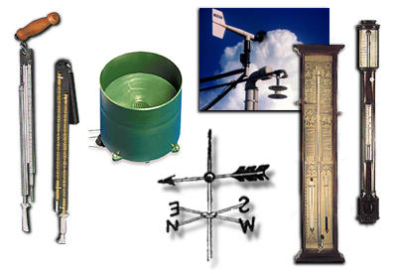
The Transition To Modern Weather Forecasting
Step 1: You need weather instruments with sufficient accuracy and reproducibility.

Slide 11

1450-1750
The Rise of Weather Instruments
Around 1600 A.D., several experimenters, including Galileo Galilei, developed air-water thermoscopes
A tube and bulb was inserted into water; as temperature changes, the water level varies in the tube

Slide 12
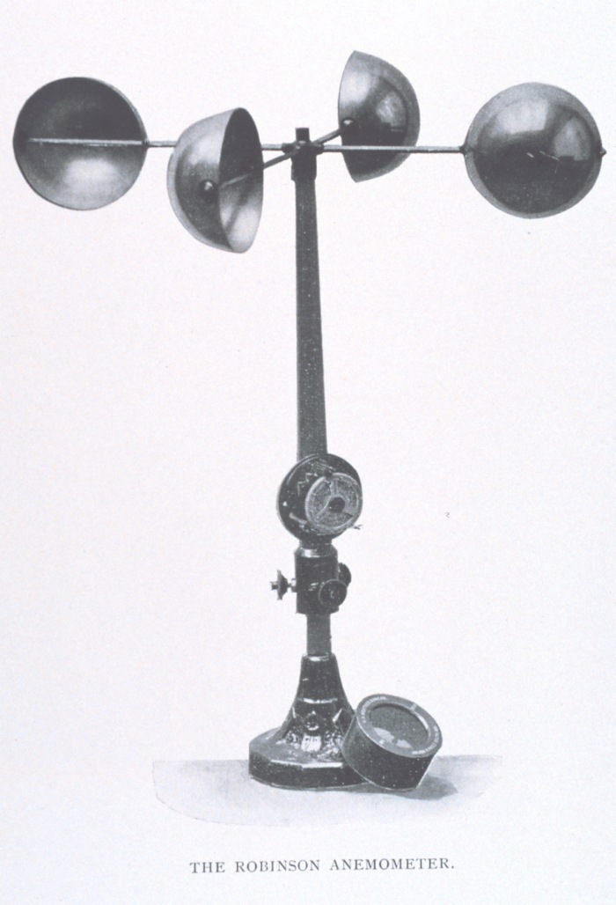
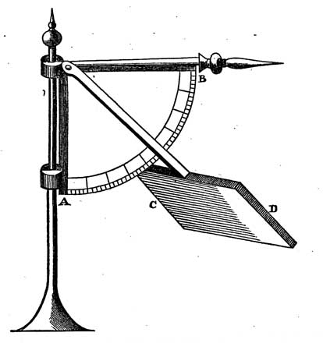
Robert Hooke (1660) Invented the Anemometer to Measure Wind Speed
Hooke, 1660
Anderson, 1840

Slide 13
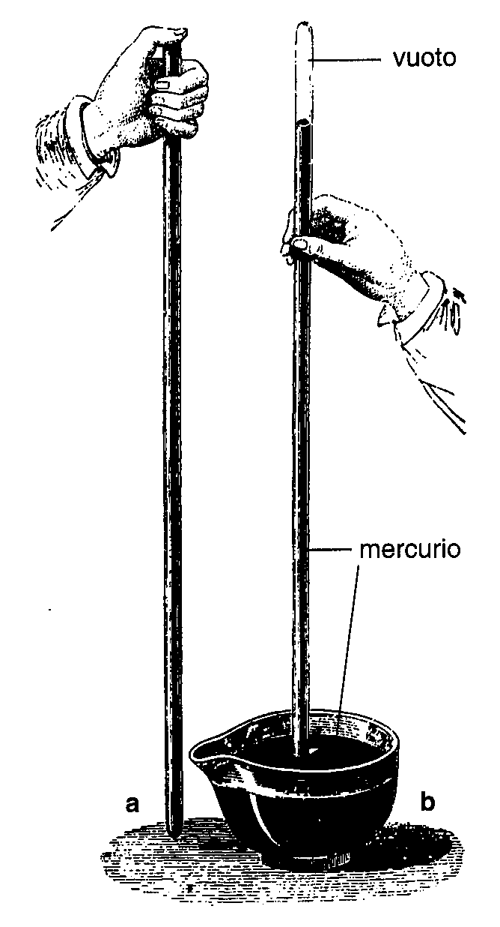
Torricelli Devised the Mercury Barometer to Measure Air Pressure (1644)

Slide 14
But there was a problem… the absence of universal scales for basic weather parameters such as temperature.
Could not exchange weather observations!

Slide 15
Solutions for Temperature
In 1665 Christian Huygens suggested the freezing and boiling points of water as standards
1724 Daniel Fahrenheit proposed a scale with 32F for freezing and 212F for boiling and used this scale in the first mercury thermometers.
In 1742 Anders Celsius introduced a temperature scale using 0 and 100C for freezing and boiling points.

Slide 16
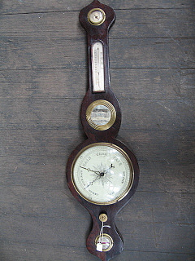
By the late 1700’s everything was in place: decent instruments and universal scales
The weather observing revolution was about to begin
Observing the weather became the high-tech craze of the period

Slide 17
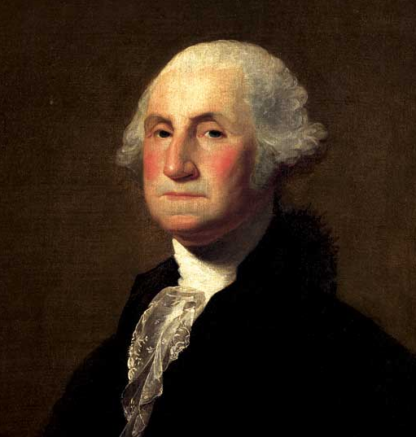
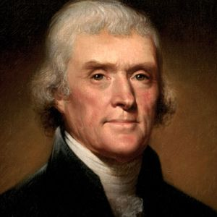
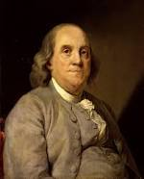
Early Weather Hobbyists
Thomas Jefferson maintained a nearly unbroken record of weather observations between 1776 and 1816. Four weather observations on July 4, 1776!
George Washington collected daily weather observations until only a few days before he died.

Slide 18
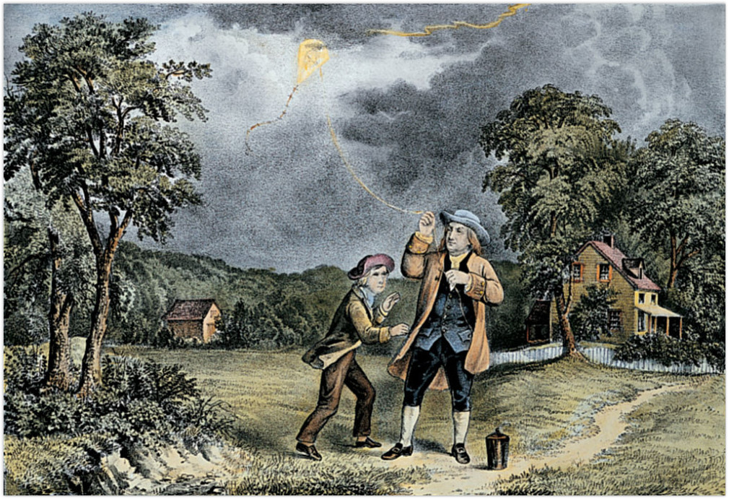
Franklin Foresaw Modern Weather Prediction

Slide 19
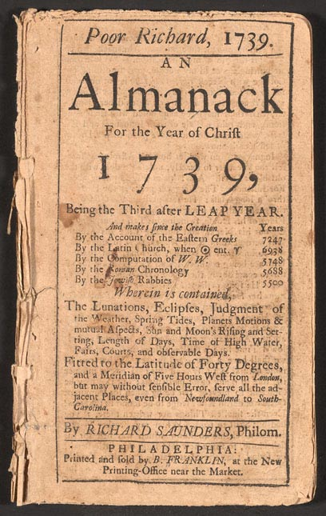
Ben Franklin, the First Modener Weather Forecaster
Franklin concluded, based on the visibility of a 1743 lunar eclipse at various locations, that the relevant storm moved to the northeast.
Thus, it might be possible to predict storm movement if the information could move faster than the storm.
Produced some of the first paid weather forecasts in Poor Richard’s Almanac

Slide 20
The Weather Observing Craze
More and more people took weather observations during the late 1700s and early 1800s
Folks mailed weather observations to each other and the first weather networks were established
Example: 1792 the Mannheim Network included 39 stations from France, Germany, Italy, Scandinavia, Poland, and Russia.

Slide 21
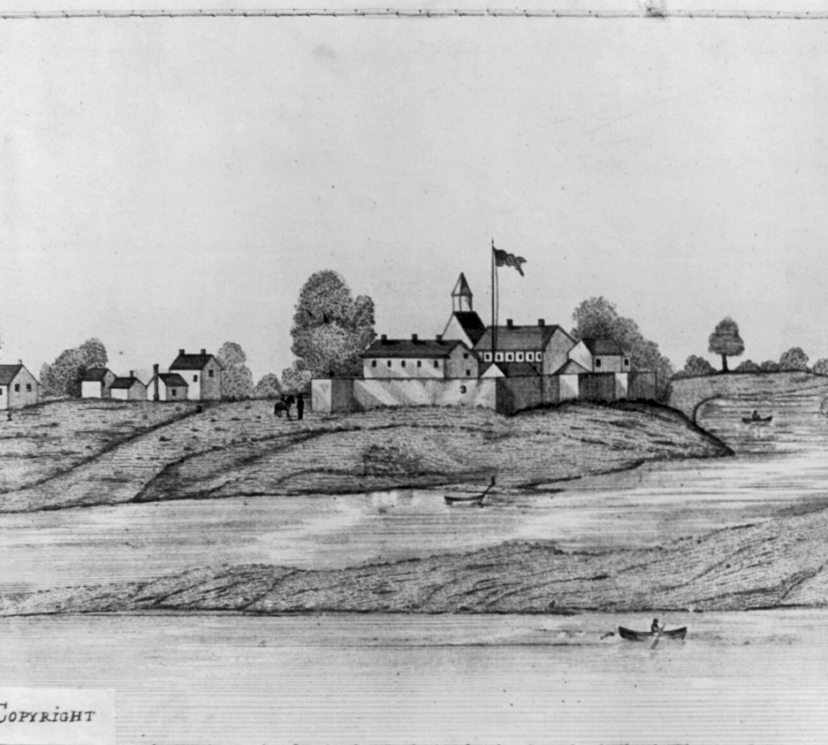
The U.S. Government Gets Involved
In 1816 all U.S. army surgeons were required to take three weather observations daily.
Other American weather networks were organized under the auspices of the U.S. Navy and the Smithsonian Institution

Slide 22
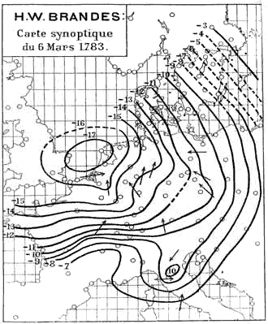
The First Weather Map (1820)
Created by H. W. Brandes for March 6, 1783.
The arrows indicate wind direction and the lines show the deviation of pressure from average conditions

Slide 23
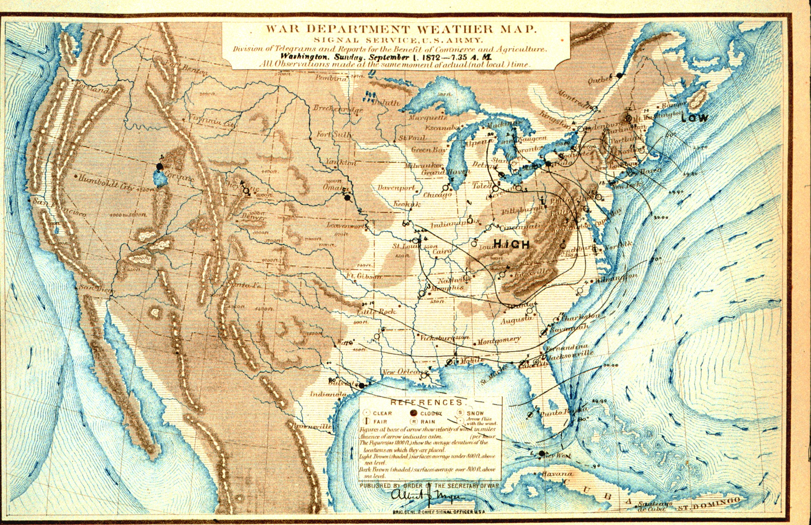
The Advent of Operational Weather Forecasting

Slide 24

By the early 1800s, there were many weather observations taken but their value was limited
Without a means for rapid communication, weather maps were created weeks or months after the observations were taken.
Weather forecasting was limited to the "local method," in which local surface and cloud observations were combined with past experience.

Slide 25
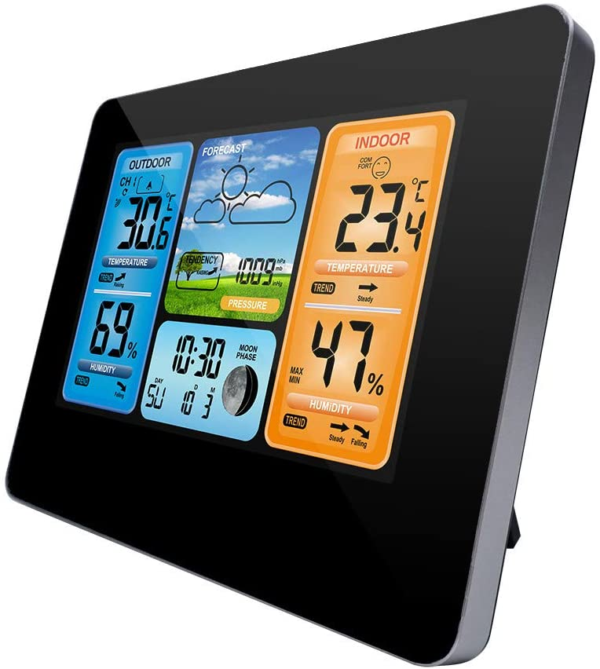
Similar Methodology Used Today for Inexpensive Home Weather Stations with “forecasts”

Slide 26
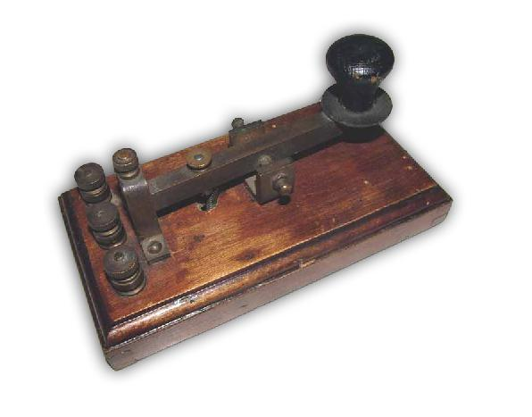
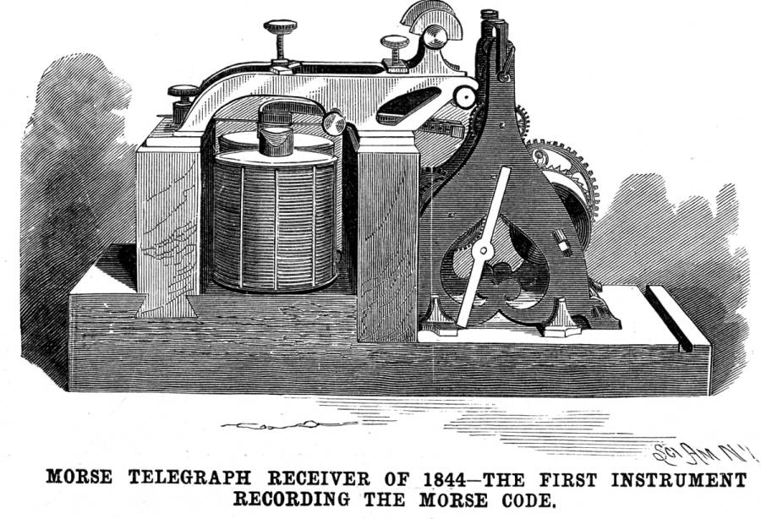
The Telegraph Changes Everything
The first practical electrical telegraph was built by Samuel Morse and Alfred Vail in 1837
In 1844, the “what hath God wrought?” message was transmitted between Baltimore and Washington, D.C.
The Internet of the 1840s

Slide 27
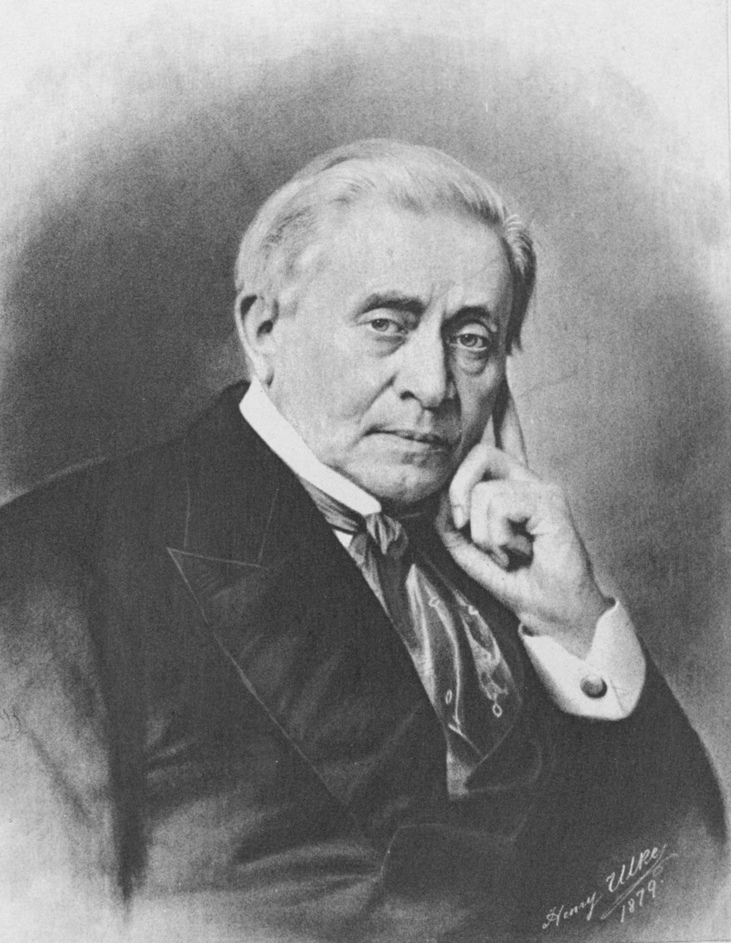
It was immediately recognized that the telegraph made weather prediction possible
Joseph Henry in 1847 provided the vision:
“… extended lines of telegraph will furnish a ready means of warning the more northern and eastern observers to be on the watch for the first appearance of an advancing storm.”

Slide 28
The Weather-Telegraph Revolution
In 1849, the Smithsonian created a network of two-dozen telegraph operators/observers, distributing daily weather reports from around the nation.
A weather map, updated daily and based on telegraphic reports, was posted in the lobby of the Smithsonian Institution. The Washington Evening Star newspaper published the maps in each issue.

Slide 29
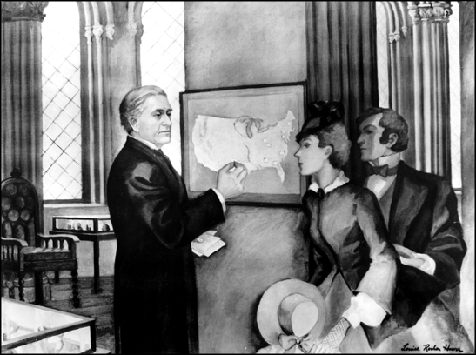
Smithsonian Weather Display 1858

Slide 30
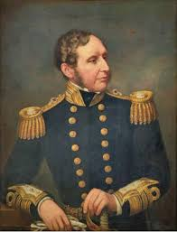
Operational Weather Prediction Begins
With telegraphic weather information, governments around the globe began to establish operational meteorological services.
In 1854 Admiral Fitzroy, famed captain of Darwin's ship the Beagle, was appointed head of the new British Meteorological Service
In 1861 began issuing daily forecasts and storm warnings.
Admiral Robert Fitzroy
Created “weather forecast”

Slide 31
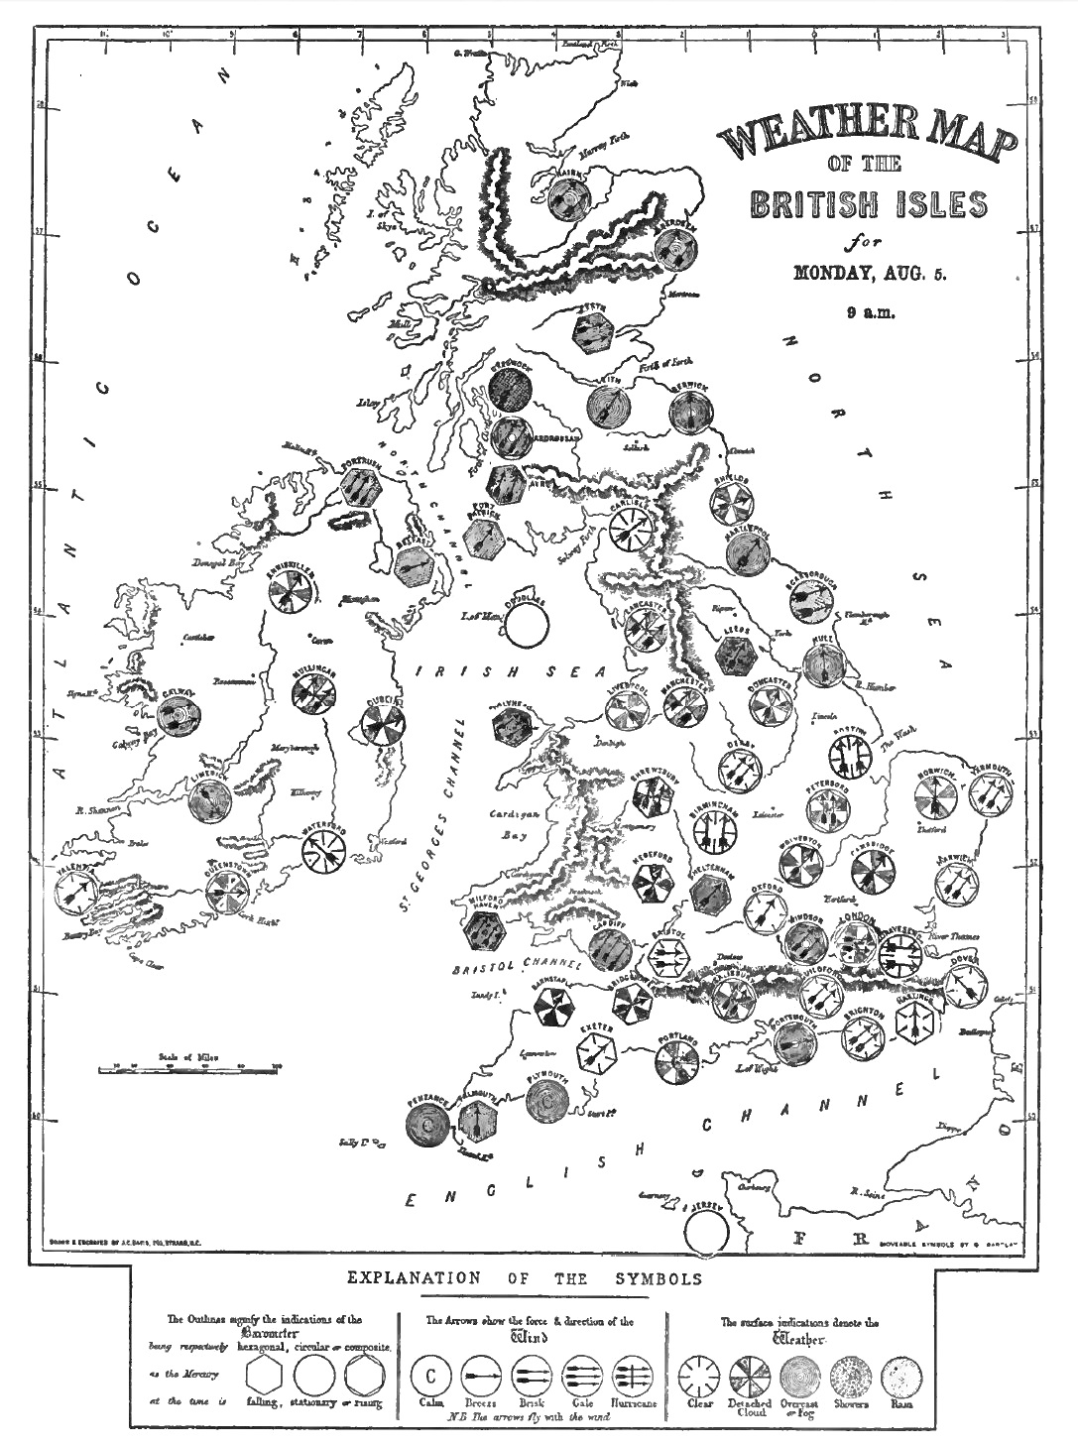
Push Back
The scientific establishment saw weather forecasting as inconsistent with proper scientific inquiry.
Fishing fleet owners objected to storm warnings, which kept ships in port.
A committee of the British Royal Society recommended that storm warnings and daily forecasts be discontinued, and in December 1866 weather forecasts were terminated.
1861 Weather Map

Slide 32
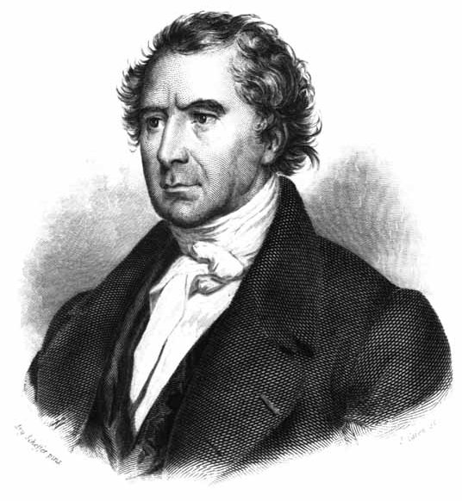
French physicist François Arago, the Director of the Paris Observatory
  “Whatever may be the progress of sciences, never will observers that are trustworthy, and careful of their reputation, venture to foretell the state of the weather.”

Slide 33
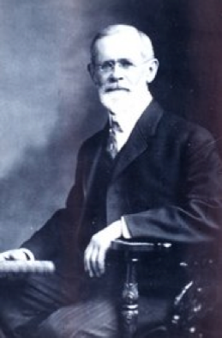
Forget Europe: The U.S. Moves Ahead
Meteorologist Cleveland Abbe, released the first U.S. public weather forecast on September 1, 1869 for Cincinnati, Ohio
In 1870, President Ulysses S. Grant authorized the establishment of a national weather service located within the Signal Service of the U.S. Army
Ol’ Probs

Slide 34
On February 19, 1871, Abbe issued the first “official” public Weather Synopsis and Probabilities based on observations taken at 7:35 a.m.

Slide 35
"Synopsis for past twenty-four hours; the barometric pressure had diminished in the southern and Gulf states this morning; it has remained nearly stationary on the Lakes. A decided diminution has appeared unannounced in Missouri accompanied with a rapid rise in the thermometer which is felt as far east as Cincinnati; the barometer in Missouri is about four-tenths of an inch lower than on Erie and on the Gulf. Fresh north and west winds are prevailing in the north; southerly winds in the south. Probabilities; it is probable that the low pressure in Missouri will make itself felt decidedly tomorrow with northerly winds and clouds on the Lakes, and brisk southerly winds on the Gulf."

Slide 36
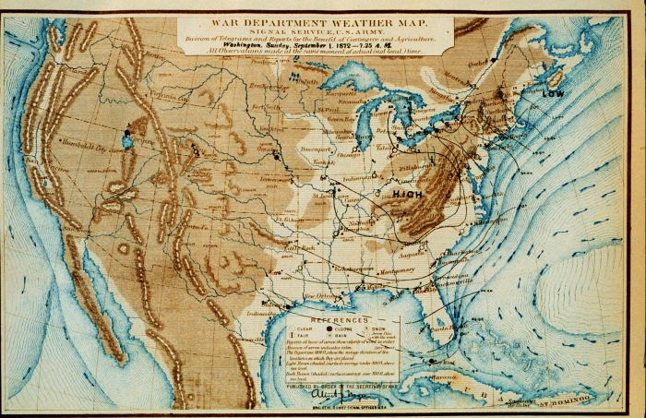
(1872) U.S. Operational Weather Map
No fronts

Slide 37
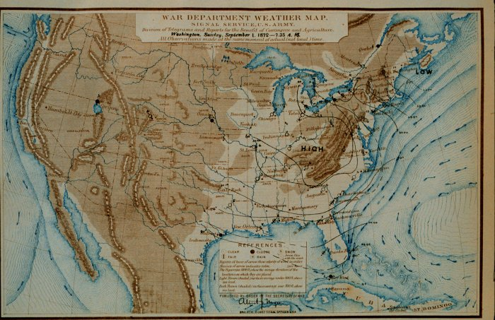
1880’s Forecasting Technology
L
L
L
Yesterday
Today
Tomorrow

Slide 38
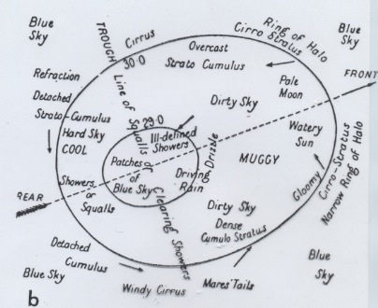
1890’s Atmospheric “Model”

Slide 39
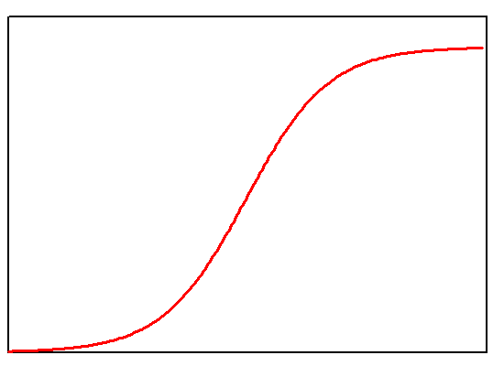
Forecast Skill Plateaus
Forecasting skill increased during the 1870s and 1880s as more observations became available.
Little understanding of the evolution of weather systems.
By the turn of the century, predictive skill had leveled off.

Slide 40
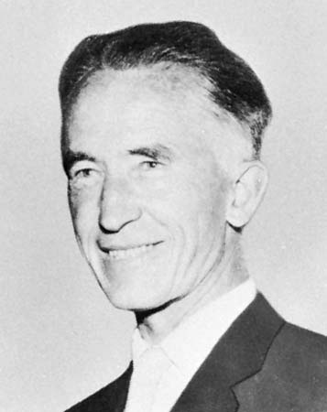
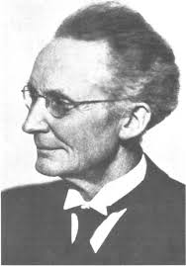
Norwegians to the Rescue
Jacob Bjerknes
Vilhelm Bjerknes

Slide 41
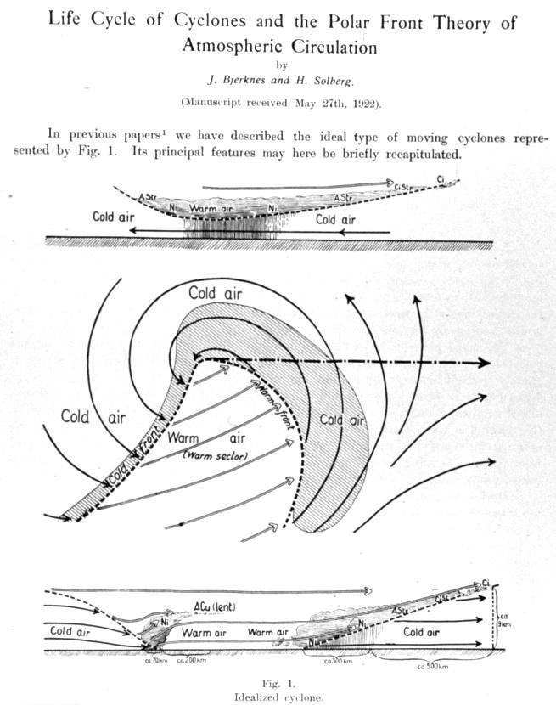
Norwegian Cyclone Model

Slide 42
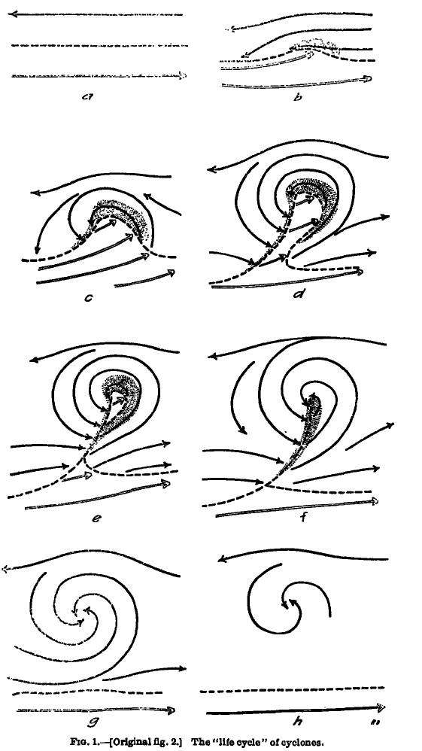
Concept of the Evolution of Cyclones
Bjerknes and Solberg
1922

Slide 43
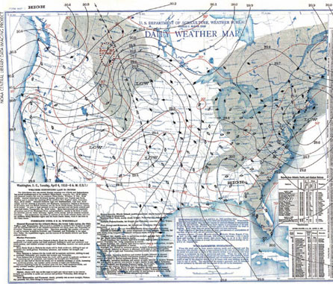
Norwegian Contribution
Gave meteorologists some guidance on how weather systems evolved over time.
Provided a conceptual model of the connection between fronts and weather.
Major aid to weather prediction.
Basically qualitative.
Lack of understanding of interactions with upper levels

Slide 44
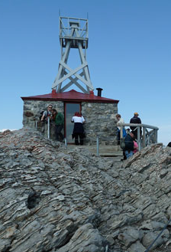
A Lack of Upper Air Observations Undermined Weather Prediction
The atmosphere is three dimensional and what happens aloft matters.
In 1920, a very sparse upper-air observational network:
  Mountain stations
  Kites and pilot balloons
  Limited aircraft observations.

Slide 45
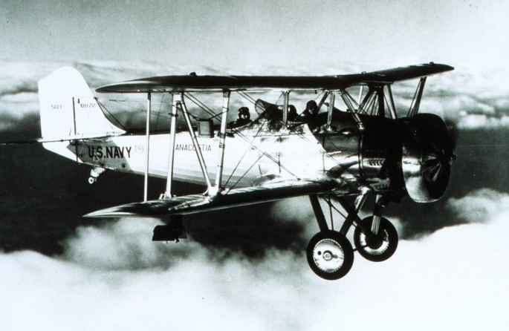
Navy bi-plane with meteorgraph on wing strut, taking measurements of pressure, temperature, and humidity

Slide 46
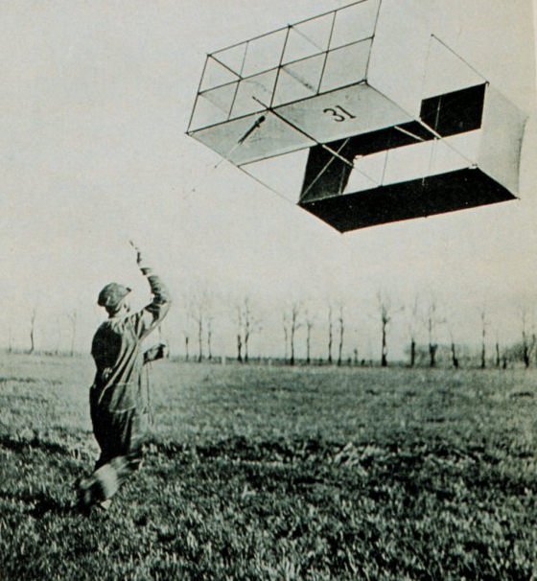
Weather Kites

Slide 47
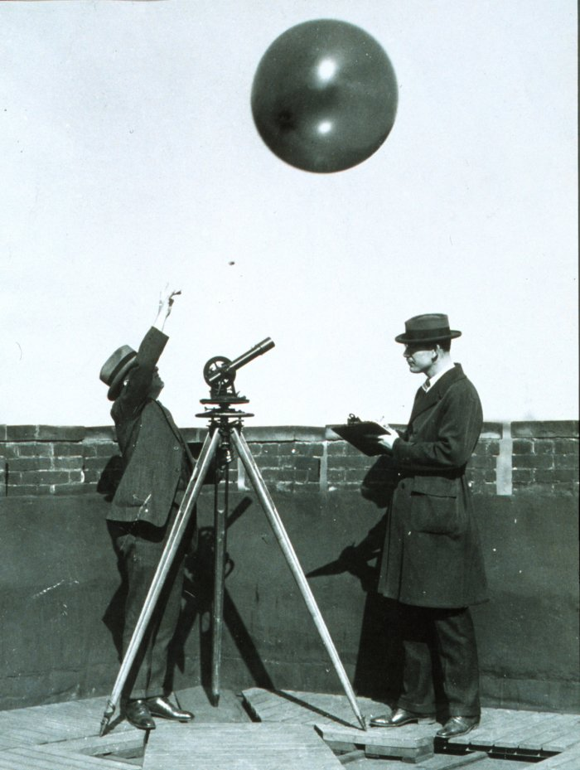
Pilot Balloons Provided Winds Aloft

Slide 48
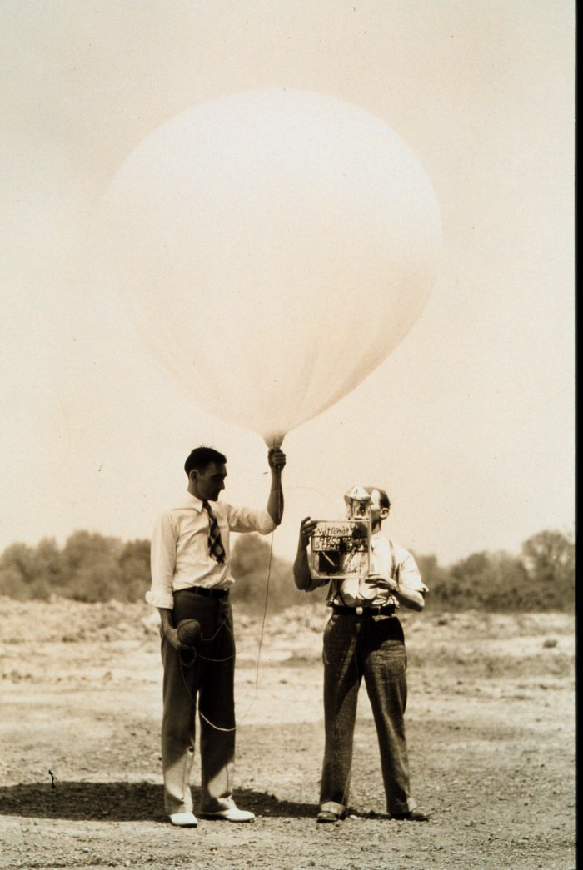
The Big Breakthrough: The Radiosonde
Mobile weather station lofted by a balloon.
Sends observations back by radio.
The first instrument launched on January 7, 1929.

Slide 49
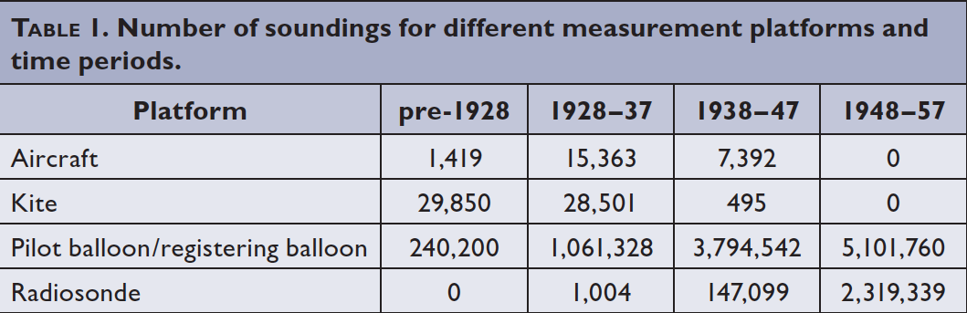
Rapid Expansion of the Upper Air Network During the 1930s and 1940s.
Note that pilot balloons did not go away!

Slide 50
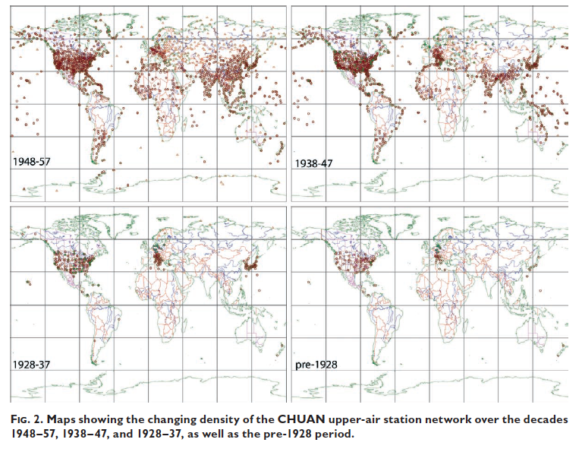

Slide 51
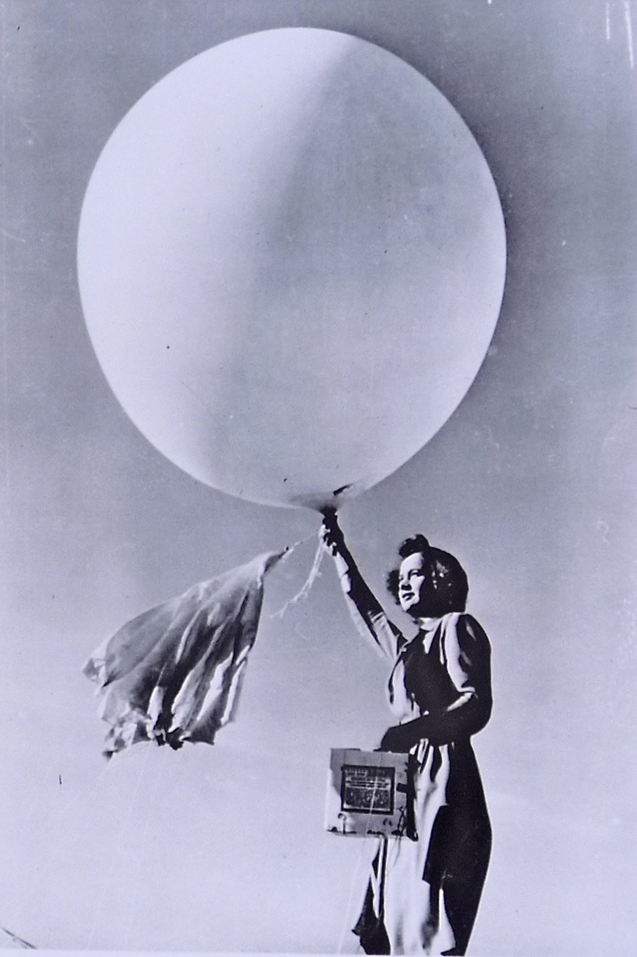
Radiosonde Data Changes Weather Prediction
Provided a 3D picture of what is happening aloft (over land!)
Defined upper-level disturbances and how they influence weather
Jet streams noted and described
Upper-level flow steered storms, and thus predicted storm movement.

Slide 52
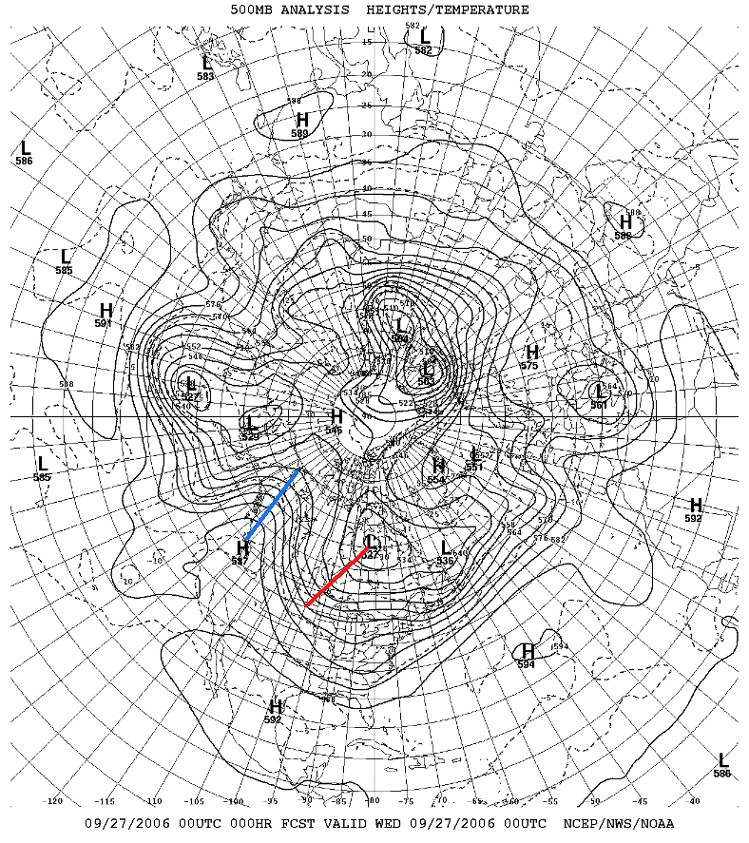
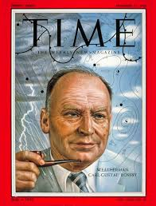
A Lot of the Seminal Work on Upper-Level Structures Done By the Chicago School (late 1940s and 1950s)
Long waves and short waves
Rossby wave dynamics
Jet Streams

Slide 53
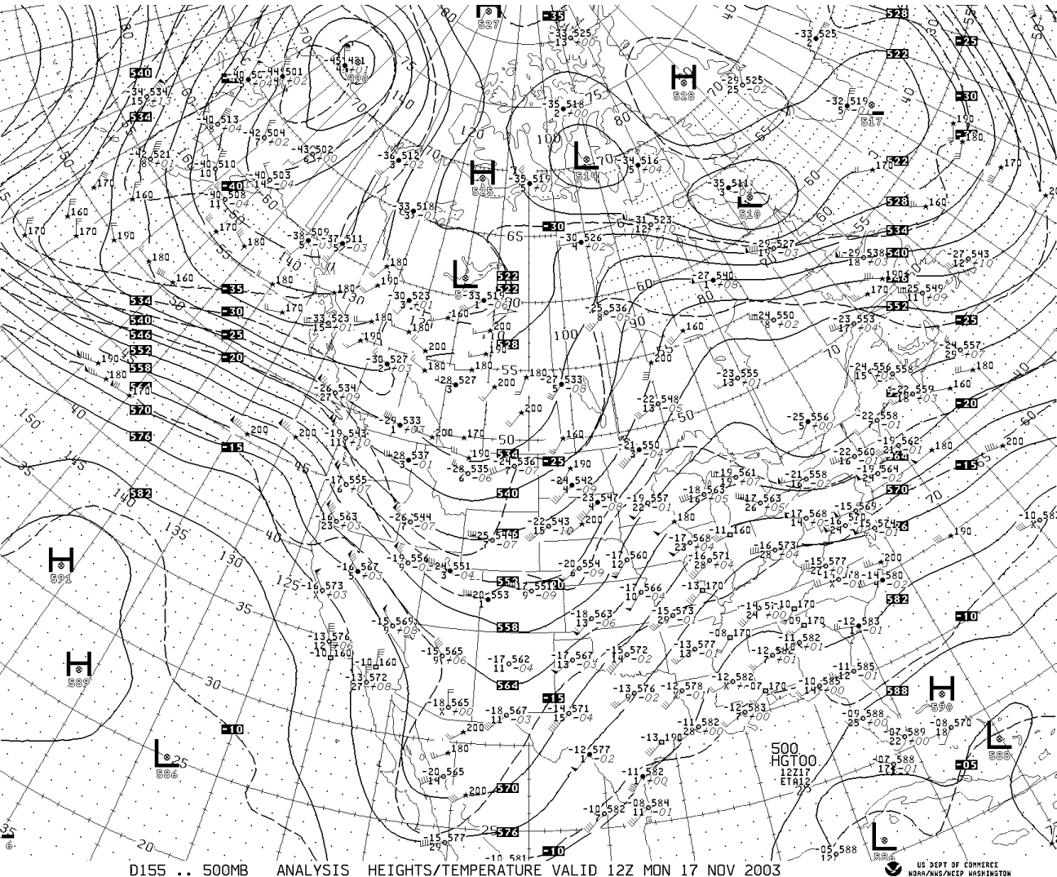
Upper
Level
Chart

Slide 54
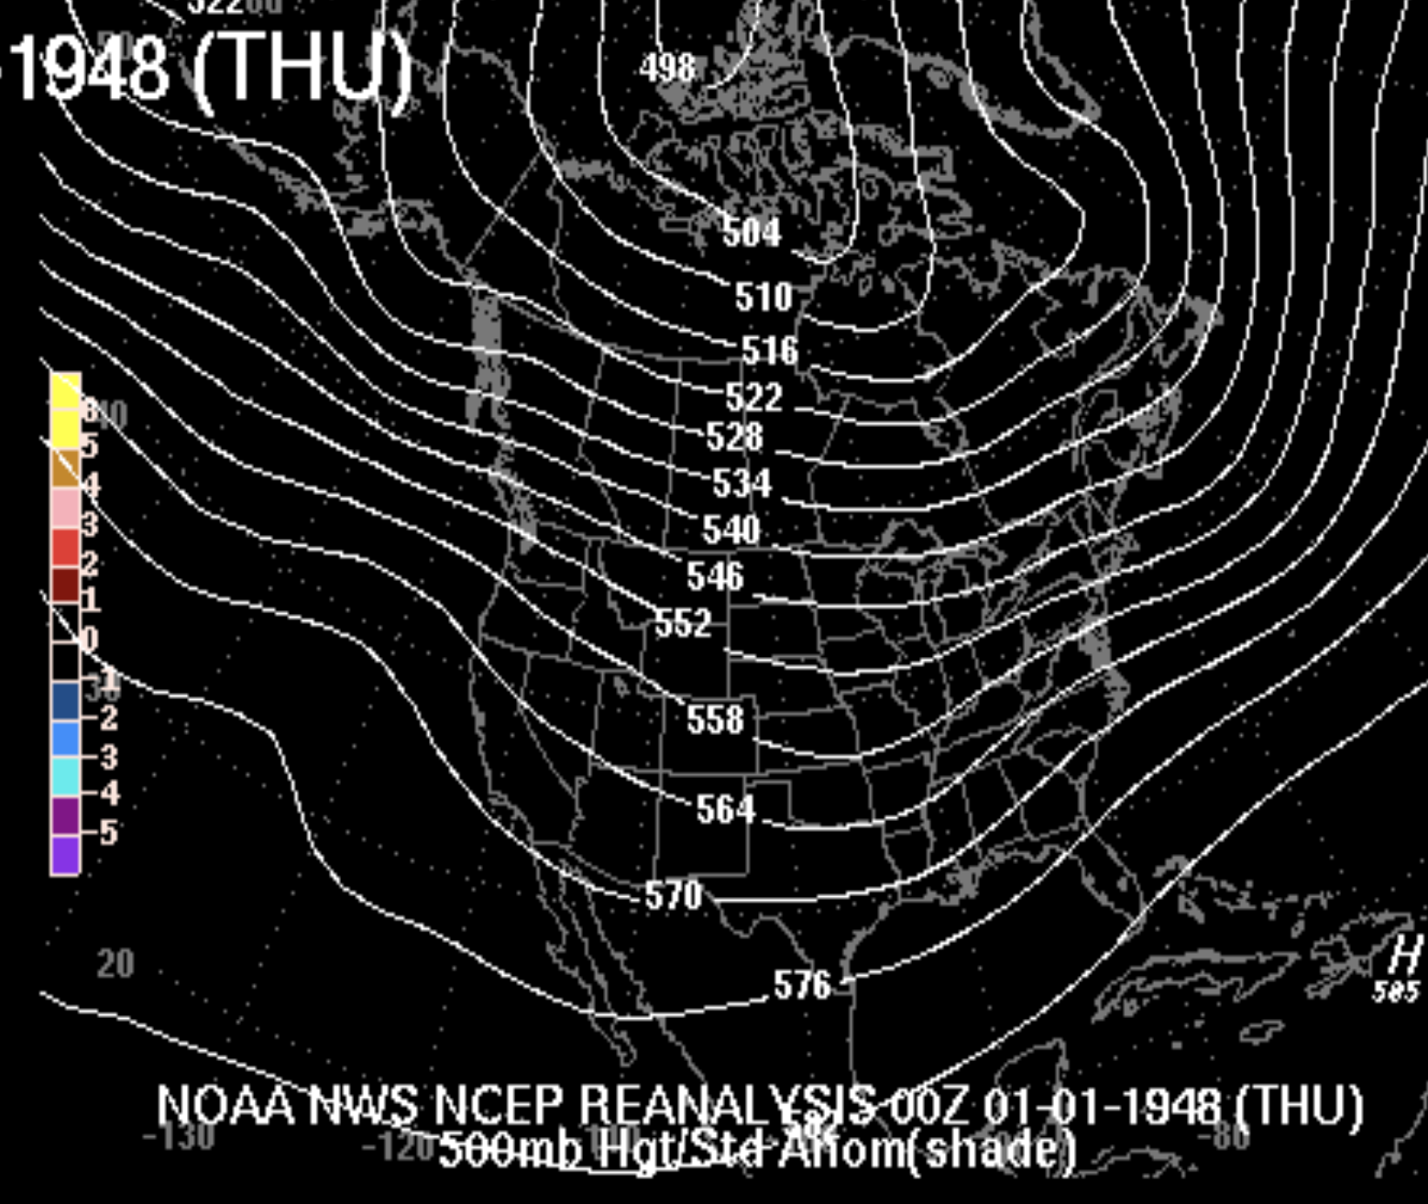
Upper Air Maps Aided Forecasting, But Was Still Essentially Qualitative

Slide 55

The Development of Numerical Weather Prediction (NWP)

Slide 56

The Equations Are Revealed
During the late 19th century, all the basic equations describing the physics of the atmosphere became known.
  Conservation of momentum
  Conservation of energy
  Conservation of mass
  Conservation of water

Slide 57

Encompassed In the “Primitive” Equations

Slide 58

The Idea of NWP is Born
In 1904, Vilhelm Bjerknes suggested that the primitive equations could predict the future atmosphere.
But NWP wasn’t practical because there was no way to do the computations quickly and 3D data for starting the forecasts did not exist.

Slide 59
Example: Predicting the Future
F = ma
If we can observe the atmosphere, we know m, the amount of mass
We also can calculate all the forces, F (such as forces due to differences in pressure)
Thus, we can calculate the acceleration, a.
Acceleration is the change of velocity in time.
THUS, WE KNOW THE FUTURE!

Slide 60

L. F. Richardson: An Insightful But Unsuccessful Attempt at Numerical Prediction
As a Quaker ambulance driver during WWI he worked on the problem.
In 1922 Richardson published a book Weather Prediction by Numerical Process that described an approach to using the primitive equations: solving the equations on a grid using finite differences

Slide 61

Finite Differences on a Grid

Slide 62

L. F. Richardson
He attempted to make a numerical forecast using a mechanical calculator
Unfortunately, the results were not good, probably because of problems with his initial conditions and an excessive time step.

Slide 63

L. F. Richardson
He imagined a giant theater filled with humans using mechanical calculators…
Practical NWP had to wait until a way of doing the computations quickly was developed and more data…especially aloft… became available.

Slide 64

World War II: Radiosondes, Weather Radar, Observing Systems, Computers

Slide 65
The Dream Becomes Possible
Facilitated by WWII, by the mid to late 1940’s there was an extensive upper-air radiosonde network. Thus, a reasonable 3-D description of the atmosphere was possible.
During this period, digital programmable computers were becoming available …the first being the ENIAC

Slide 66

The Eniac

Slide 67
The First Successful Numerical Weather Prediction
Took place in April 1950, using the ENIAC
The prediction was for 500-mb height over North America, using a two-dimensional grid with 270 points about 700 km apart.
One level barotropic model (conservation of absolute vorticity)
The results were clearly superior to human subjective prediction.
The NWP era had begun.

Slide 68

First Numerical Weather Forecast

Slide 69
Evolving NWP Models
Early 50s: one-level barotropic model
Late 50s: two-level baroclinic QG model (just like Holton!)
1960s and beyond: Primitive equation models of increasing resolution and number of levels. Better physics.

Slide 70
NWP Developed Rapidly
Resolution increases (distance between grid points decrease): 1958: 380 km, 1985: 80 km, 1995: 40 km, 2000: 22 km, 2002: 12 km, 2008: 4 km
Better description of physical processes. Like clouds and radiation.
Better use of observations: improved data assimilation
More observations (e.g., satellite)

Slide 71


Slide 72

NGM, 80 km,
1995

Slide 73

1995

Slide 74

2007-2008
4-km grid spacing

Slide 75

1.3 km grid
spacing

Slide 76

Starting in the 1960s, there was a revolution in weather observation using weather satellites
Before 1960 there was little data over most of the planet (oceans, polar regions)
Storms could approach coasts without warning and numerical modeling was crippled by lack of data.
1938 Hurricane

Slide 77


TIROS-1: The First Weather Satellite (polar orbiter)--1960

Slide 78

First
Weather
Satellite
Image

Slide 79

Starting in 1974, NOAA GOES (Geostationary) Satellite

Slide 80

In the 1980s and later, many polar orbiting satellites were launched
Provided higher resolution views
Provided information at many additional wavelengths

Slide 81

Weather Satellites Now View the Entire Planet

Slide 82
But it is more than just imagery

Slide 83

Cloud Track Winds

Slide 84

Satellite Sensors Provide Thousands of High Quality Vertical Soundings Daily over the Pacific

Slide 85

Because of weather satellites, forecast skill is the same in the northern and southern hemispheres

Slide 86

Weather Radar Advances Short-Term Prediction

Slide 87


Radar was first used operationally in WWII by the British to track German planes
But heavy precipitation got in the way!

Slide 88


After WWII Meteorologists Experimented with Military Radars

Slide 89

Hurricane Radar Image

Slide 90


In the late 1950’s a dedicated meteorological radar network was established in the U.S.

Slide 91


In the late 1980s,
the NWS installed a network of Doppler weather radars

Slide 92

Hook Echo of Supercell Thunderstorm with Tornado

Slide 93
Weather Radar Data is Now Being Used for Initialization of High-Resolution Weather Models, Such as HRRR

Slide 94
The Advent Of Statistical Post-Processing
In the 1960s and 1970s, the NWS developed and began using statistical post-processing of model output…known to most as Model Output Statistics…MOS.
The idea: models have systematic biases …why not remove them based on past performance?
Also, might be able to statistically add the effects of local features not resolved by the model.

Slide 95
MOS
Based on linear regression: Y=a₀ + a₁X₁ + a₂X₂+ a₃X₃ + …
MOS is available for many parameters and projection times and greatly improves the quality of most model predictions.

Slide 96



Slide 97

Post Processing Is Now More Advanced in the Private Sector
Weather.com/weather channel

Slide 98

Better Post-Processing of Model Forecasts Explains Private Sector Superiority

Slide 99

A Fundamental Problem
The way we have been forecasting has been essentially flawed.
The atmosphere is a chaotic system, in which small uncertainties in how we start the forecast (the initialization) have large impacts on the forecasts.
Not unlike a pinball game….

Slide 100

A Fundamental Problem
Similarly, there are uncertainties in processes, such as the development of clouds and precipitation, which produce uncertainty in forecasts.
Thus, all forecasts have uncertainty.
The uncertainty generally increases in time.

Slide 101

Forecast Probabilistically
Weather forecasters need to tell users about the uncertainties in the forecast.
Give forecasts in terms of probabilities.
There is an approach to produce such guidance …ensemble forecasts

Slide 102

Ensemble Prediction
Instead of making one forecast…make many…each with a slightly different initializations or different model physics.
Possible to do this now with the vastly greater computation resources that are available.

Slide 103

UW Ensemble System

Slide 104
Ensemble Prediction
Ensemble can provide probabilities.
The ensemble mean is more accurate than any individual member.
Ensembles will dominate forecasting in the future.

Slide 105


Slide 106
Evolving Forecasting Technology
Prior to ~1955, humans did everything--subjectively forecasting at all scales.
Between 1955 and 1980 numerical weather prediction essentially took over synoptic forecasting. Humans were left with deciding between models or modifying (often unsuccessfully) the computer guidance.
Humans retained the role of translating synoptic guidance to the mesoscale/microscale.
Model Output Statistics (MOS) became competitive with human forecasters during the 1980s.

Slide 107
The Evolving Forecasting Problem
Between 2000 and now, high-resolution modeling increasingly dominated local forecasting.
Sophisticated model post-processing is getting hard for humans to beat. (e.g., Weather.com)
Probabilistic prediction based on ensembles will become dominant in the upcoming decades.

Slide 108


Communication Has Vastly Improved: From TV to Smartphones
Over a thousand weather apps are now available for smartphones

Slide 109

Major Promise of Machine Learning
Can ML replace numerical, physics-based models?
Certainly, ML can improve observation quality control and post-processing to remove bias and other errors.

Slide 110
Final Considerations
Weather prediction, particularly on the smaller spatial scales, is more skillful and useful that even 20 years ago.
Great value economically. A large weather prediction industry has developed.
Far fewer people are being killed and injured by extreme weather.
Better weather prediction is an important tool for adaptation to climate change.

Slide 111
The End

