Slide 1
The Olympic Rain Shadow

Slide 2
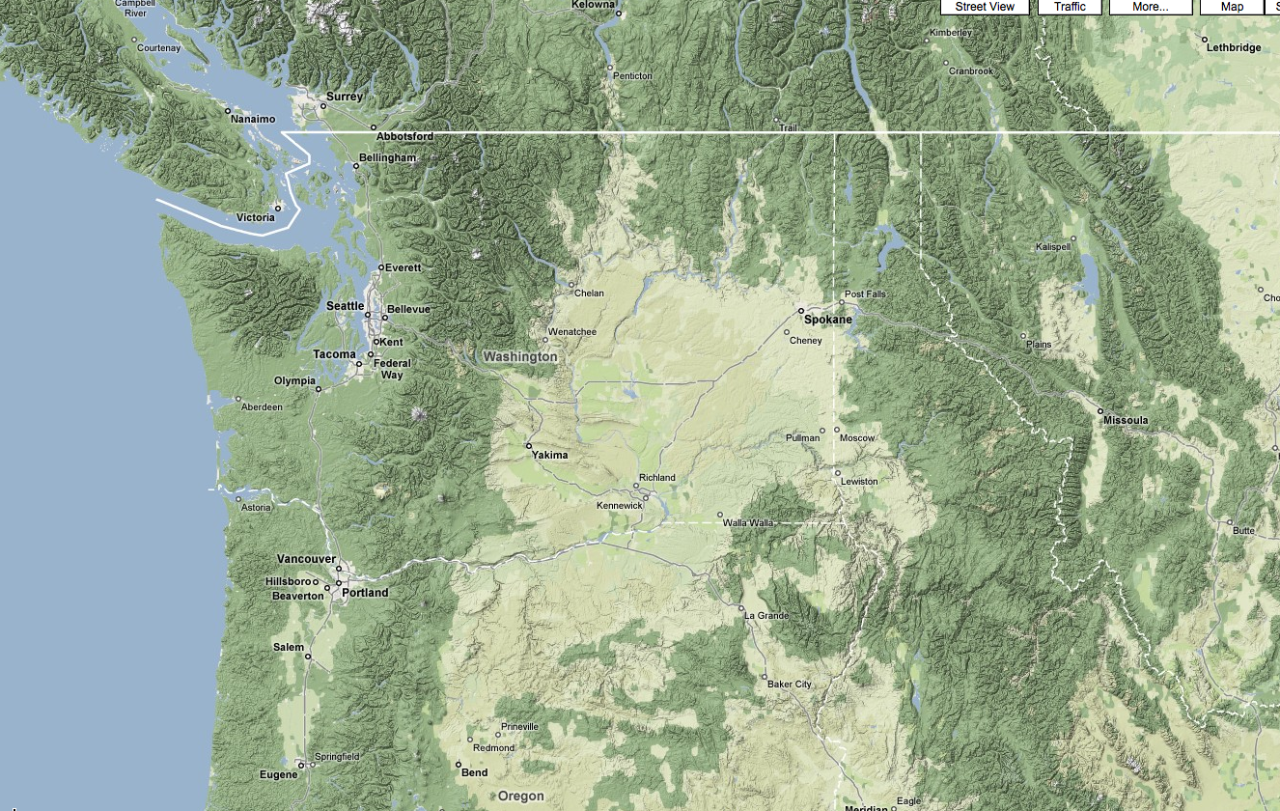
The weather of the Pacific Northwest is dominated by local weather phenomena, most forced by our regional terrain and water bodies

Slide 3
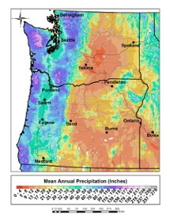

Slide 4
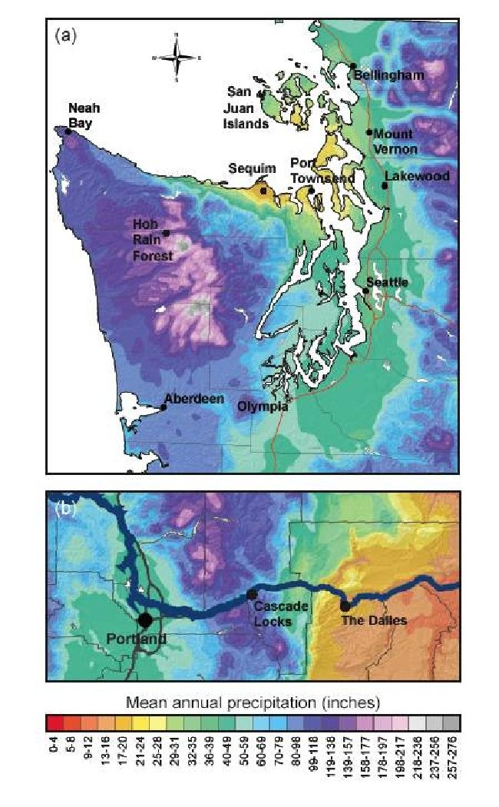
Extraordinary Precipitation Contrast

Slide 5
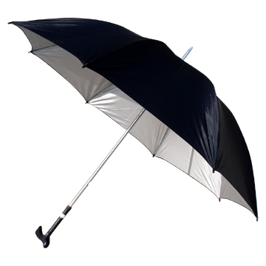
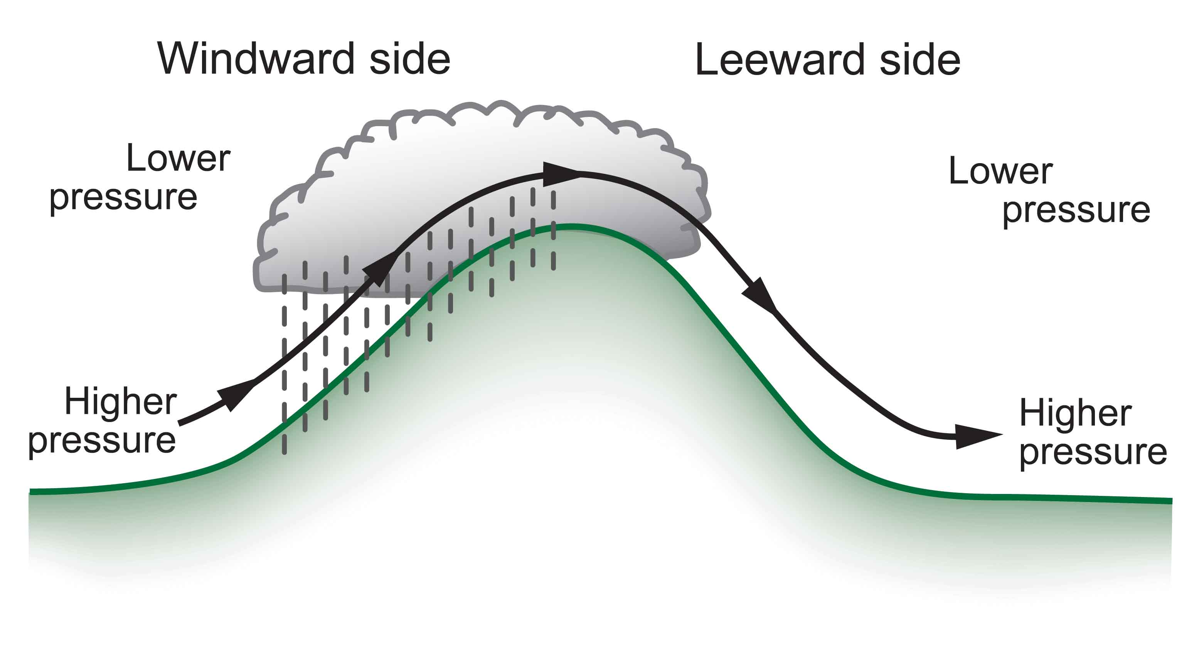
Rainshadows are as important as windward enhancement
The result is huge precipitation contrasts…some of the largest in the nation.
Substantial variations in solar radiation as well

Slide 6
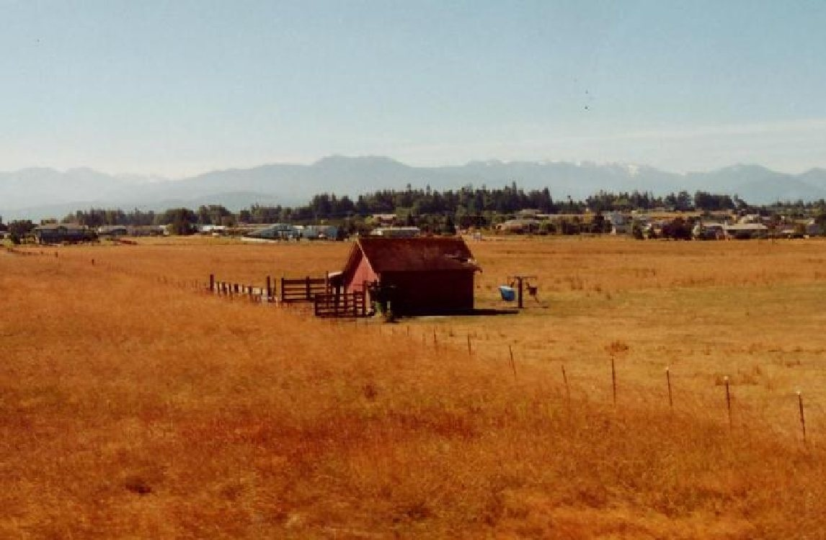
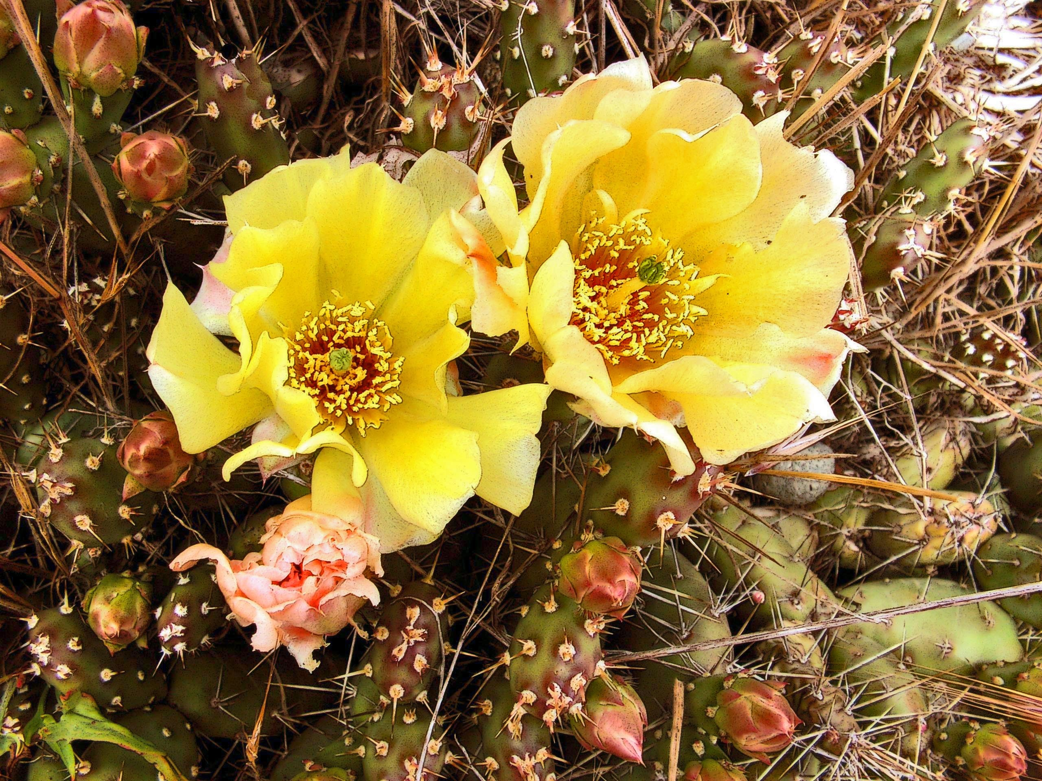
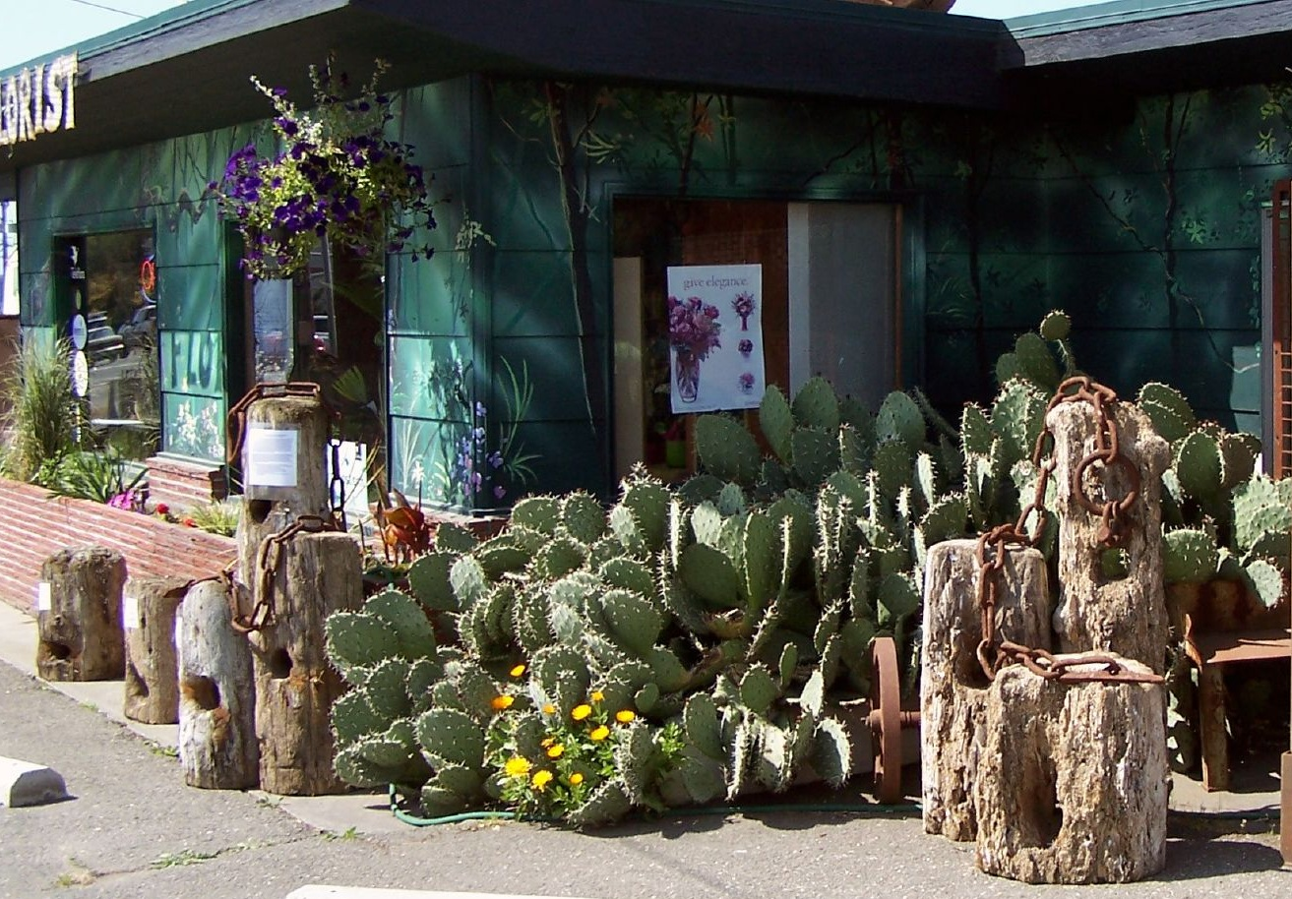
Sequim: Irrigation Needed, Cacti

Slide 7
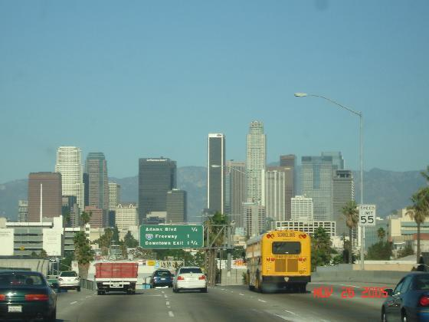
Annual Precipitation
Sequim: 15.97 inches
Los Angeles: 14.89 inches

Slide 8
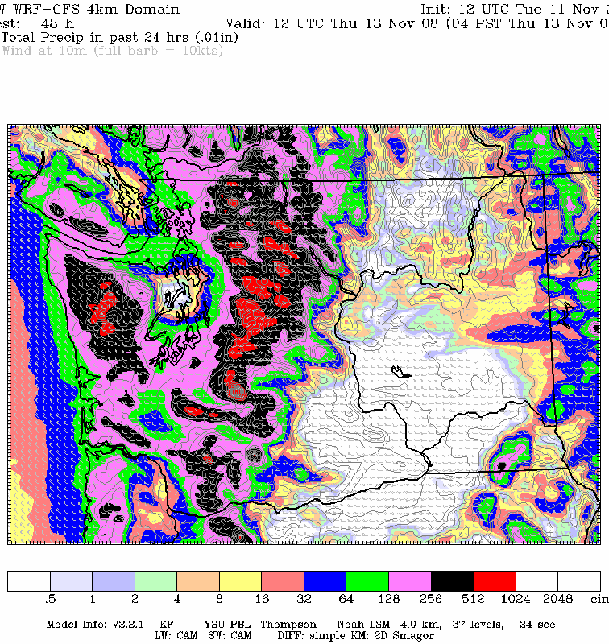
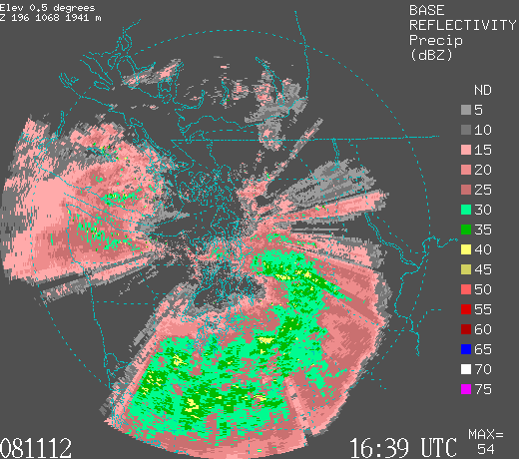
Rainshadows can move: depending on direction of the wind

Slide 9
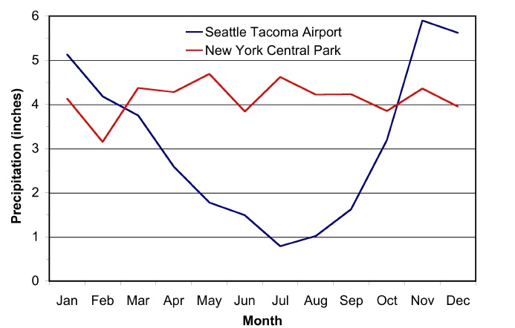
The Northwest Has a Mediterranean Climate
Football
Baseball Season
Football

Slide 10
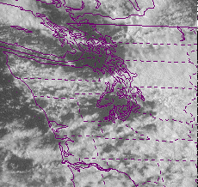
Puget Sound Convergence Zone

Slide 11
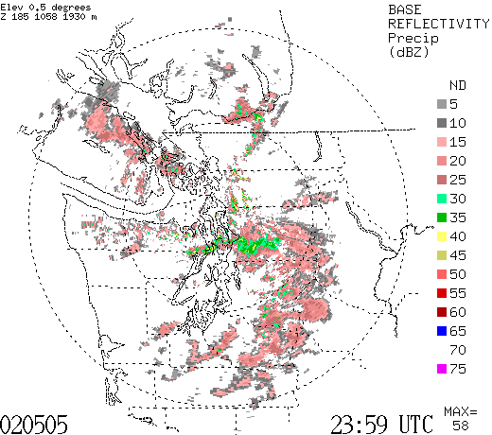

Slide 12
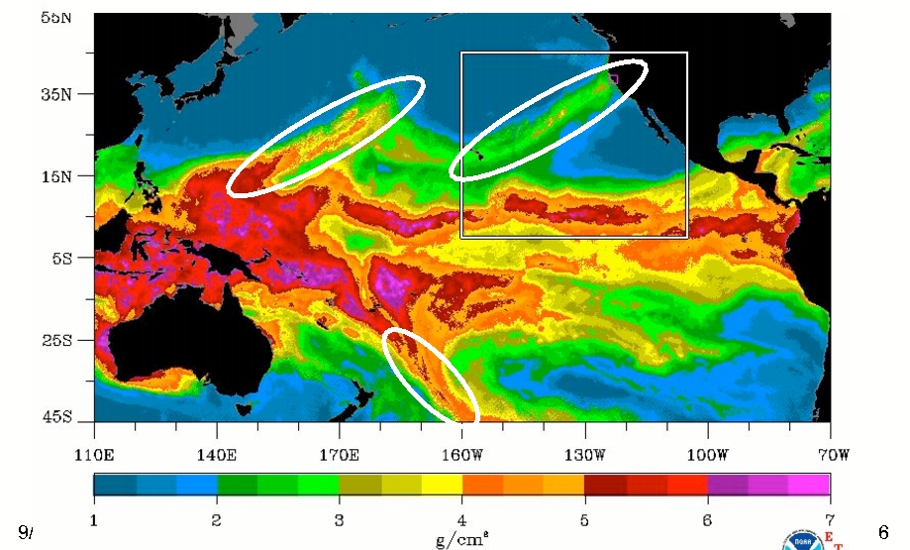
Most are associated with the “Pineapple Express”
A relatively narrow current of warm, moist air from the subtropics…often starting near or just north of Hawaii.
a.k.a.
Atmospheric rivers

Slide 13
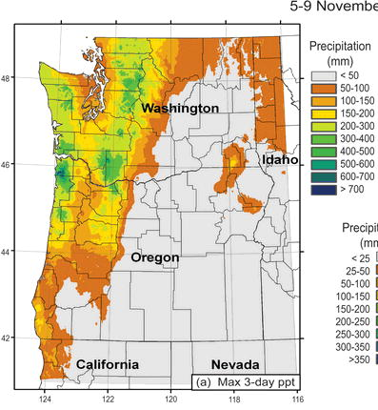
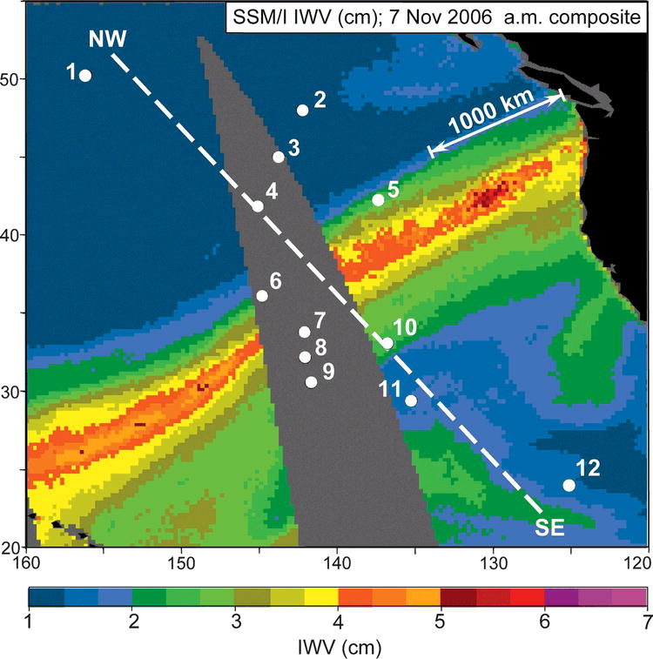
A Recent Devastating Pineapple Express: November 6-7, 2006
Dark Green: about 20 inches

Slide 14
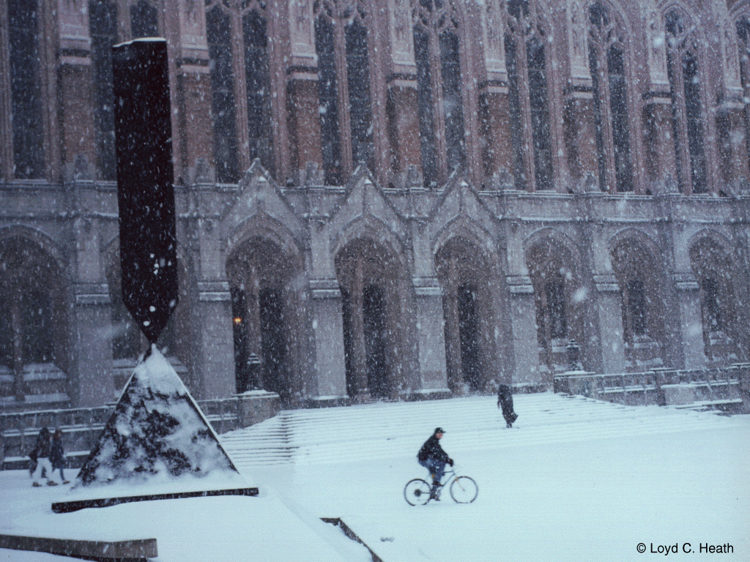
The End

