Slide 1
Model Post Processing
Atmospheric Sciences 452
Spring 2024

Slide 2
Model Output Can Usually Be Improved with Statistical Post Processing
Can remove systematic bias
Can produce probabilistic information from deterministic forecasts and historical performance.
Can provide forecasts for parameters that a model is incapable of simulating successfully due to resolution or physics issues (e.g., shallow fog)

Slide 3
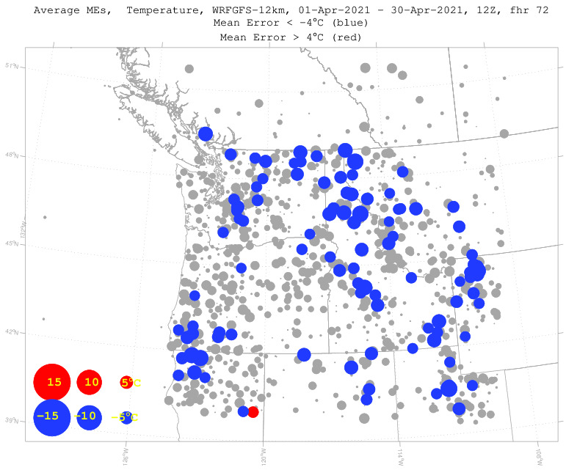

Slide 4
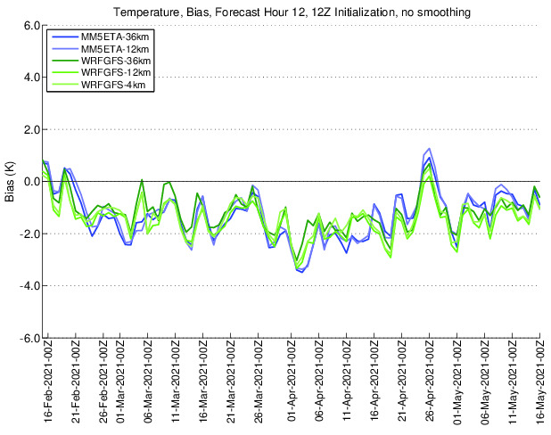

Slide 5
Model Post-Processing
There are a variety of approaches:
  Simple bias removal
  Model output statistics (MOS)
  National Blend of Models (NBM)
  Machine learning (ML) and artificial intelligence (AI)
  Bayesian model averaging
  Neutral nets
  And more….

Slide 6
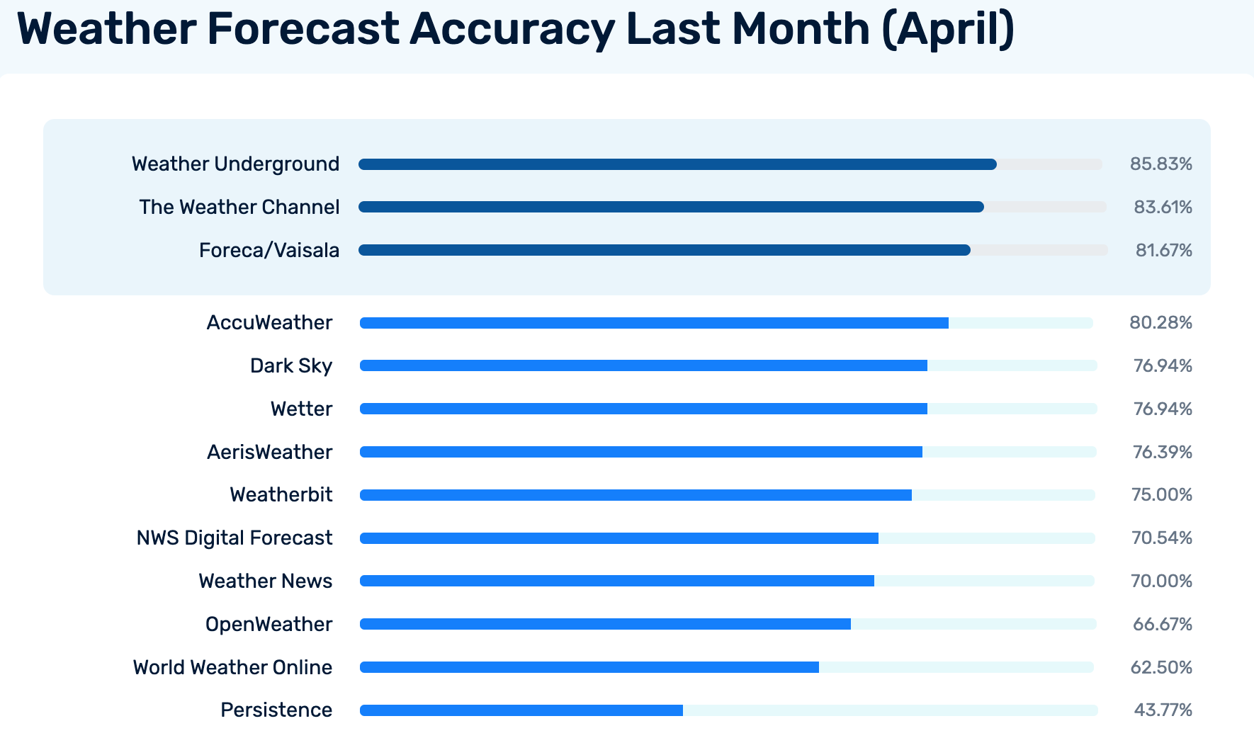
Post Processing is the Secret Sauce for the Private Sector
Seattle

Slide 7
Model Output Statistics (MOS)
Model Output Statistics was the first post-processing method used by the NWS (1969)
Based on multiple linear regression.
Essentially unchanged over the past 50 years.
Generally assumes linear relationships between predictors and predictands.
Can remove systematic bias.
Does improve the forecast!

Slide 8
Based on Multiple Linear Regression
Y=a₀ + a₁ X₁+ a₂X₂ + …
Y is the predictand—what we want to predict (e.g., probability of precip at SEA)
X_{i} are the predictors….can be model output or observations.
a_{i} are coefficients

Slide 9
Multiple Linear Regression in MOS
Select X_{i} and calculate a_{i} using BOTH model and observational data. So X_{i} can be either model output or observations.
Advantage: can adjust for model biases (e.g., too warm) since uses model forecasts as predictors
Disadvantage: Requires several years of model runs to derive equations. If model changes significantly, have to rederive equations.

Slide 10
How do we select X_{i}?
Use screening regression
Start with at least two years of model output and observations.
Go through a long list of potential predictors
Select the one that has the highest correlation with the predictand.
Then select a second predictor that produces the greatest further increase in correlation between predictand and observations
Keep on going, typically until 12 predictors are found.

Slide 11
Correlation Coefficient (r) Between Two Time Series
0—no correlation
1—perfect correlation
r² = percent of explained variance
So if r = .5, 25% of the variance or variability of the second time series can be explained by the variability in the first.

Slide 12
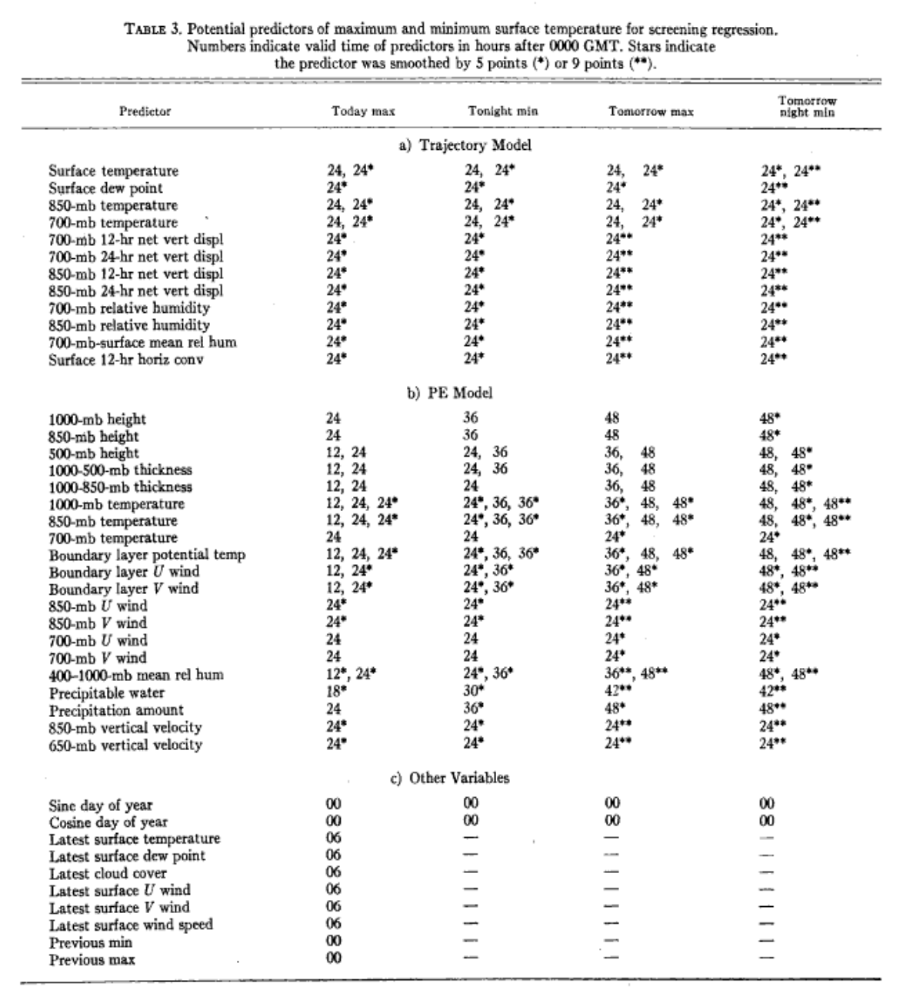
Example of potential predictors

Slide 13
NWS MOS Stops at 12 predictors
WHY????

Slide 14
Why does the NWS stop at 12 predictors?
Too many predictors can be detrimental!
  Adds little improvement but adds to computational expense
  Can overfit the data. Why? Because one can fit small, random, or unique events.
Most of the benefit are with the first 3-4 predictors.

Slide 15
Examples of MOS predictors

Slide 16
Day 2 (30-h) GFS MOS Max Temp Equation for KSLC
(Cool Season – 0000 UTC cycle)
N | Predictor (X_{N}) | Coeff. (a_{N})
0 |  | -467.7800
1 | 2-m Temperature (21-h proj.) | 1.7873
2 | 2-m Dewpoint (21-h proj.) | 0.1442
3 | 2-m Dewpoint (12-h proj.) | -0.2060
4 | 2-m Dewpoint (27-h proj.) | 0.1252
5 | Observed Temperature (03Z) | 0.0354
6 | 850-mb Vertical Velocity (21-h proj.) | 19.5759
7 | 925-mb Wind Speed (15-h proj.) | 0.6024
8 | Sine Day of Year | 1.7111
9 | 700-mb Wind Speed (15-h proj.) | 0.2701
10 | Sine 2*DOY | 1.5110

Slide 17
Day 2 (42-h) GFS MOS Max Temp Equation for KUNV
(Warm Season – 1200 UTC cycle)
N | Predictor (X_{N}) | Coeff. (a_{N})
0 |  | -432.2469
1 | 2-m Temperature (33-h proj.) | 0.9249
2 | 2-m Dewpoint (33-h proj.) | 0.5751
3 | 950-mb Dewpoint (24-h proj.) | 0.4026
4 | 950-mb Rel. Humidity (27-h proj.) | -0.1784
5 | 850-mb Dewpoint (39-h proj.) | -0.2439
6 | Observed Dewpoint (15Z) | -0.1000
7 | Observed Temperature (15Z) | 0.1270
8 | 1000-mb Rel. Humidity (24-h proj.) | 0.0027
9 | Sine Day of Year | 0.9763
10 | 500-1000mb Thickness (45-h proj.) | 0.0057

Slide 18
Day 2 (30-h) GFS MOS Min Temp Equation for KDCA
(Cool Season - 1200 UTC cycle)
N | Predictor (X_{N}) | Coeff. (a_{N})
0 |  | -374.9980
1 | 2-m Temperature (21-h proj.) | 0.9700
2 | 1000-mb Temperature (12-h proj.) | 0.3245
3 | 2-m Dewpoint (27-h proj.) | 0.1858
4 | 2-m Relative Humidity (27-h proj.) | -0.0037
5 | 2-m Relative Humidity (15-h proj.) | -0.0380
6 | 975-mb Wind Speed (21-h proj.) | -0.0653
7 | Observed Temperature (15Z) | 0.1584
8 | Sine Day of Year | -0.0342
Develop /
Evaluate

Slide 19
There are HUNDREDS of THOUSANDS of MOS equations
Separate equations for each of thousands of locations (see more on this later)
Different equations for each variable
Different equations for each season, initialization time (e.g., 0 or 12 UTC)
Different equation for each projection (e.g., 30 h forecasts)

Slide 20
A Very Important Point
For some variables, there is a different equation for each station.
  Such as temperature and wind speed.
  Such equations can take in consideration local biases, local weather features, etc.
  Example: temperature MOS knows about the Puget Sound convergence zone and its effects even if the model doesn’t.

Slide 21
A Very Important Point
For other variables/parameters, the same equation is used for several locations in a region.
  Parameters in which there FEW samples each hour (e.g., precipitation, severe weather)
  Need to pool observations to get enough samples
  Such equations DO NOT take in account local biases, local weather features, etc.
  Thus, these MOS equations do no add any information on local weather features (other than information the model provides).

Slide 22
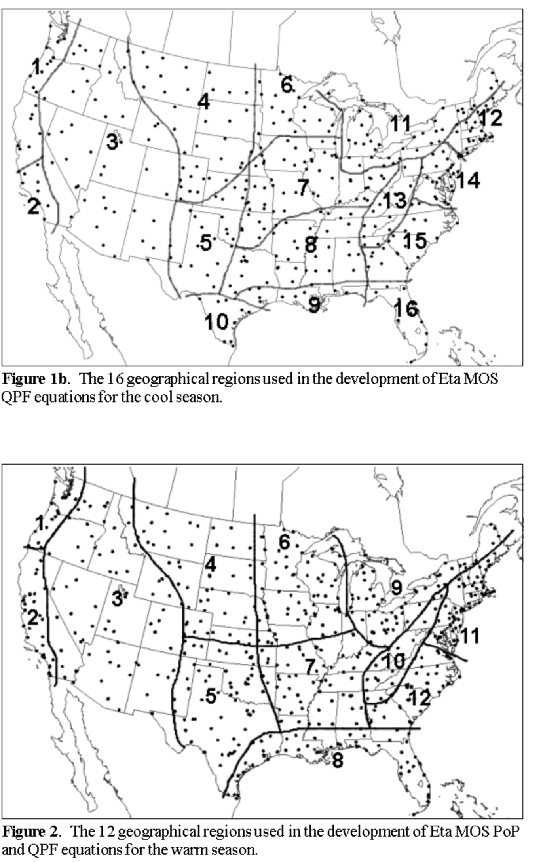
Precipitation Regions
With Same MOS Equation

Slide 23
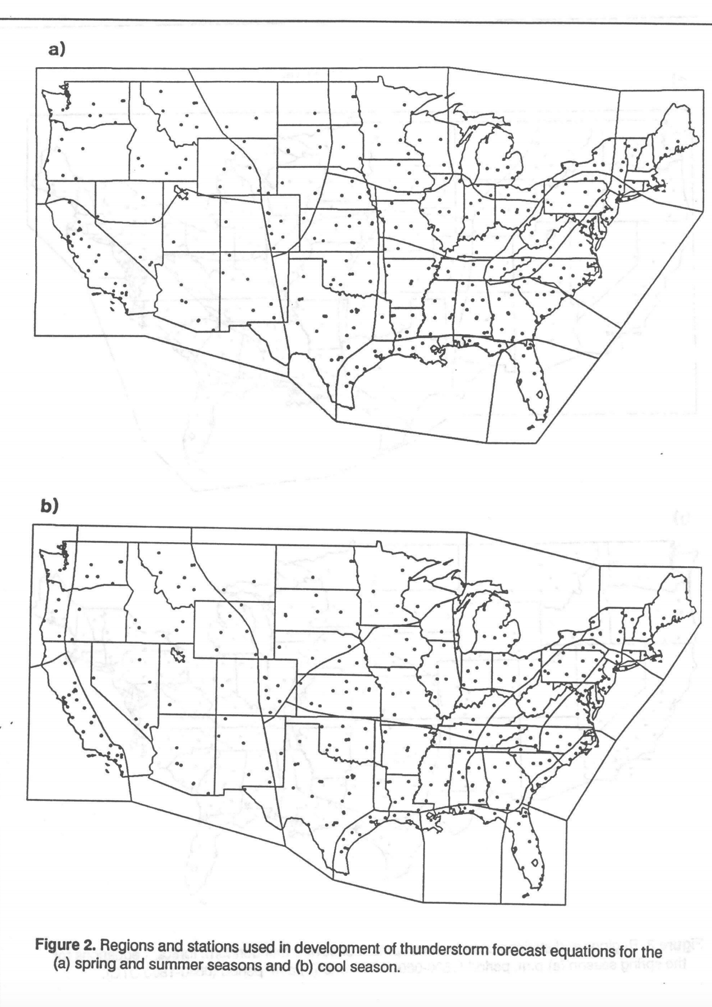
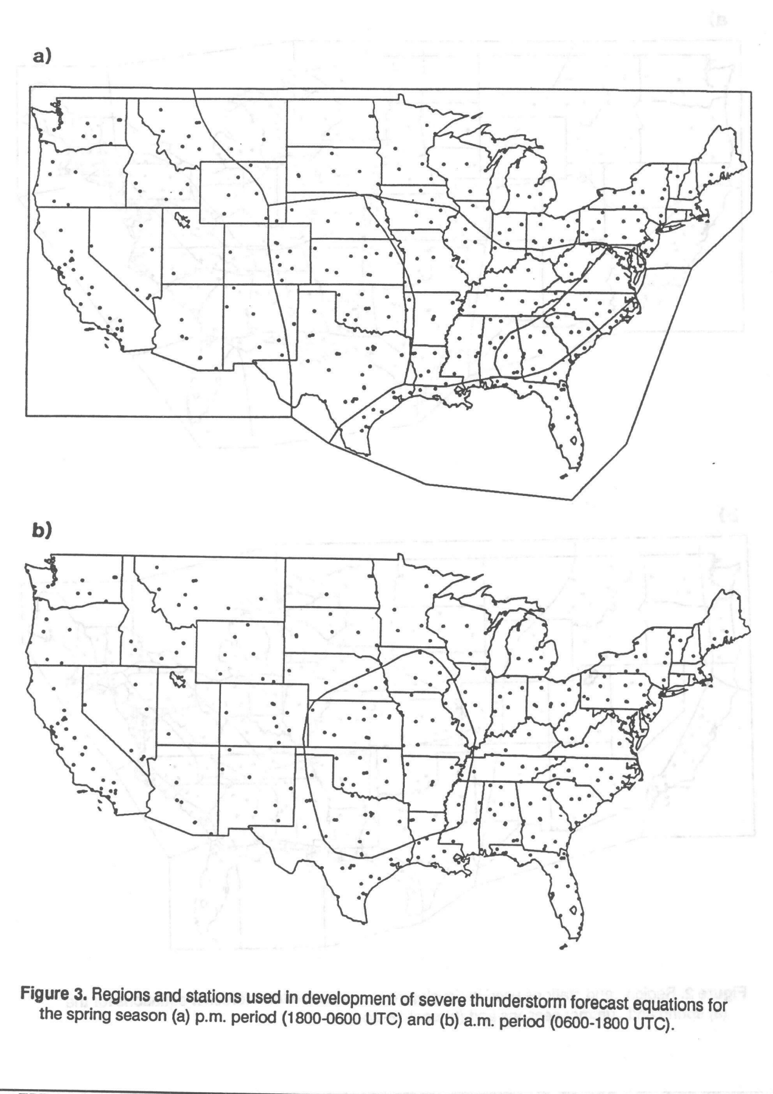
Thunderstorms

Slide 24
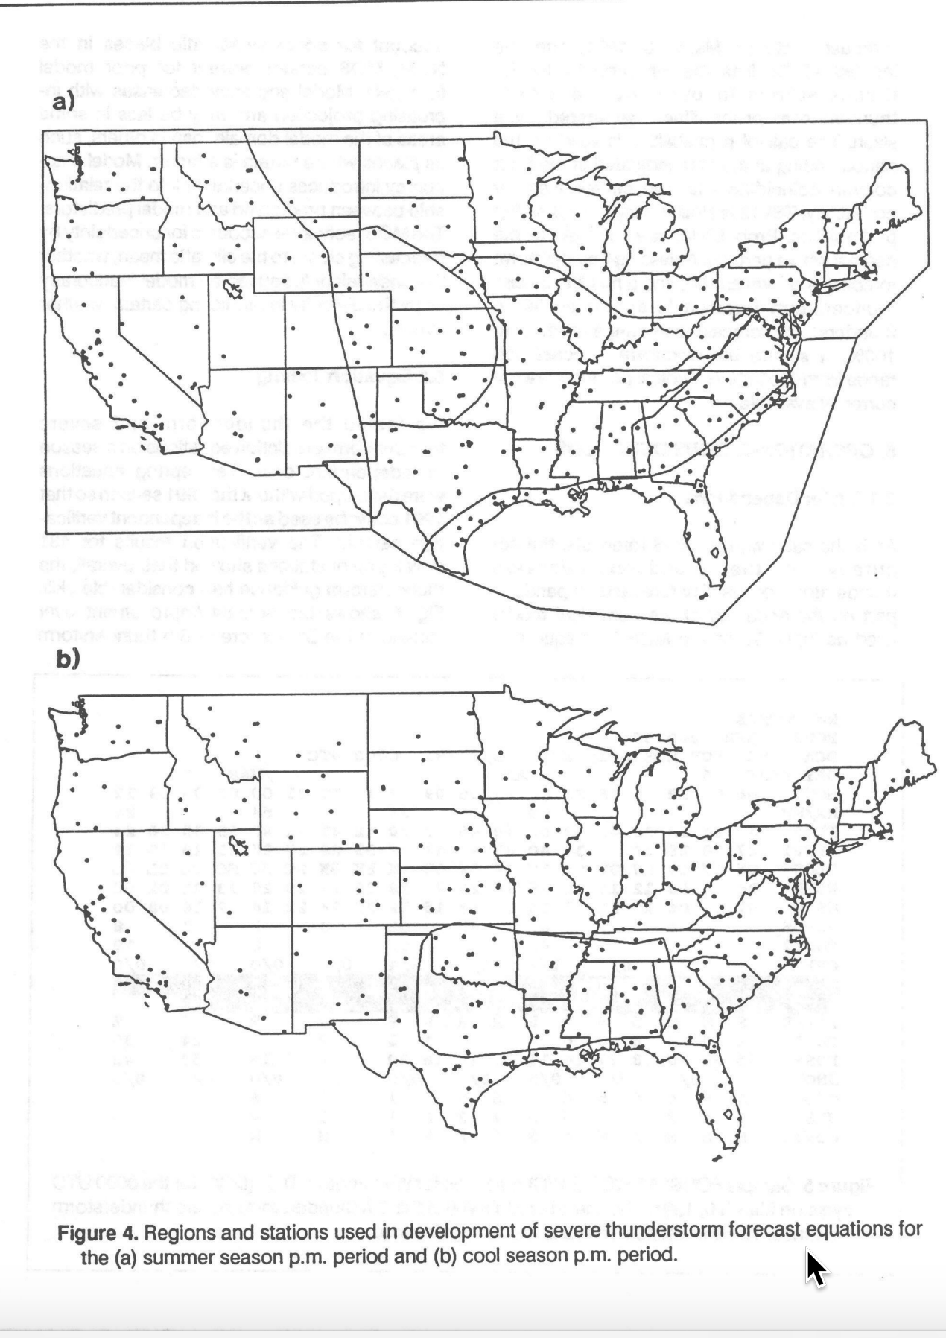

Slide 25
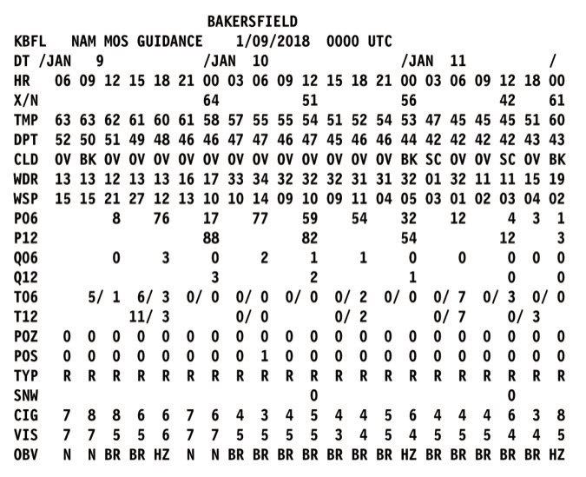
Repeat So You Don’t Forget
Temperature MOS equations are site specific
Precipitation and severe weather MOS equations are regional in nature.

Slide 26
MOS Characteristics
Trends toward climatology at longer periods
Does poorly for transient (short-term) model failures
  From poor synoptic forecastd
  Unusual biases (too warm in a cold wave)
Can go for extreme events, but often misses them

Slide 27
MOS Comments
Good for “garden variety” events. Very hard for humans to beat—but it is possible for some situations (shallow cold air)
Average of several MOS forecasts (e.g., NAM and GFS), better than single MOS
Available for several modeling systems:
  NAM MOS
  GFS MOS
  GEFS MOS

Slide 28
MOS Developed by and Run at the NWS Meteorological Development Lab (MDL)
Full range of products available at:
http://www.nws.noaa.gov/mdl/synop/index.php

Slide 29
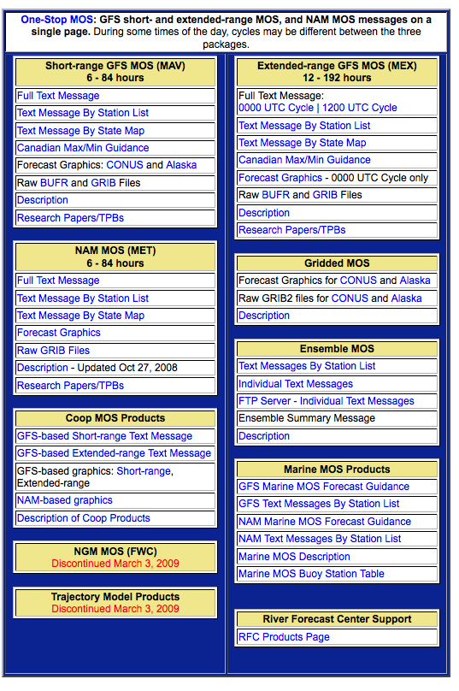

Slide 30
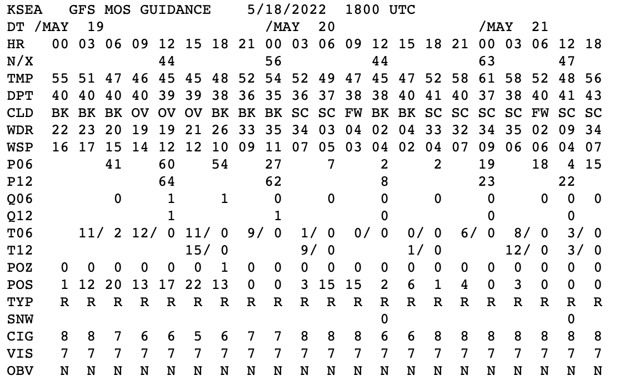

Slide 31
Gridded MOS
The NWS needs MOS on a grid for many reasons, including for use in their analysis/forecasting system, AWIPS.
The problem is that MOS is only available at station locations.
To deal with this, NWS created Gridded MOS.
Takes MOS at individual stations and spreads it spatially based on proximity and height differences. Also does a topographic correction dependent on climatological lapse rate.

Slide 32
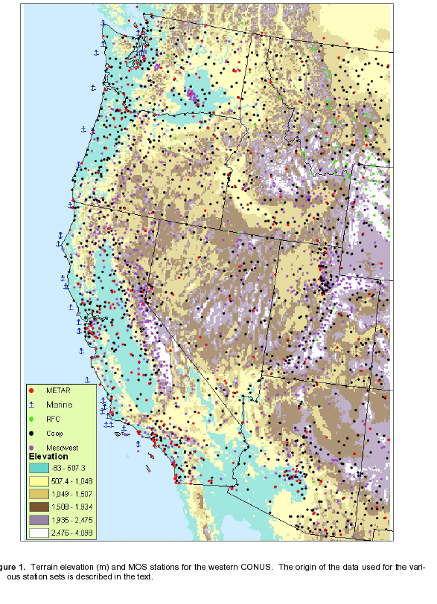

Slide 33
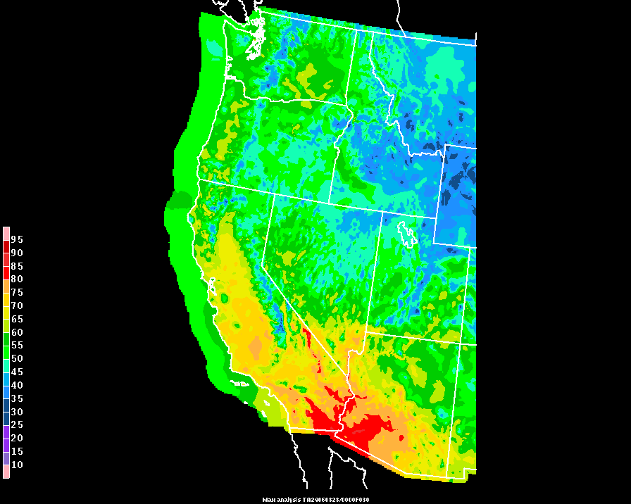
Current “Operational” Gridded MOS

Slide 34
Localized Aviation MOS Program
(LAMP)
Hourly updated statistical product- uses rapidly updated MOS forecasts!
Combines:
  MOS guidance
  the most recent surface observations
  local models run hourly
  GFS output

Slide 35
Practical Example of Solving a LAMP Temperature Equation
Y = b + a₁x₁ + a₂x₂ + a₃x₃ + a₄x₄
Y = LAMP temperature forecast
Equation Constant b = -6.99456
Predictor x₁ = observed temperature at cycle issuance time (value 66.0)
Predictor x₂ = observed dew point at cycle issuance time (value 58.0)
Predictor x₃ = GFS MOS temperature (value 64.4)
Predictor x₄ = GFS MOS dew point (value 53.0)

Slide 36
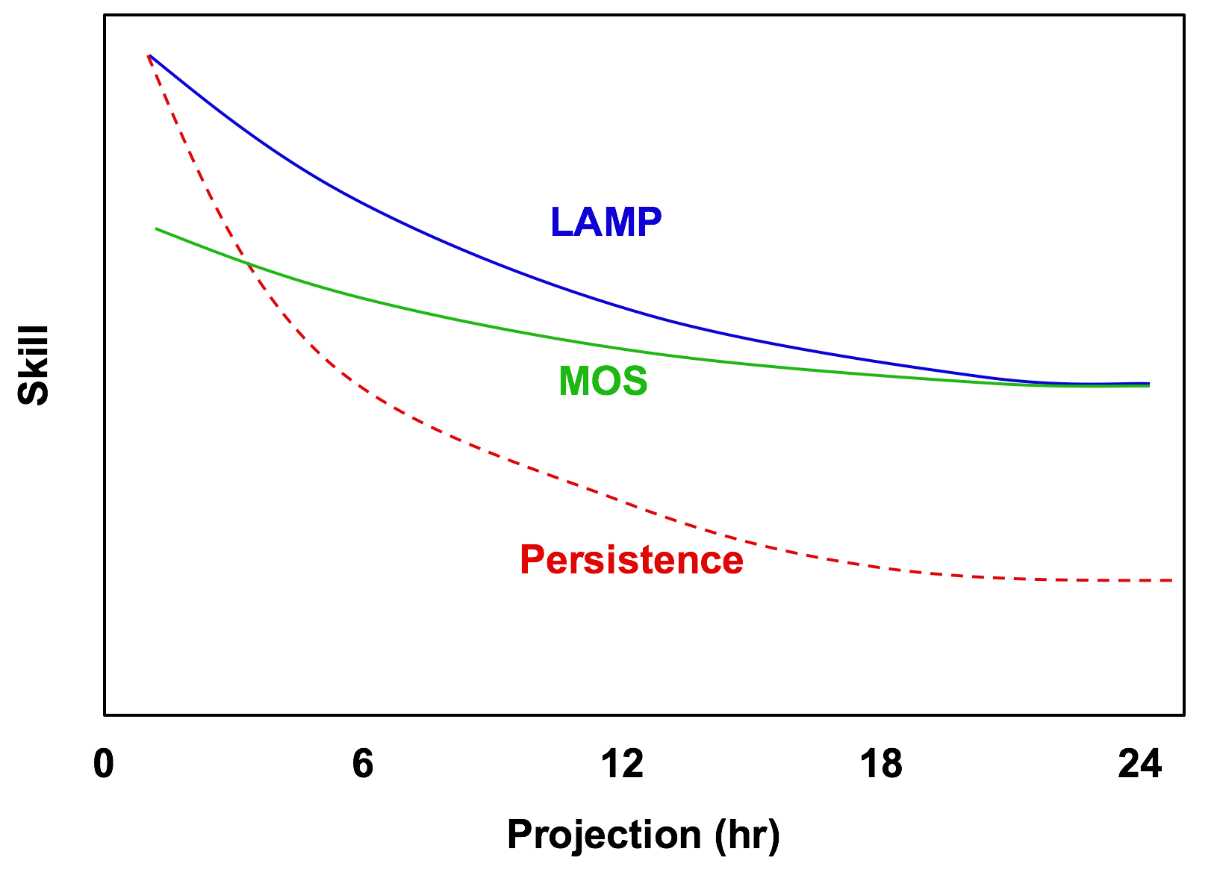
Theoretical Model Forecast Performance of LAMP, MOS, and Persistence

Slide 37
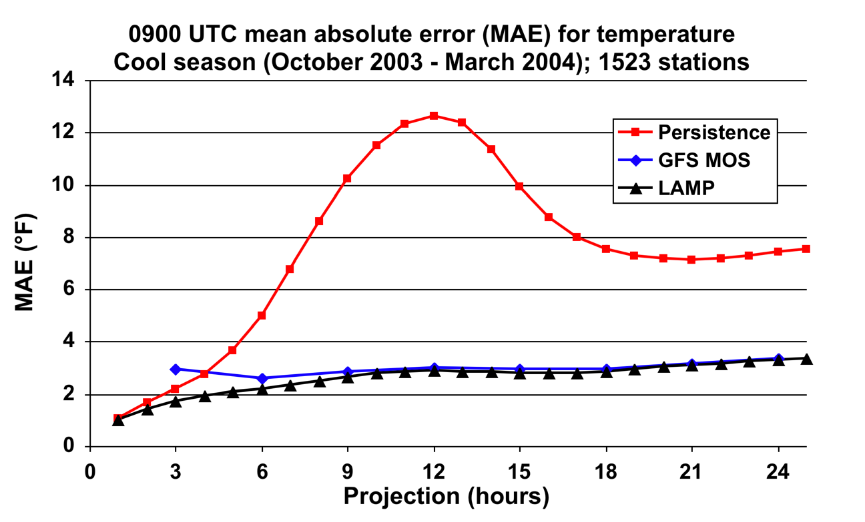
Verification of LAMP 2-m Temperature Forecasts

Slide 38
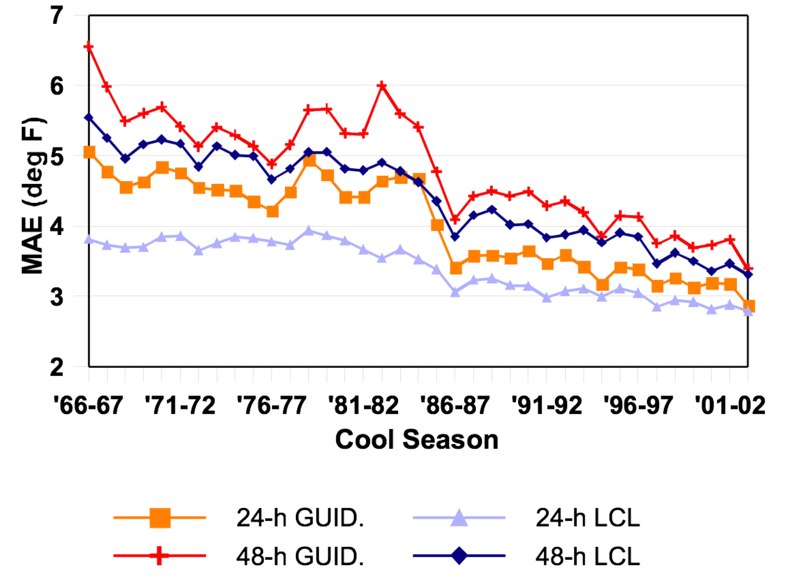
MOS Verification
During the late 20th century, MOS essentially matched human forecaster skill for “typical” weather conditions”

Slide 39
MOS Won the Department
Forecast Contest in 2003
For the First Time!

Slide 40
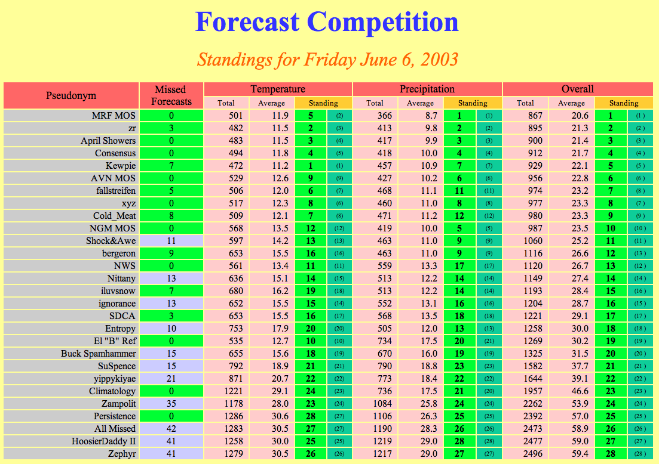

Slide 41
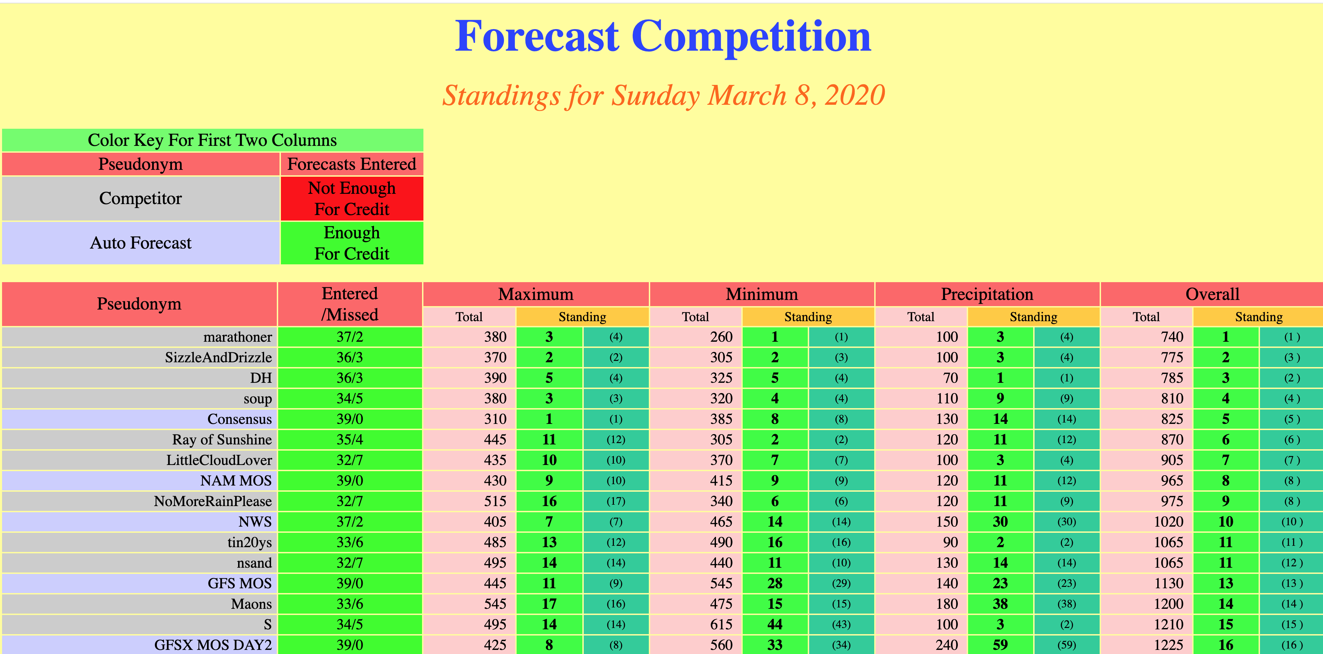

Slide 42
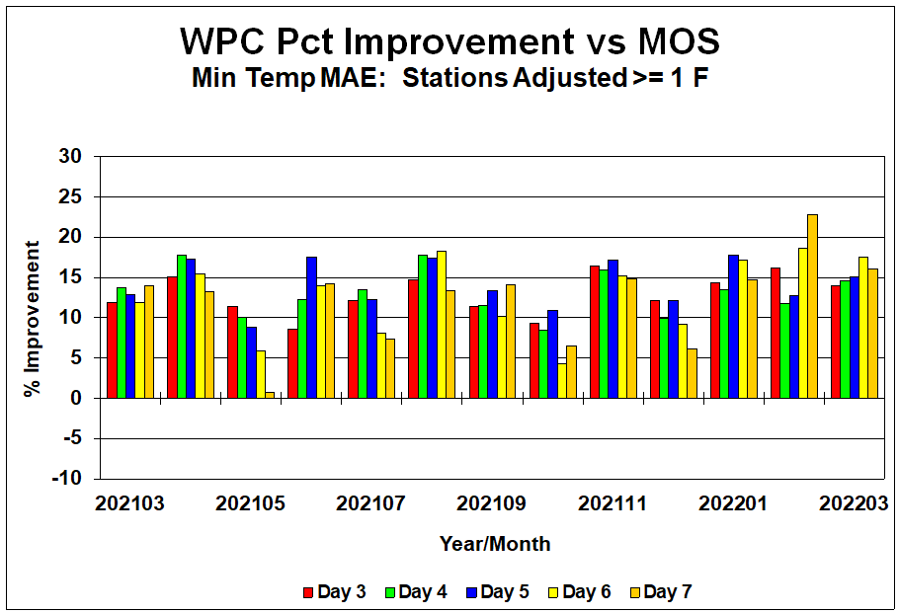
Lately, Human’s Have Been Able to Slightly Improve on MOS

Slide 43
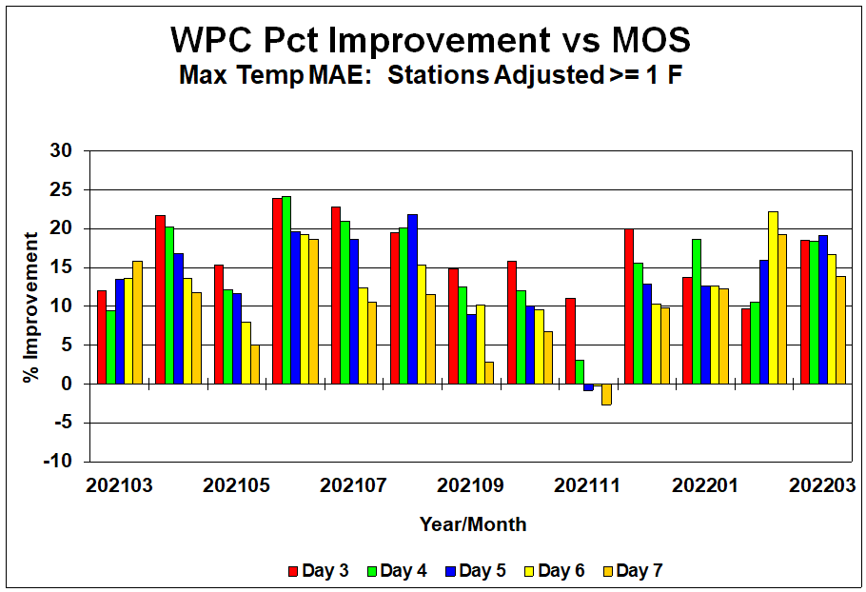

Slide 44
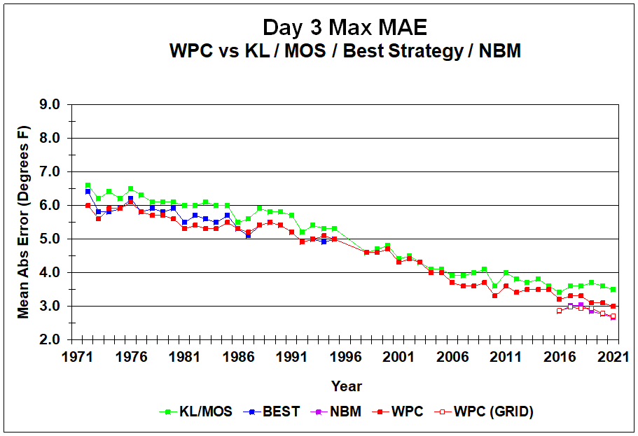

Slide 45
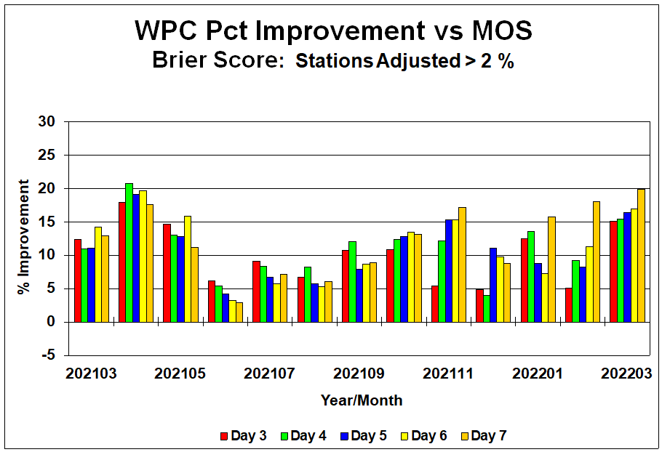
Precipitation

Slide 46
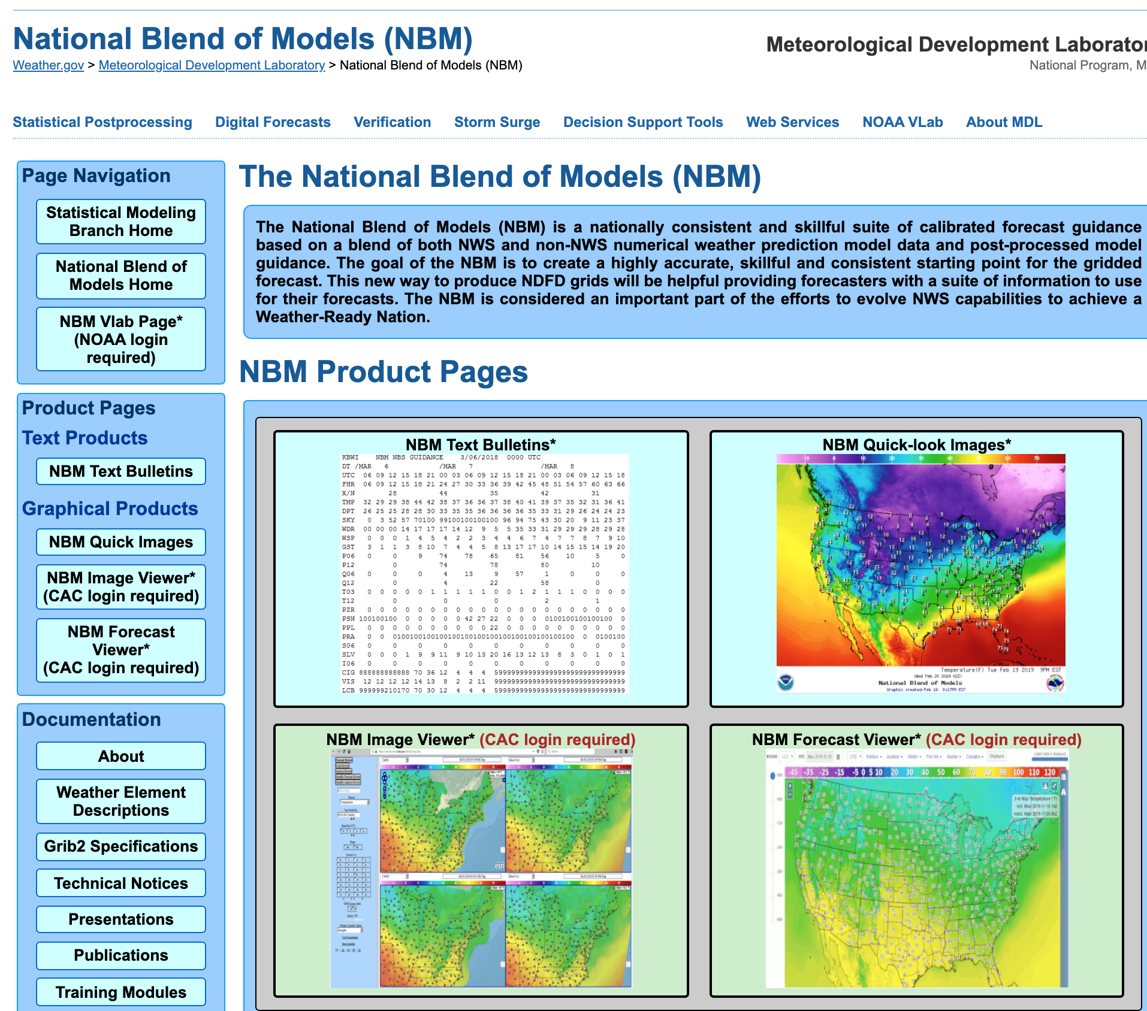
The National Blend of Models

Slide 47
New NWS Approach: National Blend of Models
The National Blend of Models (NBM) is calibrated forecast guidance based on a combination of both NWS and non-NWS numerical weather prediction model guidance and observations.
The goal of the NBM is to create a highly accurate, skillful, and consistent starting point for the NWS gridded forecast.
Attempts to be more skillful than MOS.

Slide 48
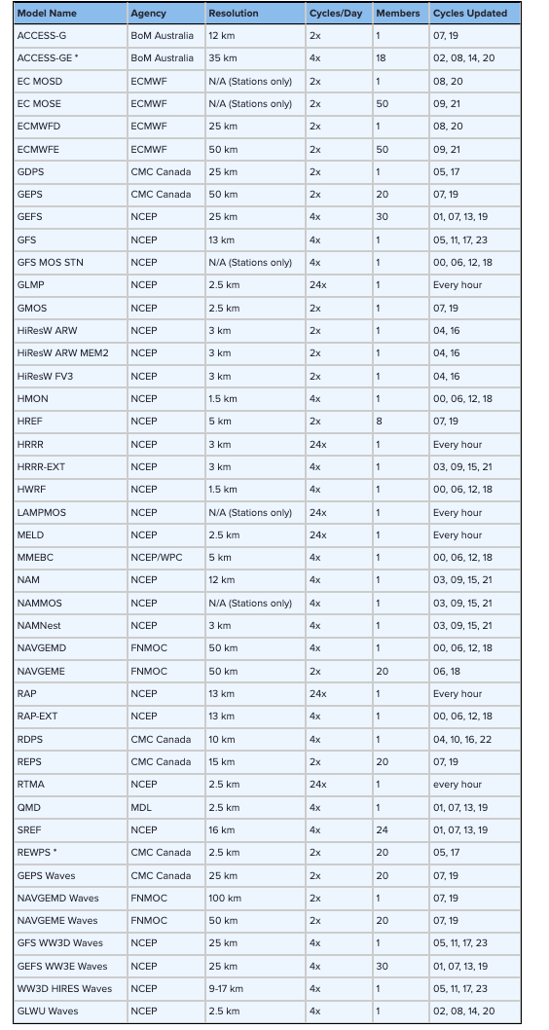
Potential
Model Inputs

Slide 49
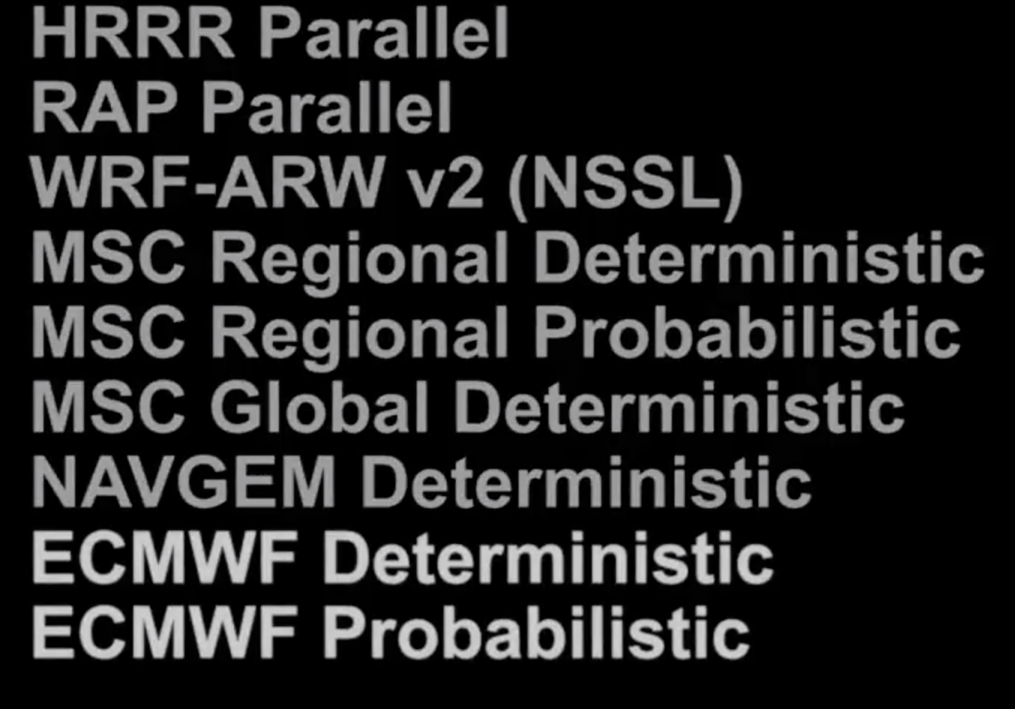
Blend of Models
Combines statistically a collection of models
2.5 km grid , V4.2 currently
website

Slide 50
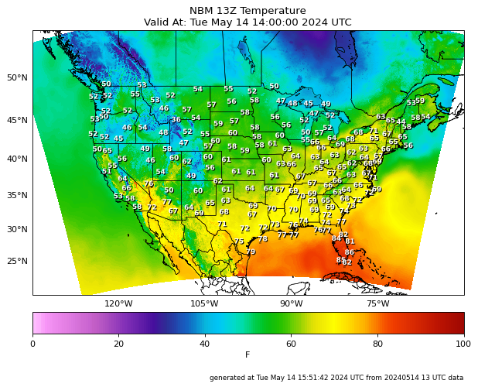

Slide 51
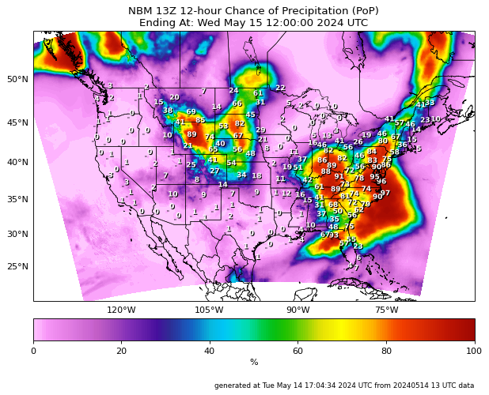

Slide 53
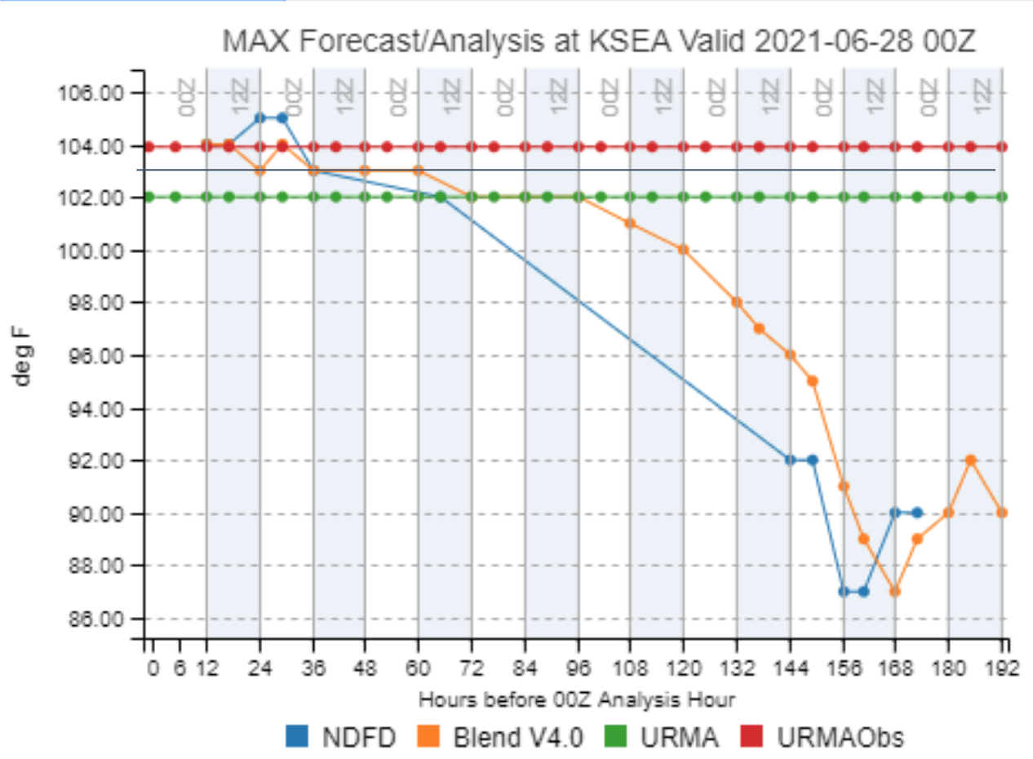
Impressive Performance During June 21 Heatwave

Slide 54
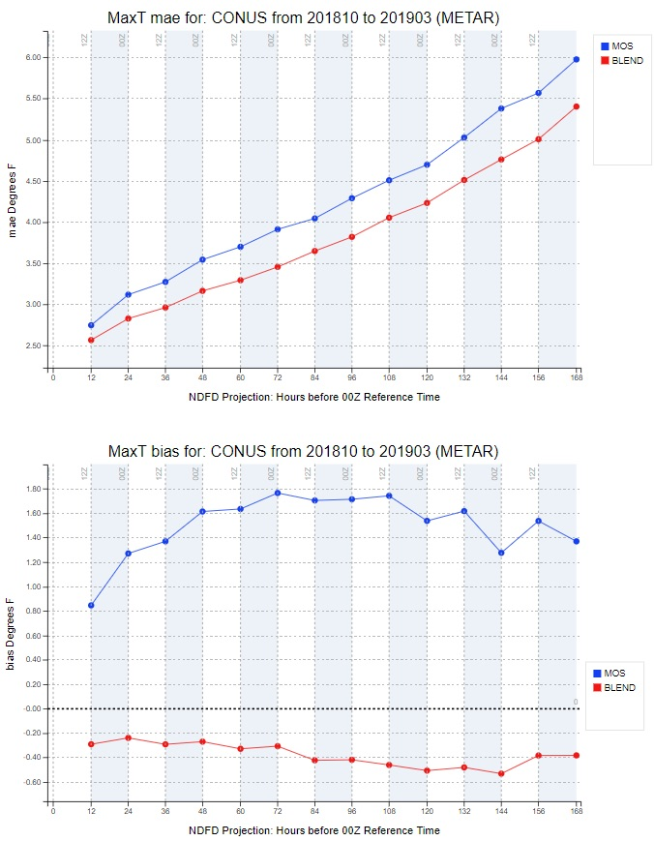
NBM
Better than MOS
For tmax!

Slide 55
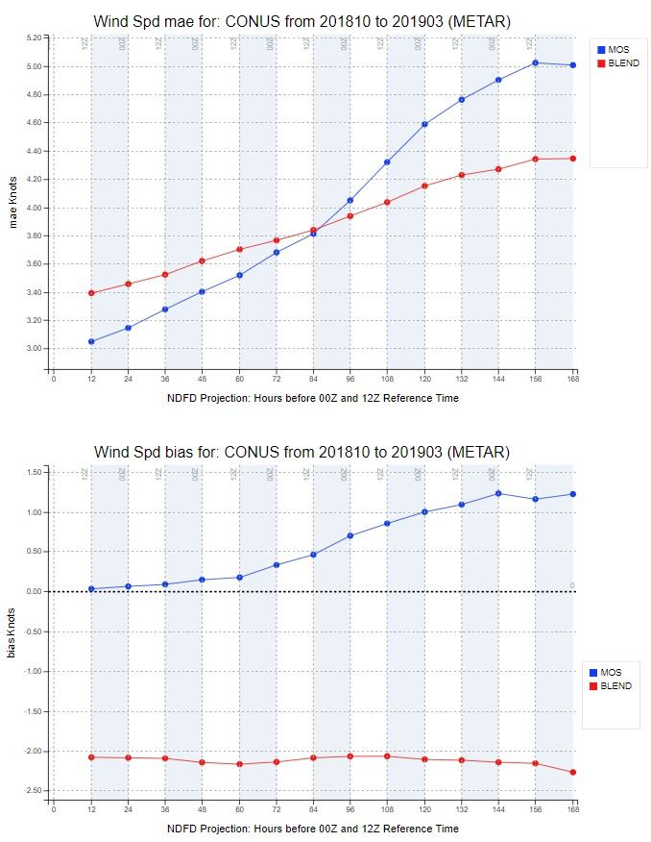
Mixed
Results
For
Wind

Slide 56
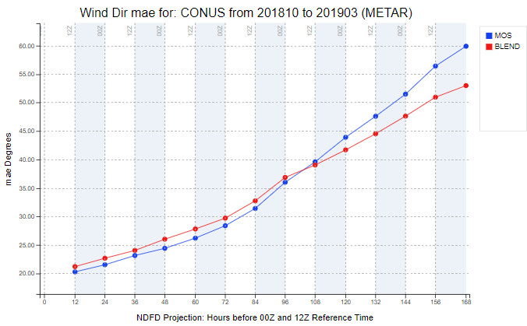

Slide 57
NBM Text Output

Slide 58
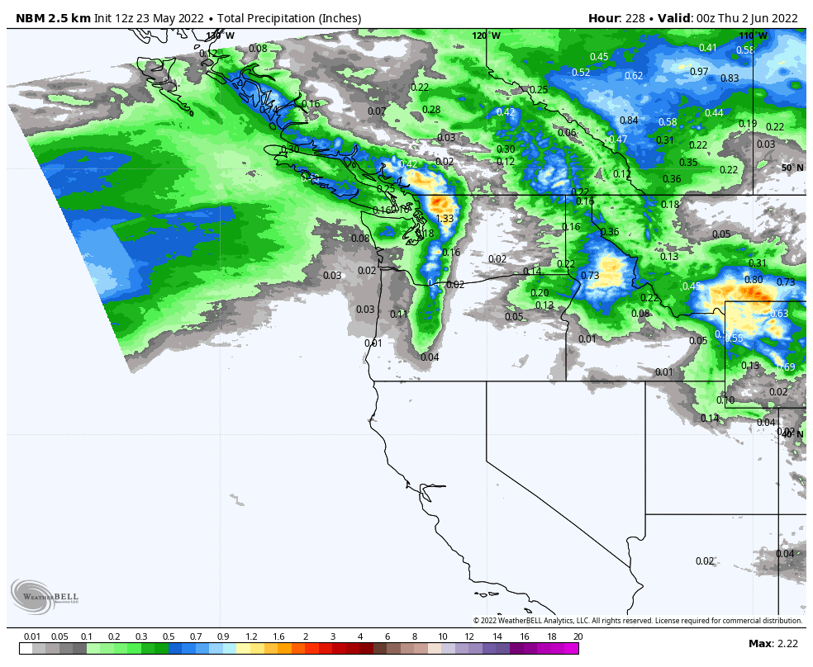
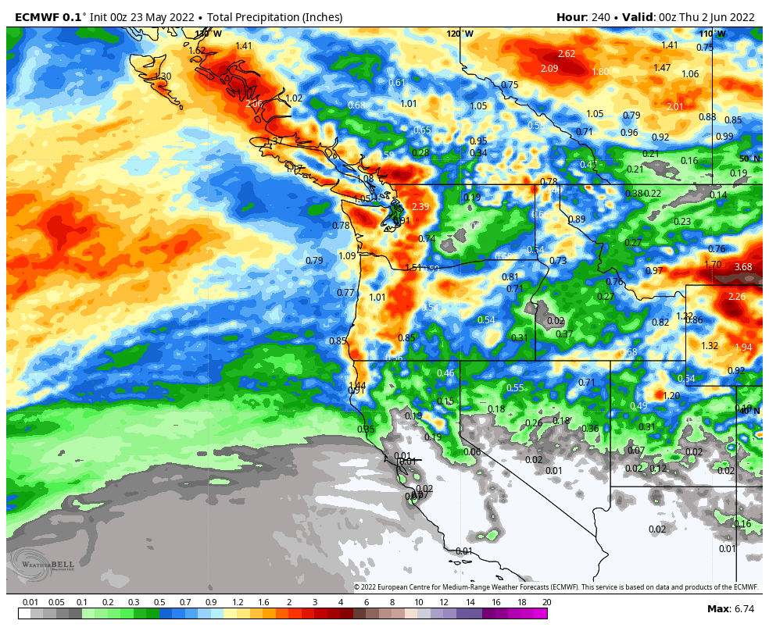
And Graphic

Slide 59
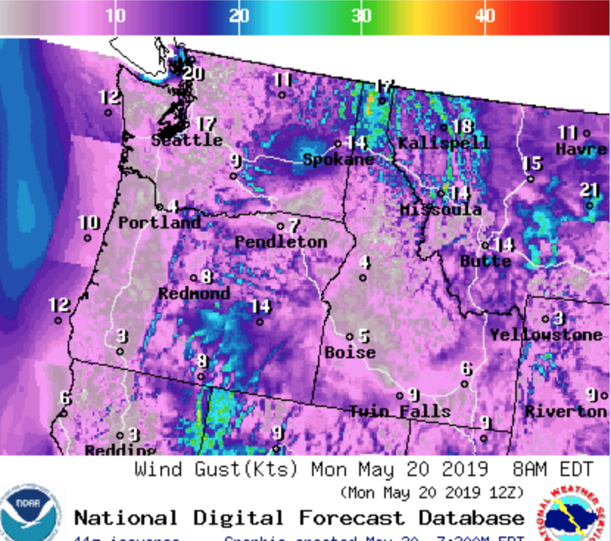
National Blend of Models
The starting point of NWS gridded forecasts
Save forecasters time
Reduce issues between boundaries of different offices.

Slide 60
The Private Sector Has Gone Beyond MOS to Superior Post Processing

Slide 61
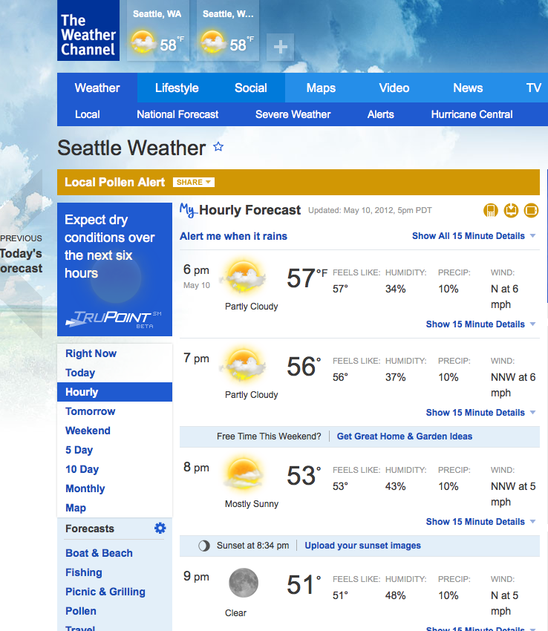
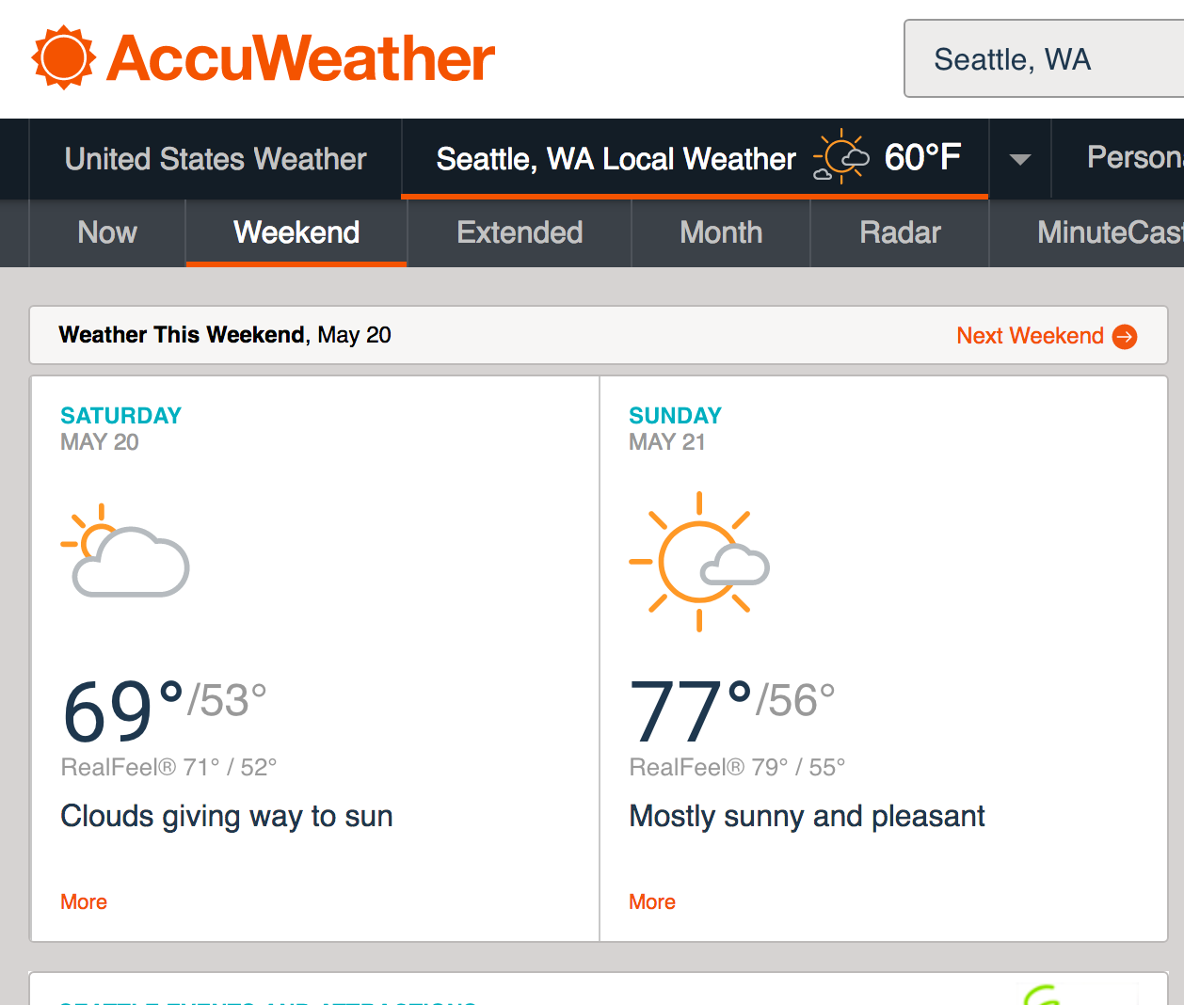
They don’t use traditional MOS

Slide 62
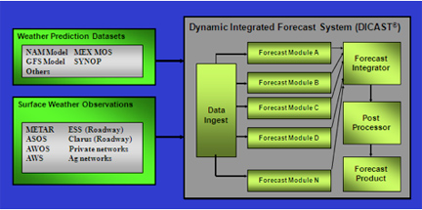
Dynamic MOS Using Multiple Models
MOS equations that are updated frequently, not static like the NWS.
Multiple model and observation inputs
Example: DiCast used by the Weather Channel and Accuweather, Developed by NCAR
Like NBM

Slide 63
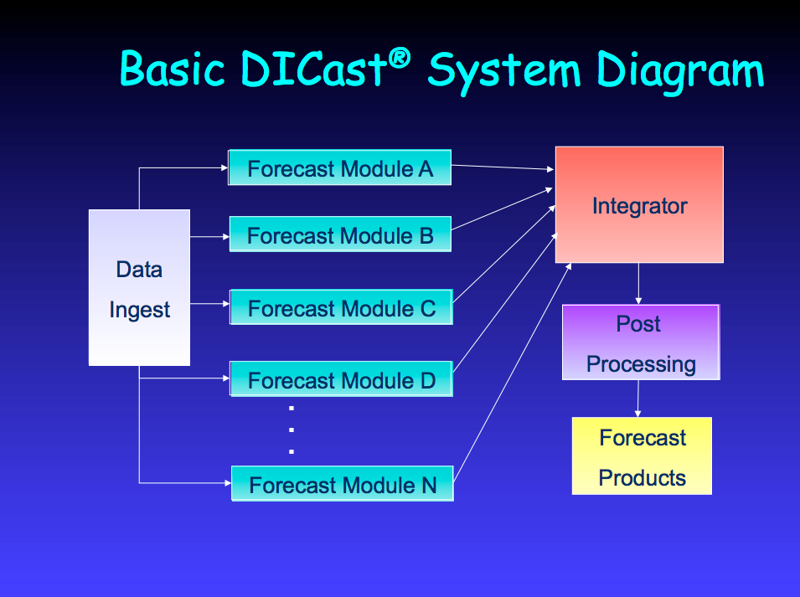
Dynamical MOS of MOSs

Slide 64
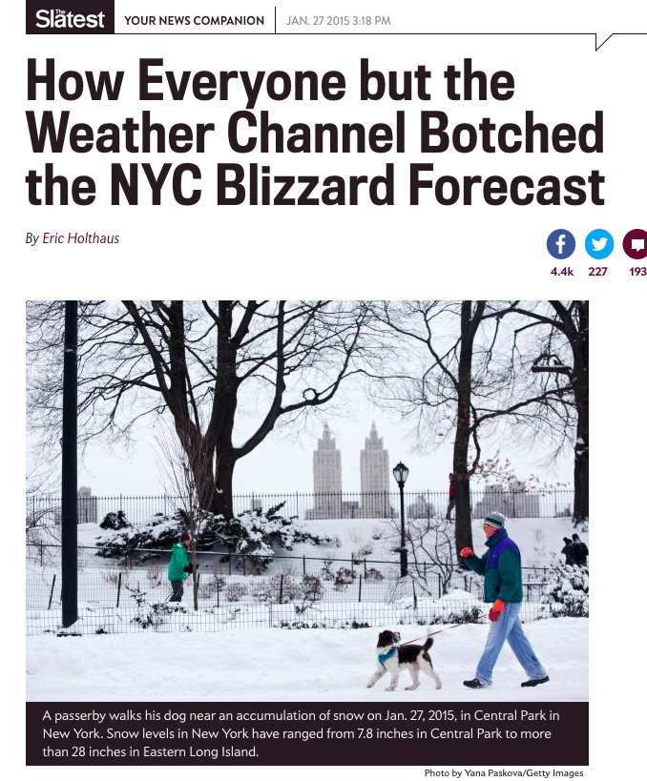
DICAST skill is quite good

Slide 65
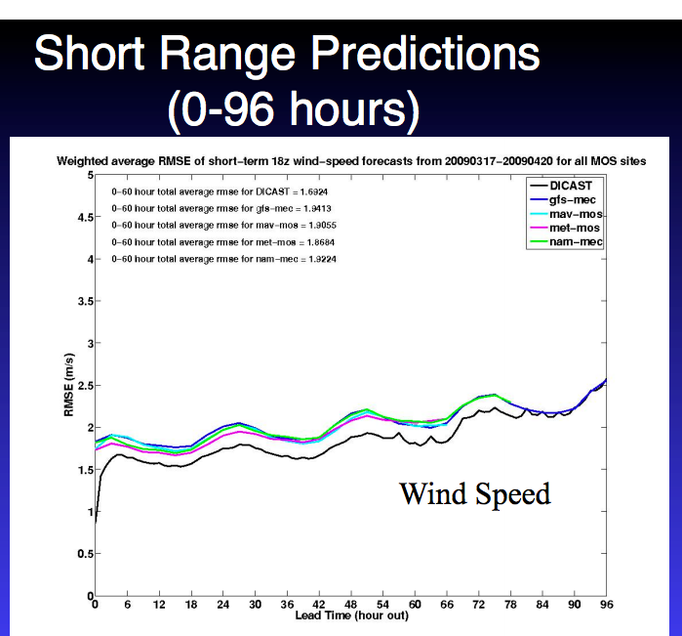
Better than NWS MOS

Slide 66
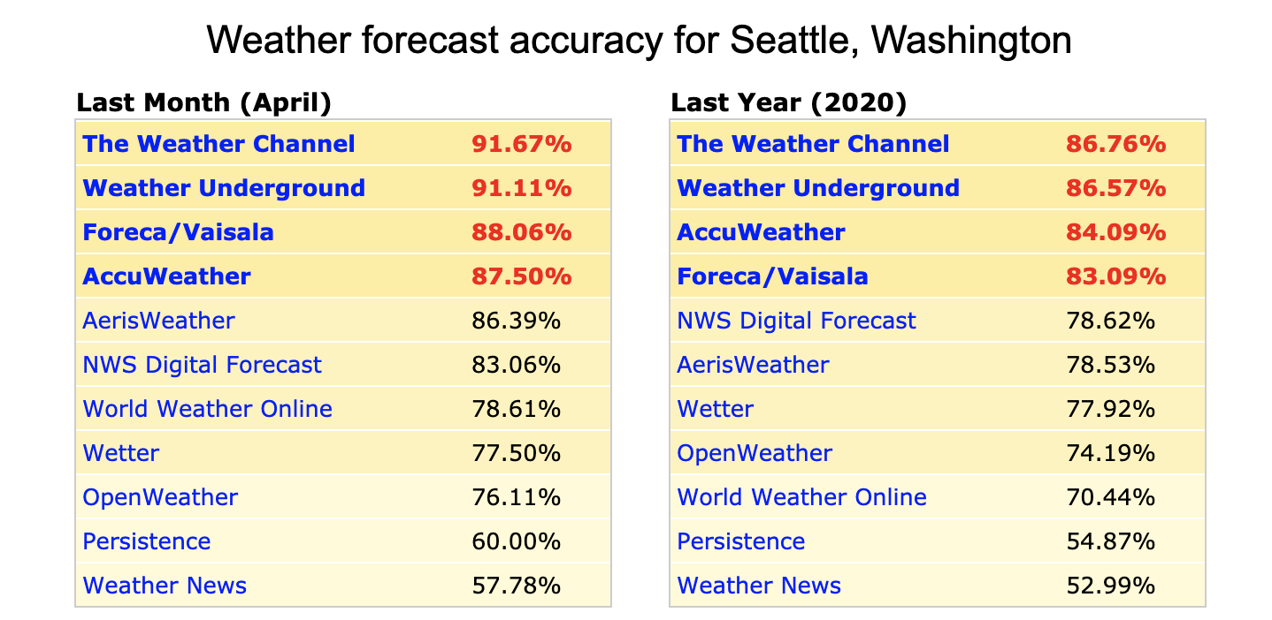
Clearly Better Than MOS or NBM

Slide 67
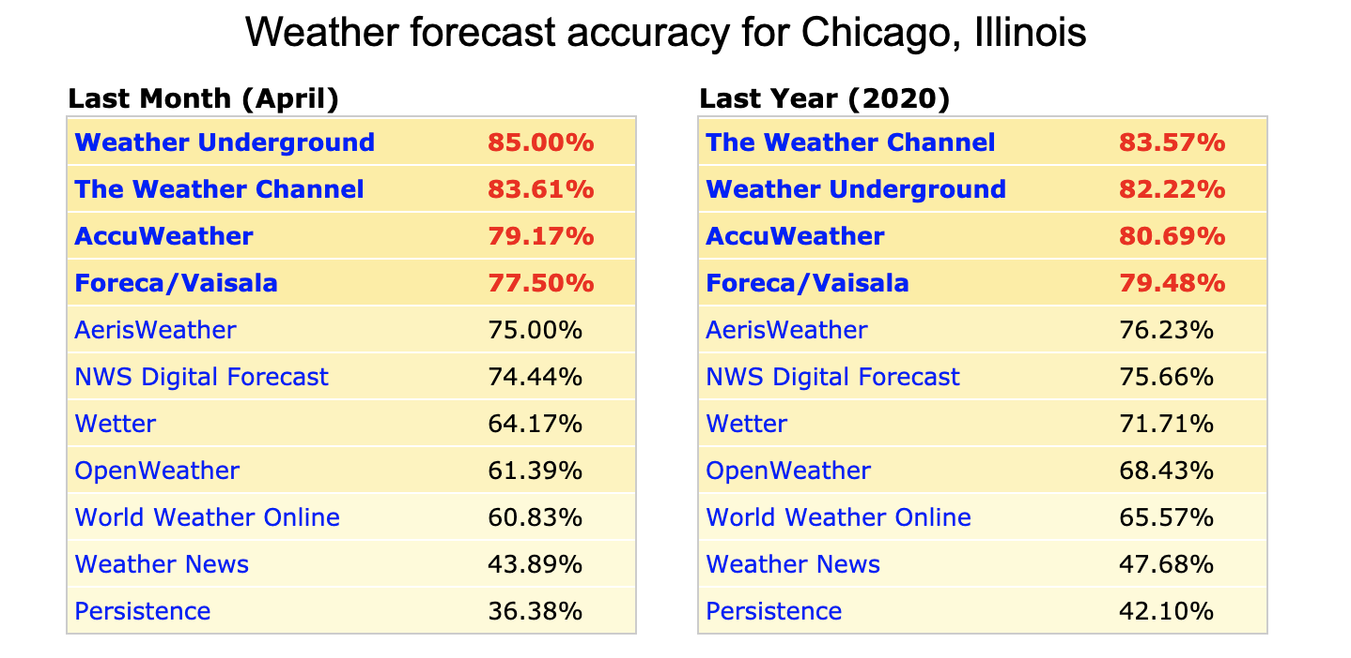

Slide 68
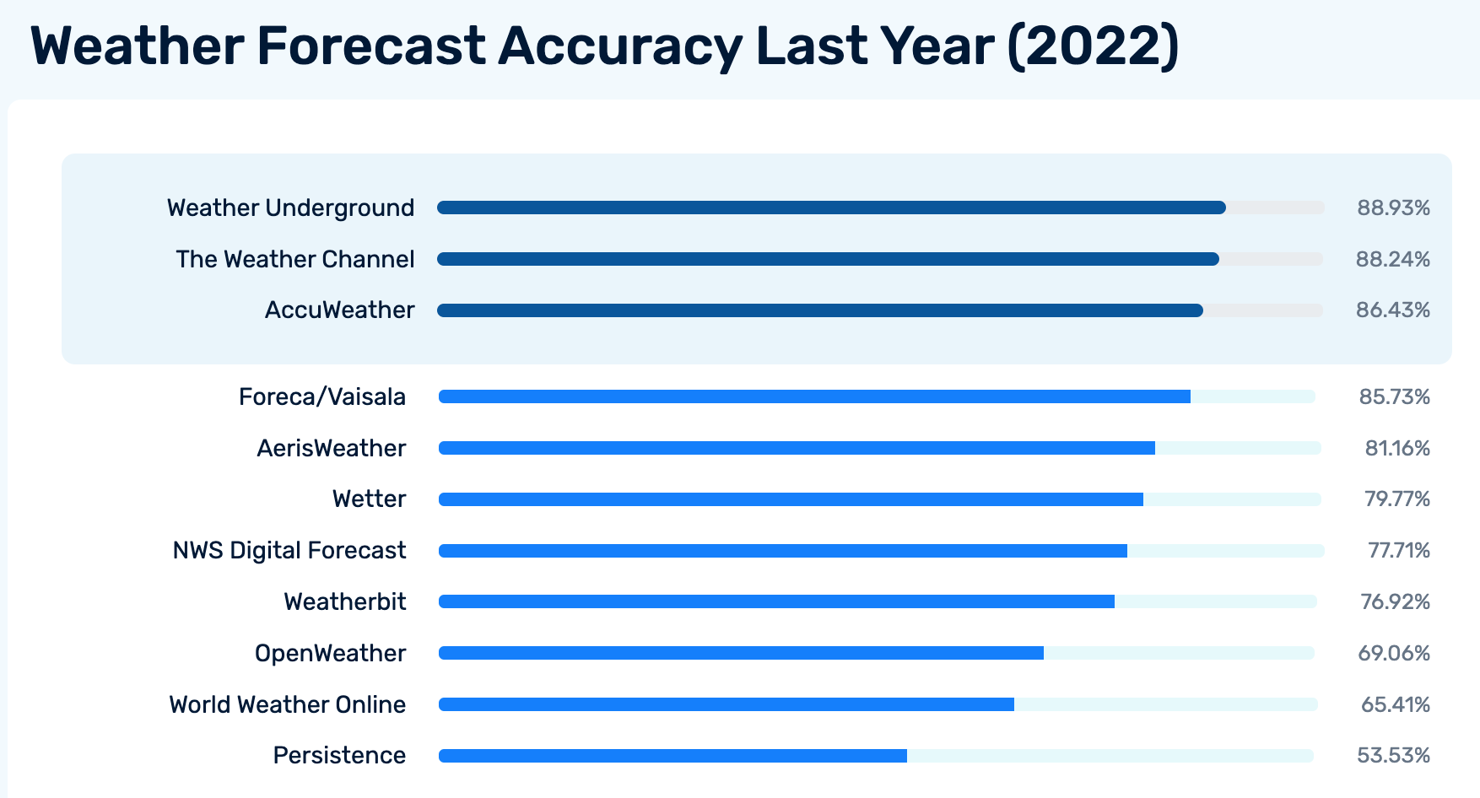
Seattle

Slide 69
Bayesian Model Averaging (BMA)
A good way to optimize the use of ensembles of forecasts to provide calibrated probabilistic guidance.
Can weight models and their spread by their previous performance.
Can bias correct each model before combining together

Slide 70
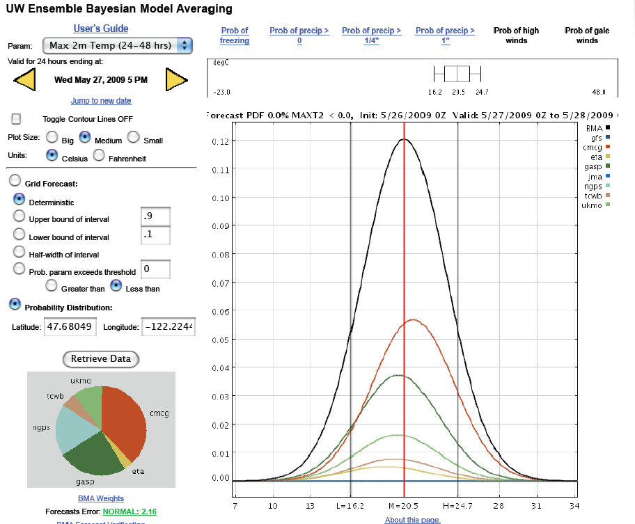

Slide 71
A PDF from each model based on historical performance
And then combine them based on their recent skill

Slide 72
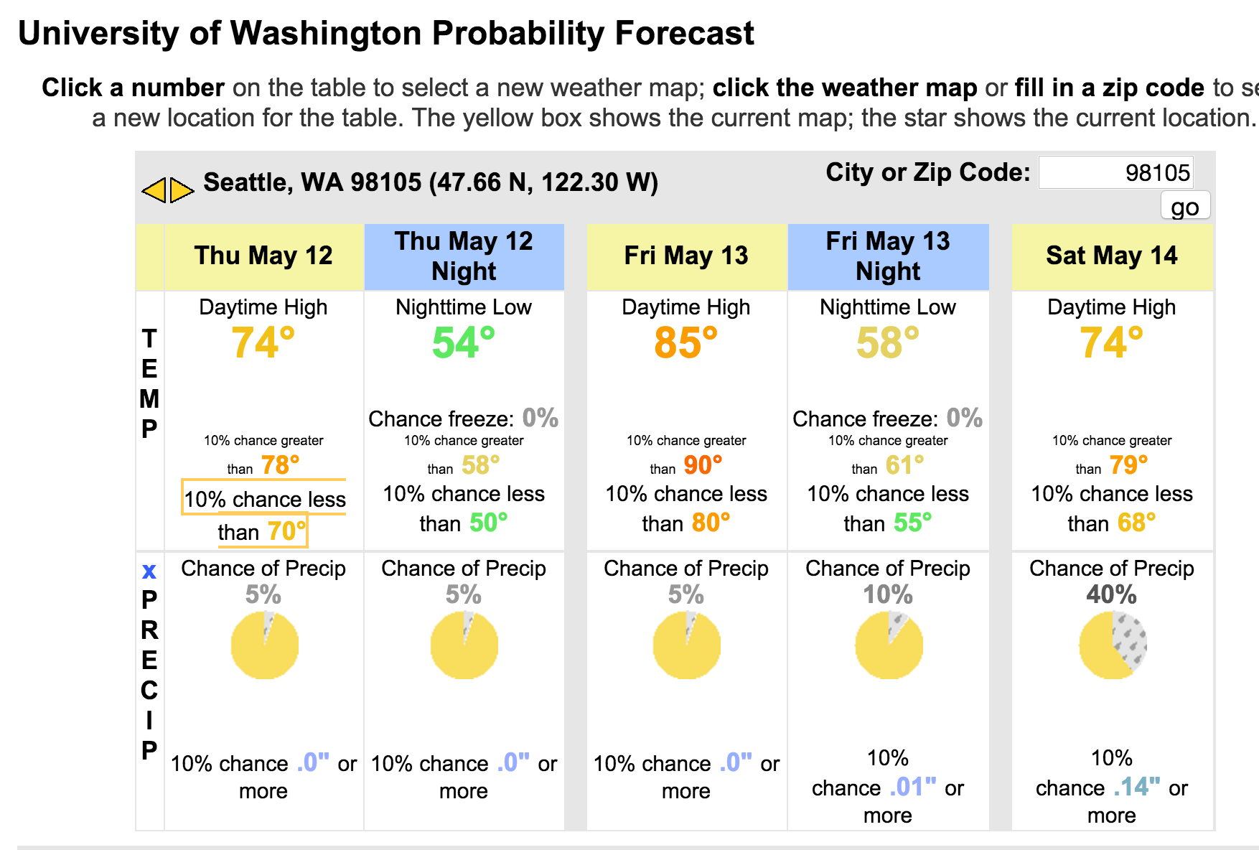

Slide 73

Machine Learning/Artificial Intelligence

Slide 74
Machine Learning/AI
Machine learning/AI algorithms “learn” information directly from data without relying on a predetermined equation.
The algorithms adaptively improve their performance as the number of samples available for learning increases.
Heavily dependent on a large training data set

Slide 75
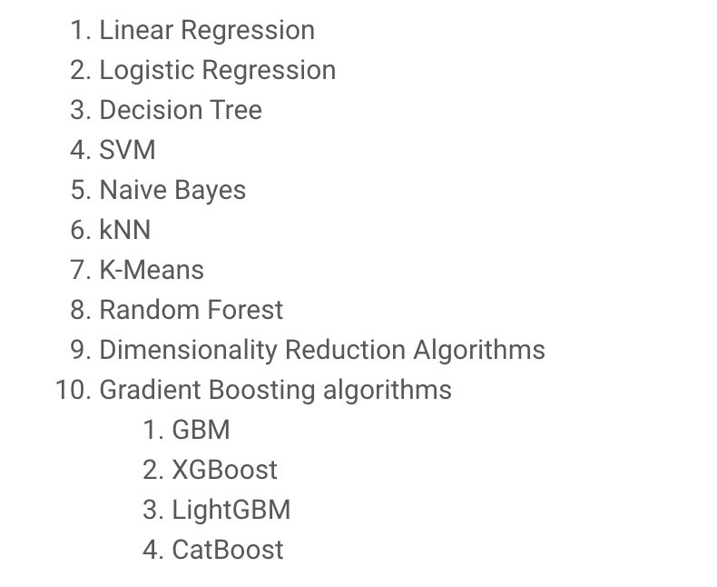
Commonly Used Machine Learning Algorithms

Slide 76
Not Conceptionally Different from old MOS
Use observations/forecasts to create calibrated prediction.
Training data set
New methods are more complex and non-linear

Slide 77
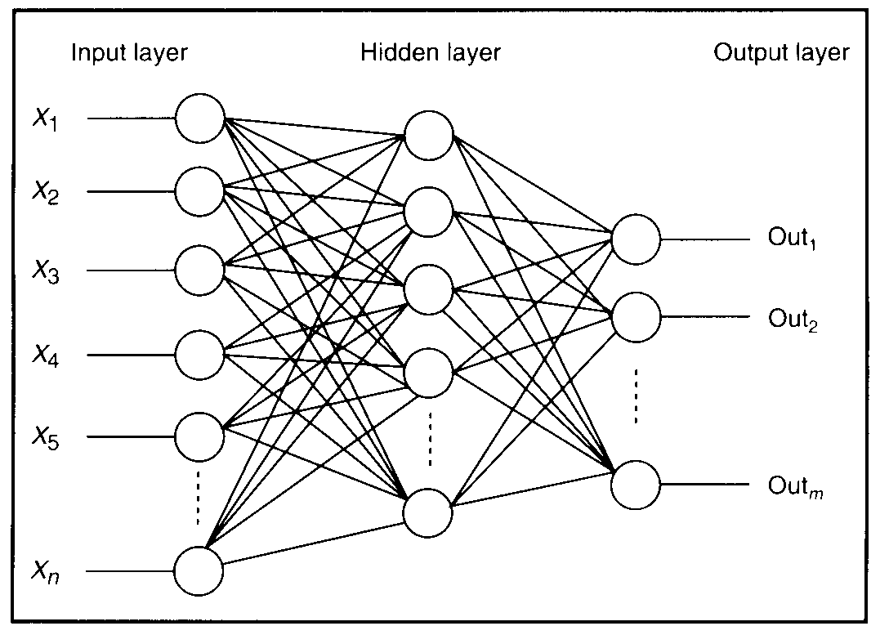
Neural Nets Was One of the First “Modern” ML Approaches
  Attempts to duplicate the complex interactions between neurons in the human brain.

Slide 78
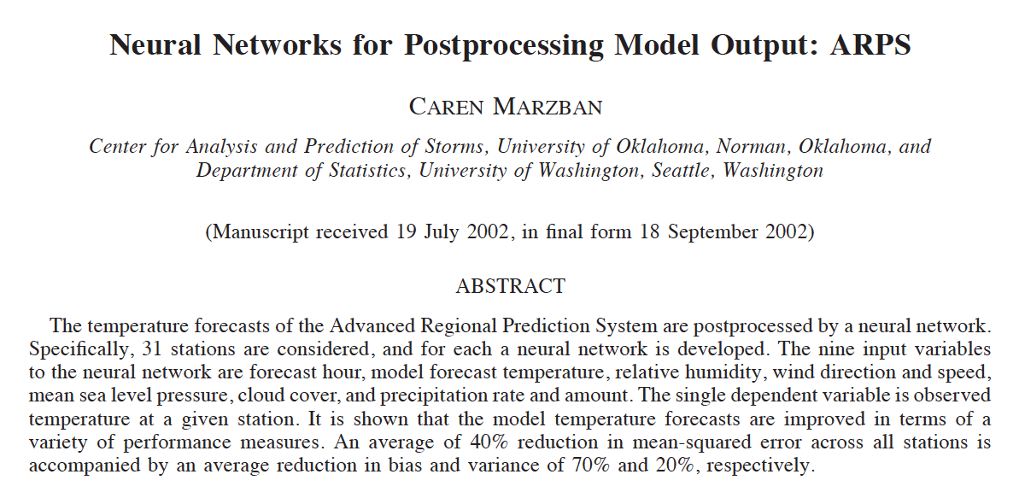

Slide 79
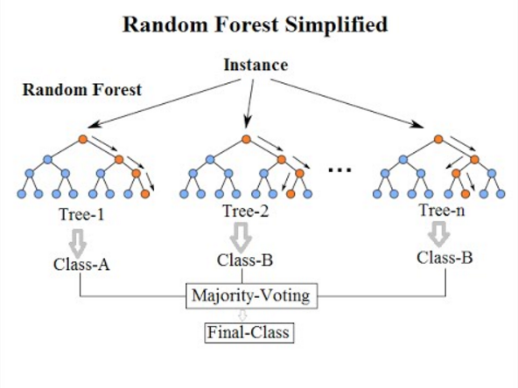
Decision Trees are Very Popular
Particularly Random Forest

Slide 80


Slide 81
Machine Learning and the Future of Weather Prediction
Clearly valuable for quality control of observations (e.g., smartphones)
Clearly valuable for post-processing of model forecasts.
Very promising results in using ML to replace or improve parameterizations.
Some attempts to replace the whole modeling system for single variables

Slide 82
Machine Learning Thoughts
We have a HUGE amount of observational data (e.g., satellites) and a complex non-linear system to deal with.
ML should be useful in such an environment
But our equations (e.g., primitive equations) DO have important information and are significant restraints.
Probably a mixture of ML and the dynamical equations will be optimal.

