Slide 1
Moisture and Its Measurement
Autumn 2025

Slide 2
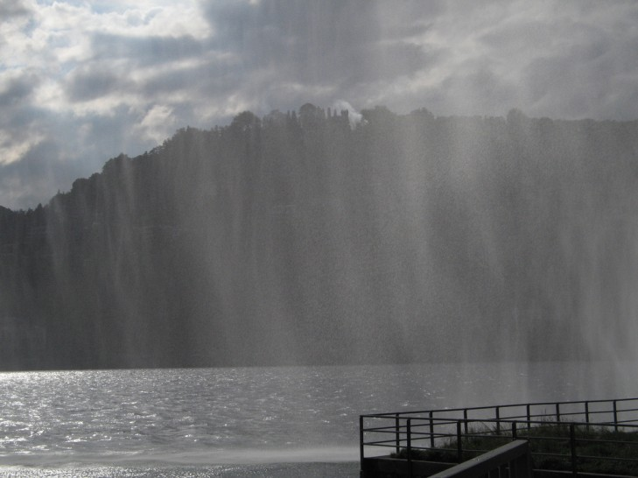
H₂0 vapor plays a critical role in the atmosphere
Controls clouds and precipitation
Moves energy horizontally and vertically
Influences temperature
Major greenhouse gas

Slide 3
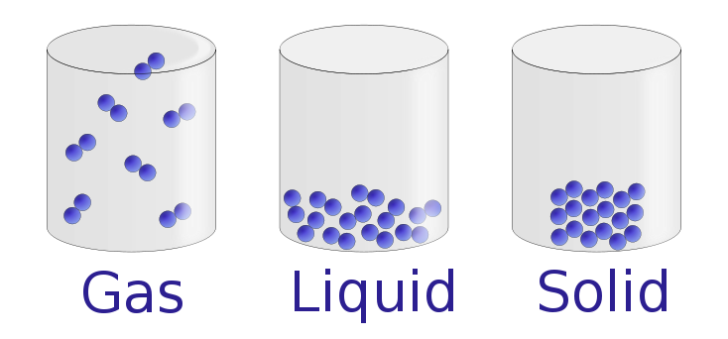
Solid versus liquid versus gas
Water vapor
Liquid water
ice
Particles can move
independently
Particles can move but
are bound together
Rigid structure but can vibrate

Slide 4
The Concept of Saturation: A Thought Experiment
Imagine an air-tight box with liquid water at the bottom and completely dry air above. (T>0C)
Keep at a constant temperature (T)
What will happen?
Dry Air
Liquid Water

Slide 5
A Thought Experiment
H₂0 molecules in liquid are moving since T>0°K.
Not all moving at the same speed.
They have some attraction for each other…as in all liquids.
Some of the fastest molecules will escape the liquid and move into the air above as a gas molecule.
Dry Air
Liquid Water

Slide 6
A Thought Experiment
More and more molecules end up in the dry air
Occasionally, one heads back into the liquid
The more molecules in the air above, the more heading back into the liquid
Liquid Water

Slide 7
A Thought Experiment
Eventually, there are enough water molecules in the air above so that as many come back to the water as leave.
This equilibrium situation is called saturation. The air is saturated with respect to water vapor at that temperature.
Water vapor
Liquid Water

Slide 8
A Thought Experiment
What if there was a vacuum above the liquid water? Would it make a difference?
NO. Same story. Water molecules would increase in numbers until there was saturation.
So air doesn’t really “hold” water vapor.
Water vapor
Liquid Water
T > 0°K

Slide 9
A Thought Experiment
The H₂0 molecules above the liquid exert a pressure, called the water vapor pressure.
During our thought experiment the water vapor pressure rose until it reached the saturation vapor pressure, the pressure due to water vapor when the air is saturated (holding as much water vapor as it can)
Water vapor
Liquid Water

Slide 10
Vapor Pressures and Total Atmospheric Pressure
Note that the total atmospheric pressure we experience is the SUM of the vapor pressures of all the gases around us.
Total atmospheric pressure = Vapor Pressure of N₂ + Vapor Pressure of O₂+ Vapor Pressure of Ar + Vapor Pressure of H₂0 vapor+ …

Slide 11
Back to the Thought Experiment
What if we raised the temperature of the water?
The water molecules in the water would speed up.
The rate of escape from the liquid would INCREASE.
More would go out into the air until a new equilibrium was established, with MORE water vapor molecules in the air than before.
Water vapor
Liquid Water

Slide 12
Back to the Thought Experiment
A new HIGHER saturation vapor pressure would occur.
To say it another way, the saturation vapor pressure increases with temperature
Or another way, the amount of water vapor in a volume above liquid water increases with temperature.
Water vapor
Liquid Water

Slide 13
Sloppy Language
One way this idea is often expressed is by saying that warm air can hold more water vapor than cold air
BUT NOTHING IS HOLDING ANYTHING.
We would have the same water vapor pressure if there was no other gas above the liquid.
Perhaps “contain” is a better word.
Hold

Slide 14
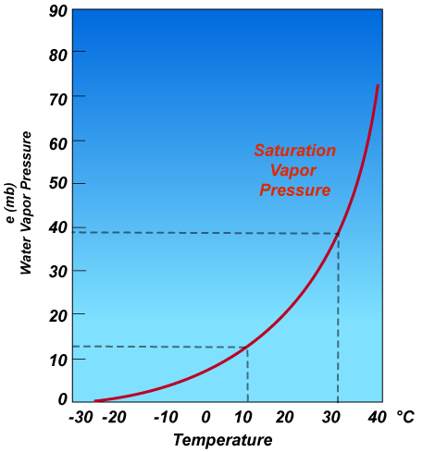
Quantitatively: How Does the Maximum Amount of Water Vapor that Can be Contained in a Volume Increase with Temperature? EXPONENTIALLY!

Slide 15
At 35C (95F) the saturation vapor pressure is 4x more than at 10C (50F)

Slide 16
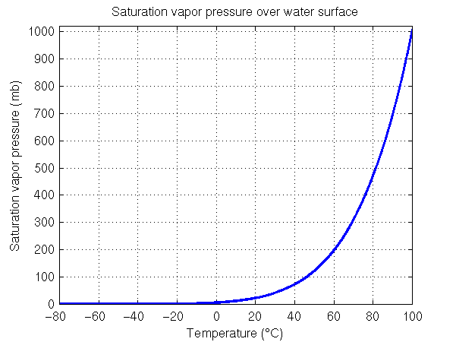
What happens when the saturation vapor pressure of water equals atmospheric pressure? You get boiling! For typical atmospheric pressure (~ 1000 hPa) that occurs around 100°C

Slide 17
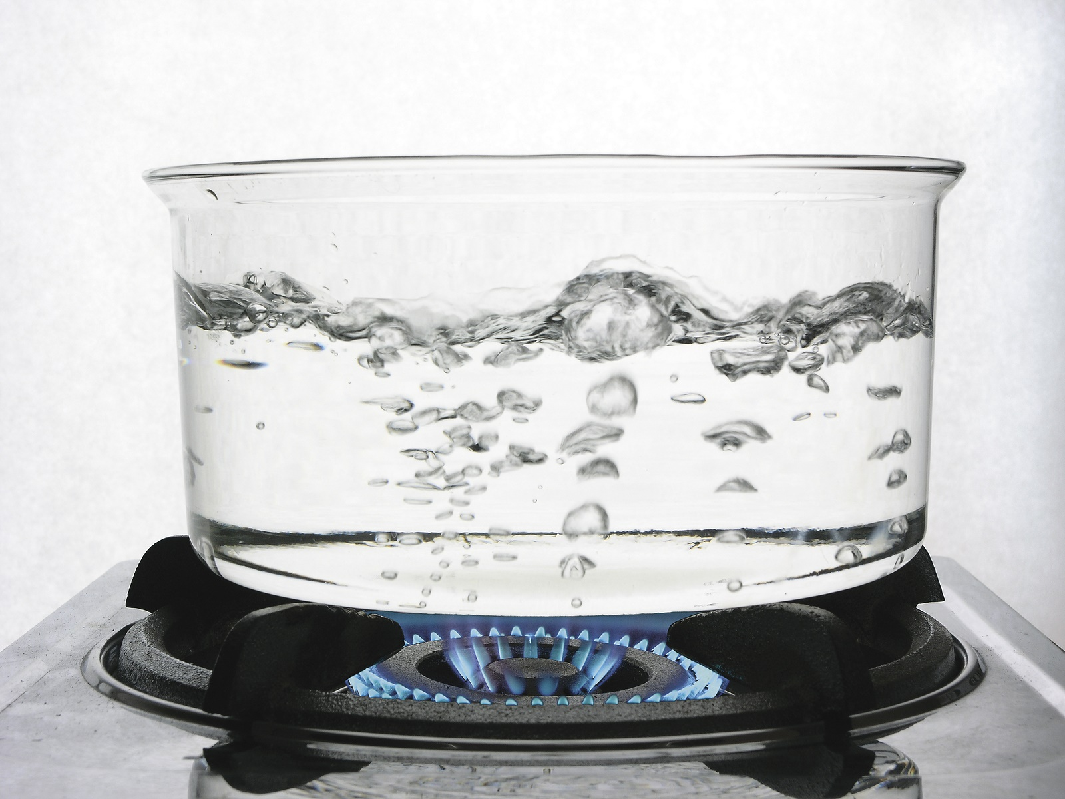
As long as atmospheric pressure is greater than saturation vapor pressure bubbles of water vapor can not grow.

Slide 18
But as soon as the saturation vapor pressure equals the atmospheric pressure, the bubbles expand explosively……boiling has begun!

Slide 19

If atmospheric pressure is lower than 1000 hPa, the temperature of boiling is also lower.. Why? the saturation vapor pressure needed to equal atmospheric pressure is less. Since saturation vapor pressure depends on T, a lower temperature is required.
At the top of Mt. Everest (about 29K feet ASL) water boils at 70C (160F)
Denver: 95C, 203F, not 212!

Slide 20
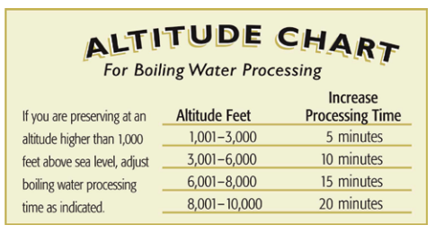
Cooking While High
This explain high-altitude cooking instructions for some recipes…need to cook longer to make up for lower boiling temperature

Slide 21
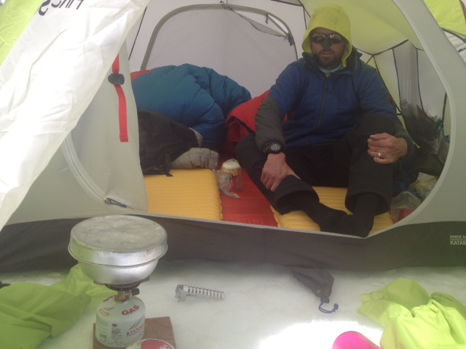
Needs to be patient

Slide 22
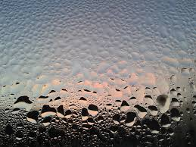
Measures of Water Vapor in the Atmosphere
Meteorologists have quite a collection of them!

Slide 23
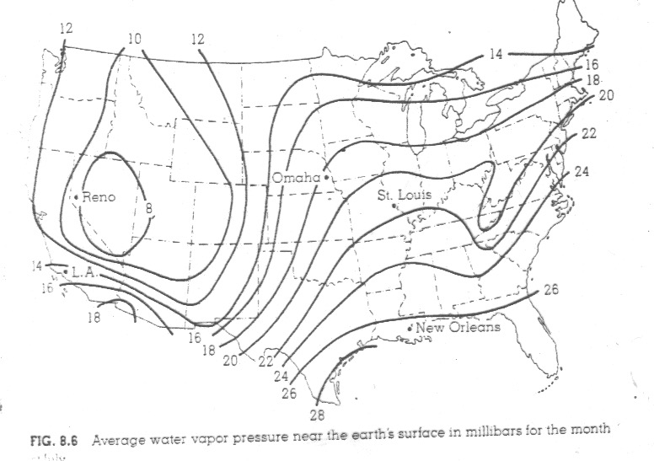
Water Vapor Pressure: Not on Your TV News
H₂0 vapor pressure: air pressure contribution of water vapor only (hPa)

Slide 24
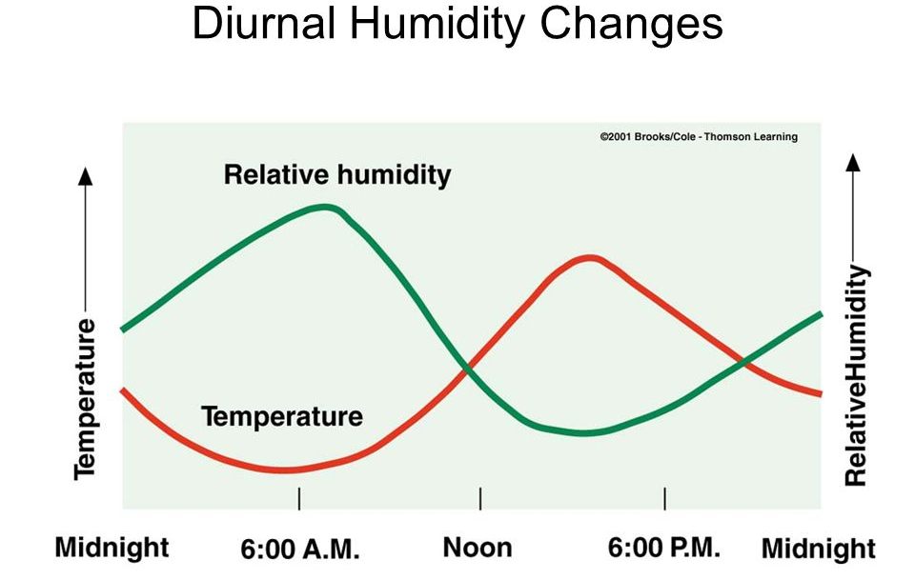
Relative Humidity (RH) = 100* amount of H20 vapor in the air max possible amount of H20 vapor in the air at that temp RH varies during the 24-h day: lower during the day when temps are high, higher in early morning when temps are low
During the day, when it is warmer, the saturation vapor pressure is higher, so max amount of H2O vapor it can hold is higher.

Slide 26
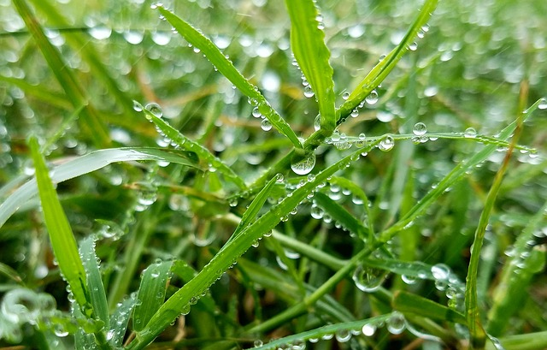
Dew Point (T_{d}) or Dew Point Temperature
Definition: the temperature at which air becomes saturated when it is cooled at constant pressure. Given in °F or °C
More moisture in the air gives a higher dew point. WHY?
Less moisture. Have to cool the air down more to get saturation.
At saturation, T = T_{d}

Slide 27
Dew Point Facts
T_{d} does not change rapidly because the amount of water vapor often doesn’t change much
At night, if T drops to T_{d}, dew or fog can form
T_{d} can decline if dew or fog forms (water is taken out of air)
T_{d} can increase if water vapor is added

Slide 28
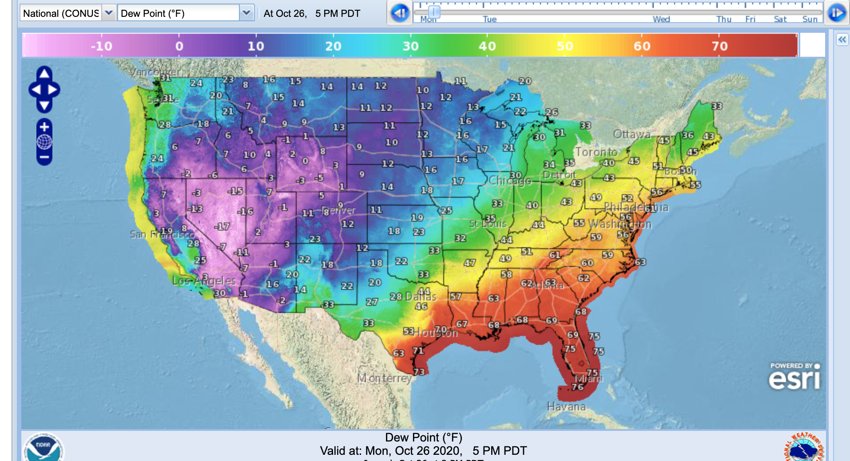
Dew Point
Seattle in summer ~45-50F
E. Washington in summer ~20-30F
DC in summer, 65-75F
You feel uncomfortable with high dew points. Harder to evaporate water off skin.
Is an absolute measure of how much water vapor in air

Slide 29
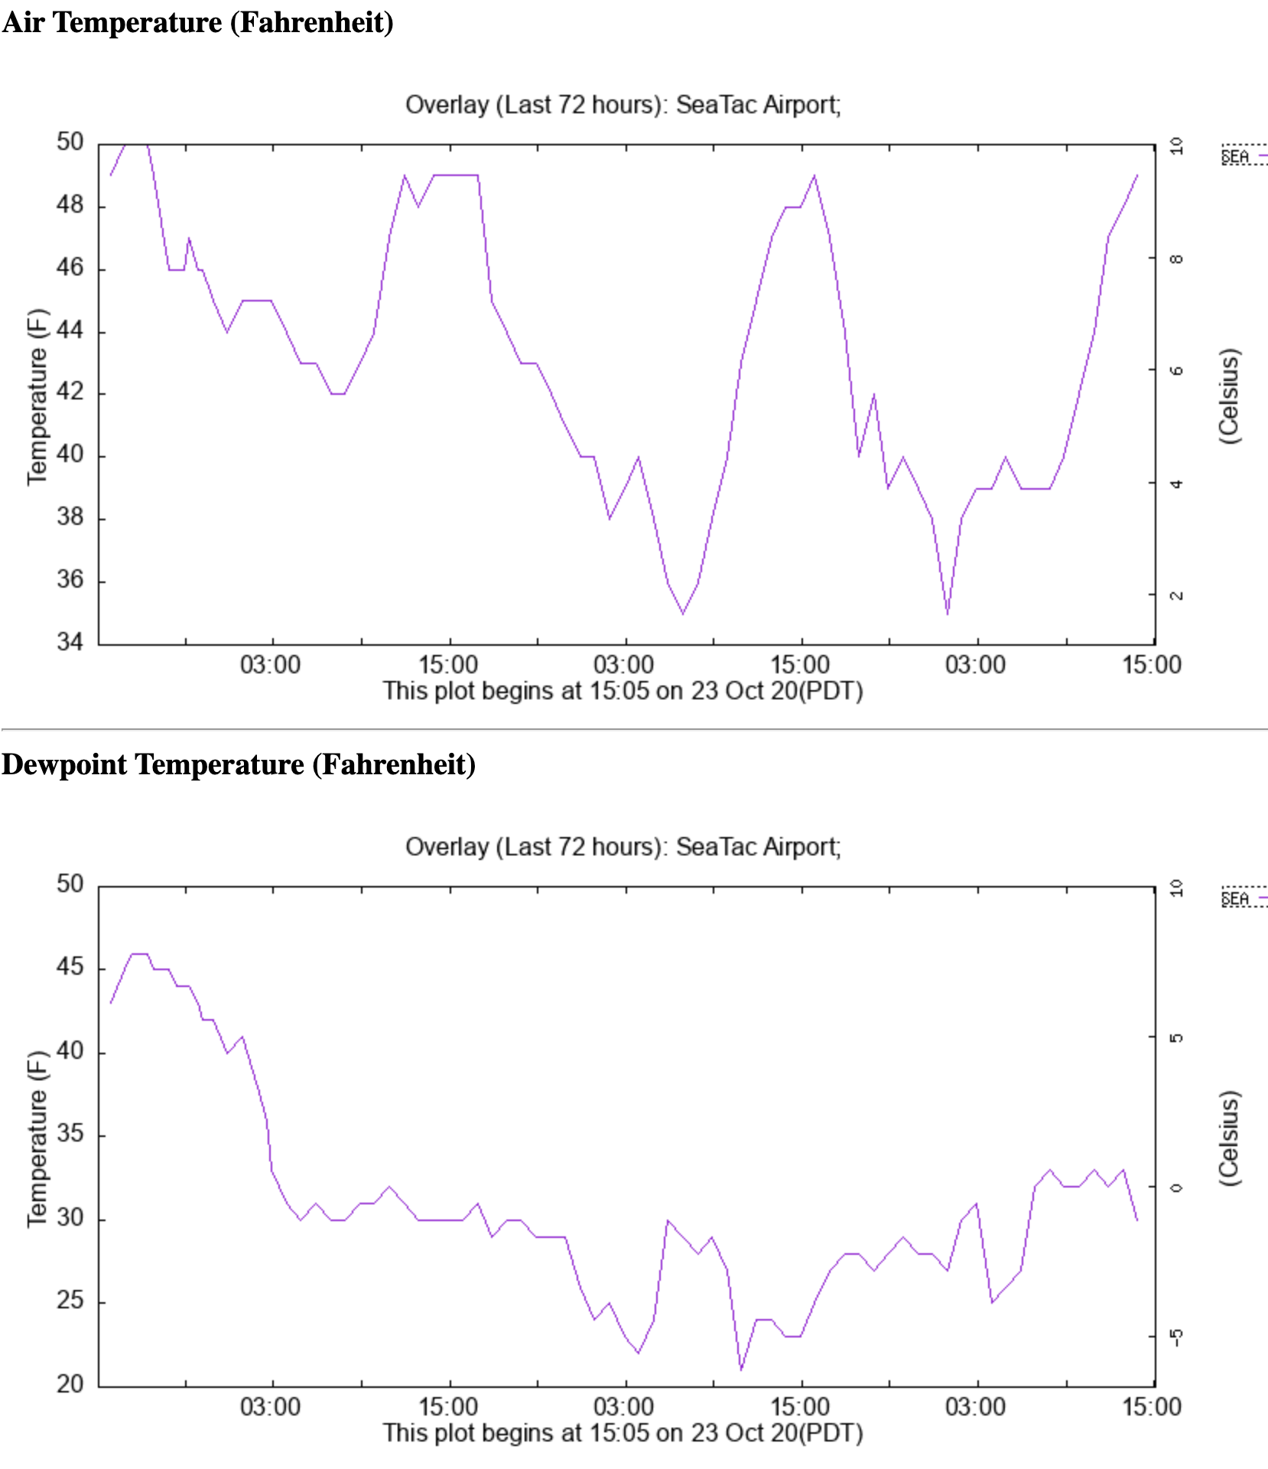
Dew Point Varies Less Than Temperature

Slide 30
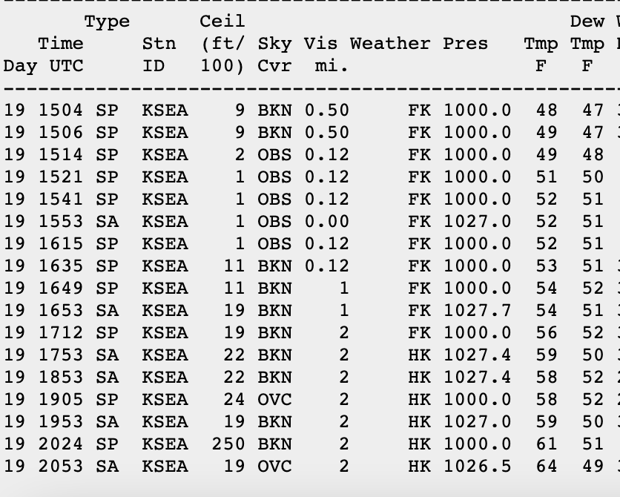

Slide 31
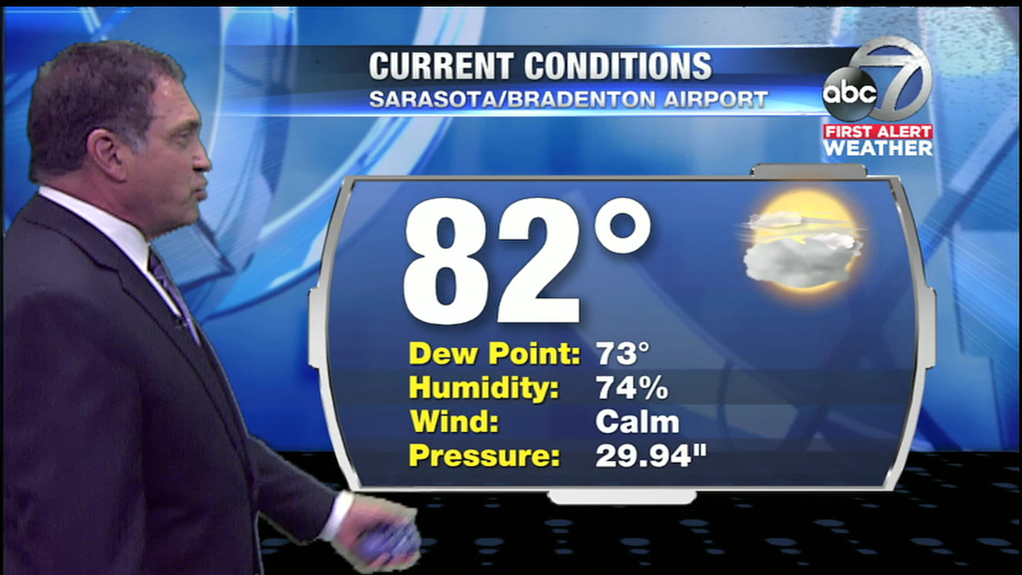

Slide 32
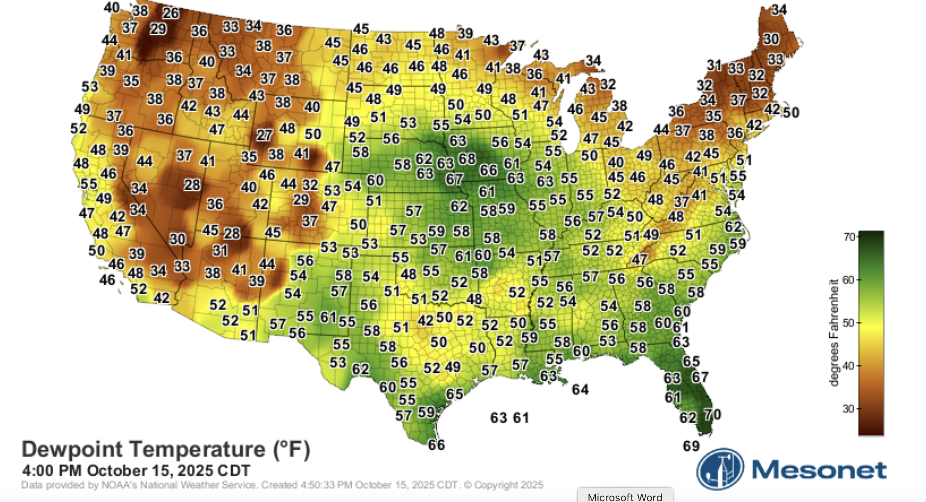

Slide 33
Measuring Humidity

Slide 34
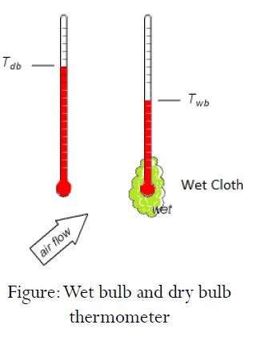
Measuring Humidity
The classic approach before solid state sensors was to measure both regular temperature (dry bulb temperature, T) and the wet bulb temperature (T_{w}) at the same time
Definition:
Wet bulb temperature (Tw): the temperature given by a thermometer with a wet wick.
Contrasts with the dry bulb temperature (T), the temperature provided by a normal thermometer.

Slide 35

Wet Bulb and Dry Bulb Temperatures
If the air is saturated T = T_{w}
If the air is unsaturated T > T_{w. (}Cooling evaporation in wet wick.)
The bigger the difference, the drier the air
Can determine the relative humidity (and dew point) if one has T and T_{w}.

Slide 36
Wet Bulb and Dry Bulb Temperatures
When rain starts to fall, the temperature often declines to the wet bulb temperature.

Slide 37
You can sometimes feel the cooling when rain starts above

Slide 38
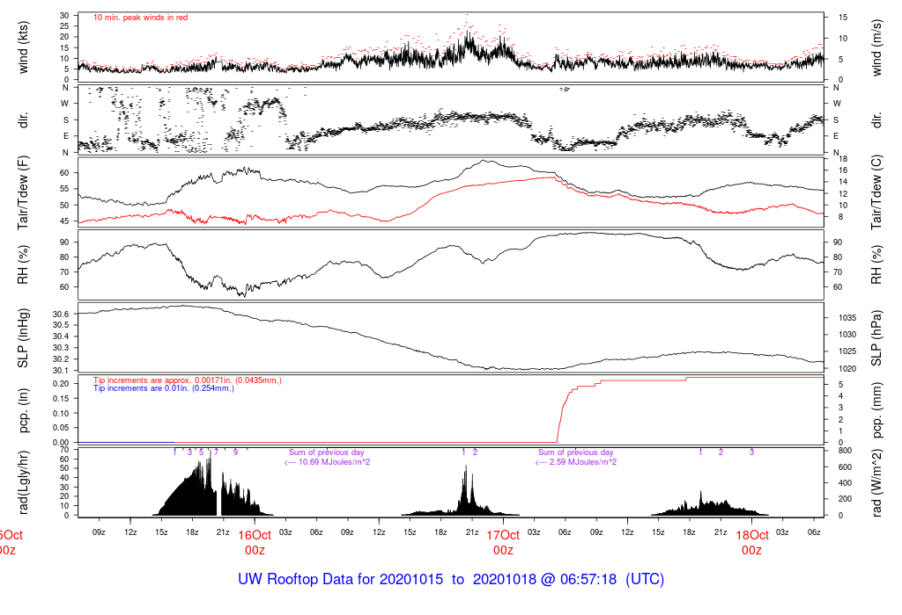

Slide 39
Meteorologists have tables: given dry bulb and wet bulb temperatures can calculate relative humidity and dew point

Slide 40
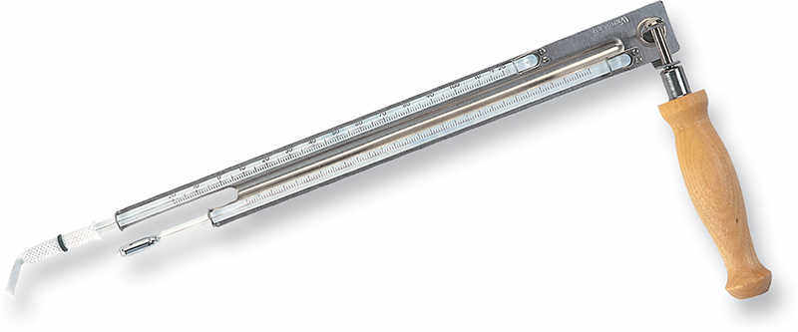
Psychrometers Used to Measure T, T_{w} and Thus Humidity

Slide 41
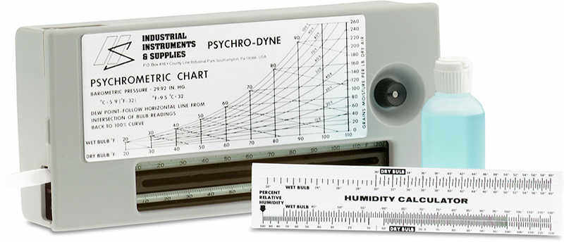

Slide 42
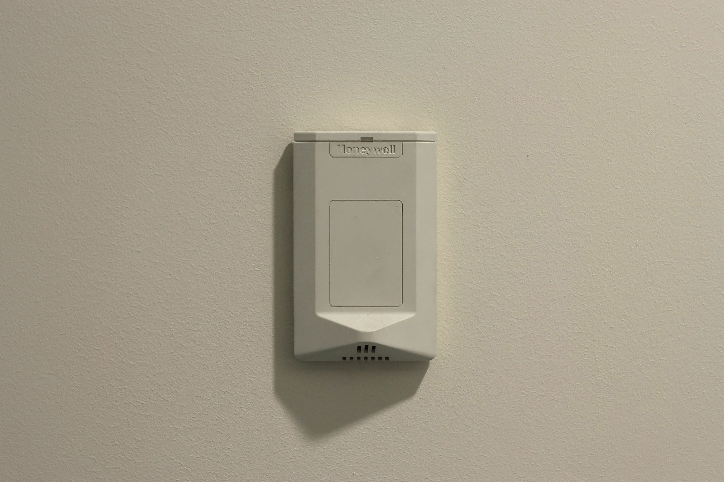
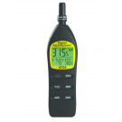
Digital Hygrometer (taking over)
Uses electronic sensors that can determine atmospheric moisture content

Slide 43
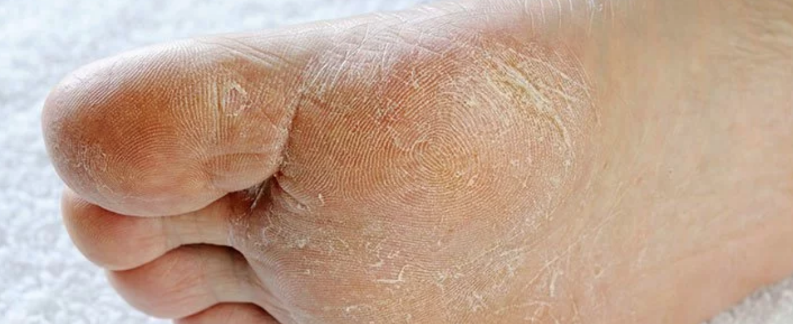
Next Important Topic: Dry Skin in Winter

Slide 44
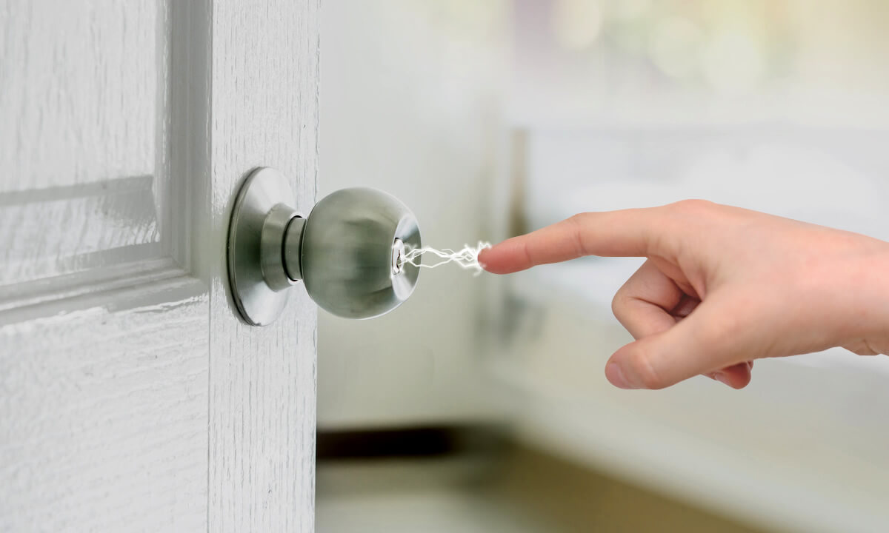
Why are the interiors of homes and buildings dry in winter?
Dry conditions cause chapped lips, cracked skin, dry mouths, health issues.
Even an issue here in wet Seattle. Why?

Slide 45
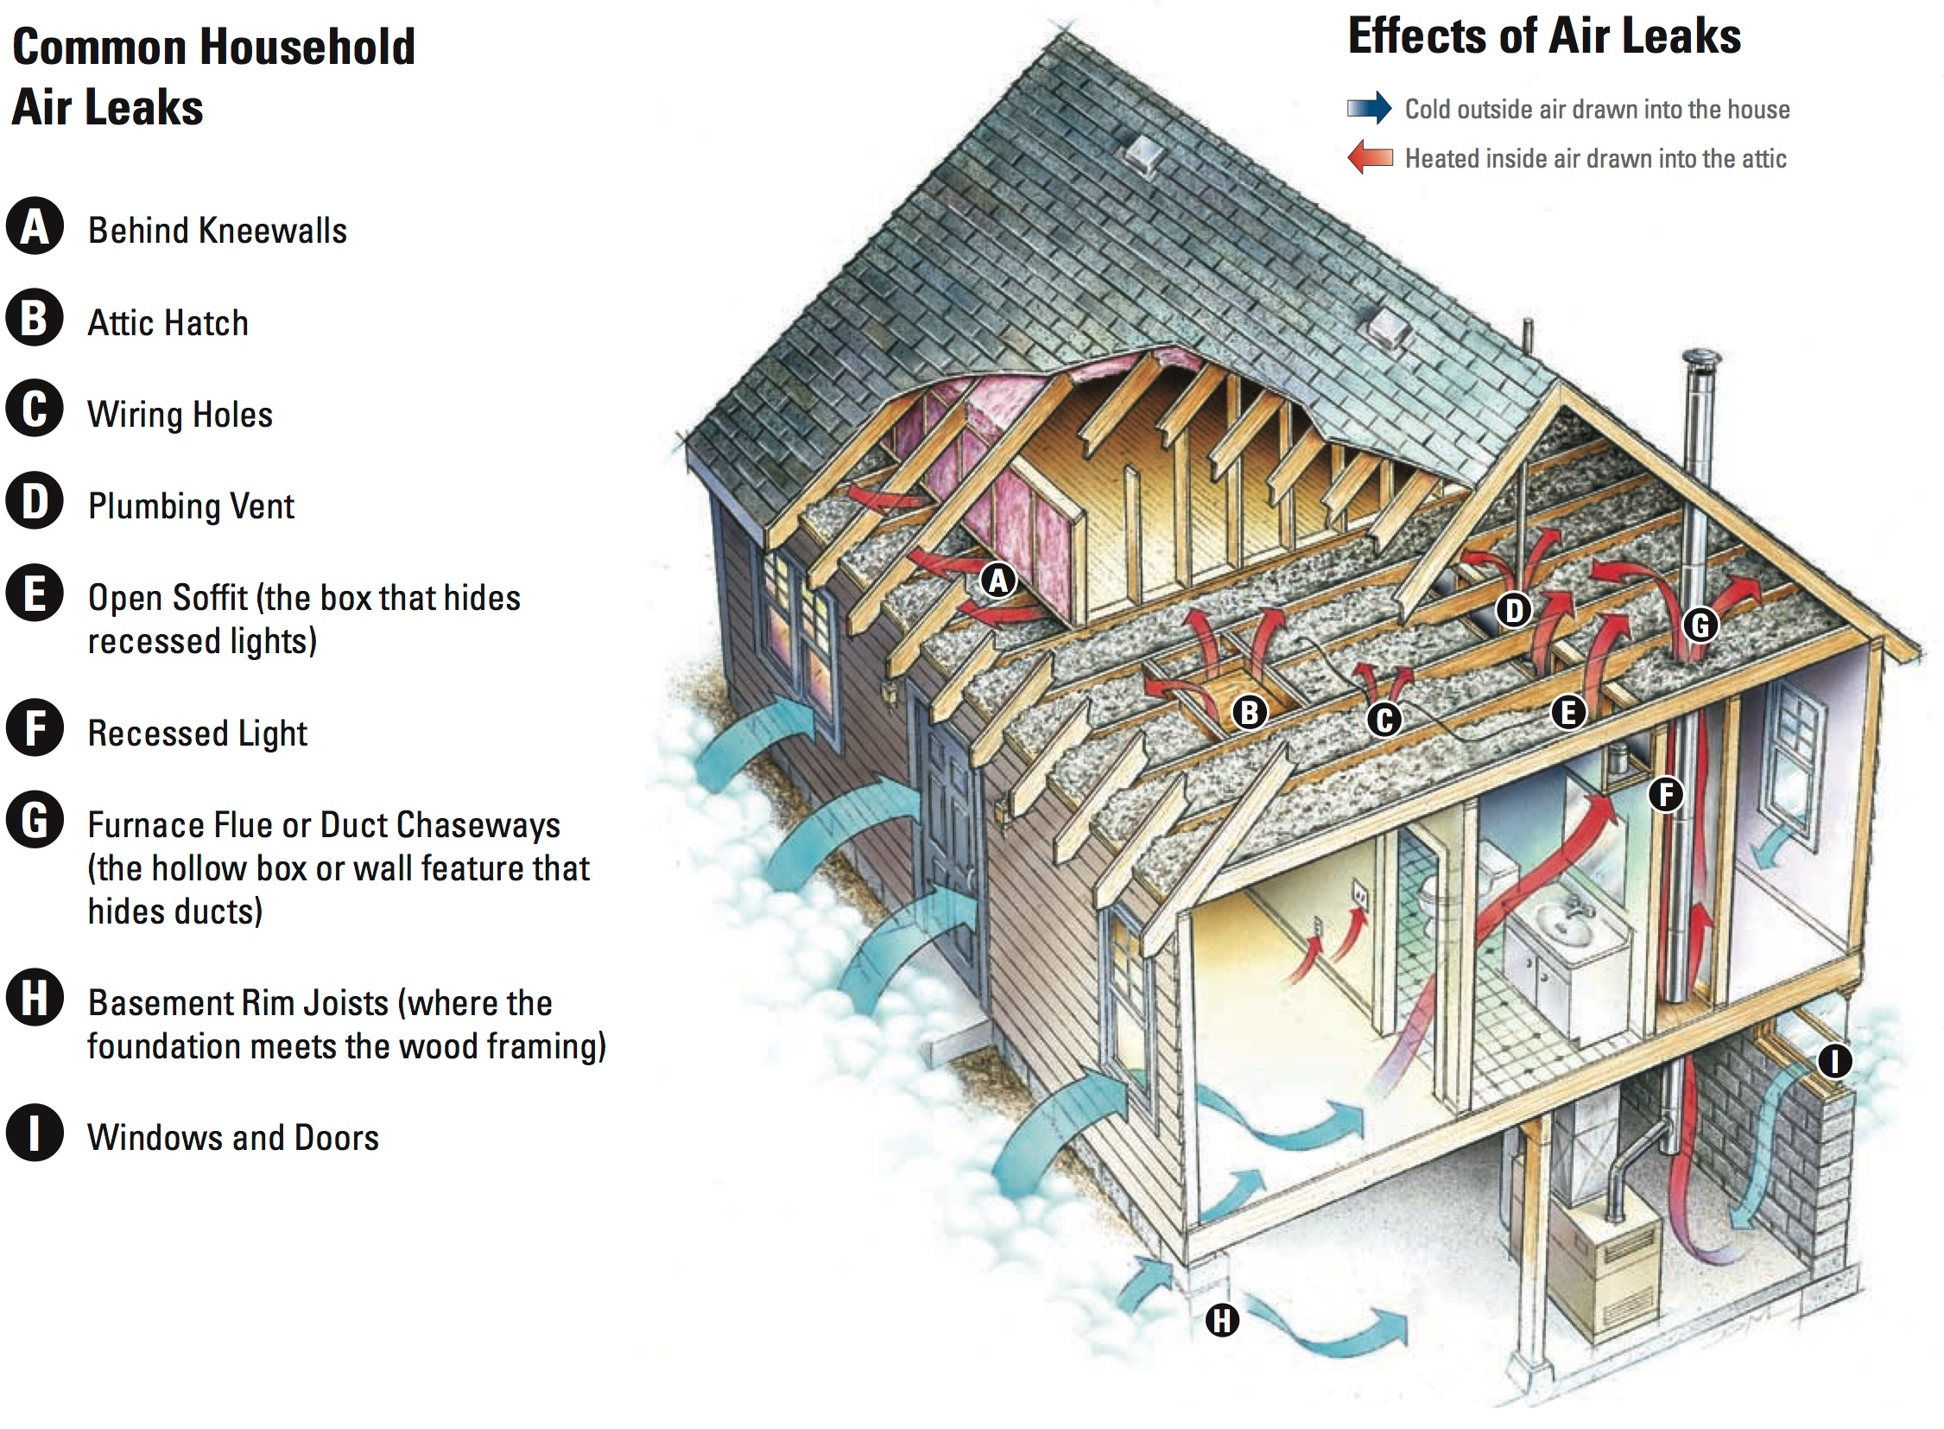
Typical Situation
Outside: T=0°C (32F) and RH=100%
Air infiltrates into the house and is warmed to 20C (68F)
What is the RH inside?
MUCH LOWER THAN OUTSIDE!

Slide 46
Remember Relative Humidity (RH) = 100* amount of H20 vapor in the air max possible amount of H20 vapor in the air at that temp Since air is much warmer in the house, the saturation vapor pressure is MUCH higher. In other words, the air can hold much more moisture. Thus, RH is far less

Slide 47

RH inside the house
If outside air is cold or dry, easy to get RH less than 10% in a home

Slide 48
That is why your foot looks like this in winter

Slide 49
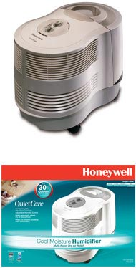

And this is why some people use humidifiers during the winter

Slide 50
Relative Humidity Can Vary Substantially During the Year: Less in Summer When Temperatures are Warmer

Slide 51
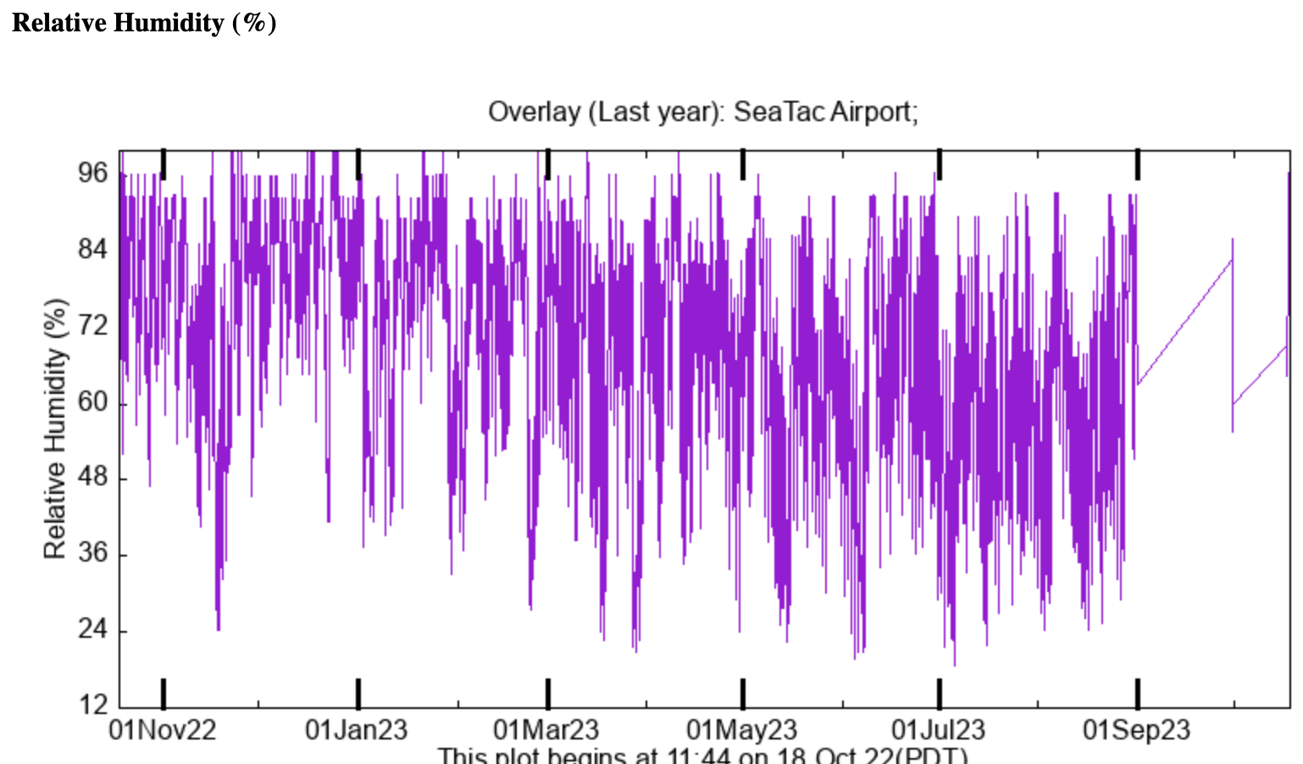

Slide 52
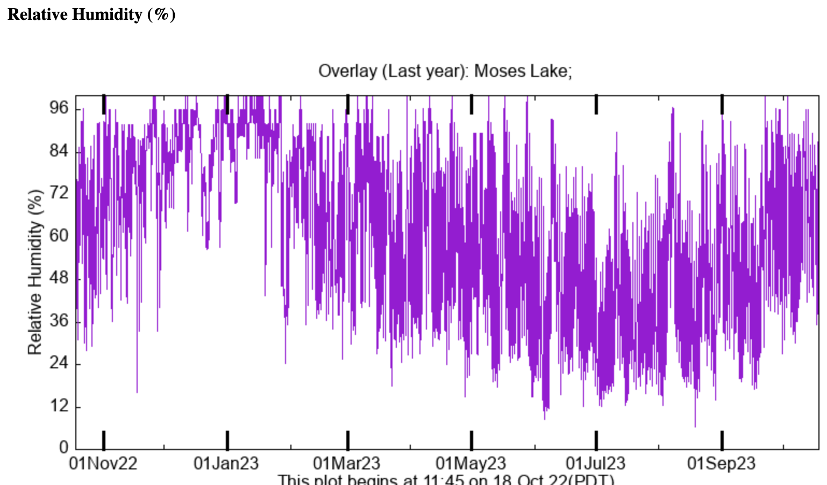

Slide 53
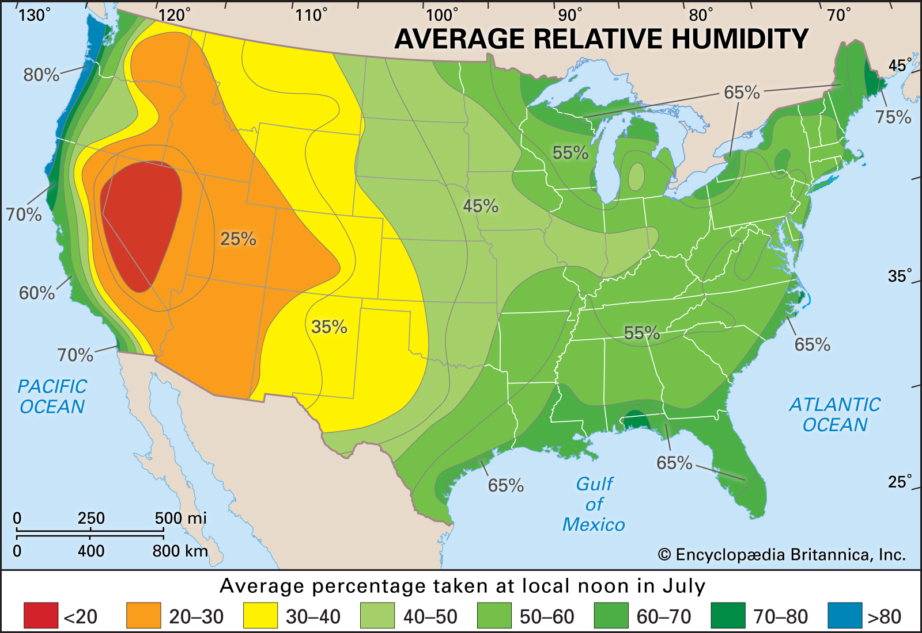
July Relative Humidity: Lowest in the Desert SW

Slide 54
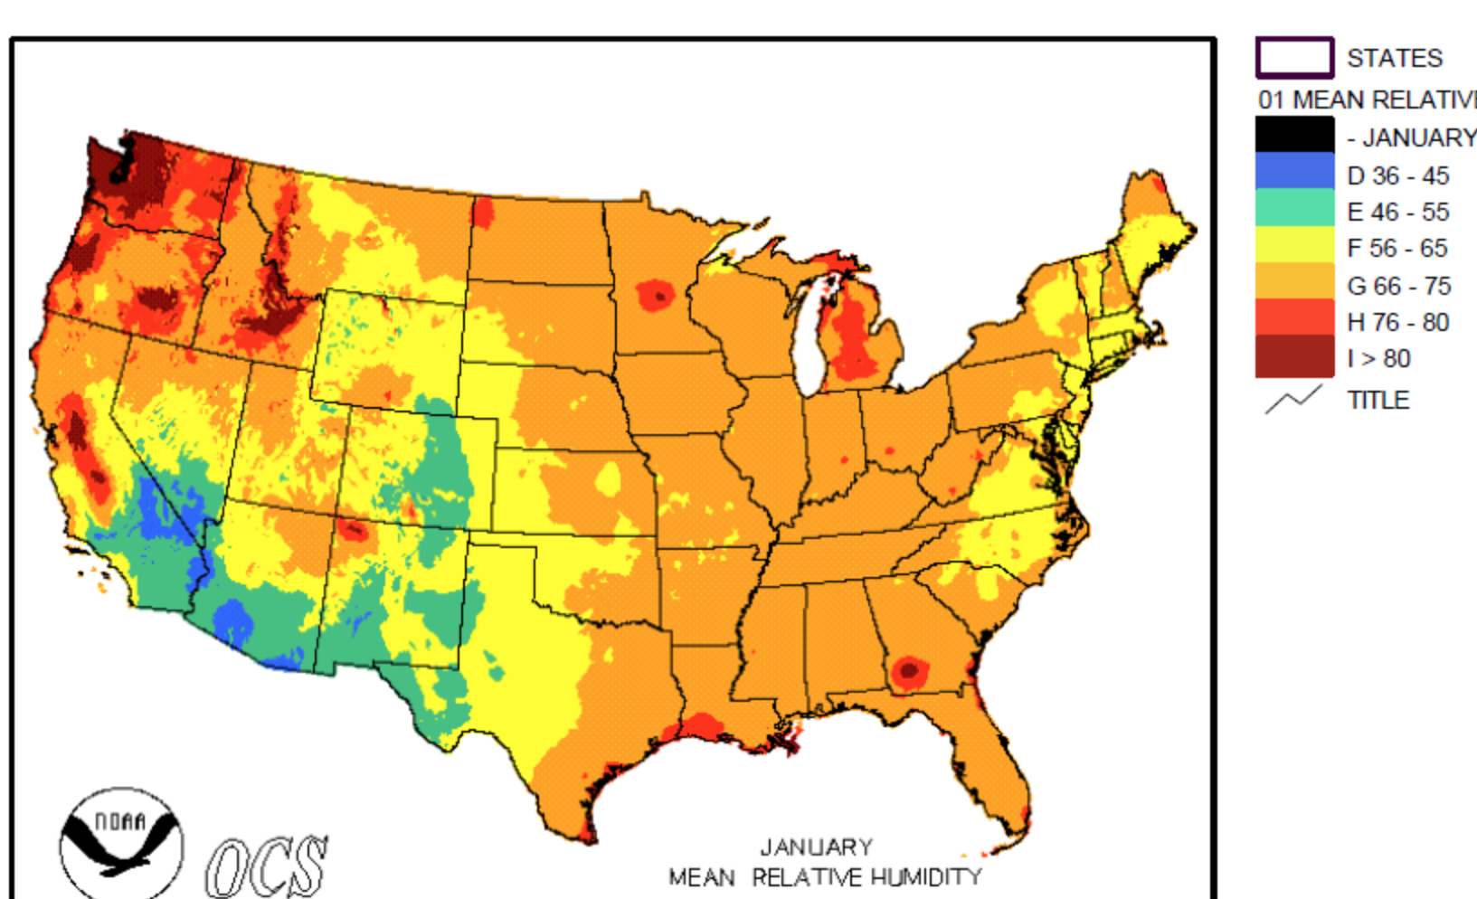
January
Relative
Humidity

Slide 55
Relative Humidity Does Not Tell the Whole Story of How Comfortable We Feel
High Relative Humidity Is Not a Problem When Temperatures
Are Cool
July
RH

Slide 56
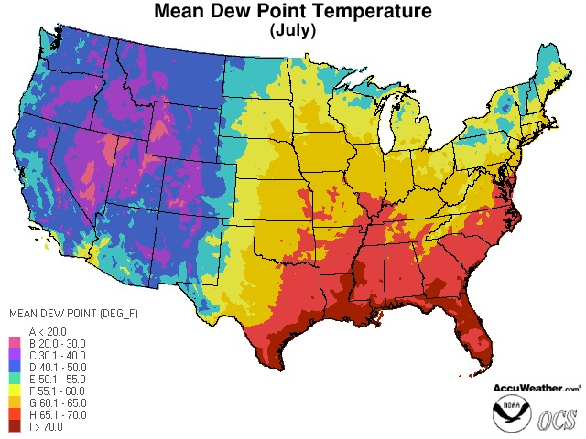
Dew Point is A Better Measure: It is a measure of the absolute amount of water vapor in air

Slide 57
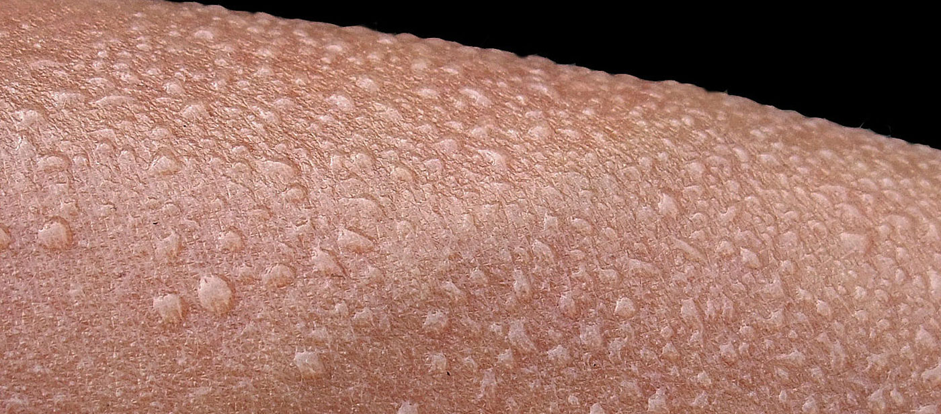
The Higher the Dew Point, The Less Comfortable We Feel
If the air is saturated (T=T_{D}), evaporation from the skin does not occur. Thus, no evaporative cooling. You feel sticky and hot.
The bigger the difference between temperature and dew point, the greater the amount of evaporative cooling.

Slide 58
The higher the temperature, the greater the thermal stress on us
Warm temperatures make you feel hot by warming your skin
Dew points near air temperature reduce your cooling ability from evaporation.
Thus, when both are high…you feel warm.

Slide 59

Why is dew point and water vapor content of the air quite low downstream of the (very wet) Pacific Ocean?

Slide 60
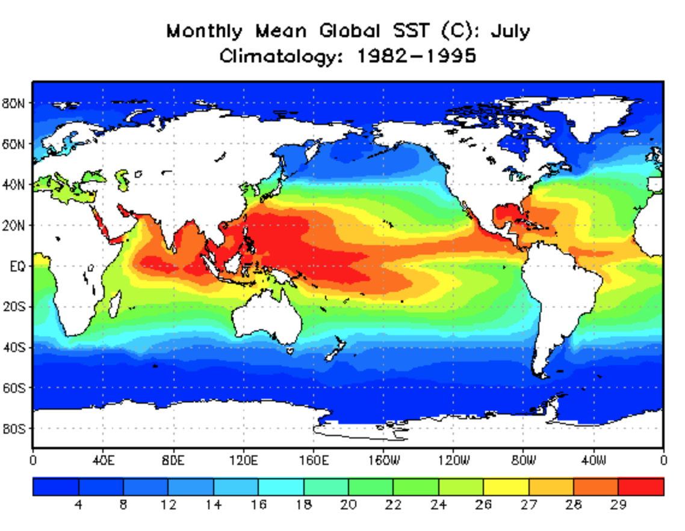
Because the water (Pacific Ocean) is cool and the amount of water vapor in air, even at saturation, depends on temperature

Slide 61
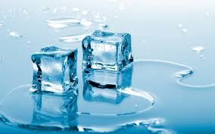
Many of the most profound effects of atmospheric moisture occur when water experiences phase changes.
Phase change: when a substance goes from liquid to solid, liquid to gas, solid to gas, or vice versa.

Slide 62
Phase Changes
evaporation: liquid to gas
condensation: gas to liquid
sublimation: solid to gas (e.g., dry ice or loss of snow)
deposition: gas to solid (frost)
melting: solid to liquid
freezing: liquid to solid

Slide 63
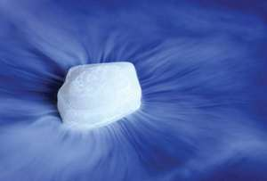
Sublimation (ice to water vapor)

Slide 64
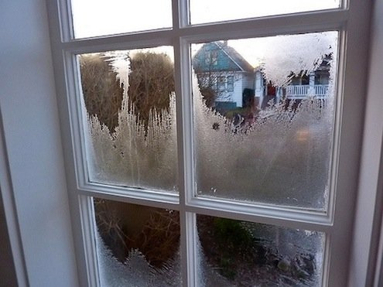
Deposition (vapor to ice)

Slide 65
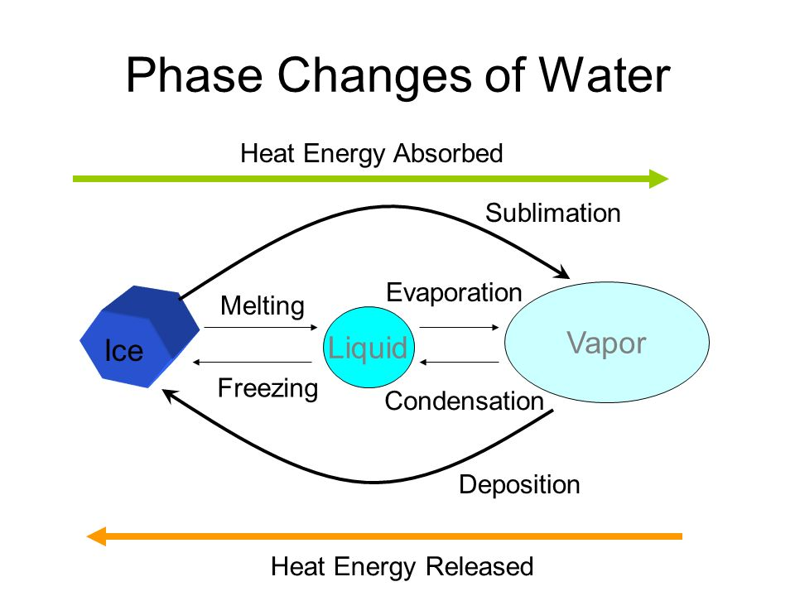

Slide 66
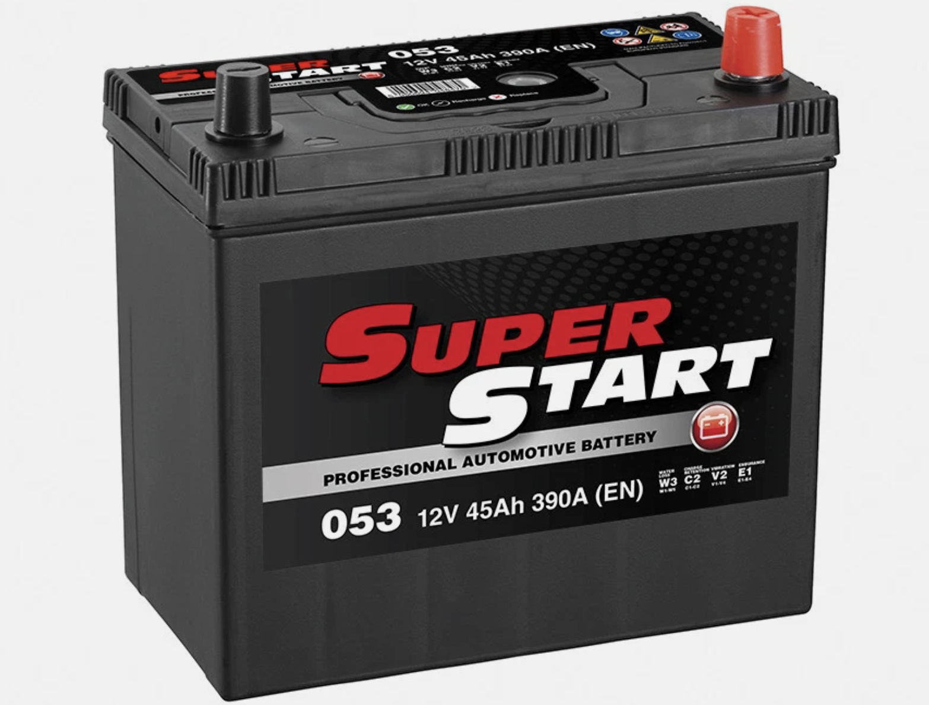
Water Phase Changes Are the Batteries of the Atmosphere

Slide 67
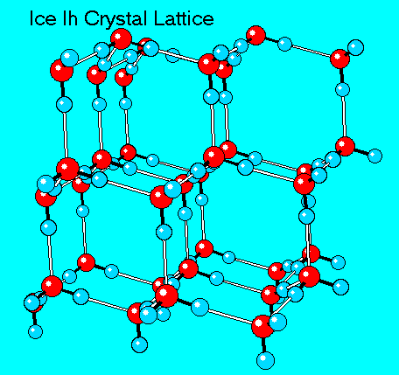
Phase changes of water are associated with heating and cooling, gain or loss of energy
Melting: ice to liquid water
Ice has crystalline structure, with strong bonds. Water molecules can vibrate in position
To break these bonds takes energy: ~80 calories per gram.
Called the latent heat of fusion.

Slide 68

Freezing
When the liquid water later freezes, that amount of heat is released.
This is why orchards in eastern Washington spray water on blossoms in spring when freezing conditions are forecast.

Slide 69
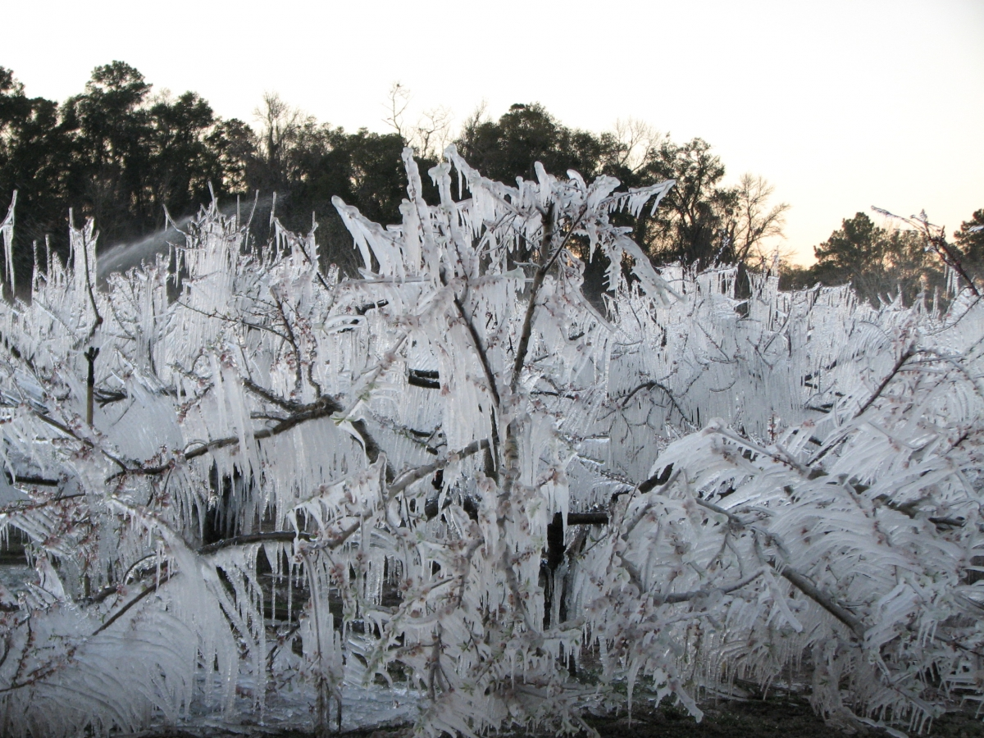
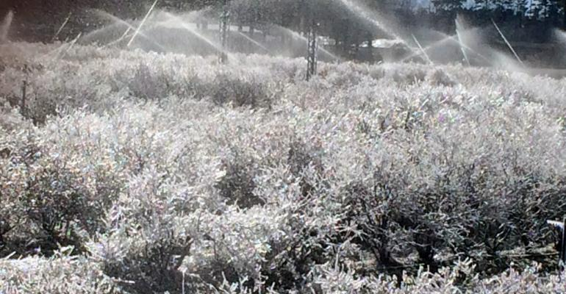

Slide 70
Liquid to Vapor-- Evaporation
Takes energy to break the bonds between water molecules
For 1 gram of water to go from liquid to vapor takes 600 calories of energy
Called the latent heat of vaporization (600 calories per gram)
When water condenses that energy is released back (often called the latent heat of condensation).

Slide 71

For the earth, HUGE amounts of solar radiation in the tropics/subtropics goes into evaporating water over the tropical and subtropical oceans.

Slide 72
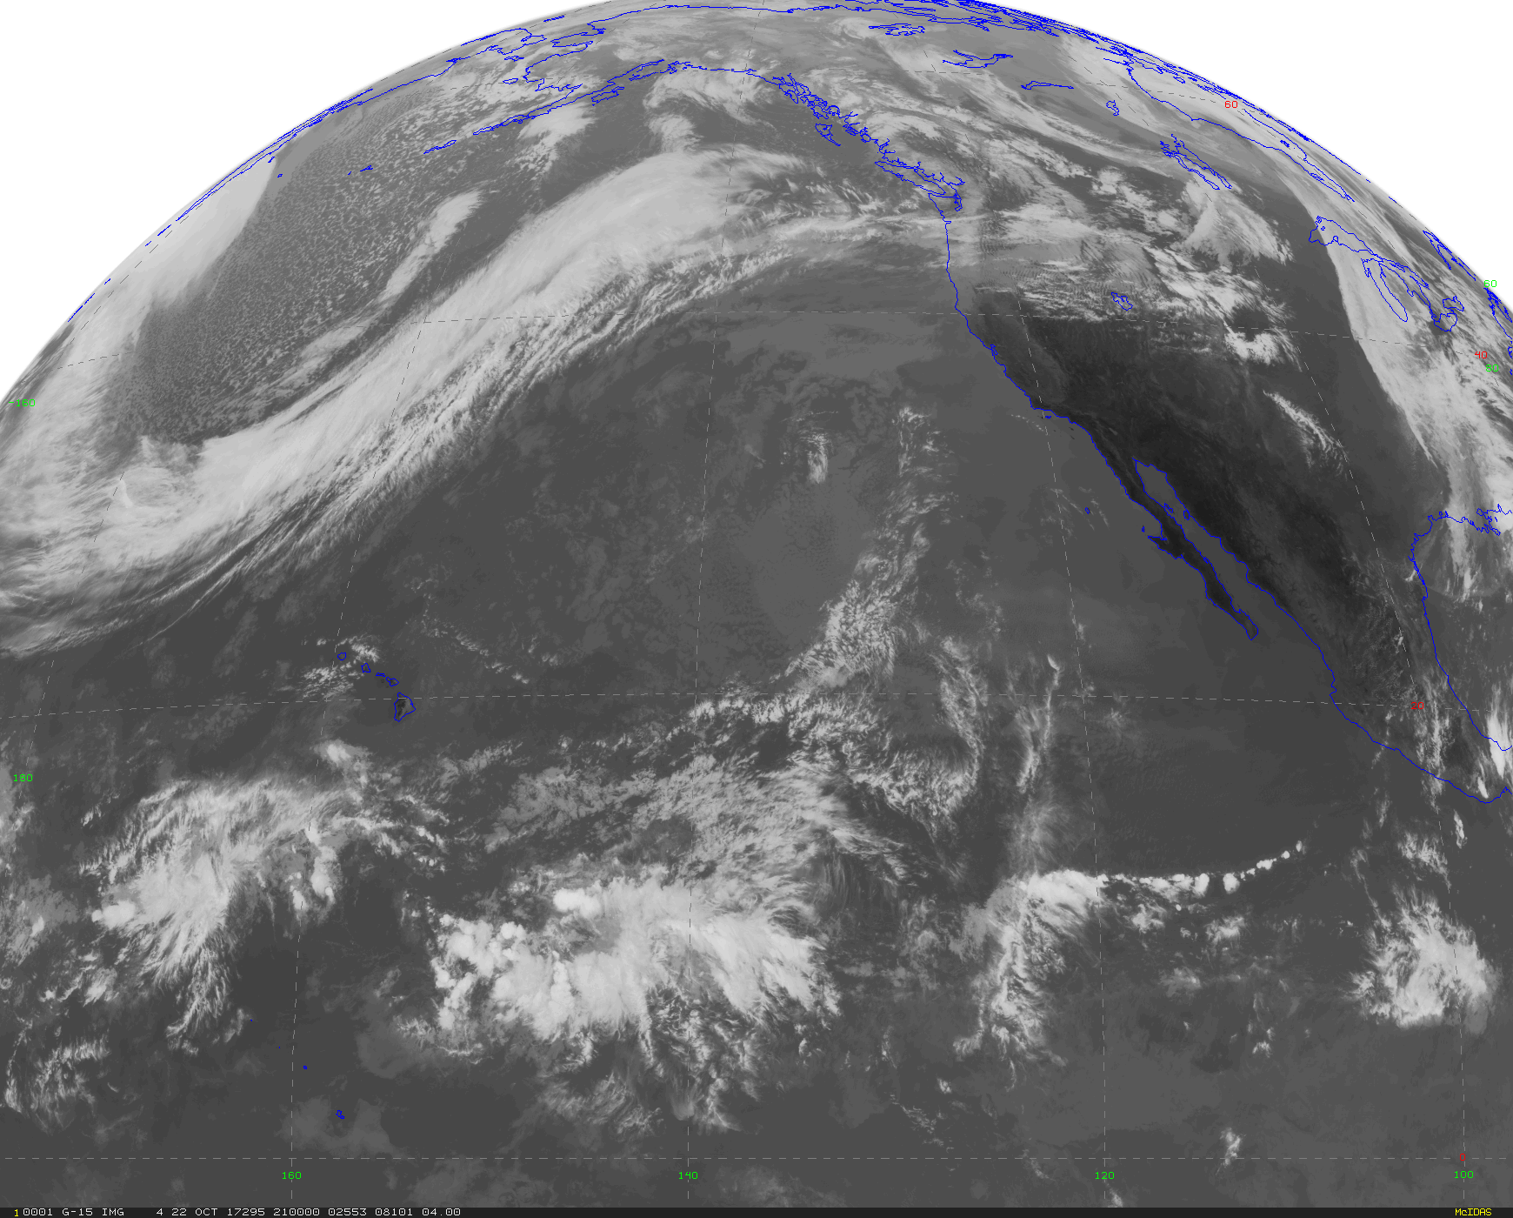
The water vapor is transported northward and then condenses in midlatitude clouds, releasing huge amounts of heat.

Slide 73
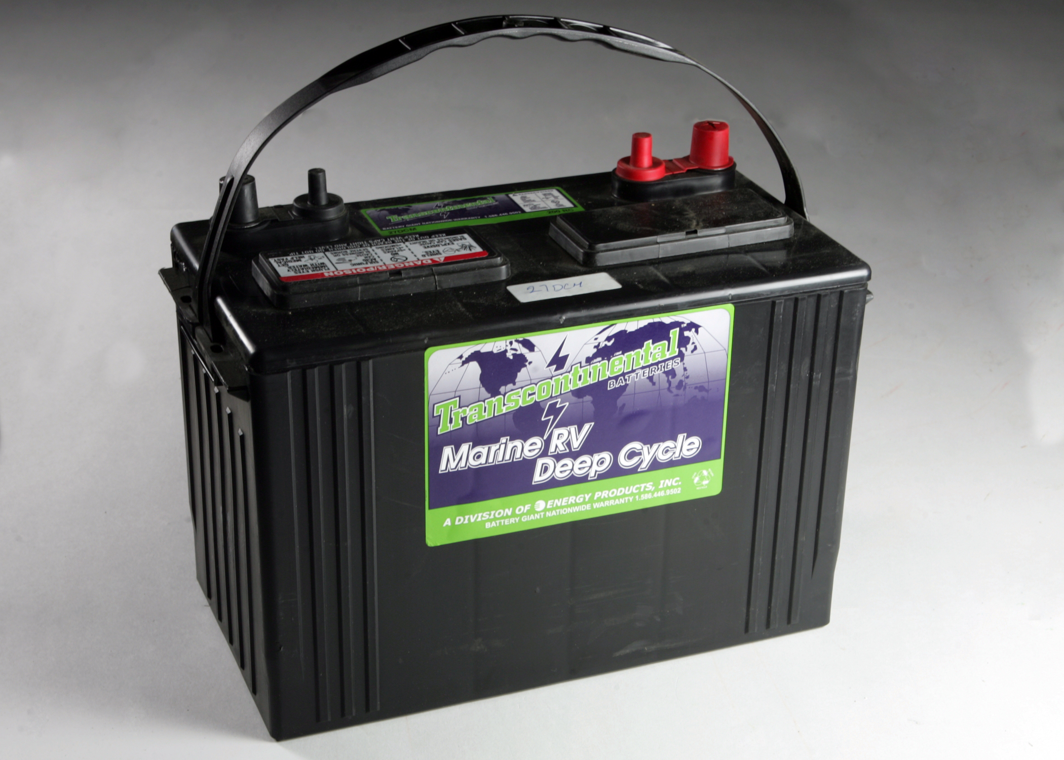
Phase Change of Water Is Like A HUGE Battery for the Atmosphere
Evaporation over
tropical oceans
Condensation in clouds
In midlatitudes

Slide 74
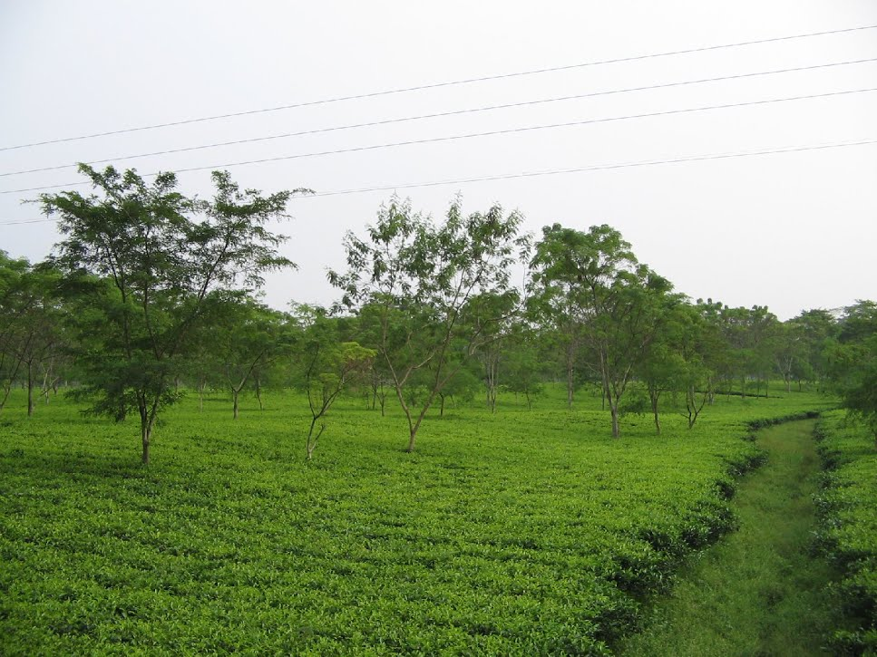
The evaporation of water over land in the midlatitudes reduces temperature rise at the surface—a lot of the sun’s energy goes into evaporating water

Slide 75

Irrigated agricultural land is cooler than its surroundings because of evaporation

Slide 76
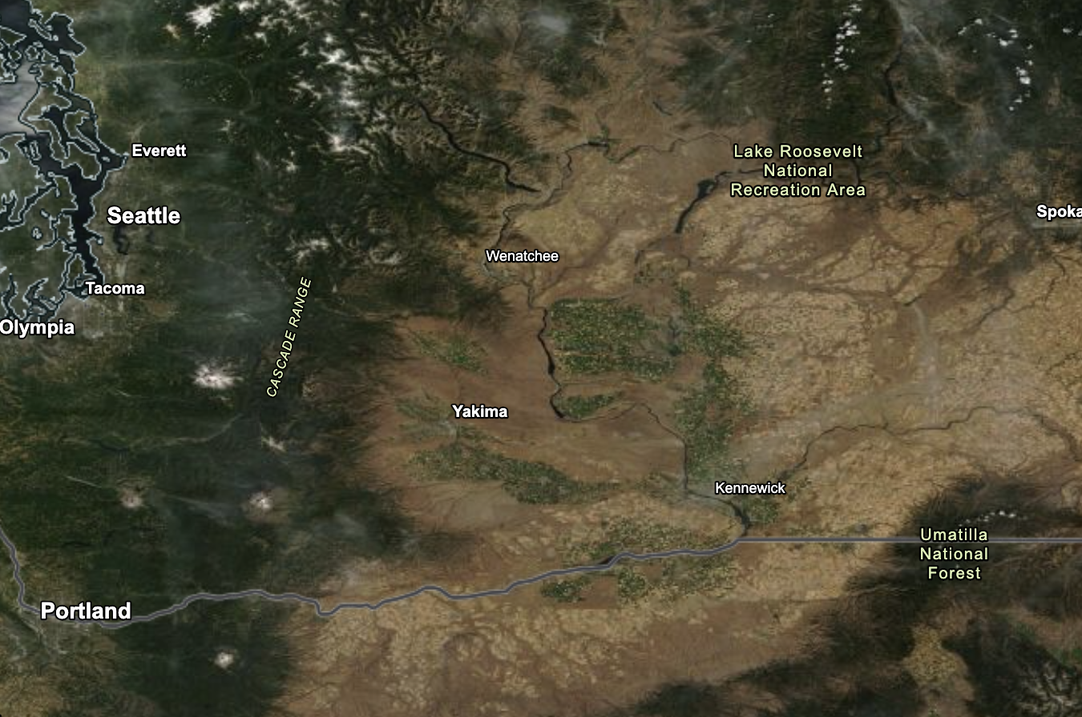
Eastern WA is COOLED by Evaporation from Agriculture

Slide 77

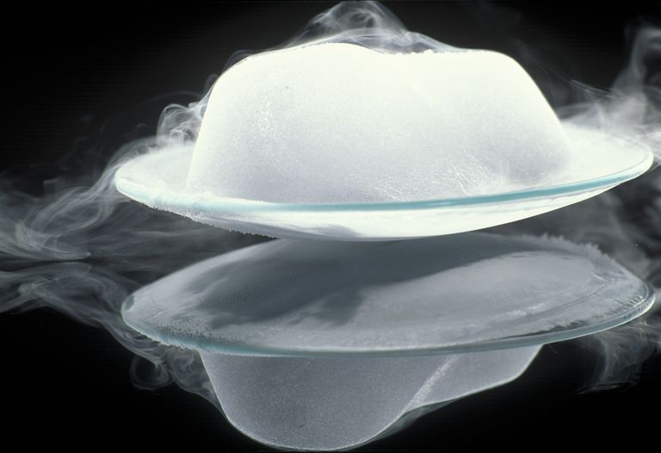
Sublimation
Sublimation: ice to vapor. Requires the latent heat of sublimation.
680 calories per gram
Associated with gradual loss of snow on clear days
Dry ice sublimation

Slide 78

Deposition (e.g. frost)
Vapor to ice. Releases 680 calories per gram (Latent Heat of Deposition)
Strangely,
frost is a heating machine

Slide 79
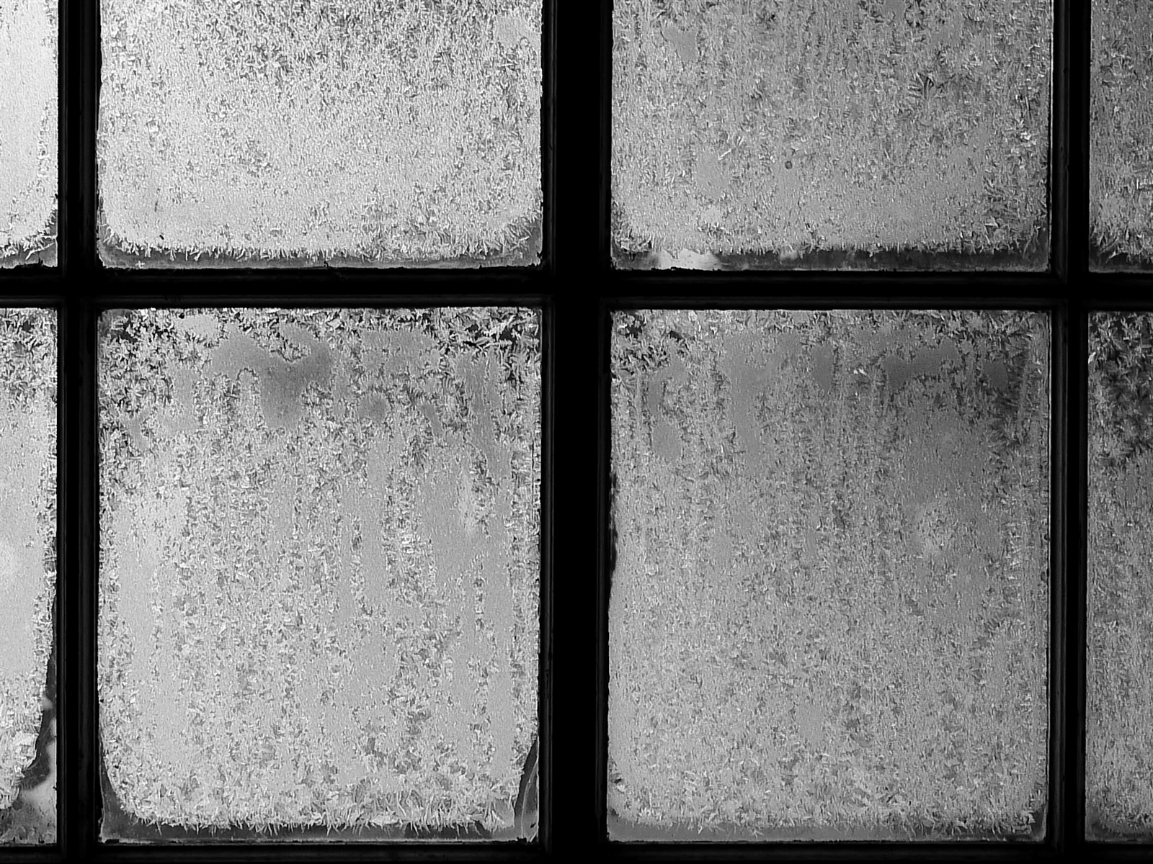

Slide 80
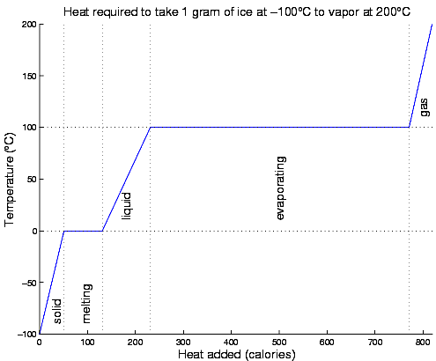
Water Phase Change Overview
Temperature remains constant during phase changes.
Good way to calibrate thermometers

Slide 81
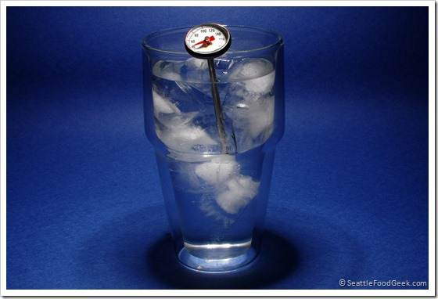
Good way to test/calibrate your thermometer

Slide 82
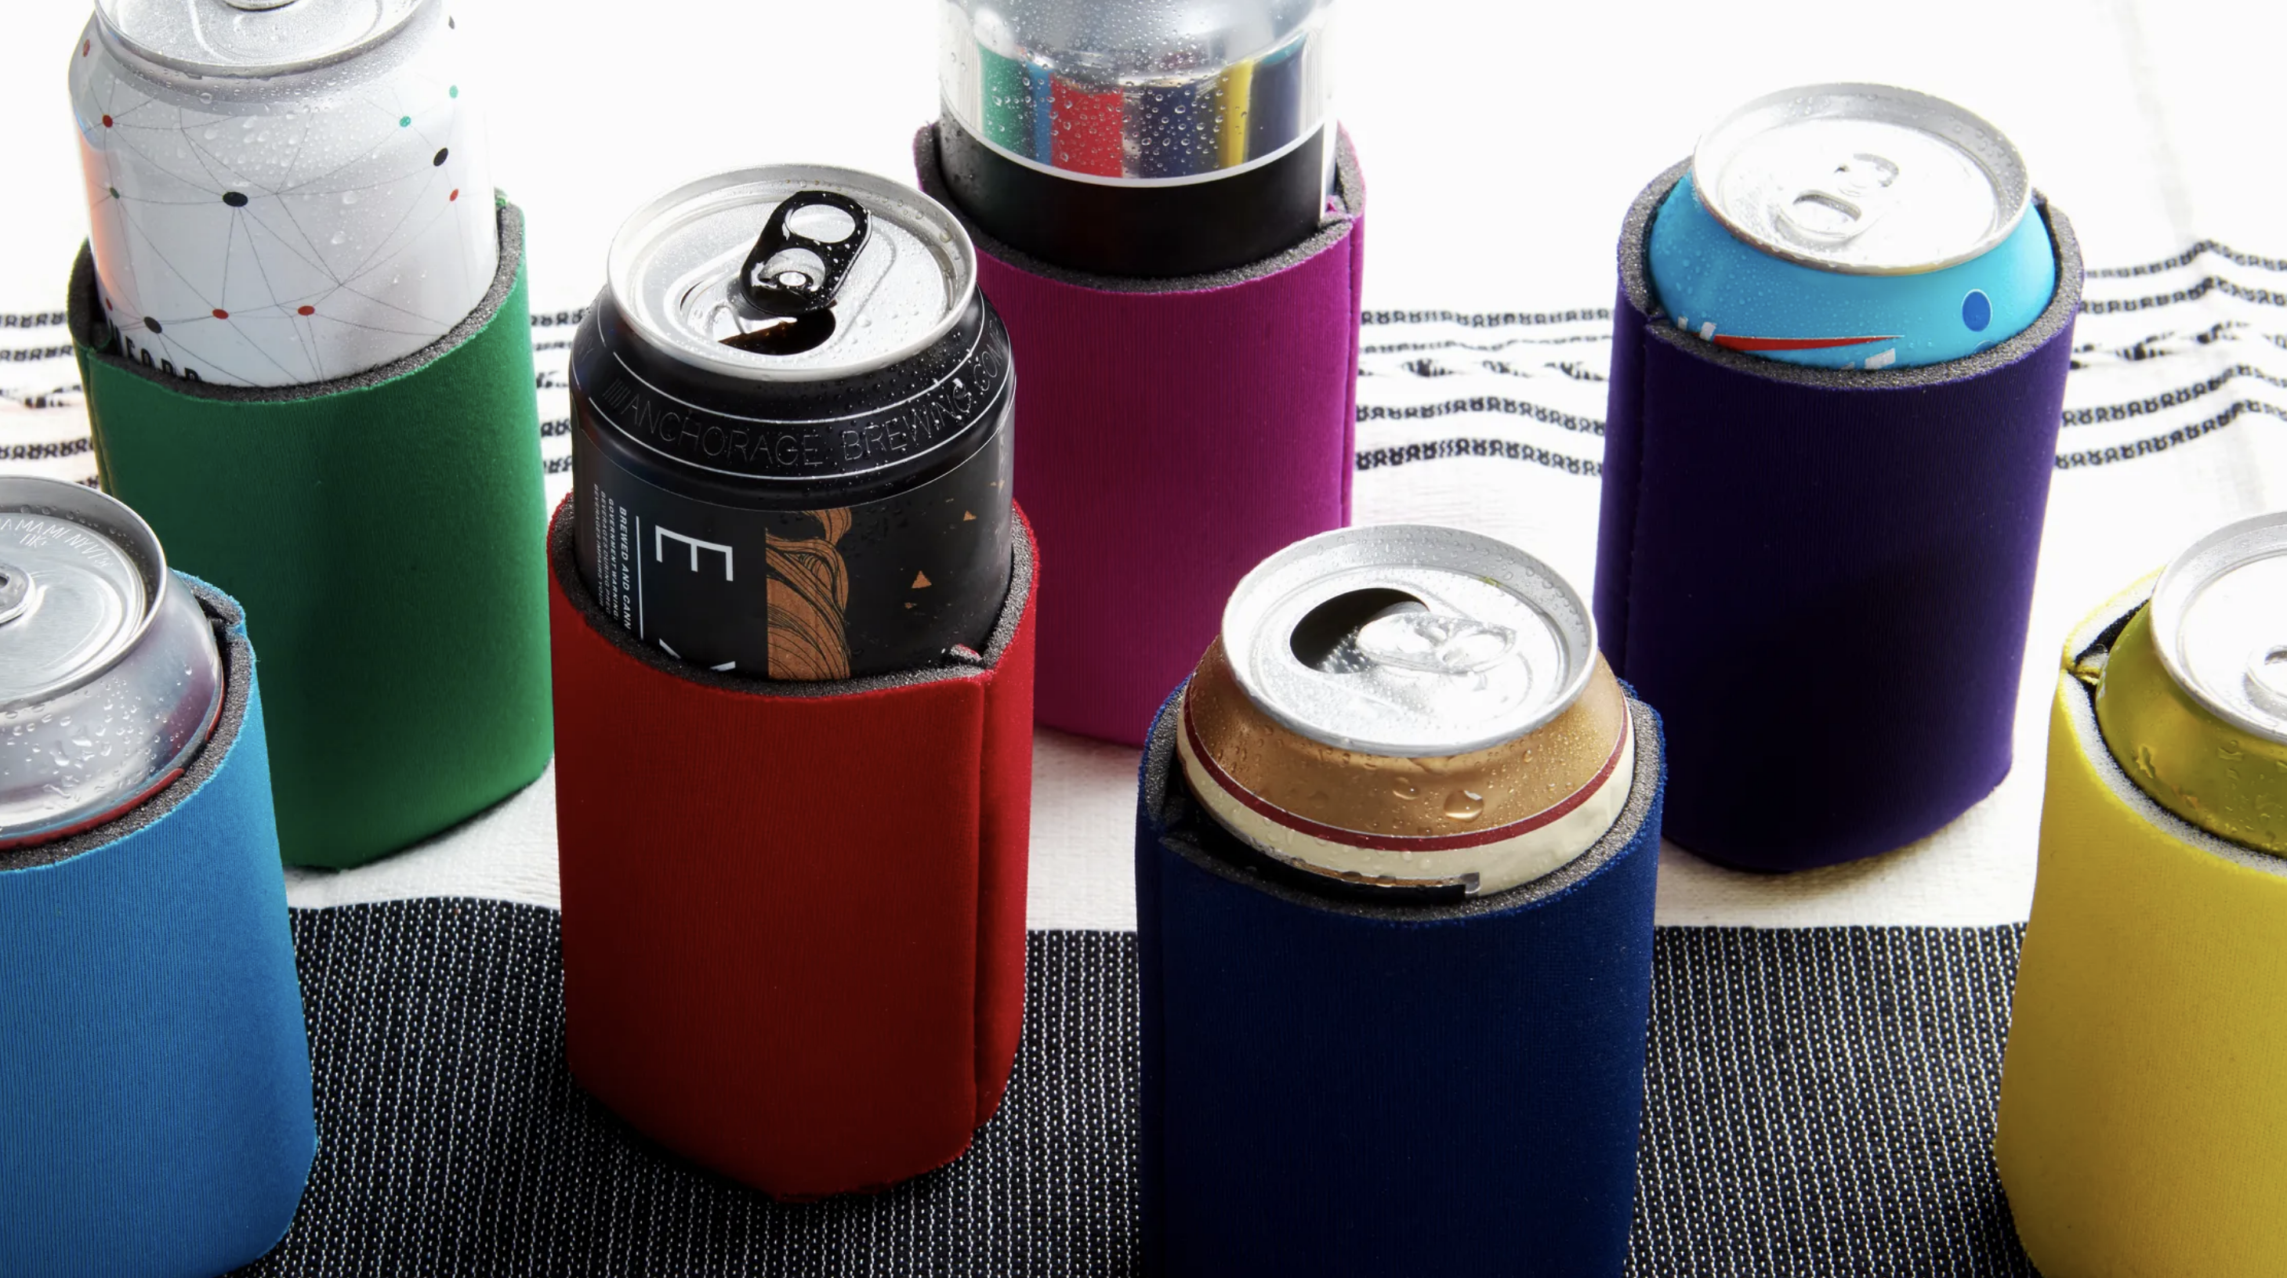
An Application of Today’s Lecture: The Koozie

Slide 83

Koozies insulate the can from warmer air around them….but that is NOT the key reason they keep your drink cold
What do you think it is?

Slide 84

Condensation on cans result in intense warming due to release of latent heat of condensation.
Koozies insulate the can and reduces condensation

