Slide 1
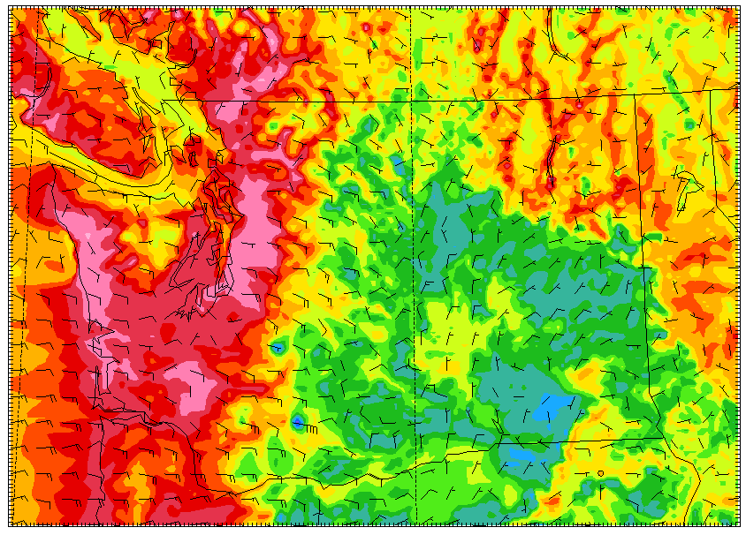
Advances in High Resolution Numerical Weather Prediction over the Pacific Northwest
Cliff Mass
University of Washington

Slide 2
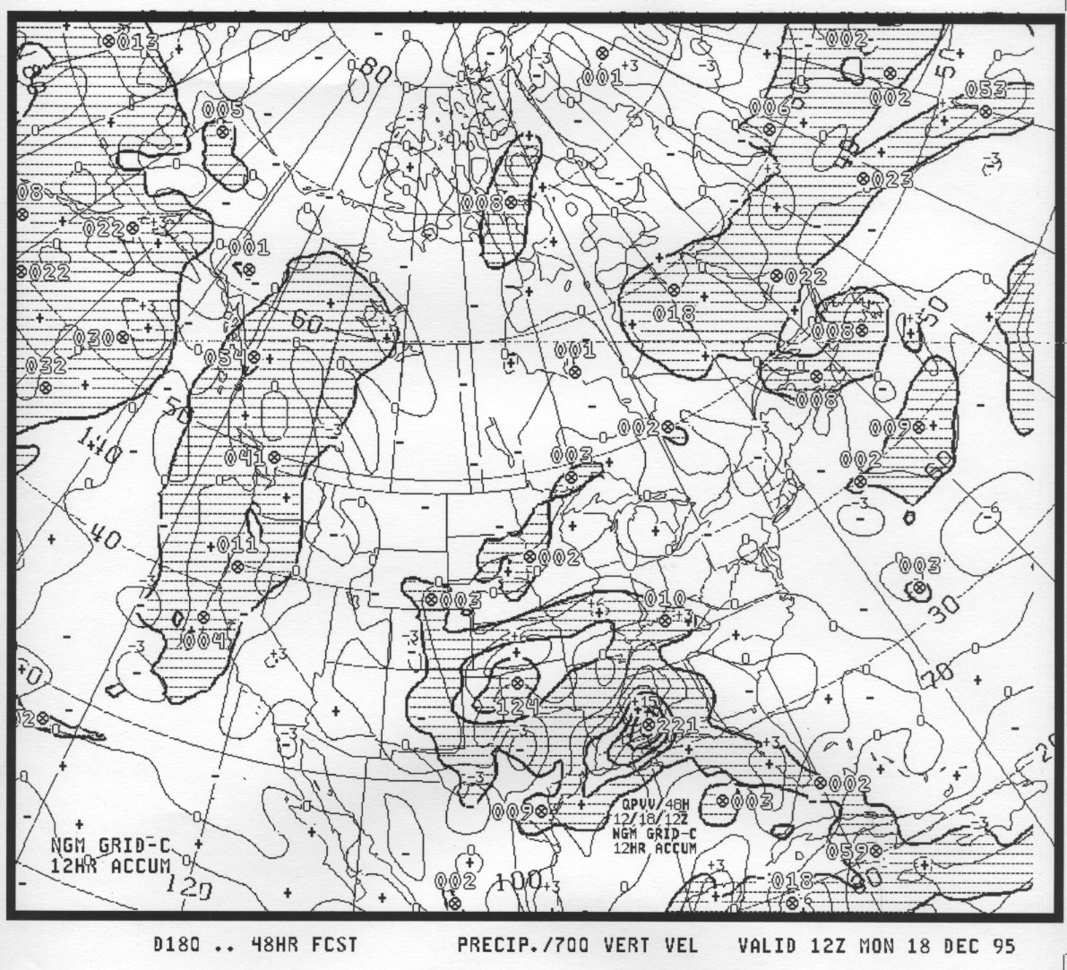
An Extraordinary Story
More than 30 years ago, there was essentially no high-resolution numerical weather prediction, defined as applying sufficient resolution to describe key regional weather features.
NGM 1995

Slide 3
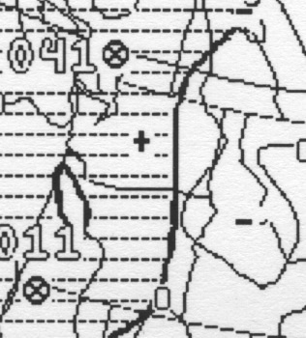
NGM, 80 km grid spacing, 1995

Slide 4
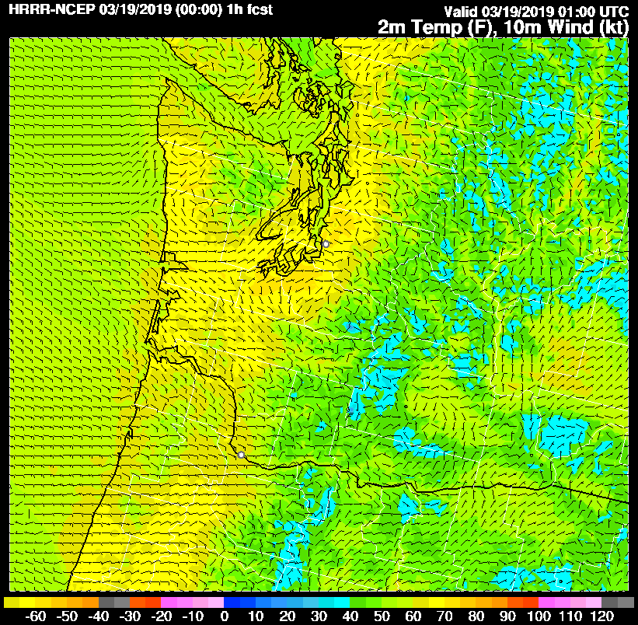
Today, High-Resolution Numerical Weather Prediction is Available from Several Sources, and Has Transformed Local Weather Forecasting
NOAA/NWS HRRR Model

Slide 5
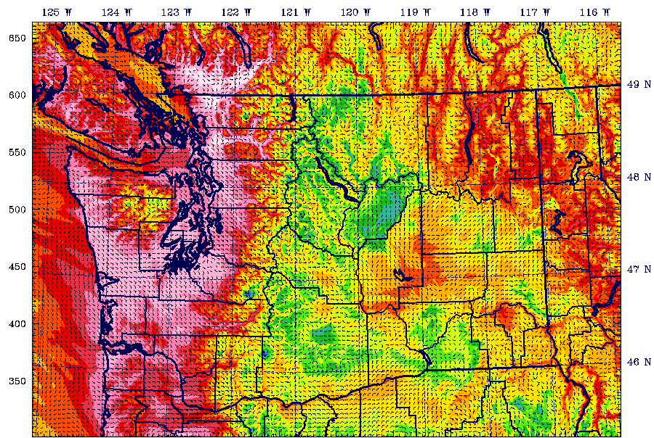
UW
WRF
Surface
Air
Temperature

Slide 6
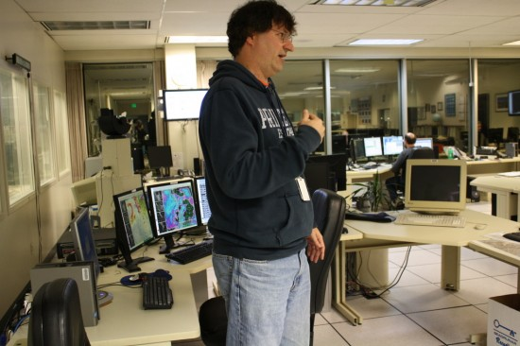
Before ~2000 all local weather features were forecast subjectively

Slide 7
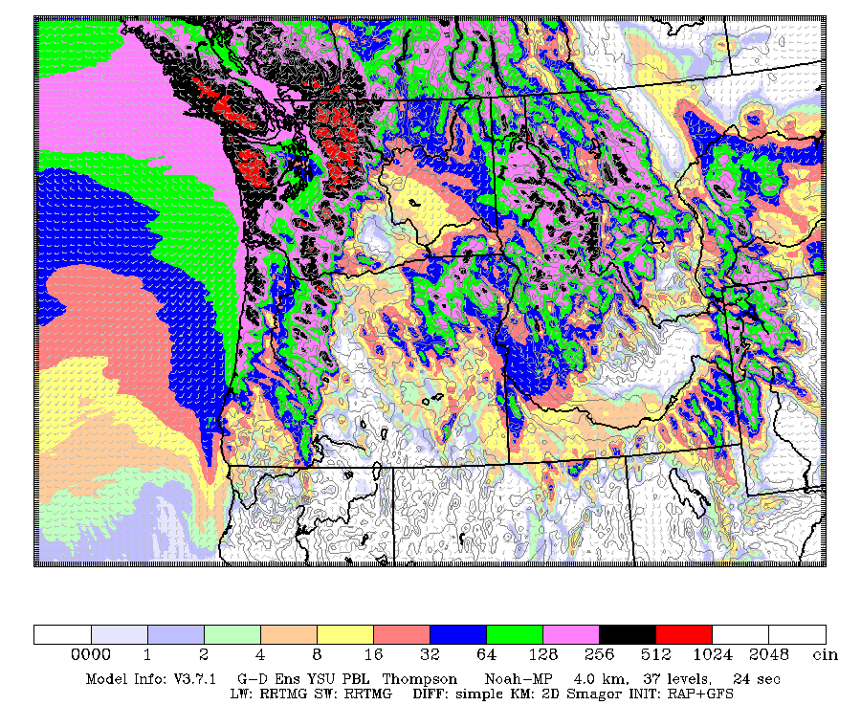
Today, high-resolution NWP has taken over

Slide 8

What Has Changed?
Availability of flexible mesoscale models (e.g.,. MM5, WRF)
Improved physics parameterizations
Far better large-scale (synoptic-scale) forecasts (which drives the high-resolution models)
Much, much more computer resources

Slide 9
How Much Horizontal Resolution is Needed to Prediction Northwest Weather Features?

Slide 10
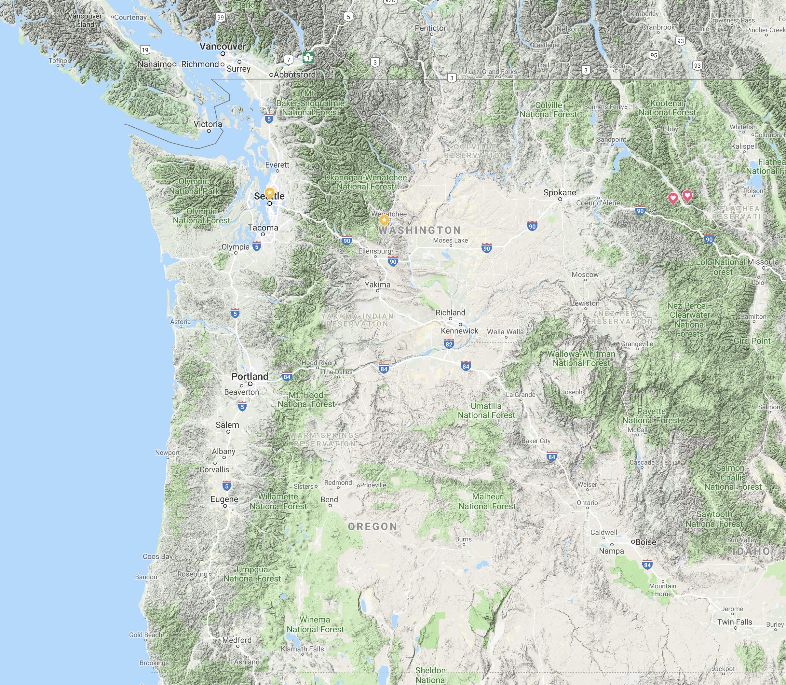
Many Local Weather Phenomena Are Produced By the Interaction of Large Scale Atmospheric Circulation with Local Topography
Gap winds
Orographic precipitation
Rain shadows
Downslope windstorm
Downslope warming
Fraser River cold air
Diurnal circulation
….and many more

Slide 11
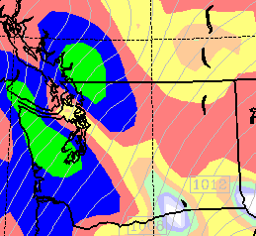
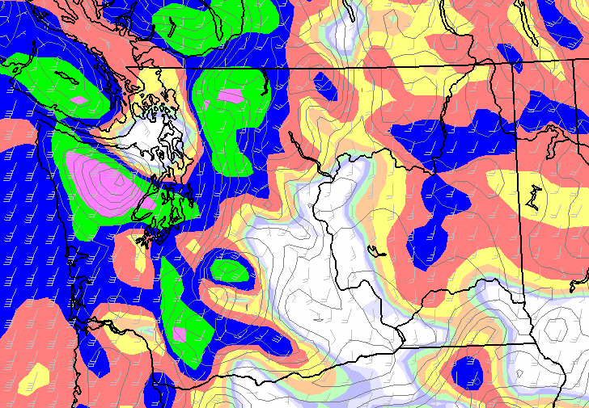
Extensive numerical experimentation has shown
That one needs to get down to ~ 12 km grid spacing to secure realistic regional mesoscale circulations
36-km
12-km

Slide 12
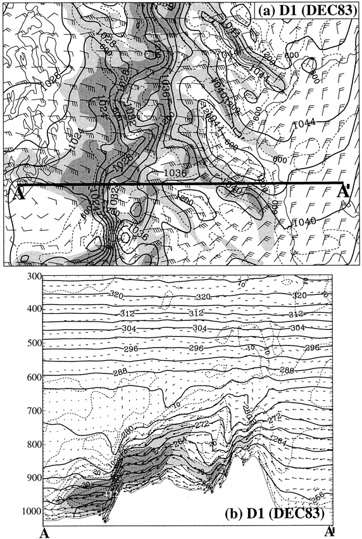
3-4 km Grid Spacing for the Puget Sound Convergence Zone and Downslope Windstorms
3-km MM5 Simulation Did An Excellent Job In Duplicating Downslope Windstorm,9 and 27-km did not

Slide 13
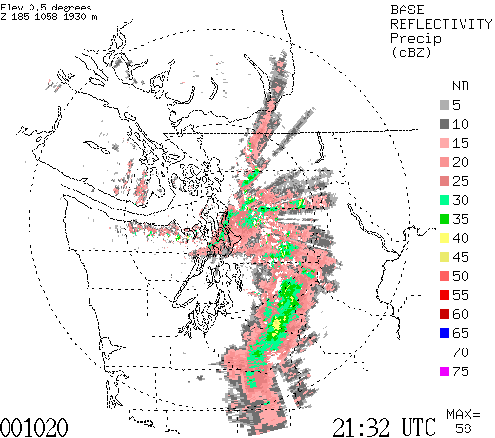

Slide 14
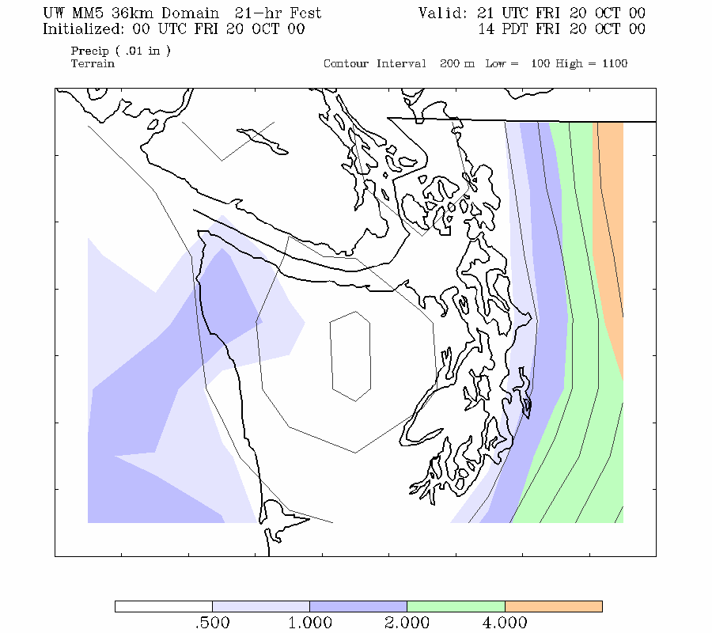

Slide 15
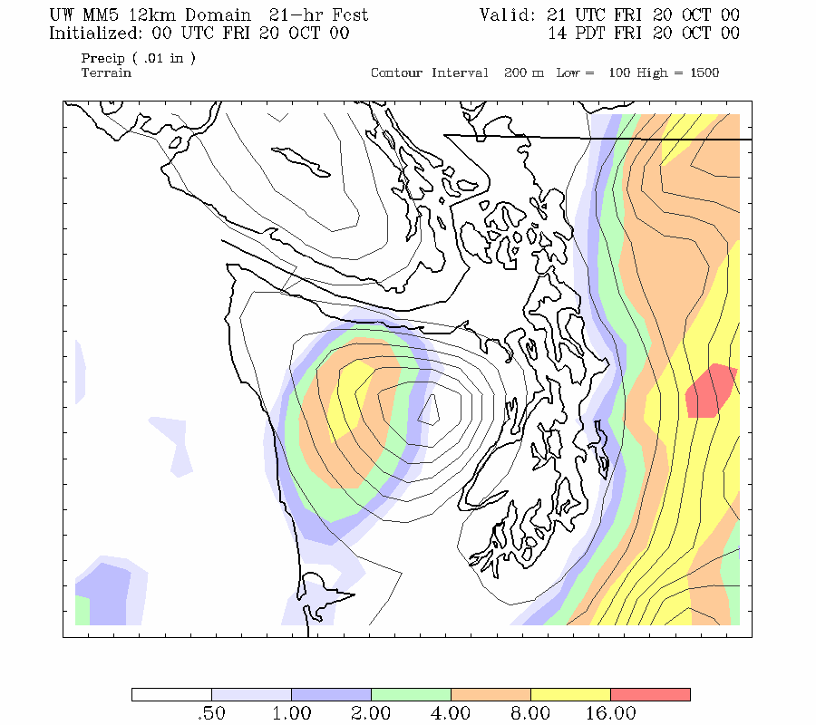

Slide 16
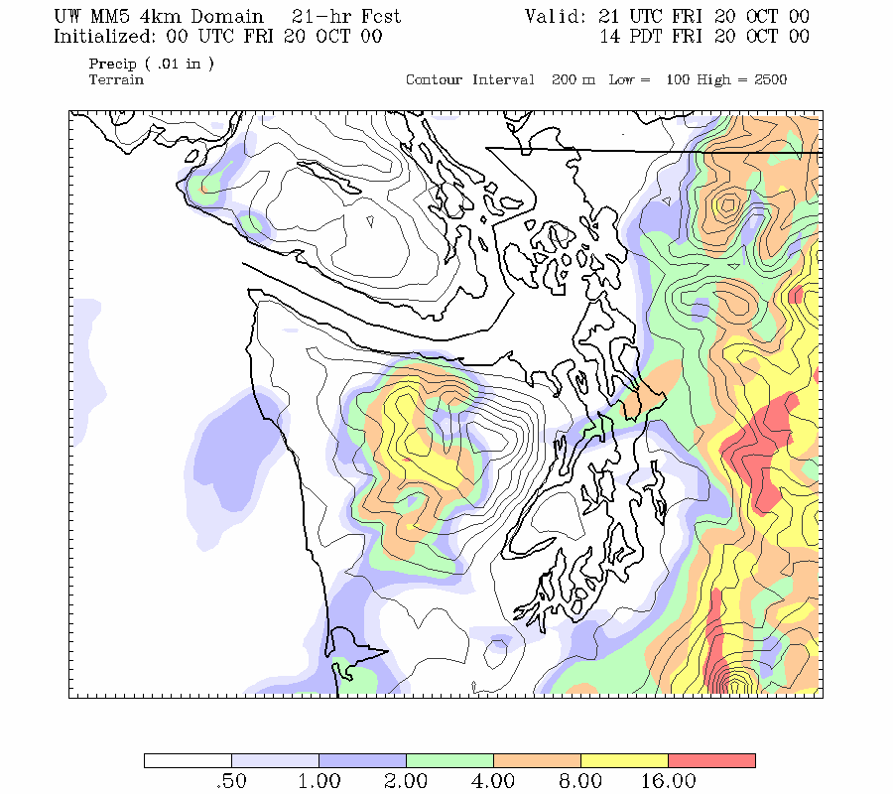

Slide 17
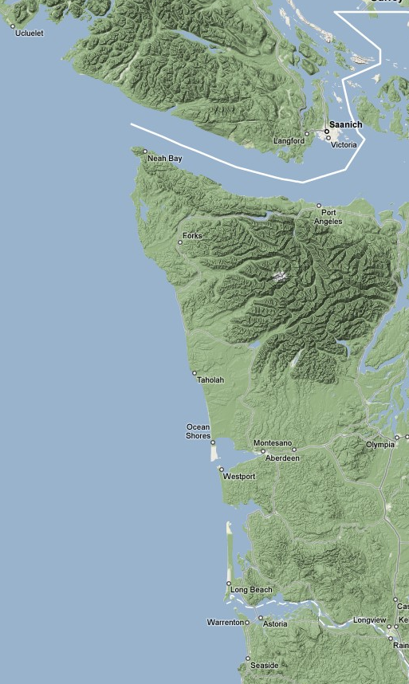
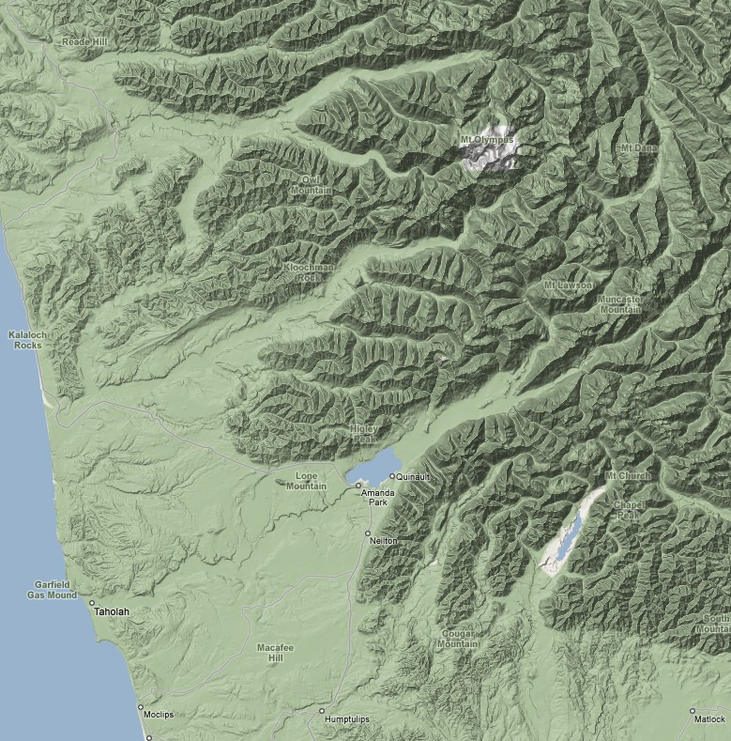
Smaller Scale Terrain Modulates
Precipitation
10-km

Slide 18
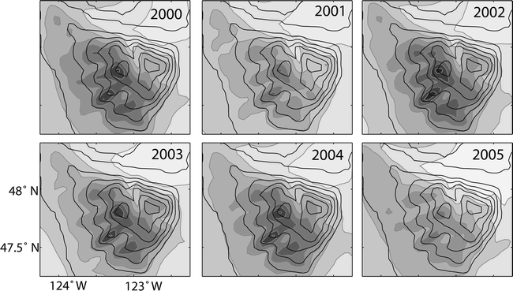
Annual Climatologies of MM5 4-km domain

Slide 19
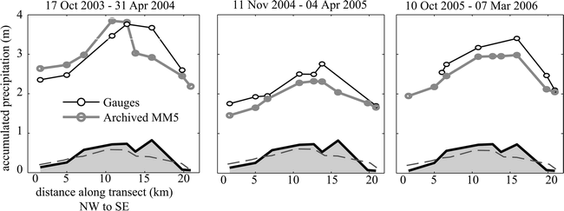
Verification of Small-Scale Orographic Effects

Slide 20
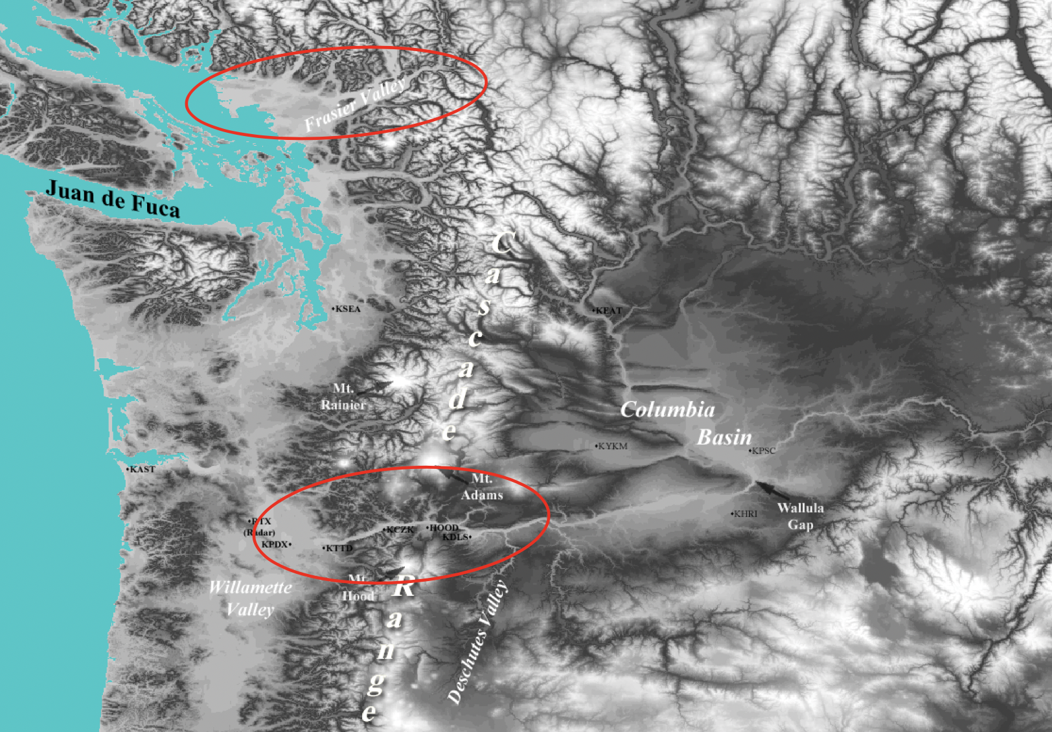
High Resolution Modeling Proves Capable of Simulating Regional Gap Flows

Slide 21
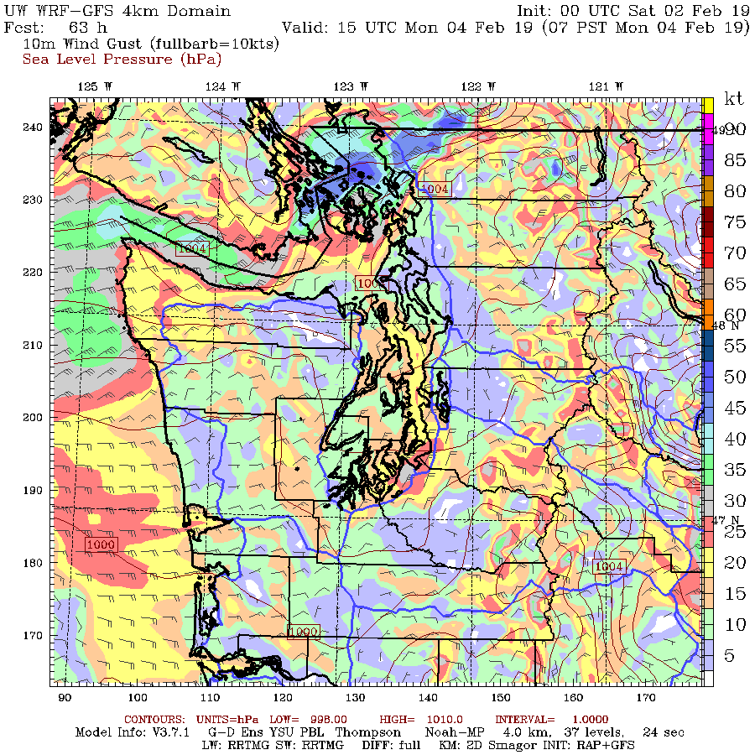
The Fraser Gap is an important sources of cold air and well forecast

Slide 22
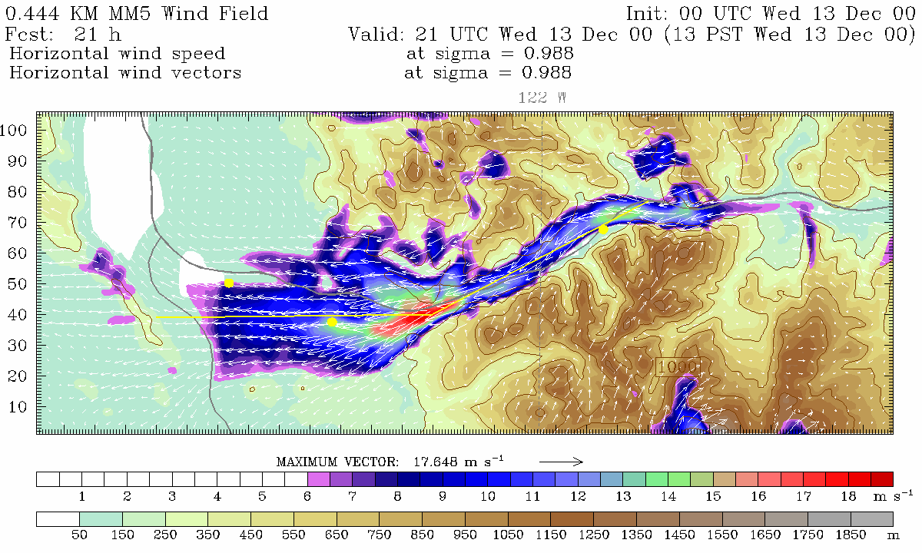
1-km Grid Spacing or Less Needed for Narrow Gaps (Columbia Gorge)

Slide 23
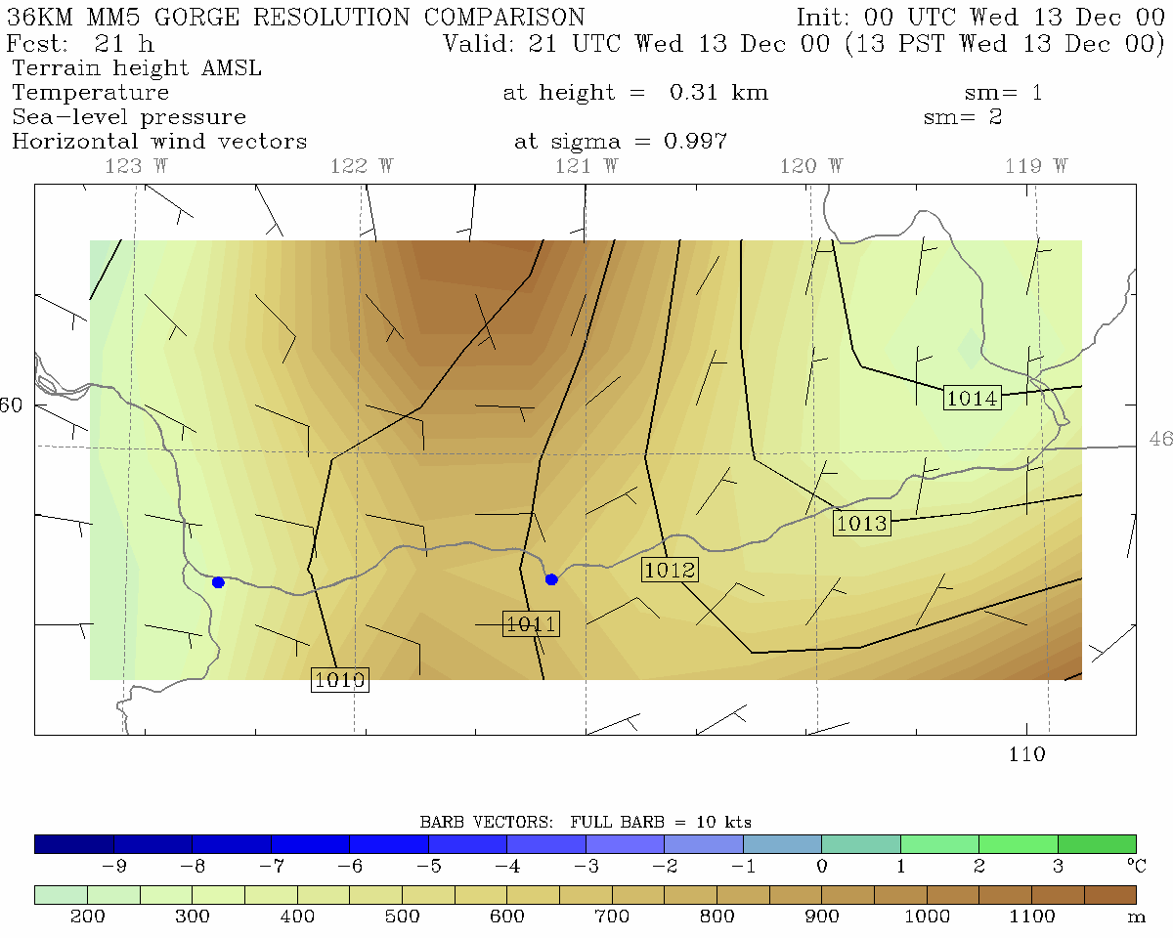
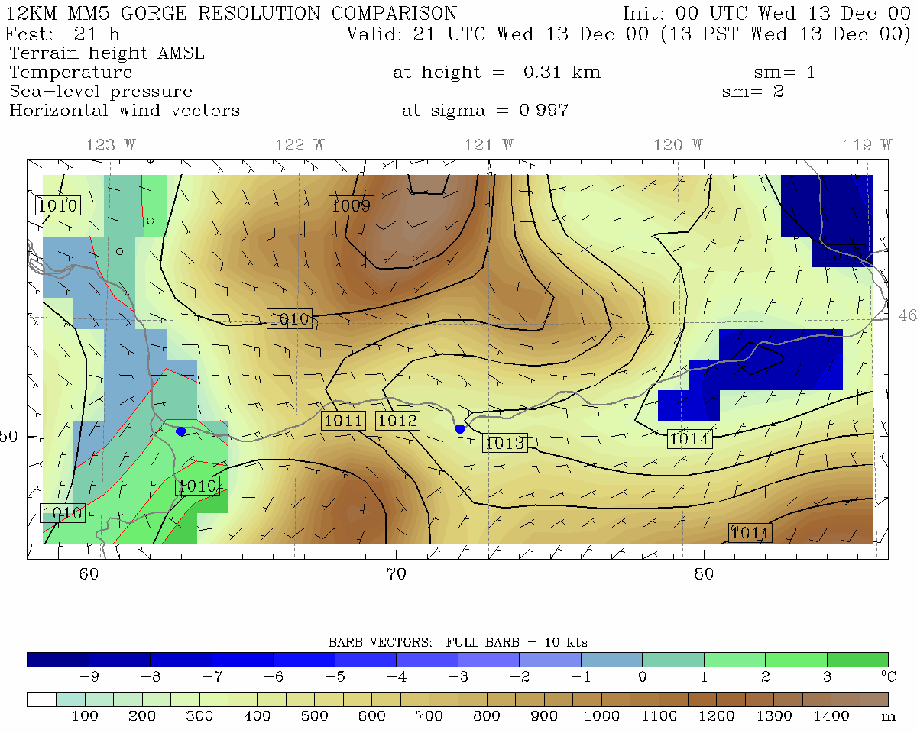
36 km grid spacing
12 km grid spacing
Portland
The Dalles
Portland
The Dalles
Pass Height = 700 m
Pass Height = 600 m

Slide 24
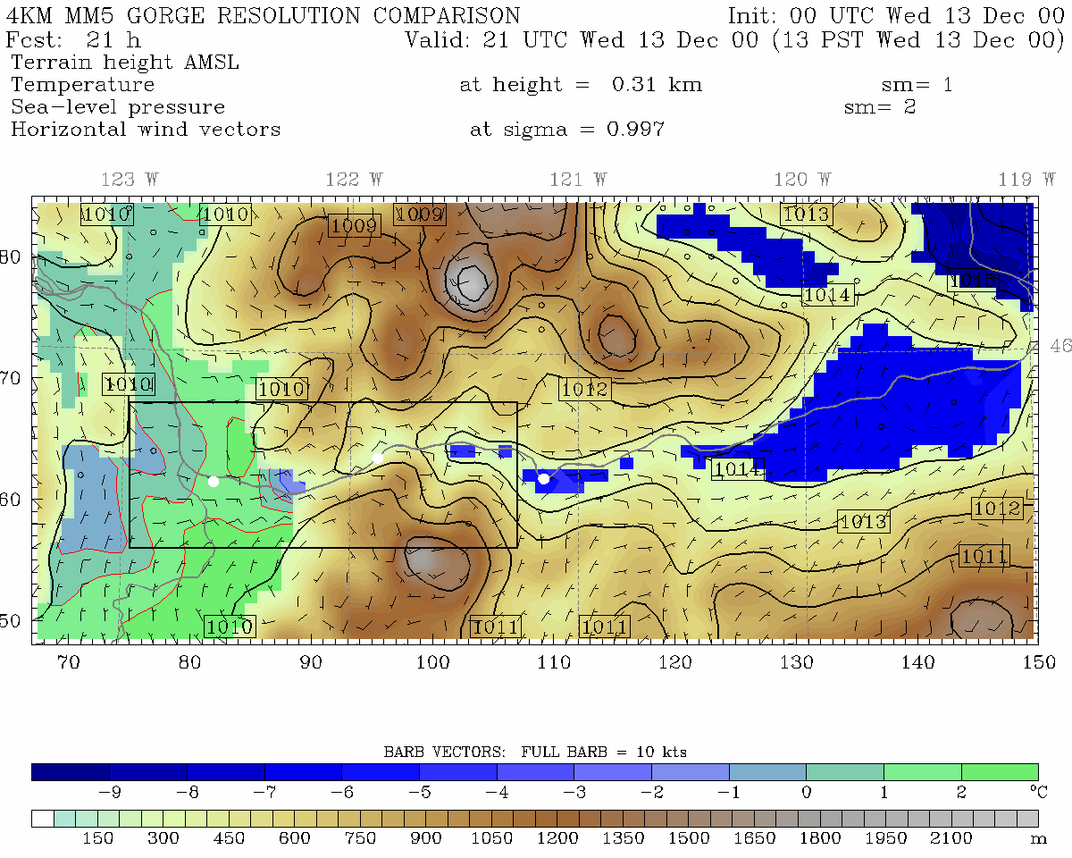
4 km grid spacing
12 km grid spacing
Portland
Cascade Locks
The Dalles
Portland
The Dalles
Pass Height = 400 m
Pass Height = 600 m

Slide 25
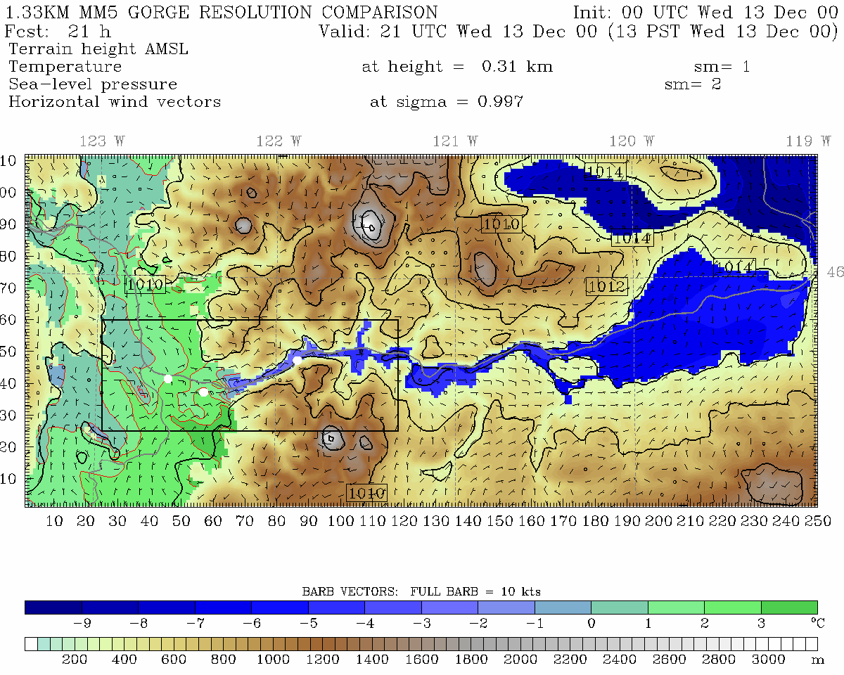
1.33 km grid spacing, Pass Height = 150 m
•
Portland
Cascade Locks
The Dalles
Troutdale
Notes:
Min pass height is at far right of domain near Cascade Locks

Slide 26
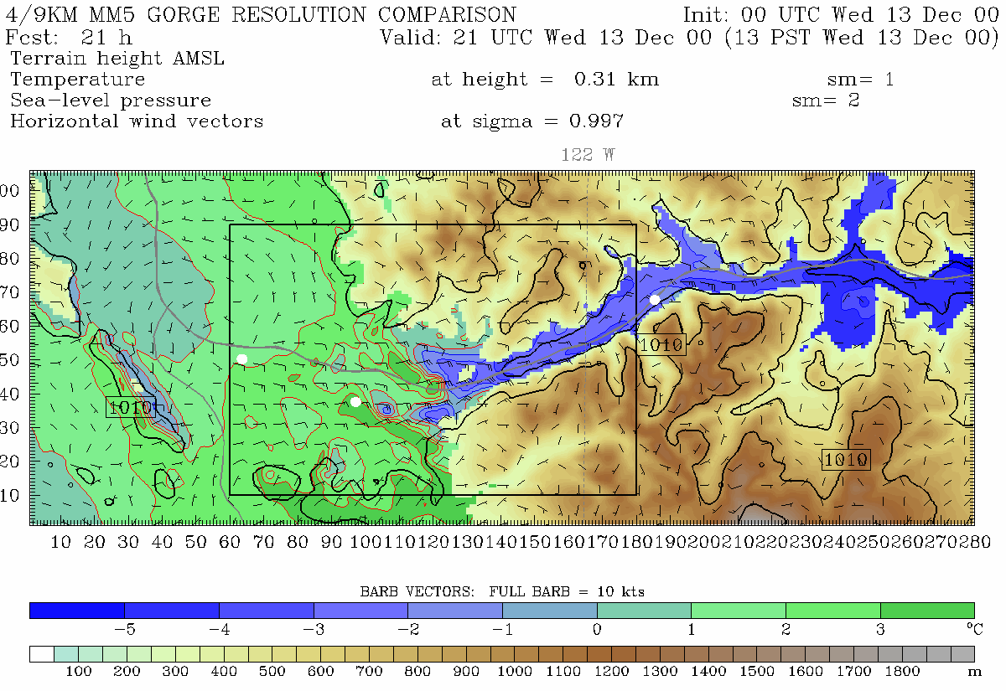
444.4 m grid spacing, Pass Height = 100 m
Portland
Troutdale
Cascade Locks
Notes:
Min pass height is at far right of domain near Cascade Locks (same place as 4/3 domain)
This plot is from 310 m. Note, vortex. See this on radar data too. Zoomed in plot will be from 150 m

Slide 27
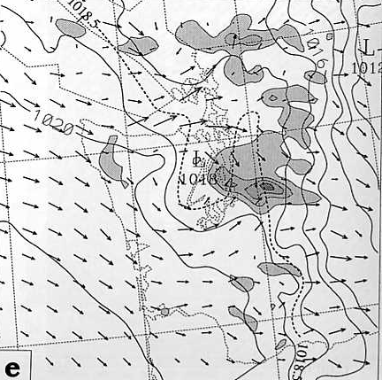
Another Interesting Finding
Many of our local weather effects result from the interaction of large-scale fields with fixed terrain.
Thus, the predictability of many of local features reflect large-scale predictability rather than more chaotic internally driven mesoscale circulations.

Slide 28
Perhaps the most profound example of progress is in western WA snowstorms

Slide 29
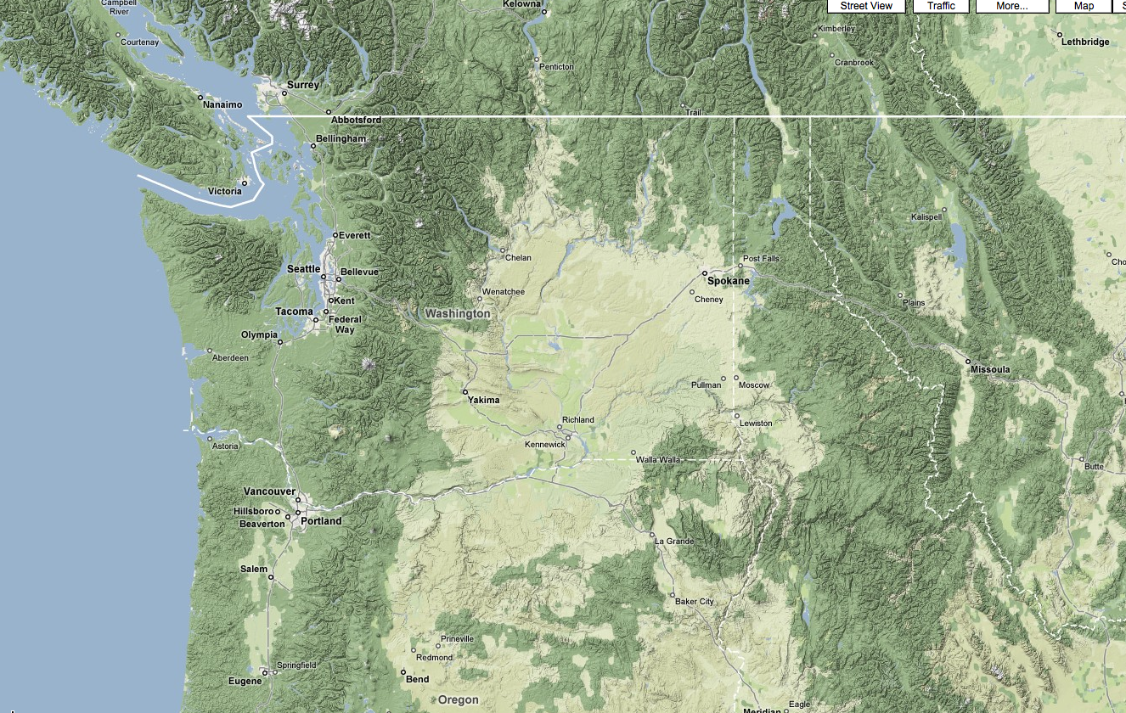
Cold Air
Moisture

Slide 30
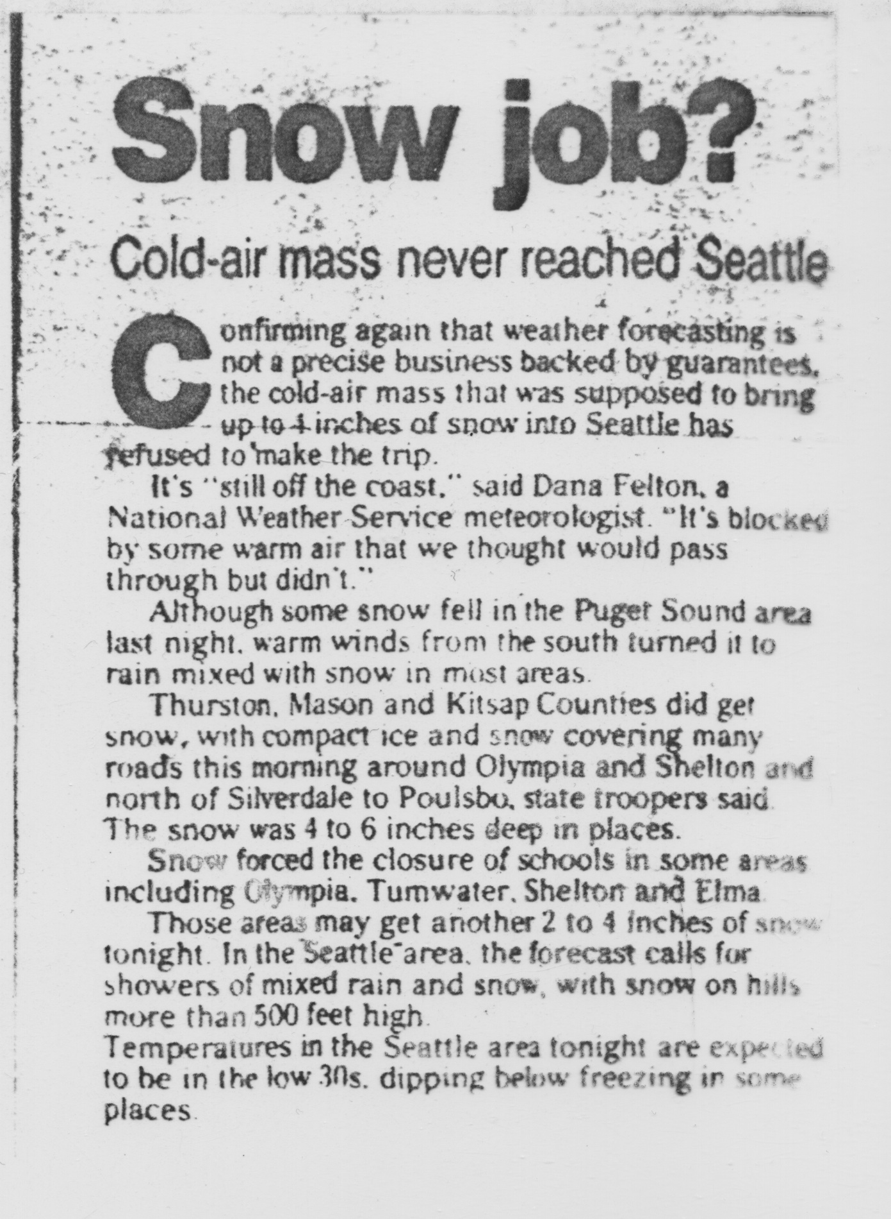
Historically, models have done a very poor job (Feb 1999)

Slide 31
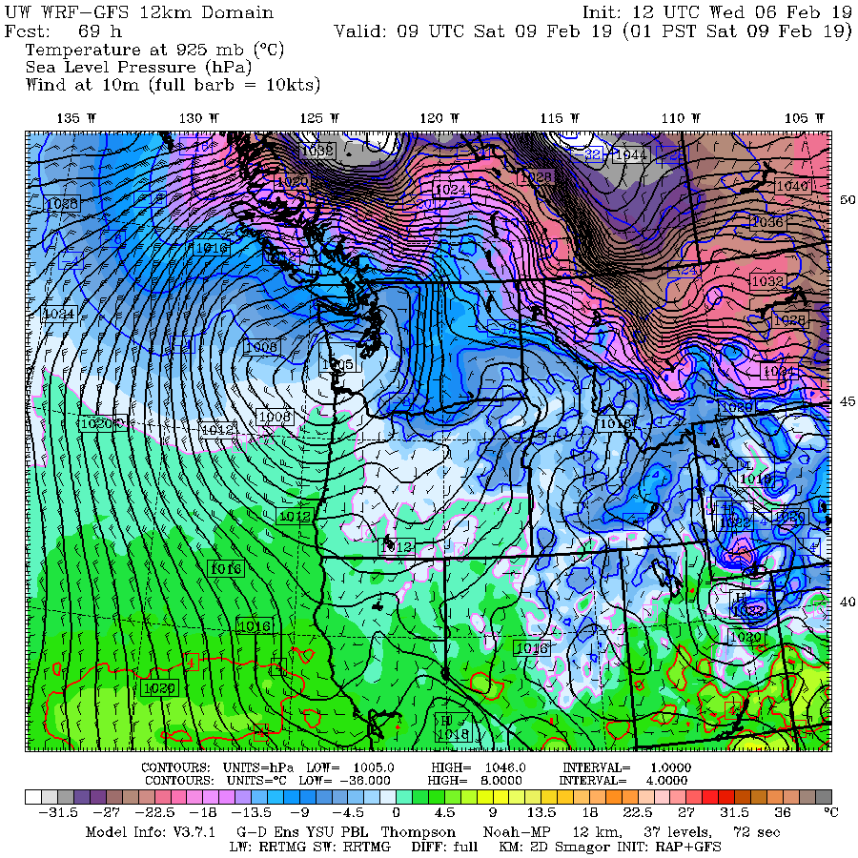
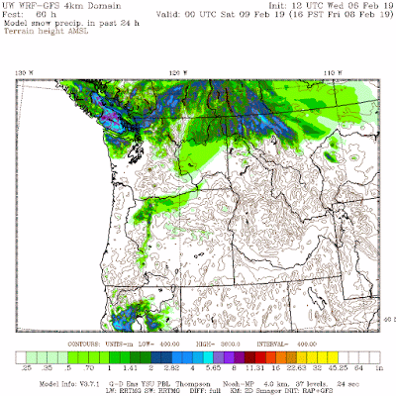
This year was different: we nailed one after another

Slide 32
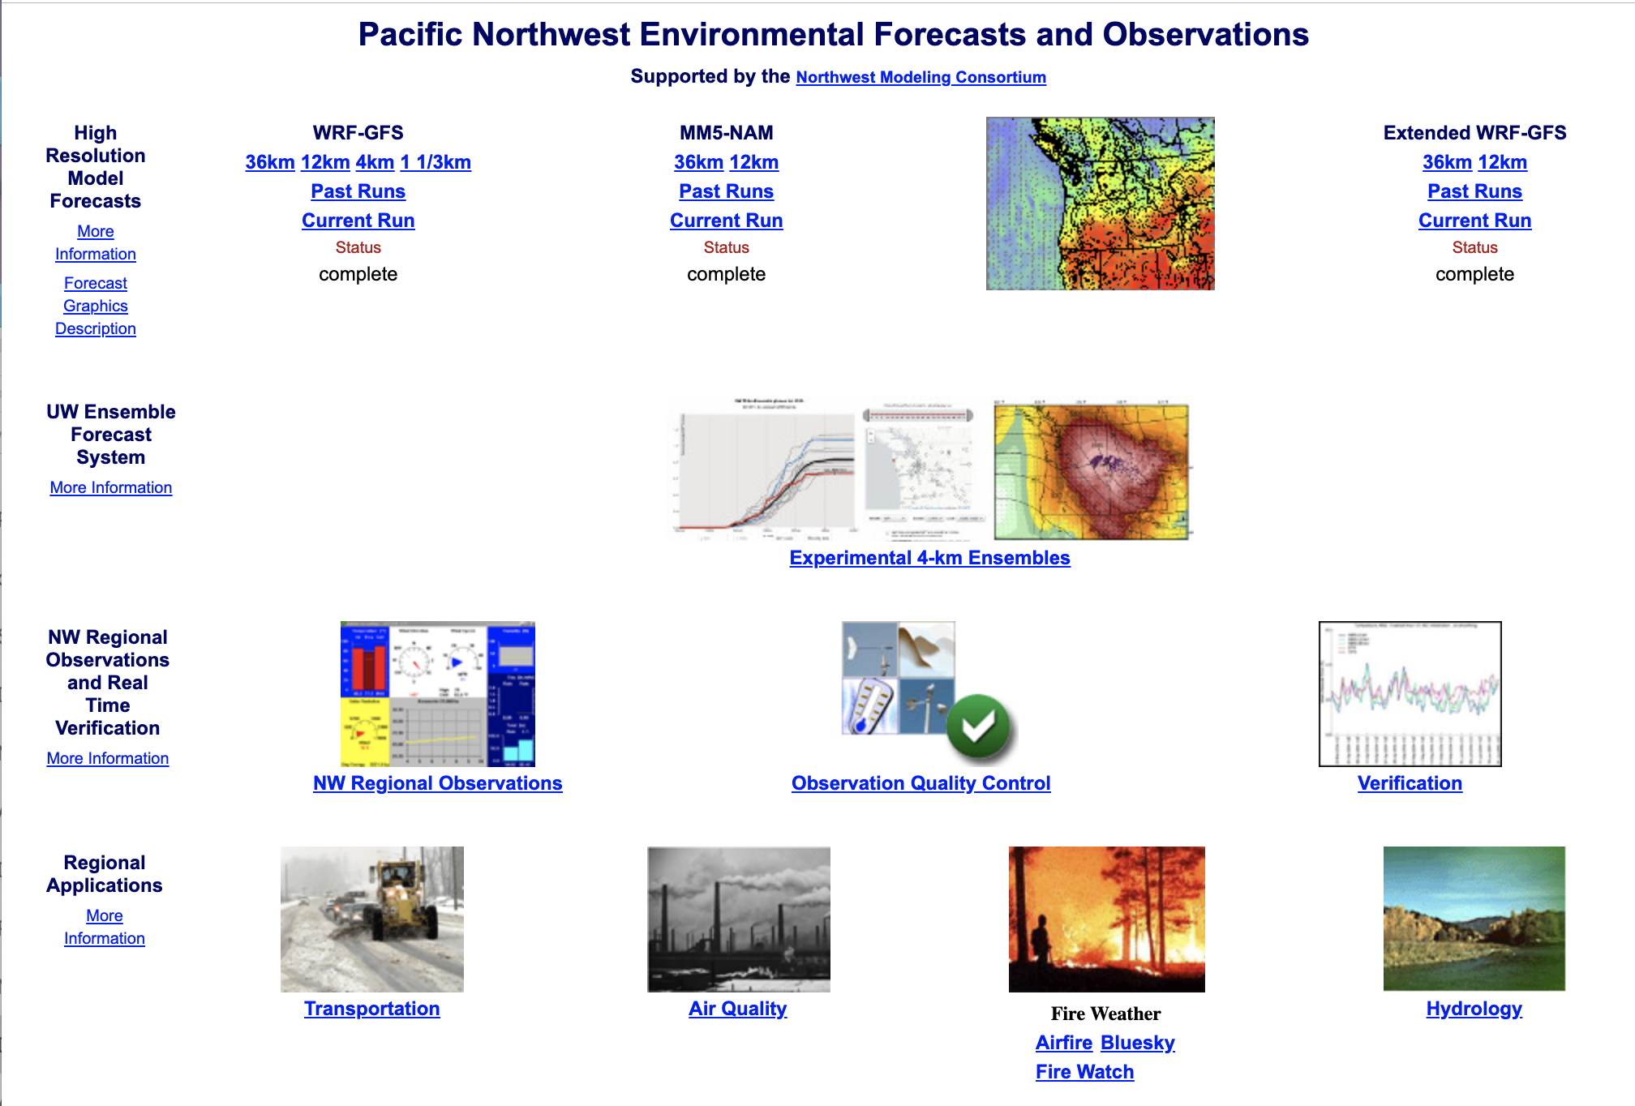
Current UW Real-Time WRF Modeling System
Funded by the Northwest Modeling Consortium
Runs WRF twice a day at 36-12-4-1.3 km grid spacing
Physics optimized for the region
Out to 84 hr at 4/1.3 km, 180 h for 12-km
16 member 4-km ensemble
Run on ~440 cores

Slide 33
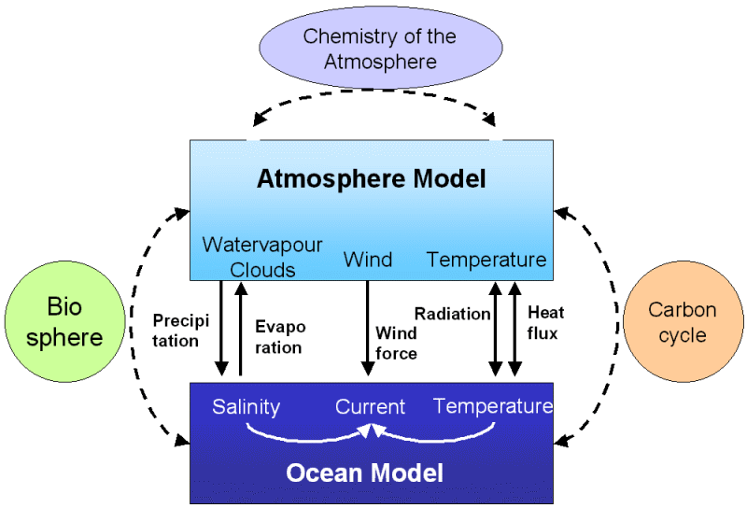
The Advent of High-Resolution Model Coupling
It became obvious by the late 1990s that high resolution atmospheric models had substantial skill.
Why not couple them with other models (ocean, hydrological, air quality) to create more complete environmental prediction systems?

Slide 34
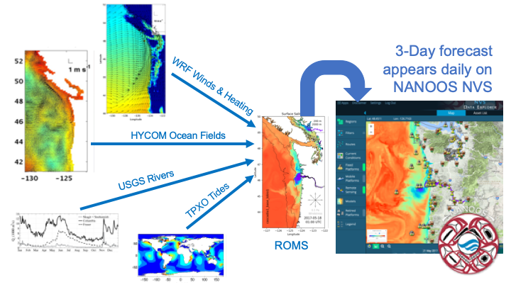
Regional Ocean Modeling Driven by the High-Resolution WRF: Live Ocean with Parker McCready’s Group

Slide 35
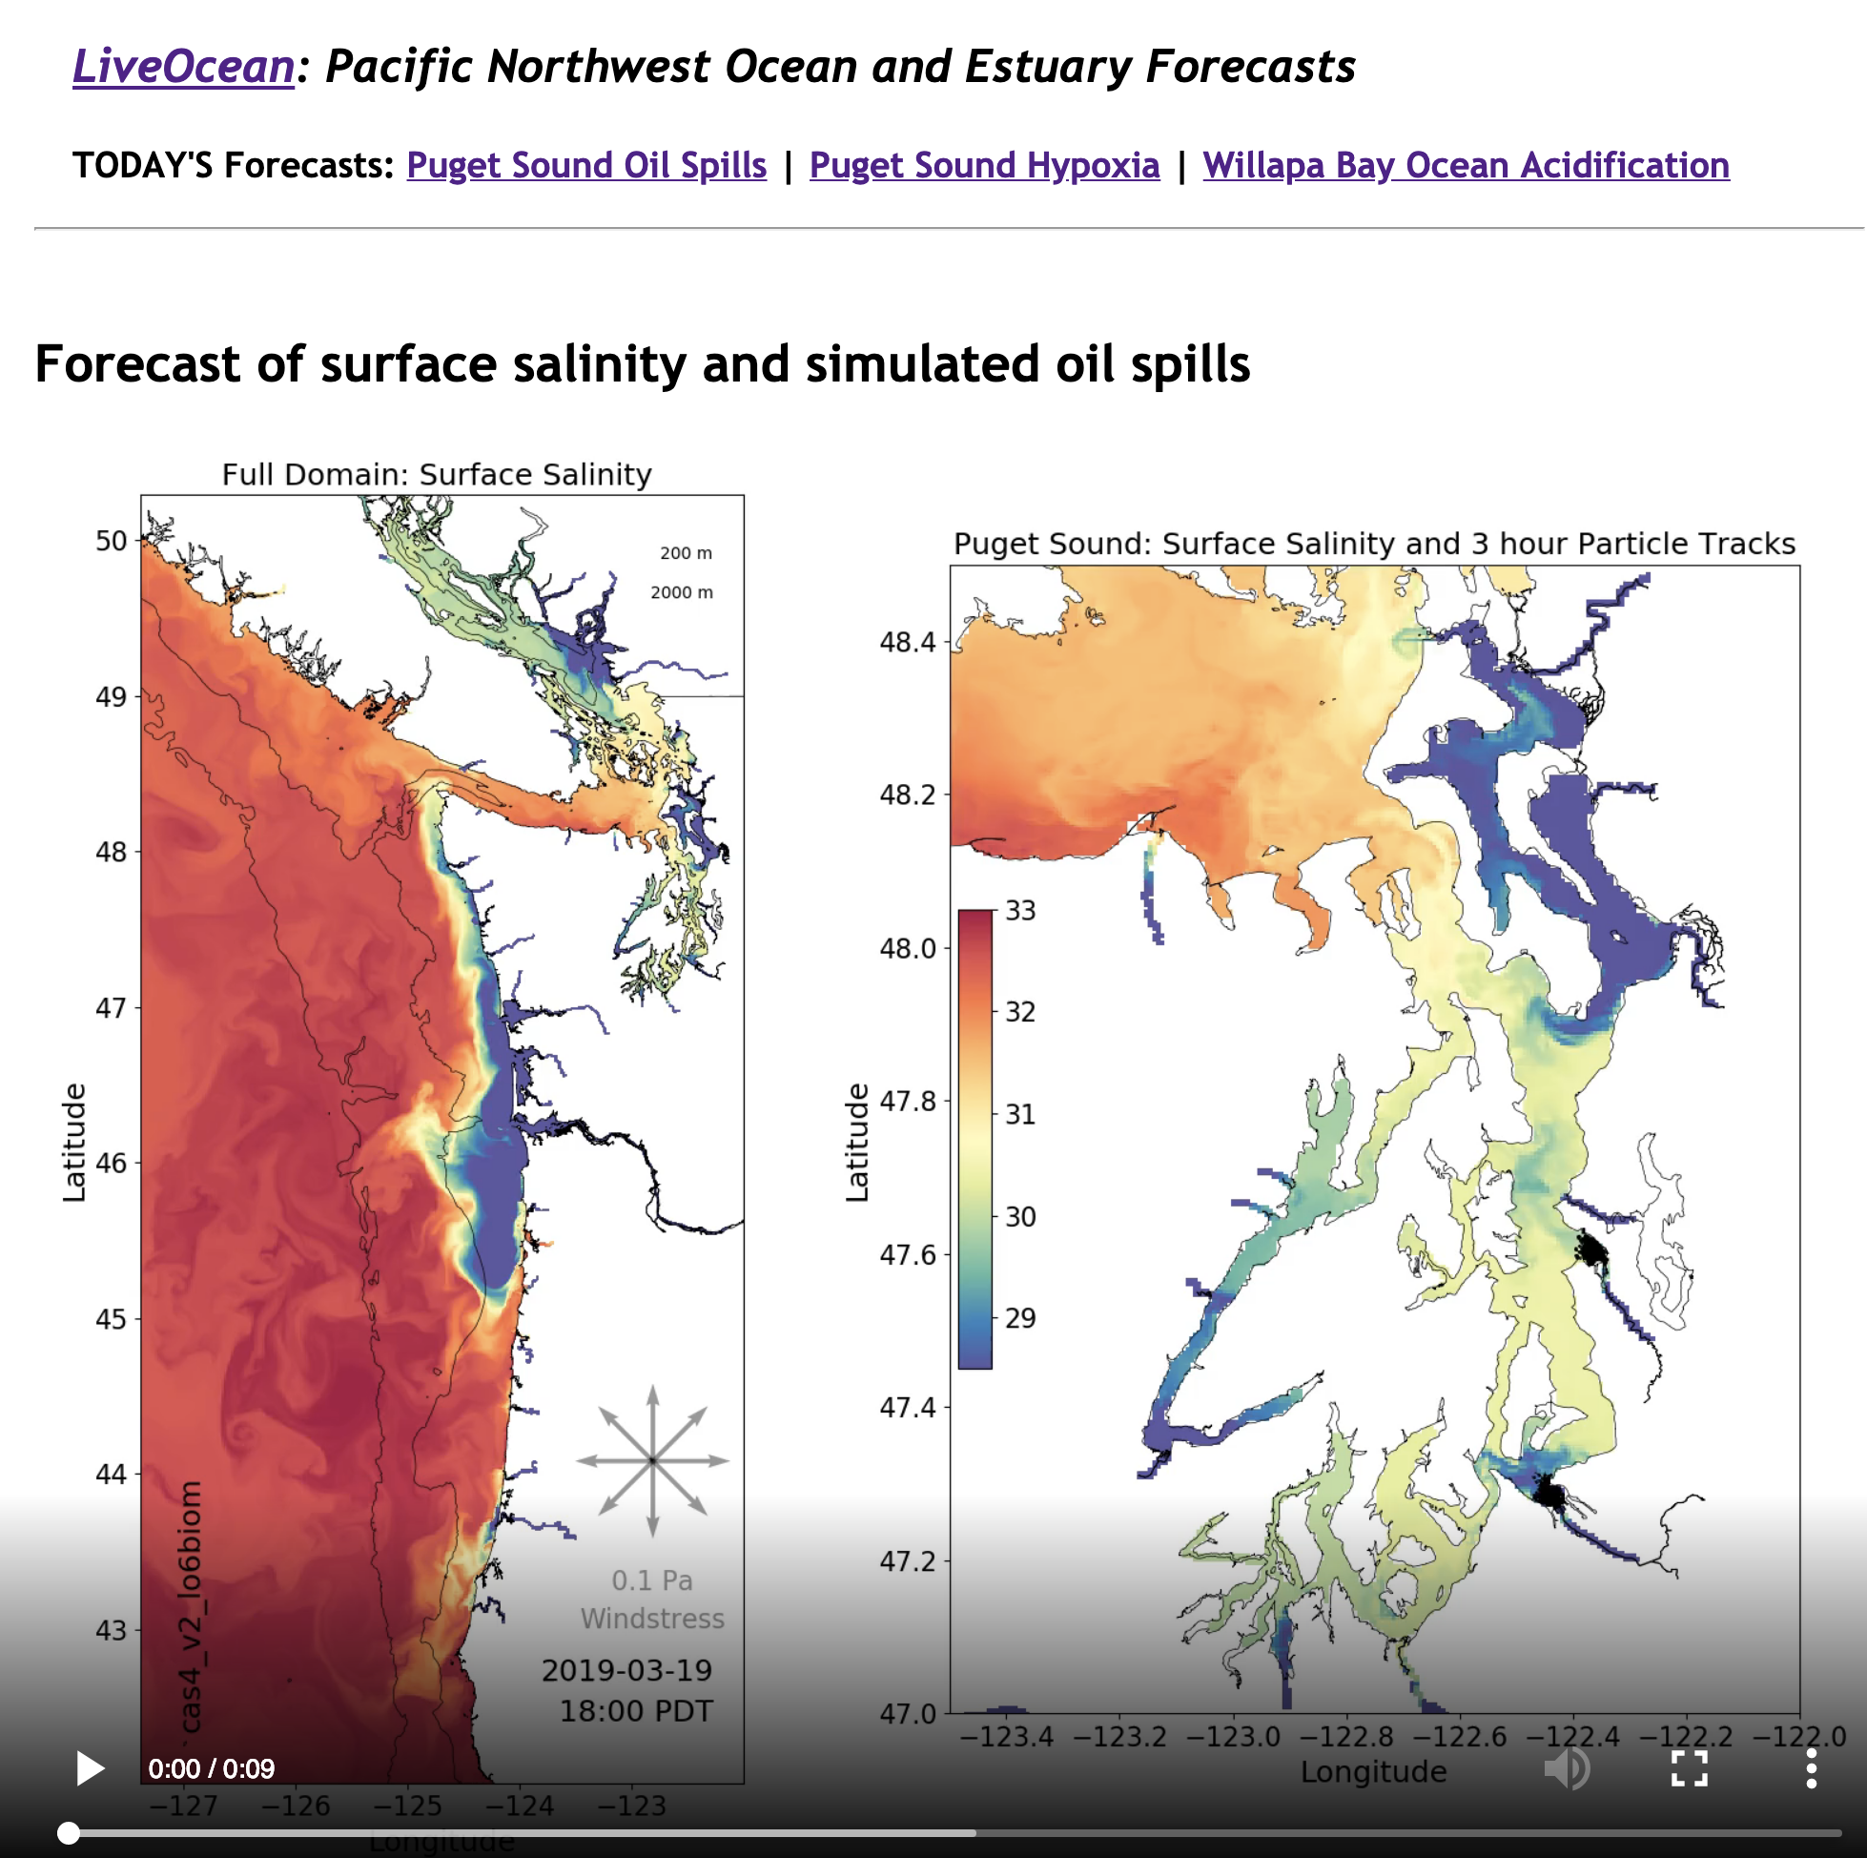

Slide 36
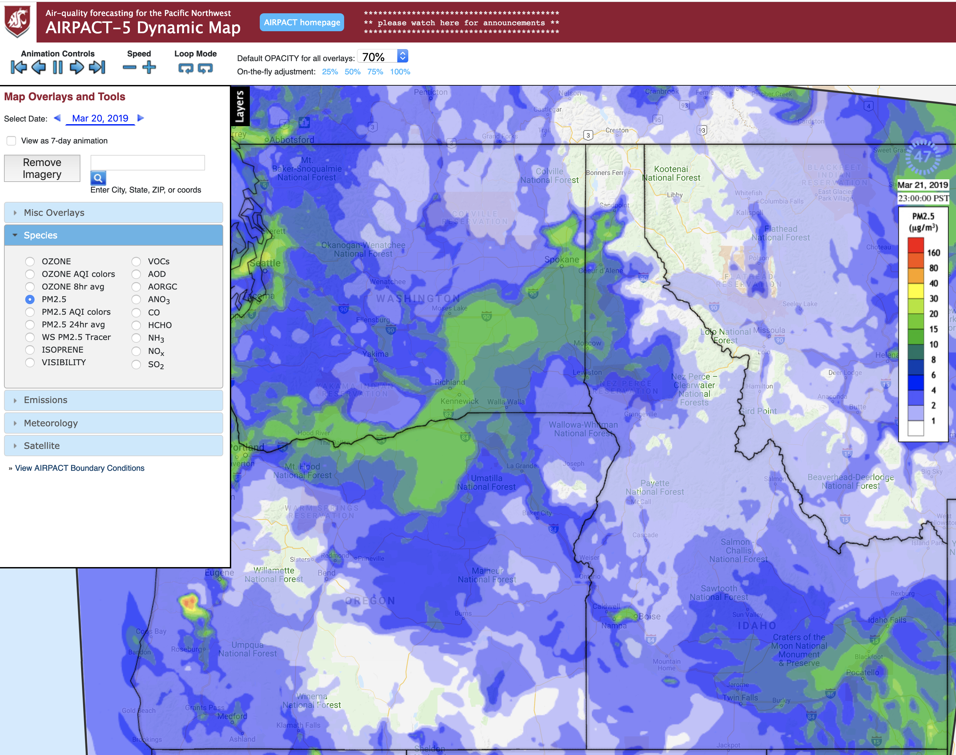
Air Quality and Smoke Modeling with WSU

Slide 37
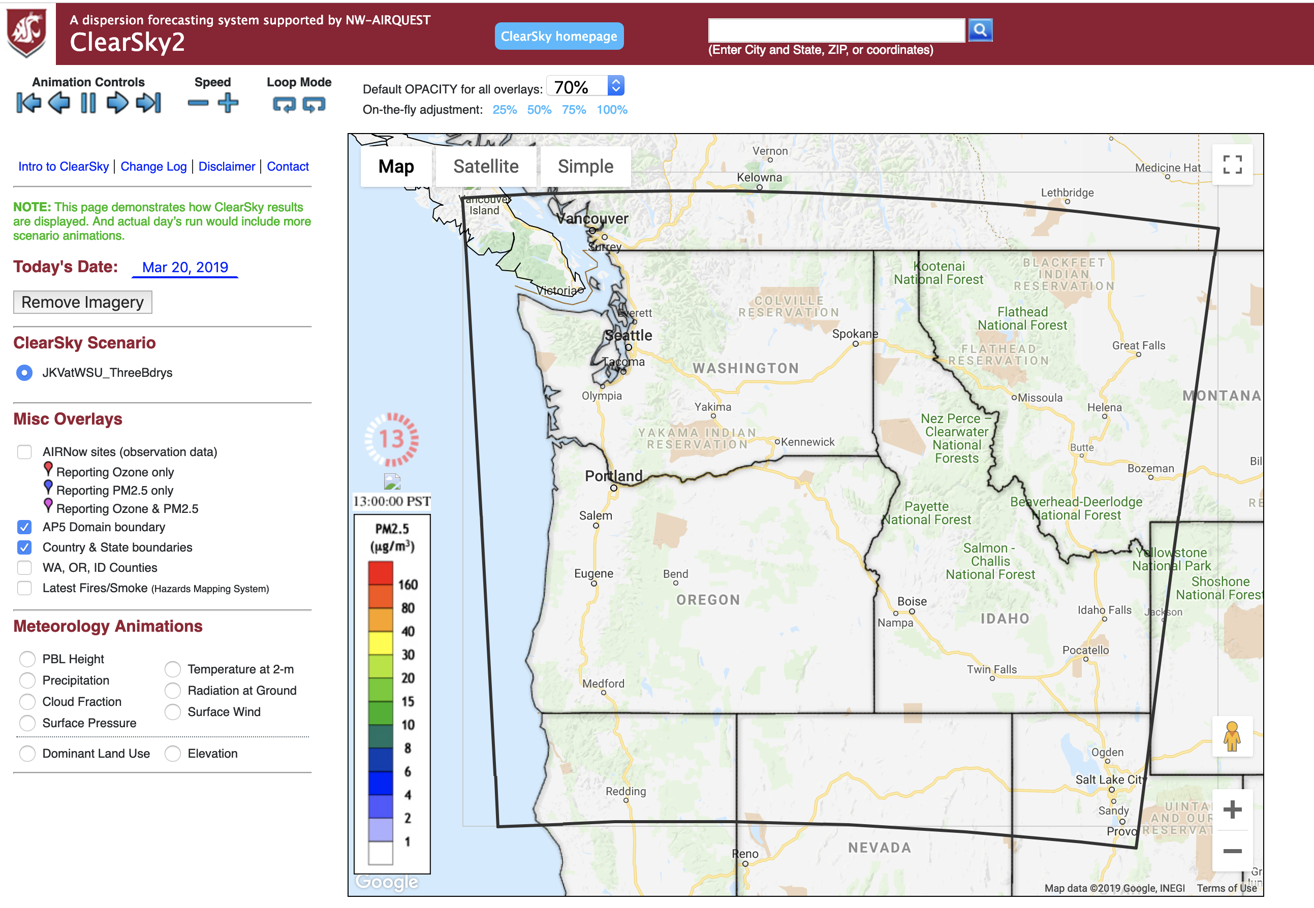
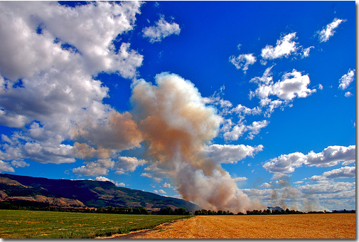

Slide 38
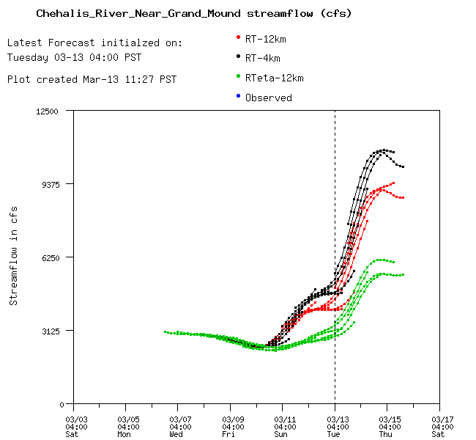
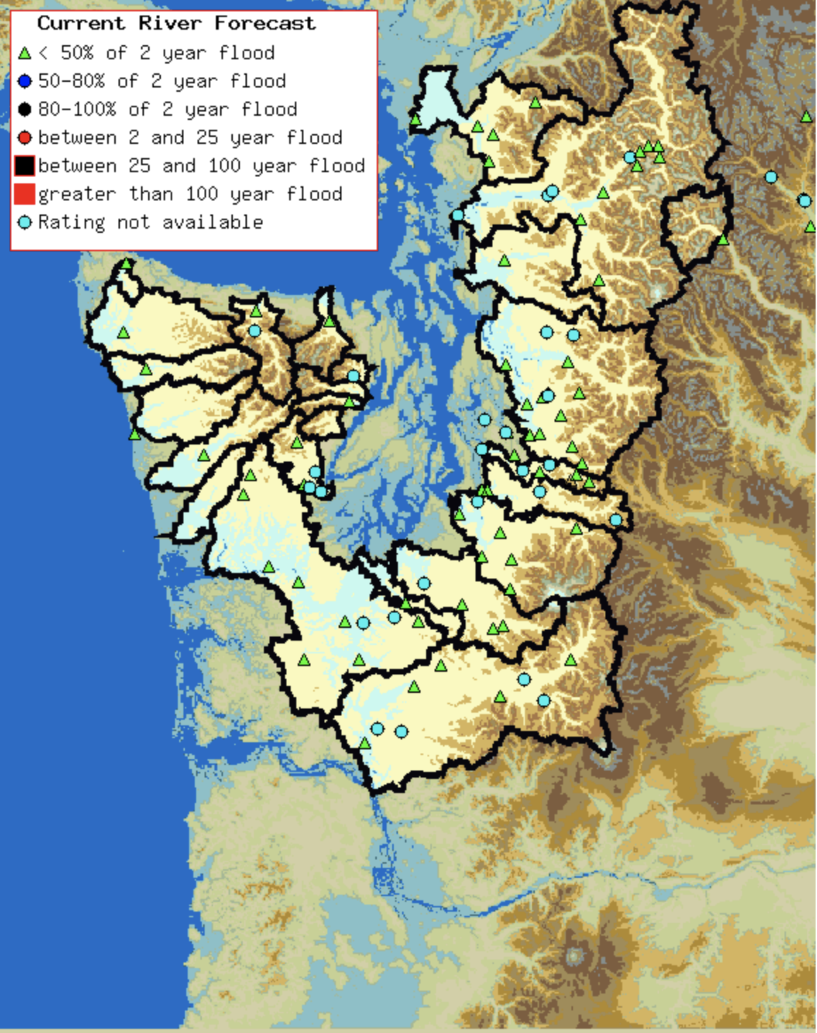
Hydrological Modeling
DHSVM Hydrograph
From WRF driven by
A large-scale model

Slide 39
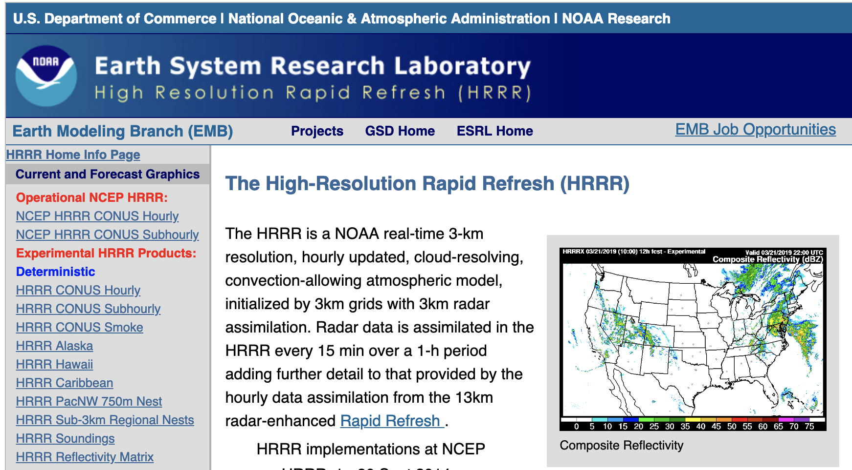
Major Advance: NOAA/NWS High Resolution Rapid Refresh (HRRR)
Runs every hour at 3-km grid spacing
Run out to 36 hr
Uses a wide variety of data sources

Slide 40
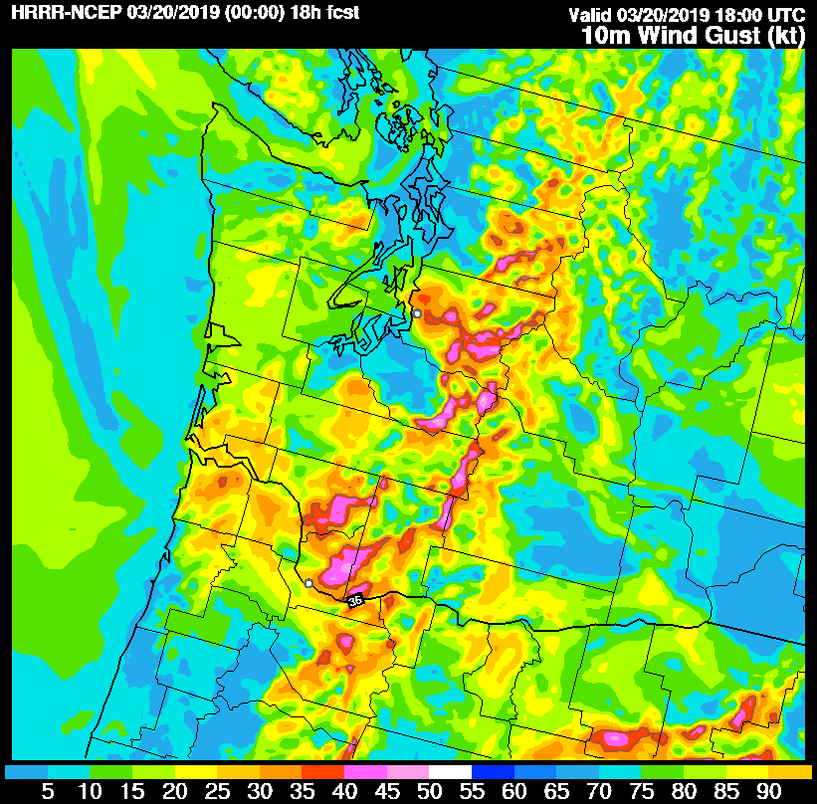

Slide 41
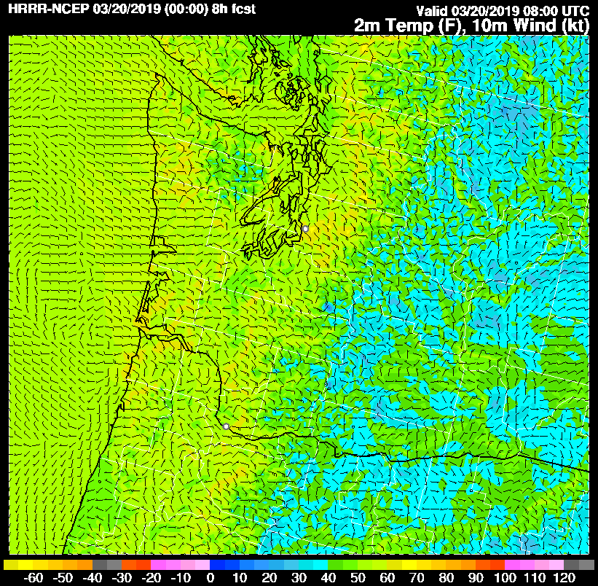

Slide 42

But high resolution regional modeling is not good enough
There is uncertainty in initial conditions
There is uncertainty in boundary condition
There is uncertainty in model physics
Uncertainty varies by synoptic situation
Need to quantify this uncertainty and provide probabilistic high-resolution predictions

Slide 43
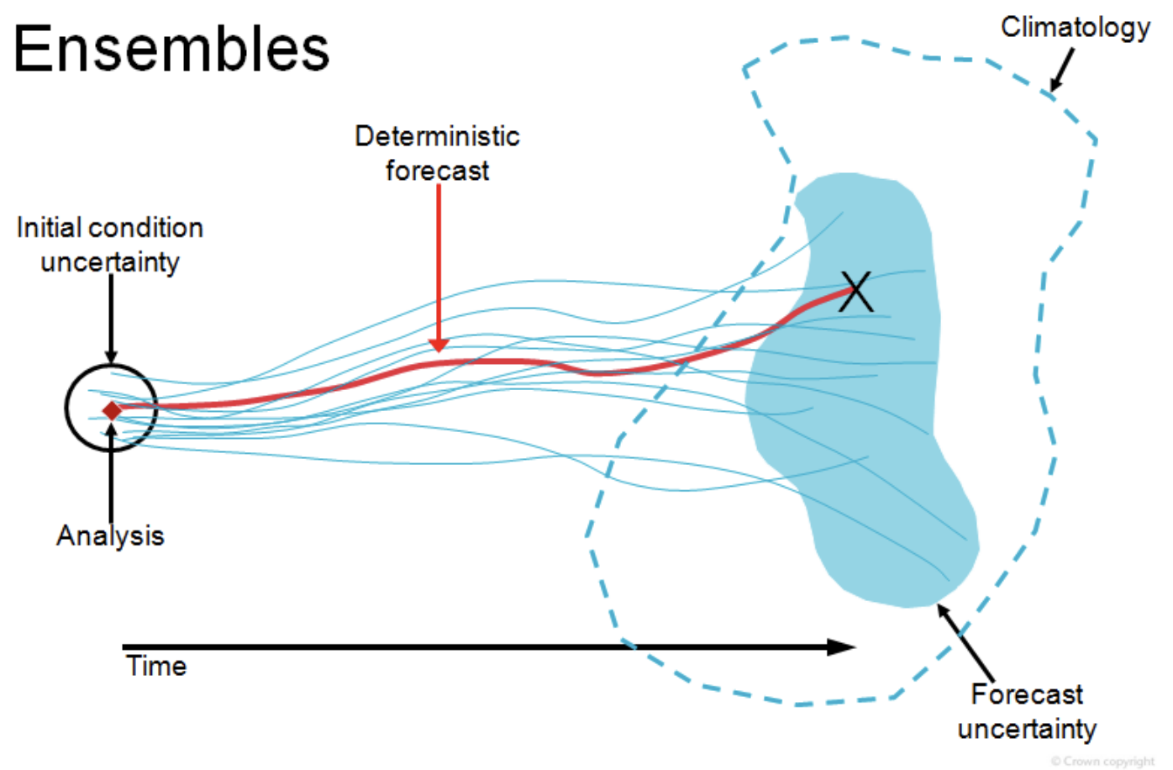
Need high-resolution ensembles
Run the regional model many times to explore initial condition and physics uncertainty.
Inherently parallel and possible to do as computer nodes got cheaper.
Needs statistic post-processing to calibrate

Slide 44
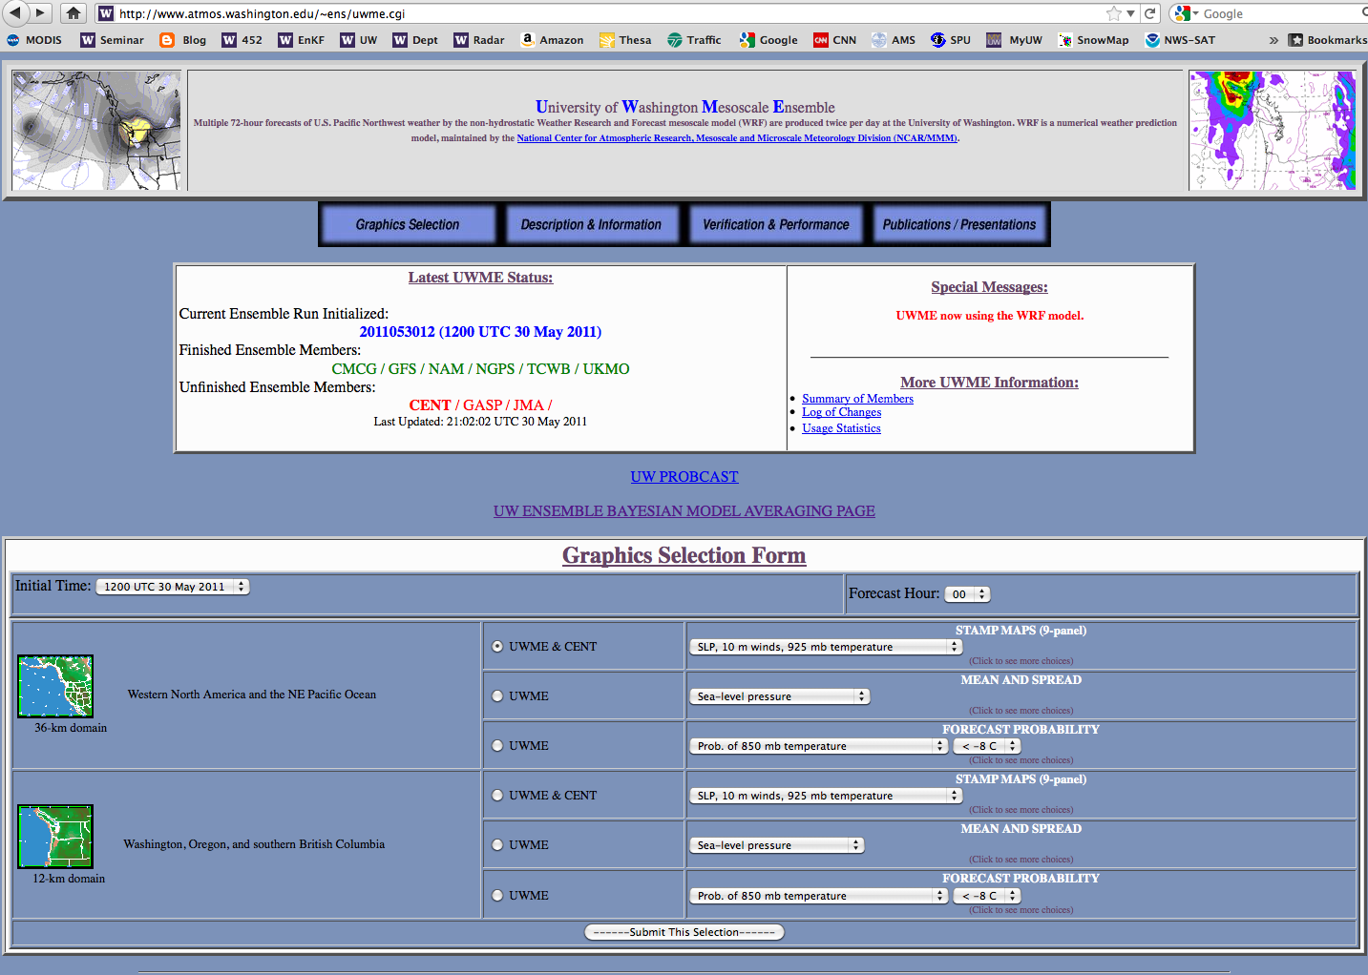

Slide 45
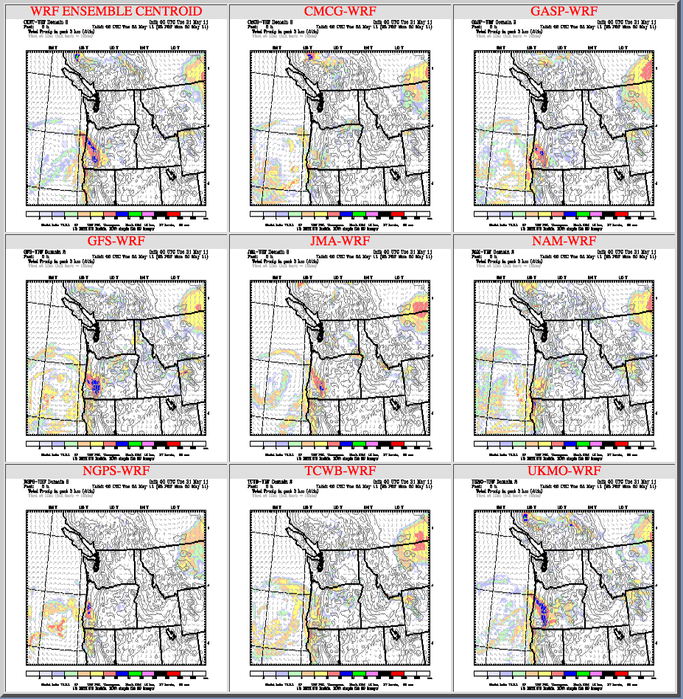

Slide 46
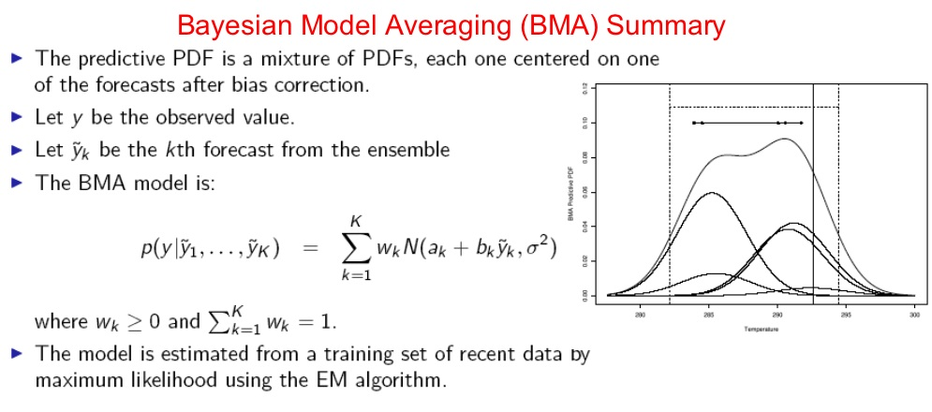

Slide 47
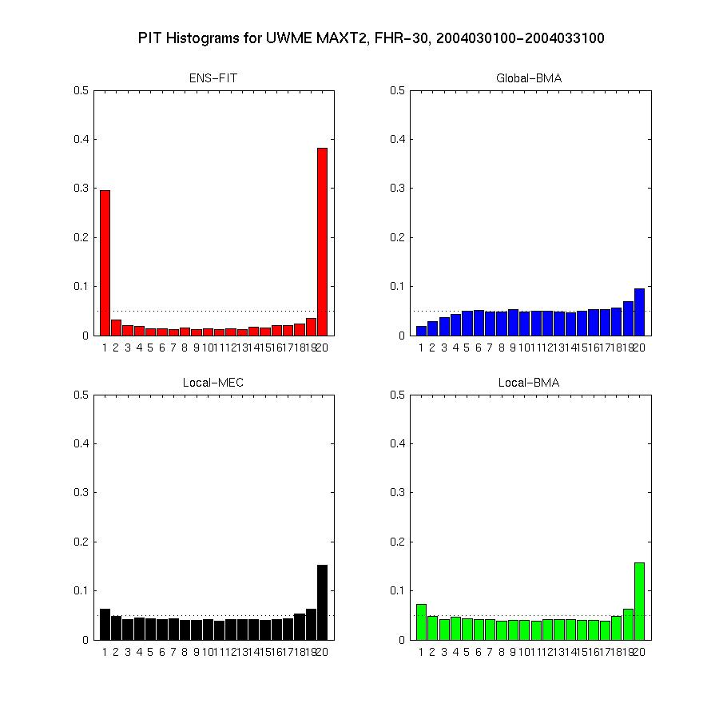
Application of BMA-Max 2-m Temperature (all stations in 12 km domain)
Improves reliability and sharpness

Slide 48
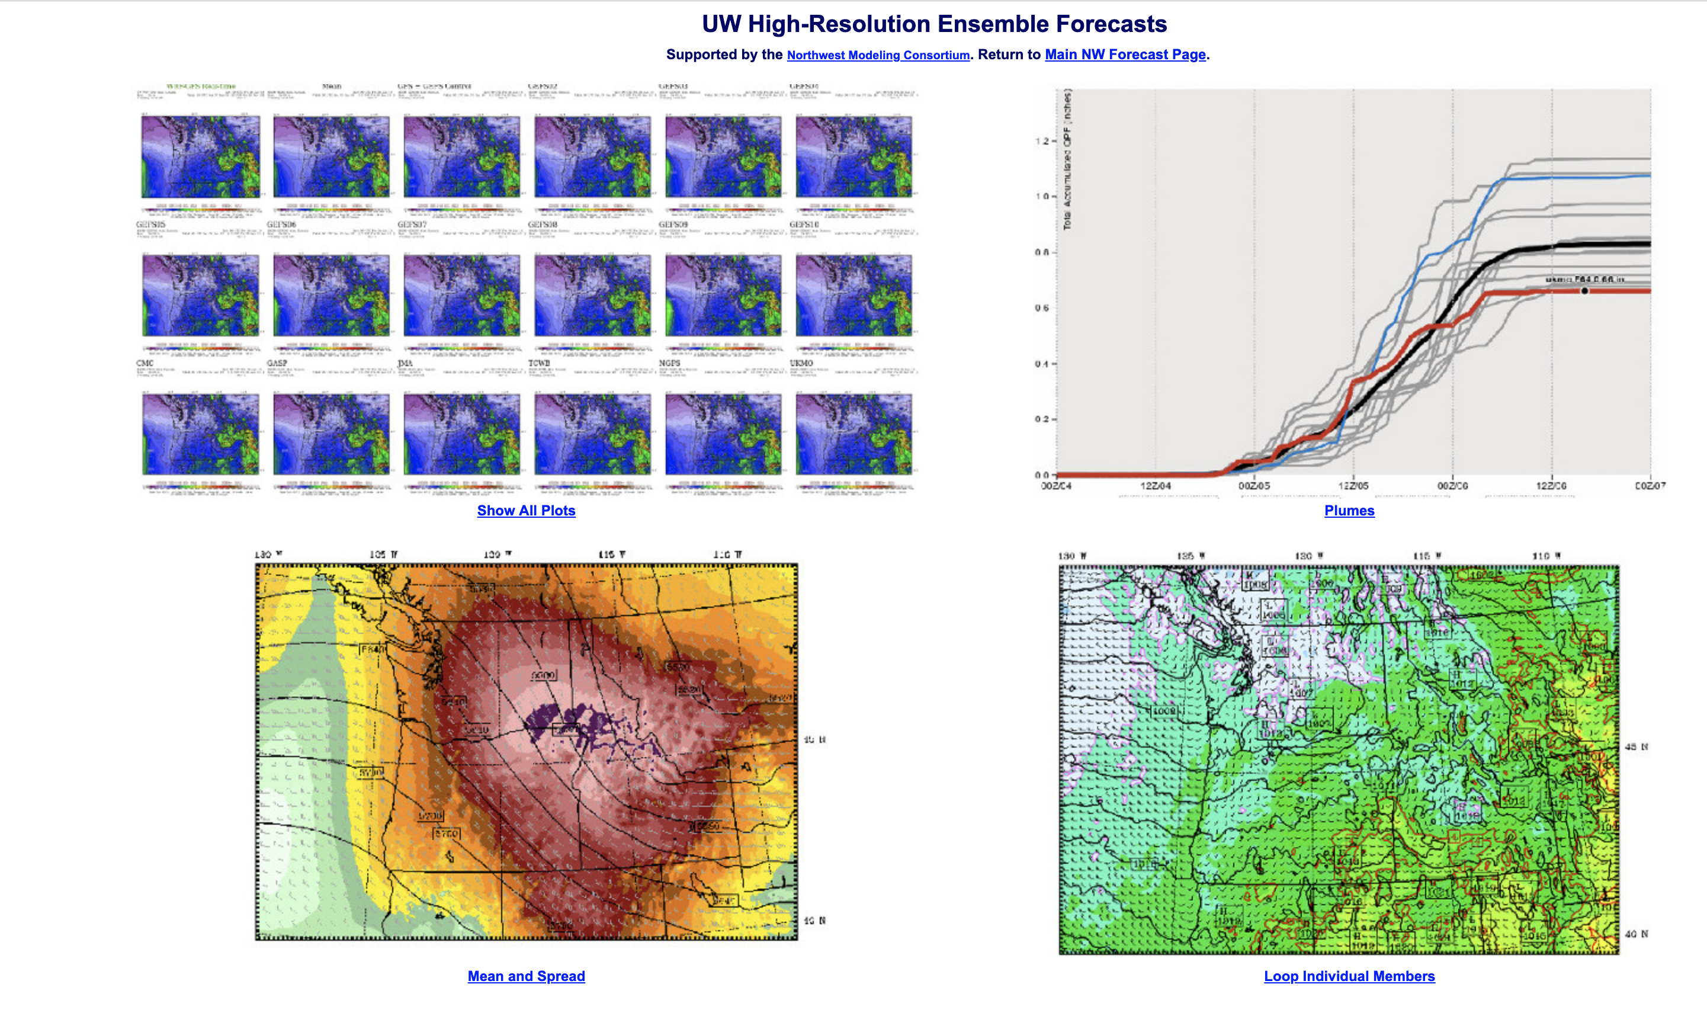
Current System-16 members

Slide 49


Slide 50


Slide 51
If high-resolution is required to secure reasonable forecasts, what do we do about understanding the regional impacts of global warming?
Answer: We run high-resolution models like WRF for 100 years or more!

Slide 52

Problem: Global climate models are too coarse to simulate the effects of critical Northwest terrain
Climate Model Terrain

Slide 53
: Regional Climate Modeling (a.k.a. dynamical downscaling) Run WRF model at 12-km over the region, driven by global climate models (GCMs) for 130 years (1970-2100) Using RCP8.5

Slide 54

Change in Winter Surface Air Temperatures (F)
Notes:
54

Slide 55

Notes:
55

Slide 56

Notes:
56

Slide 57

Notes:
57

Slide 58

But warming will result in more precipitation falling as rain rather than snow
Change in Snowpack from 1990 to 2090
Lower
0%
Higher

Slide 59

More low clouds during spring/early summer west of Cascades

Slide 60


March-April-May Changes

Slide 61


Slide 62
Taking it one step further: running an ensemble of high-resolution climate runs to get a better handle on uncertainty

Slide 63


Slide 64


Slide 65


Slide 66

High Resolution Regional Modeling: The Big Picture

Slide 67

Big Picture
During the past 30 years, the big advances in local NWP skill have been driven by:
Rapidly increasing horizontal resolution (~80 km to 4 km)
Far better large scale forecasts, driven by satellite observations, non-traditional observations (e.g., aircraft), and better data assimilation.

Slide 68

The Models Have Become More Complex, But Not That Much Better

Slide 69

Some Parameterizations are Like This.

Slide 70

Comparing the latest version of WRF 4.0.3 against one of 3 years ago, show little improvement

Slide 71
The same was true comparing early versions of WRF to later ones a few years ago

Slide 72


Slide 73
WRF Versions Tested
2.2.1 - October 31, 2007
3.1.1 - July 31, 2009
3.5 - April 18, 2013
3.7 - April 20, 2015

Slide 74

Sea Level Pressure (24h Forecast)
221 WINS, Forecasts GET WORSE Over
Time

Slide 75

How can this be?
The dynamical cores have been ”good enough” for a long while.
Model physics has really not improved much—and that is where some of the biggest problems are:
Cloud and precipitation microphysics
Boundary layer physics
Convective parameterization
Surface physics

Slide 76






Preliminary Results: Nov. 2015 - Feb. 2016
1.3 km WRF appears to have the best forecast.
GFS has larger spread than 12 km WRF.
Figure 3: Scatterplots of total precipitation for the 1.3 km domain (left), the 12 km domain (center), and the GFS 13 km domain (right).
Overprediction of GFS is evident in the error maps (lots of blue).
Less error in 1.3 km WRF also apparent.
Figure 4: Error maps of total precipitation for the 1.3 km domain (left), the 12 km domain (center), and the GFS 13 km domain (right). Blue is overprediction. Red is underprediction.

Slide 77

Example: mesoscale models are two “mixy” particularly in situations with shallow, surface cold layers

Slide 78



Slide 79


Noah MP Night-time Cold Bias over Snow
WRF 2-m Temperature Forecasts over Snow are Unrealistically Cold
12Z Feb 5, 2019 forecast over Western Washington showed cold biases around Seattle of more than 4ºF.
For all sites within the 4-km domain, the mean error was -4.97ºF.

Slide 80
Advice
Need to put considerable resources into model physics verification and improvement
Also need to improve “stochastic physics” as a way to add realistic uncertainty information.
And, of course, high-resolution ensemble technology, including their calibration, needs emphasis.
Need to build fully coupled high-resolution environmental prediction systems

Slide 81
The END

