Slide 1
NCEP Model Comparisons over the East and West Coast of the US
Lynn McMurdie
Garrett Wedam
Cliff Mass
Wedam, McMurdie and Mass, 2009: Comparison of Model Forecast Skill of Sea-level Pressure along the East and West Coasts of the United States. Wea. Forecasting, 24, 843-854 .
May 27, 2009

Slide 2
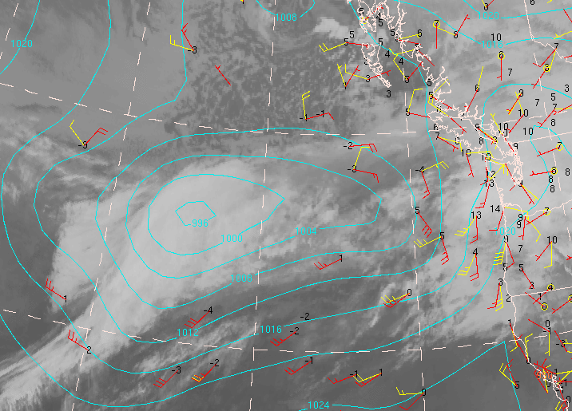
Large Short-term forecast errors can still occur despite recent model improvements
NCEP NAM 72-h forecasts (white), analyses (black), slp errors (black numbers) valid on 0000 UTC 24 December 2006.
NCEP GFS 72-h forecast (cyan) and slp errors (black numbers) valid 1200 UTC 1 January 2009

Slide 3
Goals
Document the frequency and magnitude of sea level pressure forecast errors
Compare the accuracy of several operational (deterministic) numerical model systems
Compare the accuracy of forecasts along the East and West Coasts of the US
Examine preliminary results from the past winter (2008 – 2009)

Slide 4
Methods -- Observations
Used buoys and c-man observations along the east and west coast.
Observed SLP variance was calculated and west and east coast buoys were matched if they had the same 30-day variance – 11 pairs total
For each model and forecast hour, an average error (Coastal Mean Absolute Error, CAE) was calculated for every forecast cycle. These CAE’s were then averaged for each month.
Also calculated the large-error frequency (number of forecasts exceeding a large-error criteria)

Slide 5
Buoys matched by variance
Compare results for the ECMWF, CMC-GEM and NCEP GFS and NAM models for three winter seasons: Nov 2005– Mar 2006, Nov 2006 – Mar 2007, Nov 2007 – Mar 2008.

Slide 6
Coastal Mean Absolute Error for all models,
forecast hours and both coasts
NAM upgrade to WRF-NMM
ECMWF has smaller errors than other models for most months. NAM has larger errors than other models for most months and forecast hrs.

Slide 7
Coastal Mean Absolute Error for all models,
forecast hours and both coasts
East Coast errors smaller than West Coast errors for all months and forecast hours

Slide 8
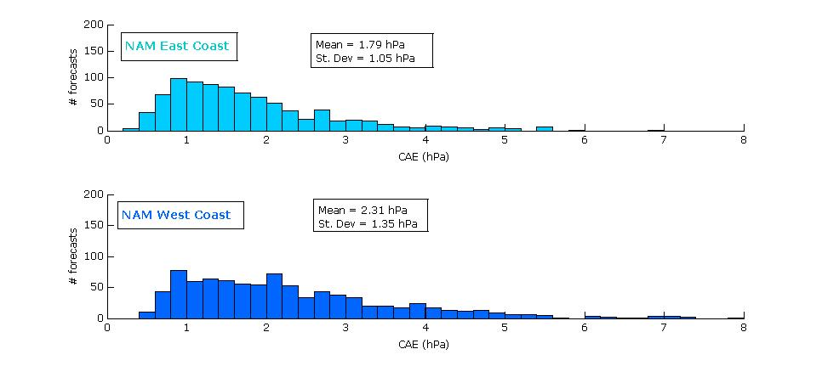
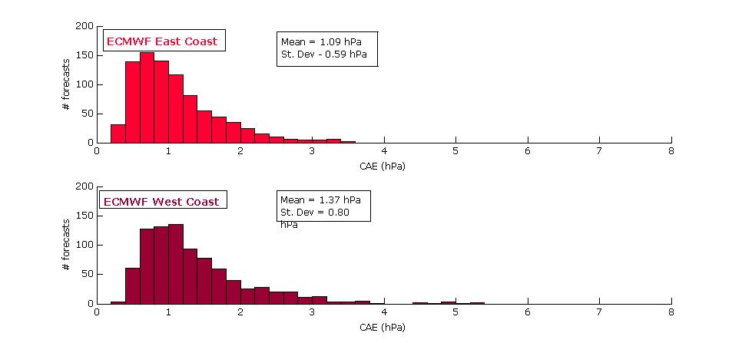
Histograms of f48 Errors

Slide 9
Frequency of Large Errors
>3hPa
>5hPa
>7hPa
Same conclusions apply: ECMWF smallest frequency and NAM the largest frequency of large errors, East Coast smaller frequency of large errors than West Coast for all models and forecast hours.

Slide 10
Have any models shown improvement over the course of the study?
Anomaly CAE = 3-season CAE minus
individual season CAE
NAM ??
ECMWF improved
GFS improved West Coast
CMCG improved second year

Slide 11
Did the data assimilation upgrade in Dec 2008 improve forecasts of SLP for the NAM?
“Background for the first analysis is from the GDAS instead of the previous NDAS”
NAM forecast errors much larger than GFS errors
Assimilation upgrade Dec 2008
NAM forecast errors NOT significantly larger than GFS

Slide 12
Summary
The West Coast has larger and more frequent SLP forecast errors than the East Coast.
The NAM consistently underperformed and the ECMWF outperformed all the other models in the study
Preliminary results from this past winter (2008-2009) show that the data assimilation upgrade has improved SLP forecasts for the NAM model

Slide 14
