Slide 1
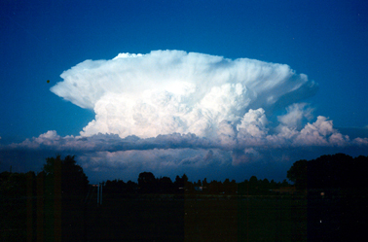
Thunderstorms
ATMS 101 Autumn 2025

Slide 2
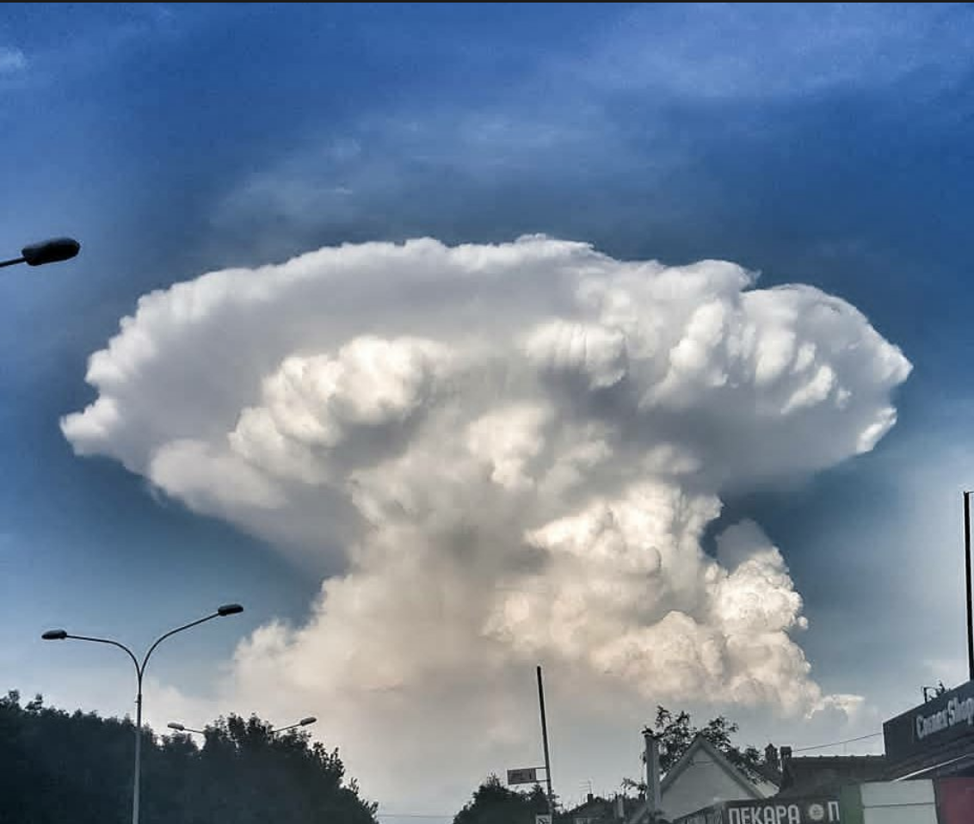
Thunderstorms: Some Key Facts
Produced by cumulonimbus clouds and are accompanied by lightning and thunder.
Occurs when the atmosphere becomes unstable—when a vertically displaced air parcel becomes buoyant and rises on its own.

Slide 3
Thunderstorm Amazing Facts
Some can extend as high as 40,000-65,000 ft!
Are capable of releasing tremendous amounts of energy (equivalent to several hydrogen bombs)
Some are associated with tornados, heavy rain, and hail.
Some have winds gusting to over 100 mph!

Slide 4
Thunderstorms Generally Require Three Ingredients
Unstable lapse rate of temperature: a rapid change of temperature with height.
  This large lapse rate can be forced by warming below or cooling above.
Sufficient low-level moisture
Lifting to get the parcels started upwards
  Fronts, mountains, sea breeze, etc.

Slide 5
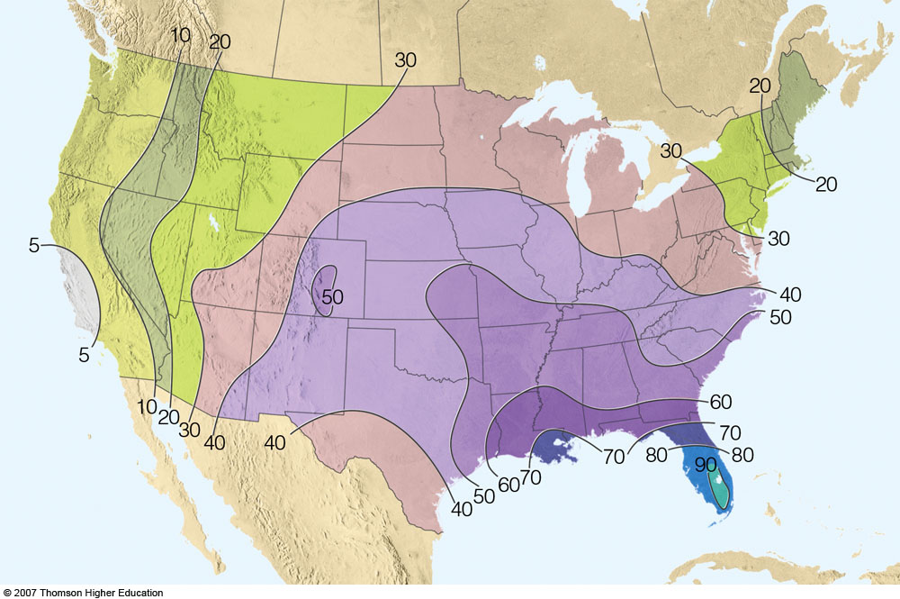
Thunderstorm Climatology: Not Many on West Coast
Notes:
Figure 10.18: The average number of days each year on which thunderstorms are observed throughout the United States. (Due to the scarcity of data, the number of thunderstorms is underestimated in the mountainous west.)

Slide 6
Cold Water of the East Pacific is bad for thunderstorms. Why?
Notes:
Figure 10.18: The average number of days each year on which thunderstorms are observed throughout the United States. (Due to the scarcity of data, the number of thunderstorms is underestimated in the mountainous west.)

Slide 7
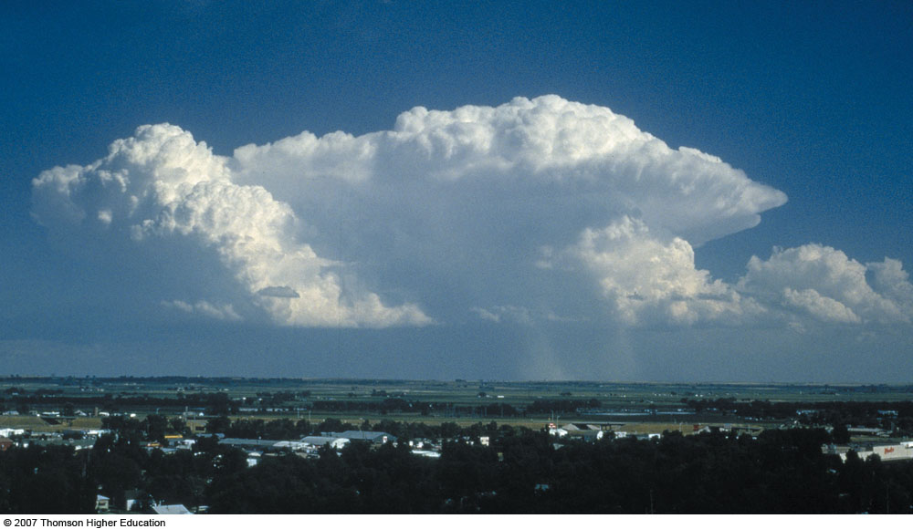
Two Main Types of Thunderstorms
Air mass thunderstorms—usually harmless and short-lived (less than an hour). The kind we get here.
Severe thunderstorms – can last for hours and can become very strong. Associated with powerful winds, tornadoes and hail. Examples include: supercell storms and squall lines. We rarely get these!

Slide 8
The Life Cycle of Air Mass Thunderstorms
We understood very little about the structure and evolution of thunderstorms before the famous Thunderstorm Project of the late 1940s, when armored aircraft (P-61) were flown in thunderstorms in Ohio and Florida.

Slide 9
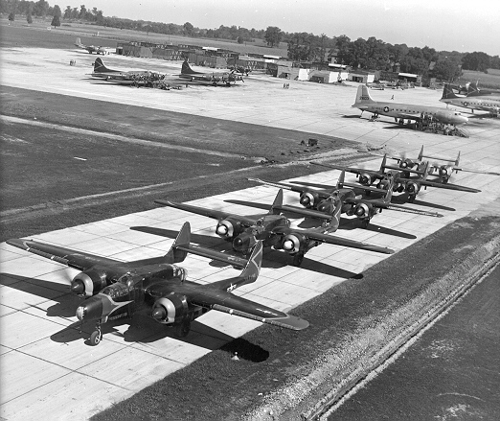
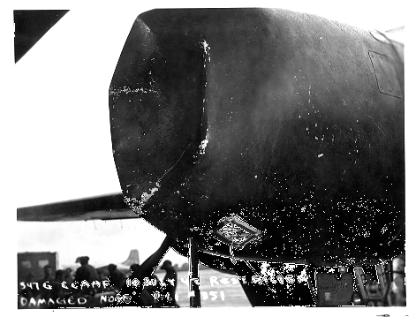
M
P-61 Squadron
Hail Damage!

Slide 10
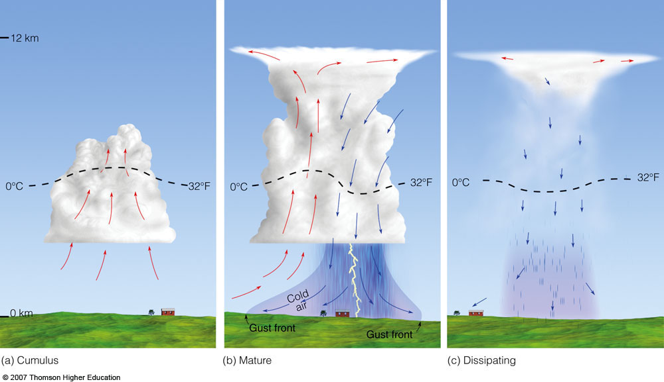
Single Cell Air Mass Thunderstorm
Cumulus
Mature
Dissipating
Fig. 10-1, p. 265
Notes:
Figure 10.1: Simplified model depicting the life cycle of an ordinary thunderstorm that is nearly stationary. (Arrows show vertical air currents. Dashed line represents freezing level, 0°C isotherm.)
Watch this Active Figure on ThomsonNow website at www.thomsonedu.com/login.

Slide 11
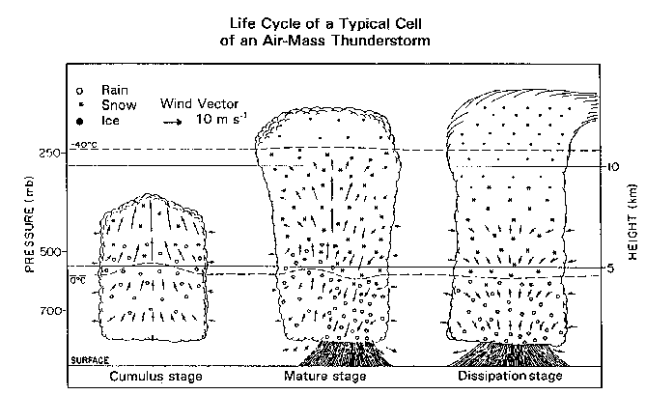
Air Mass thunderstorms are SUICIDAL. The cool downdraft kills the updraft…that is why they don’t live long enough to become severe.

Slide 12
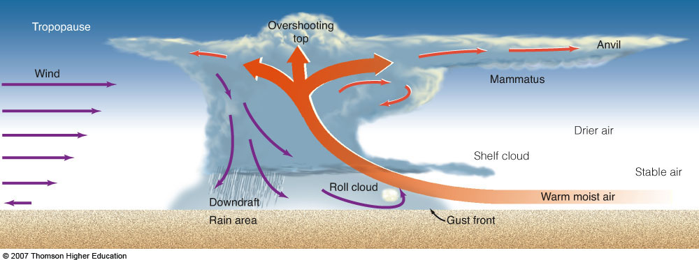
Major Thunderstorm Structures
updraft
Cirrus Anvil, Gust Front, Updraft, Downdraft
Notes:
Figure 10.10: A simplified model describing air motions and other features associated with an intense thunderstorm that has a tilted updraft. The severity depends on the intensity of the storm’s circulation pattern.
Watch this Active Figure on ThomsonNow website at www.thomsonedu.com/login.

Slide 13
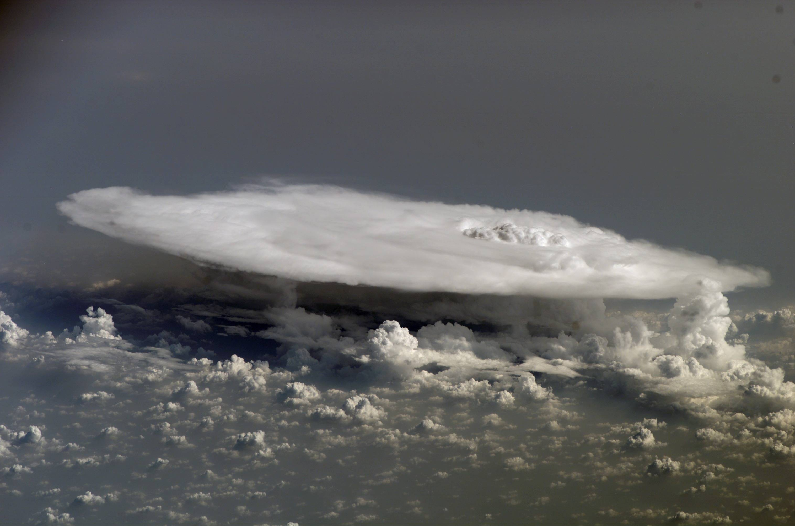
Anvil and Overshooting Top

Slide 14
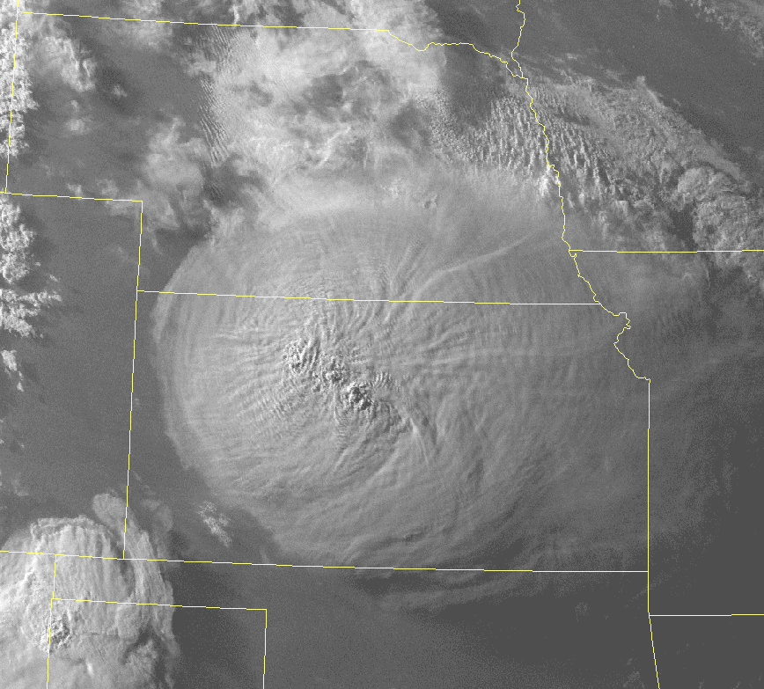
Anvil with overshooting tops

Slide 15
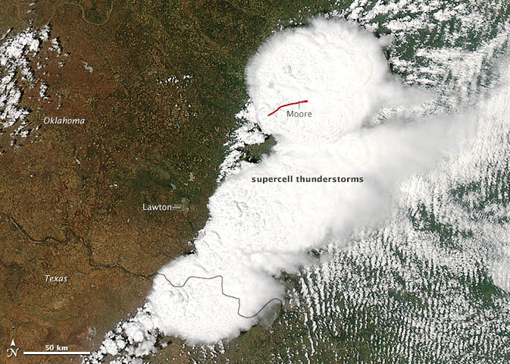

Slide 16
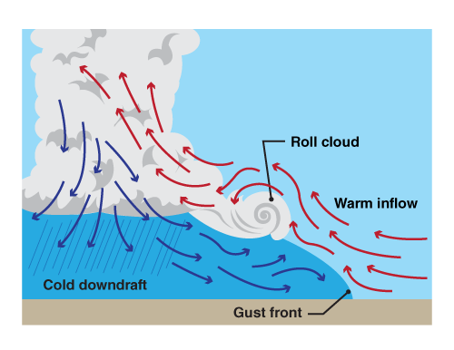
Gust Front: leading edge of cool, downdraft air

Slide 17
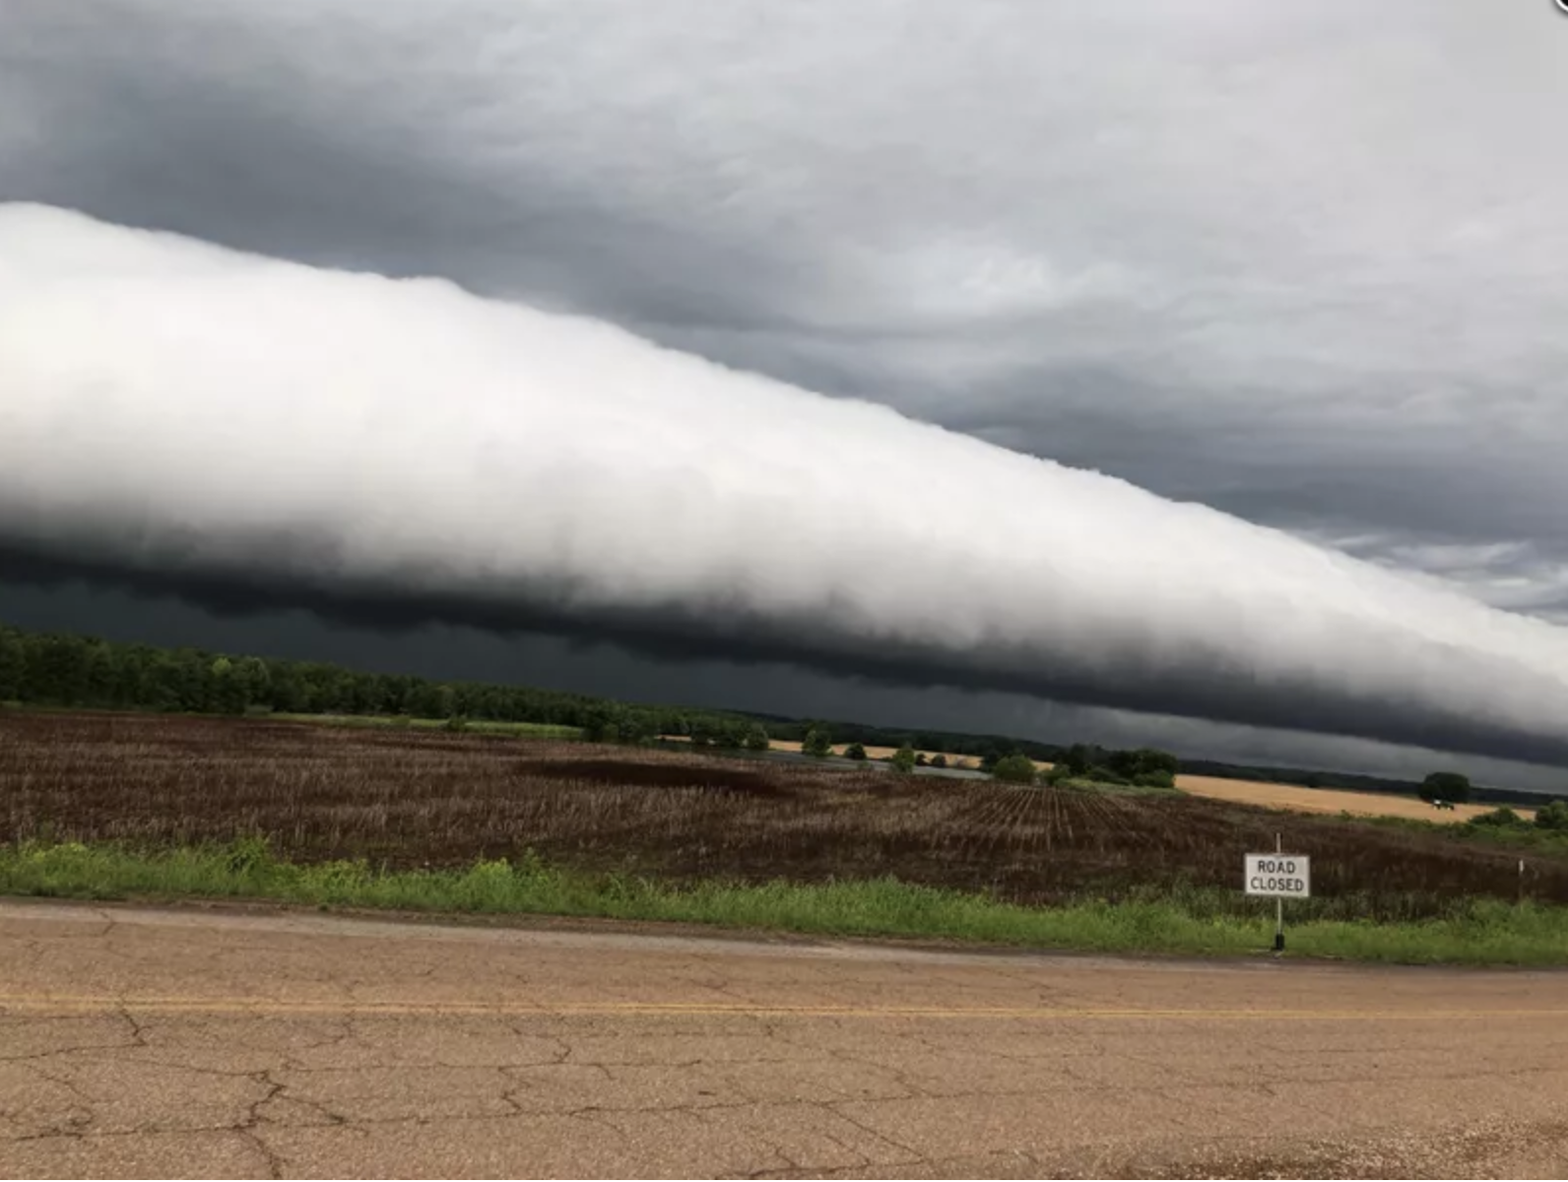
Roll or Arcus Cloud Associated with Leading Edge of Gust Front

Slide 18
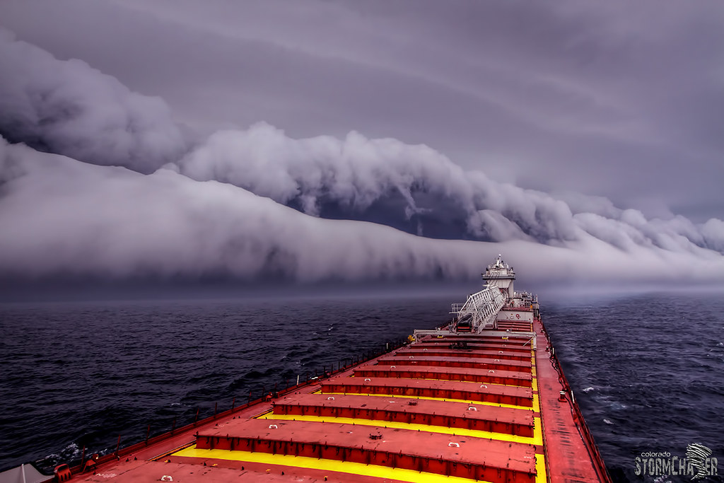

Slide 19
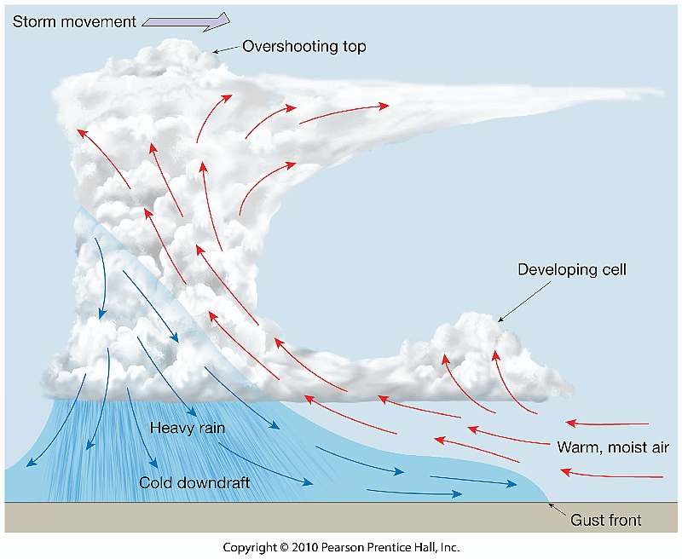
Why Downdrafts In Thunderstorm?
Precipitation falls into unsaturated air below. Evaporation, cooling results. Cool air is denser and heavier. Sinks.
Falling precipitation drags air downward.

Slide 20
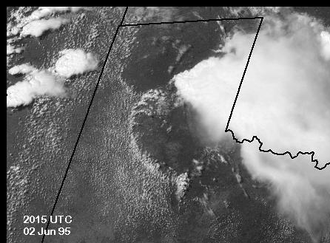
Gust Front

Slide 21
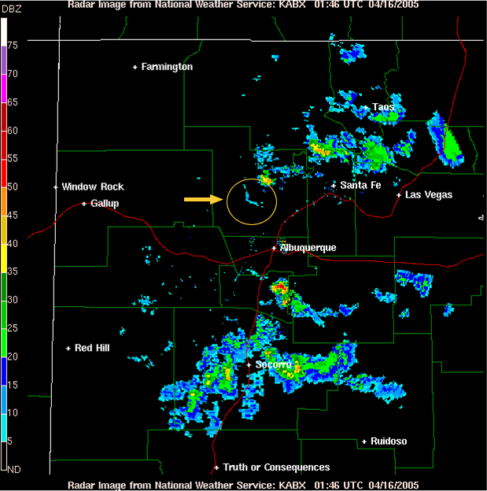
Air Mass Thunderstorms
Can have several cells at various stages in their life cycle
Updrafts of 2-20 knots
Cells generally 3-6 miles across
Radar Image of Air Mass
Thunderstorm

Slide 22
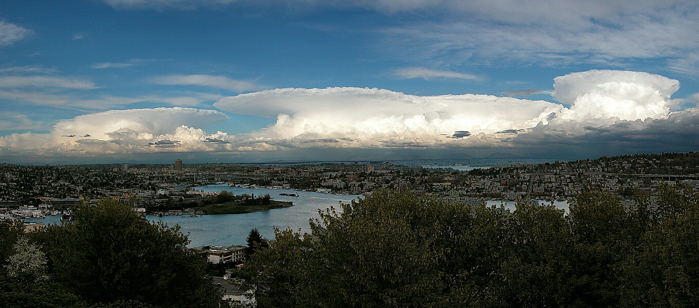
Air Mass Thunderstorms on the Cascades

Slide 23
Lightning and Thunderstorms

Slide 24
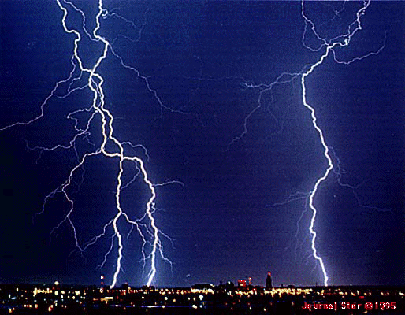

Slide 25
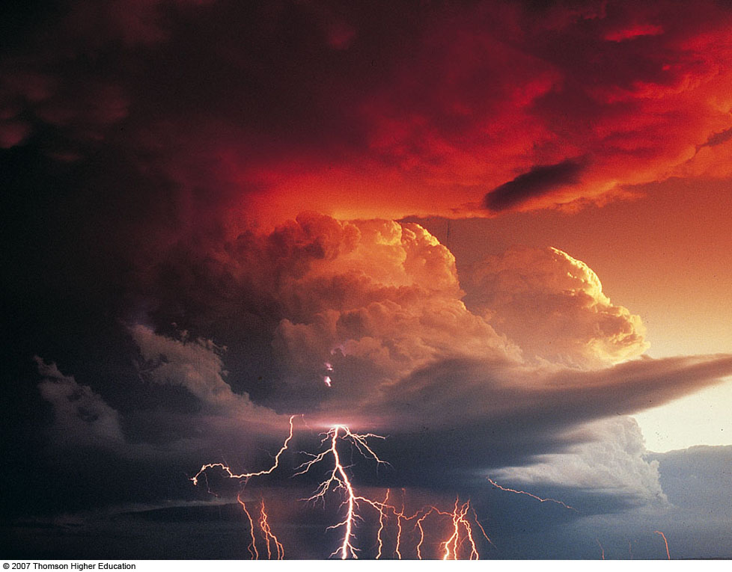
Fig. 10-23, p. 280
Notes:
Figure 10.23: Time exposure of an evening thunderstorm with an intense lightning display near Denver, Colorado. The bright flashes are return strokes. The lighter forked flashes are probably stepped leaders that did not make it to the ground.

Slide 26
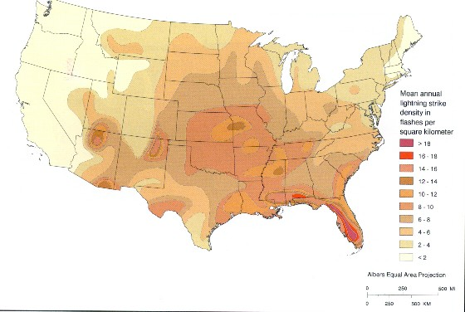
Mean Annual Lightning Strike Frequency

Slide 27
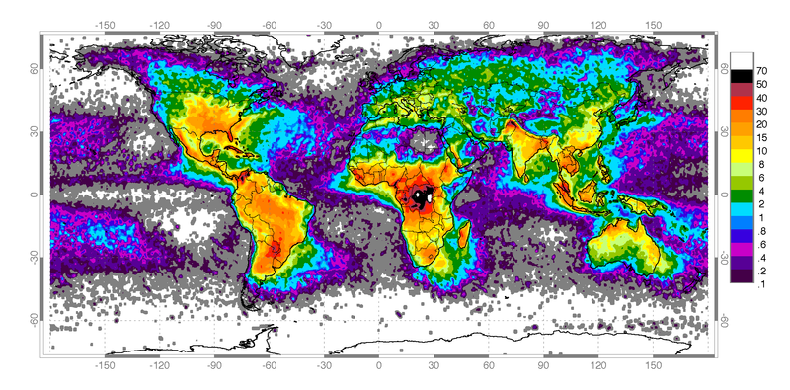
Lightning Detection Networks Sense Lightning by their radio signals

Slide 28
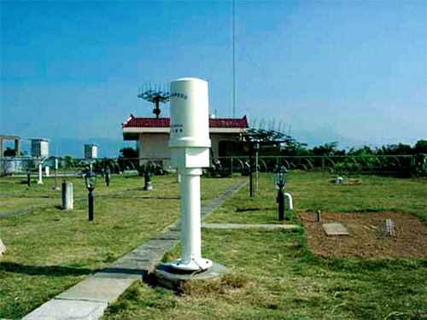
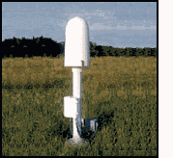
Lightning Detection Networks
Sensors detect the radio waves emitted by lightning strokes

Slide 29
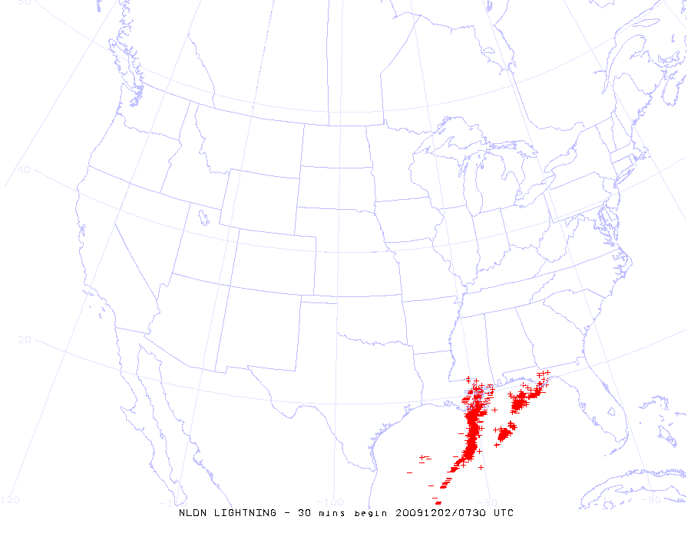
An Example

Slide 30
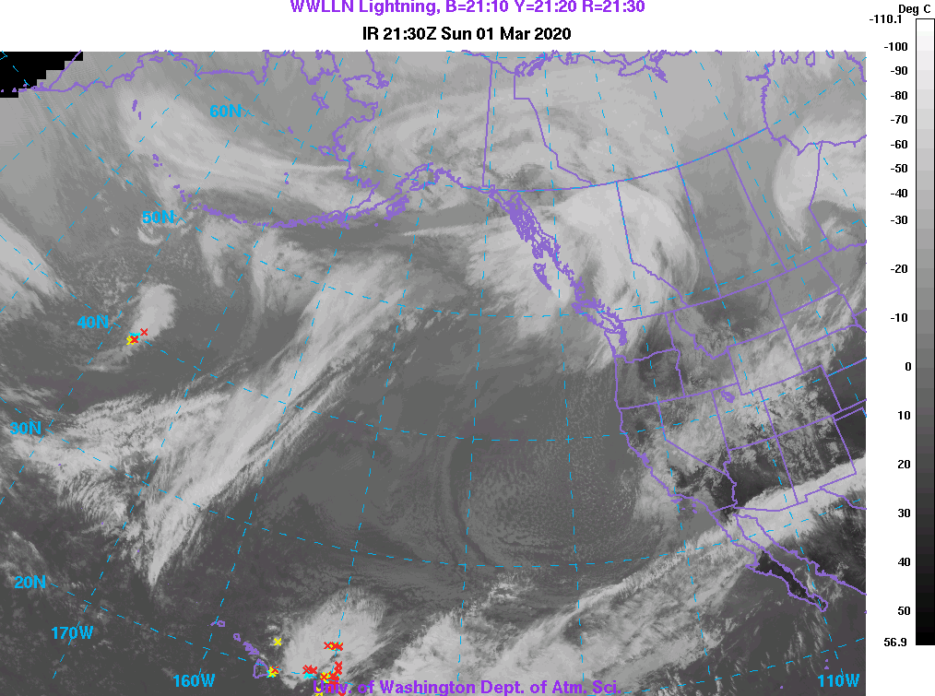

Slide 31
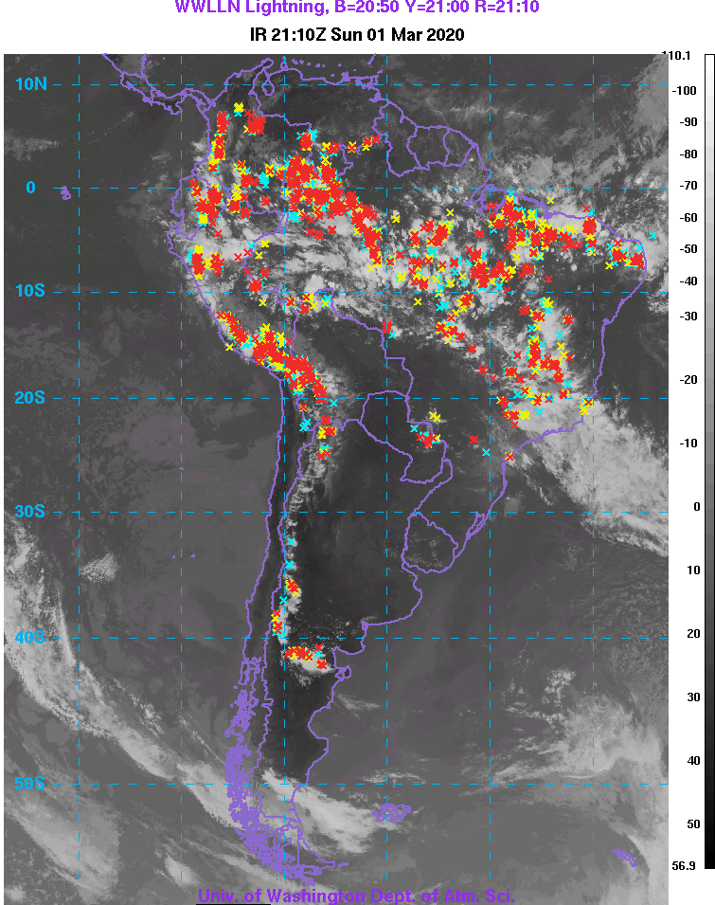

Slide 32
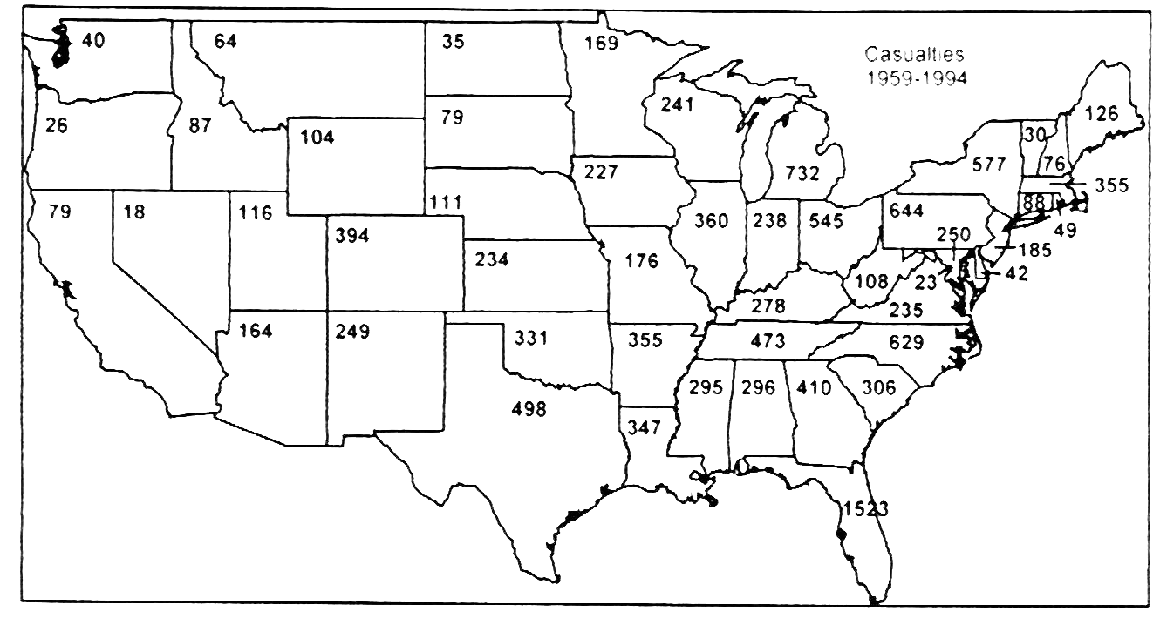
Lightning Kills!

Slide 33

Lightning is attracted to elevated metal, grounded objects
Lightning Rod
Metal Cleat Shoes…good grounding

Slide 34


Slide 35
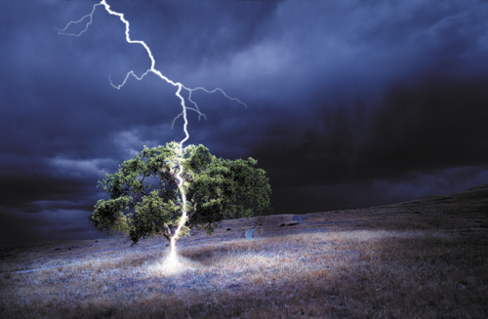
What do you do when lightning is around
Cars are very safe!
Stay away from trees!
Go inside

Slide 36
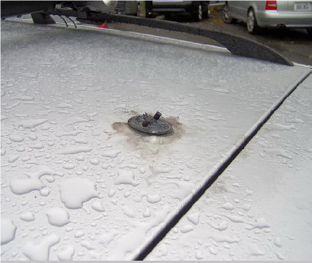

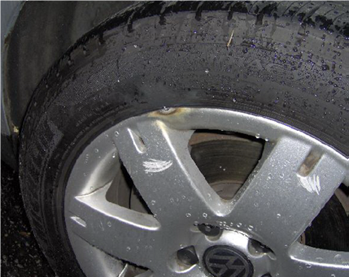
A car struck by lightning on the 520 bridge

Slide 37
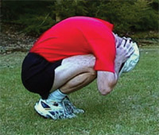
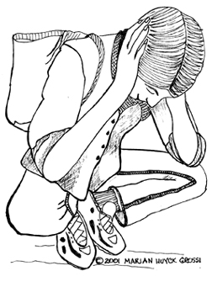
What to do if you are outdoors?
No more golf!
If out in the open go to a low spot and crouch down—the lightning crouch!
DON’T put your hands on the ground!

Slide 38
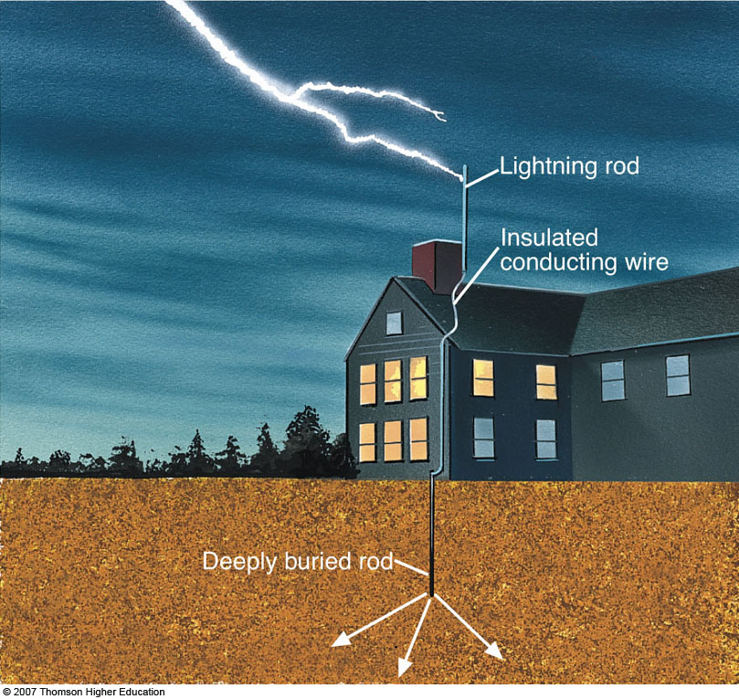
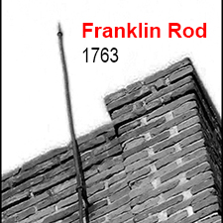
Lightning rods can protect buildings
Fig. 10-24, p. 281
Notes:
Figure 10.24: The lightning rod extends above the building, increasing the likelihood that lightning will strike the rod rather than some other part of the structure. After lightning strikes the metal rod, it follows an insulated conducting wire harmlessly into the ground.

Slide 39
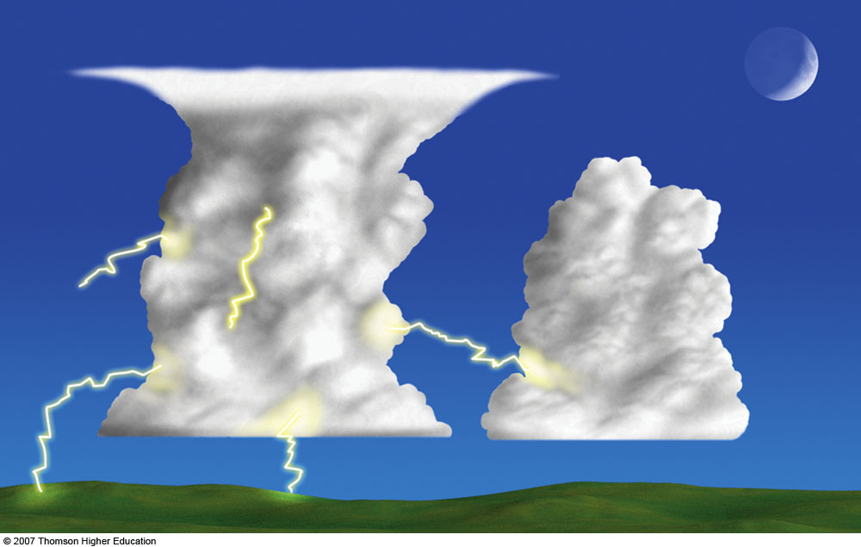
Lightning can occur cloud to cloud,
cloud to ground, cloud to air, or within a cloud
Notes:
Figure 10.20: The lightning stroke can travel in a number of directions. It can occur within a cloud, from one cloud to another cloud, from a cloud to the air, or from a cloud to the ground. Notice that the cloud-to-ground lightning can travel out away from the cloud, then turn downward, striking the ground many miles from the thunderstorm. When lightning behaves in this manner, it is often described as a “bolt from the blue.”

Slide 40
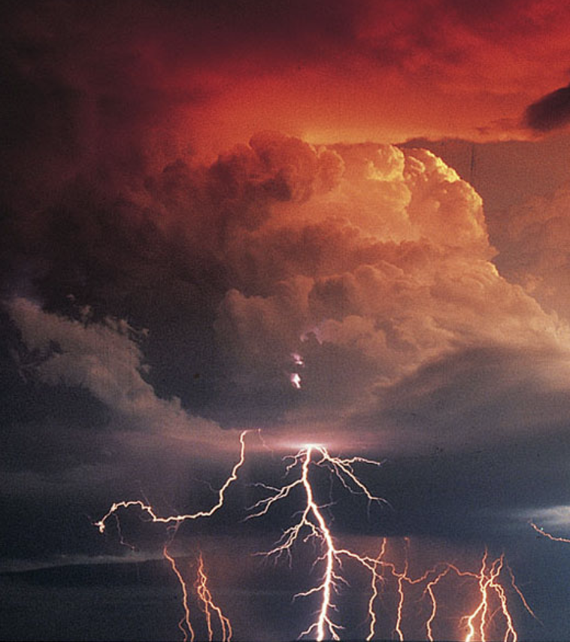
Lightning Facts
The majority of lightning occurs within clouds…and only about 20% between cloud and ground.
A lightning strike heats a narrow channel to roughly 54,000 F—much hotter than the surface of the sun. Causes air to expand explosively—producing thunder.

Slide 41
Lightning Facts
Light from lightning moves at the speed of light (186,000 miles per second), while sound of thunder only moves at 1/5 mile per second.
Can use the difference in time between lightning flash and thunder to determine how far the lightning stroke is: for every 5 second difference-lightning is one mile away

Slide 42
If you see a lightning flash, and thunder comes 10 seconds later, the lightning strike was 2 miles away

Slide 43
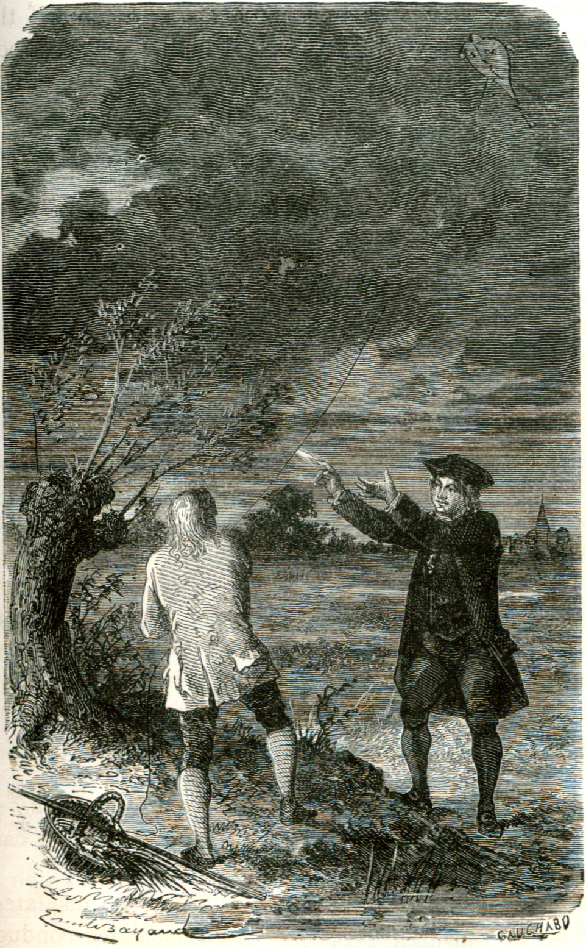
Benjamin Franklin was the first to suggest that lightning originated from sparks between areas of charge.

Slide 44
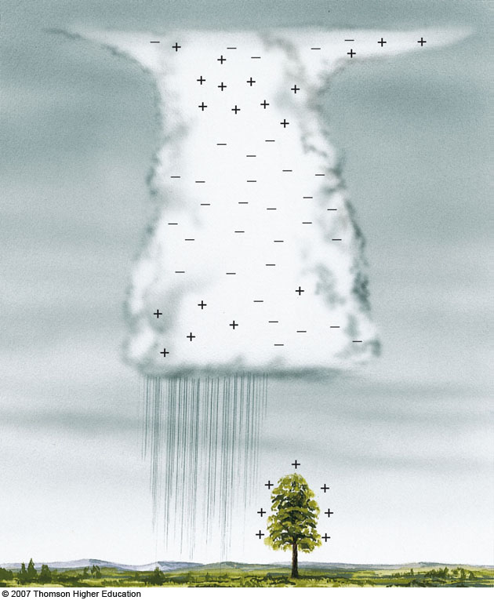
Before Lightning Strikes: Development of Areas of
Charge in Clouds and Surface
Notes:
Figure 10.21: The generalized charge distribution in a mature thunderstorm.

Slide 45
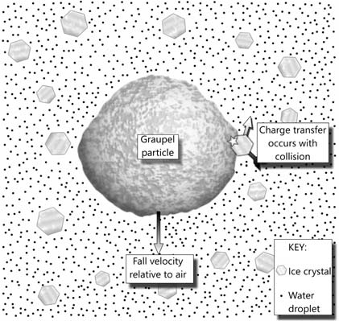
Charge Separation in Clouds
NOT WELL UNDERSTOOD!
When ice particles fall through supercooled water and ice crystals, they acquire one charge, and the water-ice mix acquires the opposite charge.

Slide 46
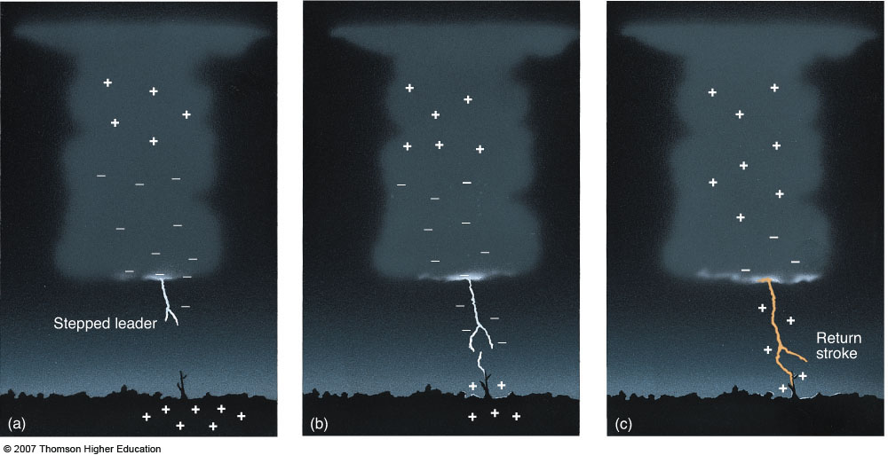
Typical Cloud to Cloud Lightning Stroke
(a) Negative charge descends the cloud in a series of steps (roughly 50-100 long)—called “stepped leaders”
Notes:
Figure 10.22: The development of a lightning stroke. (a) When the negative charge near the bottom of the cloud becomes large enough to overcome the air’s resistance, a flow of electrons—the stepped leader—rushes toward the earth. (b) As electrons approach the ground, a region of positive charge moves up into the air through any conducting object, such as trees, buildings, and even humans. (c) When the downward flow of electrons meets the upward surge of positive charge, a strong electric current—a bright return stroke carries positive charge upward into the cloud.
Watch this Active Figure on ThomsonNow website at www.thomsonedu.com/login/.

Slide 47
Typical Cloud to Cloud Lightning Stroke
(b) As the stepped leader approaches the surface, positive charges move upwards to meet it. When the potential gradient (volts per meter) increases to about one million volts per meter, the insulating properties of the air begins to break down
Notes:
Figure 10.22: The development of a lightning stroke. (a) When the negative charge near the bottom of the cloud becomes large enough to overcome the air’s resistance, a flow of electrons—the stepped leader—rushes toward the earth. (b) As electrons approach the ground, a region of positive charge moves up into the air through any conducting object, such as trees, buildings, and even humans. (c) When the downward flow of electrons meets the upward surge of positive charge, a strong electric current—a bright return stroke carries positive charge upward into the cloud.
Watch this Active Figure on ThomsonNow website at www.thomsonedu.com/login/.

Slide 48
Typical Cloud to Cloud Lightning Stroke (negative lightning)
(c) With break down, a return stroke begins, with negative charge surging downward in the stroke.
Notes:
Figure 10.22: The development of a lightning stroke. (a) When the negative charge near the bottom of the cloud becomes large enough to overcome the air’s resistance, a flow of electrons—the stepped leader—rushes toward the earth. (b) As electrons approach the ground, a region of positive charge moves up into the air through any conducting object, such as trees, buildings, and even humans. (c) When the downward flow of electrons meets the upward surge of positive charge, a strong electric current—a bright return stroke carries positive charge upward into the cloud.
Watch this Active Figure on ThomsonNow website at www.thomsonedu.com/login/.

Slide 49
You can see the “stepping”

Slide 50
Severe Thunderstorms
Can last for hours and produce strong winds, large hail, flash flooding, tornadoes.
Have found the secret of longevity (will reveal later!)
Most important types are supercell storms, squall lines, and bow echo storms.

Slide 51
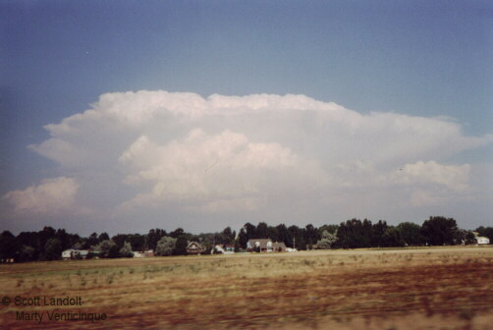
Supercell Thunderstorm

Slide 52
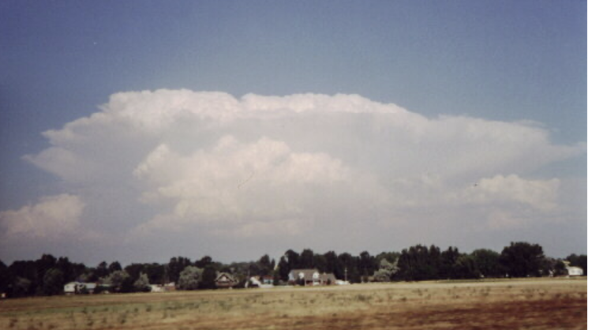
Supercell Storms
One giant updraft that can have upward speeds as high as 60-100 mph
Large size: 30-50 miles in diameter.
Forms in environments of great vertical instability and wind shear
The large updraft is often rotating: called a mesocyclone.

Slide 53
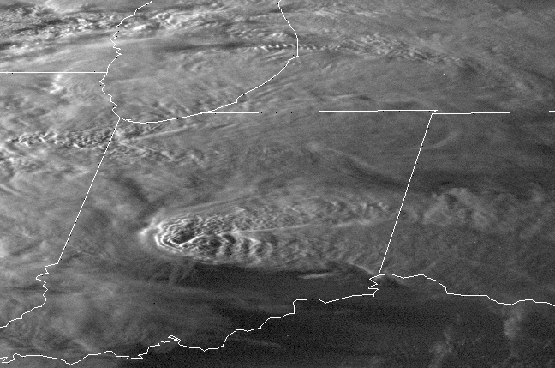

Slide 54
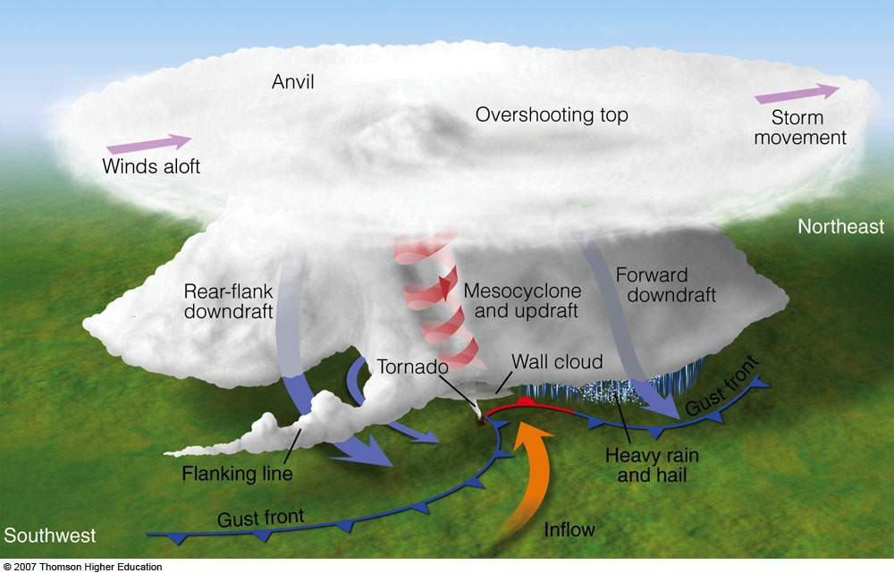
Fig. 10-37, p. 291
Notes:
Figure 10.37: A classic tornadic supercell thunderstorm showing updrafts and downdrafts, along with surface air flowing counterclockwise and in toward the tornado. The flanking line is a line of cumulus clouds that form as surface air is lifted into the storm.

Slide 55
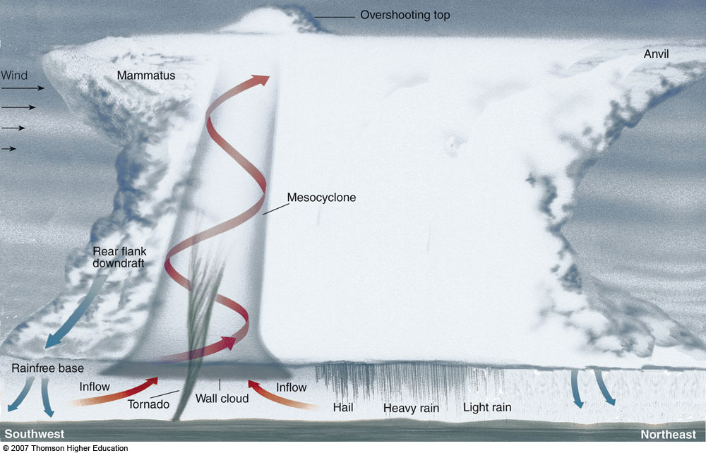
Fig. 10-35, p. 290
Notes:
Figure 10.35: Some of the features associated with a tornado-breeding supercell thunderstorm as viewed from the southeast. The storm is moving to the northeast.

Slide 56
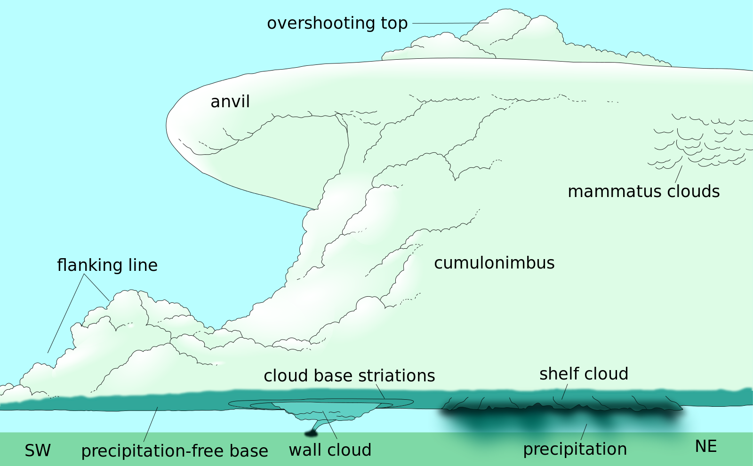

Slide 57
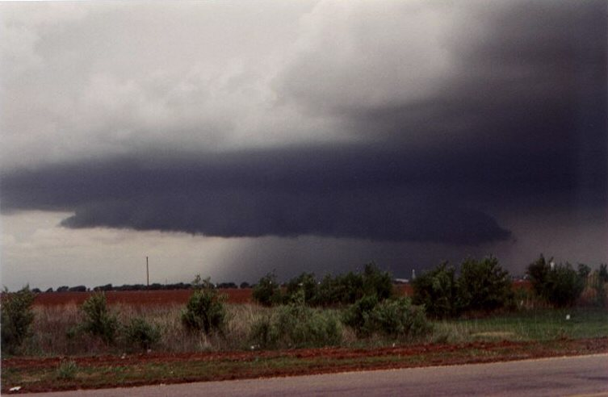
Wall cloud

Slide 58
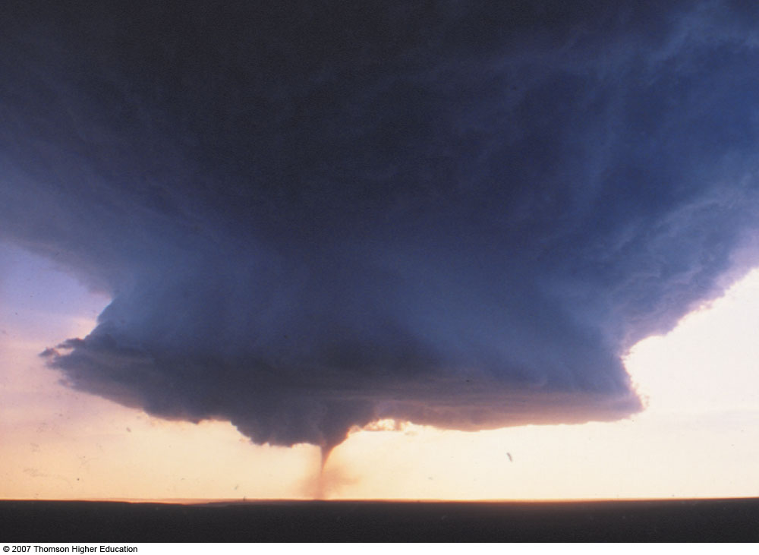
Fig. 10-4, p. 268
Notes:
Figure 10.4: A supercell thunderstorm with a tornado sweeps over Texas.

Slide 59

Supercells on Radar
In conventional weather radars, supercell storms are usually apparent as hooked echoes.

Slide 60

Fig. 10-36, p. 290
Notes:
Figure 10.36: A tornado-spawning supercell thunderstorm over Oklahoma City on May 3, 1999, shows a hook echo in its rainfall pattern on a Doppler radar screen. The colors red and orange represent the heaviest precipitation.

Slide 61


Slide 62

The mesocyclone can also be seen with the Doppler winds.

Slide 63

Why mesocyclones in severe thunderstorms?
Turns out that wind shear is important!
Origin of rotation in the mesocyclone
Notes:
Figure 10.34: (a) Spinning vortex tubes created by wind shear. (b) The strong updraft in the thunderstorm carries the vortex tube into the thunderstorm, producing a rotating air column that is oriented in the vertical plane.

Slide 64


Slide 65
What is the secret of the strength and longevity for severe thunderstorms?
They grow in environments with large vertical instability.
But they also grow in an environment of large wind shear—wind changing significantly with height.
What difference does that make?

Slide 66

Wind Shear in the Vertical is the Fountain of Youth for Severe Thunderstorms

Slide 67

The problems

Slide 68
Wind shear stops the “rotation” of cold air in front of storm

Slide 69

Squall Lines
Long, linear lines of strong thunderstorms
Strong narrow convective lines, followed by a wide region of stratiform (layered) precipitation
Mainly in the central and eastern U.S.

Slide 70


Slide 71
Fig. 10-6, p. 269
Notes:
Figure 10.6: A Doppler radar composite showing a pre-frontal squall line extending from Indiana southwestward into Arkansas. Severe thunderstorms (red and orange colors) associated with the squall line produced large hail and high winds during October, 2001.

Slide 72

Squall Line

Slide 73

Bow Echoes or Derechos
Can occur when a squall line or group of thunderstorms “bow out”
Can produce strong (60-100 mph) straight-line (non-rotating) winds.

Slide 74
Notes:
Figure 10.16: The red and orange on this Doppler radar image show a line of intense thunderstorms (a squall line) that is moving south southeastward into Kentucky. The thunderstorms are producing strong straight-line winds called a derecho. Notice that the line of storms is in the shape of a bow. Such bow echos are an indicator of strong, damaging surface winds near the center of the bow. Sometimes the left (usually northern) side of the bow will develop cyclonic rotation and produce a tornado.

Slide 75

Bow Echo Development

Slide 76

Many Bow Echos Assoiated with Strong Straight-Line Winds Called Derechos
Winds can reach 85-100 mph
Can produce extensive damage
http://www.youtube.com/watch?v=EGJmOeDEBtw

Slide 78


Slide 79

Flattens Crops and Forests

Slide 80

DC Derecho: June 10, 2013

Slide 81


Slide 82




Slide 83
Tornadoes

Slide 84


Slide 85


Slide 86

Fig. 10-32, p. 288
Notes:
Figure 10.32: A devastating F5 tornado about 200 meters wide plows through Hesston, Kansas, on March 13, 1990, leaving almost 300 people homeless and 13 injured.

Slide 87

Fig. 10-33, p. 289
Notes:
Figure 10.33: Total destruction caused by an F5 tornado that devastated parts of Oklahoma on May 3, 1999.

Slide 88

Annual Number of Tornadoes per State (upper number)
Notes:
Figure 10.28: Tornado incidence by state. The upper figure shows the number of tornadoes reported by each state during a 25-year period. The lower figure is the average annual number of tornadoes per 10,000 square miles. The darker the shading, the greater the frequency of tornadoes.

Slide 89

Average Number of
Tornadoes by Month in US
Notes:
Figure 10.29: Average number of tornadoes during each month in the United States.

Slide 90

EF: Enhanced Fujita Scale
Table 10-2, p. 288

Slide 91


Slide 92


Slide 93
Tornado Videos
http://www.youtube.com/watch?v=xCI1u05KD_s
http://www.youtube.com/watch?v=iJ26HnnUuO0
Joplin Tornado

Slide 94
Origin of rotation in tornadoes
Two Main Mechanisms
Severe thunderstorms associated with mesocyclones (strongest tornadoes)
Weaker thunderstorms associated with fronts and shear lines (weaker ones)

Slide 95


Mesocyclones
And Supercell
Thunderstorms
Stepped Art
Fig. 10-34, p. 289
Notes:
Figure 10.34: (a) Spinning vortex tubes created by wind shear. (b) The strong updraft in the thunderstorm carries the vortex tube into the thunderstorm, producing a rotating air column that is oriented in the vertical plane.

Slide 96


Final Spin-Up: Conservation of Angular Momentum
Angular momentum= mvr=constant

Slide 97
Column of air gets stretched in vertical by updraft

Slide 98
Final Spin-Up: Conservation of Angular Momentum
Angular momentum= mvr=constant

Slide 99

Another way to get rotation: weaker storms
Weaker Tornadoes on Fronts and Shear Lines
Fig. 10-40, p. 293
Notes:
Figure 10.40: (a) Along the boundary of converging winds, the air rises and condenses into a cumulus congestus cloud. At the surface the converging winds along the boundary create a region of counterclockwise spin. (b) As the cloud moves over the area of rotation, the updraft draws the spinning air up into the cloud, producing a nonsupercell tornado, or landspout. (Modified after Wakimoto and WIlson)

Slide 100

Northwest Tornadoes are generally the weaker variety (West Seattle shown)

Slide 101

Lots of horizontal winds shear with Puget Sound Convergence Zone

Slide 102

1972 Vancouver Tornado: EF3
The Strongest Observed So Far

Slide 103

Tornado Seasons
In Washington State

Slide 104


A Tornado Almost Took Out Bill Gates!

Slide 105


Large Hail

Slide 106

Hail Occurs in Strong Thunderstorms with Very Large Upward Velocities
Ice particles can go up and down several times, growing they do so

Slide 107
Some Hail Facts
Range in size from 0.2 to 6 inches in diameter.
Large hailstones have alternating layers of clear and opaque ice, caused by cycles of vertical motion, riming, and freezing.
Hail produces substantial damage to buildings, cars, and crops. Major agricultural problem in areas of the Midwest and overseas with strong thunderstorms.

Slide 108

Car Damage

Slide 109


Crop Damage

Slide 110

Average Number of Days with Hail
Notes:
Figure 10.19: The average number of days each year on which hail is observed throughout the United States.

Slide 111
Thunderstorm and Cumulus Downbursts/Microbursts: A Major Threat to Aviation

Slide 112

Downburst
A downburst is a strong ground-level wind system generally associated with falling precipitation from a cumulonimbus cloud that blows radially after it hits the ground

Slide 113

Notes:
113

Slide 114

Notes:
114
Wet microburst photo taken by Bill Bunting. A series of three sides.
Downburst Hazards. Downburst winds can exceed 100 mph and are capable of doing the same damage as a weak to strong tornado. Rapidly shifting wind direction and changes in visibility pose problems to mobile spotters.

Slide 115

Notes:
115

Slide 116

Notes:
116
Strongest winds occur in the curl.
Heavy rains and flooding are likely when you see something like this. Don’t drive your vehicle into something like this.

Slide 117


Slide 118
Two Sizes of Convective Downbursts
Microbursts
  4 km and less
Macrobursts
  Larger than 4 km

Slide 119

Tucson Microburst
https://youtu.be/jIhesf1_WTo

Slide 120
Downbursts are a major threat to aviation

Slide 121

Research by NCAR and collaborators in the 1980s uncovered the deadly one-two punch of microbursts: aircraft level off when they encounter headwinds, then find themselves pushed to the ground by intense downdrafts and tailwinds.
Notes:
121

Slide 122


Eastern Air Lines 66
June 24, 1975
New York – Kennedy Airport
112 killed
12 injured
Crashed while landing
Boeing 727
Notes:
122

Slide 123

August 1, 1983 the strongest microburst recorded at an airport was
observed at Andrews Air Force Base in Washington DC. The wind speeds
may have exceeded 150 mph in this microburst. The peak gust was
recorded at 211 PM – 7 minutes after Air Force One, with the President
on board, landed on the same runway.
Notes:
123

Slide 124

Low Level Windshear Alert System (LLWAS)
We now have
Observing
Systems
Designed to
Spot microbursts

