Slide 1
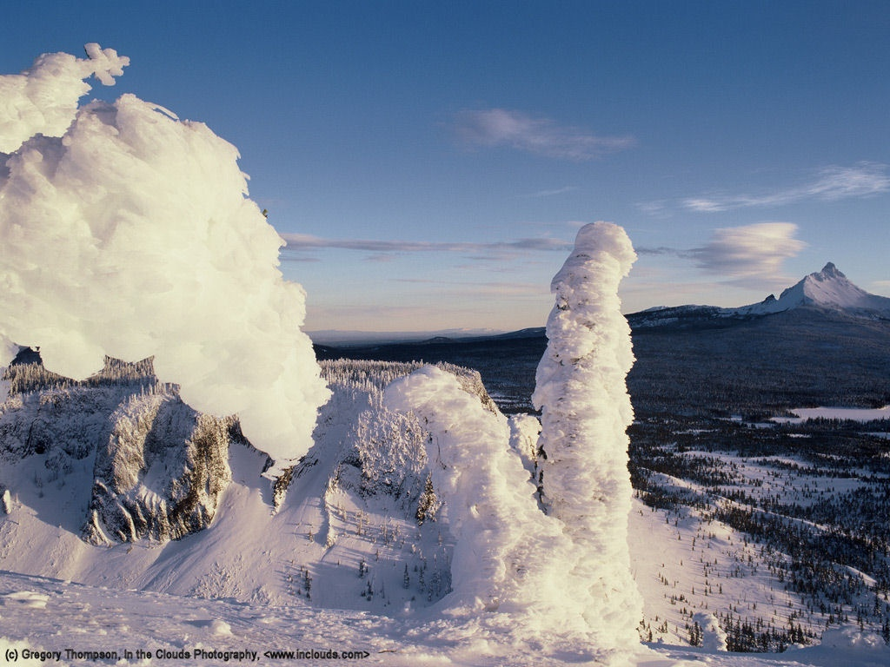
Northwest Weather 101
Cliff Mass
University of Washington

Slide 2
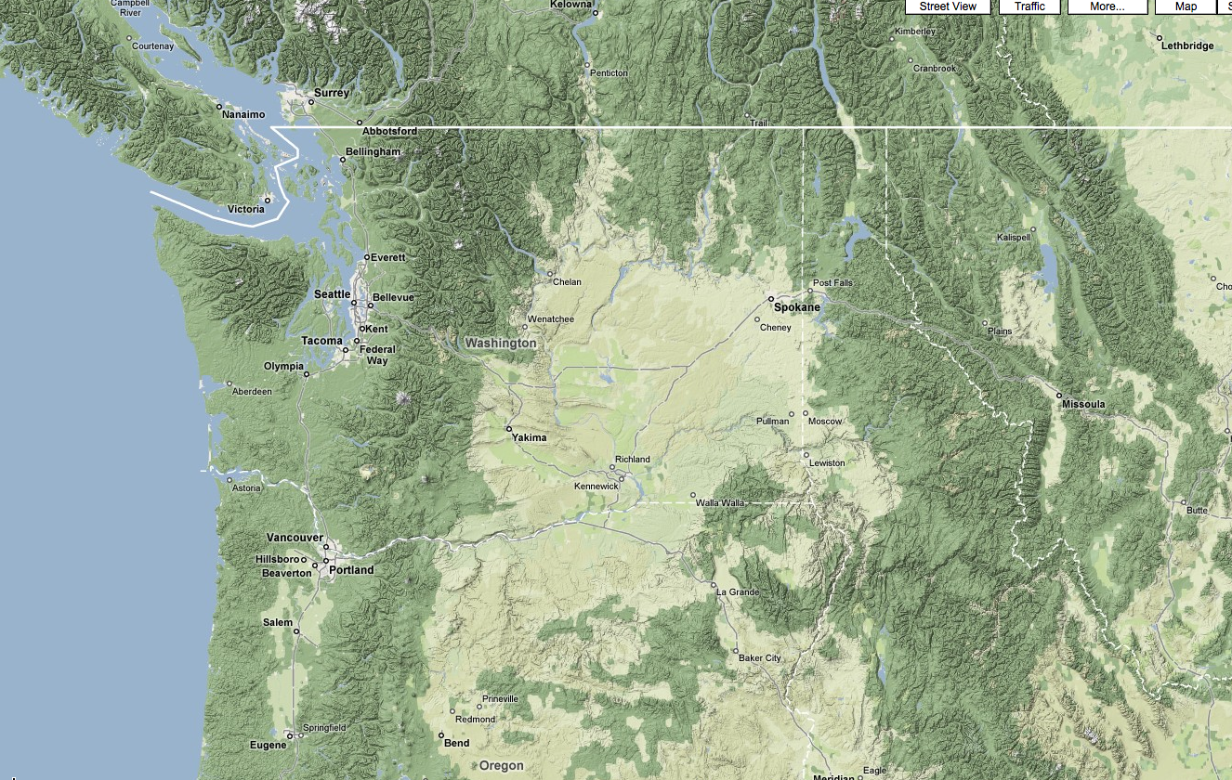
The weather of the Pacific Northwest is dominated by local weather phenomena, most forced by our regional terrain and water bodies

Slide 3
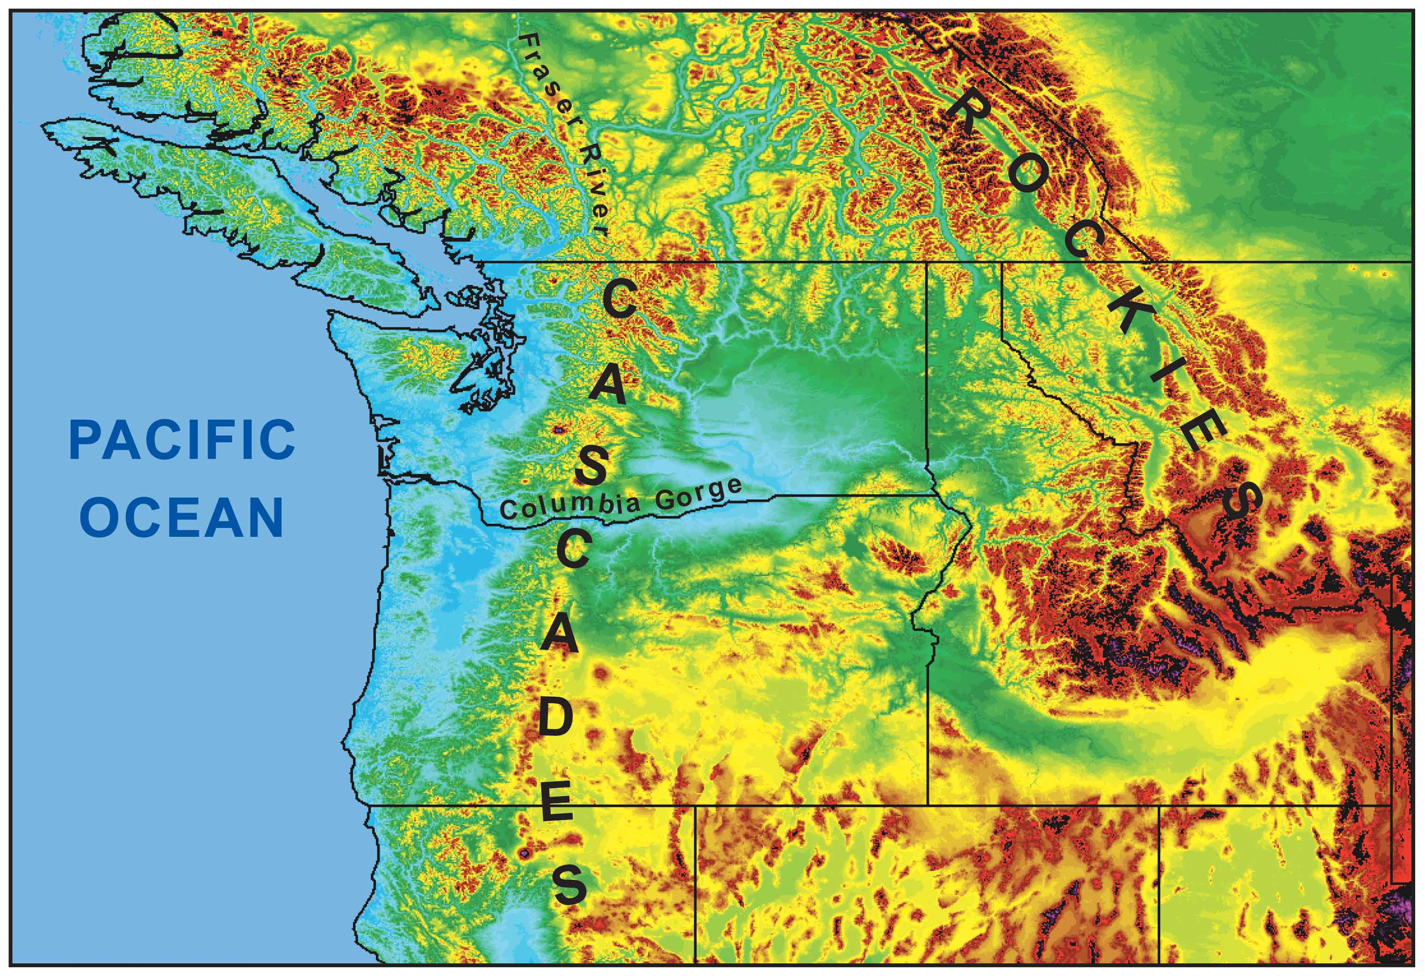
During the winter, the mountains block the cold air from the interior.
Cold
Air

Slide 4
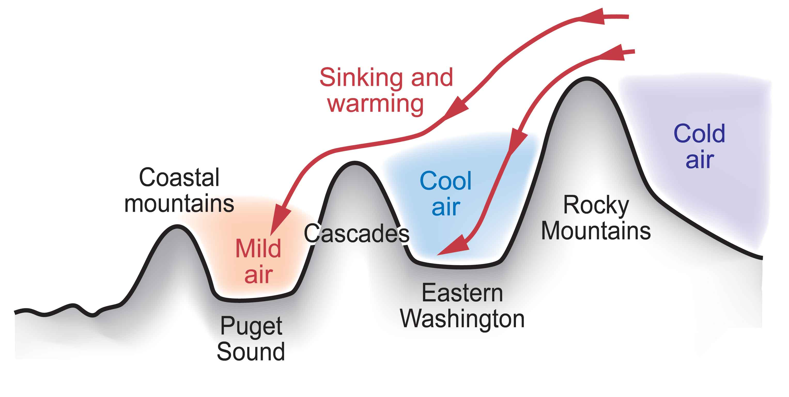
Cold Air from the Continental Interior Has a Hard Time Reaching Western Washington
Adiabatic compressional warming as air sinks on western slopes

Slide 5
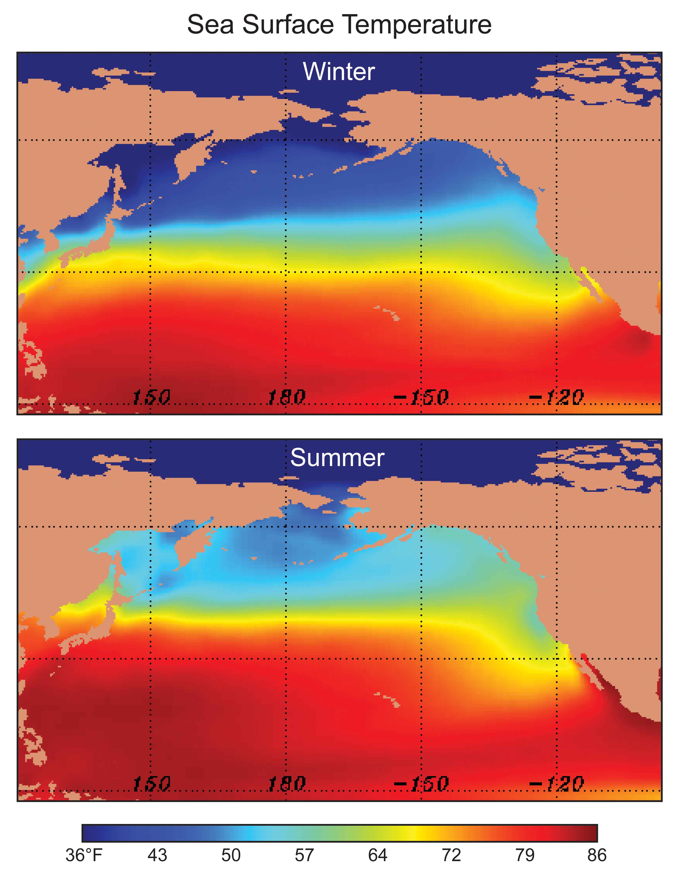
Our air and weather systems generally
move west
to east:
Thus, our
weather comes from off
the mild
Pacific--so we tend to be wet and mild.

Slide 6
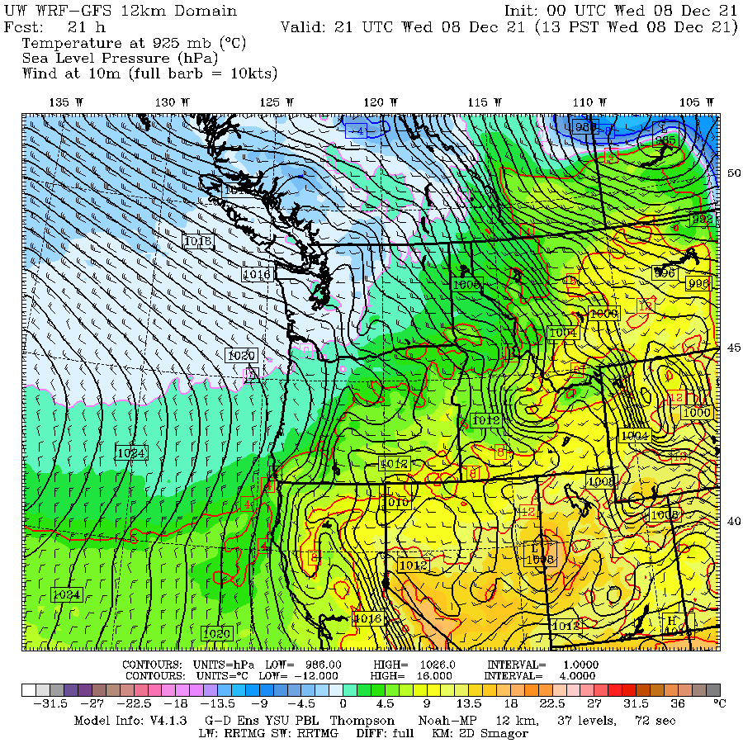

Slide 7
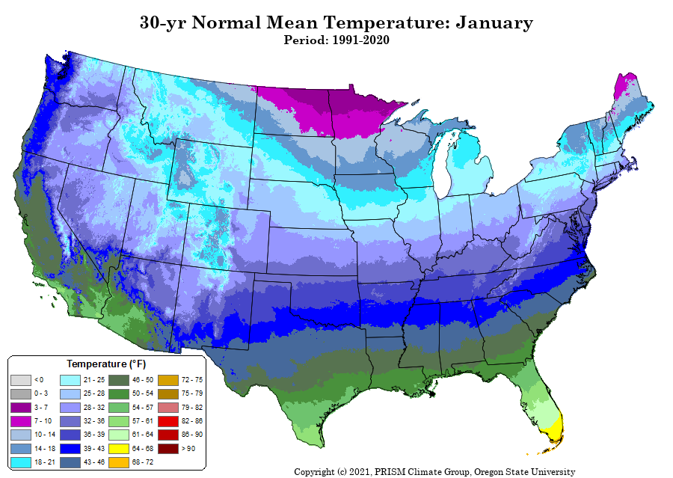
Mild Winter

Slide 8
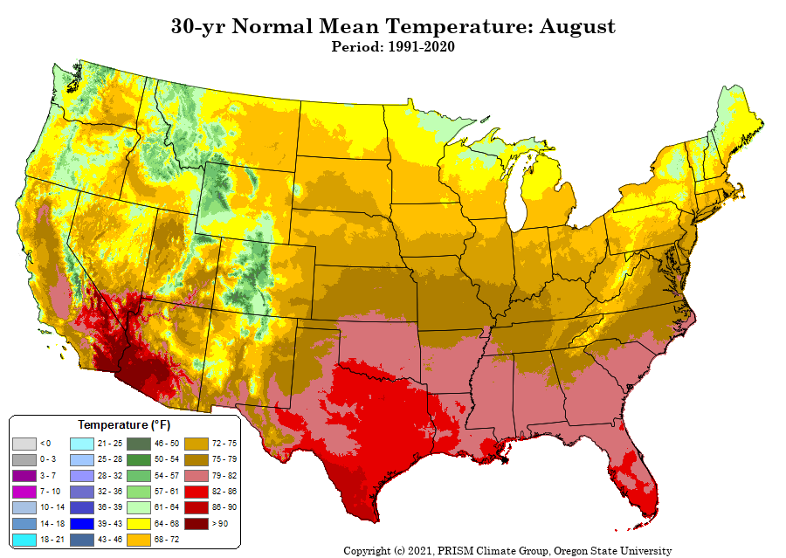
Mild Summers

Slide 10
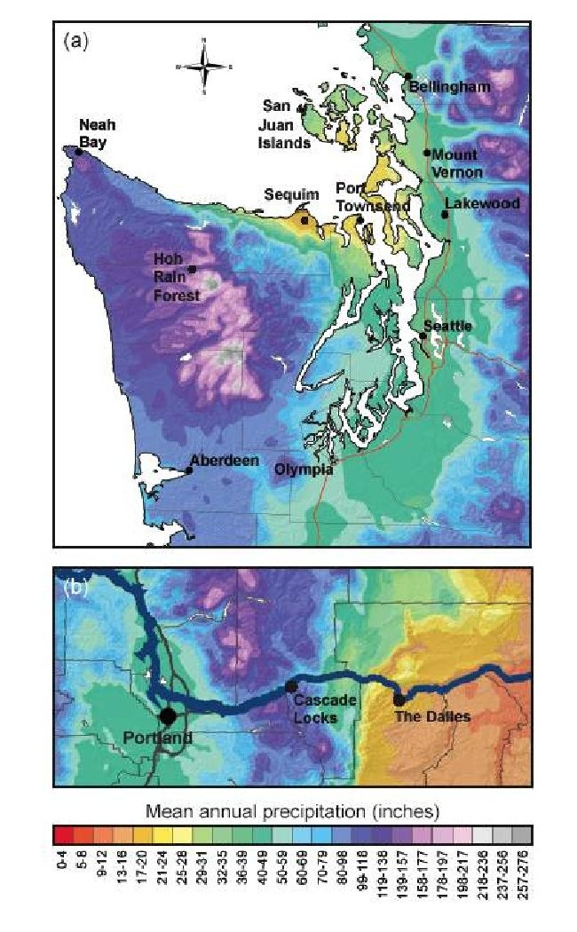
Extraordinary Precipitation Contrasts

Slide 11
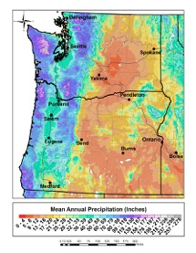

Slide 12
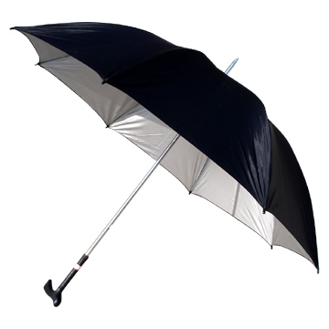
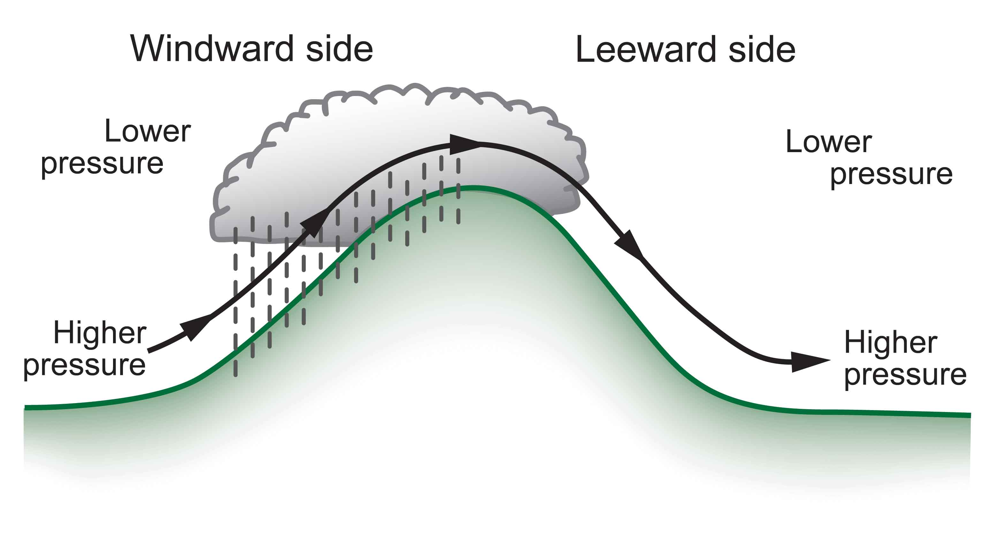
Rainshadows are as important as windward enhancement
The result is huge precipitation contrasts…some of the largest in the nation.
Substantial variations in solar radiation as well

Slide 13
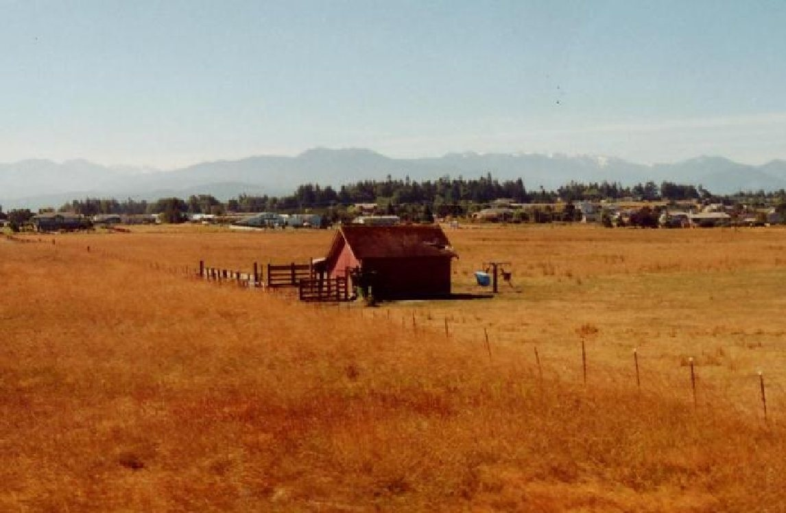
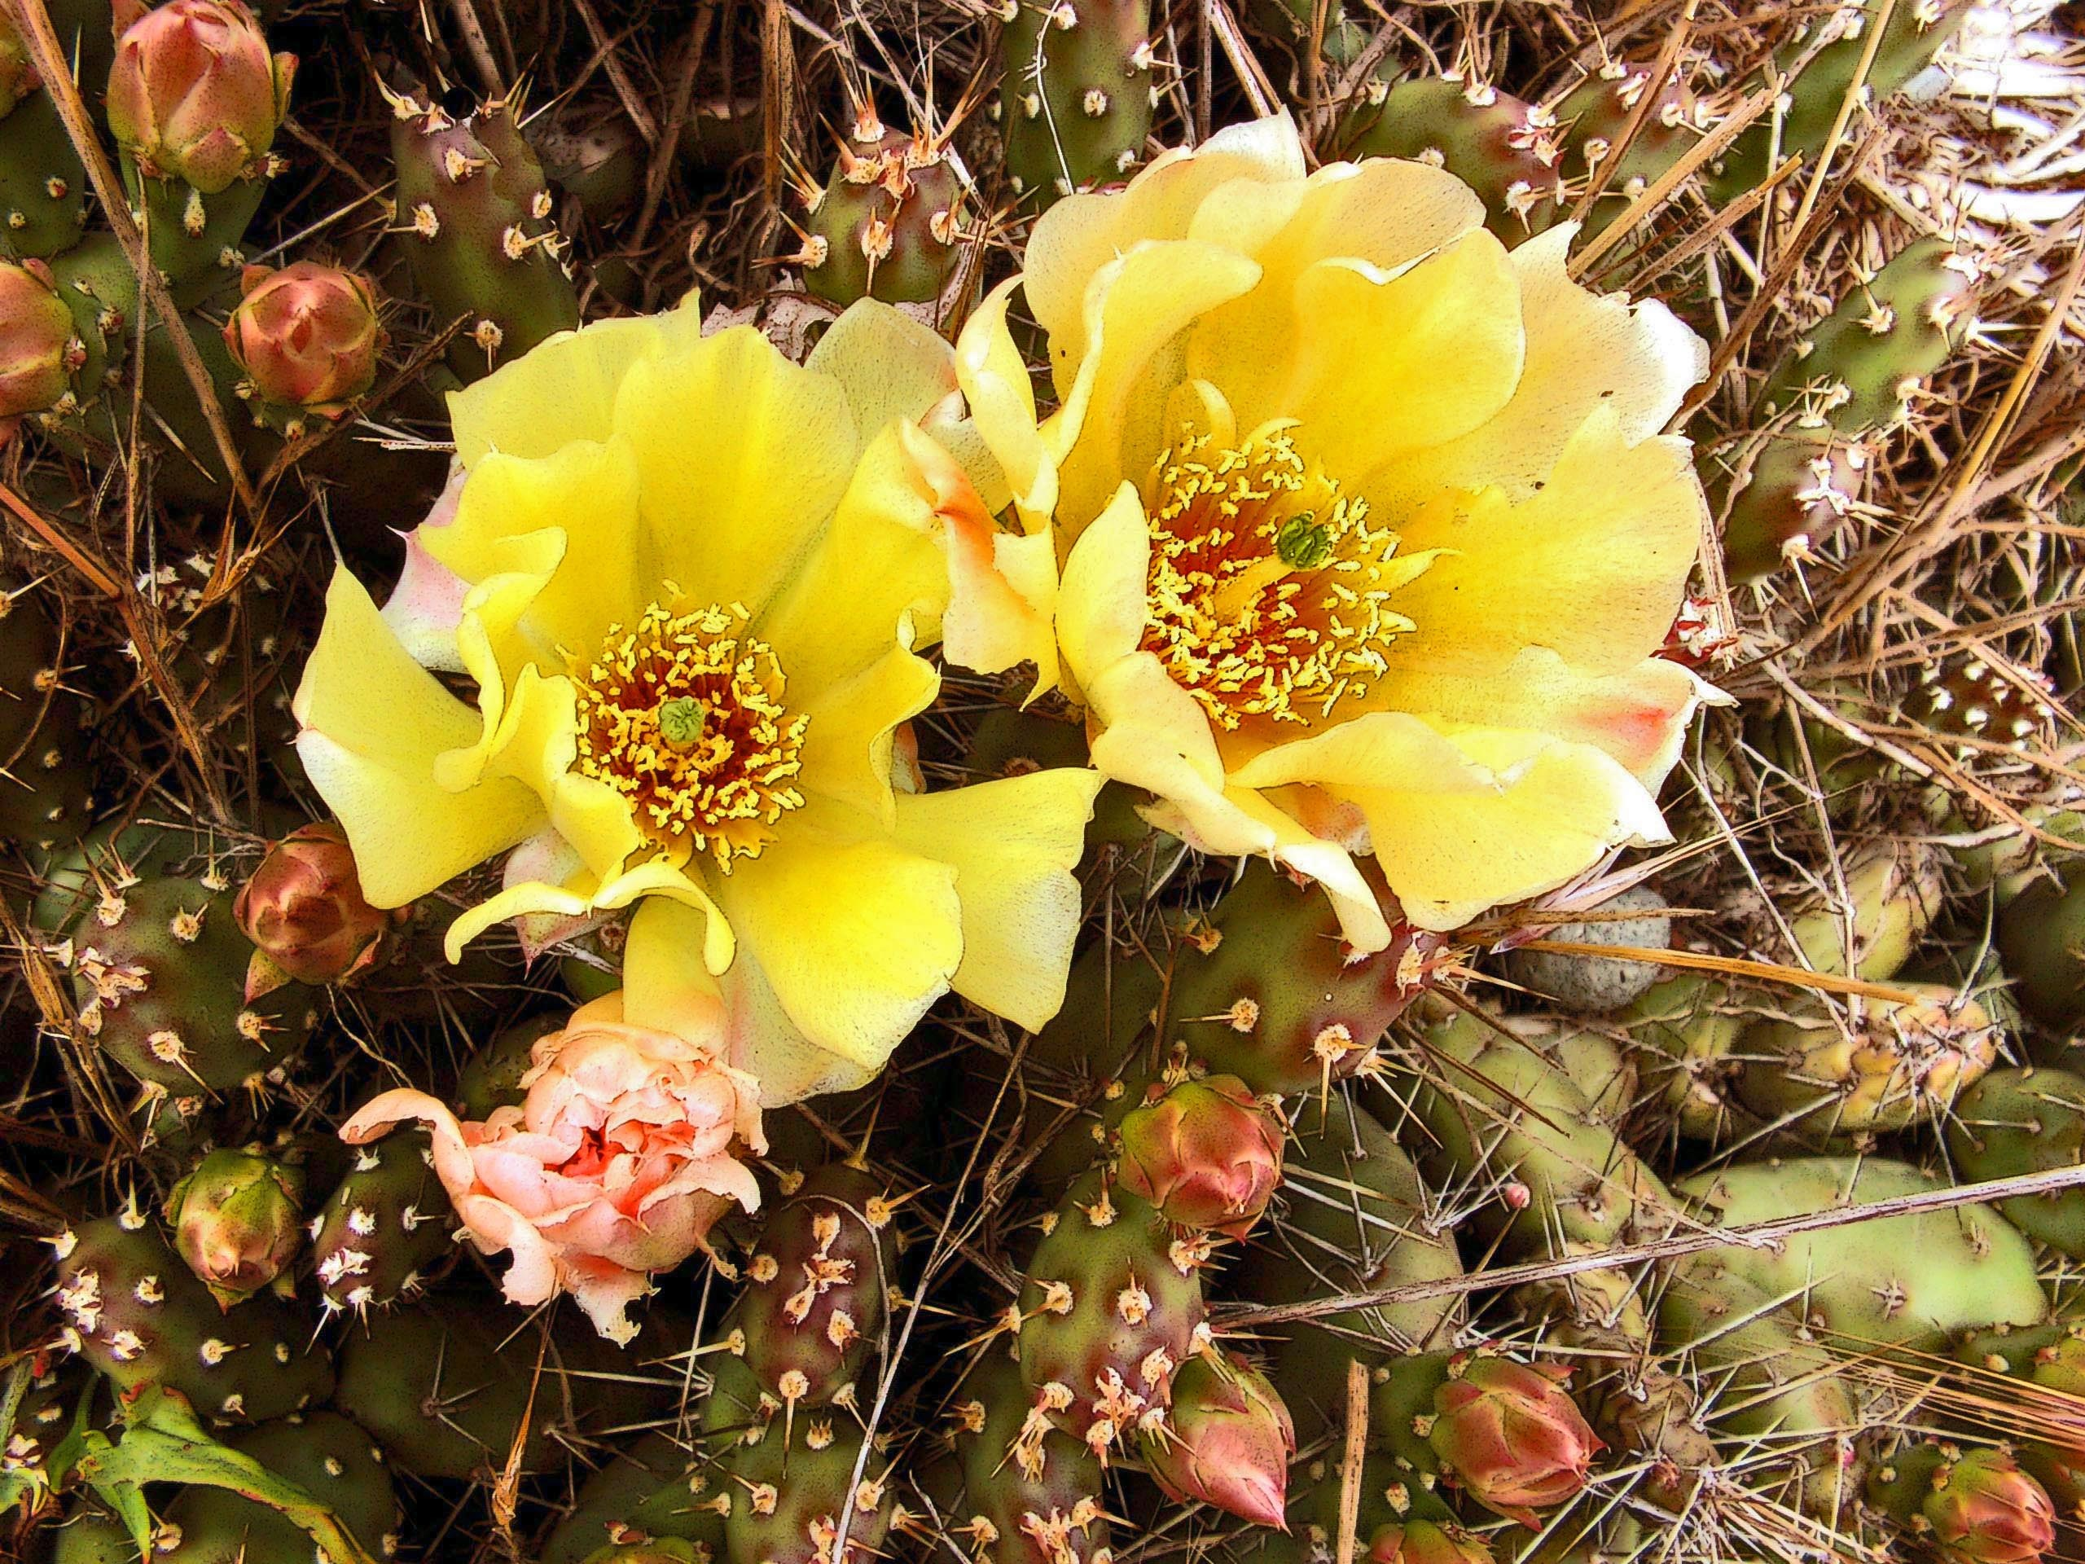
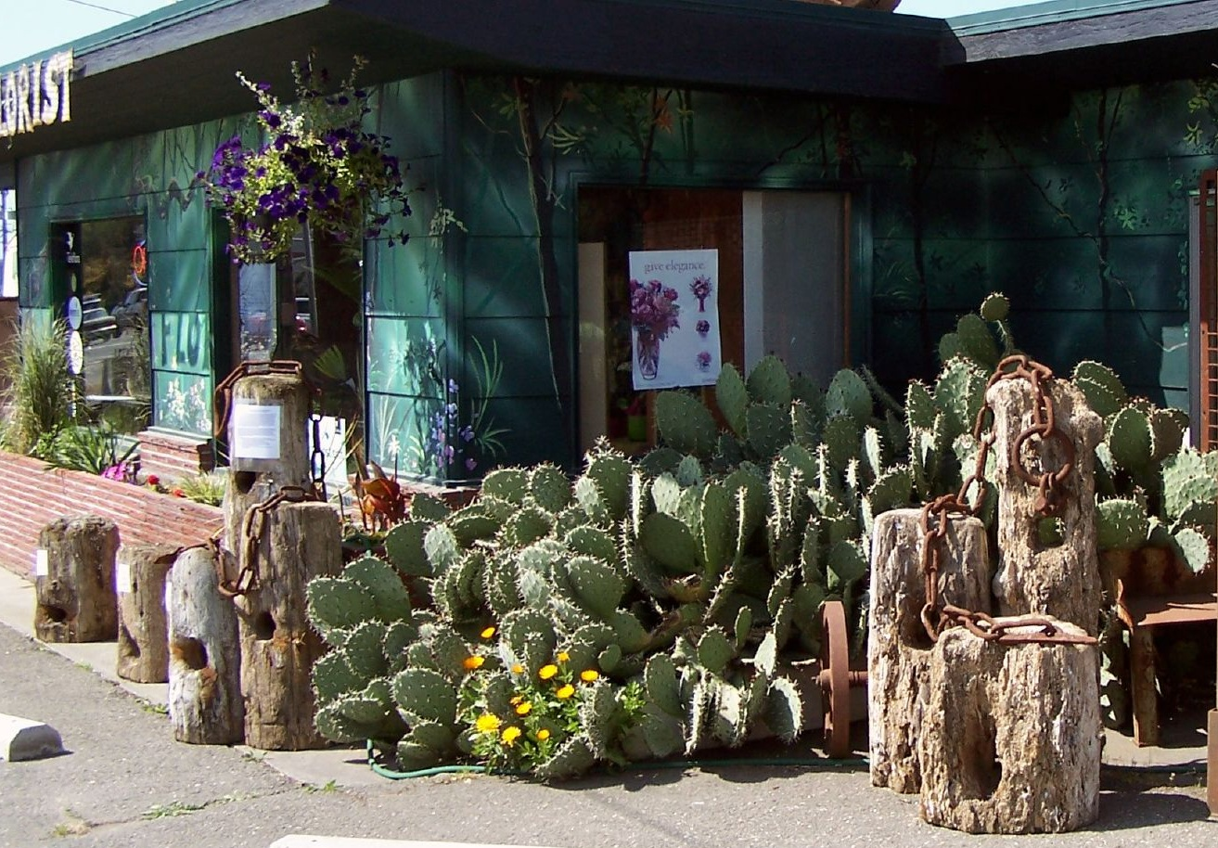
Sequim: Irrigation Needed, Cacti

Slide 14
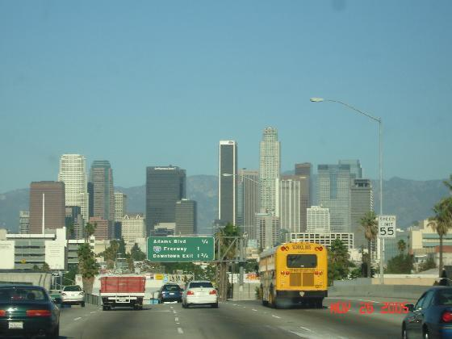
Annual Precipitation
Sequim: 15.97 inches
Los Angeles: 14.89 inches

Slide 15
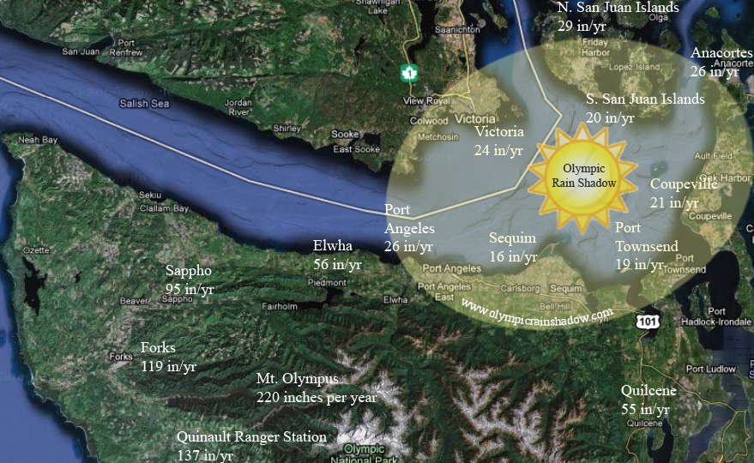

Slide 16
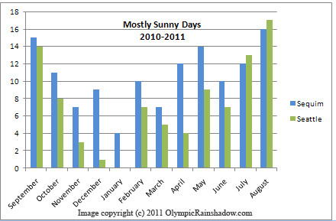

Slide 17
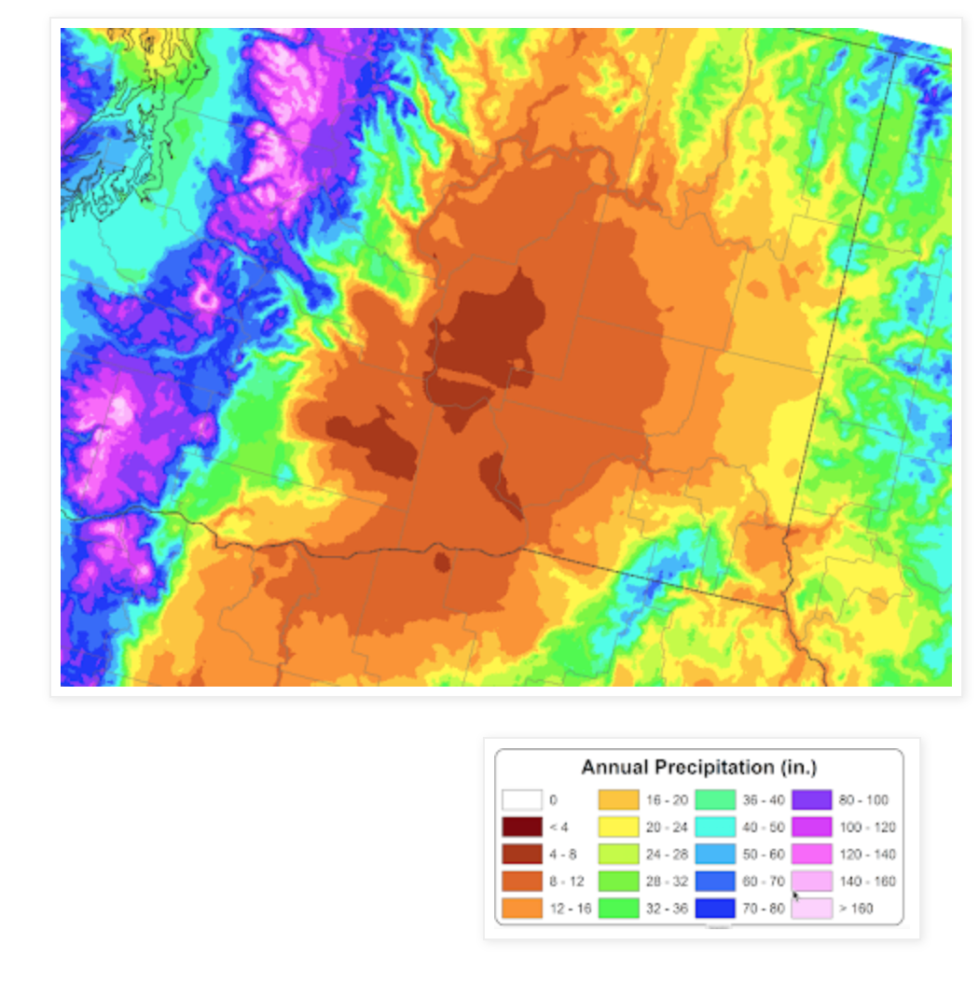
The Driest Location in Washington State?

Slide 18
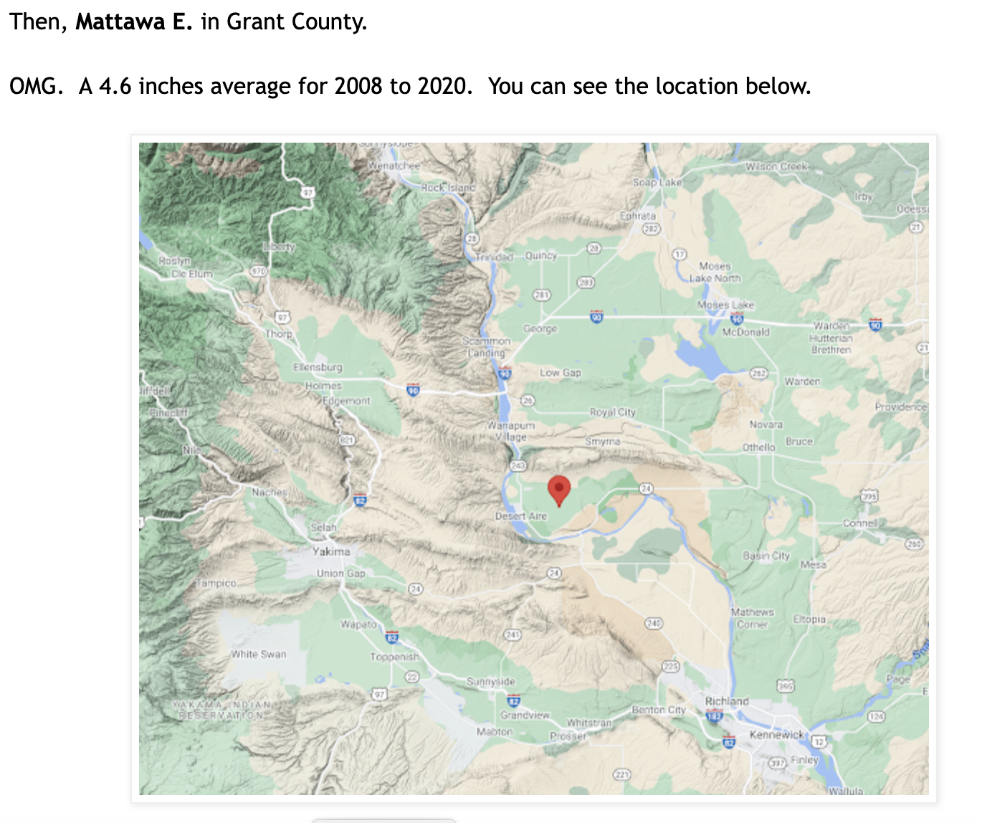

Slide 19
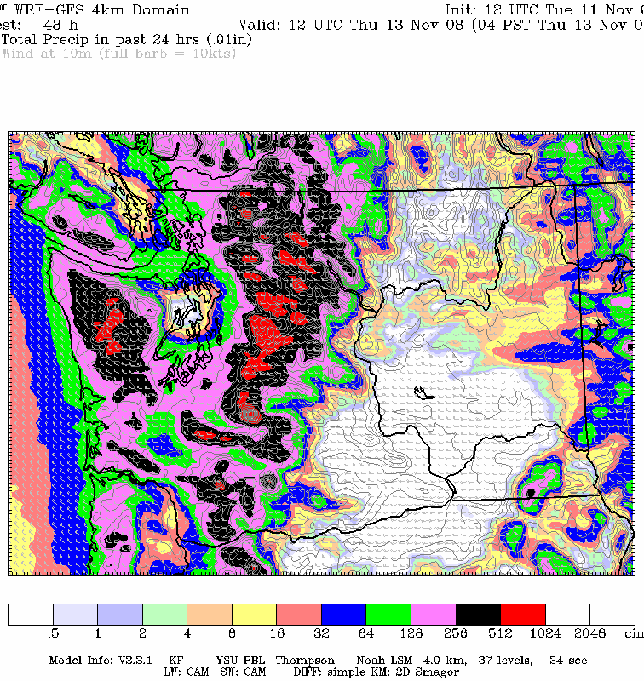
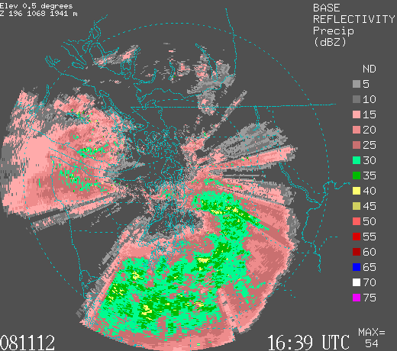
Rainshadows can move: depending on direction of the wind
For westerly winds, Seattle can be in the rainshadow

Slide 20
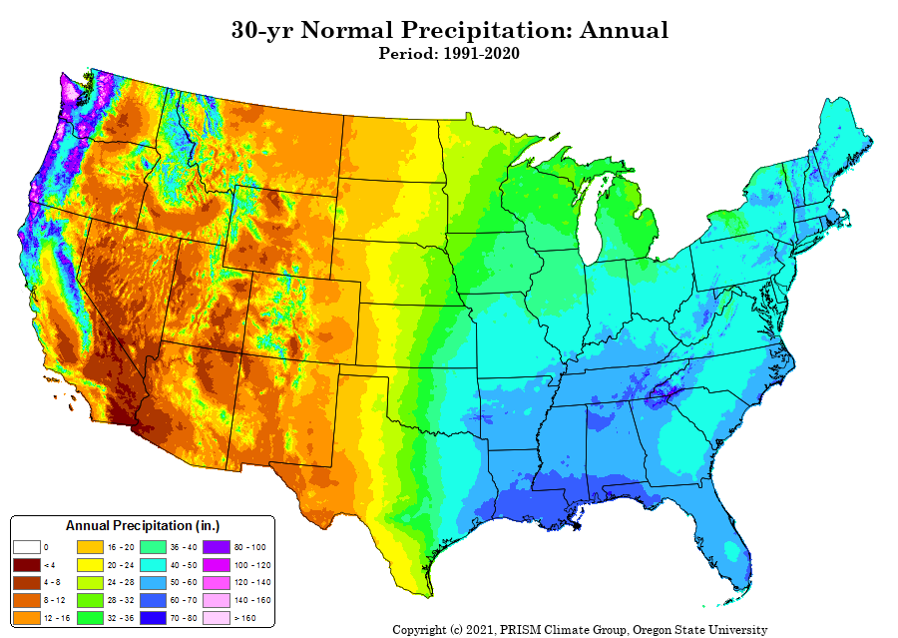
Western WA is the wettest part of US

Slide 21
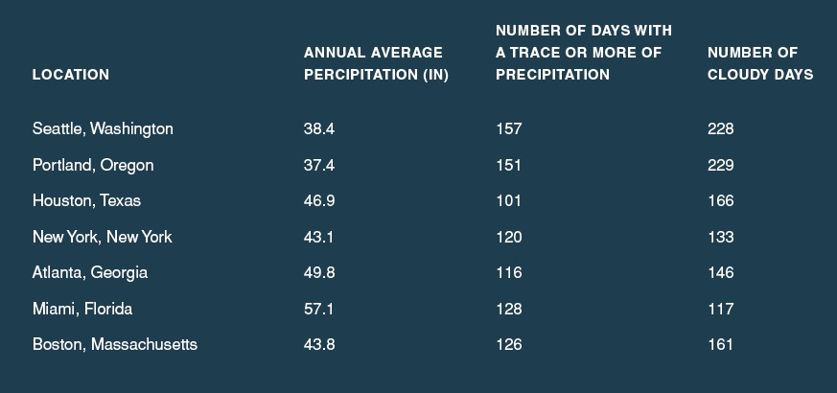
The western Washington lowlands really aren’t that wet—partially because we are often in the rainshadow of the Olympics and Mts. Of Vancouver Island…but the NUMBER of light rain/cloudy days is substantial

Slide 22
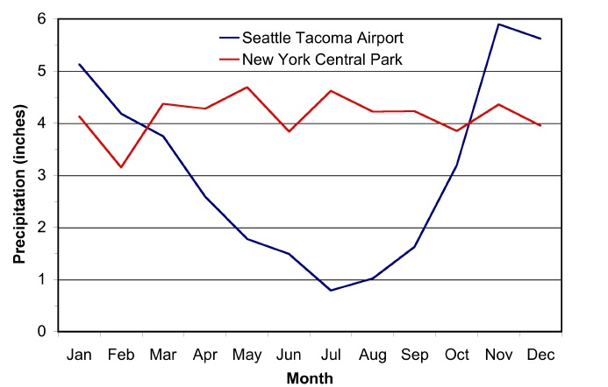
The Northwest Has a Mediterranean Climate
Football
Baseball Season
Football

Slide 23
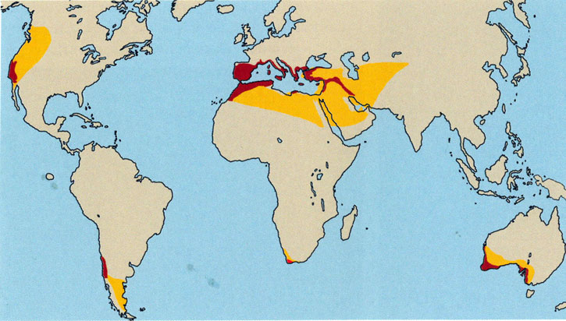
Mediterranean Climate: Dry Summers/Wet Winter

Slide 24
Why Dry Summers?

Slide 25
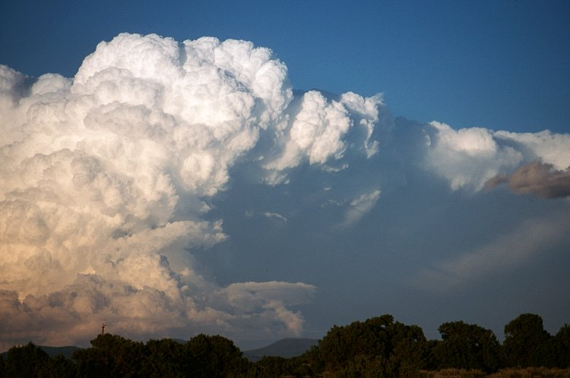
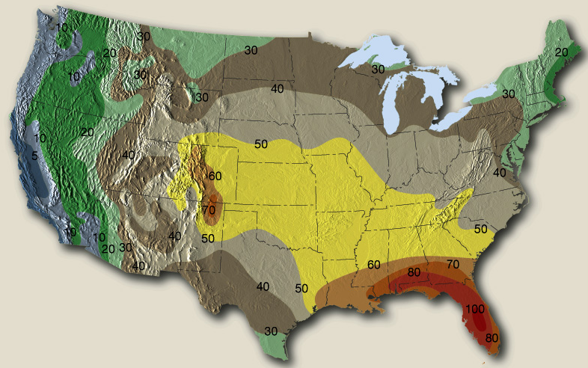
The Northwest Gets Fewer Thunderstorms Than Almost Anywhere in the U.S. Except CA
Why?
Cool Pacific

Slide 26
Local Weather Features are Essential Elements of NW Weather
Many are associated with the interaction between the large-scale flow coming over the Pacific and local terrain barriers.

Slide 27
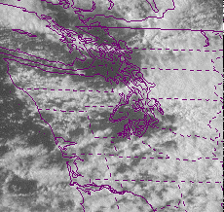
Puget Sound Convergence Zone

Slide 28
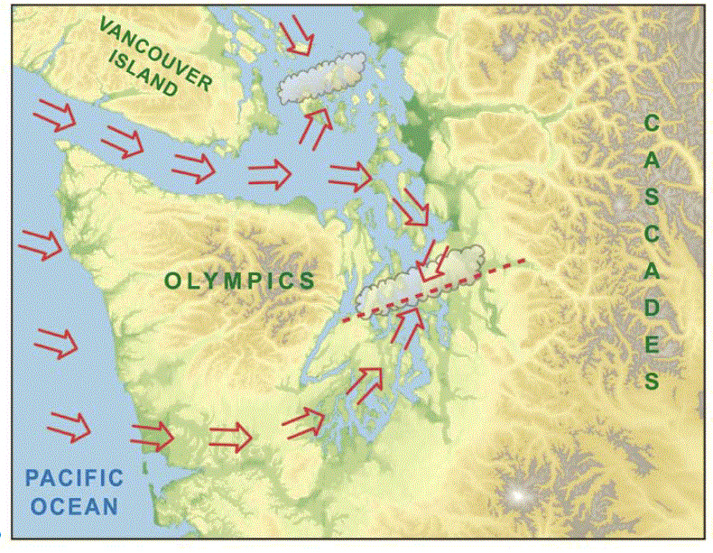

Slide 29
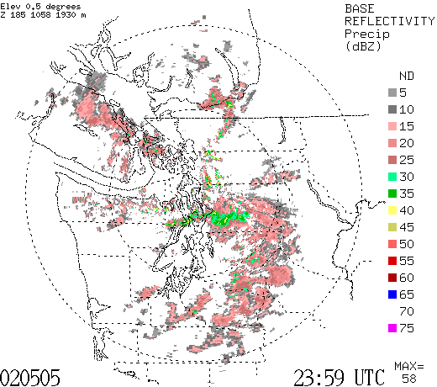

Slide 30
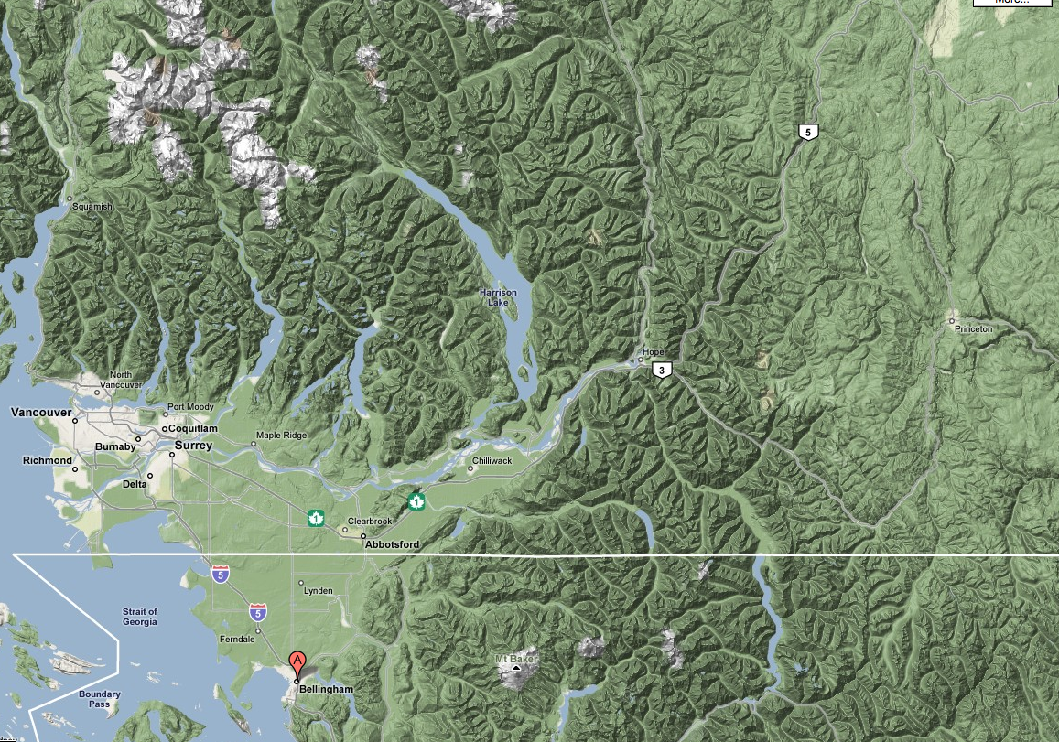
Fraser River Gap

Slide 31
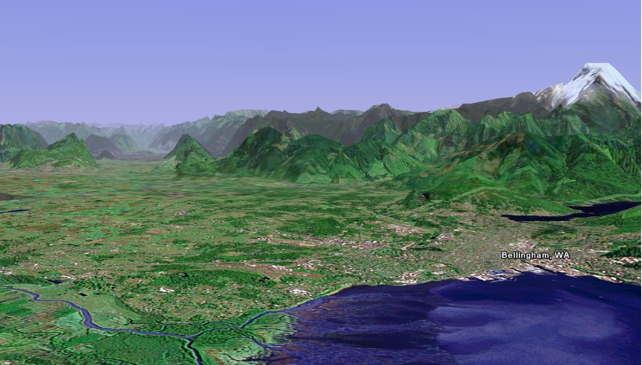
The Fraser River Gap

Slide 32
Can Get Strong Northeasterly Outflow Winds into Bellingham and NW Washington When Cold Air and High Pressure Builds in the Interior of BC

Slide 33
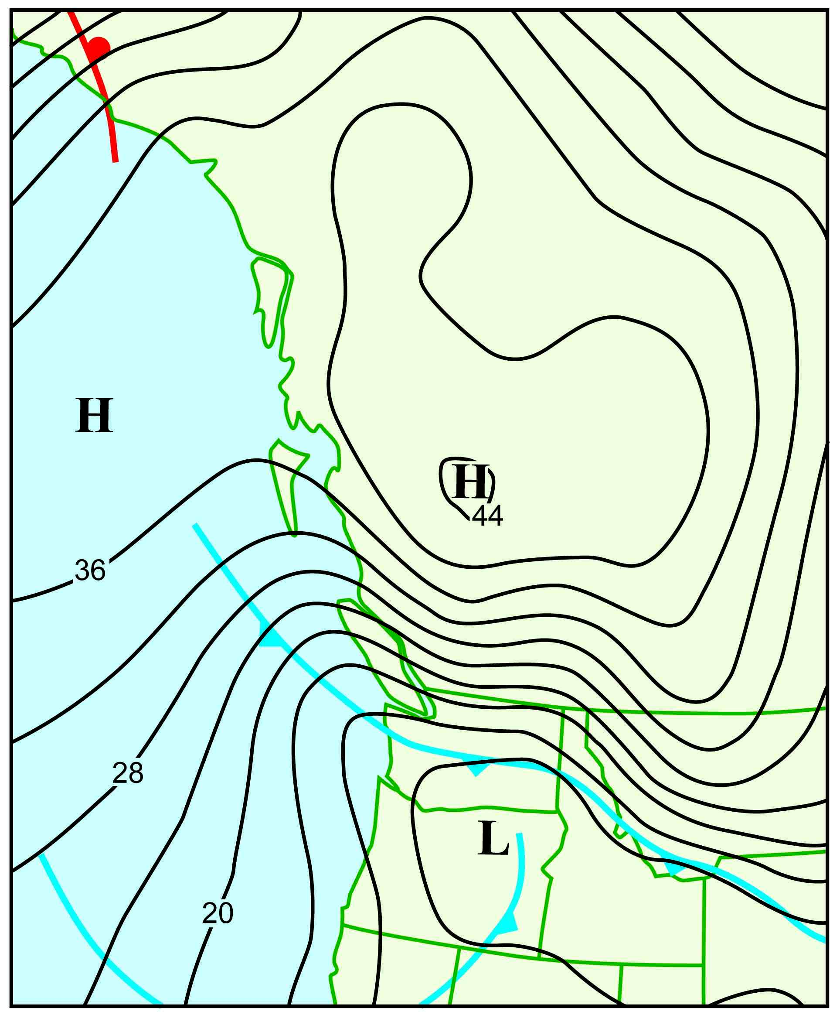
Major Fraser Gap Windstorm of December 28, 1990

Slide 34
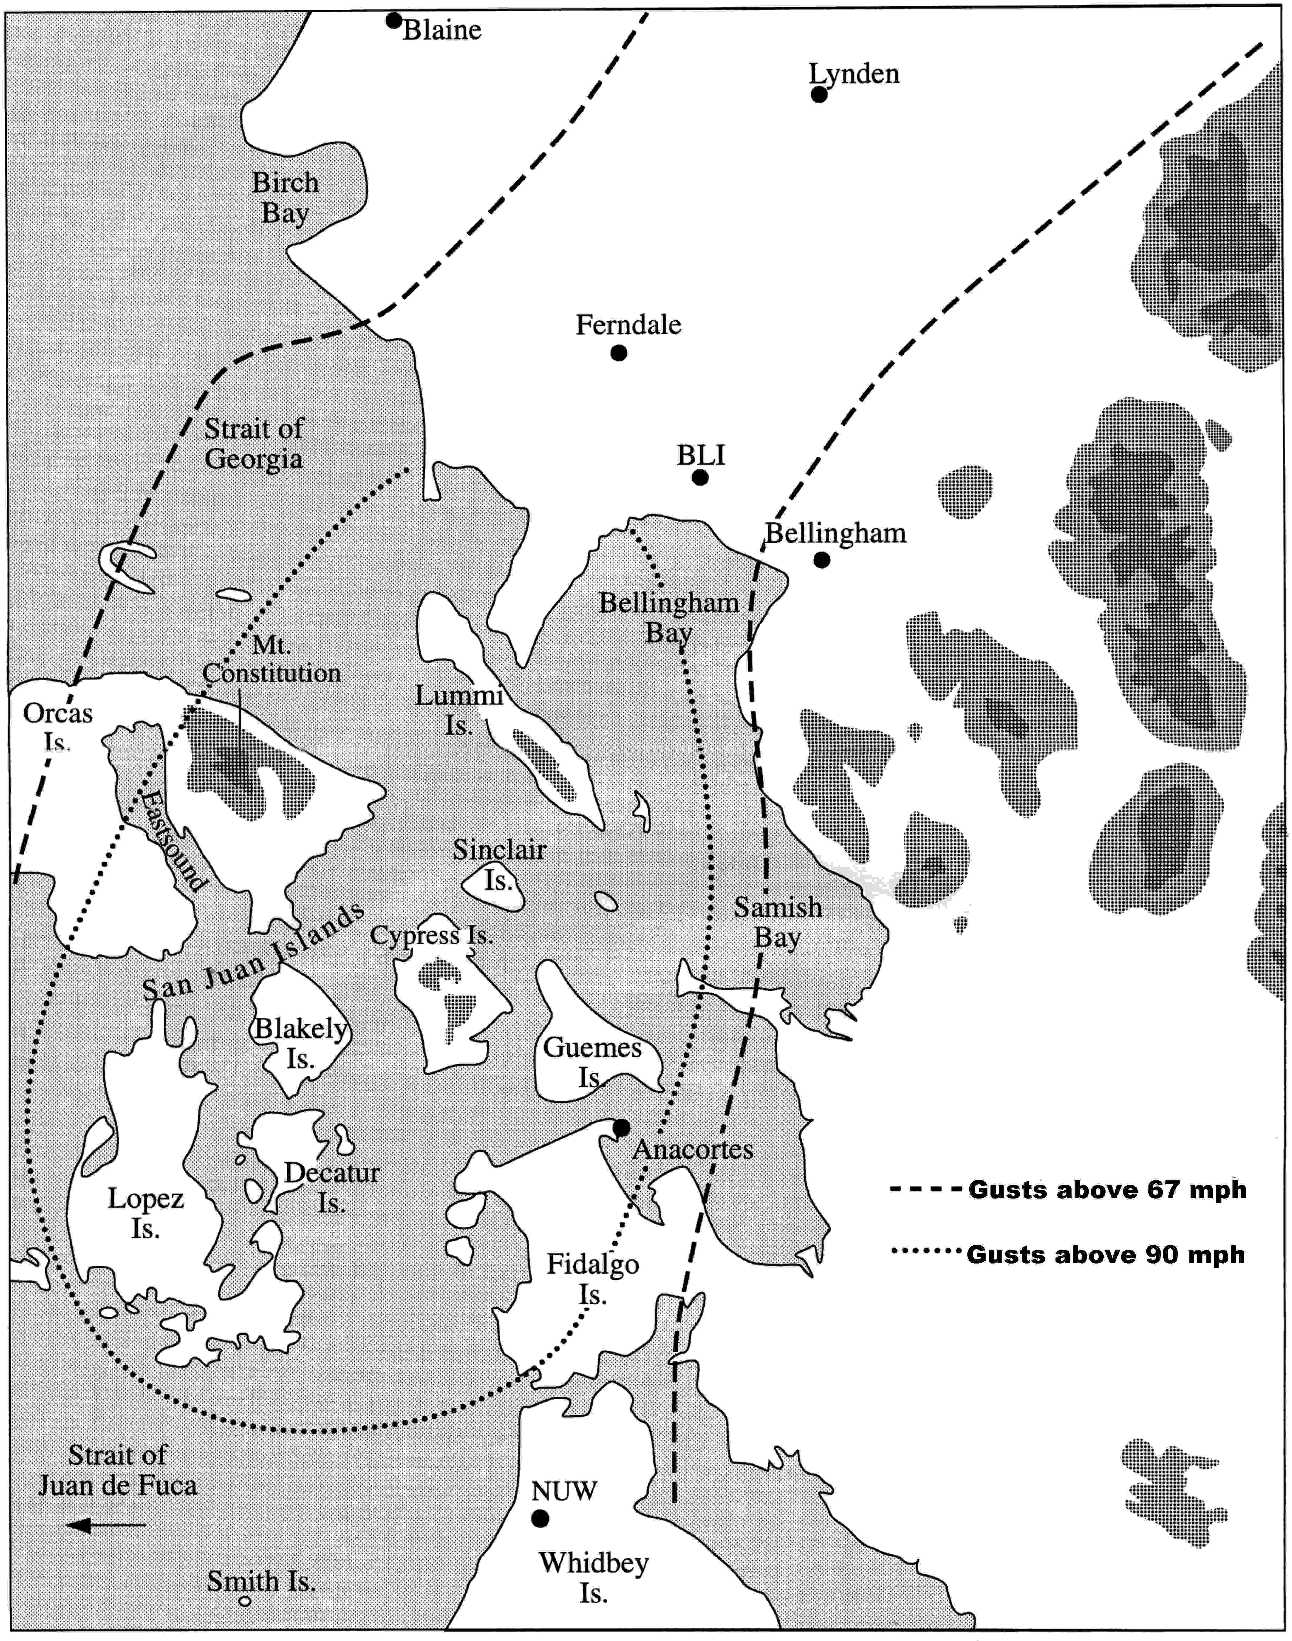

Slide 35
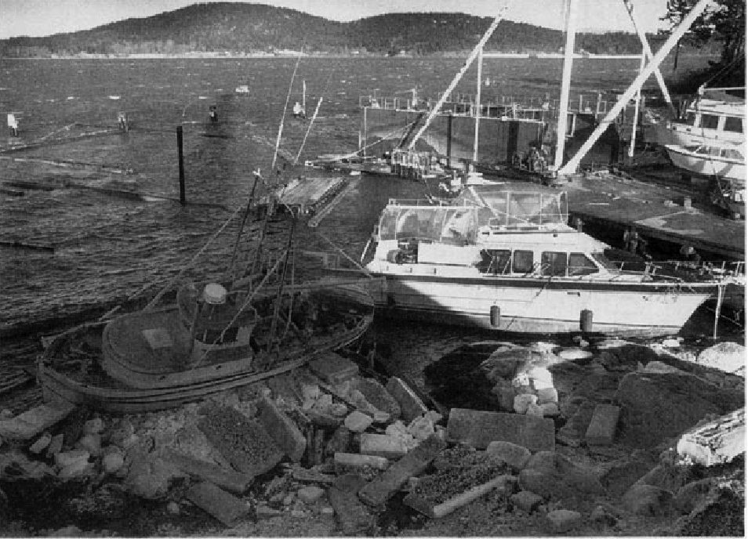
Anacortes Dec 1990

Slide 36
The Big Storms of the Pacific Northwest

Slide 37
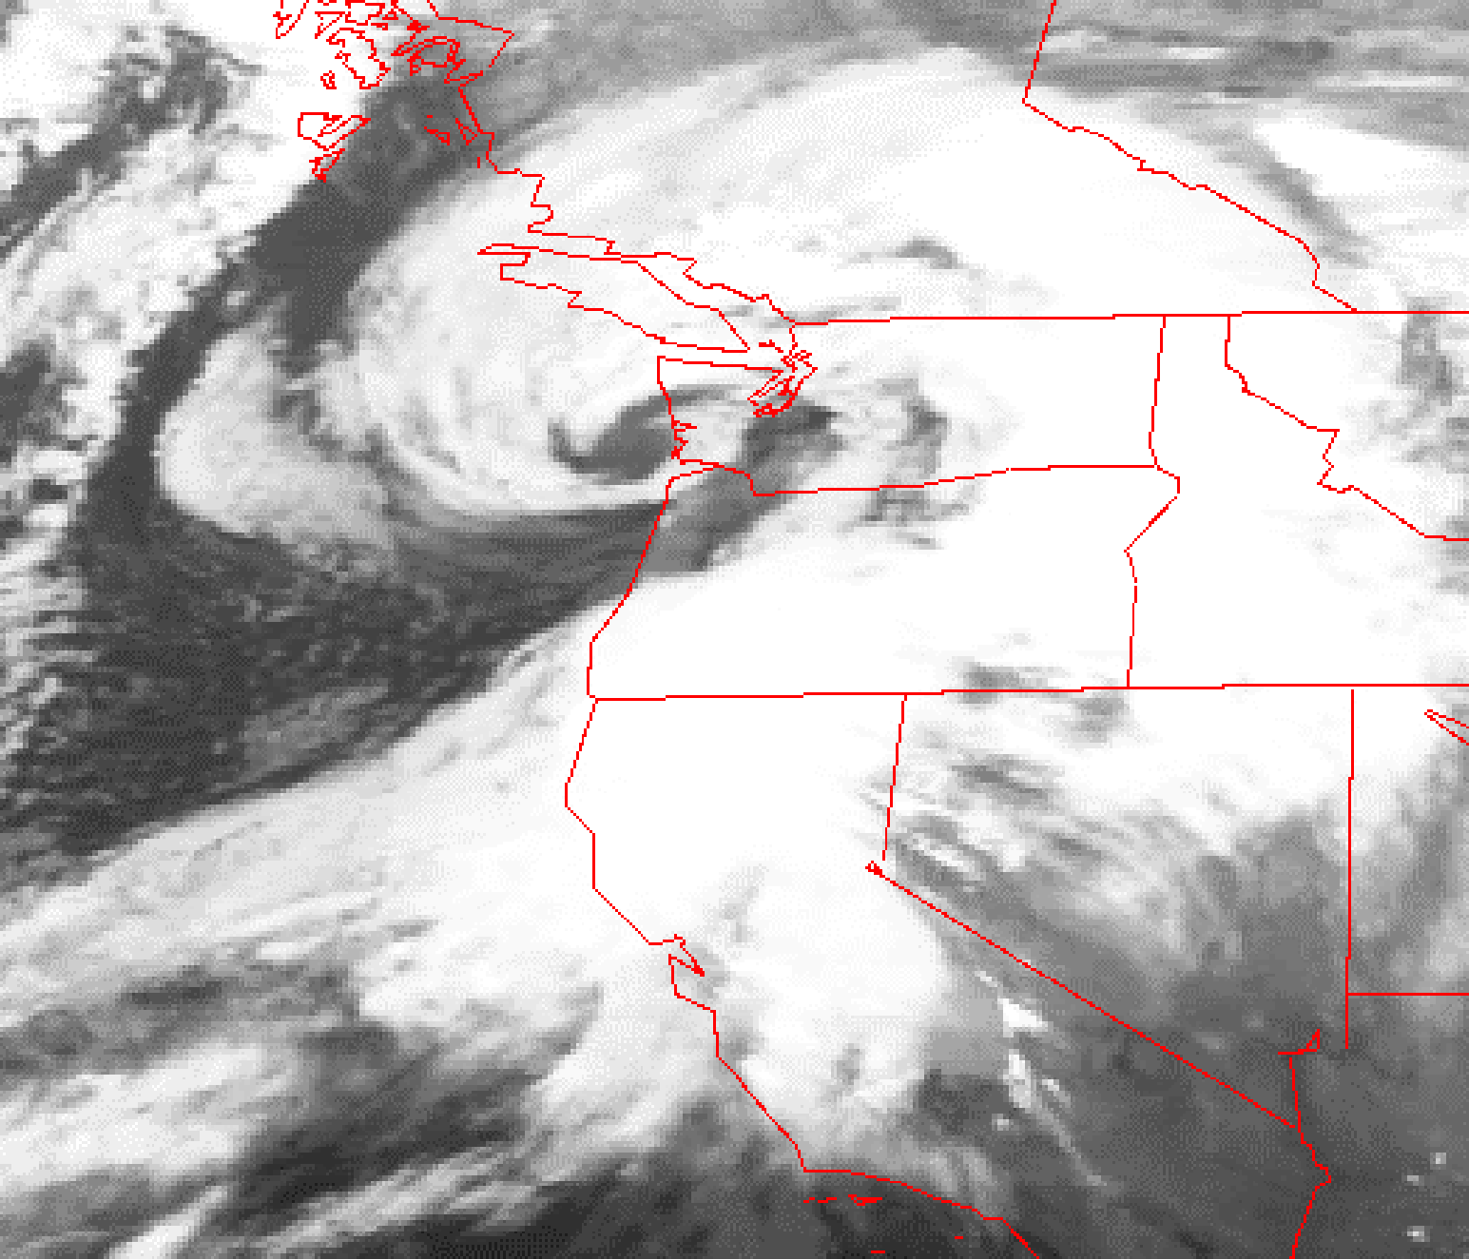
Our major windstorms are generally associated with strong midlatitude
cyclones
Inauguration Day Storm January 20, 1993

Slide 38
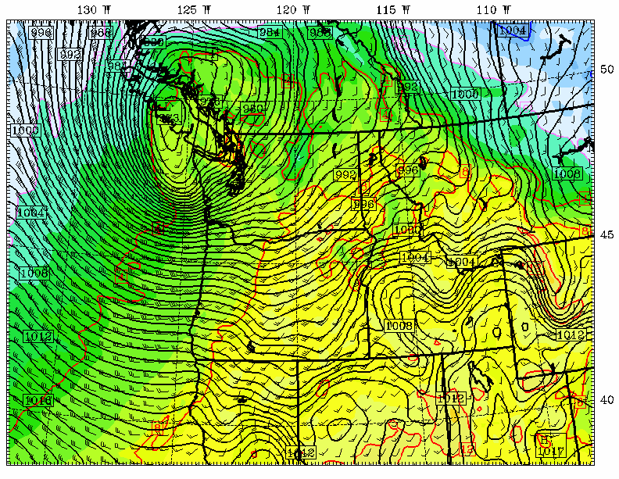
Chanukah Eve Storm: 18-h forecast for 10 PM December 14, 2006
L

Slide 39
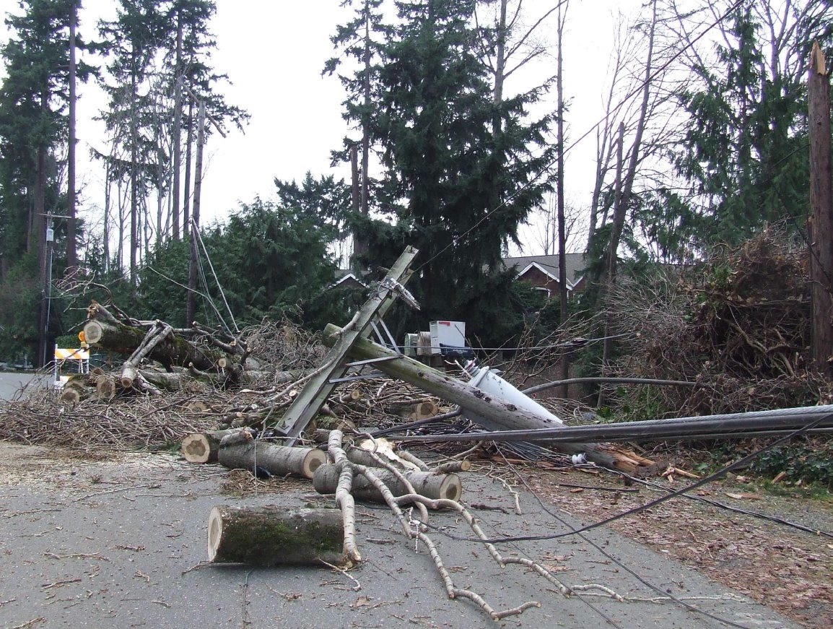
Mercer Island, December 15, 2006

Slide 40
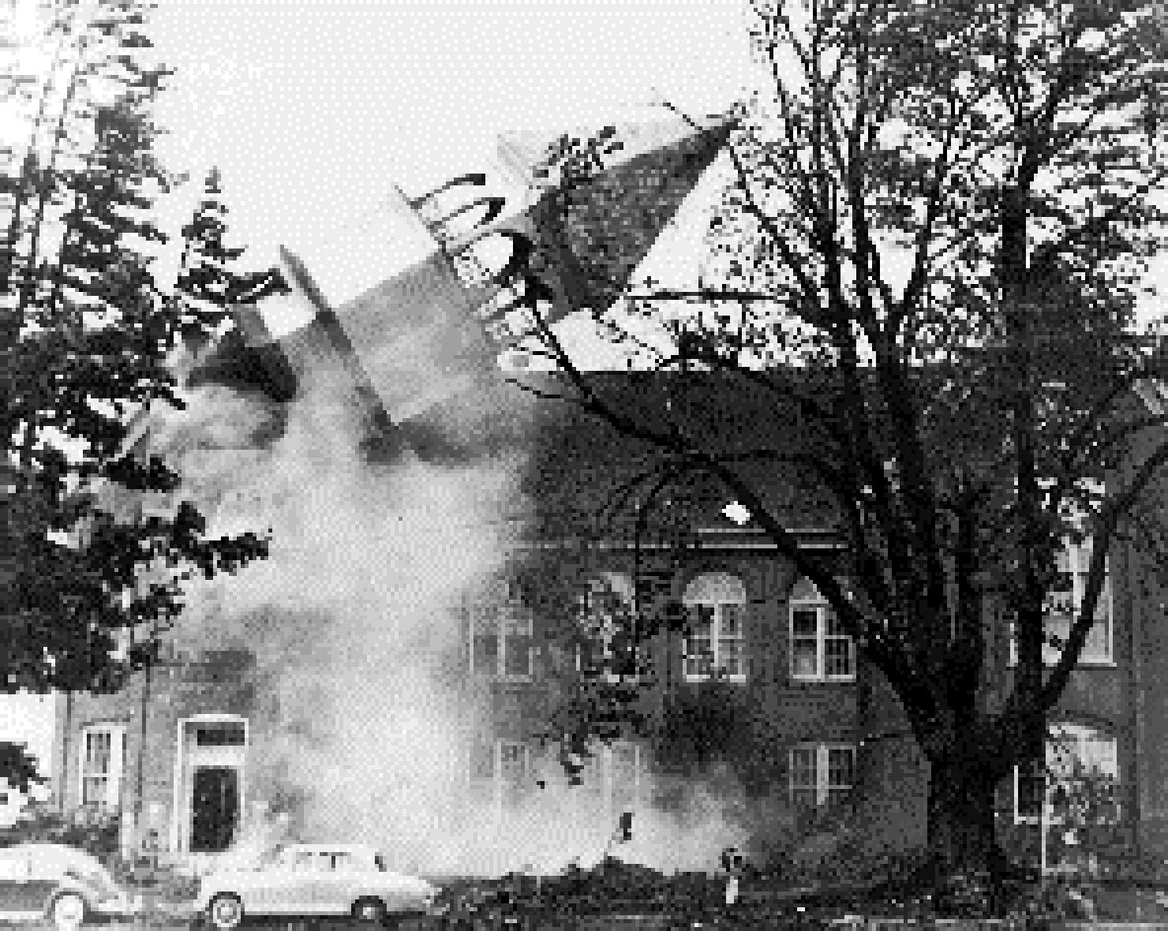
The Most Extreme Northwest Windstorm: The Columbus Day Windstorm of 12 October 1962

Slide 41
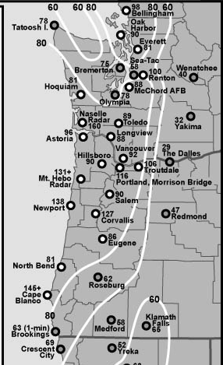
Max Winds (mph)
Columbus Day Storm 1962

Slide 42
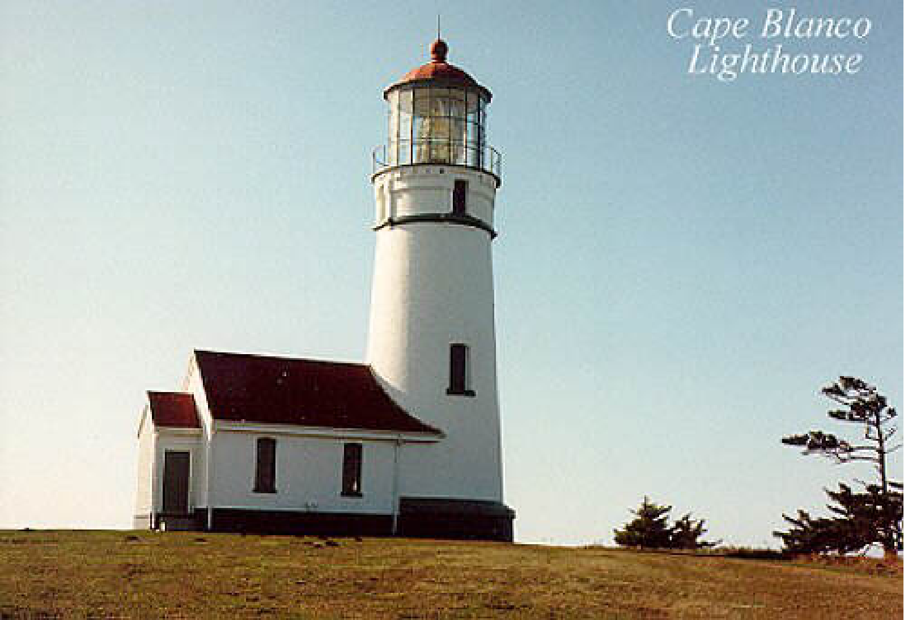
Columbus Day 1962: At Cape Blanco there were 150 mph with gusts to 179! Strongest winds on bluffs and windward slopes of coastal orography

Slide 43
The most costly extreme weather of the Northwest:
Flooding

Slide 44
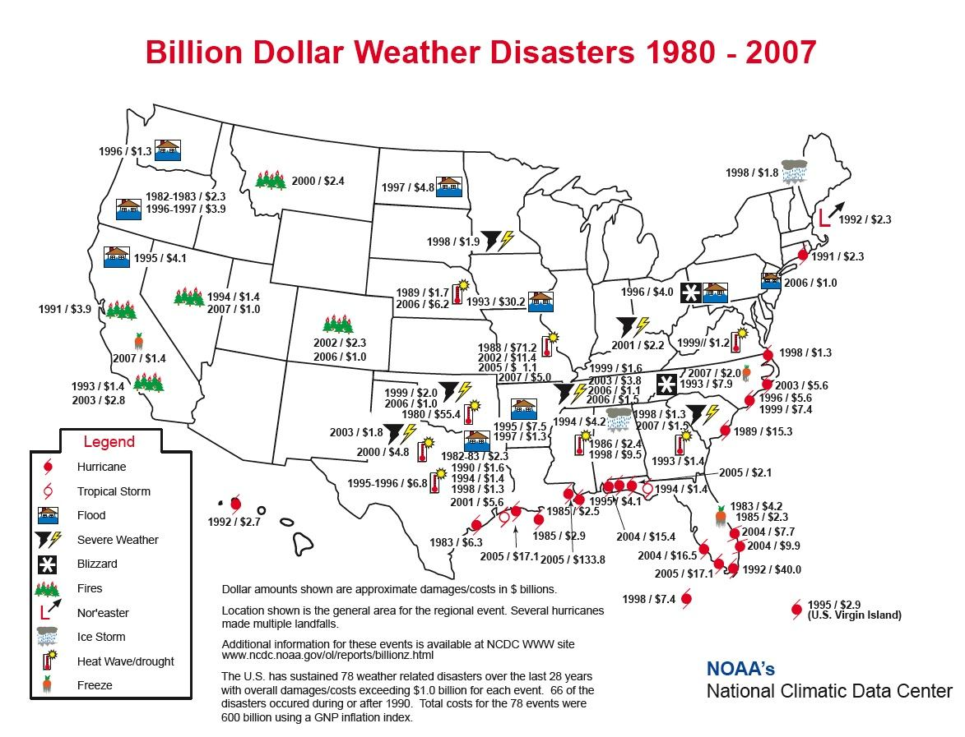

Slide 45
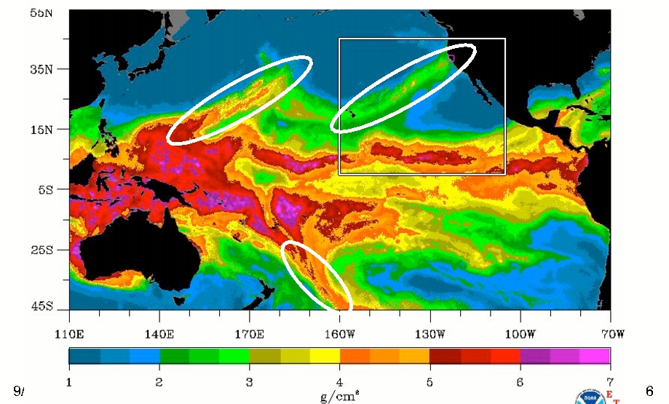
Most are associated with the “Pineapple Express”
A relatively narrow current of warm, moist air from the subtropics…often starting near or just north of Hawaii.
a.k.a.
Atmospheric rivers

Slide 46
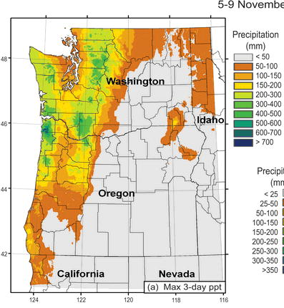
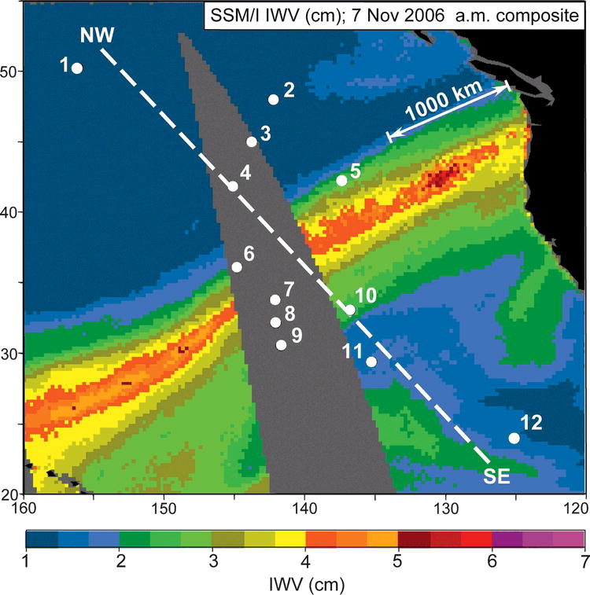
A Recent Devastating Pineapple Express: November 6-7, 2006
Dark Green: about 20 inches

Slide 47
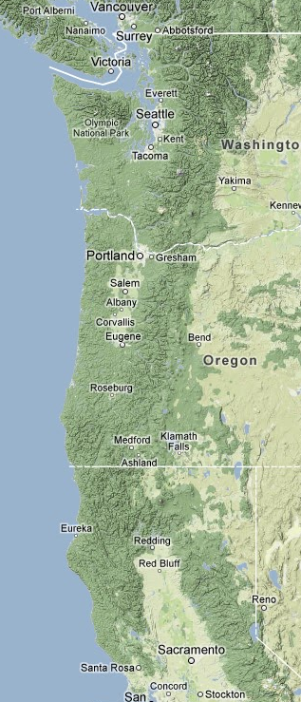
Extraordinary Impact
An extensive area, stretching from northern California to southern British Columbia experienced hurricane-force winds, massive treefalls, and power outages.
Sustained winds reaching 60-70 mph and gusts over 120 mph.
In Oregon and Washington, 46 died and 317 required hospitalization.
Flooding and landslides in northern California.

Slide 48
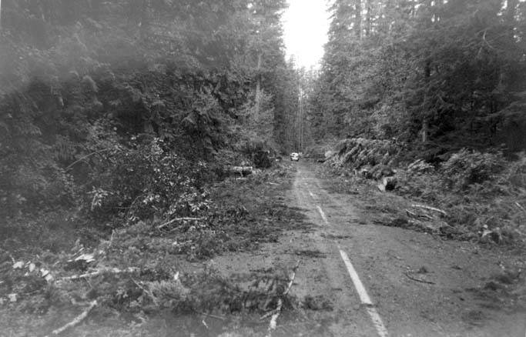
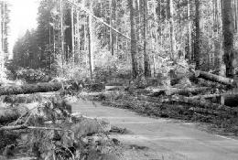
Impacts
Ten to 15 billion board feet of timber were downed, enough to build a million homes and far greater than the yearly output of the NW forest industry.
53,000 homes were damaged, thousands of utility poles were toppled, and the twin 520-ft steel towers that carried the main power lines of Portland were crumpled.

Slide 49
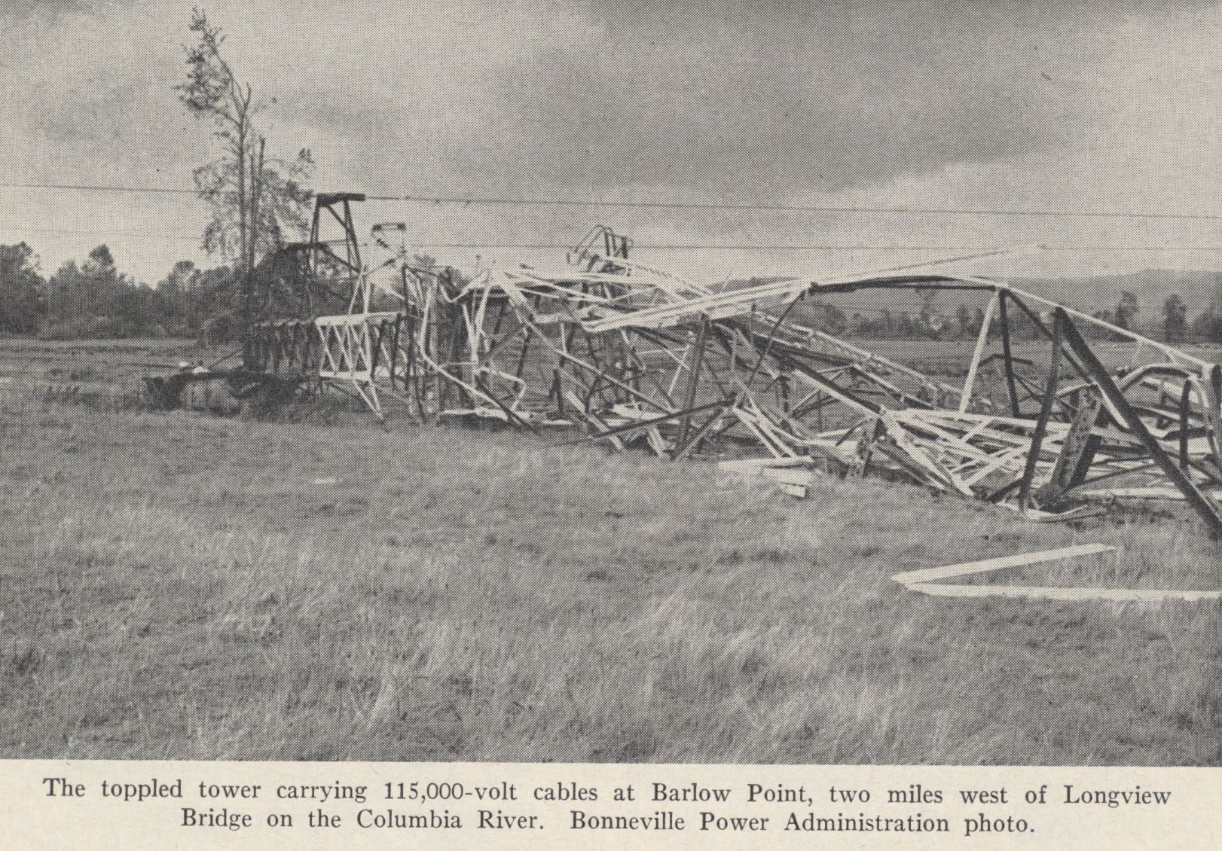

Slide 50

On the state capitol ground in Salem, Oregon, the bronze status, the Circuit Rider was toppled

Slide 51
Columbus Day 1962: At Cape Blanco estimated winds were 150 mph with gusts to 179!

Slide 52

Mt. Hebo Radar Facility: Gusts exceeding 130 mph
Courtesy: Mark Cole

Slide 53

Mount Rainier National Park 18 inches in 36 hr (Nov 8, 2006)

Slide 54



Mt. Rainier damage

Slide 55
Snowstorms
The most difficult forecasting problem in the NW….but we are getting better at it.

Slide 56

Seattle 1916 or 2008?

Slide 57
The Set Up
Cold Air
Moisture

Slide 58


Slide 59


Slide 60

The End

