Slide 1
Final Day of ATMS 101!
Final Exam
  Online
  Wednesday, December 15 at 8:30 AM-10:20 AM
  Comprehensive, but will more questions on second half
  Open book
Online Question/Answer/Review Session on Tuesday at 4 PM (zoom)

Slide 2
Last Day
Happy to answer your questions via email.
Can talk over the phone or through zoom for individual questions.
Course Evaluation is now online. Appreciate your feedback.

Slide 3
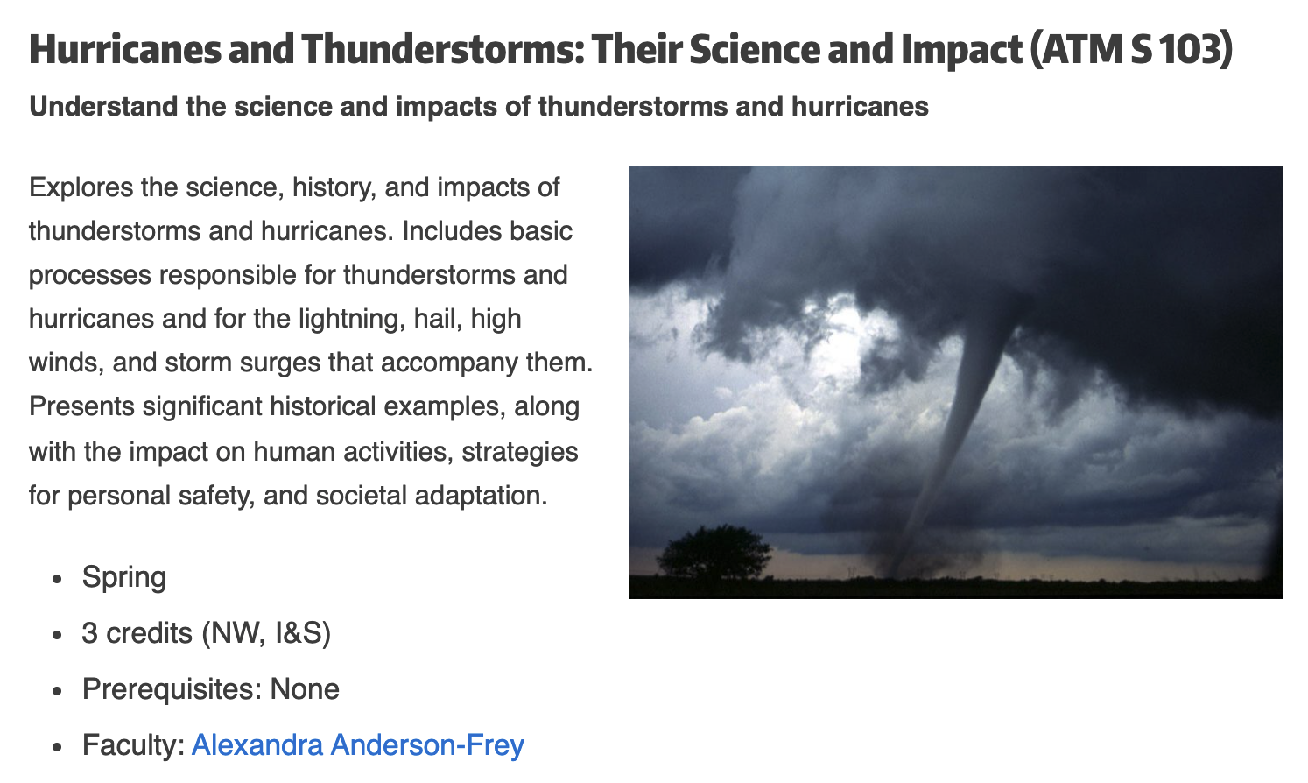
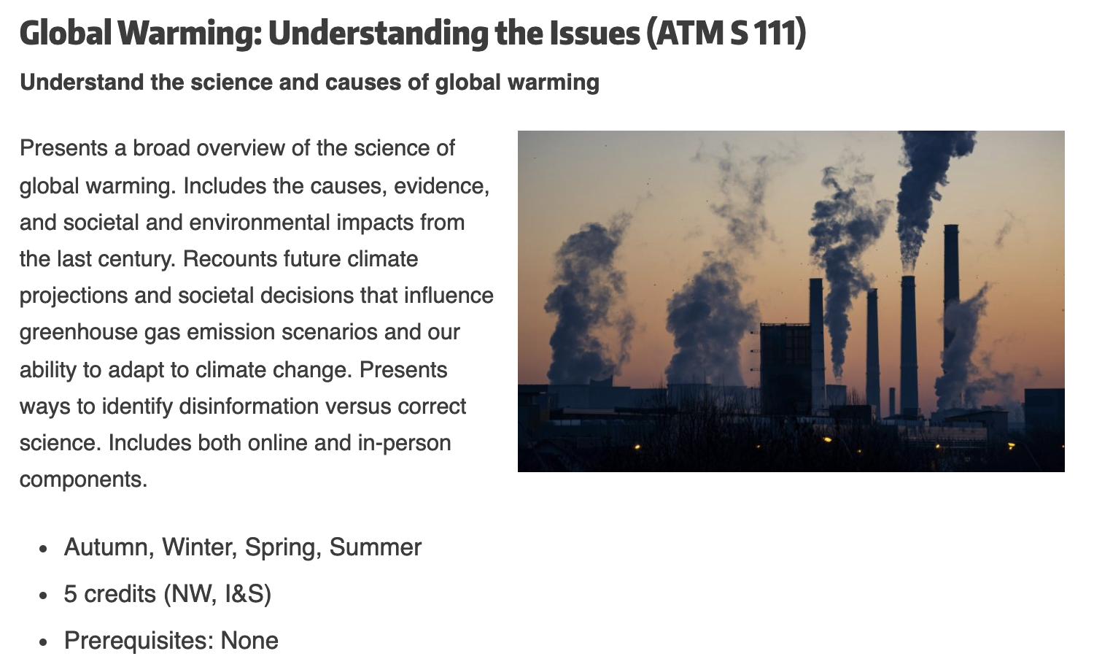
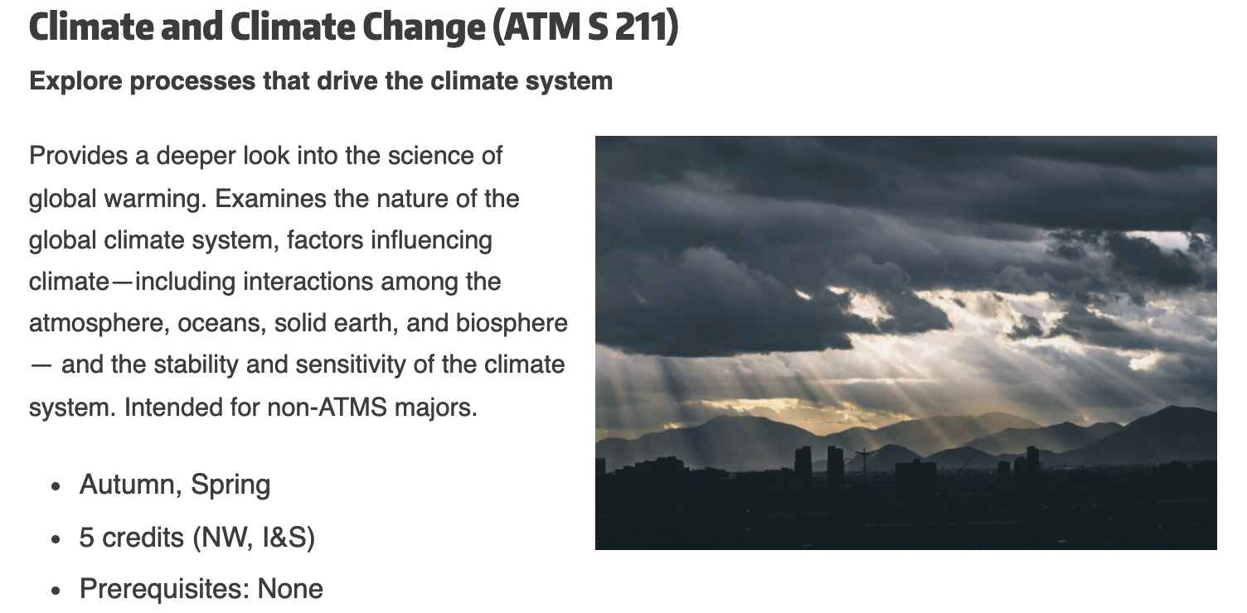
Want to learn more about the atmosphere?

Slide 4
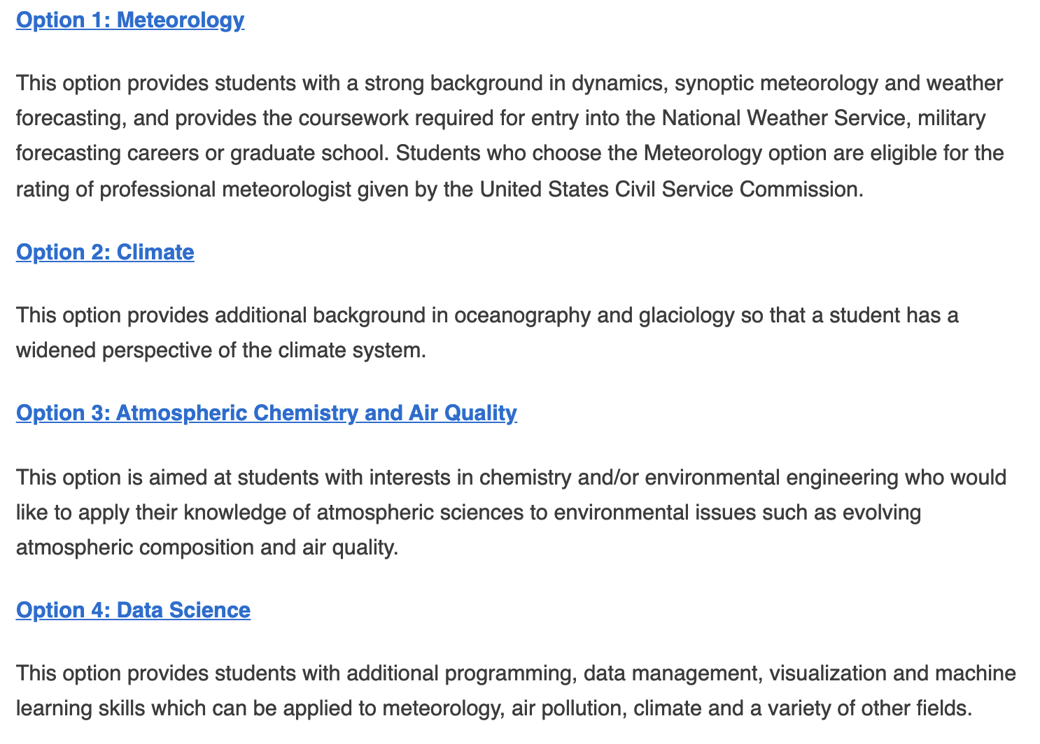
Atmospheric Sciences Major
B.S. in Atmospheric Sciences
Four tracks

Slide 5
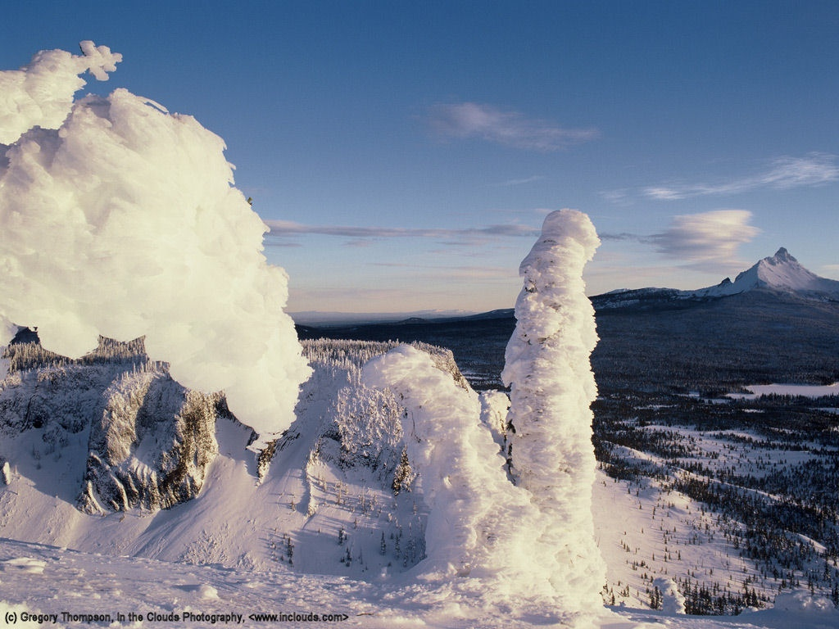
Northwest Weather 101
Cliff Mass
University of Washington

Slide 6
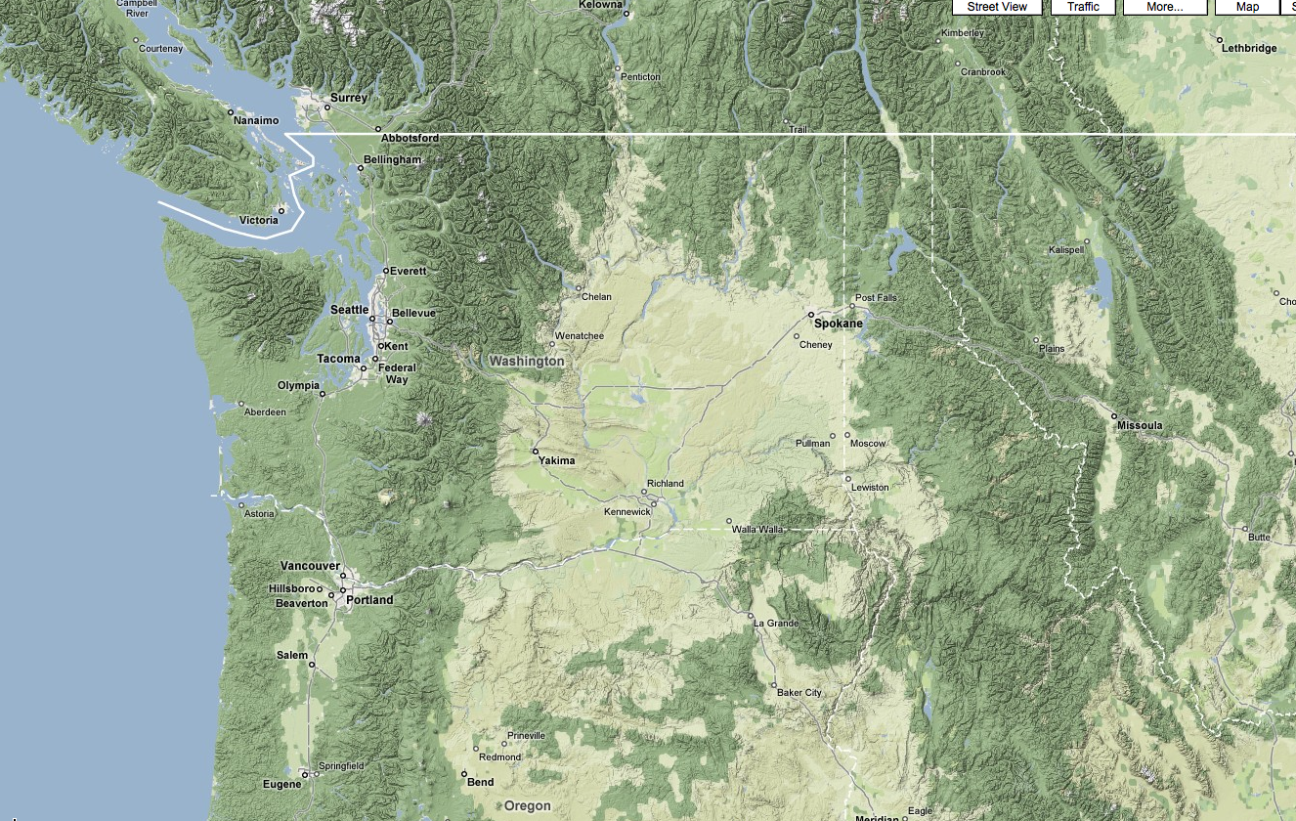
The weather of the Pacific Northwest is dominated by local weather phenomena, most forced by our regional terrain and water bodies

Slide 7
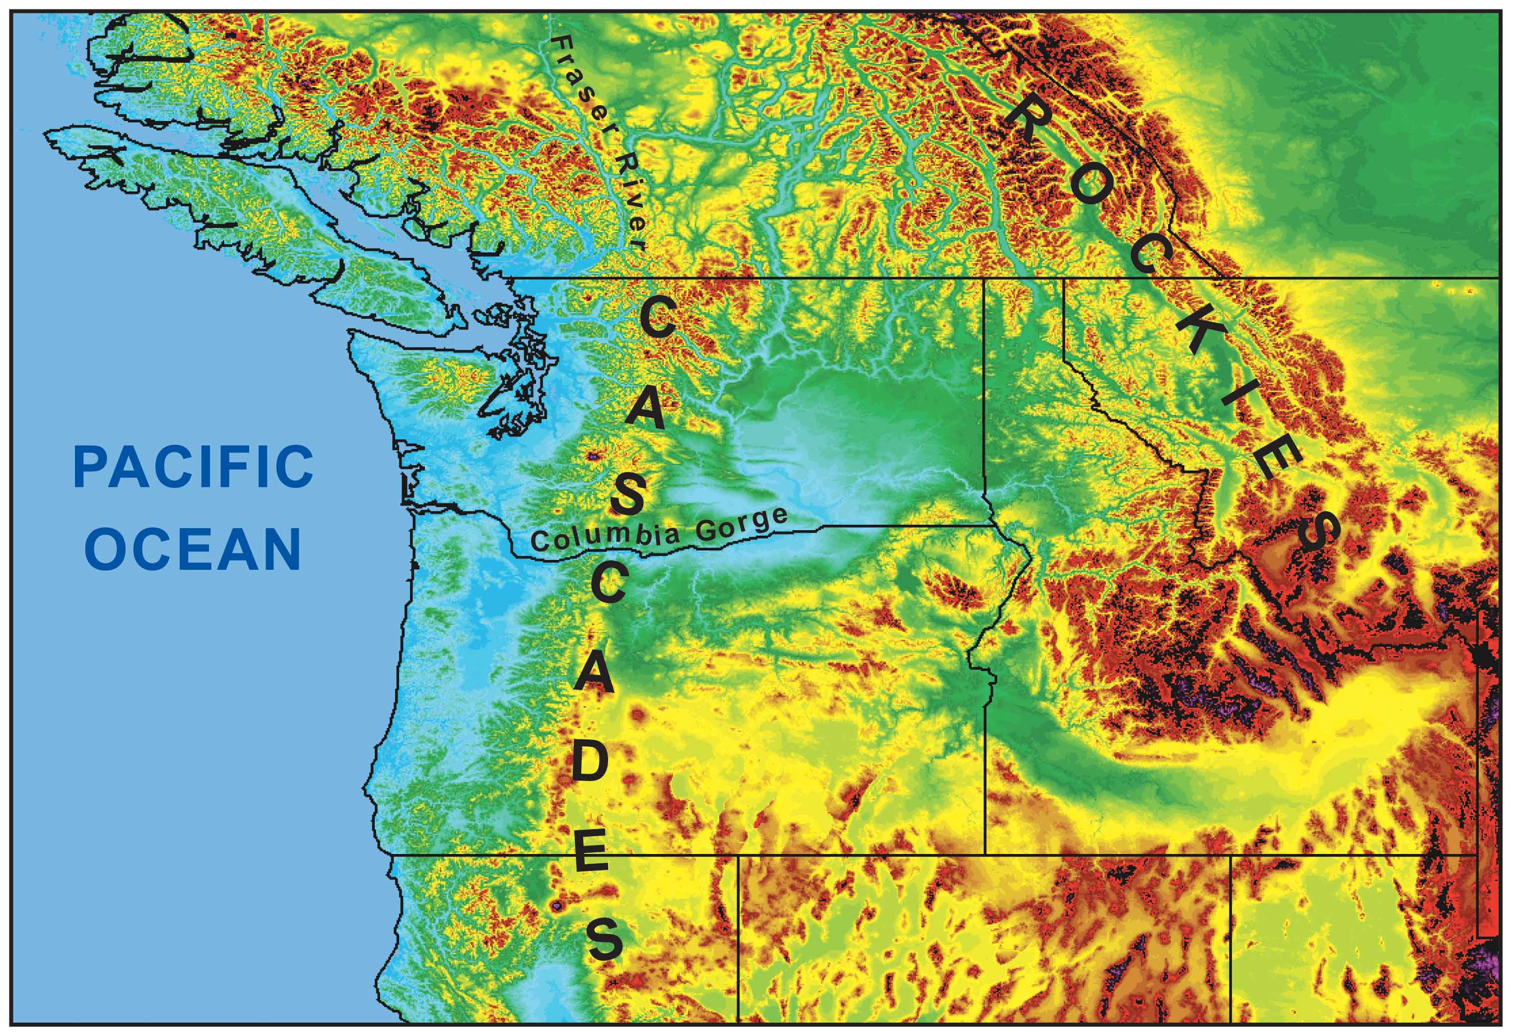
During the winter, the mountains block the cold air from the interior.
Cold
Air

Slide 8
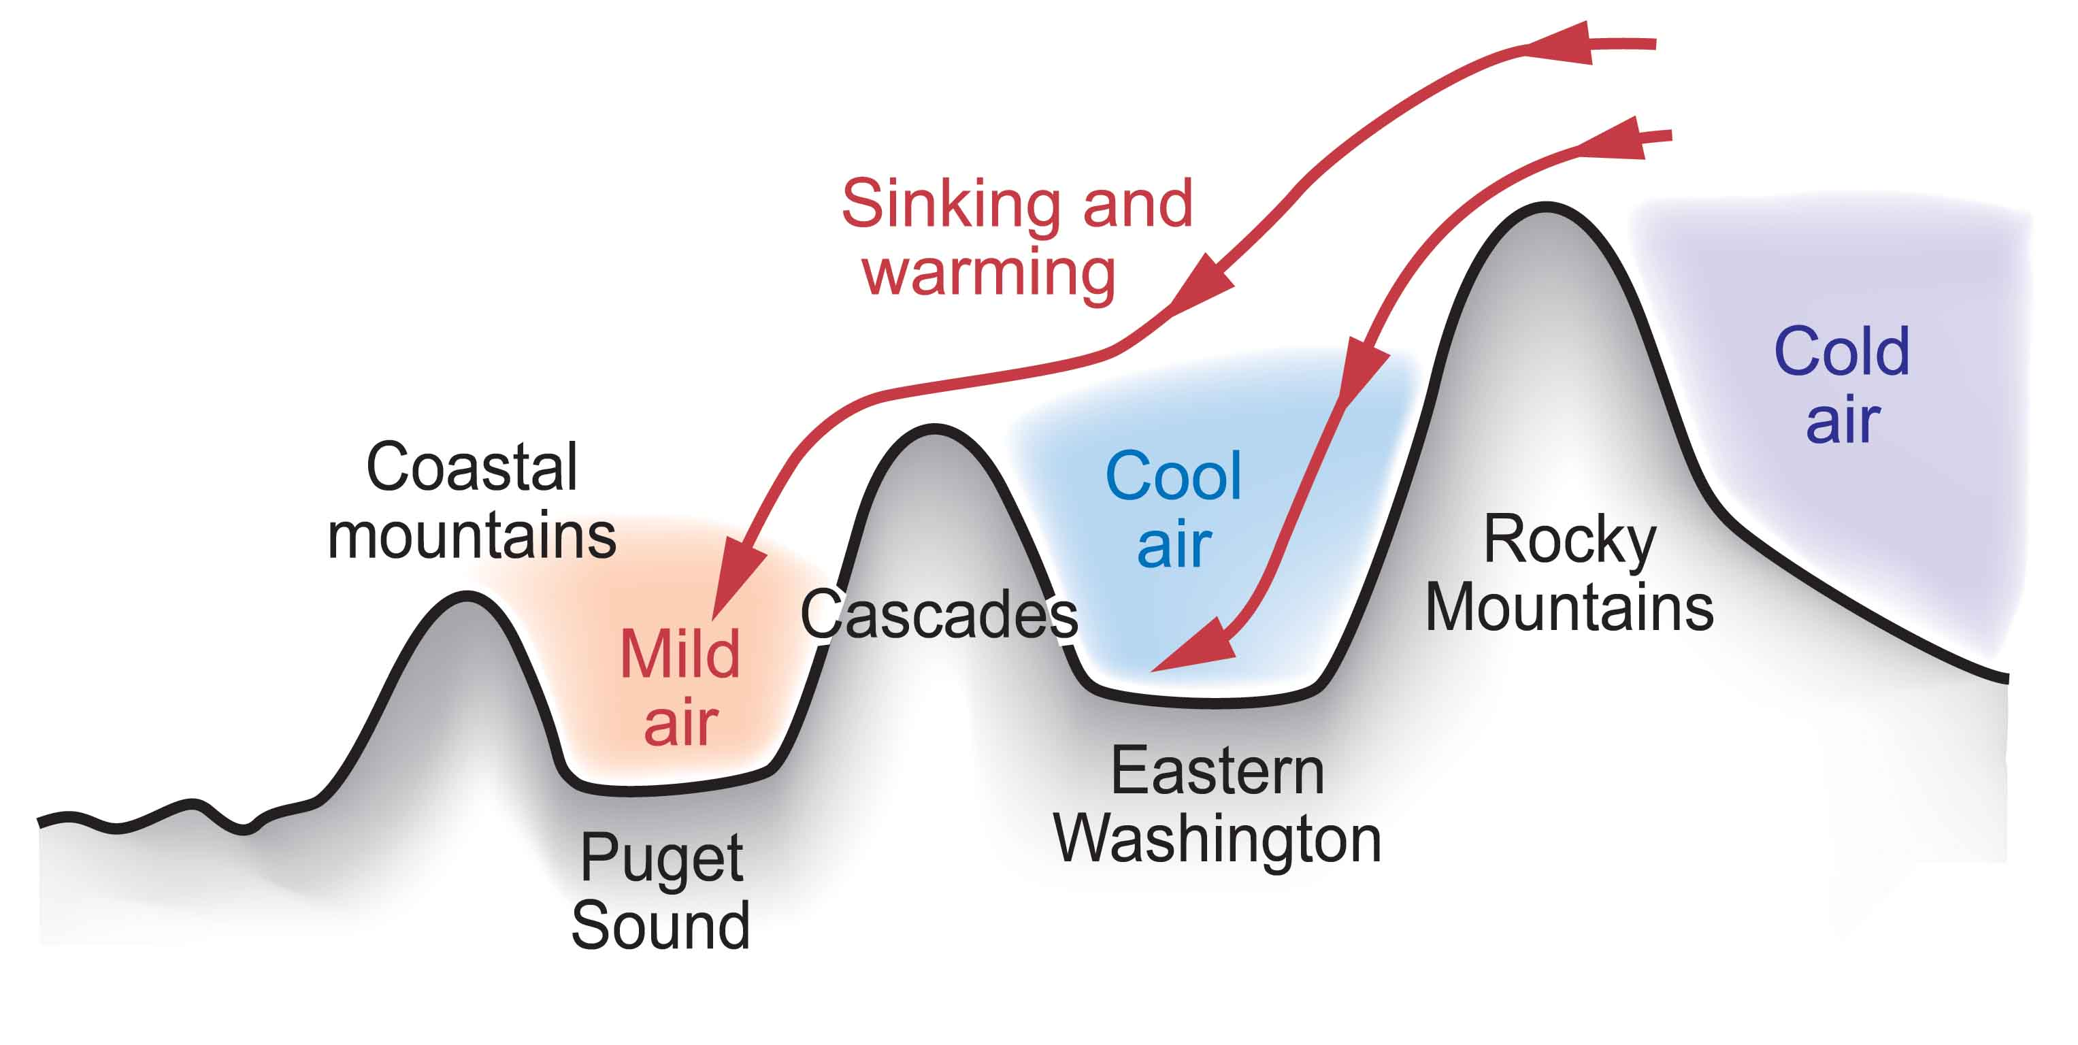
Cold Air from the Continental Interior Has a Hard Time Reaching Western Washington
Adiabatic compressional warming as air sinks on western slopes

Slide 9
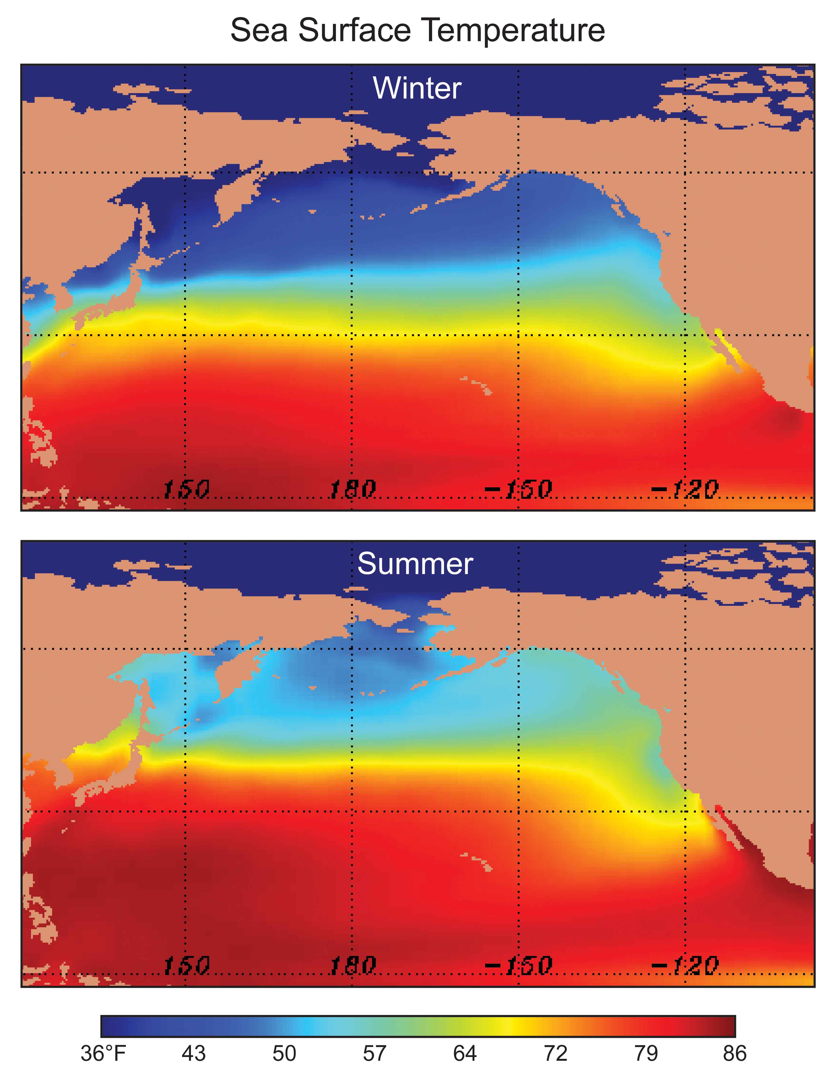
Our air and weather systems generally
move west
to east:
Thus, our
weather comes from off
the mild
Pacific--so we tend to be wet and mild.

Slide 10
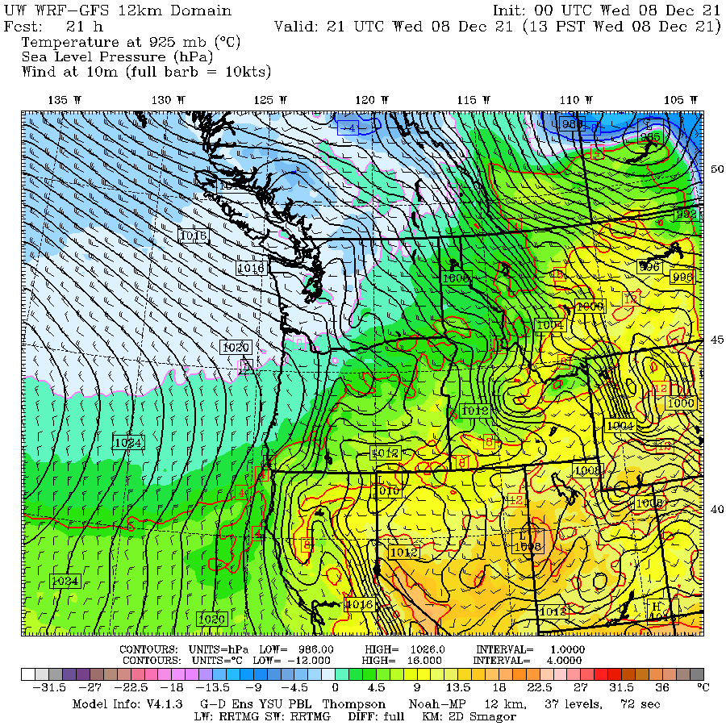

Slide 11
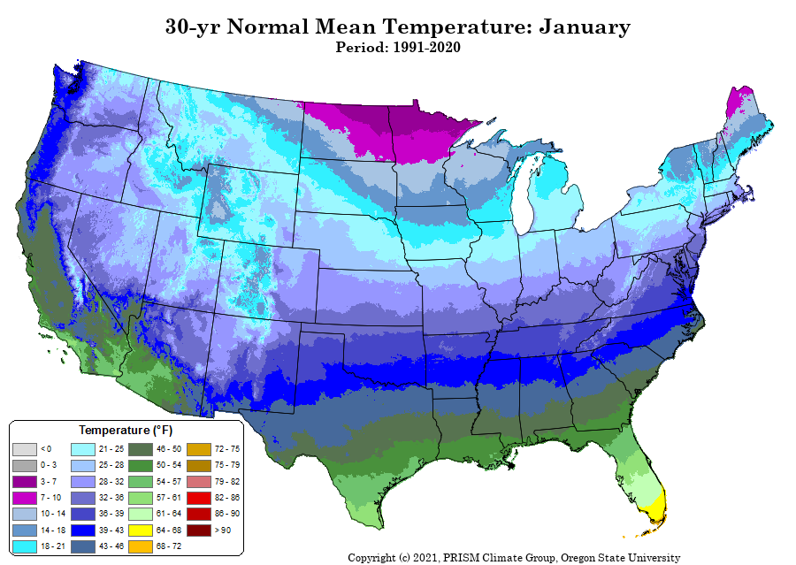
Mild Winter

Slide 12
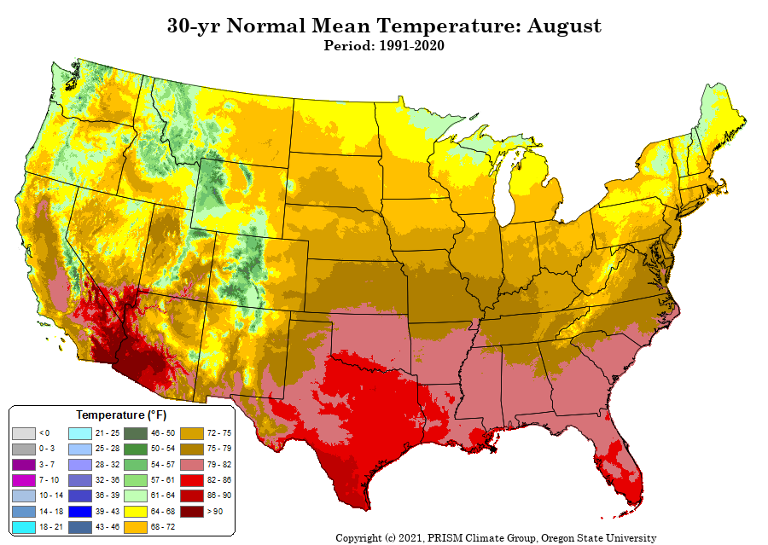
Mild Summers

Slide 14
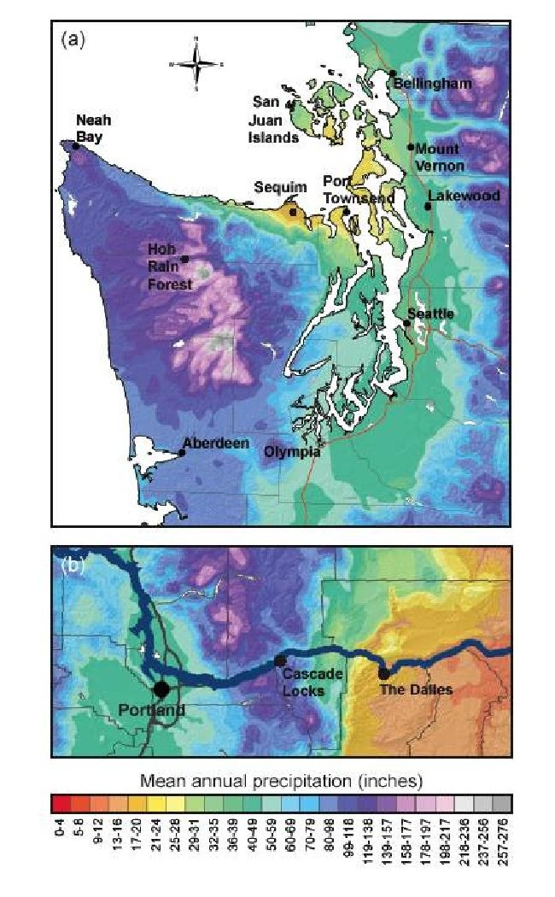
Extraordinary Precipitation Contrasts

Slide 15
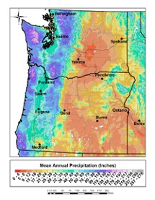

Slide 16
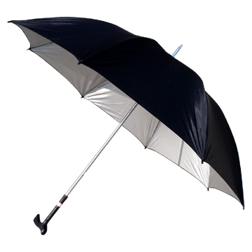
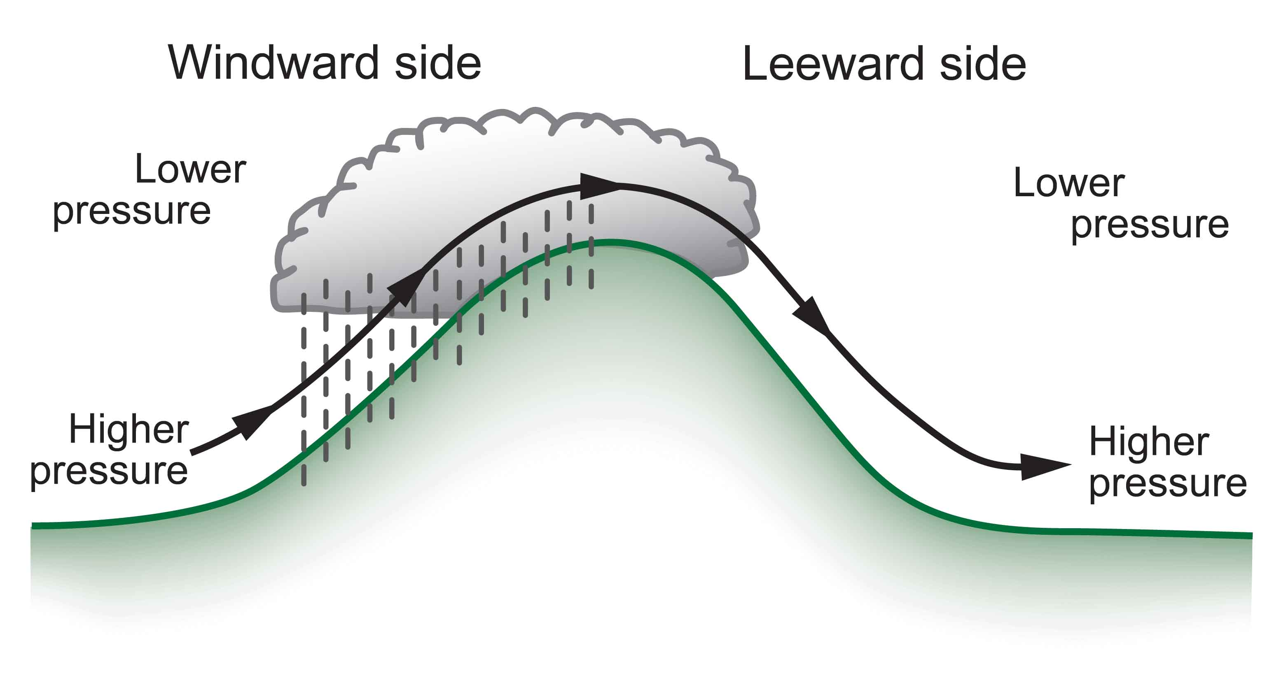
Rainshadows are as important as windward enhancement
The result is huge precipitation contrasts…some of the largest in the nation.
Substantial variations in solar radiation as well

Slide 17
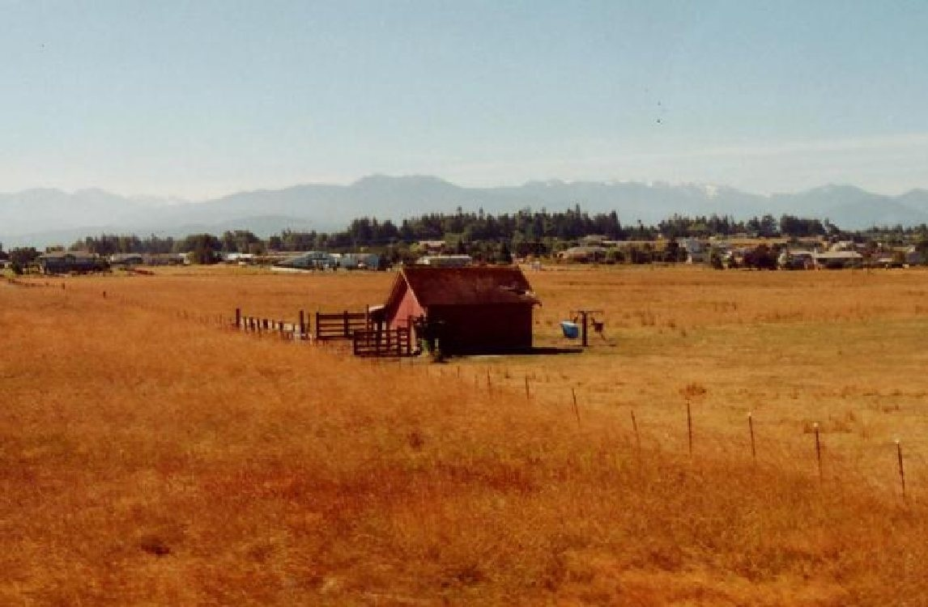
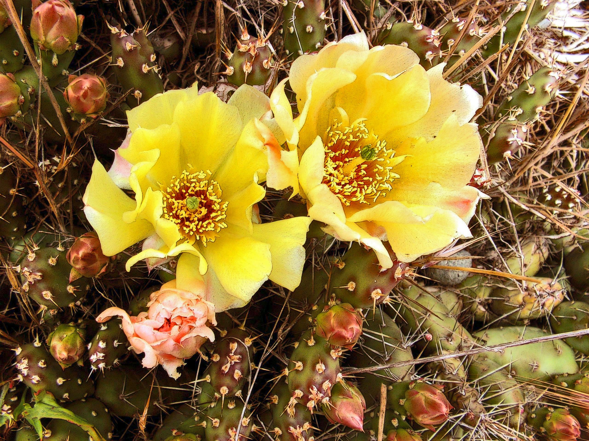
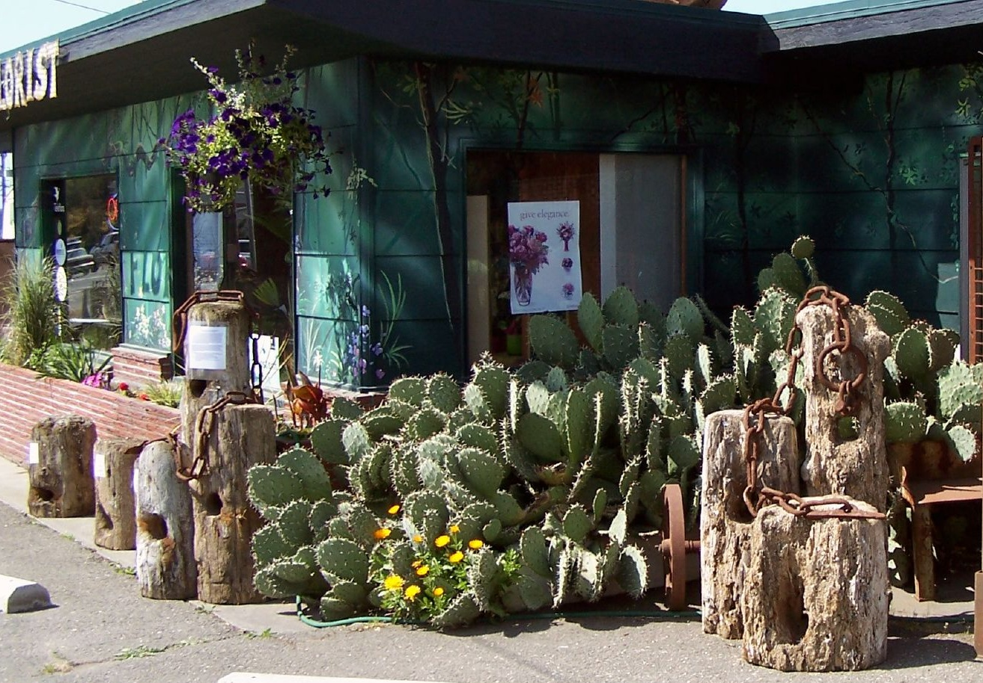
Sequim: Irrigation Needed, Cacti

Slide 18
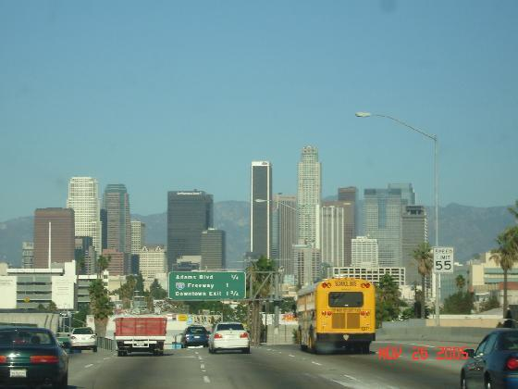
Annual Precipitation
Sequim: 15.97 inches
Los Angeles: 14.89 inches

Slide 19
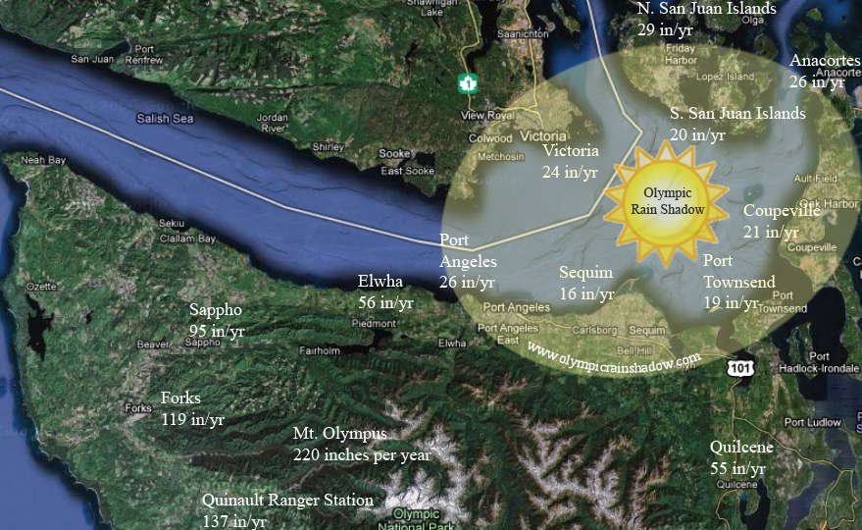

Slide 20
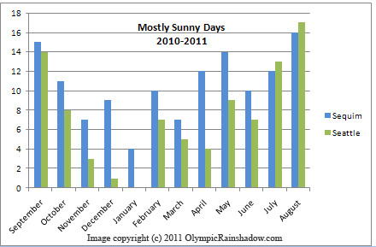

Slide 21
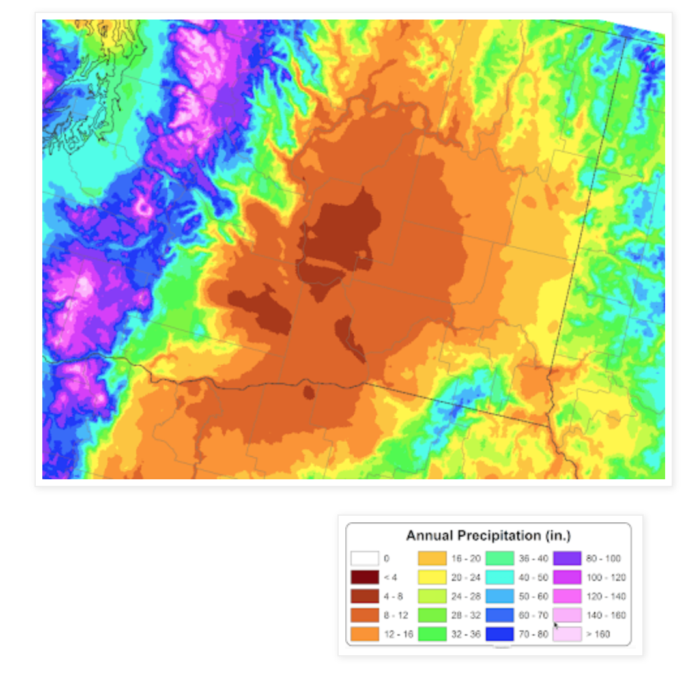
The Driest Location in Washington State?

Slide 22
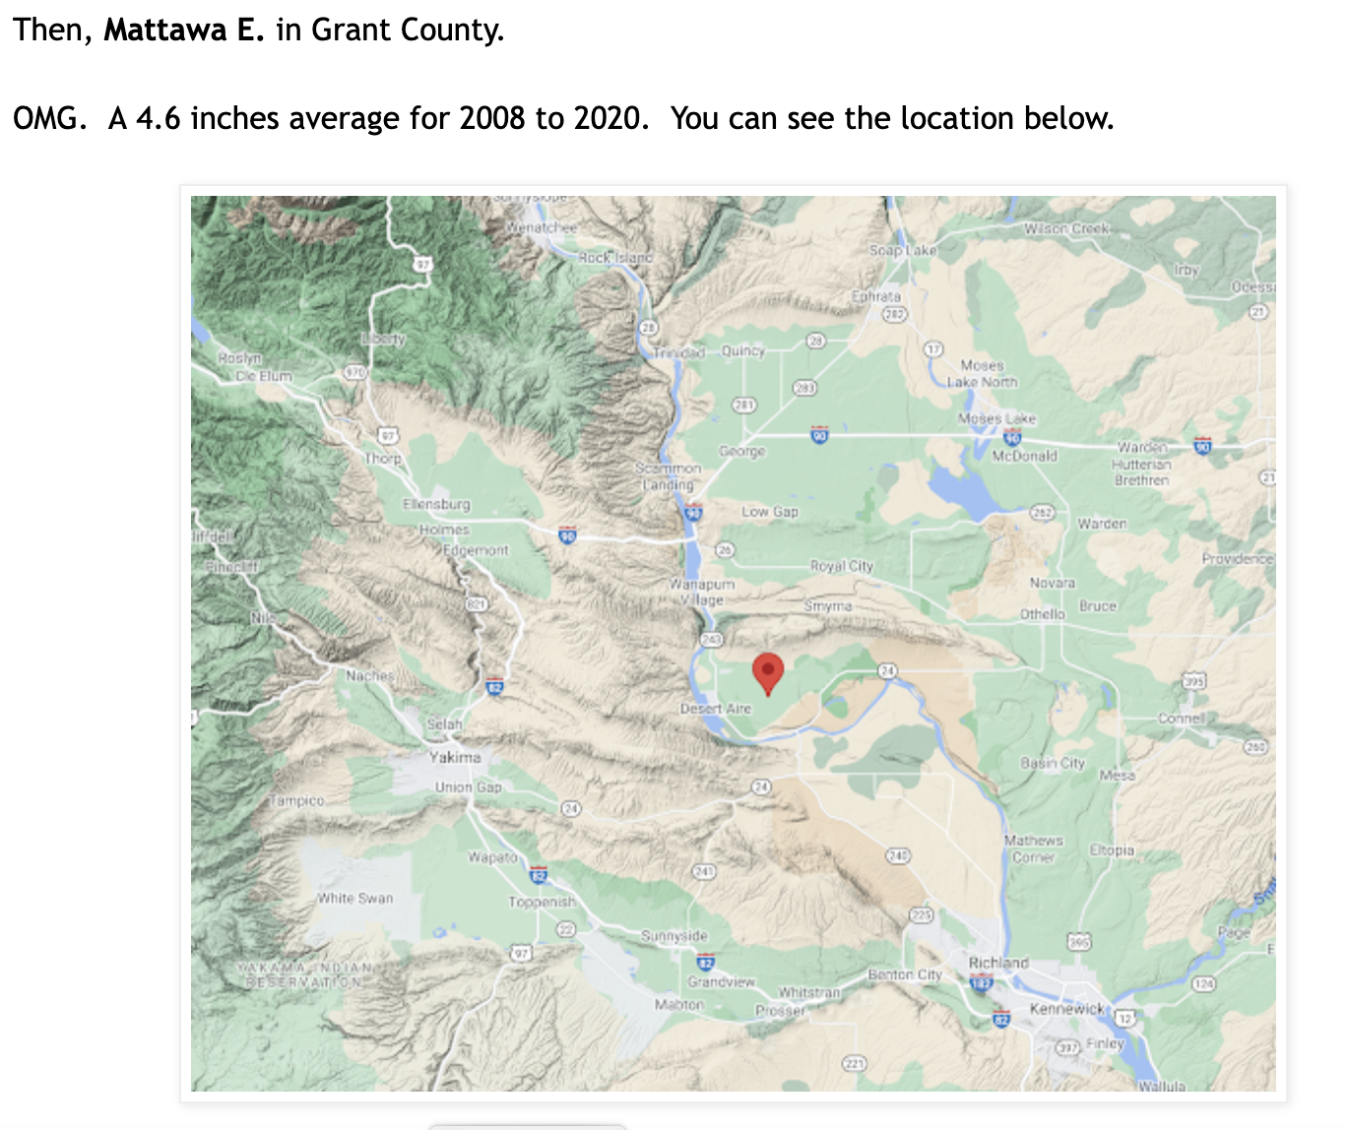

Slide 23
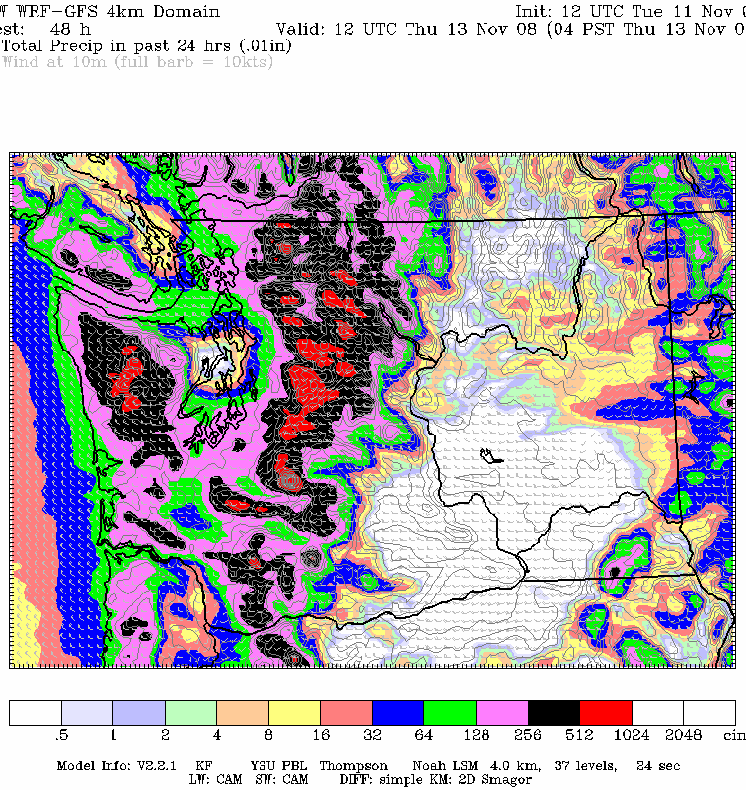
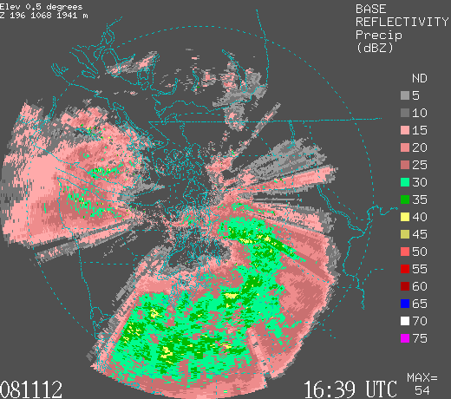
Rainshadows can move: depending on direction of the wind
For westerly winds, Seattle can be in the rainshadow

Slide 24
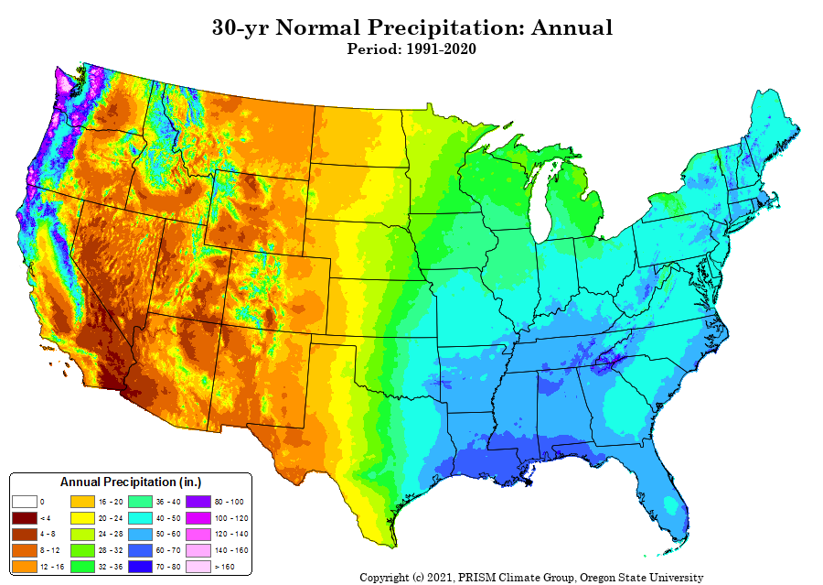
Western WA is the wettest part of US

Slide 25
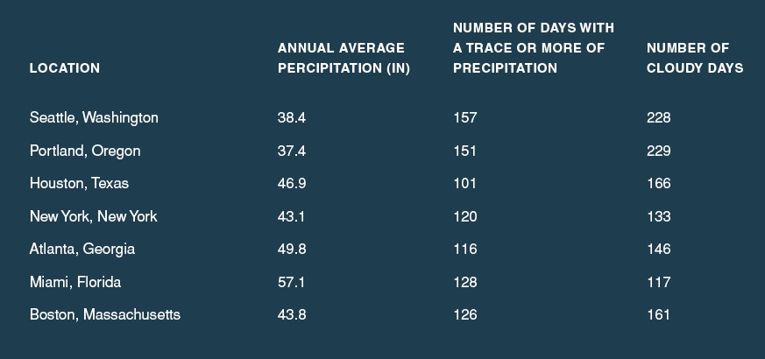
The western Washington lowlands really aren’t that wet—partially because we are often in the rainshadow of the Olympics and Mts. Of Vancouver Island…but the NUMBER of light rain/cloudy days is substantial

Slide 26
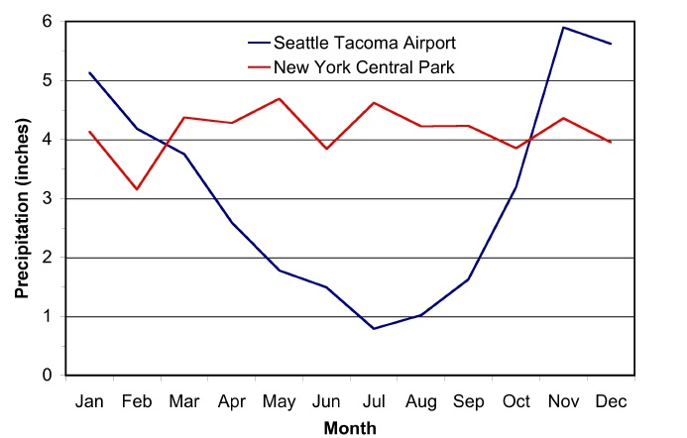
The Northwest Has a Mediterranean Climate
Football
Baseball Season
Football

Slide 27
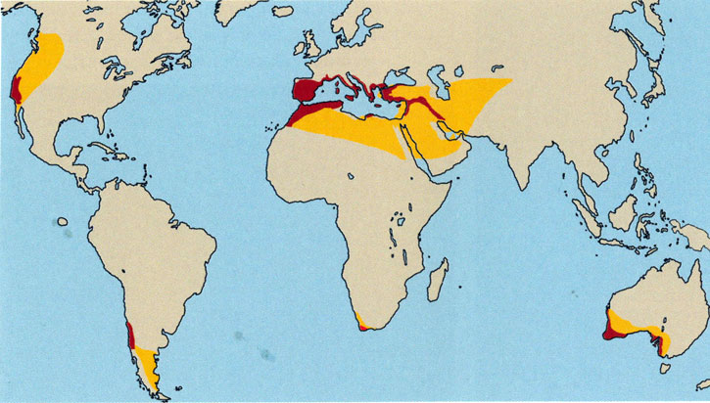
Mediterranean Climate:
Dry Summers/Wet Winters

Slide 28
Why Dry Summers?

Slide 29
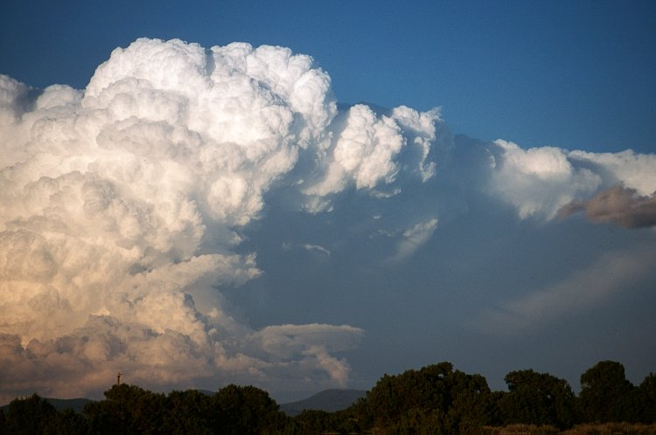
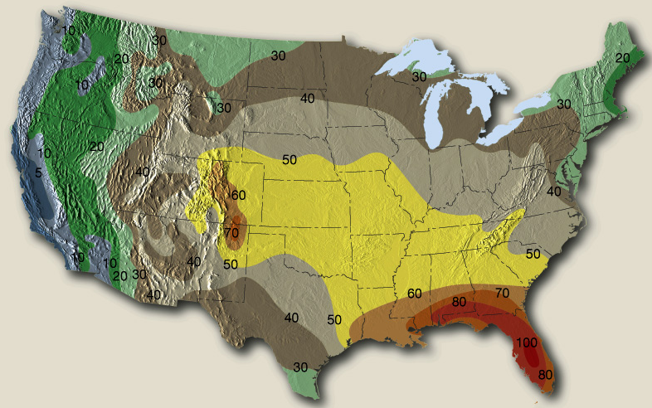
The Northwest Gets Fewer Thunderstorms Than Almost Anywhere in the U.S. Except CA
Why?
Cool Pacific

Slide 30
Local Weather Features are Essential Elements of NW Weather
Many are associated with the interaction between the large-scale flow coming over the Pacific and local terrain barriers.

Slide 31
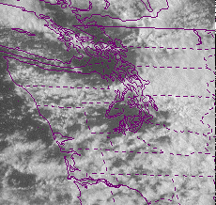
Puget Sound Convergence Zone

Slide 32
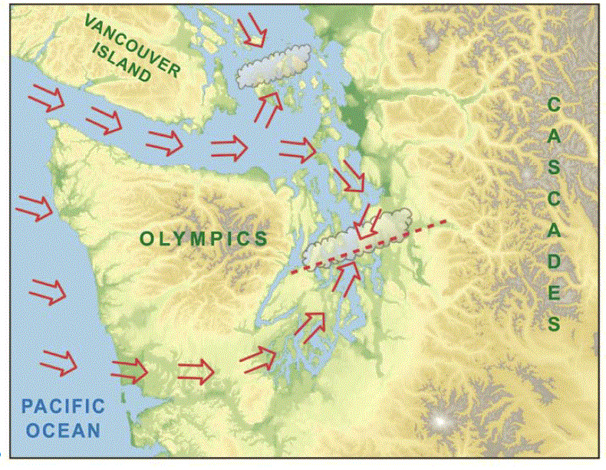
10-25 times year

Slide 33
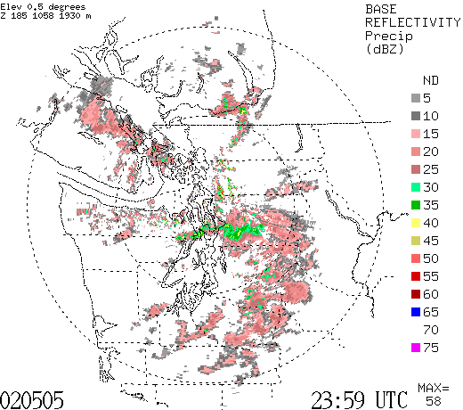

Slide 34

Gaps In Regional Mountains Have Big Meteorological Effects

Slide 35
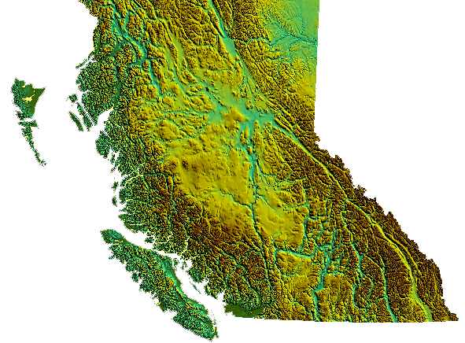
Fraser River Gap of British Columbia

Slide 36
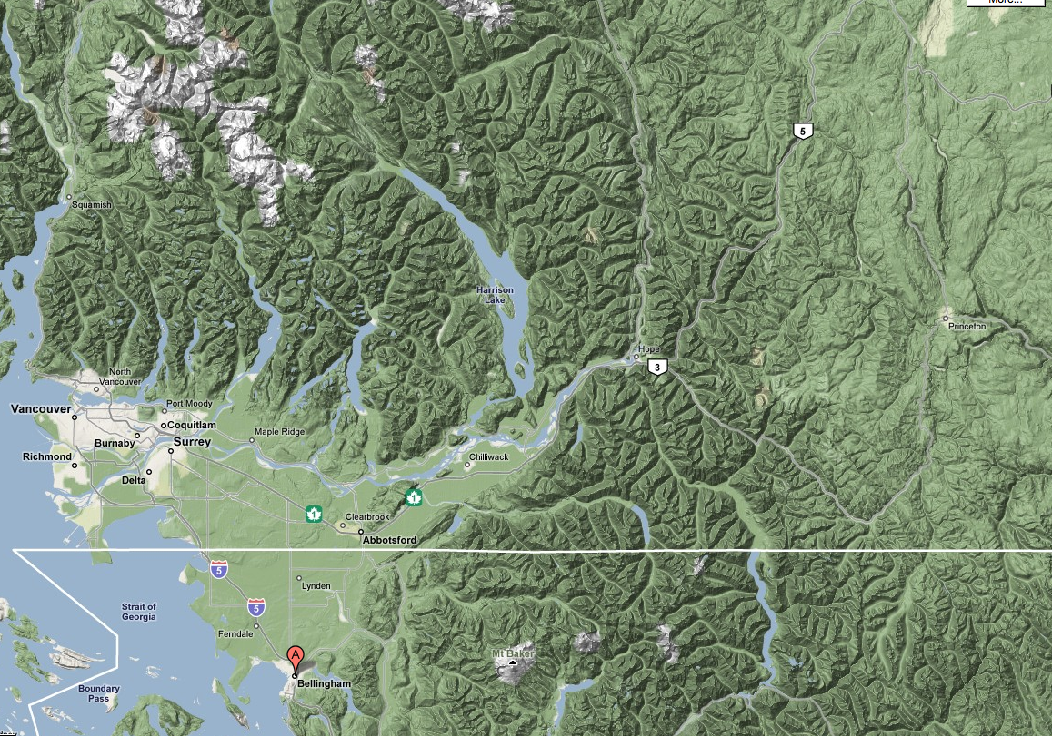
Fraser River Gap

Slide 37
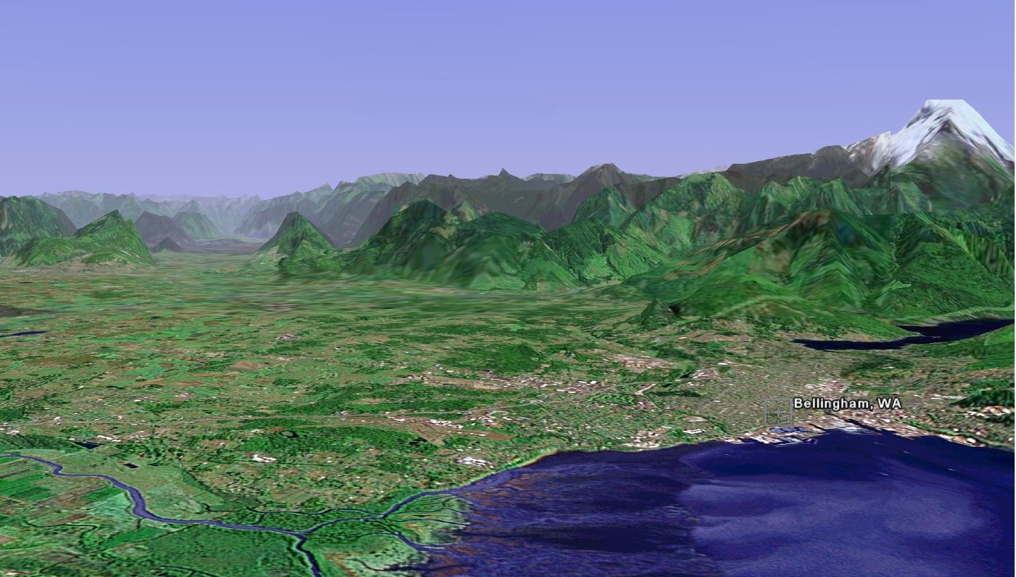
The Fraser River Gap

Slide 38
Can Get Strong Cold Northeasterly Outflow Winds into Bellingham and NW Washington When Cold Air and High Pressure Builds in the Interior of BC

Slide 39
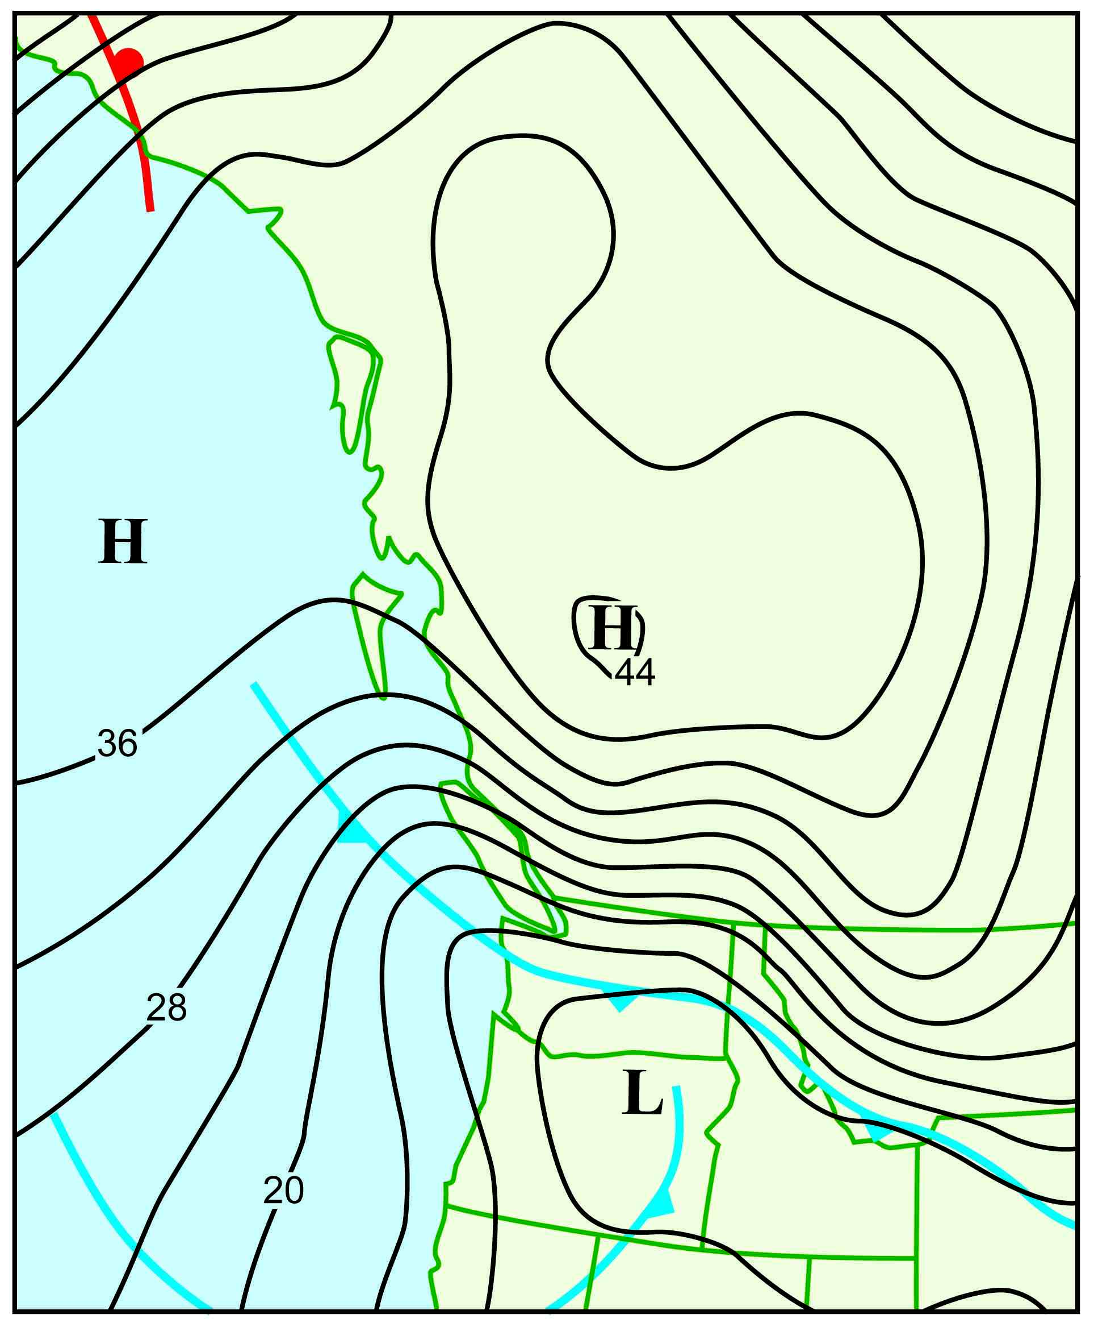
Major Fraser Gap Event of December 28, 1990

Slide 40
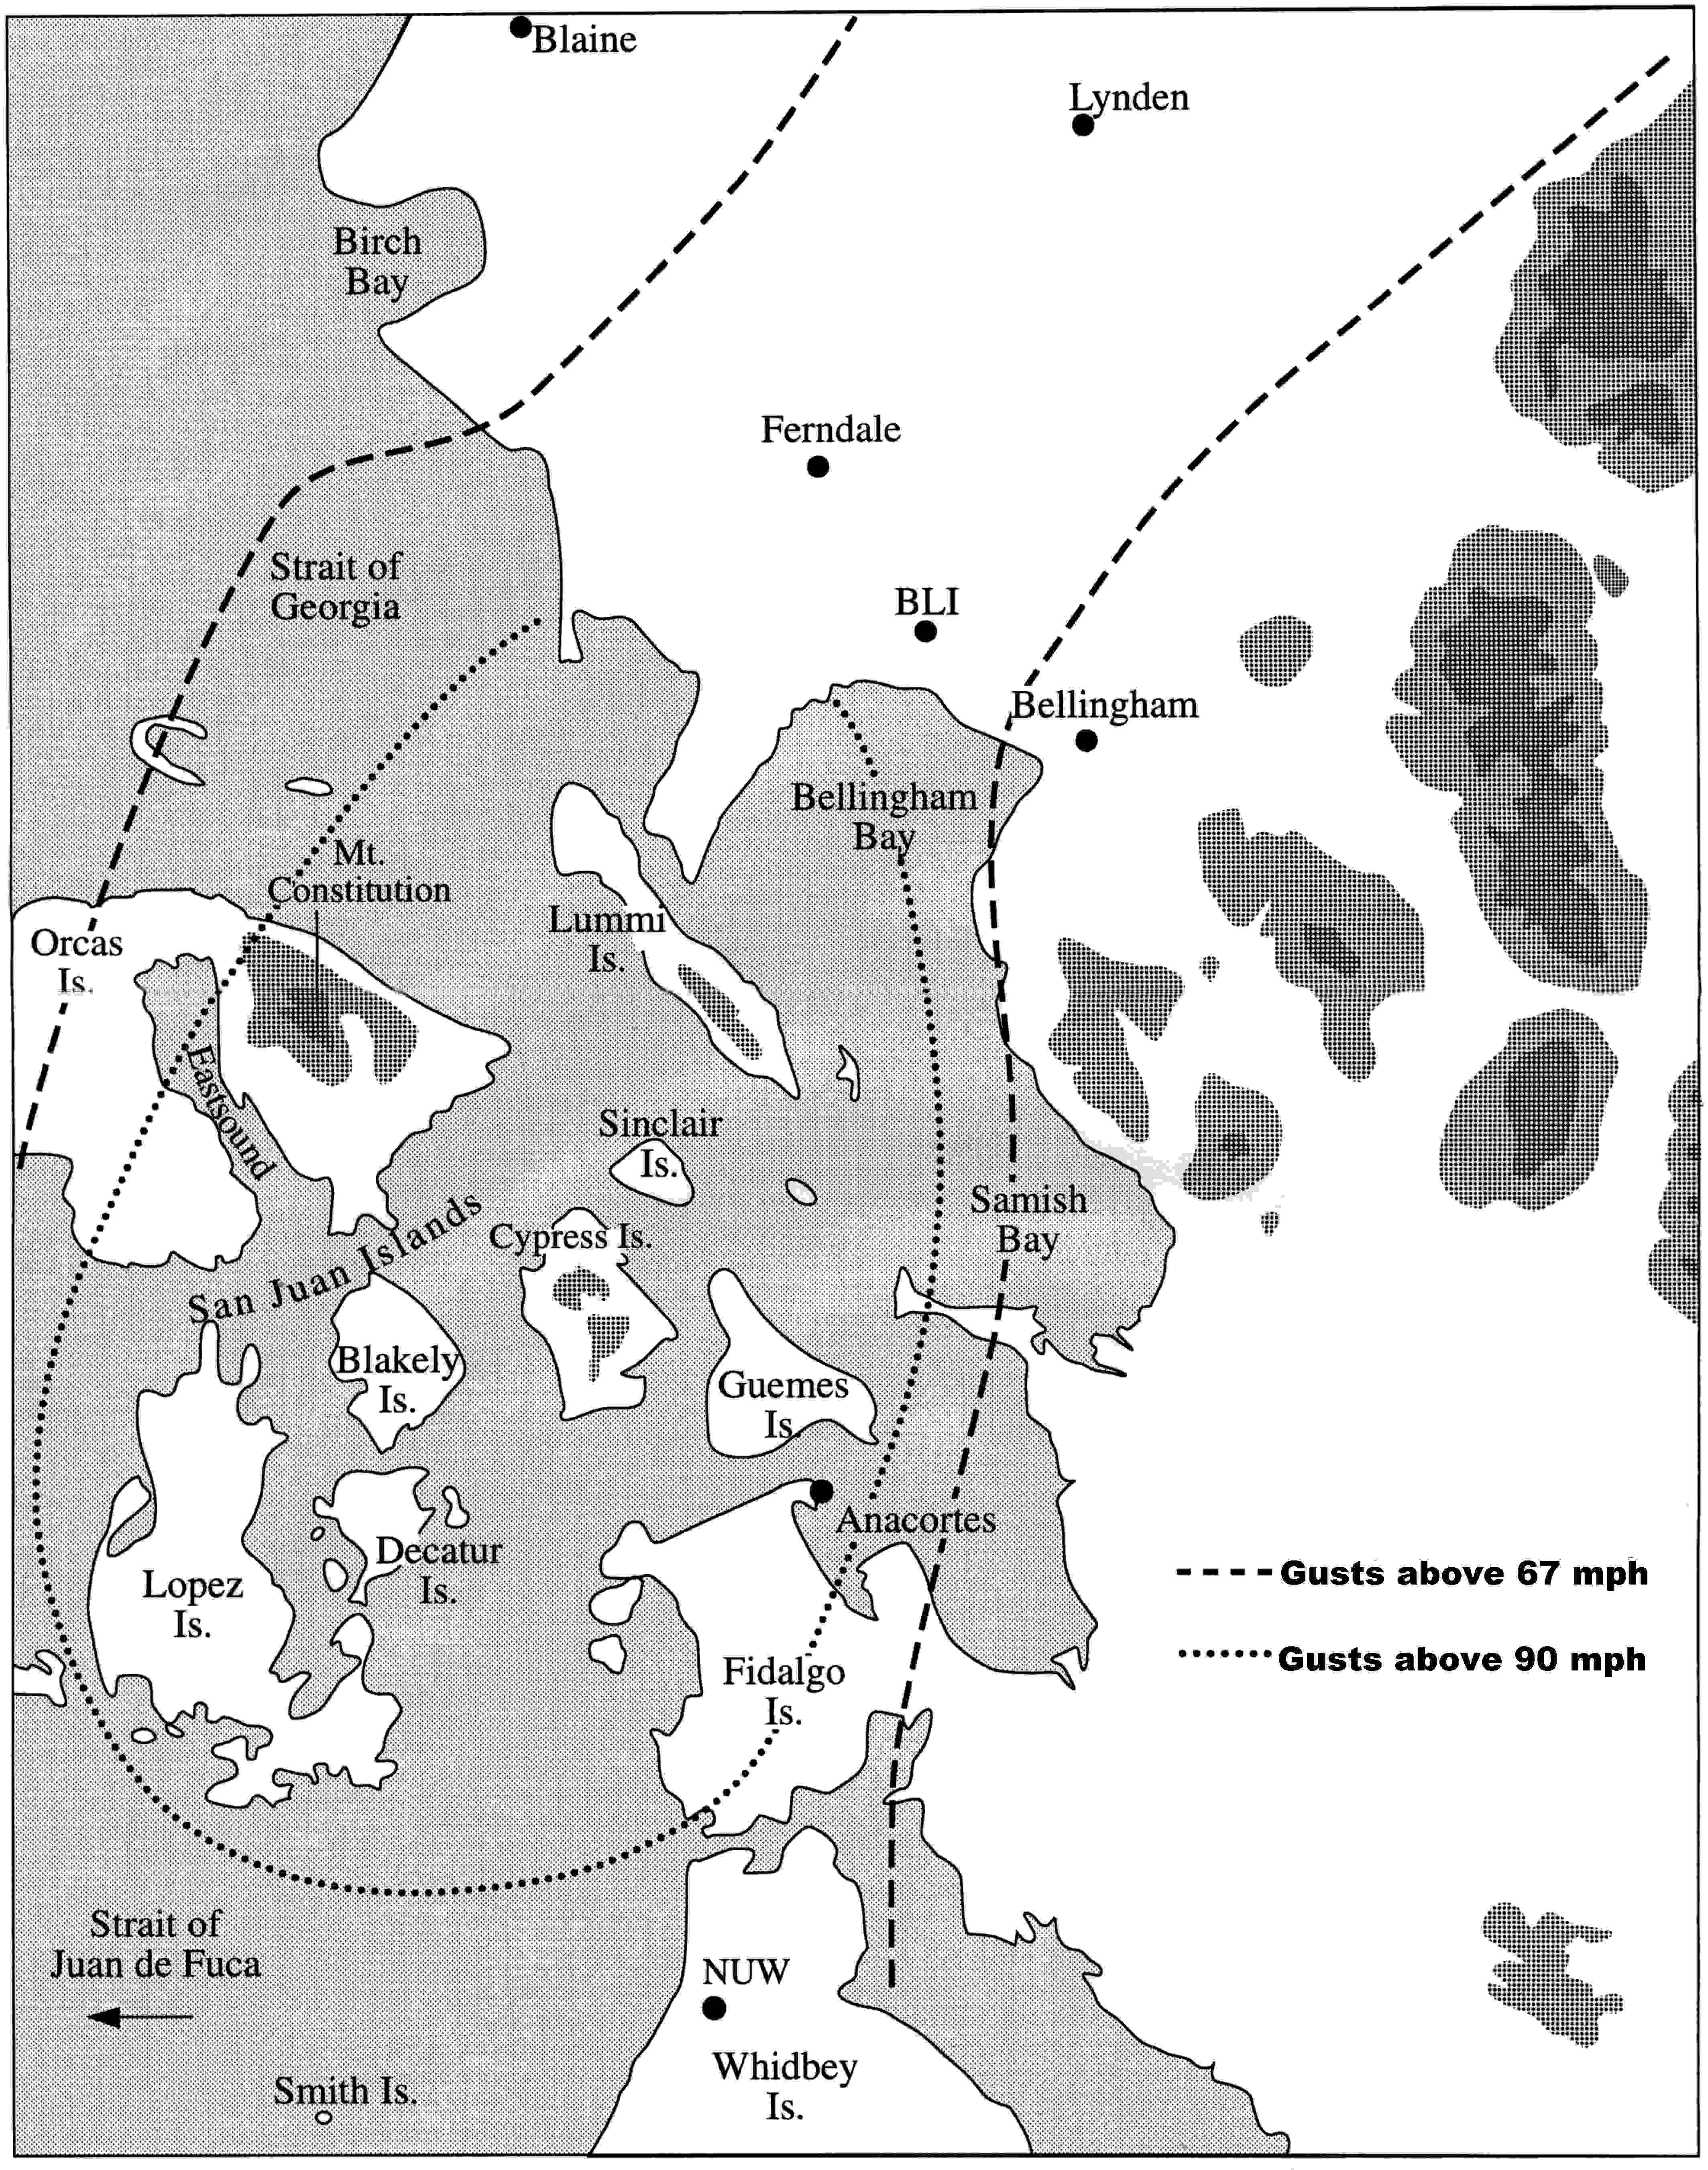

Slide 41
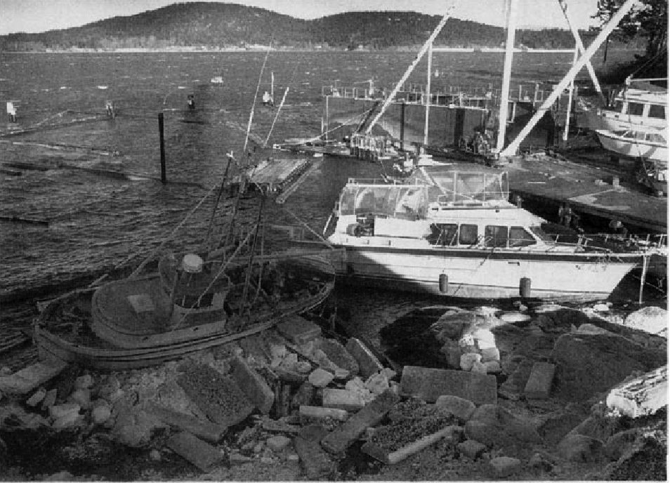
Anacortes Dec 1990

Slide 42
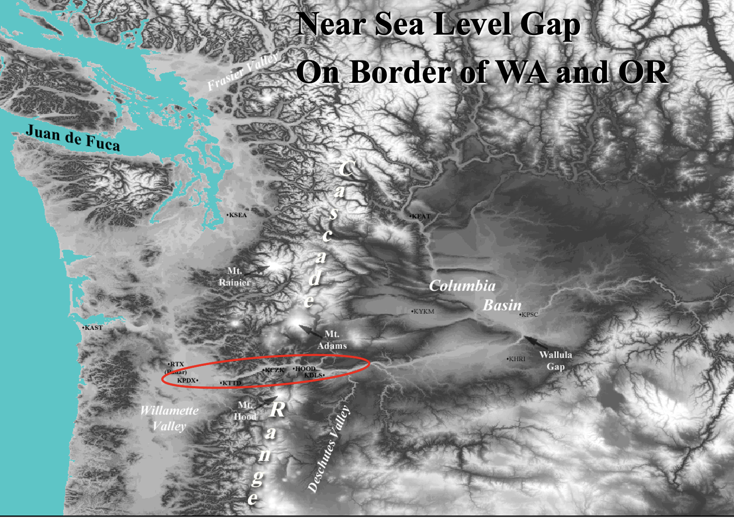
The Columbia Gorge: A Near Sea Level Passage Between the Columbia Basin and western Oregon/WA

Slide 43
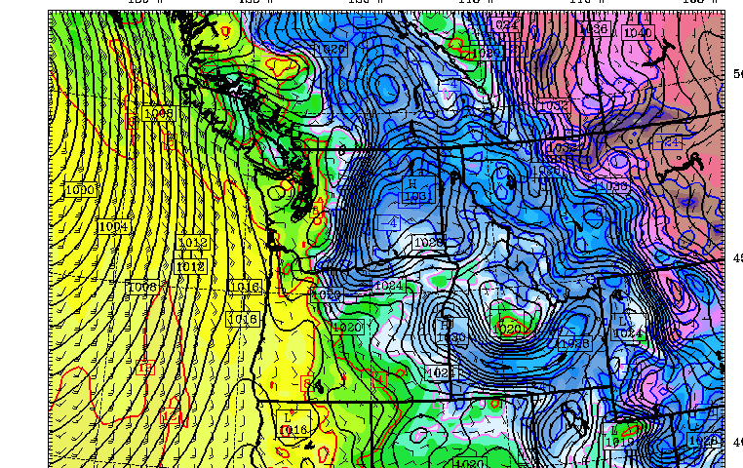
Strong easterly winds develop in the Gorge when cold air and high pressure develop over eastern WA

Slide 44
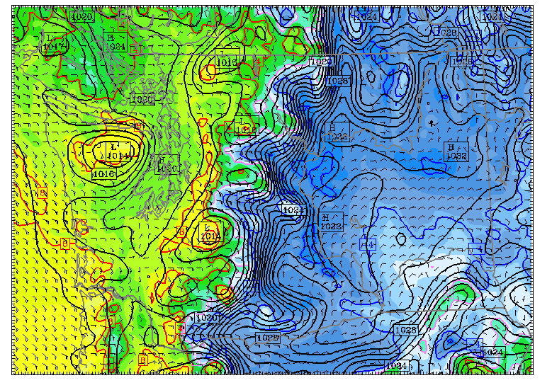

Slide 45
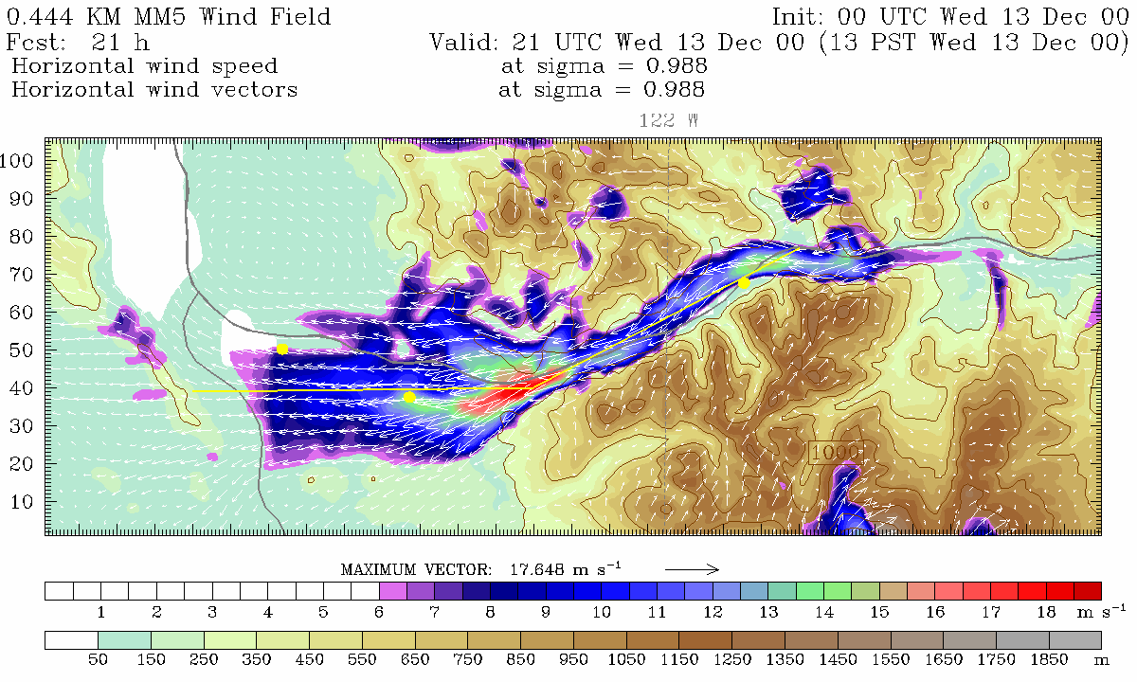
High Resolution Model Simulation
Troutdale
Notes:
Also note increased wind speed near CZK. Possible where the flow becomes supercritical. Also possibly Venturi.

Slide 46
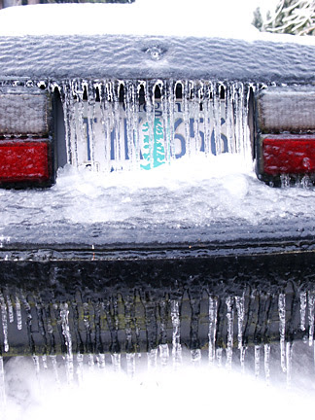
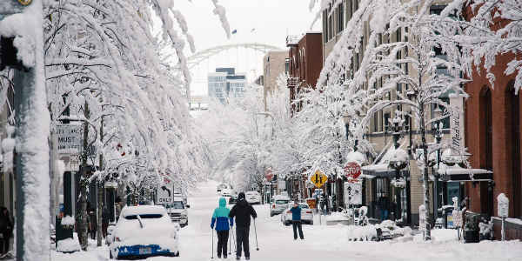
The outflow of very cold air in the Gorge can produce freezing rain and ice storms as warm rain falls into it

Slide 47
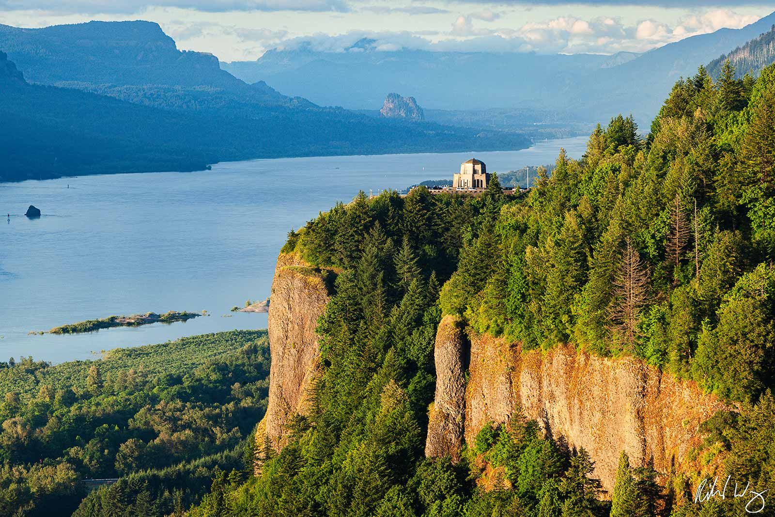
Crown Point/Vista House

Slide 48
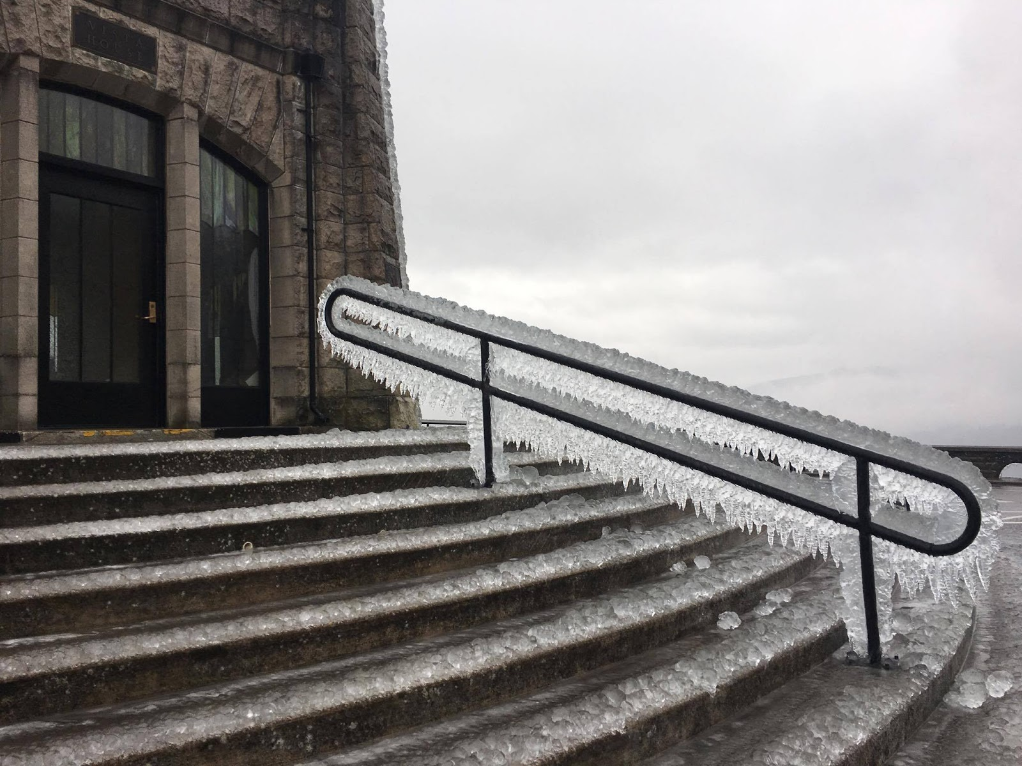
Vista House, Right Above the Gorge

Slide 49
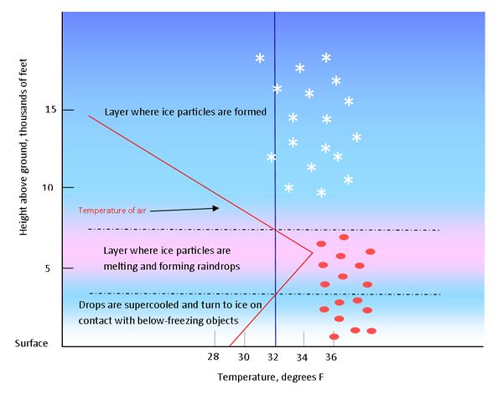

Slide 50

Strong Winds Can Also Develop in the Strait of Juan de Fuca

Slide 51

Strong easterly winds can produce dangerous conditions

Slide 52

Strong Westerly Winds in the Strait
Higher pressure along the coast and lower pressure over the western interior contributes to acceleration of winds down the Strait.
High
Low

Slide 53

Under these conditions, Whidbey Island, Everett, and Mukilteo can be hit by fierce winds approaching hurricane force.

Slide 54



Everett Harbor, December 17, 1990
Seattle Times and The Snohomish County Daily Herald
Notes:
This is a newspaper article published the next day in the Snohomish County Daily Herald showing ferry.
An article run in the Seattle Times illustrates the destruction at local marinas.
Another dangerous aspect of these storms, and one that was left off of the earlier list… TREE BRANCH MISSLES. I love the look on this lady’s face… NOT AMMUSED.
54

Slide 55


October 28, 2003
Ivar’s Mukilteo Landing Restaurant was destroyed by wind-produced, large waves
Notes:
Ah yes, poor Ivar’s restaurant. Deck destruction and “pile-o-chairs” Big news.
The windstorm makes front page news in the Seattle Times. Death and power outages highlighted.
Ivar’s mural and carp next…

Slide 56

Mural in the Restaurant
Notes:
And since the storm was named after it… This presentation wouldn’t be complete without talking about Ivar’s further… so here we go…
After the storm, Ivar’s redecorated their entire restaurant, incorporating the storm into their décor. I actually had the chance to have lunch with the artist, who painted the mural as accurately as possible according to first hand accounts… like by these people…
Also, as you can see in the painting, there is the wooden statue of “the carp”… which was washed away in the storm. Free fish and chips for a year to anyone who safely returns the beloved carp to its home… and here it is.

Slide 57
Ultra Localized Stong Winds

Slide 58

February 13
1979: The Hood Canal
Storm
Winds over 110 mph destroyed the Hood Canal Bridge
Cost to replace: over 100 million dollars

Slide 59


Slide 60

The Hood Canal Storm

Slide 61

February 13
1979: The Hood Canal
Storm

Slide 62

Enumclaw, Washington
“Place of evil spirits”

Slide 63


Enumclaw and nearby foothills locations can experience severe windstorms…while calm winds occur a dozen miles away
Winds over 118 mph
December 24, 1983

Slide 64

December 24, 1983

Slide 65


Slide 66

Why Enumclaw?

Slide 67

Enumclaw Windstorm Pressure Pattern
December 28, 1990
December 24, 1983

Slide 68

Northwest Windstorms
Associated with Midlatitude Cyclones Coming off the Pacific
1993 Inauguration Day Storm

Slide 69


Very evident from the fallen trees that something severe can happen here
John Meares,
1788, off Cape
Flattery of the Olympic Peninsula
The force of southerly storms was evident to every eye; large and extensive woods being laid flat by their power, the branches forming one long line to the North West, intermingled with the roots of innumerable trees, which have been torn from their beds and helped to mark the furious course of their tempests.

Slide 70

Strong winds associated with deep low-pressure centers
Chanukah Eve Storm : 18-h forecast for 10 PM December 14, 2006
L

Slide 71

The Most Extreme Northwest Windstorm: The Columbus Day Windstorm of 12 October 1962
Equivalent to a Category 3 Hurricane in Winds/Pressure

Slide 72

Columbus Day Storm: The Big One
The most damaging windstorm to strike the Pacific Northwest in 100 years.
From northern California to southern British Columbia experienced hurricane-force winds, massive treefalls, and power outages.
In Oregon and Washington, 46 died and 317 required hospitalization as a result of the storm.

Slide 73

Columbus Day 1962: At Cape Blanco, on the Oregon coast, there were 150 mph with gusts to 179!

Slide 74

Mt. Hebo Radar Facility:
Gusts exceeding 130 mph
Courtesy: Mark Cole

Slide 75

Max Winds (mph)
Columbus Day Storm 1962

Slide 76

The most costly weather of the Northwest: Flooding

Slide 77


Slide 78

Most are associated with the “Pineapple Express”
A relatively narrow current of warm, moist air from the subtropics…often starting near or just north of Hawaii.
a.k.a.
Atmospheric rivers

Slide 79


Slide 80

Precipitation is Released by Lifting on Terrain

Slide 81


A Recent Devastating Pineapple Express: November 6-7, 2006
Dark Green: about 20 inches

Slide 82

Mount Rainier National Park
18 inches in 36 hr (Nov 8, 2006)

Slide 83



Mt. Rainier damage

Slide 84
Northwest Snow
We have world records in the mountains
Generally, low snowfall over the western lowlands

Slide 85

Seattle 1916: More than two feet

Slide 86


Greatest Annual Snowfall Totals in the World in our Mountains
The Mt. Baker Ski Area in northwestern Washington State reported 1,140 inches of snowfall for the 1998-99 snowfall season

Slide 87

Annual
Snowfall

Slide 88

Why are snowstorms rare over the western Washington lowlands?
To get snow you need cold and wet.
It is easy to be mild and wet here
Sometimes we are cold and dry (last week!).
To get cold and wet is very hard…
Seattle 2007

Slide 89

The secret of Northwest snow is usually to bring in cold air from the north and interior while moist, cool Pacific air moves in aloft.

Slide 90
Cold Air
Moisture

Slide 91

The Fraser River Valley is an important conduit of cold air into western Washington.

Slide 92

The Pressure
Pattern That
Does It

Slide 93


Slide 94

Upper Level Chart for Snow

Slide 95


Slide 96

The End

