Slide 1
Final Exam
Final Exam
  Online
  Wednesday, December 10 at 8:30 AM-10:20 AM
  Comprehensive, but will more questions on second half
  Open book

Slide 2
Final Exam
Happy to answer your questions via email.
Can talk over the phone or through zoom for individual questions.
Course Evaluation is now online. Appreciate your feedback.

Slide 3
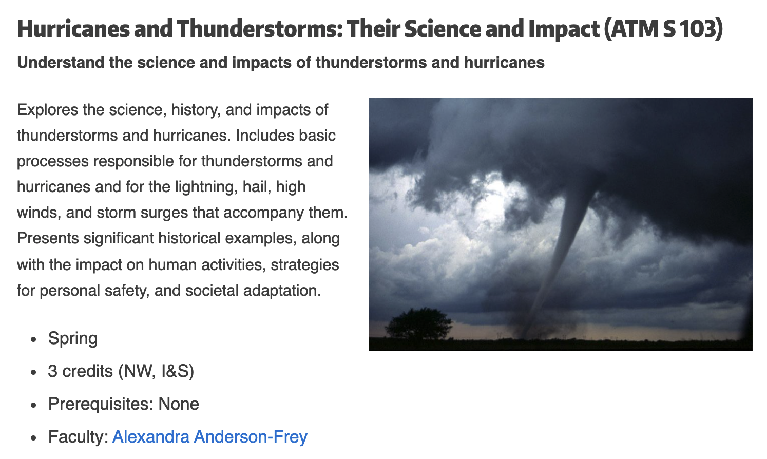
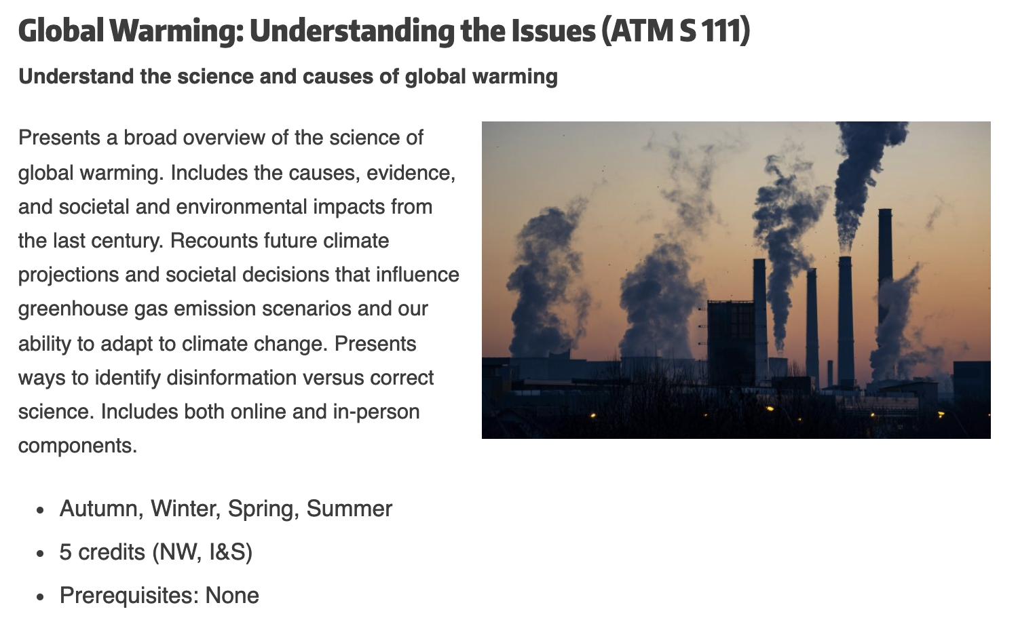
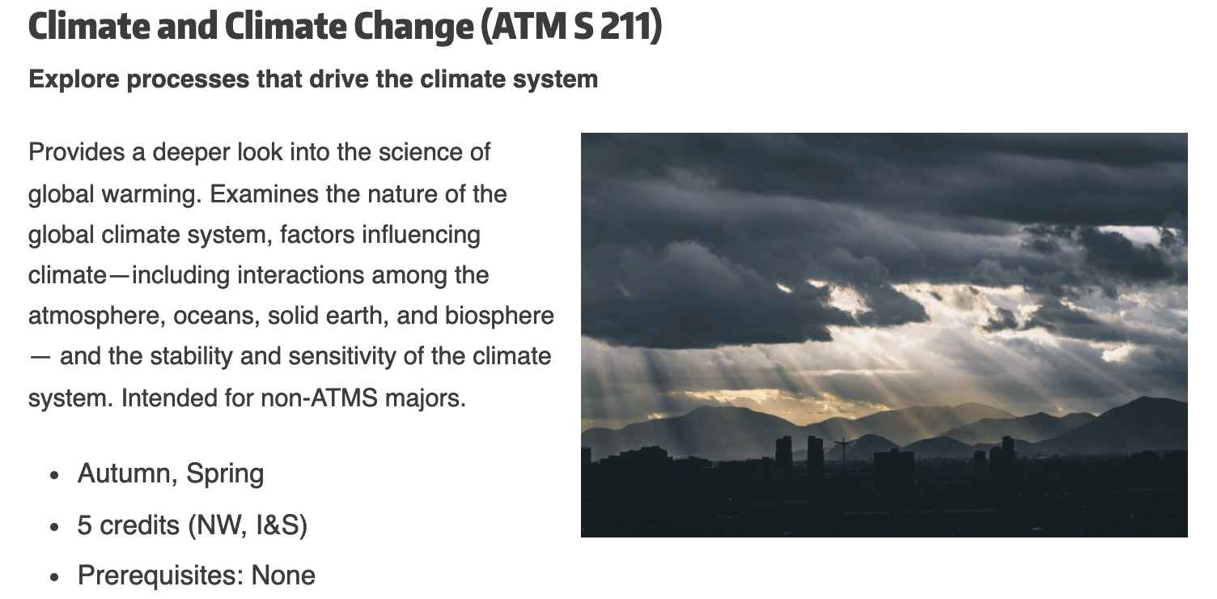
Want to learn more about the atmosphere?

Slide 4
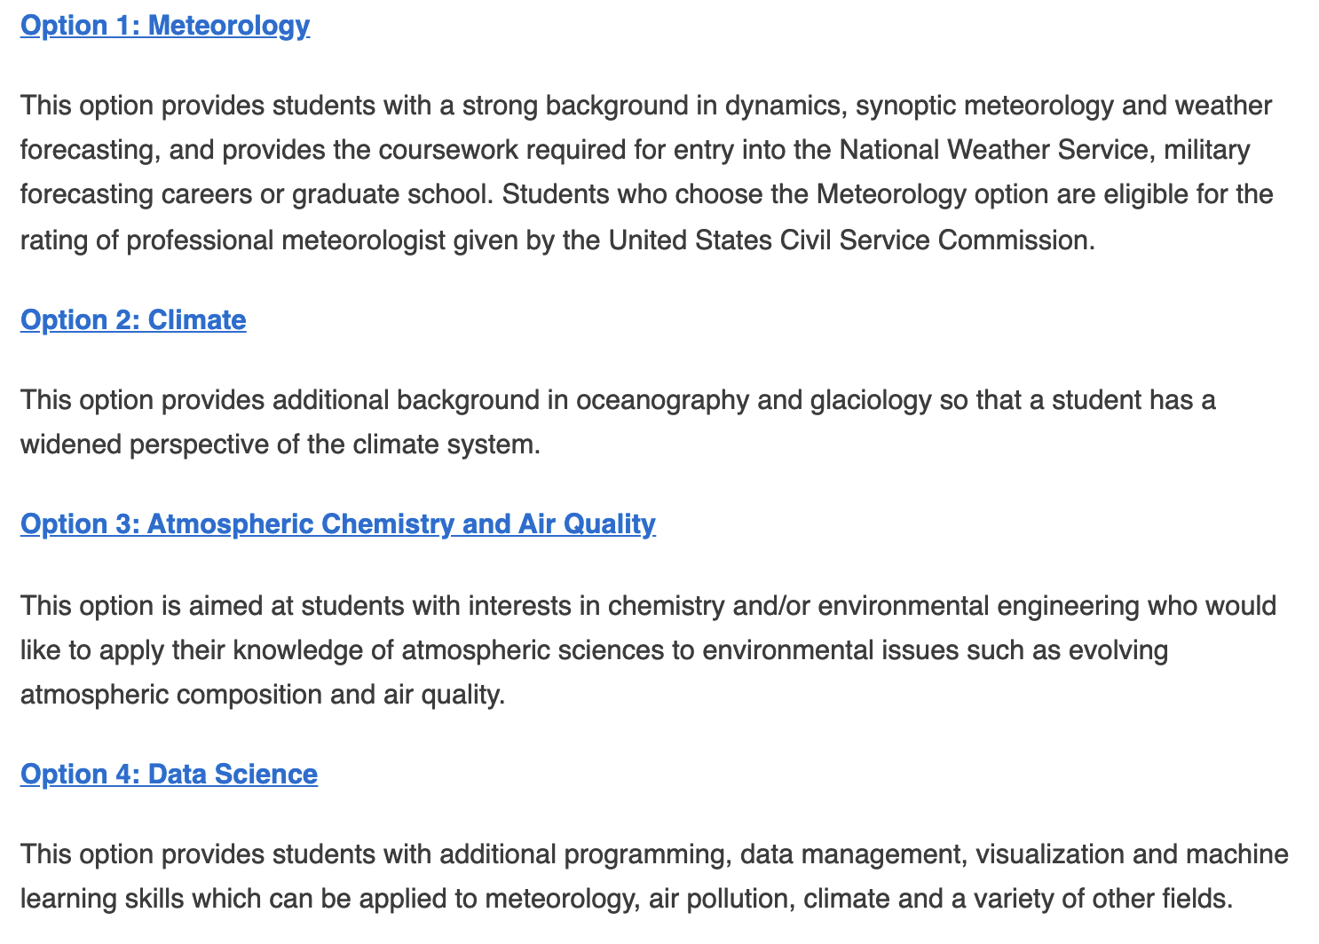
Atmospheric Sciences Major
B.S. in Atmospheric Sciences
Four tracks

Slide 5
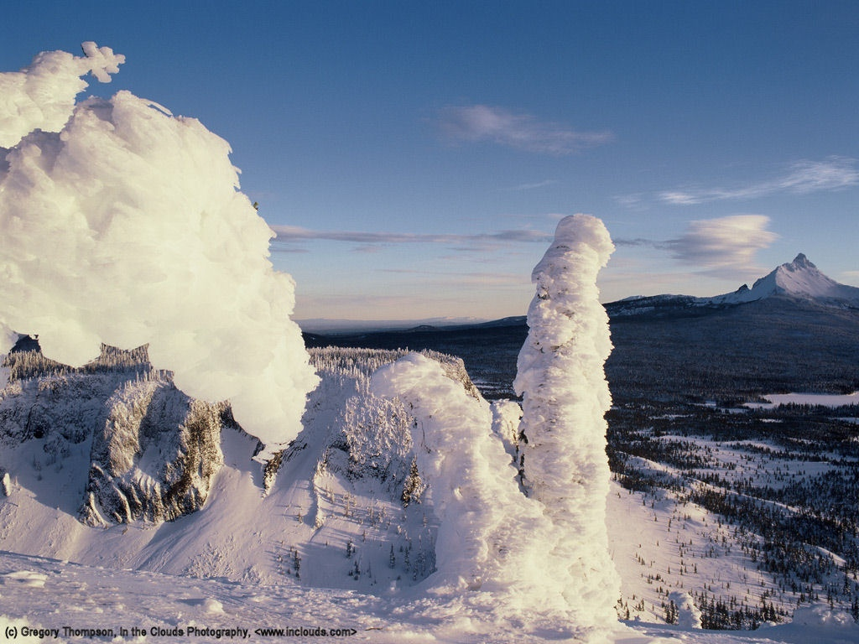
Northwest Weather 101

Slide 6
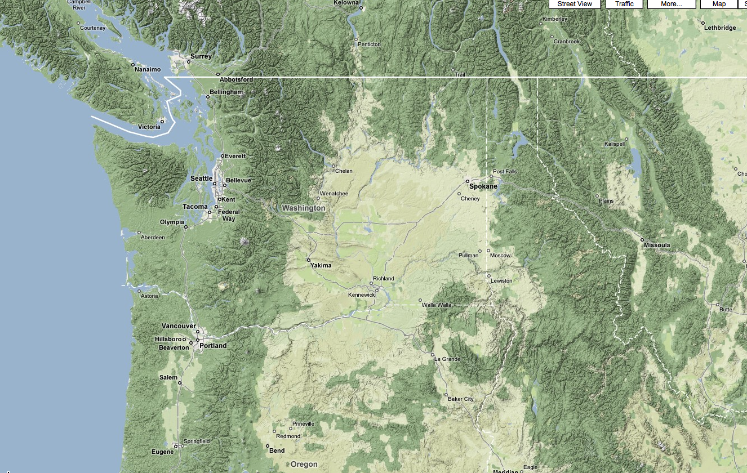
The weather of the Pacific Northwest is dominated by local weather phenomena, most produced or modulated by our regional terrain and water bodies

Slide 7
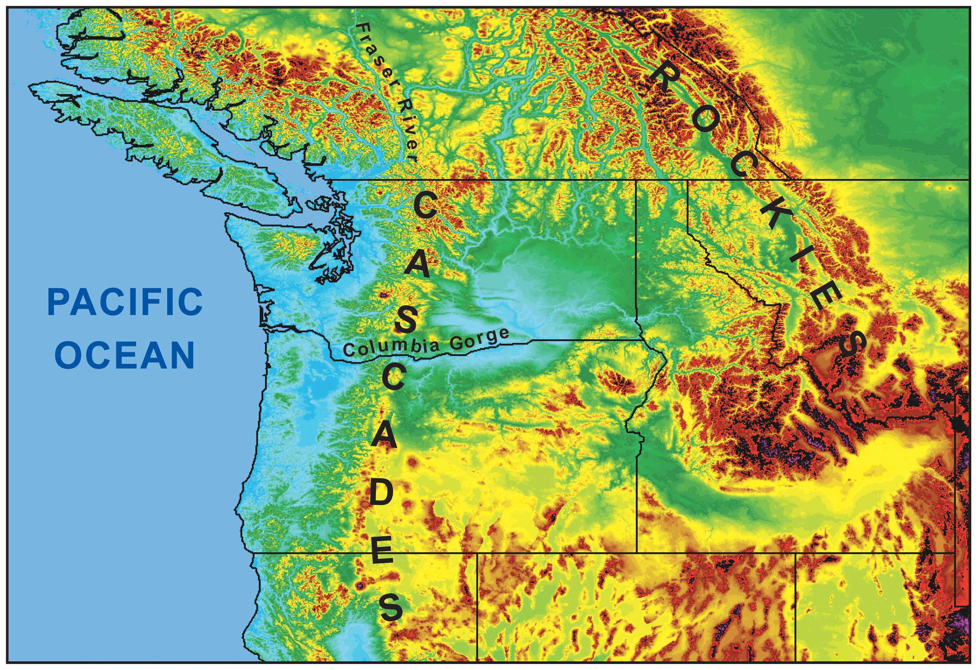
During the winter, the mountains block the cold air from the interior.
Cold
Air

Slide 8
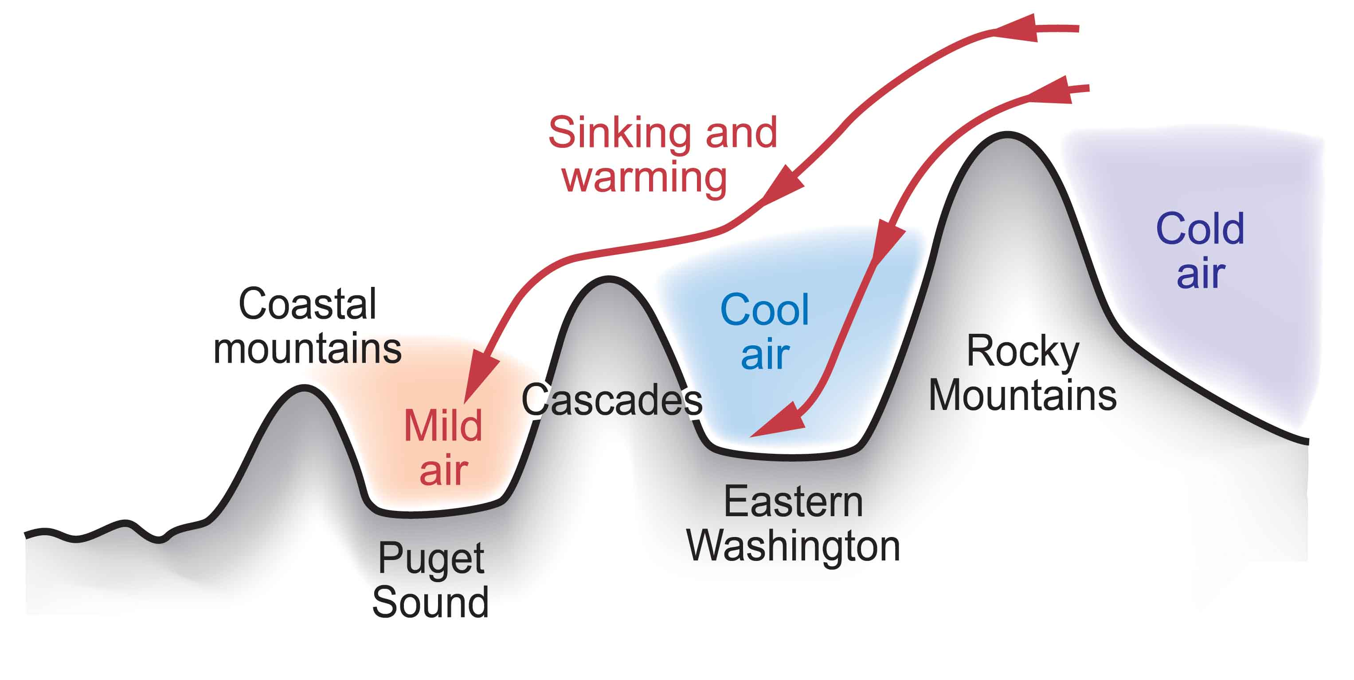
Cold Air from the Continental Interior Has a Hard Time Reaching Western Washington
Adiabatic compressional warming as air sinks on western slopes

Slide 9
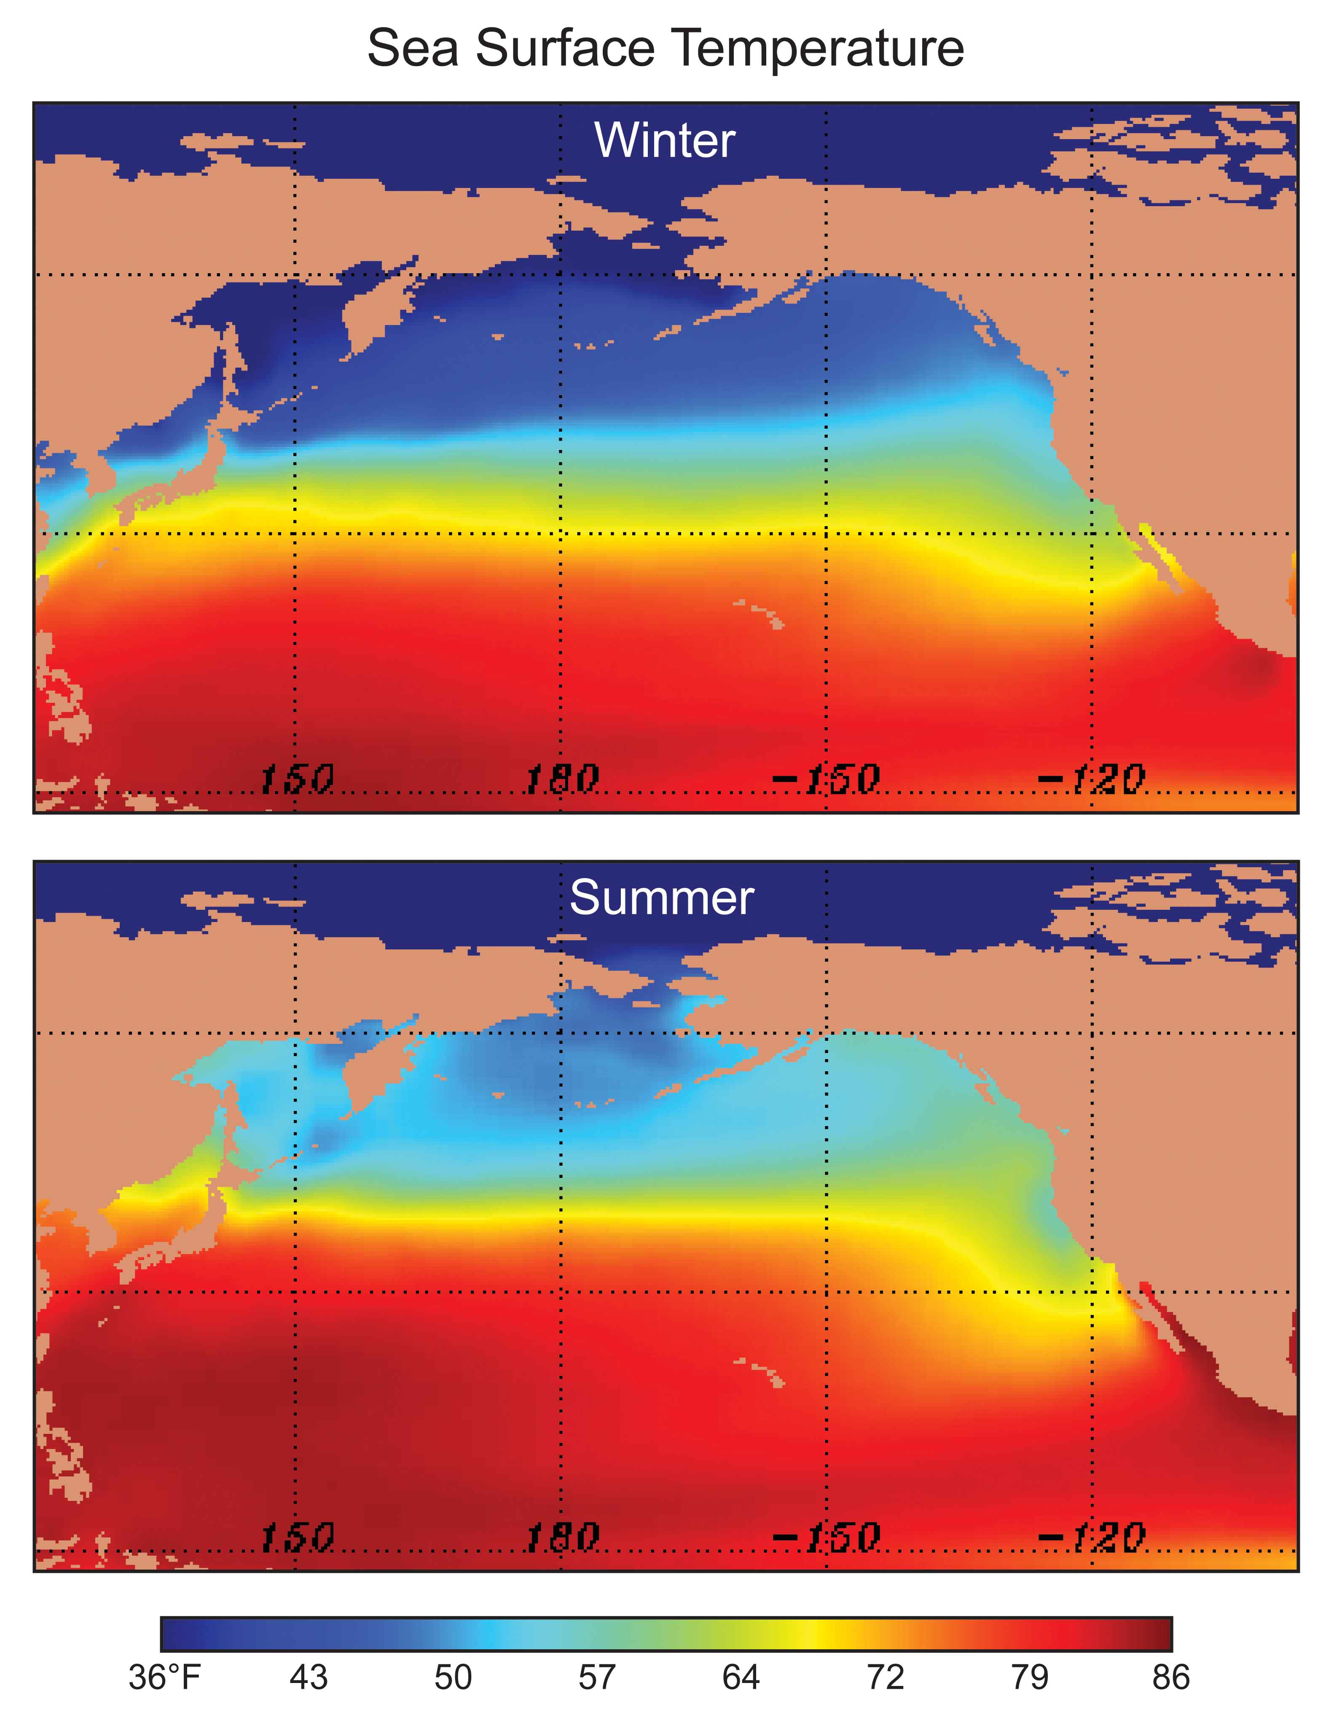
Our air and weather systems generally
move west
to east:
Thus, our
weather generally comes from off
the mild
Pacific--so we tend to be wet and mild.

Slide 10
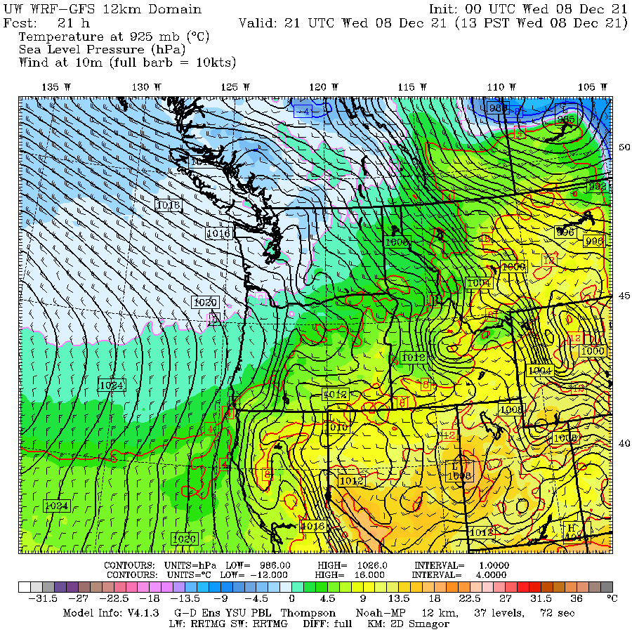

Slide 11
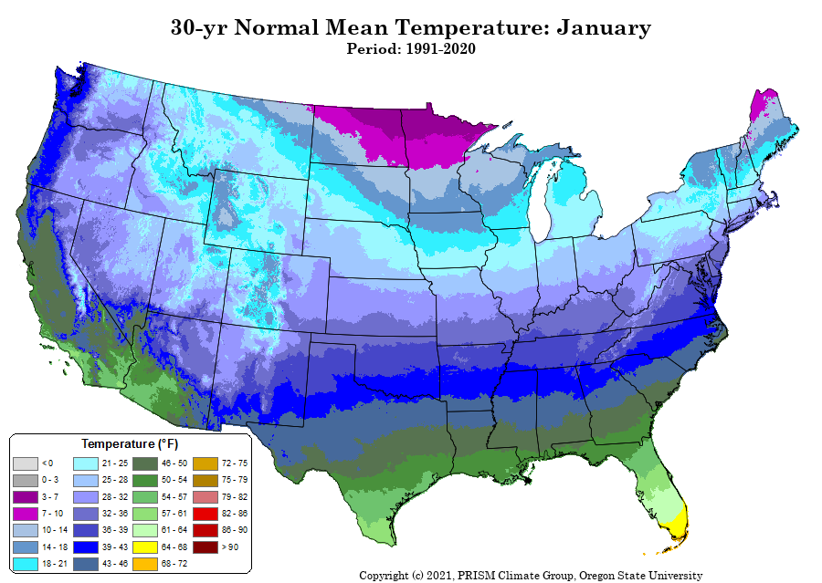
Mild Winter

Slide 12
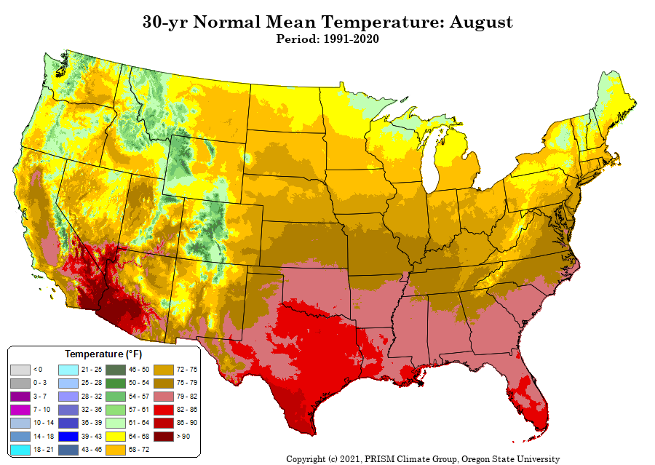
Mild Summers

Slide 14
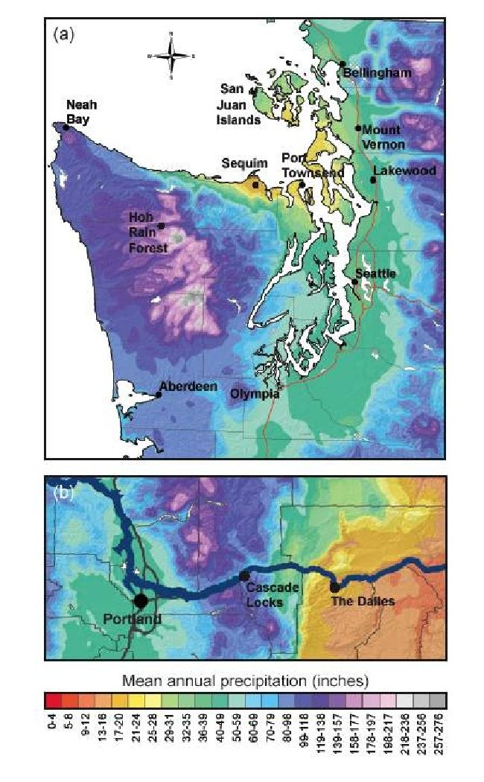
Extraordinary Precipitation Contrasts

Slide 15
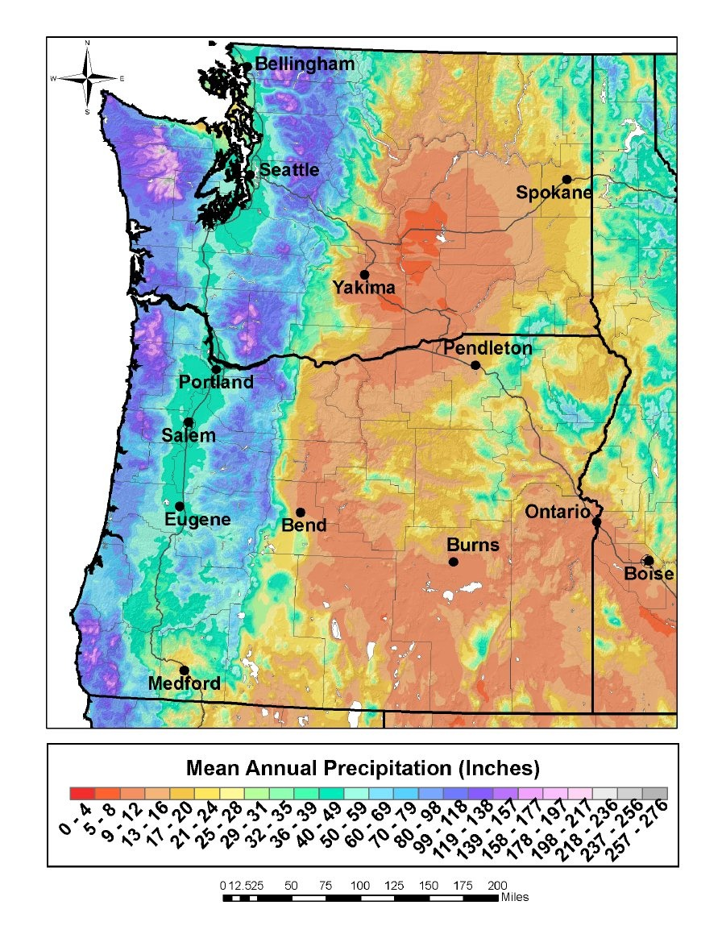

Slide 16
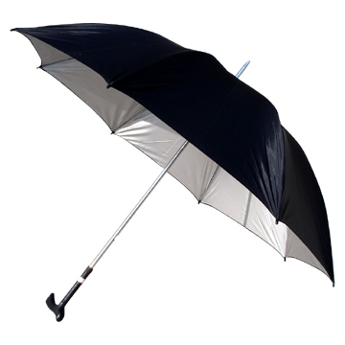
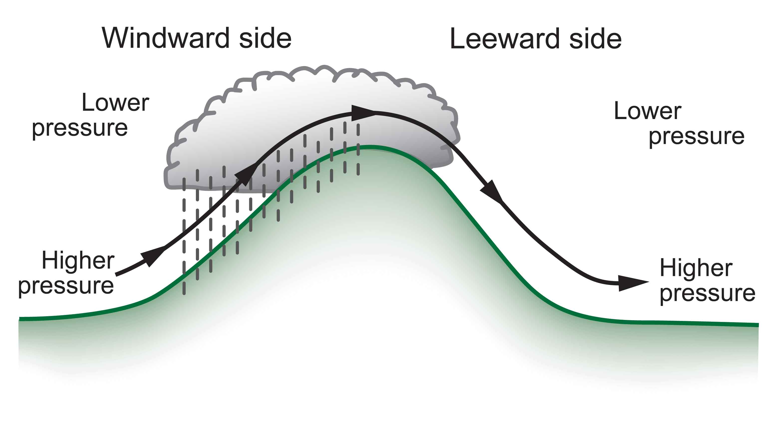
are as important as windward enhancement
The result is huge precipitation contrasts…some of the largest in the nation.
Substantial variations in solar radiation as well

Slide 17
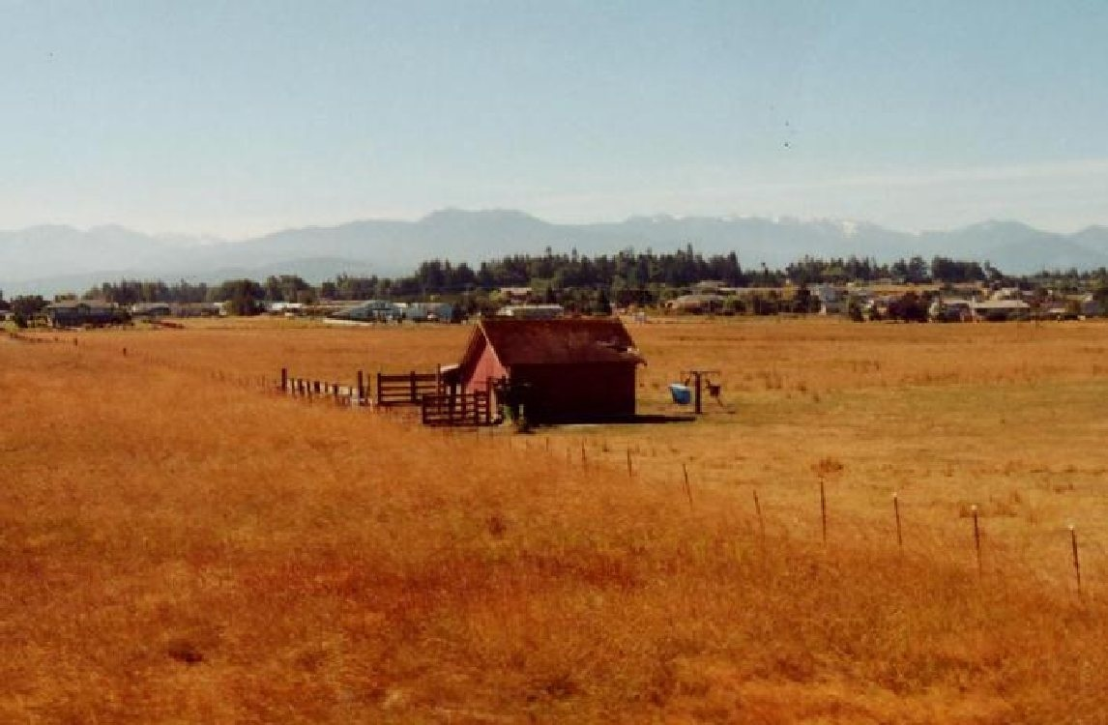
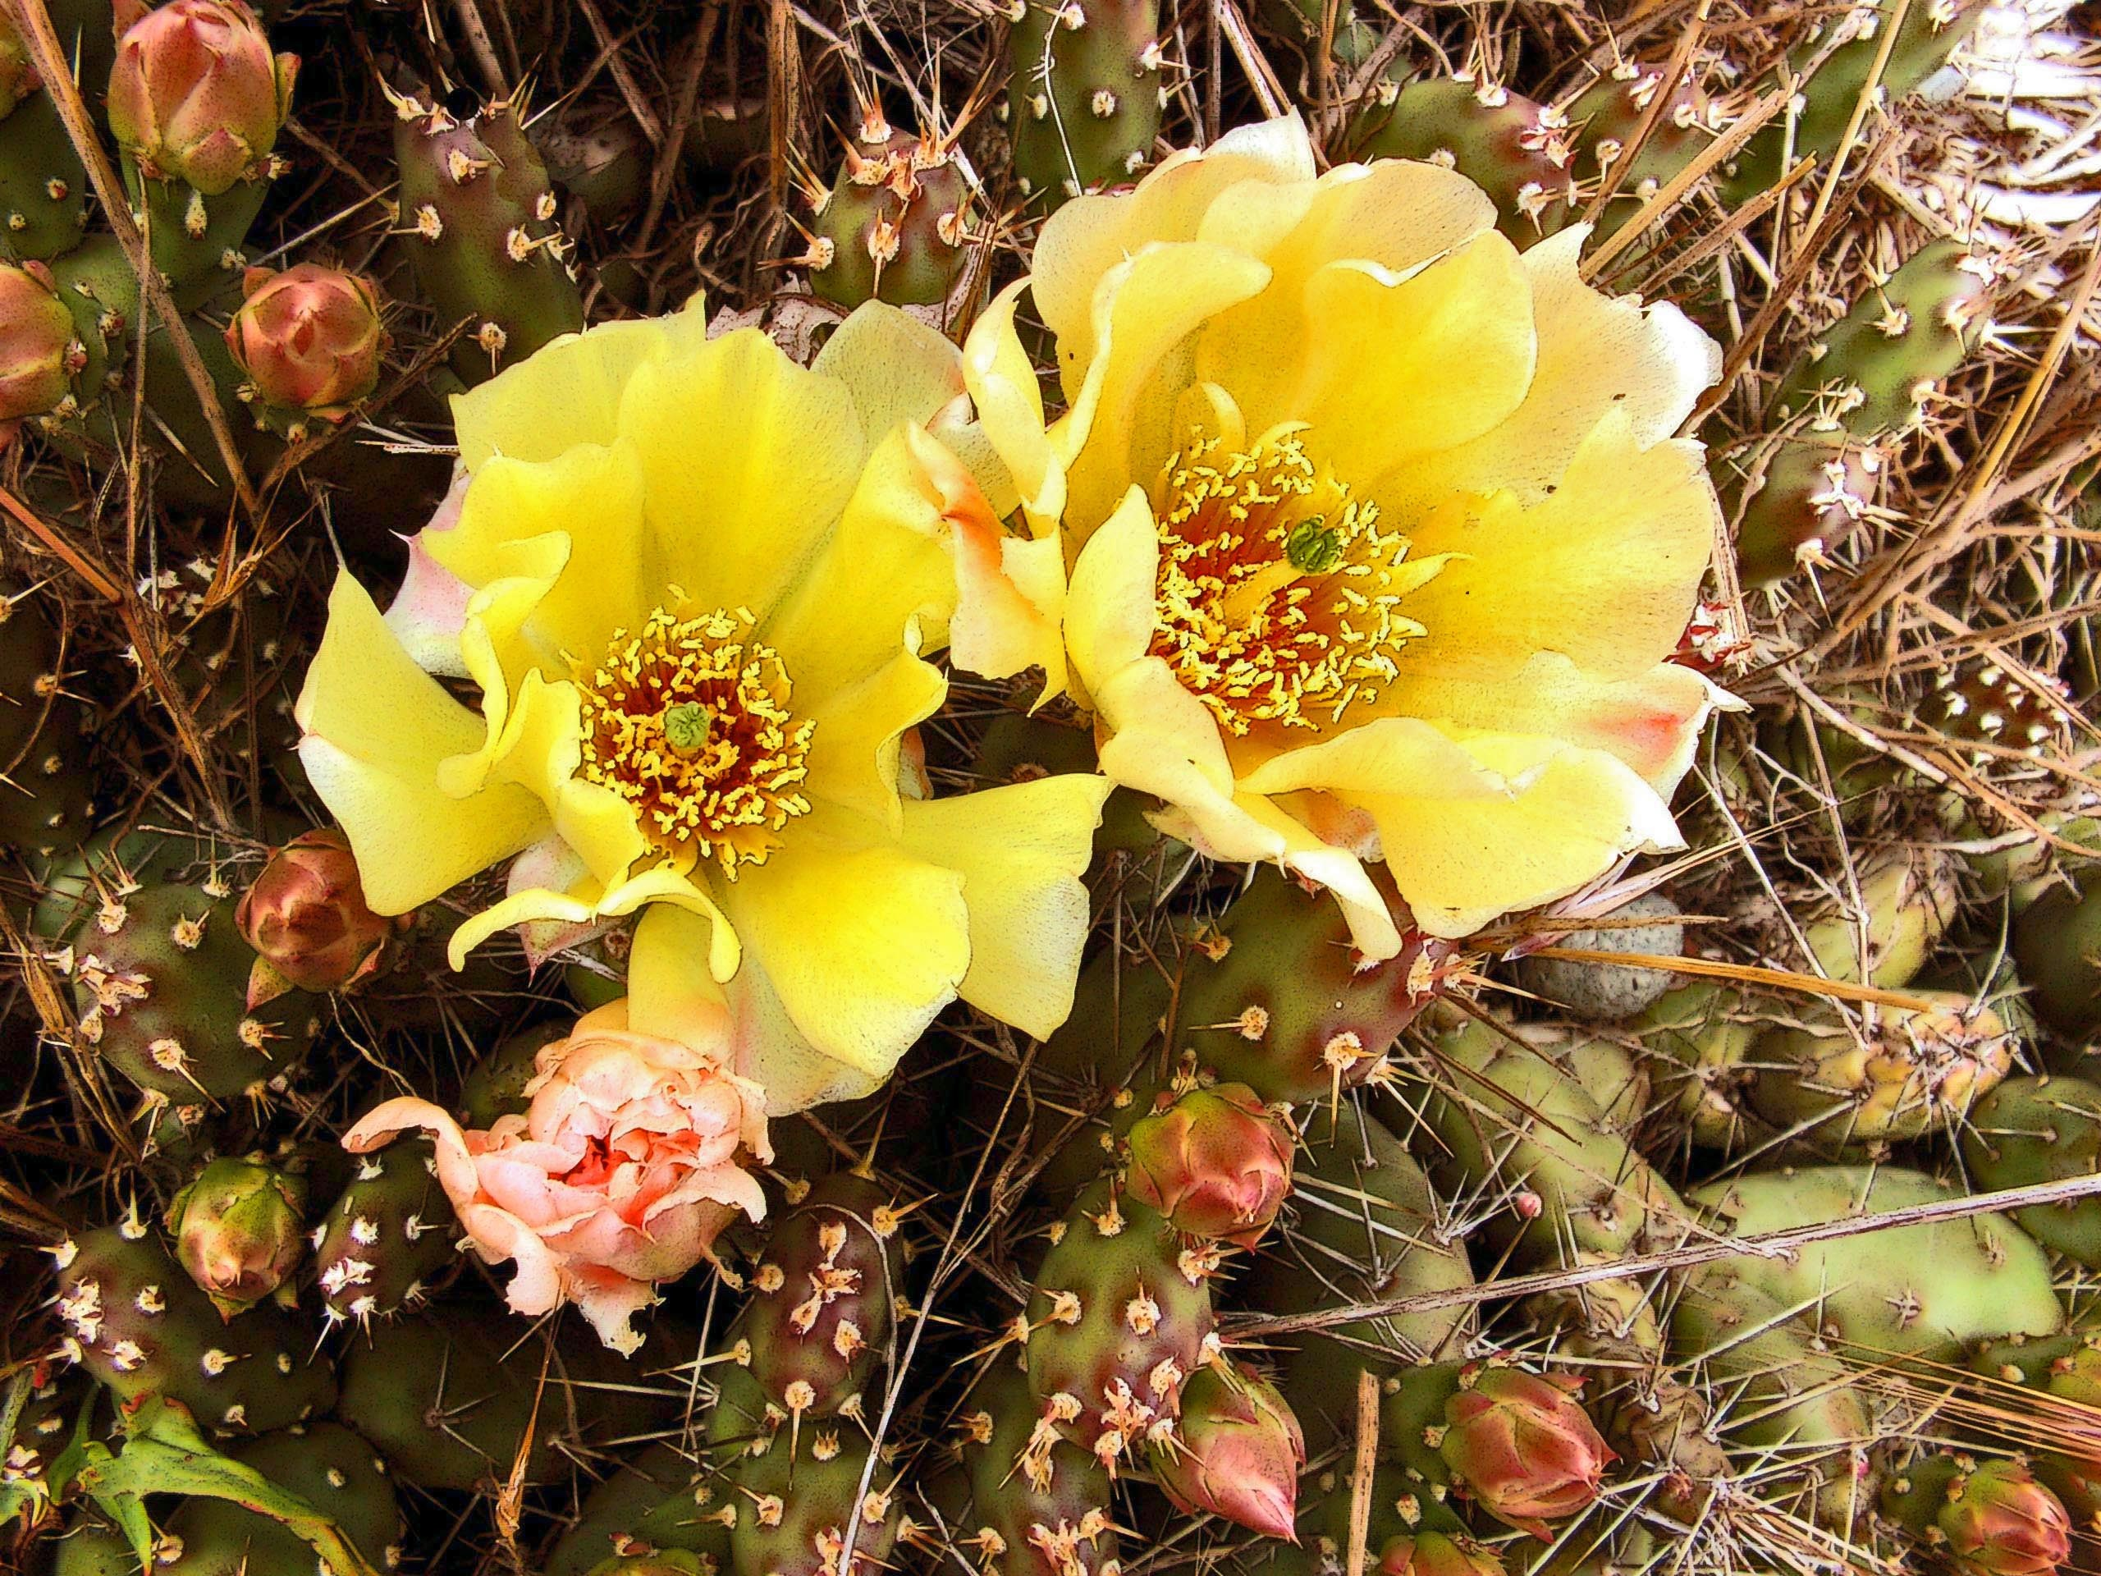
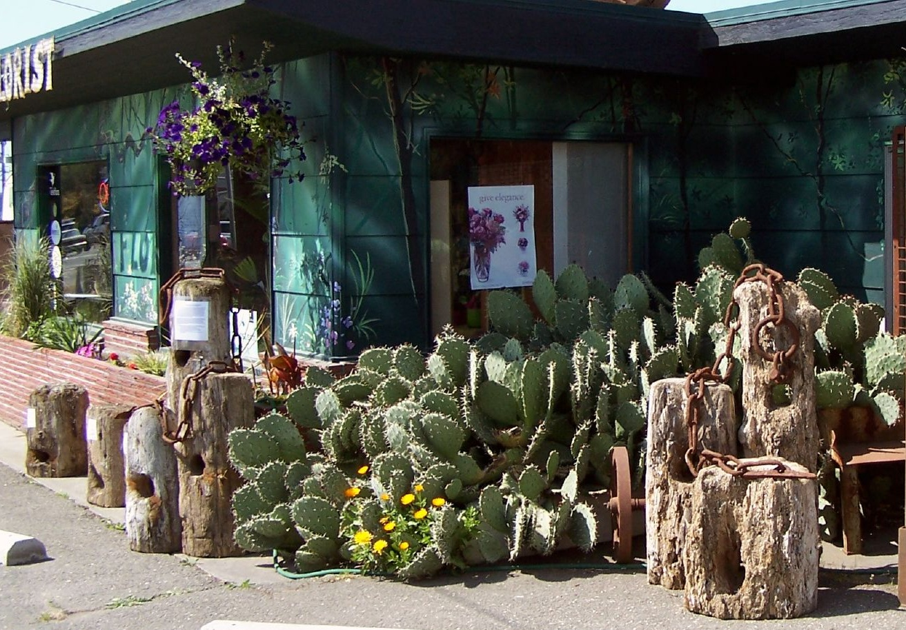
Sequim: Irrigation Needed, Cacti

Slide 18
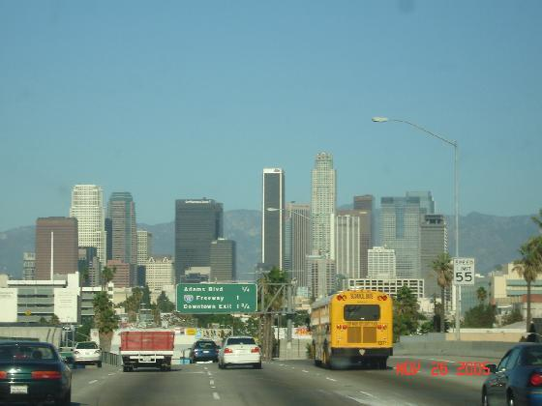
Annual Precipitation
Sequim: 15.97 inches
Los Angeles: 14.89 inches

Slide 19
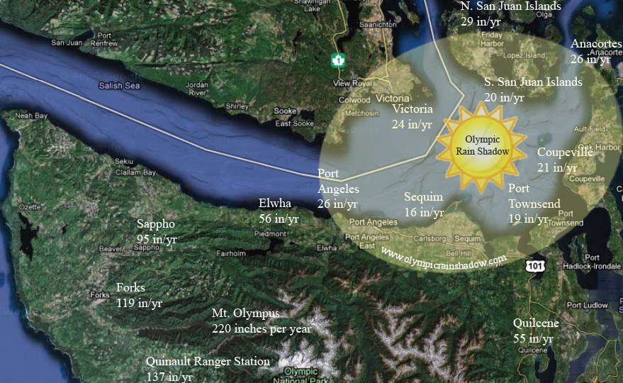

Slide 20
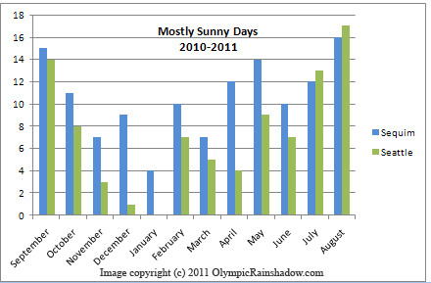

Slide 21
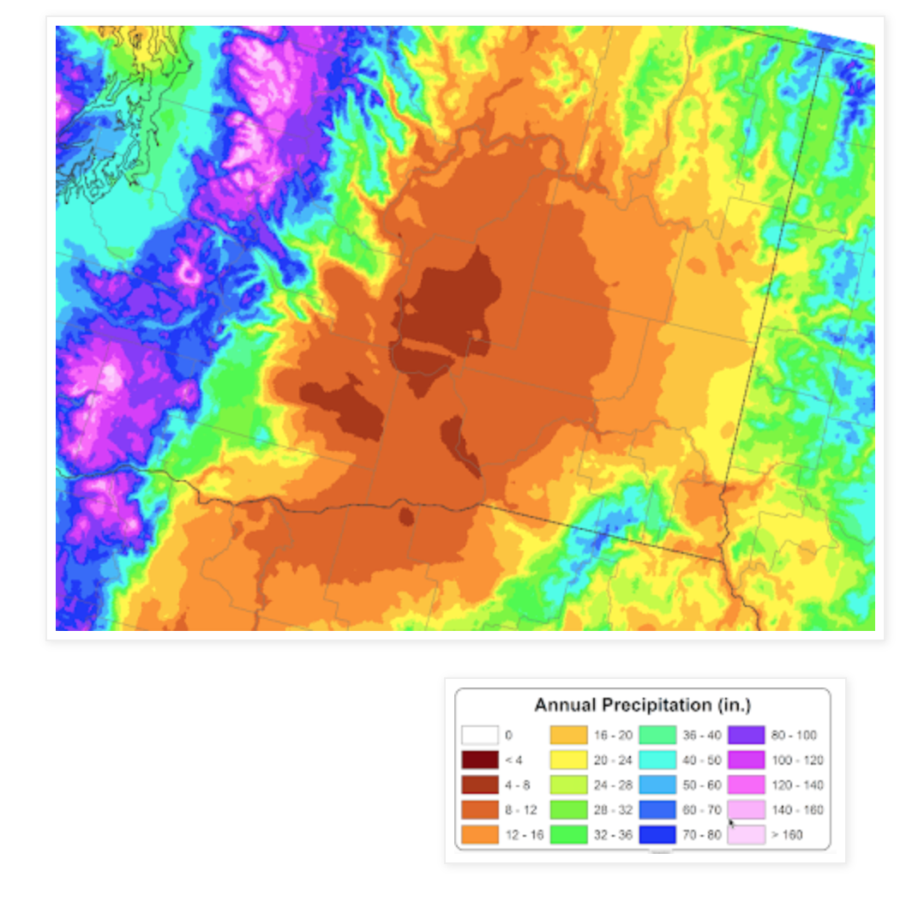
The Driest Location in Washington State?

Slide 22
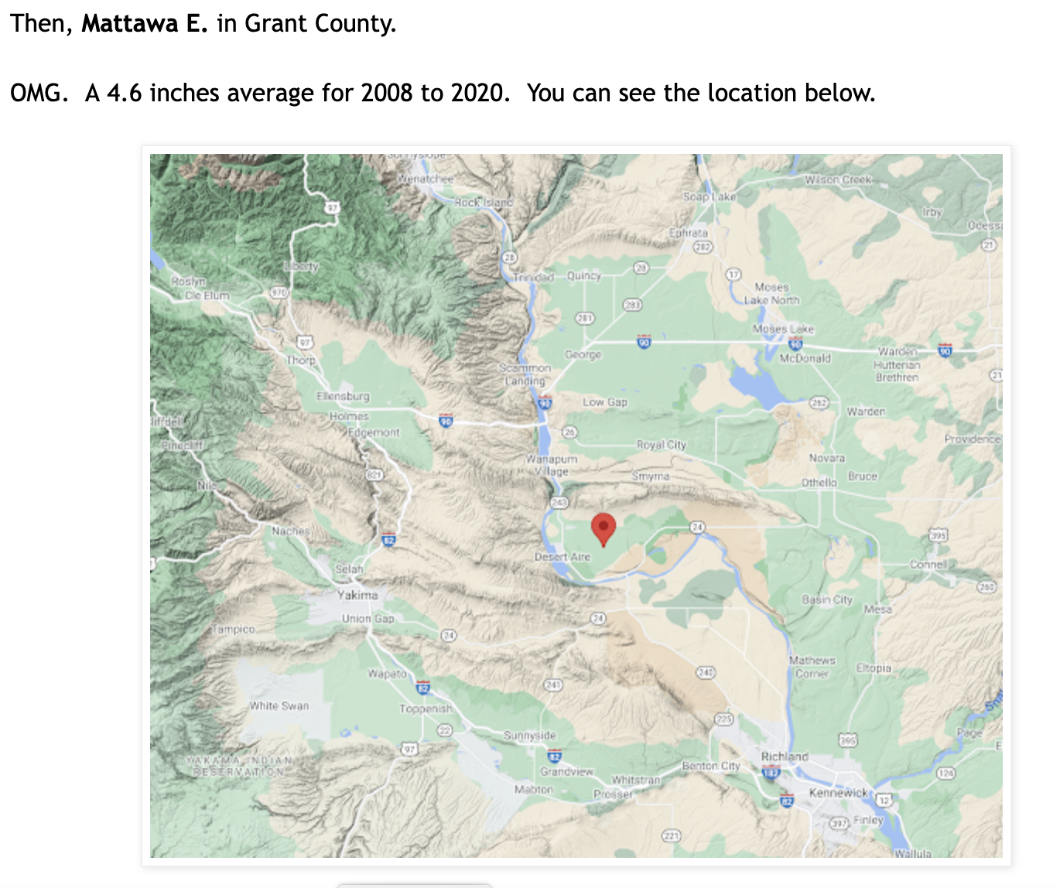

Slide 23
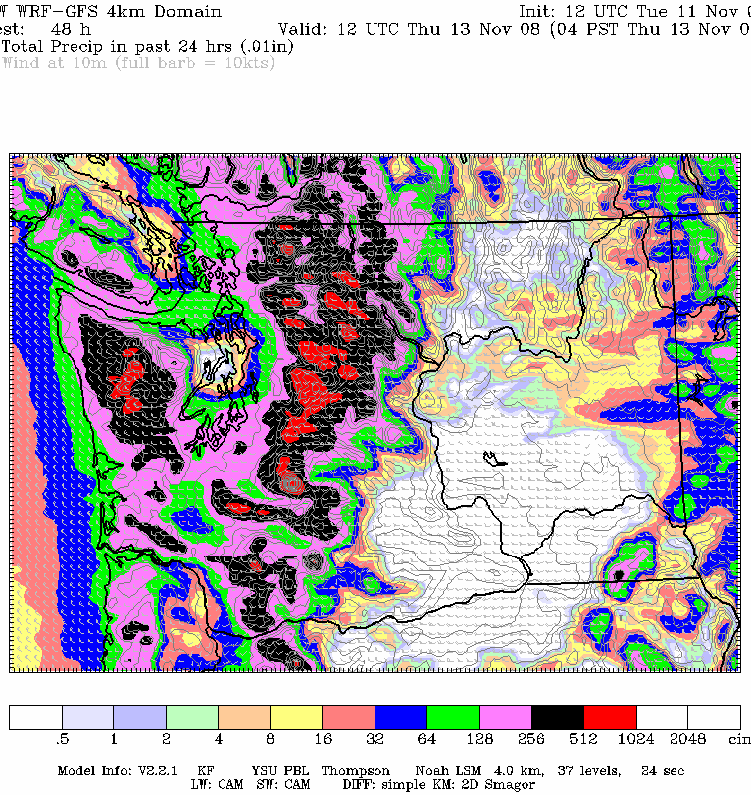
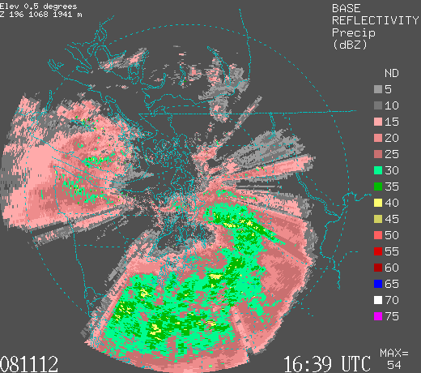
Rain shadows can move: depending on direction of the wind
For westerly winds, Seattle can be in the rainshadow

Slide 24
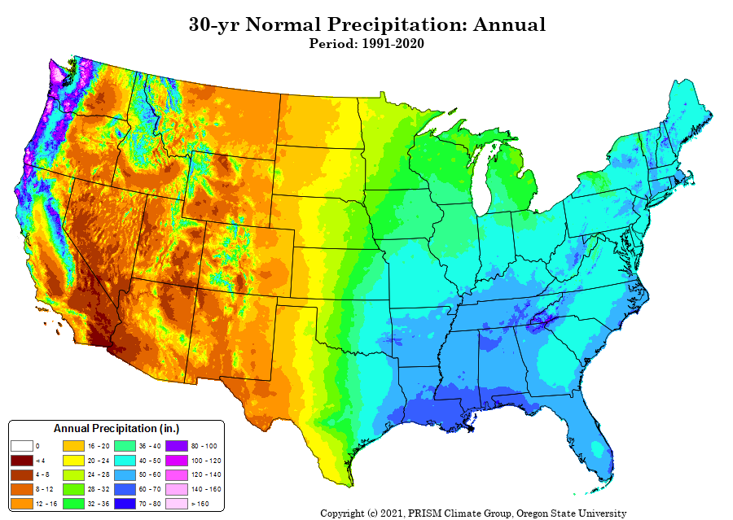
Western WA is the wettest part of Lower 48 states

Slide 25
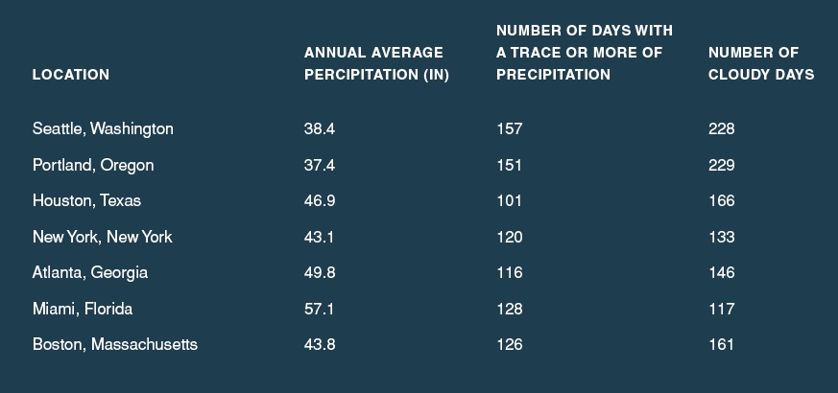
The western Washington lowlands really aren’t that wet—partially because we are often in the rain shadow of the Olympics and Mts. Of Vancouver Island…but the NUMBER of light rain/cloudy days is substantial

Slide 26
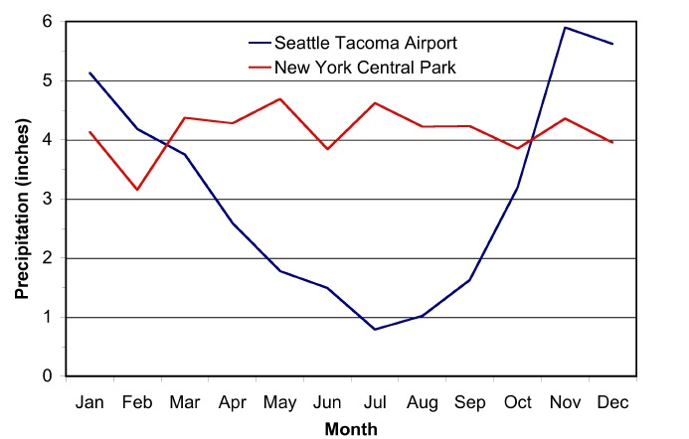
The Northwest Has a Mediterranean Climate
Football
Baseball Season
Football

Slide 27
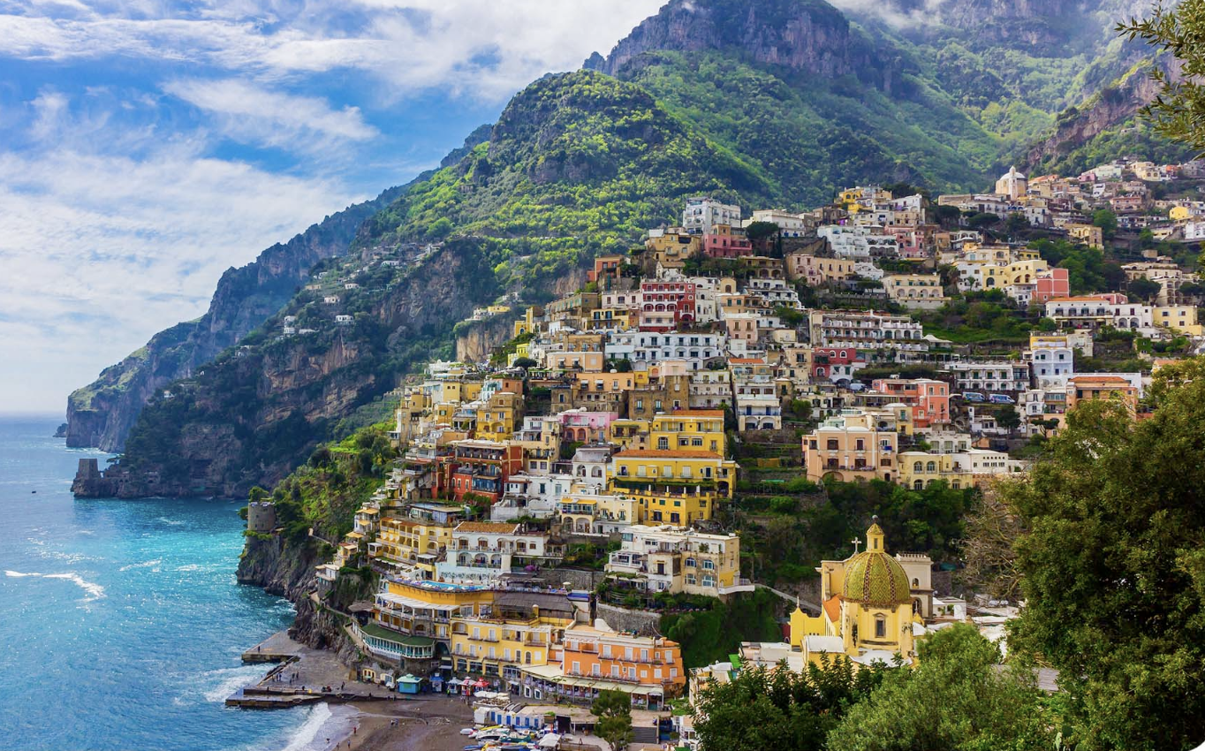

Slide 28
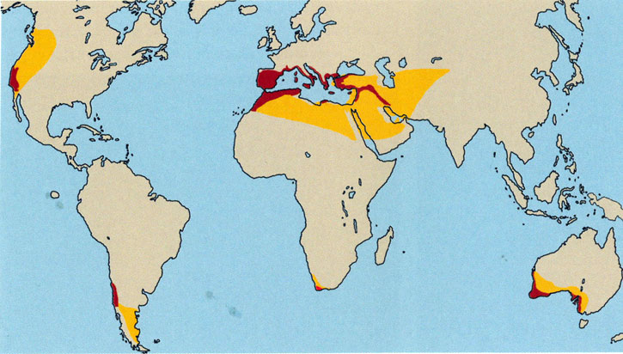
Mediterranean Climate:
Dry Summers/Wet Winters

Slide 29
Why Dry Summers?

Slide 30
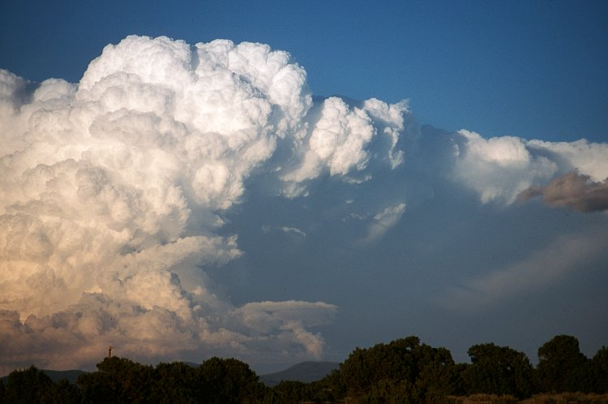
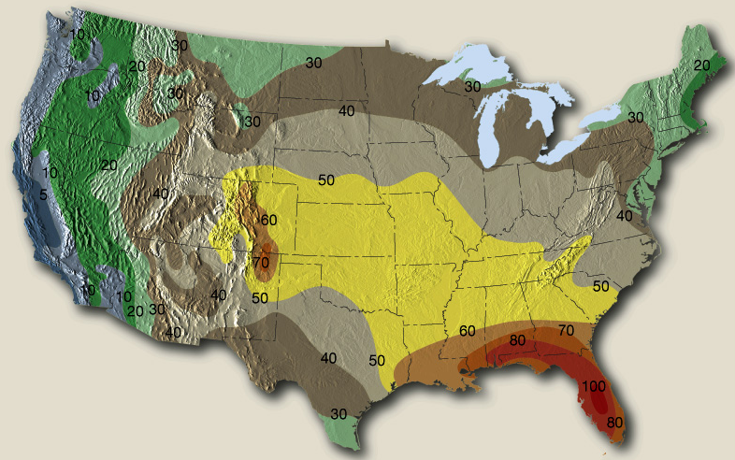
The Northwest Gets Fewer Summer Thunderstorms Than Almost Anywhere in the U.S. Except CA
Why?
Cool Pacific

Slide 31
Local Weather Features are Essential Elements of NW Weather
Many are associated with the interaction between the large-scale flow from the Pacific and local terrain barriers.

Slide 32
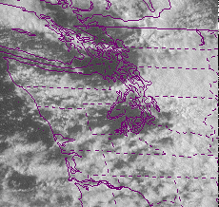
Puget Sound Convergence Zone

Slide 33
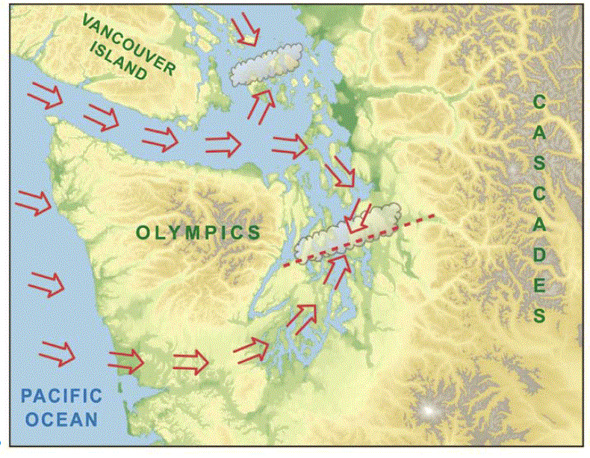
10-25 times year

Slide 34
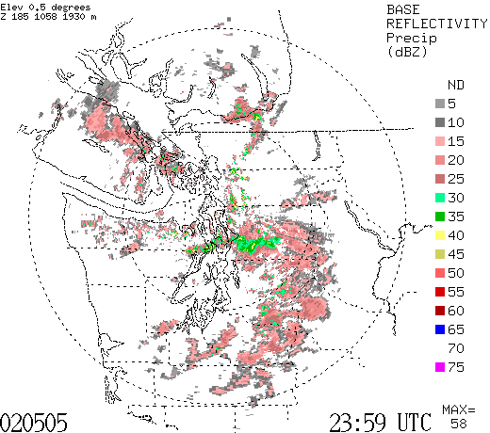

Slide 35
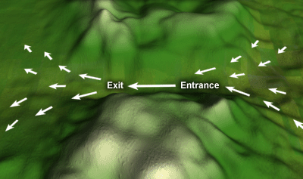
Gaps In Regional Mountains Have Big Meteorological Effects
Low
Pressure
HIGH
Pressure

Slide 36
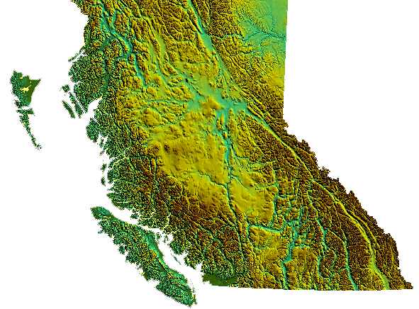
Fraser River Gap of British Columbia

Slide 37
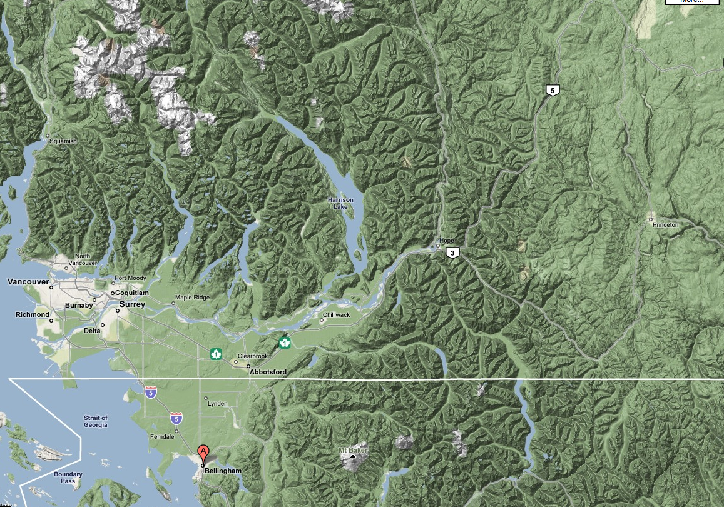
Fraser River Gap

Slide 38
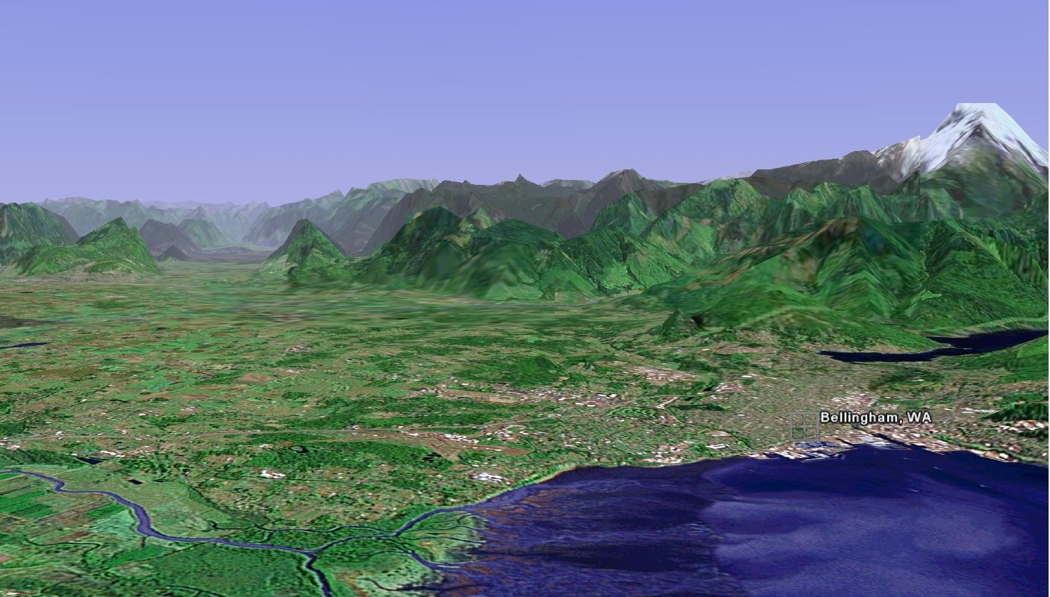
The Fraser River Gap

Slide 39
Can Get Strong Cold Northeasterly Outflow Winds into Bellingham and NW Washington When Cold Air and High Pressure Builds in the Interior of BC

Slide 40
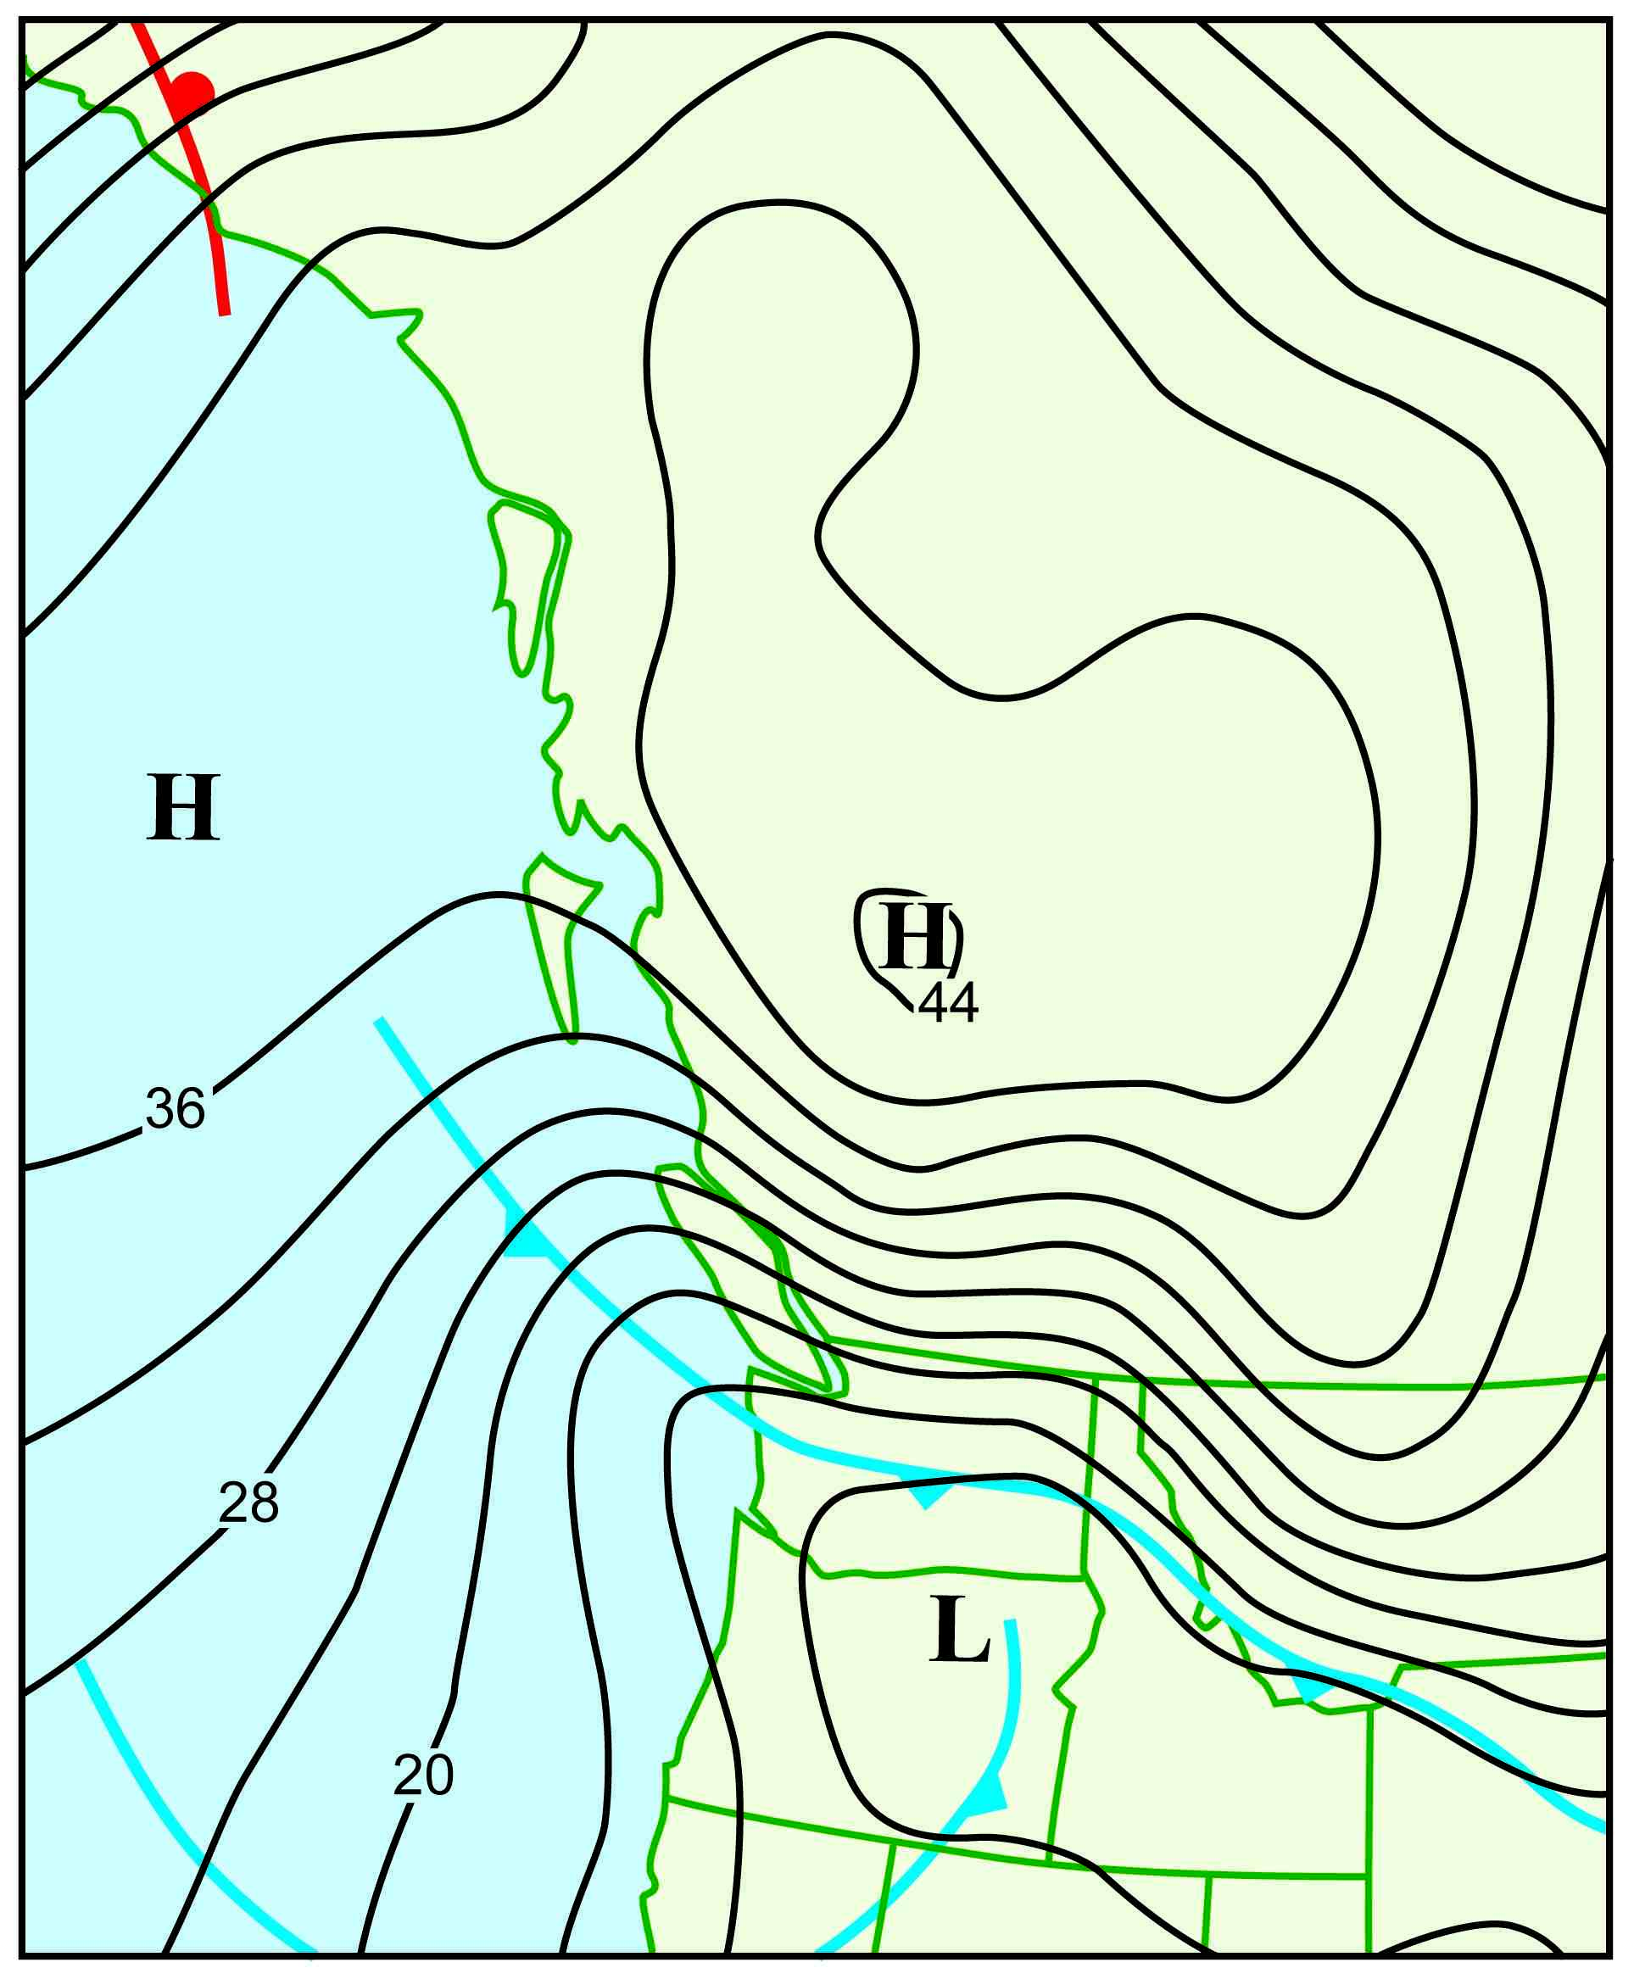
Major Fraser Gap Event of December 28, 1990

Slide 41
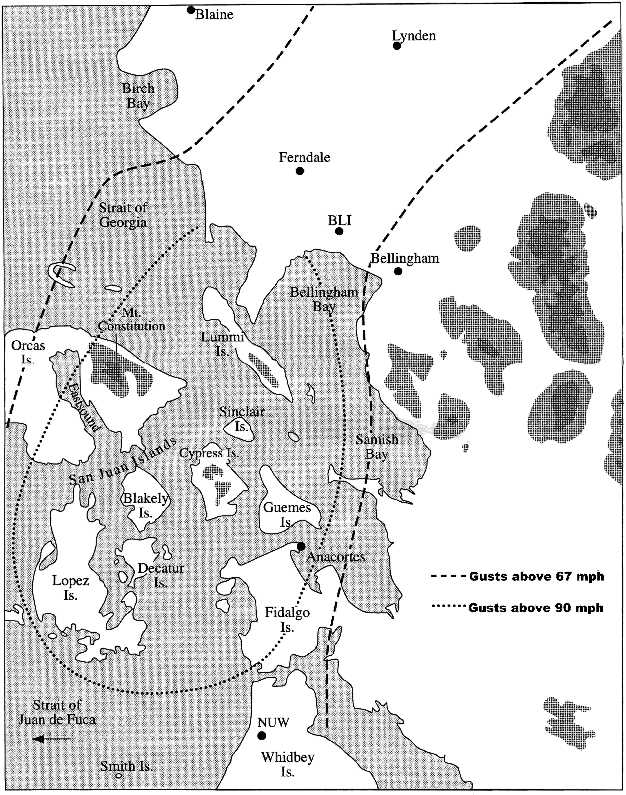

Slide 42
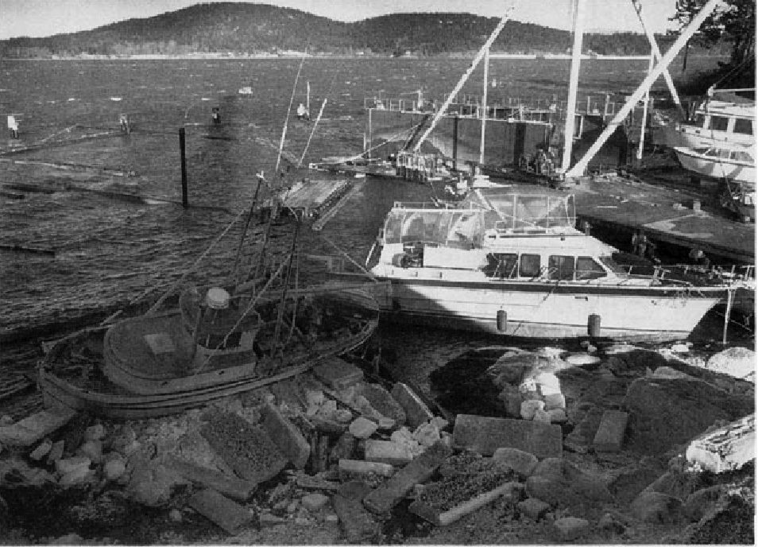
Anacortes Dec 1990

Slide 43
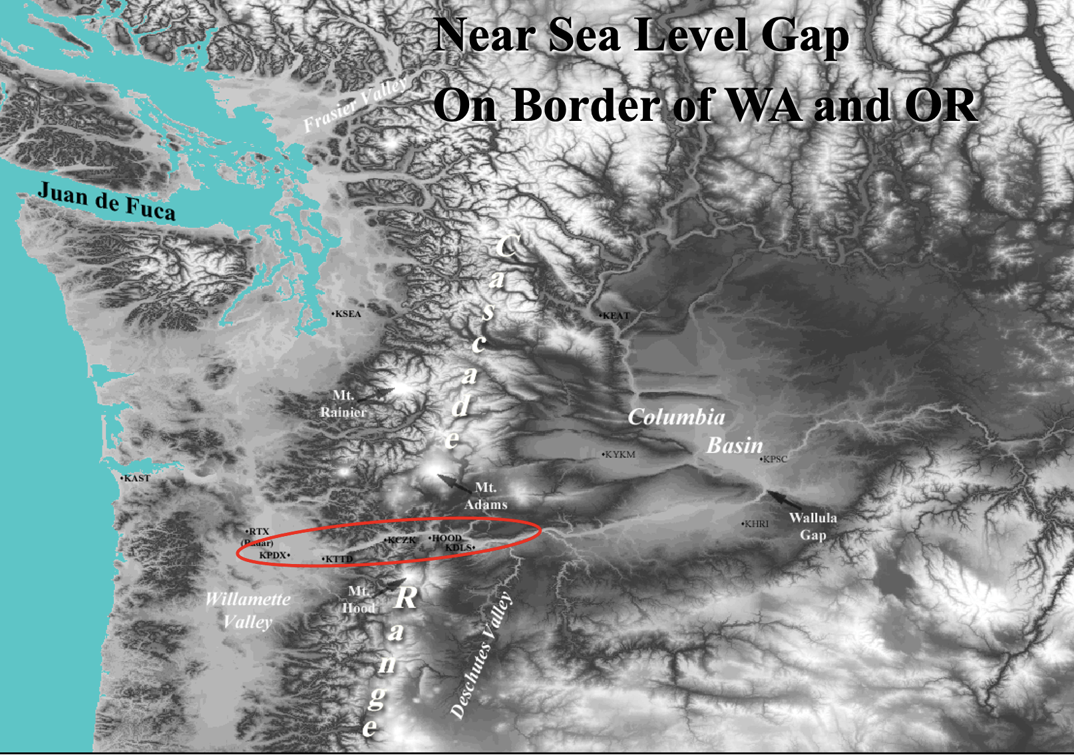
The Columbia Gorge: A Near Sea Level Passage Between the Columbia Basin and western Oregon/WA

Slide 44
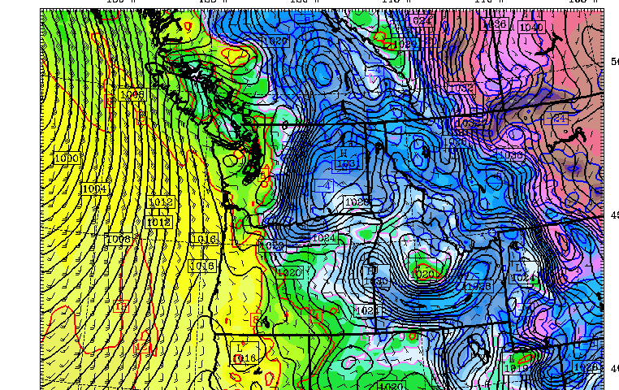
Strong easterly winds develop in the Gorge when cold air and high pressure develop over eastern WA, Lower pressure on the coast

Slide 45
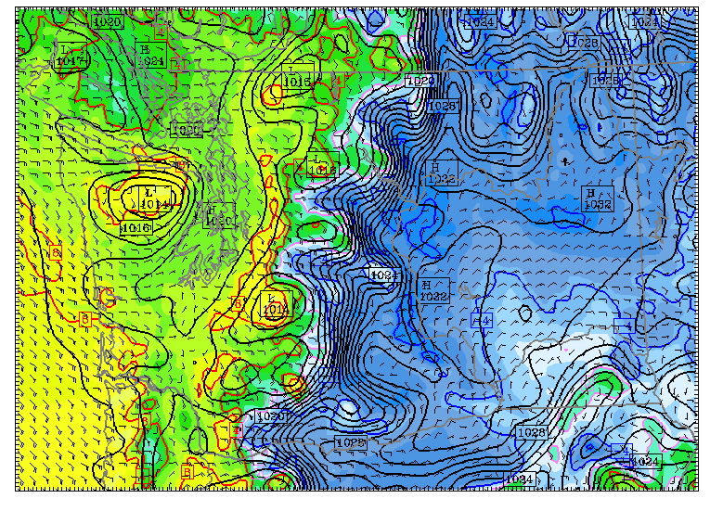

Slide 46
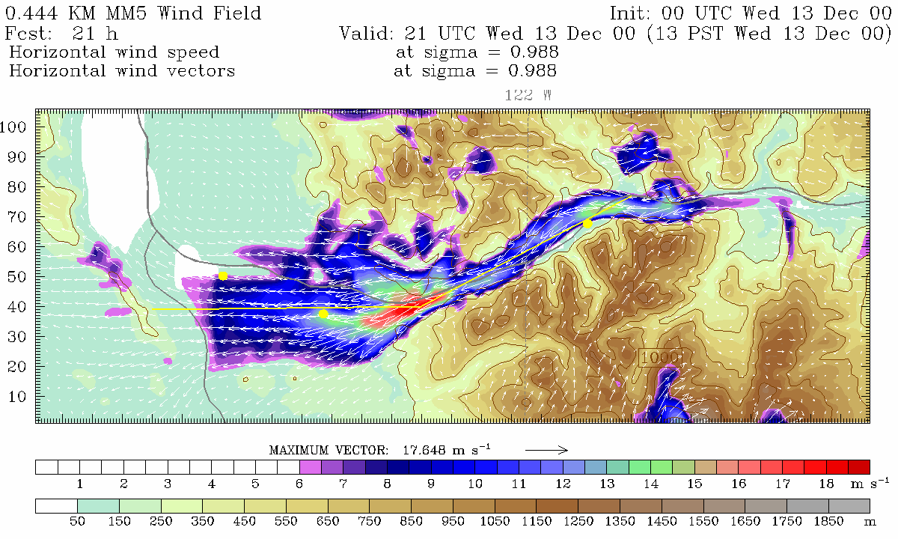
High Resolution Model Simulation
Troutdale
Notes:
Also note increased wind speed near CZK. Possible where the flow becomes supercritical. Also possibly Venturi.

Slide 47
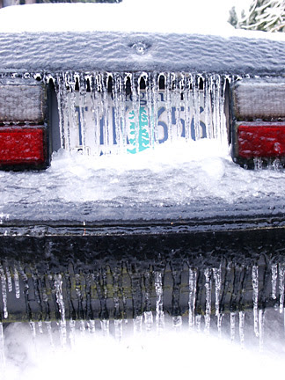
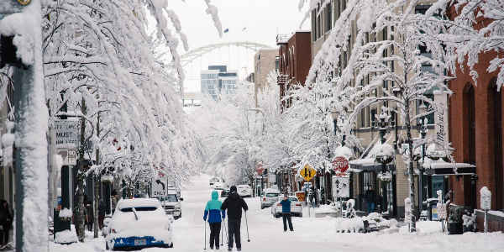
The outflow of very cold air in the Gorge can produce freezing rain and ice storms as warm rain falls into it

Slide 48
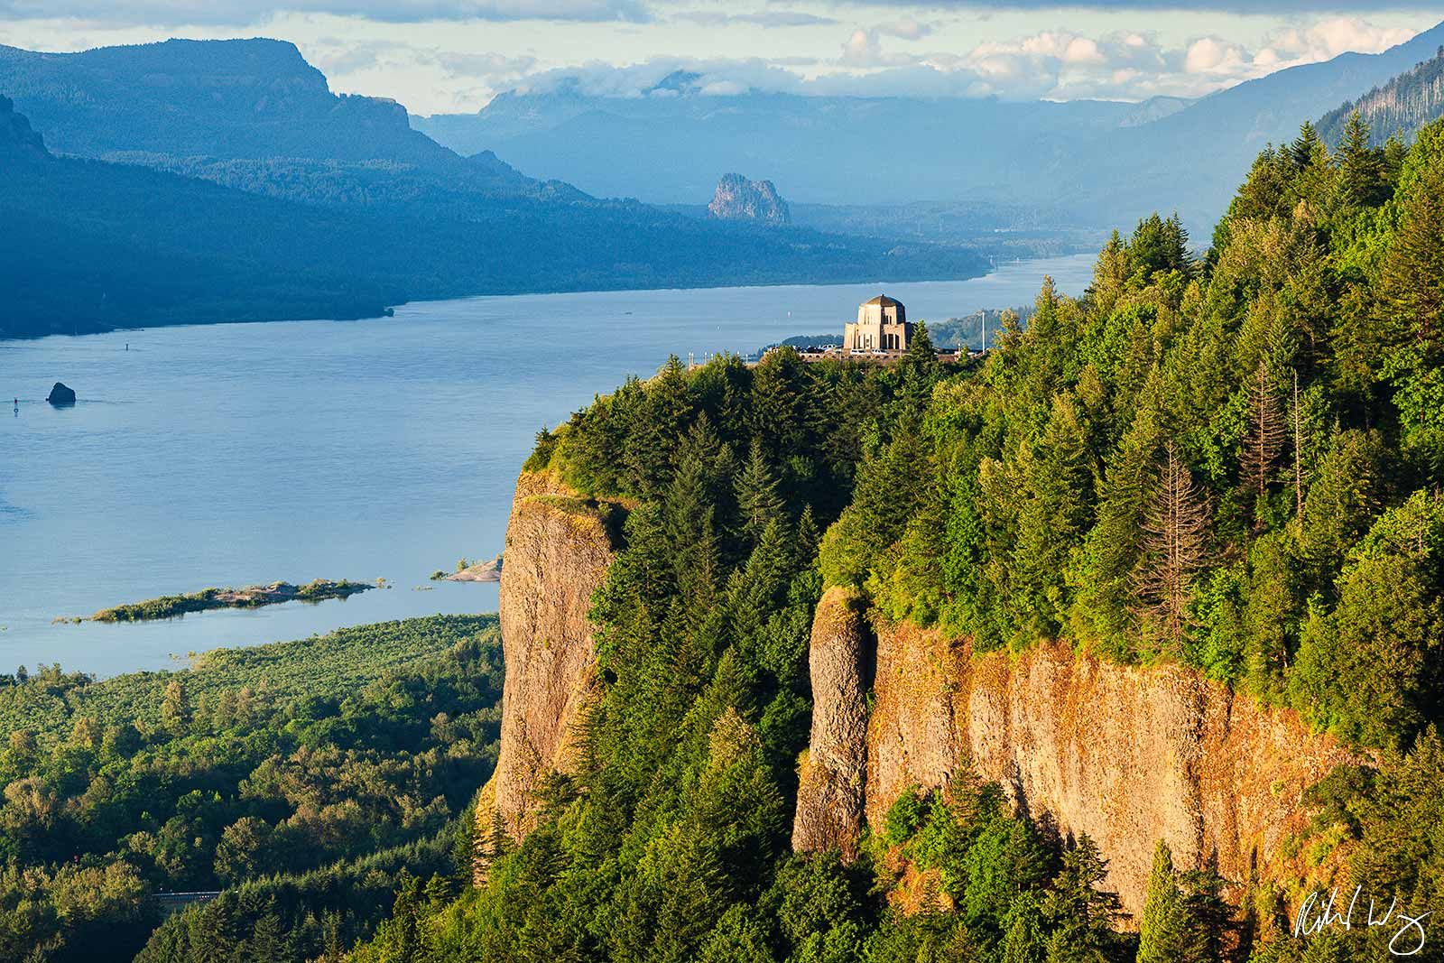
Crown Point/Vista House

Slide 49

Vista House, Right Above the Gorge

Slide 50


Slide 51

Strong Gap Winds Can Also Develop in the Strait of Juan de Fuca

Slide 52

Strong easterly winds can produce dangerous conditions

Slide 53

Strong Westerly Winds in the Strait
Higher pressure along the coast and lower pressure over the western interior contributes to acceleration of winds down the Strait.
High
Low

Slide 54

Under these conditions, Whidbey Island, Everett, and Mukilteo can be hit by fierce westerly winds approaching hurricane force.

Slide 55



Everett Harbor, December 17, 1990
Seattle Times and The Snohomish County Daily Herald
Notes:
This is a newspaper article published the next day in the Snohomish County Daily Herald showing ferry.
An article run in the Seattle Times illustrates the destruction at local marinas.
Another dangerous aspect of these storms, and one that was left off of the earlier list… TREE BRANCH MISSLES. I love the look on this lady’s face… NOT AMMUSED.
55

Slide 56


October 28, 2003
Ivar’s Mukilteo Landing Restaurant was destroyed by wind-produced, large waves
Notes:
Ah yes, poor Ivar’s restaurant. Deck destruction and “pile-o-chairs” Big news.
The windstorm makes front page news in the Seattle Times. Death and power outages highlighted.
Ivar’s mural and carp next…

Slide 57

Mural in the Restaurant
Notes:
And since the storm was named after it… This presentation wouldn’t be complete without talking about Ivar’s further… so here we go…
After the storm, Ivar’s redecorated their entire restaurant, incorporating the storm into their décor. I actually had the chance to have lunch with the artist, who painted the mural as accurately as possible according to first hand accounts… like by these people…
Also, as you can see in the painting, there is the wooden statue of “the carp”… which was washed away in the storm. Free fish and chips for a year to anyone who safely returns the beloved carp to its home… and here it is.

Slide 58
Ultra Localized Stong Winds

Slide 59

February 13
1979: The Hood Canal
Storm
Winds over 110 mph destroyed the Hood Canal Bridge
Cost to replace: over 100 million dollars

Slide 60


Slide 61

The Hood Canal Storm

Slide 62

February 13
1979: The Hood Canal
Storm

Slide 63

Enumclaw, Washington
“Place of evil spirits”

Slide 64


Enumclaw and nearby foothills locations can experience severe windstorms…while calm winds occur a dozen miles away
Winds over 118 mph
December 24, 1983

Slide 65

December 24, 1983

Slide 66


Slide 67

Why Enumclaw?
A Lower-Elevation Pass in Cascades

Slide 68

Enumclaw Windstorm Pressure Pattern
December 28, 1990
December 24, 1983

Slide 69

The most costly weather of the Northwest: Flooding

Slide 70


Slide 71

Most are associated with the “Pineapple Express”
A relatively narrow current of warm, moist air from the subtropics…often starting near or just north of Hawaii.
a.k.a.
Atmospheric rivers

Slide 72


Slide 73

Precipitation is Released by Lifting on Terrain

Slide 74


A Recent Devastating Pineapple Express: November 6-7, 2006
Dark Green: about 20 inches

Slide 75

Mount Rainier National Park
18 inches in 36 hr (Nov 8, 2006)

Slide 76



Mt. Rainier damage

Slide 77
Northwest Snow
We have world records in the mountains
Generally, low snowfall over the western lowlands

Slide 78

Seattle 1916: More than two feet

Slide 79


Greatest Annual Snowfall Totals in the World in our Mountains
The Mt. Baker Ski Area in northwestern Washington State reported 1,140 inches of snowfall for the 1998-99 snowfall season

Slide 80

Annual
Snowfall

Slide 81

Why are snowstorms rare over the western Washington lowlands?
To get snow you need cold and wet.
It is easy to be mild and wet here
Sometimes we are cold and dry.
To get cold and wet is very hard…
Seattle 2007

Slide 82

The secret of Northwest snow is usually to bring in cold air from the north and interior while moist, cool Pacific air moves in aloft.

Slide 83
Cold Air
Moisture

Slide 84

The Fraser River Valley is an important conduit of cold air into western Washington.

Slide 85

The Pressure
Pattern That
Does It

Slide 86


Slide 87

Upper Level Chart for Snow

Slide 88


Slide 89
The Most Extreme Weather Event in the Last 50 Years

Slide 90

The Northwest Heat Wave of June 2021

Slide 91
June 2021 Was the Most Extreme Heatwave In Northwest History
Station | Old Record | New Record
SeaTac | 103 | 108
Olympia | 105 | 109
Quillayute | 99 | 110
Portland | 107 | 116
Dallesport | 118 | 118-120 (all time state record was 118)
Many locations in western WA east of I-5 were above 110

Slide 92

An Extraordinarily Extreme Event
Temperature at Forks Near the WA Coast

Slide 93


Why did it happen?
Was this a black swan event, driven by natural processes, with a modest assist by global warming?

Slide 94
The evidence appears to strongly suggest that natural variability was key and that global warming was a minor contributor.

Slide 95

Climatological Perspective
The maximum temperatures during the event were 30-40 F above normal.
The region has warmed up 2 F over the past century.
Assume this all due to anthropogenic global warming

Slide 96

The heatwave amplitude is far larger than the background global warming signal

Slide 97

Extreme (Record) Upper Level
Ridge of High Pressure
Record intensity aloft
Record temperature aloft
Extraordinary subsidence in the ridge

Slide 98

The Air Experienced Intense Sinking and Compressional Heating,

Slide 99

The Heat Wave Was Supercharged!

Slide 100

Approaching trough resulted in enhanced downslope (southeasterly) winds at low levels
500 hPa
850 hPa

Slide 101

The Great Storms of the Northwest Coast

Slide 102

The Pacific Northwest does not experience tropical storms or hurricanes
But we do experience very strong Pacific cyclones, with winds equal to category 2-3 hurricanes
1993 Inauguration Day Storm

Slide 103
Intense midlatitude cyclones
Wind can exceed 100 mph
The energy source?
The large horizontal temperature contrasts in the midlatitudes.

Slide 104
Reminder: Northwest Windstorms are strong examples of midlatitude cyclones

Slide 105

Midlatitude Cyclones
The lower the central pressure the stronger the winds. Typical winter low 990-1000 hPa. Moderate windstorms 980-990 hPa. Strong ones, 950-980hPa
Deep lows have strong pressure gradients, which result in the strong winds.

Slide 106
Weather Satellites Imagery of Our Storms Reveal The Huge Scale of Our Major Storms

Slide 107


Tropical Cyclones: Much Smaller

Slide 108

The Media Often Calls our storms “bomb cyclones” because most develop rapidly

Slide 109

When is a midlatitude cyclone a “bomb”?
When the central pressure lowers by about 24 hPa in 24 hr
hPa is hector (100) Pascals– unit of pressure

Slide 110

Last Year We Had Several “Bomb Cyclones” That Stayed Offshore

Slide 111

Ocean Midlatitude Cyclone Have Modestly Different Structure than Land Cyclons

Slide 112


Example: Strongest Winds Are in the Back-Bent Trough on the Southwest Side

Slide 113

Native Americans knew about NW windstorms and had several legends regarding their origins
The Thunderbird

Slide 114



Slide 115


Early European Explorers Realized the Profound Effects of Strong Winds in our Region
John Meares,
1788, off Cape
Flattery of the Olympics Peninsula
The force of southerly storms was evident to every eye; large and extensive woods being laid flat by their power, the branches forming one long line to the North West, intermingled with the roots of innumerable trees, which have been torn from their beds and helped to mark the furious course of their tempests.

Slide 116


Early Settlers
European settlers during the later half of the nineteenth century, learned that Northwest windstorms were a force to be reckoned with.
Seattle pioneer Arthur Denny noted that "the heaviest windstorm since the settlement of the country" occurred on 16 November 1875 and was "a strong gale, which threw down considerable timber and overturned light structures, such as sheds and outbuildings.”
Arthur Denny
Seattle

Slide 117

The Great Gale: January 9, 1880
Hit northern Oregon and southern Washington toppling tens of thousands of trees.
Wind gusts were estimated to reach 138 mph on the coast and 70-80 mph in the interior.
Buildings throughout the Willamette Valley, were damaged or destroyed. Part of the roof of the Oregon State Capital in Salem was blown off.
955 hPa central pressure

Slide 118

The 1880 Storm
Had Both
Wind and Snow
Courtesy of Wolf Read

Slide 119

January 29, 1921
A Pacific storm brough hurricane-force winds to the entire Washington Coast
  At North Head sustained winds reached 126 mph, with a maximum one-minute wind of 150 mph before the sensor failed.
  At Tatoosh Island, 150 miles to the north, winds reached 110 mph.

Slide 120

1921 Historical Photograph
Of Tree Blow-Down

Slide 121

In some areas over 40% of the trees were blown down
As a result, this event has become known as the
“The Olympic Blowdown Storm”

Slide 122

Why Strongest Winds on the Central WA coast?
Low
Pressure pattern produced by the Olympics
High

Slide 123

The Columbus Day Storm
October 12, 1962
The steeple atop historic Campbell Hall, on the Oregon College of Education Campus, Monmouth.

Slide 124

The Strongest Pacific Storm To Strike the Northwest Since the Arrival of European Settlers
Probably the most powerful non-tropical cyclone to hit the lower-48 states in a century. Maybe more.

Slide 125

Extraordinary Impact
An extensive area, stretching from northern California to southern British Columbia experienced hurricane-force winds, massive treefalls, and power outages.
Sustained winds reaching 60-70 mph and gusts over 120 mph.
In Oregon and Washington, 46 died and 317 required hospitalization.
Flooding and landslides in northern California.
955 hPa low moved northward along the coast.

Slide 126





Slide 127


Impacts
Ten to 15 billion board feet of timber were downed, enough to build a million homes and far greater than the yearly output of the NW forest industry.
53,000 homes were damaged, thousands of utility poles were toppled, and the twin 520-ft steel towers that carried the main power lines of Portland were crumpled.

Slide 128


Slide 129

On the state capitol ground in Salem, Oregon, the bronze status, the Circuit Rider was toppled

Slide 130

Columbus Day 1962: At Cape Blanco estimated winds were 150 mph with gusts to 179!

Slide 131

Mt. Hebo Radar Facility on the Oregon Coast
Gusts exceeding 130 mph
Courtesy: Mark Cole

Slide 132
How good were the Weather Bureau Predictions for the Columbus Day Storm?

Slide 133

The Lead Up
Forecasters in the Portland and Seattle offices of the Weather Bureau knew there was a fast-moving disturbance out there.
But the position and amplitude were uncertain.
The weather models of the day predicted a modest system making landfall south of Portland.

Slide 134


October 11th Forecast: No Storm on October 12th!
Seattle Times

Slide 135

As Weather Bureau forecasters analyzed the sparse data over the Pacific for the 5 AM October 12th chart, they realized that the storm was stronger and the threat to the West Coast was substantial

Slide 136

Forecasts were updated to predict a more dangerous storm—hours before it hit

Slide 137


Slide 138


Slide 139


Slide 140


Slide 141


Slide 143

Impact on the Forestry Industry

Slide 144

Max Winds (mph)
Columbus Day Storm 1962
Credit:
Wolf
Read

Slide 145
The Columbus Day Storm was the equivalent to a category 3 hurricane.
The Saffir-Simpson Hurricane Scale
Note that 1-minute average winds are used below.
Category One:
  Winds 74-95 mph, above 980 mb
Category Two:
  Winds 96-110 mph, 965-980 mb
Category Three:
  Winds 111-130 mph , 945-965 mb
Category Four:
  Winds 131-155 mph, 920-945 mb
Category Five:
  Winds greater than 155 mph, below 920 mb
  Category Six:
  Only in the imagination of TV scriptwriters

Slide 146
Inauguration
Day
Storm
January 20,
1993

Slide 147

The first major windstorm to be highly skillfully forecast….
But the media and public were not paying attention!

Slide 148
Inauguration Day Storm
Probably the third most damaging storm during the past 50 years (Columbus Day Storm being number one, 2006 Chanukah Eve number 2)
Winds of over 100 mph were observed at exposed sites in the coastal mountains and the Cascades, with speeds exceeding 80 mph along the coast and in the interior of western Washington.
In Washington State six people died, approximately 870,000 customers lost power, 79 homes and 4 apartment buildings were destroyed, 581 dwellings sustained major damage, and insured damage was estimated at 159 million.

Slide 149


Slide 150


Slide 151

Chanukah Eve Storm
December 15, 2006

Slide 152
And I have mentioned only a few of the major storms….
The January 29, 1921 Olympic Blowdown
The Classic Sou'wester of December 21, 1940
The Major Sou'wester of December 4, 1945
The Double Windstorms of October 26-27, 1950
The Double Windstorms of December 21-22, 1955
The Spring Gale of April 14, 1957
The Columbus Day "Big Blow" of 1962
The Big Sou'wester of March 26, 1971
The Double Windstorms of November 13-15, 1981
The Strong Gale of December 21, 1982
The Surprise Gale of March 16, 1984
The Major Windstorm of December 12, 1995
The New Year's Day Storm of January 1, 1997
The Windstorm of January 16, 2000
The Storms of December 14-16, 2002
Kitsap Blowdown of February 13, 1979:
The Thanksgiving Day Storm of 1983
The Gale of January 16-17, 1986
The Devastating Inaugural Day Storm of January 20, 1993
The Underachieving Cyclone of January 18, 1996
The Major Windstorm of March 2-3, 1999
The Storm King of January 9, 1880
The Springtime Gale of March 27, 1963
The Gale of February 5, 1965: Storm King Redux
The October 2, 1967 Storm King "Jr."
The Sudden Windstorm of March 1, 1974
The Intense Cyclone of November 9-10, 1975
The Sudden Blast of January 10-11, 1988
The November 15, 1994 South Valley Windstorm
The February 7, 2002 South Valley Surprise
The December 16, 2002 South Valley Storm
The January 1, 2004 Cyclone: Snowstorm and Blizzard Storms
The Major Windstorm of October 21, 1934
The Intense Spring Gale of April 23, 1943
The Strong Storm of January 15, 1951
The Major Windstorm of December 4, 1951
The Intense Cyclone of November 3, 1958
The Windstorm of December 20, 1961
The Mid-Spring Gale of April 27, 1962
The Powerful Windstorm of January 19, 1964
On the Track of '58: The Windstorm of December 15, 1977

Slide 153

The perfect path for major NW cyclones to give powerful winds over western WA
Southwest to northeast path
Crossing the coast just north of Washington

Slide 154

Why is this a perfect location/path of the low center for big winds in western Washington?
The Ideal Path for Western WA Strong Winds

Slide 155

That path creates a strong north-south pressure difference over the region
Chanukah Eve Storm: 18-h forecast for 10 PM December 14, 2006
L

Slide 156

Big Trees: Our Force Multiplier
Easter Sunday, April 97

Slide 157

Hurricanes have this to work with….

Slide 158

Main Season: Nov-Feb

Slide 159

Major Progress:
Since the early 1990s meteorologists have successfully predicted nearly every major Pacific windstorm the day before…and many several days before.

Slide 160

The Main Reason the Forecasts are Better?
Satellites Provide Lots of Data over the Ocean!

Slide 161
Will Northwest Windstorms
Increase in Intensity Under Global Warming?

Slide 162
The Answer Appears to be No
No observed increasing trend
None suggested by climate models.
UW investigated this issue for Seattle City Light

Slide 163


Slide 164

Number of times per year winds exceed a high-wind threshold (DJF) at Seattle for several simulations

Slide 165

UW Climate Impacts Report
“For the 2030s and 2050s, most regional climate models project a slight decrease in the number of hours where wind gust speeds exceed 30, 40, 50 mph”

Slide 166

The End

