Slide 1
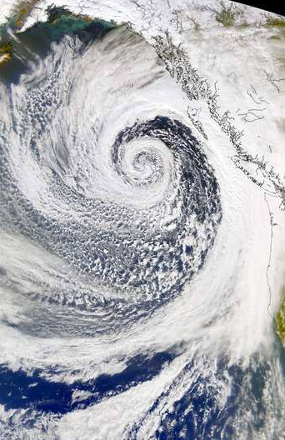
The Great Historical Windstorms of the U.S. West Coast
Cliff Mass
Atmospheric Sciences
University of Washington

Slide 2
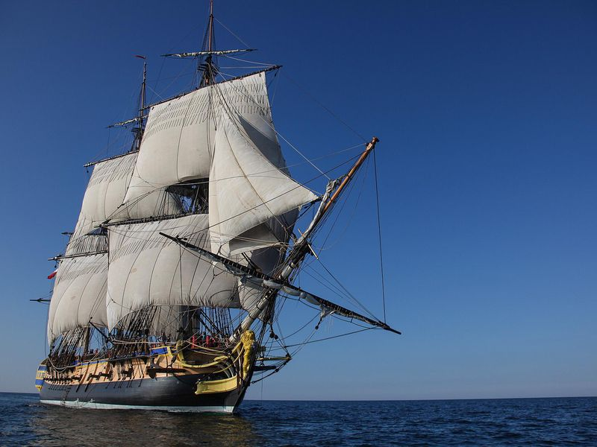
When the first European Explorers Arrived….They Rapidly Learned That Something Extreme Was Happening Here

Slide 3
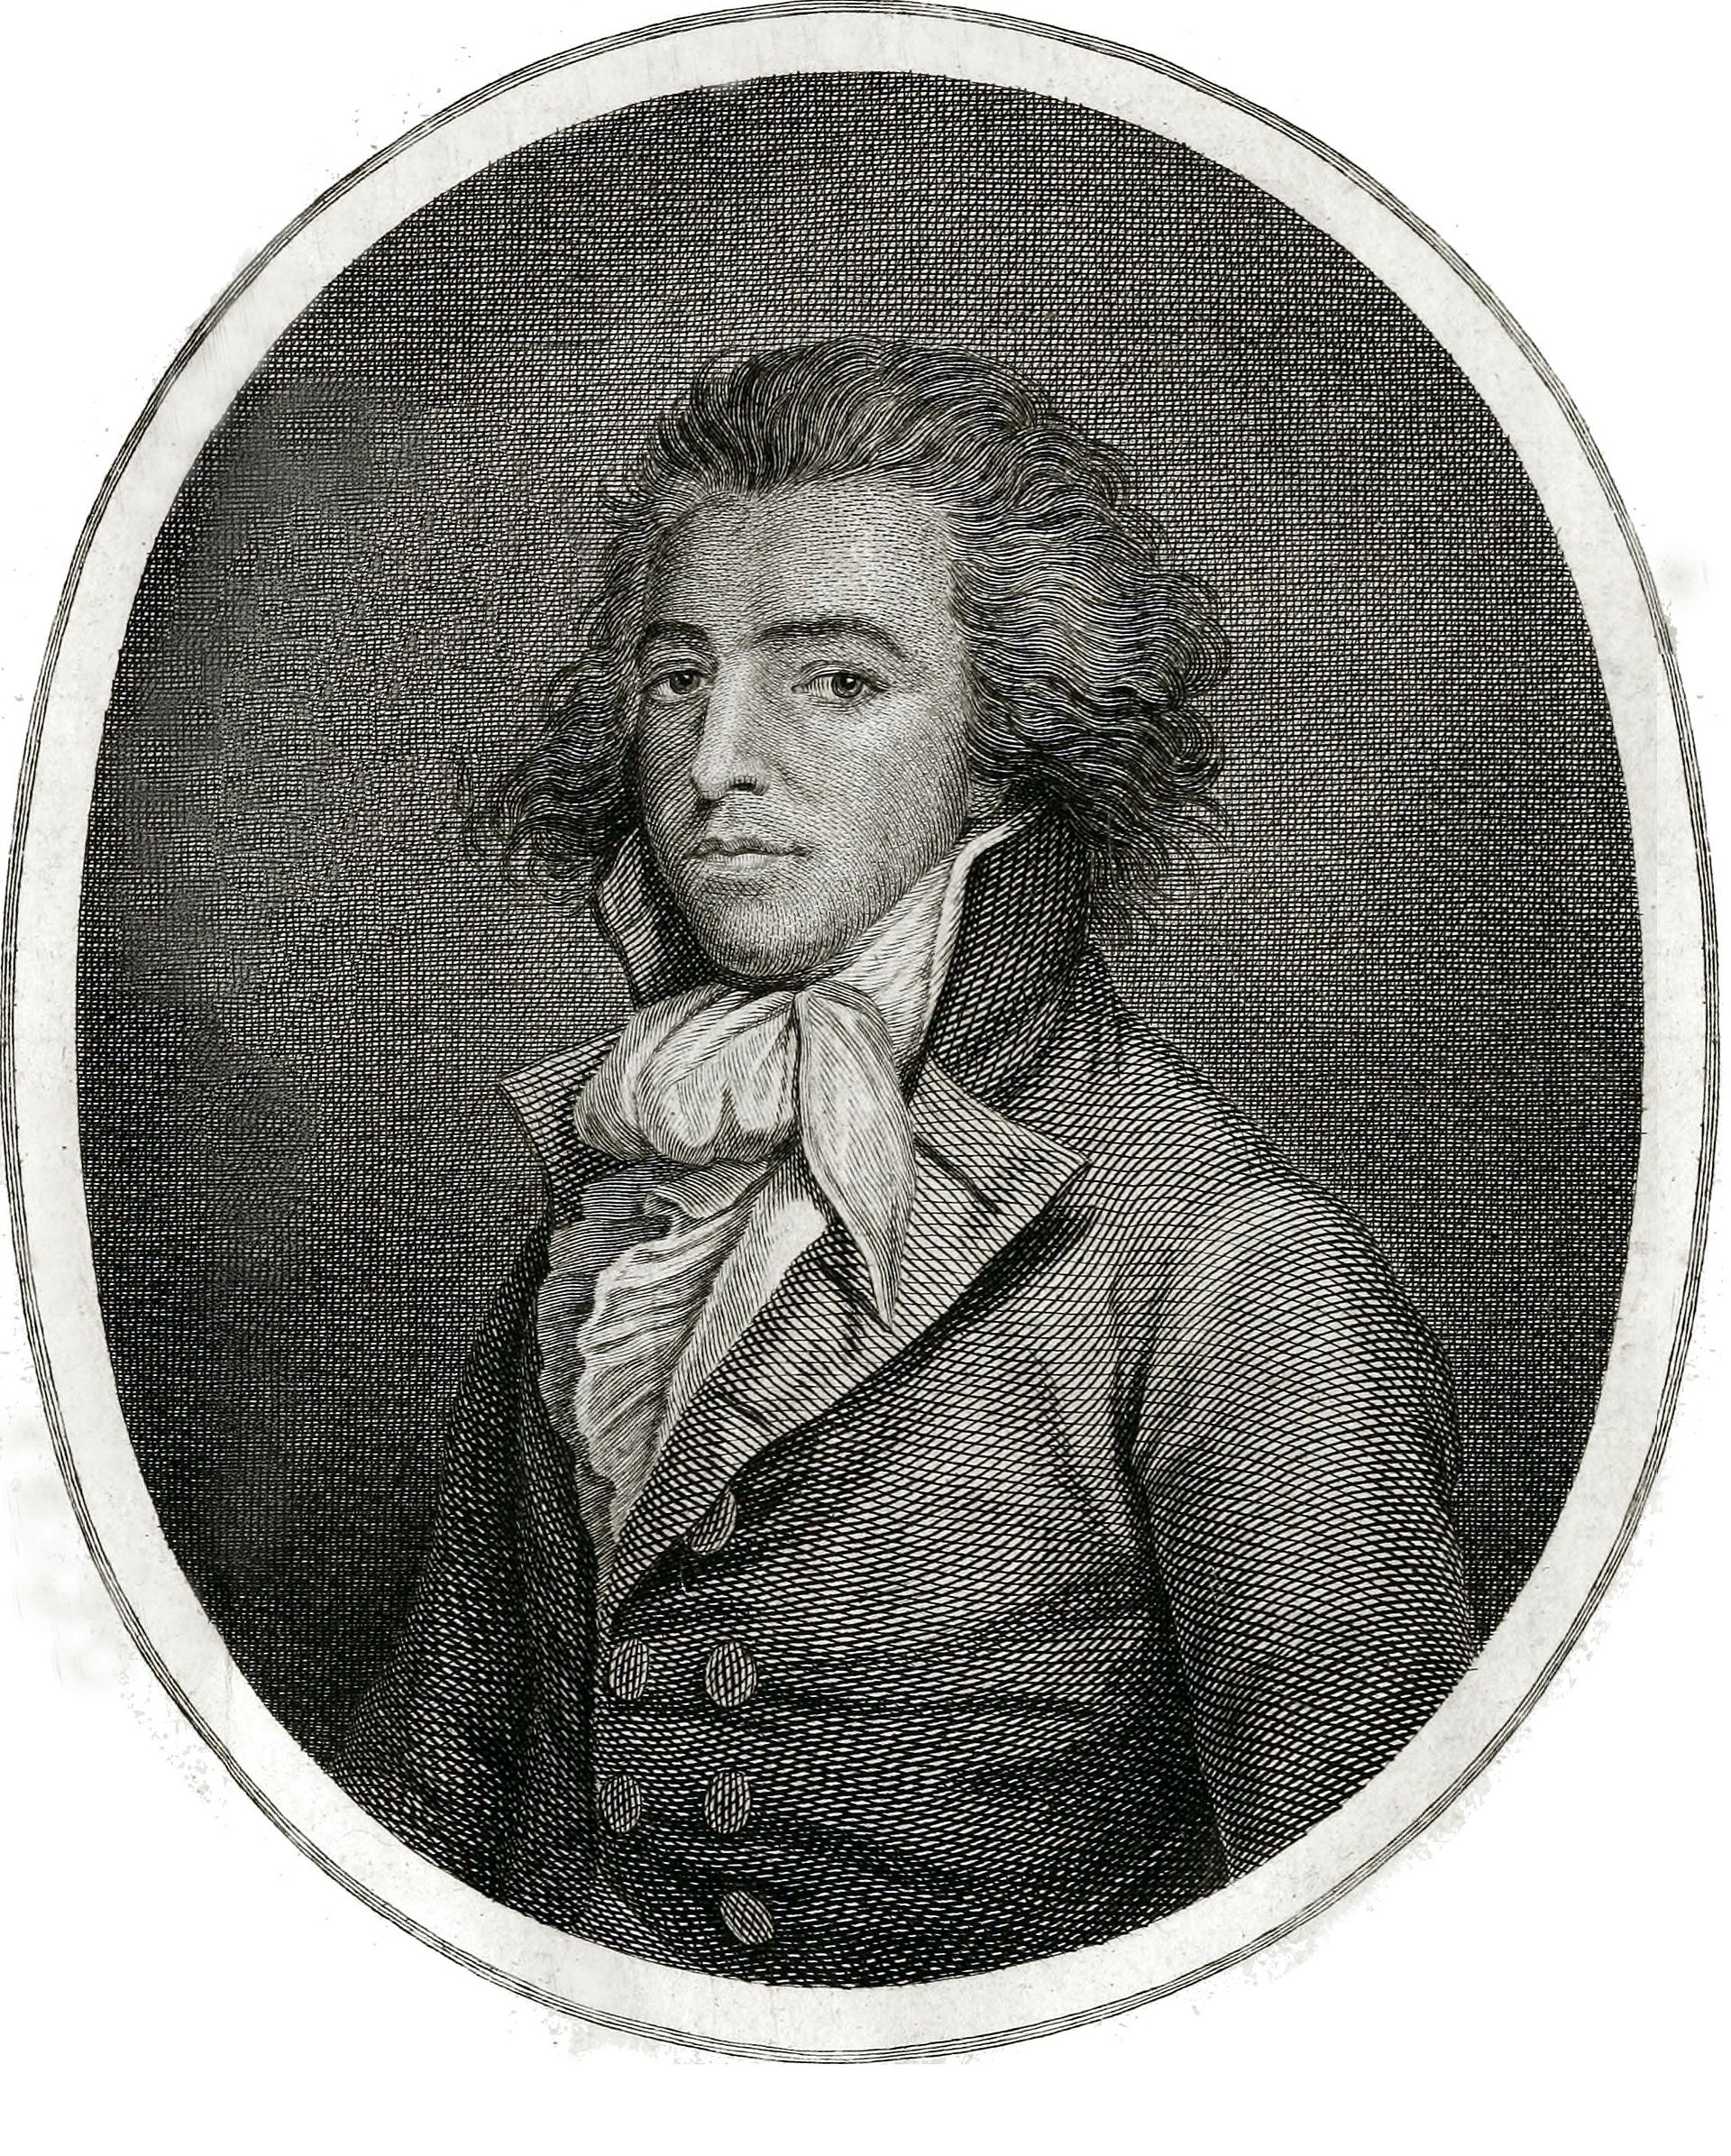
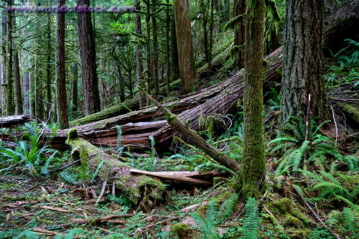
1788—John Meares
“The force of southerly storms was evident to every eye; large and extensive woods being laid flat by their power, the branches forming one long line to the North West, intermingled with the roots of innumerable trees, which have been torn from their beds and helped to mark the furious course of their tempests.”

Slide 4

The Thunderbird
Native Americans knew about West Coast windstorms, retreated from the coast during the winter, and had several legends regarding their origin.

Slide 5


Slide 6
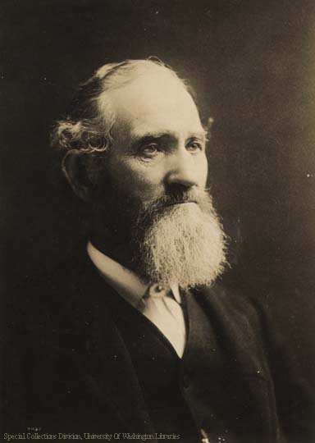
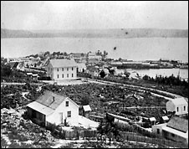
Early Settlers Rapidly Learned the Perils of the Great NW Cyclones
Arthur Denny
Seattle pioneer Arthur Denny noted that "the heaviest windstorm since the settlement of the country" occurred on 16 November 1875 and was "a strong gale, which threw down considerable timber and overturned light structures, such as sheds and outbuildings.”
Seattle

Slide 7
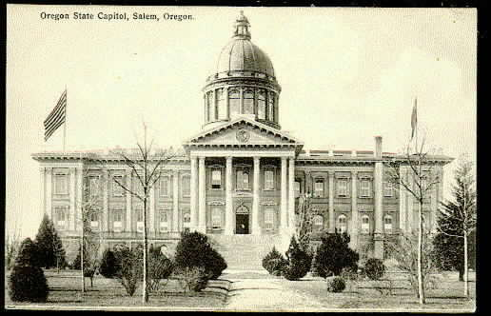
January 9, 1880
Wind gusts on the coast reached 138 mph, and 70-80 mph in the interior.
Virtually all fences in the Willamette Valley were downed, and every barn near the coastal town of Newport, Oregon was destroyed
Extraordinary deep low, with pressure falling to 955 mb (28.20 inches of mercury)
Part of the roof of the Oregon State Capital in Salem was blown off.

Slide 8
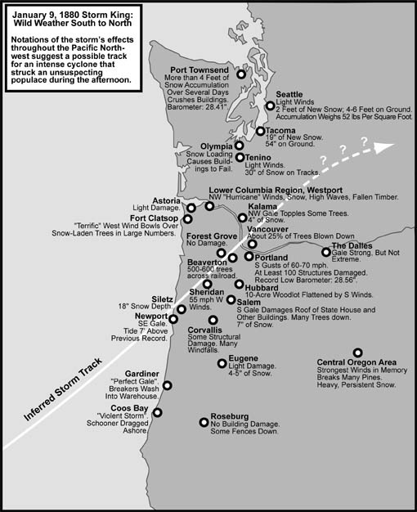
The 1880 Storm
Had Both
Wind and Snow
Courtesy of Wolf Read

Slide 9
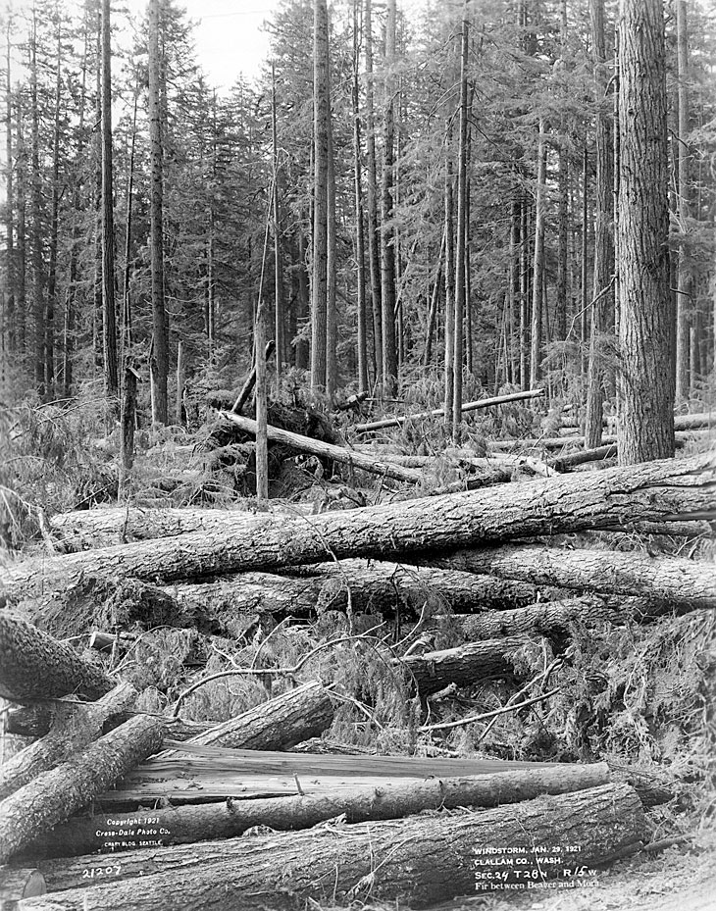
January 29, 1921
The Olympic
Blowdown
Storm

Slide 10
An Extraordinary Event
Hurricane-Force Winds Struck the Entire Washington Coast
  At North Head sustained (5 minute average) winds reached 126 mph, with a maximum one-minute wind of 150 mph before the sensor failed.
  At Tatoosh Island, 150 miles to the north, winds reached 110 mph.
  At Astoria, on the south side of the Columbia, there were unofficial reports of gusts to 130 mph.

Slide 11
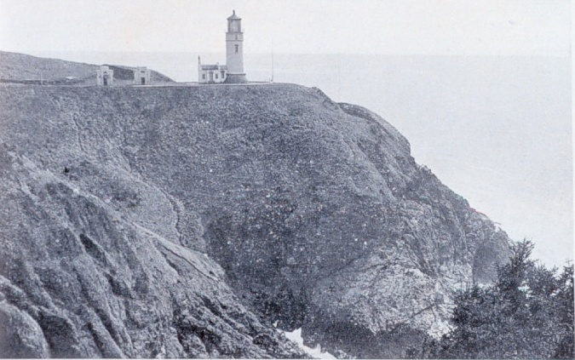
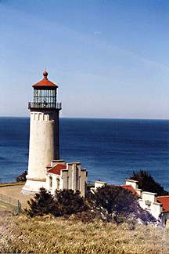
Circa 1912
North Head,WA Lighthouse
Also a co-located Navy wireless station

Slide 12
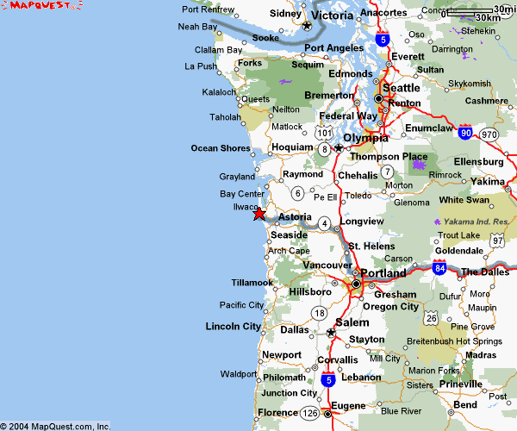
North Head
Light

Slide 13
1921 Windstorm Account: Mr. Mills, U.S. Weather Bureau North Head Observer
“On the return trip, a telephone pole across the roadway brought the car to a stop, and a short distance beyond the pole an immense spruce tree lay across the road. We left the machine and started to run down the road toward a space in the forest where the timber was lighter.
The southeast wind roared through the forest, the falling trees crashed to the ground in every direction from where we stood. Many were broken off where their diameter was as much as 4 feet. A giant spruce fell across the roadway burying itself within 10 feet of where we stood. Tree tops broke off and sailed through the air, some of the trees fell with a crash, others toppled over slowly as their roots were torn from the earth. In a few minutes there were but two trees standing that were dangerous to us and we watched every movement of their large trunks.
The wind shifted from the southeast to the south and the velocity decreased to probably 100 mph. We climbed over fallen trunks, crawled under others, and pushed our way through tangled masses of tops that lined the roadway. We supposed that all the houses at North Head had been leveled and the wireless station demolished for we knew that the storm was the most severe that had occurred in the vicinity of the mouth of the Columbia with the last 200 years."

Slide 14
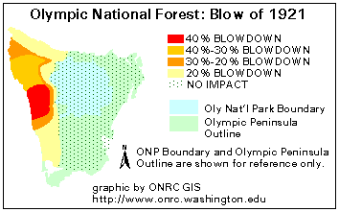
In some areas over 40% of the trees were blown down
As a result, this event has become known as the
“The Olympic Blowdown Storm”

Slide 15
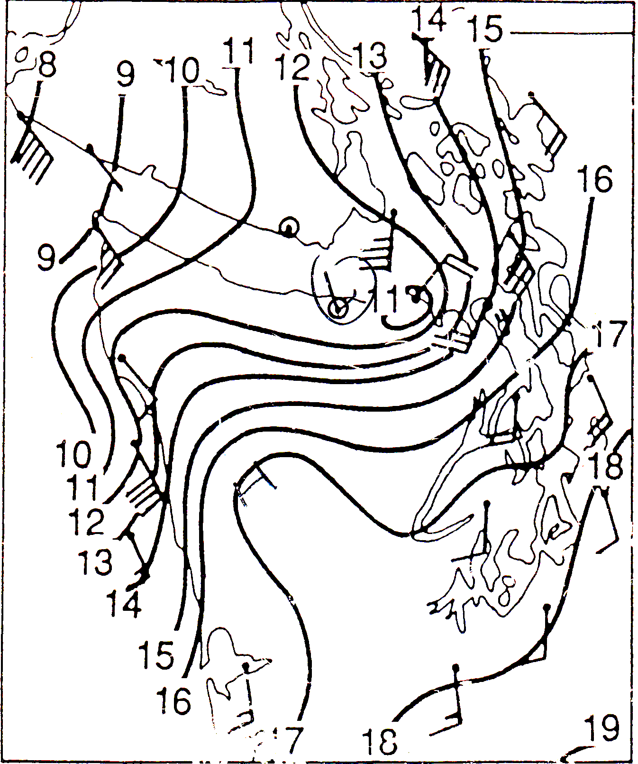
Why all the trees down north of
Ocean Shores?

Slide 16
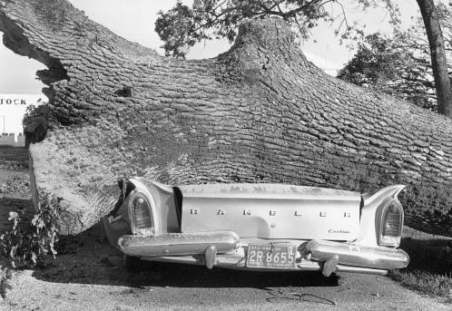
But these and other storms were overshadowed by the Columbus Day Storm: October 12, 1962
The strongest Pacific storm to strike the NW since the arrival of European settlers
Probably the most powerful non-tropical cyclone to hit the lower-48 states in a century. Maybe more.

Slide 17
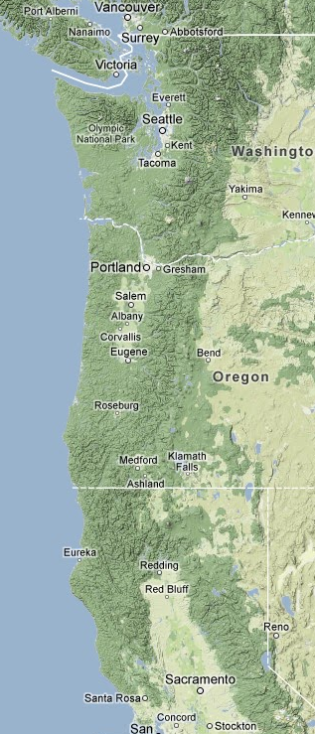
Extraordinary Impact
An extensive area, stretching from northern California to southern British Columbia experienced hurricane-force winds, massive treefalls, and power outages.
Sustained winds reaching 60-70 mph and gusts over 120 mph.
In Oregon and Washington, 46 died and 317 required hospitalization.
Flooding and landslides in northern California.
955 hPa low moved northward along the coast.

Slide 18
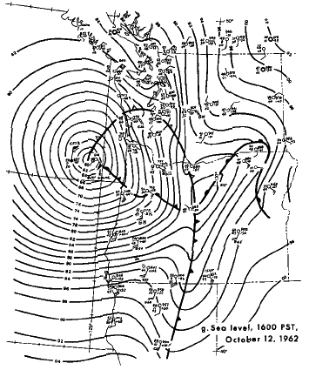
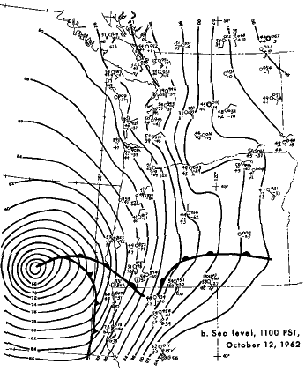
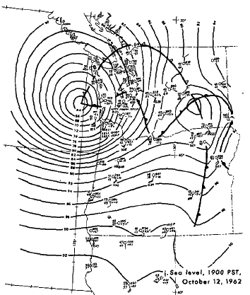
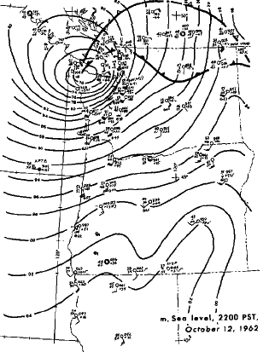

Slide 19
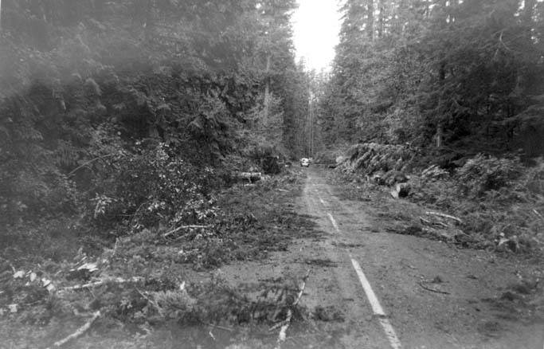
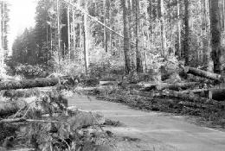
Impacts
Ten to 15 billion board feet of timber were downed, enough to build a million homes and far greater than the yearly output of the NW forest industry.
53,000 homes were damaged, thousands of utility poles were toppled, and the twin 520-ft steel towers that carried the main power lines of Portland were crumpled.

Slide 20
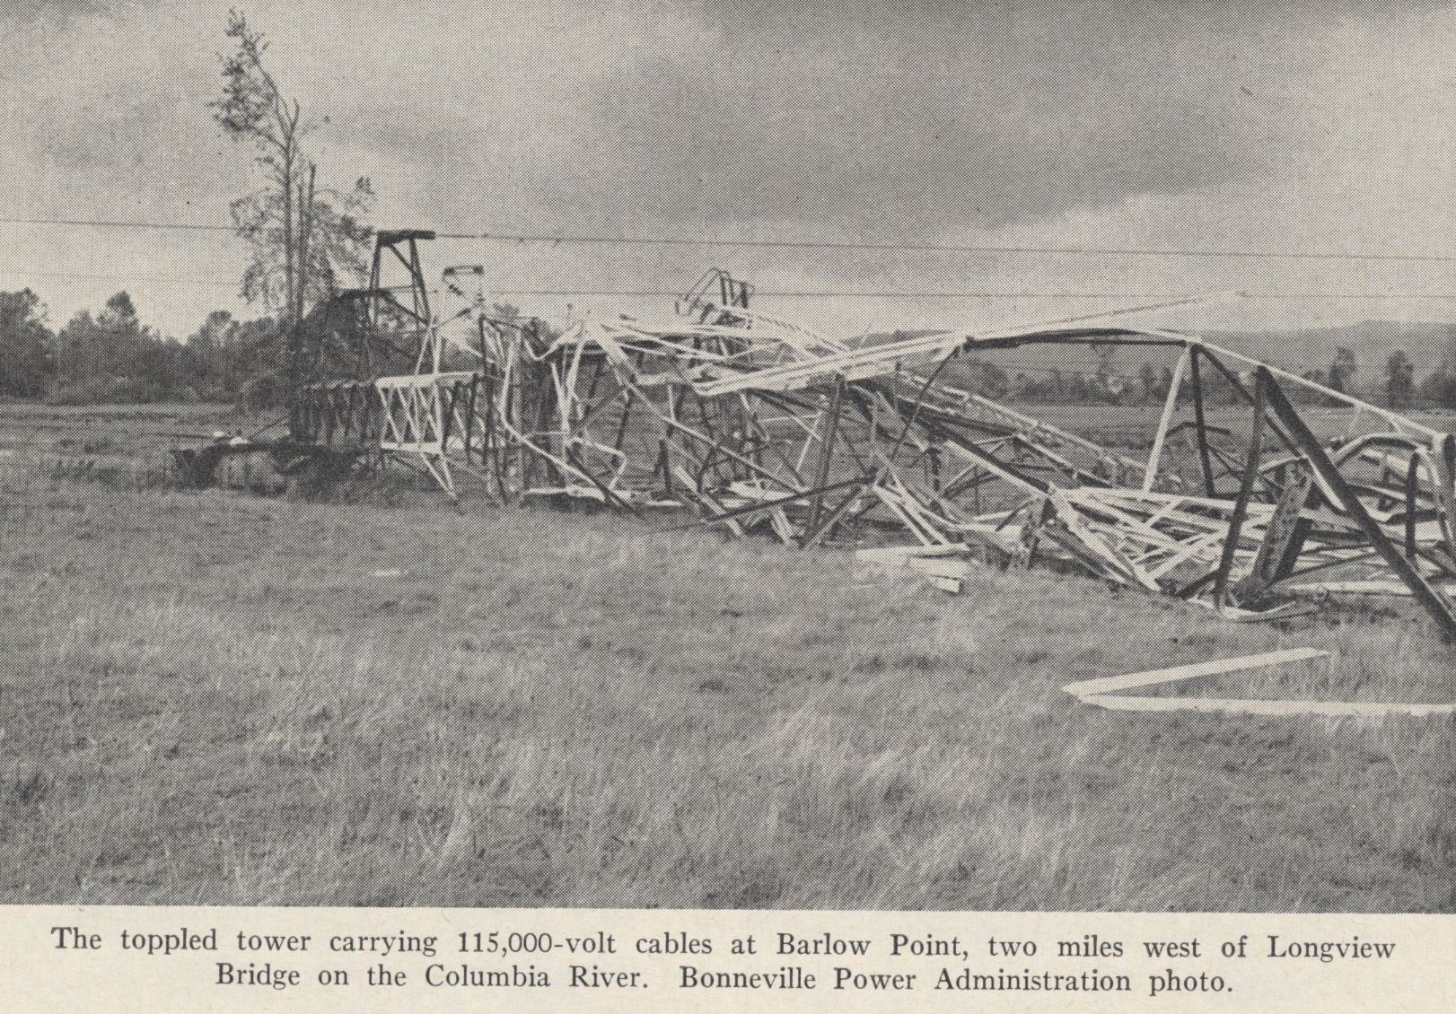

Slide 21
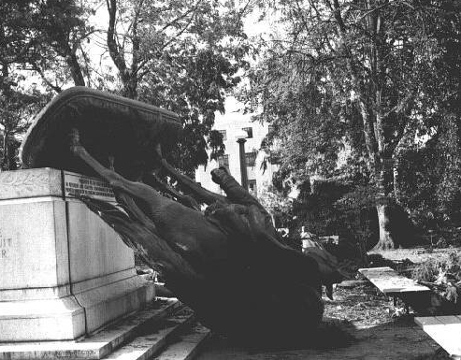
On the state capitol ground in Salem, Oregon, the bronze status, the Circuit Rider was toppled

Slide 22
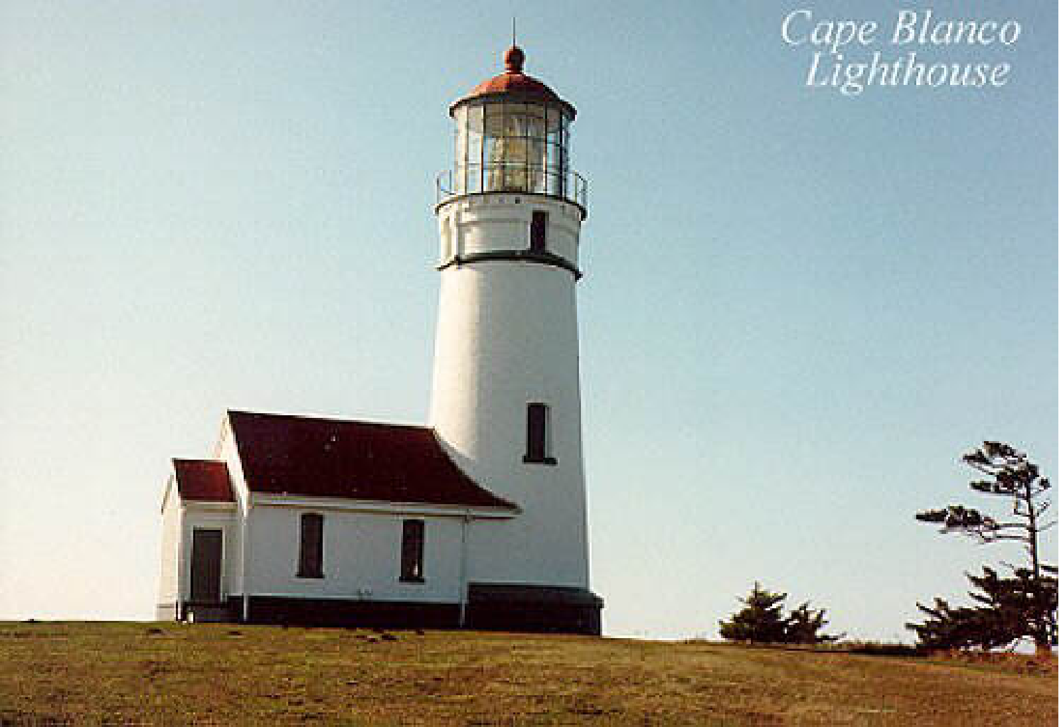
Columbus Day 1962: At Cape Blanco estimated winds were 150 mph with gusts to 179!

Slide 23
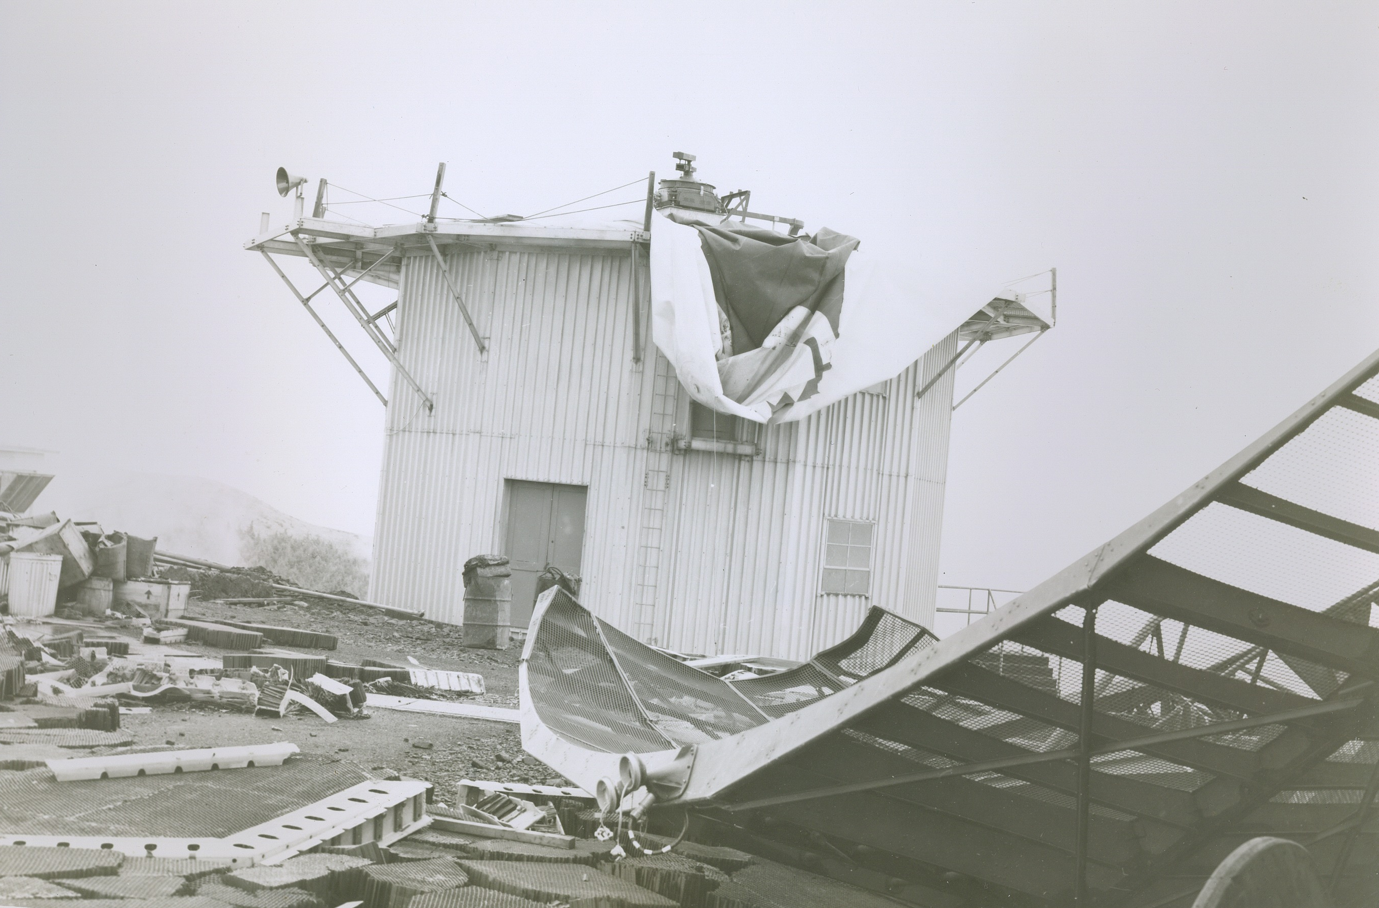
Mt. Hebo Radar Facility:
Gusts exceeding 130 mph
Courtesy: Mark Cole

Slide 24
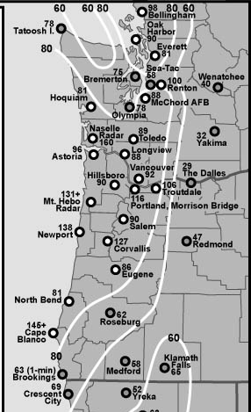
Max Winds (mph)
Columbus Day Storm 1962

Slide 25
How good were the Weather Bureau Predictions for the Columbus Day Storm?

Slide 26
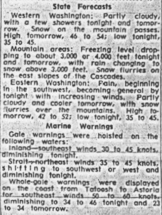
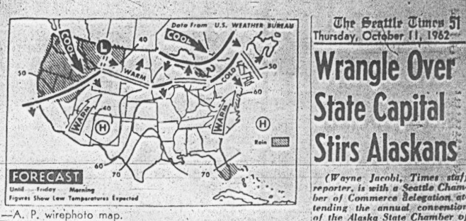
October 11th Forecast: No Storm on October 12th!
Seattle Times

Slide 27
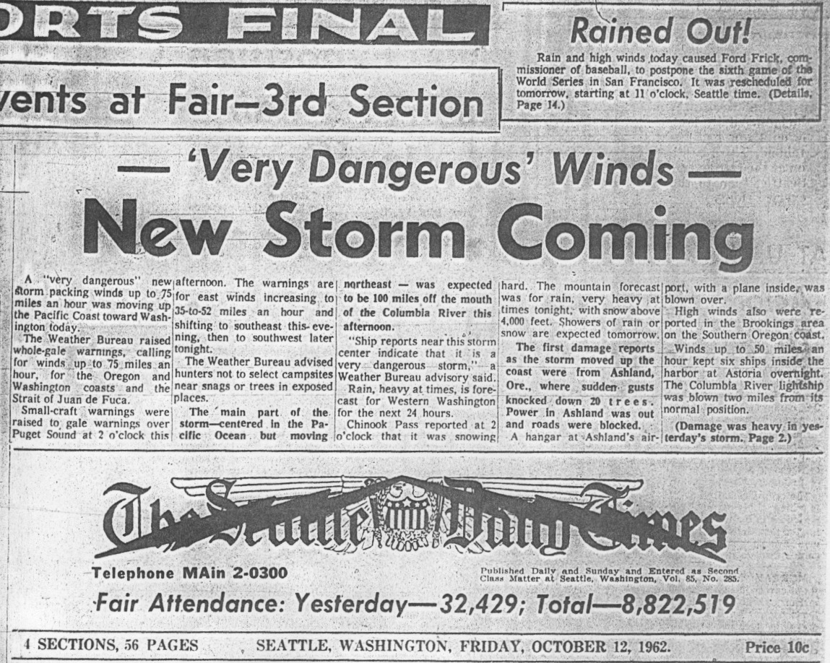
Forecasts were updated to predict a more dangerous storm—hours before it hit

Slide 28
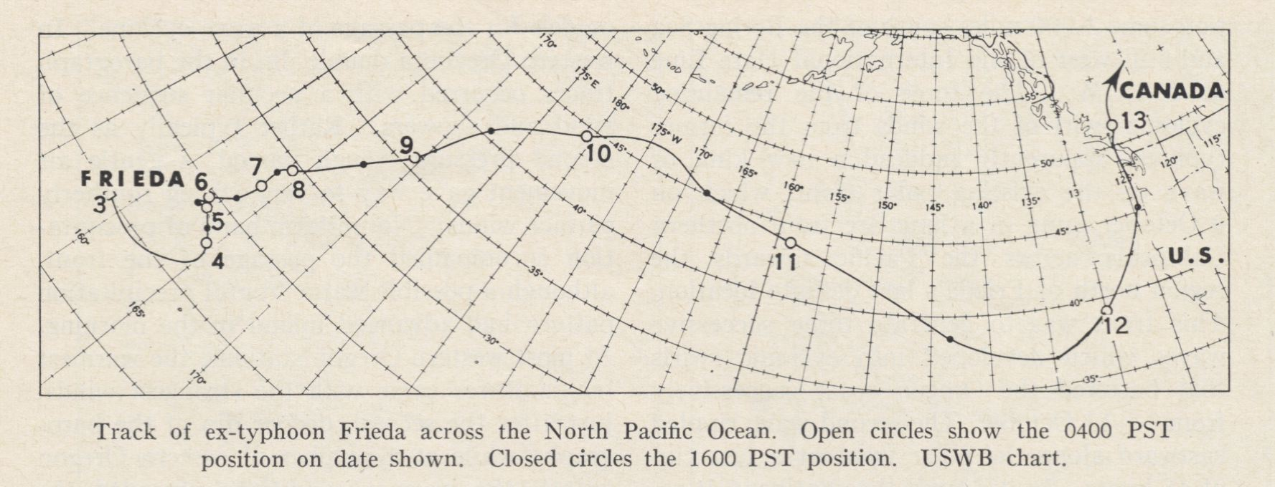
Began as Typhoon Frieda and then moved northward and transformed into a midlatitude cyclone.

Slide 29
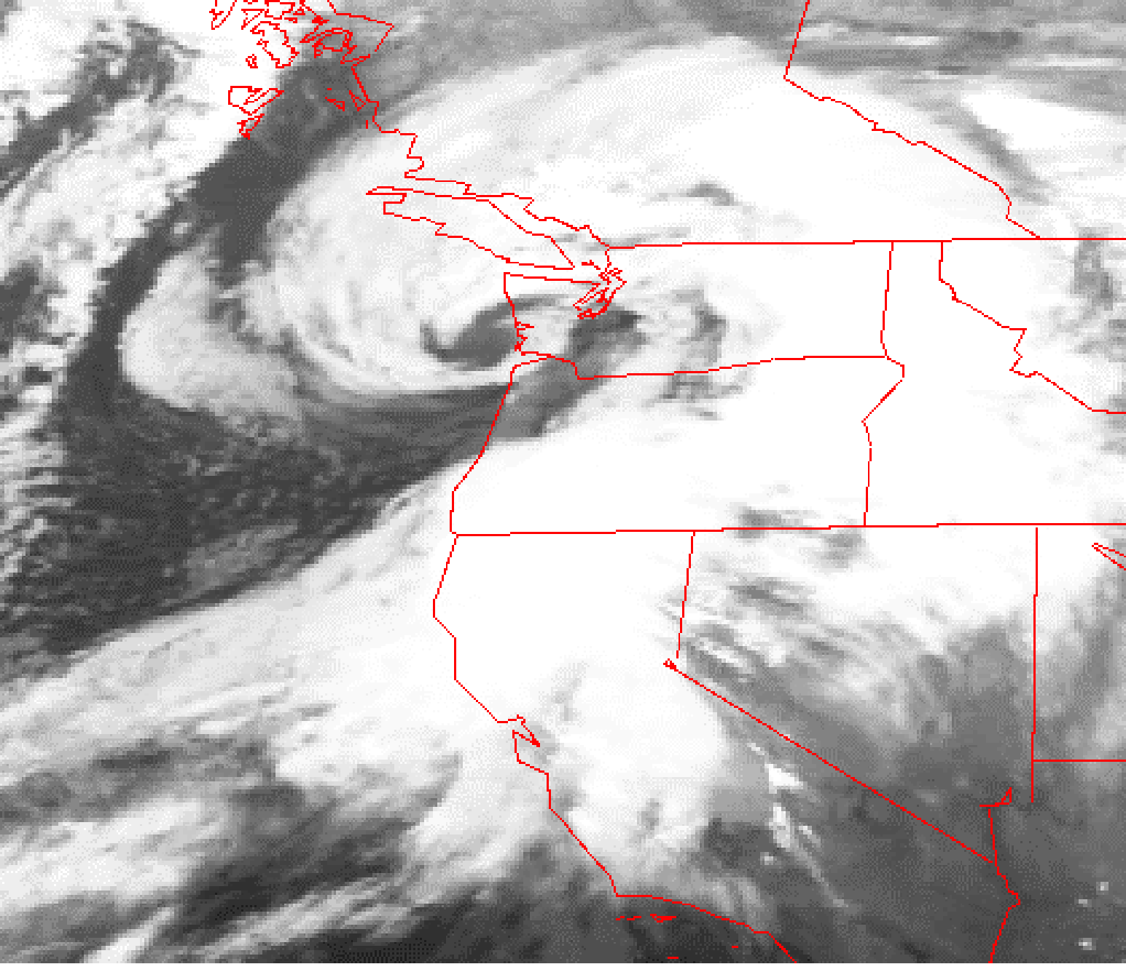
Inauguration
Day
Storm
January 20,
1993

Slide 30
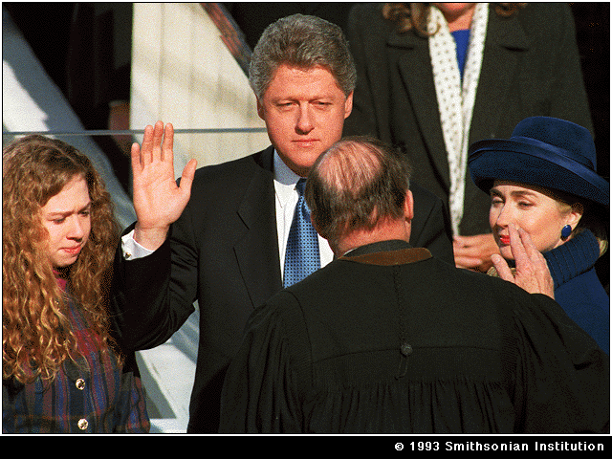
The first major windstorm to be highly skillfully forecast….
But the media and public were not paying attention!

Slide 31
Inauguration Day Storm
The third most damaging storm during the past 50 years (Columbus Day Storm being number one, 2006 Chanukah Eve number 2)
Winds of over 100 mph at exposed sites in the coastal mountains and the Cascades, over 80 mph along the coast and in the interior of western Washington.
In Washington State six people died, approximately 870,000 customers lost power, 79 homes and 4 apartment buildings were destroyed, 581 dwellings sustained major damage, and insured damage was estimated at 159 million.

Slide 32
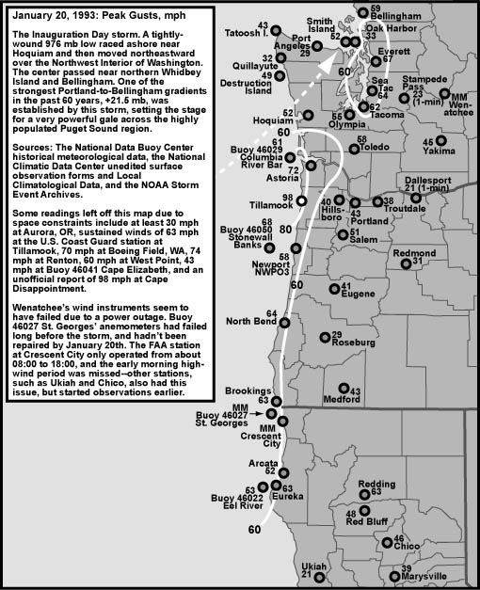

Slide 33
Chanukah Eve Storm
December 14-15, 2006

Slide 34
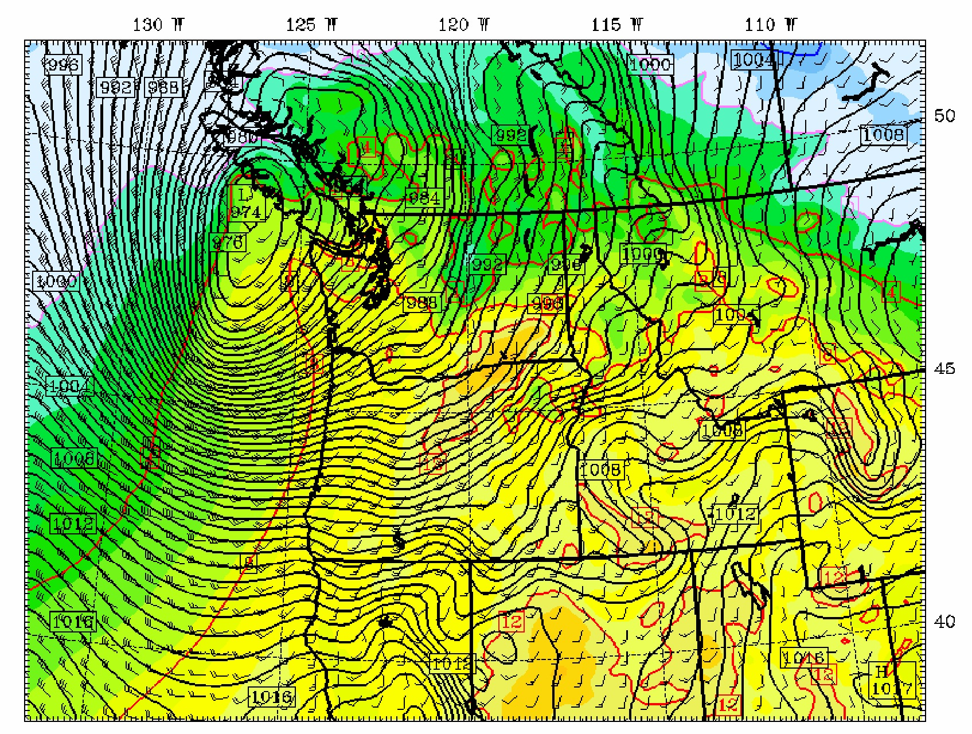
Model forecast of sea level pressure of the Dec. 2006 windstorm

Slide 35
Chanukah Eve Winds
Winds gusted to 90 mph along the coast, 80 mph in the eastern Strait of Juan de Fuca, and 70 mph over the Puget Sound lowlands.
In the Cascades, winds reached 100 mph at Sunrise on Mt. Rainier and 113 mph at Chinook Pass.
Nearly twice the households lost power during the 2006 event (than 1993) and more roads were blocked.

Slide 36
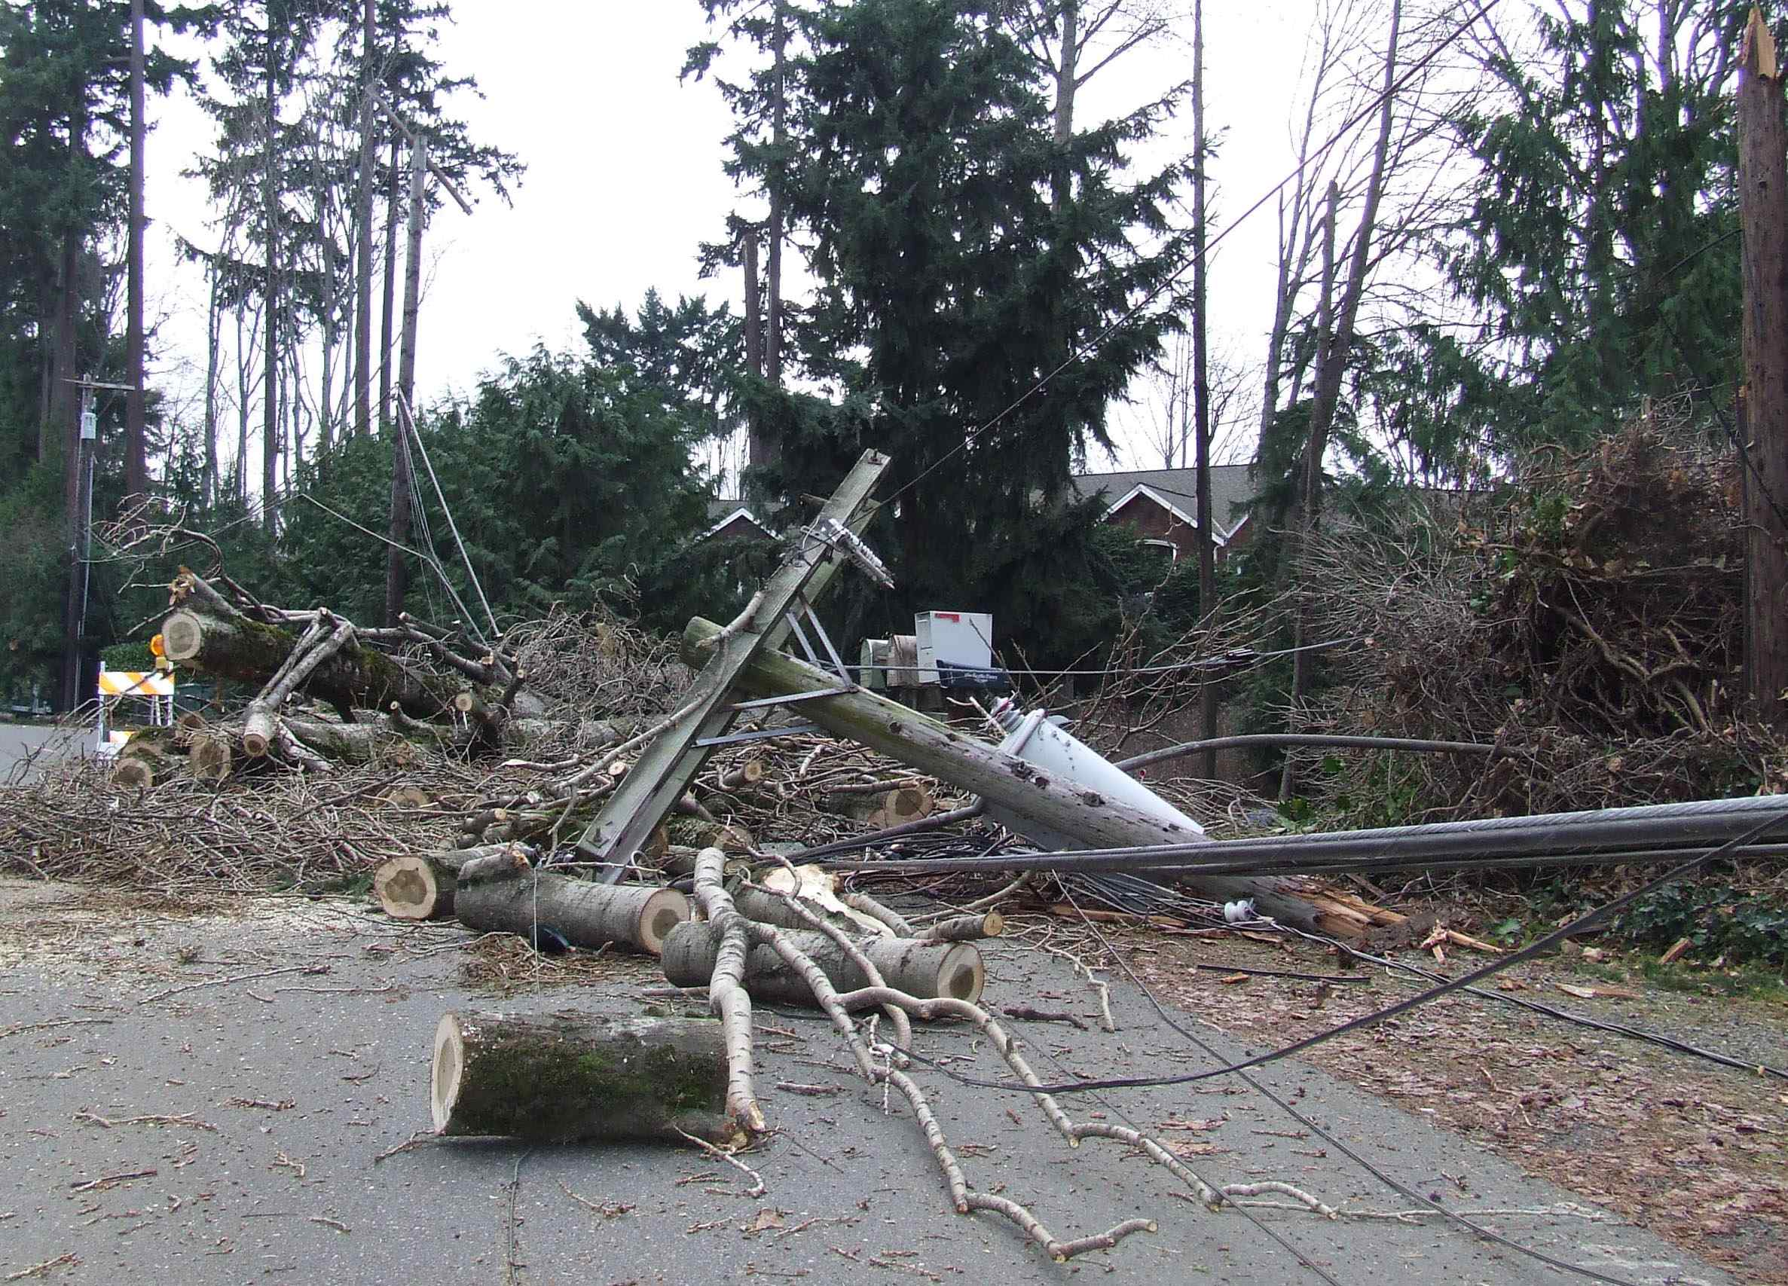
East Mercer Way

Slide 37
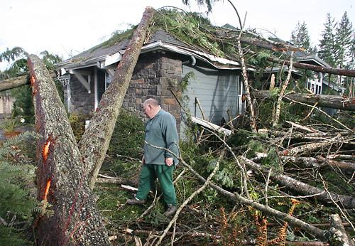
Redmond Ridge

Slide 38
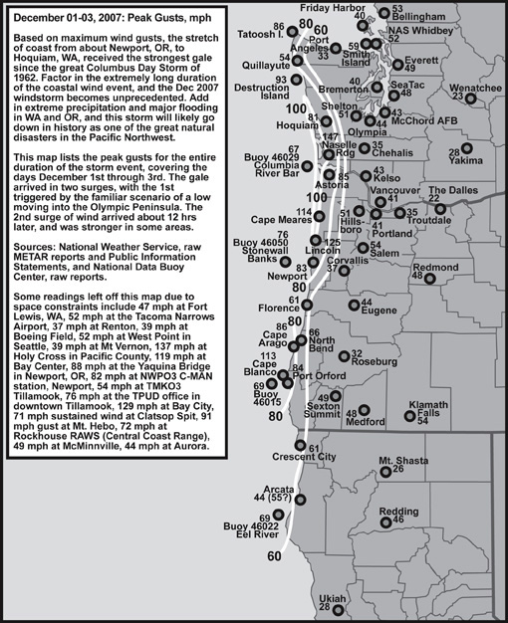
The Great Coastal Gale of December 2007

Slide 39
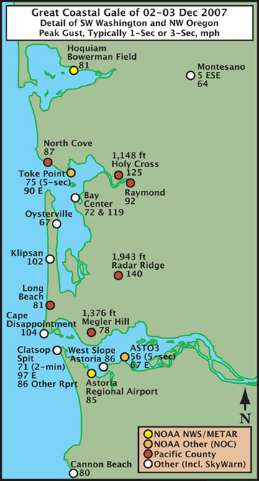

Slide 40
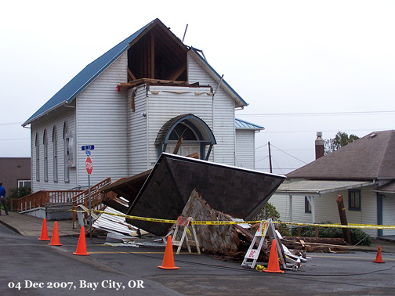

Slide 41
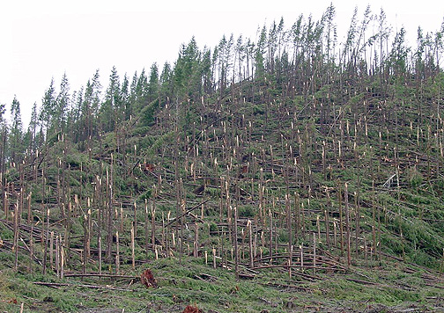

Slide 42
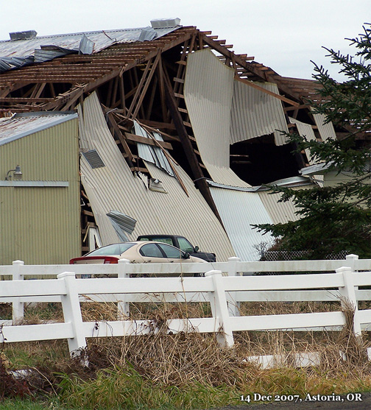

Slide 43
An Unusual Event
The strong winds of the December 2007 were limited to the coast
The winds were maintained for over a day at some locations. Extremely rare for this to happen.
The low pressure center stayed well offshore.

Slide 44
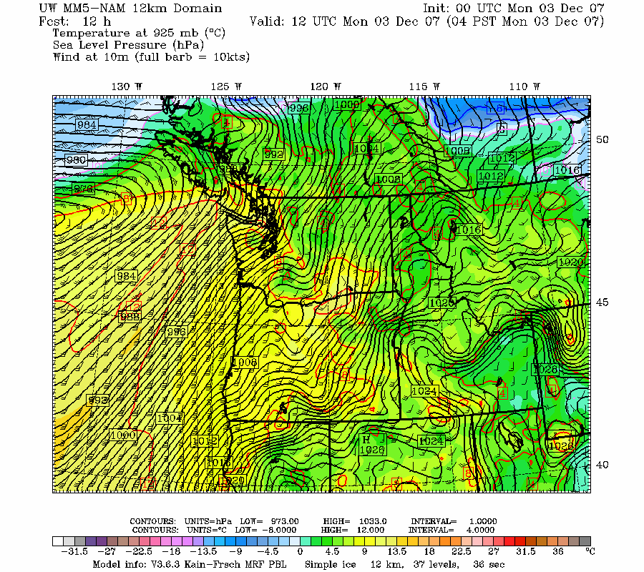

Slide 45
Windstorm 101

Slide 46
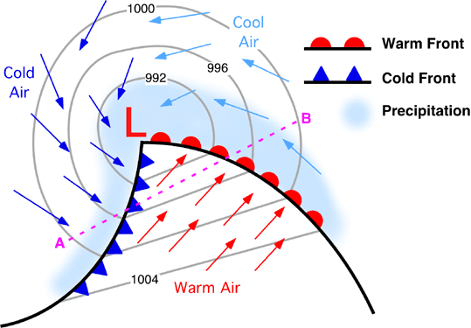
Most Northwest Windstorms are Produced by Midlatitude Cyclones
A cyclone is an area of low pressure around which air circulates in a counterclockwise direction (in the northern hemisphere)

Slide 47
Midlatitude Cyclones
The lower the central pressure the stronger the winds. Typical winter low 990-1000 mb.
mb --millibar is a unit of pressure. 1013 mb is equivalent to 29.92 inches--average sea level pressure
The energy source of these storms are the temperature changes between warm air from the south and cooler air from the north.
Dominate north of approximately 30N

Slide 48
Weather Satellites Show These Storms As Cloud Swirls

Slide 49
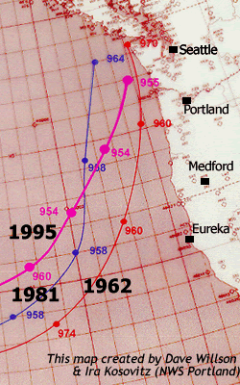
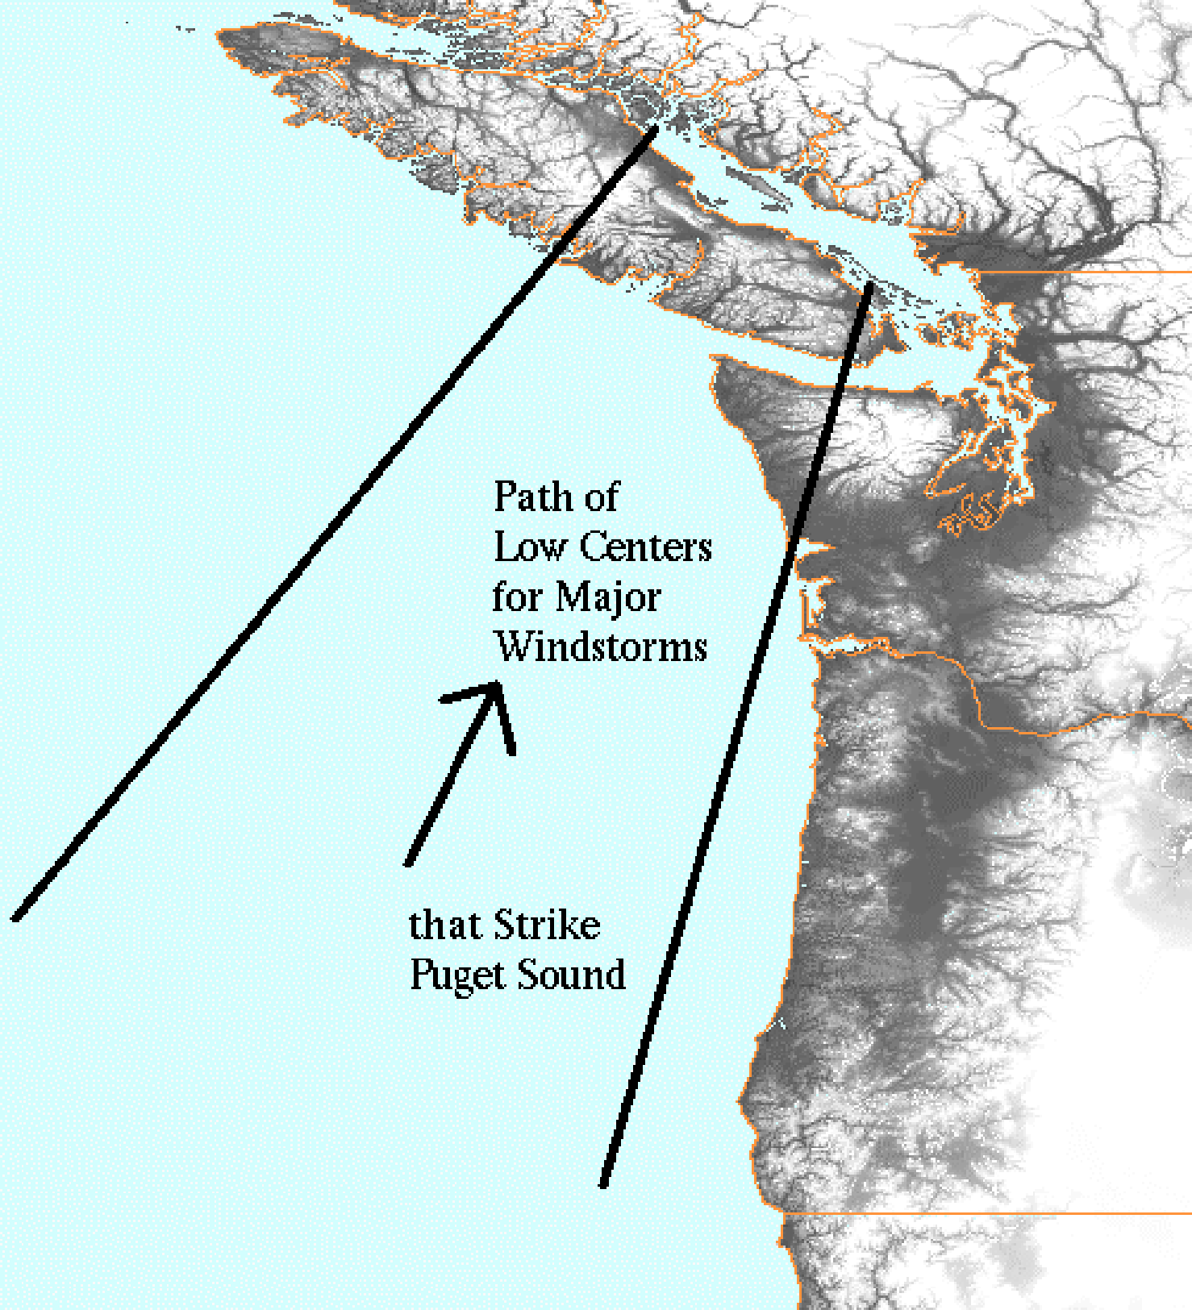
Most Major Northwest Windstorms Are Associated with Lows that Follow a SW to NE Track
Western WA Storms

Slide 50
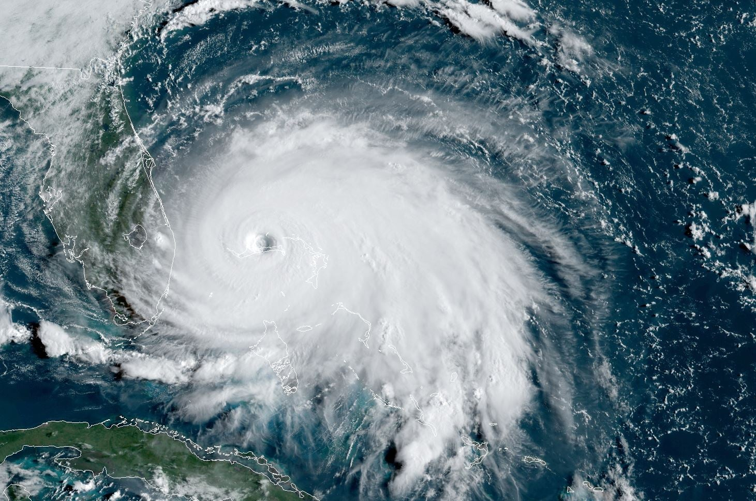
In Contrast: Tropical Cyclones and Hurricanes
Strong low pressure centers in the tropics.
No fronts or temperature contrasts
Associated with convection…thunderstorms
Their energy source is the heat and moisture of warm tropical oceans. Water temperatures greater than 80F.
Weaken rapidly over land or over cooler water.

Slide 51
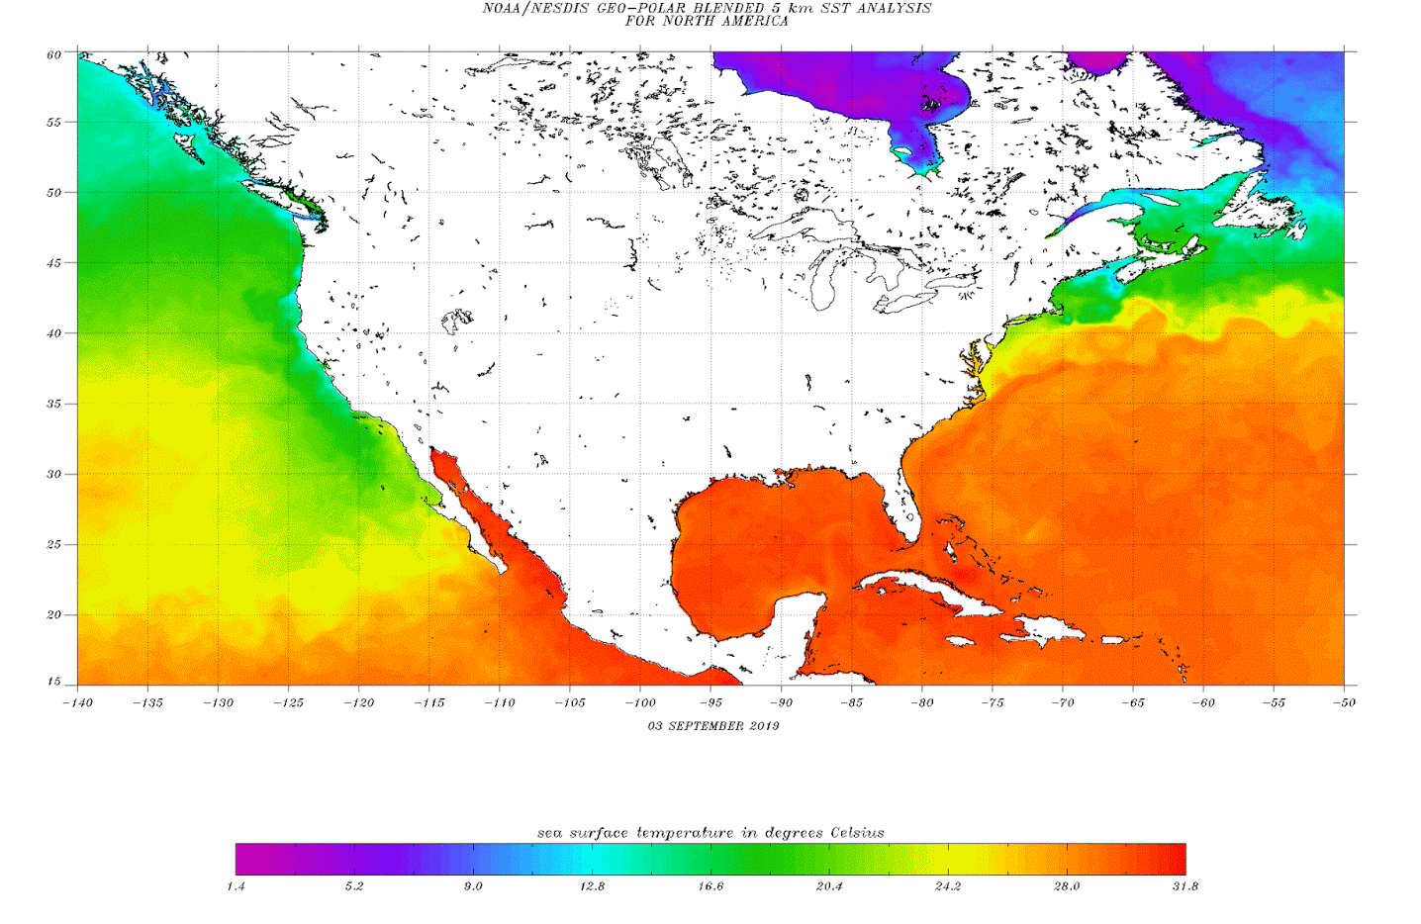
No Hurricanes for the NW
Why? Water too cold!

Slide 52
Some NW Windstorms Equivalent to Category 1-2 Hurricanes. A few cat 3.
The Saffir-Simpson Hurricane Scale
Note that 1-minute average winds are used below.
Category One:
  Winds 74-95 mph, above 980 mb
Category Two:
  Winds 96-110 mph, 965-980 mb
Category Three:
  Winds 111-130 mph , 945-965 mb
Category Four:
  Winds 131-155 mph, 920-945 mb
Category Five:
  Winds greater than 155 mph, below 920 mb
  Category Six:
  Only in the imagination of TV scriptwriters

Slide 53
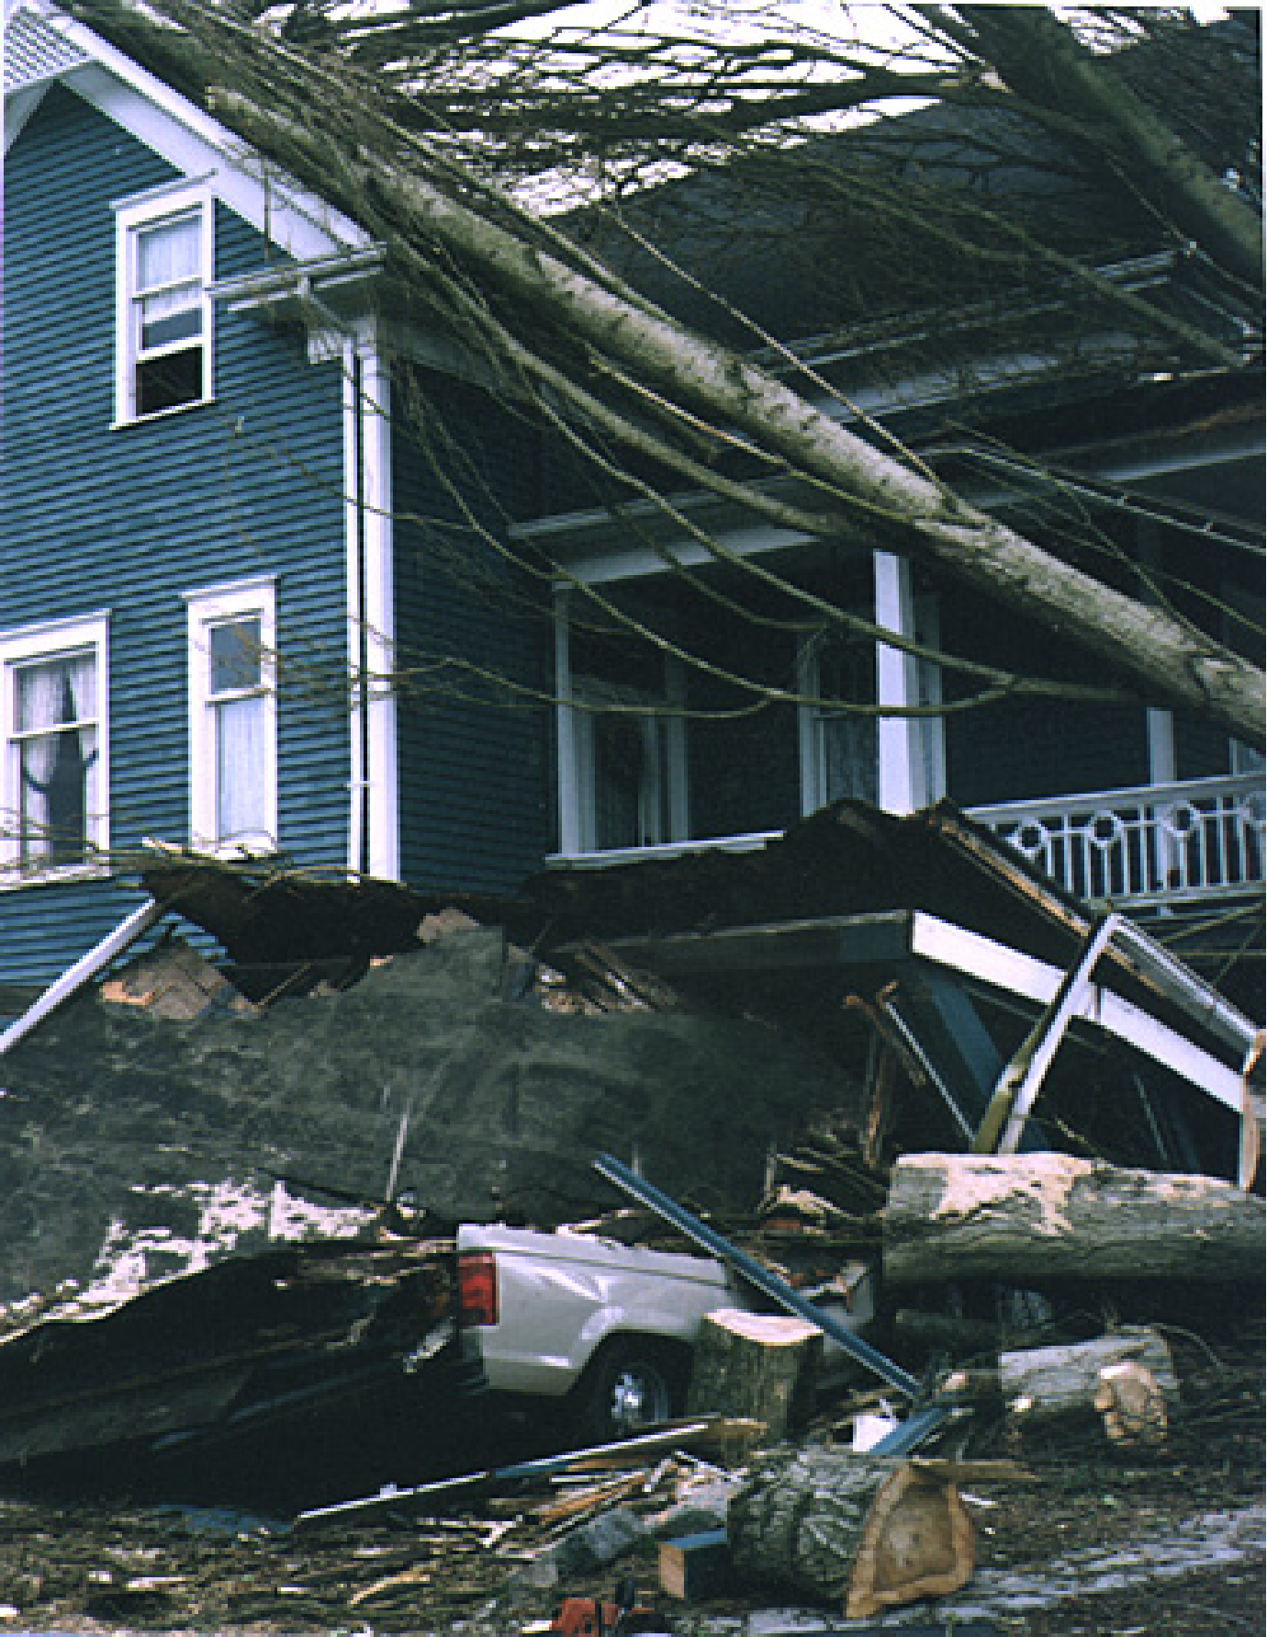
Force Multiplier
For NW
Windstorms:
Trees
Easter Sunday, April 97

Slide 54
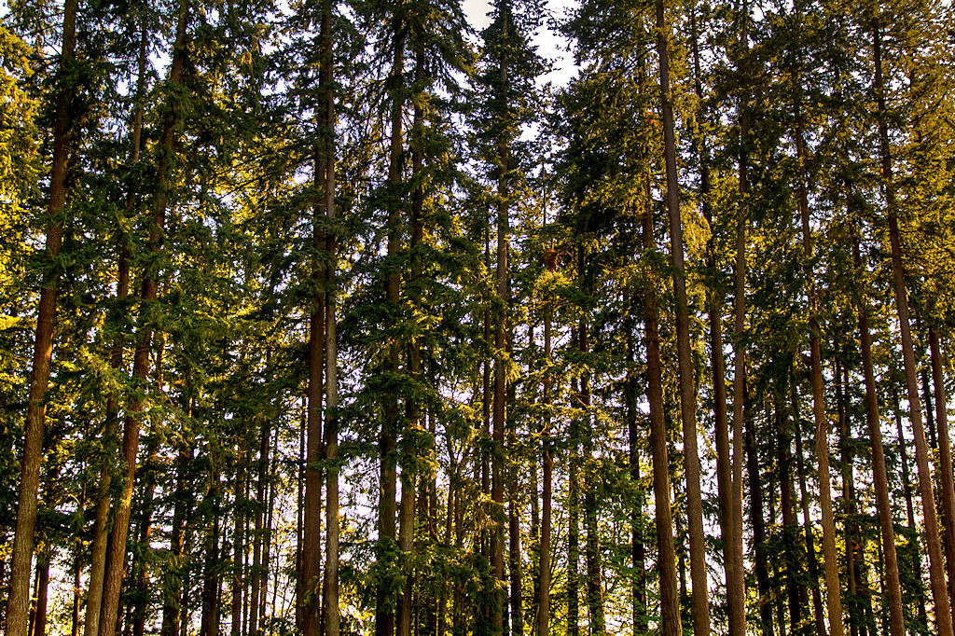
Big Trees: Windstorm Force Multiplier in the Northwest

Slide 55

Compared to this…

Slide 56


The Strongest Winds Are in the Back-Bent Trough

Slide 57

Storm Season: Nov-Feb

Slide 58
Interactions with our local mountains can amplify or weaken the effects of our great storms

Slide 59

Feb. 13, 1979: Winds over 100 kts destroyed the Hood Canal Bridge
Cost to replace: over 100 million dollars

Slide 60



Slide 61


Slide 62



Slide 63

February 13
1979: The Hood Canal
Storm

Slide 64


Slide 65

Massive Treefalls
Accompanied
The Storm-- particularly near the bridge

Slide 66

Forecasts of Pacific Storms Has Been Highly Skillful Since the Early 1990s
Little skill before 1990s
Get most right since the early 90s?
Why?
Weather Satellites

Slide 67

Cloud Track Winds

Slide 68


Better than Star Trek!

Slide 69

Satellite Sensors Provide Thousands of High Quality Vertical Soundings Daily over the Pacific

Slide 70

And Much More
Much better computer models
Much more computer resources
Higher-resolution models

Slide 71
How Will Global Warming Influence the Great NW Windstorms?
City Light Sponsored a study

Slide 72

Number of times above 90 percentile for 1970-2000 (DJF)
Just offshore of Washington Coast

Slide 73

Seattle

Slide 74
Little Change
Cyclone energy source is the jet stream and the strong horizontal temperature gradients associated with it.
Most global climate models suggest that the temperature gradients will weaken at low levels as the Arctic heats up more than the poles.
In contrast, temperature gradient increases in upper troposphere.
Adding both together…a wash

Slide 75
The End

