Slide 1
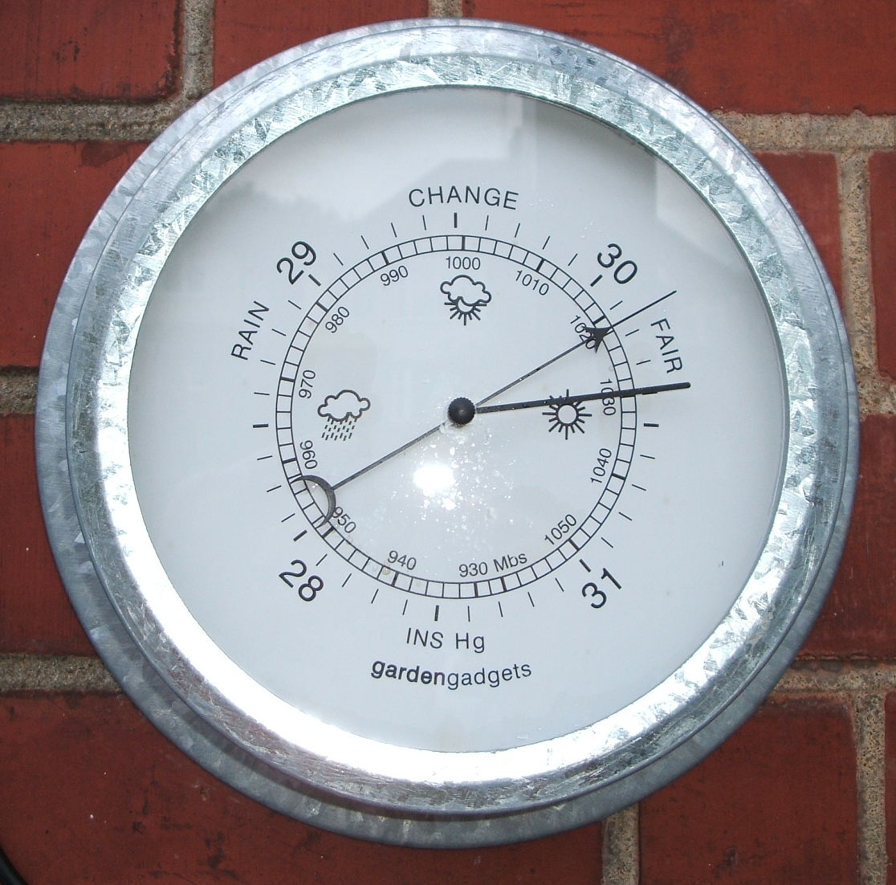
Forecasting Sea Level Pressure
ATMS 452
Spring 2025

Slide 2
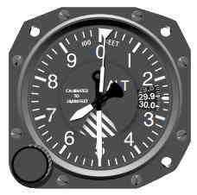
Remember: There Are Two Versions in General Use
Sea level pressure: takes station pressure to sea level using hypsometric equation. Uses temporally averaged surface temperature for reduction to SL.
Altimeter setting: also uses hypsometric equation but applies U.S. standard atmosphere for temperature structure.

Slide 3
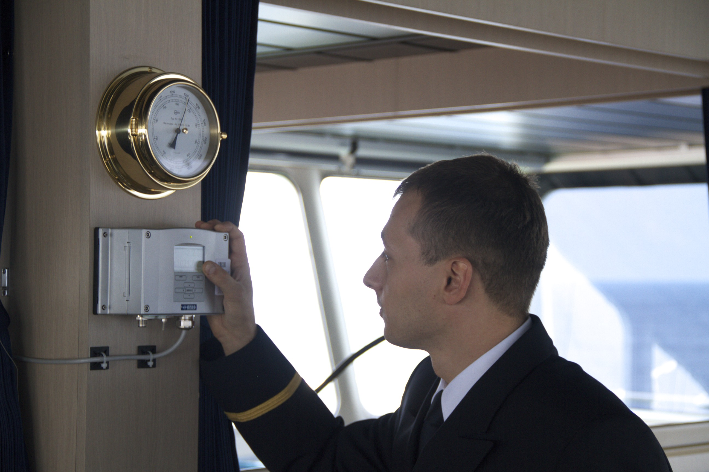
Surface Pressure Observations
ASOS is the most accurate…the gold standard
Ships generally the worst
Huge number of pressures from smartphones and other “crowdsourcing” sources are now becoming available

Slide 4
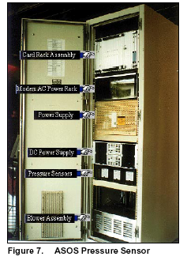
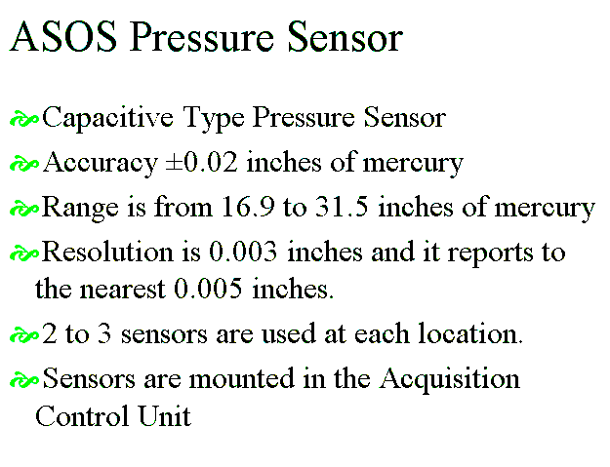

Slide 5
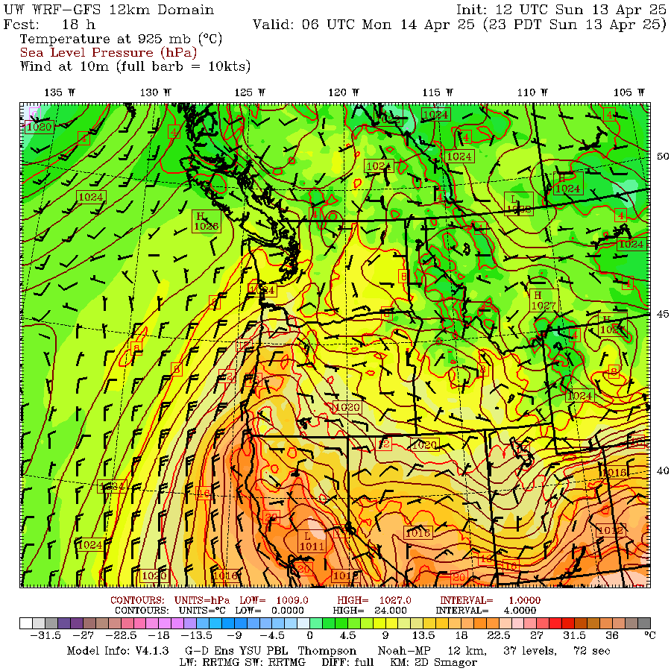
Can You Trust Model Sea Level Pressures?

Slide 6
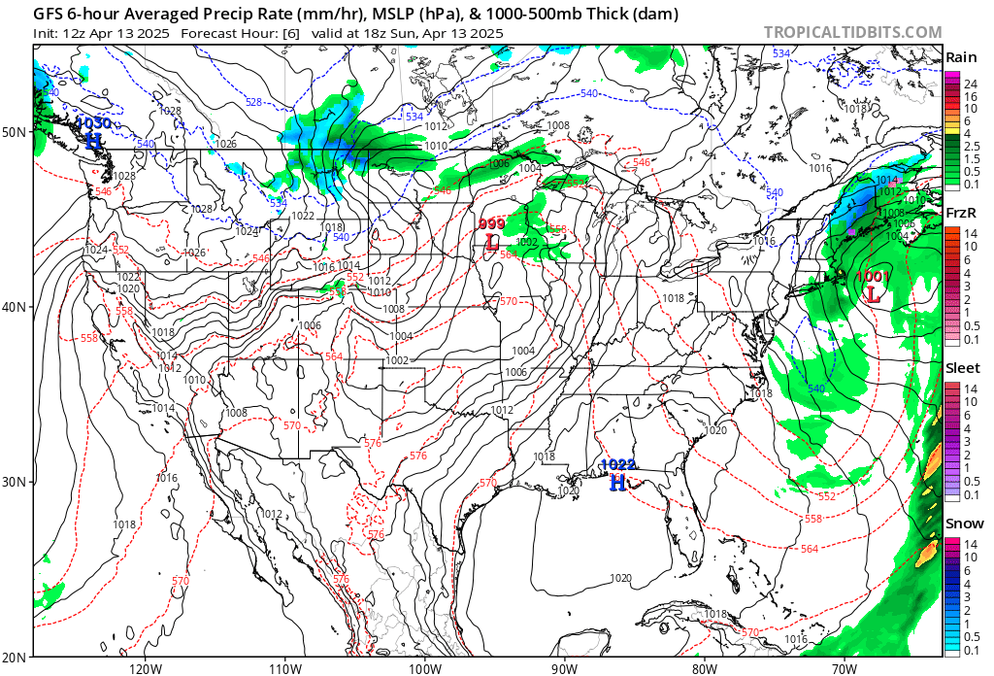

Slide 7
High-Resolution Models Can Greatly Improve Pressure Forecasts Near Terrain Compared to Coarse-Resolution Models

Slide 8
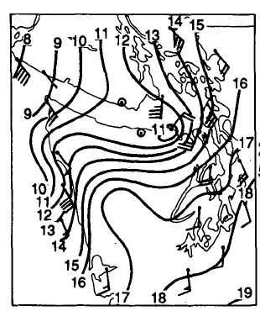
Example of Effect of Terrain: Pressure rridge on windward side, pressure trough on lee side

Slide 9
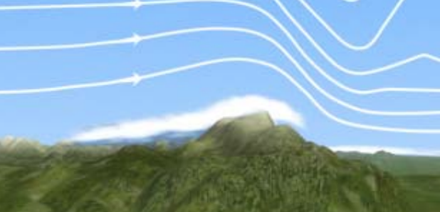
WHY?
adiabatic
warming
adiabatic
cooling
High
Low

Slide 10
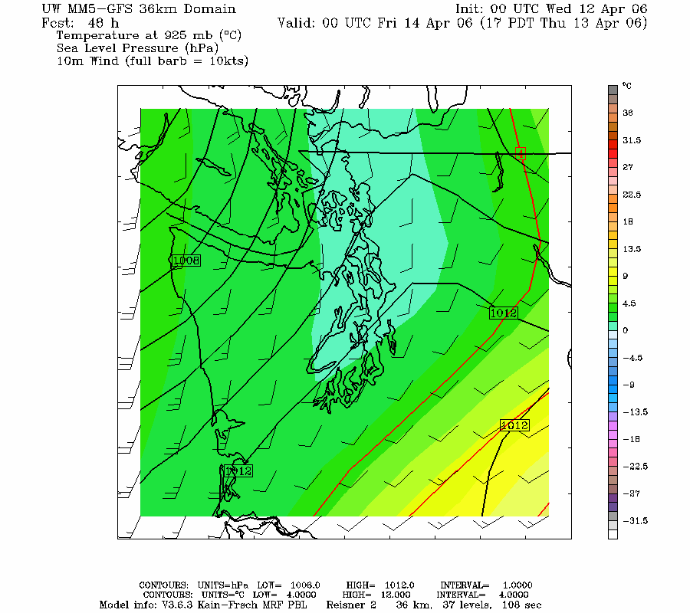
36 km

Slide 11
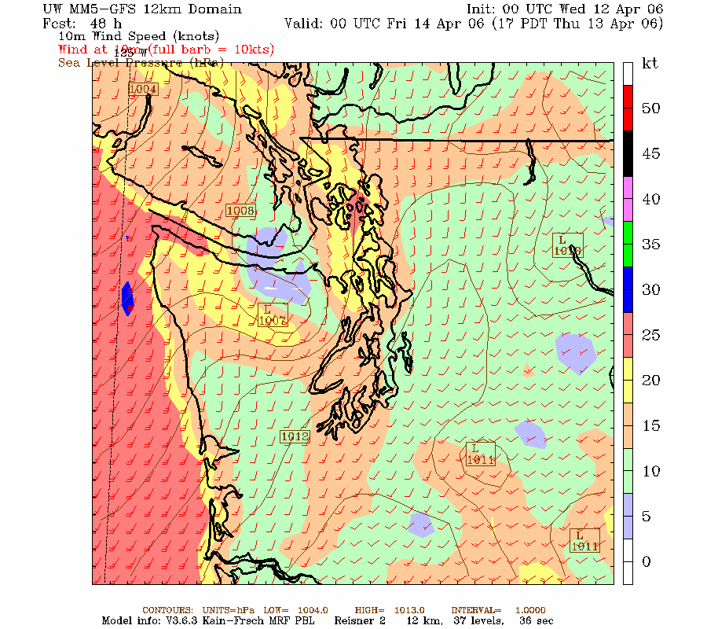
12 km

Slide 12
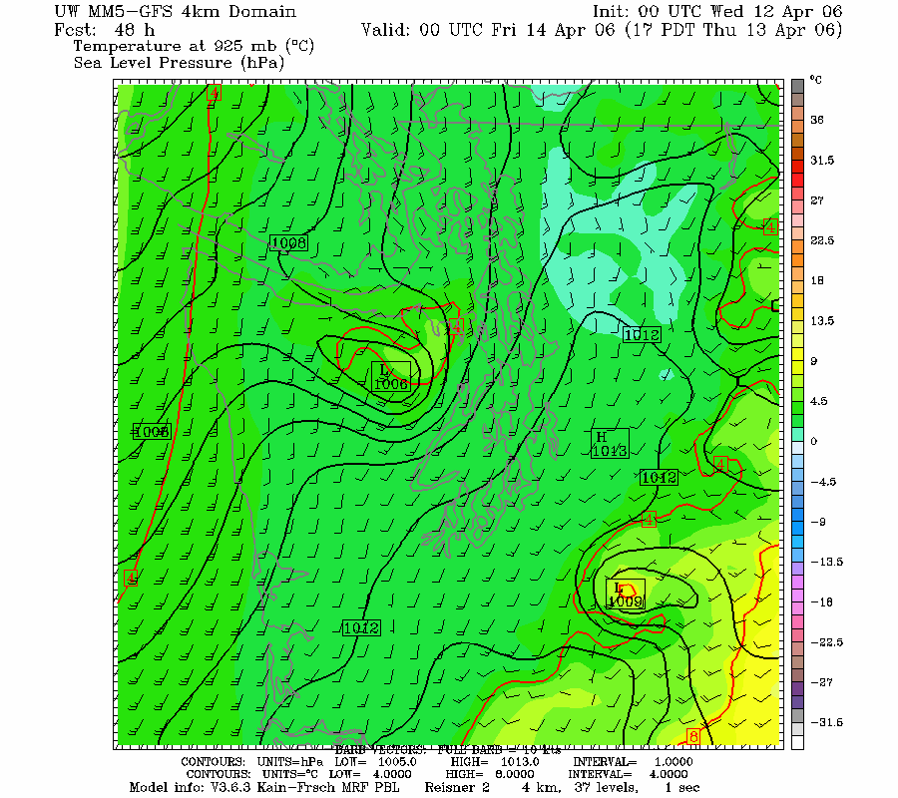
4km

Slide 13
Pressure “Reduction” to Sea Level
A Major Problem

Slide 14
Major Problems in Pressure Reduction to SL for BOTH Analyses and Forecasts
Model pressures at sea level and geopotential heights at lower levels below terrain (e.g., 925 hPa) are based on assuming a 6.5 K per km lapse rate through the ground
Can give deceiving or WACKY results when actual lapse rate differs

Slide 15
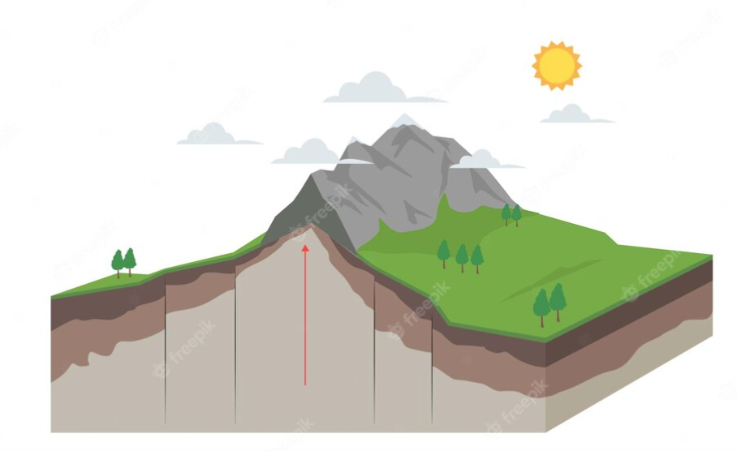
Surface Pressure
SL

Slide 16
Often the free atmosphere has a different lapse rate than assumed in terrain and that can lead to problems
Can result in fictious pressure features in model output
The fictious pressure features change during the day.

Slide 17
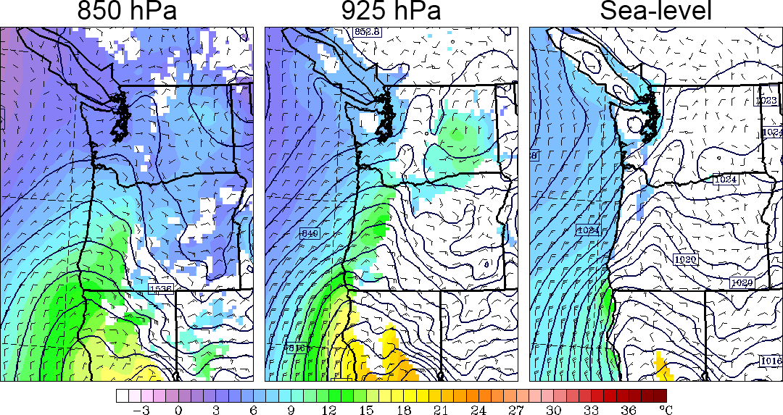
At Night During Warm Season: phony troughs under terrain during night
Fake

Slide 18
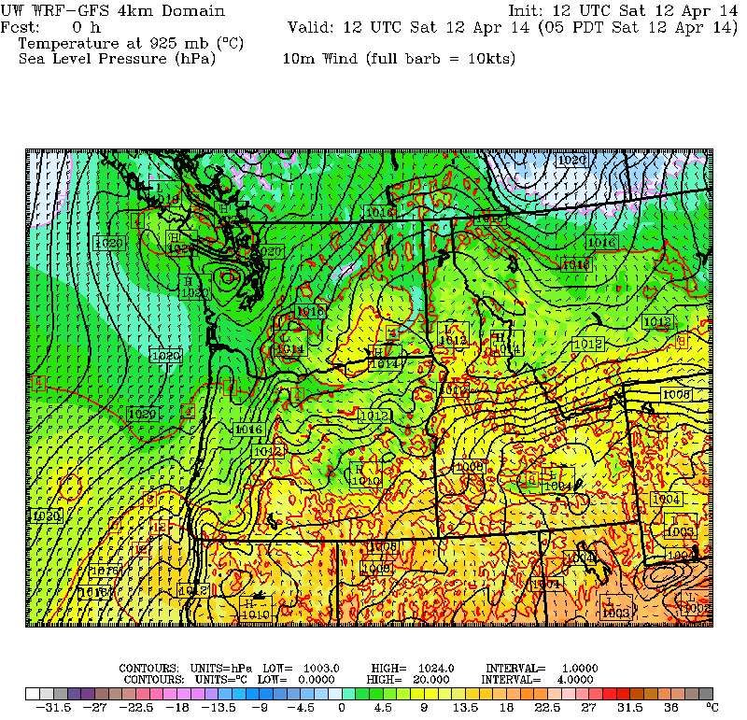

Slide 19
Why?
Models usually use the U.S. Standard Atmosphere for pressure reduction
During the night, as the lower atmosphere stabilizes (cools), the free (real) atmosphere can develop a smaller decrease of temperature with height than the U.S. Standard Atmosphere at low levels (smaller lapse rate than 6.5 C per km).
Warmer than reality under model terrain.
This produces an artificial horizontal SL pressure gradient, with unreasonable low pressure under terrain

Slide 20
Nighttime Situation
Same pressure at 1 km
0C
0 C
1km
Free
Atmosphere
cooler
US Standard
Atmosphere
warmer
4 C
6.5 C
Higher SLP
Warmer…Lower SLP
Thus, the model atmosphere under terrain is warmer than in the real world producing unrealistic low pressure.
Away from terrain there are no reduction issues.

Slide 21
Thus you get phony trough at night under terrain
Fake

Slide 22
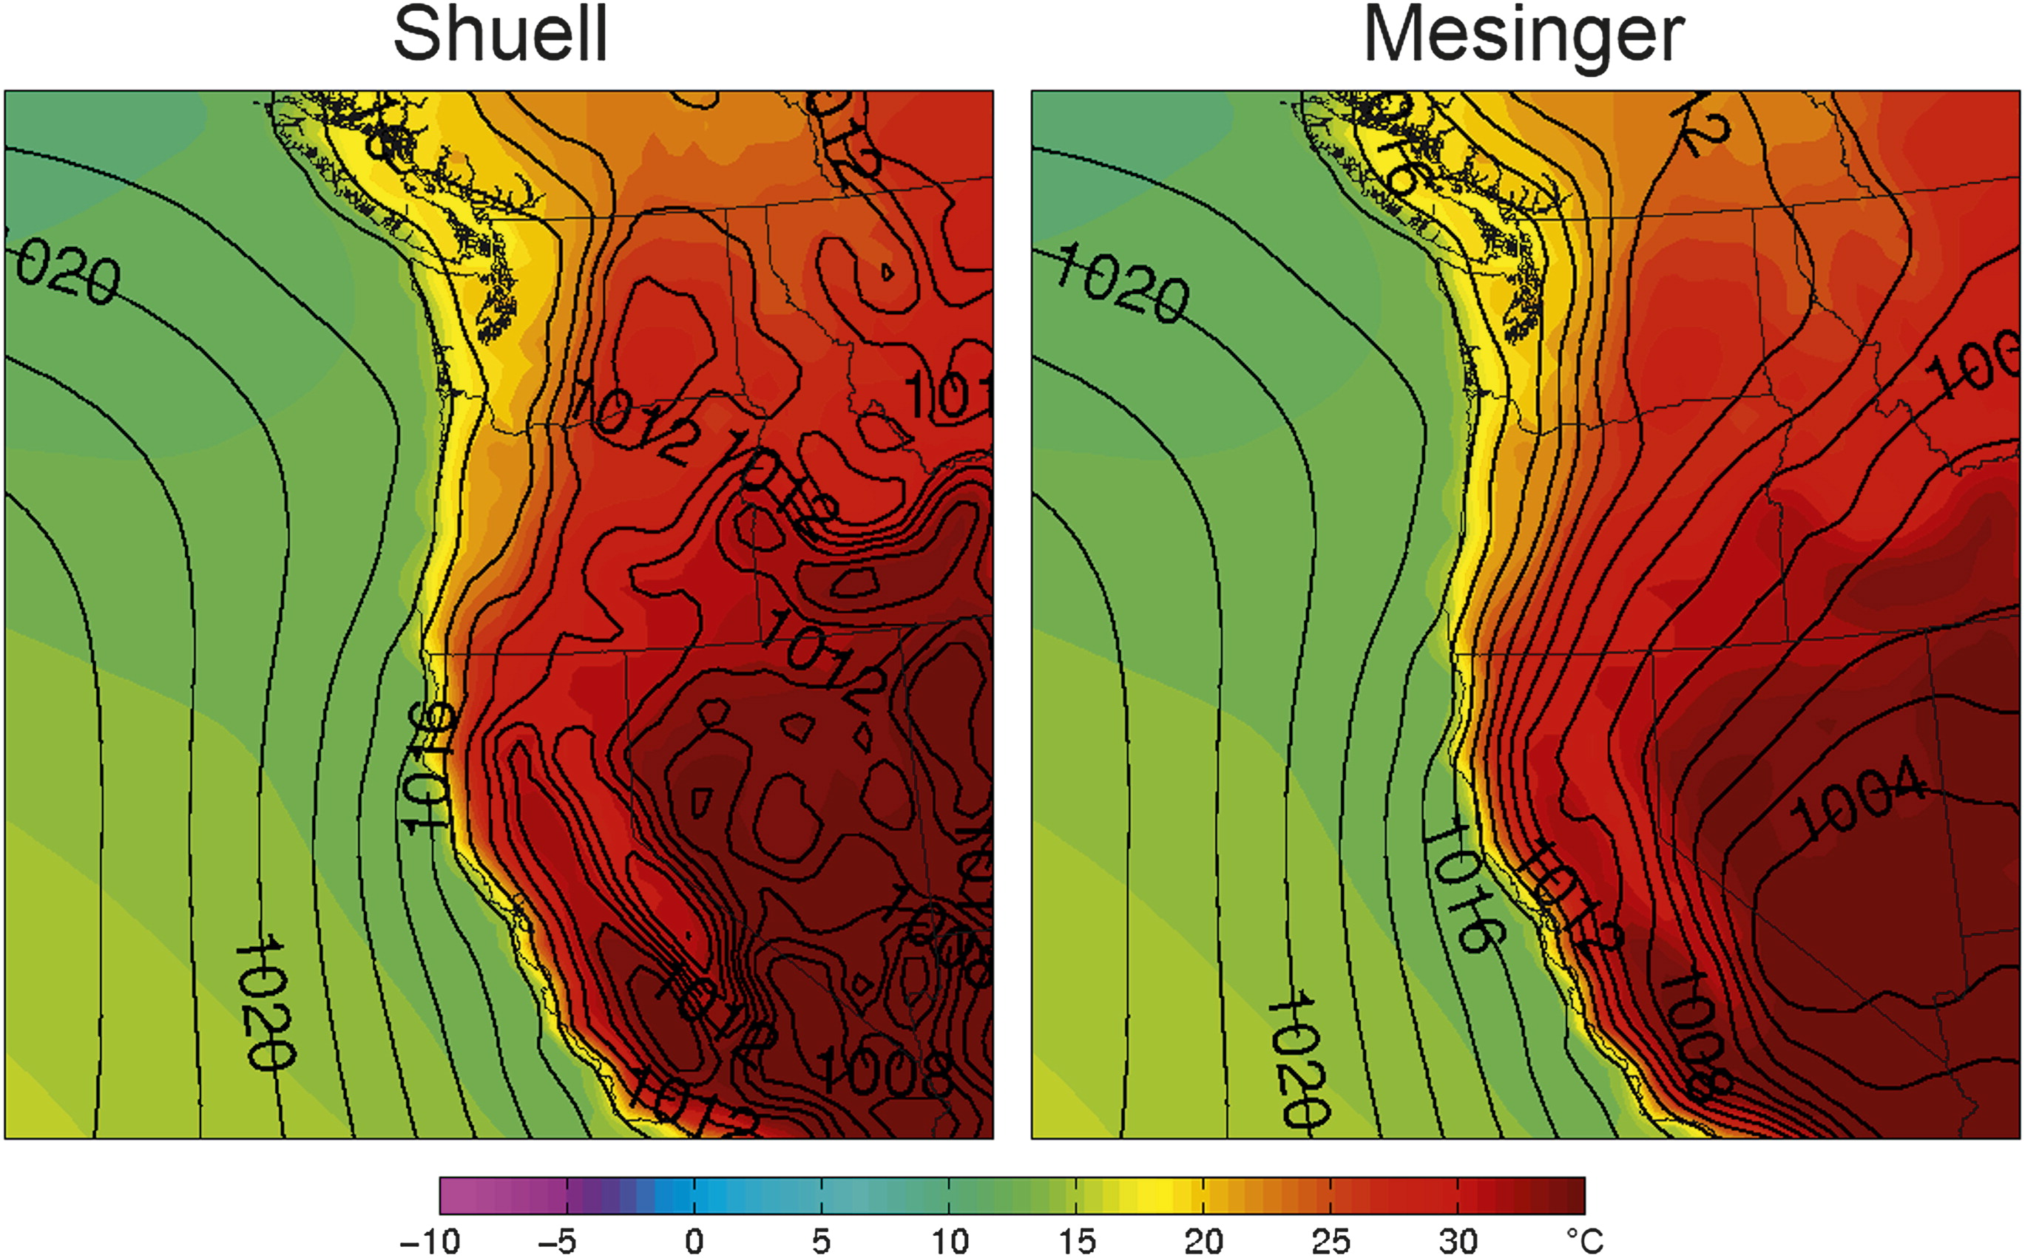
During the day just the opposite, phony troughs inland at low elevations
Fig. 5. Composites of sea level pressure (solid lines, hPa) and 1000-hPa temperature (color shading, C) for JJA at 0000 UTC.

Slide 23
Why?
During the day, the real atmosphere over the Central Valley is ~dry adiabatic (9.8 C per km), while over the mountains we assume U.S. Standard atmosphere (6.5C per km).
Becomes cooler at low levels inside the mountains…thus higher pressure.

Slide 24
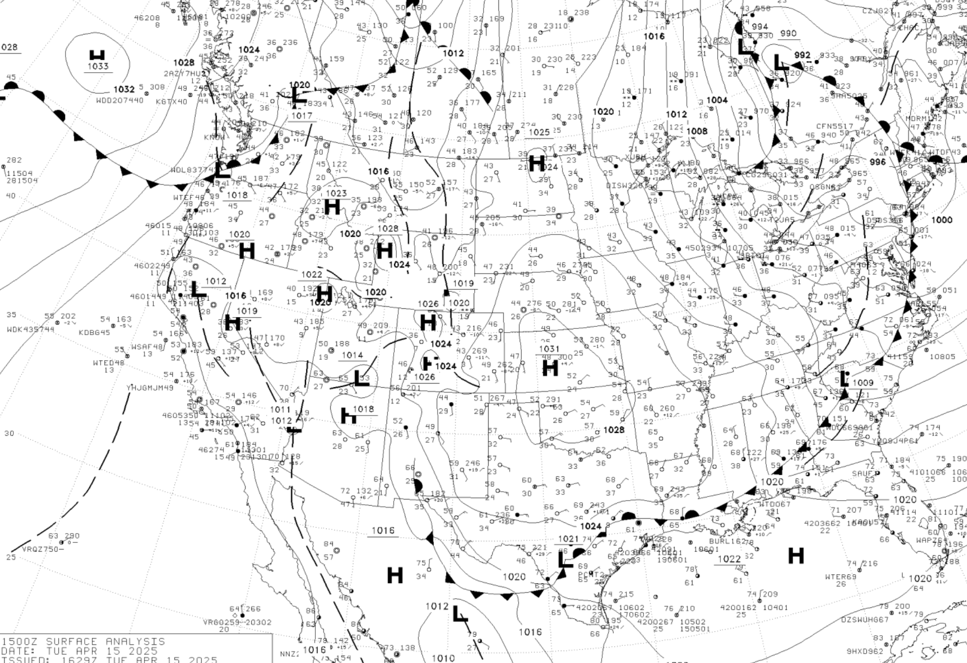
Keep in Mind: SLP Pressures are not Reliable over the High Terrain

Slide 25
\

Slide 26
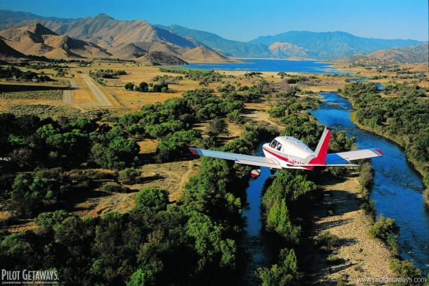
Why unrealistic high pressure areas in high terrain?

Slide 27
Although model improvements have occurred, significant pressure errors sometimes occur

Slide 28
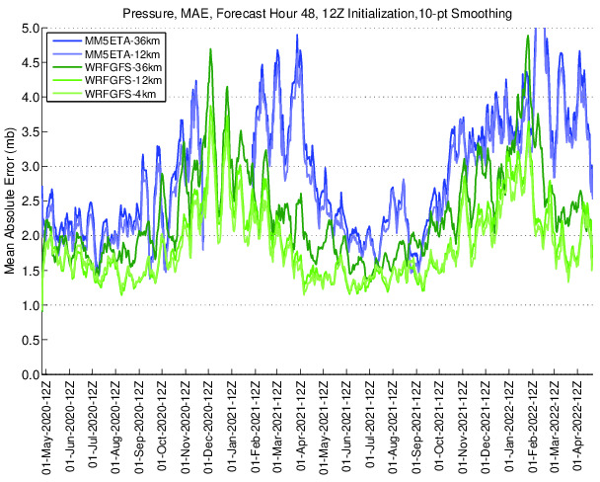
Errors
Larger in
Winter
Stronger synoptic

Slide 29
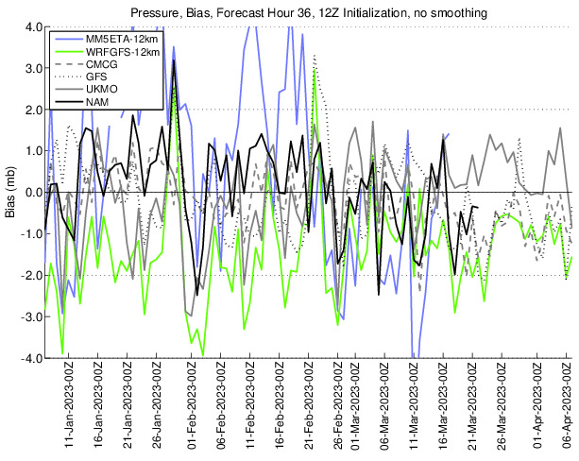
Different modeling systems have different pressure biases

Slide 30
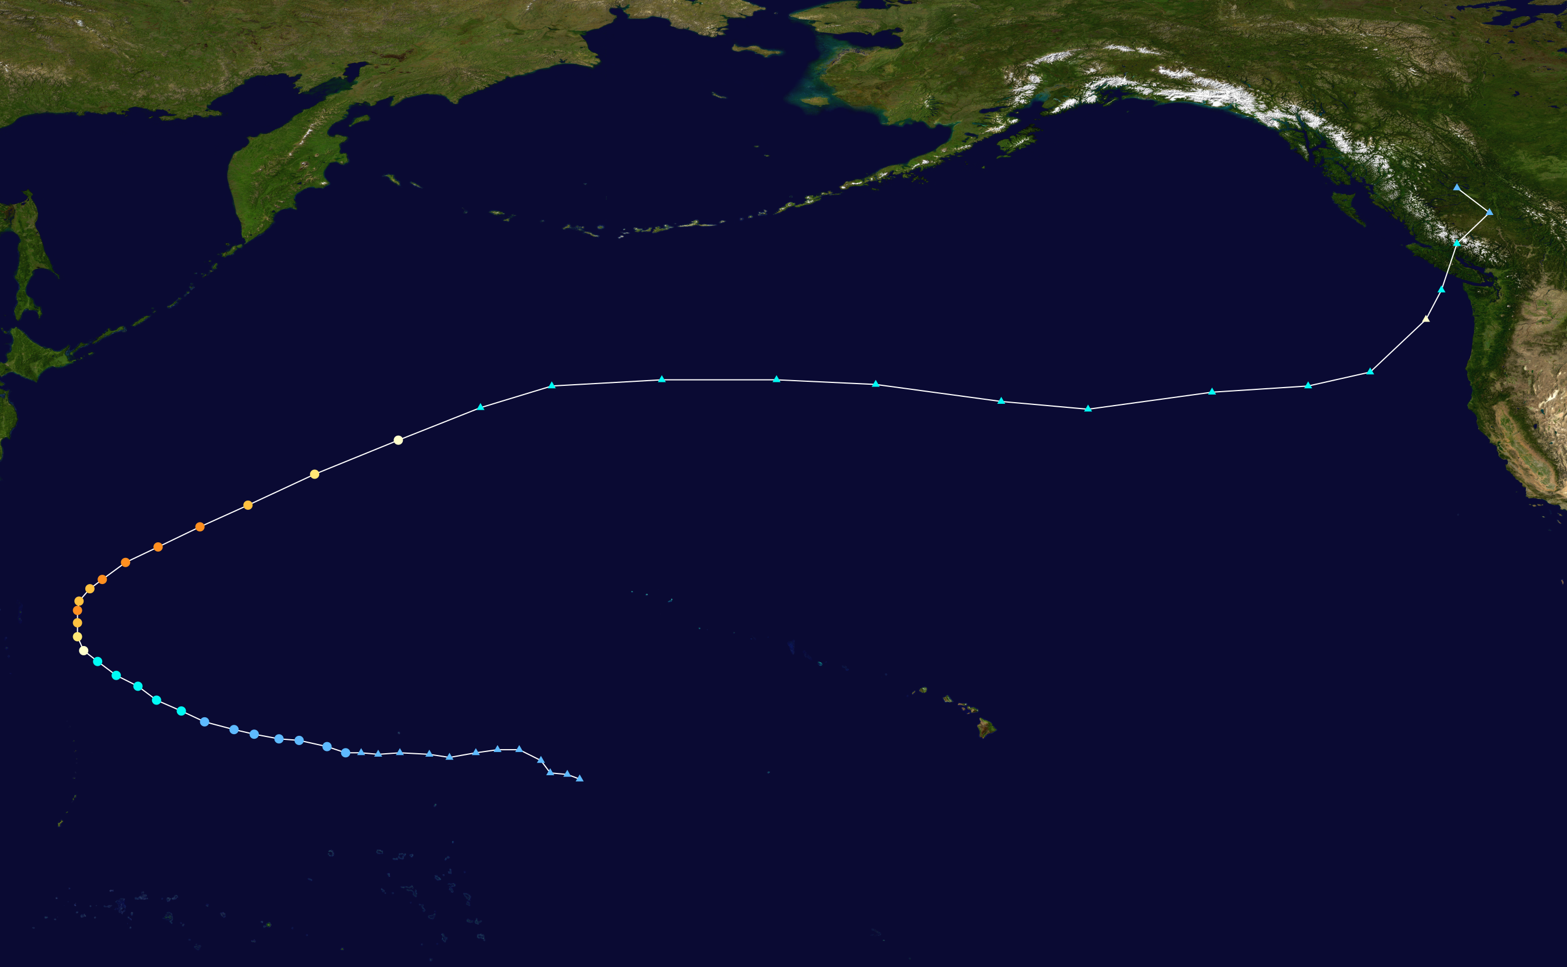
Major Pressure Errors Often Occur with Extratropic Transition Events
Typhoon Songda: October 2016

Slide 31
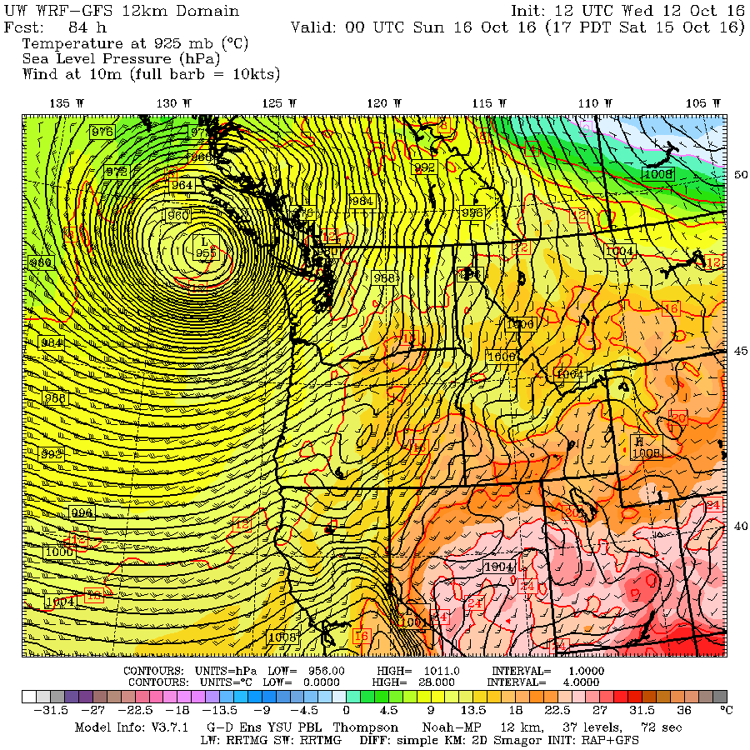
955 hPa

Slide 32
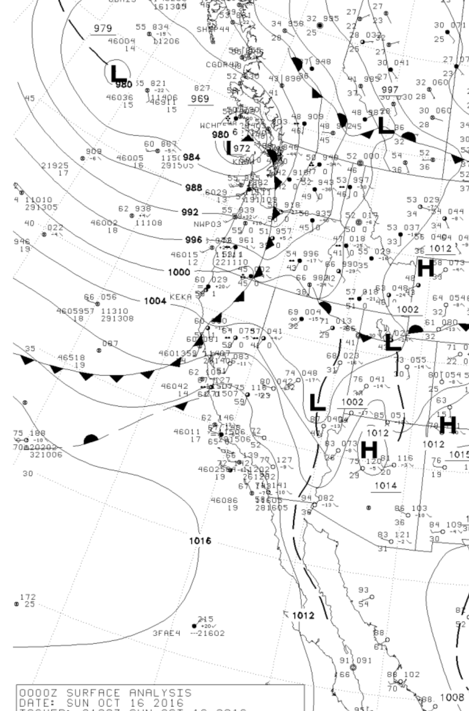

Slide 33
GFS Generally Has Far Better Pressure Forecasts Than NAM

Slide 34
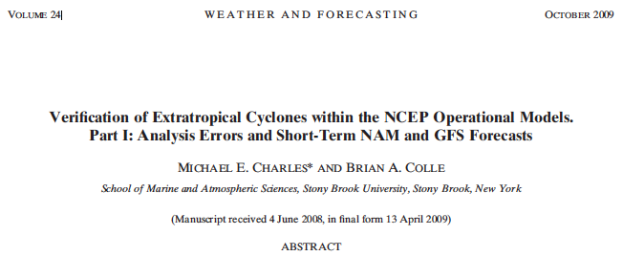
The NCEP GFS has more skillful cyclone intensity and position forecasts than the NAM over the continental United States and adjacent oceans
Over the eastern Pacific the NAM has a large positive (underdeepening) bias in cyclone central pressure.
For the short-term (0–60 h) forecasts, the GFS and NAM cyclone pressure errors over western North America are larger than the other regions to the east.

Slide 35
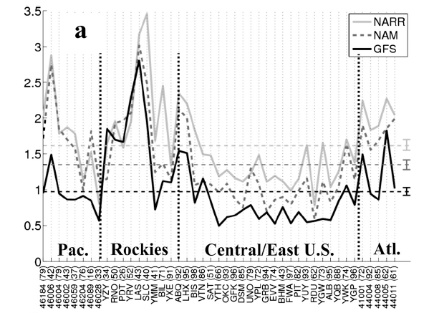
SLP analysis MAE for the GFS (solid black), NAM
(dashed), and NARR (gray). The numbers of cyclones verified between 2002 and 2007 are shown in the parentheses. The dashed horizontal lines represent the average error during the period and the 90% confidence intervals are shown using the vertical bar on the right.
Pressure Errors Vary Spatially

Slide 36
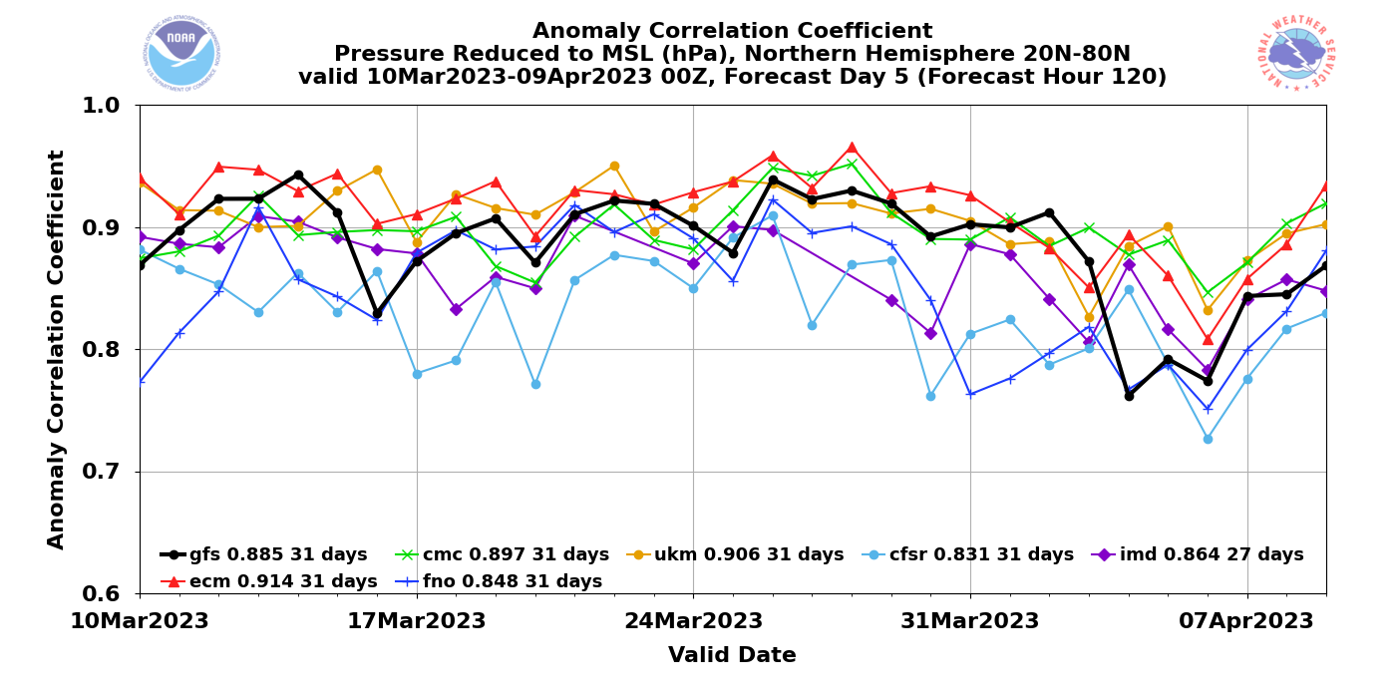
Global Models: ECMWF is best. UKMET is second
GFS is more likely to have pressure “drop outs”

Slide 37
Smartphone Pressures
Some smartphones measure pressure information
Encouraging data assimilation experiments using this data source.

Slide 38


Some of the smartphones/pads with pressure sensors
iPhone
Samsung Galaxy III, IV, V, VI
Nexus 4 and 10
Some Sony, Nokia, and Chinese phones

Slide 39
Smartphone Pressures
Currently getting 60 million a day from IBM/weather.com
Excellent calibration using machine learning.
There may be a new source with much more data.

Slide 40
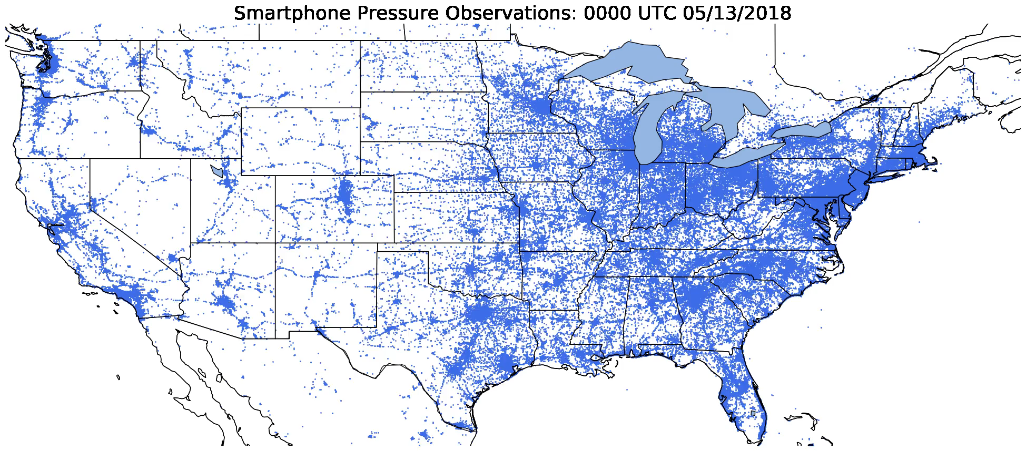
Notes:
Hook: Show time-lapse of madis pressure observation locations in the United States. Then show time-lapse of smartphone pressure observations (ask what if it looked like this).
Reasons why more surface data is necessary:
- Extending predictability requires better initial conditions (Zhang et al., 2019)
- Increased surface observation density in space and time has been shown to be beneficial for convective forecasting (Sobash and Stensrud, 2015; Gasperoni et al. 2018)
- Verification for high resolution numerical models.

Slide 41
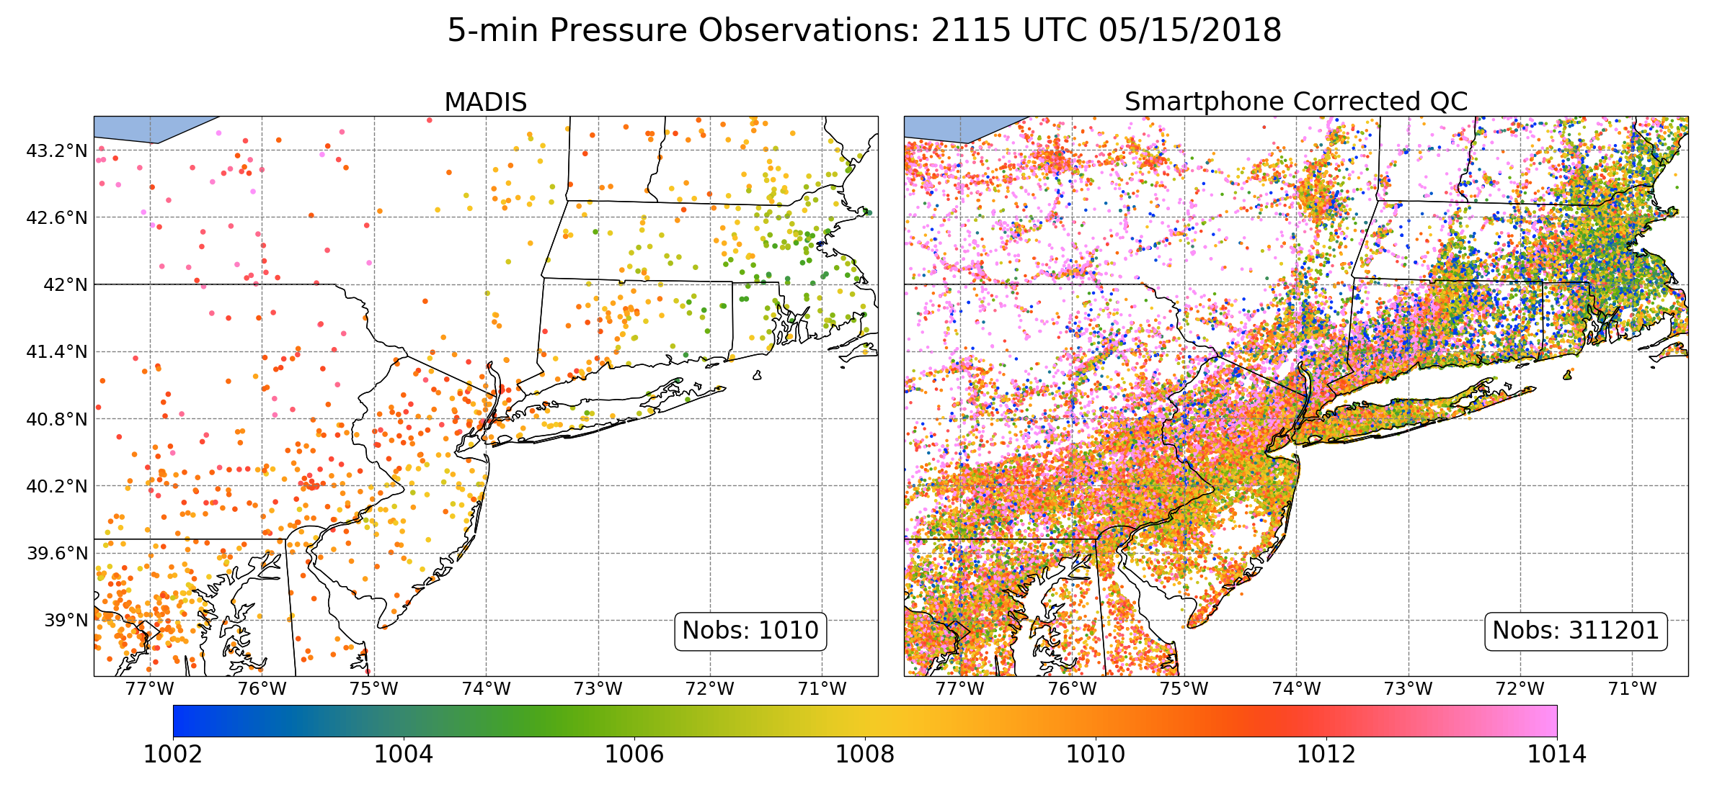
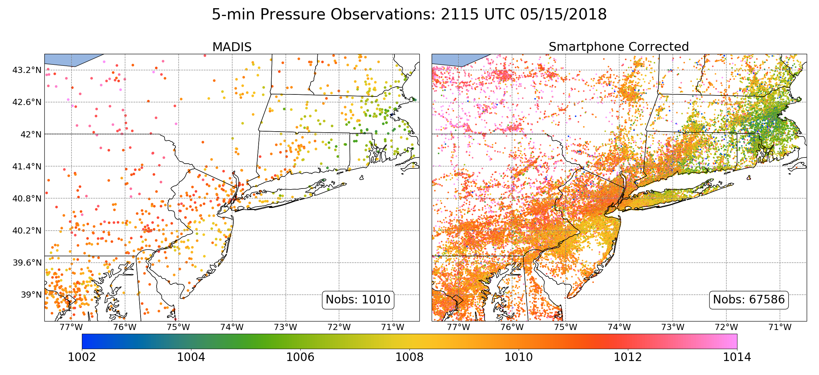
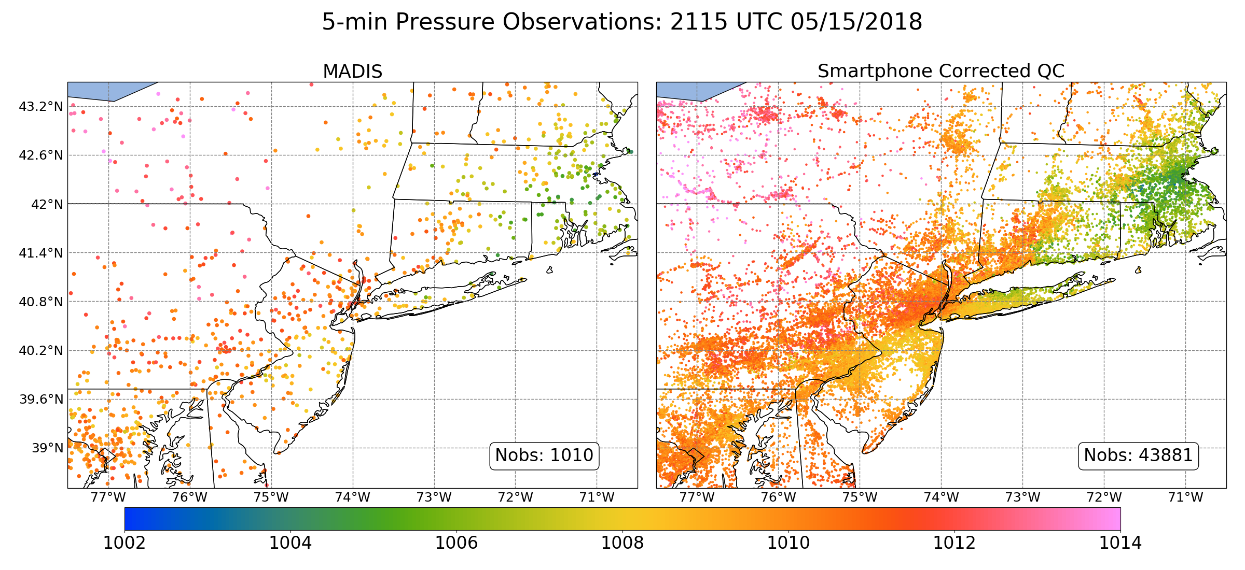
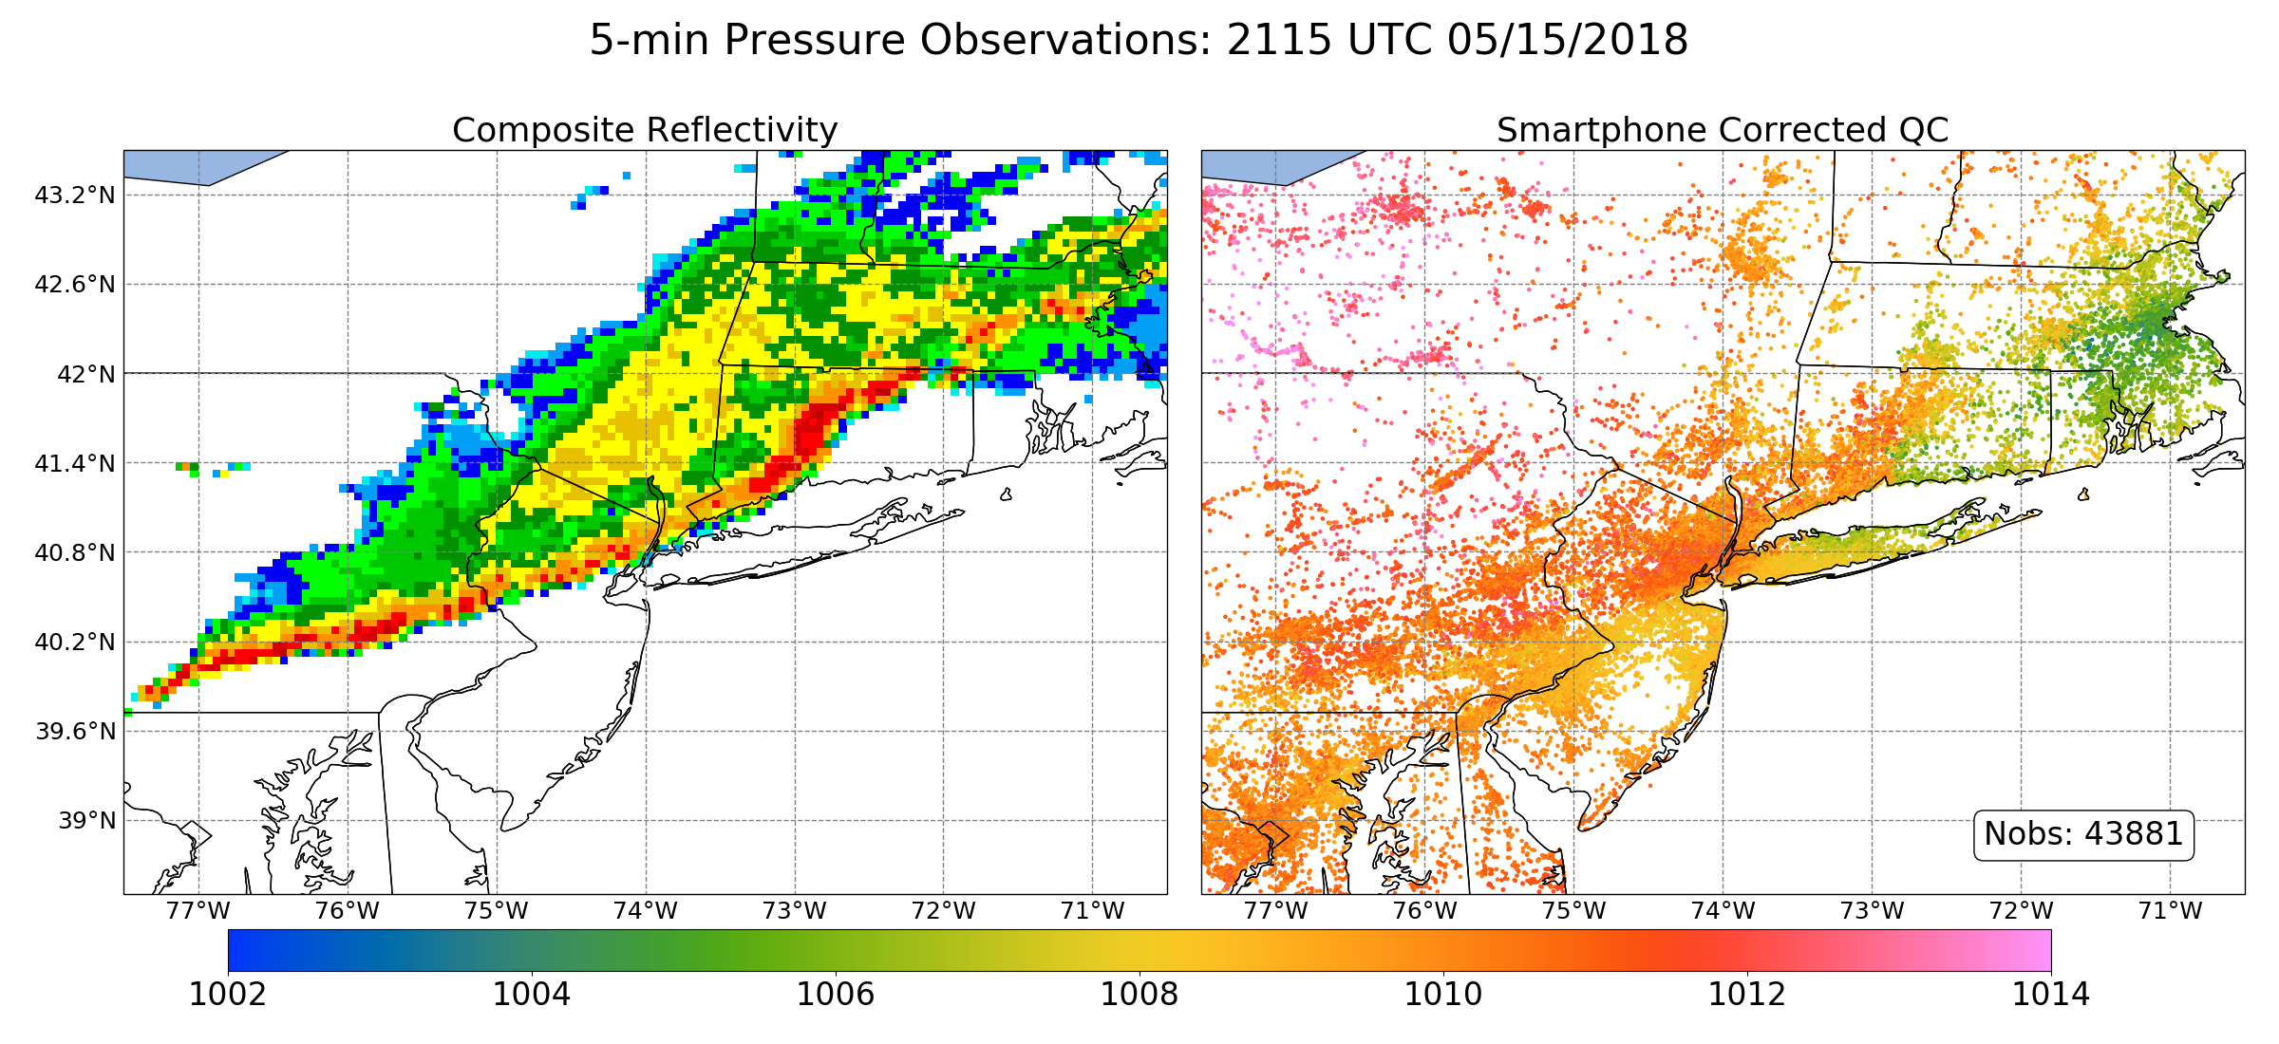
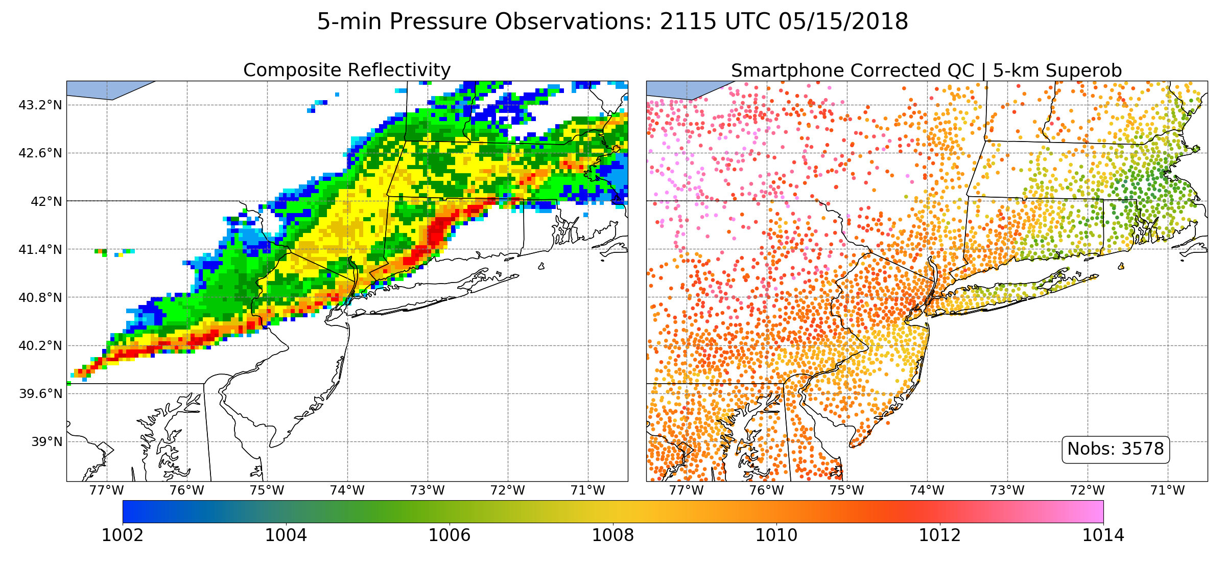
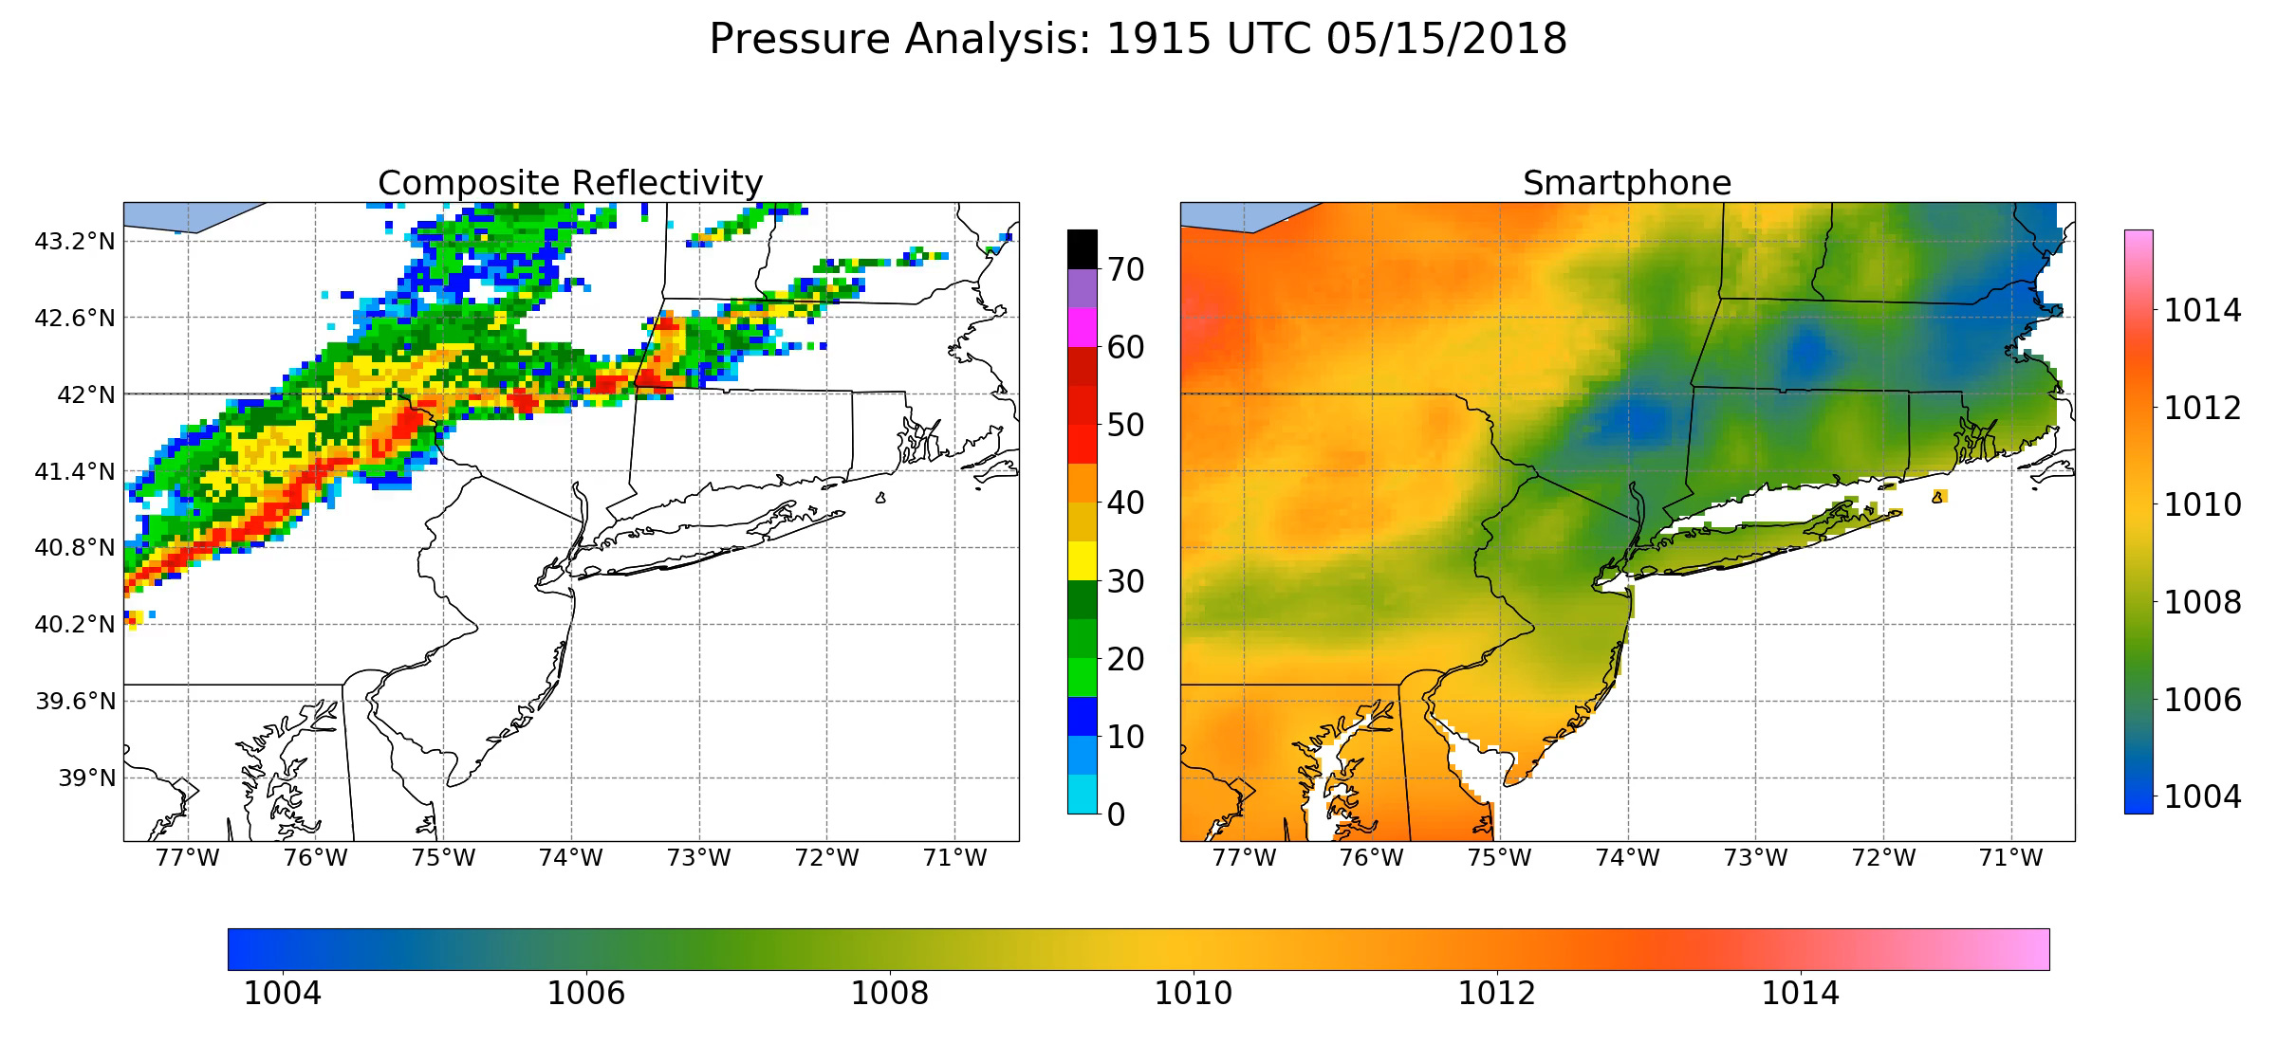
Notes:
Hook: Show time-lapse of madis pressure observation locations in the United States. Then show time-lapse of smartphone pressure observations (ask what if it looked like this).

Slide 42
Many other networks provide sea level pressure

Slide 43
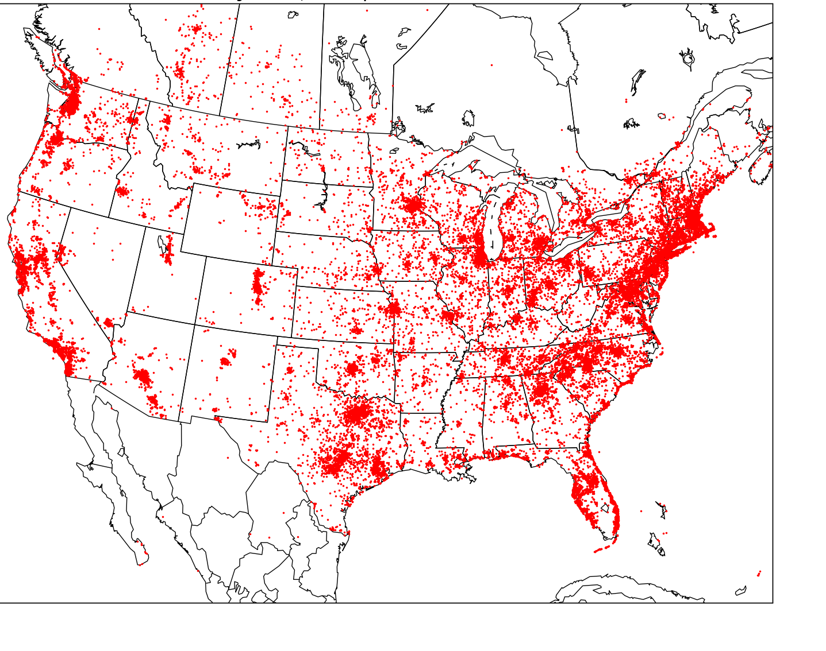
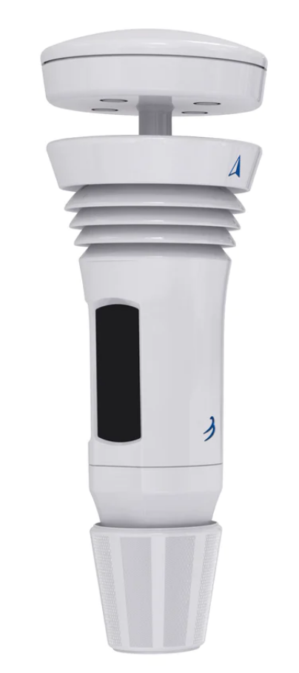
Tempest
37612 obs in one hour

Slide 44
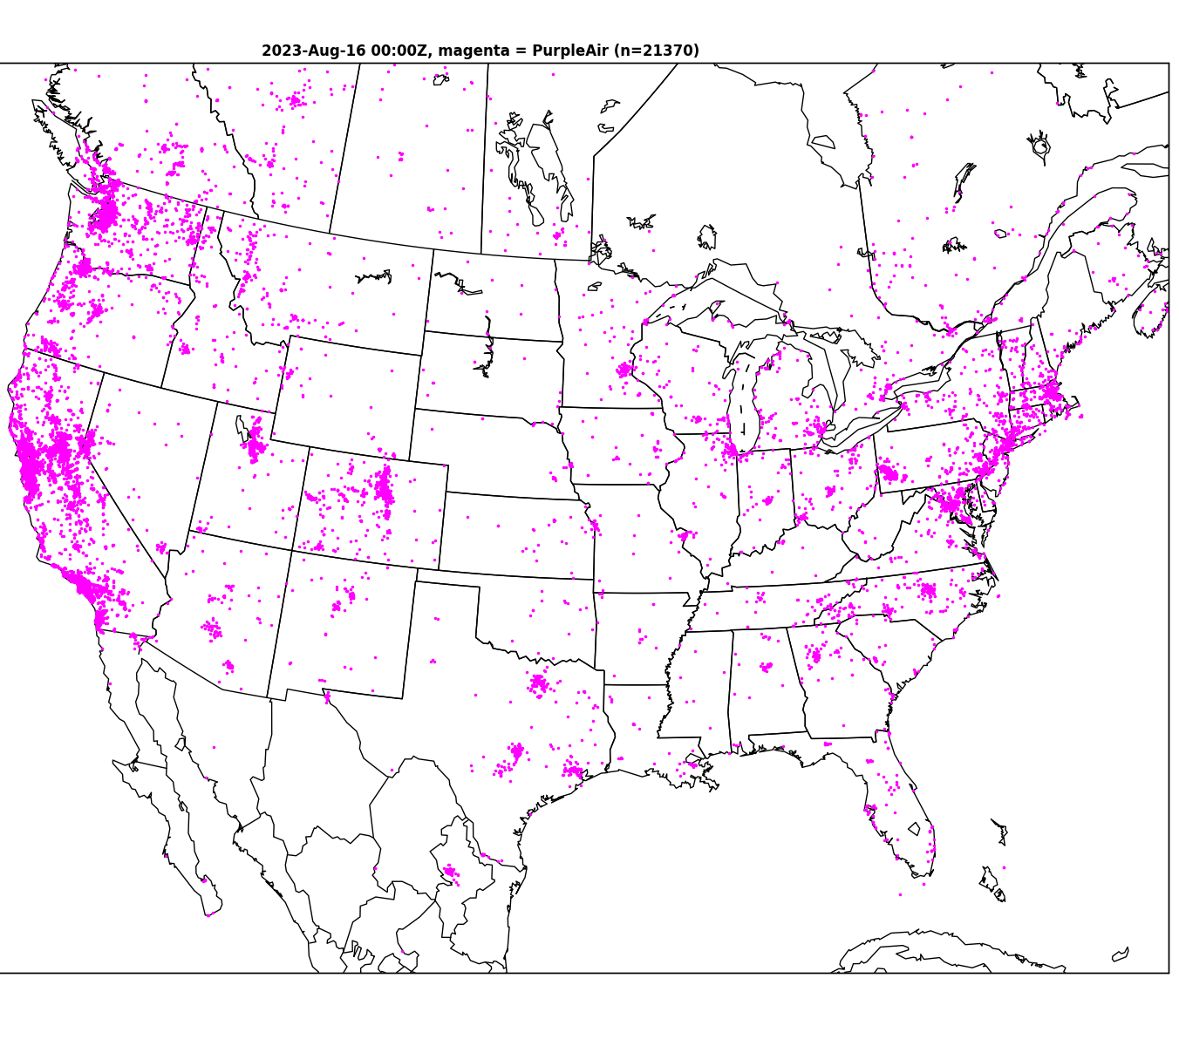
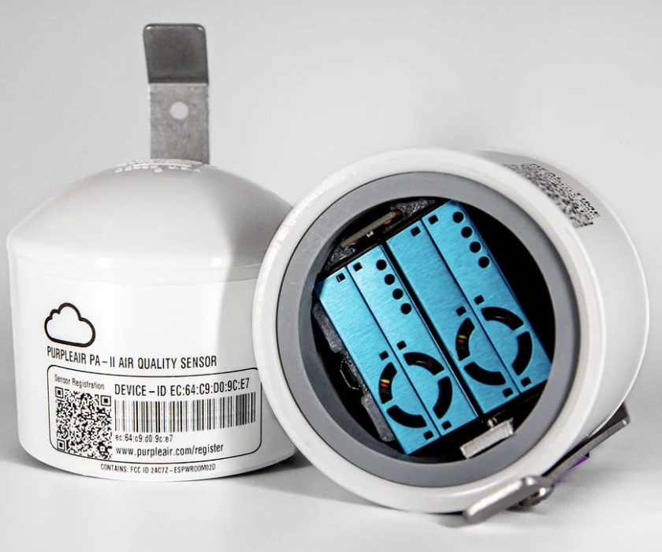
Purple Air
21670 obs

Slide 45
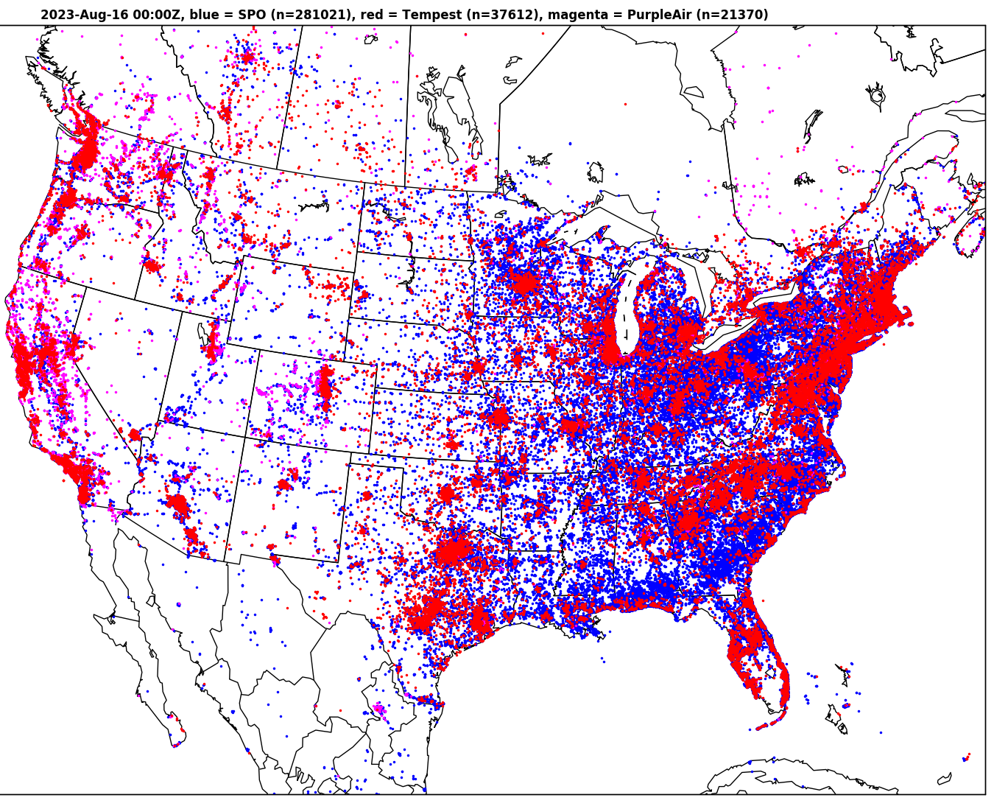
All Three Networks
OVER
340,000 observations in ONE HOUR

Slide 46
Forecasting Strategy for Pressure
You are dependent on the models
Your task is to pick the best one for your area.
ECMWF/UKMET generally the best synoptic pressures across the globe.
High-resolution models needed to get pressures right in areas of complex terrain.
Learn about model pressure biases for locations of interest.

Slide 47
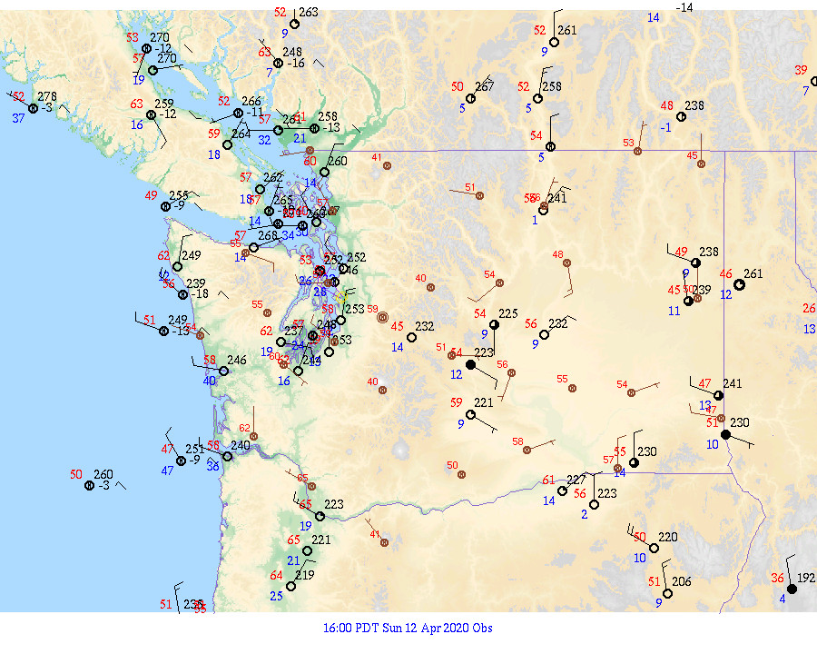
The value of isallobaric analyses and pressure tendency
Isallobar: lines of constant pressure change.

Slide 48
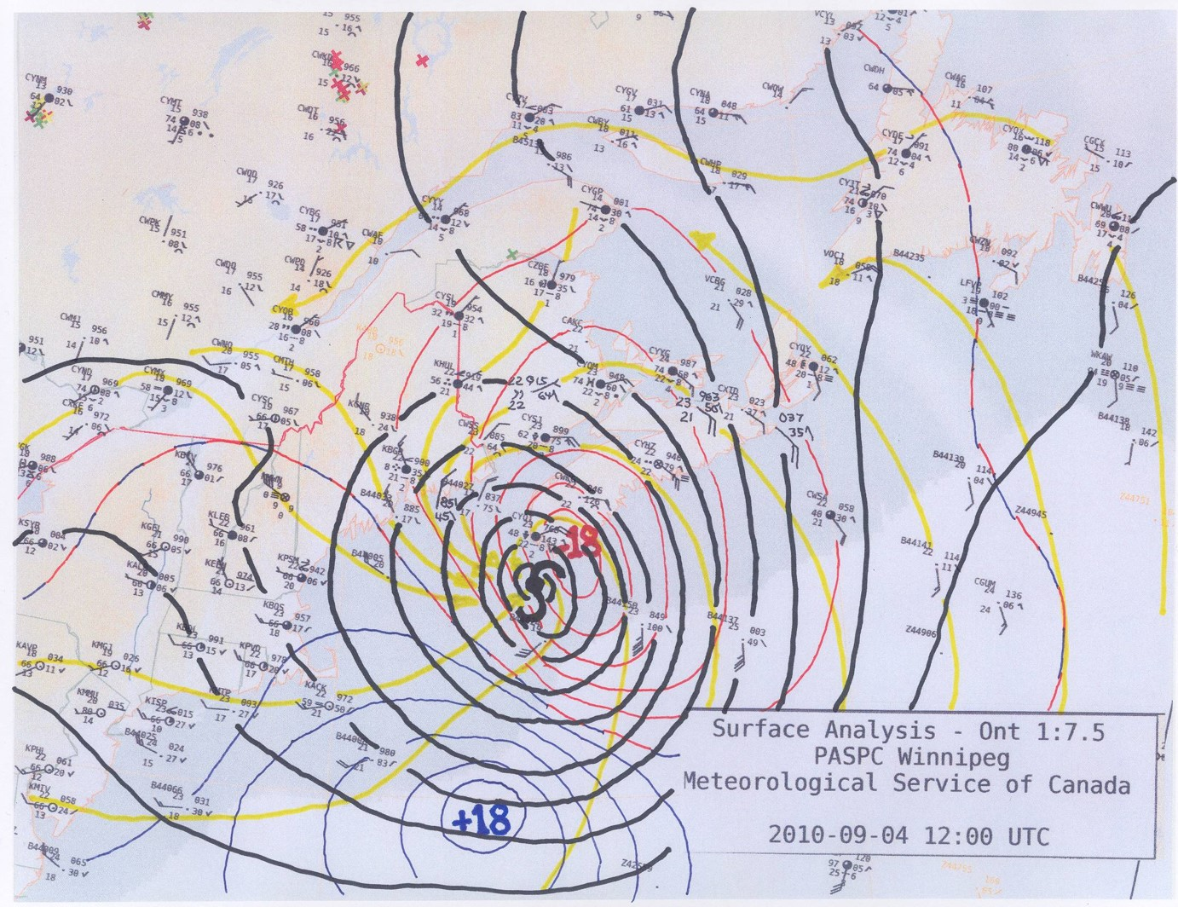
Isallobaric analysis

Slide 49
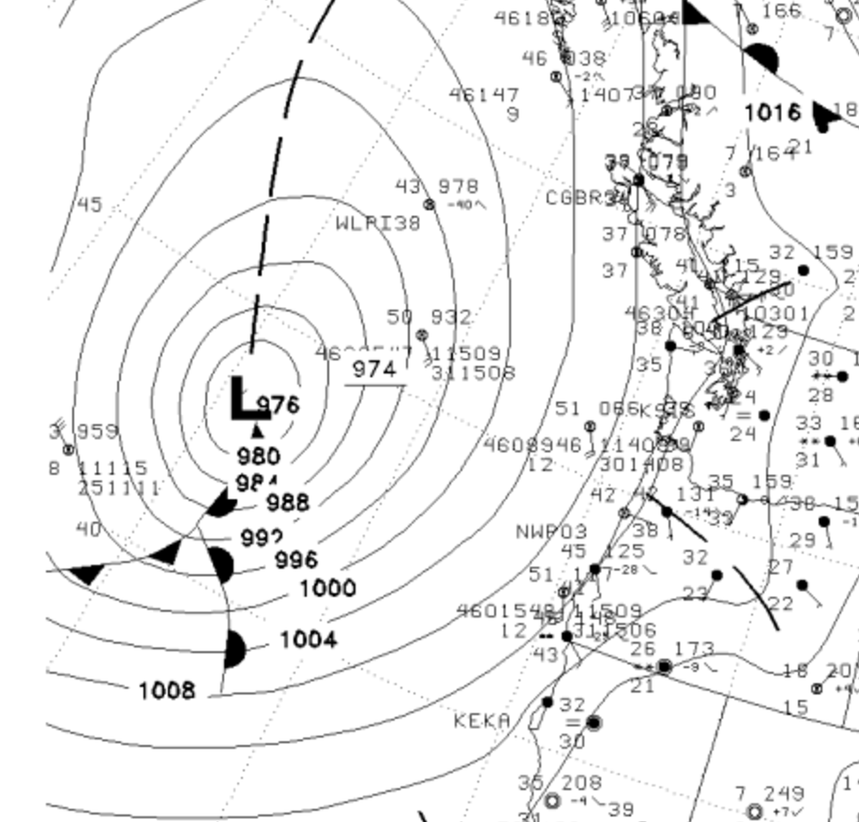
When models are going bad
The use of pressure change can help identify where low centers are heading if NWP has problems.
?

