Slide 1
Radiation
Atmospheric Sciences 101
Autumn 2025

Slide 2
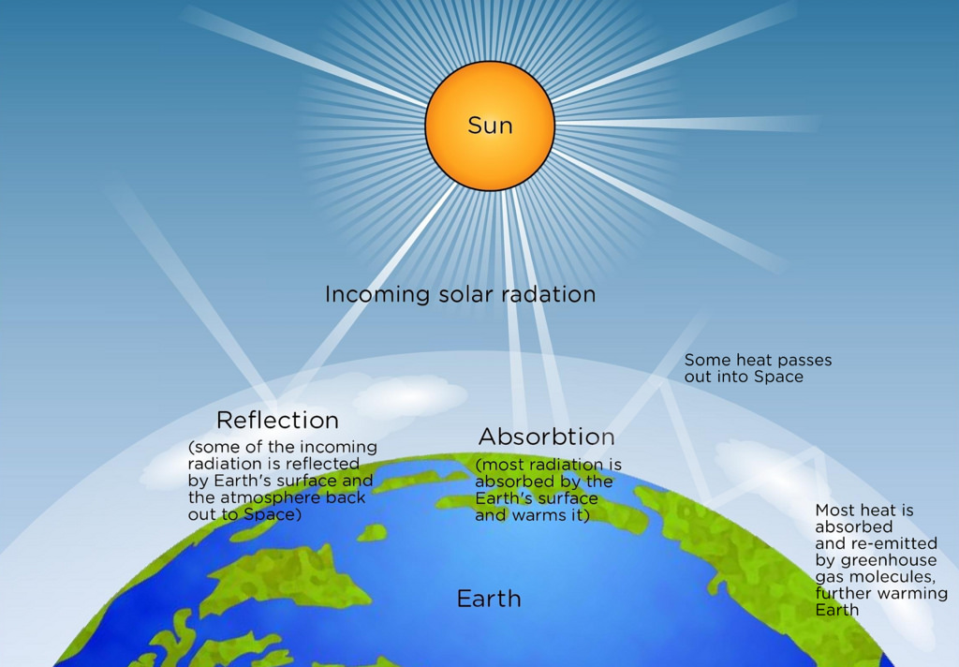
Atmospheric Radiation
The ultimate source of energy that drives the atmosphere comes from the sun.
Radiation from the sun moves through the earth/atmosphere/ocean system producing the weather and climate we know.

Slide 3
Radiation
Understanding radiation can explain many interesting questions, such as:
  Why do temperatures cool more on clear nights?
  Why does CO₂ warm the earth?
  What is the greenhouse effect?

Slide 4
Definition
Radiation: the process whereby energy is transferred through space without the need for an intervening medium.
Radiation is transmitted by electromagnetic waves that move through a vacuum at 300,000 km per second (186,000 miles per second)
Examples; visible light, radio waves.

Slide 5
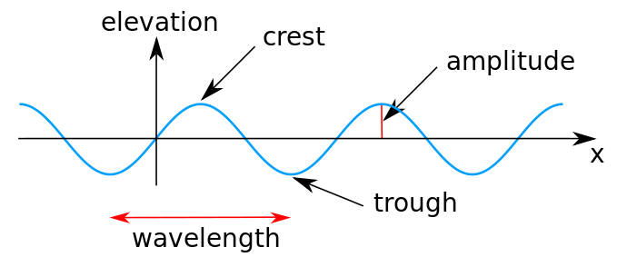
Electromagnetic Waves Vary by Wavelength
One wavelength is the distance from ridge to ridge or crest to crest

Slide 6
Electromagnetic wave wavelengths vary from less than a micron (ultraviolet, UV) to hundreds of meters (radio)
This range of wavelengths is called the electromagnetic spectrum

Slide 7
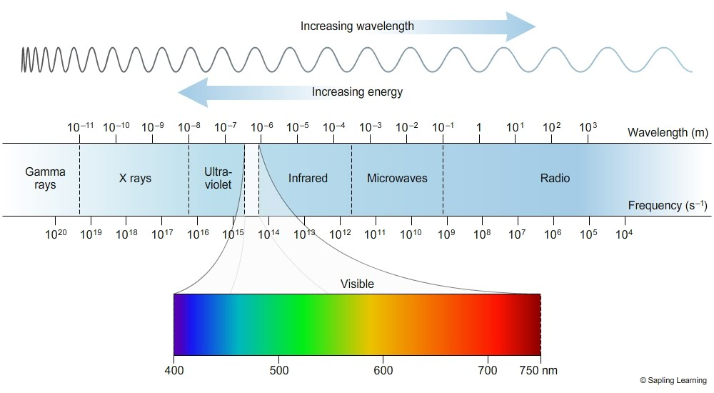
Electromagnetic Spectrum

Slide 8
All objects with T> 0 K emit radiation, although some objects are more efficient than others
The amount of radiation emitted by an object depends on temperature, with warmer objects emitting more radiation.

Slide 9
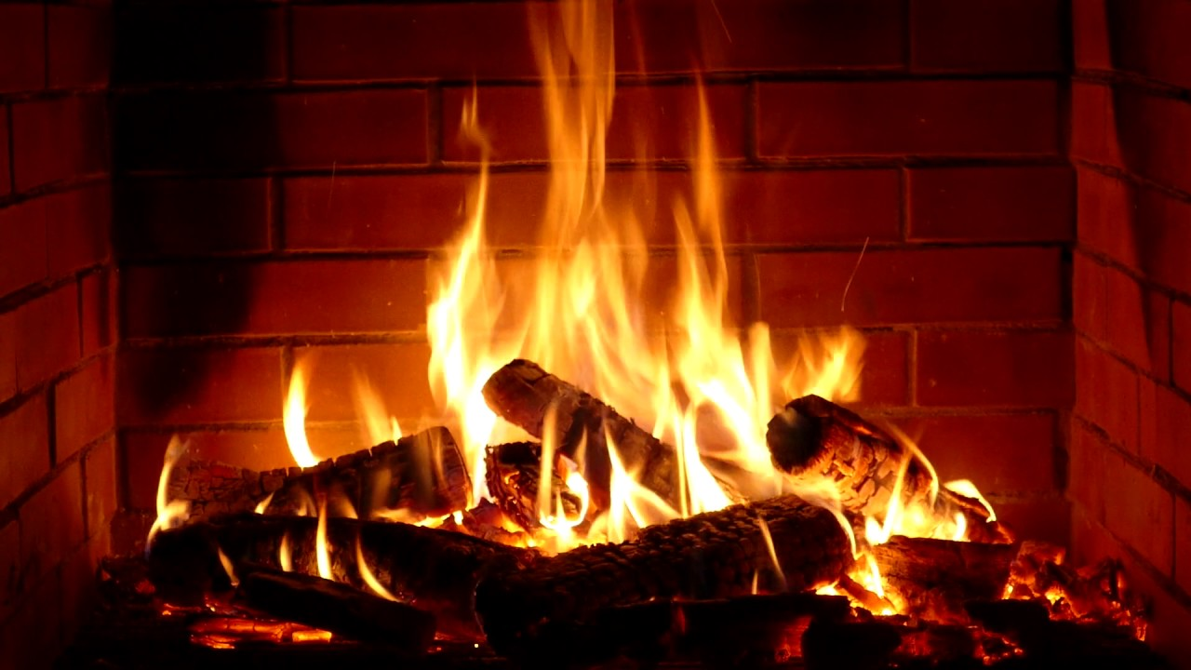
Which Shouldn’t Surprise Anyone

Slide 10
Stefan—Boltzman Law
R = cT⁴
R is the amount of radiation emitted per unit area for a surface of temperature T (K). C is a constant
Doubling the temperature results in 16x the radiation.

Slide 11
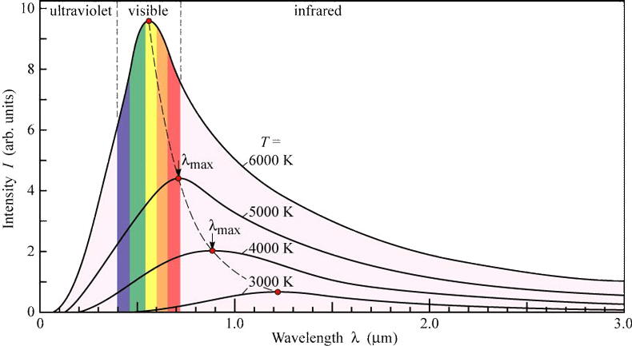
The amount of radiation emitted by an object varies by wavelength.
Characteristic shape of this variation

Slide 12
Peak Radiation Versus Temperature
The wavelength of the peak radiation emitted by an object varies with temperature, with warmer objects having peak radiation at shorter wavelengths.

Slide 13
Wien’s Law
Expressed in famous Wien’s Law:
λ_{max} (μm)= 2892/T(K)
λ_{max} is the wavelength of the maximum or peak radiation.
μm is microns…millionths of a meter

Slide 14
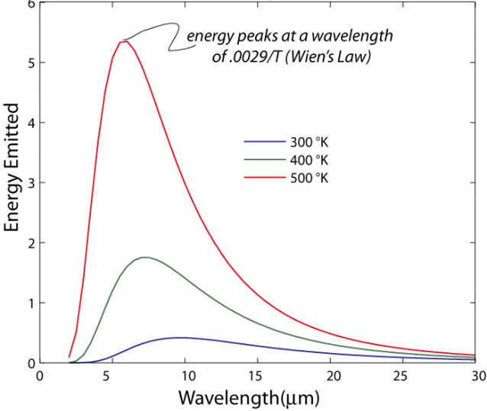

Slide 15
Wien’s Law
For the temperature typical of the earth’s surface, say 20C or 293K, λ_{max}= 9.9 microns (in the infrared)
For the temperature of the sun’s surface (T~6000K), λ_{max} =~.5 microns (in the visible portion of the spectrum)

Slide 16
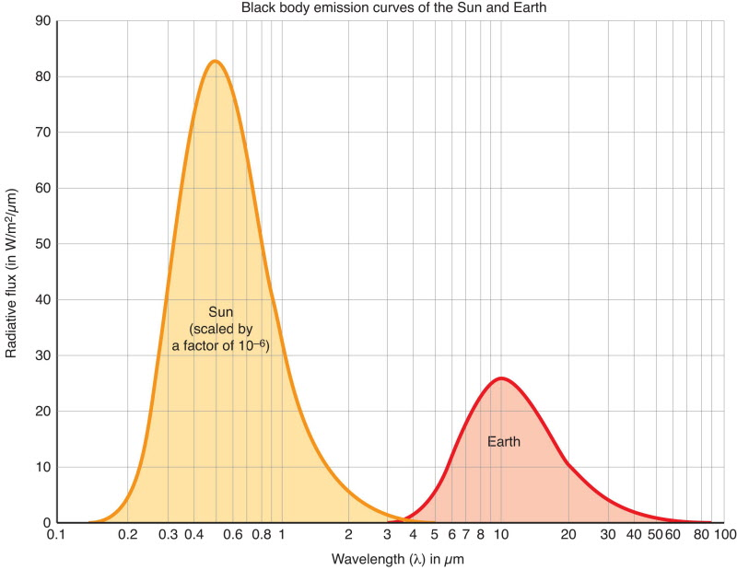
Earth Versus Sun Emission
Visible
Infrared

Slide 17
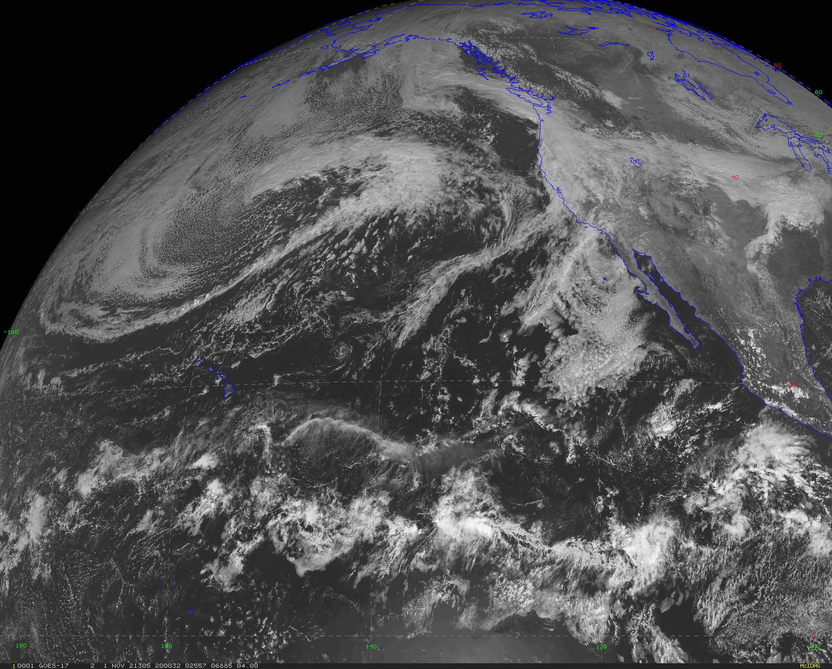
Visible satellite image: reflected solar radiation

Slide 18
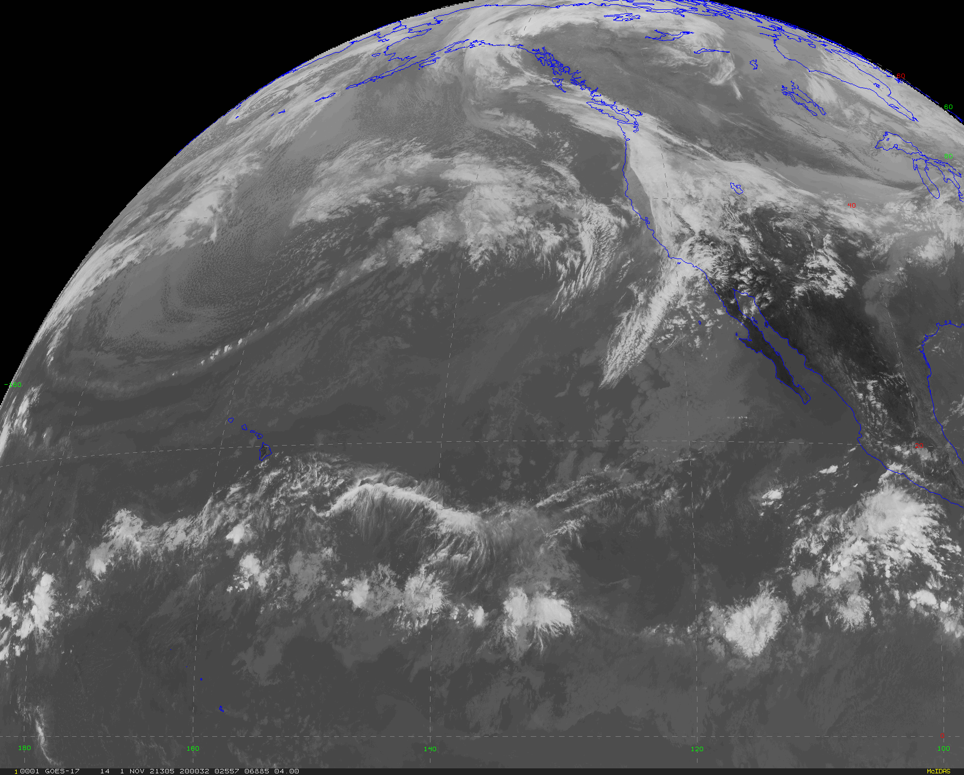
Infrared satellite image: radiation emitted by the surface and clouds

Slide 19
To summarize
Warmer objects emit more radiation
Warmer objects emit their maximum radiation at shorter wavelengths.

Slide 20
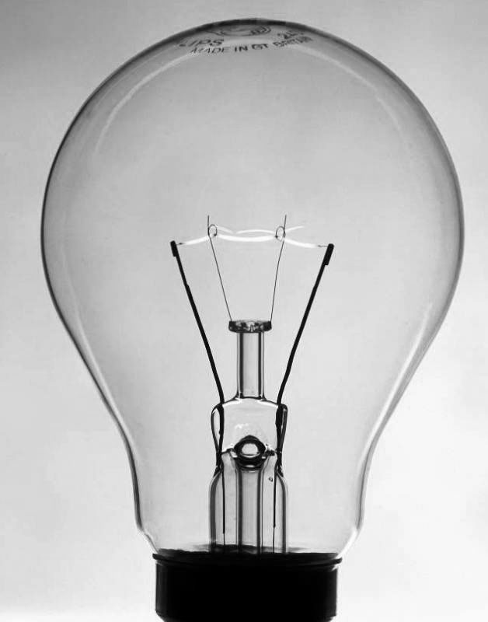
What about lightbulbs?
Traditional lightbulbs (not LEDs) emit a lot in the visible, which means they have to be approximately the same temperature as the sun’s surface. Also called incandescent bulbs.
Typical tungsten filament has a T of ~2700K
Max not in visible, but close enough for useful light
Most of the energy in the IR…this is wasted!

Slide 21
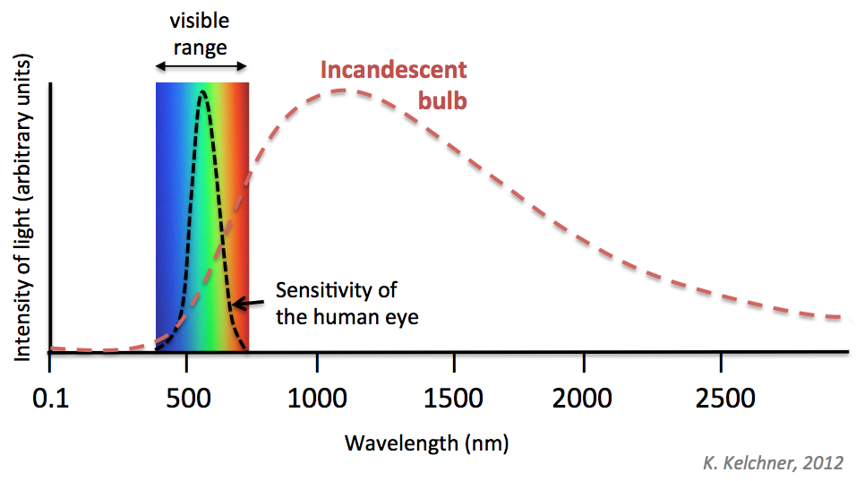
Why traditional light bulbs are inefficient
Infrared

Slide 22
Kirchoff’s Law and Black Bodies
Objects and substances can not only emit radiation, they can absorb it too!
Turns out there is a connection between the two, expressed by Kirchoff’s Law.
Kirchoff’s Law: A good emitter of radiation at some wavelength is a good absorber at that wavelength. And vice versa.

Slide 23
Kirchoff’s Law
Thus, a perfect emitter at some wavelength will be a perfect absorber at that wavelength.
If an object is a perfect absorber of radiation at some wavelength, none is reflected or scattered back,
Such an object is called a blackbody at that wavelength

Slide 24

No light reflected back for an object that is blackbody at visible wavelengths
Appears black, since a perfect absorber

Slide 25
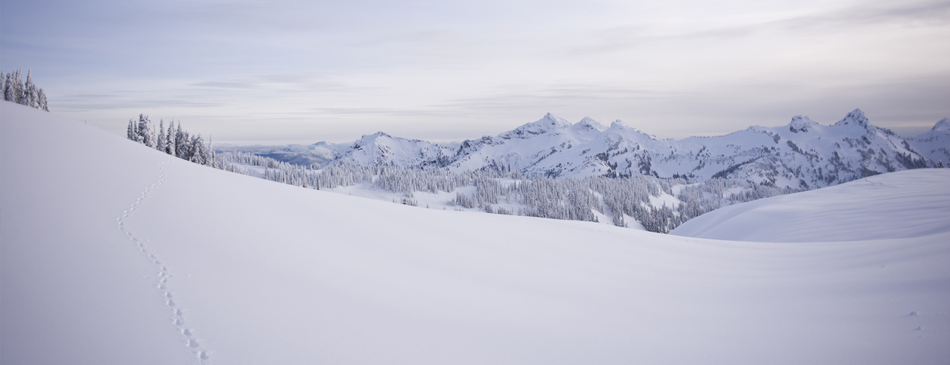
An object can be a blackbody at some wavelengths but not in others
Such behavior explains a lot of interesting phenomena.
Take snow and why it results in cold temperatures.

Slide 26
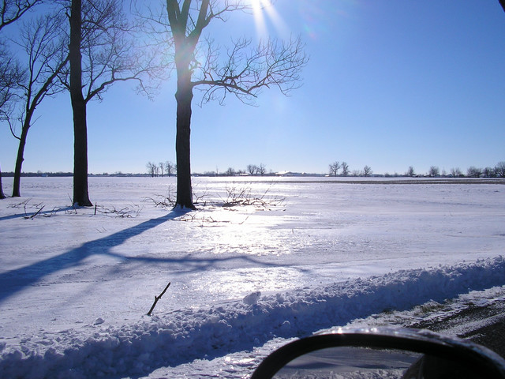
Snow
Not a blackbody (BB) in the visible (poor emitter and absorber), so reflects much of the solar radiation.
But nearly a BB in the infrared, thus a good emitter at that wavelength.
Thus, snow promotes cold temperatures and cold records.

Slide 27
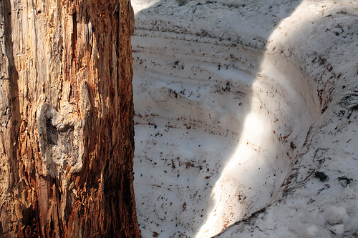
Why tree wells?

Slide 28
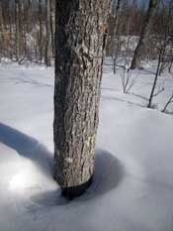
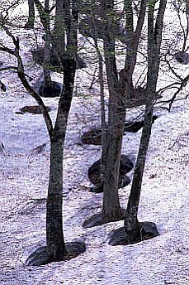
Why Tree Wells?
Snow not a BB for solar radiation. Reflects solar radiation and thus doesn’t melt much.
Snow is a BB in IR. Tree can heat up from sun and emits IR radiation that the snow can absorb

Slide 29
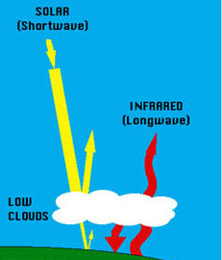
Clouds?
Not a blackbody in the visible, so reflects solar radiation considerably.
Nearly a blackbody in the infrared, so emits/absorbs in the infrared.
Big Implications: clouds cool the surface during the day (reflects solar), but warms at night (absorbs and emits infrared)

Slide 30
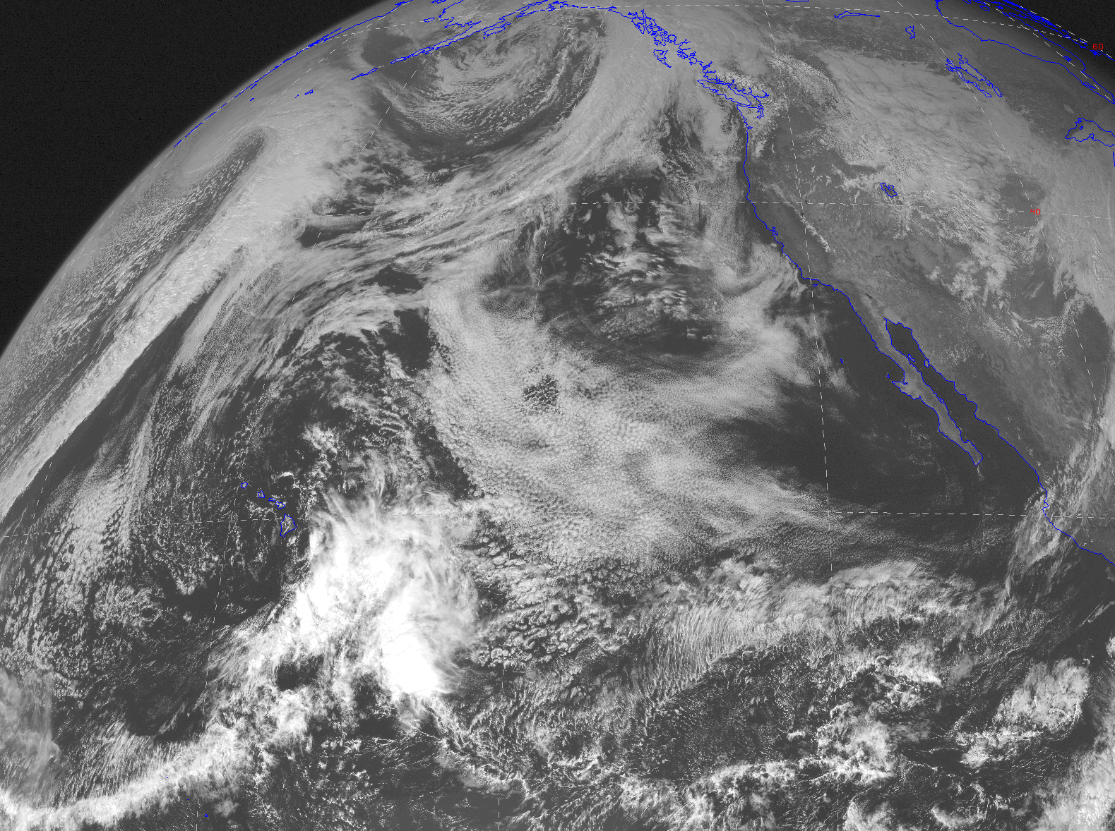
Visible image—solar reflected off clouds and surface

Slide 31
Snow and clouds are selective absorbers and emitters, acting like blackbodies at some wavelengths but not in others.
The same is true of many gases in the atmosphere.
This fact will be critical for you in understanding global warming

Slide 32
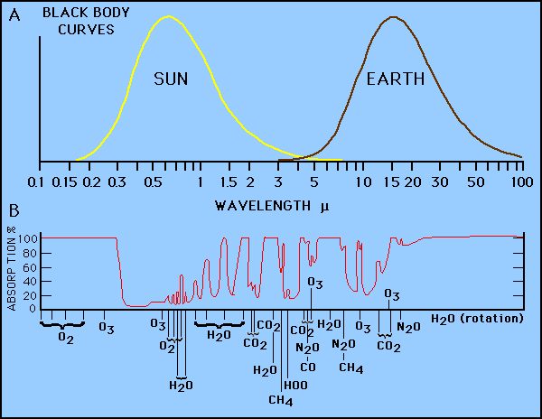
The atmosphere is relatively transparent in the visible: an atmospheric window region

Slide 33
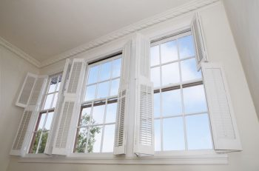

Slide 34
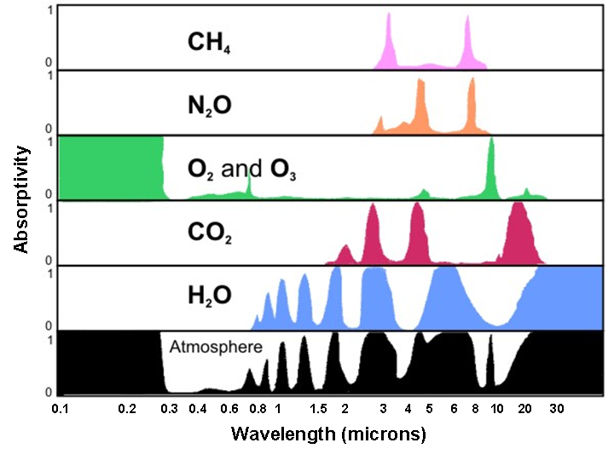
More complicated picture in the infrared (IR)
IR

Slide 35
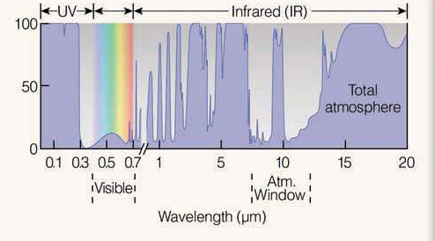
IR satellite imagery is mainly in a window region in the IR (roughly 8-12 microns)

Slide 36
Why select a window region?
So one does not see the atmosphere, but rather clouds and the surface

Slide 37
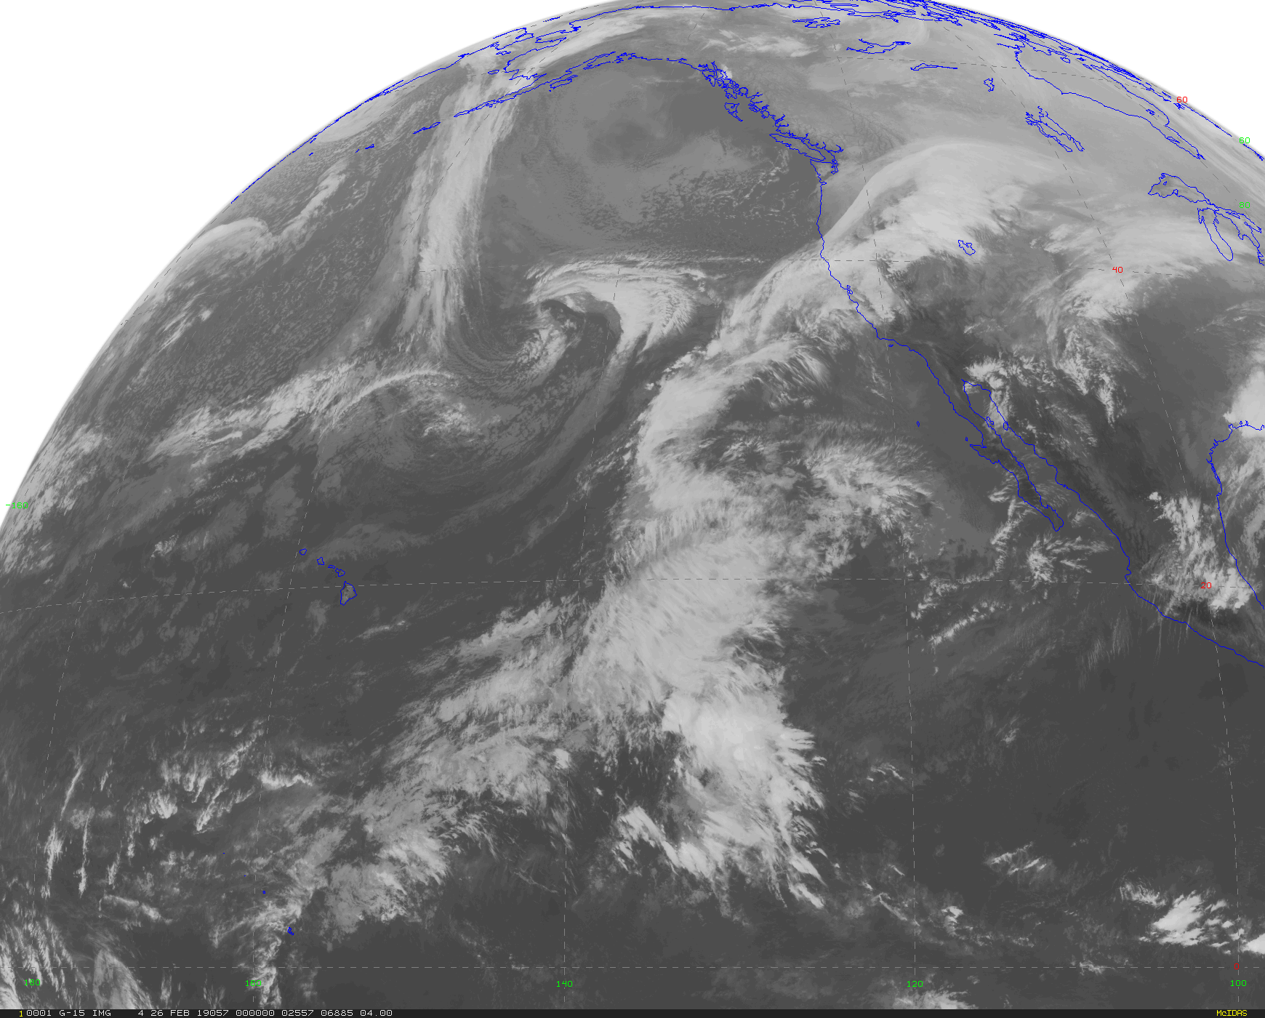

Slide 38
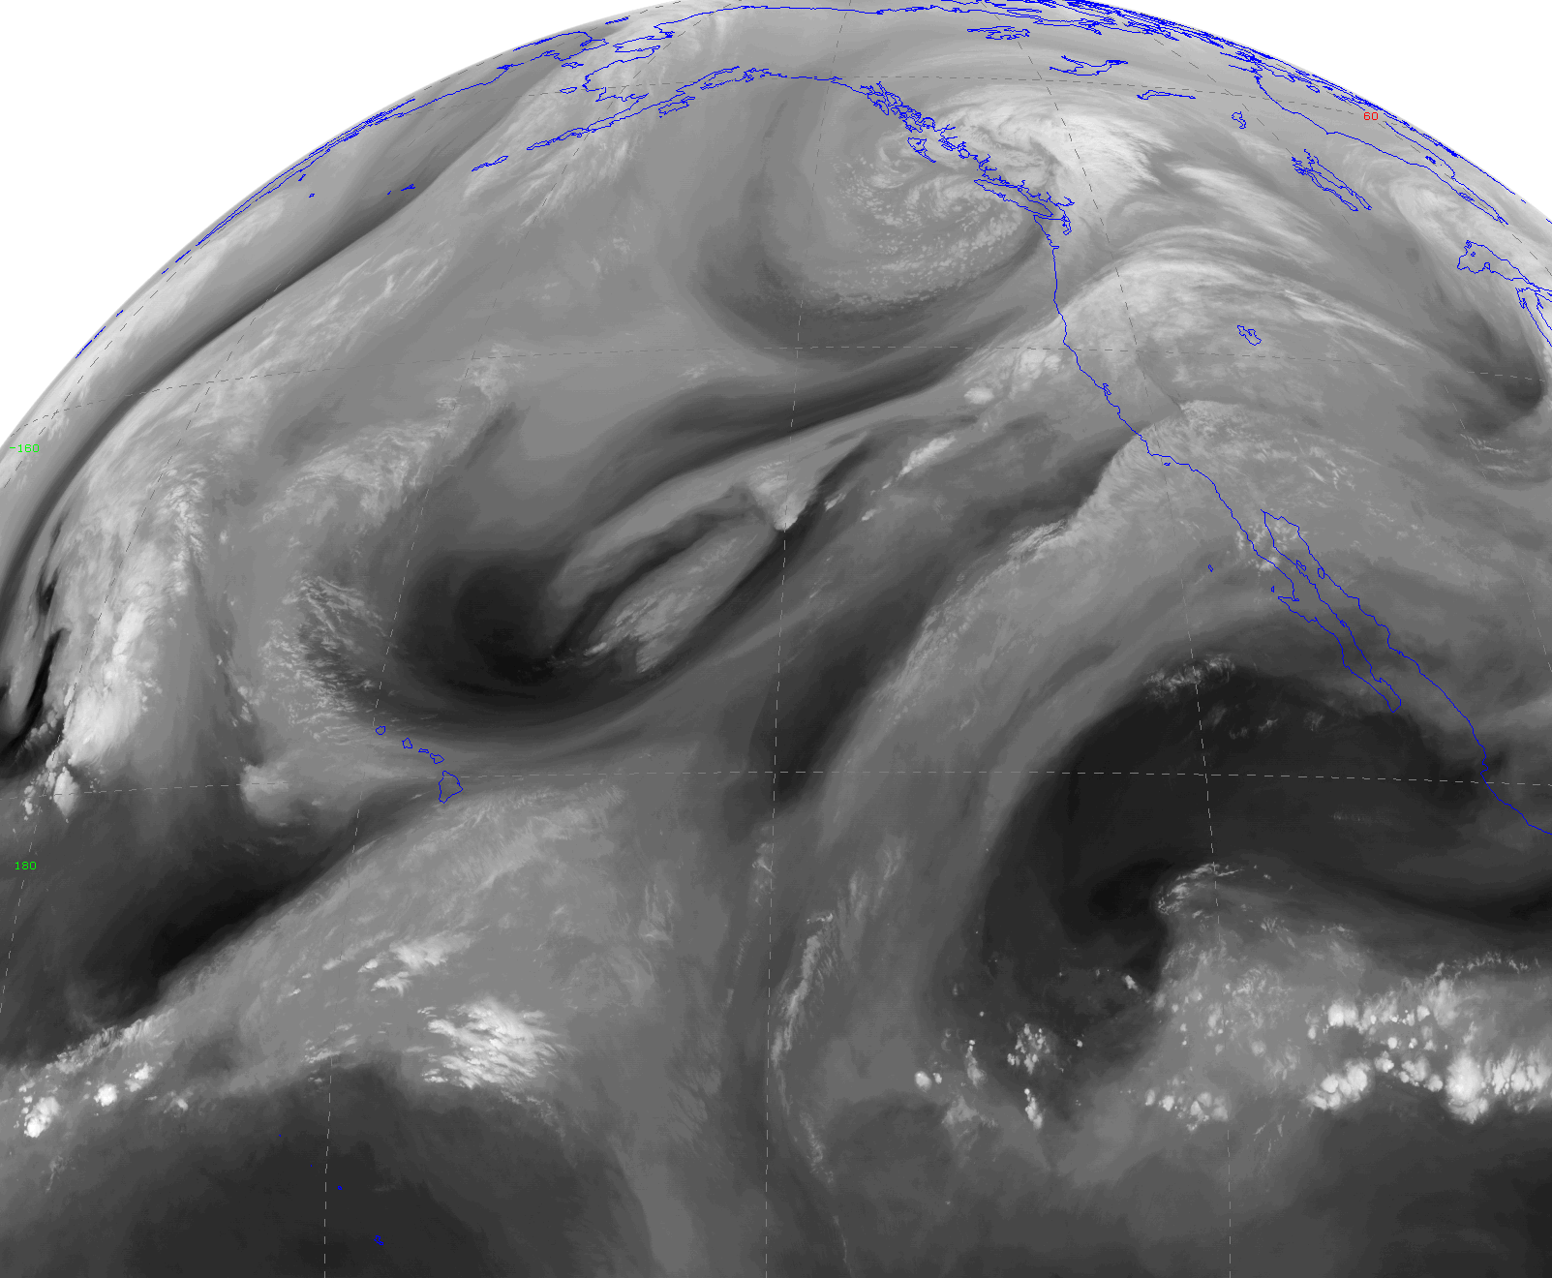
There is one satellite image that is NOT in a window region: Water Vapor Image (6-7 micron)ry
Uses a wavelength
range in which water vapor is active.

Slide 39
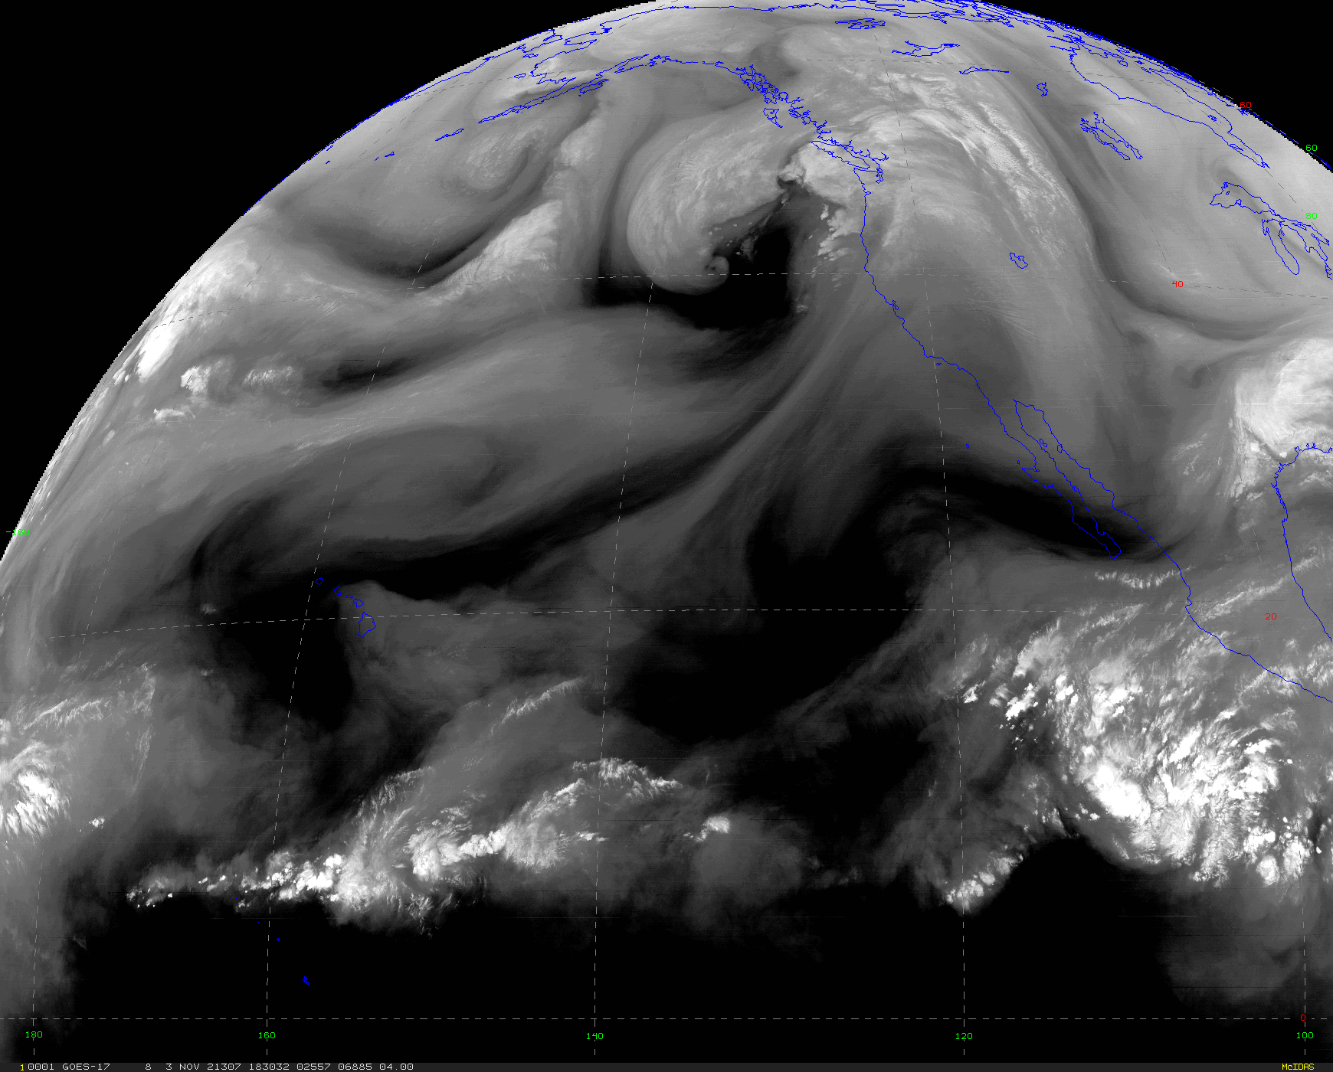
Water vapor imagery shows atmospheric structures where there are no clouds!

Slide 40
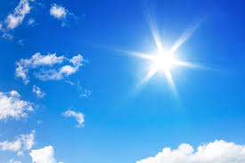
Solar Radiation and How it Varies

Slide 41
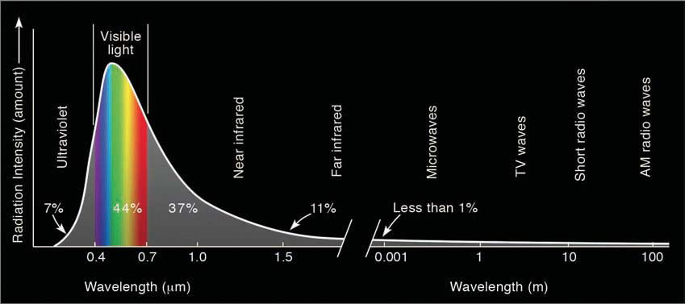
The temperature of the Sun is ~6000K and thus the max radiation is in the visible part of the spectrum (~.4-.7 microns)
Visible~44%, IR~48%

Slide 42
The solar constant
Definition: the average amount of solar radiation per unit area reaching the distance of the earth from the sun
Approximately 1366 W m⁻² (watts per meter squared)
Roughly enough energy to light 14 100-watt bulbs for every square meter.
Not exactly a constant…some small variability, particularly due to variation in sunspots (~.1% variability)

Slide 43
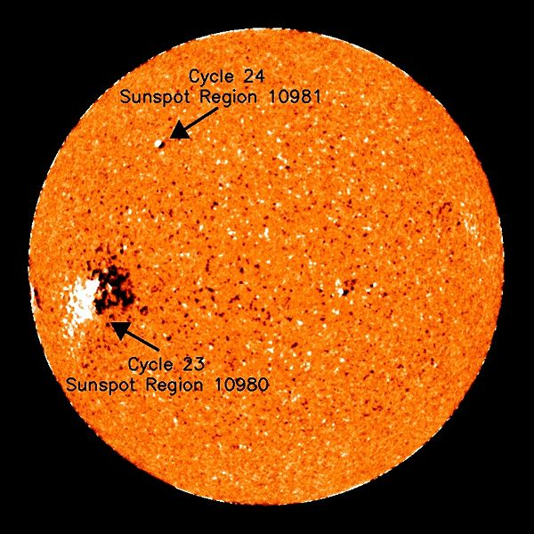
Solar emissions varies slightly due to variation in sunspots
More sunspots, more emission

Slide 44
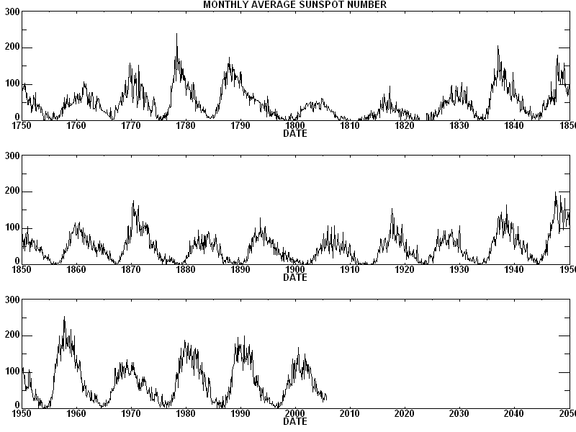
Sunspots vary on ~ 11 year cycle

Slide 45
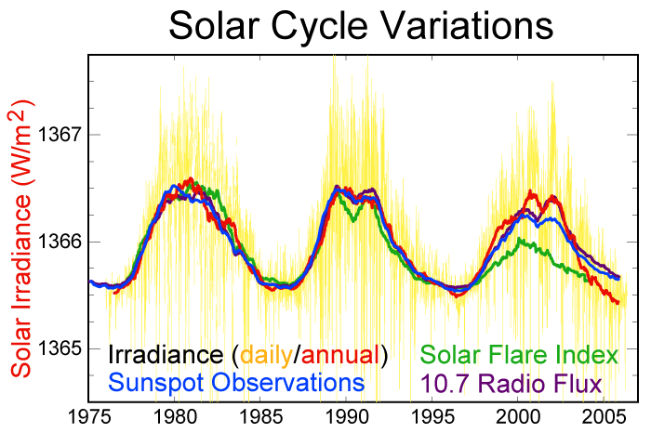
Solar radiation Varies With Sunset Cycle

Slide 46
The Amount of Solar Radiation that reaches the top of the Earths atmosphere depends on:
Latitude
Time of day
Day of year
But why?

Slide 47
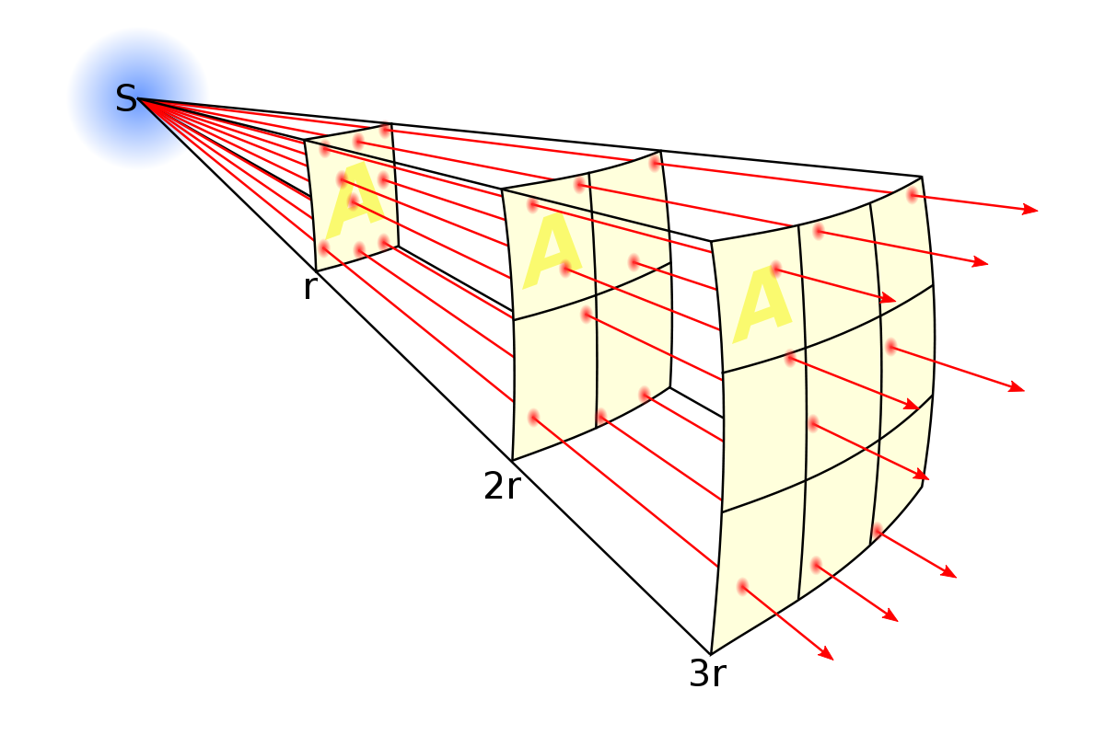
Solar Radiation Spreads Out With Distance. Thus intensity weakens with distance from the sun

Slide 48


Slide 49
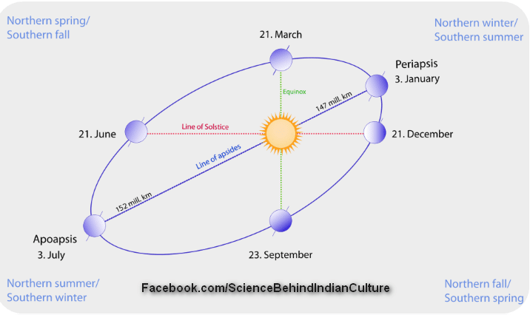
Distance to the sun varies during the year!
Earth travels in an ellipse around the sun
Earth is 5 million km closer in January than July
6.6% more intense solar radiation reaches the earth’s orbit in January than July

Slide 50
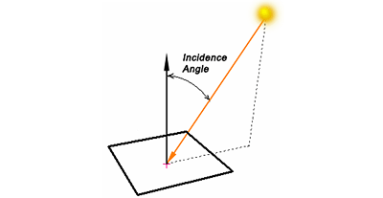
Angle of incidence of the solar beam changes during day and over the year

Slide 51
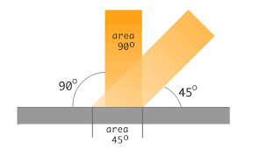
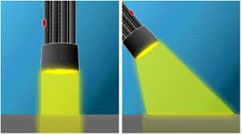
Larger angle, less intensity.
Same radiation is spread over more area and thus less intense

Slide 52
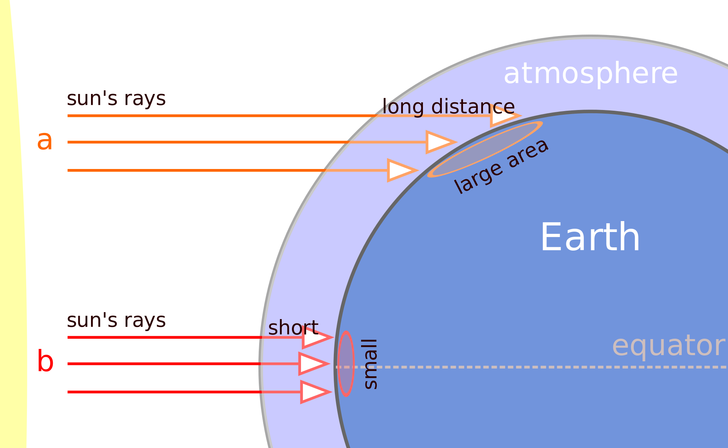
Variation in solar incidence angle caused by changes in latitude, season, time of day
Latitude
Equinox

Slide 53
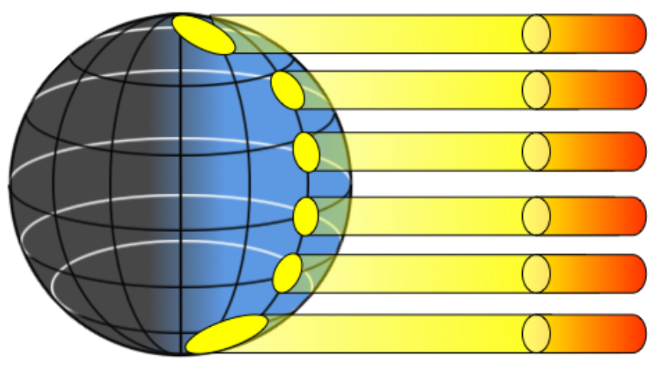
Situation at the Equinox (start of spring or fall)
Weaker
Stronger

Slide 54

21°N

Slide 55
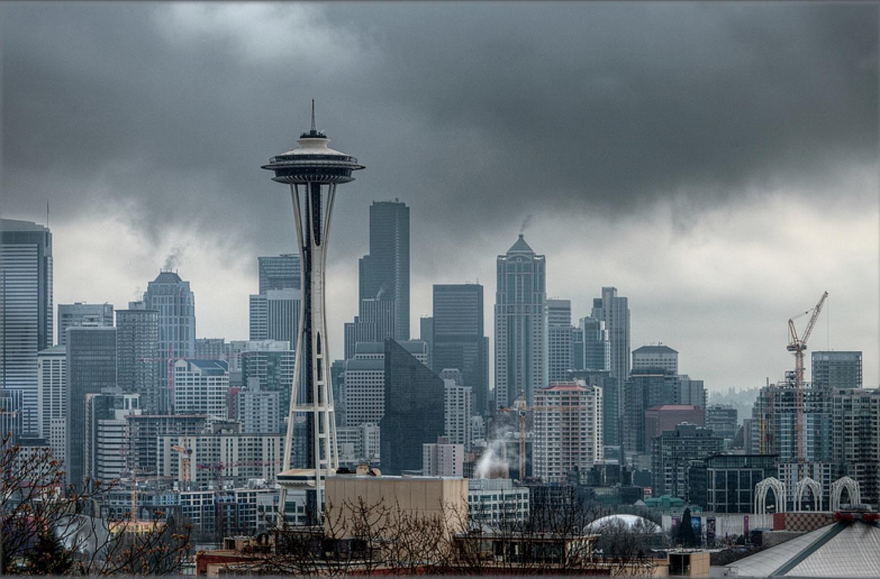
47°N

Slide 56
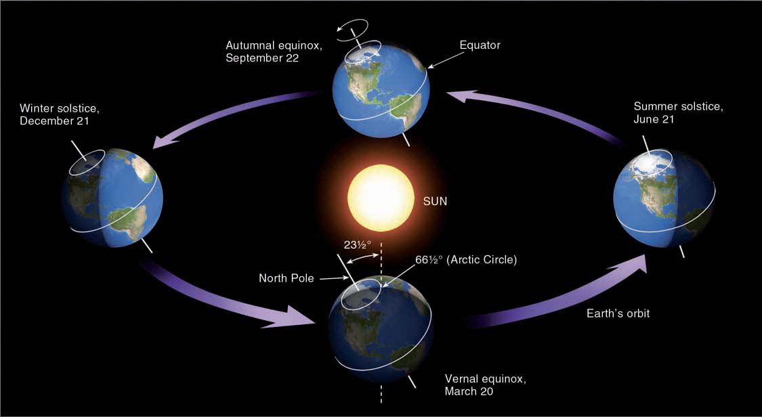
Seasonal Changes Sun Angle and Thus Intensity

Slide 57
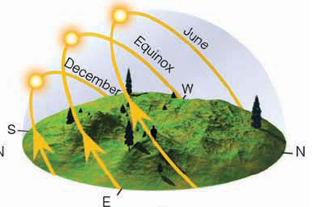
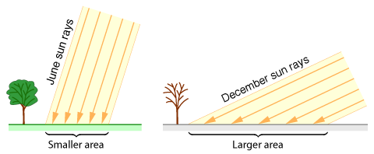
Seasonal Changes

Slide 58
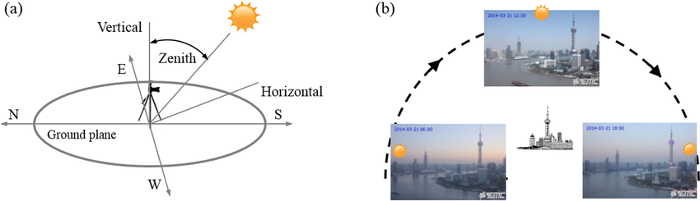
Diurnal Changes (Time of Day

Slide 59
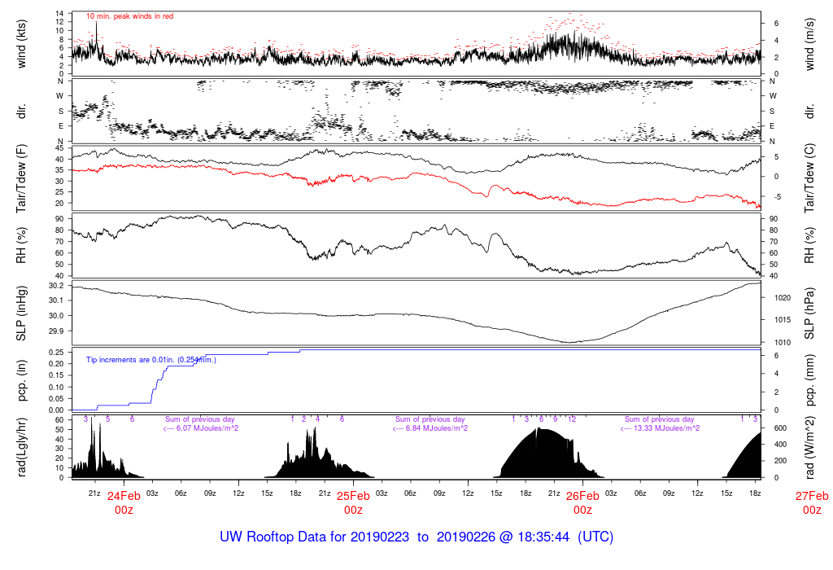

Slide 60
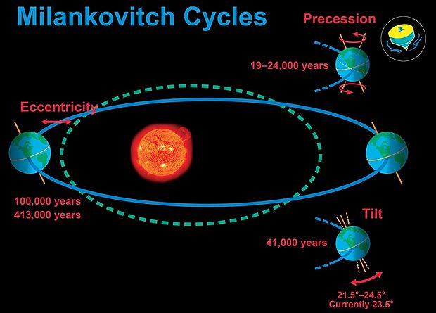
The earth’s orbital parameters change over tens of thousands of years.
Changes solar radiation and how it varies over the year. Results in ice ages and more.

Slide 61
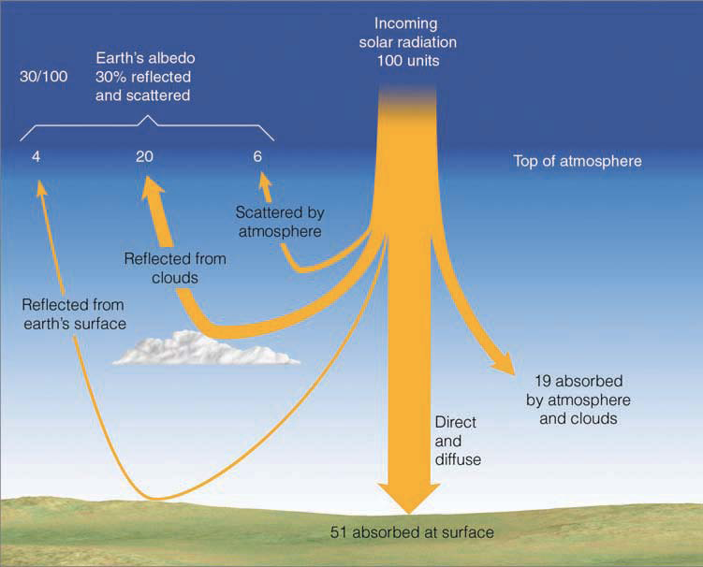
The amount of solar radiation reaching the surface is affected by the atmospheric, clouds and particles

Slide 63
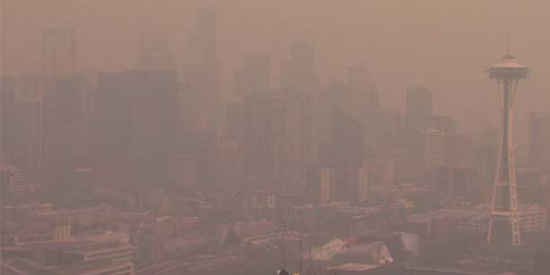
Wildfire Smoke Reduces Solar Radiation Reaching the Surface

Slide 64
So, we know what is coming in (solar radiation).
What is going out?

Slide 65
Mainly infrared radiation (IR)!
Why mainly IR?
Because the earth/atmosphere is much cooler than the sun, the maximum emission is around 10 microns…in middle of the IR portion of the spectrum

Slide 66
Infrared Radiation
Earth to
space
From sun
Atmosphere

Slide 67
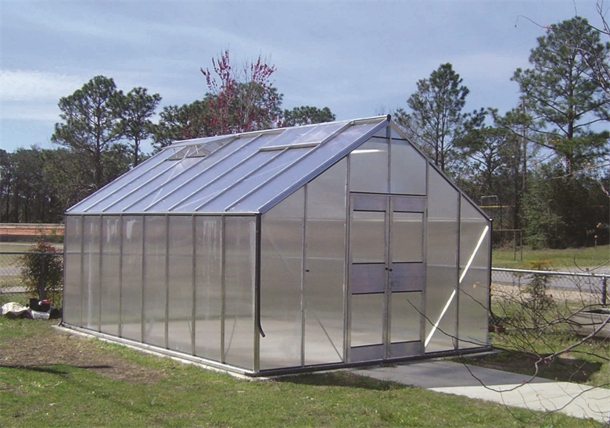
You are Now Ready to Understand The Greenhouse Effect

Slide 68
Imagine an Earth with no clouds or atmosphere.
The surface would warm until a balance developed between incoming solar and outgoing IR
solar
Infrared

Slide 69
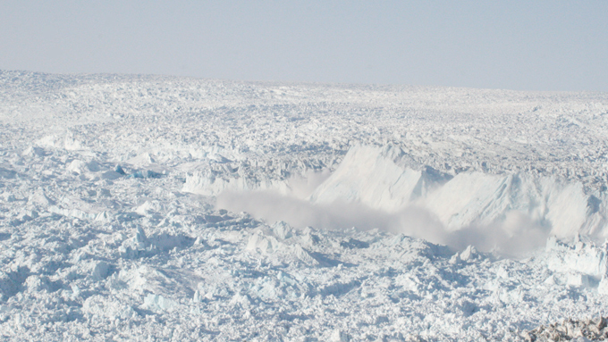
A simple calculation shows that such an Earth would end up with an average surface temperature of -18C (0F)
Welcome to Miami

Slide 70
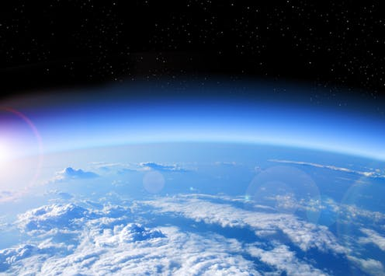
But now add at atmosphere that can absorb and emit in the infrared: major changes occur!

Slide 71
The planet will warm up until the amount coming in from the sun equals IR radiation leaving top of atmosphere.
Top of atmosphere has to be effectively -18C (0F) to do this. Thus, surface must be warmer.
Solar
Infrared
Atmosphere

Slide 72

Blankets are like the atmosphere
The amount of heat transferred through the blanket depends on temperature difference across the blanket

Slide 73
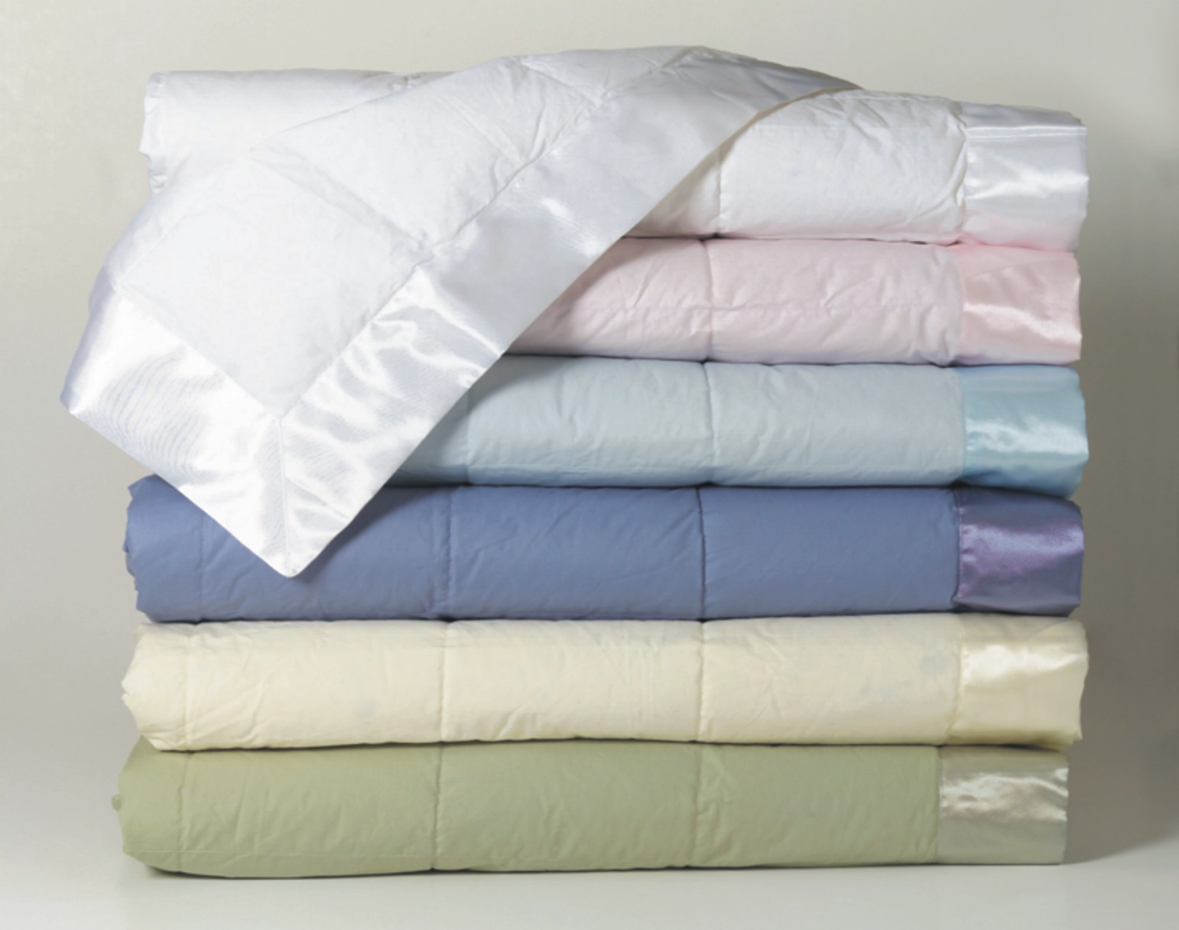
More blankets = warmer

Slide 74
How do blankets work?
They make it more difficult for heat to be conducted away from skin.
To get a steady state temperature requires the heat transferred away from the outside of a blanket must equal what your body is producing.
To do so, the temperature inside the blanket, next to your body, has to be greater.

Slide 75
With an atmosphere that is active in the infrared like our current atmosphere, the average surface temperature on Earth becomes 59F!
Known as the greenhouse effect

Slide 76


Slide 77


No Greenhouse Effect in Greenhouses

Slide 78
Greenhouses
Warm by preventing warm air from mixing into atmosphere.
Glass lets solar in and IR out. Not a selective absorber like the atmosphere.

Slide 79
Greenhouse Gas
An atmospheric gas (such as carbon dioxide, water vapor or methane) that absorbs and emits infrared radiation, traps heat in the atmosphere, and contributes to warming the atmosphere and surface.

Slide 80

Greenhouse gases that warm the planet
Carbon Dioxide
Water Vapor
Methane
Nitrous Oxide
… and others
Water Vapor is Number One

Slide 81


Water Vapor is the Main Greenhouse Gas

Slide 82
Greenhouse gases from human emissions and natural processes also warm the planet

Slide 83

The basic physics has been known for a long time
Svante Arrhenius, 1896

Slide 84
The Issue:
Rapidly Rising Greenhouse Gases Due to Mankind

Slide 85


Slide 86

Gases Trapped in Ice Gives Us a History of the Gases in the Atmosphere

Slide 87

The concentrations of a variety of greenhouse gases are increasing

Slide 88

The issue: increasing concentrations of CO2
A greenhouse gas

Slide 89
But it is worse than that…
There are a number of natural “amplifiers” of mankind’s emission of greenhouse gases.
The warming due to increased carbon dioxide, methane, and other anthropogenic greenhouse gases will cause more water to be evaporated from the earth’s oceans.

Slide 90

More Water Vapor
The amount of surface evaporation increases with temperature.
The amount of water vapor air can contain increases rapidly with temperature
Water vapor is the most potent greenhouse gas and thus causes even MORE warming.
This is caused a positive feedback.

Slide 91

Positive Feedback
Warmer temperatures cause more water vapor into the atmosphere.
More water vapor causes more warming
Which causes more evaporation into the atmosphere.

Slide 92

But it is even worse…
Warming temperatures melt snow and ice.
Snow and ice help cool the planet because they reflect much of the sun’s radiation.
As the snow and ice sheets melt, less radiation is reflected to space and more is absorbed.
Thus, the earth gets warmer, which melts more snow.
Another positive feedback!

Slide 93


Slide 94
The Technology of Climate Prediction
Atmospheric scientists use complex climate prediction models…called General Circulation Models or Global Climate Models (GCMs)…to predict the future climate.
These models are similar to weather forecast models but allow the gases in the atmosphere to change.
They also simulate the evolution of the oceans.
Known as coupled atmosphere-ocean GCMs.

Slide 95

Technology
Have to make assumptions about the future emission of greenhouse gases by mankind…a major uncertainty.
These models are imperfect and cannot exactly replicate the current climate….but they are getting better each year.

Slide 96

Technology
Use some of the largest supercomputers in the world
Today run at typical grids spacings of 100-150 km

Slide 97

Global climate models are too coarse to simulate regional effects.
Climate Model Terrain

Slide 98

Representative Concentration Pathways (RCP): Scenarios of How Greenhouse Gases Will Change in Time

Slide 99


Slide 100

Representative Concentration Pathway (RCP) Impacts

Slide 101

Some Warming is Guaranteed No Matter What We Do
The atmosphere has not caught up with the greenhouse gases that are in the atmosphere now.

Slide 102
Global Warming is NOT Uniform
Arctic warms up the most for a number of reasons, including the melting of sea ice.
Continents warm up more than oceans.
Eastern oceans up less than western oceans.
In general, the dry areas (e.g., the SW) will get drier and wet areas (e.g., British Columbia) will get wetter.

Slide 103

Sample Climate Model Output for 2100

Slide 104

Precipitation: Subtropics Drier, Midlatitudes/Polar Regions/Equatorial Tropics Moisten
Winter
Summer
Change during this century, RCP8.5/A2 scenario

Slide 105
Uncertainty
Considerable uncertainty regarding global temperature changes for doubling CO2 (roughly 1.5 to 4 C)
Even more uncertainty for local changes
Uncertainty has not lessened much even with decades of research.

Slide 106

GCMs don’t necessarily agree. There is uncertainty
Surface Temperature Change from 1970-2000 compared to 2070-2100

Slide 107
Climate Change in the NW
Temperatures have warmed by about 1-2 F over the past 100 years.
This warming has proceeded on and off for the past century, with short-term ups and downs due to natural variability (e.g., the Pacific Decadal Oscillation, PDO)
There is no discernable trend in precipitation.

Slide 108
Essential Point
Climate variations over decades can vary from:
  Human forcing, such as greenhouse gas increases
  Natural variability of the complex weather/climate system.

Slide 109

The Pacific Decadal Oscillation: A Mode of Natural Variability
More snow
Less Snow

Slide 110

Seattle Snow
Cold PDO
Phase
Warm PDO
Phase
48
70
95

Slide 111

NWS Temperature Trend for Washington
Mainly Natural
Natural & Anthropogenic

Slide 112
Warming in the Northwest
It appears that there has been relatively modest human-caused warming over most of the Northwest so far (around 2F)
This makes a lot of sense--our weather is controlled by the Pacific and the eastern Pacific is one of the last places that will warm significantly.
Global warming will be weaker and delayed here…but it will happen in force by the end of the century.

Slide 113

Change in Winter Surface Air Temperature (°C) for 1950-2023
-1.4
-1.2
-1.0
-0.8
-0.6
-0.4
-0.2
0.0
+0.2
+0.4
+0.6
+0.8
+1.0
+1.2
Air Temperature Trend (1979-2005)
Notes:
113

Slide 114

Cascade snowpack hasn’t changed in the last 30 years

Slide 115
Future of the Northwest
Several groups are using very high resolution simulations forced by the global climate model predictions
Gives a view of the local implications of global warming.
Could our mountains and other local features make it worse or better?

Slide 116

Simulations Using Worst Case Assumptions of Use of Fossil Fuels

Slide 117


Slide 118


Slide 119


Slide 120

Why banded structure of warming? Loss of snow

Slide 121


Slide 122


Slide 123

But warming will result in more precipitation falling as rain rather than snow
Change in Snowpack from 1990 to 2090
-40%
0%
+40%

Slide 124

Advice: Don’t buy this after 2050!

Slide 125

Another issue: more extreme precipitation and flooding

Slide 126

Super Atmospheric Rivers

Slide 127

A.K.A.: Pineapple Express

Slide 128

When atmospheric rivers hit our terrain, intense precipitation falls

Slide 129
Global warming will intensify atmospheric rivers
Warmer air holds more water vapor.
Examined a large collection of climate models simulation for changes from 1970-2000 to 2070-2100 based on RCP8.5 greenhouse gas emissions.
Winter-mean precipitation along the West Coast increases by 11-18% while precipitation on extreme atmospheric river days increases by 15-39% .

Slide 130

Flooding Potential Increases
Snow absorbs and helps to buffer heavy rain events.
With less snow, there will be less “protection.”
Thus, heavier rainfall could lead to greater flooding on major rivers.

Slide 131

Change in annual streamflow timing

Slide 132

Northwest Windstorms
Will there be more of them?
Will they become more intense?
The Inauguration Day Storm
1993

Slide 133

Northwest Windstorms
The answer appears to be no. No increasing trend in observations and none suggested by climate models.
UW investigated this issue for Seattle City Light

Slide 134

Number of times per year winds exceed a high-wind threshold (DJF) at Seattle for several simulations

Slide 135
Why windstorms do not intensity? Horizontal temperature gradient weakens

Slide 136

Sea Level Rise
Best estimates are 1-2 feet between 2000 and 2100, assuming continued greenhouse gas increases.

Slide 137

Sea Level Rise
From BOTH expansion of the ocean with warming and melting of glaciers and ice sheets.
SL rise also varies depending on whether the land is rising or sinking.

Slide 138


Slide 139

Slow Rise Historically (2 mm a year, 8 inches a century)
Seattle, Washington

Slide 140

Northwest Wildfires and Climate
Recent increase in large wildfires, but the small increase in temperature does not explain it.

Slide 141

More fires in the early 20th century followed by suppression

Slide 142


Increasing Risk of Major Wildfires
Climate change is probably a modest part of increasing fires.
Suppression has produced unhealthy forests with lots of fuels ready to burn.
Now
Original

Slide 143


Increasing Wildfire Risks
Huge increases of population in the urban/fire interface
Large increase of recreation use of forests.

Slide 144

Interestingly, a prime sign of human-forced climate change is the cooling of the upper atmosphere.

Slide 145

More CO2 in the upper atmosphere produces more emission to space.

Slide 146
Can We Predict Climate When We Can’t Forecast Next Week’s Weather?

Slide 147


Slide 148

In weather prediction we forecast the exact state of the atmosphere at some time in the future
Tomorrow’s high in Spokane will be 67F
It will rain tomorrow afternoon after 3 PM

Slide 149
In Climate Prediction we DON’T do this.
We predict average quantities over extended periods.
Example: the mean winter temperatures will be 3F higher over the Pacific Northwest.
MUCH easier to do than time specific forecasts.
Furthermore, the average conditions are closely controlled by the amount of radiation reaching and leaving the planet--and we can predict that fairly well.

Slide 150
How to deal with global warming?
Greatly reduce greenhouse gas emissions
Pull CO2 out of the atmosphere (some technologies available, but need energy)
Adapt to the warming.
Geoengineering to reduce warming.

Slide 151

Geoengineering?

Slide 152
But even without human-caused greenhouse warming the earth’s climate would change

Slide 153

Milankovitch Cycles

Slide 154


Eccentricity of Earth’s Orbit
Varies over 10s of thousands of years

Slide 155


Obliquity and Precession
Change over tens of thousands of years

Slide 156

Fig. 14-12, p. 396
Notes:
Figure 14.12: The earth currently revolves around the sun while tilted on its axis by an angle of 23½°. During a period of 41,000 years, this angle of tilt ranges from about 22° to 24½°.

Slide 157


Slide 158


Slide 159

Periodic Ice Ages

Slide 160


Slide 161

Can We Stop the Next Ice Age?

Slide 162
Human-forced (anthropogenic) climate change has already affected our region
Even without any effects from increasing greenhouse gases like CO2

Slide 163

Massive Irrigation in Eastern WA

Slide 164

The result: cooling of 1-4F and higher humidity

Slide 165

Plowed fields: More Eastern WA dust storms

Slide 166

Seattle’s urban core is 2-10F warmer due to concrete and buildings

Slide 167

The End

