Slide 1
Atm Sci 370
Winter 2021
Mesoscale Rainbands in Fronts and Cyclones

Slide 2
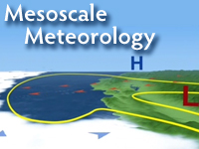
Terminology Review
Synoptic scale: 1000-5000 km
Mesoscale: 10-1000 km
Microscale: 1- 10 km

Slide 3
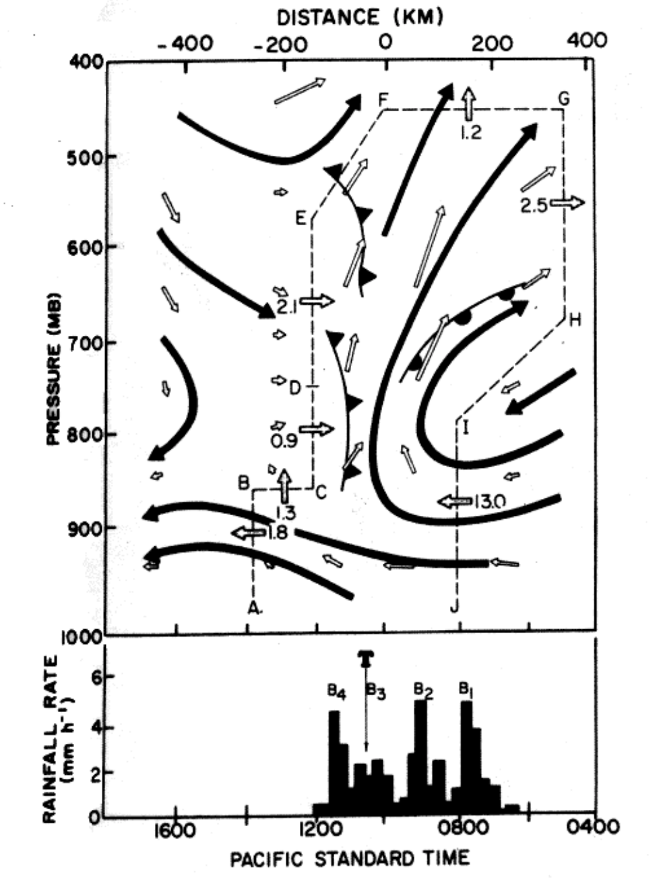
Precipitation Rates are Never Uniform in Cyclones and Fronts and Mesoscale Structure

Slide 4
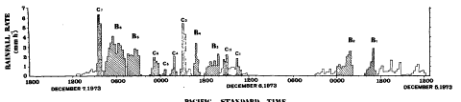

Slide 5
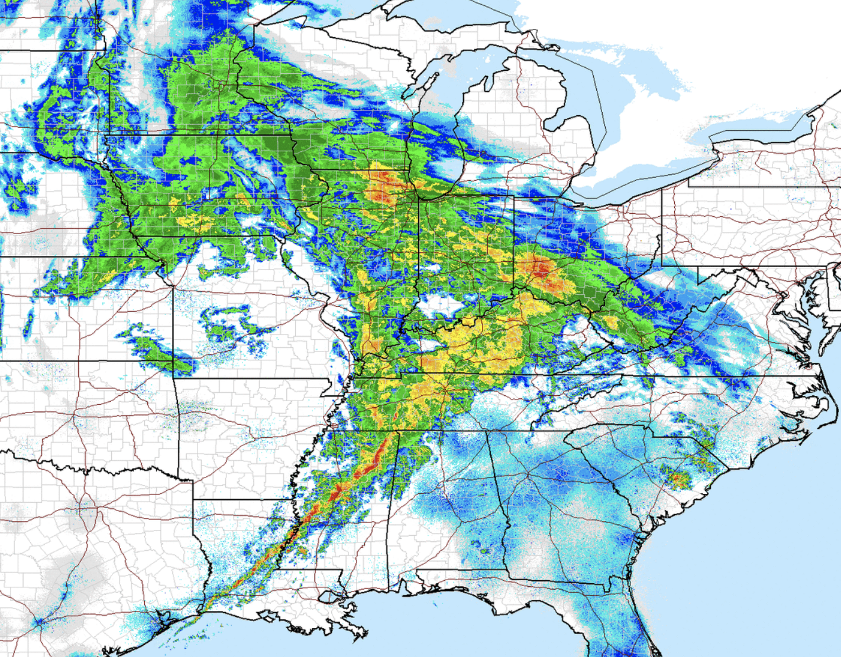
Precipitation Generally Has Substantial Mesoscale Structure

Slide 6
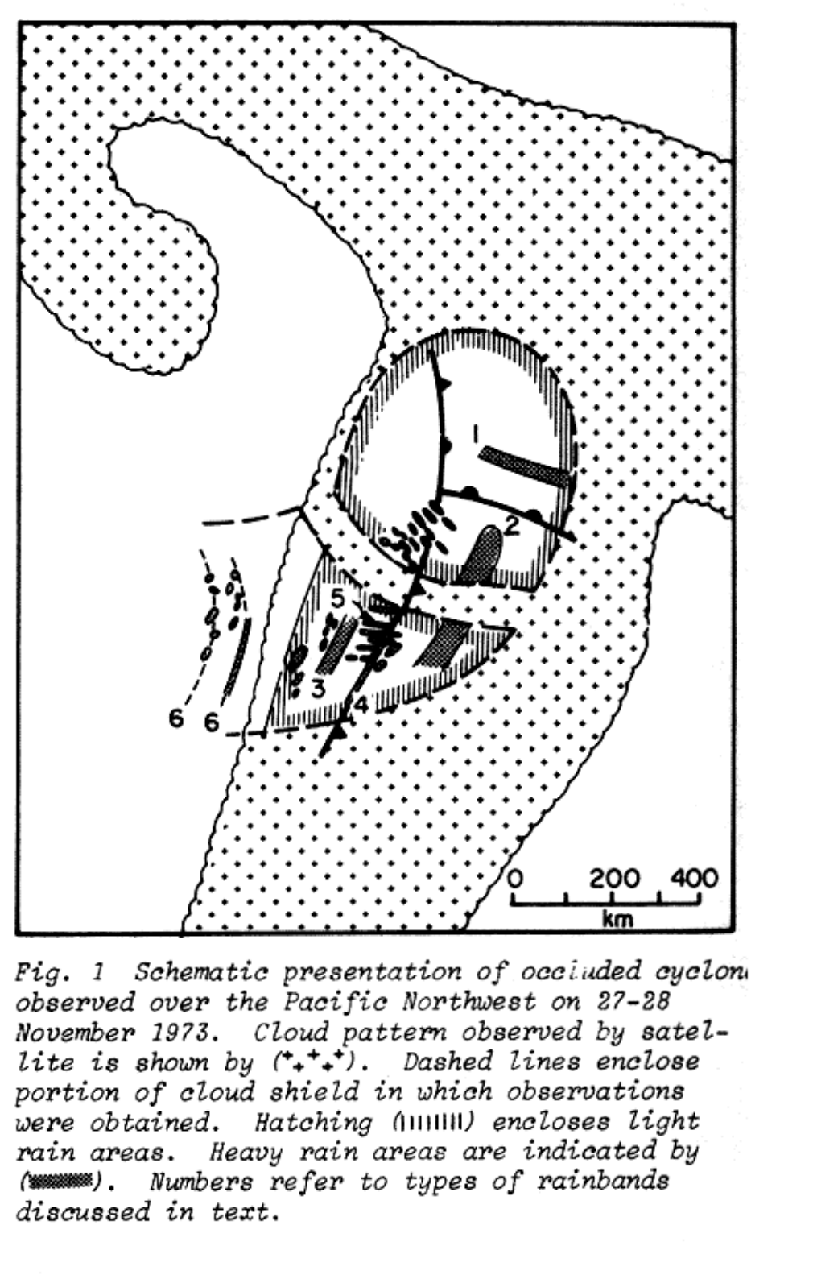
A great deal of research has documented a variety of mesoscale rainbands in fronts and cyclones

Slide 7
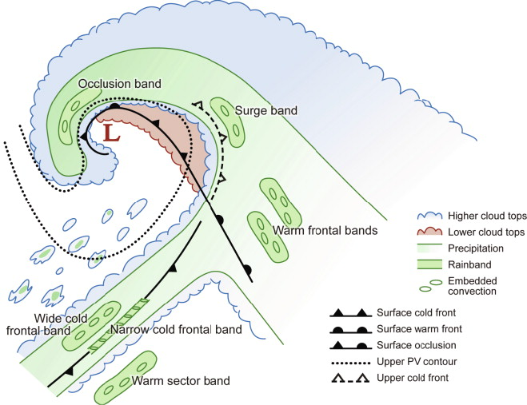

Slide 8
Major Mesoscale Rainbands in Midlatitude Cyclones
Warm frontal rainband parallel to warm front
Warm sector rainband parallel to cold front
Narrow cold frontal rainband within cold front
Wide cold frontal rainband behind cold front
Post-frontal rainbands

Slide 9
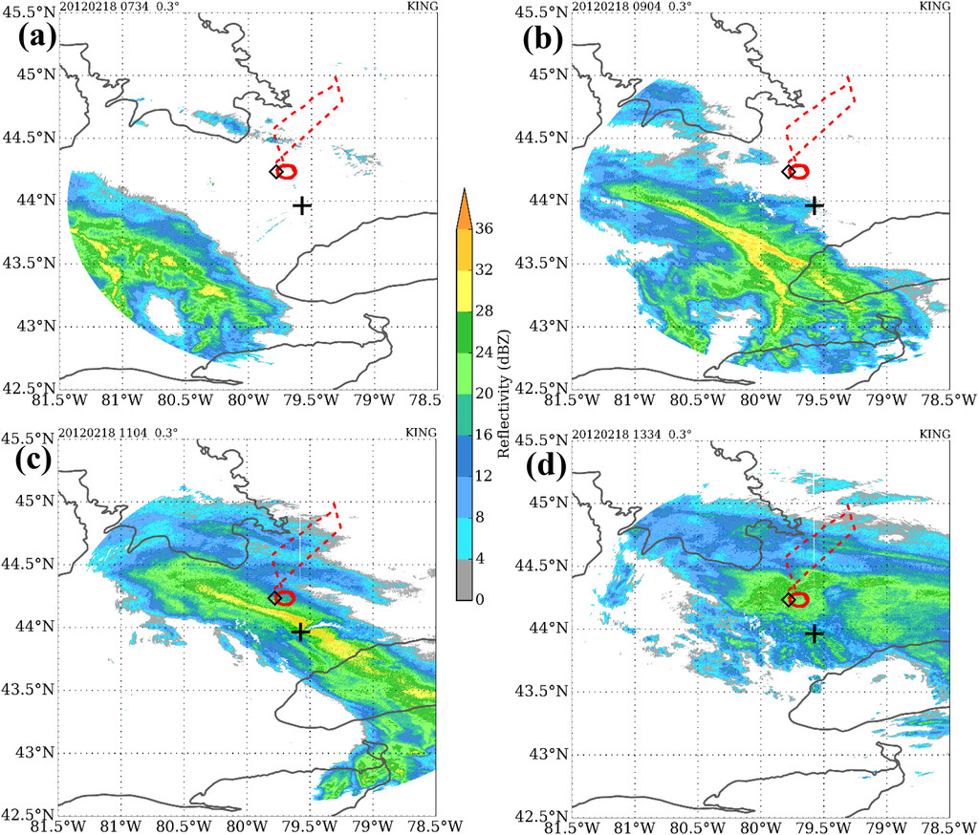
Warm Frontal Rainband within Warm Frontal Zone

Slide 10
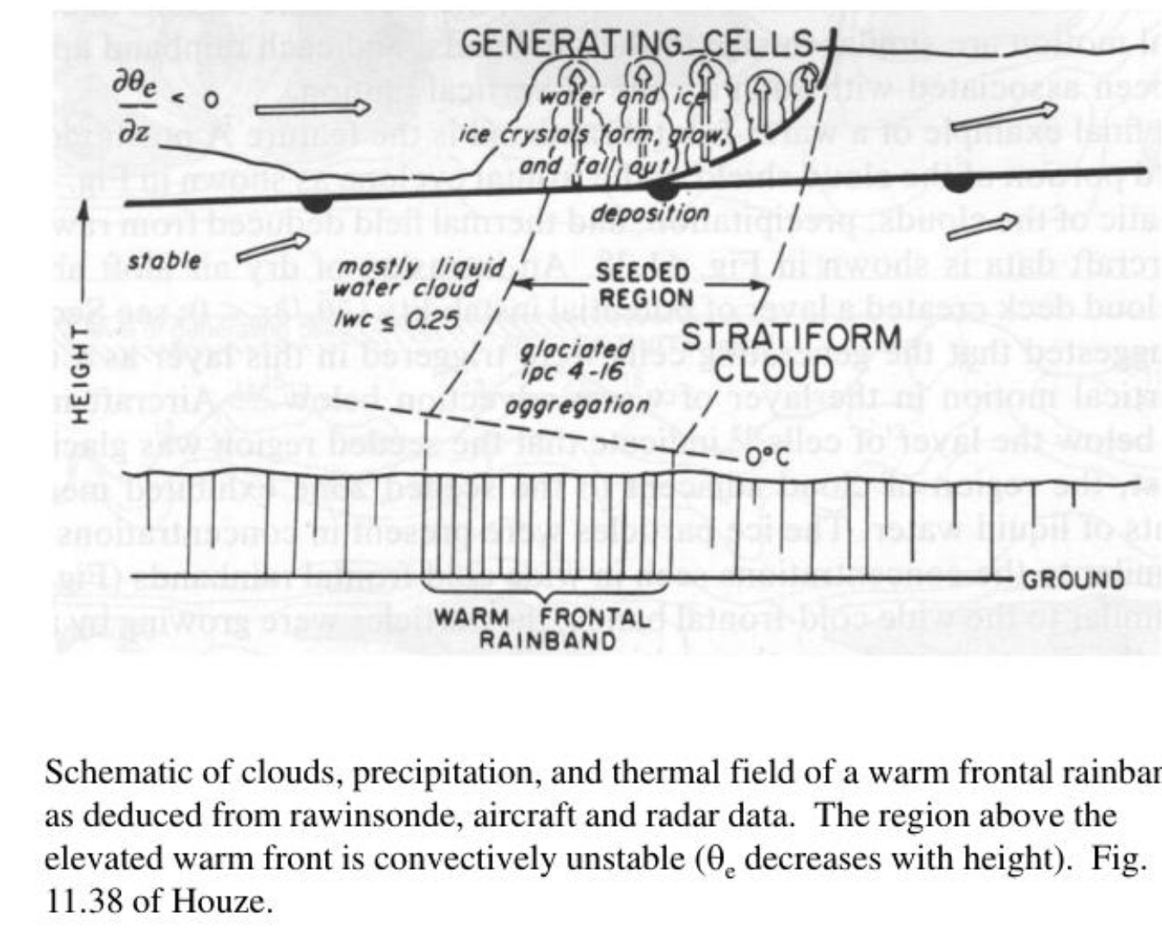
Why?

Slide 11
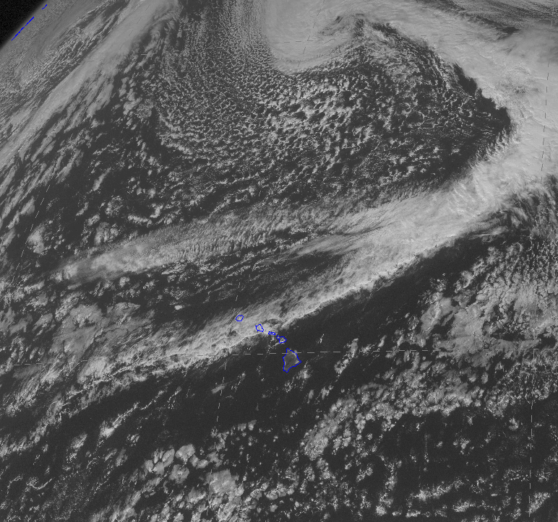
Narrow Cold Frontal Rainband

Slide 12
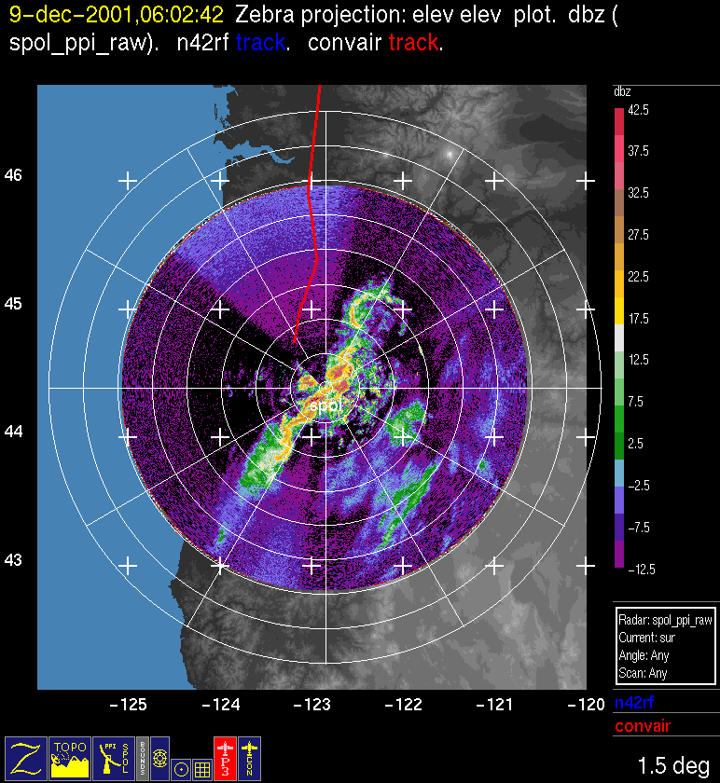

Slide 13
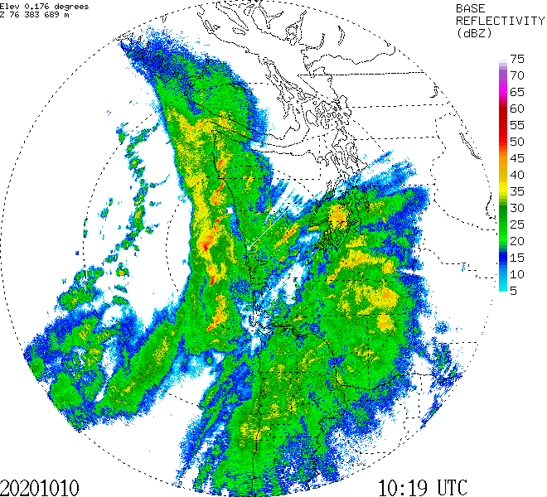

Slide 14
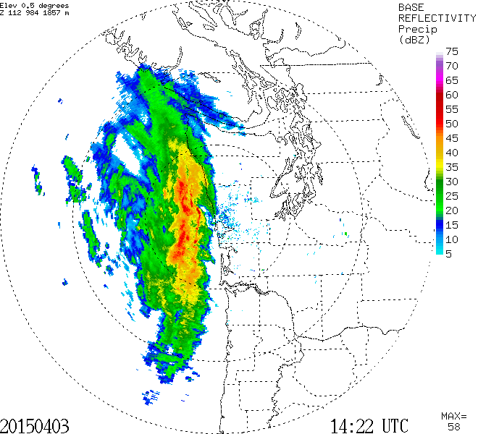
Both a narrow and wide cold frontal RB

Slide 15
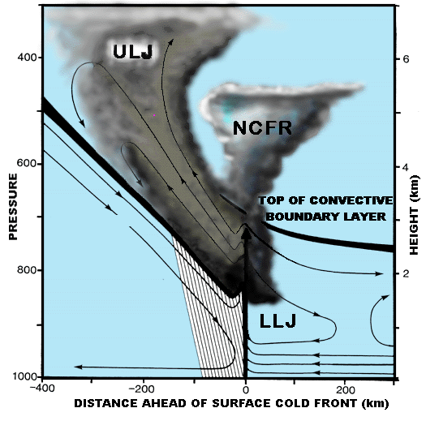
Why Narrow Cold Frontal Rainband

Slide 16
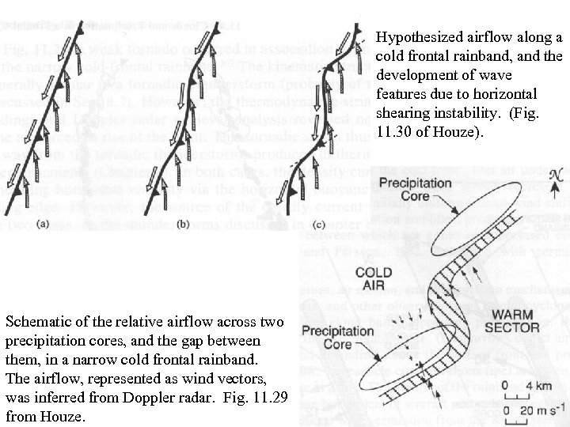
Cores and Gaps

Slide 17
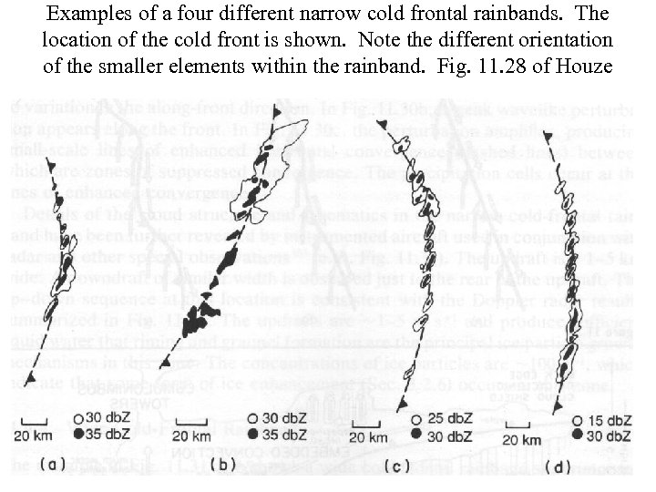

Slide 18
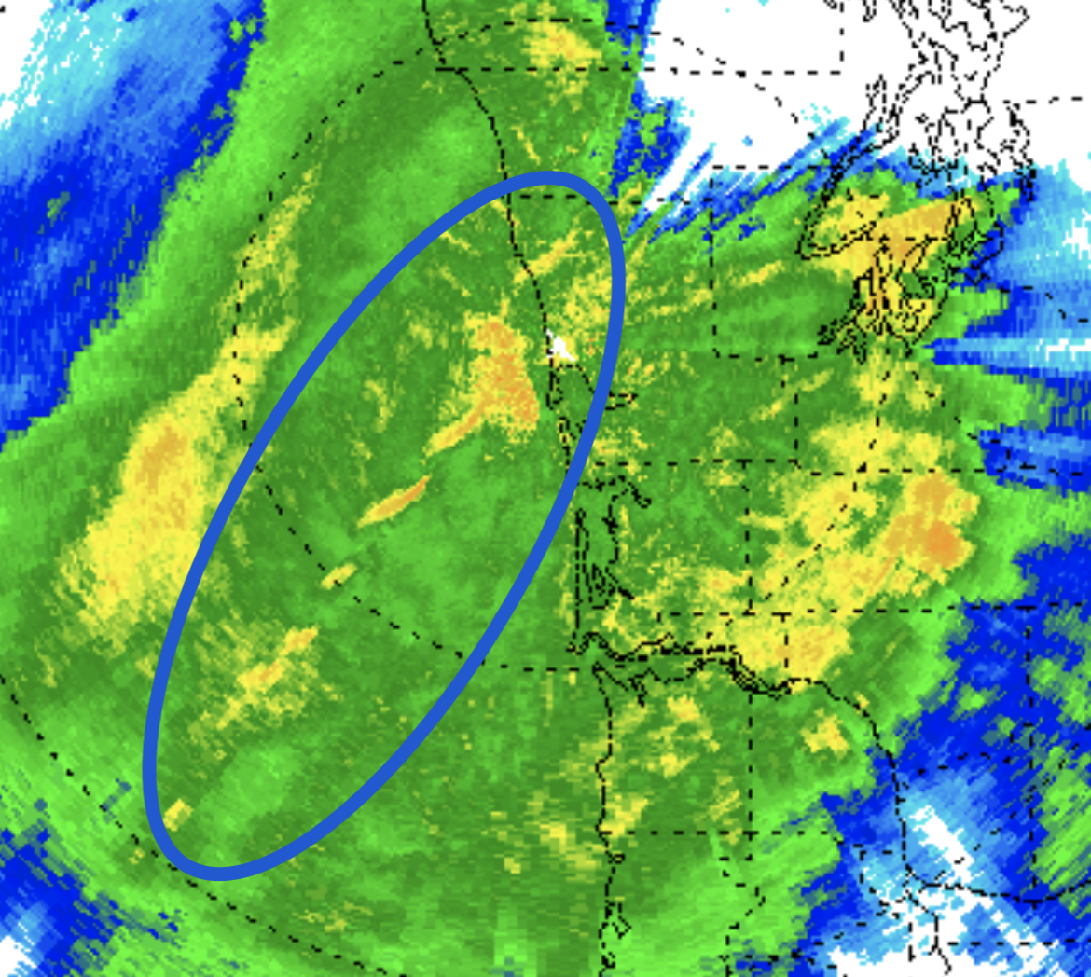
Wide Cold Frontal Rainband (orange circle)

Slide 19
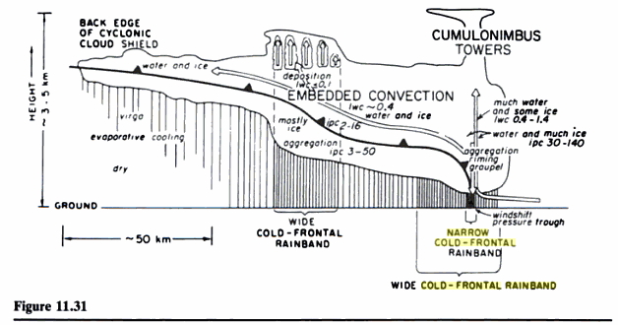
Wide Cold Frontal Rainband

Slide 20
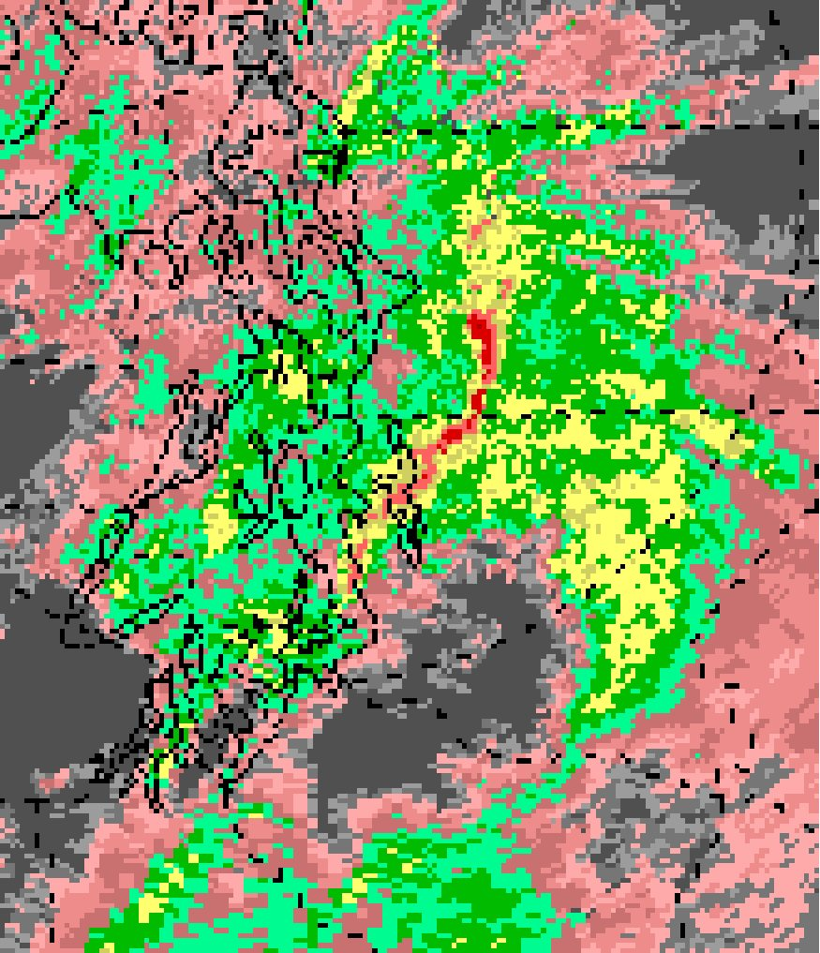
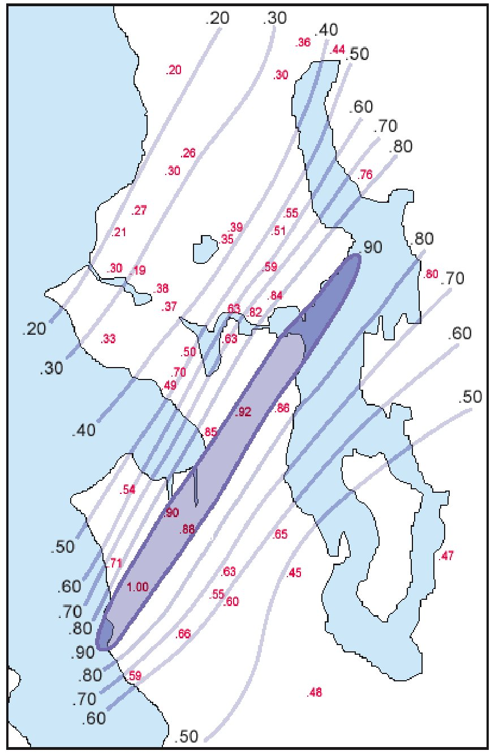
December 13, 2006: The Madison Valley Storm
Rainbands Can Cause Damage and Even Kill
One-hour
totals
December 14, 2006
Nearly 1 inch in an hour

Slide 21
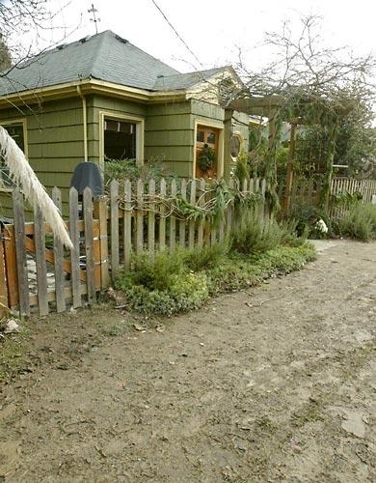
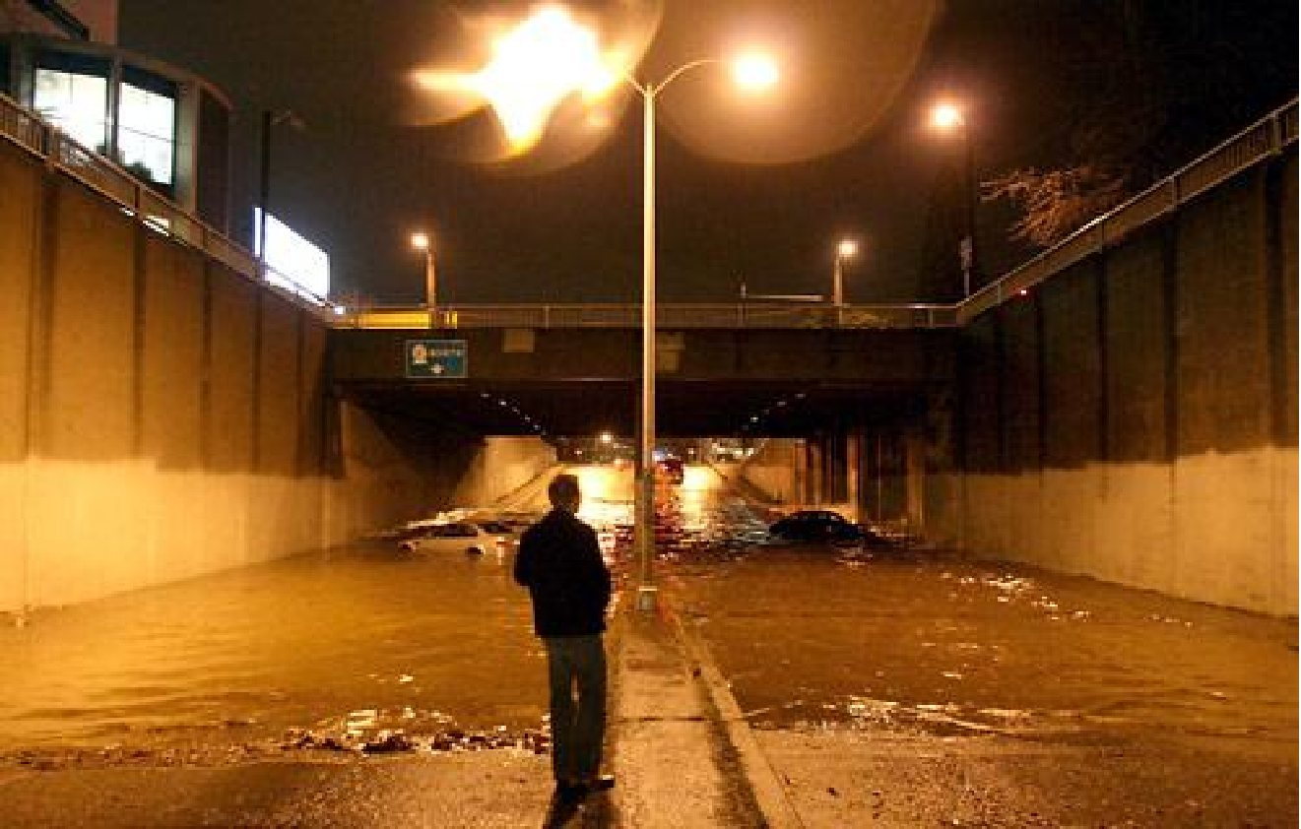
Do We Expect Such Events to Increase in Frequency or Intensity Under Global Warming?
A woman drowned in her basement and dozens of cars lost.

